Slide 1
PSORIASIS
Dr Aleena Nasir
Resident Dermatologist
CMH Abbottabad

Slide 2
LEARNING OBJECTIVES
Definition
Types
Epidemiology
Pathophysiology
Clinical features
Classification of severity
Complications and co morbidities
Treatment

Slide 3
DEFINITION
It is a group of common ,chronic, inflammatory and proliferative conditions of the skin, associated with systemic manifestations
The characteristic lesions are red ,scaly ,sharply demarcated plaques present over the extensor surfaces of the body and scalp

Slide 4
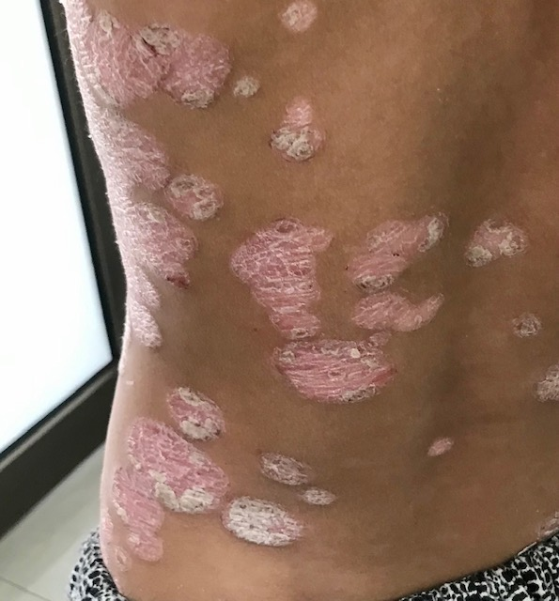

Slide 5
EPIDEMIOLOGY
Adult psoriasis affects 2-3% population of Europe
More common in white people
Equally affects men and women
Men develop more severe symptoms
In 35 percent of patients disease onset is before the age of 20 years
Earlier age of onset in women

Slide 6
Lifetime risks of psoriasis are 4%, 28% and 65% if neither, one or both parents are affected
Age of onset:
There are 2 peaks:
Between ages of 16 and 22 | Between the ages of 57 and 62
More common | Less common

Slide 7
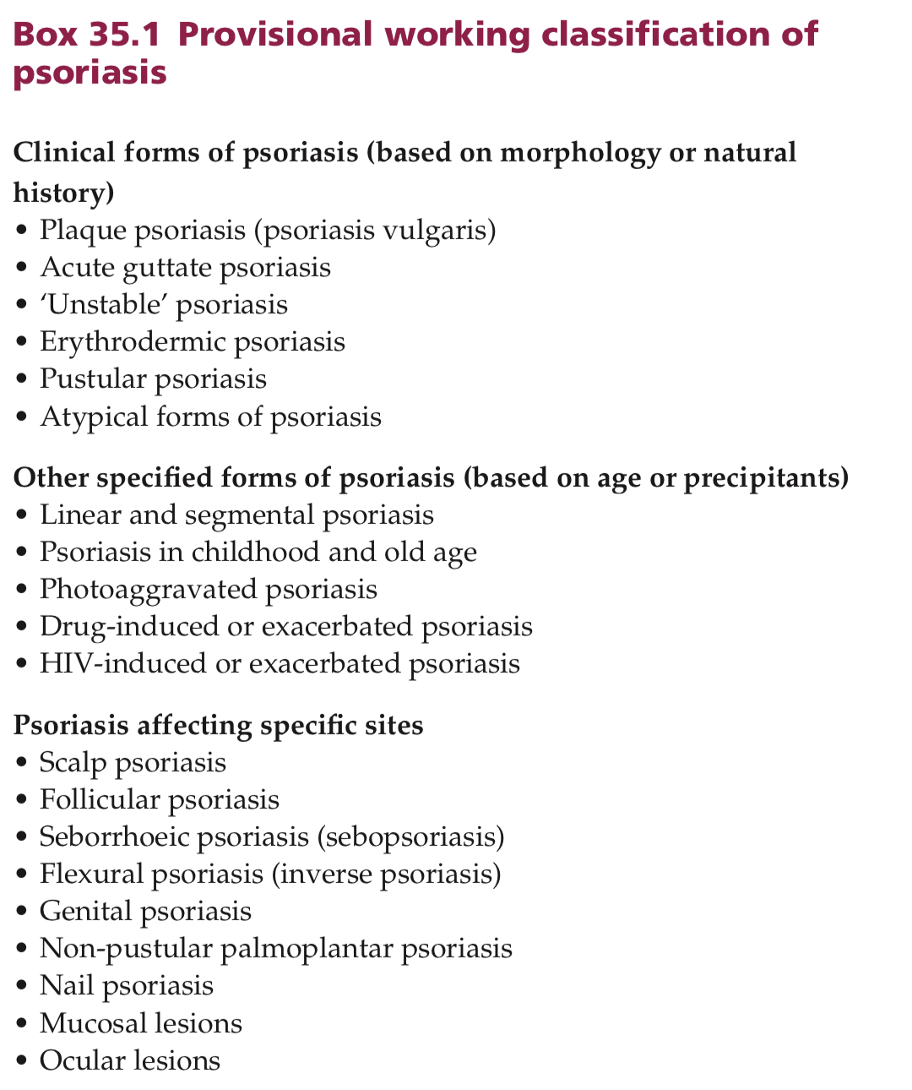

Slide 8
Pathophysiology
1. Genetics:
Strongly associated with HLA-C: 06:02
9 chromosomal loci (PSORs-1 to PSORs-9) are linked to psoriasis

Slide 9
2. Environmental Factors
Infections:
Streptococcal Infection: Guttate psoriasis
HIV Infection: Can cause flares
Cigarette Smoking: Associated with Initiation and persistence of psoriasis
Psychological distress: Associated with flares

Slide 10
2. Environmental Factors (contd)
Medications:
Lithium
Beta-Blockers
Anti-malarials
NSAIDS
Oral Steroids: Can lead to the development of unstable psoriasis

Slide 11
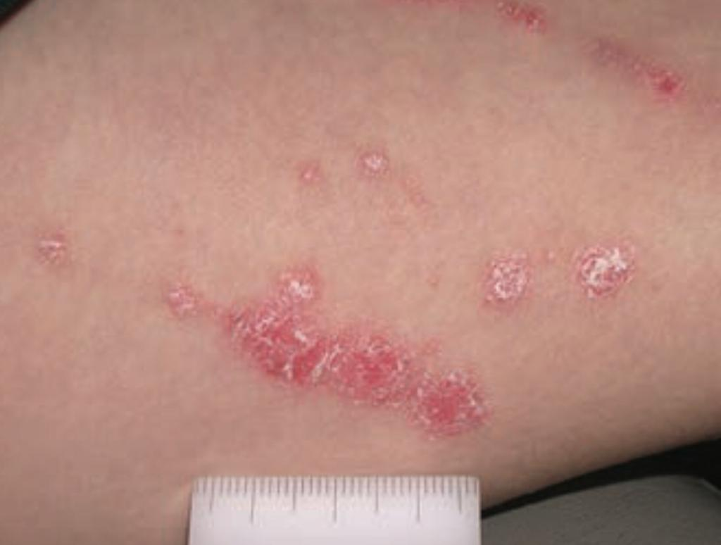
Koebner’s phenomenon
Physical trauma:
Psoriasis can occur in sites of cutaneous trauma and old scars (Koebner’s phenomenon)
Koebnerization is noted in 25% psoriasis patients

Slide 12
Pathogenesis
There are 3 key pathological features:
1. Epidermal hyperproliferation
2. Increased dermal angiogenesis
3.Marked dermal and epidermal inflammatory infiltrate

Slide 13
1. Epidermal hyperproliferation
There is excessive keratinocyte proliferation and abnormal differentiation
Rapid progression of the basal cell keratinocytes through the epidermal layers, taking only 4-5 days in active plaques as compared to 30 days in normal skin

Slide 14
2. Vascular changes
There is increased dermal angiogenesis
Vertical dermal capillary loops in the lesional skin of psoriasis patients are dilated, elongated or twisted

Slide 15
3. Immunology and Inflammation
Activated T-cells are crucial to psoriasis pathogenesis
There is accumulation of both CD4+ and CD8+ T-lymphocytes
Cells of the innate immune system including macrophages, neutrophils, mast cells, plasmacytoid dendritic cells and NK cells are present in significantly larger number as compared to healthy skin
Psoriasis results from the inappropriate persistent activation of inflammation in response to commensal viruses or bacteria

Slide 16
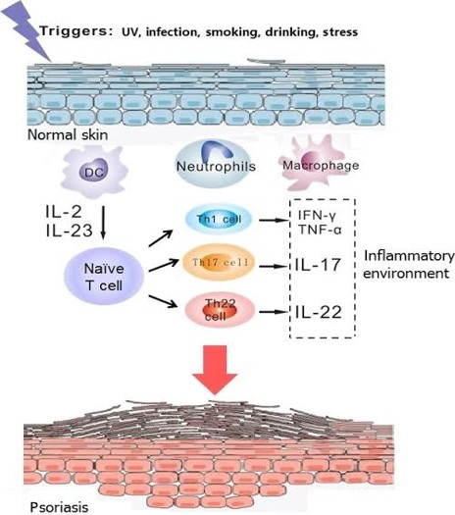

Slide 17
Pathophysiology
Injury or infection of the skin results in antimicrobial peptide (AMPs) production the most being LL37 ( cathelicidin)
These AMPs are recognized by dendritic cells to produce TNF-alpha, IL-6 and IL-23
This causes the activation of T-cells of adaptive immune system specifically Th17 and Th22 phenotype which in turn activate keratinocytes to proliferate and produce multiple chemokines and AMPs
T-cells also produce cytokines such as interferon gamma, TNF-alpha, IL-6 and IL-22 and chemokines such as CCL20 and CCR6

Slide 18
Pathophysiology
These cytokines cause activation of innate immune cells including IL-17 , activation of neutrophils, antigen processing dendritic cells which in turn activate T-cells and the inflammatory loop self-perpetuates
Drugs targeting TNF-a, IL-23 and IL-17 and signaling pathways such as JAK/STAT(Th1 and Th2 cytokines act through JAK-STAT signaling pathways) are effective in clinical management of plaque psoriasis
There is a distinct absence of Th2 cytokines and regulatory T-cells

Slide 19
HISTOPATHOLOGY:
Normal basal keratinocytes proliferate, differentiate and ascend through the layers of epidermis to reach the keratin layer in 30 days
In psoriasis, this process takes 4-5 days in active plaques. There is
Hyperproliferation of basal layer
Decreased differentiation
Elongation of rete ridges
Acanthosis
Absence of granular layer

Slide 20
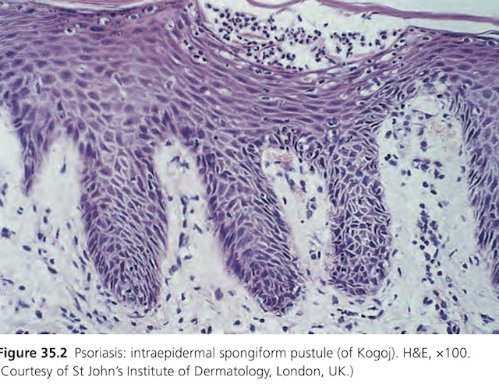
HISTOPATHOLOGY:
In malpighian layer, neutrophils accumulate to form the characteristic Spongiform Pustules of kogoj

Slide 21
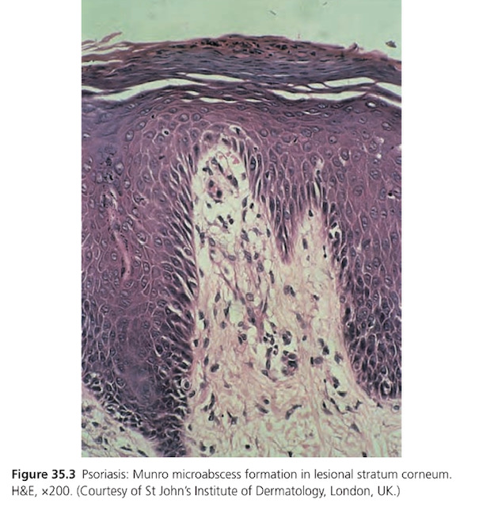
HISTOPATHOLOGY:
In the fully developed plaques there is focal orthokeratosis and accumulation of neutrophils called Munro micro abscesses

Slide 22
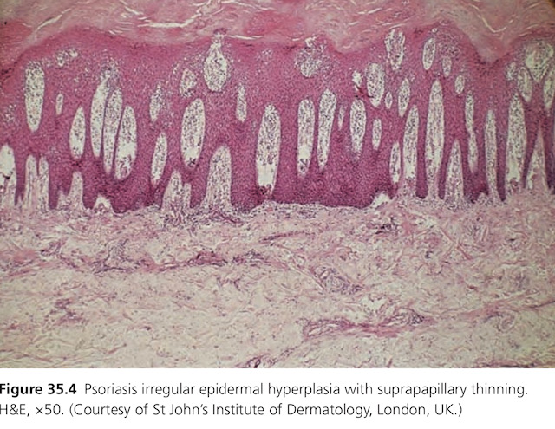
HISTOPATHOLOGY:
Irregular Epidermal Hyperplasia
Suprapapillary thinning

Slide 23
Clinical Features
History:
Itching
Shedding of scale
Family history
Detailed medical history especially articular symptoms (features of psoriatic arthritis)

Slide 24
Presentation
Most common form: Plaque psoriasis
Typical lesions: Red, scaly plaques which are well demarcated
Ring of Woronoff: May be surrounded by a clear, peripheral zone or halo
Size: 1 to several centimeters, Coalesce to form larger plaques is common
Number of lesions: Single or multiple
When multiple, the lesions are usually monomorphic and distributed relatively symmetrically over the trunk and extensor surfaces of limbs

Slide 25
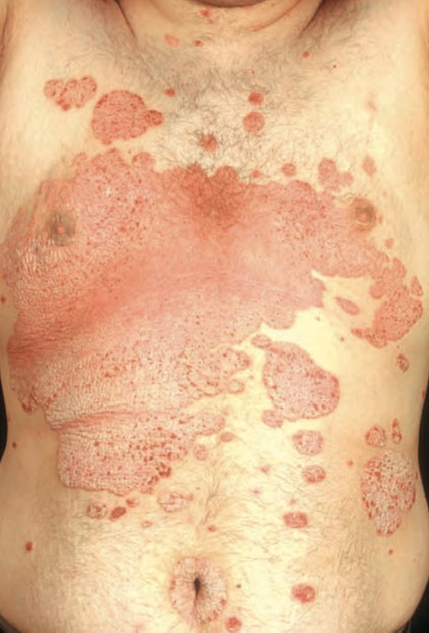

Slide 26
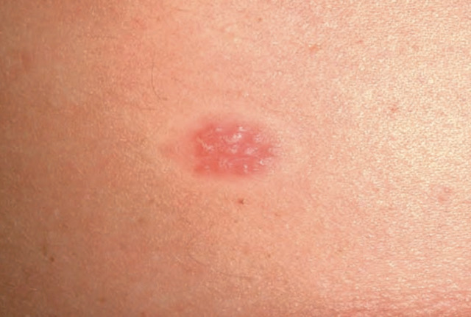

Slide 27
Presentation
Color: A full, rich, red, salmon pink color is of particular diagnostic value
Scales: Silvery, white scales which vary in thickness
Auspitz signs:
The successive removal of scales reveals an underlying smooth, glossy red membrane with small bleeding points where the thin supra-papillary dermis has been torn off
Thickness:
The epidermal thickening characteristic of the psoriatic process causes the lesions to be raised from the adjoining skin and easily palpable

Slide 28
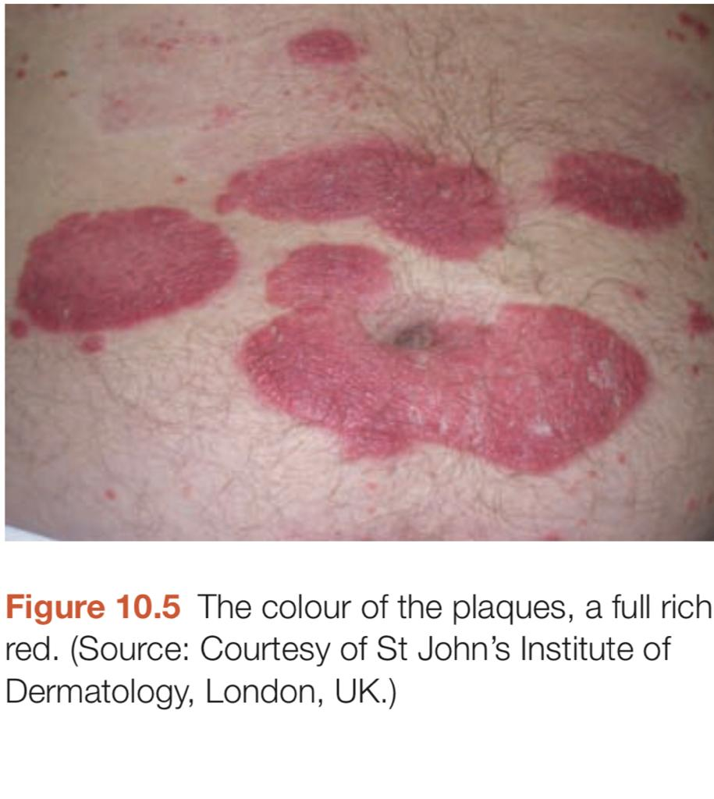

Slide 29
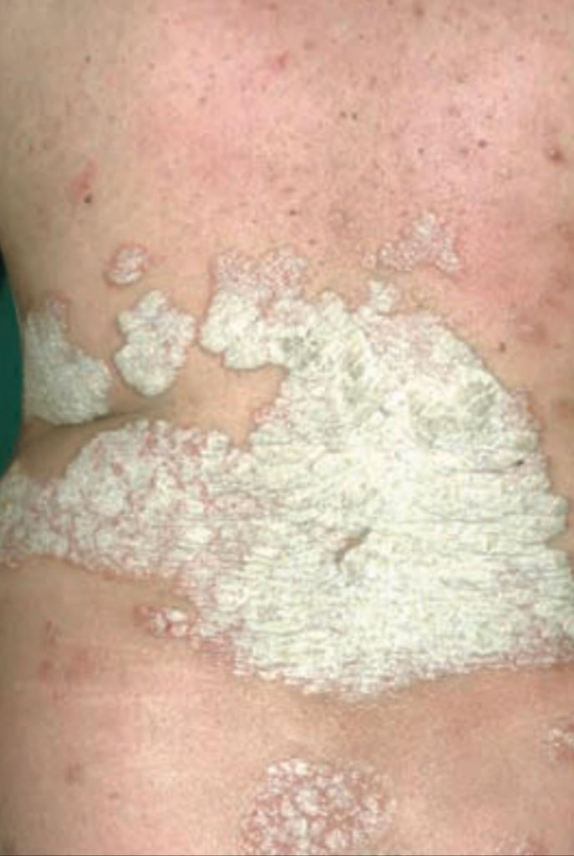

Slide 30
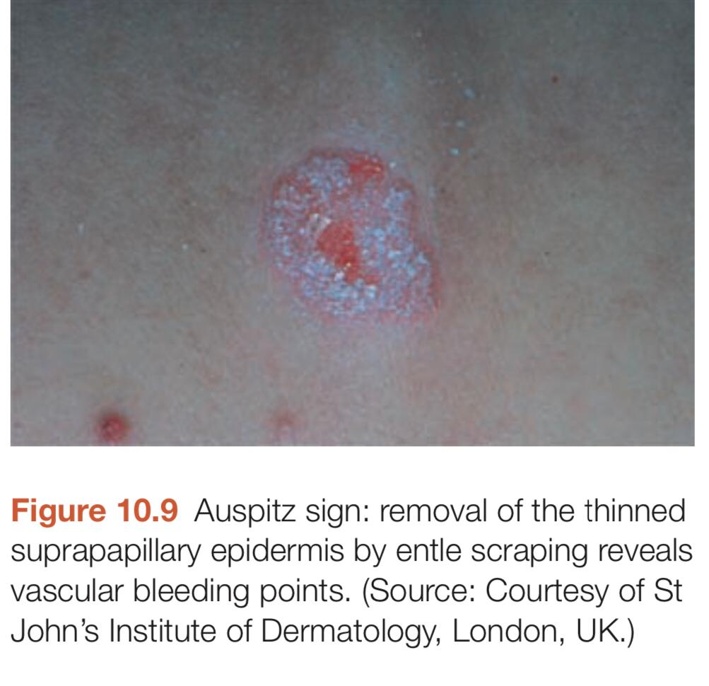

Slide 31
Psoriasis Affecting Specific Sites
Scalp psoriasis:
Commonest area of plaque psoriasis and often the first affected
Whole scalp may be involved diffusely or multiple discrete plaques may be present
The rate of hair growth is normal and it is not a cause of alopecia
Psoriatic erythroderma is associated with severe hair loss

Slide 32
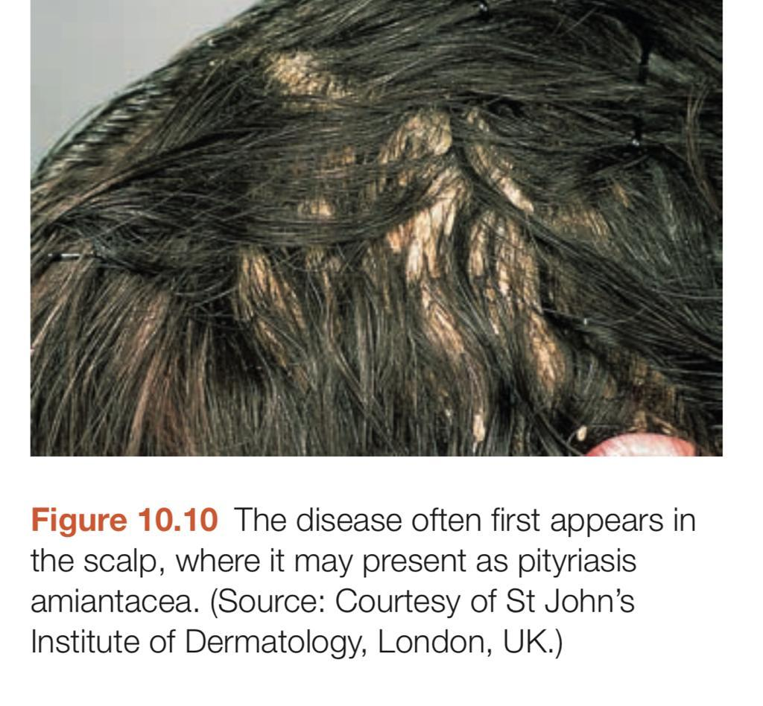

Slide 33
Follicular Psoriasis:
Affects the hair follicles on the trunk and limbs
May occur as an isolated phenomenon or in association with plaque psoriasis
Seborrheic Psoriasis (Sebopsoriasis):
Involves paranasal areas, external ears, medial eyebrows, hairline ,pre-sternal & interscapular chest wall

Slide 34
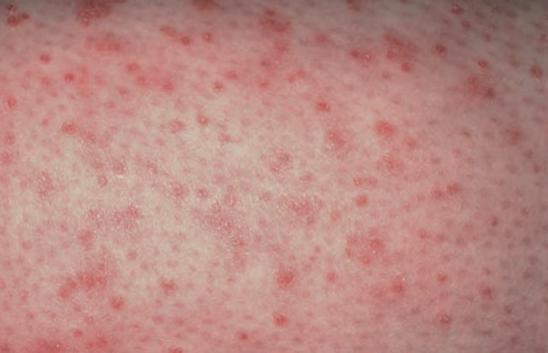

Slide 35
Flexural (Inverse) Psoriasis
Involves inguinal creases, axillae,submammary folds, gluteal cleft and umbilicus
Seen in adults and obese people
Flexural plaques are thin & scaling is greatly reduced, the surface has a glazed hue
Maceration and friction can alter the appearance of psoriasis
Involvement of napkin area may be first presentation of psoriasis in infancy

Slide 36
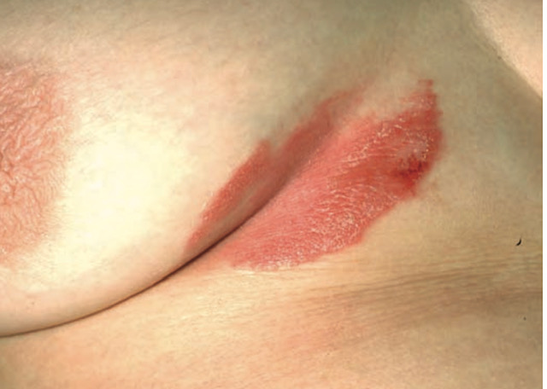

Slide 37
Genital Psoriasis
Males:
Glans is the most frequently affected
Skin of scrotum and penile shaft may be affected
Females:
Most common vulval presentation is a symmetrical, erythematous, non-scaly, well-demarcated thin plaque affecting the labia majora

Slide 38
Nail psoriasis
Associated with increased disease severity, longer disease duration & psoriatic arthritis(twice as common in the presence of nail psoriasis)
Nail changes are present in about 40% of cases
Can present with pits, ridges and grooves of nail plates or subungual oil drops, subungual hyperkeratosis or distal onycholysis

Slide 39
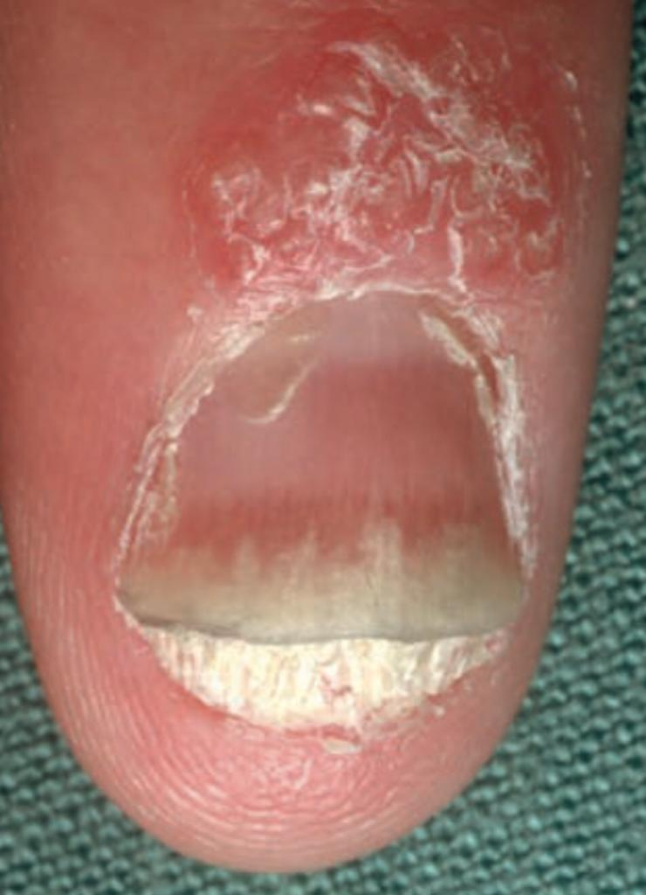

Slide 40
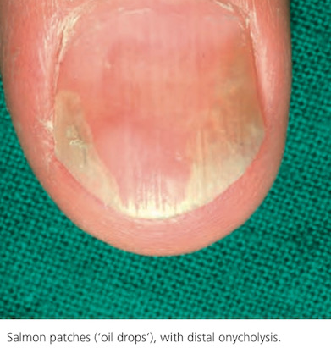
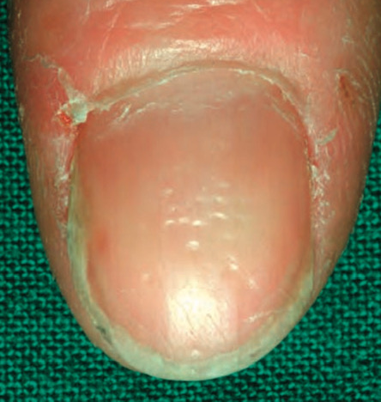

Slide 41
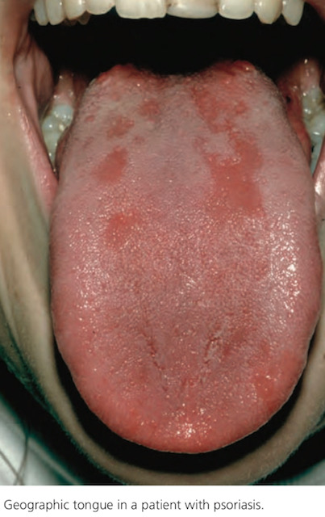
Mucosal Lesions
Rare but can cause:
Geographic tongue(benign migratory glossitis)
Fissured tongue

Slide 42
Ocular lesions
Most common ocular complication is blepharitis
Chronic nonspecific conjunctivitis Uveitis
More strongly associated with psoriatic arthritis

Slide 43
Non-pustular Palmoplantar Psoriasis
A sharply defined edge at wrist, forearm, palm and absence of vesiculation are helpful to differentiate from pustular psoriasis
knuckles show dull, red thickening of skin
There may be a relationship to trauma or occupational irritants

Slide 44
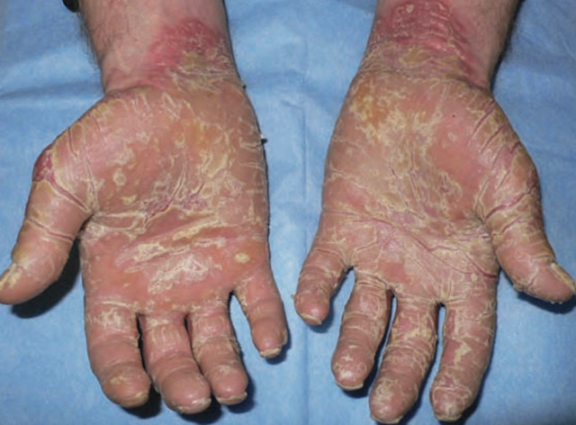

Slide 45
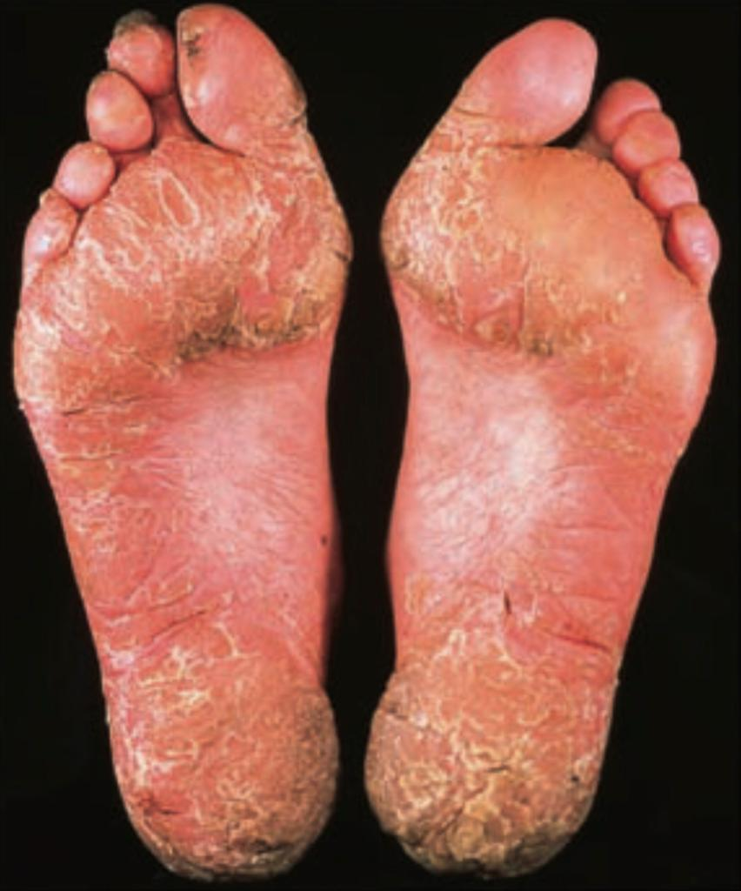

Slide 46
CLINICAL VARIANTS BASED ON MORPHOLOGY & NATURAL HISTORY
Acute Guttate Psoriasis:
Sudden onset of shower of small lesions
More commonly on trunk and proximal part of limbs
Most common in children and young adults
Frequently occurs after pharyngitis with group-A streptococci (serological evidence- 60%)
One third of guttate psoriasis patients develop plaque psoriasis

Slide 47
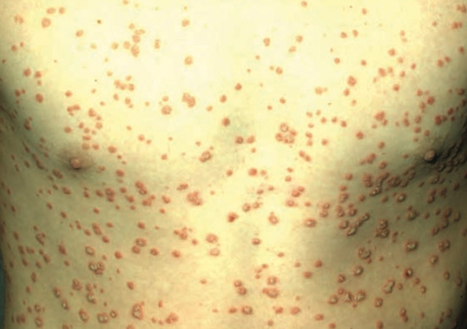

Slide 48
Unstable/ Eruptive Inflammatory Psoriasis
In contrast to plaque psoriasis which is static for prolonged periods ,there is enlargement of plaques which can become erythematous
Koebner’s phenomenon is more frequent
May progress to localized pustular psoriasis or erythrodermic psoriasis

Slide 49
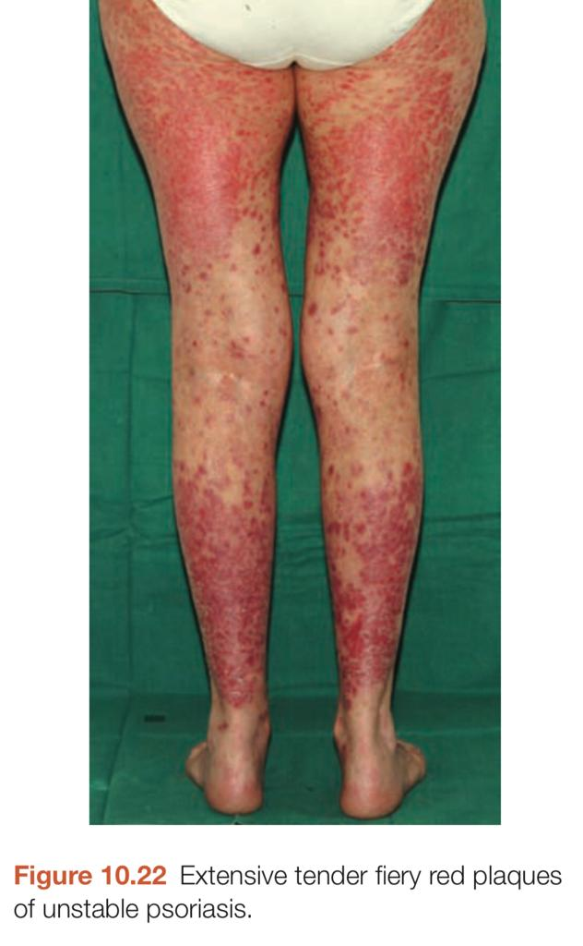

Slide 50
Erythrodermic Psoriasis
Psoriasis is the underlying cause of erythroderma in 25% of cases
Most or all of body surface is affected by psoriasis
Can be:
Acute
Chronic

Slide 51
Acute Erythrodermic Psoriasis
Patient is febrile and systemically unwell
May cause skin failure
Precipitated by:
Systemic illness
Withdrawal of systemic corticosteroids
Administration of Anti-malarial drugs

Slide 52
Chronic Erythrodermic Psoriasis
Due to gradual extension of plaque psoriasis
Patient is systemically well
Prognosis is good

Slide 53
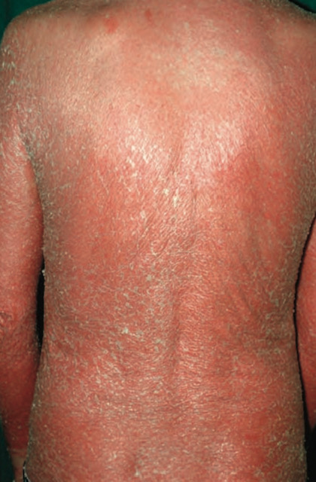

Slide 54
Atypical Forms Of Psoriasis
Digital and interdigital forms
Verrucous lesions
Rupioid psoriasis
Elephantine psoriasis
Ostraceous psoriasis

Slide 55
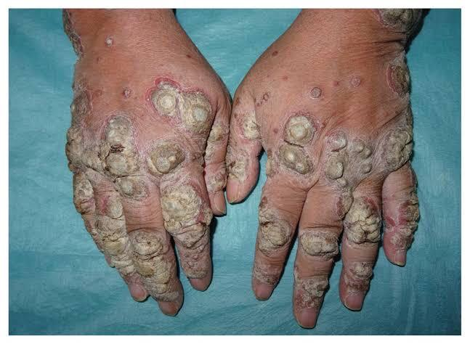

Slide 56
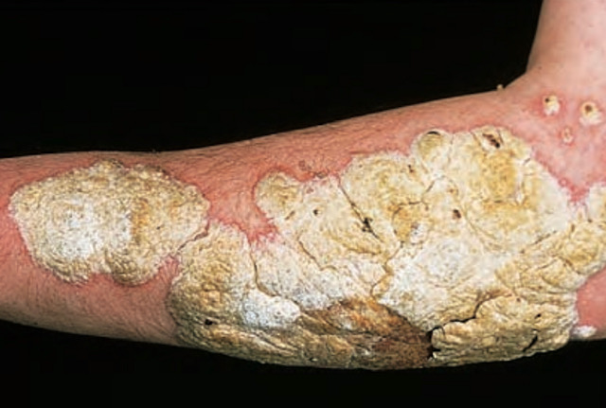

Slide 57
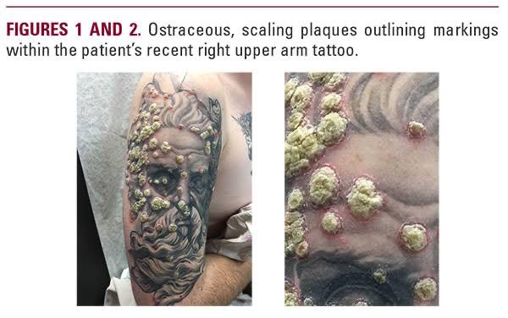

Slide 58
OTHER SPECIFIED FORMS OF PSORIASIS
(BASED ON AGE & PRECIPITANTS)
Linear & segmental psoriasis
Psoriasis in childhood or old age
Drug induced or exacerbated psoriasis
Photo-aggravated psoriasis
HIV induced or exacerbated psoriasis

Slide 59
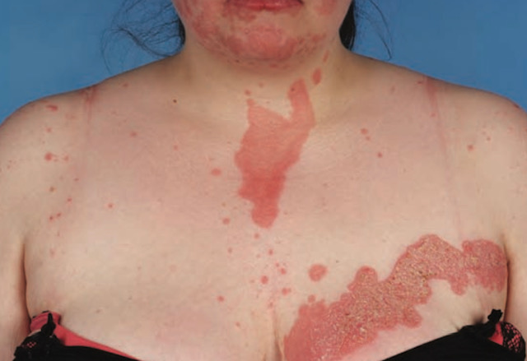

Slide 60
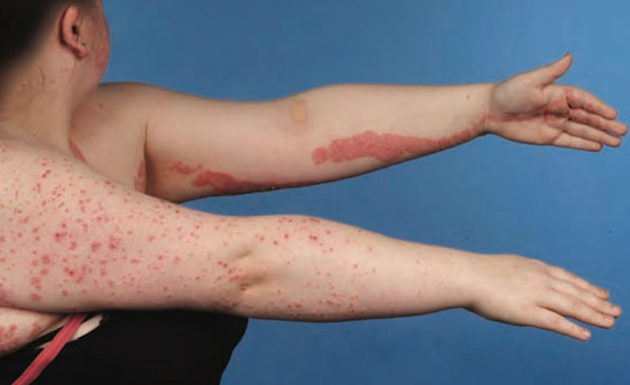

Slide 61
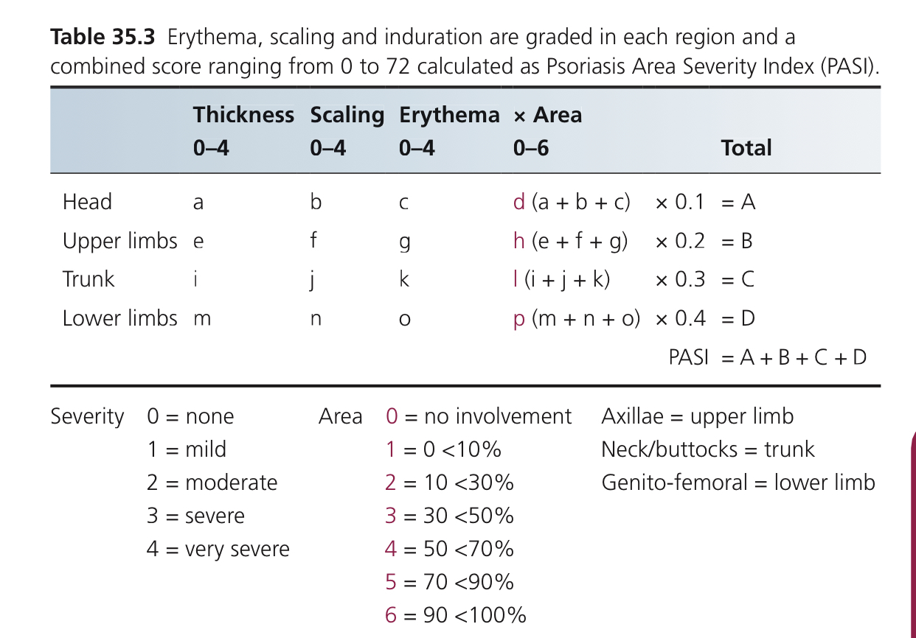

Slide 62
Complications and Co-morbidities:
Immune mediated inflammation: Psoriatic arthritis is more frequent
Psychological distress
Cancer
Metabolic syndrome

Slide 63
Investigations:
Diagnosis is clinical
Skin biopsy for atypical cases
CRP: Marked elevation in psoriatic arthritis
Relevant monitoring for systemic and biologic treatment
Screening for co-morbidities eg psoriatic arthritis & metabolic syndrome

Slide 64
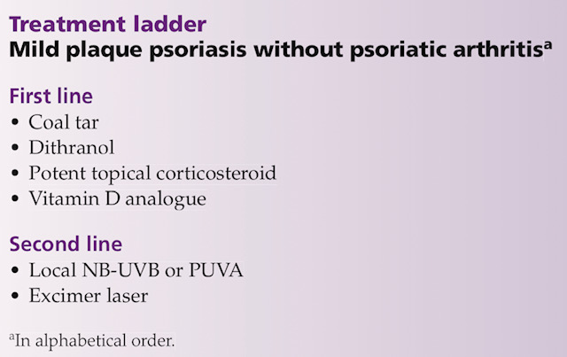

Slide 65
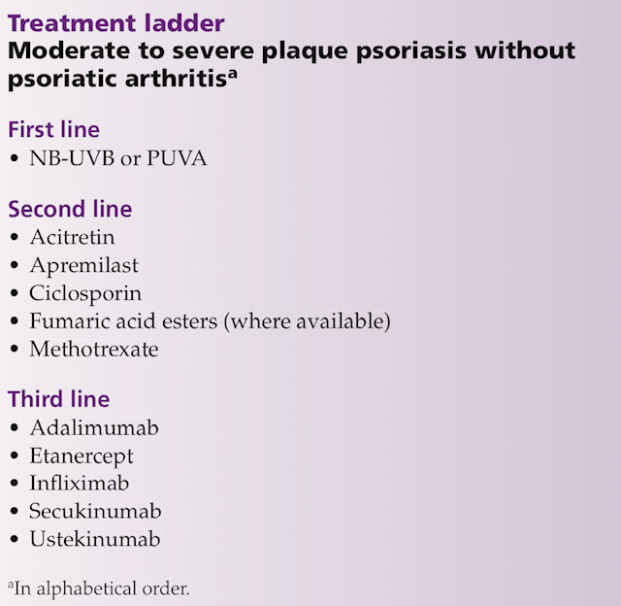

Slide 66
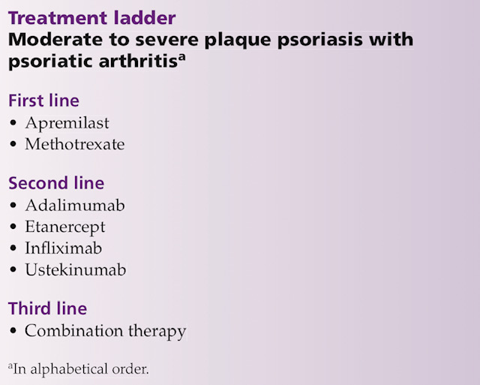

Slide 67
Pustular Psoriasis (classification)
Generalized Pustular Psoriasis:
Acute generalized pustular psoriasis(Von Zumbusch)
Subacute annular and circinate pustular psoriasis
Acute generalized pustular psoriasis of pregnancy(impetigo herpetiformis)
Infantile and juvenile generalized pustular psoriasis
Localized Pustular Psoriasis:
Palmoplantar pustulosis
Acrodermatitis continua of Hallopeau

Slide 68
Generalized Pustular Psoriasis
Predisposing factors:
Drugs: Most important is by corticosteroids. Other drugs include:
Terbinafine
Propranolol
Lithium
Infection
Pregnancy

Slide 69
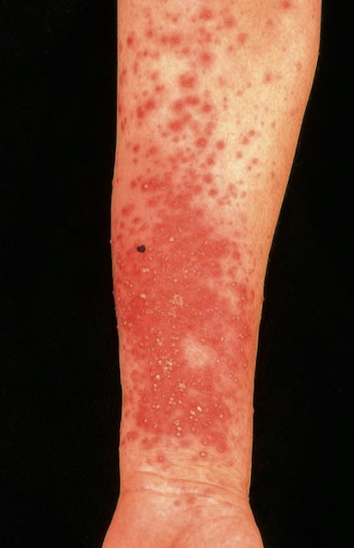

Slide 70
Acute Generalized Pustular Psoriasis
(Von Zumbusch)
Most acute and severe form
Recurrent episodes of fever with general malaise
Multiple isolated sterile pustules
Leukocytosis & Increased ESR
Kogoj’s spongiform pustules on histopathology

Slide 71
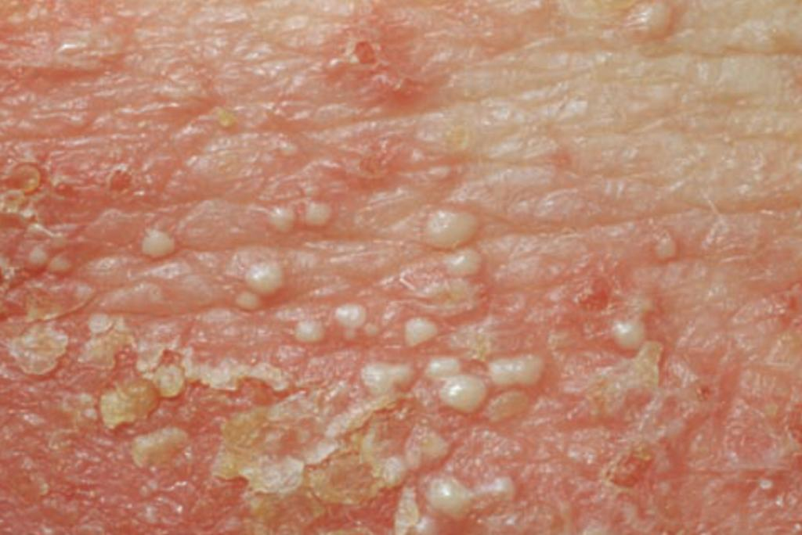

Slide 72
Subacute Annular Generalized
Pustular Psoriasis
Annular lesions begin as discrete areas of erythema which become raised& edematous
Slow centrifugal spread
Pustules appear peripherally and then become desiccated
Leave a scale as the lesion slowly advances
There are no systemic symptoms

Slide 73
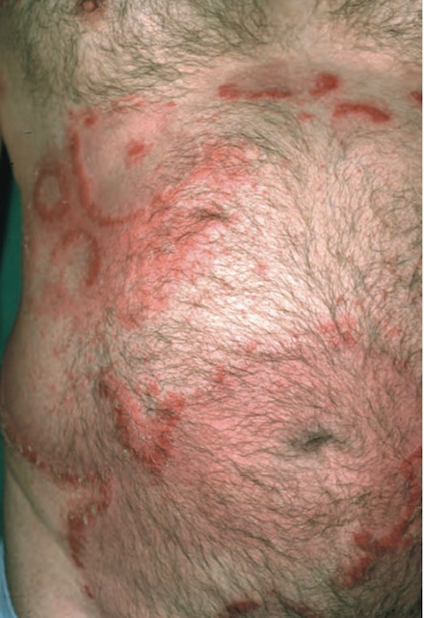

Slide 74
Acute Generalized Pustular Psoriasis Of Pregnancy (Impetigo Herpetiformis)
It usually starts in the flexures
Constitutional symptoms occur
Onset is usually in the last trimester of pregnancy
The more severe and long lasting the disease, the greater the risks of placental insufficiency leading to stillbirth, neonatal death or fetal abnormalities
Characteristically, the disease recurs in subsequent pregnancies

Slide 75
Infantile And Juvenile Generalized
Pustular Psoriasis
The majority of children are aged 2-10 years at onset
Von Zumbusch pattern is more common
May rapidly develop to erythroderma

Slide 76
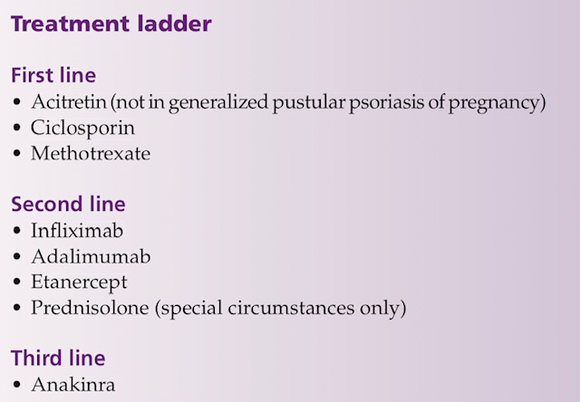

Slide 77
Palmoplantar Pustulosis
Erythematous & scaly plaques studded with sterile pustules - persist on palms or soles
Peak Age: Btw 30 and 50 years
Women are affected more than men (Ratio of about 5:1)
Affected area is dusky red and scaly
Within this plaque, numerous pustules are present
Associated with autoimmune thyroid disease and SAPHO syndrome (synovitis, acne, pustulosis, hyperostosis and osteitis)

Slide 78
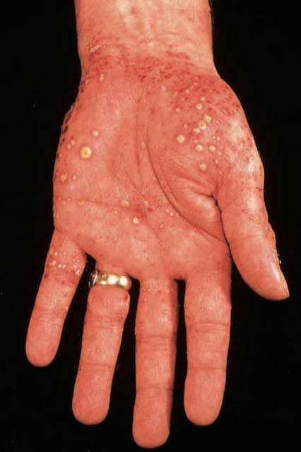
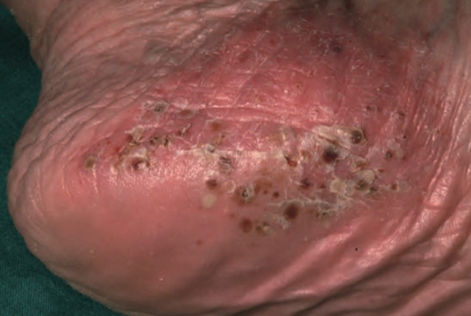

Slide 79
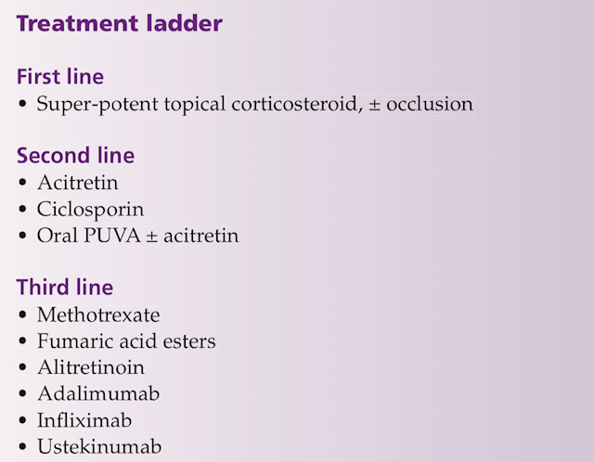
TREATMENT:
Affective treatment is often as disappointing for the physician as for patient.

Slide 80
Acrodermatitis Continua Of Hallopeau
Rare. Chronic, sterile pustular eruption affecting initially the tips of fingers or toes
Local destruction of soft tissue, nail apparatus and sometimes the terminal digit
It is more common in women
There is slow proximal extension
Bone changes can occur with osteolysis of the distal phalanx

Slide 81
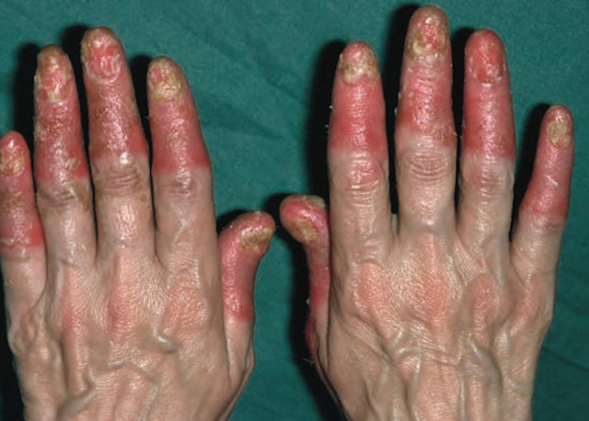

Slide 82
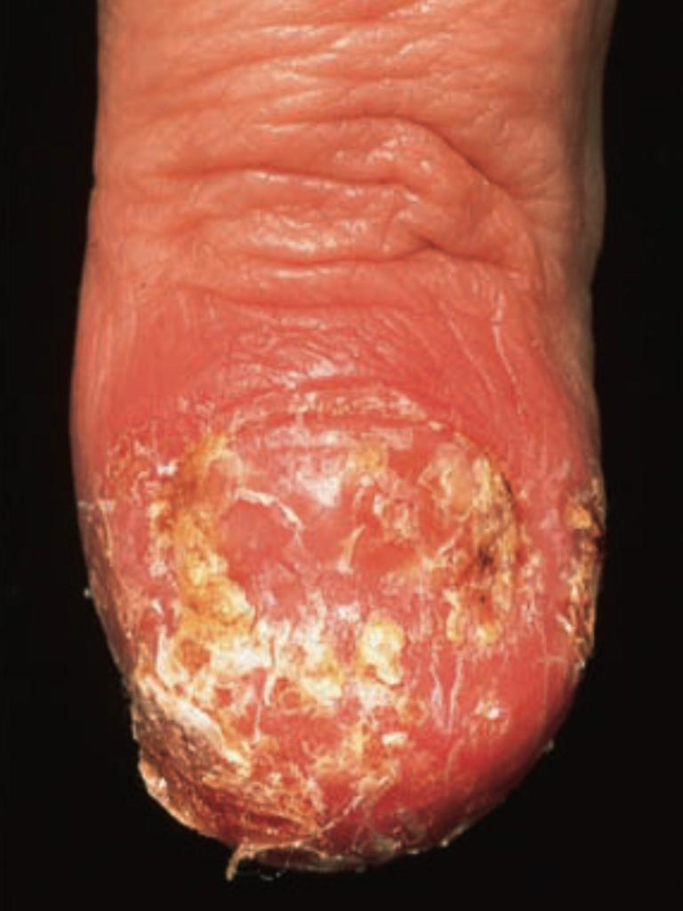

Slide 83
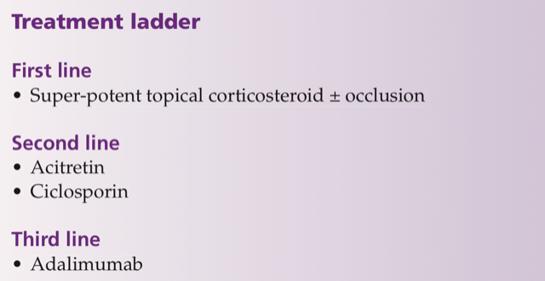

Slide 84
Psoriatic Arthritis
Seronegative inflammatory arthritis - occurs in 40% of patients with moderate to severe psoriasis
70% patients : Skin features of psoriasis prior to joint disease
20% patients: Joint disease presents first
10% patients: Skin and joints are affected concurrently
Enquiry about joint symptoms should be made at every consultation in psoriatic patients
Ask about early morning stiffness, joint swelling and heel pain
Refer patients for appropriate rheumatological assessment

Slide 85
Moll And Wright Clinical Patterns Of Psoriatic Arthritis
Distal arthritis characterized by involvement of DIP joints
Asymmetric oligo-arthritis, in which less than 5 small or large joints are affected in an asymmetric distribution
Symmetric polyarthritis, similar to and, at times, indistinguishable from rheumatoid arthritis
Arthritis mutilans, characterized by deforming and destructive arthritis
SpA, including sacroiliitis and spondylytis

Slide 86
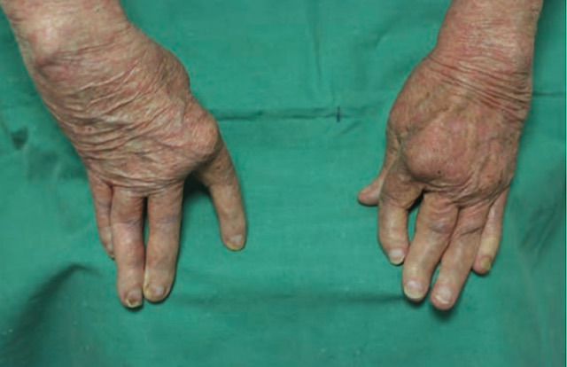

Slide 87
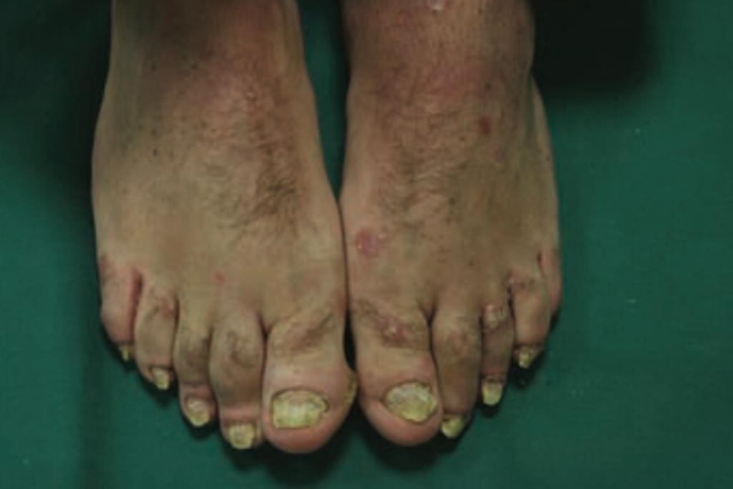

Slide 88
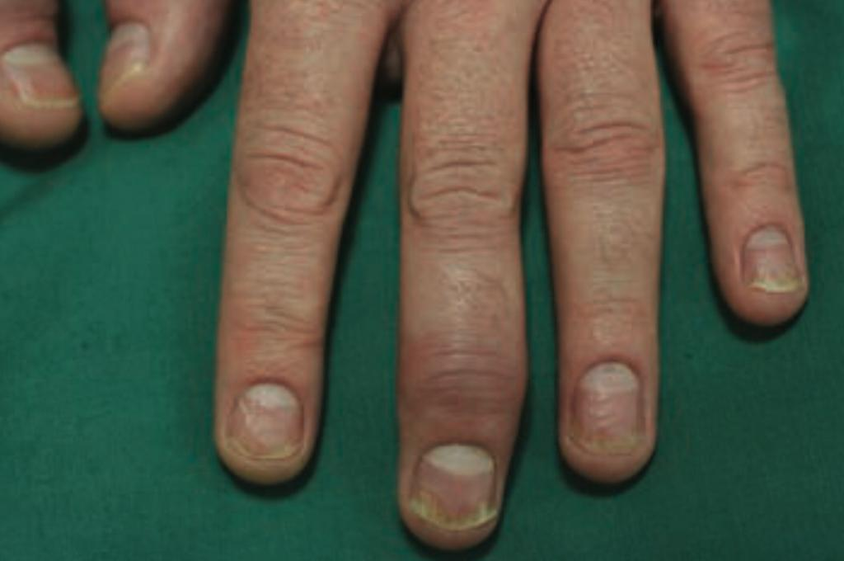

Slide 89
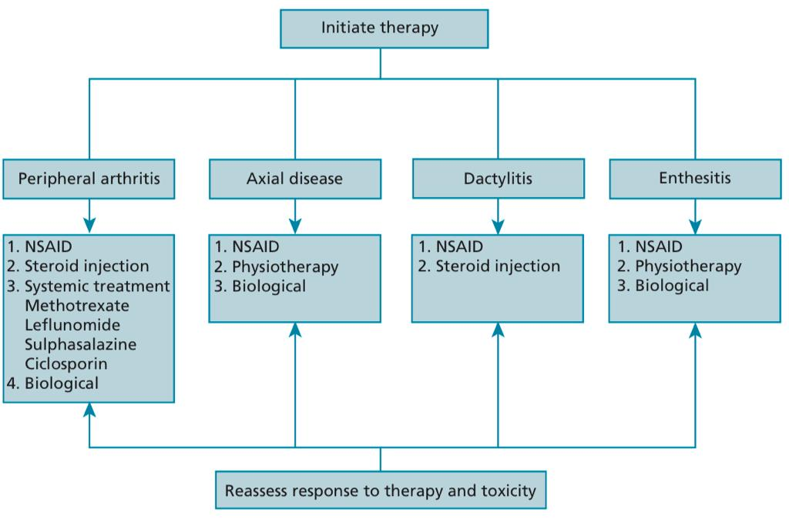

Slide 90
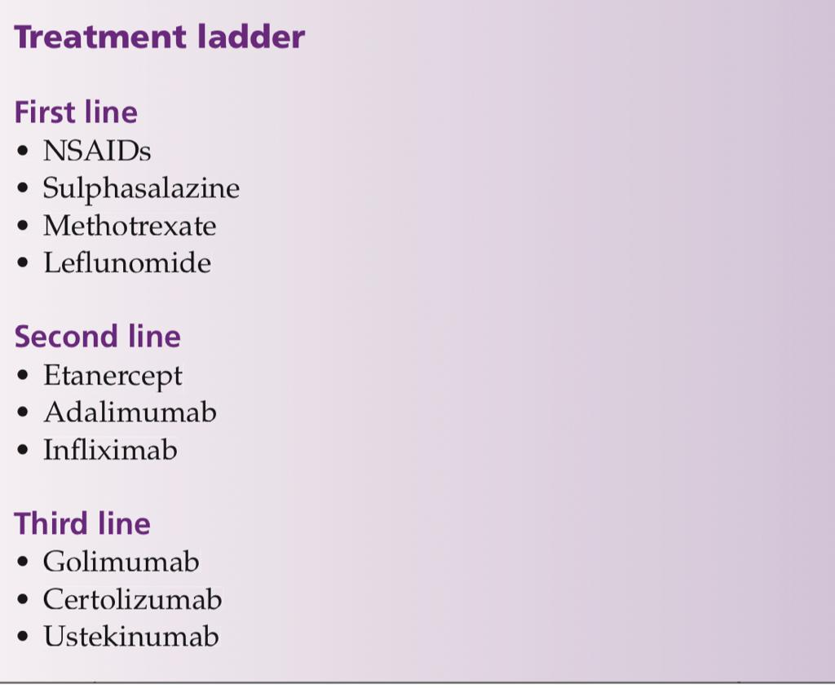

Slide 91
Drug Therapy
A: Small-Molecule Therapies
Methotrexate (MTX), ciclosporin A, and retinoids are systemic treatment options for psoriasis Oral drugs with the exception of MTX, which is also available for subcutaneous administration
Fumarate and Apremilast: Newer drugs

Slide 92
1. Methotrexate (MTX)
    A folic acid analogue inhibits DNA synthesis by blocking thymidine & purine biosynthesis
    Dose: 7.5–10 mg weekly
    May be increased to a maximum of 25 mg weekly

Slide 93
2. Ciclosporin
A T cell-inhibiting immunosuppressant
Inhibits IL 2 production by lymphocytes via calcineurin inhibition
Effective for remission induction
Dose: 2.5 to 5.0 mg/kg for up to 10 to 16 weeks
Side effects: Renal impairment Hypertension

Slide 94
3. Retinoids
Natural or synthetic vitamin A related molecules
Acitretin is the retinoid used in the treatment of psoriasis
Affects keratinocyte proliferation and differentiation
Dose: 0.3–0.5 mg/kg/day. Maximum dosage is 1 mg/kg /day
Side effects: is the most common appearing dose dependently, others are conjunctivitis, hepatitis, and teratogenicity

Slide 95
4. Fumaric Acid Esters (FAES)
Small molecules with immunomodulatory and anti-inflammatory properties
Mechanism of action involves an interaction with glutathione, which among other mechanisms, inhibits the transcriptional activity of NF-κB

Slide 96
5. Apremilast
A phosphodiesterase-4 inhibitor
Inhibits the second messenger cAMP
This leads to the reduced expression of proinflammatory cytokines
Adverse effects: GI upset (nausea and diarrhea)
Upper respiratory tract infections and nasopharyngitis

Slide 97
B: Biologics
The term biologics refers to complex engineered molecules including monoclonal antibodies and receptor fusion proteins
Biologics target specific inflammatory pathways
Are administered SC or IV on different weekly schedules
Biologics presently target two pathways : the IL-23/Th17 axis and TNF-α-signaling

Slide 98
1. TNFa Inhibitors
Effective for plaque psoriasis and psoriatic arthritis
4 drugs in this category: Etanercept, Infliximab, Adalimumab & Certolizumab
Etanercept: a recombinant human fusion protein
Infliximab: chimeric monoclonal IgG1 antibody
Adalimumab: a fully human monoclonal IgG1 antibody
Certolizumab: is a pegylated fab fragment of a humanized monoclonal antibody against TNF-α. Approved for use during pregnancy and breastfeeding

Slide 99
2. IL12/IL 23 p40 Inhibitors
IL-23:Ustekinumab, which is a monoclonal antibody directed against the p40 subunit that is common to both IL 12 and IL 23
Dose: 45mg at weeks 0,4 and then every 12 weeks in those < 100 kg
90 mg at weeks 0,4 and then every 12 weeks in those >100 kg
Adverse effects:
Nasopharyngitis, Upper respiratory tract and other infections
Fatigue and headache
Cardiovascular events

Slide 100
3.IL-17 Inhibitors
Three human monoclonal antibodies targeting IL-17 are available
Secukinumab, Ixekizumab and Brodalumab
Secukinumab: First IL-17A inhibitor approved for psoriasis
Also approved for PsA and ankylosing spondylitis
Adverse effects:
Nasopharyngitis, headache, upper respiratory tract infections & Candida infections
Risk of tuberculosis reactivation is considered small under biologic therapies other than anti-TNF-α drugs

Slide 101
C: Biosimilars in Psoriasis
A biosimilar is a biological product that must fulfill two requirements:
It must be highly similar to an approved biologic product
Have no clinically meaningful differences in safety, purity, or potency when compared with the reference product
There are currently eight adalimumab biosimilars, four infliximab biosimilars, and two etanercept biosimilars approved in Europe

Slide 102
THANK YOU

