Slide 1
PRINCIPLES OF CUTANEOUS LASER THERAPY
BY DR.SAMAN MUBASHAR
PGR DERMATOLOGY
SZH LAHORE

Slide 2
INTRODUCTION:
‘Light’ is a form of energy and falls within the electromagnetic spectrum which extends from X‐rays to radio waves.
Optical radiation refers to:
• Ultraviolet (100–400 nm)
• Visible (400–750 nm)
• Infrared (750 nm to 1 mm
‘laser’ is an acronym for ‘light amplification by stimulated emission of radiation’.

Slide 3
LASER
During the operation of a laser,these light– matter interactions take place simultaneously
energizing of atoms
spontaneous emission of photons
stimulated emission of photons
energy that is required to excite the atoms in a laser is provided by an external power source in a process called pumping.

Slide 4
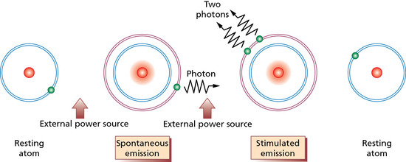

Slide 5
LASER LIGHT CHARACTERISTICS
Monochromaticity.
Coherence: Laser light is both temporally and spatially coherent, that is, the waves are in phase in time and space.
Collimation: It means that the diameter of the beam changes only minimally over distance, unless it is focused by a lens.

Slide 6
LASER AND LASER BEAMS
Lasers are usually named after the constituents of the active or gain medium, which may be a gas, liquid, solid or semiconductor.
1. solid state material : ruby, alexandrite, Nd:YAG (neodymium:yttrium‐aluminium‐garnet), Er:YAG (erbium:yttrium‐aluminium‐garnet) or semiconductor diodes.
2. liquid: organic dyes in a solvent, for example rhodamine.
3 . gas: carbon dioxide, argon, rare gas–halide mixtures and metal vapours.

Slide 7
Lasers are sometimes classified according to the pulse characteristics of the beam:
continuous: uninterrupted beam of relatively low power
Super pulsing: laser emits a rapid train of higher peak power pulses of energy.
pulsed or quality switched (Q‐switched): creating an ultrashort pulse (5–100 ns) together with an extremely high peak power.

Slide 8
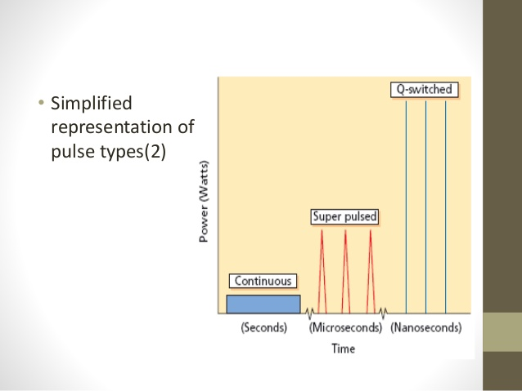

Slide 9
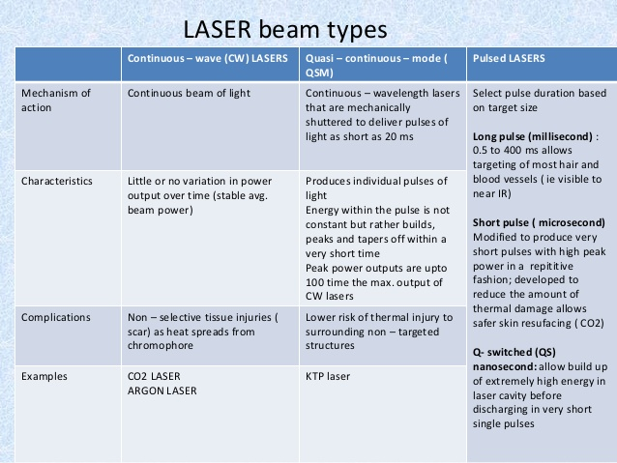

Slide 10
Tissue optics
Reflection:About 4–6% of light is reflected at the skin surface
Absorption: BEERS LAW : the law states that there is a logarithmic dependence between the transmission of light through a substance and the concentration of that substance as well as between the transmission of light and its path length through the substance.

Slide 11
The endogenous chromophores of importance are melanin, haemoglobin, water and collagen
Melanin absorption includes ultraviolet and visible light, with decreasing absorption into the near infrared spectrum.
Haemoglobin has absorption peaks in the UVA, blue (400 nm), green (541 nm) and yellow (577 nm) wavelengths.
Collagen absorbs in the visible and near infrared spectra,
Water in the mid and far infrared regions

Slide 12
SCATTERING: mostly due to collagen in dermis.
Light between 600 and 1200 nm is an optical window into the skin because it is subject to low scattering in addition to being well absorbed by endogenous chromophores. Longer wavelength light is absorbed by water and does not penetrate deeply.
TRANSMISSION:Light that is not reflected, absorbed or scattered passes to deeper tissue
Wavelengths in the 600–1200 nm range penetrate more deeply because they are scattered less.

Slide 13
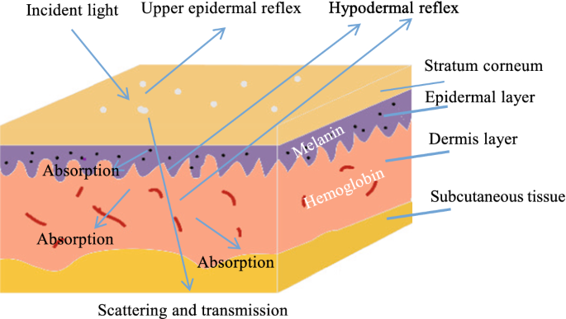

Slide 14
LIGHT TISSUE INTERACTION:
Pulse duration (the duration of each individual pulse of laser light) is the single most significant variable in light–tissue interaction
PULSE DURATION | INTERACTION | TYPICAL APPLICATION
CONTINUOUS WAVE > 1SEC | PHOTOCHEMICAL INTERACTIONS | PHOTODYNAMIC THERAPY
MILISECONDS TO MICROSECONDS | PHOTOTHERMAL INTERACTIONS | HAIR REDUCTION VASCULAR LESIONS
MICROSECONDS TO NANOSECONDS | PHOTOABLATION PHOTMECHANICAL | PIGMENTED LESIONS ABLATIVE REJUVENATION

Slide 15
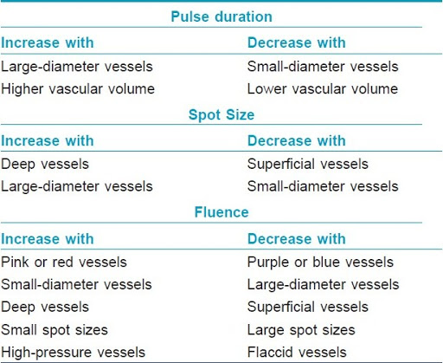

Slide 16
SELECTIVE PHOTOTHERMOLYSIS
light can be used to selectively damage or destroy a chromophore depending on
1.WAVELENGTH:determines the fate of incident light on tissue e.g Haemoglobin has a number of different absorption peaks, whereas absorption by melanin gradually diminishes with longer wavelengths of incident light.

Slide 17
2.ENERGY FLUENCE :fluence or energy density per unit area in J/cm2 .
For laser–chromophore interaction to be successful, the fluence should be high enough to cause destruction of the chromophore.
3.THERMAL RELAXATION TIME :The TRT is the time taken for the target to dissipate about 63% of the incident thermal energy.

Slide 18
THERMAL DAMAGE TIME (TDT):
The time to achieve selective damage of the target.
This is how long it takes for the entire target, including the primary chromophore (e.g. melanin) and the surrounding target (e.g. a hair follicle), to cool by 63%.
The TDT is longer than the TRT as it takes into account heat diffusion from the chromophore throughout the target.

Slide 19
LASER AND IPL ( INTENSE PULSE LIGHT SYSTEMS)
LASER | FLASHLAMP (IPL)
Single wavelength, e.g. pulsed dye laser (595 nm) | Multiple wavelengths tuned according to application, e.g. 590–950 nm for vascular indications
Small(er) circular or square spot sizes | Larger rectangular or square spot sizes or footprints
High(er) repetition rate (Hz) | Low repetition rate (Hz)
Smaller hand‐piece | Bulkier hand‐piece, which houses the lamp and lamp cooling device
Single pulses of variable or fixed duration for efficient heating of target | Multiple pulses with variable or fixed delay for slow heating of target and sparing of epidermis

Slide 20
TISSUE COOLING
cooling of the epidermis reduces the risk of undesired damage to pigmented skin
cooling decreases the pain associated with treatment
METHODS:
Cold air convection
Contact cooling
Cryogen spray (dynamic) cooling

Slide 21
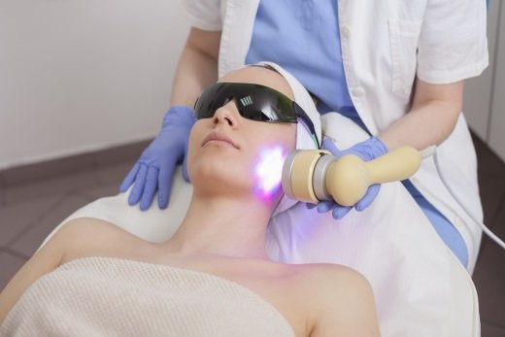
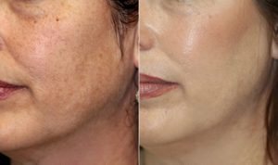
IPL

Slide 22
CLINICAL APPLICATIONS OF LASER
VASCULAR LESION TREATMENT LASERS:
KTP(532nm)laser(frequency doubled Nd:YAG laser) : Light produced by KTP lasers is highly absorbed by haemoglobin (and melanin) but its wavelength penetrates only superficially
PULSED DYE LASER(585–600 nm) 0.45 and 1.5–40 ms:
Light penetrates the dermis to a depth of 1.2 mm and photocoagulates vessels of up to 100 μm in diameter .

Slide 23
Alexandrite (755 nm) and Nd:YAG (1064 nm) lasers:
role in treating relatively deep and large vessels, including those on the legs.
Flashlamps (500–1200 nm):
These emit non‐coherent light over a broad spectrum.
LASER | WAVELENGTHS
COPPER VAPOUR | 578
KTP | 532
PULSED LASER | 577,585,590,595,600
ALEXANDRITE | 755
Nd:YAG | 1064
DIODE | 800,810,930
FLASHLAMPS | 515-1200

Slide 24
INDICATIONS FOR VASCULAR LESIONS
Primarily vascular conditions:
Haemangiomas
Congenital capillary malformations (port‐wine stains)
Facial telangiectases and erythema
Angioma serpiginosum
Radiotherapy telangiectasesand telangiectases in CREST syndrome and hereditary haemorrhagic telangiectasia
‘Spider’ telangiectases
Cherry angiomas
Superficial leg veins and telangiectases
Angiokeratomas
Venous lakes

Slide 25
OTHERS:
Angiofibromas
Viral warts
Erythematous and hypertrophic scars
Psoriasis
Granuloma faciale
Poikiloderma of Civatte
Stretch marks

Slide 26
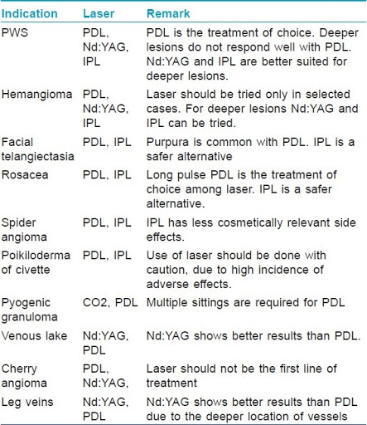

Slide 27
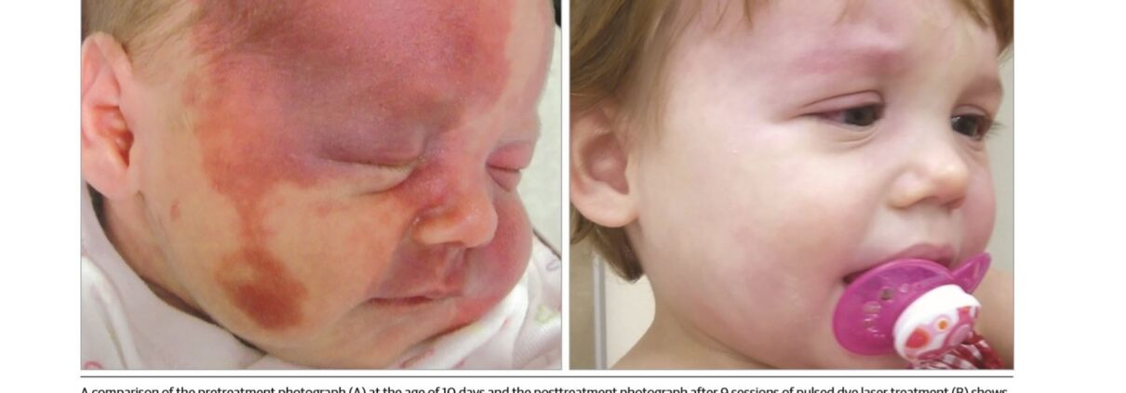
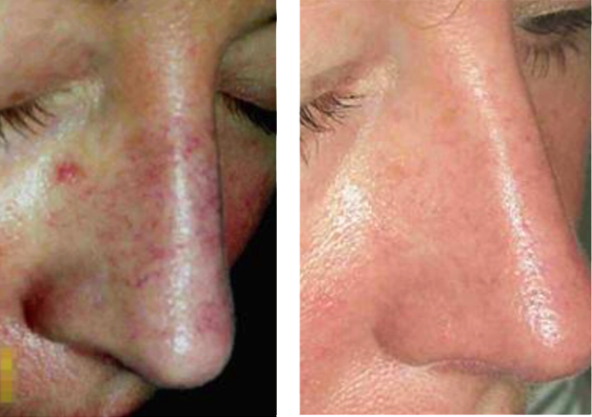

Slide 28
POOR PROGNOSTIC FACTORS FOR PWS LASER RESULT:
age over 1 year
central facial location
size >40 cm2
Nodular or hypertrophic lesions
vessels >400 μm below the dermal–epidermal junction
vessel diameter >20 μm
more than five previous laser treatments

Slide 29
COMPLICATIONS OF VASCULAR LASER:
POST INFLAMMATORY DYSPIGMENTATION
ATROPHIC AND HYPERTROPHIC SCARRING
ERYTHEMA
PALLOR
VESICULATION N CRUSTING AFTER KTP LASER.
ATROPHIC SCARRING AFTER NASAL TELANGIECTASES TREATMENT

Slide 30
TATOO AND PIGMENTED LESIONS:
The ‘therapeutic window’ for treatment of pigmented lesions lies between 630 and 1100 nm
DEVICES USED :
Q-switched Nd:YAG (1064 nm) laser and Q-switched frequency doubled Nd:YAG (532 nm) laser
Q‐switched ruby (694 nm), alexandrite (755 nm) and diode (810 nm) lasers
Flashlamps (500–1200 nm)

Slide 31
TATOO AND PIGMENTED LESIONS:
INDICATIONS:
Tattoos
Epidermal lesions
Freckles
Lentigines
Labial melanotic macules
Flat and darkly pigmented seborrhoeic keratoses
Café‐au‐lait macules
Dermal melanocytosis
Naevi of Ota and Ito
Drug‐induced pigmentation
Mongolian blue spot

Slide 32
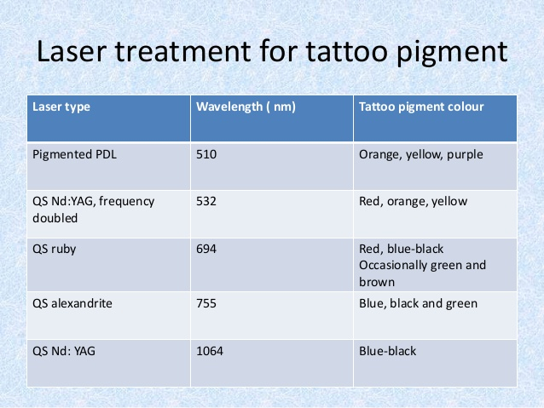
TATOO REMOVAL

Slide 33
Ephelides (freckles) and actinic (solar)lentigines:
respond well to treatment with the Q‐switched KTP laser (532 nm).
Facial lentigines, labial lentigines and genital melanosis (genital lentiginosis) improve with the Q‐switched alexandrite laser.
Naevus of Ota: has been treated with the Q‐switched ruby, alexandrite and Nd:YAG lasers
Drug‐induced hyperpigmentation secondary to the administration of minocycline and amiodarone responds readily to treatment with the Q‐switched ruby, alexandrite and Nd:YAG lasers.

Slide 34
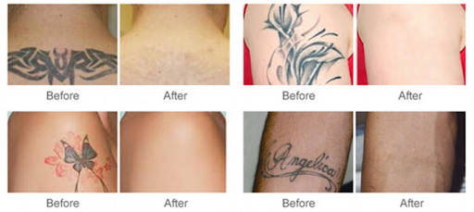
Q SWITCHED Nd:YAG LASER TATOO REMOVAL

Slide 35
COMPLICATIONS OF PIGMENT LASERS:
Whitening and subsequent erythema
pin‐point bleeding
laser burns
dyspigmentation
Scarring
Certain tattoo pigments can darken with laser treatments and care must be taken when treating traumatic tattoos, which may consist of combustible material.

Slide 36
HAIR REDUCTION:
DEVICES USED :
ruby (694 nm)
alexandrite (755 nm): skin prototypes I to III
diode (800 nm)
Nd:YAG (1064 nm): for dark skinned prototype

Slide 37
LASER ASSISSTED HAIR REMOVAL
Patients with light skin colour and dark hair are best suited to laser hair removal. Patients should be informed that lasers may not work on light‐coloured, red, grey or white hair nor fine vellus hair.
GOAL: The number of hairs regrowing must be stable over a time period greater than the duration of the complete growth cycle of hair follicles, which varies from 4 to 12 months according to body location

Slide 38
INDICATIONS:
Hirsutism
Hairy congenital naevi
Faun tail and Becker naevi
Hair‐bearing skin grafts
Folliculitis decalvans
Pseudofolliculitis

Slide 39
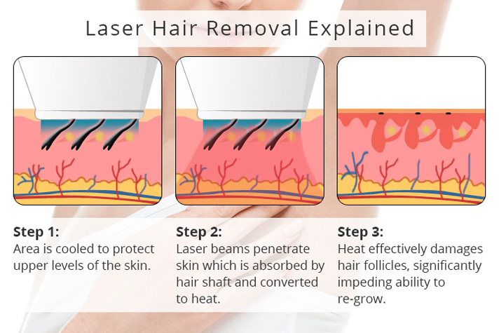
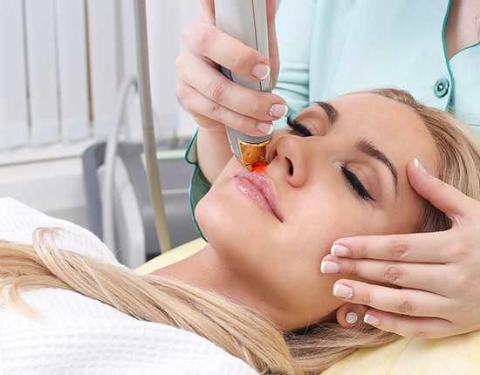

Slide 40
COMPLICATIONS OF LASER ASSISSTED HAIR REMOVAL :
Pain
transient erythema
perifollicular oedema
folliculitis
Aggravation of pre‐ existing skin conditions, including acne, can occur

Slide 41
PHOTOTHERMAL ABLATION:
LIGHT-TISSUE INTERACTION:
1. Incisional with haemostasis: The CO2 laser (10 600 nm) can be used as an incisional or resurfacing instrument.
The main advantage of thermal damage, in this context, is haemostasis
2.Ablative laser resurfacing :CO2 and Er:YAG lasers used

Slide 42
DEVICES USED
CO2 LASER (10600nm)
Er:YAG LASER (2940nm)
LASER | CO2 | Er:YAG
WATER AFFINITY | HIGH | VERY HIGH
ABLATION PER PASS | 20–60 μm | 5–15 μm
HEMOSTASIS | YES | NO
ABLATION PLATEAU | YES | NO
RESIDUAL THERMAL DAMAGE | 150 μm | 15μm

Slide 43
INDICATIONS FOR PHOTO THERMAL ABLATION:
Malformations : Epidermal naevi , Lymphangioma circumscriptum
Epidermal dysplasia and neoplasia : Actinic keratoses and actinic cheilitis , Squamous cell carcinoma in situ (Bowen disease) , Porokeratosis , Melanoma metastases
Benign cutaneous tumours and proliferations:Rhinophyma and sebaceous hyperplasia , Xanthelasma , Seborrhoeic keratoses , Dermatosis papulosa nigra , Syringomas , Angiofibromas , Familial trichoepitheliomas , Hidrocystomas , Viral warts , Neurofibromas.

Slide 44
Dermal infiltrates: Xanthelasma,Granuloma faciale, Sarcoidosis , Amyloidosis
Miscellaneous : Darier disease (keratosis follicularis) , Hailey–Hailey disease (familial benign chronic pemphigus) , Pemphigus vegetans , Colloid milium
Cosmetic : Acne scarring , Rhytides

Slide 45
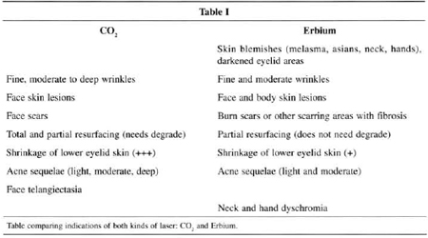

Slide 46
COMPLICATIONS:
Before re-epitheliazation:infection,usually due to staphylococci, although infections with Candida species and herpes simplex also occur.
acneform folliculitis
milia formation
contact reactions
dyspigmentation and scarring.

Slide 47
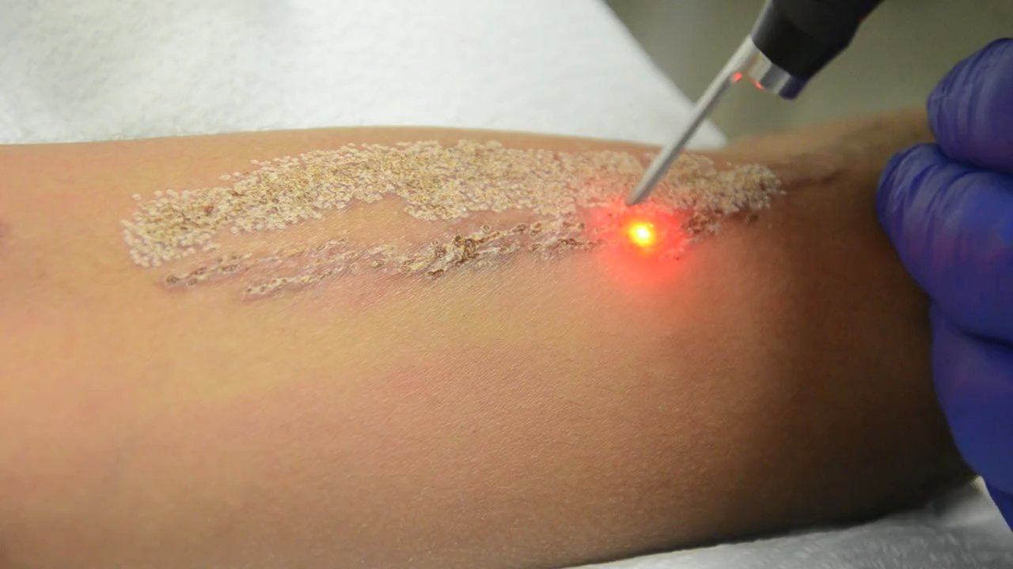
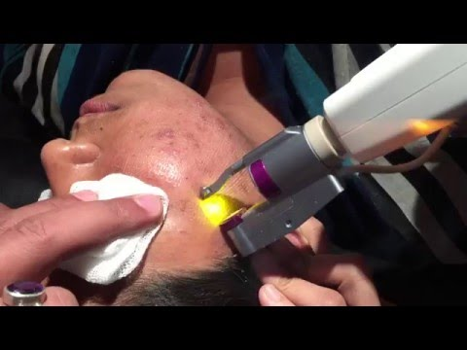
CO2 AND Er:YAG LASER

Slide 48
NON ABLATIVE AND SURFACING MODALITIES:
1. Non‐ablative resurfacing: selectively wound the upper dermis in order to induce dermal fibrosis (or collagen remodelling) and the epidermis is protected
2. Fractional non‐ablative resurfacing: creation of microscopic treatment zones of coagulative damage to the epidermis and upper dermis.
3. Fractional ablative resurfacing : fractional non‐ablative modalities on the one hand and ablative resurfacing on the other.

Slide 49
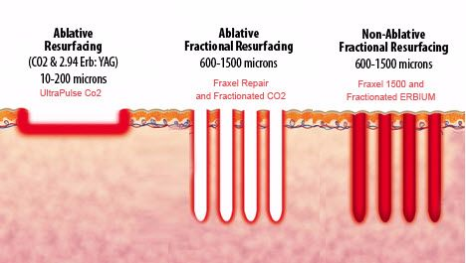

Slide 50
THANKYOU

