Slide 1
PITYRIASIS RUBRA PILARIS
DR KIRAN GUL
RESIDENT DERMATOLOGY
CMH ABBOTTABAD

Slide 2
OUTLINE
Definition
Epidemiology
Pathophysiology
Clinical Features
Types
Investigations
Management

Slide 3
LEARNING OBJECTIVES
Definition
Pathophysiology
Types
Diagnosis
Treatment

Slide 4
DEFINITION
Pityriasis rubra pilaris is name given to a group of clinically similar
papulosquamous dermatoses,underlying pathogenesis is unknown.
Erythematous hyperkeratotic perifollicular papules
Coalesce into plaques
May progress to erythroderma

Slide 5
SYNONYMS
Pityriasis pilaris
Lichen ruber acuminatus
Keratosis universalis multiformis
Keratosis circumscripta

Slide 6
EPIDEMIOLOGY
INCIDENCE AND PREVALENCE
1 in 5000 patients
Uncommon condition
AGE
Familial = early childhood
Acquired= bimodal age distribution (1st and 5th decades)
Sex
Equal incidence

Slide 7
ASSOCIATED DISEASES
CA colon, larynx, kidney and lung
Autoimmune diseases= systemic sclerosis, autoimmune thyroiditis
HIV infections

Slide 8
PATHOPHYSIOLOGY
Unknown
Mutations in CARD14 gene, activator of nuclear factor kappa light chain, enhancer of activated B cells (NF-KB)
Streptococcal superantigens in children with sporadic form
Autosomal dominant trait
17q25.3 overlaps with PSOR2 locus of psoriasis

Slide 9
HISTOLOGY
Hyperkeratosis with perifollicular plugging
Parakeratosis in perifollicular shoulders
Patchy or confluent hypergranulosis
Dermal capillaries are dilated but not tortuous( psoriasis)
Acantholysis
Lymphocytic dermal infiltrate

Slide 10
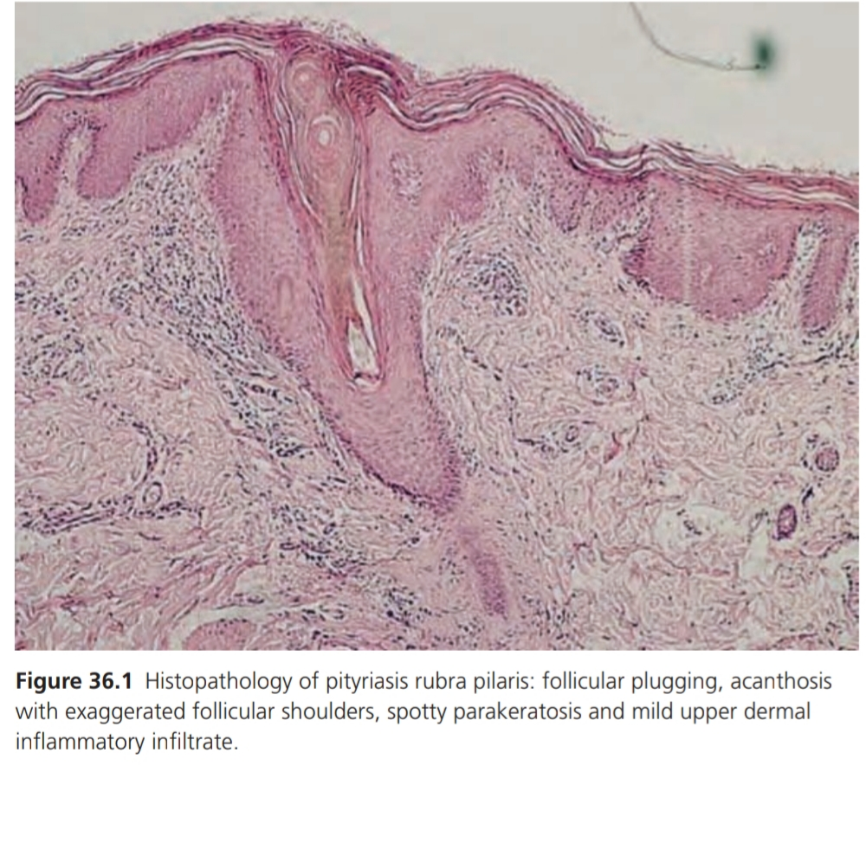

Slide 11
CLINICAL FEATURES
HISTORY
Sporadic ( 1 and 3) ,acute onset
Familial ( 4 ) , slow and gradual onset

Slide 12
PRESENTATION
Well defined salmon-red or orange red dry scaly plaques
Island of normal skin called “island of sparing”
Starts on the scalp
Pruritus in early stages
Follicular hyperkeratosis ( elbows, wrists and back of fingers )
“ NUTMEG GRATER” papules
Palms and soles ( fissured, thickened and orange discoloration )

Slide 13
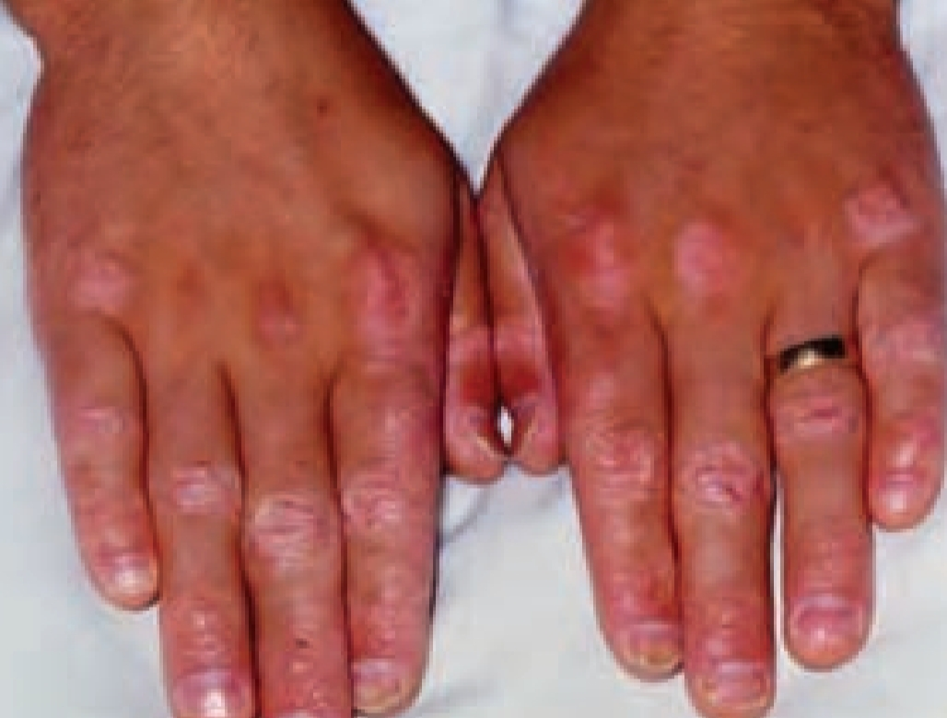

Slide 14
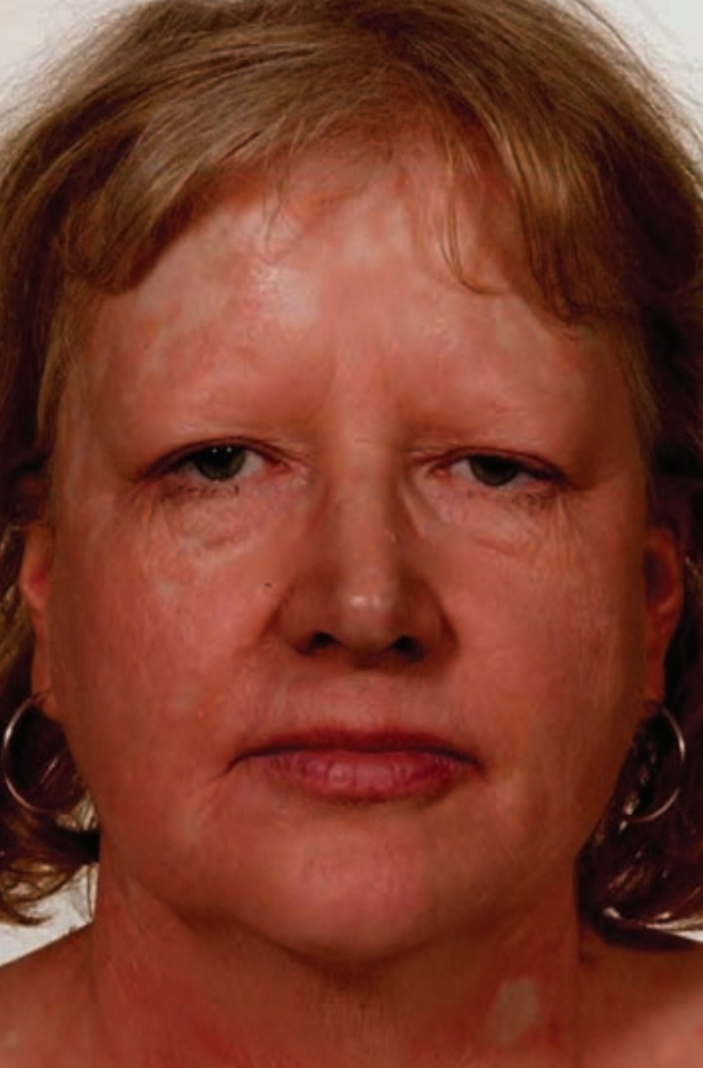

Slide 15
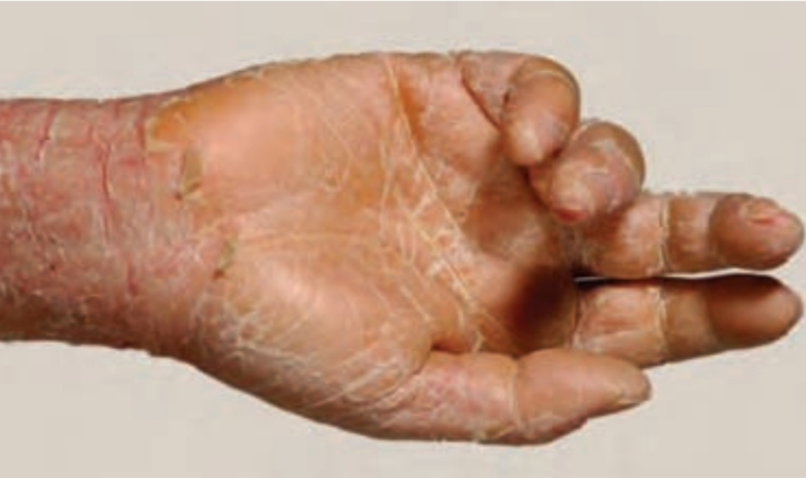

Slide 16
CLINICAL VARIANTS
CLASSICAL ADULT ONSET PRP (TYPE 1)
Most common (50 % of all cases)
Equal sex distribution
Highest incidence ( 40 and 60 years )
Erythematous scaly macule on head, neck and upper trunk
Erythematous perifollicular papules with central acuminate keratotic plug

Slide 17
Follicular lesions submerged into sheets of erythema of a slight orange hue
Face ( mild erythematous and mild ectropion)
Scalp ( diffuse bran-like scaling)
Erythrodema ( 2/3 months)
Islands of sparing
Palms and soles ( hyperkeratotic and yellow )
Nails ( thickened and discolored distally ) no dystrophy of nail plate and pitting is minimal

Slide 18
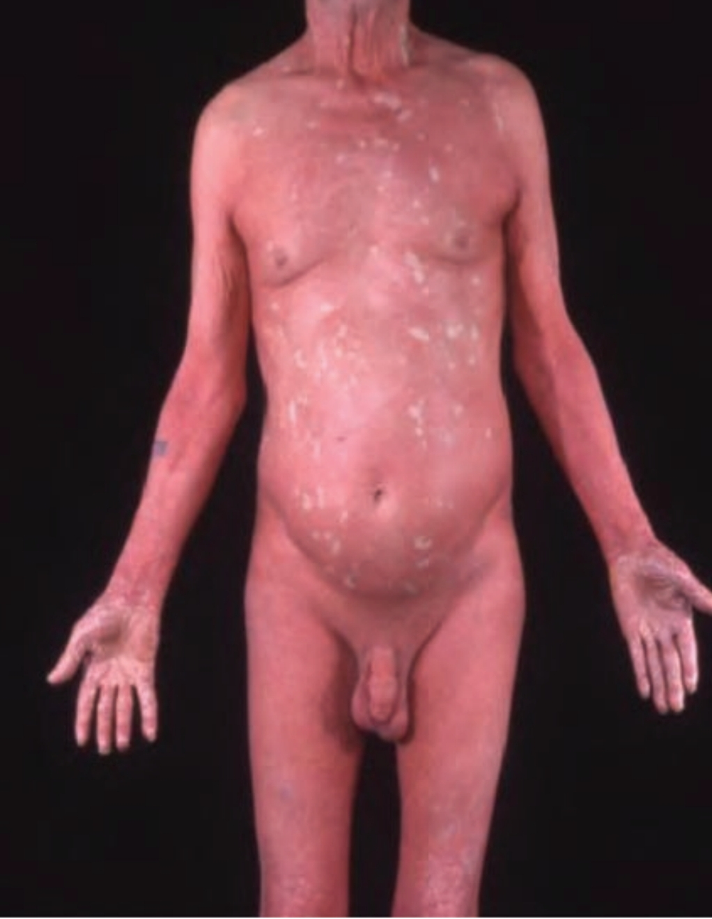

Slide 19
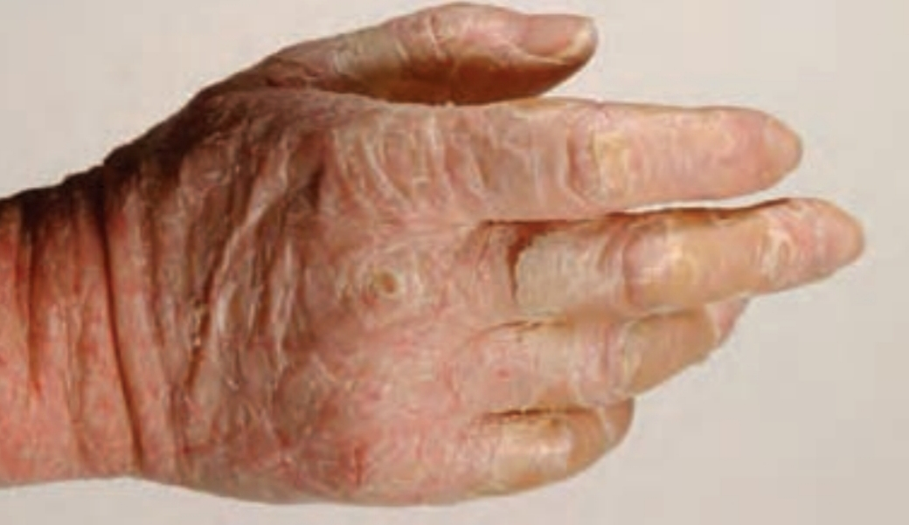

Slide 21
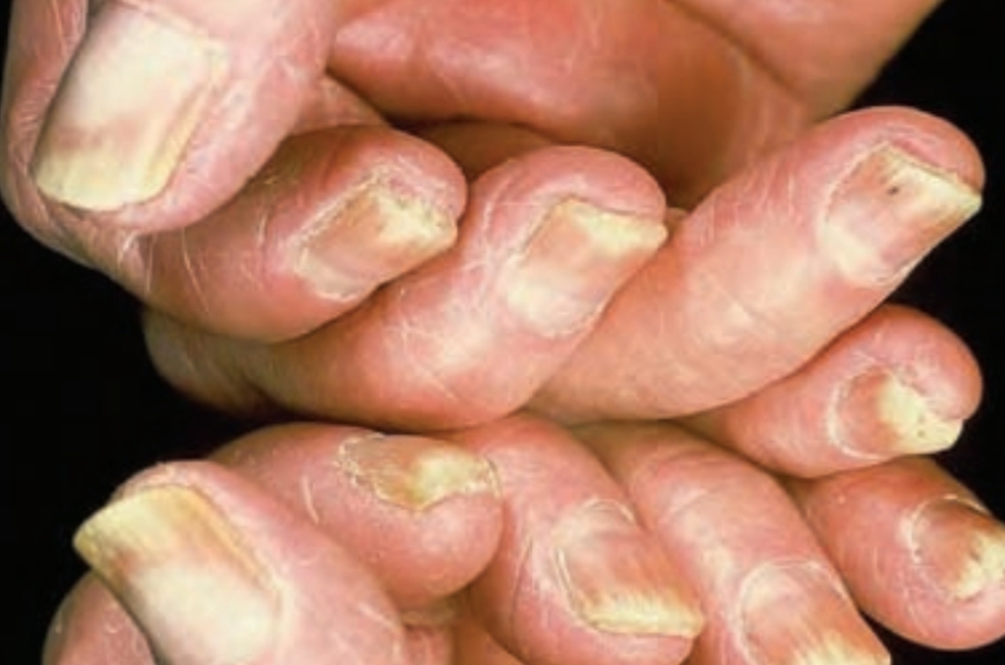

Slide 22
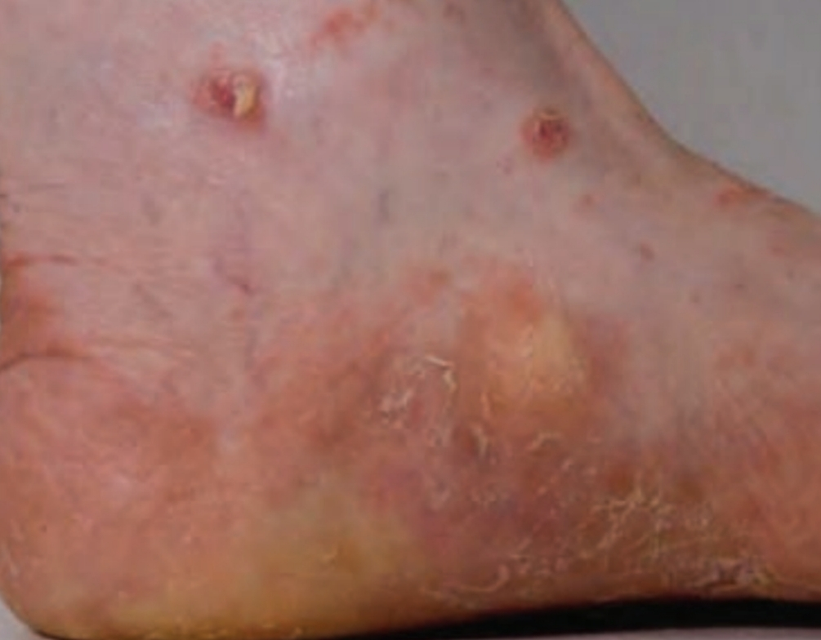

Slide 23
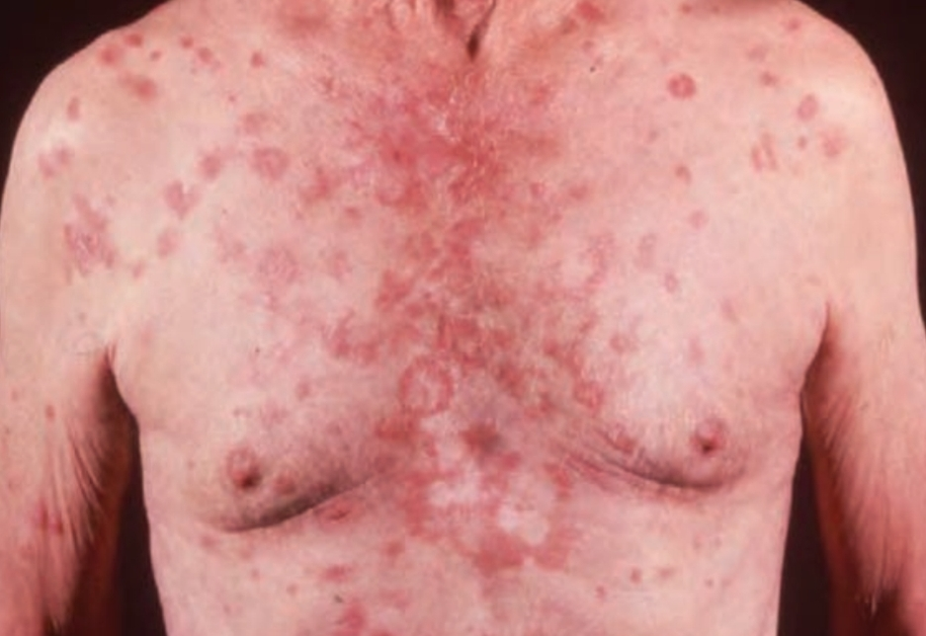
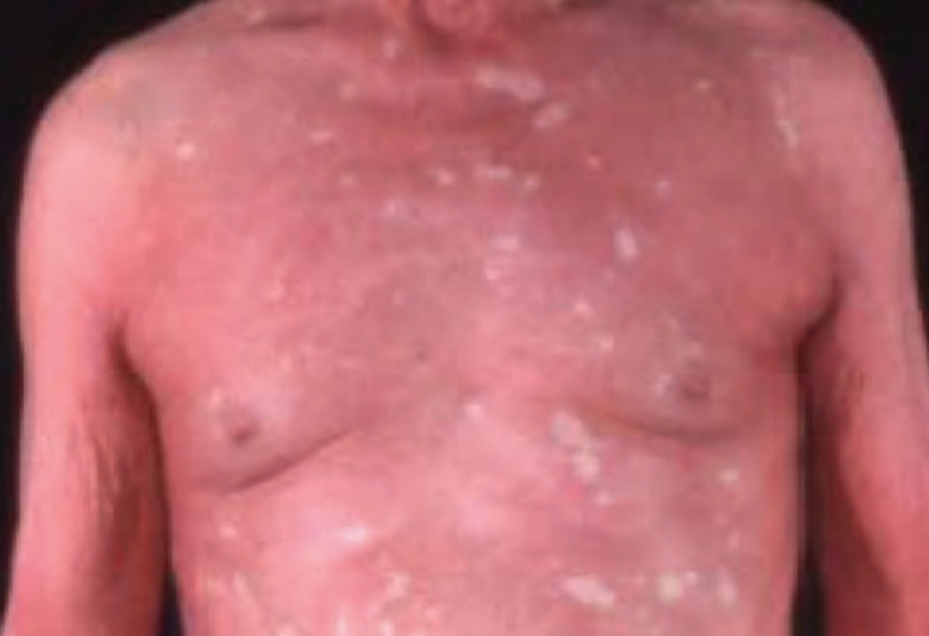

Slide 24
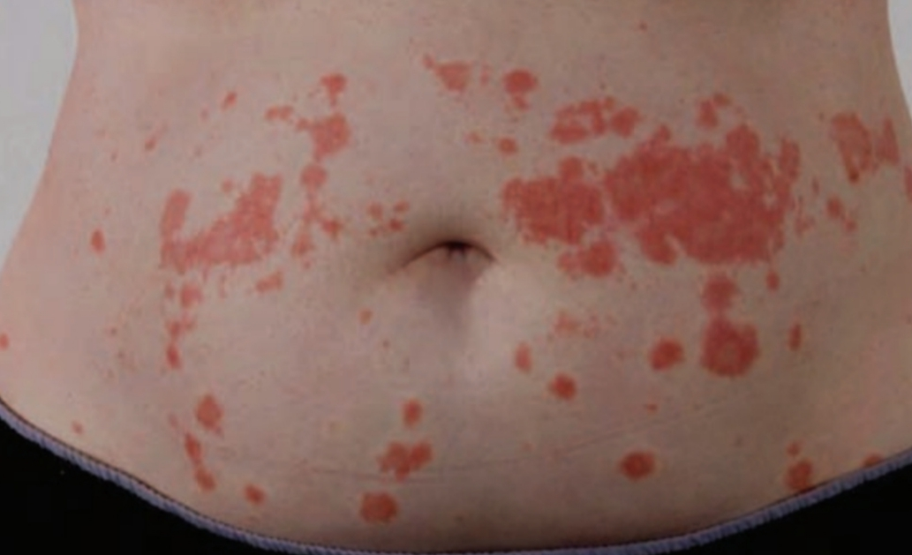
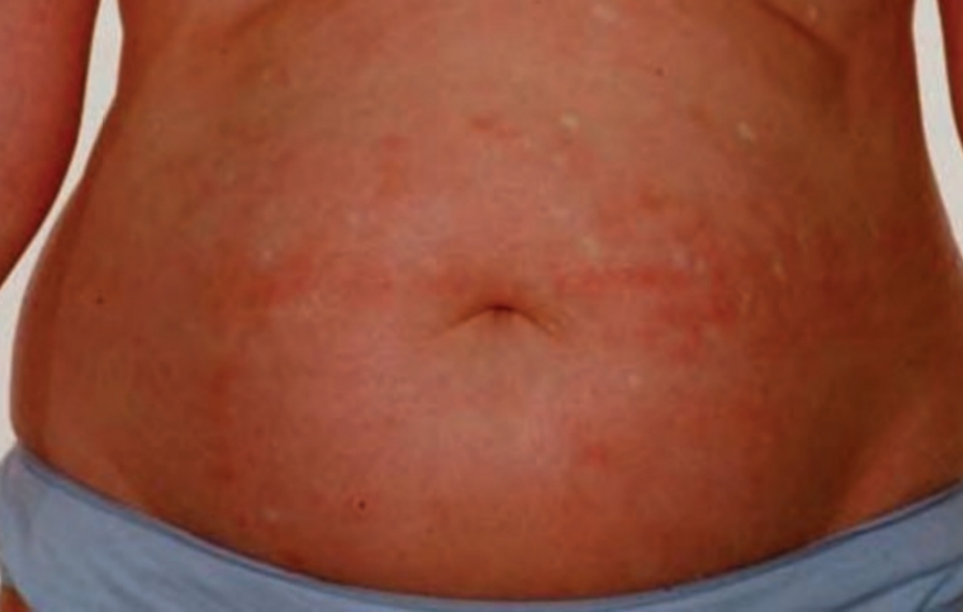

Slide 25
ADULT ONSET PRP(type II)
Chronic form
Perifollicular scale and palmoplantar keratoderma are features
Coarse keratoderma
Erythroderma is less common

Slide 26
CLASSICAL JUVENILE-ONSET PRP
(TYPE III)
Most common childhood form
Counterpart of type I PRP
Onset ( 5 to 10 years of age)
Spontaneous resolution in-2 years
Some evolve into type IV PRP.

Slide 27
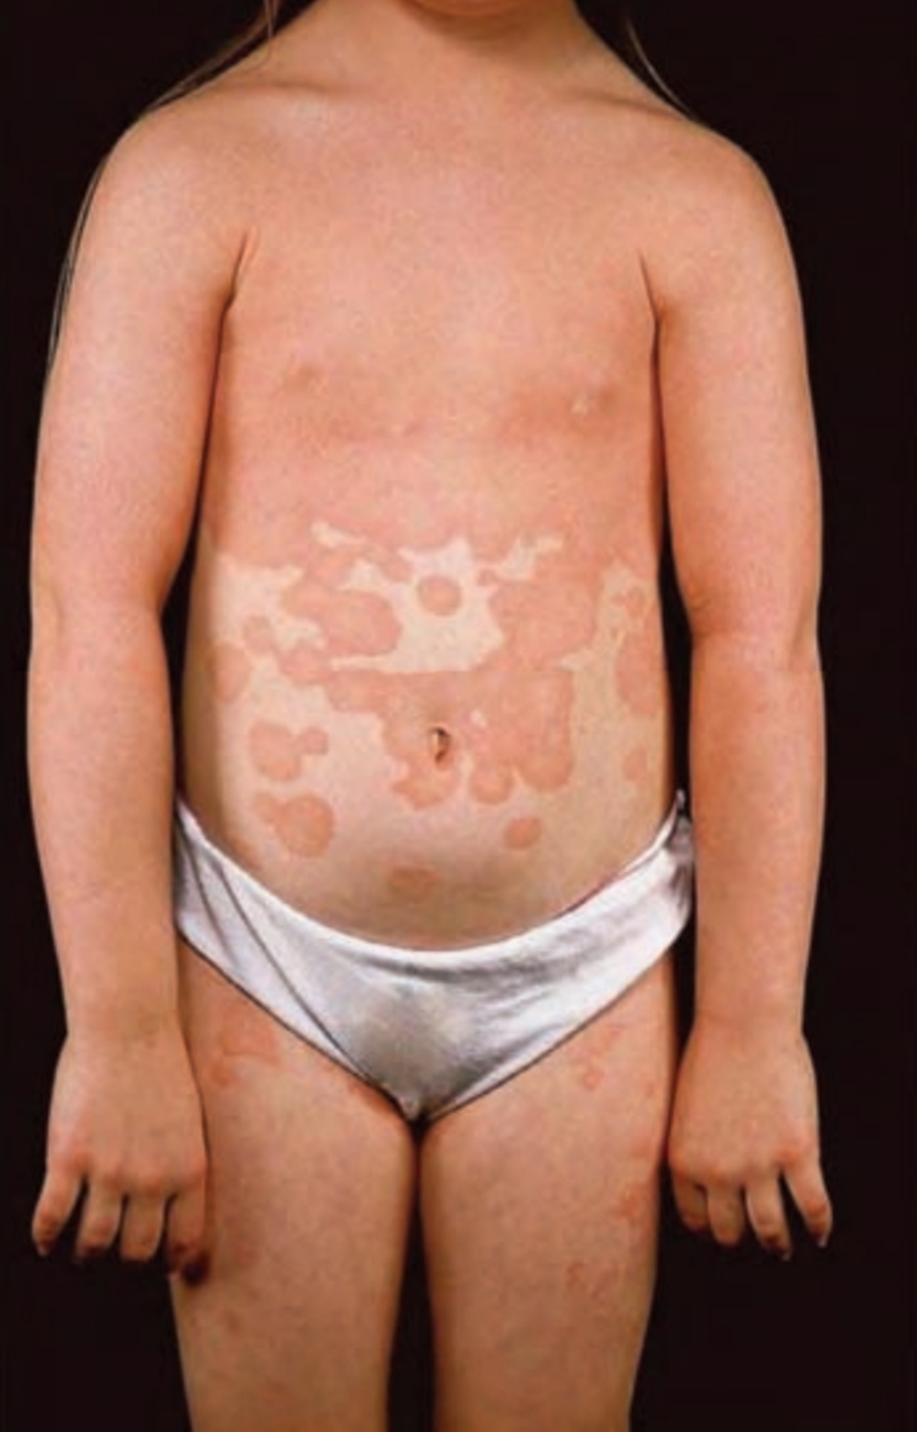

Slide 28
CIRCUMSCRIBED JUVENILE PRP
(TYPE IV)
25% cases
Prepubertal children, under 12 years of age
Well circumscribed plaques of erythema and follicular hyperkeratosis on elbows and knee
Scattered scaly macules may be present on trunk and scalp
Palmoplantar keratoderma may be observed

Slide 29
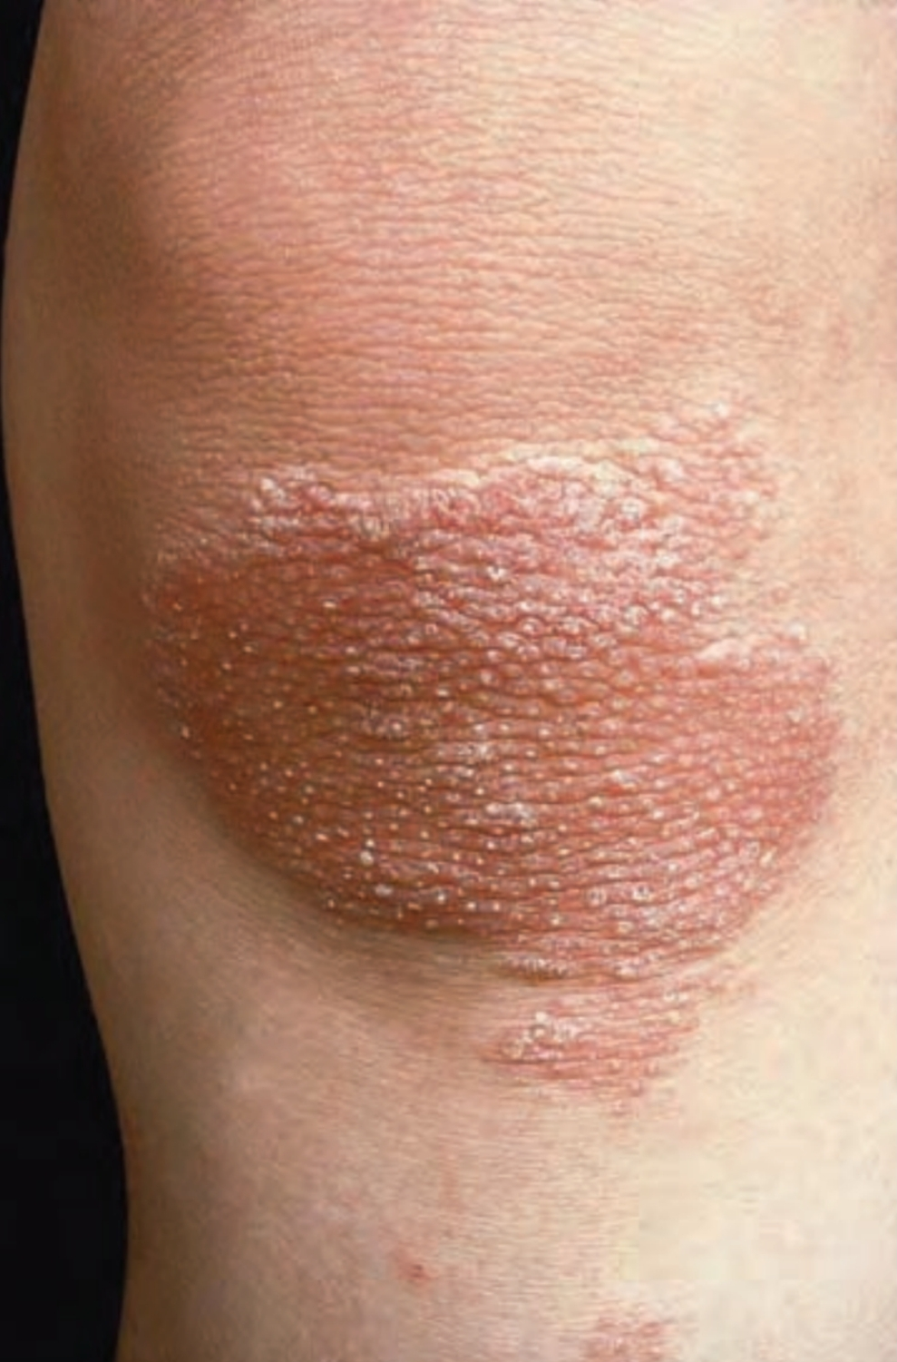

Slide 30
ATYPICAL JUVENILE PRP
(TYPE V)
Chronic type
5% of cases
May be present at birth or start in early childhood
Erythema and follicular hyperkeratosis are features
Keratoderma is common

Slide 31
HIV RELATED PRP ( TYPE VI)
Apparent with onset of HIV epidemic
Resemble type I but resistant to treatment
Respond to antiretroviral therapy

Slide 32
COMPLICATIONS AND CO-MORBIDITIES
Dependent edema
Risk of high output cardiac failure

Slide 33
DISEASE COURSE AND PROGNOSIS
Type I may progress from limited disease to erythroderma in weeks
Clear spontaneously in majority of the patients
In some patients it may persist
Type III has shorter course with remission in average of 1 year
Type II and type IV are chronic but limited diseases
Type IV prognosis is uncertain

Slide 34
INVESTIGATIONS
Diagnosis is made on clinical basis and supported by histology

Slide 35
MANAGEMENT
Treatment ladder
First line
• Emollients
• Topical corticosteroids
• Acitretin
Second line
• Topical calcipotriol
• Topical tazarotene
• Methotrexate
• Ustekinumab
Third line
• TNF‐α antagonists
• UVB phototherapy
• Extracorporeal photochemotherapy

Slide 36
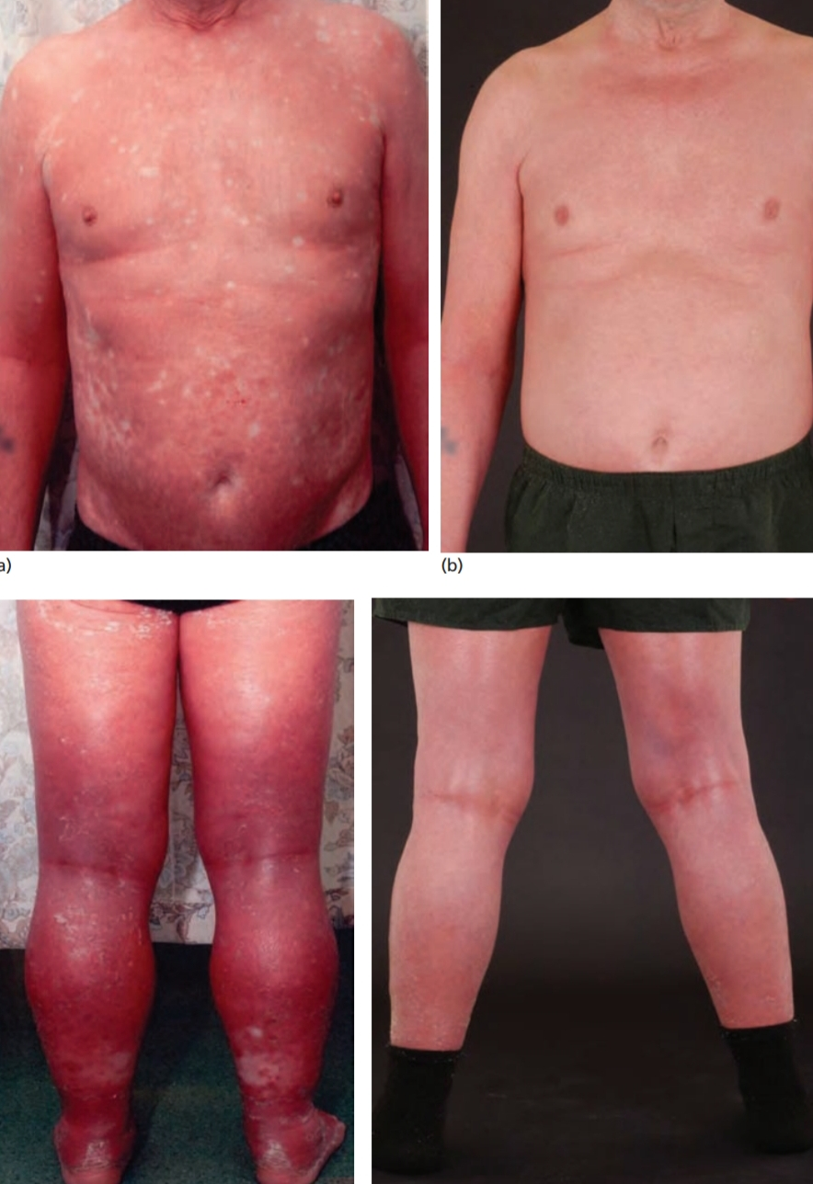
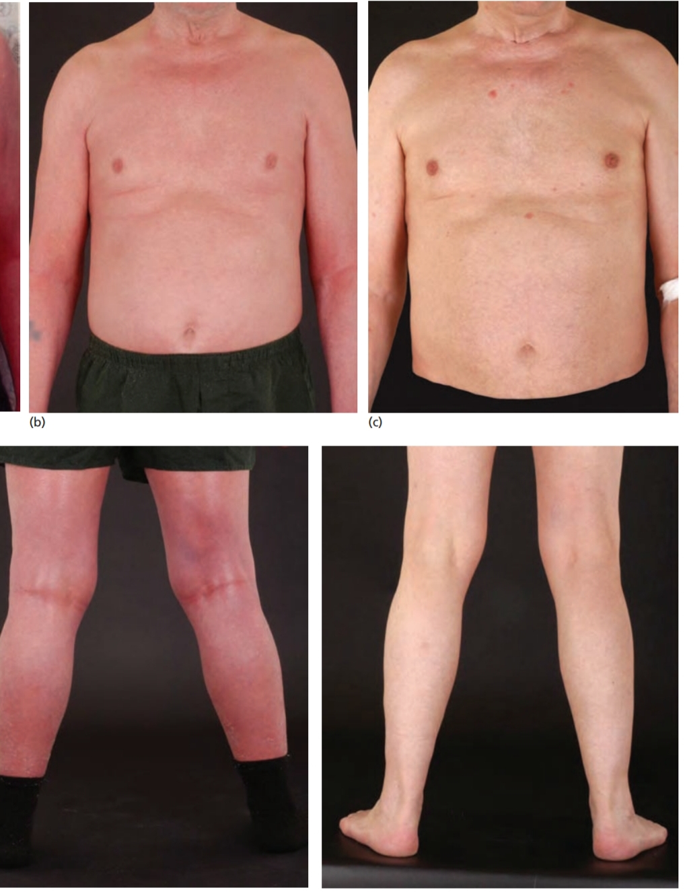

Slide 37


