Slide 1
PHOTOTHERAPY
Dr.Rahima Munir

Slide 2
Ultra violet radiations
UVR is that part of the solar electromagnetic spectrum that lies between X‐rays and visible light.
UVA (320–400 nm),
UVB (280–320 nm)
UVC (<280 nm)
UVC radiation is absorbed by the earth atmosphere
UVB radiation is significantly more effective (100–1000 times more potent) than UVA at producing erythema, cellular effects and DNA damage.
UVA radiation is less energetic but penetrates more deeply into the skin, (photoageing)

Slide 3
phototherapy
It is the use of UV/visible light for theraputic purpose
In use today are
NB and BB UVB
Psoralen photochemotherapy
Uva1 photochemotherapy
Targeted phototherapy

Slide 4
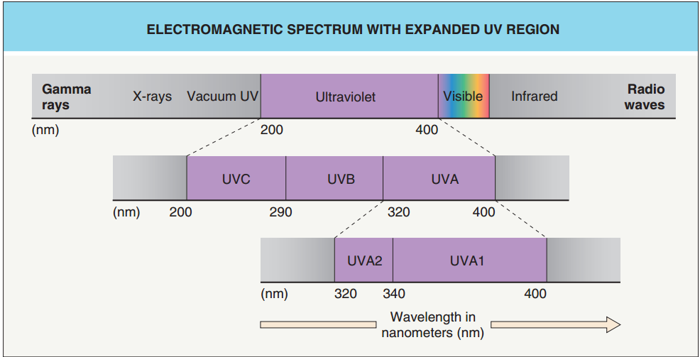

Slide 5
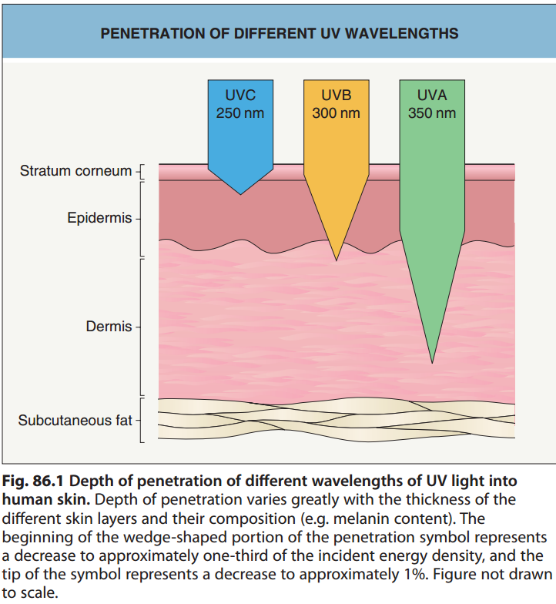

Slide 6
UVB Radiation
290-320 nm
Absorbed by epidermis and superficial dermis
MECHANISM OF ACTION
Produces DNA damage
Cis uroconic acid formation
6 formylindolocarbazole formation
ROS formation

Slide 7
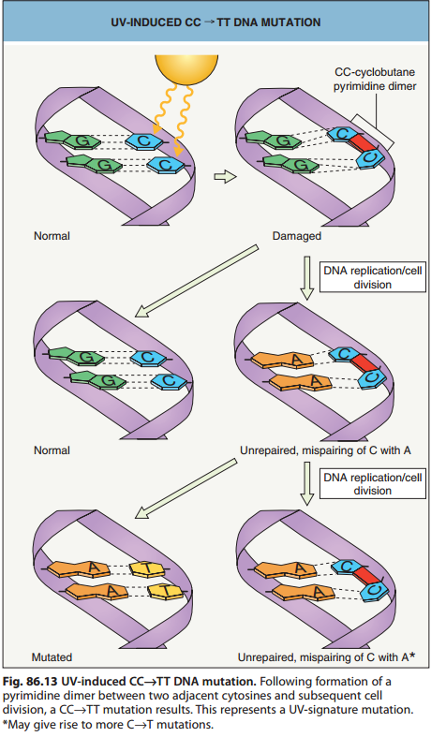

Slide 8
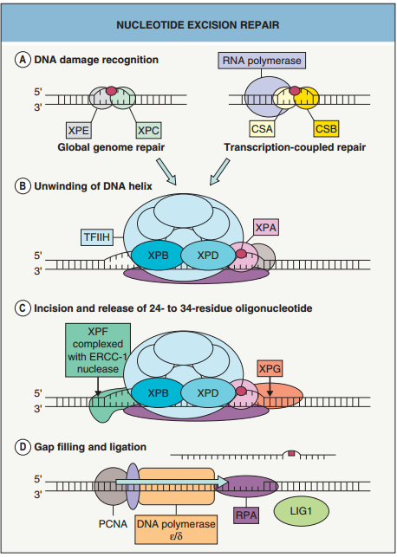

Slide 9
INHERITED DISORDERS WITH ABNORMAL DNA REPAIR – TYPES OF IMPAIRED FUNCTION
 | Global genome NER | Transcription-coupled NER | Translesional DNA synthesis | Mismatch DNA repair
(XP) | + | + | +(xp varient)
Cockayne syndrome |  | +
XP–CS overlap | + | +
Trichothiodystrophy |  | +
Muir–Torre syndrome |  |  |  | +

Slide 10
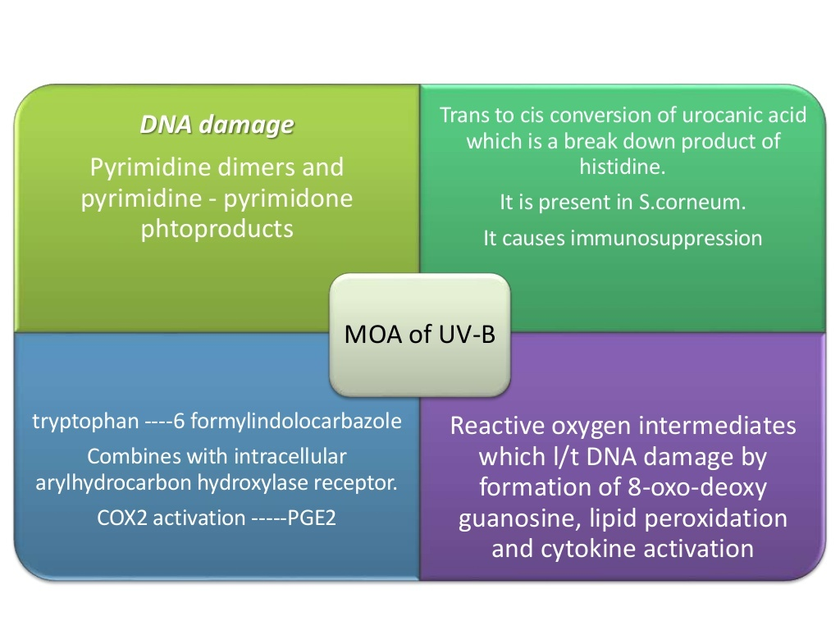

Slide 11
UVA Radiaton
320-400 nm.
Can reach to mid or lower epidermis.
More effective than UVB when pathology is in deeper dermis.
MECHANISM OF ACTION
Reactive oxygen intermediate formation
Pyrimidine dimers
The oxidant formation results in photoaging and skin cancer.

Slide 12
Psoralen Photochemotherapy
Psoralen photosensitizers are activated by UVA radiation
Depth of PUVA is mid dermis
MECHANISM OF ACTION
DNA damage
(intercalates with thymine,forms adduct,DNA cross linking)
Reactive oxygen intermediate formation

Slide 13
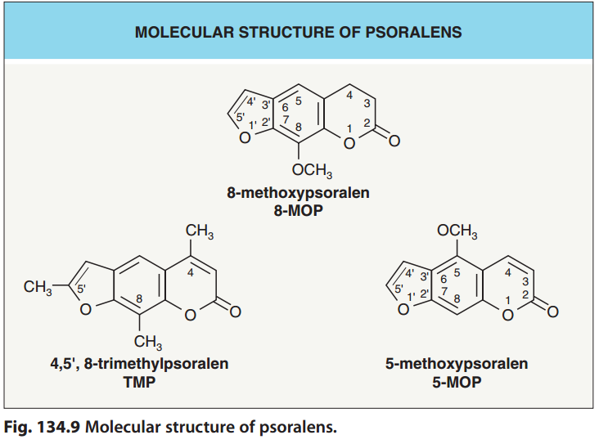

Slide 14
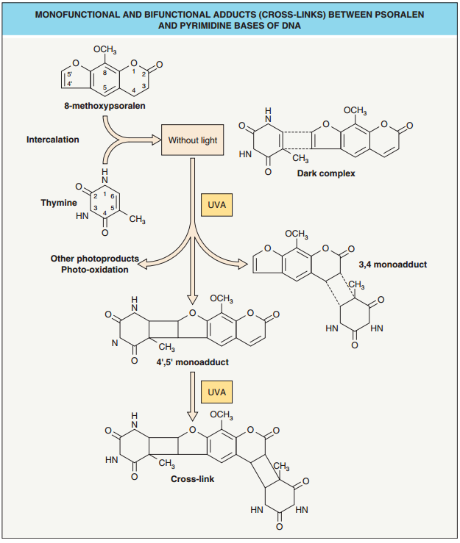

Slide 15
UVA1 phototherapy
340-400 nm.
Penetrates deeper than UVB
MECHANISM OF ACTION
Induce T cell apoptosis (atopic dermatitis)
Reduction in mast cells and langerhan cells
Increase collagenase expression (morphoea,keloid)
Tannning (prophylaxis of PLE)

Slide 16
Effects of phototherapy on immune cells
Dec capacitity of APCs within skin(by IL 10 PGE2 and direct effect of UVB)
Balance bw effectors (dec) and regulatory Tcells is altered
Production of immunosuppressive mediators
(IL 7,IL 6,IL 8,TNF alpha)
Alters ICAM-1 expression(icam facillitates tcell binding to keratinocytes)
Apoptosis in T cells(UVA1 In atopic,UVB in psoriasis)

Slide 17
Effects of phototherapy on mast cells
UVA1 RESULTS in apoptosis of mast cells.
PUVA is not cytotoxic it stabilizes mast cell membrane and limits release of histamine and other mediators.
Effects of phototherapy on collagen
Activates metalloproteinase-1(it degrades collagen)
Helpful in sclerotic skin diseases
UVA and PUVA both increase MMP-1 activity

Slide 18
Effect of phototherapy on epidermis
UVB,PUVS,and UVA all cause acanthosis of the epidermis and thickening of stratum corneum
Accentuates light scattering
Phototherapy doses progressively increase
Hardens skin so permitting patients to tolerate greater amount of sun exposure(chronic photosensitivity)

Slide 19
Effect of phototherapy on melanocytes
UV stimulates melanogenesis,which is a consequence of DNA damage/or its repair.
Treatment of melanocytes with DNA repair enzymea increases melanin content of melanocytes
Increases tolerance of patients with some photosensitivity disoerder but dec efficasy of phototherapy
NB UVB,PUVA repopulate vitiliginous skin with melanocytes(stimulates hair follicle melanocyte proliferation and migration)
Cyto kines stimulate inactive melanocytes

Slide 20
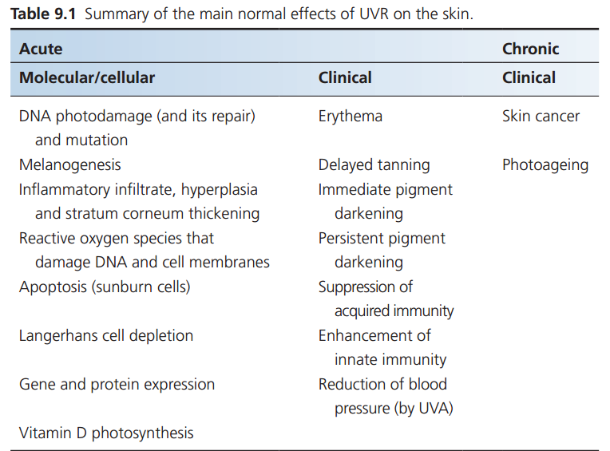

Slide 21
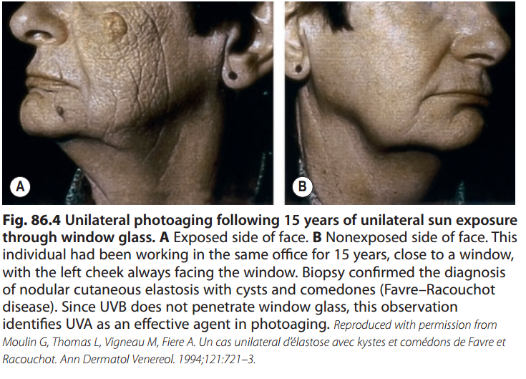

Slide 22
skin types based on Fitzpatrick classification
Skin type | Skin color on sun protected sites | Sunburn risk | Approximate SED for 1 MED on sun‐protected site | Tanning ability | Cancer risk
I II III IV V VI | White White White Olive Brown Dark brown | ++++ +++ ++ + ± ± | 2–3 2-3 4-6 4-6 6-20* 6-20* | ± + ++ +++ ++++ ++++ | High High Moderate Moderate Low Low

Slide 23
Bsic principles of phototherapy devices and types of lamps
Devices generate light by conversion of electrical energy to electromegnetic energy
Filters and fluorophores are used to modify the output such that desired wavelength are emitted

Slide 24
Types of lamps
Incandescent lamps(insufficient light sources)
Arc or gas discharge lamps
Fluorescent lamps
(chromophore,phosphors)

Slide 25
Minimal erythema dose
It is determined by exposing 1cm2 area on the lower back/inner aspect of fore arm to 200,400,600,800,1000,1200 mJ/cm2 of UVB from same device that will be used for phototherapy.
Examined after 24hr of exposure,smallest uniform erythema is MED.
Poor correlation with MED and skin type
Phototherapy initiated at 50 percent -70 percent of MED
If erythema occurs dose either reduced or treatment is delayed

Slide 26
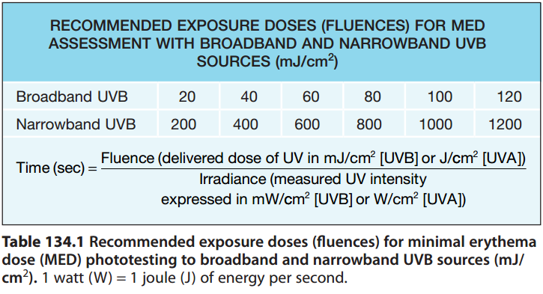

Slide 27
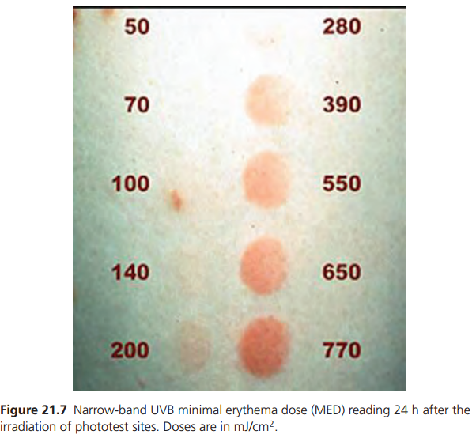

Slide 28
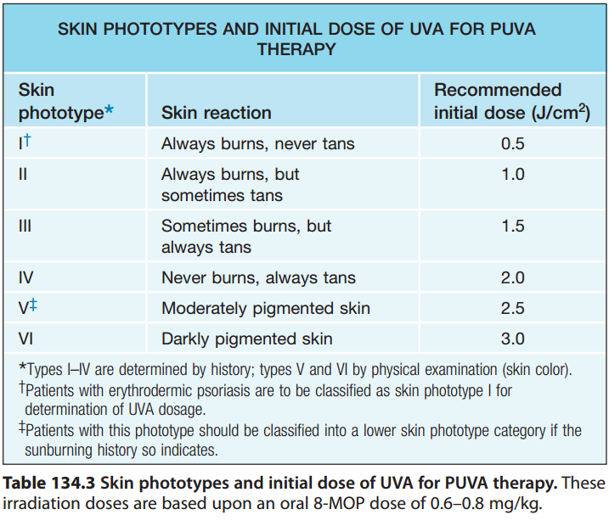

Slide 29
phototherapy
It is the use of UV/visible light for theraputic purpose
In use today are
NB and BB UVB
Psoralen photochemotherapy
Uva1 photochemotherapy
Targeted phototherapy

Slide 30
UVB PHOTOTHERAPY(290-320nm)
Two types
BB UVB
NB UVB
BB UVB:Fluorescent lamps are used
Wavelength< 300 nm induces erythema,non melanoma skin cancer
NB UVB: 308-311 nm wavelength
5-6 fold inc emission of longer UVB
5-10 folds potent than BB UVB
More suppressive effect

Slide 31
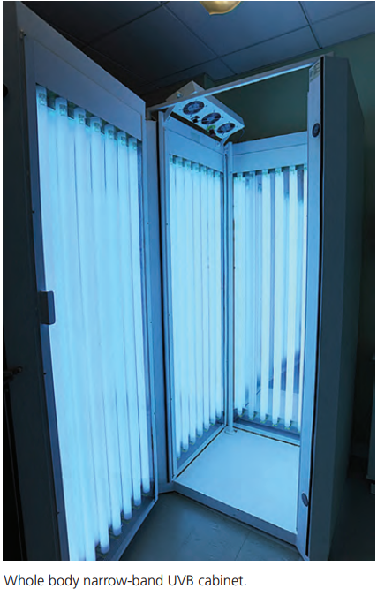
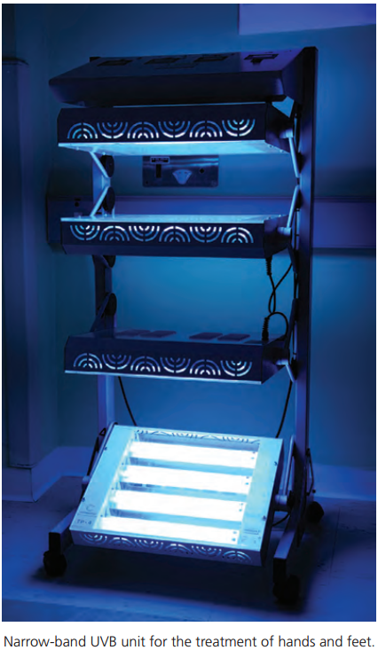

Slide 32
Indications
Psoriasis
Chronic atopic dermatitis
Generalized vitiligo
Lichen planus
CTCL,early stage
Seborrhiec dermatitis
Photosenstive disorders:PMLE/solar urticaria
Chronic urticaria
Pruritis due to polycythemia vera,liver cirhosis,renal insufficiency
Actinic prurigo
Acquired perforating dermatosis

Slide 33
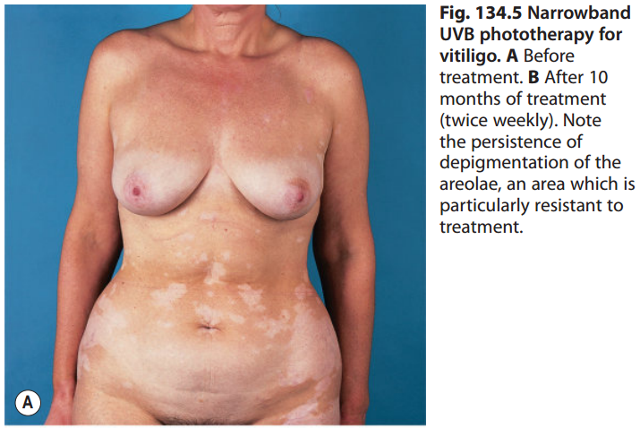
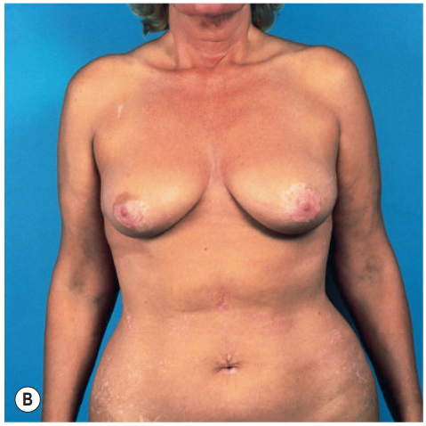

Slide 34
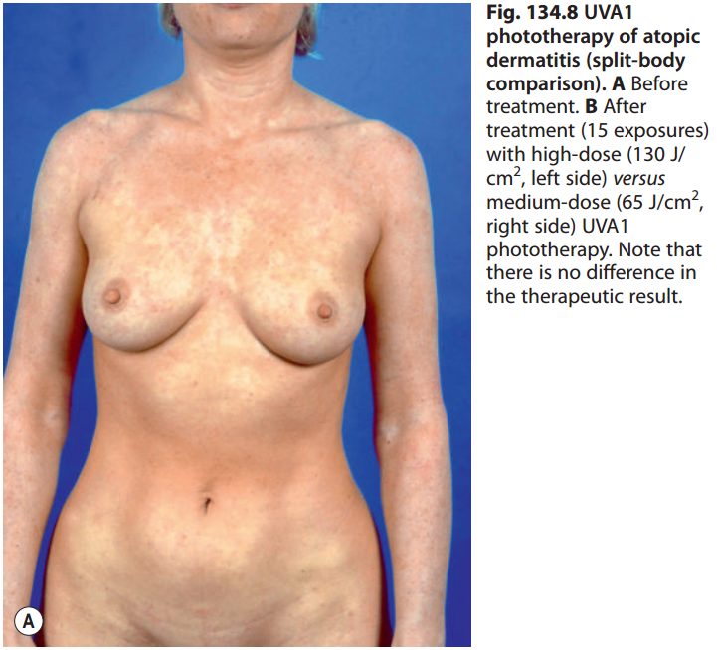
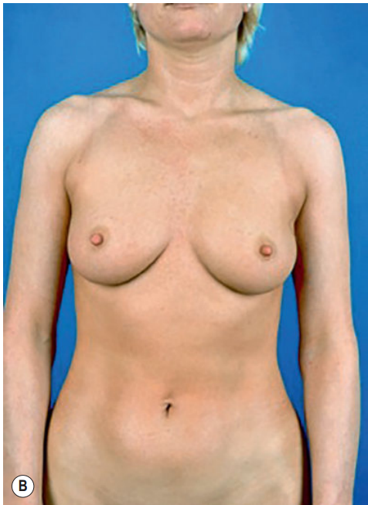

Slide 35
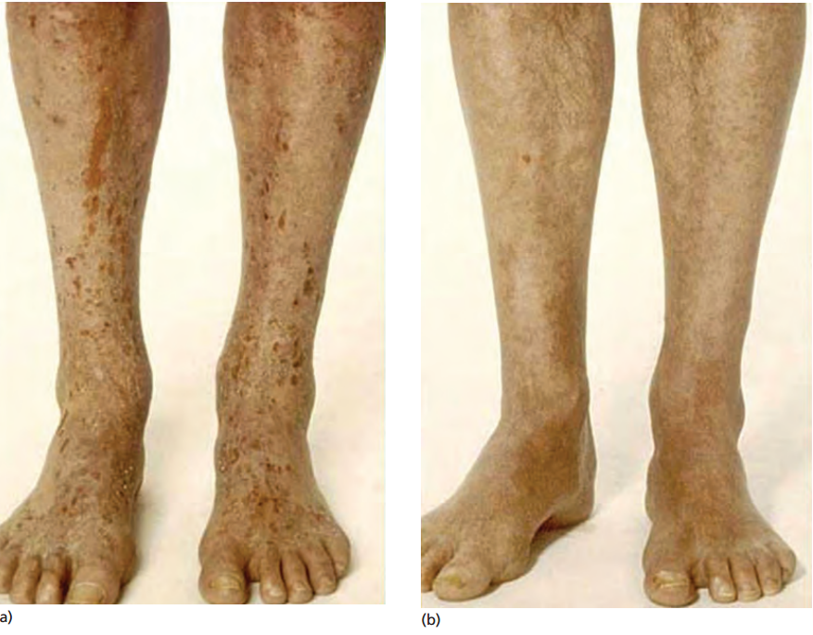
NB UVB in atopic eczema

Slide 36
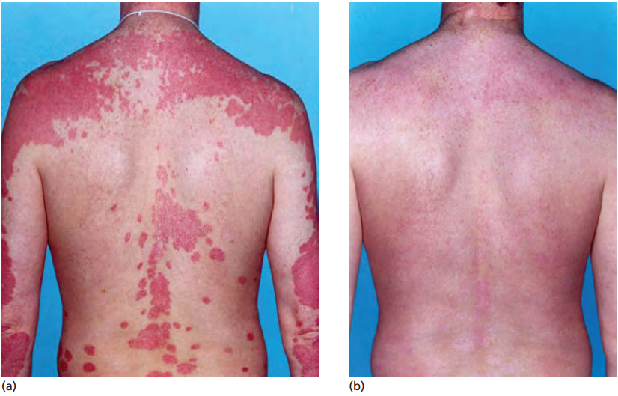
NB UVB in psoriasis

Slide 37
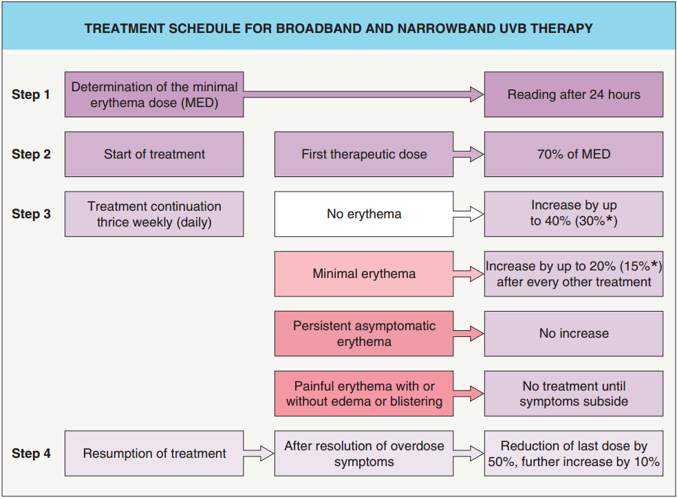

Slide 38
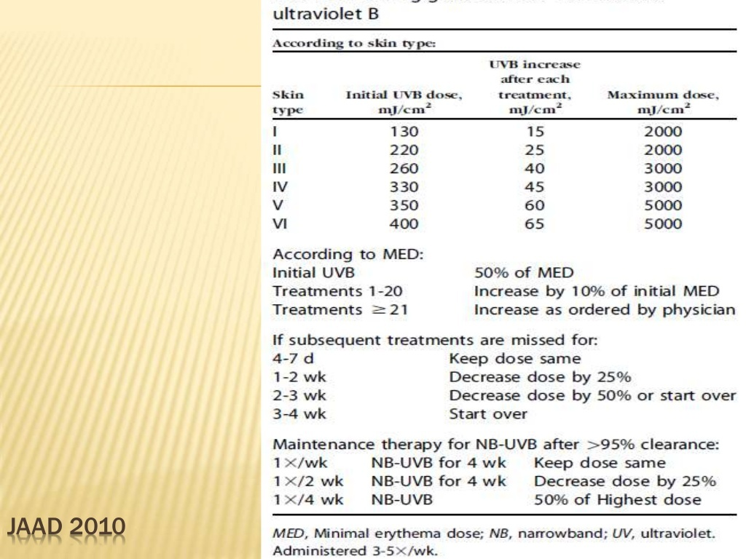

Slide 39
Safe limit
Responsive pts can be given t/t for a max of 24 months.after 1 year,resting period of 3 months .
In children max duration 12 months.limited area exposure
If no response is observed after 6 months further therapy should be discouraged

Slide 40
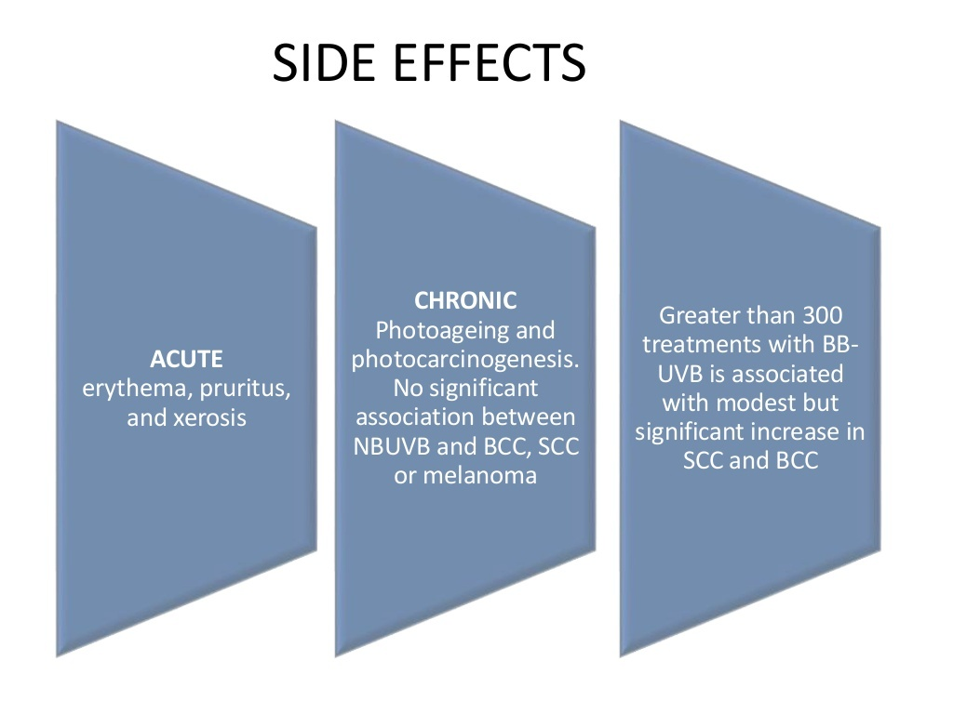

Slide 41
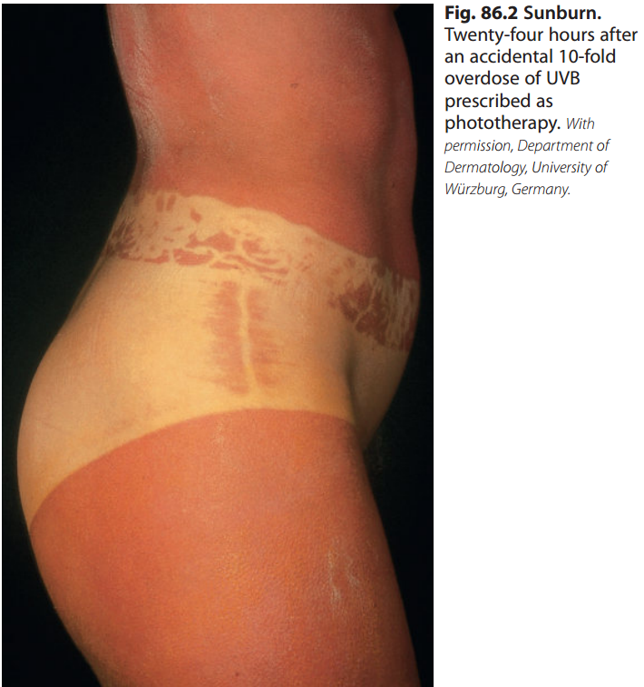

Slide 42
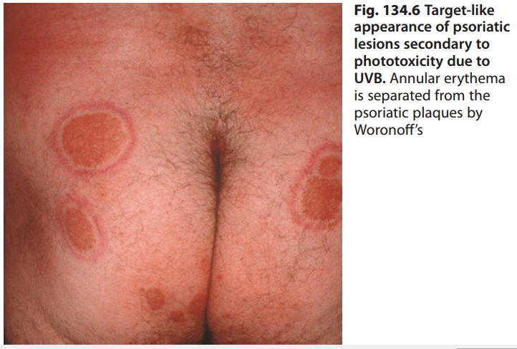

Slide 43
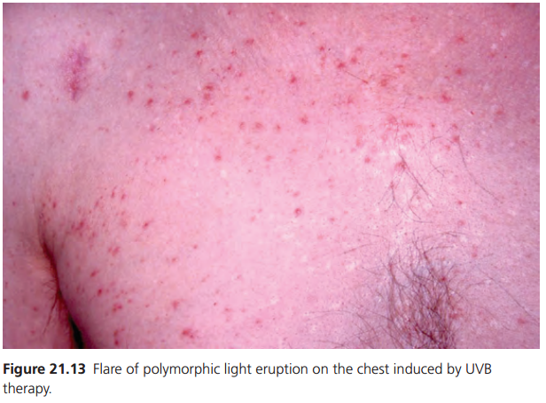

Slide 44
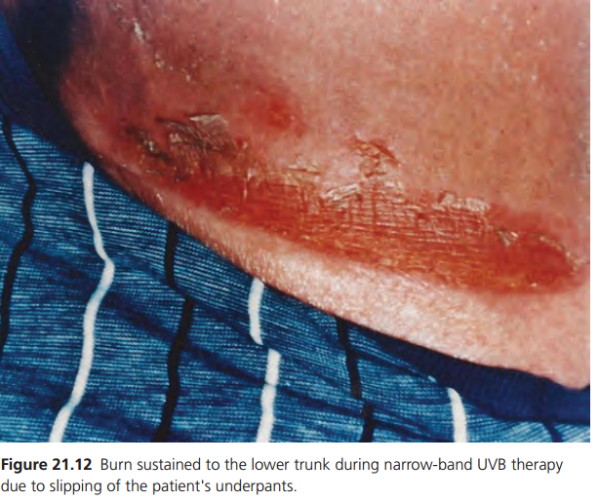

Slide 45
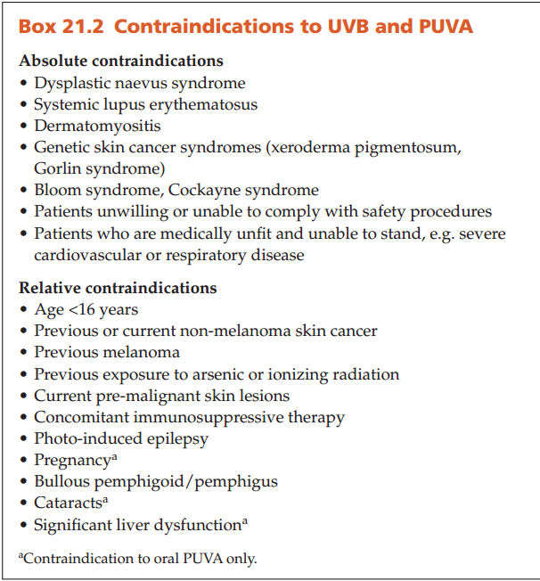

Slide 46
THANK YOU

Slide 47
PUVA

Slide 48
Psoralen Photochemotherapy
Psoralen-UVA photochemotherapy combines oral ingestion or topical application of psoralens with uVA exposure
Three forms
8-methoxypsoralen
5-methoxypsoralen
4,5,8-trimethylpsoralen

Slide 49
Psoralen Photochemotherapy
Psoralen photosensitizers are activated by UVA radiation
Depth of PUVA is mid dermis
MECHANISM OF ACTION
DNA damage
(intercalates with thymine,forms adduct,DNA cross linking)
Reactive oxygen intermediate formation

Slide 52
PUVA is not cytotoxic it stabilizes mast cell membrane and limits release of histamine and other mediators.
PUVA increase MMP-1 activity
cause acanthosis of the epidermis and thickening of stratum corneum
repopulate vitiliginous skin with melanocytes(stimulates hair follicle melanocyte proliferation and migration
Effect on dendritic cells,fibroblasts,endothelial cells, granulocytes and lymphocytes
ROS formation.

Slide 53
PUVA penetrates more deeply into the skin than UVB radiation and is thus better suited for thick plaque disease and for treating the palms and soles

Slide 54
Factors favouring the use of PUVA
• Failure to respond to UVB or rapid relapse following UVB
• Thick plaques
• Palmo‐plantar disease
• Nail disease
• Photosensitivity to UVB but not UVA
• Erythrodermic or generalized pustular psoriasis
• Pityriasis rubra pilaris – which usually flares with UVB but can respond well to PUVA

Slide 55
indications
psoriasis(erythrodermic,generalized pustular psoriasis)
Atopic eczema(UVB failed,children with growth retardation)
Cutaneous t cell lymphoma(plaque stage)
vitiligo (twice a week, but not more than three times, with at least one day between treatments. If there is no response after 4–5 months or~30–40 treatments, PUVA should be terminated)
Polymorphic light eruption

Slide 56
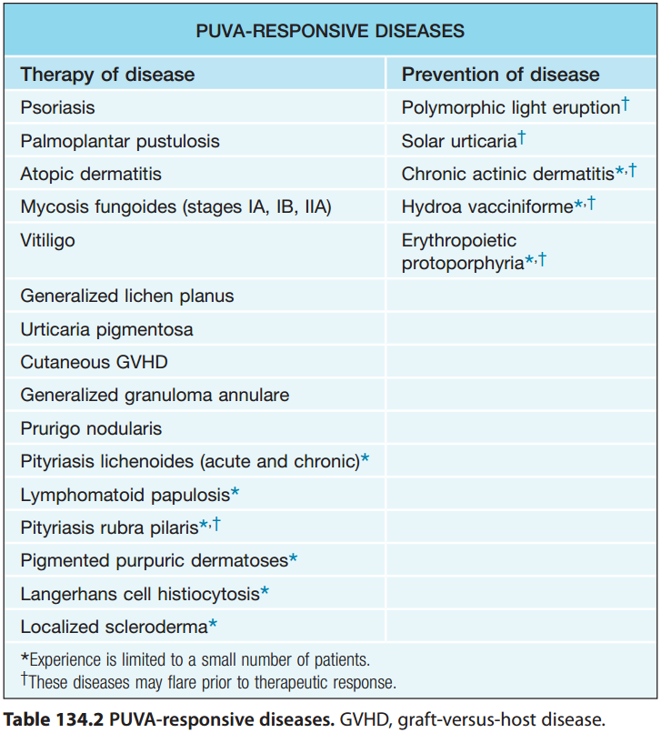

Slide 57
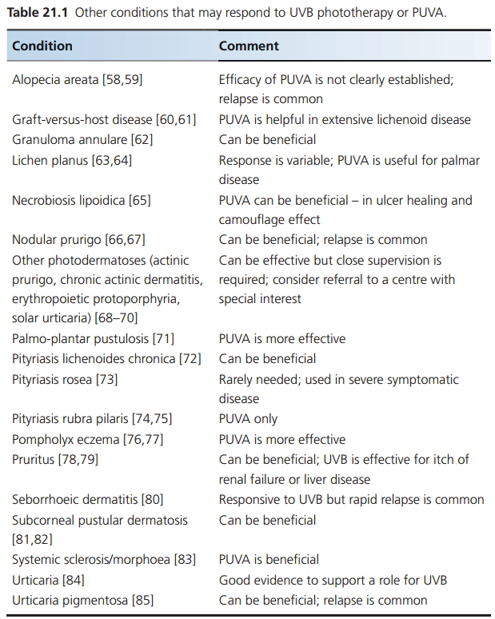

Slide 58
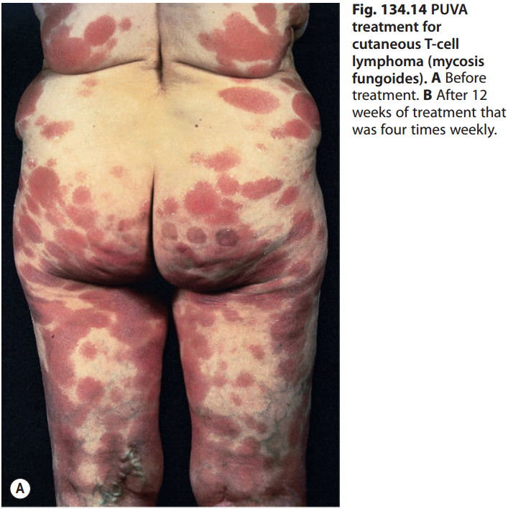
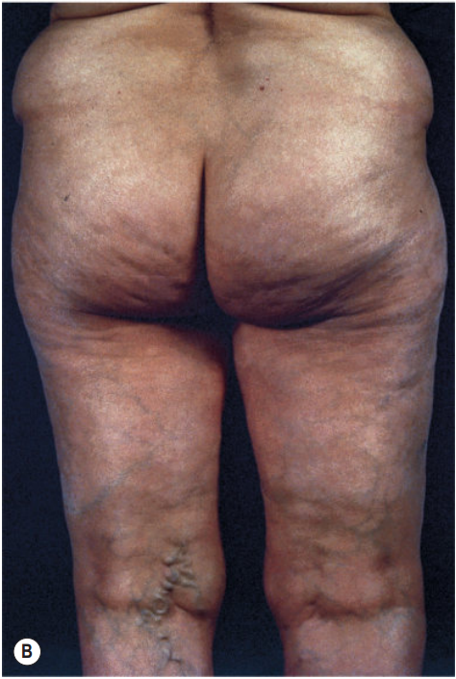

Slide 59
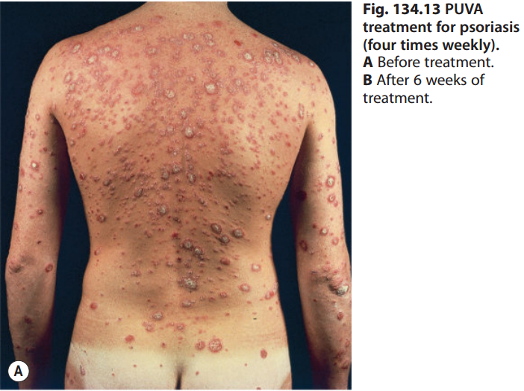
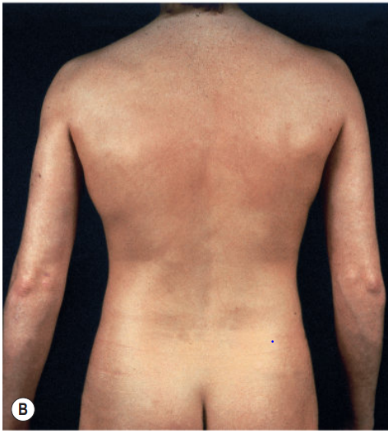

Slide 60
oral use
8‐methoxypsoralen (8‐MOP) | 5‐methoxypsoralen (5-MOP)
more effective less expensive dose:0.6 mg/kg Dose body surface area: 25 mg/m2 8‐MOP is taken 2 h before treatment with a light meal | Less effective More expensive Dose:1.2 mg/kg Dose body surface area: 50 mg/m2 5‐MOP should be taken at 2–2.5 h before treatment.

Slide 61
Topical use
0.1-.01% cream,ointment,lotion
psoriasis of the palms and soles and limited stable vitiligo
8‐MOP and trimethylpsoralen (TMP)
TMP is up to 30 times more phototoxic,
bath solution,soak, paint, cream or gel
preferable in patients with hepatic dysfunction, git disease, cataracts, poor compliance with eye protection and risk of drug interactions (e.g. warfarin), and to allow shorter irradiation times (e.g. for children, the elderly or those with claustrophobia).

Slide 62
Bath puva
TMP/8-MOP.
0.5–5.0 mg of 8-MOP per liter of bath water.
patient bathes for 15 min, followed by immediate exposure to UVA
In hands and feet a 30 min delay for panetration
Even drug distribution,low plasma level, rapid elimination.

Slide 63
Treatment protocol
Initial treatment (clearing) phase
Maintenance phase
Initial treatment (clearing) phase
Treatment should not be started until the end of the 72-hour period after MPD testing.
oral PUVA is 70% of the MPD
bath PUVA is 30% of the MPD
2-4 times weekly. Dose increments no more often than twice a week (at least 72 hours apart) and never during the first week of treatment
MPD can even decrease during the first days after initiation of treatment by up to 50%, but then increase at later stages

Slide 64
Maintenance phase
one month of twice-weekly, followed by another month of once-weekly exposures
Once monthly treatment would be a feasible compromise.
Mild relapses temporarily increasing the frequency of treatments
severe relapse the original clearing phase schedule must be resumed until clearing is once again achieved.

Slide 65
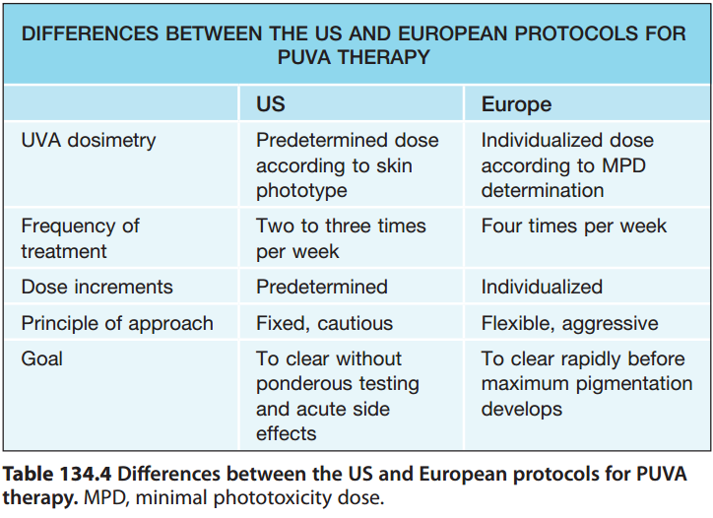

Slide 66
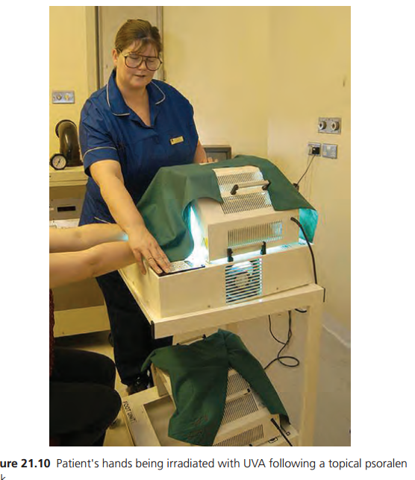

Slide 67
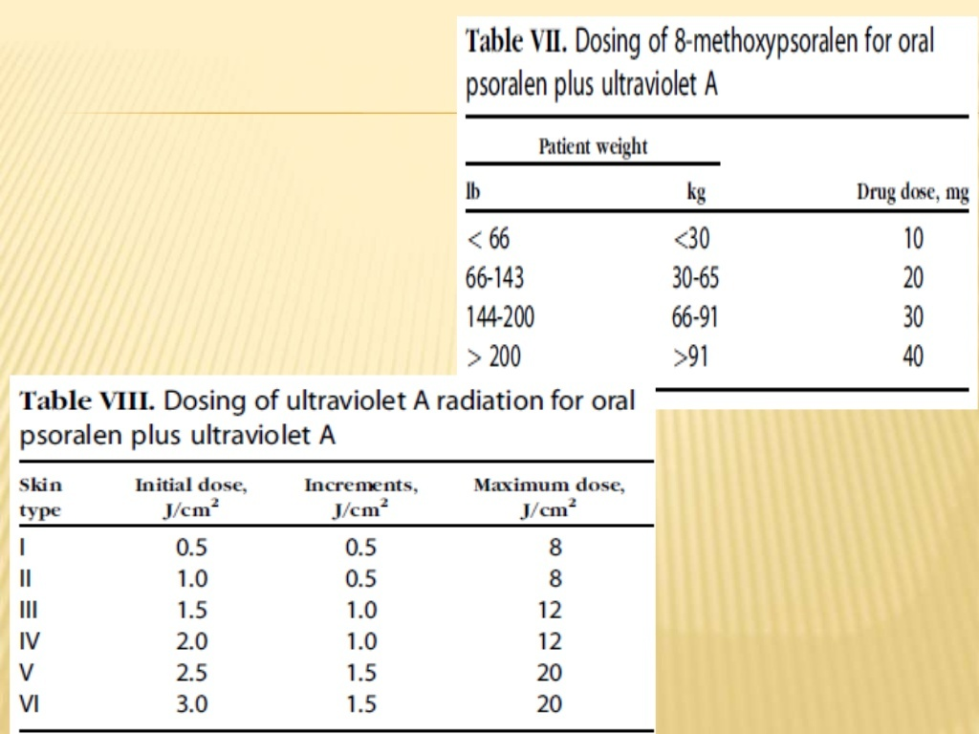

Slide 69
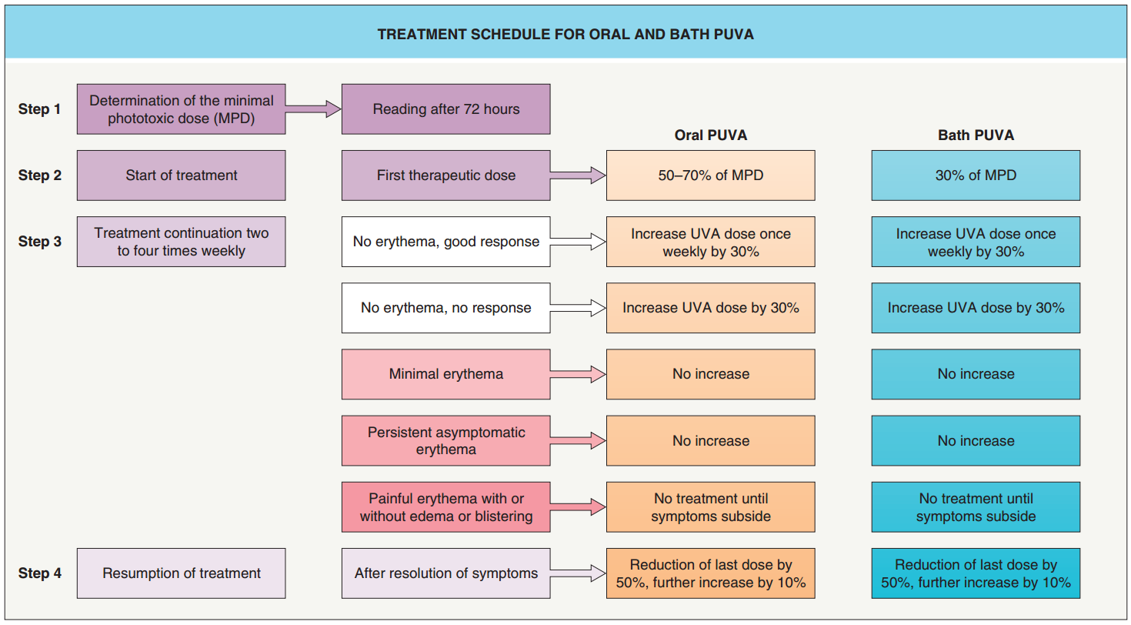

Slide 70
contraindications
Absolute contraindications
• Dysplastic naevus syndrome
• Systemic lupus erythematosus
• Dermatomyositis
• Genetic skin cancer syndromes (XP)
• Bloom syndrome, Cockayne syndrome
• Patients unwilling or unable to comply with safety procedures
• Patients who are medically unfi t and unable to stand, e.g. severe cardiovascular or respiratory disease

Slide 71
Relative contraindications
• Age <16 years
• Previous or current non‐melanoma skin cancer
• Previous melanoma
• Previous exposure to arsenic or ionizing radiation
• Current pre‐malignant skin lesions
• Concomitant immunosuppressive therapy
• Photo‐induced epilepsy
• Pregnancya
• Bullous pemphigoid/pemphigus
• Cataractsa
• Significant liver dysfunctiona

Slide 72
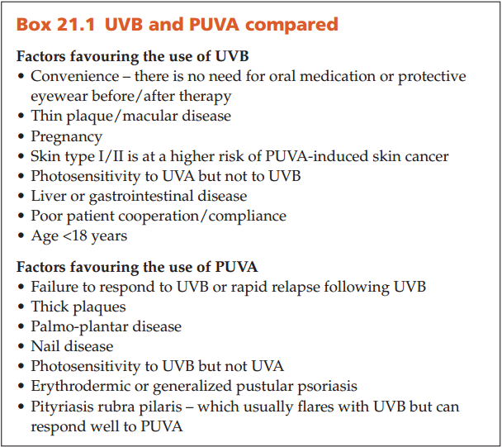

Slide 73
Side effects

Slide 74
Acute side effects
Acute phototoxicity
Pruritis and pain
Nausea
Blistering
Provocation of photodermatosis
Herpes simplex reactivation
others

Slide 75
Chronic side effects
Photoaging
Puva keratosis
Puva lentigines
Non melanoma skin cancer
melanoma
Internal malignancy
Ophthalmological effects

Slide 76
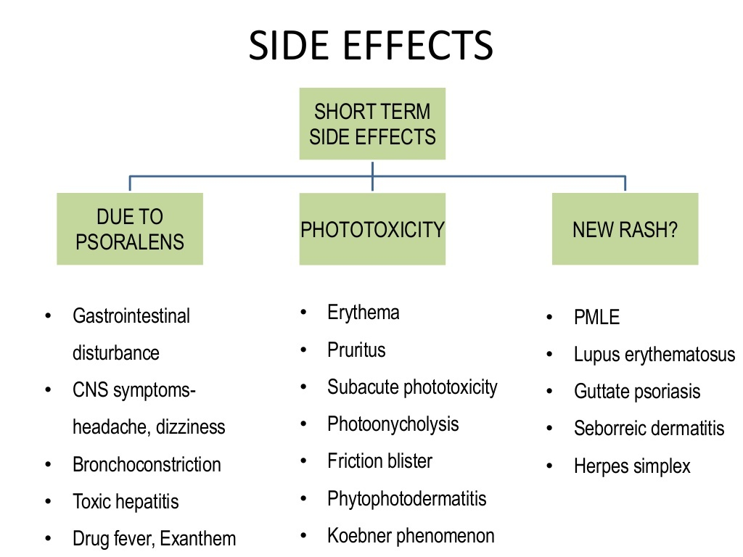

Slide 77
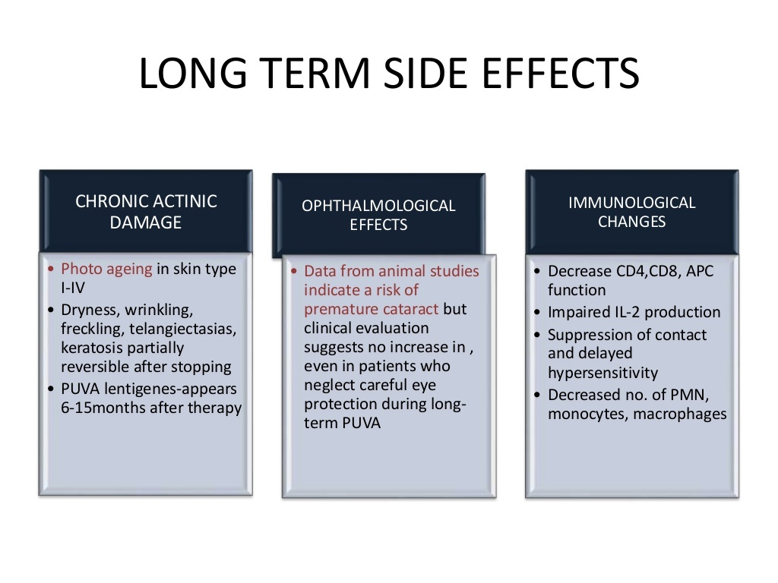

Slide 78
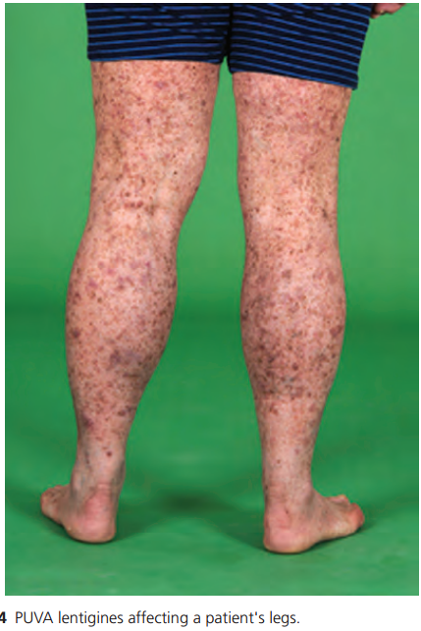

Slide 79
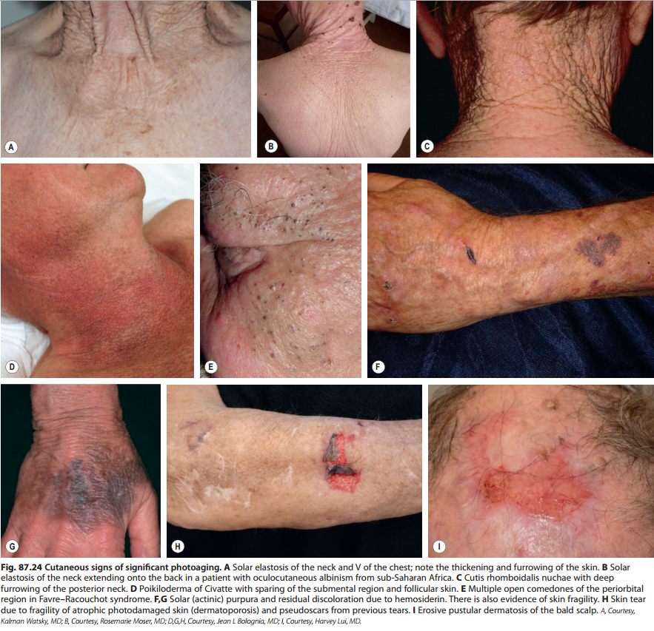

Slide 80
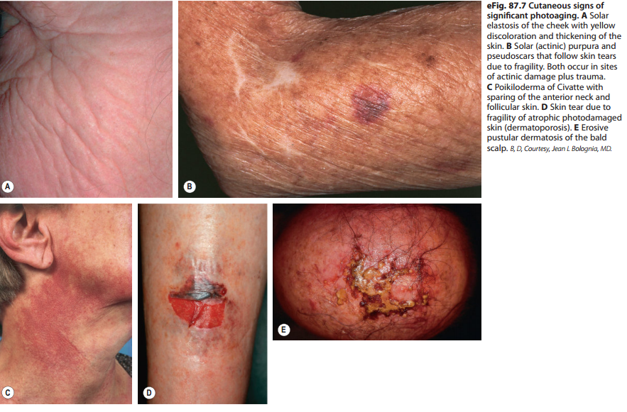

Slide 81
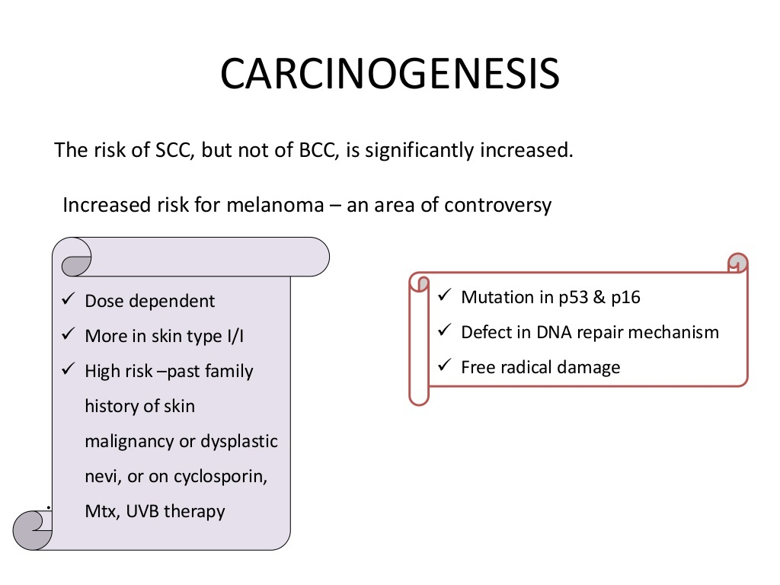

Slide 82
Thankyou

Slide 83
UVA PHOTOTHERAPY

Slide 86
UVA1 (340–400 nm)
UVA2 (320–340 nm)

Slide 87
UVA1
Longer wavelength allowes deeper panetration
Atopoic dermatitis and MF (t cells apoptosis and dec interferon gamma)
Dec mast cells and langerhans beneficial in atopics and cutaneous mastocytosis
Inc collagenase expressions helpful in scleroderma

Slide 88
beneficial in:
Sclerosing dermatoses
several other dermatoses
acute GVHD
chronic sclerodermoid GVHD
urticaria pigmentosa
MF

Slide 89
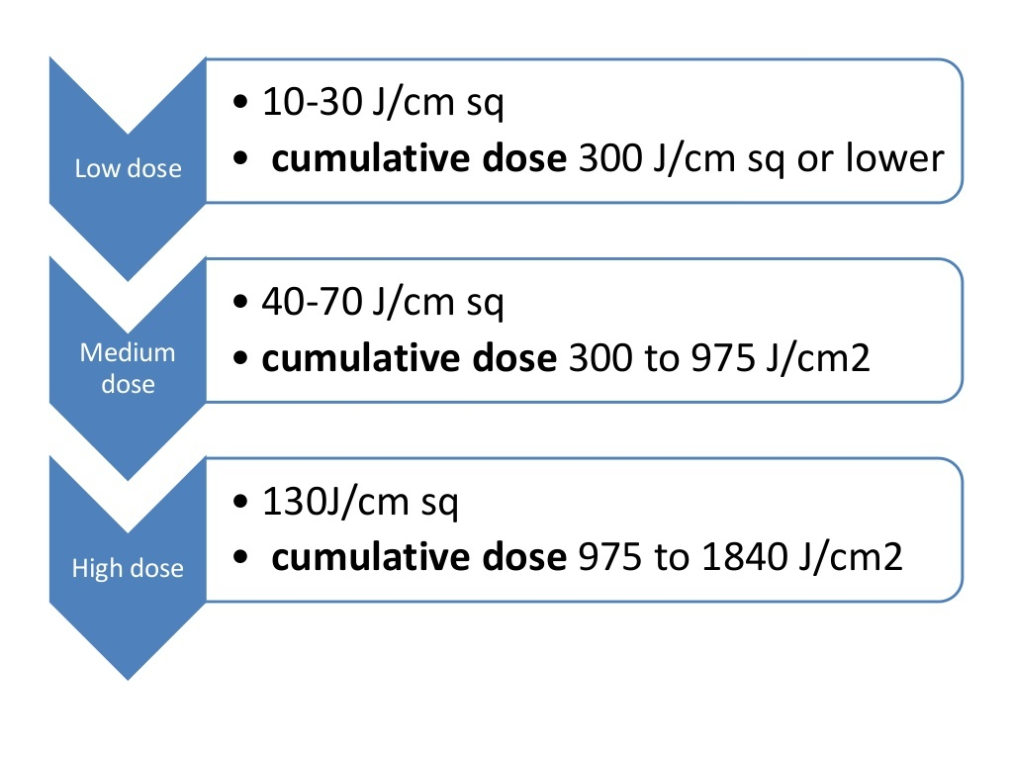

Slide 90
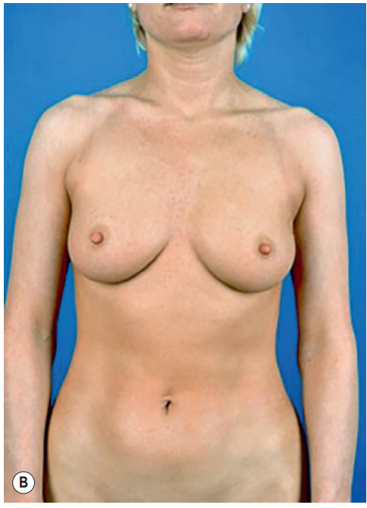
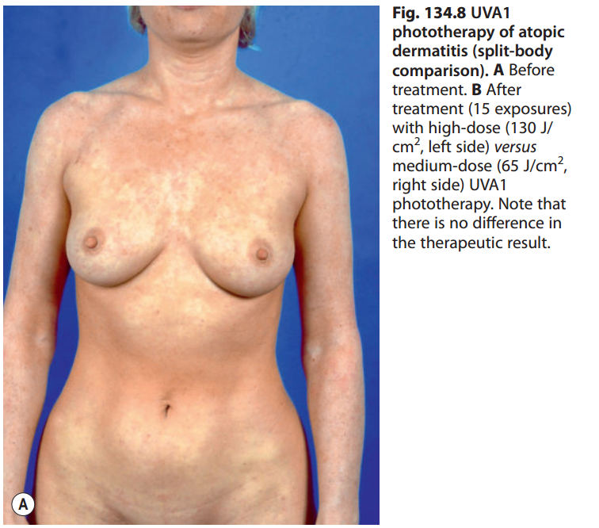

Slide 91
Its major disadvantages are
1.higher fluences (e.g. 30–130 J/cm2 per session)
2.higher exposure times that are required 3.higher costs for the lamps

Slide 92
Side effects
Acute:
Erythema
Tanning
PMLE
itching
Chronic :
Long term effects of carcinogenesis are under investigation and photoaging

Slide 93
in general, one treatment cycle should not exceed 15–20 successively administered exposures
and should not be repeated more than once a year
Not recommended in less than 18 years

Slide 94
Extracorporeal photochemotherapy
(photopheresis)
Used as palliative treatment of CTCL
Immunomodulatory therapy combines leukopheresis with phototherapy
Treats autoreactive or neoplastic dosorders caused by t cells

Slide 95
There seems to be a significant linear association b/w response and CD4:CD8 ratio. Patients with a ratio <10 are more likely to respond than are patients with a ratio >10.
Patients whose LDH is not elevated at the start of treatment tend to have a better response
Rx of acute and chronic cutaneous GVHD

Slide 96
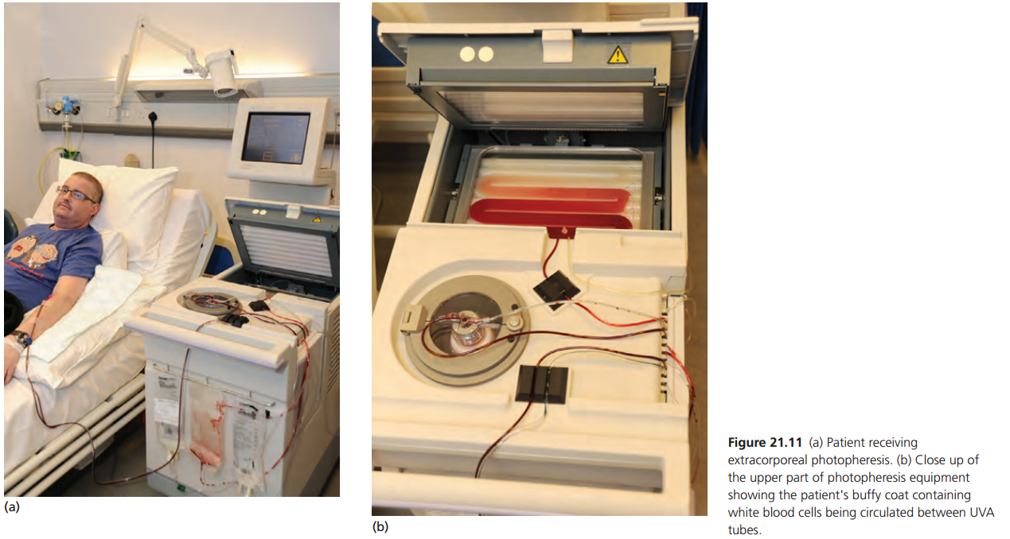

Slide 97
Treatment protocols
Blood is extracted,centrifuged to the leukocyte concentrate
8-MOP is administered directly to the bag containing leukocytes(avoids nausea)
8-MOP enters cell and its nucleus
Then it is exposed to UVA(1-2j?cm2)
This treatment is typically repeated on two successive days
with 2- to 4-week intervals.

Slide 98
Mechanism of action
ECP is due to the induction of an immune response against the malignant cells.
T cell apoptosis
Anti tumor response-CD 8 cells
Stimulates Th1 response

Slide 99
Indications
CTCL
Chronic GVHD
Atopic dermatitis
systemic sclerosis
pemphigus vulgaris
systemic lupus erythematosus

Slide 100
Side effect
episodes of hypotension
vasovagal reflex due to volume shifts during treatments

Slide 101
Patient safety during phototherapy or PUVA
Eye protection
• Patients must wear UV‐blocking goggles
• Individuals receiving oral PUVA must wear UVA‐blocking glasses for 12 h following ingestion of psoralen (longer if risk factors for cataract development are present)
• Patients should be provided with a list of approved UV protective eyewear

Slide 102
Prevention of burning
• Minimal erythema dose/minimal photoxic dose testing
• Accurate dosimetry
• Patient education
• Obese patients
• Use of correct UV source
• Lamp maintenance
• Psoralen dosage

Slide 103
Reducing skin cancer risk
• Male patients should wear appropriate clothing to protect the genitalia
• The face (if not involved by the dermatosis being treated) should be shielded
• For some indications, whole body treatment may not be required (e.g. for polymorphic light eruption desensitization, treatment limited to the photoexposed skin may be sufficient)

Slide 104
Thankyou

