Slide 1
OCCUPATIONAL DERMATOLOGY
MADE BY,
DR BUSHRA JAWAID

Slide 2
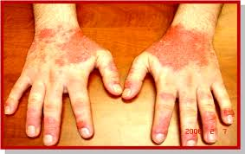
outline
OCCUPATIONAL IRRITANT CONTACT DERMATITIS
OCCUPATIONAL ALLERGIC CONTACT DERMATITIS
ACNE OF CHEMICAL ORIGIN
OCCUPATIONAL DYSPIGMENTATION
OCCUPATIONAL INDUCED SKIN TUMORS
VIBRATION WHITE FINGER

Slide 3
Occupational irritant contact dermatitis
It is the cutaneous response to the physical/toxic effects of a wide range of environmental exposures in the workplace.
It is the commonest form of occupational skin disease.

Slide 4
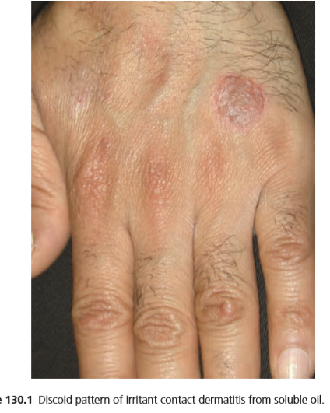
Dermatitis from the type of metal‐working fluid or coolant most commonly known in the UK as ‘SOLUBLE OIL’ is a prime example of occupational contact dermatitis.
Soluble oils are oil‐in‐water emulsions used to cool and lubricate metal‐working and certain other industrial manufacturing operations.
Synthetic coolants are aqueous chemical solutions and can have similar effects on the skin.

Slide 5
Biocides is the substantial content of surface‐active agents as emulsifiers or wetting age nts in coolants that appears to underlie their potential for skin irritation.
Synthetic coolants also contain traces of nitrosamines, formed by triethanolamine or diethanolamine reacting with nitrites.
The degree of skin contact , individual susceptibility, machine type and ontrol method , and biocide additions are all important factors, in addition to the specifi cation and condition of the metal‐working fluid itself.
Clinically, the dorsa of the hands, finger webs, wrists and forearms are predominantly affected and the dermatitis can have a patchy distribution that mimics nummular eczema.

Slide 6
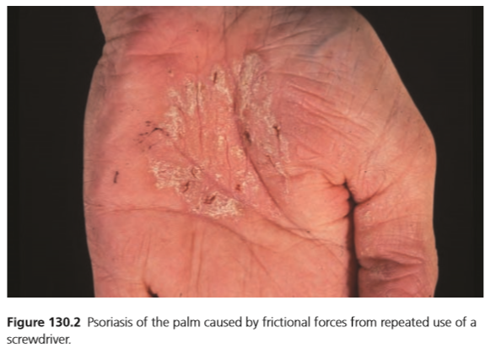
The skin can react in a variety of ways to excessive friction and microtrauma to produce a physical irritant contact dermatitis. The reaction depends upon constitutional factors, such as a tendency to develop psoriasis , or the type of trauma.
Various types of reactions can occur: calluses, fissuring, lichenification, blistering, Koebner phenomenon aggravating psoriasis and granuloma.

Slide 7
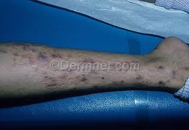
FIBERGLASS dermatitis is a well‐known example of a physical irritant contact dermatitis.
Fibreglass consists of sharp glass spicules which are capable of penetrating the superficial part of the horny layer of the skin to cause immediate skin irritation.
The acute irritation reaction results in a pruriginous dermatitis; as clothing may trap the fibreglass, this may occur on covered parts of the body.

Slide 8
AGE
Occupational dermatitis may occur at any age.
The average age of onset varies from one occupation to another .
In some studies , two peaks appear, one at each end of working life.
The young age group includes many patients with irritant and atopic eczema of the hand.

Slide 9
OCCUPATIONS
Hairdressers
Bricklayers
Agriculture
Construction and manufacturing industry
Veterinary surgeons
Housewives dermatitis
Bakers

Slide 10
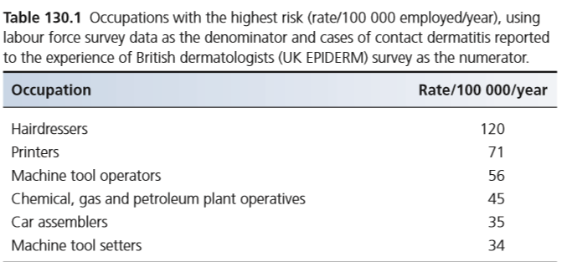

Slide 11
History
The hands are affected, alone or together with other sites, in 80–90% of all cases of occupational contact dermatitis .
Irritant contact dermatitis started under finger rings in 12% of women and 2% of men.
The arms are also involved, especially if not covered by sleeves.
Dusts and vapours affect the face and neck. Cement workers and miners often have dermatitis on the lower legs and feet. Those wearing rubber boots may have dermatitis from footwear.

Slide 12
Differential diagnosis
Allergic contact dermatitis
Atopic eczema
Non‐occupational irritant/allergic contact dermatitis
Fungal infection

Slide 13
Complications and co‐morbidities
Fissured dermatitis commonly becomes infected and prolonged ill‐health and absence from work (with possible financial implications) may cause psychological disease such as anxiety and depression.

Slide 14
Basic workplace skincare principles
Luke‐warm water for washing
Use correct gloves before exposure for the shortest time
Remove rings
Cotton liners underneath protective gloves
Avoid disinfectant hand cleansers
Apply emollient hand creams
Protect hands at home
Workforce education

Slide 15
TREATMENT
First line
Prevention
2. Second line
Irritant avoidance by minor changes in procedure or personal protective equipment
3. Third line
Change of occupation and consideration of systemic immunosuppressive treatment if appropriate

Slide 16
Occupational allergic contact dermatitis
It is a specific type IV hypersensitivity reaction to an allergen present in the workplace.
It is eczematous in character and may be provoked by exposure to the allergen in the home/recreational environment as well as at least partly at work.

Slide 17
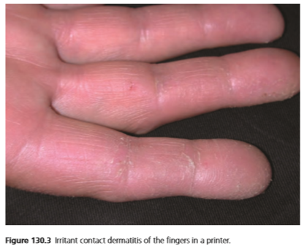
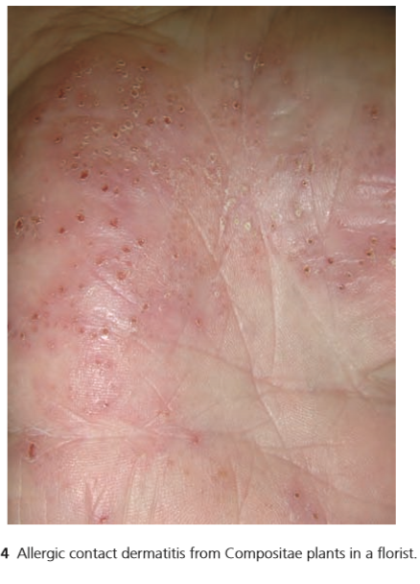
The most common allergens are
cobalt,
chromium,
cosmetics,
fragrances,
epoxy resin,
nickel, plants,
preservatives,
resins and acrylics

Slide 18
CLINICAL FEATURES
The clinical distinction on the hands, forearms .
There is a tendency for irritant contact dermatitis to affect the dorsa of the hands and fingers and the finger webs, rather than the palms.
There is a tendency for vesicular eczema of the palms and sides of the fingers to be involved.
Gross eyelid swelling usually indicates allergic contact dermatitis.

Slide 19
Differential diagnosis
Non‐occupational allergic contact dermatitis
Occupational irritant contact dermatitis
Non‐occupational irritant contact dermatitis
Atopic eczema.

Slide 20
Baking and pastry making
Irritants
Flour, detergents.
Sensitizers
Citrus fruits, flour improvers, thiamine, spices (cinnamon, cardamom), essential oils, azo dyes, fat preservatives (lauryl gallate), sodium carboxymethyl cellulose.
Contact urticaria
Flour, spices, essential oils, α‐amylase

Slide 21
COOKING INDUSTRY
Irritants
Detergents, dressings, vinegar, fish, meat, fruit and vegetables.
Sensitizers
Fruit and vegetables (onions, garlic, lemons, lettuce, artichokes), hardwood knife handles, spices, formaldehyde, rubber gloves.
Contact urticaria
Meat, fish, fruit, vegetables

Slide 22
Hairdressers and barber
Irritants
Shampoos, soaps, permanent‐wave liquids, bleaching agents.
Sensitizers
Hair dyes, rubber, nickel, perfumes, lanolin, thioglycolates, cocamidopropyl betaine, methylisothiazolinone.
Contact urticaria
Ammonium persulphate, henna, rubber gloves.

Slide 23
Hospital workers
Irritants
Disinfectants, quaternary ammonium compounds, hand creams, soaps, detergents
Sensitizers
Rubber gloves, formaldehyde, chloroxylenol, penicillin, cephalosporins, streptomycin, neomycin, piperazine, phenothiazines, hand creams, nickel, glutaraldehyde, acrylic monomer, nitrogen mustard, local anaesthetics, propacetamol.
Contact urticaria
Rubber gloves, cisplatin

Slide 24
housework
Irritants
Detergents, solvents, polishes, wet work, vegetables.
Sensitizers
Rubber (gloves), nickel, chromate, flowers and plants, hand creams and lotions, handles of knives and irons, oranges, balsams, spices, pyrethrum, methylisothiazolinone.
Contact urticaria
Vegetables, fruits, meats, fish, spices, rubber gloves.

Slide 25
TREATMENT
First line
Primary prevention
2. Second line
Allergen substitution or avoidance, including personal protective equipment
3. Third line
Redeployment, topical or systemic immunosuppressive treatment

Slide 26
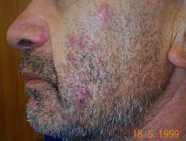
Acne of chemical origin
It is an acneform eruption caused by exposure to chemicals or physical irritation.

Slide 27
Halogenated aromatic hydrocarbons are the most potent acnegenic agents. The chloronaphthalenes, chlorobiphenyls and chlorobiphenyl oxides are used as dielectrics in conductors and insulators.
Exposure occurs in those manufacturing these substances or making or handling cables .
A naphthalene wax used to ‘feather proof’ a counterpane caused acne on the face and arms of a children.
These substances will induce acne at any site and at any age, usually after 1 or 2 months of exposure.
The chlorophenols are used as insecticides, fungicides, herbicides and wood preservatives.

Slide 28
  Crude petroleum is acnegenic in oilfield and refinery workers .
  Diesel oil can cause acne in motor mechanics .
  Heavy coal‐tar distillates, especially pitch and creosote, are also to some extent acnegenic.

Slide 29
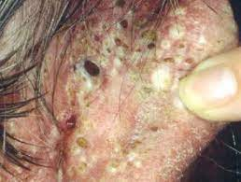
Cosmetics : mild comedonal acne with occasional papulopustules occurs in one‐third of adult women in the USA.
Pomades, asbestos and topical steroids also cause comedonal acne.
A predominantly perioral acne can appear during psoralen and UVA (PUVA) therapy .

Slide 30
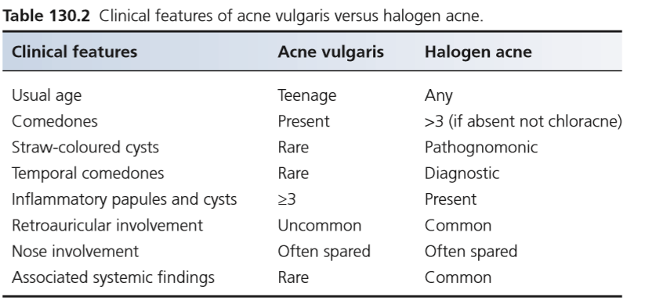

Slide 31
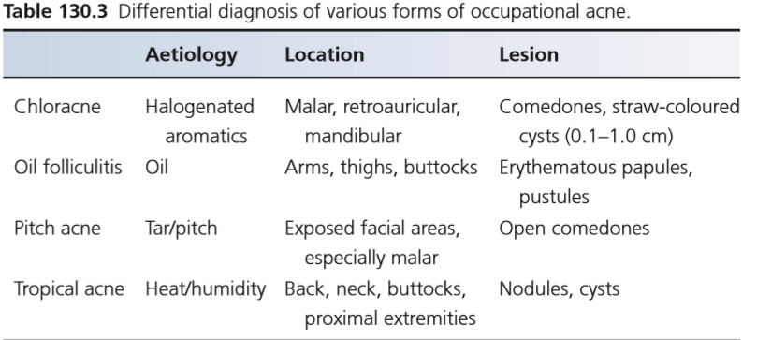

Slide 32
treatment
First line
• Acnegen avoidance and/or occupational redeployment
Second line
• Oral antibiotics
Third line
• Oral isotretinoin

Slide 33
Occupational dyspigmentation
It is a colour change on the skin partially, or entirely, due to work‐related factors.
Occupational leukoderma is defined as depigmentation or hypopigmentation of the skin due to industrial exposure to a chemical or chemicals known to have a destructive effect on epidermal melanocytes.

Slide 34
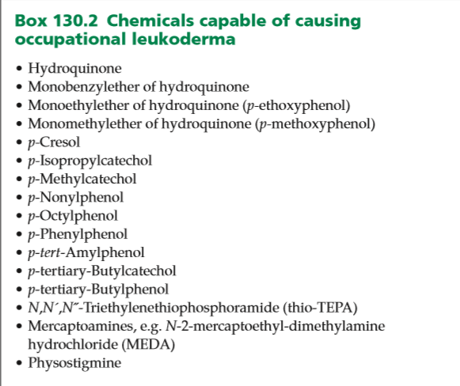

Slide 35
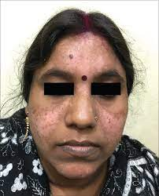
Clinical features
The patient presents with asymptomatic hypopigmented macules in exposed areas, especially on the dorsa of the hands.
The diagnosis of occupational leukoderma should be suspected if a worker who potentially has been exposed to depigmenting chemicals develops localized or generalized hypopigmentation . There should be particular suspicion if more than one worker is involved.

Slide 36
Differential diagnosis
Vitiligo.
Post‐inflammatory hypopigmentation (e.g. from seborrhoeic dermatitis, irritant contact dermatitis, etc.)

Slide 37
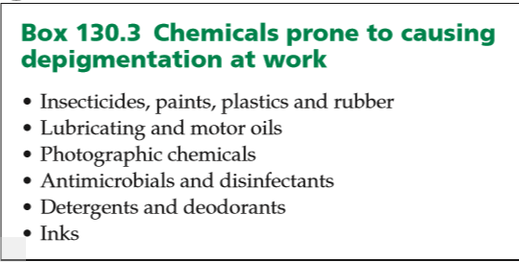

Slide 38
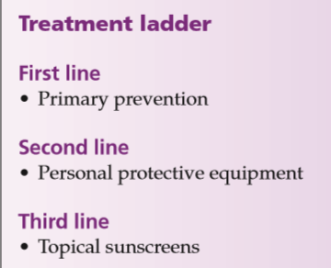

Slide 39
Occupationally induced skin tumors
Occupational skin cancers are defined as those in which a person’s occupation has played a major role in the aetiology of the tumours.
The major occupational carcinogens recognized are polycyclic hydrocarbons, ionizing radiation and arsenic.
UV radiation is now the most important carcinogen in occupational skin cancer.
Sun exposure from outdoor work is the most common cause of occupational skin cancers, with other work‐related exposure to chemicals, ionizing radiation or other carcinogens.

Slide 40
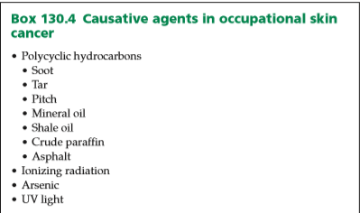

Slide 41
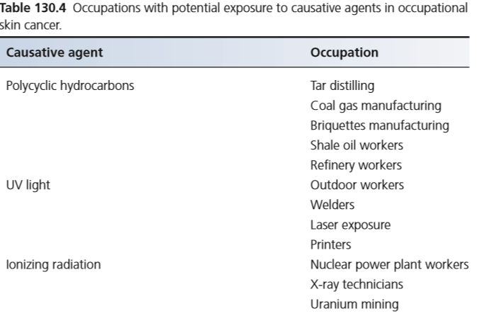

Slide 42
Clinical features
The exposed sites are involved.
Previously, the scrotum was involved frequently, because of continuous exposure to carcinogens and the increased likelihood of skin absorption in that site.
These may include oil folliculitis and hyperkeratoses, described in people working with mineral oil, and pitch or tar warts.
Oil hyperkeratoses were described as being flat, white, circular, hyperkeratotic smooth plaques, small in diameter and often clustered.

Slide 43
In addition, there were verrucose, pigmented round or oval irregular raised ‘warts’.
Tar ‘warts’ are pigmented small papules, often seen around the face on the eyes, eyelids, cheek, forearms and back of the hands.

Slide 44
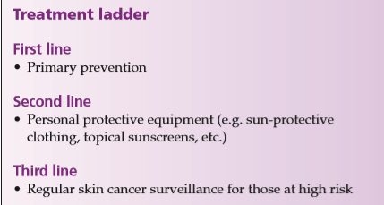

Slide 45
Vibration white finger
Vibration white finger is the episodic appearance of white finger skin patches (Raynaud phenomenon) in response to vibrational tools (especially at 50–150 Hz) or environmental cold and is accompanied by secondary loss of sensation caused by vascular ischaemia.
Chronic vibration exposure may damage endothelial vasoregulatory mechanisms by disturbing the endothelial‐derived relaxing factor‐mediated vasodilatory function.

Slide 46
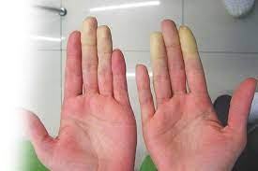
Operatives using vibrating tools, such as lumberjacks, coal miners and road and construction workers, are at risk of developing vibration white finger.
Affected individuals develop symptoms of Raynaud phenomenon on exposure to cold or vibration, usually after many years of working with vibrating tools .
Episodic numbness, tingling, colour change and loss of manual dexterity are typical.

Slide 47
Differential diagnosis
Raynaud phenomenon of non‐occupational origin

Slide 48
investigations
The diagnosis is usually made by history alone; ice provocation tests are not always reliable in precipitating attacks of vibration white finger.

Slide 49
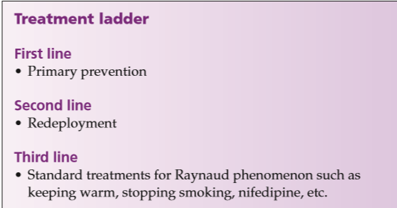
management

