Slide 1
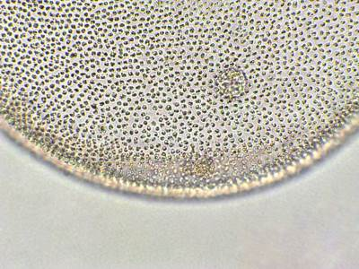
Neutrophilic Dermatoses
DR. ABRAR UL HAQ
(PGR DERMATOLOGY)

Slide 2
Learning objectives
Diseases included in Neutrophilic Dermatoses spectrum
Diagnostic criteria
Histopathology
Management
Clinical presentations

Slide 3
Diseases included in Neutrophilic Dermatoses spectrum:
Pyoderma gangrenosum
Sweet syndrome
Bowel associated dermatitis arthritis syndrome
Subcorneal pustular dermatosis
pyostomatitis vegetans
Amicrobial pustulosis of skin folds
Aseptic abscess syndrome
Notes:
The neutrophilic dermatoses are a group of disorders characterized on histologic examination reveals intense epidermal, dermal, or hypodermal infiltrates neutrophils with no evidence of infection or true vasculitis.

Slide 4
Pyoderma gangrenosum
PG is an idiopathic, either acute or chronic.
It is characterized by neutrophilic infiltration.
It occurs most commonly in association with a systemic disease, especially arthritis, inflammatory bowel disease, hematologic dyscrasias, and malignancy.
Characterized by the presence of painful, irregular, blue-red (violaceous) ulcers with undermined borders and purulent necrotic bases.

Slide 5
PATHOGENESIS
Immune dysregulation:
Increased expression of interleukin (IL)1, IL-8, IL-12, IL-15, IL-17, (TNF)-alpha, JAK2, and STAT1.
This leads to a proinflammatory state and recruitment and activation of neutrophils
Genetic factors:
Genetic susceptibility also likely to contributes.
PAPA syndrome: PSTPIP1/CD2BP1 gene.
Notes:
The complement pathway, particularly C5a and its role in neutrophil activation, and inflammatory signaling, may also contribute to the complex pathogenesis of PG.
PAPA =》auto_inflammatory syndromes (pyogenic arthritis, pyoderma gangrenosum, and acne) ....!
This mutation leads to decreased inhibition of the inflammasome.
**PASH (pyoderma gangrenosum, acne, and suppurative hidradenitis)

Slide 6
Clinical variants
Classical ulcerative
Parastomal PG
Bullous PG
Granulomatous superficial PG
Pustular PG
Notes:
Comments about how the treatment

Slide 7
Classical ulcerative PG
This is the commonest form, and most commonly occur on the legs and trunk ( in 70%).
Presented with small, tender, red-blue papules or pustules that evolve into painful ulcers with characteristic violaceous undermined edges.
Healing usually occurs with an atrophic cribriform scar.
Associated symptoms include fever, malaise, myalgia and arthralgia.

Slide 8

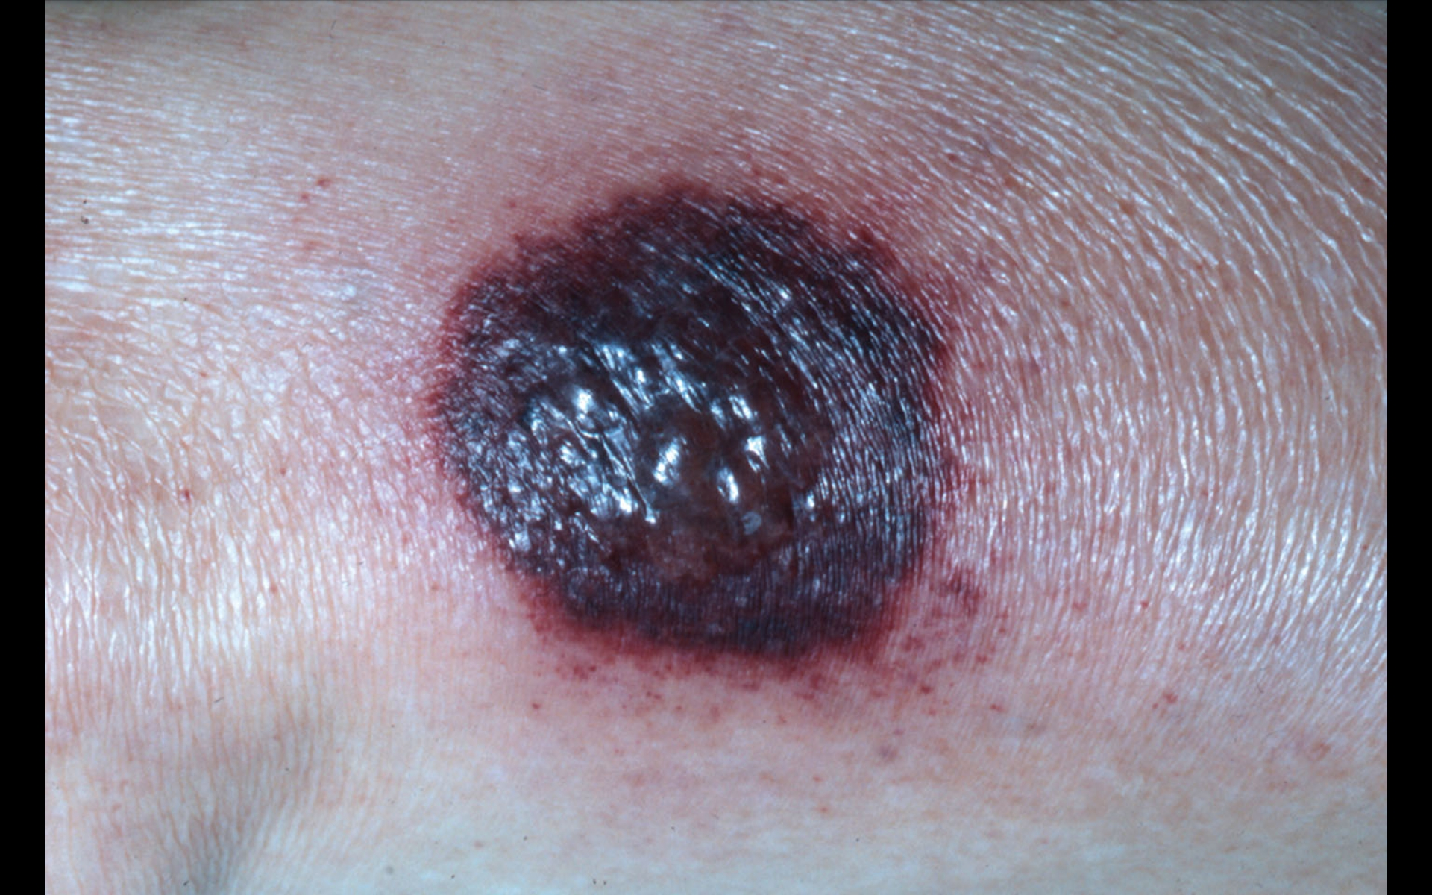
Notes:
Superficial hemorrhagic pustule surrounded by erythematous halo; very painful.

Slide 9
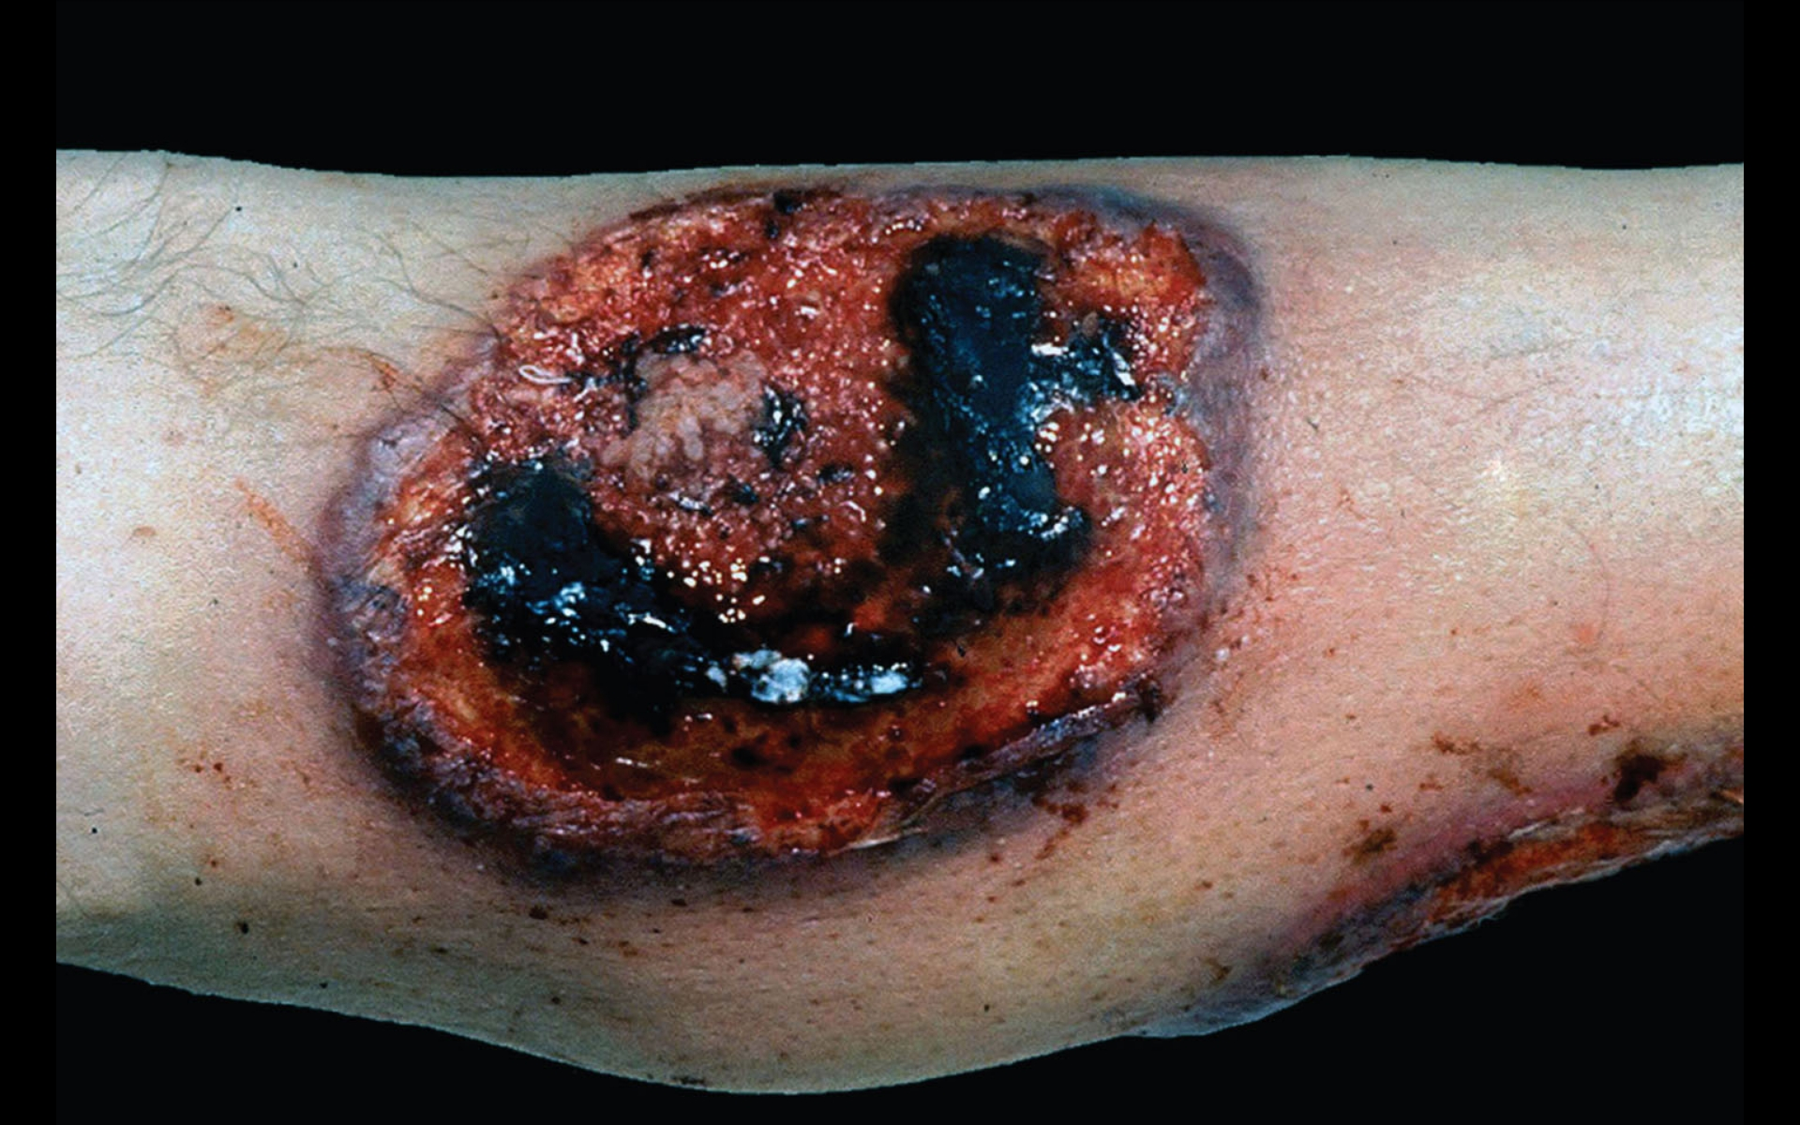
Notes:
Breakdown occurs with ulcer formation, whereby ulcer borders are purple, irregular and raised, undermined edges with perforations that drain pus.

Slide 10
Parastomal PG
It is most common with ileostomy in patients with “Ulcerative colitis or Crohn’s disease”.
Trauma caused by maintenance of the stoma or irritation from stoma secretions may play a role in the development of peristomal PG.
Pathergy: in common with other vasculitides, is the phenomenon whereby skin trauma provokes lesions or the first onset of the disease at a site of injury.
Notes:
1) may develop months to a few decades after placement of a stoma.
2) What is pathergy.?

Slide 11
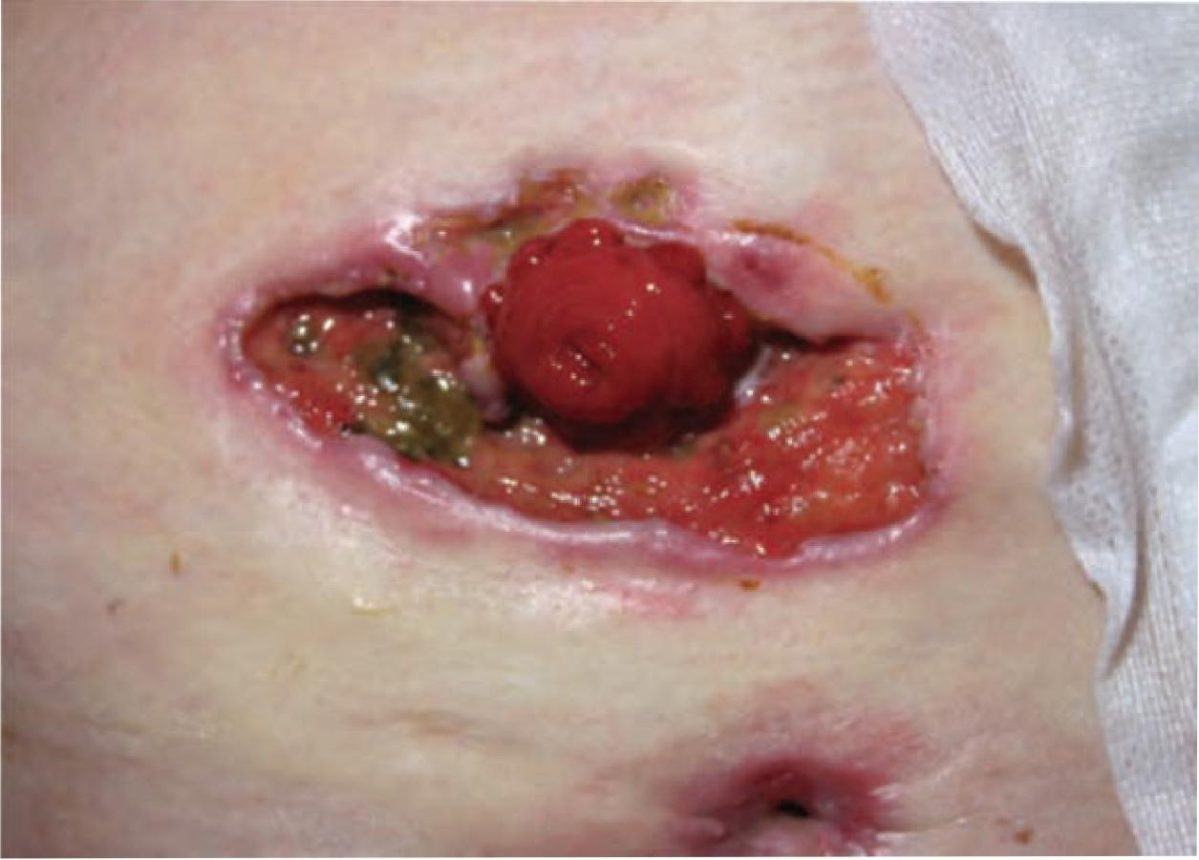

Slide 12
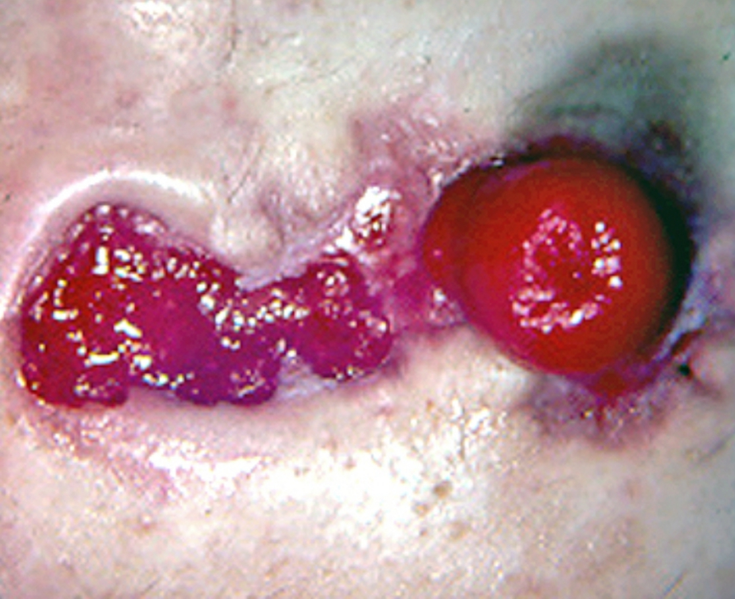

Slide 13
Bullous (atypical) PG
Bullous PG is a less common, the arms and face are the most common sites of involvement.
Patients typically present with the rapid development of blue-gray, inflammatory bullae in the involved areas. The bullae quickly erode, resulting in superficial ulcers.
These is a strong association between bullous PG and hematologic disease.
Notes:
1) patients who present without an associated hematologic disorder should be followed closely for the development of a hematologic disorder. (CML,AML)

Slide 14
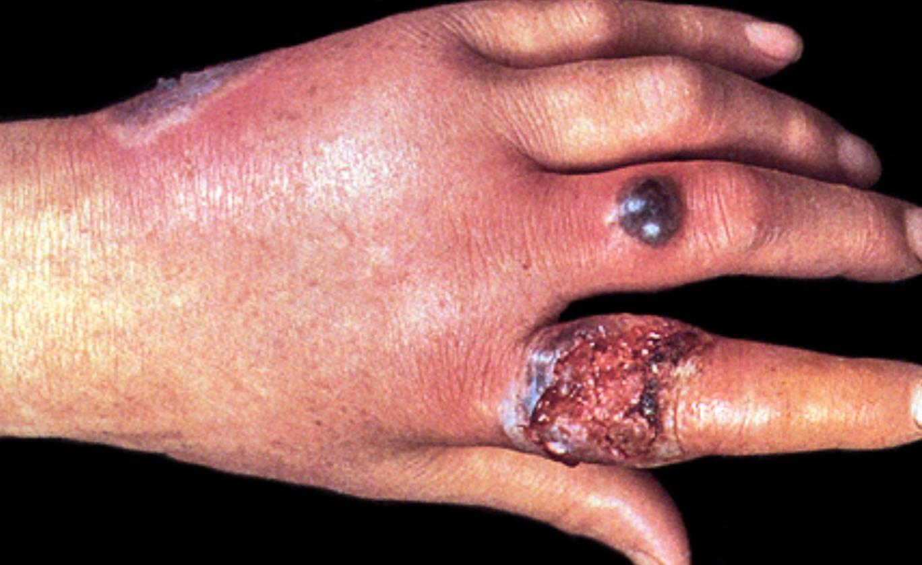
Notes:
Three large hemorrhagic bullae on the dorsum of the hand and fingers. The bulla on the index finger has ruptured, resulting in a large erosion with an irregular, raised, pustular border and a purulent hemorrhagic exudate.

Slide 15
Pustular PG
Pustular PG usually occurs in patients with inflammatory bowel disease, and tends to arise during periods of acute exacerbations of bowel disease.
Rapid development of painful pustules surrounded by erythema.
Concomitant fever and arthralgias are common.

Slide 16
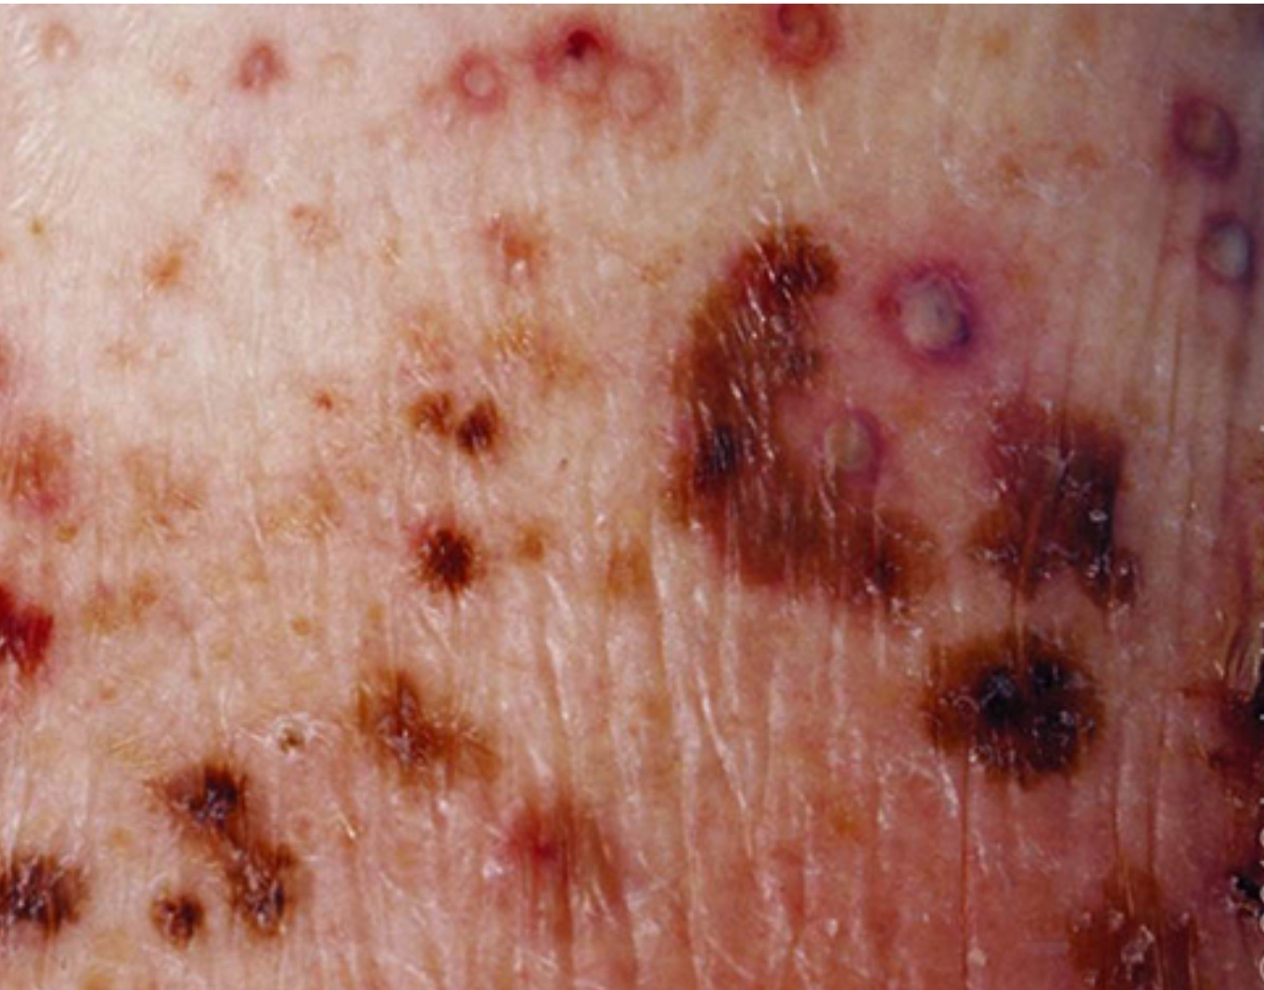
Notes:
Multiple pustules with peripheral erythema consistent with pustular pyoderma gangrenosum are on the extremity. Scattered hemorrhagic macules are also present.

Slide 17
Granulomatous superficial PG
Typically localized, solitary, superficial form of PG.
Presents as painful ulcer with granulations and an elevated edge.
The undermined borders and purulent bases of ulcerative PG are absent.
The head, neck, and trunk are the most common sites.

Slide 18
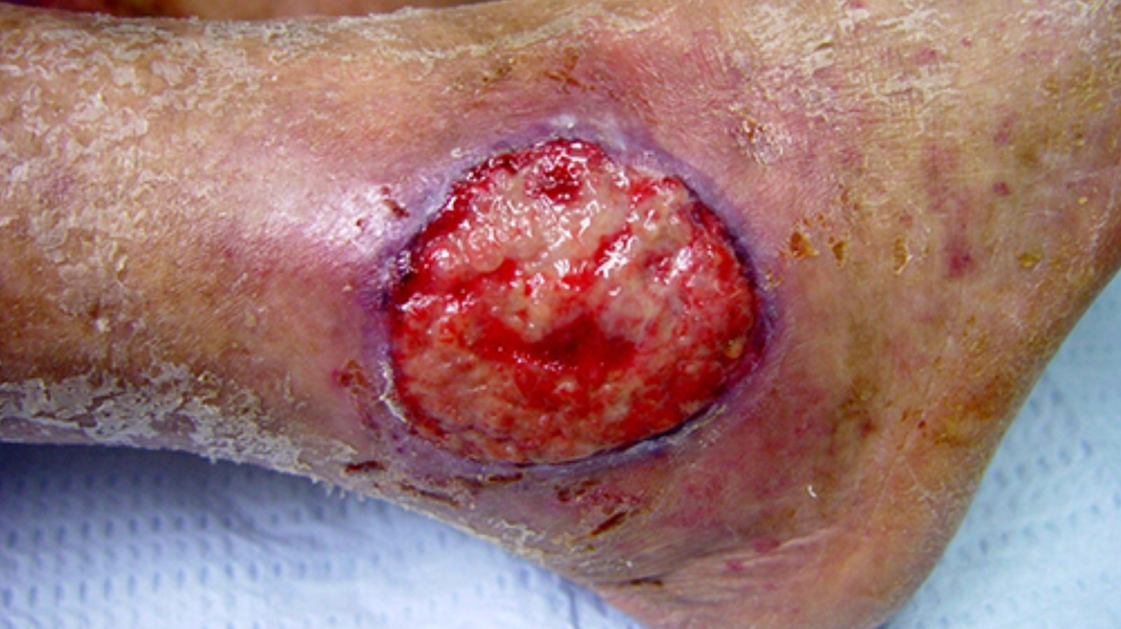
Notes:
An ulcer with a verrucous surface is present on the ankle.
Typically localized, solitary, superficial form of PG that presents as painful ulcer with granulations and an elevated edge.

Slide 19

ASSOCIATED DISORDERS
Inflammatory bowel disease (41%)
Inflammatory arthritis (21%)
Solid organ malignant neoplasms (7%)
Hematologic malignant neoplasms (6%)
Notes:
More than 50 percent of patients with PG have an associated systemic disease.
IBD -Pustular PG
Hematological ---Bullous PG
Other associations:
pulmonary disease, systemic lupus erythematosus, thyroid disease, solid organ cancers, viral and autoimmune hepatitis, sarcoidosis, major depression, and diabetes.

Slide 20
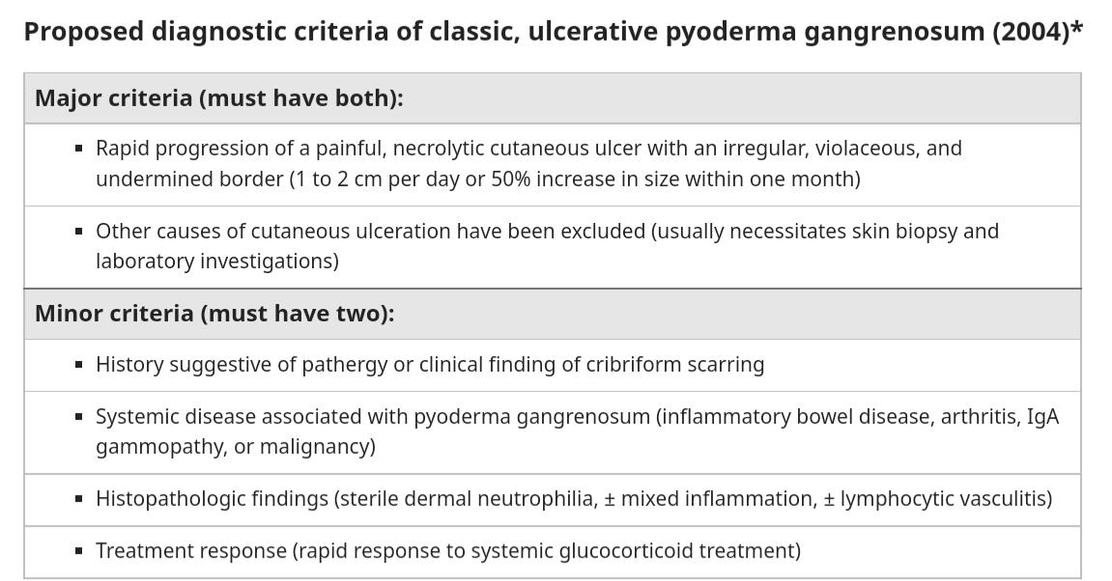
Notes:
Historically, universally accepted and validated diagnostic criteria for PG have been lacking. Diagnostic criteria published in 2004 require the exclusion of all other diagnoses, which can be challenging or impractical in the clinical setting.
These criteria include a single major criterion and eight minor criteria, including histologic, history, clinical examination, and treatment findings.
● Major criterion:• Biopsy of ulcer edge demonstrating a neutrophilic infiltrate
● Minor criteria:• Exclusion of infection • Pathergy • Personal history of inflammatory bowel disease or inflammatory arthritis • History of papule, pustule, or vesicle that rapidly ulcerated • Peripheral erythema, undermining border, and tenderness at site of ulceration • Multiple ulcerations (at least one occurring on an anterior lower leg) • Cribriform or "wrinkled paper" scar(s) at sites of healed ulcers • Decrease in ulcer size within one month of initiating immunosuppressive medicationsAt least the major criterion and four minor criteria are necessary for diagnosis.

Slide 21
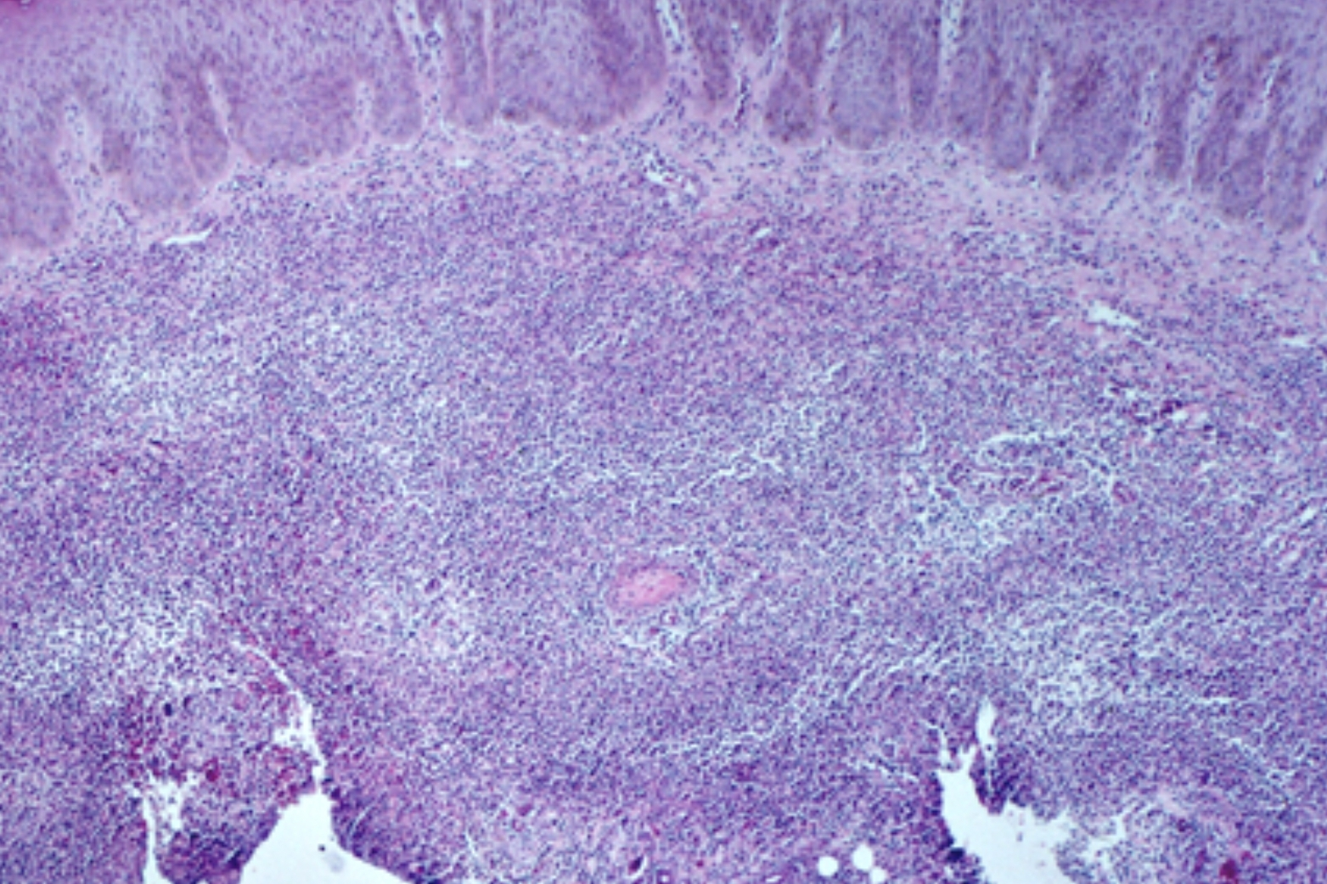
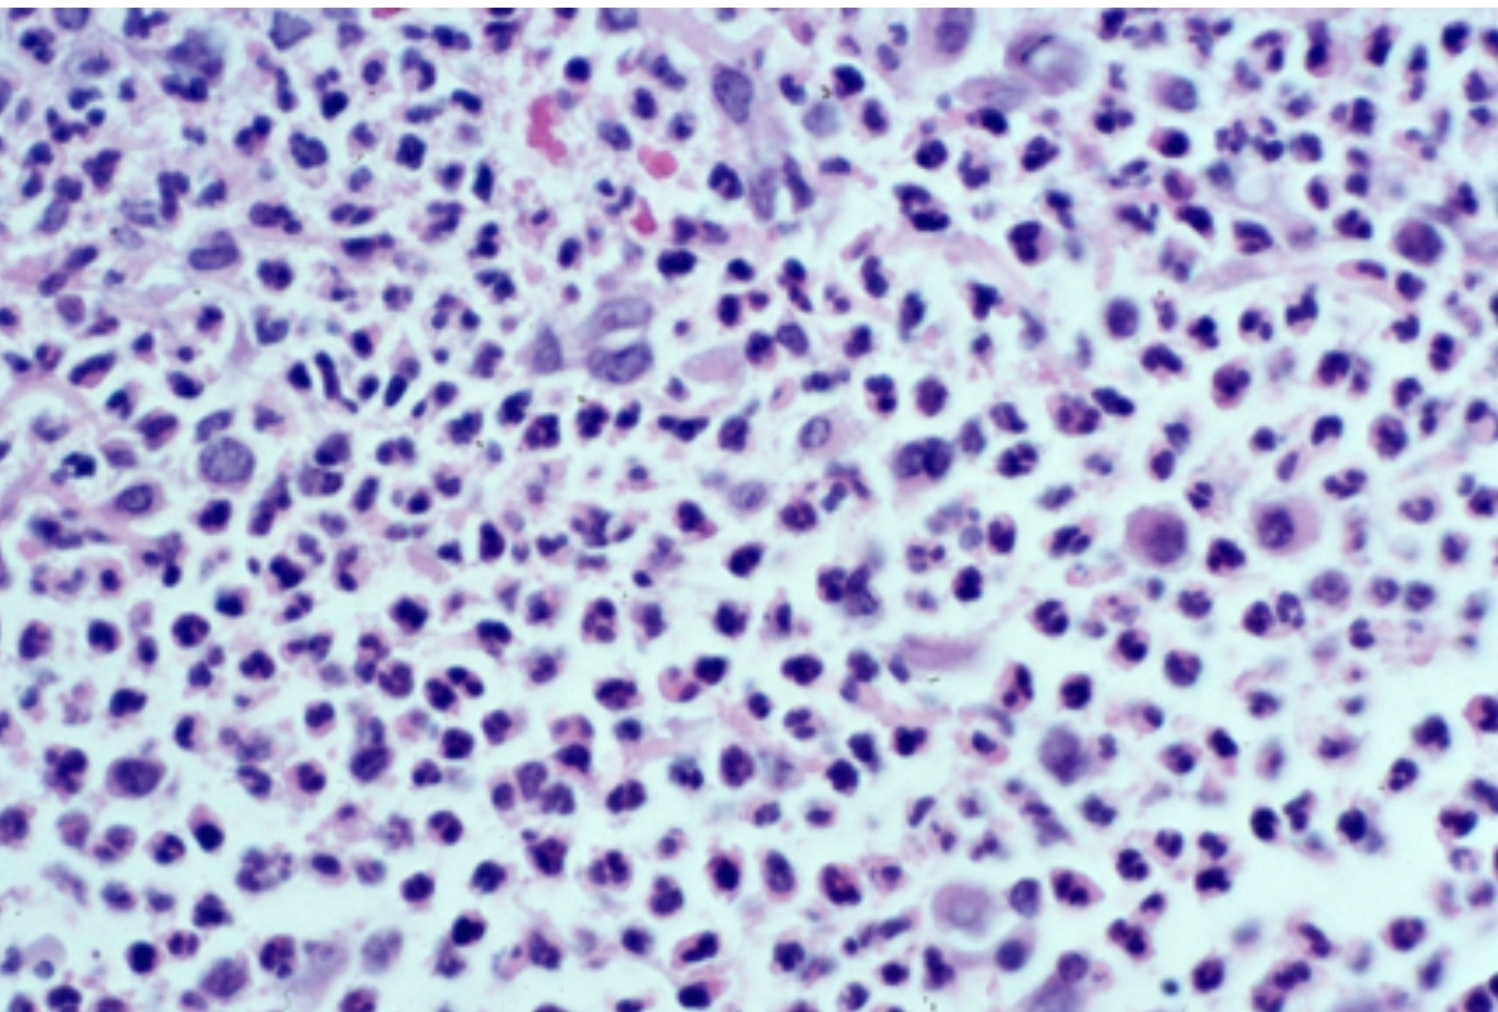
Histopathology of PG
Notes:
A dense neutrophil infiltrate are present in the dermis.
Dense neutrophilic infiltrate in pyoderma gangrenosum.
earliest lesions of PG demonstrate perifollicular inflammation and intradermal abscess formation (picture 8A-B). Once lesions progress to ulceration, epidermal and superficial dermal necrosis with an underlying mixed inflammatory cell infiltrate and abscess formation are typically detected. Giant cells may be found.

Slide 22
First line | Second line | Third line
PG which occurs on the legs and can be associated with vascular disease and obesity. | Severe disease PG not responding to simple measures | Anti-TNF biologic therapy (Infliximab, Adalimumab, Etanercept)
Supportive therapy: Dressings pain relief Topical agents for cleansing debriding and keeping the wound moist. | Prednisolone 0.5–1g/kg Ciclosporin 5 mg/kg Combined prednisolone and ciclosporin | first line therapy (particularly for those with associated IBD)
For smaller lesions: Topical corticosteroids Intralesional corticosteroids Topical tacrolimus | Methotrexate Mycophenolate mofetil Dapsone | Alternative therapies: Skin grafting can be very successful if the inflammation has already resolved.
Notes:
corticosteroids being the most frequently used and the mainstay of therapy
On the basis of cost, biological therapy is considered third line therapy, although growing evidence suggests that antiTNF biologic therapy should be considered as a first line therapy

Slide 23
A middle age lady recently diagnosed with systemic lupus erythematosus visited skin OPD with complains of a single painful ulcer on her left leg for six months. On examination ulcer have irregular, violaceous undermined edges. What is the best treatment option in this patient?A. CiclosporinB. ColchicineC. PrednisoloneCiclosporin plus prednisoloneDE E. Hyperbaric oxygen

Slide 24
A 70-year-old female known case of ulcerative colitis for 05 years, presented with rapidly progressing painful ulcer with irregular, violaceous and undermined borders. The ulcer developed around the colostomy site of the patient. Regarding the wound care in this patient, which of the following option you will consider?
Moderate potency topical steroid should be used with simple dressing, Topical tacrolimus and alginate dressing should be used for oozing wound Normal saline dressing would be best to useD.Oral prednisolone should be used in this patientABCDE No role of intralesional steroid in local wound care.

Slide 25
Sweet syndrome
Sweet syndrome is an uncommon inflammatory disorder.
Characterized by the abrupt appearance of painful, edematous, and erythematous papules, plaques, or nodules on the skin.
Fever and leukocytosis frequently accompany the cutaneous lesions. In addition, involvement of the eyes, musculoskeletal system, and internal organs may occur.
Notes:
(acute febrile neutrophilic dermatosis)
Sweet syndrome into three subtypes based upon etiology:
● Classical Sweet syndrome
● Malignancy-associated Sweet syndrome
● Drug-induced Sweet syndrome (ipilimumab,Minocycline,Nitrofurantoi,Norfloxacin,Ofloxacin,Trimethoprim-sulfamethoxazole)

Slide 26


PATHOGENESIS:
Hypersensitivity reaction
Cytokine dysregulation
Genetic susceptibility
Immune reaction to bacterial, viral, other antigens stimulate production of cytokine that promote neutrophil activation and infiltration.
Granulocyte colony-stimulating factor
Interleukins ( IL-1, IL-3, IL-6, and IL-8)
Abnormalities in chromosome 3q
(G-CSF).
Notes:
The positive response to systemic glucocorticoids and reports of improvement in Sweetsyndrome following treatment of bacterial infections or malignancies offer some support to this theory.
G-CSF increases circulating neutrophils and exogenous G-CSF is a common cause of drug-induced Sweet syndrome.

Slide 27
Clinical presentation
The classical appearance is of tender, red papules, nodules and eventually plaques distributed over the head, neck, upper trunk and upper arms.
The plaques are often oedematous and as the process develops they may become studded with pseudovesicles.
An association of arthralgia, conjunctivitis and episcleritis occur.

Slide 28
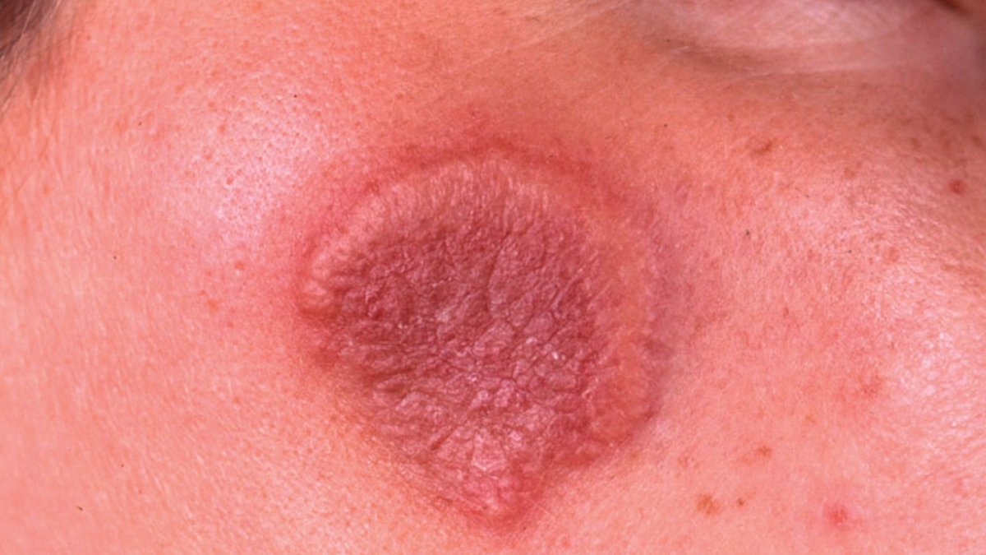
Notes:
An erythematous, edematous plaque that has formed from coalescing papules on the right cheek.
The border of the plaque looks as if composed of vesicles, but palpation reveals that it is solid (pseudovesiculation).
This lesion occurred following an upper respiratory infection, and the patient also had fever and leukocytosis.

Slide 29
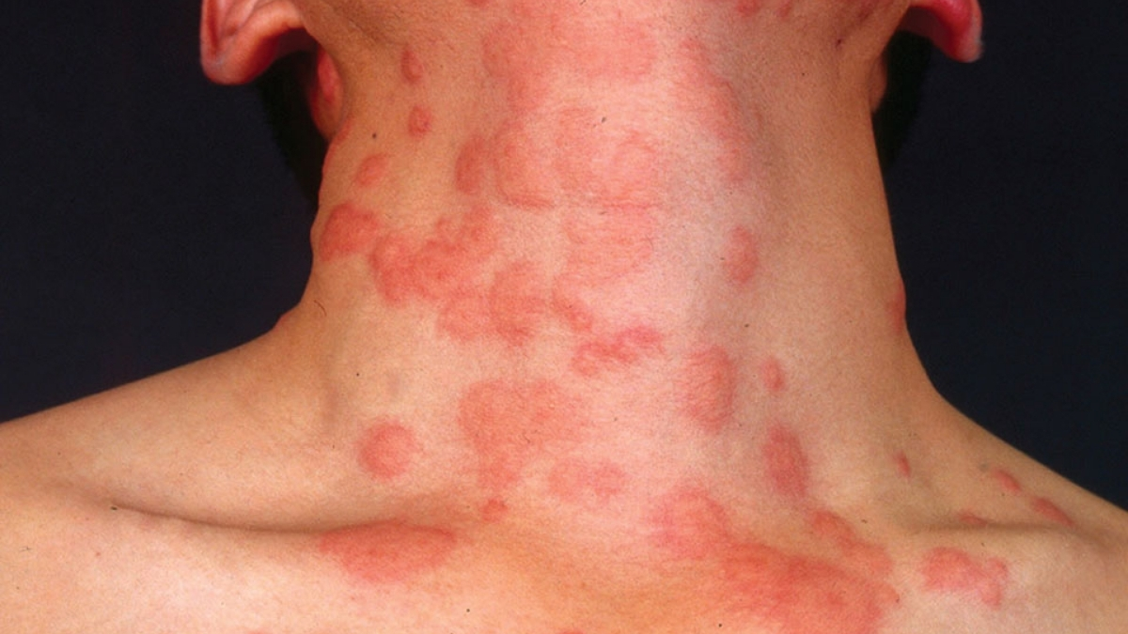
Notes:
There are multiple, coalescing, and inflammatory papules with a wheal-like appearance on the neck. This patient also had leukocytosis and fever.

Slide 30
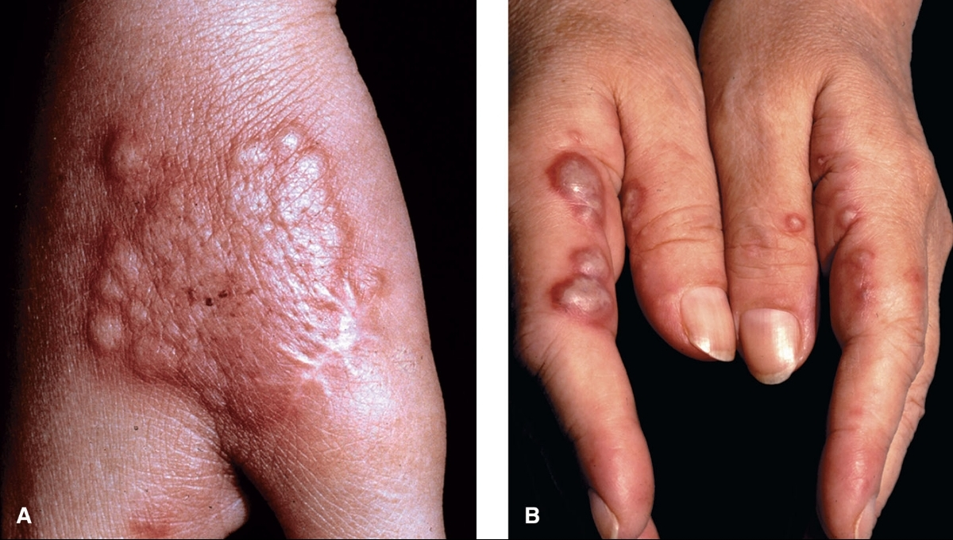
Notes:
(A) Coalescing exudative papules that look like vesicles. Upon palpation, lesions were solid. (Neutrophilic dermatosis of dorsal hands)
(B) Bullous type of Sweet syndrome. These are true bullae and pustules. The patient had *leukemia.

Slide 31
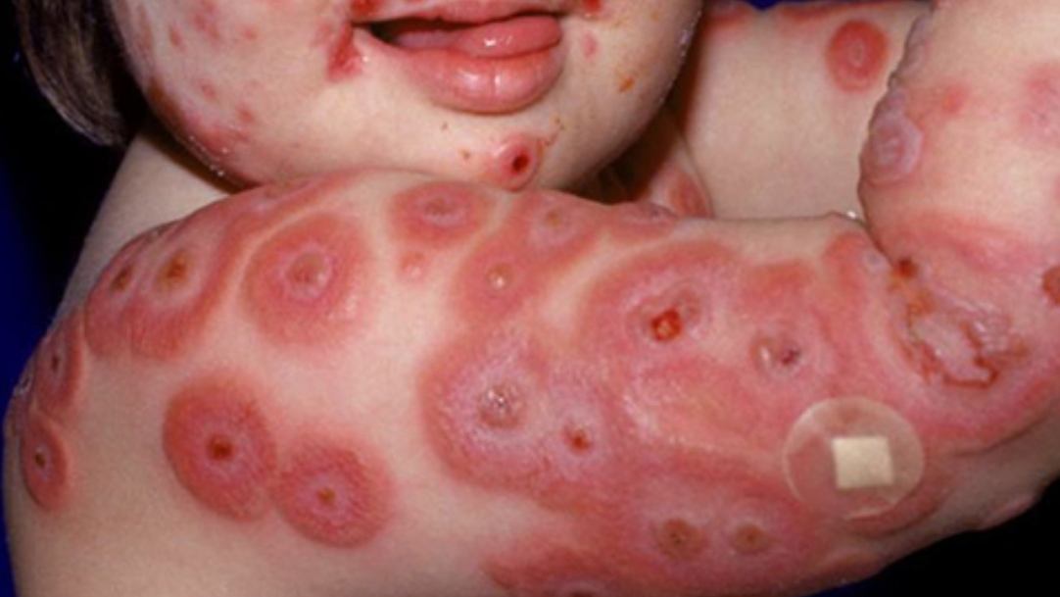
Notes:
Multiple inflammatory plaques are present on the face and upper extremities.

Slide 32
Clinical variants
Neutrophilic dermatosis of dorsal hands
Subcutaneous sweet syndrome
Histiocytoid sweet syndrome
Notes:
Clinical distinction from PG-bullous , and pustular vasculitis may be difficult. Cases have been associated with myeloproliferative disorders, occult malignancy, IBD and rheumatoid arthritis.
Subcutaneous Sweet syndrome Presents with erythema nodosum-like, tender subepidermal nodules on the extremities, usually the legs.
Characterised by a dermal infiltrate of large histiocytoid mononuclear cells. Haematological malignancy-associated.

Slide 33
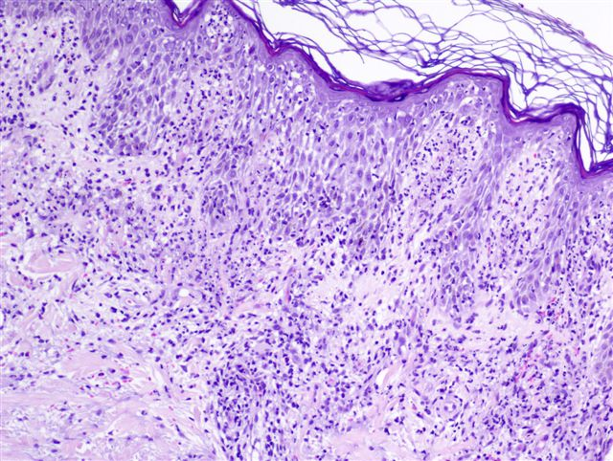
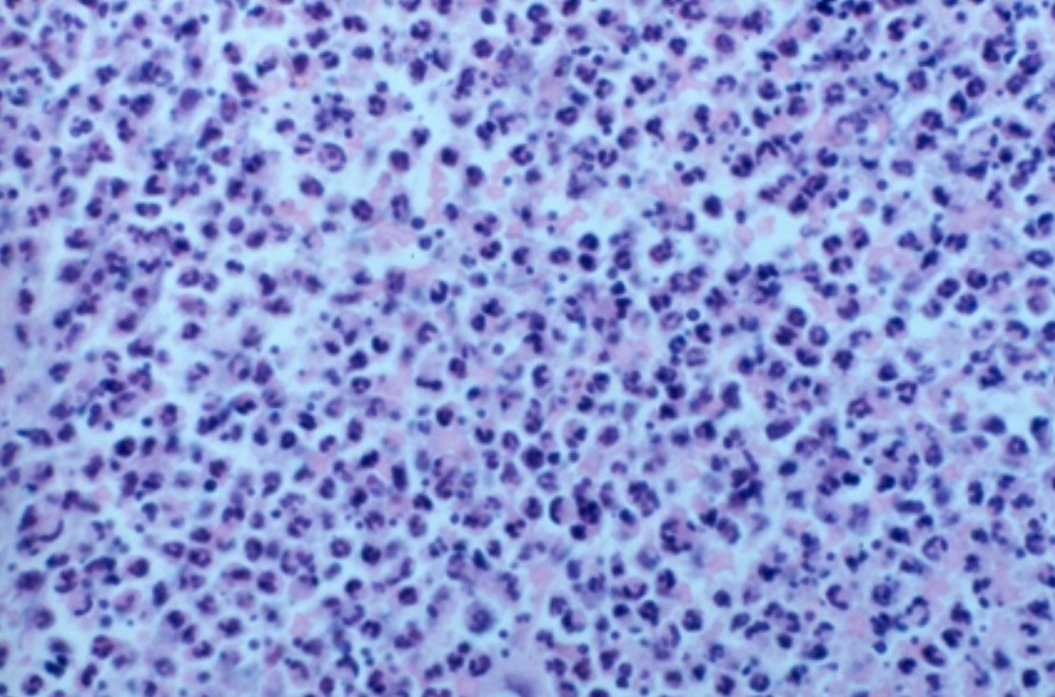
Histopathology
Notes:
● The detection of consistent histologic findings is a major diagnostic criterion for Sweet syndrome.
●massive papillary dermal edema is common
●Dense infiltrate of neutrophils in the upper and mid-dermis with sparing of the epidermis.
●Absence of vasculitis (fibroid necrosis, infiltration of neutrophils, lymphocytes, eosinophils)

Slide 34
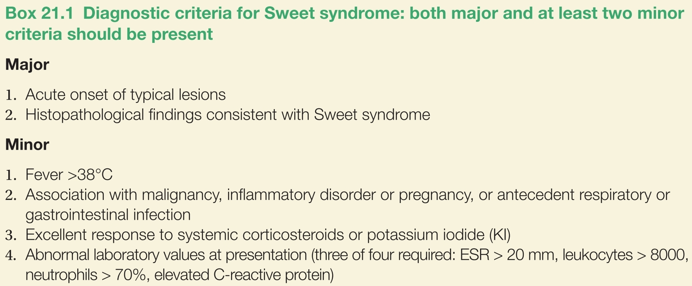
Sweet syndrome

Slide 35
Associations
Infections (Streptococcal,Salmonella,Yersinia,Mycobacterial infection)
Inflammatory bowel disease
Immunological disorder (LE,Sjogren Syndrome)
Hematological malignancies (AML,MDS,HL,NHL)
Solid organ malignancies
Medications (CSF, Retinoids,Imatinib, PTU,OCP)

Slide 36

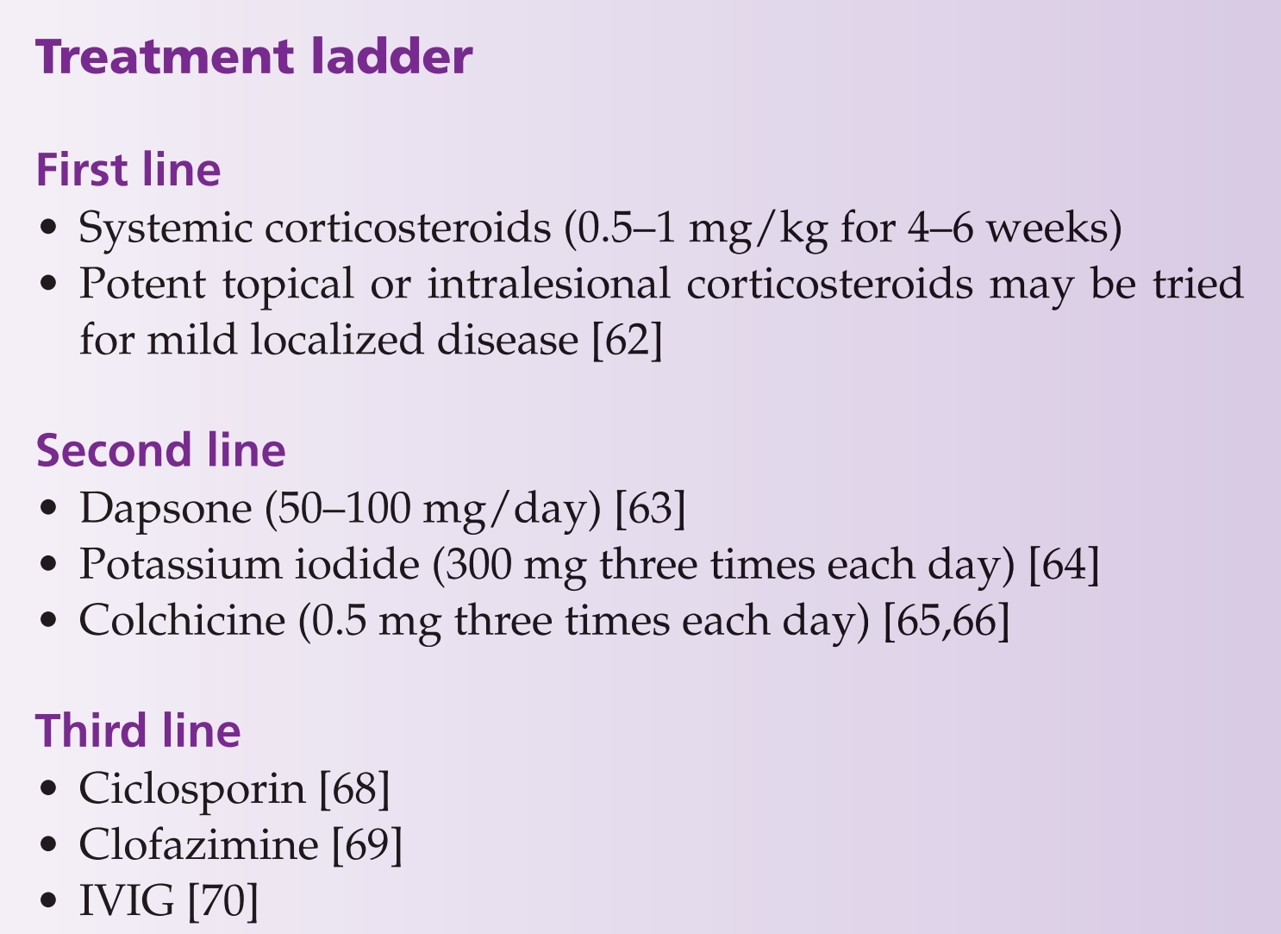

Treatment
Notes:
First line: most of the time systemic prednisolone is the first choice, If remission has not been induced after 3 months, a steroid‐sparing agent should be added.
Steroid sparing drugs dapsone, potassium iodide and colchicine => Dapsone in glucose‐6phosphate dehydrogenase (G6PD) should be started cautiously, as it can cause hemolysis ( especially when started with 100mg/day)

Slide 37
A 35-year-old lady recently underwent modified radical mastectomy for metastatic breast carcinoma presented in dermatology OPD with complain of few bluish papules which she noted on dorsum of her right index and little finger followed by formation of pustules,bullae swelling and ulcer on same sites.She visited local general practioner who gave topical antibiotics with no response. On examination hemorrhagic bullae and ulcerated plaque with violaceous border were noted on dorsal aspect of her hand which were tender. Rest of examination was unremarkable. How will you confirm your diagnosis? slim bloA.Skin biopsy for histopathologyB. Rheumatoid factorC. Thyroid function testD. Full blood countE. Anti-streptolysin O antibody titre.

Slide 38
Subcorneal pustular dermatosis
A rare neutrophilic dermatosis.
Recurrent crops of sterile pustules appear in the most superficial (subcorneal) layers of the skin.
The distribution is mainly in the flexures of the trunk and proximal limbs (including axillae, groins, neck and inframammary, sparing the face and mucous membranes)
Notes:
The differential diagnosis includes impetigo, pustular psoriasis, pemphigus foliaceus, dermatitis herpetiformis, intercellular IgA pemphigus and acute generalized exanthematous pustulosis (AGEP).

Slide 39
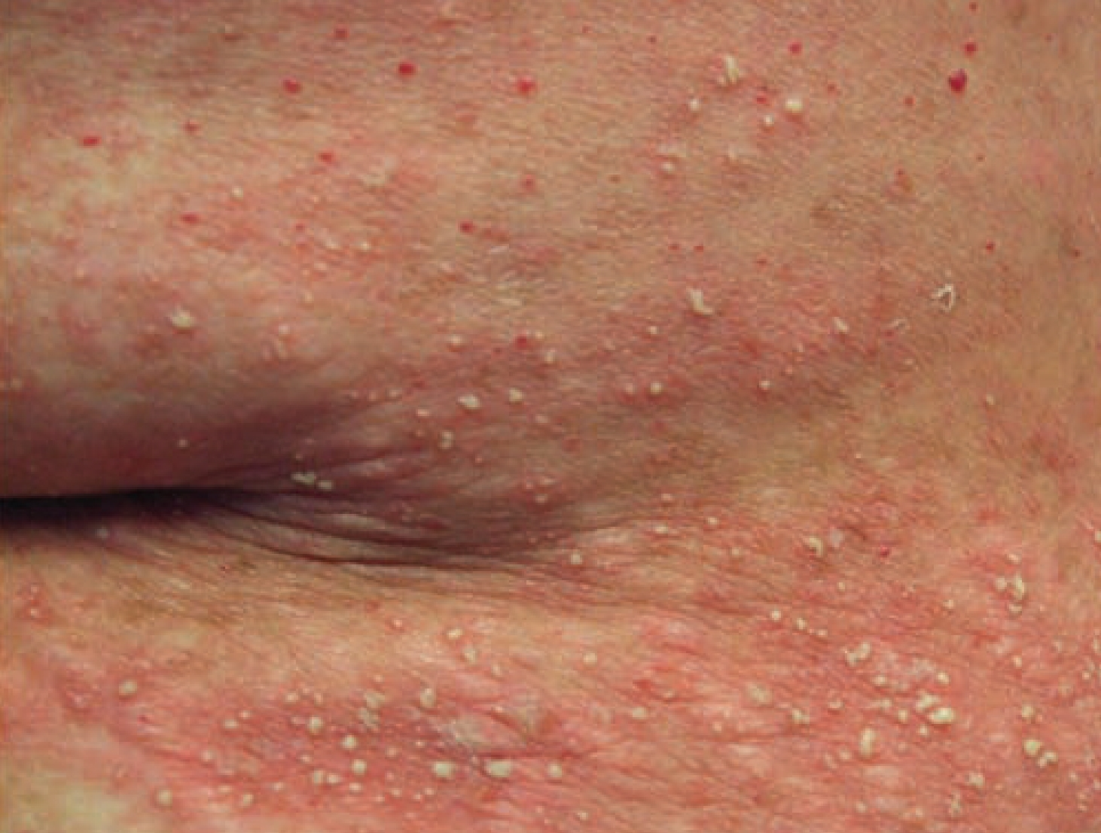
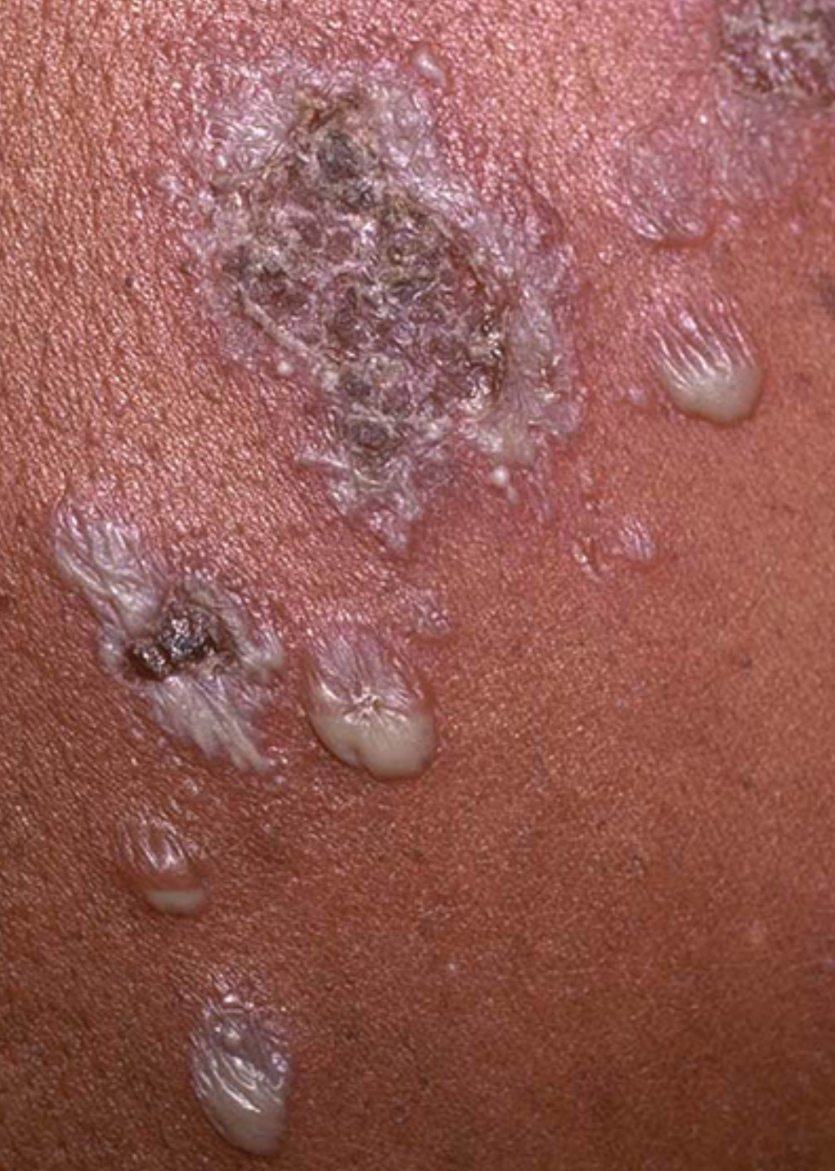
Notes:
Lesions are oval, pea-sized flaccid pustules on a normal or erythematous base.
These patients may also develop larger, flaccid bullae that contain sterile pus in the lower portion. These bullae are often called "half-half" blisters.

Slide 40
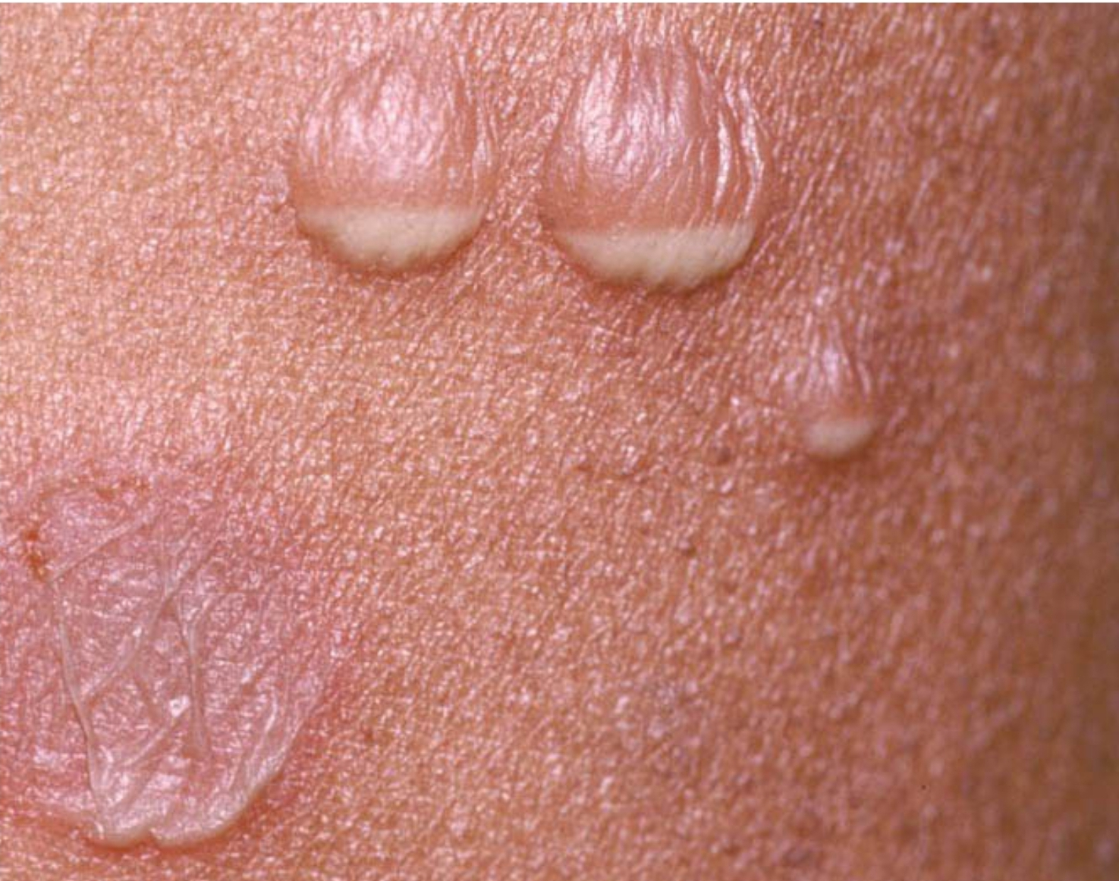
Notes:
Bullae with purulent collections in the lower portion ("half-half blisters").

Slide 41
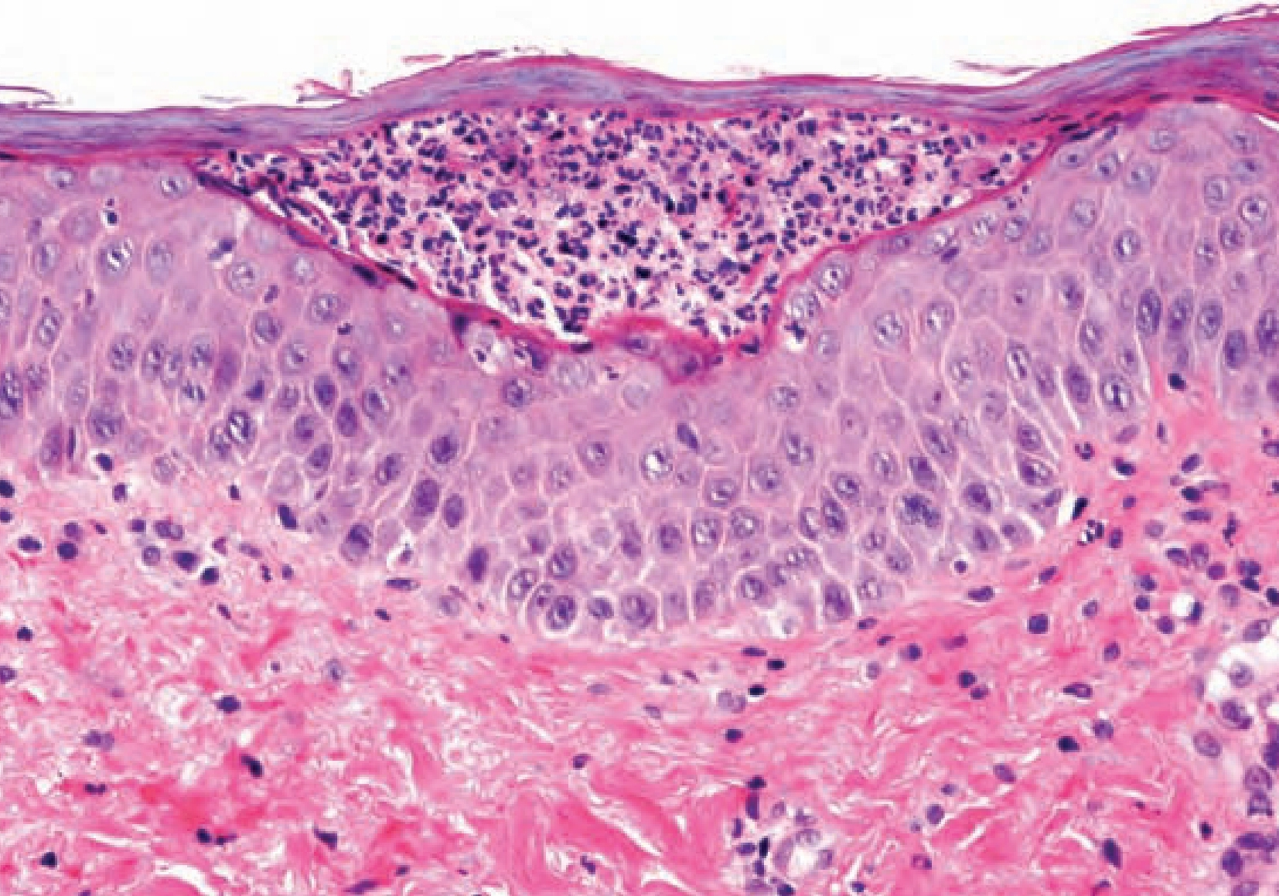
Notes:
Histology showing subcorneal neutrophils.
Pustules sit on the surface of the epidermis without spongiosis or acantholysis.

Slide 42
Treatment
First line: Dapsone 50-150mg daily (treatment of choice)
Second line:
  Potent topical or oral corticosteroid
  Phototherapy(NB-UVB, PUVA, RePUVA), Ciclosporin in combination with prednisolone also effective.
Third line :
  Ketocoazole
  Anti-TNF therapy

Slide 43
You received call from oncology ward to see a patient who had develop a rash on his upper limbs .You attended the patient who is 70 year male diagnosed with multiple myeloma for last one year and is on cancer chemotherapy .After receiving his last cycle of chemotherapy one week back he developed fever and was admitted in ward was given intramuscular injection on left arm later he developed few pustules which spread and involved his both arms mainly in flexures of elbow. On examination multiple pustules with few blisters on an erythematous base coalescing to form plaques, were noted. Rest of the examination was unremarkable.What is the most specific treatment of this disease?A.DapsoneB. AcitretinC. NBUVB, PUVAD. Ciclosporin +prednisoloneE. Adalimumab

Slide 44
Bowel‐associated dermatitis–arthritis syndrome
(BADAS)
Pustular vasculitic lesions.
Predisposing factors: jejunoileal bypass surgery for obesity, inflammatory bowel disease, a Billroth II procedure for peptic ulcer disease, biliopancreatic diversion, or blind loops of bowel following surgery.
Pathogenesis: Bowel bacterial overgrowth with subsequent immune complex formation within the circulation causes blood vessel damage.

Slide 45
Clinical Features:
Affected patients present with a serum sickness-like syndrome characterized by fever, chills, malaise, arthralgia, arthritis, and myalgia.
Cutaneous skin lesions:
Erythematous macules up to 1 cm in diameter that develop a central pustule.
Notes:
The aseptic, nonerosive, asymmetric polyarthritis , affects both small and large joints
The eruption most often occurs on the upper extremities and trunk but can occur anywhere, except the face and genitalia.

Slide 46
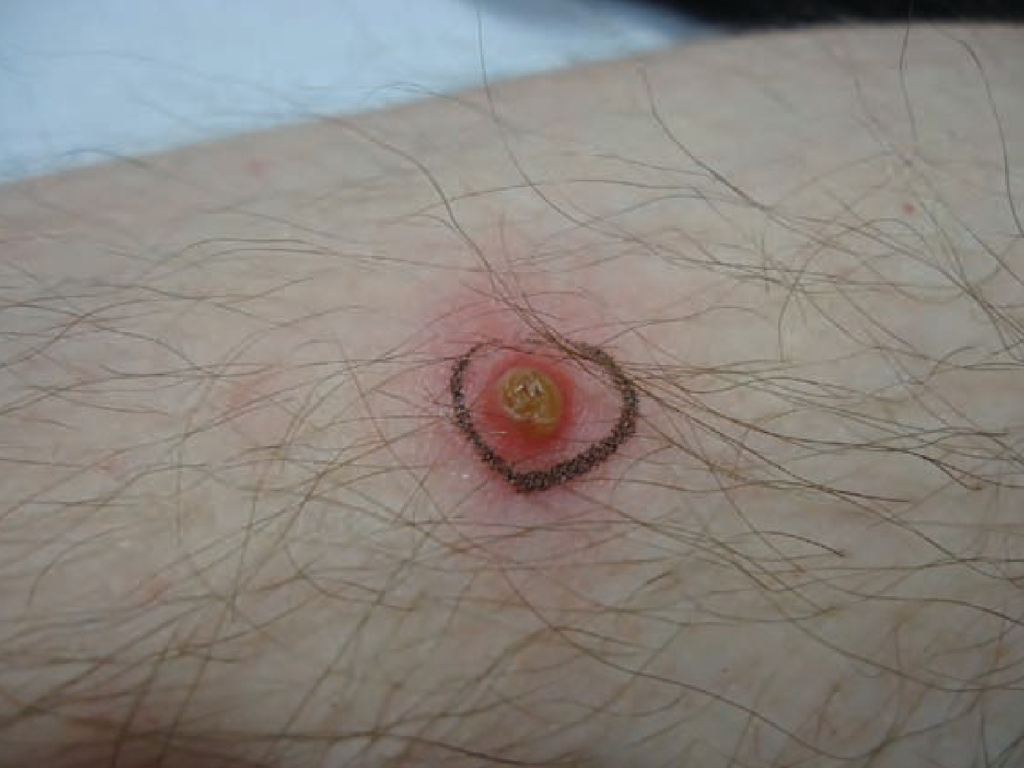
Notes:
A typical initial lesion in BADAS showing a large deep pustule on an erythematous base.

Slide 47
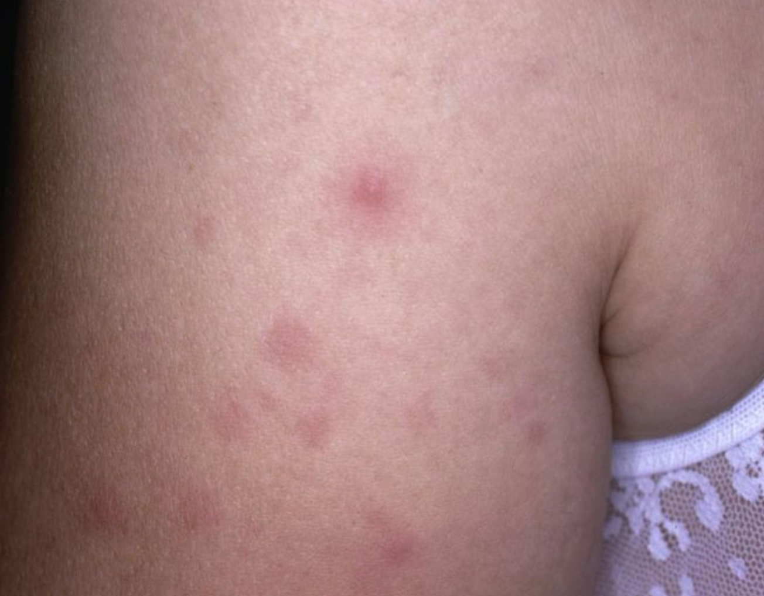
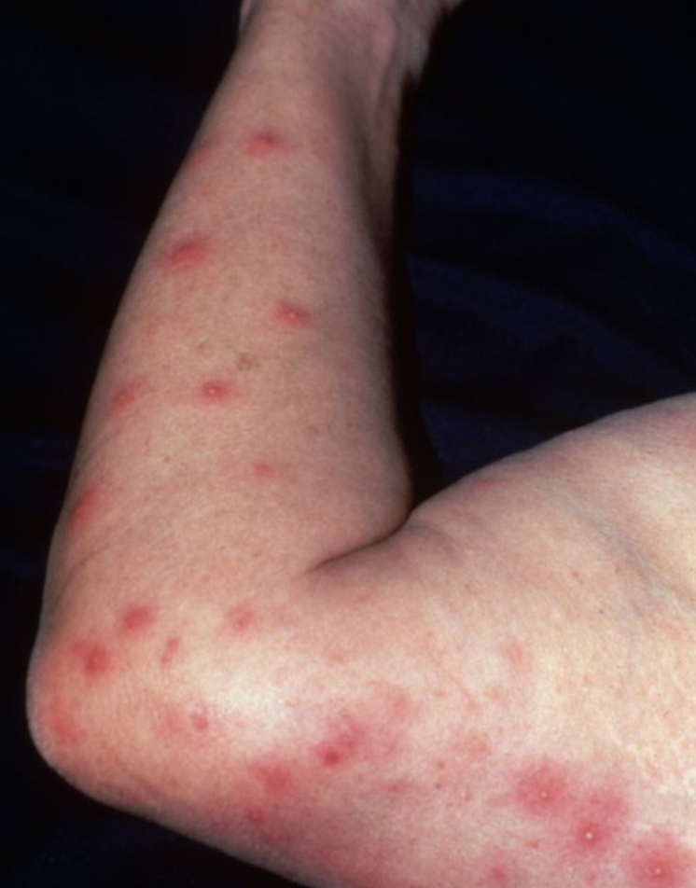
Notes:
Erythematous macules and a papulo-pustule on the upper extremity.
Multiple erythematous macules, papules, and papulopustules on the upper extremity.

Slide 48
Treatment
First line:
  Systemic tetracycline, metronidazole, ciprofloxacin or erythromycin.
Second line:
  Systemic corticosteroids
  Oral colchicine
  Dapsone
  Mycophenolate
Notes:
this further suggests the important role of bacterial colonization in triggering the systemic response in BADAS
Systemic corticosteroids are typically unnecessary for the treatment of BADAS but may be justified depending on the degree of skin, joint or systemic symptoms, or to concurrently treat IBD.

Slide 49
Amicrobial pustulosis of skin fold
APF is rare and has a predilection for females, with a mean age of onset of 30 years
It is associated with a spectrum of autoimmune diseases, especially systemic lupus erythematosus.
Histologically: there is a superficial spongiform pustulation in the epidermis with perivascular neutrophilic infiltration of the dermis and no evidence of infection or vasculitis
Notes:
other autoimmune conditions including autoimmune thyroid disease and autoimmune hepatic disease.

Slide 50
Clinical Presentation
Characterized by a relapsing, primary follicular and non-follicular pustular dermatosis.
which favors the cutaneous folds of the skin, the scalp, and the periorificial areas of the mouth, nostrils, and the external ear canals.

Slide 51
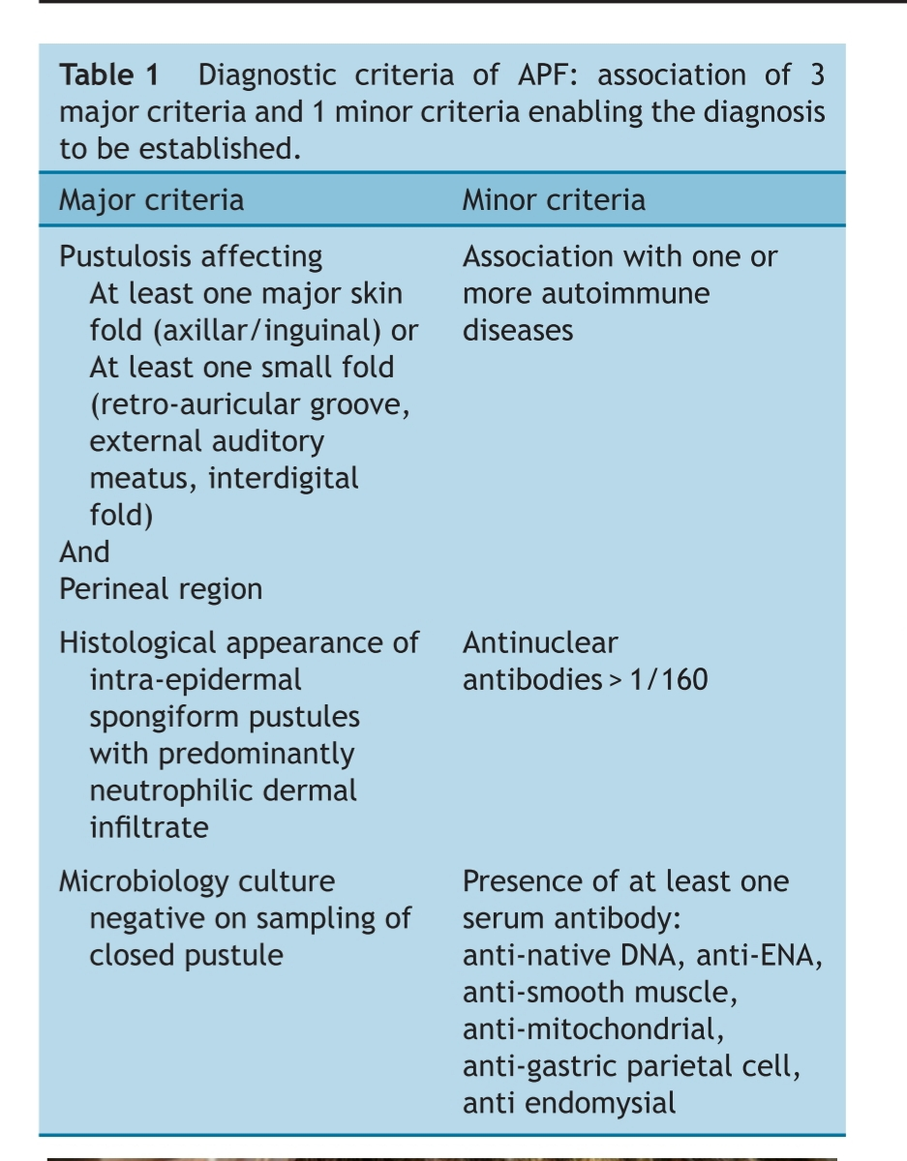
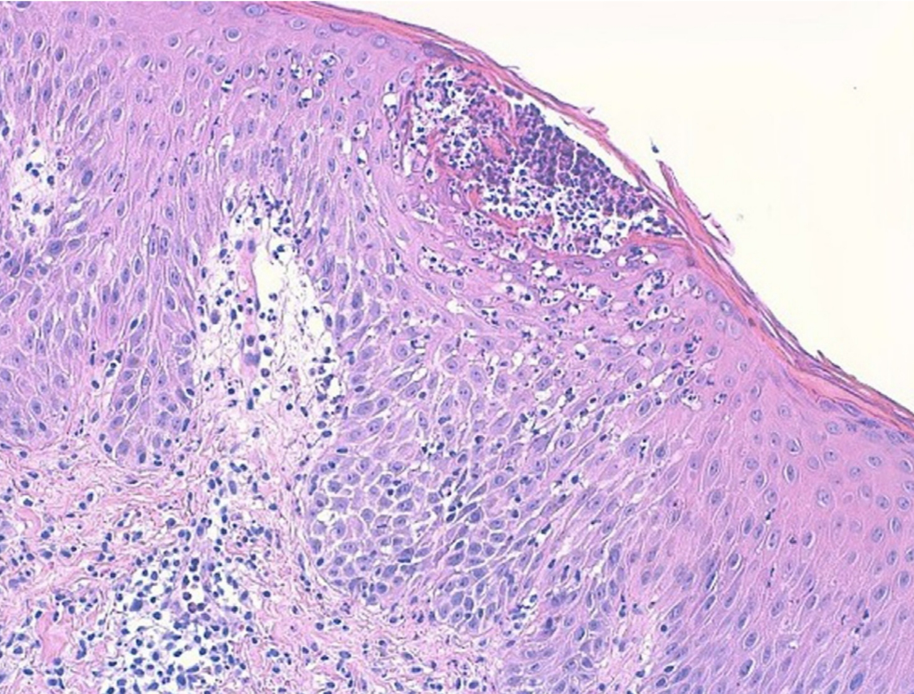
Notes:
Spongiosis of the epidermis with subcorneal pustules and inflammatory infiltrate of neutrophils in the dermis.

Slide 52
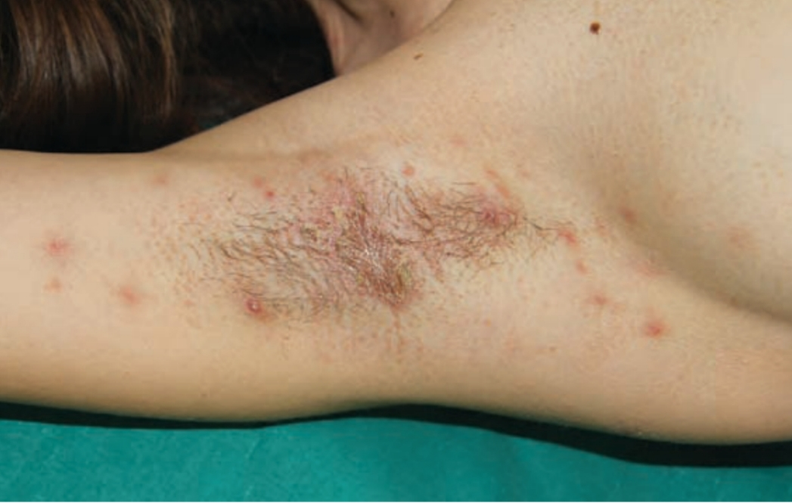
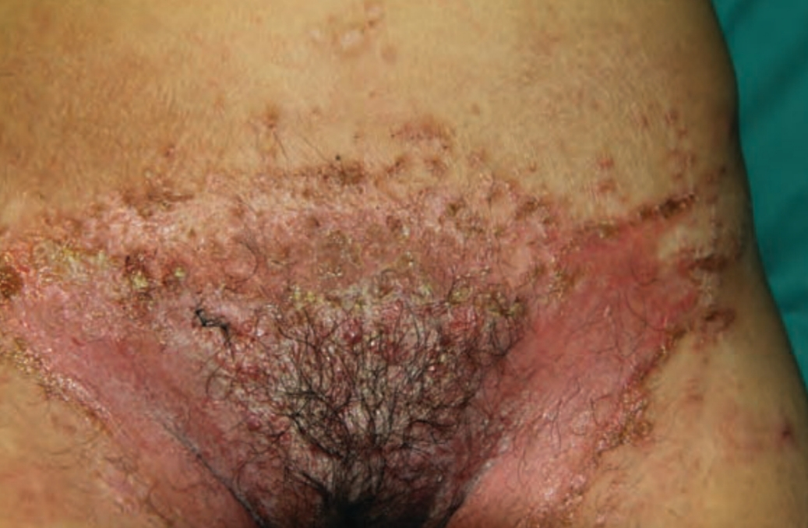
Notes:
Sterile pustules, erosions and crusts on the axillary fold of a patient with amicrobial pustulosis of the skin folds.
Amicrobial pustulosis of the inguinal folds. Erosive and exudating lesions, partially covered by crusts, symmetrically involving the inguinal folds and extending to the genital region.

Slide 53
Treatment
First line:
  Oral corticosteroids are effective in most cases
Second line:
  Dapsone or cyclosporin
  Topical corticosteroids
  Colchicine

Slide 54
A 35-year-old male who is known case of celiac disease presented with rapidly evolving pustules that are matting on places like genital, inguinal fold and axillae, lesions are covered with crust. What will be the diagnosing features of this disease on skin biopsy?A.Sub corneal neutrophilic infiltrate and perivascular neutrophilic cells B. Neutrophilic epidermal and ostial exocytosis seen with spongiform pustulesC. Negative immunofluorescence for IgM, C3 and less often IgGD. E. Raised eosinophils with intraepithelial abscesses Dense infiltrate neutrophil in dermis and prominent dermal papillary edema

