Slide 1
Neurological conditions affecting the skin

Slide 2
Neuropathic ulcer
Chronic ulceration in an area of skin anesthesia
Common sites are weight bearing area
Like heals and metatarsals heads
painless

Slide 3
Associated diseases
Type 2 diabetes
Renal failure
Alcoholism
Vitamin deficiencies
Leprosy
Pernicious anemia
Hereditary sensory and autonomic neuropathy

Slide 4
pathophysiology
Peripheral nueropathy and ischemia results in nerve dysfunction that result results in sensory loss
Trauma to affected sites goes unnoticed that leads to repetitive shear forces

Slide 5
Clinical features
Metatarsal or heels
Surrounded by thick hyperkeratosis with punched base that is painless
Neuropathic limbs warm insensitive and on soles
Neuro ischemic limbs cold discoloured and mostly on foot margins

Slide 6
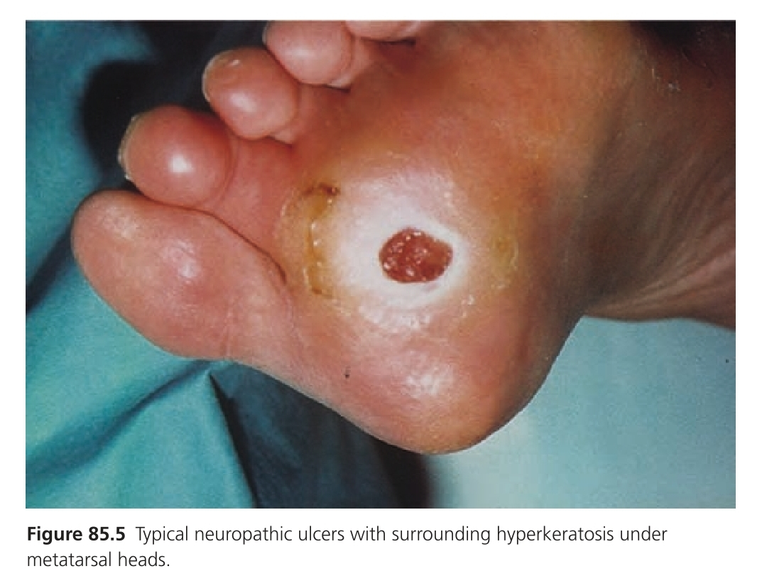

Slide 7
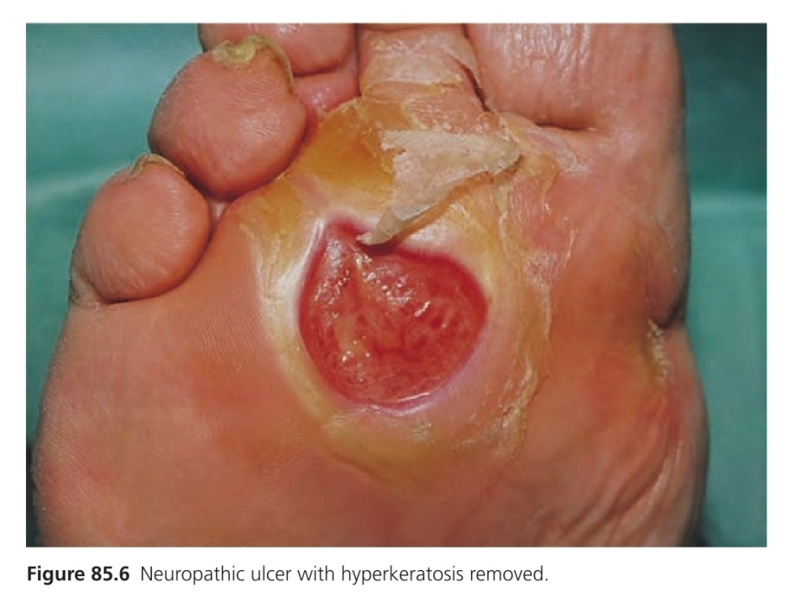
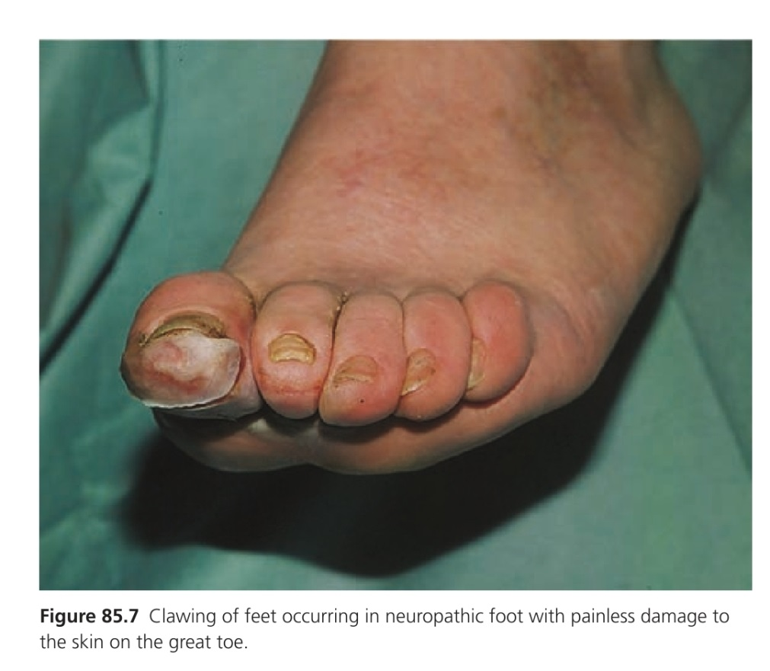

Slide 8
Complications
Cellulitis
Deep infection
Abscess formation
osteomyelitis
Orgnanism staphaureus and MRSA

Slide 9
Investigations
Xray foot periosteal reaction and osteolysis
Sinogram communication of sinus with a joint or a sub facial plantar abcess
CBC ESR RBS etc

Slide 10
treatment
1st line
Proper foot care
Control of diabetes and hypertension
Smoking cessesation
2nd line
Orthotic devices
Electrical modalities
3rd line
Laser therapy
Vaccume assisted wound closure

Slide 11
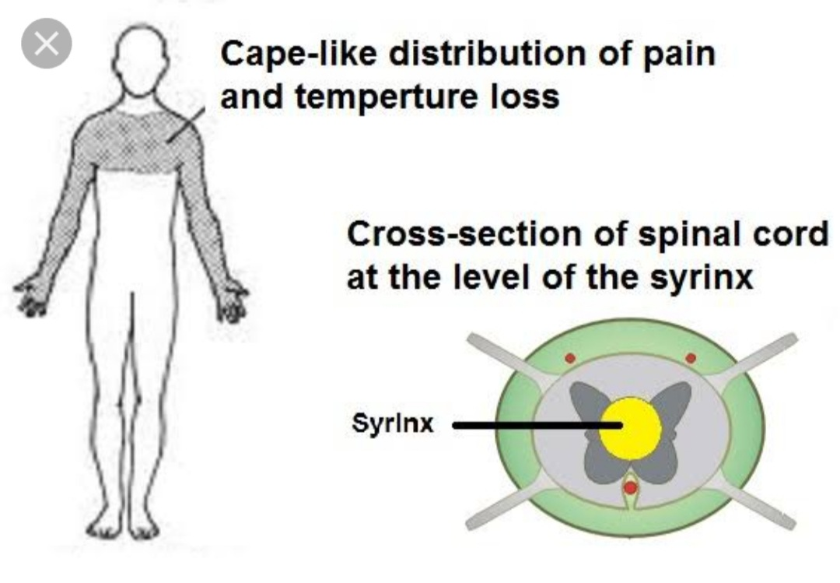
syringomyelia
Longitudinal cyst in the cervical cord and or medulla(syringobulbia)immediately anterior to the central canal which spreads usually asymmetrically to each side.
Notes:
add Pictrure from phone

Slide 12
Epidemiology
Incidence and prevelance
8.4 cases per 100 000 population
Age
Young adults usually progress slowly over 20-30 years
Associated diseases
chiari malformation type 1

Slide 13
Clinical features
Dissociated sensory loss pain and temp in upper limb
Painless burns on hand and forearms
Dyshidrosis usually over face and upper
Asymmetry of scalp hair with denervated area
Morvan syndrome
Progressive pain loss resultant skin ulceration soft tissue loss resorption of phalanges and muscular atrophy occurs

Slide 14
Complications
Infections
Decubitus ulcers
Scoliosis

Slide 15
Diseases course and prognosis
Slowly progresses over many years
Repeated burns leads to cause skin of finger to become thickened swollen and keratotic
Syringobulbia
May affect vestibular pathway descending trigeminal neve sympathetic pathways

Slide 16
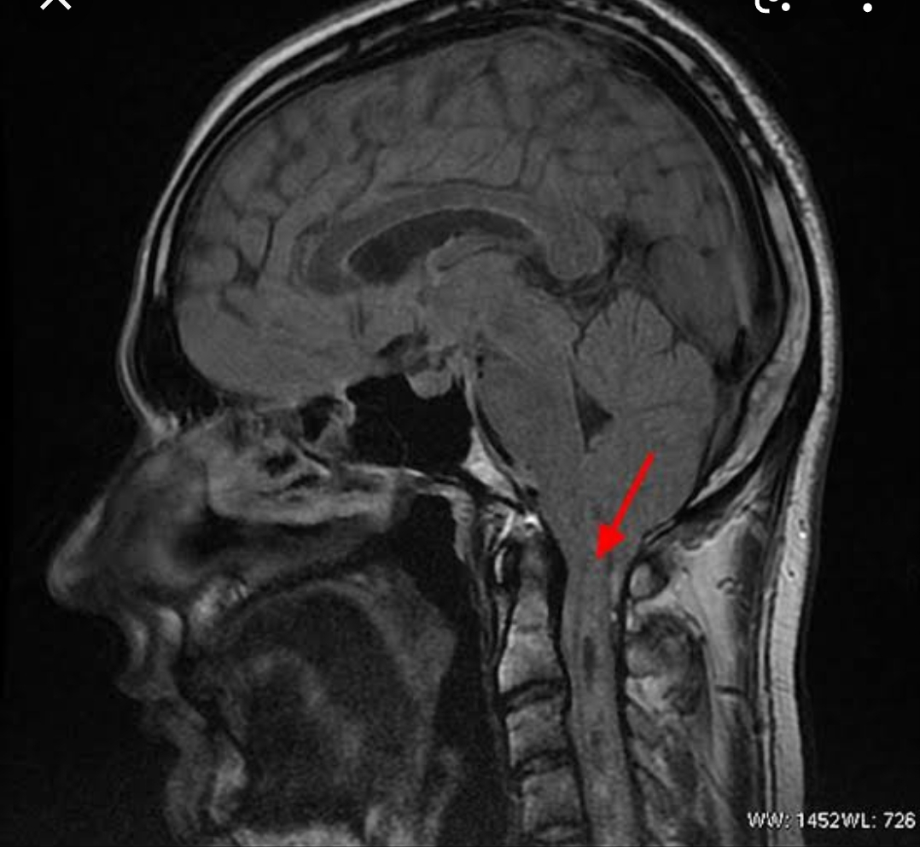
investigations
MRI scanning of hind brain and upper spinal cord
Notes:
Add pic oF MRI here

Slide 17
managment
Neurosurgical and orthopedic evaluation is warranted for all patients

Slide 18
Spinal dysraphism
Malformation of spinal cord due to failure of symmetrical fusion of embryological spinal structures
Two substes
Exposed to enviroment e.g spina bifida,myelomeningocele
covered by intact skin

Slide 19
epidemiology
Incidence
1;1000 births
Age
From birth
Associated disesaes
Trisomy 13 18
CHILD syndroms
Wardenburrg syndrome
Meckel_gruber syndrome

Slide 20
pathophysiology
Predisposing factors
Exact cause unknown
Folate deficiency
Antiepleptic drugs (Na valproate carbamizapine)
Exposure to radiations

Slide 21
Clinical features
Lumbosacral dimples
Tufts of hair at lower back
Lipoms
Port wine stains
Hamangiomas
pigmented macules
Slow learning to walk
Sensory sensations may be impaired innervated by lowest sacral segment like over buttocks and thighs

Slide 22
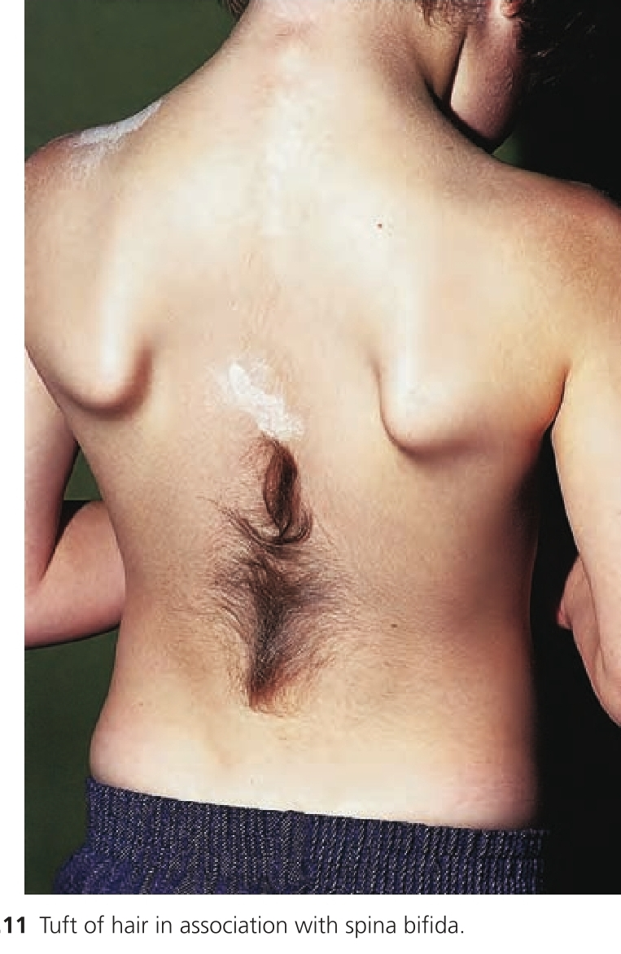

Slide 23
Investigations
Alpha-feto protien in amniotic fluid
Spinal ultrasound
Spinal sonography
Screening test in newborn in 1st 4 months with suspected cutaneous lesion
Radiography
confirmatory
Defective fusion of lamina n affected region usually L5 and S1

Slide 24
Management
Saline gauze at 37 degree C and non permeable dressing
Postnatal surgery

Slide 25
Hereditary sensory and autonomic neuopathy
Inherited disorder associated with sensory dysfunction and varying degree of autonomic dysfunction
Epidemiology
Both sexes affected equally
HSAN3 is exclusive to jewish extraction

Slide 26
TYpes
HSAN 1
Autosomal dominant chromosome 9q22.1-q.22.1
LATE adult hood or adolescence
Progressive Sensory and motor loss particularly in lower limbs
Chronic ulcerations on weight bearing area

Slide 27
HSAN2
Autosomal recessive
Congenital or early onset
Sensoy loss in hands and feet leading to ulcerationsat such sites
Fingers shows anhinum like band and amputation

Slide 28
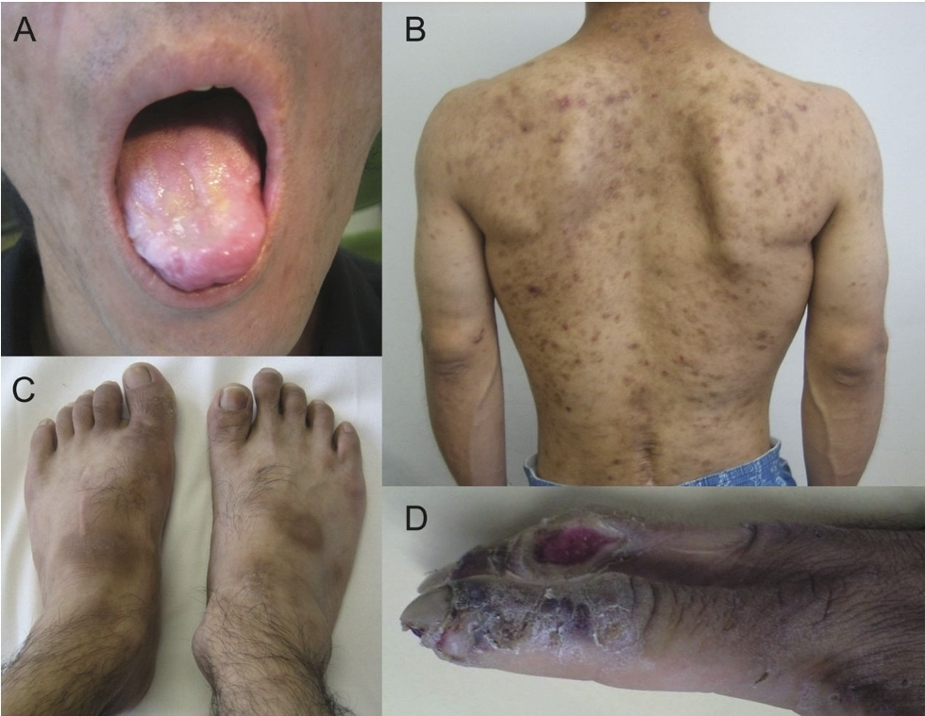

Slide 29
HSAN3
Autosomal recessive
congenital
Prevalent in Ashkenazi jews
Autonomic features e.g impaired tear production unstable temp postural hypotension
Blotchy erythema occurs during overheating
Absence of fungiform papillae on tongue

Slide 30
HSAN4
Autosommal recessive
Absence of nociception leading to self inflicted injuries
self mutilation
Learning difficulties
Anhidrosis leading to high fevers

Slide 31
HSAN5
Also called congenital insensitivity to pain
Early childhood
Self mutilating behaviour
Anhidrosis
Learning difficulties
Corneal reflexes present deep tenden absent

Slide 32
Complictions
Corneal scarring
Malignant hyperthermia
osteomyelitis
Sepsis
INVESTIGATIONS
Genetic testing
Electrophysiology

Slide 33
Sympathetic nerve injury
Loss of sympathetic innervation leads
Loss of vasoconstricter impulses causing erythema
Loss of sweting causing ahidrosis
Affected area of skin is scaly and fissured
Investigations
Thermoregulatory sweat test
Quantitative sudomotor axon reflex test
Skin wring on water immersion

Slide 34
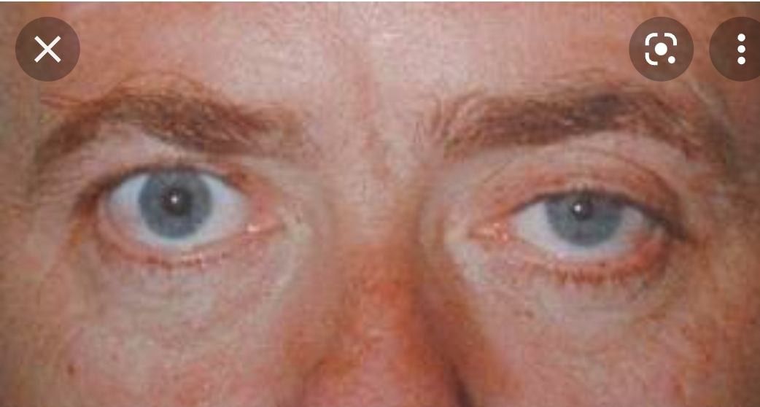
Horner syndrome
Partial or complete interuption of 3 neuron sympathetic pathwayis interrupted any where from poster lateral nuclei of hypothalamus through spinal cord to eye

Slide 35
causes
central | peripheral
Myocardial infarction | Aortic anerysm
syringomylia | Cervical lymphadenopathy
Multiple sclerosis | Surgery
Interaspinal tumours | Regional anesthetic procedures

Slide 36
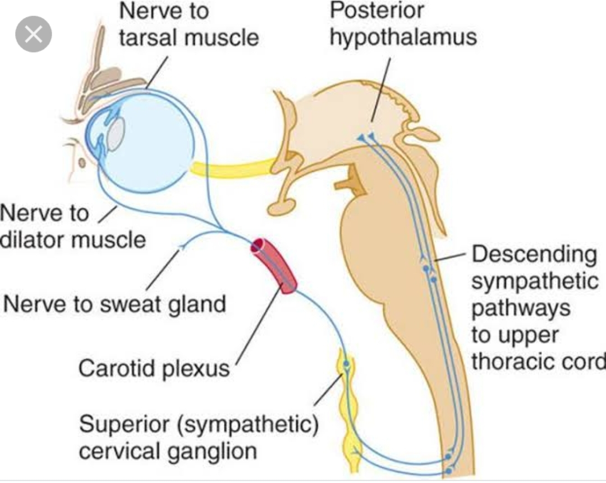
pathophysiogy
Notes:
Add picture

Slide 37
Clinical features
Irritative phase
Unilateral hyperhidrosis
Vasoconstriction
Paralytic phase
Ptosis
Anhidrosis on ipsilateral side
Enophtholmos

Slide 38
Investigations
Physical and pupil dilatation test
Xray MRI urine tsy
TREATMENT
Treat the under lying cause

Slide 39
Gustatory hyperhidrosis
Excessive sweating on scalp upperlip peri oral or sternum immediately aftr eating spicy or hot foods
Causes
Damage to
sympathetic cervical trunk
Vagus nerve
Auriculotemporal nerve

Slide 40
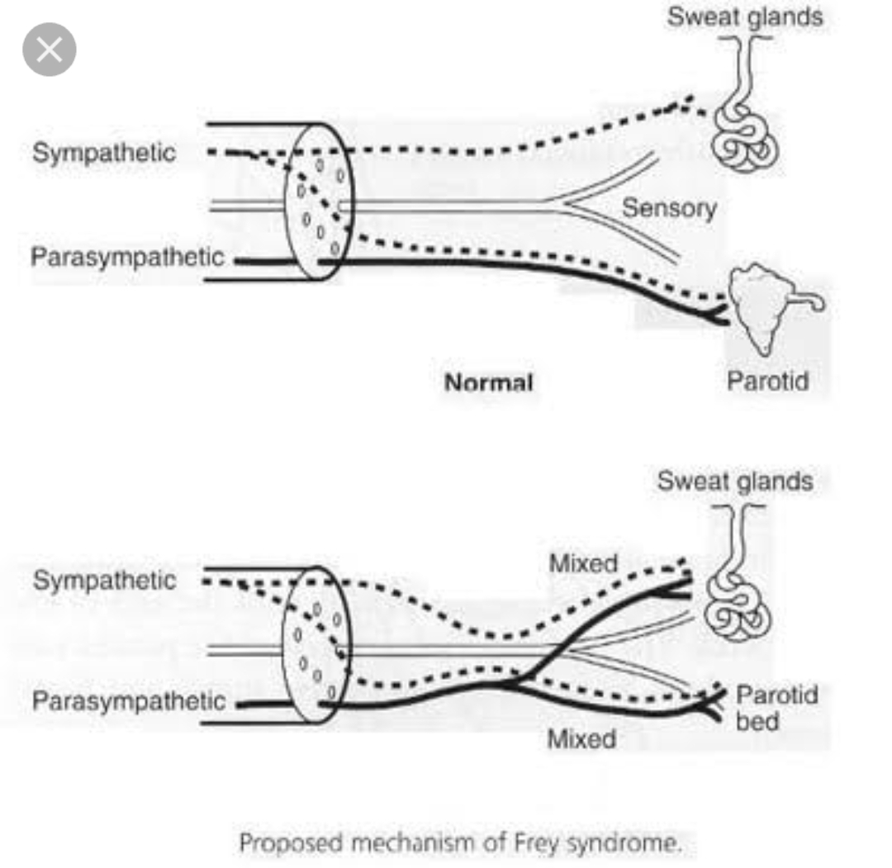
pathophysiology
Notes:
Add picture

Slide 41
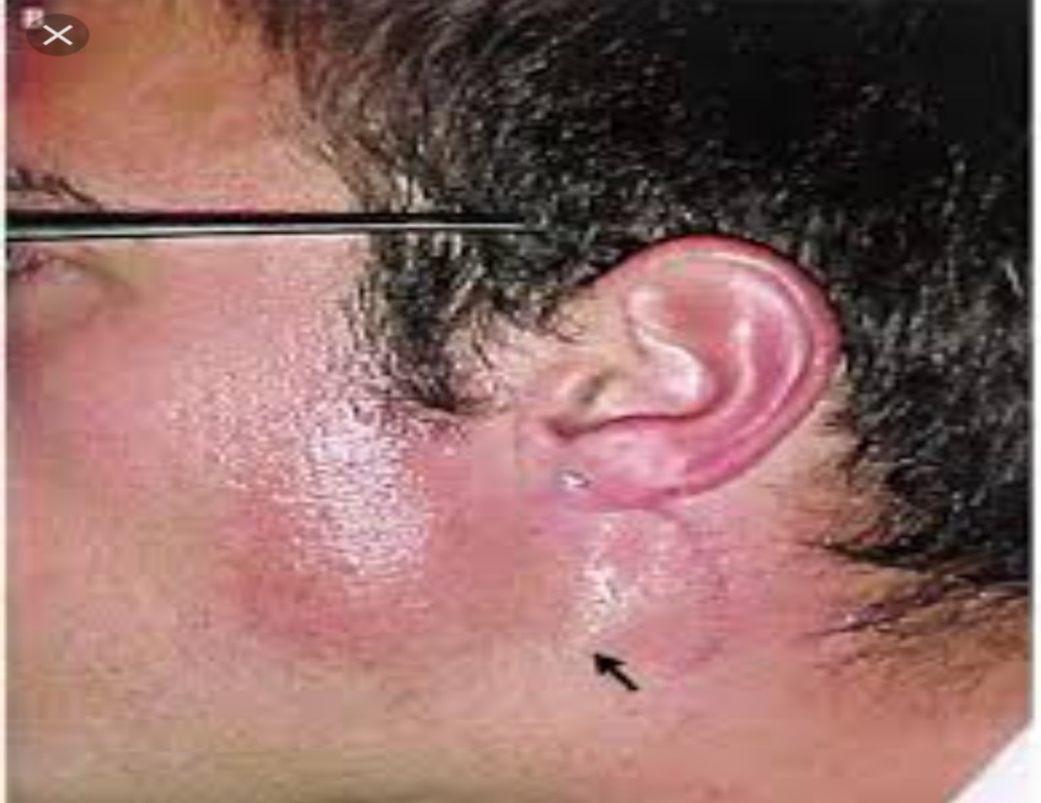
Clinical features
Facial flushing
Gustatory sweating
Notes:
Add picture

Slide 42
Investigations
Startch iodine test
Infrared thermography
MANAGEMENT
Aluminium chloride hexahydrate
0.5 %of aquous solutionglycopyronium bromide
Botuinum toxin

Slide 43
Restless leg syndrome/burning feet syndrome
Common sleep and movement disorder
Irresistible urge occuring at rest to move the legs
AGE
30-40 years
SEX
More prevelent in females

Slide 44
Predisposing factors
Dibetes mellitus | Heavy metal poisoning
B12 deficiency | Vasculitis
Alcohol abuse | Sarcoidosis
Hypothyroidism | GBS
HIV | Arterial disease
Lyme diseases | hypertension

Slide 45
TYPES
1st
Familial associated with childhood hx of growing pains
2nd
Late onset late family hx with milder paresthesias dysthesias

Slide 46
International restless leg severity scale
All four essential criteria must be present for positive dignosis
Unpleasent sensations or urges to move beginning or worsening during rest or inactivity
An rge to move legs with an unpleasent sensation
Unpleasent sensations or urges to move that’s partly or totally relieved by movement
Unpleasent sensations or ures to move worse in evening or night time

Slide 47
investigations
To exclude peripheral nueropathy
TREATMENT
1ST line
Sleep hygene
2nd line
Levodopa
Dopamine agonist

Slide 48


