Slide 1
NUTRITIONAL DISORDERS AFFECTING THE SKIN

Slide 2
SEQUENCE
Malnutrition
Vitamins
  Vit A,D,E,K
  Vit B1,B2,B3,B6,B7 ( Biotin ), B9,B12
  Vit C

Slide 3
MALNUTRITION

Slide 4
MALNUTRITION
Imbalance between the intake of necessary nutrients and physiological needs.
Prolonged imbalances resulting in derangements of normal physiological processes.

Slide 5
PROTEIN ENERGY MALNUTRITION
Imbalance between defcient intake of protein in relation to carbohydrate, fat and physiological needs.
cutaneous and systemic changes.

Slide 6
CLASSIFICATION
Clinical Variants
  Kwashiorkor
  Marasmus
  Marasmic Kwashirkor

Slide 7
EPIDEMIOLOGY
Typically among infants and younger children
Conventionally evaluated in those under 5 years of age.
Adults particularly those who are elderly, debilitated with chronic illness, or hospitalized
Girls > Boys in developing countries
More prevalent in Asia and Africa

Slide 8
PREDISPOSING FACTORS
Political instability
War
Natural disasters
Poor socioeconomic status
Food allergies
Hypermetabolic (catabolic) states associated with inﬂammatory or infectious diseases.e.g CLD, AIDS or those undergoing dialysis for CRF.
Decreased absorption of protein from GI disorders such as IBD, protein‐losing enteropathies ,cystic fbrosis or bariatric surgery.

Slide 9
KWASHIORKOR
Deficient Protein intake despite sufficient calorie intake .
Protein – calorie malnutrition.
As a result of hypoproteinaemia, affected individuals manifest signs of growth retardation and most notably oedema.

Slide 10
MARASMUS
Globally decreased intake of all macronutrients, including carbohydrate, protein and fat.
Growth retardation.
No hypoproteinaemia or oedema.

Slide 11
MARASMIC KWASHIORKOR
Variant state in which those affected are not only signifcantly growth retarded (stunting) as in marasmus, but also show evidence of hypoproteinaemia and oedema as in kwashiorkor.

Slide 12
PATHOPHYSIOLOGY
kwashiorkor | Marasmus
Excess carbohydrate without signifcant protein intake suppresses insulin production, resulting in the inhibition of protein synthesis. Clinically signs of hypoproteinaemia, including oedema and fatty infltration of the liver due to defciencies in lipoproteins. Immune suppression due to decreased production immunoglobulins and are therefore at risk for opportunistic infections. Growth retardation is noted but typically falls between 60 and 80% of ideal body weight. | Because global macronutrient intake is decreased, the catabolic state leads to fat breakdown and growth retardation Growth retardation <60% of ideal body weight .

Slide 13
PRESENTATION
KWASHIORKOR
  Failure to thrive
  Growth retardation
  Loss of subcutaneous fat.
  Peripheral oedema.
  Abdominal distention owing to hepatomegaly
  ‘Cracked skin’, ‘peeling paint’, ‘enamel paint’, ‘ﬂaky paint’ or ‘crazy paving’ due to the typical scale and irregular fissuring over time.
  More defined plaques may arise that may be more concentrated in areas of friction such as the intertriginous areas.

Slide 14
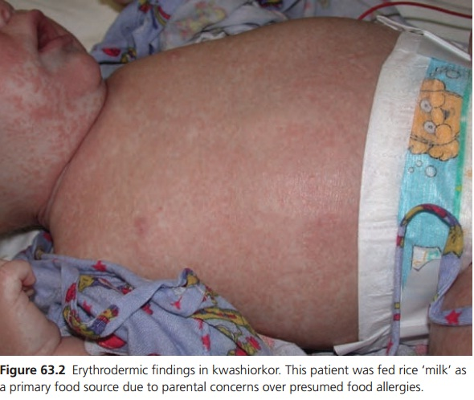

Slide 15
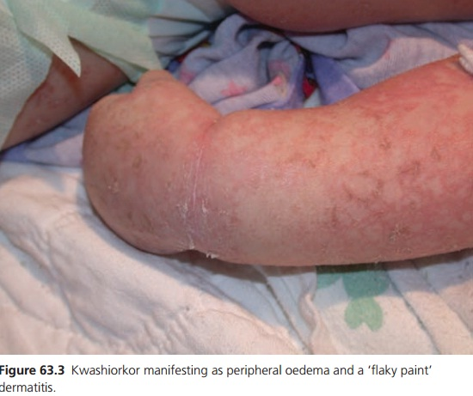

Slide 16
  Hair and nails grow slowly and may be brittle
  Flag Sign = Hair develop a lustreless, red‐brown colour that may show alternation with more normal colour. corresponds to alternating periods of signifcant undernutrition and improved nutrition.
  Inﬂammatory changes of the mucous membranes – xerophthalmia, cheilitis, stomatitis and
  vulvovaginitis – may arise in association with other co‐morbid vitamin and mineral micronutrient defciencies .

Slide 17
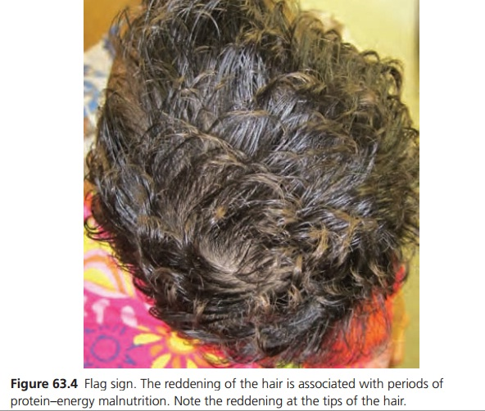

Slide 18
PRESENTATION
MARASMUS
  Failure to thrive
  Growth retardation
  loss of subcutaneous fat which may result in a wizened or prematurely aged appearance when the buccal fat pads are affected.
  Loss of perianal fat can result in rectal or anal prolapse.
  The abdomen may become distended due to hypotonia of the abdominal musculature.

Slide 19
  The skin is typically wrinkled, loose and dry .
  The hair and nails often grow slowly and may show brittleness. The hair often falls out easily and areas of alopecia may be evident.
  Lanugo hair may be observed on the face and neck.

Slide 20
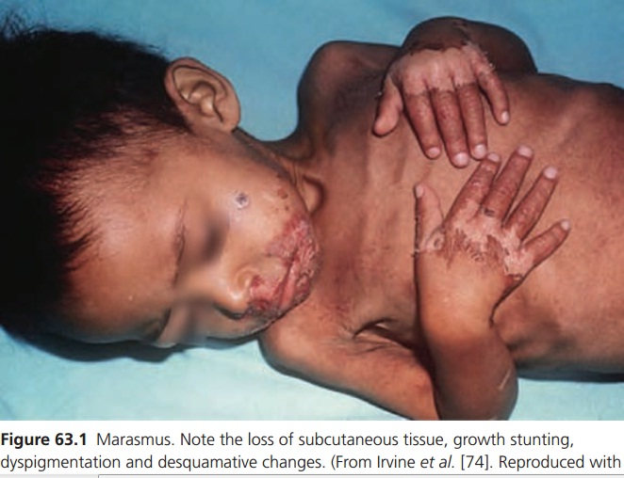

Slide 21
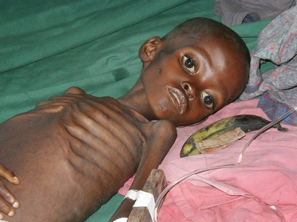

Slide 22
DIFFERENTIAL DIAGNOSIS
Atopic eczema
seborrhoeic dermatitis
contact dermatitis.
Heavy metal toxicities related to mercury
or selenium can present with erythroderma and oedema.
Other nutritional defciencies may resemble protein–energy malnutrition or may present as co‐morbid skin conditions, particularly acrodermatitis enteropathica or acquired zinc defciency and pellagra.

Slide 23
COMPLICATIONS
Re-feeding Syndrome
Dental caries, periodontal disease , tooth loss particularly with associated malnutrition in renal disease
Personality and mood disturbances
Attention defcit disorder
Neurodevelopmental abnormalities including cerebellar development and motor coordination and externalizing behaviours.

Slide 24
INVESTIGATIONS
Monitoring of vital signs.
Complete blood count, to help evaluate for infection and assessthe degree of iron defciency.
Comprehensive metabolic panel (e.g. electrolytes, renal function, liver function including total protein and albumin); in addition to sodium, potassium, chloride and bicarbonate, calcium, phosphorus and magnesium should be monitored closely.

Slide 25
Infectious disease evaluation,
  Urine culture
  Stool for ova and parasites
  Chest X‐ray
  Testing for tuberculosis and HIV

Slide 26
HISTOPATHOLOGICAL FEATURES
Psoriasiform hyperplasia
Hyperkeratosis
Epidermal pigmentation or atrophy.
Focal dyskeratosis may be observed.
If there is accompanying micronutrient defciency, parakeratosis and epidermal pallor may also be present.

Slide 27
MANAGEMENT
Treatment involves
  Gradual replenishment of nutrients to prevent refeeding syndrome and associated electrolyte and micronutrient depletion.
  Management of coexisting micronutrient defciencies, immune suppression and co‐morbid infections.
In-patient care for
  Severe edema and malnutrition
  Mild to moderate edema with no appetite
  Other associated medical complications

Slide 28
Antibiotic therapy
  Moderate to severe malnutrition
  Treatment should be directed at identifed infections; otherwise, empirical therapy with amoxicillin should be given.
  Those with mild undernutrition without evidence of an infection should not receive routine antibiotic therapy.

Slide 29
PROGNOSIS
Left untreated, signifcantly increased mortality risk.
Severe malnutrition = 9X Inc risk of death than those with mild malnutrition .
uncomplicated cases > 88% recovery rate and < 4% case fatality rate when treated appropriately .
Underlying co‐morbid disease states such as HIV have a signifcantly greater case fatality rate, particularly during the frst 4 days of treatment initiation.

Slide 30
VITAMINS

Slide 31
VITAMIN A

Slide 32
Vitamin A is a fat‐soluble vitamin
keratinization, epithelial proliferation, vision and development.
primarily derived from precursors found in dietary plant and animal sources, where it exists as β‐carotene and retinyl esters respectively.
Rich sources are dark green leafy vegetables, brightly coloured fruits (e.g. carrot, tomato, mango, apricot),egg yolk, animal liver, fsh, red palm oil and fortifed milk.

Slide 33
Dietary carotenes and retinyl esters are converted to retinol, absorbed in the small intestine, transported via chylomicrons to the liver where they are either stored as retinyl esters or exported as retinol bound to retinol‐binding protein to various tissue sites.
Importantactive metabolites of vitamin A include retinal, which functions in rhodopsin generation, and retinoic acid, which modulates cell differentiation
Daily recommended dose is 1000-5000IU

Slide 34
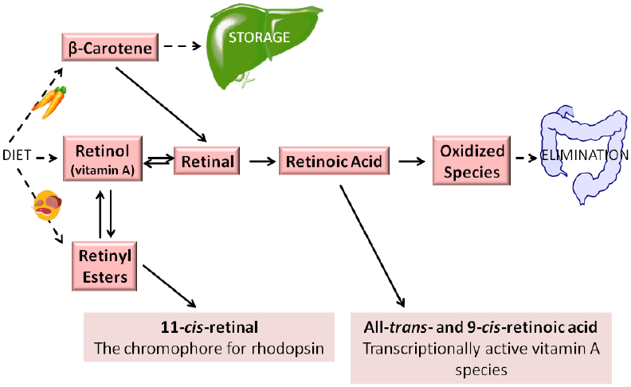

Slide 35
DEFICIENCY
Ocular complications
Muco-cutaneous disease

Slide 36
EPIDIMIOLOGY
WHO estimated globally that 5.2 million preschool‐aged children were affected with night blindness.
Can present at any age.
> developing countries .
No predilection for gender and ethinicity
Deficiency can occur with other fat soluble vitamins.

Slide 37
PREDISPOSING FACTORS
Inadequate dietary intake
  eating disorders
  restrictive diets i.e. vegan diet
  chronic illness
  poverty or malnutrition
Malabsorption of fat and fat‐soluble vitamins
  coeliac disease
  cystic fbrosis
  gastric bypass surgery
  pancreatic insuffciency and biliary duct disease.

Slide 38
  Chronic intestinal inﬂammation and diarrhoea associated with IBD
  chronic parasitic infections
Liver disease

Slide 39
PRESENTATION
Ocular presentations
  Night blindness
  corneal xerosis
  Bitot spots (white keratinized lesions)
  corneal ulceration,
  keratomalacia,
  corneal perforation
  iris prolapse
  blindness.

Slide 40
Cutaneous fndings
  xerosis and scaling,
  dermomalacia and phrynoderma. Phrynoderma is characterized by keratotic follicular papules involving the anterolateral thighs and posterolateral upper arms, and can spread to the extensor extremities, shoulders, posterior neck, back, buttocks and abdomen.

Slide 41
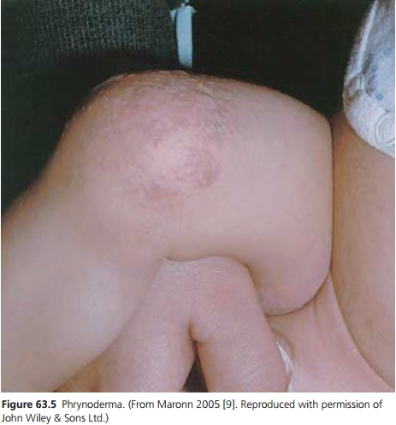

Slide 42
D/Ds
Phrynoderma is not specifc to vitamin A defciency, and has been described in association with defciencies in;
  B‐complex vitamins
  vitamin C
  vitamin E
  Essential fatty acids

Slide 43
DIAGNOSIS
Serum Retinol levels
  Normal range 20-50 ug/dl
MANAGEMENT
50 000–200 000 IU of daily vitamin A supplementation until clinical signs/symptoms resolve and serum retinol levels normalize.

Slide 44
EXCESS
Excessive intake of vitamin A can lead to acute or chronic vitamin A toxicity,
overconsumption of carotenes can manifest with
carotenaemia/carotenoderma.
Vitamin A excess can occur at any age.
There is no predilection for gender and etnicity.
Studies have suggested that β‐carotene supplementation (20–30 mg/day) may be associated with an increased risk of lung and gastric
cancer as well as an increased risk of aggressive prostate cancer

Slide 45
CLINICAL VARIANTS
Vit A Toxicity ( Hypervitaminosis A )
  Acute overdose over hours –days
  Chronic excessive intake over months –yrs
  Nutritional supplements
  Prescription medications containing vitamin
  A derivatives and foods high in vitamin A.
  Ingestion of greater than 20 times the RDAof vitamin A in a child, or greater than 100 times the RDA in an adult may lead to toxicity

Slide 46
Patients with chronic hypervitaminosis A presents with;
  dry and scaly skin
  desquamation
  cheilitis,
  alopecia,
  follicular hyperkeratosis and hyperpigmentation
  Pseudotumor cerebri
  skeletal changes (premature closure of the epiphyses and pathological bone fractures)
  Long term toxicity can lead to liver cirrhosis

Slide 47
Carotenaemia
  Excessive β‐carotene intake.
  Up to one‐third of carotene bypasses conversion to retinol, and is directly absorbed in the small intestine. Increased
  absorption of carotene can be seen in the setting of hypothyroidism, pancreatic lipase and bile acid defciencies, and with processing of foods (e.g. mashing, pureeing) .
  Individuals with hyperlipidaemia may develop carotonaemia due to a direct relationship and correlation between β‐lipoprotein and β‐carotene levels.

Slide 48
  Liver disease predisposes to carotenaemia as a result of impaired conversion of β‐carotene to vitamin A.
  Excessive ingestion of carotenes does not lead to vitamin A toxicity given the slow conversion of carotene to vitamin A in the intestinal mucosa

Slide 49
  In carotenaemia, carotenes are excreted from sebaceous glands and sweat glands, and ultimately deposit in the stratum corneum. This results in carotenoderma, characterized by prominent yellow‐orange pigmentation of the face, palms and soles of the feet .
  Mimics jaundice and medication induced pigmentation but it doesnt involve mucous membranes.
  No long term complications associated with carotenoderma.

Slide 50
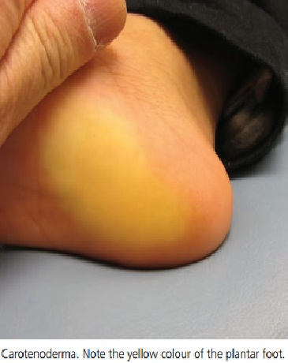

Slide 51
INVESTIGATIONS
Vitamin A toxicity
  Measurement of serum vitamin A level will
  confIrm the diagnosis. Associated elevation in calcium and alkaline phosphatase may be observed.
Carotenaemia
  Elevated serum carotene level greater than
  250 μg/dL.

Slide 52
MANAGEMENT
Treatment is discontinuation of excess vitamin A and β‐carotene intake.
RDA of vit A is 1000-5000IU

Slide 53
PROGNOSIS
Discontinuation of vitamin A leads to resolution of almost all symptoms of vitamin A toxicity, with the
exception of cirrhosis and sequelae related to pseudotumour cerebri
excellent prognosis with no clear long‐term
adverse effects. Pigmentary changes resolve within weeks to months of decreasing β‐carotene intake .

Slide 54
VITAMIN D

Slide 55
Vitamin D is a fat‐soluble vitamin .
Essential in the regulation of calcium and phosphorus metabolism.
Vitamin D stimulates intestinal absorption of dietary calcium, activates bone resorption and mobilization of calcium and phosphorus, and increases renal tubular reabsorption of calcium and phosphate.
It is derived from dietary sources (ergocalciferol, vitamin D2), such as fsh, fsh oils, fortifed milk, egg, liver and shiitake mushrooms, as well as endogenous synthesis from the skin (cholecalciferol, vitamin D3).

Slide 56
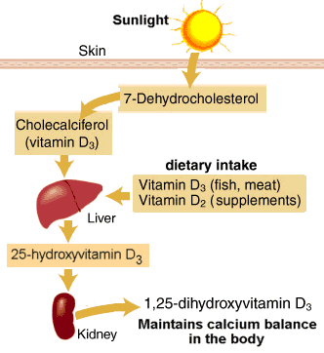

Slide 57
Upon exposure to UV light in the 290–320 nm range, photoisomerization of 7‐dehydrocholesterol occurs in the epidermis, producing previtamin D3. This subsequently undergoes a spontaneous temperature‐dependent isomerization to cholecalciferol. Both vitamin D2 and D3 are hydroxylated in the liver to form 25‐hydroxyvitamin D (calcidiol), which then circulates to the kidneys where it is converted to the active form, 1,25-hydroxyvitamin D (calcitriol).

Slide 58
DEFICIENCY
A defciency of vitamin D is defned by most experts as a vitamin D level of less than 20 ng/mL, while a relative insuffciency of vitamin D lies between 21 and 29 ng/mL .
Vitamin D defciency classically results in Skeletal abnormalities, as seen in vitamin D‐defcient rickets.
1 Billion people worldwide have vit D deficiency

Slide 59
Can affect all ages but new borns and elderly are at greater risk.
> women
> dark skinned ppl
Protective against musculoskeletal disease, infection, autoimmune disease, cardiovascular disease, diabetes, neurocognitive dysfunction, various common cancers, infertility and adverse pregnancy/birth outcomes.

Slide 60
associated with various congenital ichthyoses. It has also been described in the setting of various photosensitivity disorders, including xeroderma pigmentosum and porphyria.
There are two inherited autosomal recessive forms of vitamin D‐dependent rickets.
  Type I involves a defect in vitamin D 1α‐hydroxylase of the kidneys
  Type II is associated with defectsin the vitamin D receptor, resulting in end‐organ resistance to
  physiological amounts of 1,25‐hydroxyvitamin D

Slide 61
PREDISPOSING FACTORS
Decreased synthesis
  Individuals with increased melanin pigment
  Decreased sun exposure
Malabsorption
  Fat malabsorption states, including coeliac disease, cystic
  fbrosis, pancreatic disease, biliary disease [33] and gastric
  bypass surgery.

Slide 62
  Liver disease, renal disease and anticonvulsants can
  also interfere with vitamin D metabolism
Poor dietary intake.
  Exclusively breastfed infants
  preterm infants (due to lower stores and higher demand)
  elderly or disabled

Slide 63
PRESENTATION
Dental defects
  delayed erruption
  caries
Seizures in infants
Tetany
Carpopedal spasm
Limb pain

Slide 64
Skeletal defects
  Prominent costochondral joints ( Richitic rosary)
  Bowing of lower extremeties
  Fraying and widening of metaphysis
  Frontal bossing
  Scoliosis
  fractures

Slide 65
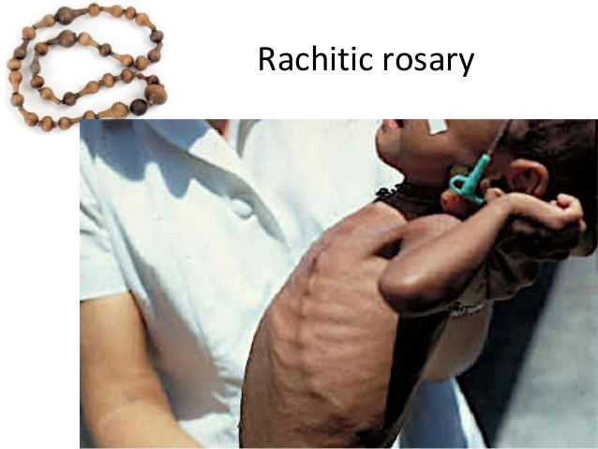

Slide 66
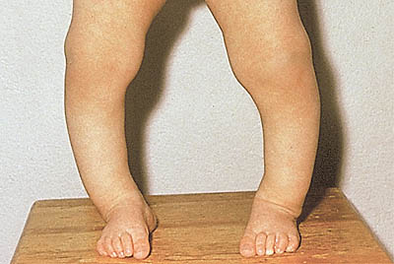

Slide 67
Cutaneous manifestation
  The only cutaneous manifestation of acquired vitamin D defciency is Alopecia. Although born with hair, generalized alopecia with preservation of the eyebrows and eyelashes is observed
  within a few months.
  Additionally, small papules and cysts commonly arise on the face and scalp

Slide 68


Slide 69
COMPLICATIONS
Osteopenia and/or osteoporosis
Hyperparathyroidism.

Slide 70
INVESTIGATIONS
Serum 25‐hydroxyvitamin D
Serum calcium and phosphate levels
Alkaline phosphatase
Parathyroid hormone

Slide 71
MANAGEMENT
RDA of vitamin D is 200–600 IU, depending on age. Individuals without adequate sun exposure require 800–1000 IU daily.
Older than 1 year of age
  50 000 IU of vit D2 ( Erdocalciferol )weekly for 8 weeks
  1000 IU of vit D3 or 3000 IU of vit D2 daily may also be effective .

Slide 72
Under 1 year of age
  1000–5000 IU of vitamin D2 daily until radiological abnormalities normalize.
  All breastfed infants should be supplemented with 400 IU of vitamin D daily as prophylaxis .
Sun exposure and UV light therapy may be useful in correcting vitamin D defciency
D‐α‐tocopheryl polyethylene glycol‐1000 succinate, a vitamin E compound, has been successfully used to treat hepatic rickets

Slide 73
PROGNOSIS
Increased rate of all‐cause mortality.
There is some data to suggest that vitamin D defciency is also associated with poorer survival in patients with malignant melanoma, though clinical trials are needed to determine if vitamin D supplementation would be benefcial

Slide 74
VITAMIN E

Slide 75
Vitamin E is a fat‐soluble vitamin and potent antioxidant.
There are no cutaneous manifestations of
vitamin E defciency.
Excess can occur from over supplementation and causes easy bleeding and bruising due to its antiplatelet effect.
Pt presents with purpura and haemorrhage.
Other causes of haemorrhage should be evaluated as Vit E excess is rare.
RDA is 4-15mg depending on age .

Slide 76
VITAMIN K

Slide 77
Fat‐soluble vitamin
Necessary co‐factor in the synthesis of coagulation factors II, VII, IX , X, and proteins C and S
Two main sources ; Dietary intake and production by gut flora .
Vitamin K deficiency results in impaired coagulation and haemorrhage.
Vitamin K defciency is more frequently encountered in newborns.
Defciencies in other fat‐soluble vitamins (A, D and E) can occur in the setting of fat malabsorption

Slide 78
PRESENTATION
Vitamin K defciency in older children and adults can present with purpura, ecchymoses, and gastrointestinal, genitourinary and retroperitoneal haemorrhage.

Slide 79
MANAGEMENT
I/M or I/V Vit K. Children are administered 2 mg, while adults are given 5–10 mg. Acute bleeding is treated with fresh frozen plasma.
Prophylaxis with single I/M dose of 0.5–1.0 mg of vitamin K at birth.

Slide 80
VITAMIN B
COMPLEX

Slide 81
VITAMIN B1 (THIAMINE)
Water soluble vitamin
Necessary co‐enzyme for the metabolism of carbohydrates, lipids and branched chain amino acids.
Deficiency can cuase glossitis
No cutaneous manifestations

Slide 82
VITAMIN B2 (RIBOFLAVIN)
water‐soluble .
Essential co‐factor for cellular oxidation‐reduction reactions and vitamin B6 metabolism.
Exists as two biologically active forms – ﬂavin mononucleotide (FMN) and ﬂavin‐adenine dinucleotide (FAD).
Found in milk, dairy products, meats, fatty fsh, eggs, green leafy
vegetables, whole grains and enriched breads.
Dietary FMN and FAD are both hydrolysed to riboﬂavin, then actively absorbed in the proximal small intestine.

Slide 83
Defciency in riboﬂavin can lead to various cutaneous, mucosal and ocular manifestations, the so‐called oculo‐orogenital syndrome.
Endemic in populations whose dietsnrely heavily on unenriched cereals, or lack dairy products and meats.
Deficiency is associated with ;
  increased plasma homocysteine levels
  Anaemia
  Cardiovascular disease
  Night blindness

Slide 84
  Developmental abnormalities
  Peripheral neuropathy
  cancer .

Slide 85
PREDISPOSING FACTORS
Decreased dietary intake
  Eating disorders
  Breastfed infants of riboﬂavin‐defcient mothers,
Malabsorption
Phototherapy.

Slide 86
PRESENTATION
Acute riboﬂavin defciency presents with
Deep red erythema
Epidermal necrolysis
Mucositis.
The severity of these fndings depends on the degree of defciency

Slide 87
Chronic riboﬂavin defciency include
Angular stomatitis
  presents with small papules at the corners of the mouth, which subsequently extend laterally, macerate, fissure and bleed.
Glossitis
  characterized by prominent lingual papillae early
  on, with transition to a smooth magenta‐coloured tongue over time.

Slide 88
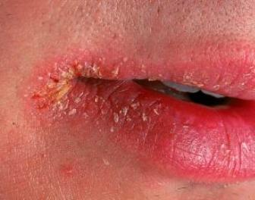
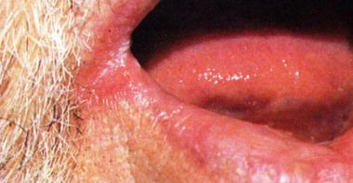
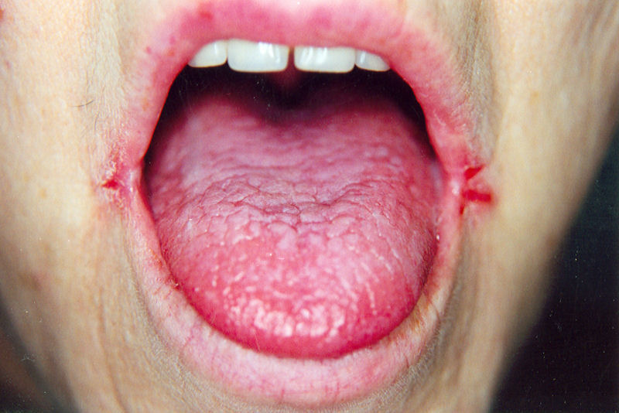
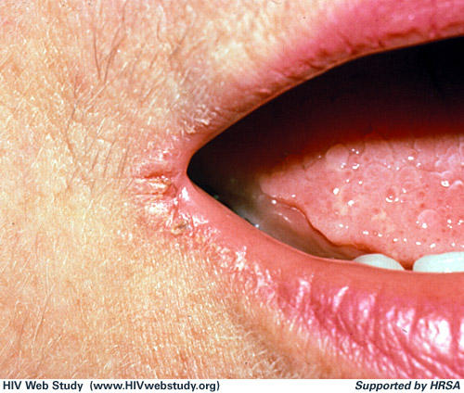

Slide 89
Dyssebacia of the nose and a seborrhoeic dermatitis‐like eruption.
  Nasolabial folds, nasal ala, nasal bridge
  Forehead, cheeks and postauricular regions.
  Flexural extremities,inner thighs and genitalia

Slide 90
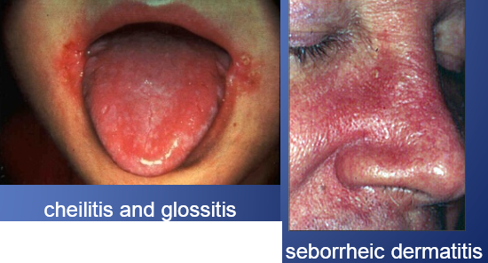
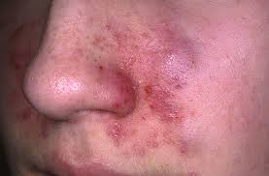

Slide 91
DIAGNOSIS
Erythrocyte glutathione reductase activity.
MANAGEMENT
1–2 mg/day in infants and children and 10–20 mg/day in adults.
RDA is 0.3-1.6 mg
Striking response to supplementation.

Slide 92
VITAMIN B3 (NIACIN)
Water‐soluble
Important component of two co‐enzymes, nicotinamide‐adenine dinucleotide (NAD) and NADP
50% from diet and 50% by endogenous synthesis from tryptophan.
Niacin exists as NAD and NADP in meats, fsh, nuts, eggs, dairy products, dried beans and fortifed grains.

Slide 93
NAD and NADP
hydrolysed in intestinal lumen
Nicotinamide
intestinal bacteria
Nicotinic acid.
Both nicotinamide and nicotinic acid are absorbed and transported to the liver, kidneys and intestines, where they are transformed back to NAD and NADP for use in oxidation and reduction reaction

Slide 94
DEFICIENCY
Niacin defciency is endemic in areas with a high grain (unfortifed), low meat diet and where corn and maize remain a mainstay,
Pellagra
  Dermatitis
  Diarrhea
  Dementia
  Death

Slide 95
Hartnup disease
  Rare metabolic disorder (impaired tryptophan absorption)
  Pellagra like presentation alongwith ataxia and psychiatric symptoms

Slide 96
PREDISPOSING FACTORS
Decreased dietary intake,
  Alcoholism
  Eating disorders
  Presumed food allergies.
Defective absorption of niacin or tryptophan.
  Inﬂammatory bowel disease,
  Gastroenterostomy, subtotal gastrectomy, jejunoileitis and gastric bypass surgery.

Slide 97
Impaired conversion of tryptophan to Niacin
  Medications, including isoniazid , 5‐ﬂuorouracil and 6‐mercaptopurine, may interfere with the conversion of tryptophan to niacin.

Slide 98
PRESENTATION
Dermatitis
  intermittent, painful or pruritic erythema
  oedema in photodistributed areas after sun exposure
  Vesicles and bullae may develop in severe cases.
  Over time, the eruption becomes fIxed and is defned by sharply marginated, hyperpigmented
  and keratotic plaques .

Slide 99
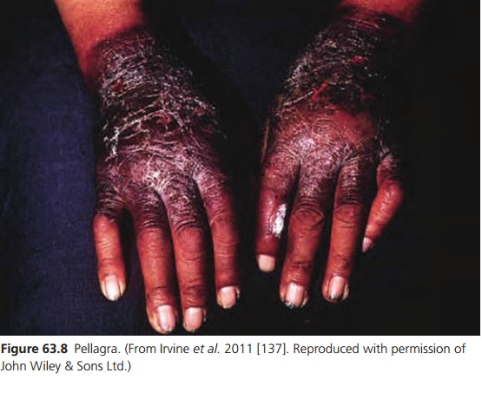

Slide 100
  Dorsal hands are most comonly affected .
  Facial involvement in a butterﬂy distribution.
  Neck and upper chest = Casal necklace.
  Angular stomatitis, cheilitis, glossitis and oral or perirectal ulcers.
  Half and half nails.

Slide 101
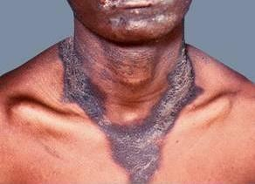
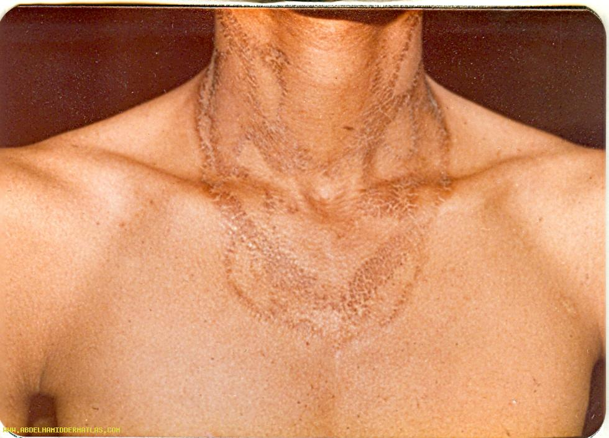

Slide 102
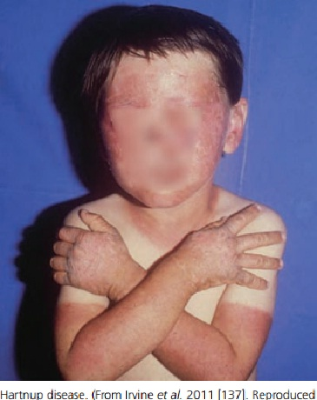

Slide 103
Gastrointestinal symptoms
  Abdominal pain
  Anorexia
  Nausea, vomiting
  Diarrhoea.
Neurological symptoms
  Headache, anxiety, irritability, fatigue, insomnia, apathy, depression and impaired memory, can ultimately progress to psychosis
  and Dementia

Slide 104
DIFFERENTIAL DIAGNOSIS
Pyridoxine defciency
Photosensitive dermatoses
  Porphyrias
  polymorphic light eruption
  chronic actinic dermatitis
  photosensitive drug eruptions
  cutaneous lupus

Slide 105
COMPLICATIONS
Severe neurological decompensation
Stupor
Coma
Death

Slide 106
INVESTIGATIONS
Mainly a clinical diagnosis.
Reduced niacin urinary metabolites, such as N‐methylnicotinamide and 2‐pyridone, can be helpful in confirming diagnosis.

Slide 107
MANAGEMENT
RDA of niacin is 13–20 mg, depending
on age and gender.
500 mg/day of nicotinamide or nicotinic
acid over several weeks.
Nicotinamide is preferred because nicotinic acid can cause headaches and ﬂushing.
Avoidance of sun exposure
Topical emollients for skin lesions

Slide 108
Sunscreen
High protein diet
Vit B complex supplementation
Complete rest till recovery
Regular follow ups

Slide 109
PROGNOSIS
Neuropsychiatric symptoms improve within the frst 24–48 h of treatment
Cutaneous disease may require weeks to remit
Pellagra is progressive and can be fatal if not treated.
Death can occur within 4–5 years

Slide 110
VITAMIN B6 (PYRIDOXINE)
Water‐soluble B‐complex vitamin
essential co‐enzyme for various metabolic processes including
  Conversion of tryptophan to niacin
  Fatty acid metabolism
  Gluconeogenesis,
  Decarboxylation and transamination of amino acids,
  Prostaglandin and neurotransmitter synthesis.

Slide 111
3 forms
  Pyridoxine
  Pyridoxamine
  Pyridoxal
They are available in meats, vegetables, nuts and whole grains.
After dephosphorylation, absorbed in the jejunum and ileum, transported to the liver and rephosphorylated to their active forms.

Slide 112
Defciency results in
  Cutaneous
  Neurological
  Haematological manifestations.
Features of B6 defciency may overlap with those of niacin defciency.

Slide 113
PREDISPOSING FACTORS
Decreased dietary intake
Malabsorption
Medications.
  Isoniazid
  Hydralazine
  Penicillamine
  Oral contraceptives
  Haemodialysis patients

Slide 114
PRESENTATION
Seborrhoeic dermatitis‐like eruption
  Face
  Scalp
  Neck
  Shoulders
  Buttocks and perineum.
Angular stomatitis, glossitis and cheilitis
Pellagra‐like dermatitis has been reported
Hypochromic microcytic anaemia

Slide 115
Neuropsychiatric symptoms
  Confusion
  Somnolence
  Weakness
  Depression
  Paraesthesias and peripheral neuropathy

Slide 116
INVESTIGATIONS
Low plasma pyridoxal‐5‐phosphate is indicative of vitamin B6 defciency.
Indirect tests, such as a tryptophan load test or measurement of erythrocyte aminotransferase activity, may be useful [93].

Slide 117
DIFFERENTIAL DIAGNOSIS
Niacin defciency also manifests with similar neuropsychiatric and cutaneous symptoms.

Slide 118
MANAGEMENTT
RDA vitamin B6 is 0.1–2 mg
stop inciting medications and supplement with pyridoxine 100 mg daily.
Mucosal lesions resolve within days, while cutaneous and haematological manifestations improve over weeks and neurological sequelae over months.

Slide 119
VITAMIN B7 (BIOTIN)
Essential co‐factor for enzymes
involved in fatty acid synthesis and lipogenesis , gluconeogenesis and amino
acid catabolism.
Synthesized by intestinal bacteria and also obtained through dietary sources.
Sources are eggs, cow’s milk, soybeans, liver, mushrooms, peanuts, hazelnuts and walnuts.

Slide 120
Metabolism
  Pancreatic biotinidase releases biotin from dietary proteins.
  Biotin diffuses across the gut epithelium, binds
  to plasma proteins, and travels to the liver where it complexes with various carboxylase enzymes via holocarboxylase synthetase.
  Endogenous biotin is recycled by biotinidase.

Slide 121
Biotin defciency can be
  Acquired
  Inherited.
Acquired biotin defciency can affect all ages.
heridetary Holocarboxylase synthetase defciency presents within the 6wks of age.
Biotinidase defciency presents in infancy or early childhood, after 3 months of age.
Both heriditary forms are autpsomal recessive.

Slide 122
PREDISPOSING FACTORS
Excessive intake of raw egg white .
  Avidin is a glycoprotein found
  in egg whites which binds to free biotin and prevents its absorption.
Receiving unsupplemented parenteral nutrition.
Unsupplemented infant formula
Prolonged antibiotic course
Long‐term anticonvulsants

Slide 123
PRESENTATION
Similar to acrodermatitis enteropathica and essential fatty acid defciency.
Erythematous and scaly periorifcial dermatitis.
Alopecia, glossitis and conjunctivitis have also been observed.
Affected individuals present with a collodion membrane and subsequent ichthyosis.

Slide 124
Inherited deficiencies presents with
  Metabolic acidosis
  Hyperammonemia
  Organic aciduria.
  Hypotonia
  Ataxia
  Seizures
  Developmental delay

Slide 125
DIFFERENTIAL DIAGNOSIS
zinc defciency
Essential fatty acid defciency

Slide 126
COMPLICATIONS AND CO‐MORBIDITIES
Patients with multiple carboxylase defciency may develop permanent neurodevelopmental deficits.
DISEASE COURSE AND PROGNOSIS
Good with early diagnosis and treatment.
Mortality rate is close to 100% with untreated holocarboxylase defciency.

Slide 127
INVESTIGATIONS
serum biotin levels
ammonia, serum amino acids, and urine organic acids
Urinary biotin metabolites
Decreased biotinidase activity in serum, leukocytes or cultured skin fbroblasts is indicative of biotinidase defciency.

Slide 128
MANAGEMENT
The recommended daily intake of biotin is 5–35 ug, depending on age.
Acquired biotin defciency is treated with 150 ug of biotin daily until symptoms resolve.
Biotinidase defciency often responds
well to 5–10 mg of biotin daily
holocarboxylase synthetase defciency requires at least 10–40 mg daily, with higher doses frequently needed.

Slide 129
VITAMIN B9 (FOLATE)
Water‐soluble.
Important co‐enzyme for amino acid, purine and pyrimidine metabolism.
Tetrahydrofolate is biologically active co‐enzyme form.
Available in leafy green vegetables,dried beans, liver and grains.

Slide 130
DEFCIENCY
Manifests with both haematological and mucocutaneous disease.
All age groups.
˃ Pregnant women due to increased requirement.
Associated with elevated homocysteine levels, cardiovascular disease, neuropsychiatric disease and certain cancers.

Slide 131
PREDISPOSING FACTORS
Defcient intake of folate
  overly boiled cow’s milk or being fed goat’s milk
  exclusively .
  Alcoholics.
Malabsorption due to
  coeliac disease
  chronic diarrhoea
  gastrectomy

Slide 132
  Antifolate medications such as
    Methotrexate.
    Trimethoprim.
    Pyrimethamine.
  Oral contraceptive
  Antiepileptic Medications;
    Phenobarbital, phenytoin and carbamazepine,
    Induce microsomal hepatic enzymes, thus diminishing folate stores

Slide 133
CLINICAL FEATURES
Haematological
  Megaloblastic anaemia.
  Neutropenia and thrombocytopenia.
Mucocutaneous
  Glossitis withnatrophic fliform papillae (Hunter’s glossitis)
  Angular cheilitis
  Mucosal ulceration

Slide 134
    Perineal seborrhoeic dermatitis.
    Localized or diffuse hair depigmentation.
    Mucocutaneous hyperpigmentation.
    Hyperpigmentation is frequently seen in the palmar creases and ﬂexural regions, but can also affect the oral mucosa.

Slide 135
  Vitamin B12 defciency can mimic folate defciency but in B12 defciency there is neurological involvement .
Folate defciency in women of childbearing age may result in fetal neural tube defects.

Slide 136
INVESTIGATIONS
Serum and red blood cell
folate levels .
Identifying a megaloblastic anaemia with
hypersegmented neutrophils is also helpful.

Slide 137
MANAGEMENT
RDA 65–600 μg/day, depending on age.
Treatment includes addressing any underlying causes of folate defciency.
1–5 mg of folate daily.
Concurrent vitamin B12 defciency should be ruled out prior to initiating treatment, as the haematological manifestations of vitamin B12 defciency will respond to folate, but the neurological symptoms will not.

Slide 138
VITAMIN B12 (COBALAMIN)
Water‐soluble B‐complex .
critical co‐enzyme involved in DNA, protein, lipid and carbohydrate metabolism.
obtained through dietary sources such as eggs,milk, beef, liver and organ meats.

Slide 139
ABSORPTION
Gastric acid dissociates vitamin B12 from food proteins.
Intrinsic factor in binds in the duodenum.
B12 actively taken up by terminal ileum.
1–5% of free vitamin B12 is absorbed via passive diffusion.
In the enterocyte, vitamin B12 separates from intrinsic factor, binds to transcobalamin II and is released into the portal circulation for transport to other tissues.

Slide 140
Biologically active forms are
  methylcobalamin .
  5’‐adenosylcobalamin.
A defciency in vitamin B12 leads to a clinical profle similar to folate defciency, with mucocutaneous and haematological manifestations.
The distinguishing feature of vitamin B12
defciency is its important neurological fndings.

Slide 141
Since the body is able to store a large amount of vitamin B12, symptoms of acquired
defciency may take 3–6 years to develop. Vitamin B12 defciency can be associated with both congenital and acquired pernicious
anaemia.

Slide 142
PREDISPOSING FACTORS
Inadequate intake
  Elderly
  Vegans and their breastfed infants.
  Individuals with psychiatric disease.
Malabsorption
  Decreased gastric acid production (chronic proton pump inhibitors and H2 histamine blockers).
  Decreased intrinsic factor (pernicious anaemia, atrophic gastritis, postgastrectomy).
  Inﬂammatory bowel disease, coeliac disease, Whipple disease and Zollinger–Ellison syndrome.

Slide 143
Inborn errors of transport and metabolism
  destruction of gastric parietal cells
  Loss of intrinsic factor
Bacterial overgrowth.

Slide 144
PRESENTATION
haematological manifestations,
  Megaloblastic anaemia
  Hypersegmented neutrophils
Mucocutaneous manifestations
  Hunter glossitis
  Angular cheilitis,
  Localized or diffuse hair depigmentation and cutaneous hyperpigmentation (of the face, nails, palmar creases and ﬂexural surfaces)

Slide 145
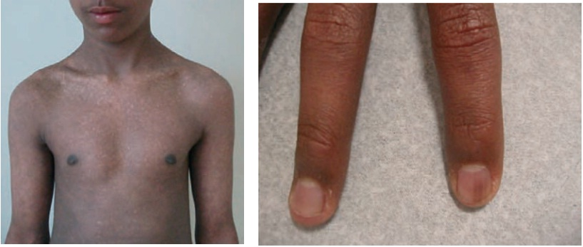

Slide 146
Neurological manifestations
  Subacute combined degeneration of the
  dorsal and lateral spinal column, resulting in generalized weakness, paraesthesias, ataxia and symmetrical loss of vibration and proprioception.
  Somnolence, irritability, apathy, memory loss, dementia and psychosis.
  If left untreated, patients can develop spasticity,
  paraplegia and incontinence.

Slide 147
INVESTIGATIONS
Serum cobalamin level < 200 pg/mL. A serum cobalamin level of 200–300 pg/mL is
borderline low.
Megaloblastic anaemia with hypersegmented
neutrophils is also observed.
Schilling test
Serological antibodies to intrinsic factor and parietal cells.
Biopsies of the gastric mucosa.

Slide 148
MANAGEMENT
RDA of B12 is 0.4–2.8 μg, depending on age.
Administered either parenterally or orally.
Parenterally, it is recommended that patients receive 8–10 1 mg loading doses spaced daily to weekly, then monthly 1 mg injections thereafter.
Orally, 1–2 mg daily is considered to
be effective therapy.

Slide 149
VITAMIN C (ASCORBIC ACID)
Water‐soluble
Antioxidant and essential co‐factor for collagen biosynthesis and dietary iron absorption.
Required for hydroxylation of proline residues on procollagen, in turn making it necessary for triple‐helix formation of mature collagen.
The lack of a stable triple helical structure compromises the integrity of the skin, mucous membranes, blood vessels and
bone.

Slide 150
Humans are unable to synthesize vitamin C.
Citrus fruits, berries, tomatoes, potatoes and green leafy vegetables.
Defciency in vitamin C results in scurvy,
which is comprised
  Haemorrhage.
  Hyperkeratosis .
  Haematological abnormalities.
Associated with both folate and iron deficiency.

Slide 151
PREDISPOSING FACTORS
Decreased intake
  Elderly
  Alcoholics
  Food faddists
  Anorexics
  Cancer patients
  Presumed food allergies
  Unsupplemented parenteral nutrition

Slide 152
    restricted diets secondary to IBD, GERD or Whipple disease
  Increased requirements
  tobacco smoking
  Medications including aspirin, indometacin, oral contraceptives, tetracyclines and corticosteroids.
losses
  Renal failure patients are prone to scurvy due to fltration of water‐soluble vitamin C during dialysis.
  Scurvy has been reported as a complication of interleukin‐2 treatment of metastatic renal cell carcinoma and among patients receiving liver transplants.

Slide 153
PRESENTTION
Lethargy, fatigue, malaise
Emotional lability
Arthralgias
Anorexia ,weight loss and diarrhoea.
Easy bleeding, bruising and poor wound healing.
Phrynoderma ,enlarged hyperkeratotic hair follicles, initially presents on the posterolateral arms. It subsequently generalizes to involve the buttocks, posterior thighs, calves, shins and back.

Slide 154
Corkscrew hairs, fractured and coiled hairs due to impaired keratin cross‐links by disulfde bonds. With time, signifcant vascularcongestion occurs perifollicular haemorrhage and purpura,
Oedema of the lower extremities and splinter haemorrhages particularly in the lower extremities, leading to perifollicular haemorrhage and oedema .This purpura is occasionally palpable, mimicking a cutaneous vasculitis.
Blood vessel wall fragility also results in splinter haemorrhages of the nail bed.

Slide 155
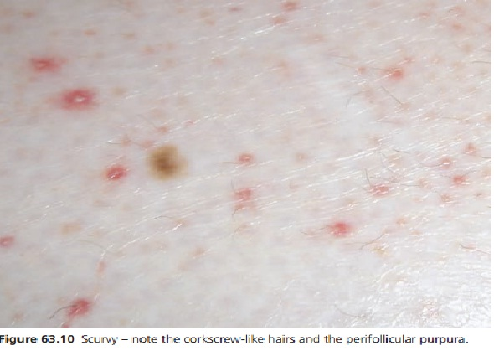

Slide 156
Haemorrhagic gingivitis, gingiva is initially red, swollen and shiny, and later becomes purple, necrotic and prone to bleeding.
Musculoskeletal disease is frequently seen in children. Haemorrhage can be intramuscular, intra‐articular or subperiosteal, leading to pain and pseudoparalysis.
Bowing of the long bones,depression of the sternum, and swelling of the costochondral junctions are noted on physical examination.

Slide 157
DIFFERENTIAL DIAGNOSIS
Trauma
Medications
Haematological abnormalities
collagen vascular diseases
Infections can cause large ecchymoses and be
confused with scurvy

Slide 158
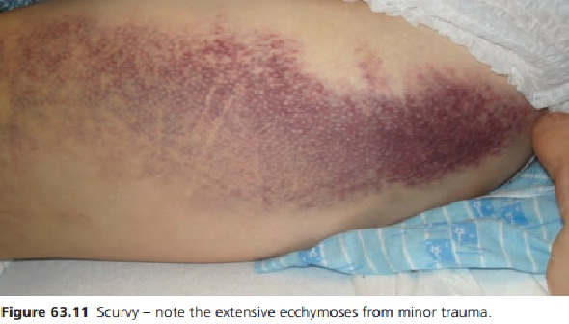

Slide 159
COMPLICATIONS AND CO‐MORBIDITIES
The major complication associated with scurvy is haemorrhage into various tissue sites, which has the potential to result in permanent functional defcits.

Slide 160
INVESTIGATIONS
Scurvy is largely a clinical diagnosis.
leukocyte ascorbic acid
A normochromic normocytic anaemia is common resulting from blood loss, folate defciency and iron defciency.

Slide 161
Radiography
  Transverse metaphyseal radiolucent band (scurvy line or Trummerfeld zone)
  widening at the zone of calcifcation (white
  line of Frankel),
  Ring of increased density around the epiphysis
  (Wimberger ring) and
  Metaphyseal spurs with marginal fractures
  (Pelkan spurs)

Slide 162
MANAGEMENT
RDA is 40–120 mg, depending on age and sex
Ascorbic acid 100–300 mg daily until
symptoms remit.
Clinical improvement is noted within the frst
1–2 weeks, with resolution of fatigue, joint swelling and ecchymoses, and healing of the gingiva.
Complete recovery frequently occurs within 3 months

