Slide 1
Mucocutaneous Pain Syndromes
Dr Hafsa Nazeer
PGR dermatology

Slide 2
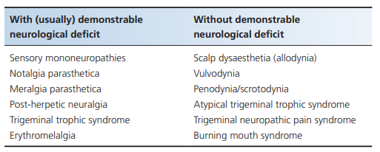
The mucocutaneous pain syndromes (MCPs) typically involve the head, neck and mouth. Genital dysaesthetic syndromes (vulvodynia, vestibulodynia, penoscrotodynia) are also common

Slide 3
Burning mouth syndrome
Definition and nomenclature
Burning mouth syndrome (BMS) is a sensation of continuous burning, often accompanied by taste changes for which no dental or systematic cause can be found and in which there are no gross clinical signs.
Synonyms and inclusions
• Glossodynia • Stomatodynia
• Oropyrosis • Scalded mouth syndrome
• Glossopyrosis • Glossalgia

Slide 4
There is a peak age of 50–60 years.
F:M = 20 : 1.
Patients often have a history of mental health problems, most commonly anxiety and depression.
The exclusion of organic oral disease is important

Slide 5
Pathophysiology
Burning mouth syndrome is most likely a form of neuropathic pain
Neuropathic changes inside the taste neuronal connections induce the burning sensation by removing the inhibitory control on somatic small‐fibre afferents.
Damage to the chorda tympani during the removal of wisdom teeth.

Slide 6
Clinical feature
Patients present with a history of several months to several years of increasing oral burning, pain or discomfort.
The intraoral area most frequently affected is the tongue, may involve the lips and oral mucosa, and does not usually follow the distribution of any one nerve.
The symptoms do not radiate outside the mouth.
Dysgeusia and dryness or xerostomia can occur.
Many describe a metallic or bitter taste.
The burning pain may be triggered or exacerbated by certain (usually spicy or acidic) foods.
However, in most patients, food or drink alleviates the pain, at least, temporarily. Some patients have a habit of thrusting their tongue against the teeths.

Slide 7
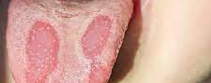
Oral examination
Complications and co‐morbidities
Disease course and prognosis
The oral mucosa looks normal to examination and there is no objective evidence of dryness.
Some patients may have a (normal) fissured tongue or geographic tongue
Burning mouth syndrome may be associated with affective disease such as anxiety and depression.
Some patients have been known to attempt suicide.
The prognosis is very variable. Spontaneous remission rates of 20% after 7 years or 3% after 5 years have been reported

Slide 8
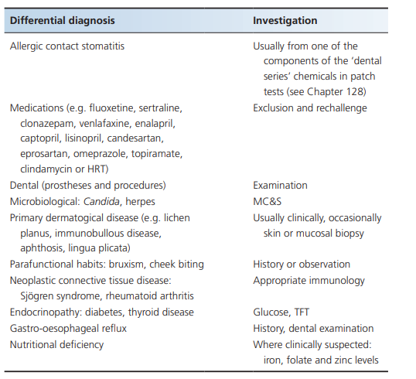
Investigations and differential diagnosis

Slide 9
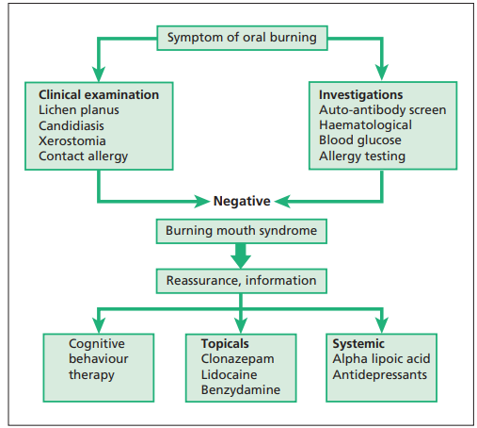
Management algorithm

Slide 10
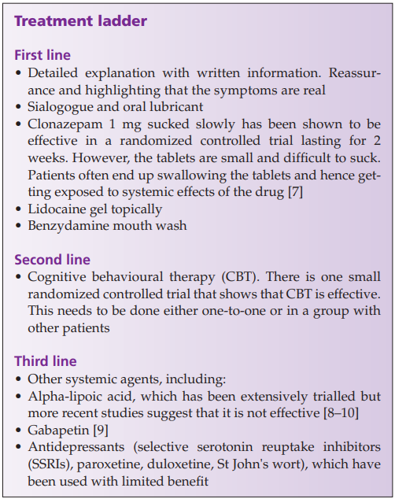

Slide 11
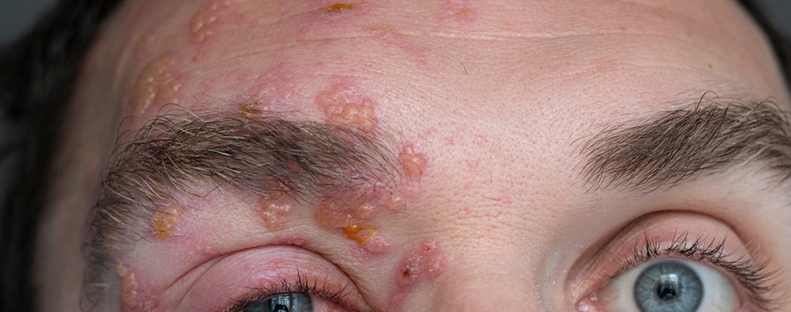
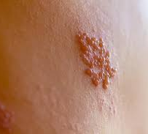
Post herpetic neuralgia
Post‐herpetic neuralgia (PHN) is a neuropathic pain that develops in the distribution of one or more branches of the nerve affected. It occurs 3–6 months after a herpes zoster infection. If the seventh cranial nerve is involved the acute phase is termed Ramsay Hunt syndrome.

Slide 12
Introduction and general description
Post‐herpetic neuralgia presents with a persistent burning, stabbing or itchy pain with sharp exacerbations and associated sensory changes. If there is involvement of the seventh cranial nerve, the pain will be felt in the ear and tongue. If involving the trigeminal nerve, the ensuing facial and or eye pain can be severe

Slide 13
Epidemiology
Incidence of 3.4 per 1000 patients per year.
The risk for developing PHN 1 month after the acute herpes zoster infection was 6.5%.
An annual incidence has been estimated at 40 per 100 000 person‐years
It is more common in the elderly aged over 55 years – a risk of 11% as compared with 6.5% in younger individuals.
Associated diseases Post‐herpetic neuralgia often results in low mood, poor sleep and social isolation

Slide 14
Predisposing factors
Pathology
Causative organism
Immunocompromised individuals
Elderly patients.
Patients with severe or disseminated rash, involvement of the trigeminal nerve’s ophthalmic division, allodynia, poor mood and viraemia during acute herpes zoster are at higher risk of PHN
PHN may be caused by neurological lesions at all levels of the nervous system (peripheral, central, autonomic).
Skin from 70% of PHN patients demonstrates loss of function and degeneration of small‐fibre afferents in the affected dermatome.
Ectopic impulses may occur at the site of dorsal root ganglion damage
It results from infection with herpes zoster virus.
The virus lies dormant in the dorsal root ganglion after infection.
When reactivated, patients present with shingles. Nerve injury occurs and results in persistent pain after the acute phase in up to 11% of patients

Slide 15
Clinical features
Painful sensations with different components, including spontaneous and continuous deep aching and throbbing pain, burning, lancinating pain or paroxysms of burning pain, sometimes provoked by non‐noxious stimuli, such as contact with clothing or changes in temperature .
The pain is accompanied by autonomic instability and its intensity is exacerbated by physical and emotional stress and alleviated by relaxation.
Some patients with PHN have profound sensory loss in the area of maximum pain (anaesthesia dolorosa),
while others have pronounced allodynia with minimal sensory loss.
Some patients describe areas of sensory loss surrounded by a ‘transition zone’ within which a noxious stimulus can elicit a particularly unpleasant pain that radiates widely.
These patients may go to extraordinary lengths to protect the area from innocuous stimuli, while firm compression of the skin may actually produce pain relief

Slide 16
Complications and co‐morbidities
Disease course and prognosis
These include
depression,
isolation,
poor sleep
a significant impact on the activities of daily living
A long‐term study over 3 years showed that there is a gradual improvement over time
but that sensory changes take longer to recover

Slide 17
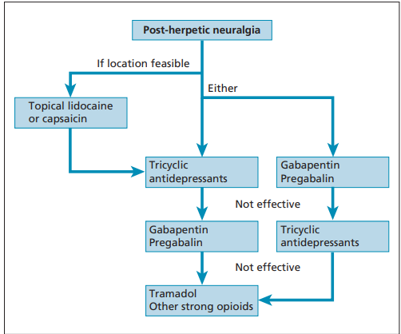
Management of PHN

Slide 18
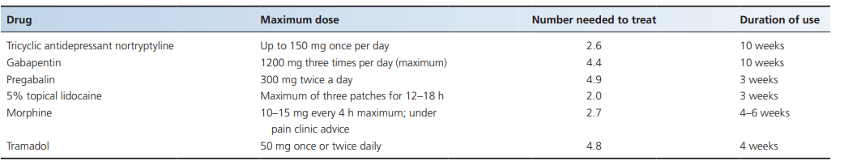

Slide 19
Prevention
Acyclovir 800 mg5 times daily 7 days(reduce the duration of disease but no help in PHN and reduction of pain)
Famiciclovir 500mg three times daily for 7 days.
Valaciclovir 1000mg three times daily for 7 days.
Both helps in reducing the duration of disease and prompt relief of zoster associated pain.

Slide 20
Trigeminal neuropathic pain syndrome
Neuropathic pain is defined by the International Association for the Study of Pain (IASP) as ‘pain arising as a direct consequence of a lesion or disease affecting the somatosensory system’. If the pain is in the distribution of the trigeminal nerve it can be termed a trigeminal neuropathic pain

Slide 21
Predisposing factors
The condition can occur in 3–6% of teeth that have been root‐filled.
Pain can also occur after the removal of teeth, especially wisdom teeth when the inferior alveolar nerve or lingual nerve has been injured.
Trigeminal neuropathic pain syndrome can also be triggered by the placement of implants or injection of local anesthetic .
It may occur following healing of mucosal lesions, such as lichen planus

Slide 22
Associated diseases
Pathology
More common in females
It is often co‐morbid with temporomandibular disorders and psychological factors [
It is often termed an idiopathic pain there may be both psychological and neuropathic elements to be considered.
There may also be central changes as not all patients get pain relief with the use of a local anaesthetic

Slide 23
Clinical features
History
Most patients will link the start of their symptoms to some dental procedure ranging from root canals, extractions, minor surgical procedure or trauma
Presentation
The pain is continuous, at least 8 h daily for over 15 days per month and of 3 months’ duration.
It is described as a dull, aching, throbbing pain that can occasionally be sharp and even burning.
It is localized to an anatomical area around a tooth. There are often features of depression, anxiety and somatization.
Marked allodynia in the area is typical, as well as hyperaesthesia or hypoaesthesia/anaesthesia. Swelling and flushing can occur.

Slide 24
Differential diagnosis
This can include dental causes, such as a cracked tooth.
Classification of severity
It can vary in severity from moderate to severe.
Disease course and prognosis
Up to a third of patients improve and 10% become pain‐free over a 7‐year period
Investigations
Intraoral X‐rays have often been performed prior to referral to a specialist centre.
More sophisticated cone beam computer tomography can help to identify other causes such as fractured teeth, inadequate root fillings or damage to local nerves.

Slide 25
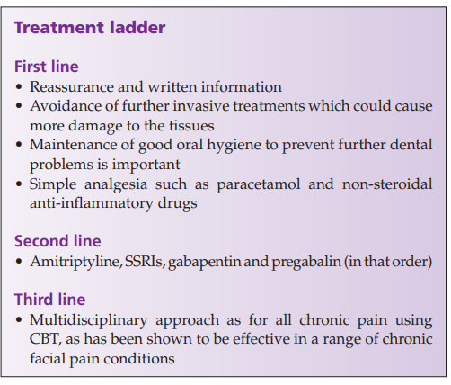
Management

Slide 26
Trigeminal trophic syndrome
Trigeminal trophic syndrome (TTS) is an uncommon disorder in which chronic pain, burning and stinging sensations in the distribution of the trigeminal nerve are associated with an irresistible desire to pick at the involved skin.
The skin itself may be relatively anaesthetic so that the patient does not realize the damage that he or she is doing.
Alternatively, the involved skin may be dysaesthetic. With either anaesthetic or dysaesthetic sensations, picking at the skin is conducted in an attempt to relieve the unpleasant sensations that patients experience.

Slide 27
Epidemiology
Trigeminal trophic syndrome is rare but occurs in all ethnicities, usually in middle‐aged individuals.
(M : F is 2 : 1)

Slide 28
Causes of TTS
Causes of this disorder include
Central sensory damage,
Post‐encephalitic parkinsonism,
Syringobulbia,
Posterior fossa tumour
Occlusion of the posterior inferior cerebellar artery
Leprous neuritis and brainstem infarcts
Damage to the trigeminal nerve by attempts to relieve intractable trigeminal neuralgia (by surgery or alcohol injections into the Gasserian ganglion
Neurotrophic changes in the trigeminal area may follow the destruction of fibres conveying pain and temperature sensation.
Notes:
). Trigeminal nerve damage may also occur secondary to herpes zoster‐ or herpes simplex‐related neuritis. TTS is usually a disease of adults, although recently a case has been described in a 14‐month‐old child secondary to herpes simplex trigeminal neuritis [4]. There are almost always demonstrable defects in the trigeminal nerve pathways (peripheral or central) which lead to this condition

Slide 29
Clinical feature
The patient complains of paraesthesiae or a sensation of itchy pain or burning in an area innervated by the trigeminal nerve.
This is then picked, rubbed or scratched and the erosions increase in size and may extend to destroy the nasal cartilage
Patients freely admit to traumatizing the area in an attempt to relieve the uncomfortable sensation.
The pattern of ulceration may be sufficiently bizarre to suggest dermatitis artefacta.
Ulcers may spread towards the cheek and the upper lip; subsequent scar formation in the area of the alar can lead to lip elevation, resulting in a disfiguring sneer . Characteristically, the alar rim is involved and the tip of the nose spared.
Notes:
Sites less frequently involved include the forehead, scalp and cheeks. Neurological examination may reveal decreased perception of light touch and pain over the area, and sometimes an absent corneal reflex on the same side [2]. Ulcers may be complicated by secondary infection

Slide 30
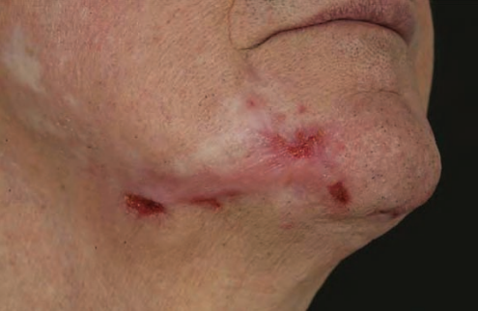
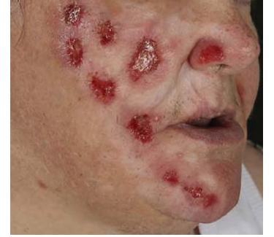

Slide 31
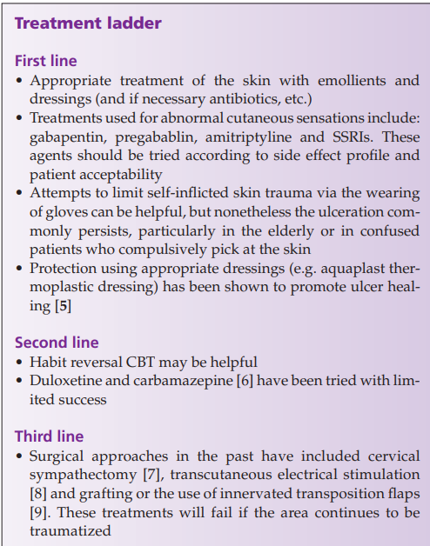
Management

Slide 32
Atypical trigeminal trophic syndrome
Atypical trigeminal trophic syndrome is different from TTS in that the distribution is unusual (often involving the neck or two areas of the trigeminal nerve). There is no demonstrable trigeminal neuropathy or any disease of the trigeminal nerve or central nervous system nuclei and connections. The ulceration may be bilateral

Slide 33
Clinical features
Presents similarly to TTS except the ulceration may be bilateral and in atypical sites.
Patients will confess that they traumatize the involved skin, and by doing so they obtain relief of their symptoms.
There appears to be less obsessive‐ compulsive behaviour.
In addition, no neuropathy can be demonstrated in the trigeminal nerve pathway and the lesions are often bilateral.
Notes:
The condition may be mistaken for dermatitis artefacta

Slide 34
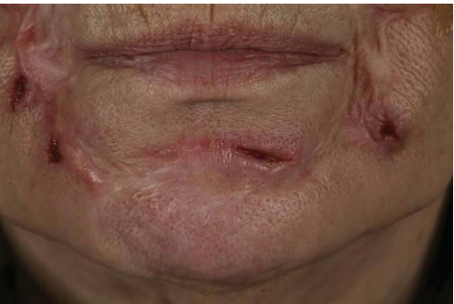

Slide 35
Vulovodynia, scrotodynia and penodynia
Vulvodynia and peno‐scrotodynia involve abnormal sensations of the skin in site‐specific locations.

Slide 36
Epidemiology
This occurs in 8% of women, and is less common in men (2%).
It usually affects younger adults in their thirties to forties, but can affect any (usually) adult age.
Associated diseases It may be associated with affective disease (anxiety and depression.
Sexual dysfunction (dyspareunia, erectile and ejaculatory disturbance) is common.
Irritable bowel syndrome, fibromyalgia and chronic fatigue syndromes are reportedly more common in patients with vulvodynia and PSD

Slide 37
Clinical features
History
Patients often describe severe, chronic (usually months or longer) sensations of burning, stabbing pain, rawness and itching affecting either the whole genital skin or a more specific part of the genital skin. The pain may be provoked (e.g. by sexual contact) or it may be present all the time.
Presentation
There is usually very little to see by way of physical signs. Patients may have localized or more generalized erythema affecting the skin or mucosa, but this may be within the normal range and should not be over‐interpreted. Point tenderness (with cotton wool tips) is more common in women than men.

Slide 38
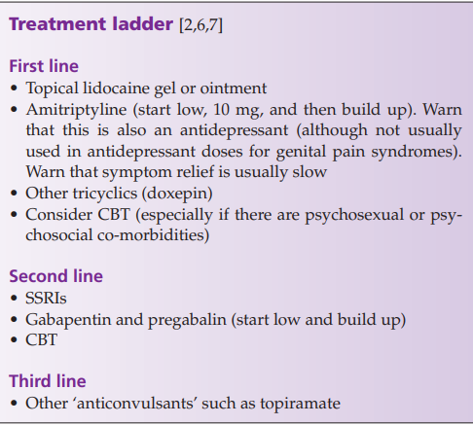
Management

Slide 39
Chronic scalp pain
Scalp pain and tenderness without any scalp disease is another mucocutaneous pain syndrome. It follows the pattern of other mucocutaneous pain syndromes in that patients complain of (usually) severe chronic pain affecting the scalp and/or hair, which may be provoked by contact (e.g. combing the hair) and for which no underlying cause can be found.
Synonyms and inclusions
• Trichodynia • Scalp allodynia
Notes:
s. Some authors indicate that the thalamus may be acting dysfunctionally and that this may lead to scalp allodynia amongst other cutaneous pain syndromes

Slide 40
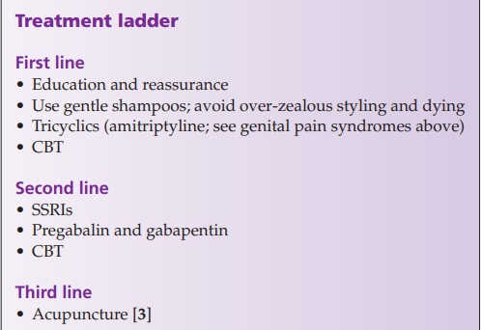
Treatment

Slide 41
Definition and nomenclature
Erythromelalgia is defined by an intense burning sensation of the extremities (usually the feet) together with persistent fixed erythema.
Synonyms and inclusions
• Mitchell disease • Acromelalgia • Red neuralgia • Erythermalgia

Slide 42
Epidemiology
The incidence of erythromelalgia is 1.3 per 100 000 persons per year.
The average age of presentation is 60 years, although diagnoses have been made in children.
Erythromelalgia is more common in females

Slide 43
Pathophysiology
Erythromelalgia is usually idiopathic.
many patients with erythromelalgia were found to have a distal cutaneous small‐fibre neuropathy that diminished sudomotor function (sweating).
It has been postulated that this neuropathy reduces the sympathetic vasoconstrictive response, which results in an increased acral blood flow.
Secondary erythromelalgia is usually due to an underlying leukaemia, thrombocytosis or polycythemia vera
Other secondary causes include peripheral neuropathies, connective tissue diseases, medications and poisons, and pregnancy.

Slide 44
Clinical features
Feet are most commonly affected, but cases involving the legs, hands, ears, neck, and face have also been described.
Symptoms may be intermittent but more usually there is a persistent background dysaesthesia with flares often at night.
Provoking and exacerbating factors include heat and exercise; relief often comes with cooling the extremities.
Between attacks, the extremities may feel normal or may be mildly cool, cyanotic, or uncomfortable.
Patients will often lie in bed with their feet facing an open window or lying on cooling ice packs (both of which probably exacerbate the disease)

Slide 45
Management
Treatment of erythromelalgia is difficult and usually achieved through trials of medication with the patient.
For mild disease, topical treatment may be first line (e.g. lidocaine patches, or doxepin cream or capsaicin cream).
For moderate disease, topicals should be combined with oral systemic therapy with gabapentin, pregabalin, SSRIs, amitriptyline or nortriptyline.
Third line agents include intravenous agents such as lidocaine, sodium nitroprusside or prostaglandins.
For patients not responsive to medical therapy, invasive procedures such as sympathetic blockade, sympathectomy or dorsal cord stimulation may be considered.
Notes:
Behaviours that may exacerbate the condition (such as using ice packs) should be strongly discouraged. Some patients feel very wretched and may even consider suicide, so assessment of psychosocial co‐morbidities and risk is important. The prognosis is variable. Some patients respond quite well whilst a few seem to have recalcitrant disease. These are best managed by a multidisciplinary team

Slide 46
Thank you

