Slide 1
Morphoea & Sclerosing
Inflammatory Dermatoses
DR HAFSA NAZEER

Slide 2
DEFINITION
Morphea is charachterized by varying degrees of sclerosis, fibrosis and atrophy in the skin and subcutaneous tissues, sometimes extending deeply into muscle bone and brain
Extracutaneous manifestations occur in up to 25% of cases but in contrast to SSc, no internal organ fibrosis or vascular changes occur.
Antinuclear antibody (ANA) positivity is common but the specific autoantibodies seen in SSc are rarely present.
There is no increased mortality, but substantial morbidity may occur as a result of joint contractures, facial and limb asymmetry, extracutaneous manifestations and the psychological impact of the condition

Slide 3
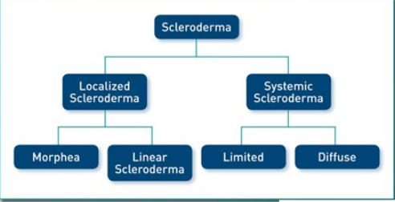
Terminology
In spite of term localized scleroderma which is confusing Morphea is preferred term to describe the specific skin condition associated with limited which do not involve internal organs like such as lungs, heart and kidneys

Slide 4
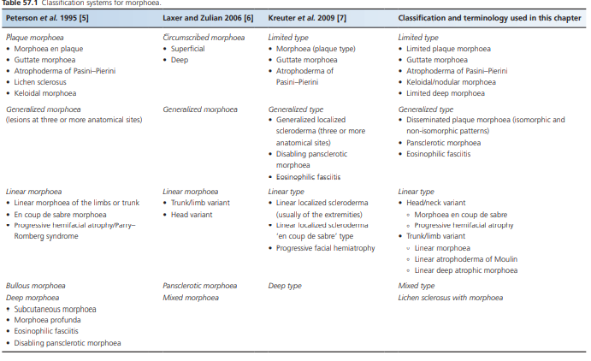
classification

Slide 5
Classification of Morphea
Linear type
• Head/neck variant
° Morphoea en coup de sabre
° Progressive hemifacial atrophy •
Trunk/limb variant
° Linear morphoea
° Linear atrophoderma of Moulin
° Linear deep atrophic morphoea
Mixed type
Lichen sclerosus with morphoea
Limited type
• Limited plaque morphoea
• Guttate morphoea
• Atrophoderma of Pasini–Pierini
• Keloidal/nodular morphoea
• Limited deep morphoea
Generalized type
• Disseminated plaque morphoea (isomorphic and non‐isomorphic patterns)
• Pansclerotic morphoea
• Eosinophilic fasciitis

Slide 6
Generalized morphoea is used as an umbrella term for those patients with widespread disease. It encompasses patients with multiple, typical morphoea plaques termed disseminated plaque morphoea, as well as a group with pansclerotic, near whole‐body
The term ‘deep morphoea’ implies involvement of the deep dermis, subcutis, fascia, muscle and sometimes bone. Lesions may involve any combination of these structure s. Lesions are poorly defined and ‘bound down’ and may have a peau d’orange or cobblestone appearance with ‘guttering’ along vessels and tendons
bullous lesions can occur in any subtype of morphoea, usually in the context of the active inflammatory phase of the disease. They are most frequent on the lower legs.

Slide 7
Introduction and general description
Morphoea comprises a group of related diseases that share a common underlying pathophysiology of increased collagen deposition in an autoimmune setting .They are largely confined to the skin and subcutaneous tissues, including the underlying fat, fascia, muscle, bone and joints and occasionally with involvement of the eye and brain.
Overall, one‐fifth to one‐quarter of patients experience extracutaneous manifestations, including musculoskeletal, neurological, ocular, vascular (including Raynaud phenomenon) and gastrointestinal complications .
Autoantibodies such as ANA, antihistone and anti‐ssDNA may be present, but the SSc‐specific autoantibodies such as antitopoisomerase, anticentromere and anti‐RNA polymerase are rarely found. It is distinguished from SSc by the absence of sclerodactyly and nail fold capillary changes

Slide 8
Cont..
he internal organ involvement typical of SSc, namely pulmonary fibrosis and pulmonary hypertension, hypertensive renal crisis, and infiltration and fibrosis of the gastrointestinal tract, do not occur in morphoea.
Although previously considered a self‐limiting condition, there is now emerging evidence that a protracted, relapsing–remitting course may be common
even though there is no increased mortality, significant morbidity can occur as a result of facial and limb asymmetry, flexion contractures, extracutaneous manifestations and psychological disability

Slide 9
Epidemiology
Age
Morphoea can occur at any age
In general, 75% of plaque disease occurs between the ages of 40 and 50 years,
whereas 75% of linear disease occurs between the ages or 2 and 14 years.
In children the mean age at onset of disease is 7.3–8.3 years
Sex
female to male ratios of between 2.6 -7 : 1
Ethnicity
Although it affects all races, between 72.7% and 82% of published cases are in white people

Slide 10
Associated diseases
psoriasis,
vitiligo,
alopecia areata,
autoimmune hepatitis,
primary biliary cirrhosis,
inflammatory bowel disease,
type 1 diabetes,
autoimmune thyroid disease,
polyglandular autoimmune disease type 2,
Ménière disease,
coeliac disease,
multiple sclerosis,
systemic lupus erythematosus,
rheumatoid arthritis,
Sjögren syndrome,
antiphospholipid syndrome,
Still disease
mixed connective tissue disease

Slide 11
Etiological factors
Trauma
Genetics
  HLA‐DRB1*04:04 and HLA‐B*37
Vaccination
  hepatitis B, MMR , diphtheria, tetanus, pertussis, pneumococcus and BCG , vitamin k and B12
Radiation
  post‐irradiation morphoea have been linked to radiotherapy for breast cancer
Drugs
  Bleomycin, pentazocine, progestin, vitamin B12, vitamin K, cocaine, d‐penicillamine, peplomycin, interferon β‐1a, uracil‐tegafur, , gemcitabine, bromocryptine, bisoprolol, balicatib, ibuprofen, mitomycin C
Infections
  Borrelia
Notes:
rarely after treatment of gynaecological and head and neck malignancies, subcut lymphoma and metastatic adenocarcinoma

Slide 12
Autoimmune profile
ANA 18-68%
Anti-histone Abs 12%
Scl 30 2%
Anticentromere 1.7%
Antibodies to fibrillin-1 and antibodies MMP-1 which inhibit collagenase activity found in linear, plaque and generalized morphoea

Slide 13
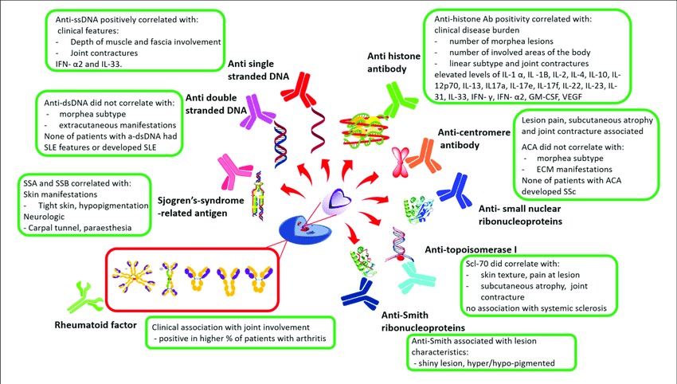

Slide 14
Immunopathology
It has been proposed that Th1 cytokines IL-, IL-6 and TNF alpha are activated during the early inflammatory stages of morphoea,
This is than followed by IL-17 cytokines IL-17, IL-22 and TGF beta in propagating inflammation and initiate fibrosis
whereas Th2 cytokines IL-4 and IL-13 correlate with later stages of damage and fibrosis

Slide 15
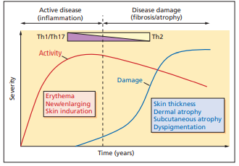

Slide 16
Cont..
Although vascular damage is well recognized to be one of the early features involved in the pathogenesis of SSc, it is less well studied in morphoea.
Nevertheless, endothelial cell swelling and apoptosis have been identified in early morphoea lesions . Direct immunofluorescence studies have shown immunoglobulin M (IgM) and C3 staining in the small blood vessels of the papillary dermis
Direct damage through trauma, infection and radiation may be contributory factors in some cases

Slide 17
Cytokines indicating damage in Morphea
vascular cell adhesion molecule 1 (VCAM‐1), intercellular adhesion molecule 1 (ICAM‐1) and E‐selectin, and increased levels of IL‐6 and chemokines including CCL2, ‐5, ‐7, ‐17, ‐22, ‐27, CCR7 and CXCL shows vascular activation
interferon‐γ‐inducible protein 10 (IP10, CXCL10). IP10 is produced by keratinocytes, neutrophils, eosinophils, monocytes and macrophages and IL-2 measures disease activity

Slide 18
Fibrosis is thought to result from a combination of increased collagen deposition by fibroblasts and reduced extracellular matrix turnover in morphoea
Enhanced type I and type III collagen mRNA and protein expression has been identified in morphoea fibroblasts and lesional skinGlycosaminoglycan and fibronectin synthesis is also increased
Skin biopsies and sera of morphoea patients have demonstrated increased TGF‐β expression and co‐localization with activated fibroblasts
CD34 positivity is lost, and factor XIIIa expression is increased in areas of fibrosis in morphoea

Slide 19
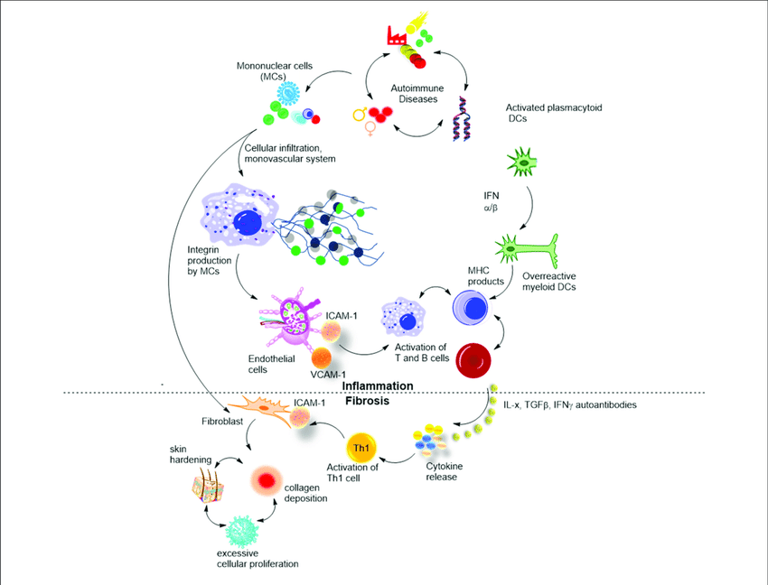

Slide 20
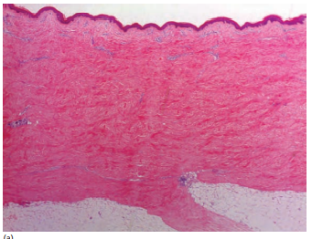
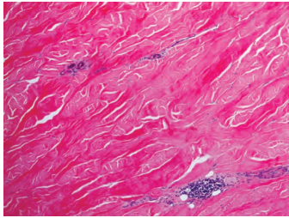
Histopathology
Notes:
(a) Low power view showing perivascular inflammation in the papillary and upper reticular dermis, dense horizontally orientated collagen bundles, loss of adnexal structures and a straight dermal–hypodermal junction. (b) Higher power view showing broad and thick collagen bundles, scattered aggregates of lymphocytes (bottom right) and atrophic sweat ducts and glands

Slide 21
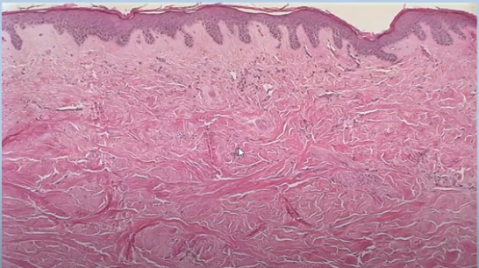
Sclerotic stage
Notes:
Little inflammation collagen dense packed horizontal arrangement lost dermal appandages and subcut fat

Slide 22
Clinical fature and history
The onset and progression of morphoea is usually insidious.
Patients may describe changes in skin texture or colour, sometimes with associated itch, pain or numbness.
When lesions extend across joints, reduced mobility or contractures and limb girth and length discrepancies may occur.
In linear disease of the face and head, asymmetry of facial features, alopecia, indentation or grooves in the skull, ocular pain and dental abnormalities may develop. Headaches and seizures may occur.
In generalized subtypes fatigue, myalgia and arthralgia are frequent. Occasionally, patients describe symptoms of gastro‐oesophageal reflux.

Slide 23
presentation
Individual lesions of morphoea generally begin with an erythematous, oedematous, inflammatory phase, which may be subtle and ‘bruise‐like’ in appearance
followed by the development of central sclerosis associated with a change in skin colour and texture to thickened, waxy, yellowish white. . This central sclerotic area may be surrounded by an erythematous to violaceous so‐called ‘lilac ring’
Over months or years, lesions become atrophic and hyper‐ or hypopigmented
Depending on the depth and type of lesion, changes in the subcutis, muscle, fascia, bone and underlying brain may be present.

Slide 24
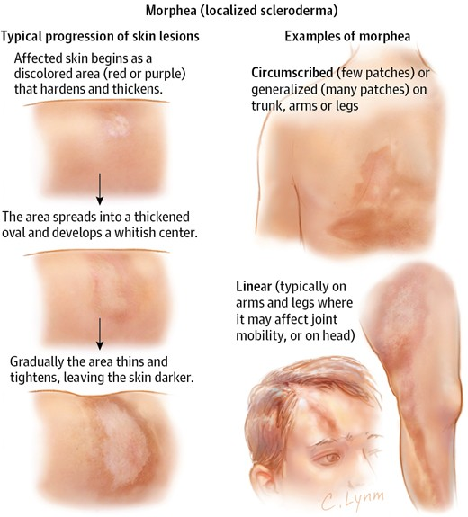

Slide 25
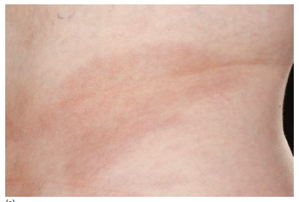
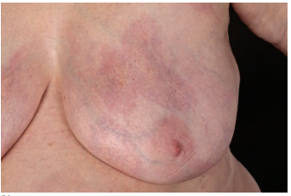
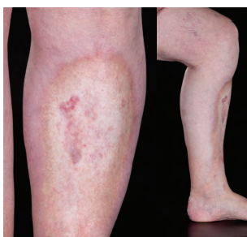
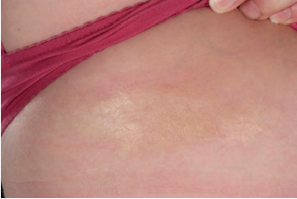
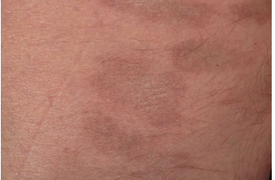

Slide 26
Limited type
Limited plaque morphea
Guttate morphea
Atrophoderma of pasini and pierini
Keloidal/nodular morphea
Limited Deep morphea

Slide 27
Limited morphea
This commonest form of morphoea presents with round to oval lesions >1 cm in diameter, in up to two of seven anatomical regions (head–neck, each limb, anterior trunk, posterior trunk).
Histopathological changes are usually limited to the epidermis and dermis.
Plaques are most frequently located on the trunk (41–74%).
The breasts are often involved, but the nipples and areolae are uniformly spared.

Slide 28
Guttate morphea
This is a rare variant, similar to plaque morphoea, in which multiple, small (<1 cm), erythematous or yellowish white, mildly indurated lesions develop, most frequently on the trunk.
Lesions are superficial and may have a shiny, crinkled surface, clinically resembling extragenital lichen sclerosis , however, lesions generally resolve leaving hyperpigmentation.

Slide 29
Atrophoderma of Pasini–Pierini.
It is a rare condition that represents 0.1% of childhood morphoea cases [8] and that usually occurs in adolescence and young adult life.
Symmetrically distributed truncal lesions are the most common but single lesions and zosteriform distributions are described .
Typically, lesions are non‐indurated, blue‐ grey to brown, hyperpigmented and sharply demarcated depressed patches, with a ‘cliff‐drop’ border
Histological appearances are variable: they may be normal or show mild lymphocytic infiltration, reduced dermal thickness and normal or sclerotic and hyalinized collegen

Slide 30
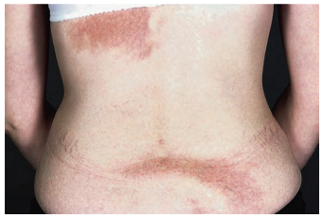
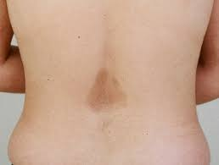

Slide 31
Keloidal /Nodular morphea
This rare subtype is characterized by the presence of keloid‐like nodules in patients with previous or coexistent morphoea or, in a majority of cases, SSc
keloidal or nodular lesions arising from sclerodermatous skin may reveal a histological appearance typical of either keloid or morphoea
Lesions are most common on the upper body where they may coalesce or occur in a linear pattern
a histological appearance typical of either keloid or morphoea

Slide 32
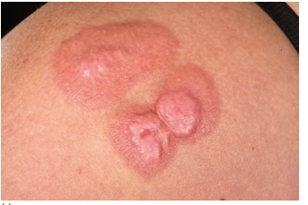
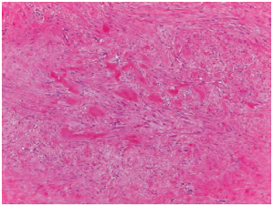

Slide 33
Limited deep morphea
(synonym morphoea profunda).
The term ‘deep morphoea’ describes a variant in which inflammation and sclerosis are found in the deep dermis, panniculus, fascia or muscle Deep involvement can occur in all subtypes of morphoea
Person and Su’s diagnostic criteria included
the presence of diffuse, taut, bound‐down, deep cutaneous sclerosis,
significant hyalinization and thickening of collagen bundles in the deep dermis, in the septa of subcutaneous fat and in the fascia and a striking accumulation of inflammatory cells predominantly composed of lymphocyte and plasma cell.

Slide 34
Rarely, a plasma cell panniculitis has been described (synonym morphoea panniculitis) reported in children and adults
Occasionally, lesions present as non‐inflammatory, cupuliform, depressed plaques with no associated induration, pigmentation or texture
Deep morphoea can thus mimic lipoatrophy clinically and should be considered in patients presenting with asymptomatic atrophic lesions

Slide 35
Generalized morphea
Falanga suggested five or more lesions, bilateral lesions and evidence of joining together of at least two individual patches .
Laxer and Zulian defined generalized morphoea as induration of the skin starting as four or more individual plaques, larger than 3 cm, that become confluent and involve at least two out of seven anatomical sites (head–neck, right upper extremity, left upper extremity, right lower extremity, left lower extremity, anterior trunk, posterior trunk).
Extracutaneous symptoms including myalgia, arthralgia and fatigue are common, dyspnoea and dysphagia may occur, and a higher prevalence of concurrent and familial autoimmune disease are documented.

Slide 36
Generalized morphea
Includes
• Disseminated plaque morphoea (isomorphic and non‐isomorphic patterns)
• Pansclerotic morphoea
• Eosinophilic fasciitis

Slide 37
Disseminated plaque morphoea
In the first type of presentation, patients gradually develop multiple plaques of morphoea at several anatomical sites, some of which may coalesce
Plaques may occur in different stages of evolution and are most frequently located on the trunk, thighs and lumbosacral area in adults
Both adults and children initially presenting with limited plaque morphoea may, as a result of ongoing or recurrent disease activity, progress to fulfil the criteria for the disseminated plaque subtype of generalized morphoea

Slide 38
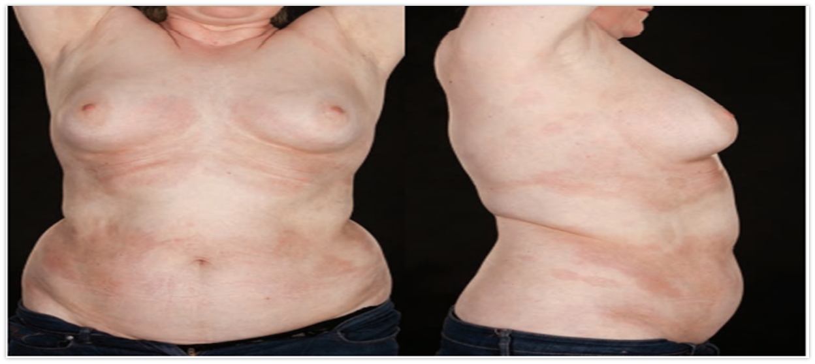
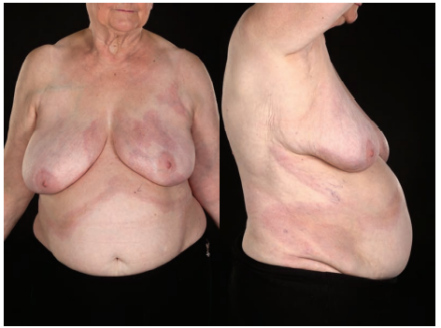
inflammatory
sclerotic

Slide 39
Pansclerotic morphoea
This is a rarer presentation and is characterized by extensive, often circumferential involvement of the majority of body surface areas with sparing of the fingers and toes, and may best be referred to as pansclerotic morphoea
. This term has traditionally been used to describe a very rare, widespread and severe progressive disease occurring predominantly in children in which deep fibrosis progresses rapidly to involve muscle, fascia and underlying bone and is frequently complicated by severe joint contractures, chronic ulceration and the development of squamous cell carcinoma
Increased serum IgG, a positive ANA and peripheral eosinophilia are documented in some cases

Slide 40
Due to the relative ambiguity as regards depth of involvement, in the literature, this criterion was removed, and pansclerotic morphoea was defined as the presence of near total body surface area involvement with sparing of the fingers and toes
Interestingly, there were no significant differences between the generalized morphoea and pansclerotic groups for age at onset of disease (mean 49 years, standard deviation 19), or prevalence of ANA (29–31%) and antihistone antibodies (7–10%). However, patients with the pansclerotic subtype were more likely to be male (46% versus 6% of generalized morphoea patients) and have a shorter time to diagnosis, higher rates of functional impairment (61% versus 16%) and higher skin sclerosis and damage scores.

Slide 41
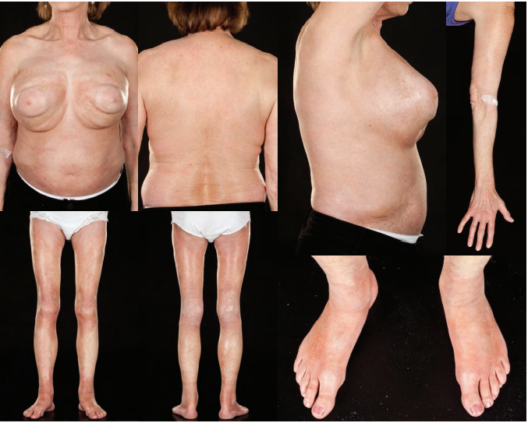

Slide 42
Eosinophilic fasciitis
(synonym Shulman syndrome)
was first described by Shulman in 1975
It symmetrically involves the extremities, particularly the lower limbs, but typically spares the fingers and face . Truncal involvement is described and there may be considerable clinical overlap with pansclerotic morphoea in such cases
Unaccustomed severe exercise may precede the onset of disease in up to 50% of cases .
In the early stages there is painful, burning erythema and pitting oedema of the limbs . This is replaced by induration and fibrosis resulting in a typical peau d’orange appearance, with tethering around vessels producing guttering referred to as the Groove sign.
.A high erythrocyte sedimentation rate (ESR) and C‐reactive protein (CRP), hypergammaglobulinaemia and peripheral eosinophilia (present in 60–90% of cases) are typical

Slide 43
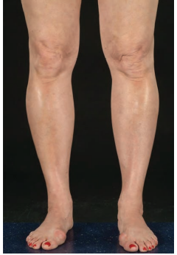
Eosinophilic fasciitis having groove sign. Limited disease involving the lower legs and ankles. The skin appears shiny and taught

Slide 44
Linear type
Linear morphoea accounts for 15–20% of morphoea cases in adults and 42–67% of cases in children
The limb/trunk variant occurs twice as often (54–65%) as the head variant (23–35%) [8,23].
Linear head and trunk/limb variants have been found to coexist in 1% of children.
It is quite common for the upper and lower limb on the same side to be affected.
Although mostly unilateral, bilateral involvement occurs in 5–25% of cases .
Linear morphoea appears to follow Blaschko lines

Slide 45
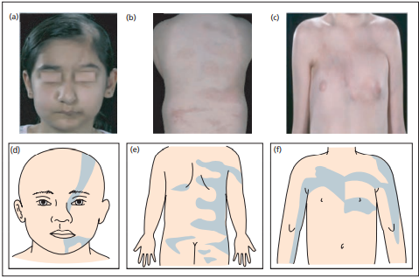
Blaschkoid nature of linear morphoea

Slide 46
Head and neck variants
• Head/neck variant
° Morphoea en coup de sabre
° Progressive hemifacial atrophy (known as Parry– Romberg syndrome)
In children, ECDS lesions are commoner than PHA, representing 87% of head variant lesions
ECDS occasionally has a sudden onset and rapidly progressive course, in a majority of cases the onset of both subtypes of disease is insidious and may progress slowly over many years

Slide 47
Morphoea en coup de sabre
Morphoea ECDS usually begins in childhood but occasional adult‐onset cases are described.
It most frequently involves the frontoparietal area of the face and scalp in a paramedian distribution and follows Blaschko’s lines.
Sclerosis is thought to involve the skin and subcutis first and then later extend to the underlying fascia and bone. Varying degrees of sclerosis, hyperpigmentation and atrophy may be observed .
Scarring alopecia of the eyelashes, eyebrows and scalp occur if they are involved in the band.
Linear depressions in the skull bones are a common.
Neurological, ocular and auditory complications are well recognized

Slide 48
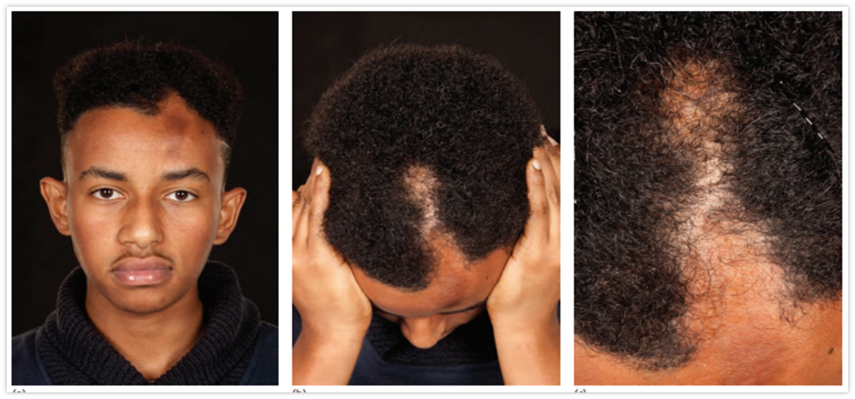
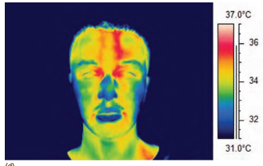
ECDS

Slide 49
Progressive hemifacial atrophy known as Parry– Romberg syndrome
A majority of cases begin in the first decade, but occasional adult‐onset cases are described.
the areas affected are those supplied by one or multiple branches of the trigeminal nerve
It is a unilateral, progressive, primary atrophic disorder of the skin, subcutaneous tissue, muscle and underlying cartilage and bone.
Altered pigmentation, usually a brownish or bruise‐like change, but occasionally hypopigmentation, occurs at the affected sites.
A progressive facial asymmetry develops as a result of a gradual loss of fat and muscle, and atrophy of the frontal, maxillary and/ or mandibular bones.
The mouth and nose become deviated towards the affected side.

Slide 50
Cont..
Enophthalmos is caused by a combination of progressive fat atrophy, shrinkage of the eyeball and thinning of the extraocular muscles .
Ocular complications including choroidal and retinal folding, hyperopia, uveitis, retinal vasculitis, glaucoma and third nerve palsies may occur as a result .
Neurological complications occur in 15% with headaches (9%) and epilepsy (13%) being the most common. Associated neuroimaging abnormalities occur in 19–44%, and may be ipsi‐, contra‐ or bilateral
Mandibular and intraoral involvement may lead to dental malocclusion and hemiatrophy of the tongue

Slide 51
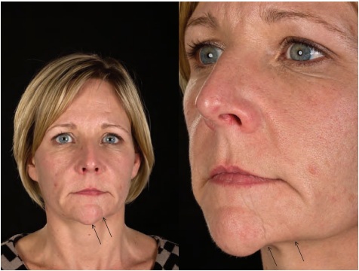
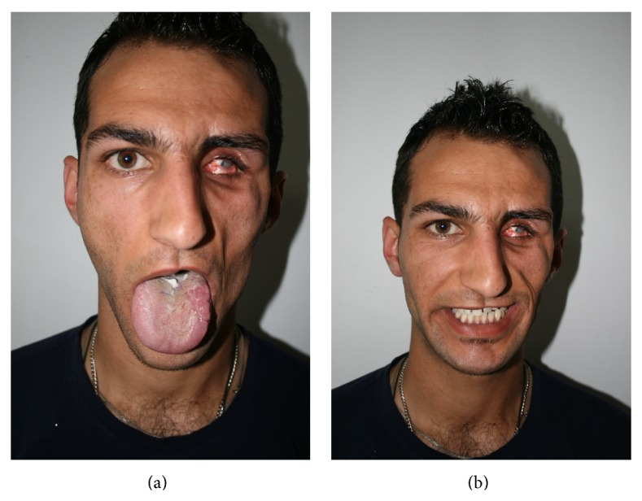
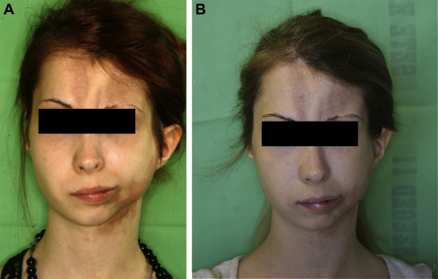
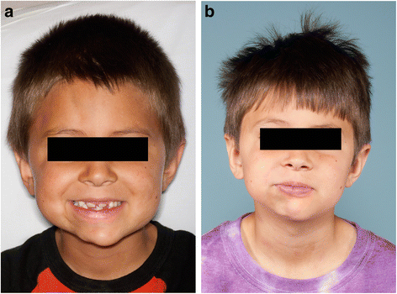
Progressive hemificial Atropy

Slide 52
Trunck / limb variants
Linear sclerotic bands may appear suddenly or insidiously and then progress. Coexistent or preceding plaque morphoea, most often on the trunk, is commonest in this form of linear disease.
A majority of linear lesions are unilateral but bilateral lesions were found in 11% in the largest childhood study
The dermis, subcutis, underlying muscle and bone may be involved. In limb lesions, generalized arthralgias and oedema of the involved extremity can precede the onset of disease
Myopathic changes, atrophy and weakness of involved and adjacent muscles may occur
Joint contractures, muscle atrophy and limb shortening cause pain and significant functional limitations, which in turn lead to a reduction in quality of life and to significant psychological morbidity

Slide 53
Linear atrophoderma of Moulin
unilateral, depressed, hyperpigmented Blaschkoid plaques on the trunk and limbs, with onset between 6 and 20 years of age. Histology showed epidermal hyperpigmentation, but a normal dermis and nod normal collagen on histology .
the impression of skin atrophy might therefore be due to atrophy of subcutaneous structures
linear atrophoderma of Moulin appears to lie within the morphoea spectrum and be akin to a linear Blaschkoid form of atrophoderma of Pasini–Pierini

Slide 54
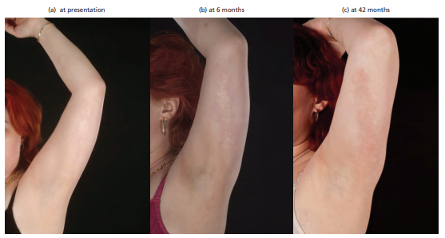
Linear morphea upper limb

Slide 55
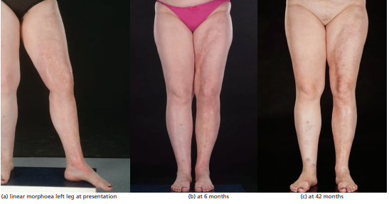
Linear morpjea lower limb

Slide 56
Linear deep atrophic morphoea
Three cases of linear primary atrophic morphoea with no preceding clinical inflammation or sclerosis, involving the subcutis and deep dermis, and resembling PHA on a limb, are reported .
Although progressive in nature, they did not result in joint contractures.

Slide 57
Mixed morphea
Mixed morphoea describes the 4% of adults and 15–23% of children with coexistence of more than one subtype of morphoea.
The commonest combination is linear limb/trunk and plaque morphoea, but any combination can occ

Slide 58
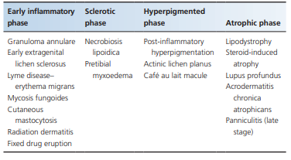
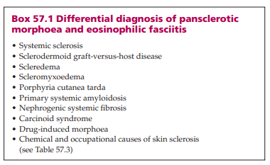
Differential diagnosis

Slide 59
Differntial diagnosis
Autoimmune disorders
  Systemic sclerosis, sclerodermoid GVHD
Metabolic disorders
  Porphyria cutanea tarda, phenylketonuria, muscle glycogenosis, hypothyroidism, carcinoid syndrome, diabetic cheiroarthropathy with skin thickening
Depositions disorders
  Scleredema, scleromyxoedema, primary systemic amyloidosis
Genetic disorders
  progeria, acrogeria and poikilodermatous epidermolysis bullosa, Moore Federman syndrome stiff skin syndrome,
Occupational causes
  Vinyl chloride disease, perchlorethylene, trichloroethylene, organic solvents, pesticides, epoxy resins, silicone
Chemically induced
  Eosinophilia myalgia, toxic oil syndrome, nephrogenic systemic fibrosis
Drug induced
  Bleomycin, progestin, vitamin B12, vitamin K, cocaine, d‐penicillamine ,carbidopa, balicatib, ibuprofen, etc
Associated with haematological disease
  POEMS (polyneuropathy, organomegaly, endocrinopathy, monoclonal gammopathy, sclerodermoid skin changes), myeloma

Slide 60
Factors determining severity
Age
Depth of involvement
Involvement of bone joint or cns
Irreversible damage
Impact of quality of life
High severity was defined as presentation with generalized or pansclerotic morphoea, craniofacial linear morphoea or another subtype with evidence of high morbidity such as CNS involvement, limb shortening or joint contracture.
Moderate severity was defined as circumscribed (limited) deep morphoea or linear morphoea of the trunk or limb without evidence of high morbidity.
Low severity disease was defined as superficial, circumscribed (limited) plaque morphoea. These measures of severity should be equally applicable to adult patie

Slide 61
Complications and co-morbidities
Extracutaneous manifestations
mild degrees of frequently asymptomatic oesophageal dysmotility as well as mild gas transfer defects and restrictive changes in lung function .
Electrocardiogram abnormalities, particularly incomplete right bundle branch block have been documented in adults and children with varying frequencies (8–88%)
the highest frequencies of arthralgia (24%), dysphagia (14%), dyspnoea (20%) and vascular complaints (mainly Raynaud phenomenon, 31%) were seen in patients with generalized morphoea.
In contrast, the linear subtype was associated with neurological (31%) and ophthalmological (8%) complications related to the affected site on the face or scalp

Slide 62
Cont..
Neurological symptoms occurred in 4.4%, predominantly in children with linear disease involving the head . Most frequently these were seizures and headache, but peripheral neuropathy, vascular
CNS complicatins include Both ipsilateral and contralateral bone thinning, cerebral atrophy, white matter lesions, focal subcortical calcifications and meningocortical changes have been described
Oral and dental problems can also occur includes malocclusion (94%), an overgrowth tendency of the anterior lower third of the face (82%), abnormal mastication (69%), dental anomalies (63%), skeletal asymmetry (56%), bone involvement (50%) and temporomandibular joint involvement (19%)
Ocular complications were seen in 2.1% of 750 children – most frequently episcleritis, anterior uveitis and keratitis, but also glaucoma, xerophthalmia, strabismus, mydriasis and papilloedema
Respiratory (0.7%), cardiac (0.3%) and renal (0.3%) complications were rarer

Slide 63
Disease course and prognosis
Early studies indicated that the duration of disease activity, although variable, was usually 3–5 years , with plaques generally resolving earlier than other subtypes.
mean disease duration of childhood‐onset morphoea may be twice as long as that for adult‐onset disease (13.5 versus 5.8 years)
Disease recurrence occurred in 27% of the paediatric‐onset group and 17% of the adult‐onset group. The linear limb variant was associated with a higher risk of recurrence, irrespective of age at the onset of disease

Slide 64
Cont..
patients described flares of activity triggered by trauma, pregnancy or reduction or discontinuation of systemic therapy
Transition from morphoea to SSc has been reported in 0.13–1.3% of morphoea cases
SSc‐specific antibodies have been identified in small numbers of morphoea patients (antitopoisomerase in 2–3% , anticentromere in 1.7%

Slide 65
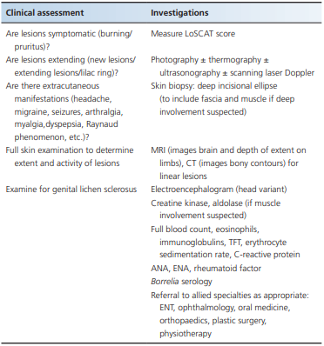

investigations
The diagnosis of morphoea is largely clinical, but a number of
investigations can be helpful in guiding management

Slide 66
Clinical scoring system
The MRSS, a measure of skin thickness which has been validated in SSc , has also been used in morphoea, but is not validated in this condition and does not assess damage.
The DIET score (dyspigmentation, induration, erythema, telangiectasia; each scored 0–3, with a maximum score of 12) , has the advantage of simplicity, but may not provide an accurate assessment of damage.
Four measures of disease activity and damage have recently been combined to develop a morphoea‐specific skin scoring system –LoSCAT

Slide 67
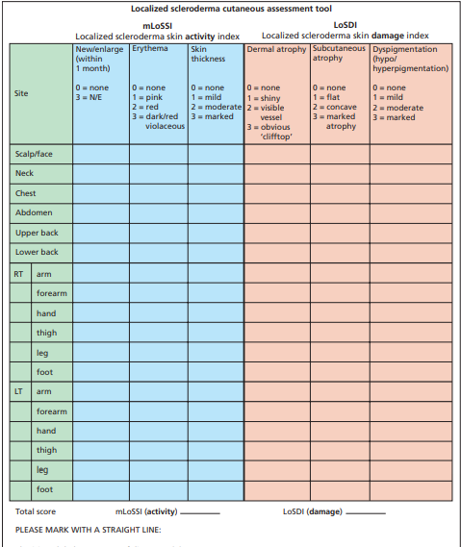
Localized scleroderma cutaneous assessment tool (LoSCAT)

Slide 68
Management
dermatologists prescribed
topical corticosteroids in 41%,
other topical treatment in 25%
phototherapy in 16% of cases,
systemic corticosteroids in 5%
methotrexate in 4% of cases.
Rheumatologists prescribed
methotrexate in 34%
systemic corticosteroids in 31%
topical treatments in 10%
phototherapy in only 2%

Slide 69
Clinicians response to active morphea
There was a wide range of responses:
methotrexate with corticosteroids was the most frequent response (37.3%),
followed by methotrexate alone (25.4%),
phototherapy (18%)
topical steroids (13%)

Slide 70
Limited superficial morphea
Limited superficial forms of morphoea can generally be treated topically
use of twice‐ daily topical tacrolimus 0.1% ointment
daily 5% imiquimod cream
twice‐daily application of topical vitamin D analogues (calcipotriol/calcipotriene 0.005%) with occlusion with steroid or low dose UVA-1 phototherapy
topical and intralesional corticosteroids are frequently used

Slide 71
UVA-1 pjototherapy
The rationale for using phototherapy in morphoea is based on the ability of UVA and UVB to induce MMPs such as collagenase
UVA wavelengths (320–400 nm) penetrate deeper into the dermis than UVB (280–320 nm). UVA‐1 (340– 400 nm) is less erythemogenic and penetrates deeper than UVA‐2 (320–340 nm)
In addition to collagenase, UVA‐1 has been shown to up‐regulate antifibrotic haem oxygenase‐1 , to cause T‐cell apoptosis, to deplete dermal Langerhans and mast cells, to induce interferon γ (INF‐γ), IL‐1 and IL‐6 production, and to inhibit TGF‐β production

Slide 72
Generalized and disseminated morphea
there is consensus that low‐dose (10–20 J/cm2), medium‐dose (>20–70 J/cm2) and high‐dose (>70–130 J/cm2) UVA‐1 have all shown efficacy, significantly reducing skin thickness and stiffness in adults and children with all forms of morphoea
Early inflammatory and sclerotic lesions appear to respond most favourably, and cases with deep involvement least favourably

Slide 73
Progressive disease
There is broad agreement that combinations of pulsed intravenous and/or oral steroids with methotrexate should be used first line
patients with severe morphoea (linear/ generalized) found that oral corticosteroids (0.5–1 mg/kg/day for 6 weeks then reducing over a mean of 18 months) produced a marked improvement,
Methotrexate is a cornerstone of morphoea management max dose 20mg/week.
It has been shown to
  enhance monocyte differentiation
  reduce peripheral blood mononuclear cell
  Reduce serum IL-1, 4 ,6 and 8
70% of responders maintained clinical remission off treatment for a mean of 25 months, but that treatment courses of at least 24 months were needed to ensure a sustained remission
MMF is used to do its antifibrotic effect

Slide 74
Other options
Ciclosporin
Abatacept
Imatinib
Extracorporeal photopheresis
High dose IV immunoglobulins

Slide 75
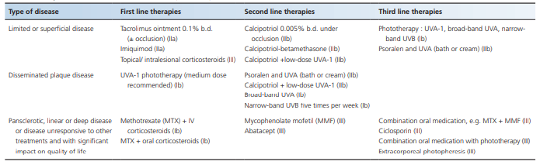

Slide 76
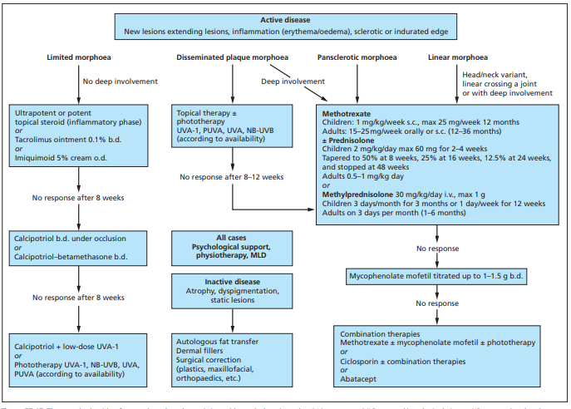

Slide 77


