Slide 1

Mastocytosis

Slide 2
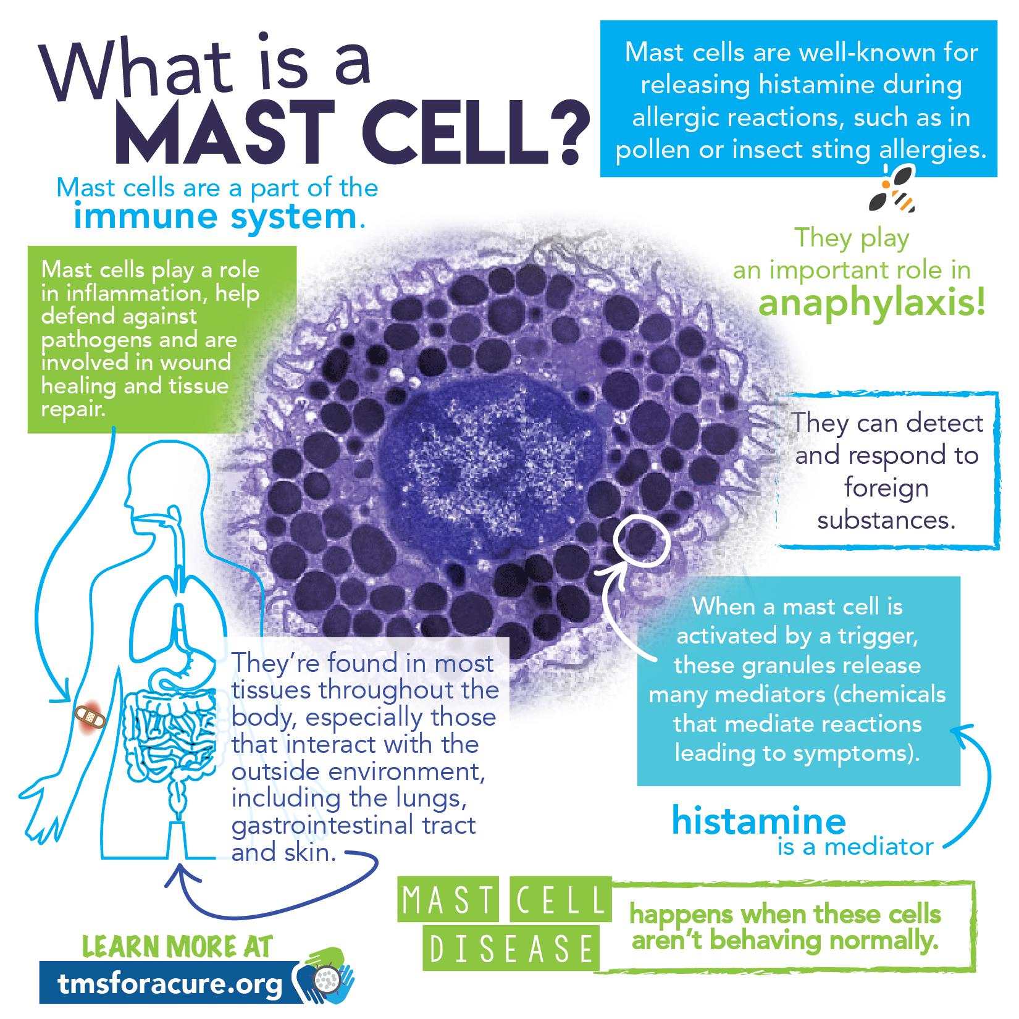
A mast cell (also known as a mastocyte or a labrocyte) is a migrant cell of connective tissue that contains many granules rich in histamine and heparin.
Specifically, it is a type of granulocyte derived from the myeloid stem cell that is a part of the immune and neuroimmune systems.

Slide 3
Introduction
Mastocytosis is a rare acquired condition characterized by too many mast cells in the skin and other tissues
The first description of mastocytosis was made by Nettleship and Tay in 1869 . The term urticaria pigmentosa was used by Sangster to describe the skin lesions in 1878 , but it was not until 1936 that the term ‘mastocytosis’ was proposed by Sézary to describe skin and systemic involvement together
Although a distinction is usually made between cutaneous and systemic mastocytosis, most adults with skin involvement will, after thorough investigation, be found to have evidence of systemic disease.
Those with skin lesions who have not been investigated for systemic disease are said to have ‘mastocytosis in the skin’. About 10% of patients with proven systemic mastocytosis do not have skin lesions.
Distinguishing between cutaneous and systemic mastocytosis in patients presenting with skin lesions depends on further investigation, including bone marrow biopsy and blood tryptase measurements

Slide 4
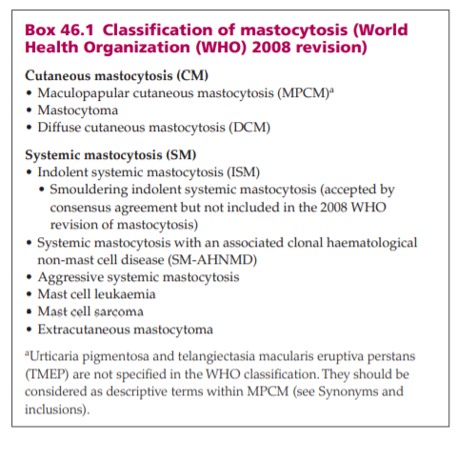
classification

Slide 5
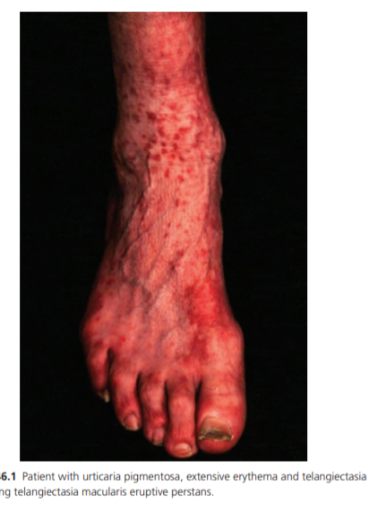
The term maculopapular cutaneous mastocytosis (MPCM) used in the World Health Organization (WHO) classification of mastocytosis includes urticaria pigmentosa and telangiectasia macularis eruptiva perstans (TMEP). This is logical because some patients with extensive urticaria pigmentosa have a marked telangiectatic component and the original descriptions of TMEP included classical lesions of urticaria pigmentosa

Slide 6
Aetiopathogenesis
The symptoms of mastocytosis are primarily due to mast cell mediator release. There is increasing evidence that mast cells accumulate in tissues as a direct consequence of acquiring a gain‐ of‐function mutation of KIT, which encodes the transmembrane receptor for stem cell factor (KIT).
Activation of KIT enhances survival and migration of tissue mast cells.
KIT is also expressed on haemopoietic stem cells and melanocytes, which might be relevant to the development of myeloproliferative and myelodysplastic disorders in mastocytosis and the hyperpigmentation that often accompanies lesions of urticaria pigmentosa

Slide 7
Epidemiology
Incidence and prevalence Mastocytosis is uncommon. Population estimates suggest a lifetime prevalence in the region of 1 : 10 000 to 1 : 30 000 including children and adults
Age The majority of childhood mastocytosis cases present in the first 2 years of life. Adults generally present between their third to sixth decades
Ethnicity Most of the reported cases of mastocytosis have been in white people
Genetics Over 50 families with familial mastocytosis had been reported by 2001;. Most of these families had urticaria pigmentosa, but four cases of TMEP occurred in three generations of one family, with an autosomal dominant pattern of inheritance.
Associated diseases Despite a higher incidence of anaphylaxis in systemic than cutaneous mastocytosis , there is no increase in atopy or specific sensitization to inhalant, food or sting allergens. About 20% of adults with indolent systemic mastocytosis (ISM) have osteoporosis. Vertebral fractures are seen in about 20% of patients with osteoporosis, especially in men. The lifetime risk of adults developing an associated non‐mast cell haematological disorder has been estimated at around 20% of adults with ISM

Slide 8
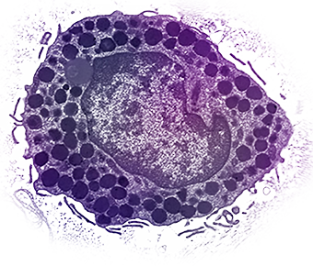
Pathophysiology
Pathology Skin Mast cell numbers are increased in the dermis of all types of mastocytosis . The epidermis is normal apart from an increase in melanin.
The mast cells are usually oval or spindle shaped with granules that stain metachromatically with toluidine blue but may be large and clustered
They are also well demonstrated by Giemsa, tryptase or chloroacetate esterase stains in formalin‐fixed biopsies. Mast cell infiltrates are predominantly found around blood vessels and skin appendages in the papillary dermis.

Slide 9
In urticaria pigmentosa, they are increased up to 15‐fold above normal. A careful technique when taking the skin biopsy, to minimize traumatic degranulation, is important. Injecting local anaesthetic around the lesion to be biopsied may yield a higher number of stainable mast cells.
Full‐thickness infiltration of the skin or a band‐like involvement of the upper dermis are seen in mastocytomas and diffuse cutaneous mastocytosis. By contrast, mast cells are confined to superficial capillaries and dilated venules in TMEP and may be only slightly increased over the numbers seen in normal skin.

Slide 10
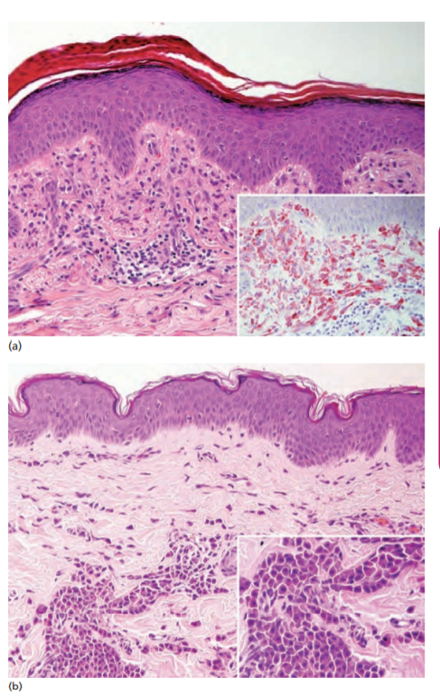
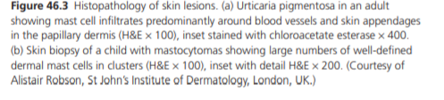

Slide 11
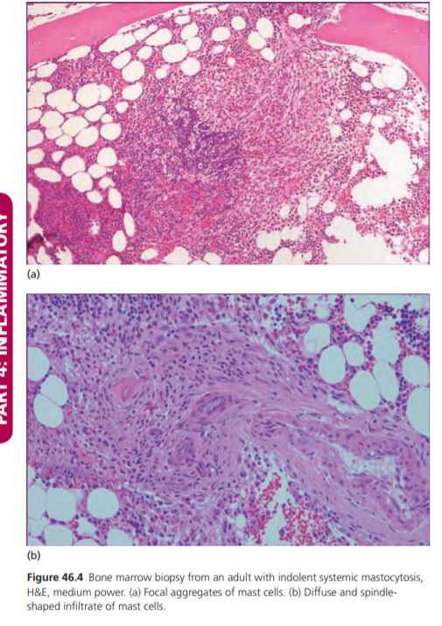
Bone marrow
Bone marrow involvement typically presents with focal aggregates of
mast cells seen on biopsy although the infiltration may be
diffuse and spindle shaped
Mast cell infiltration of the marrow is often accompanied
by increased numbers of immature neutrophils, phagocytosing
macrophages, eosinophils and lymphocytes and sometimes
by fibrosis
Clonal mast cells typically coexpress the aberrant markers CD25
and/or CD2 with tryptase, CD117 or both.

Slide 12
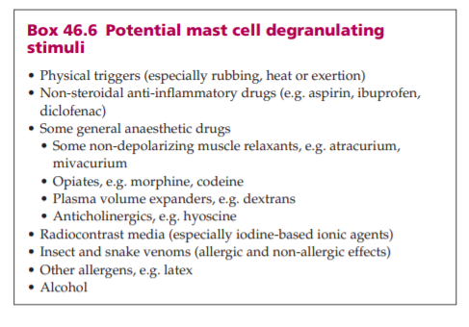
Triggering factors

Slide 13
Clinical features
Cutaneous mastocytosis
Maculopapular cutaneous mastocytosis -Urticaria pigmentosa. This is the commonest pattern of cutaneous mastocytosis in adults and children.
common age of onset for adult disease is 20–40 years.
Numerous reddish‐brown or pale monomorphic maculopapules, plaques or nodules appear in a symmetrical distribution anywhere on the body except the palms and soles, with the highest concentration usually being on the trunk and thighs
Lesions may be seen in the hairline of children and on the neck of adults but it is unusual for the face to be affected.

Slide 14
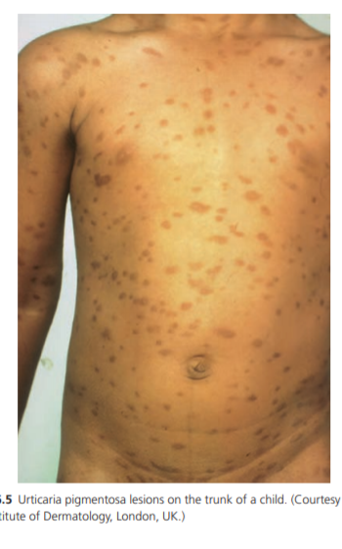
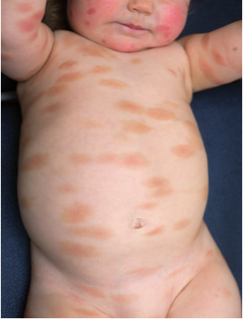

Slide 15
They characteristically urticate within minutes of gentle rubbing (Darier’s sign) in children causing localized pruritus, redness and wealing, which subside within an hour.
Gentle skin stroking does not produce wealing between lesions of urticaria pigmentosa
Stroking lesional and perilesional skin with a calibrated dermographometer at the 0 setting (20 g/mm2) provides a useful demonstration of selective wealing within lesions and can be a substitute for skin biopsy in very young children.
However, Darier’s sign is not always demonstrable, especially in the adult form of urticaria pigmentosa with a long history of the disorder or a child with resolving lesions, and is not 100% specific for mastocytosis, since it has been described on rare occasions in juvenile xanthogranuloma and acute lymphoblastic leukaemia of neonates

Slide 16
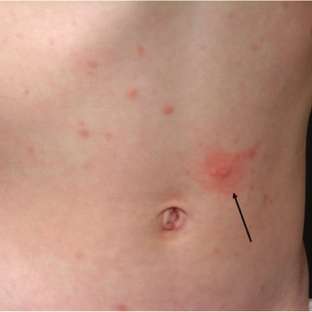
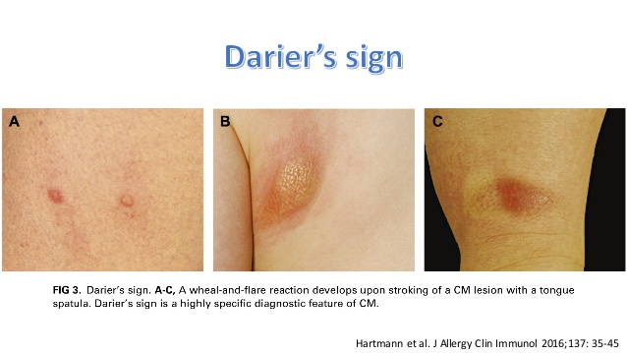

Slide 17
Lesions may blister in infancy or childhood and this may be the presenting feature, but they heal without scarring.
Bullous mastocytosis is not a specific clinical pattern. It is most often seen in infants with mastocytomas and diffuse cutaneous mastocytosis due to intense subepidermal oedema resulting from mast cell degranulation. Flushing occurs in about 50% of patients, alcohol intolerance and pruritus in slightly less .
Other symptoms may include heat or cold intolerance, recurrent diarrhoea, acid dyspepsia and urinary frequency. Depression and headache are common. Wheezing is often quoted, but is in reality extremely rare as a presentation of mastocytosis. Syncope is usually a presenting feature of anaphylaxis.

Slide 18
Early studies indicated that about 60% of adult patients have bone marrow involvement but it is now thought that the proportion of adults with skin lesions who have ISM may be as high as 90–95% .
Using sensitive molecular genetic techniques on bone marrow aspirate, blood or skin up to 95% of adults with MPCM have evidence of a clonal mast cell disease

Slide 19
Maculopapular cutaneous mastocytosis -Telangiectasia macularis eruptiva perstans. Fixed erythema may rarely be the predominant clinical feature of cutaneous mastocytosis. Patients are usually adults presenting with persistent red macules that may or may not show obvious telangiectasia, especially on the trunk, which flush but usually do not urticate on rubbing .
Finding excess mast cells on skin biopsy will confirm the clinical suspicion, although they may not be numerous. There has been debate whether the term TMEP should include patients with urticaria pigmentosa or should be restricted to those without and whether ‘pure’ TMEP carries a better overall prognosis because it is restricted to the skin. It tends to be very persistent and unresponsive to treatment.

Slide 20
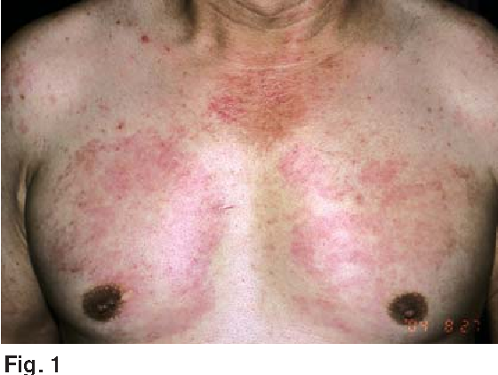
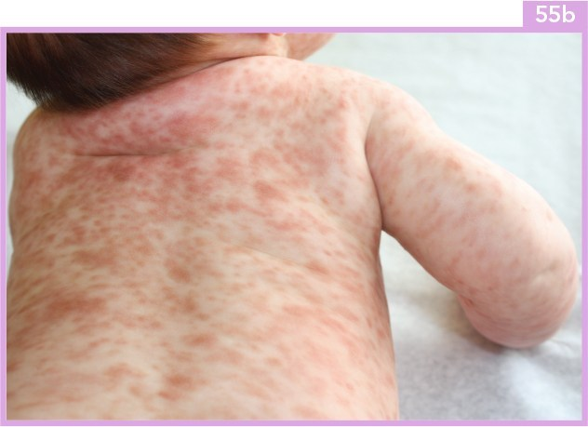

Slide 21
Mastocytoma Cutaneous mastocytosis may present with red, pink or yellowish nodules or plaques in infancy or early childhood, measuring up to 3–4 cm in diameter.
About 15% of young children will present with solitary lesions
If multiple, the lesions can be difficult to distinguish from nodular urticaria pigmentosa. They tend to blister if rubbed, especially in the napkin area of infants and occasionally, attacks of flushing can be induced by rubbing a solitary mastocytoma .
Nearly all mastocytomas involute over the first few years of childhood.

Slide 22
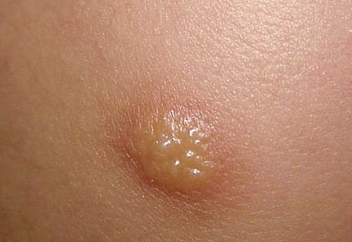
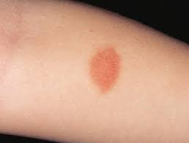

Slide 23
Diffuse cutaneous mastocytosis This is a very rare form of mastocytosis in which mast cells infiltrate the entire skin diffusely. It usually presents in the neonatal period. The skin tends to be thickened and doughy in consistency but may be smooth.
Skin colour may be normal or almost red. Pigmentation is usually absent. Blistering after minor trauma or scratching is common and pruritus for the child may be intense. The epidermis may be lost over a large area and can resemble impetigo.
Patients with this type of mastocytosis are at risk of systemic disease and severe complications including anaphylaxis and diarrhoea , but it often resolves spontaneously as in other types of childhood disease.

Slide 24
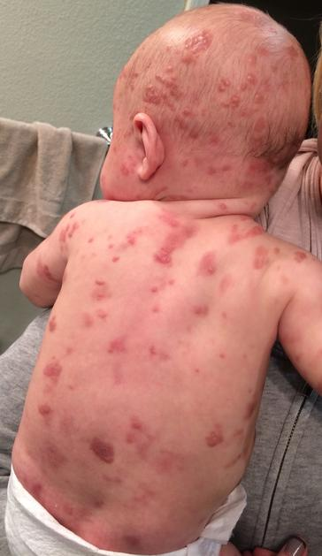
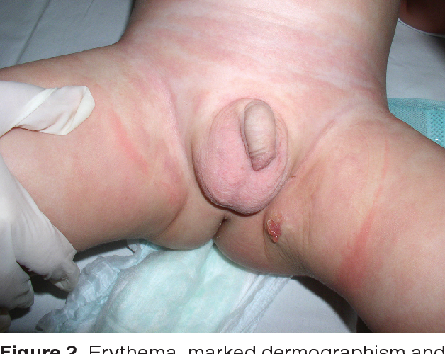

Slide 25
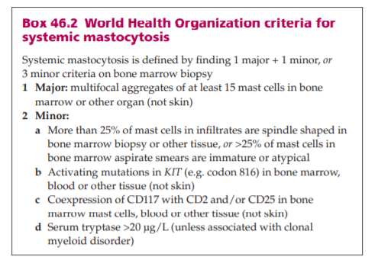
Systemic mastocytosis Patients must meet at least
one major and one minor,
or three minor criteria from the WHO criteria
to be diagnosed with systemic disease.

Slide 26
Not all patients with proven bone marrow involvement will be symptomatic, but in those who are, nausea, vomiting, diarrhoea, palpitations, hypotension, syncope, headache, dyspnoea, wheezing and sometimes fatigue and ‘brain fogginess’ may feature dominantly as symptoms.
This is partly due to release of cutaneous mast cell mediators which have distant effects and partly to direct local effects of infiltration in other tissues, such as the gastrointestinal tract. Bone pain, bone cysts, premature osteoporosis, osteosclerosis or spontaneous fractures should prompt further investigation. The majority of adult patients investigated for urticaria pigmentosa will have ISM.

Slide 27
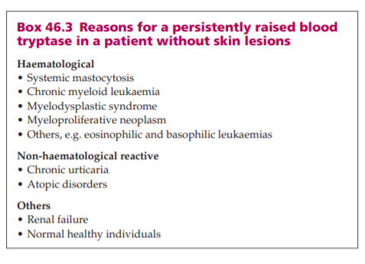
Blood tryptase and urinary methylhistamine or methyl imidazole acetic acid (MIMA) may be useful markers for bone marrow involvement. A persistent blood tryptase of 20 μg/L or greater is one of the WHO minor criteria for the diagnosis of systemic mastocytosis .
However, a persistently raised blood tryptase is not diagnostic of systemic mastocytosis since it can occur in other conditions, including chronic myeloid leukaemia, myelodylastic syndromes, atopic eczema, chronic urticaria and renal failure
Although there is a risk of progression of ISM to systemic mastocytosis
with an associated haematological clonal non‐mast cell lineage disease
(SM‐AHNMD) or aggressive systemic mastocytosis

Slide 28
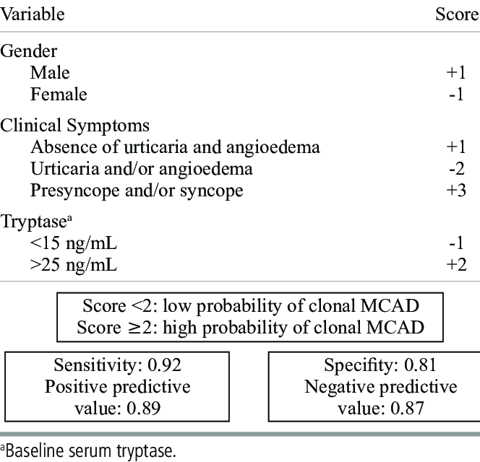
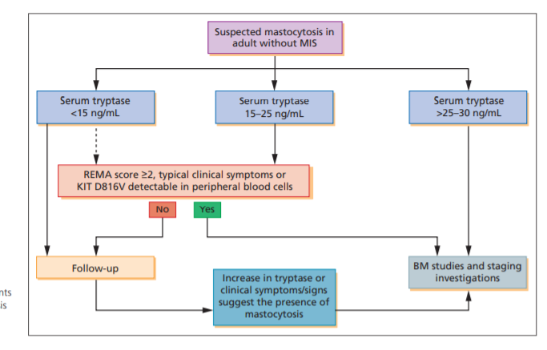
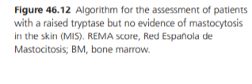

Slide 29
Monoclonal mast cell activation syndrome
Patients who show evidence of clonality on bone marrow biopsy (CD25 expression on mast cells and/or KIT D816V mutation) but do not meet the criteria for systemic mastocytosis are said to have monoclonal mast cell activation syndrome. There is an implication that these patients are at risk of developing systemic mastocytosis

Slide 30
Mast cell activation syndrome
Patients increasingly present with symptoms of mast cell mediator release who do not meet the criteria for mastocytosis. The term ‘mast cell activation disorders’ has been proposed to include patients with primary clonal mast cell disease (mastocytosis or monoclonal mast cell activation syndrome), mast cell activation secondary to known causes (e.g. immunoglobulin E (IgE)‐mediated urticaria or anaphylaxis), and non‐IgE mediated (e.g. autoimmune urticaria, physical urticarias and mast cell activation associated with chronic infl ammatory or neoplastic disorders) or idiopathic anaphylaxis or urticaria
Idiopathic mast cell activation syndrome may be considered when patients present with mast cell mediator symptoms in at least two body systems (e.g. skin/respiratory/gastrointestinal/cardiovascular), respond to antimediator therapies.

Slide 31
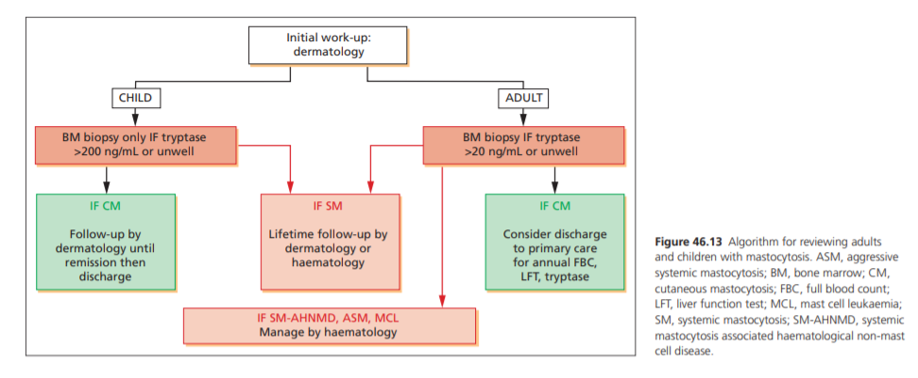
Work up

Slide 32
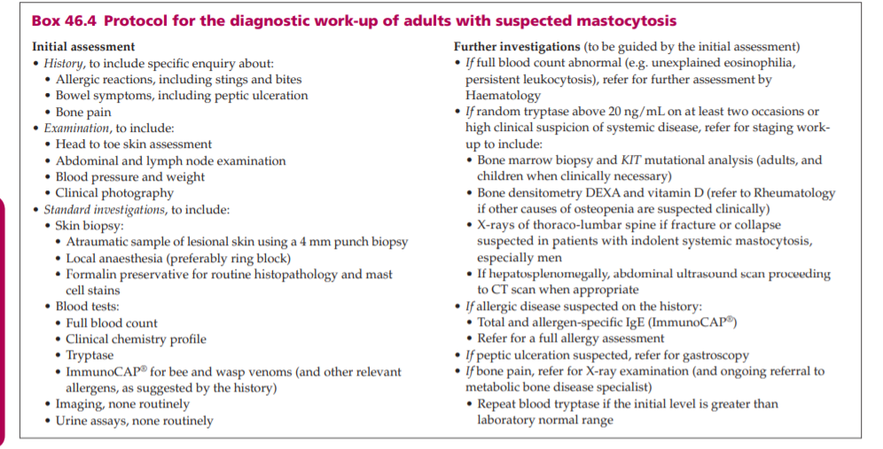
Investigations

Slide 33
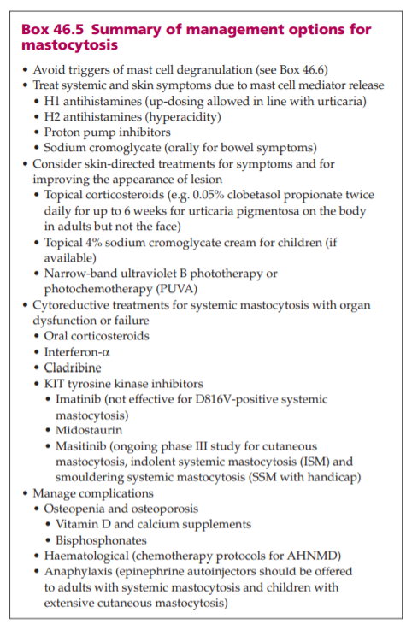
11
1st line
2nd line
3rd line

Slide 34
Disease course and prognosis
Most mastocytomas resolve in childhood.
Around 50% of children with urticaria pigmentosa clear by adolescence.
The main problems likely to be experienced by patients relate to the risks of anaphylaxis and osteoporosis. Prognosis of advanced mastocytosis with an associated blood disorder will relate to the associated haematological disorder, and management will be directed primarily towards this.

