Slide 1
MYCOBACTERIAL INFECTIONS
BY : DR KANZA AFTAB
FCPS RESIDENT
DEPARTMENT OF DERMATOLOGY
CMH ABBOTTABAD

Slide 2
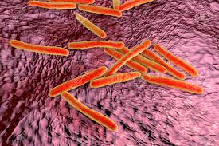
Mycobacterium
A large group of bacteria producing
mould like pellicles when grown
on liquid media.
Features:
slender
non motile
Aerobic
non sporing rods with a waxy coating that makes them resistant to most stains. (Acid Fast)

Slide 3
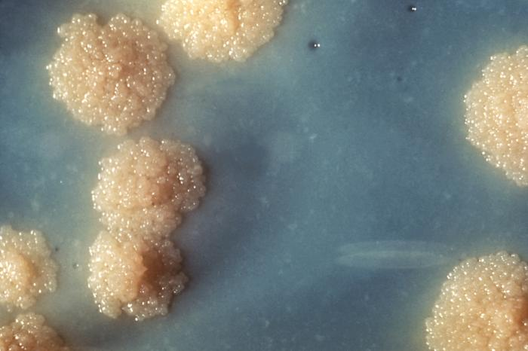

Slide 4
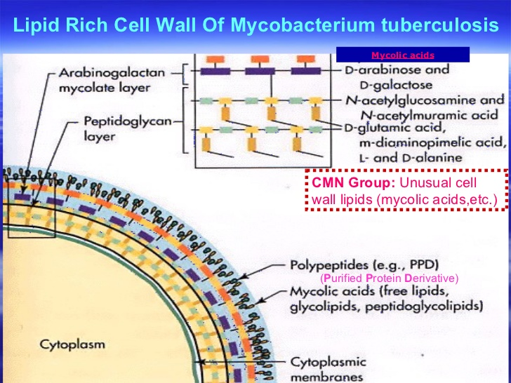

Slide 5
Classification of Mycobacterium
Rate of growth | Species
SLOW GROWERS | M.Mariunum
 | M.kansasii
 | M.avium
 | M.intracellulare
 | M.haemophillium
 | M.ulcerans
 | M.szulgai
 | M.scrofulaceum
 | M.tuberculosis

Slide 6
Rate of growth | Species
Rapid growers | M.Abscessus(group)
 | M.chelonae
 | M.Fortuitum(group)
 | M.margeritense
 | M.wolinskyi
 | M.smegmatis
 | M.mucogmenicum

Slide 7
Rate of growth | species
Non- culturable | M.Leprae
 | M.lepromatosis

Slide 8
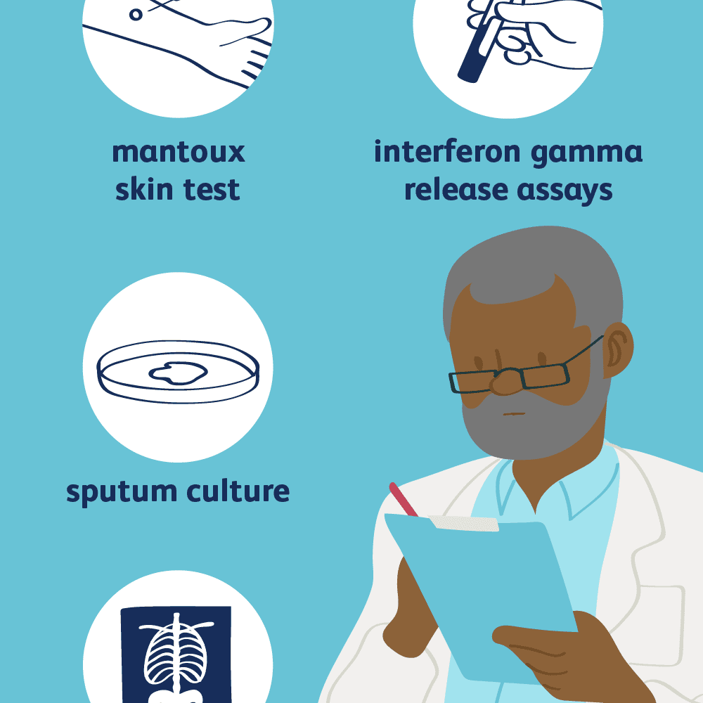
Diagnostic tests
Tuberculin reaction (Koch phenomenon)
Polymerase chain reaction
Quantiferon TB gold test
PCR

Slide 9
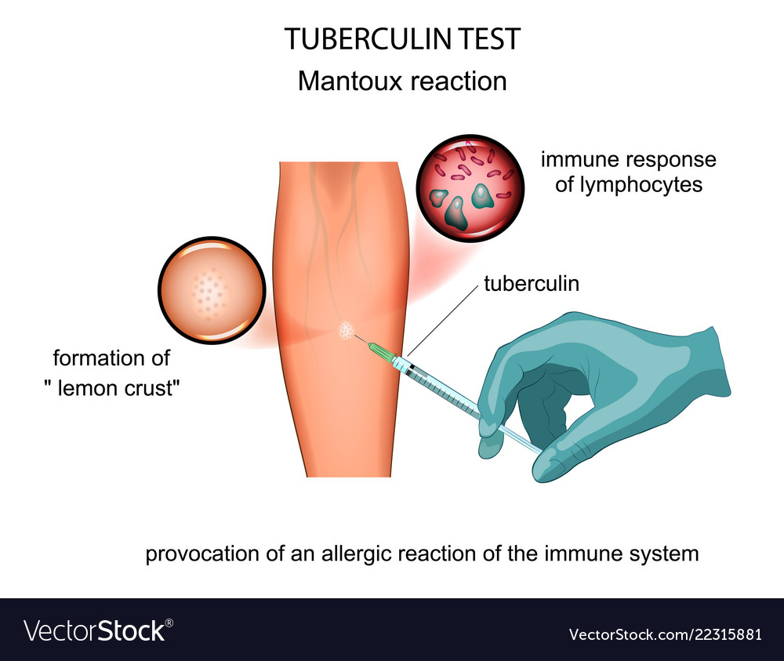
Tuberculin test

Slide 10
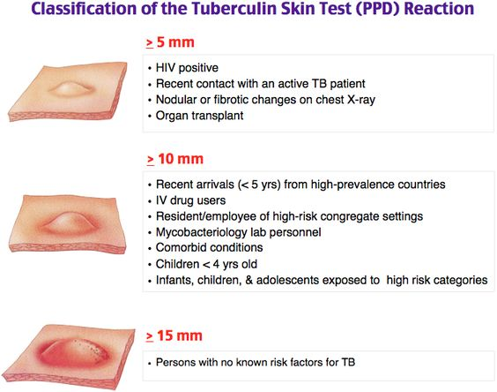

Slide 11
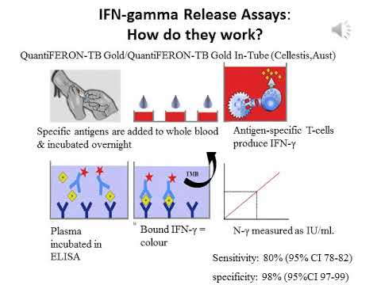
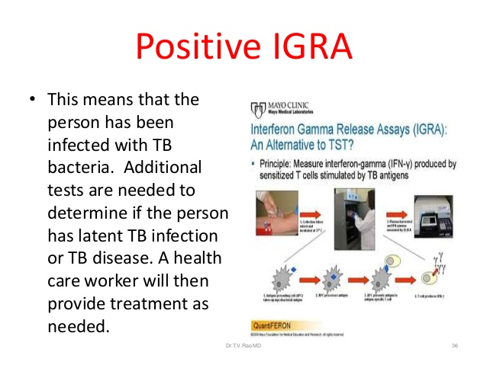

Slide 12
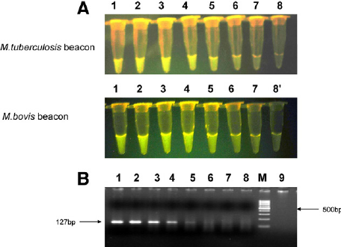
PCR

Slide 13
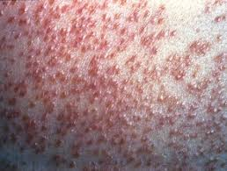
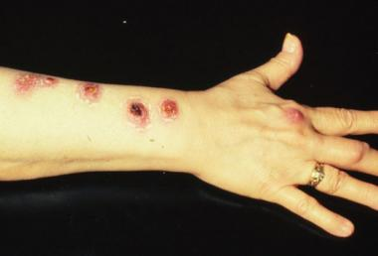
Classification Of Mycobacterial Infections
Tuberculosis of the skin
Non-Tuberculous (Atypical)

Slide 14
Classification of Cutaneous Tuberculosis
Host Immunity | Method of Inoculation | Disease
Multibacillary forms
Naïve Host | Direct Inoculation | Tuberculous Chancre(primary inoculation)
Low | Contiguous Spread | Scrofuloderma
Low | Autoinoculation | Orificial tb
Low | Haematogenous spread | Acute Miliary cutaneous
Low | Haematogenous spread | Tuberculous gumma(abscess)

Slide 15
Paucibacillary Forms
High | Direct Inoculation | Warty tb (verrucosa cutis)
High | Direct Inoculation | Lupus Vulgaris (some)
High | Haematogenous spread | Lupus vulgaris
High | Haematogenous spread | tuberculids
 |  | Lichen Scrofulosorum
 |  | Papulonectrotic tuberculid
 |  | Erythema Induratum (bazin’s)

Slide 16
1. PRIMARY INOCULATION TUBERCULOSIS synonym: chancre/tuberculosis primary complex
Chancre as a result of inoculation of M.tuberculosis into the skin of an individual without natural or artificially acquired immunity to this organism. Initial lesion contains many organisms (multibacillary).
Causative organisms
M.tubuerculosis
M. bovis
Bacille Calmette –Guerin
Mode of entry
abrasion or injury to skin

Slide 17
Predisposing factors
children particularly those who have not received BCG vaccine.
Personal and family history of pulmonary tuberculosis.
Health care workers
ritual circumcision.
inadequately sterilized syringes and needle stick injury, wounds, operations.
ear piercing/ tatooing
mouth to mouth artificial respiration

Slide 18
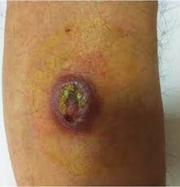
Clinical Features
Early lesions -> 2-4 weeks after inoculation
Brownish papule , nodule or ulcer with undermined edge and a granular hemorrhagic base.
As edge become firmer and adherent crust develops
Common sites: face, hands and lower extremities.
After 4-8 weeks regional lymphadenopathy develops.
Ghon focus.

Slide 19
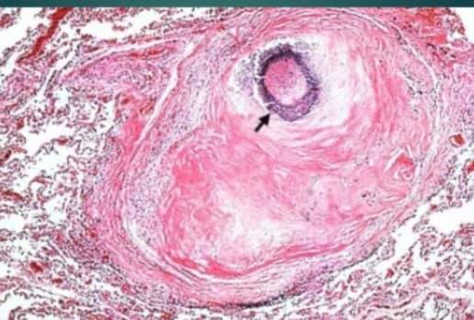
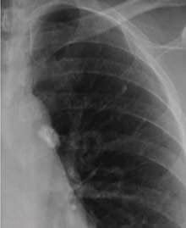
Ghon focus

Slide 20
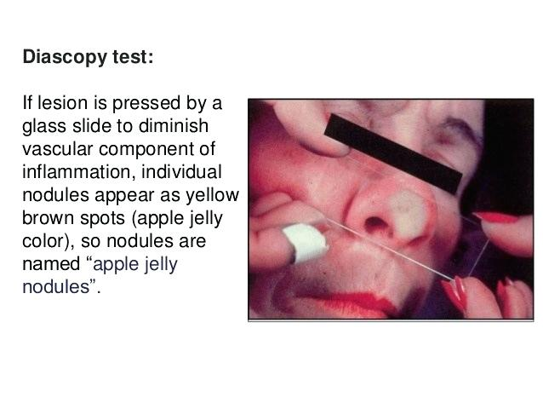
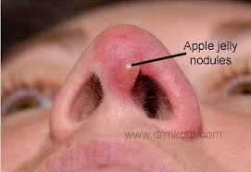
Trauma absent – small lesion with a central silvery scale is seen and shows “apple jelly” nodules on diascopy.

Slide 21
Clinical variants
Mucosal lesions
Conjunctival lesions may cause edema and irritation.
Ulceration and edema or lids with preauricular lymphadenitis.
oral uncommon but painless can be misdiagnosed.

Slide 22
Differential Diagnosis
Ulcers due to M.marinum
Buruli ulcers
Actinomycosis
Cutaneous leishmaniasis
Malignancies
Sporotrichosis
Cat scratch disease
Tularemia

Slide 23
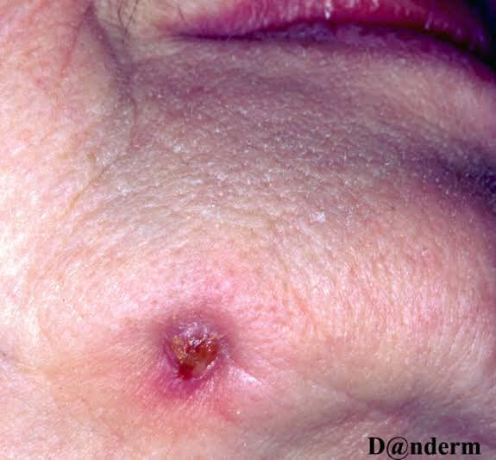
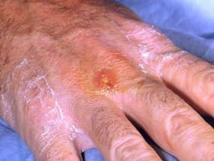
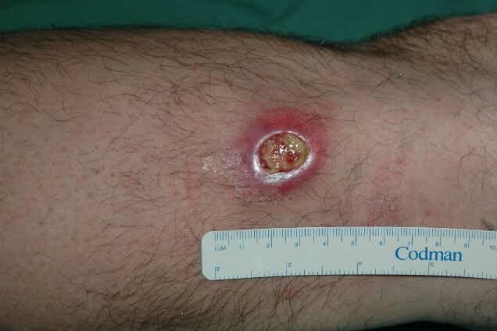
1
2
3
Notes:
1.actinomycosis.actinomyces israelli.inflammetory soft tissue mass-abscess like swelling.2.Tularemia – rabbit fever.francisella tularensis.ulcer type pneumoic type . 3.Buruli ulcer-M.ulcerans.painless nodule-swelling-ulcer

Slide 24
Complication and prognosis
Disseminated tuberculous disease
Untreated – chancre heals spontaneously over many months
Lupus vulgaris or Tb verrucosa cutis develops
Miliary tb
Erythema nodosum
Lymph nodes calcifications
Cold abscess and sinuses develop producing scrofuloderma

Slide 25
Investigations
Histology
AFB seen on microscopy
Tuberculin test (–ve earlier later may become +ve)

Slide 26
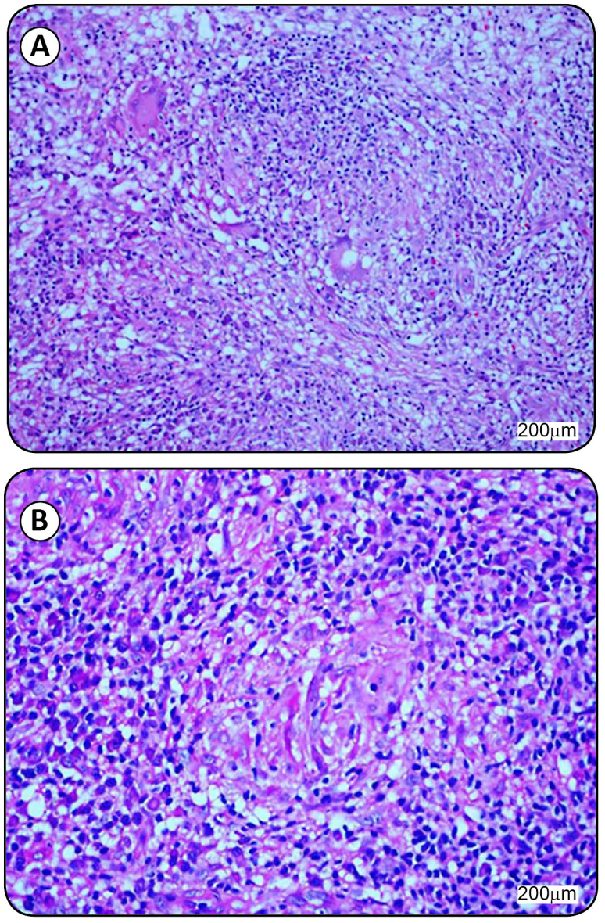
Histopathology
Acute neutrophilic inflammation
Necrosis
Numerous bacilli
After 3-6 weeks infiltrate becomes more granulomatous and caseation appears coinciding with disappearance of bacilli

Slide 27
Management
Antituberculous therapy (1st line)
ISONIAZID 300mg DAILY FOR FULL 6 MONTHS
PYRAZINAMIDE FIRST 2 MONTHS 1.5g DAILY WT<50;
2g above this wt.
All drugs to be taken on empty stomach once daily
S/E: peripheral neuropathy
Hepatitis
S/E : hypersensitivity, gout, hepatitis,arthritis
RIFAMPICIN 450mg DAILY WT<50KG ;
600 mg >50KG FULL 6 MONTHS
ETHAMBUTOL FIRST 2 MONTHS 15mg/kg body weight daily.
S/E : orange colored urine, sweat & tears
S/E: visual disturbances

Slide 28
2nd line ATT
p- Amino salicylic acid
Capreomycin
Cycloserine
Ethionamide
Levooxacina
Streptomycin
Amikacin/ kanamycina

Slide 29
MDR
XDR
Mycobacterium resistant to Rifampicin and Isoniazid.
Treament includes:
Levofloxacin
Pyrazinamide
Cyclosirine
Ethionamide
Inj: Amikacin
Mycobacterium resistant to rifampicin, isoniazid,fluoroquinolones and at least one of the injectable agents ( kanamycin,amikacin and capriomycin)

Slide 30
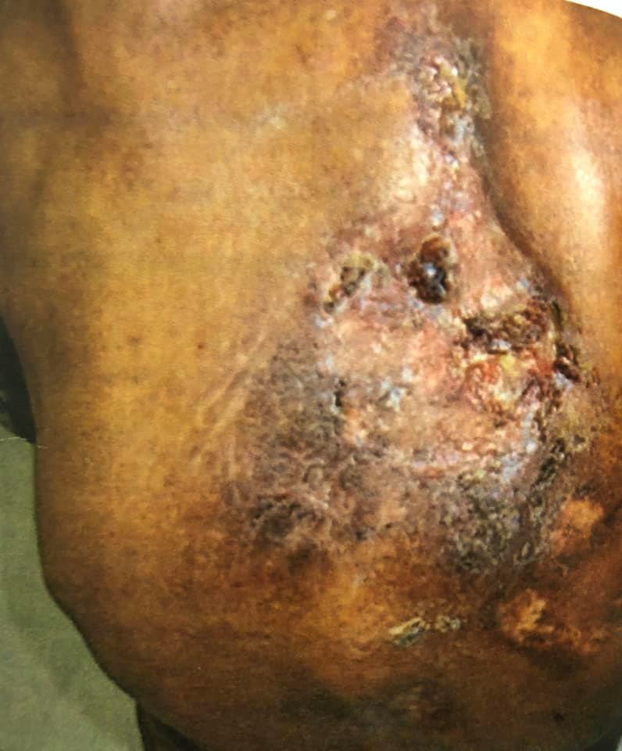
Scrofuloderma
Direct invasion of the tubercle bacillus in skin from underlying contiguous tuberculous focus
(usually a lymph gland, infected bone or joint,lacrimal duct or gland, breast or testes)
Commonest form of cutaneous tb.
Common in children
Associated diseases: Sweet disease & Systemic tb.
Causative organism : Mycobacterium tuberculosis
Notes:
Associated with tb of spine

Slide 31
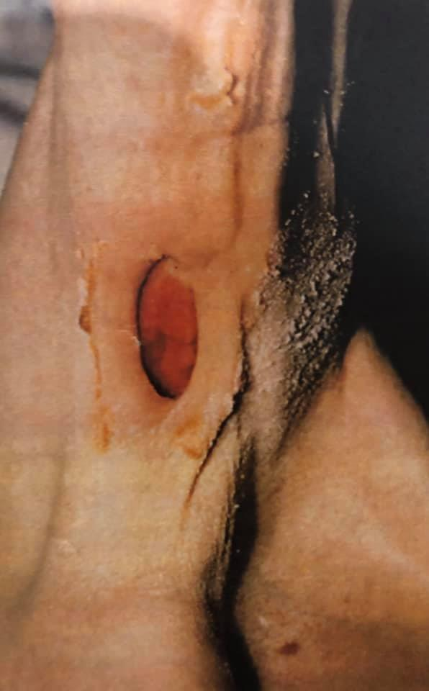
Notes:
74 yrs old man prior to ATT shows scrofuloderma associated with TB of axillary gland.

Slide 32
Clinical Features
Asymptomatic bluish red subcutaneous swelling overlie infected gland or joint,
Ulcerating and granulating tissue at base
Numerous fistulae
Irregular and adherent masses ,densely fibrous in places and fluctuant or discharging in others
Fungating tumors
Sporotrichoid spread
Puckered scarring

Slide 33
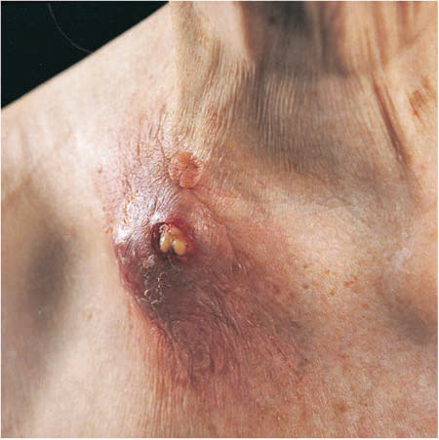
Notes:
Scrofuloderma in clavicular region-abscess formation,ulceration,purulent and caseous material coming out.

Slide 34
Clinical variants:
Extensive ulcerative lesions particularly on scalp.
Differential diagnosis:
Non tuberculous Mycobacterial Infection( M.avium complex lymphadenitis, M scrofulaceum)
Sporotrichosis
Actinomycosis
Syphillitic gumma
Hidradenitis suppuritiva
Melioidosis
Bacterial abscess

Slide 35
Spontaneous healing can occur but course is very protracted and leaves typical cord like scars.

Slide 36
Investigations
Skin biopsy
Cytology smears from FNAC
Mycobacterial Culture
Mantoux test +ve
Exclude HIV or other causes of immunosuppression.

Slide 37
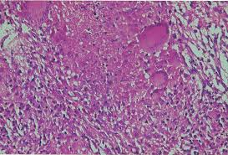
Histopathology
Ulcerated dermal abscess with ill defined histiocytic component.
Marked caseation necrosis
Numerous bacteria in deeper structures

Slide 38
Management
Antituberculous therapy

Slide 39
Lupus Vulgaris
Chronic progressive form of cutaneous TB occurring in previously sensitized individual with high degree of immunity to tuberculin.
Characteristic lesion is plaque composed of, elevated border and central atrophy. soft reddish brown papules
On Diascopy : apple jelly appearance.

Slide 40
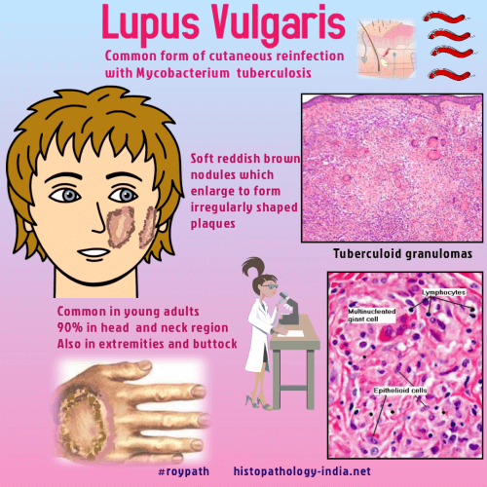

Slide 41
Pathophysiology
Originates from underlying focus of tuberculosis typically in bone joint or lymph node and arises by either contigious extension of disease from underlying affected tissue or heamatogenous or lymphatic spread.
Can also arise after exogenous inoculation or as complication of bcg vaccine.

Slide 42
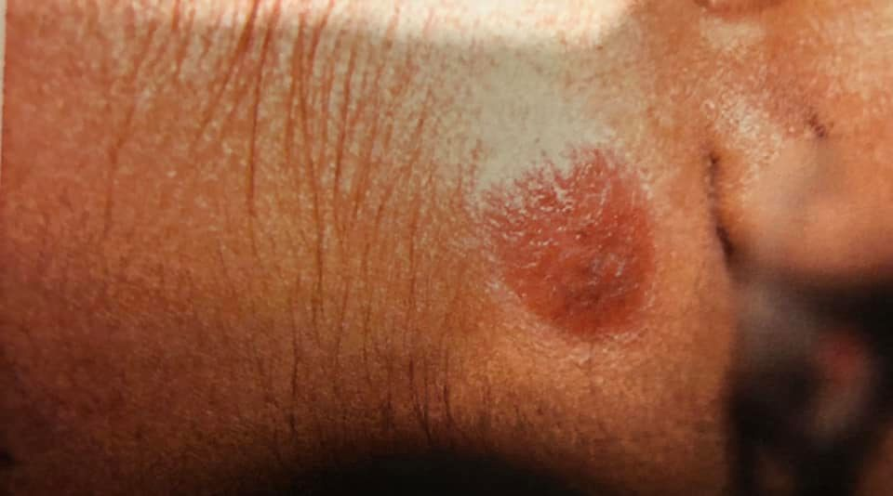

Slide 43
Causative organisms:
Mycoabacterium tuberculosis
Mycobacterium bovis
Bacille Calmette Guerin (BCG)

Slide 44
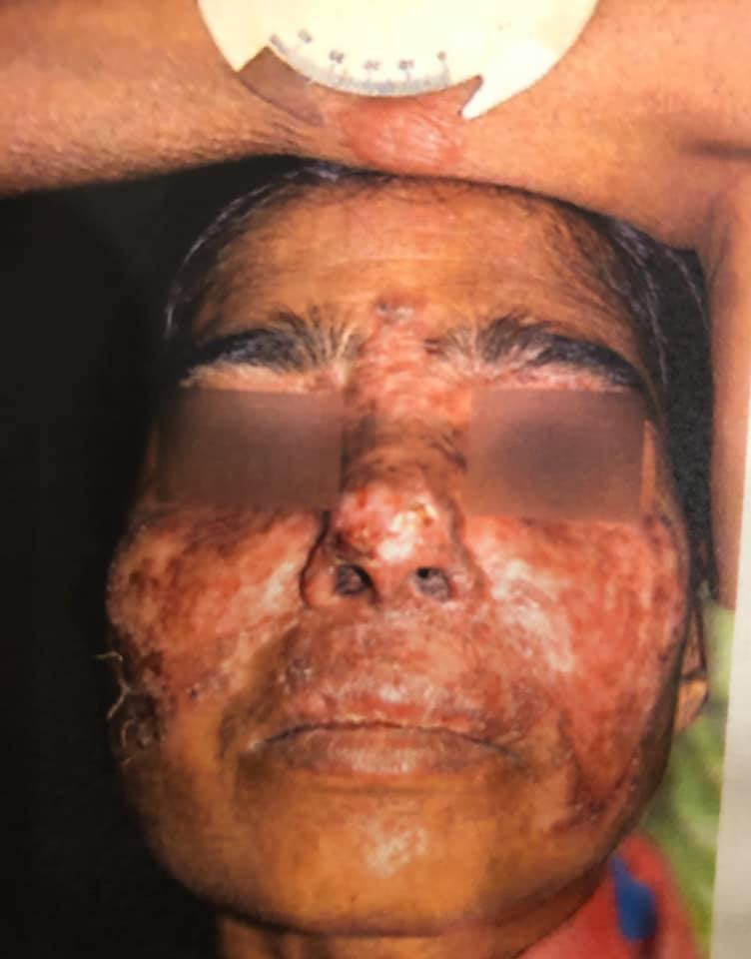

Slide 45
Presentation
Appears in normal skin as solitary lesion
Can arise after inoculation by tattoo, in scar of scrofuloderma or at bcg site
Common sites:
In Europe ->head neck and around nose
India -> buttocks and trunk
Children in developing countries -> lower limbs and buttocks
Initially small reddish brown flat plaque of soft gelatinous consistency .
On diascopy : apple jelly nodules
Lesion gradually become elevated -> gyrate/discoid with areas of atrophy
Disseminated form
Sporotrichoid like spread is reported

Slide 46
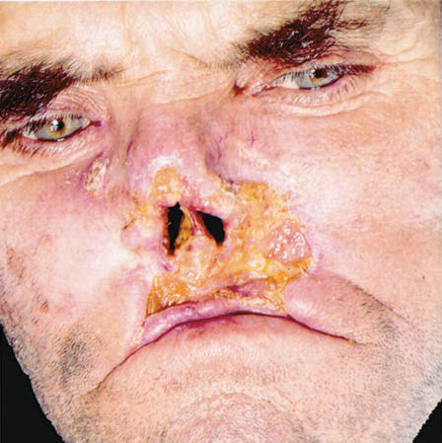

Slide 47
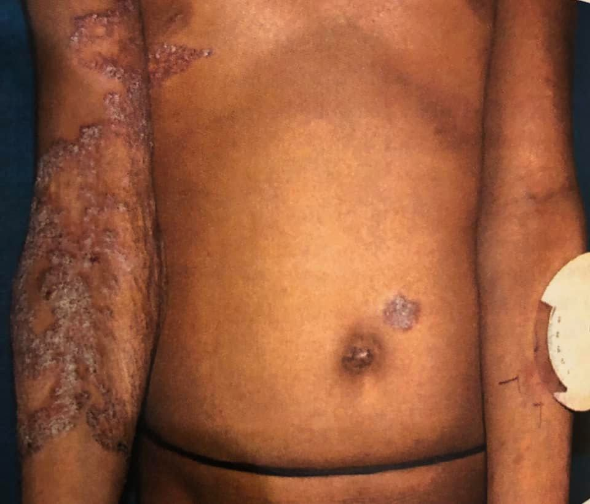
Clinical forms
Plaque form:
Flat plaques with irregular or serpiginous edge. surface smooth or covered with psoriasiform scale large plaques may show irregular areas of scarring with islands of active lupus tissue. Edge becomes hyperkeratotic and thickened.

Slide 48
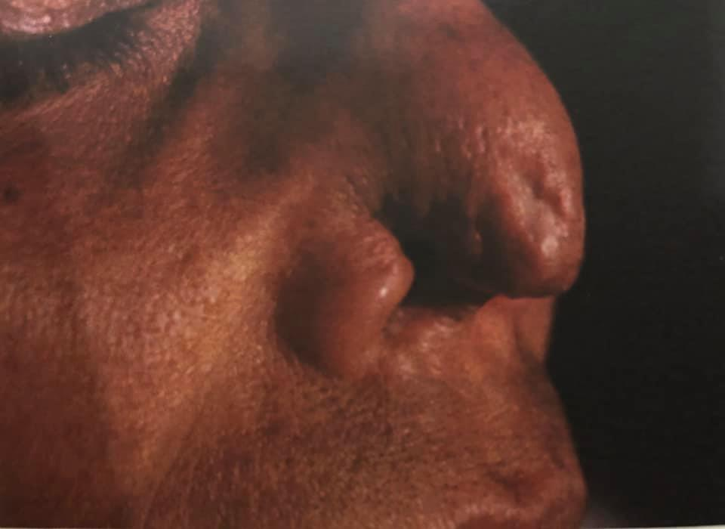
Ulcerative and mutilating forms
-scarring and ulceration predominate
-crust form over areas of necrosis
-deep tissue and cartilages are invaded and contractures and deformities occur.

Slide 49
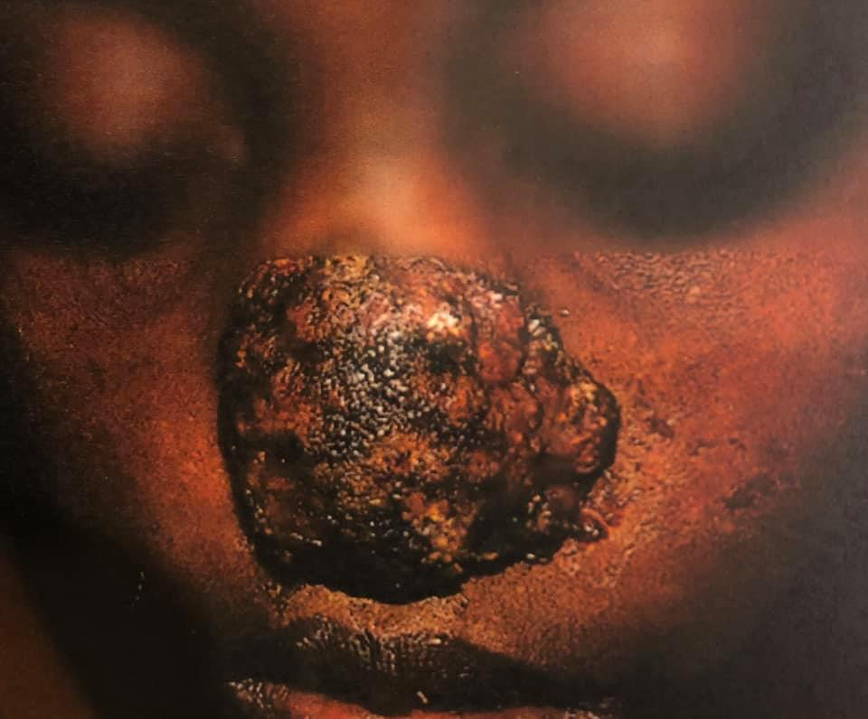
Vegetating form
Marked infiltration ulceration and necrosis with minimal scarring
Mucous membrane invaded
Cartilage slowly destroyed
disfigurement

Slide 50
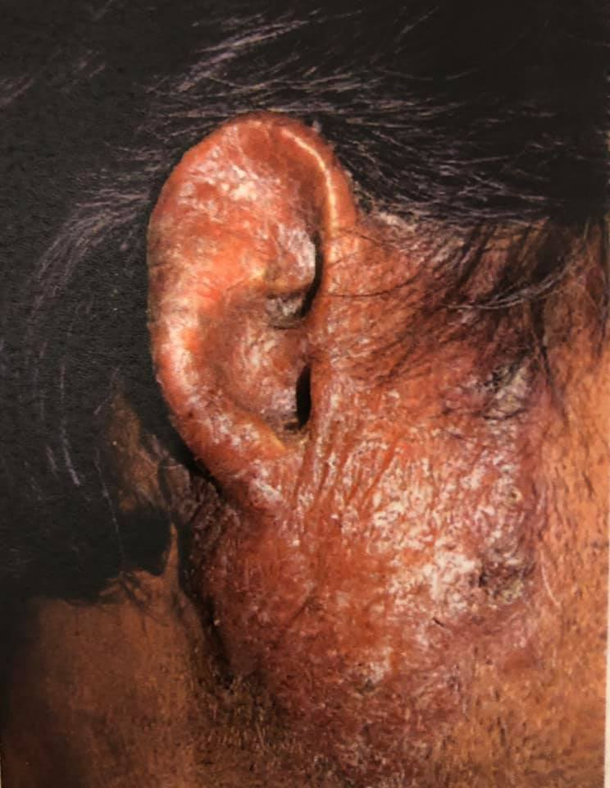
Tumor like forms
Soft tumor like nodules or as epithelial hyperplasia with production of hyperkeratotic masses
Myxomatous form: huge soft tumors on ear lobes grossly enlarged.lymphedema and vascular dilatation marked

Slide 51
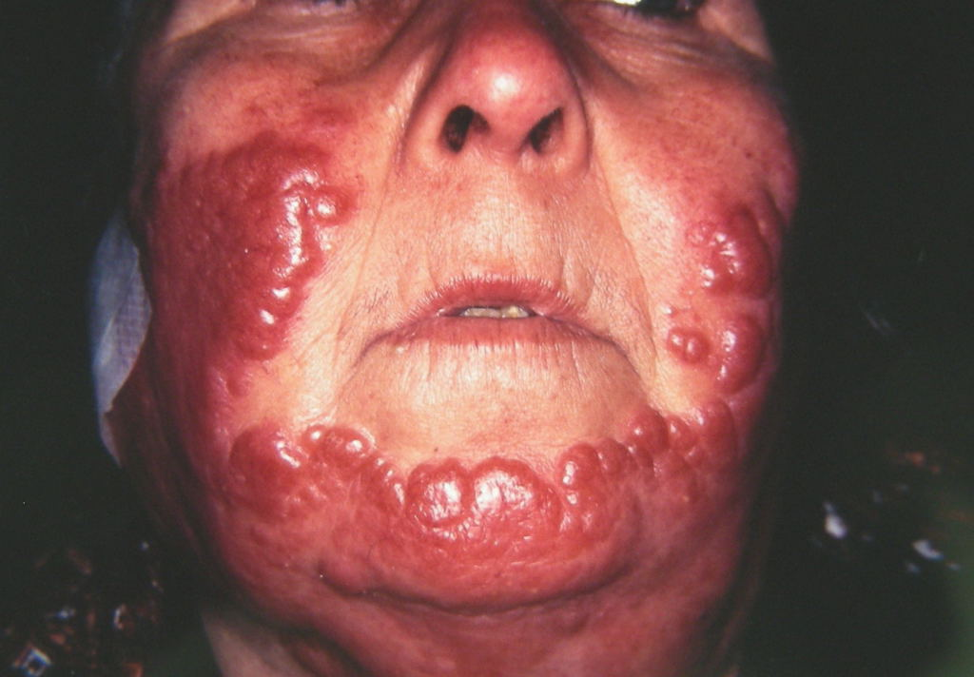

Slide 52
Papular and nodular forms
Multiple lesions simultaneously in disseminated lupus true ‘miliary lupus’
Post exanthematous forms

Slide 53
Mucosal involvement
Nasal,buccal,conjuctival
Papule,nodule,ulcer or by spread
Nose -> nodule, easily bleed ulcerate cartilage destruction, dry rhinitis.
Buccal-> granulating,vegetating,ulcerating

Slide 54
Differential diagnosis:
Lymphocytoma
Spitz nevus
Lupus erythematosus
Syphillis
Deep mycoses
Rosacea
Port wine stain
Leprosy
Sarcoidosis
Psoriasis
Bowen disease
Lichen simplex chronicus
Crohns disease
Warty tb

Slide 55
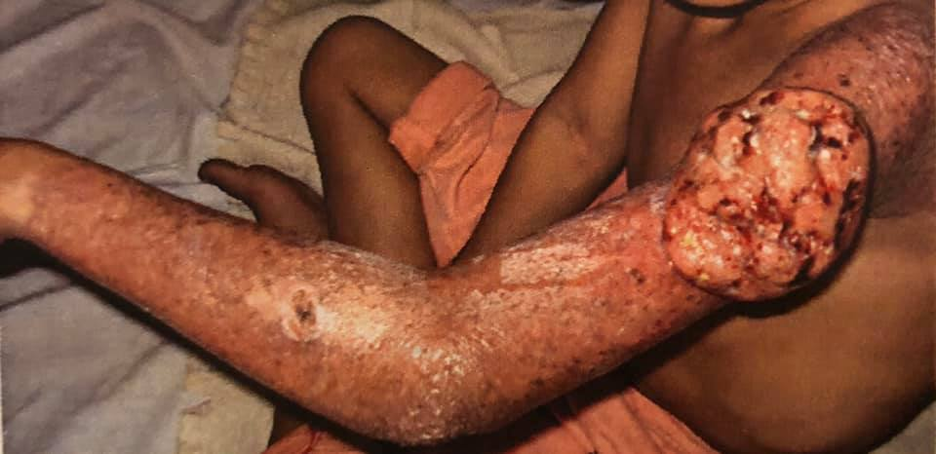
Complications
Scarring-> keloid
Contractures-> ectropion/ microstomia
Tissue destruction
In situ or invasive squamous cell carcinoma
Basal cell ca
Syringoid eccrine ca
melanomas

Slide 56
Prognosis:
course of untreated lesion is progressive
With treatment->response on 5 weeks
improvement-> 10 weeks

Slide 57
Investigations
Skin biopsy
Culture
PCR
Tuberculin test (usually +ve)
IFN gamma assays

Slide 58
Pathology
Tubercles with scanty or absent central caseation surrounded by epitheloid histiocytes and multinucleate giant cells are present in superficial dermis.
Peripheral lymphocytes
Occasionally Numerous tubercle bacilli
Epidermis maybe ulcerated with mixed infiltrate atrophic or acanthotic.
Severe acanthosis->pseudoepitheliomatous hyperplasia

Slide 59
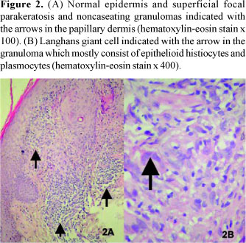

Slide 60
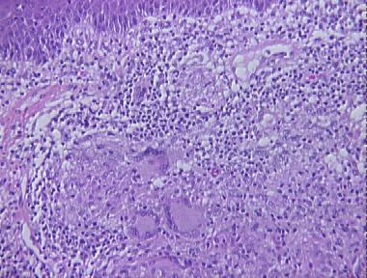

Slide 61
Management
Standard multidrug antituberculous therapy
Lupus vulgaris caused by Isoniazid resistant M.tubercculosis emphsizes that monotherapy is not effective.

Slide 62
( tuberculosis cutis orificialis)
Orificial Tuberculosis
Painful ulcerated plaues due to tuberculous infection of mucosa or skin adjoining orifices. (advanced pulmonary , intestinal or genitourinary disease)
Oral mucosa and tongue commonly affected area.
Autoinoculation into break in mucosa
Oral lesions due to ingestion of bacilli in sputum

Slide 63
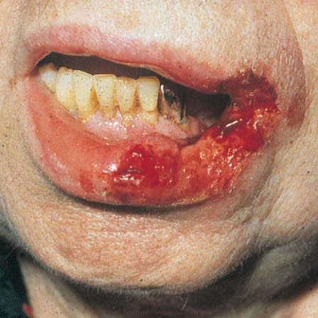

Slide 64
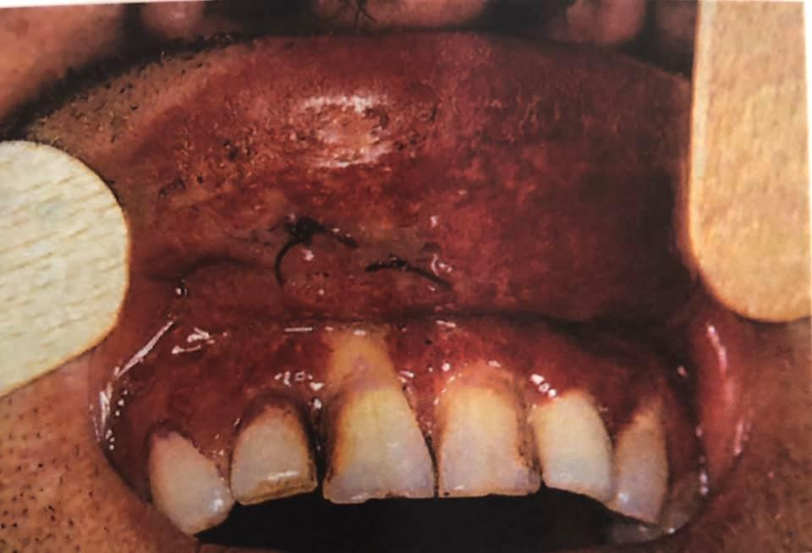

Slide 65
Associated disease :
systemic tb
Presentation:
Severely ill adult with advanced visceral tb and impaired cell mediated immunity.
Lesions: commonly in mouth.Small, red oedematous nodules rapidly breakdown to form painful shallow ulcers with undermined bluish edges seldom exceed 2cm diameter.
Involve tip and lateral margin of tongue.
Granulomatous swelling of lips.
Gingival involvement
Perianal ulcers sharply demarcated with erythematous borders and purulent base. Vulval similar appearance and painful

Slide 66
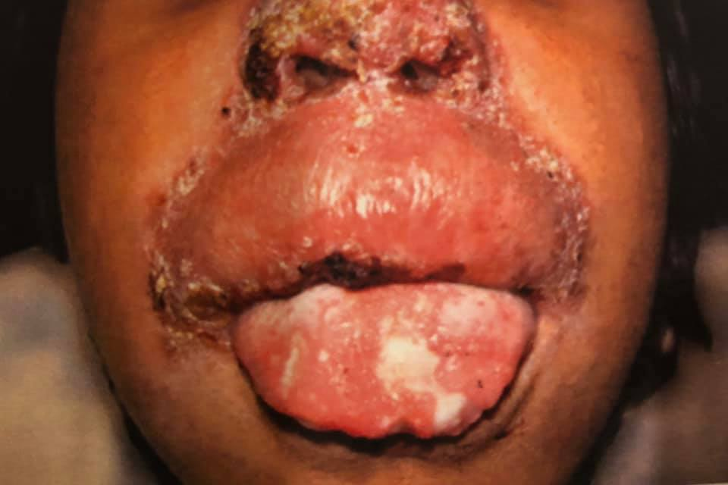

Slide 67
Clinical variants:
Plaque similar to lupus vulgaris
hypertrophic lesions similar to tuberculosis verrucosa cutis
Differential Diagnosis:
Oral lesions (in crohns)
Mucocutaneous leishmaniasis
Oral paracoccoidomycosis
Rhinoscleroma
Anogenital lesions diff from:
Malignancy
Nicrondil induced ulceration
Anal paracoccoidomycosis
Chronic herpes simplex infection
Syphillis

Slide 68
Investigations
Skin biopsy
Smear cytology from base of purulent ulcer- multiple AFB.
PCR
Tuberculin test –ve
Screening to exclude systemic tb
Exclude HIV

Slide 69
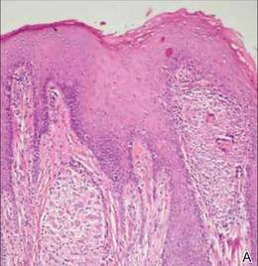
Pathology
Variable
Tuberculoid infiltrate with pronounced necrosis in deep dermis
Tuberculous bacilli

Slide 70
Management
Antituberculous therapy

Slide 71
Acute cutaneous Miliary tuberculosis
Tuberculosis cutis milaris disseminata
Due to haematogenous spread of tubercle bacilli into the skin
Affects infants and young children or immunosuppressed or following viral infections
Causative organism
Mycobacterium tuberculosis

Slide 72
Presentation
Crops of minute bluish papules, vesicles, pustules or hemorrhagic lesions in ill patient
Can occur all over body but frequently on trunk, thighs, buttocks and genitalia.
Vesicles may become necrotic to form small ulcers
Erythematous nodules
Neonates to tuberculous mothers may have mild form with limited visceral involvement and few scatter papules

Slide 73
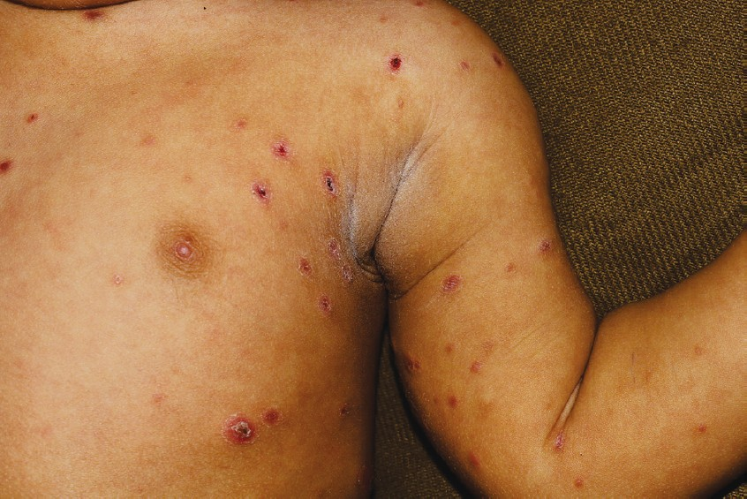

Slide 74
Prognosis : POOR but response to treatment possible
Investigations:
History of ill patient with exposure
Skin biopsy
Management:
Antituberculous therapy immediately maybe complicated by MDR tb

Slide 75
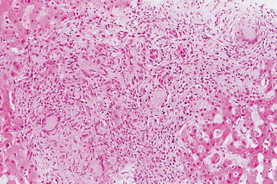
Pathology
Necrotizing tuberculous granulomas with multiple acid fast bacilli.

Slide 76
Metastatic tuberculous abscess
Or tuberculous gummata result from disseminated haematogenous spread of mycobacterium
Single or multiple dermal subcutaneous nodules which may become fluctuant or break down to form ulcers

Slide 77
Seen particularly in malnourished children or immunodeficient adults or after venepuncture
In association with underlying lymphoma and systemic immunosupressant treatment such as corticosteroids
Causative organism : Mycobacterium tuberculosis

Slide 78
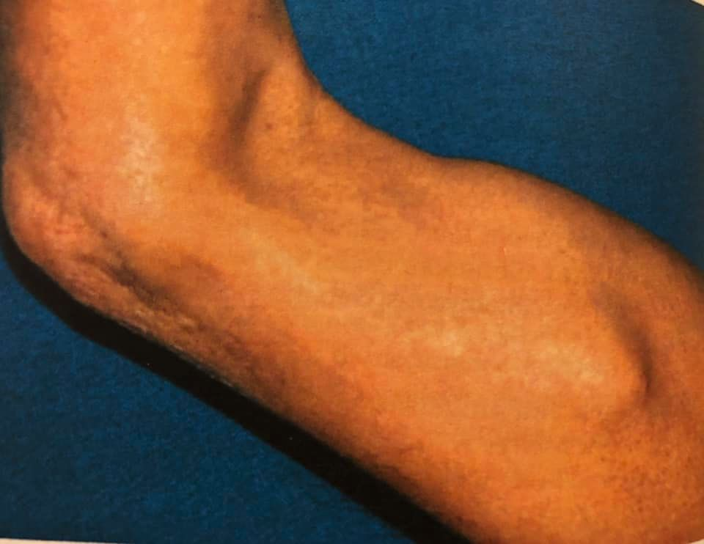

Slide 79
Presentation :
Firm subcutaneous nodule OR non tender fluctuant abscess
Extremities more affected
Overlying skin break down to form ulcer with sinus or fistulous tracts.
Lesions maybe multiple
Carpal tunnel syndrome

Slide 80
Differential diagnosis:
Pyogenic bacterial infections
Syphillis
Non tuberculous mycobacterial infections
Pyoderma gangrenosum
Fungal infections

Slide 81
Complications:
Carpal tunnel syndrome
Prognosis:
Gradually Improve on treatment

Slide 82
Investigations
Culture
Screening for focus of tb and causes of immunosuppression
Tuebrculin test +ve, can be –ve if poor general condition of patient

Slide 83
Pathology
Massive necrosis with copious amounts of bacteria.
Management:
Full antituberculous therapy guided by culture

Slide 84
Warty tuberculosis tuberculosis verrucosa cutis
Indolent, warty ,plaque like form of tuberculosis caused by exogenous inoculation of M.tuberculosis into skin through open wounds or abrasions in previously infected or sensitized individuals who will have a moderate or high degree of immunity.
Anatomists warts
Prosectors warts
Verruca necrogenica
Causative organism: M.tuberculosis

Slide 85
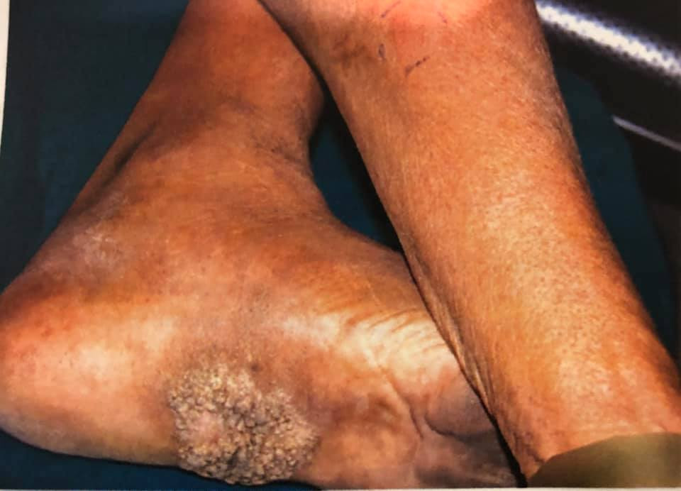

Slide 86
Clinical features
Slowly enlarging
May remain undiagnosed for long
Areas exposed to trauma or infected sputum or other tuberculous material.
Common sites in Asia : knees ,ankles and buttocks
Asymptomatic , small indurated, warty papule with slight inflammatory areola-> verrucose plaque.
Irregular extension -> serpiginous outline with finger like projections.
Centre may involute,leaving a white atrophic scar or whole lesion may form massive infiltrated pappilomatous excrescence.
Colour is purplish red or brown .
Consistency is firm but areas of softening
Pus from soft areas or fissures

Slide 87
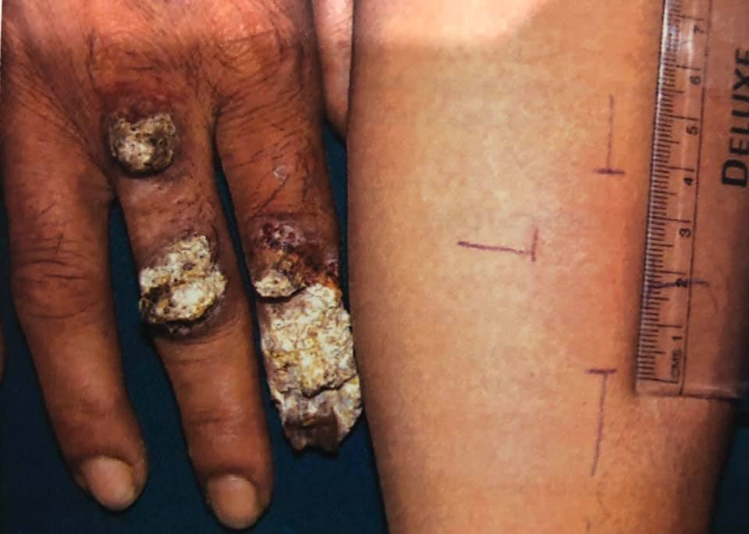

Slide 88
Resembles lupus vulgaris (Different sites)
Appearance can be psoriasiform or keloidal
Exudate and crusting predominant occasionally
Clinical variants:
Deep destructive papillomatous and sclerotic forms may cause deformity of limbs
Genralised form associated with papulonecrotic and lupoid lesions

Slide 89
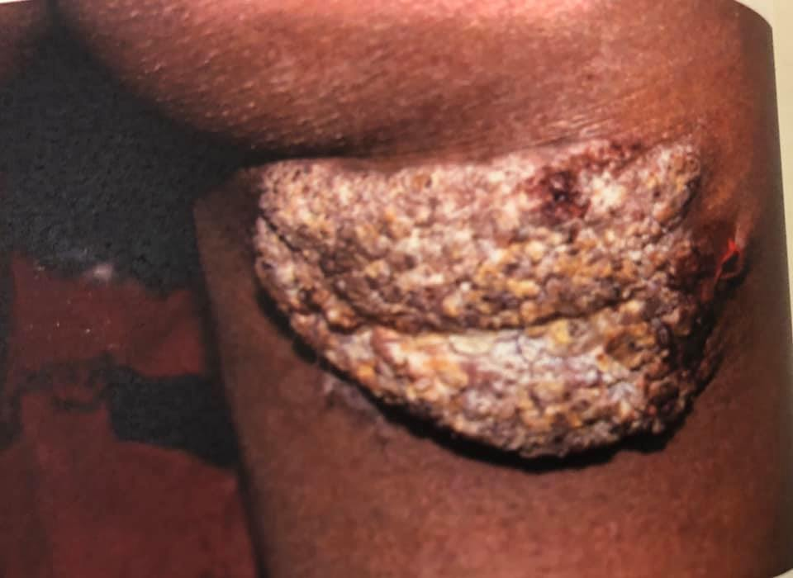

Slide 90
Differential Diagnosis
Subungual and digital lesions must be distinguished from warts and those on hands from keratoses
Blastomycosis
Chromoblastomycosis
Actinomycosis
Leishmaniasis
Tertiary syphillis
Hypertrophic lichen planus
Lesions caused by NTM can usually be distinguished by microbiological culture (M.marinum)

Slide 91
Complications
Tuberculous lymphadenitis
Pulmonary tb
Miliary tb with scrofuloderma
Prognosis:
Responds to treatment
Without it extension is slow
Lesions may remain virtually inactive
Spontaneous remission-> atrophic scars

Slide 92
Investigations
Histopathology :striking pseudoepitheliomatous hyperplasia with superficial abscess formation.
Intense mixed infiltrate may show sparse tuberculous foci.
Bacilli seen occasionally.
Culture
Commercial IFN-gamma assays
PCR

Slide 93
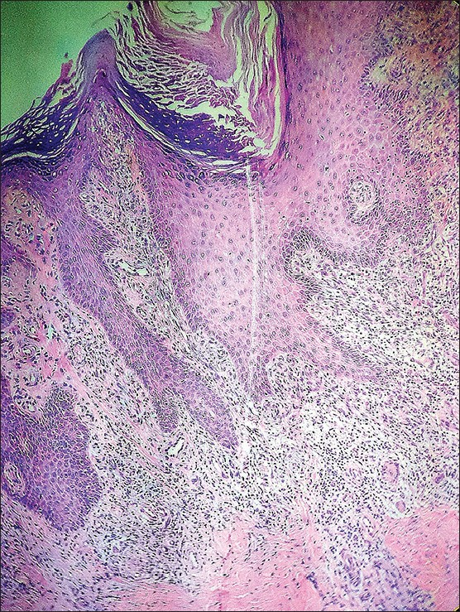
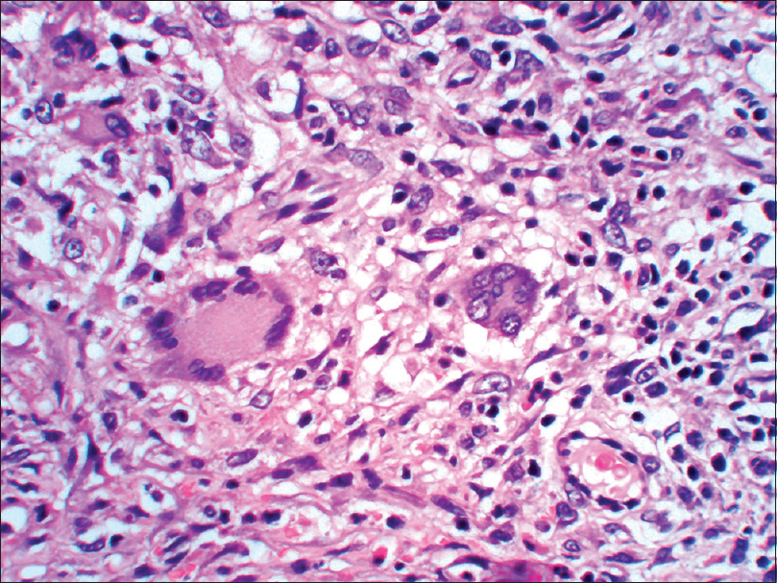

Slide 94
Management
Antituberculous therapy

Slide 95
Tuberculids
Cutaneous hypersensitivity reaction to hematogenous dissemination of M tuberculosis or its antigens from primary source in an individual with strong antituberculous cell mediated immunity
Classification of true tuberculids
1 | Micropapular | Lichen scrofulosorum
2 | Papular | Papulonecrotic tuberculid
3 | Nodular | Erythema induratum of bazin or nodular tuberculid

Slide 96
Lichen scrofulosorum
Tuberculosis cutis lichenoides
Lichenoid eruption of minute papules occurring predominantly in children and adolescents with active tb.Associated with strongly positive tuberculin reaction.
Cutaneous marker for underlying tb.focus of tb commonly on cervical,hilar and mediastinal lymph nodes,lung,bones or intracranial sites.

Slide 97
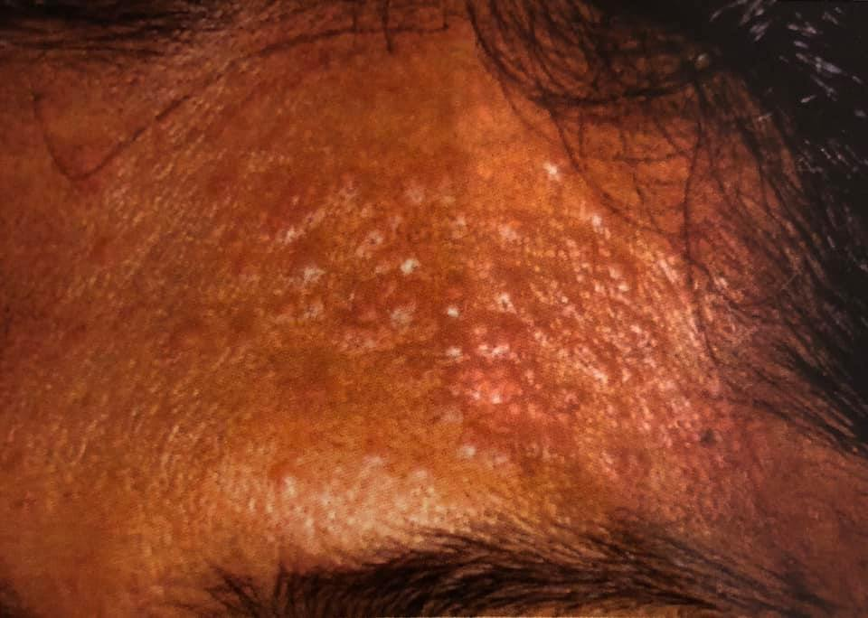

Slide 98
Associated diseases
Lupus vulgaris
Tuberculous gumma
Tuberculous verrucosa cutis

Slide 99
Pathophysiology
Unknown but maybe due to type III hypersensitivity reaction to haematogenous spread
High sensitivity to tuberculin
Continued formation of antigen antibody complex may lead to type IV hypersensitivity reaction and granuloma formation

Slide 100
Causative organisms:
M.tuberculosis
M.bovis
M.avium
M.szulgai

Slide 101
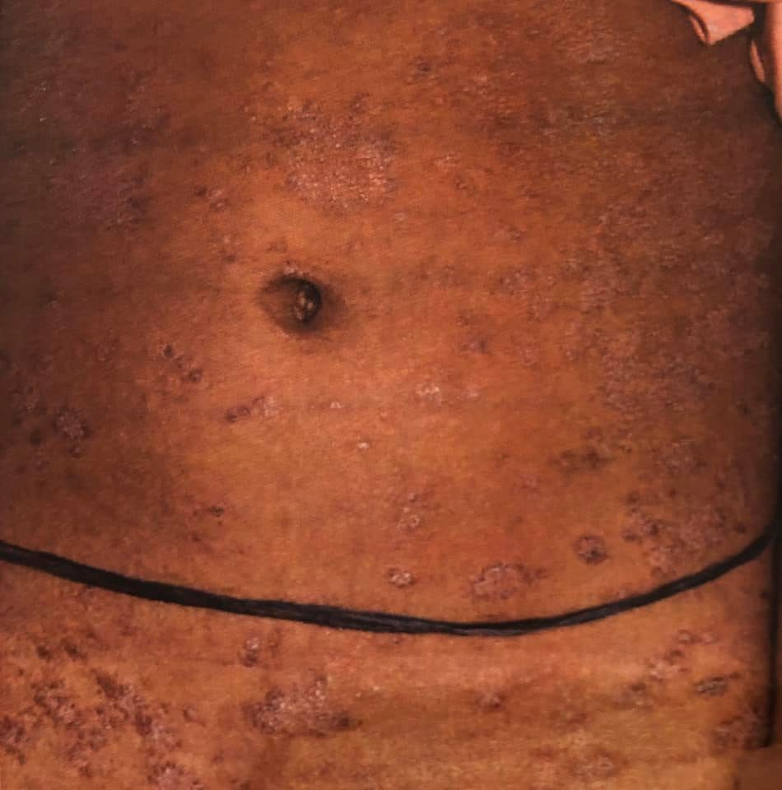
Clinical features
Eruption is symptomless 0.5-3mm closely grouped lichenoid papules. lesions are usually skin colored but maybe yellow or reddish brown. They are often perifollicular and can appear in groups or in annular arrangement or coalesce into confluent plaques.
Papules may have adherent crust or small pustules
Rare bullous lesions

Slide 102

Clinical variants
Lichenoid
Psoriasiform
Granuloma annulare like variants

Slide 103
Differential diagnosis
Lichen nitidus
Keratosis spinulosa
Keratosis pilaris
Papular or lichenoid sarcoidosis
Secondary syphillis
Drug eruptions
Pityriasis rosea

Slide 104
Co morbid:
underlying Systemic tb infection
Prognosis:
With therapy lesions clear-> 4 weeks or early as 2 weeks
Heal without scarring

Slide 105
Investigation:
Screen for focus of tb
Tuberculin reaction strongly +ve
PCR

Slide 106

Pathology:
Superficial dermal granulomas surround hair follicles and sweat ducts may occupy several dermal papillae
Epitheloid cells
Lymphocytes
Occasional giant cells
Mycobacterial DNA –ve on PCR

Slide 107
Management
Antituberculous therapy

Slide 108
Papulonecrotic tuberculid
Subtype of tuberculid presents with symptomatic clusters of small inflammatory erythematous papules that may become pustular or necrotic or evolve into discrete crusted ulcers which heals over weeks with varioliform scarring
It affects children and young adults

Slide 109


Slide 110
Associated disease:
Lupus vulgaris
Erythema induratum
Pathophysiology:
Similar to other tuberculids

Slide 111
Causative organism
M.tuberculosis
M.kansasi
M.avium complex
M.bovis

Slide 112

Clinical features:
Asymptomatic
Symptoms of tb elsewhere
Recurring crops of symmetrical hard dusky red papules which crust or ulcerate leaving pigmented sometimes atrophic varioliform scars
Children-> phlyctenular conjunctivitis
Common sites: legs ,knees ,elbows, hands and feet

Slide 113
Clinical variants:
Isolated areas of genitalia
Verrucous variant mimicking kyrles disease
Differential diagnosis:
Pityriasis lichenoides
Leukocytoclastic vasculitis
Nodular prurigo

Slide 114
Complications:
Lesions heal with scarring and hyper pigmentation
Investigation:
Regional biopsy
TST -> strongly positive
PCR
IGRA

Slide 115

Pathology

Slide 116
Erythema induratum of bazin
Most common
Tuberculosis associated pannicultis
Young-middle age females
Associations: nasopharyngeal, renal and endometrial tb,papulonectrotic tuberculid, lichen scrofulosorum
Causative organism:
M.tuberculosis
M.bovis
M.chelonae

Slide 117


Slide 118
Clinical features:
Indolent eruption of ill defined nodules or subcutaneous plaques,usually indurated with scaly surface.
Lesions may ulcerate-> ragged ,irregular , shallow with bluish edge
Lesions heal with atrophic hyperpigmented scarring
Common sites: posterior aspect of lower legs in women

Slide 119
Pathology
Focal or diffused
Lobular or septolobular
Granulomatous panniculitis in association with neutrophilic vasculitis (large/small vessels)
Areas of coagulative and caseation necrosis
Poorly developed granulomas

Slide 120


Slide 121
Clinical variants:
Nodular tuberculid
Nodular granulomatous phlebitis/ superficial thrombophlebitic tuberculid
Differential diagnosis:
Erythema nodosum
Pancreatic panniculitis
Polyeartritis nodosa
Lupus profundus
Subcutaneous sarcoid
Cutaneous t cell lymphoma
perniosis

Slide 122
Management
1st line
ATT
2nd line
Resting
Nsaids
Compression bandaging

Slide 123

Other Nodular tuberculids
Erythema Nodosum
Nodular vasculitis
Lupus Miliaris Disseminitus faciei
Tuberculous mastitis

Slide 124
THANK YOU

