Slide 1
CUTANEOUS MUCINOSIS
DR. SOHAIL SHAHEEN

Slide 2
INTRODUCTION
HETEROGENOUS GROUP OF DISORDERS
MAIN CHARATERISTIC; ABNORMAL MUCIN DEPOSTION

Slide 3
WHAT IS MUCIN?
A JELLY LIKE AMORPHOUS SUBSTANCE
NORMAL COMPONENT OF DERMAL ECM
PRODUCED BY FIBROBLASTS
MIXTURE OF ACID GLYCOSAMINOGLYCANS
2 SUBTYPES OF ACID GAGs:
  SULPHATED e.g. CHONDROITIN SULPHATE, DERMATAN SUPHATE
  NON SULPHATED e.g. HYALURONIC ACID
HYGROSCOPIC: ABSORBS 1000 TIMES ITS OWN WEIGHT IN WATER

Slide 4
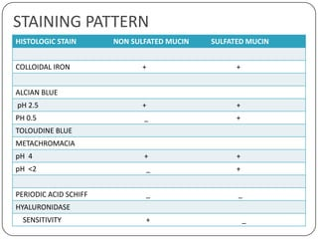
STAINING PATTERN

Slide 5
CLASSIFICATION
PRIMARY CUTANEOUS MUCINOSIS
SECONDARY MUCINOSIS
Mucin Deposit is main Histologic Feature
Mucin deposits is only additional finding and a secondary phenomenon

Slide 6
PRIMARY MUCINOSIS
DERMAL MUCINOSIS
FOLLICULAR MUCINOSIS
LICHEN MYXOEDEMATOSUS
  SCLEROMYXOEDEMA
  LOCALISED LM
RETICULAR ERYTHEMATOUS MUCINOSIS
SCLEREDEMA
MYXOEDEMA OF THYROID DISEASE
PAPULAR AND NODULAR MUCINOSIS IN CTDs
SELF-HEALING CUTANEOUS MUCINOSIS
CUTANEOUS FOCAL MUCINOSIS
DIGITAL MUCOUS CYST
PINKUS FOLLICULLAR MUCINOSIS
URTICARIA-LIKE FOLLICULAR MUCINOSIS

Slide 7
LICHEN MYXOEDEMATOSUS
PAPULAR MUCINOSIS

Slide 8
DEFINITION
CHRONIC IDIOPATHIC MUCINOSIS
CHARACTERISED BY LICHENOID PAPULES, NODULES OR PLAQUES
ABNORMAL DERMAL MUCIN DEPOSITION
FIBROSIS
FIBROBLAST PROLIFERATION
ABSENCE OF THYROID DISEASE

Slide 9
SUBTYPES
GENERALIZED PAPULAR AND SCLERODERMOID FORM:
  SCLEROMYXOEDEMA
  MONOCLONAL GAMMOPATHY
  SOMETIMES SYSTEMIC AND LETHAL MANIFESTATIONS
LOCALISED PAPULAR FORM:
  NO SYSTEMIC MANIFESTATIONS

Slide 10
SCLEROMYXOEDEMA
DEFINITION:
Sclerotic Variant of LM characterized by:
  Generalised Papular Eruption
  Sclerodermoid Background
  Mucin Deposition
  Fibroblast Proliferation and Fibrosis
  Monoclonal Gammopathy
  Systemic Implications
EPIDEMIOLOGY:
  Rare Disease
  30 to 80 Years Age

Slide 11
PATHOPHYIOSLOGY
INCREASE IS SYNTHESIS OF Gags BY FIBROBLASTS
BY CYTOKINES i.e
  TNF ALPHA, B
  TGF B
  IL 1, 6
IMMMUNOGLOBULINS

Slide 12
HISTOPATHOLOGY
TRIAD:
  DIFFUSE MUCIN DEPOSITION:
    Composed mostly of hyaluronic Acid
    Upper & mid Reticular Dermis
    Confirmed with Alcian Blue stain at pH 2.5, Iron colloid or hyaluronidase digestion
  INCREASE IN COLLAGEN DEPOSITION
  FIBROBLAST PROLIFERATION
EPIDERMIS: Normal or Thinned
HAIR FOLLICLE: Maybe Atrophic
Elastic Fiber decrease and fragment
SYSTEMIC MUCIN DEPOSITS: Heart, lungs, kidneys, Pancreas

Slide 13
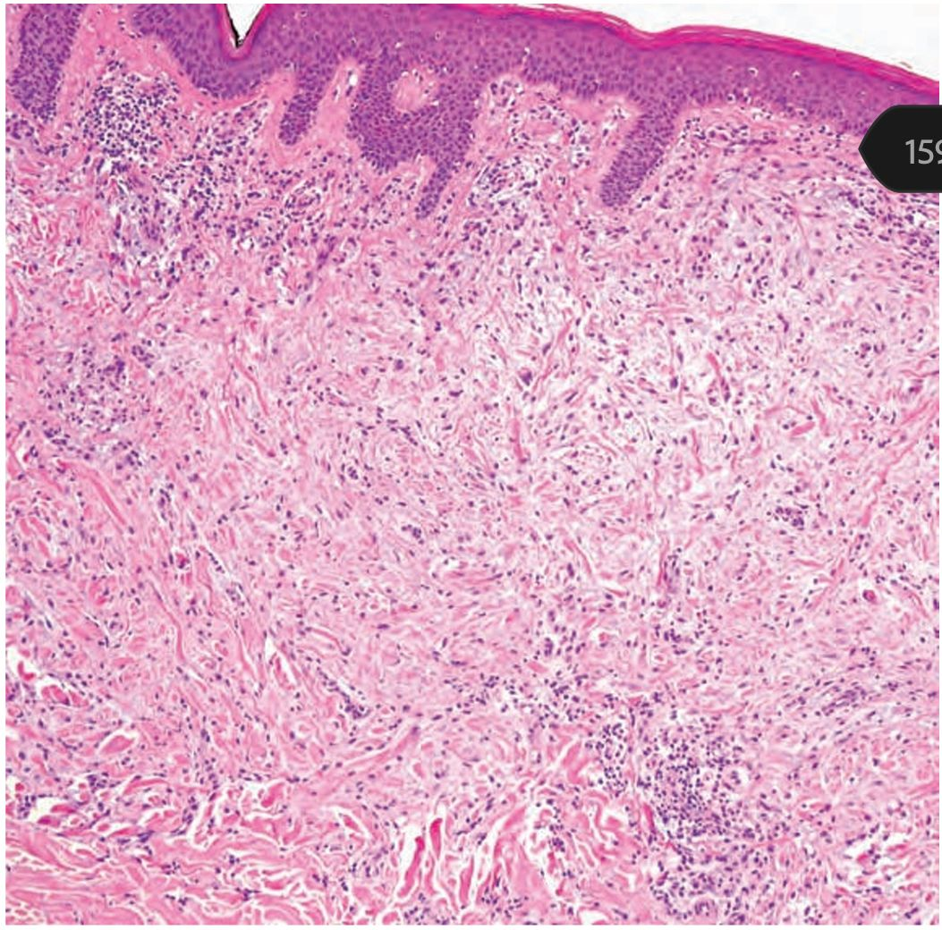

Slide 14
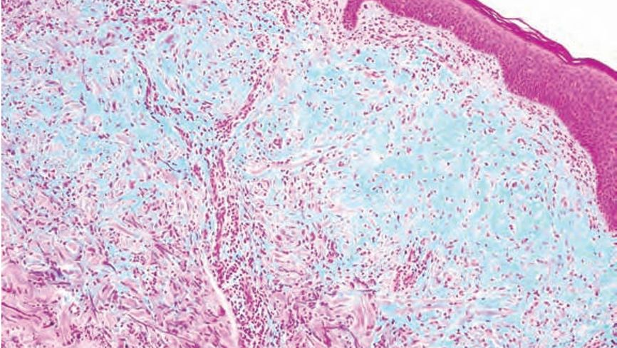

Slide 15
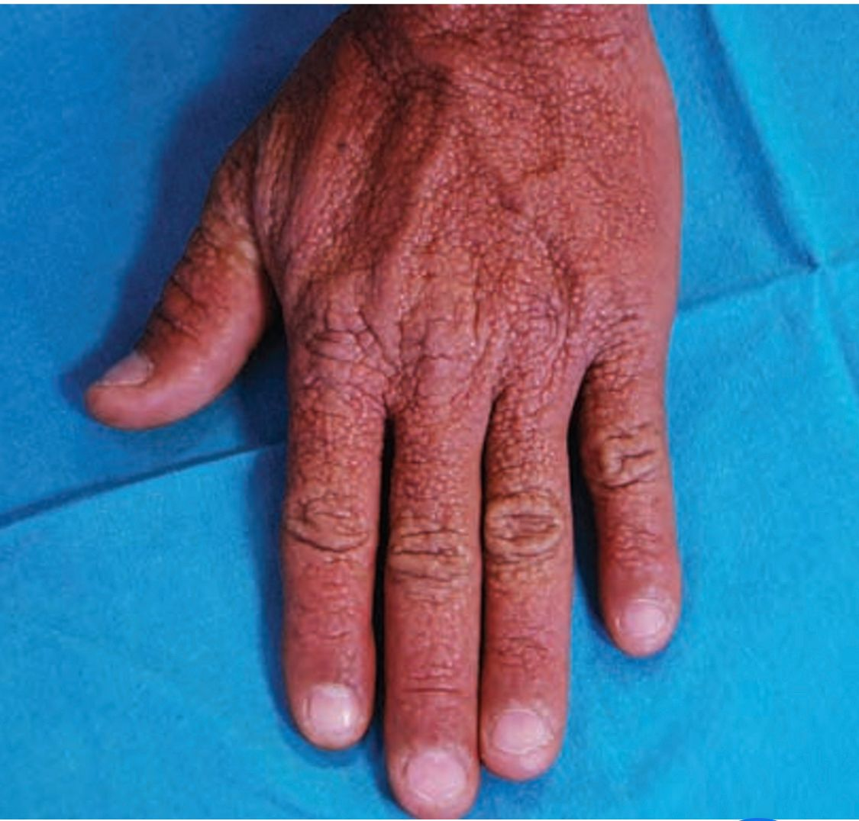
CLINICAL FEATURES
WIDESPREAD PAPULAR ERUPTION
PAPULES: 2-3mm, firm waxy, dome or flat. Often arranged in Linear Pattern
SITES: Dorsa or upper limb, head, neck, upper trunk and thighs

Slide 16
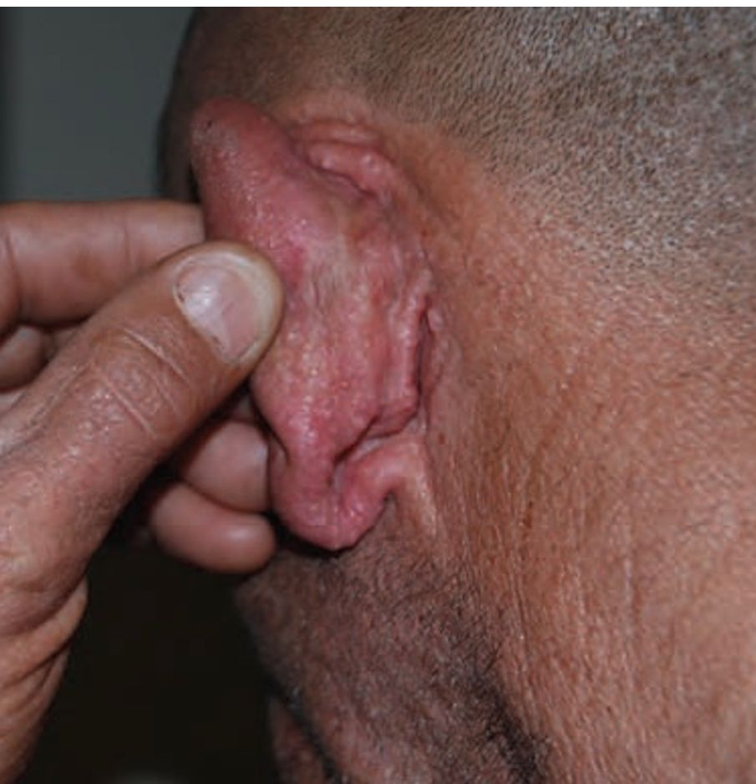
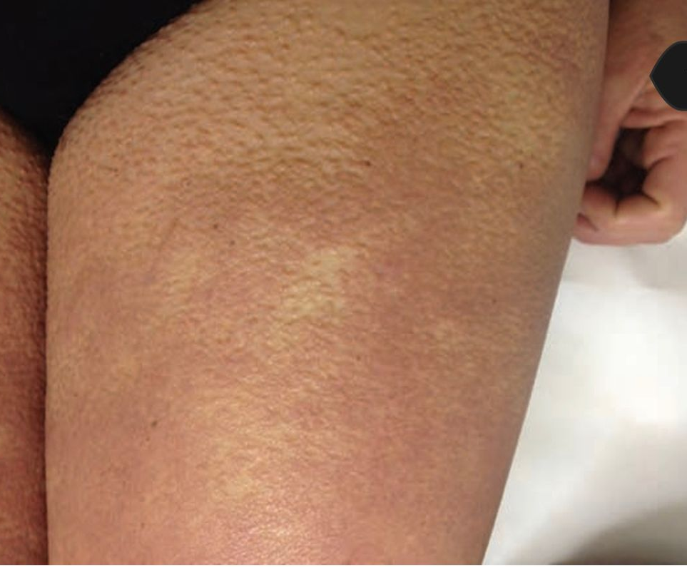
PAPULAR ERUPTION

Slide 17
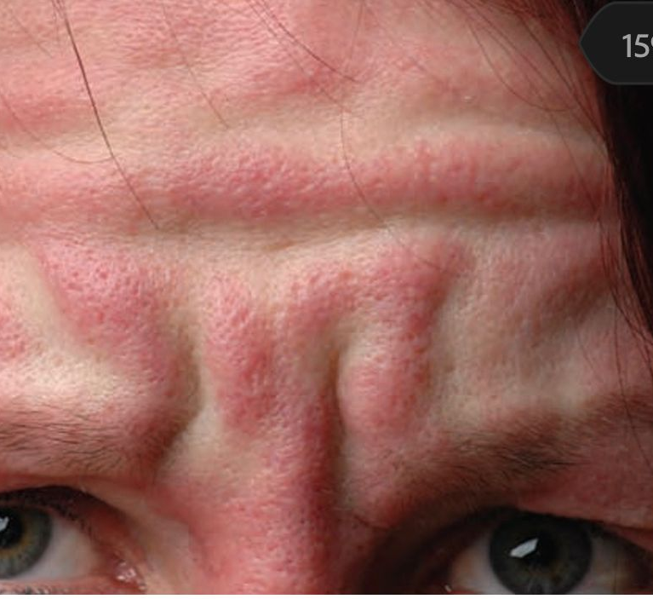
SCLERODERMOID SKIN
SHINY THICK SORROUNDING SKIN
LEONINE FACE

Slide 18

SHAR- PEI SIGN
DEEP FURROWING OF TRUNK, SHOULDERS LIMBS.

Slide 19
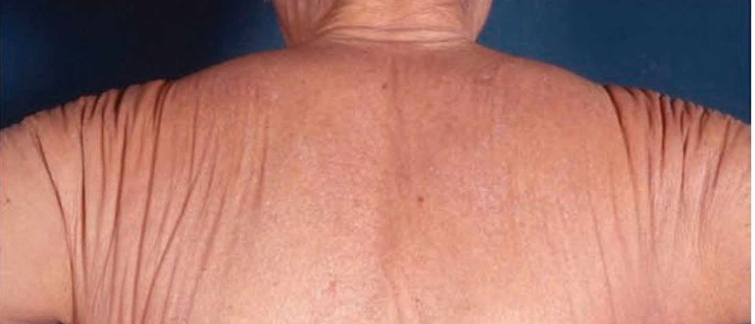
SHAR-PEI SIGN

Slide 20
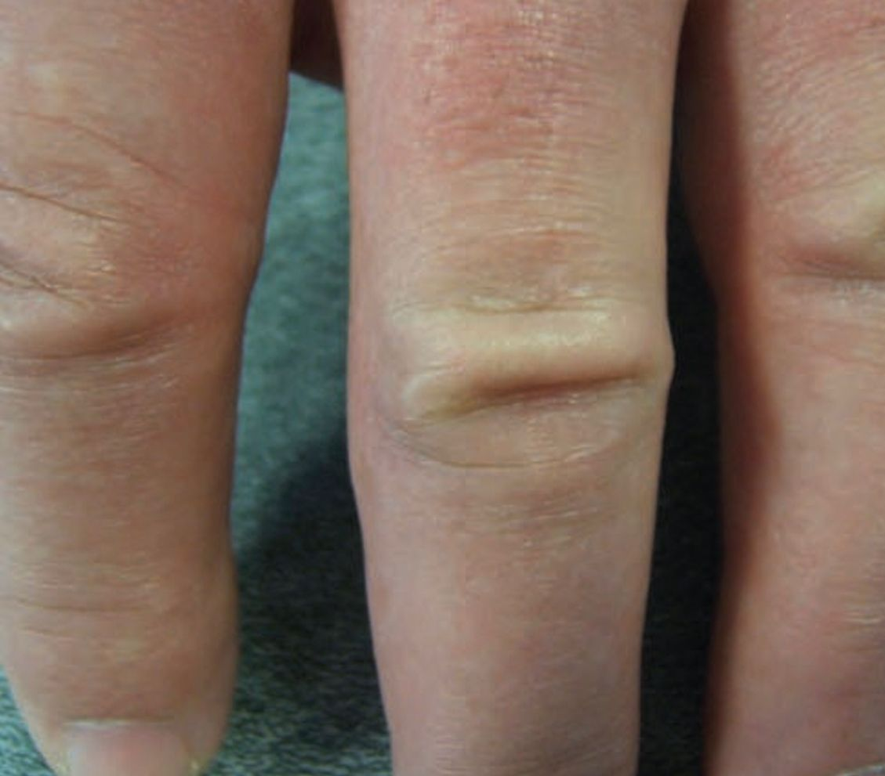
DOUGHNUT SIGN
OVER PIP JOINT
CENTRAL DEPRESSION SURROUNDED BY ELEVATE RIM

Slide 21
CLINICAL FEATURES
ITCHING
ERYTHEMA, EDEMA AND BROWINISH DISCOLOURATION
SKIN STIFFNESS, SCLERODACTLY AND REDUCED MOBILITY
MUCOSAE SPARED
EYEBROW, AXILLARY AND PUBIC HAIRS ARE SPARSE

Slide 22
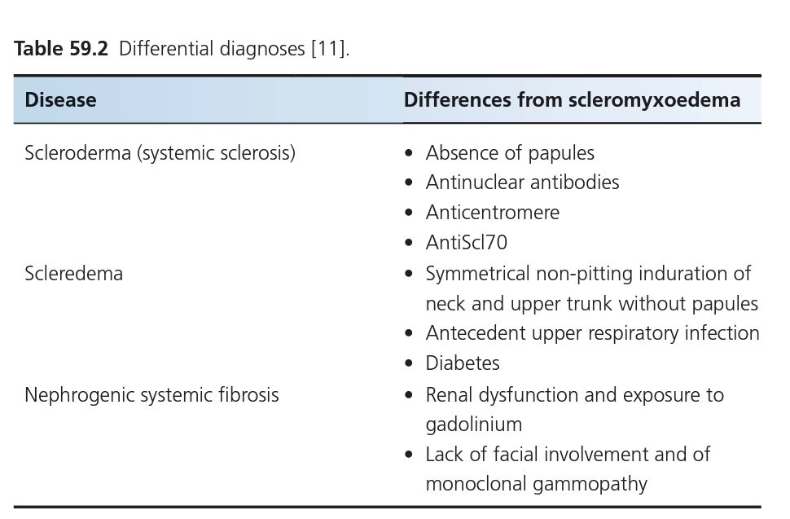
DIFFERENTIALS

Slide 23
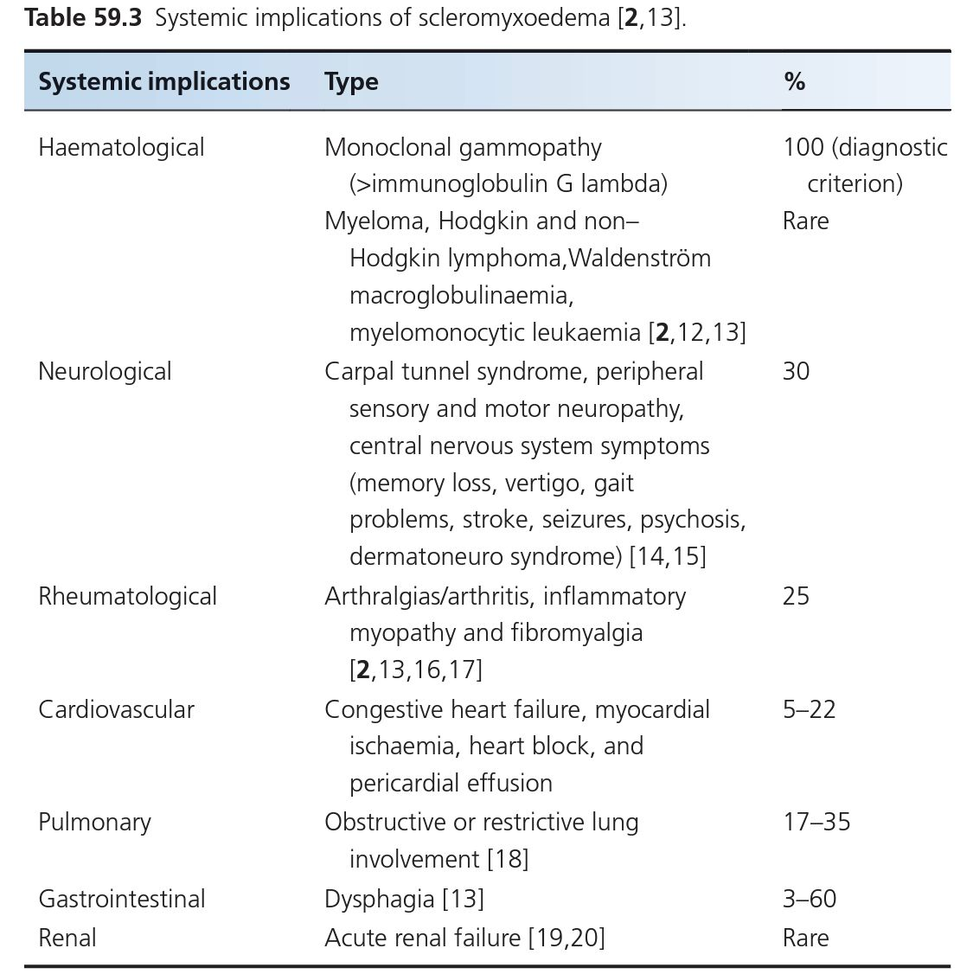
COMPLICATIONS
CAUSES OF DEATH:
  HEMATOLOGICAL
  DERMATONEURO SYNDROME
  CARDIOVASCULAR

Slide 24
COURSE AND PROGNOSIS
VARIABLE
CHRONIC, PROGRESSIVE
OR UNPREDICTABLE
SYSTEMIC INVOLVEMENT HAVE POOR PROGNOSIS

Slide 25
INVESTIGATIONS
SERUM ELECTROPHORESIS WITH IMMUNOFIXATION
SKIN BIOPSY
TFTs
FOR SYSTEMIC INVOLVEMENTS

Slide 26
MANAGEMENT
1ST LINE:
  IVIG. 2g/ KG 5 DAYS, FOR 6 MONTHS
2ND LINE:
  THALIDOMIDE; 100-400 mg/DAY OR
  SYSTEMIC STEROIDS. WITH IVIG
3RD LINE:
  AUTOLOGOUS PERIPHERAL BLOOD STEM CELL TRANSPLANTATION
  BORTEZOMIB & DEXAMETHASONE:
    AFTER STEM CELL TRANSPLANTATION
    DERMATONEUROSYNDROME

Slide 27
LOCALISED LICHEN MYXOEDEMATOSUS

Slide 28
INTRODUCTION
FIRM WAXY PAPULES CONFINED TO FEW SITES
NO SCLEROTIC FEATURES, PARAPROTEINEMIA, SYSTEMIC INVOLVEMENT, THYROID DISEASE
RARE DISEASE
HAVE 4 SUBTYPES

Slide 29
PATHOLOGY
LESS CHARACTERISTIC
MUCIN ACCUMULATION IN RETICULAR DERMIS
VARIABLE FIBROBLAST PROLIFERATION AND FIBROSIS

Slide 30
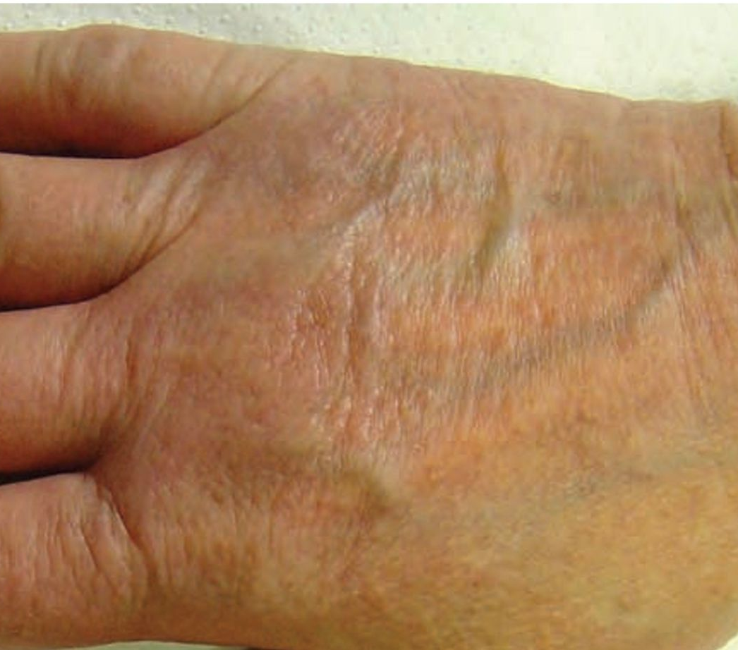
CLINICAL FEATURES
FOUR SUBTYPES
ACRAL PERSISTENT PAPULAR MUCINOSIS:
  Mutiple Ivory Skin coloured Papules
  Exclusively over dorsum of hands and extensor of distil forearm

Slide 31
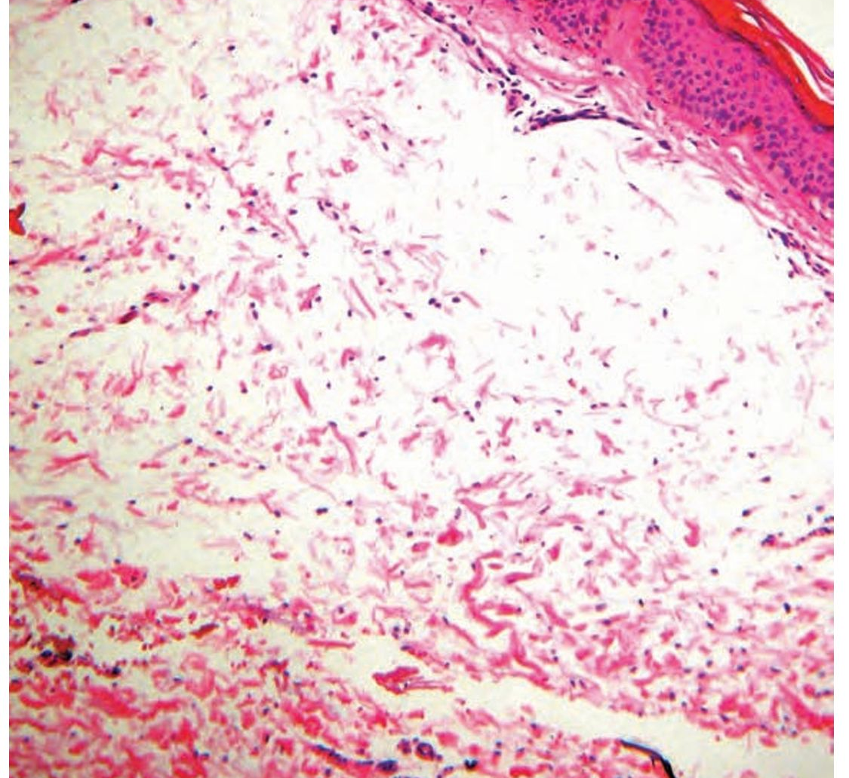
PATHOLOGY
MUCIN FOCALLY IN RETICULAR DERMIS

Slide 32
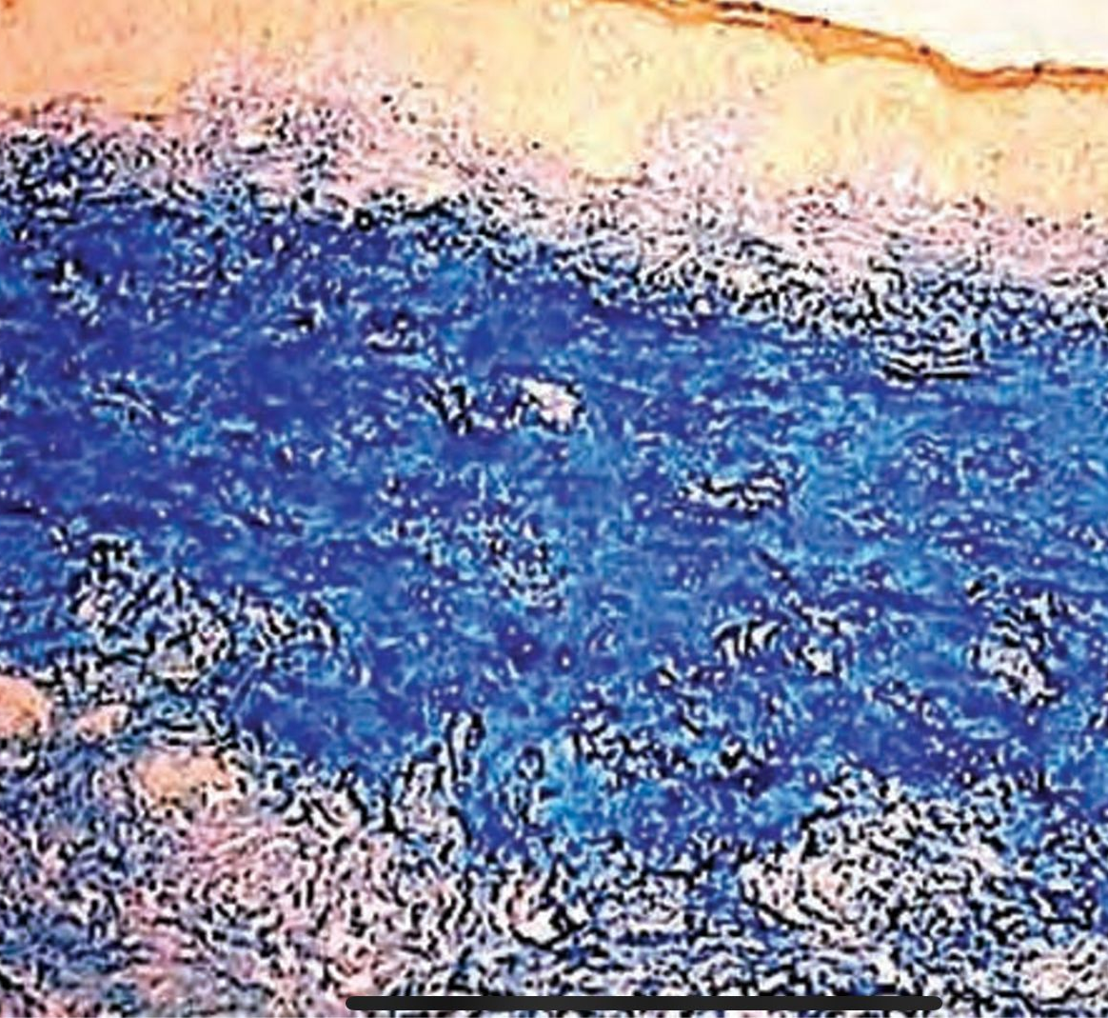
PATHOLOGY
SPARING SUBEPIDERMAL ZONE
COLLOID IRON STAIN

Slide 33
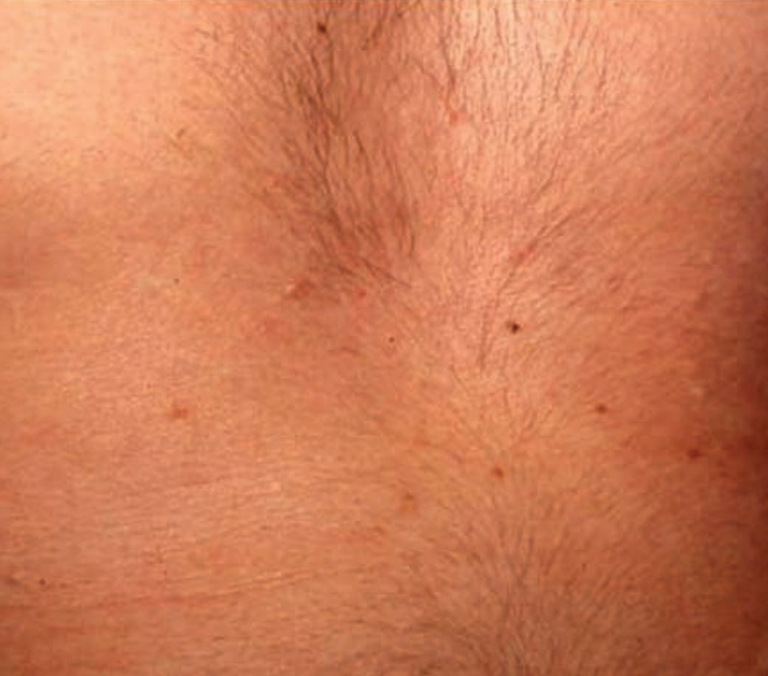
2. DISCRETE PAPULAR LM
RED, SKIN OR VOILACEOUS PAPULES
TRUNK AND LIMBS
SYMMETRICAL PATTERN
2-5 mm IN SIZE

Slide 34
LOCALISED LM
4. NODULAR LM:
3. CUTANEOUS MUCINOSIS OF INFANCY
  FIRM OPALESCENT PAPULES ON UPPER ARM, NECK AND TRUNK
  MUCIN DEPOSITION IS SUPERFICIAL JUST BELOW EPIDERMIS
  MULTIPLE NODULES ON LIMBS AND TRUNK
  ABSENT PAPULAR COMPONENT

Slide 35
DIFFERENTIALS
GRANULOMA ANNULARE
LICHEN AMYLOIDOSUS
LICHEN PLANUS
OTHER LICHENOID ERUPTIONS
COURSE:
CHRONIC BENIGN COURSE
ABSENSE OF SYSTEMIC INVOLVEMENT

Slide 36
MANAGEMENT
DOES NOT REQUIRE ANY THERAPY OFTEN
SPONTANEOUS RESULTION
OPTIONS:
  DERMABRASION
  CO2 LASER
  ELECTROCOAGULATION
  TOPICAL STEROIDS
  HYALURONIDASE INJECTION
  PUVA

Slide 37
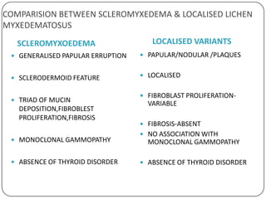
CAMPARISON BETWEEN TWO TYPES OF LM

Slide 38
RETICULAR ERYTHEMATOUS MUCINOSIS

Slide 39
INTRODUCTION
PERSISTENT RETICULAR MACULAR ERYTHEMA, PAPULES OR PLAQUES IN MIDLINE OF CHEST OR BACK
RARE DISEASE, MOSTLY EFFECTS MIDDLE AGED WOMEN
NO SYSTEMIC INVOLVEMENT
ASSOCIATIONS:
  MALIGNANCIES; BLOOD, BREAST, LUNG, COLON
  THYROID DYSFUNCTION
  AUTOIMMUNE DISORDERS: SLE, DM, ITP

Slide 40
PATHOPHYSIOLOGY
PATHOGENESIS UNCLEAR. VIRAL AND IMMUNOLOGICAL DISTURBANCE IS IMPLICATED
PREDISPOSING FACTORS:
  SUNLIGHT?
  OCPs
  PREGNANCY
  HEAT, X RAY THERAPY, PERSPIRATION
PATHOLOGY:
  INTERSTITIAL MUCIN DEPOSITS IN UPPER DERMIS
  SLIGHT VASCULAR DILATION WITH PERIVASCULAR INFILTRATE
  RARELY, IgM, IgG, C3 DEPOSITS ON DEJ

Slide 41
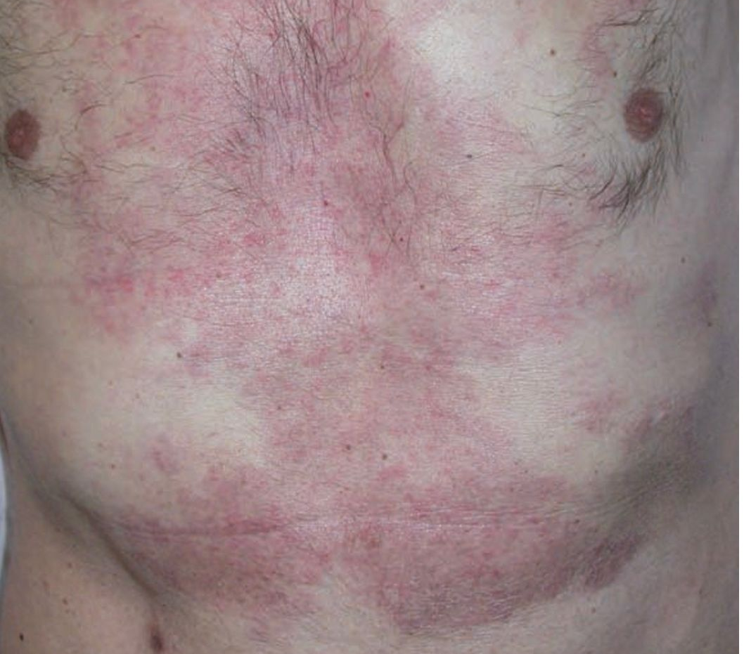
CLINICAL FEATURES
ERYTHEMATOUS MACULES AND INDURATED PAPULES OR PLAQUES
RETICUALR CONFIGURATION
LACK OF SCALE OR OTHER SURFACE CHANGES
MIDLINE OF CHEST OR BACK
PRURITIC

Slide 42
DIFFERENTIALS
OVERLAP BETWEEN REM AND TUMID LE:
  CLINICAL AND HISTOLOGICAL SIMILARITIES
  LACK IMMUNE SEROLOGICAL ABNORMALITIES
  RESPOND WELL TO ANTIMALARIALS
  RESOLVE WITHOUT RESIDUAL LESIONS
  TUMID LE; MORE PHOTOSENSTIVITY, HIGHER IMMUNEREACTANTS ON DIF
SEBORRHOEIC DERMATITIS
PITYRIASIS VERSICOLOR

Slide 43
COURSE AND PROGNOSIS
UNTREATED PATIENTS HAVE CHRONIC COURSE
MAY CLEAR SPONTANEOUSLY, EVEN AFTER 15 YEARS
REM IS NOT ASSOCIATED ABNORMAL LABS

Slide 44
MANAGEMENT
FIRST LINE:
  HCQ; 200 MG BD
SECOND LINE:
  TOPICAL AND SYSTEMIC STEROIDS
  TOPICAL CALCINEURIN INHIBITORS
THIRD LINE:
  PHOTOTHERAPY
  PULSED DYE LASER

Slide 45
SCLEREDEMA
SCLEREDEMA ADULTORUM OF BUSCHKE
SCLEREDEMA DIABETICORUM
BUSCHKE DISEASE

Slide 46
DEFINITION
A DIFFUSE PROGRESSIVE SYMMETRICAL NON-PITTING SWELLING AND INDURATION OF UPPER PART OF BODY
CAUSED BY THICKENED DERMIS AND MUCIN DEPOSITION

Slide 47
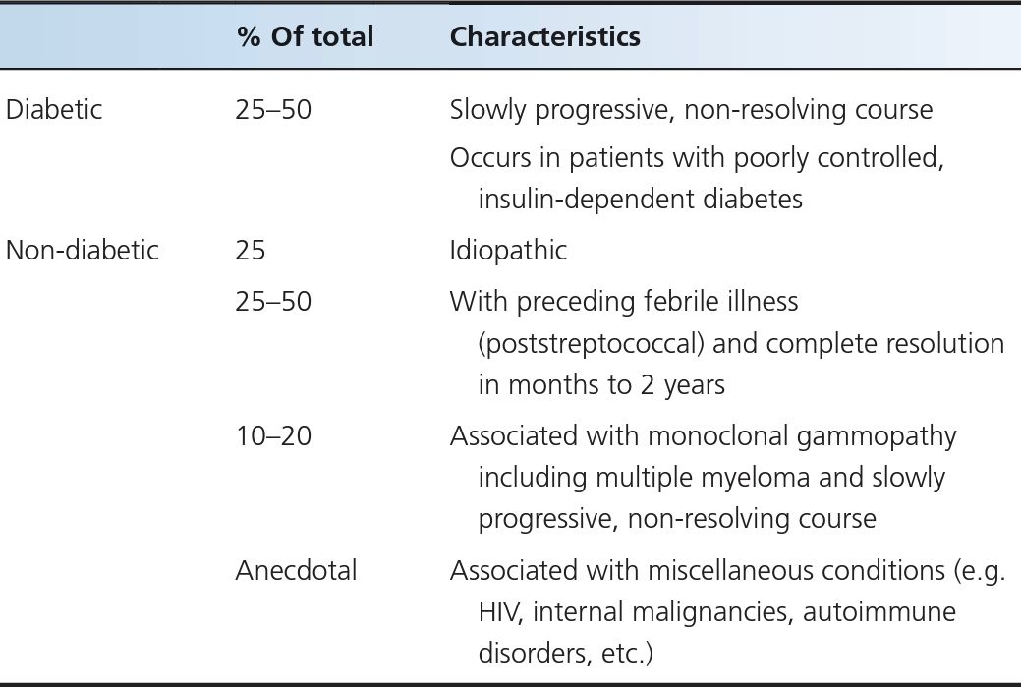
TYPES & ASSOCIATIONS

Slide 48
GENERAL DESCRIPTION
RARE DISEASE
ALL AGES
2-14% OF PATIENTS WITH DIABETES. MORE COMMON IN MALES
OTHER FORMS MORE COMMON IN FEMALE
PATHOGENESIS:
  INCREASE COLLAGEN 1 SYNTHESIS AND ACCUMULATION IN DM DUE TO IRREVERSIBLE GLYCOSYLATION AND RESISTANCE TO DEGREADATION
  ABNORMAL COLLAGEN AND MUCIN SYNTHESIS BY EXCESS STIMULATION BY INSULIN.

Slide 49
HISTOPATHOLOGY
EPIDERMIS: NORMAL
DERMIS:
  IS 3-4 TIMES THCKER
  COLLAGEN APPEARS SWOLLEN AND SEPERATED BY WIDE SPACES
  ACID GAGs FOUND IN FENESTRATED SPACES
  FIBROBLAST PROLIFERATION IS ABSENT
  SLIGHT PERIVASCULAR INFILTRATE. UNCOMMON
SUBCUTANEOUS TISSUE:
  FAT REPLACED BY COARSE COLLAGEN
MUCIN ALSO ACCUMULATES IN HEART AND SKELETAL MUSCLE

Slide 50
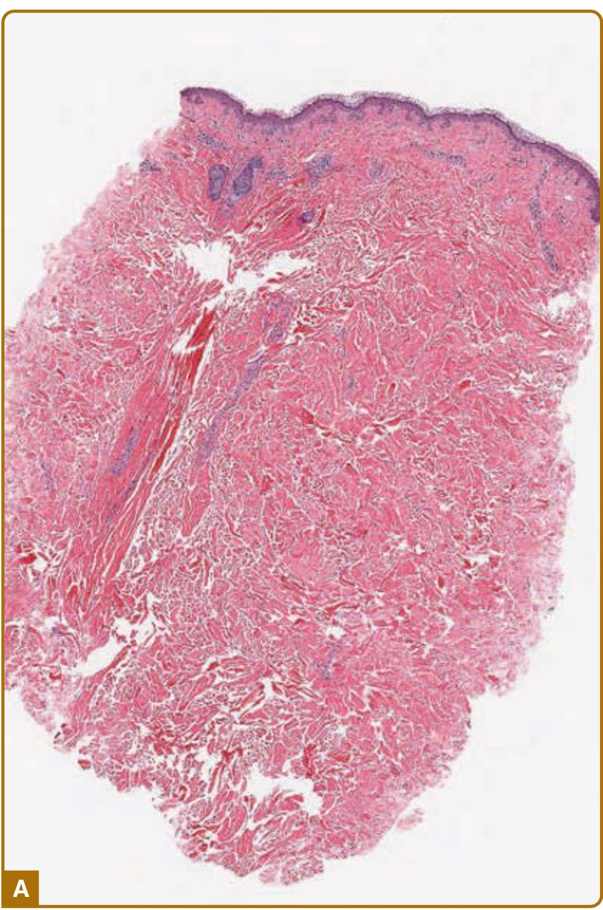
HISTOPATHOLOGY
THICK DERMIS
SWOLLEN COLLAGEN
SEPARATED BY CLEAR SPACES

Slide 51
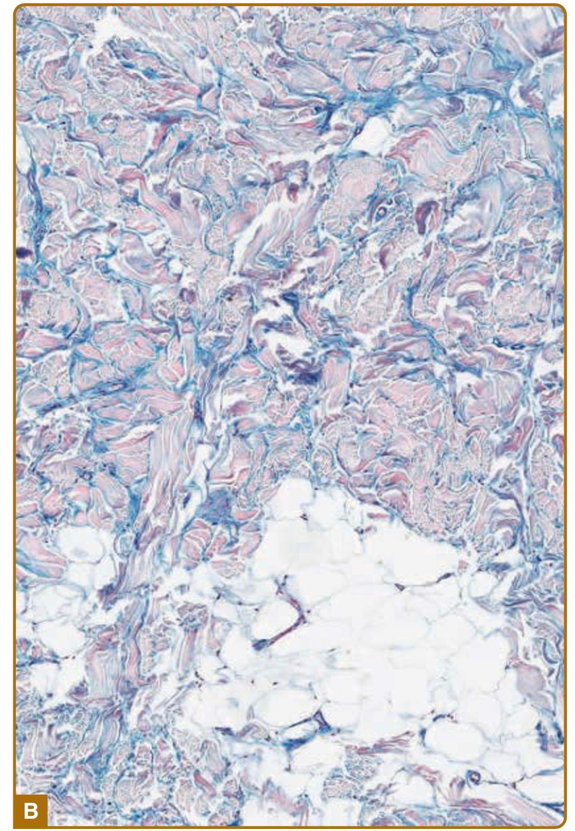
HISTPATHOLOGY
MUCIN DEPOSITION IN CLEAR SPACES
ACID MUCOPOLYSACCHARIDE STAIN

Slide 52
CLINICAL FEATURES
FIRM NON PITTING EDEMA AND INDURATION
BEGIN ON POSTERIOR NECK AND SPREAD TO UPPER BACK, SHOULDERS AND SCALP
ERYTHEMA AND peau d’orange APPEARANCE
HANDS AND FEET CHARACTERISTICALLY SPARED
DEPENDING UPON SITE:
  MOVEMENT RESTRICTION
  FACIAL EXPRESSIONS
  DIFFCULTY IN MASTICATIONS AND ARTICULATION

Slide 53
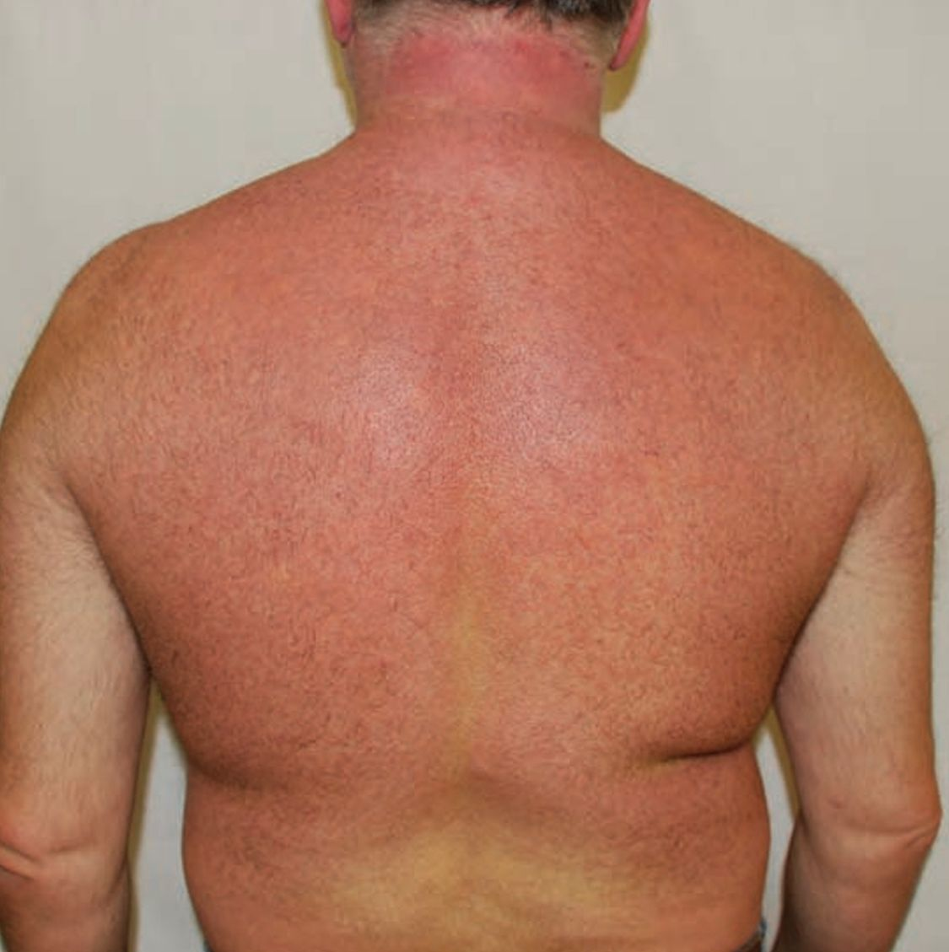
SCLEREDEMA
ERYTHEMA
INDURATION
THICK SKIN
NON PITTING EDEMA

Slide 54
DIFFERENTIALS
SYSTEMI SCLEROSIS:
  SCLERODACTLY
  RAYNAUDS
  NAIL FOLD CAPPILARIES
  SERUM ANTIBODIES
MYXOEDEMA
AMYLOIDOSIS
LYMPHEDEMA
CELLULITIS
DERMATOMYOSITIS
TRICHINOSIS

Slide 55
COMPLICATONS
SYSTEMIC INVOLVEMENT NOT FREQUENT
SEROSITIS
DYSARTHRIA
DYSPHAGIA
MYOSITIS
PAROTITIS
HEPATSPLEENOMEGALY
OCULAR
CARDIAC ABNORMALITIES

Slide 56
COURSE AND PROGNOSIS
POSTINFECTIOUS:
  HAVE BENIGN COURSE. RESOLVE SPONTENOUSLY IN 6MONTHS TO 2 YEAR
DIABETES AND GAMMOPATHY:
  CHRONIC
  LITTLE TENDENCY OF REMISSION
  DEATH FROM INTERNAL ORGAN INVOLVEMENT. RARE

Slide 57
INVESTIGATIONS
FOR UNDERLYING PATHOLOGY
INFECTIOUS:
  THROAT SWAB CULTURE AND ASO
HBA1C, FASTING BLOOD SUGAR
SERUM PROTIEN ELECTROPHORESIS WITH IMMUNOFIXATION
ULTRASOUND; for skin thickness evaluatio
MRI; disease progression

Slide 58
MANAGEMENT
DIFFICULT. NO EFFECTIVE TREATMENT
TREATMENT OF PRIMARY DISEASE:
  THERAPY IS UNNECESSARY FOR POST STREPTOCOCCAL SCLEREDEMA
  GOOD SUGAR CONTROL IN DM
  GAMMOPATHY, MULTIPLE MYELOMA: BORTEZOMIB
FOR DISABLING MANIFESTATIONS: PHOTOTHERAPY
IVIG
ELECTRON BEAM RADIOTHERAPY & PHOTOPHORESIS
IMMUNOSUPRESANTS

Slide 59
THYROID DERMOPATHY
THYROID DERMOPATHY

Slide 60
LOCALISED ( PRETIBIAL ) MYXOEDEMA
INFILTRATIVE DERMOPATHY DUE TO MUCIN DEPOSITION
SHINS
ONE OF THE SIGNS OF HYPERTHYROIDISM esp. OF GRAVE’S DISEASE
1-5% OF PATIENTS WITH GRAVE’S DISEASE
3:1 FEMALE PREDOMINENCE. 50-60 YEARS

Slide 61
PATHOGENESIS
FIBROBLASTS ALSO HAVE TSH RECEPTOR PROTEIN
THYROID STIMULATING Abs ALSO STIMULATE DERMAL FIBROBLASTS
LOWER LIMB FIBROBLAST ARE MORE SENSTIVE
FIBROBLASTS ALSO STIMULATED BY CYTOKINES TNF-A,B

Slide 62
HISTOPATHOLOGY
SEPERATION OF COLLAGEN BUNDLES BY LARGE QUANITITY OF MUCIN
ELASTIC FIBRES REDUCED
PERIVASCULAR LYMPHOCYTIC INFILTRATE AND MORE MAST CELLS
HYPERKERATOSIS, ACANTHOSIS, PAPPILOMATOSIS

Slide 63
CLINICAL FEATURES
SIGNS OF GRAVE’S DISEASE:
  GOITRE
  EXOPHTHALMOS
  THYROID ACROPATHY
  HIGH TSH
B/L THICKENING AND INDURATION OF SHINS AND DORSA OF FEET
4 MAIN SUBTYPES:

Slide 64
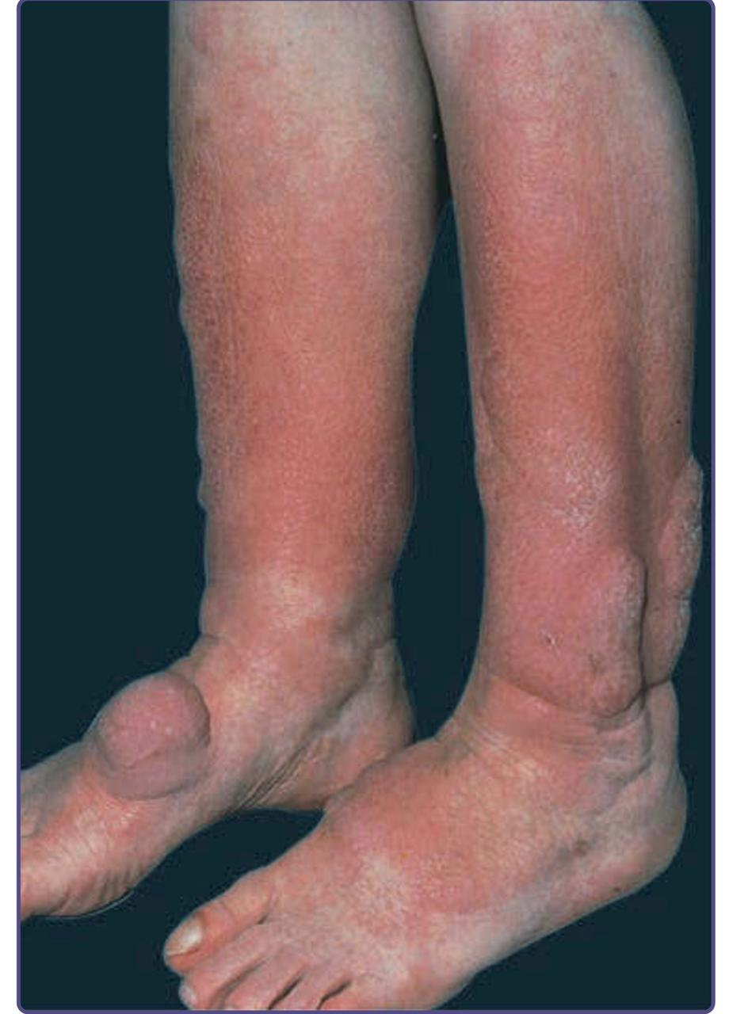
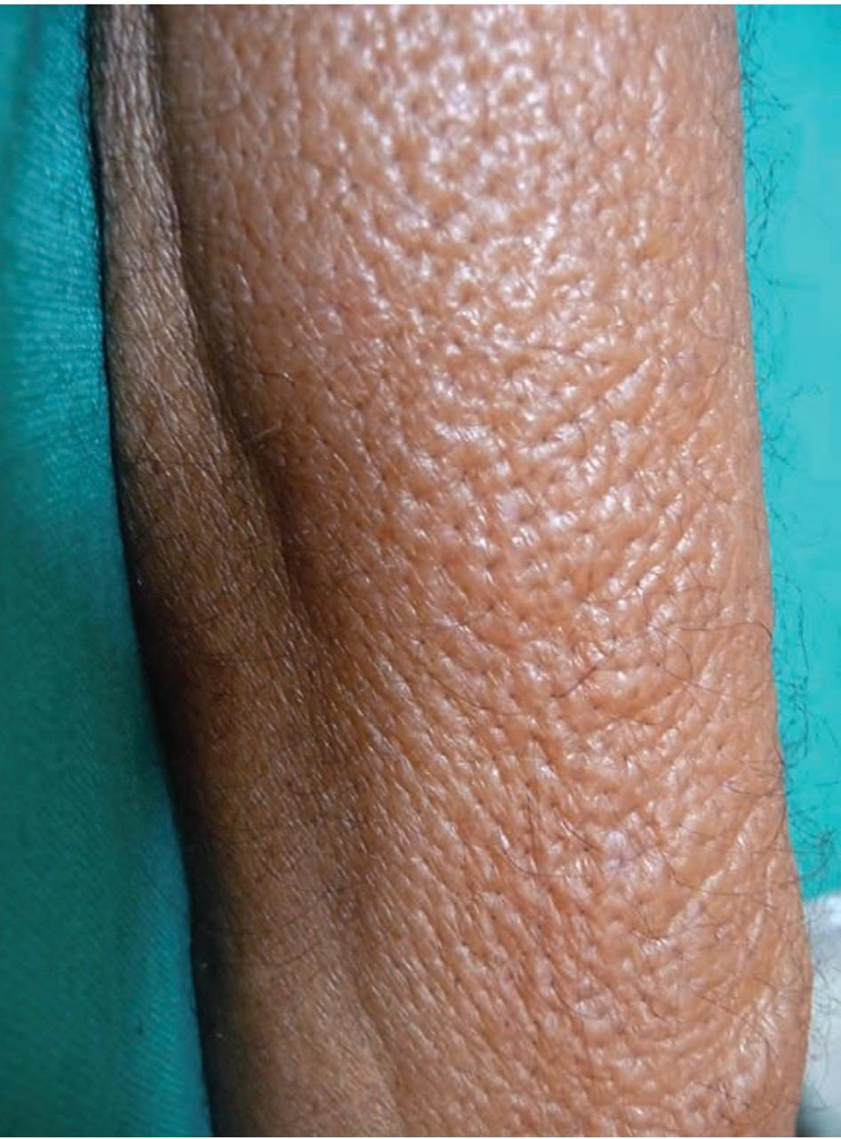
CLINCAL FEATURES
DIFFUSE NON-PITTING EDEMA:
  Orange peel Appearance

Slide 65
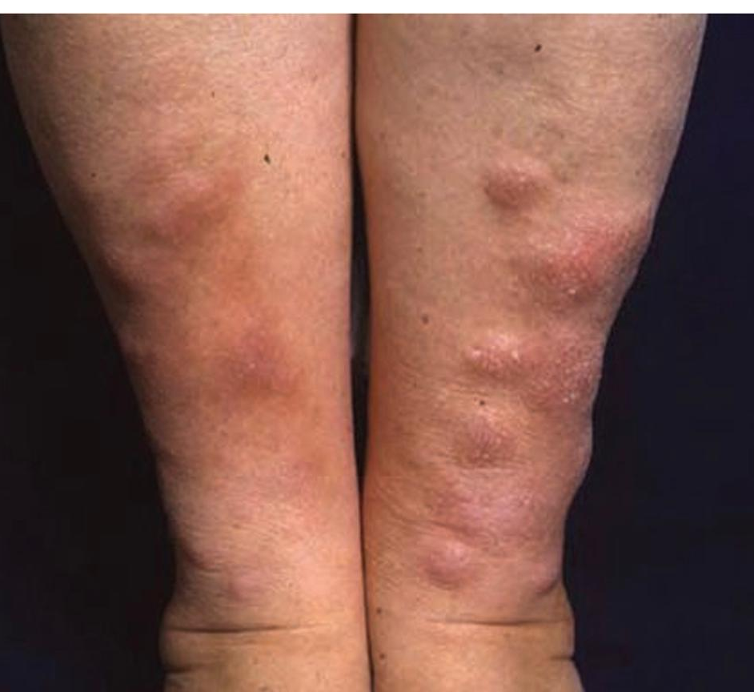
CLINICAL FEATURES
2. NODULAR:

Slide 66
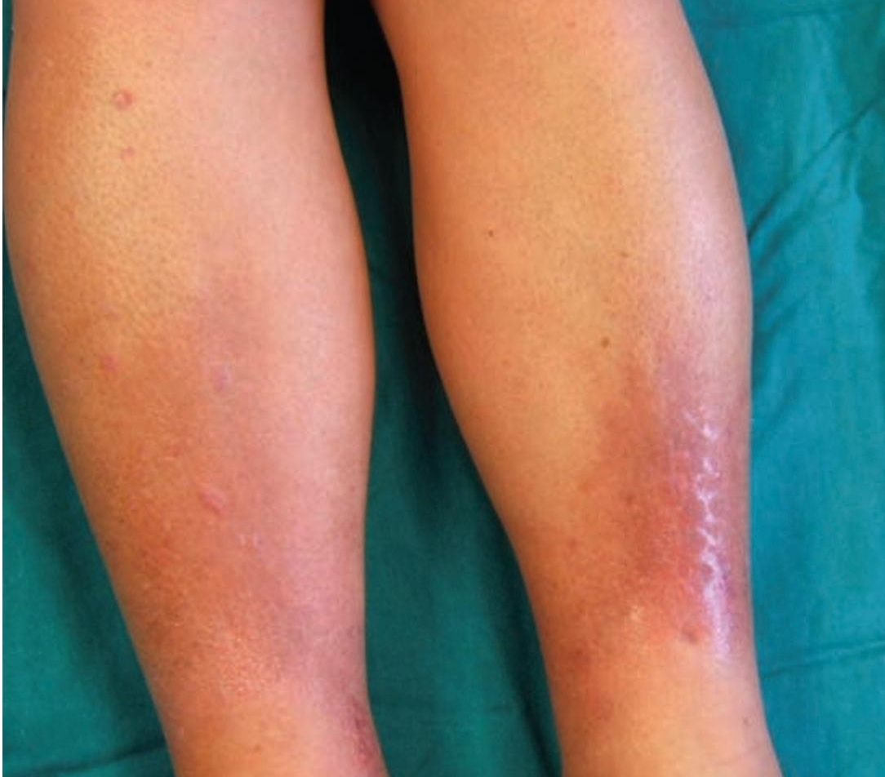
CLINICAL FEATURES
3. PLAQUE TYPE:

Slide 67
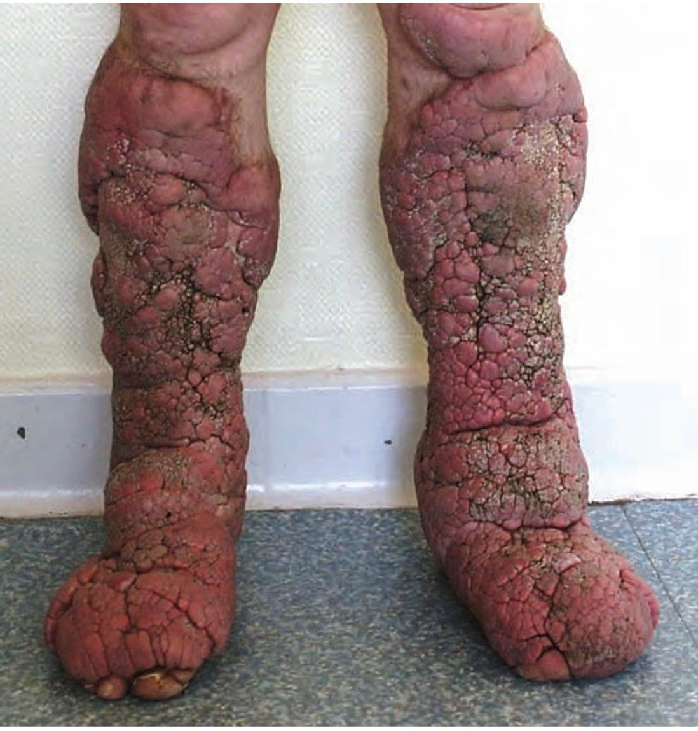
CLINICAL FEATURES
4. ELEPHANTIASIS:

Slide 68
CLINCAL FEATURES
DIFFERENTIALS:
  LSC
  Hyperthrophic LP
  Obesity- Associated Lymphoedematous mucinosis
DISEASE COURSE:
  No morbidity. Appearance defect only
  Entrapment of peroneal nerve may cause foot drop
INVESTIGATIONS:
  TSH
  Thyroid Stimulating Antibodies

Slide 69
MANAGEMENT
TOPICAL STEROIDS:
  Moderate to Potent
  Under Occlusive Dressing or I/L
  Compressing Stockings
ELEPHANTIASIS:
  Rituximab
  Plasmapheresis
  IVIG
  Octreotide
MINIMIZING RISK FACTORS: Weightloss, Smoking etc.
THERAPY FOR CONTROL OF HYPERTHYROIDISM DOES NOT IMPROVE CUTANEOUS SYMPTOMS

Slide 70
PAPULAR & NODULAR MUCINOSIS IN CTDs
SKIN COLOURED PAPULES, NODULES OR PLAQUES USUALLY IN SLE
  Cutaneous Lupus Mucinosis ( 1.5% )
TRUNK AND UPPER EXTREMETIES
INCREASE GAGs PRODUCTION BY FIBROBLAST UNDER INFLUENCE OF CYTOKINES AND IMMUNOGLOBULINS
PATHOLOGY:
  Abundant Mucin throughout Dermis. Fat Sometimes
  Perivascular Lymphocytic Infiltrate

Slide 71
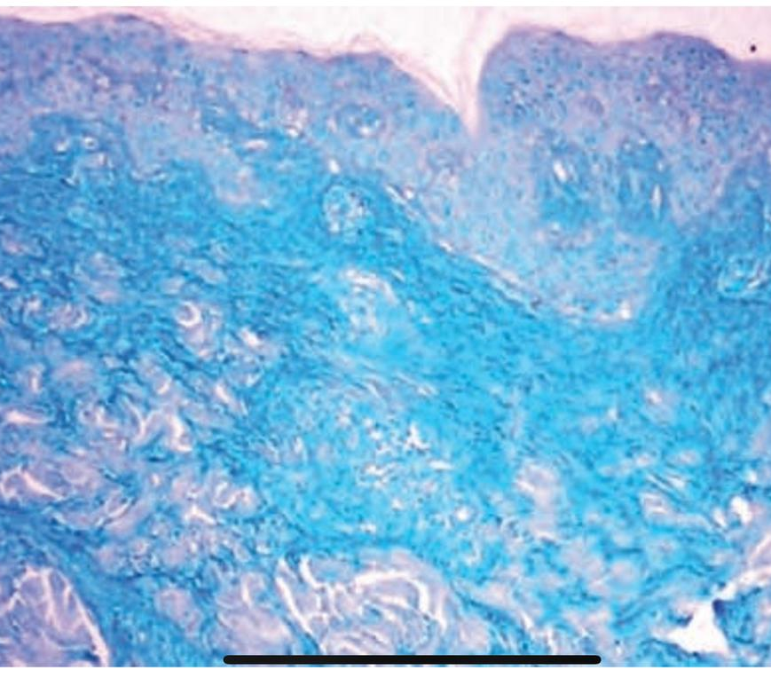
HISTOLOGY
Abundant Mucin Deposition Throughout Reticular Dermis
Alcian Blue Stain

Slide 72
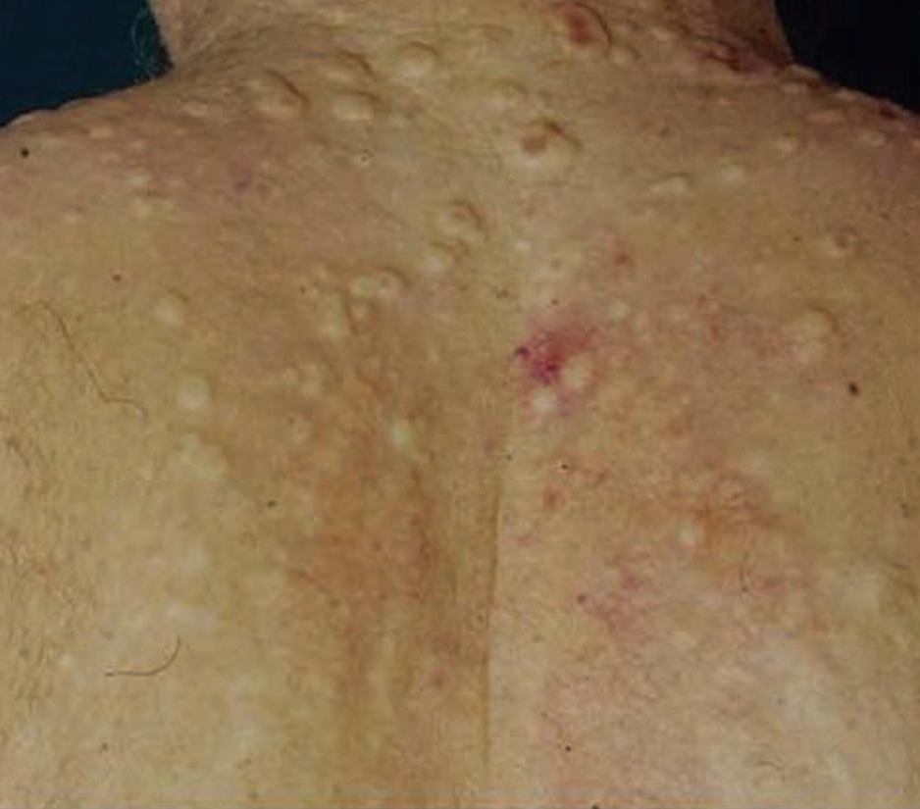
CLINICAL FEATURES
Skin coloured Papules, Nodules and Plaques
In SLE:
  75% with Mucinosis have systemic disease
  Periorbital Mucinosis rarely
In Dermatomyositis:
  Follows myositis
  Nodules and Plaques on trunk
In SSc:
  Can Occur in both, diffuse and localized forms

Slide 73
MANAGEMENT
SAME AS FOR CTDs
SUNSCREEN, TOPICAL STEROIDS AND HCQ IN SLE
RESISTANT CASES:
  Systemic Steroids
  Oral Tacrolimus

Slide 74
SELF HEALING CUTANEOUS MUCINOSIS
TRANSIENT CUTANEOUS LESIONS WITH MILD INFLAMMATION IN YOUNG PEOPLE ( 1-15 AGE )
PATHOLOGY:
  Mucin Deposition
  Mild Inflammation
  Nodules show deep mucinosis, fibrosis, gangliocyte-like giant cells
CLINCAL CRITERIA
  Acute Eruption of papules on face, neck, scalp, abdomen, thighs
  Mucinous subcutaneous Nodules; over face, joints of limbs
  Systemic Symptoms: fever, arthralgias, myalgias, weakness
  Spontaneous Resolution in usually about 2-8 months
AGGRESSIVE THERAPY AVOIDED

Slide 75
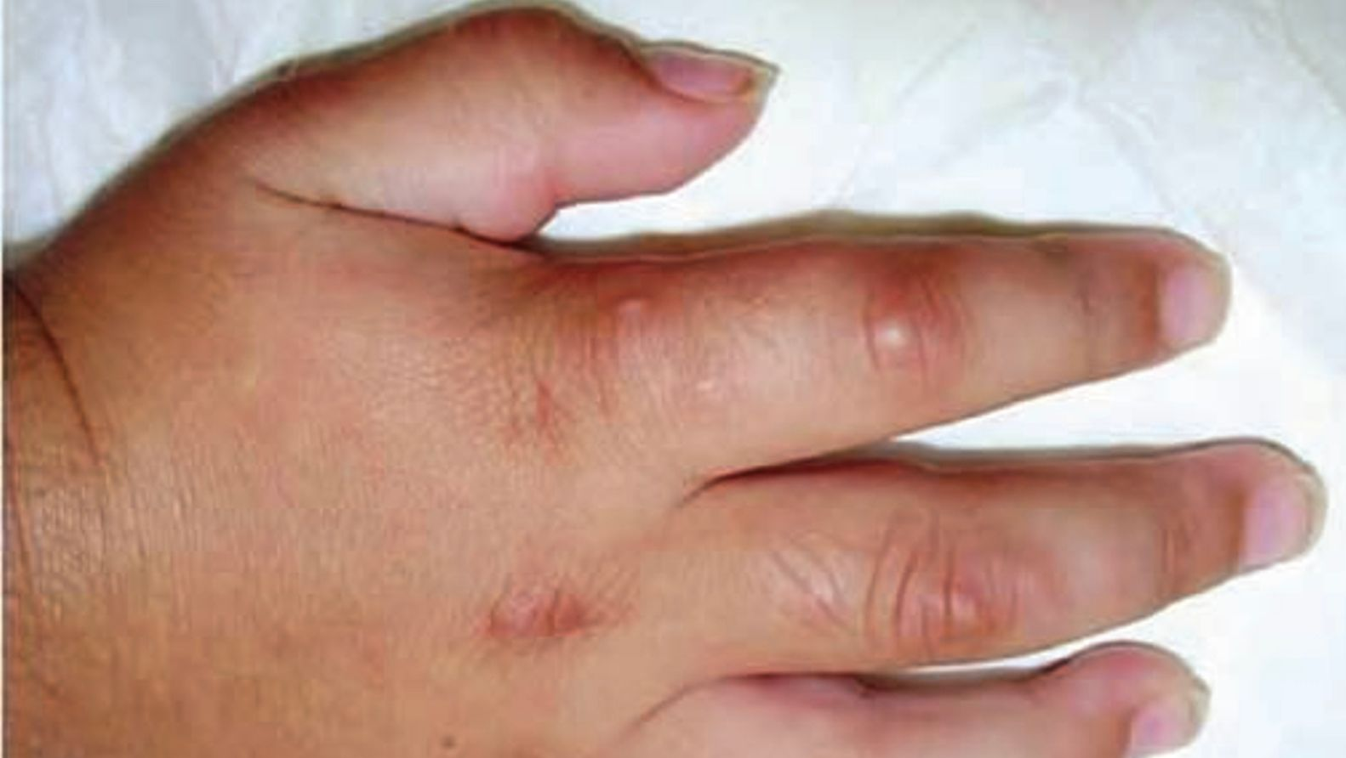

Slide 76
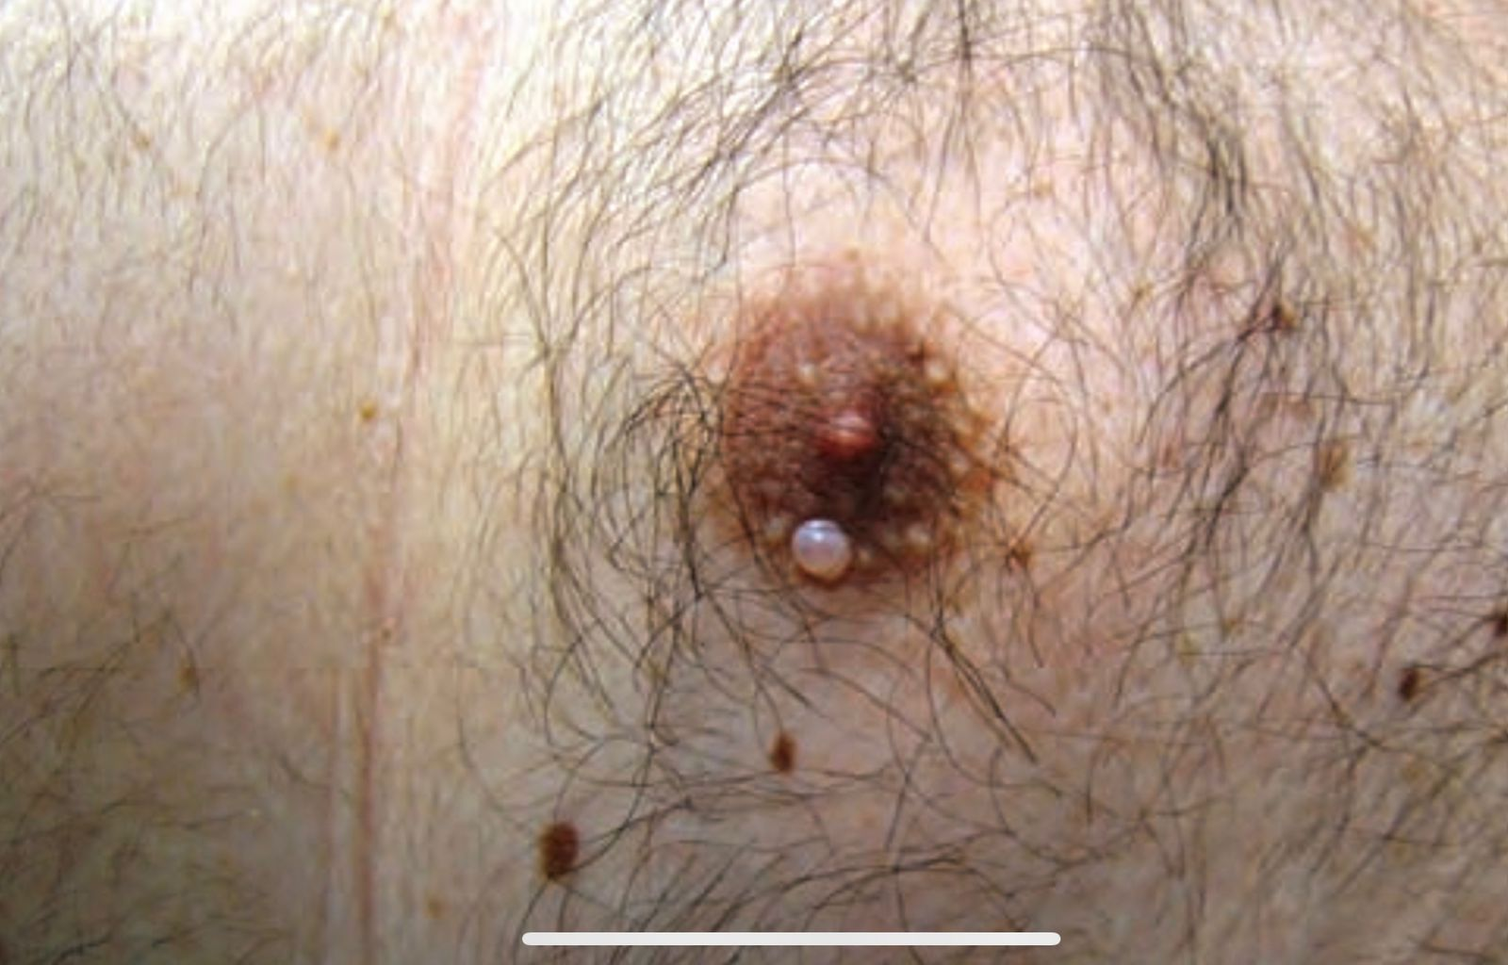
CUTANEOUS FOCAL MUCINOSIS
BENIGN, SOLITARY REACTIVE LESION IN ADULTS
PAPULE, NODULE OR CYSIC FORM. ASYMPTOMATIC. ANYWHERE
PATHOLOGY:
  Diffuse Dermal mucin deposition. Sparing subcutis
  Spindle shaped Fibroblasts predominant.
  Absence of elastic fibres
DIFFEENTIAL:
  ANGIOMYXOMA
ASSOCIATION:
  Hypothyroidism
  Other forms of Mucinosis
SURGICAL EXCISION

Slide 77
DIGITAL MYXOID CYST
BENIGN GANGLION CYST. TWICE AS COMMON IN WOMEN
TWO VARIETIES:
  GANGLION TYPE; Arise from joint cavity. Near DIP
  MYXOMATOUS TYPE; Arise from dermal fibroblasts. Between interphalangeal joints
HISTOLOGY:
  Mucin containing stellate fibroblasts.
  Epidermis Acanthotic Laterally and Atrophic Centrally
  Transepidermal Elimination of Myxoid Material

Slide 78
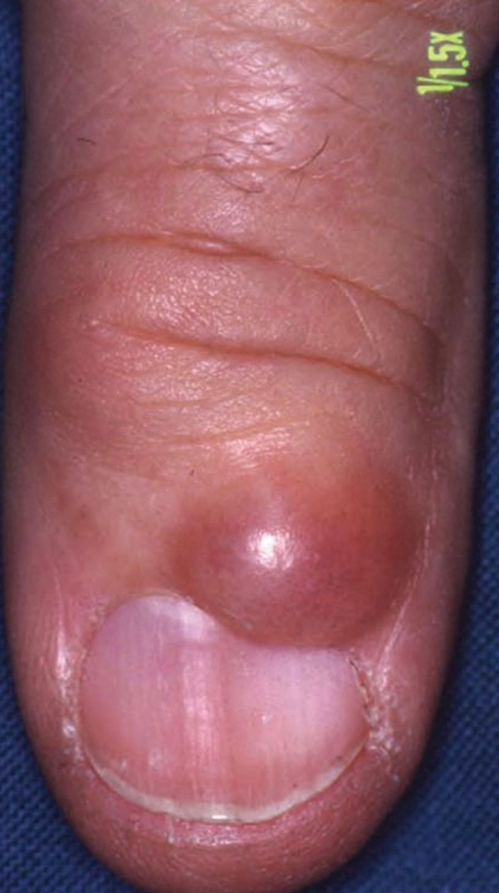
CLINICAL FEATURES
TRANSLUCENT DOME SHAPED NODULE
OVER DORSAL SKIN OF DIP
OSTEOARTHRITIS
GROOVING OF NAIL
MANAGEMENT:
  Excision
  Needling and Aspiration
  Steroid Injection, cryo, Coagulation CO2 Laser after Aspiration

Slide 79
FOLLICULAR MUCINOSIS
MUCIN IN EPITHELIAL HAIR FOLLICLE SHEATH AND SEBACEOUS GLANDS

Slide 80
PINKUS FOLLICULAR MUCINOSIS
ALOPECIA MUCINOSA

Slide 81
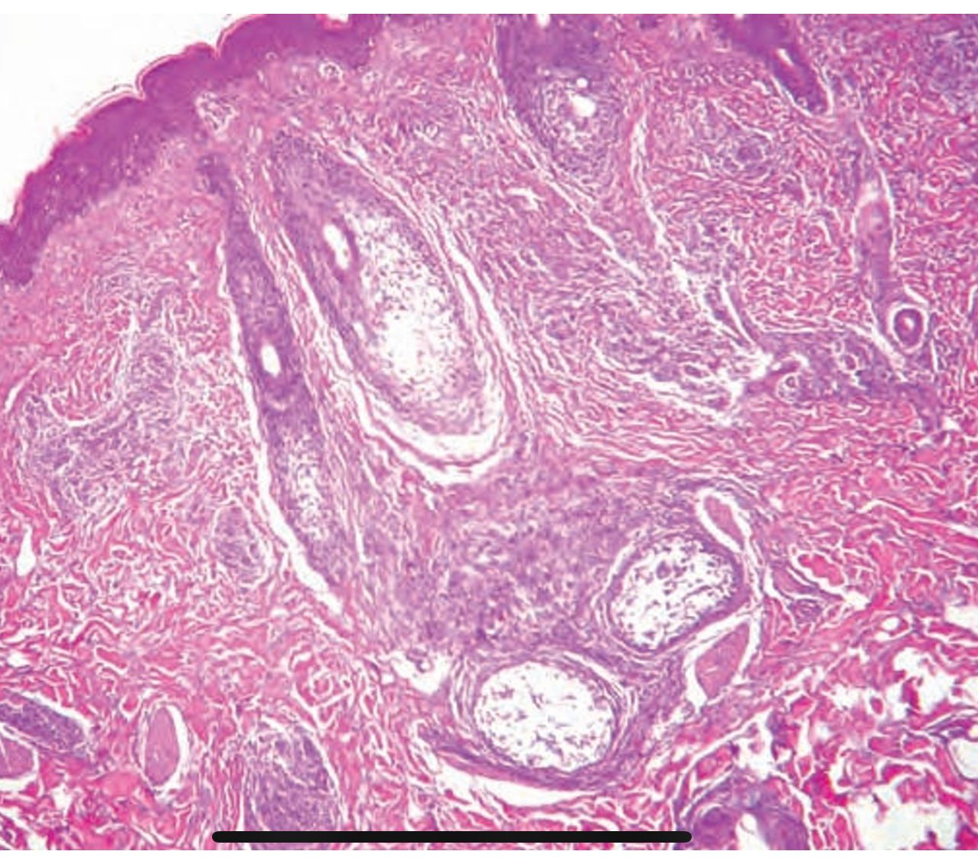
INTRODUCTION
INFLAMMATORY DISORDER EFFECTS CHILDREN AND ADULTS
FOLLICULAR KERATINOCYTE PRODUCE MUCIN
PATHOLOGY:
  Mucin Accumulated Within Follicular Epithelium
  Keratinocytes disconnect
  Cysts containing mucin, inflammatory cells, keratinocytes

Slide 82
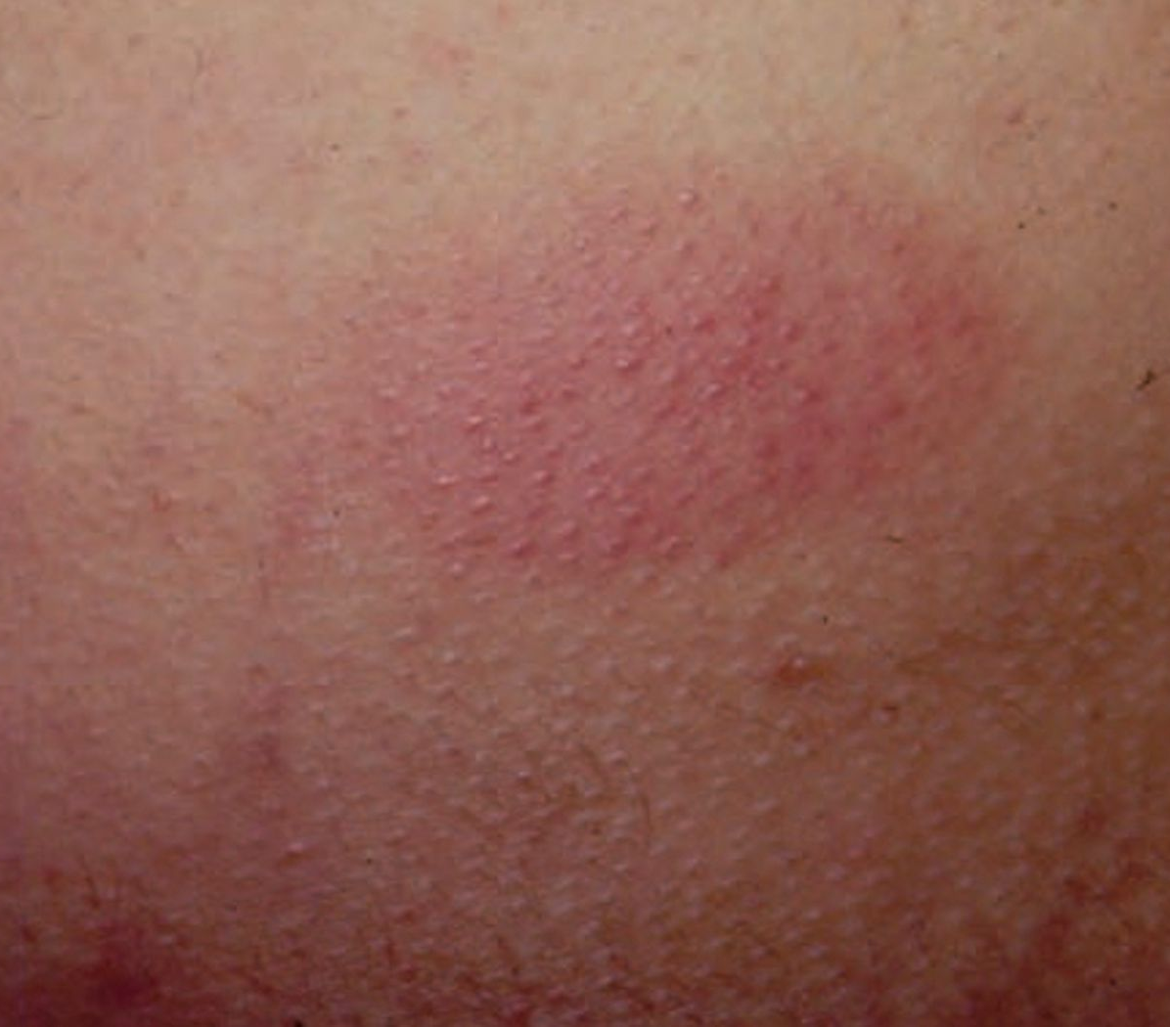
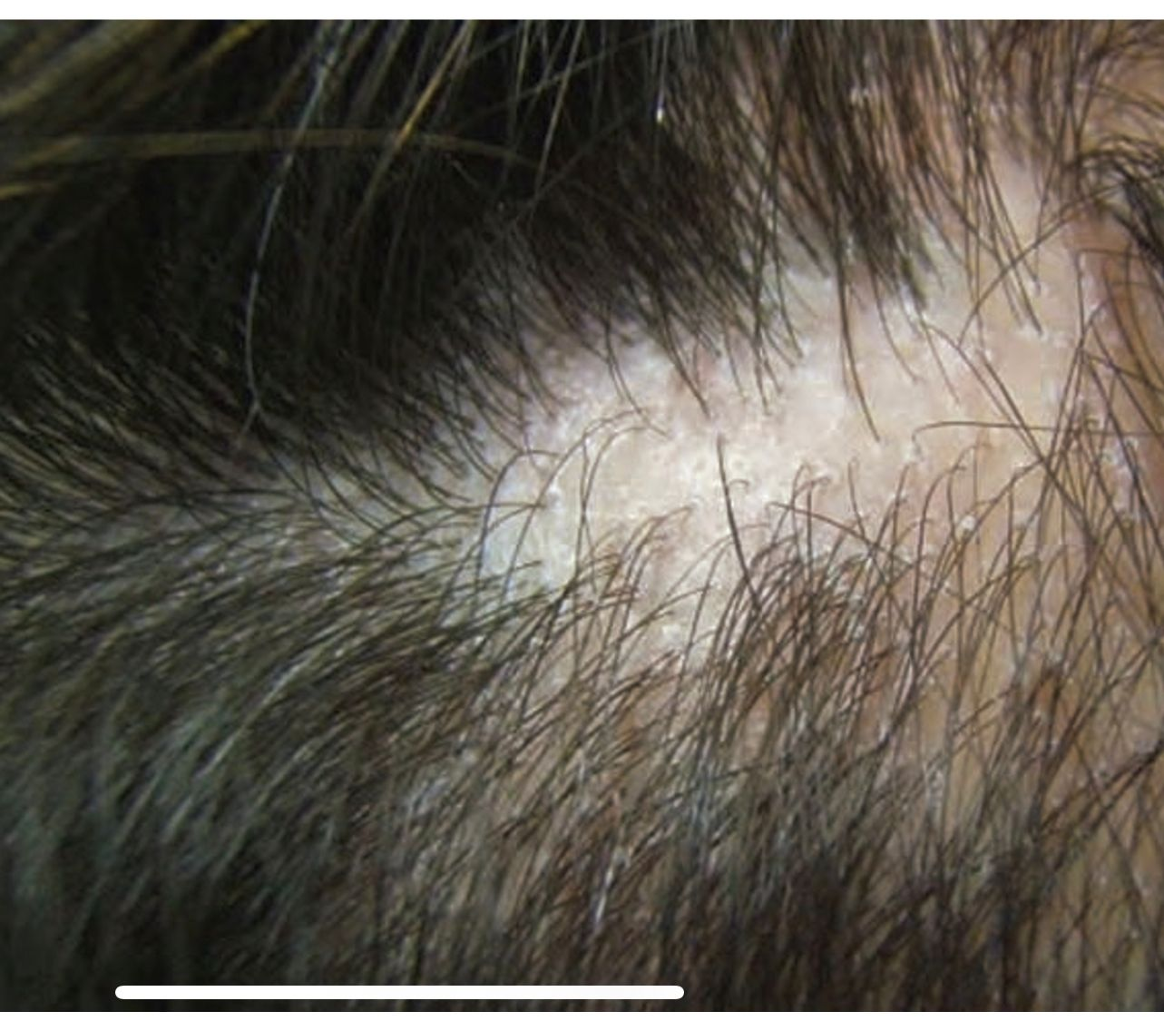
CLINICAL FEATURES
ACUTE OR SUBACUTE ERUPTION OF SHARPLY DEMARCATED PLAQUE WITH FOLLICULAR PROMINENCE
  Scaling
  Alopecia
  Folliculitis/ Follicular Spines
CUTANEOUS T-CELL LYMPHOMA ASSOCIATED:
  Chronic Generalized Form
  Larger Numerous Plaques
WAIT AND SEE APPROACH
  Resolve Spontaneously 2-24 Months

Slide 83
URTICARIA-LIKE FOLLICULAR MUCINOSIS
URTICARIA LIKE CYCLIC ERUPTIONS OVER FACE AND NECK IN ROSACEIFORM OR SEBORRHOEIC BACKGROUND
NO FOLLICULAR PLUGGING OR ALOPECIA
MANAGEMENT:
  Anti-Malarials
  Dapsone
GOOD PROGNOSIS

Slide 84
SECONDARY MUCINOSIS
MUCIN DEPOSITION AS ADDITIONAL HISTOLOGICAL FEATURE IN OTHER PRIMARY DISEASE

Slide 85
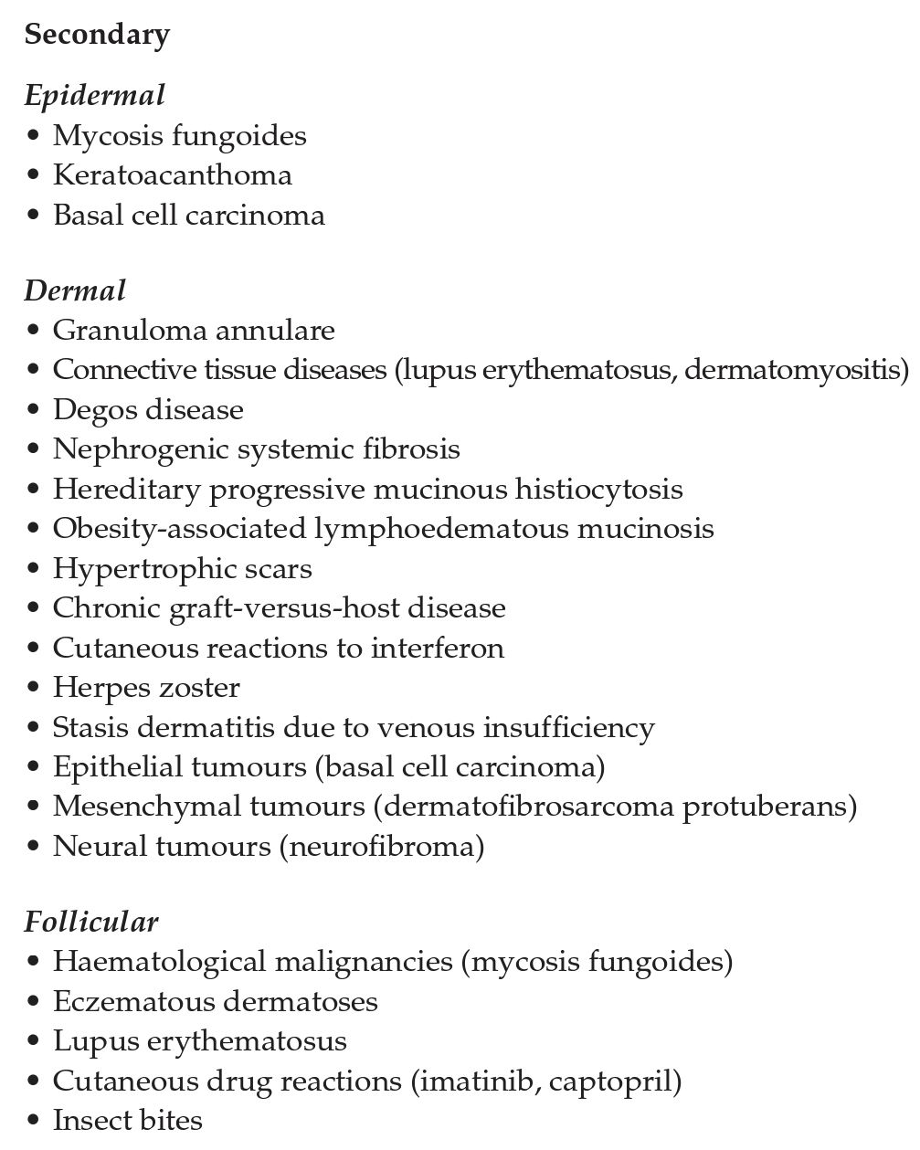
SECONDARY MUCINOSIS
ASSOCIATIONS

Slide 86
THANK YOU!
FOR Kind patience ☺

