Slide 1
MELANOMA
A HISTOPATHOLOGICAL REVIEW

Slide 2
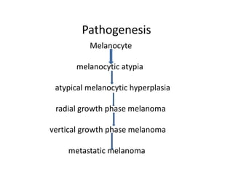
It is a multi step process that involves interaction of genomic, environmental, and host factors.
Most common mutation involves BRAF, CDKN2A loss, TP53 and TERT-p mutation.

Slide 3
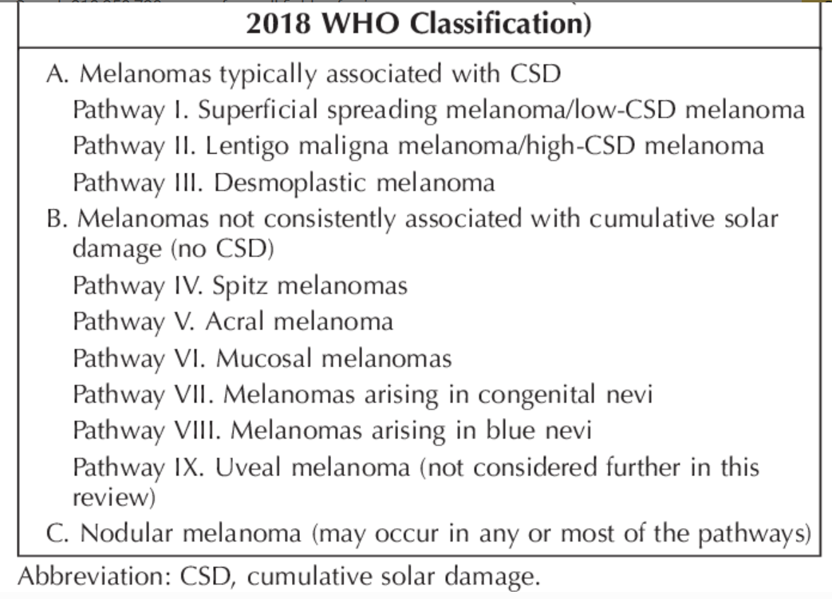

Slide 4
Histological Features
  Dimension > 6 mm
  Asymmetry (assessed at scanning magnification)
Epidermal findings / in situ melanoma
  Ill defined border
  Pagetoid melanocytes (single scattered melanocytes, especially in the upper layers of the epidermis)
  Epidermal consumption with irregular distribution of junctional melanocytes in the form of confluent nests, skip areas or dis-cohessive arrangement of melanocytes.
Dermal component
  Radial growth phase
    Invasion of single cells or small nests in the papillary dermis
  Vertical growth phase
    Complex and asymmetrical growth pattern (irregular nests / fascicles)
    Expansile growth pattern (sheet-like)
    Absence of maturation (lack of decreasing size of melanocytes / nests from the top to the base of the lesion)
    Increased dermal mitotic activity (> 1/mm²)
    Tumor necrosis

Slide 5
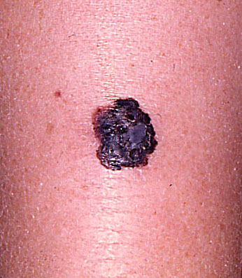
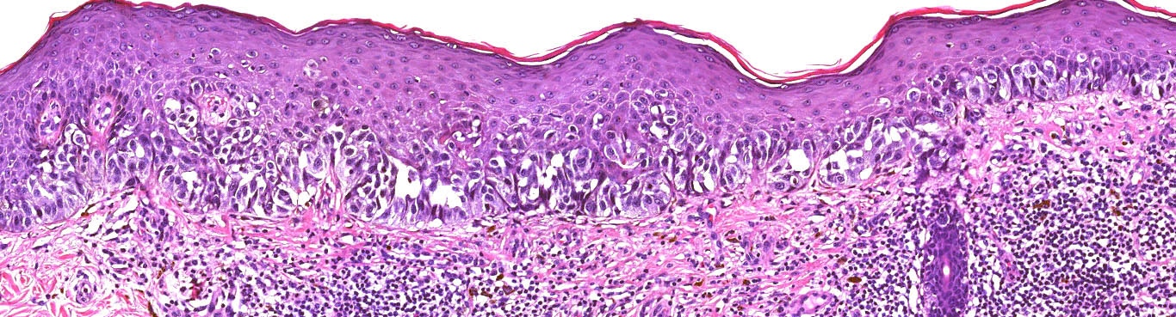
Superficial spreading melanoma
Most common subtype
Asymmetrical proliferation of atypical melanocytes
Predominant junctional single units of melanocytes rather than nests
Prominent pagetoid spread (area > 0.5 mm²)
BRAF V600E mutation

Slide 6
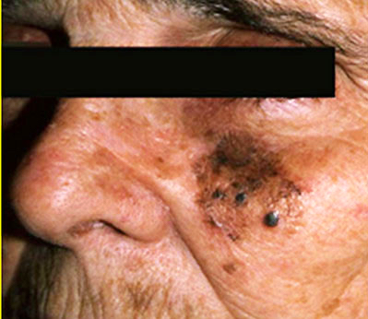
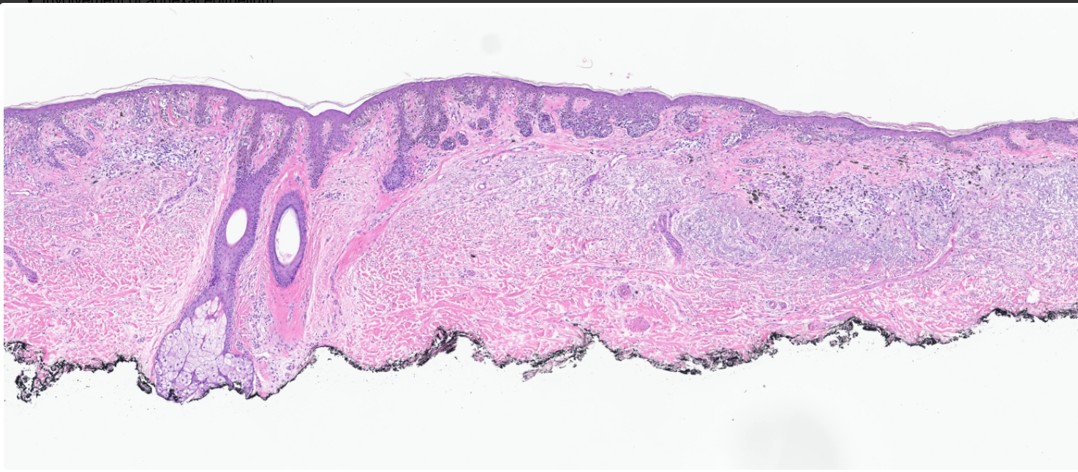
Lentigo Maligna Melanoma
Elderly patients on chronic sun damaged skin
Confluent growth of solitary units of melanocytes along the dermoepidermal junction forming small nests (lentiginous pattern)
Confluent horizontal arranged nests
Extension into the hair follicles
Prominent solar elastosis
Dermal invasion of atypical melanocytes
BRAF non-V600E, NRAS or KIT mutation

Slide 7
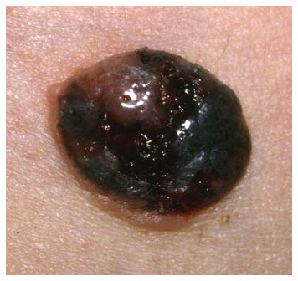
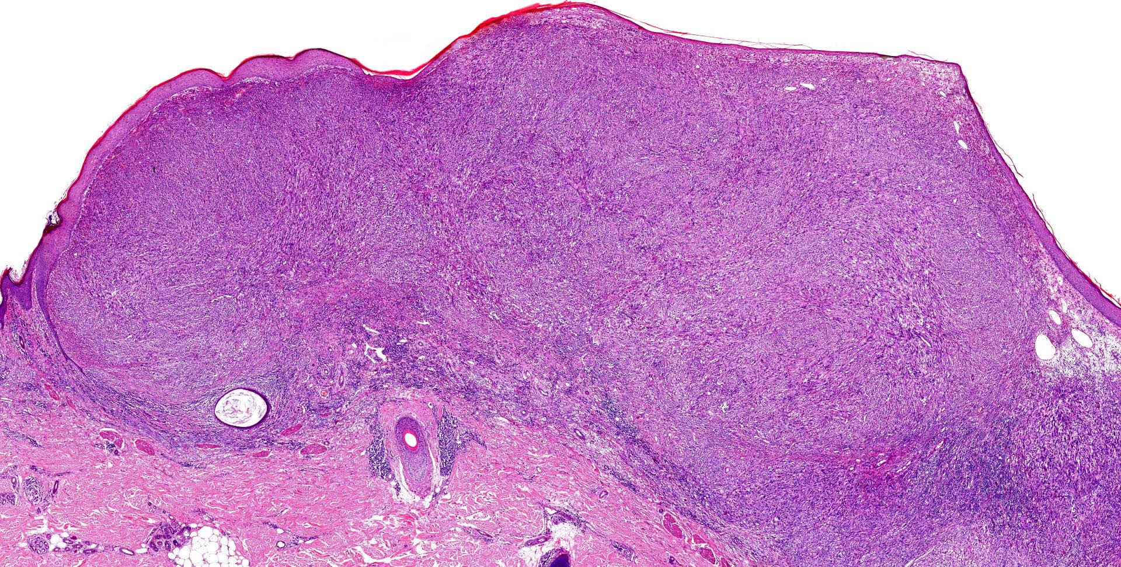


Nodular Melanoma
No radial growth phase
Junctional component not beyond the dermal component
Nodular dermal proliferation of atypical melanocytes

Slide 8
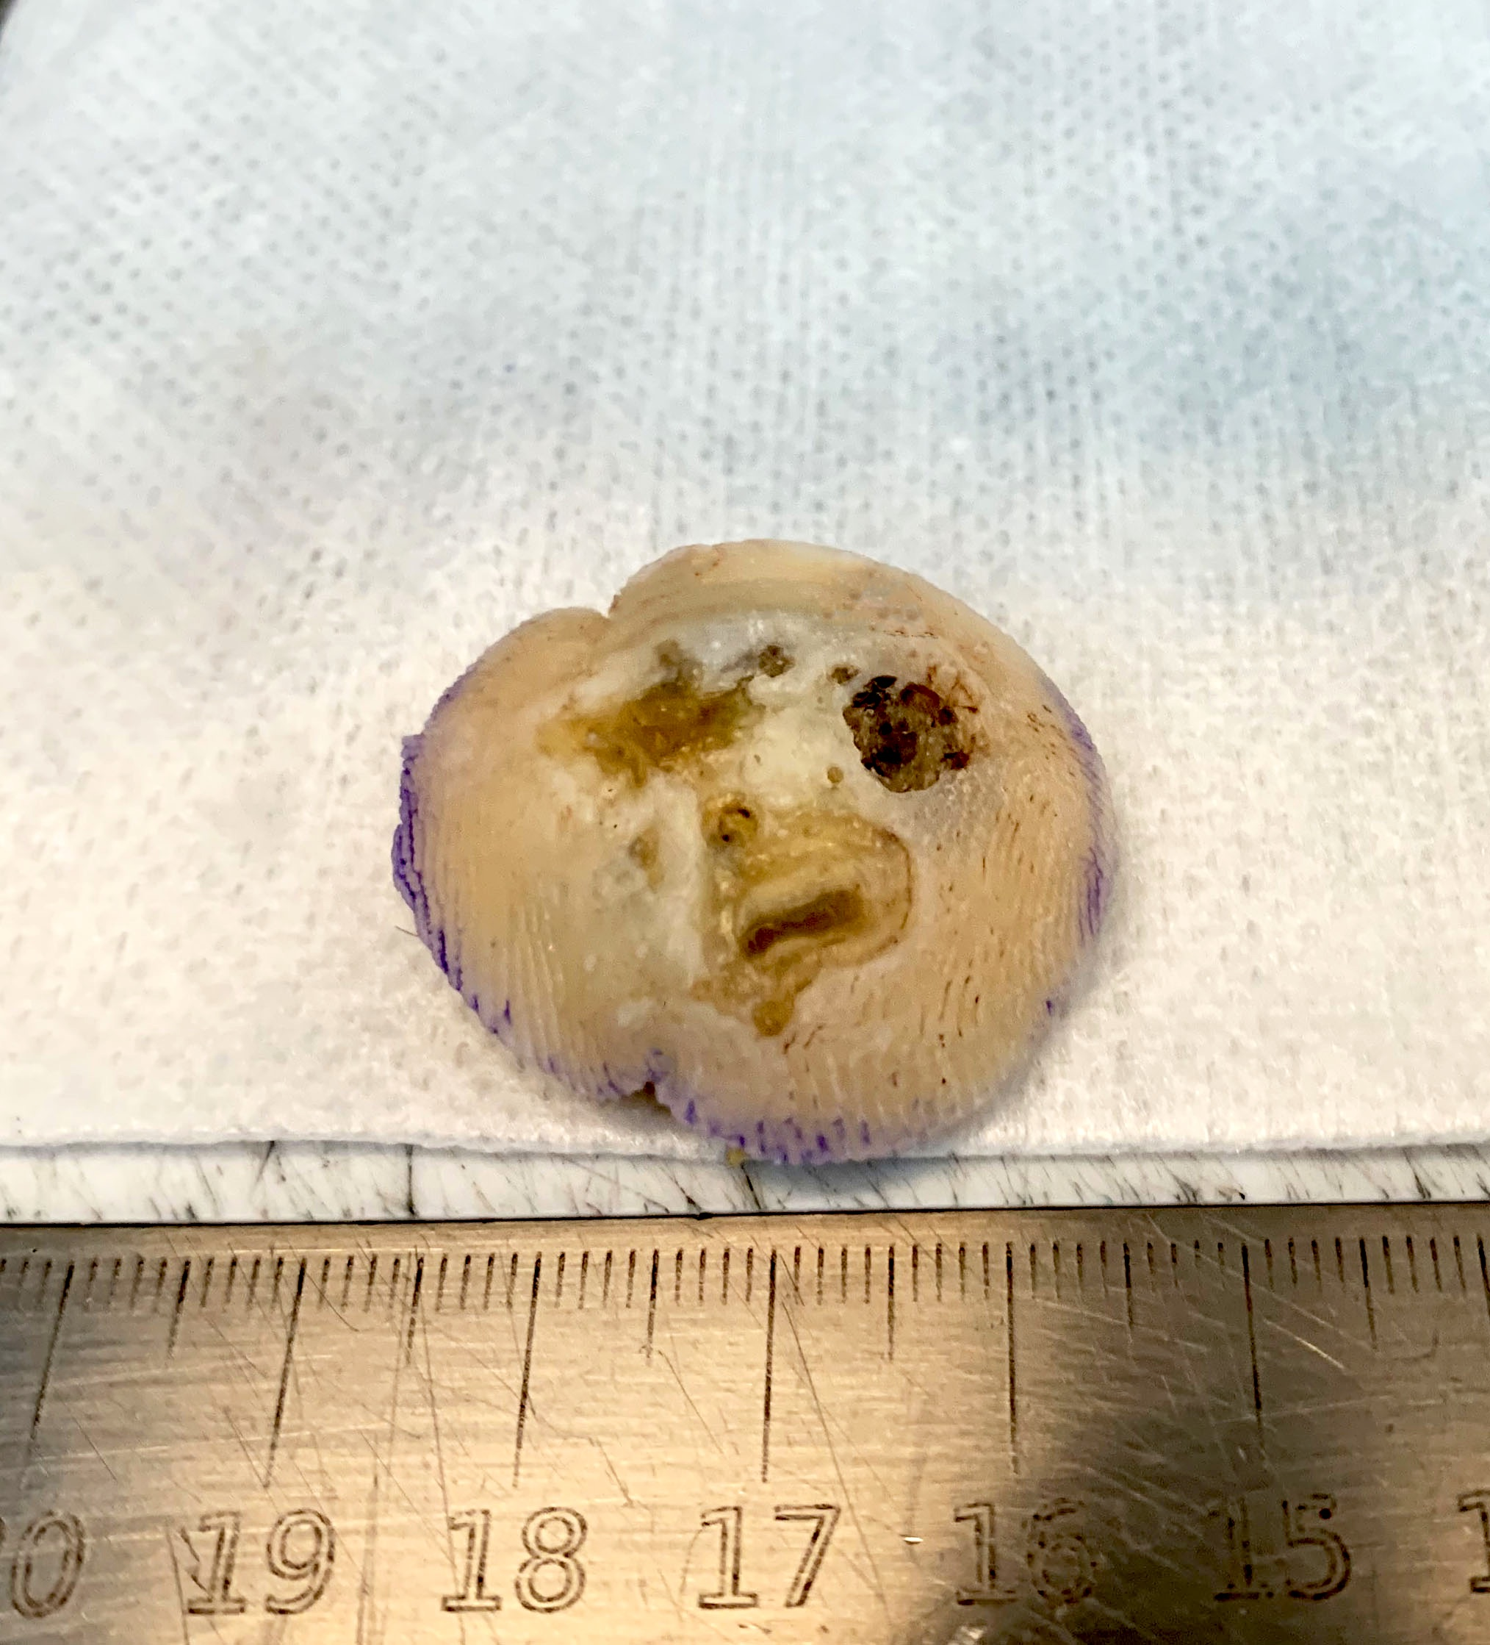
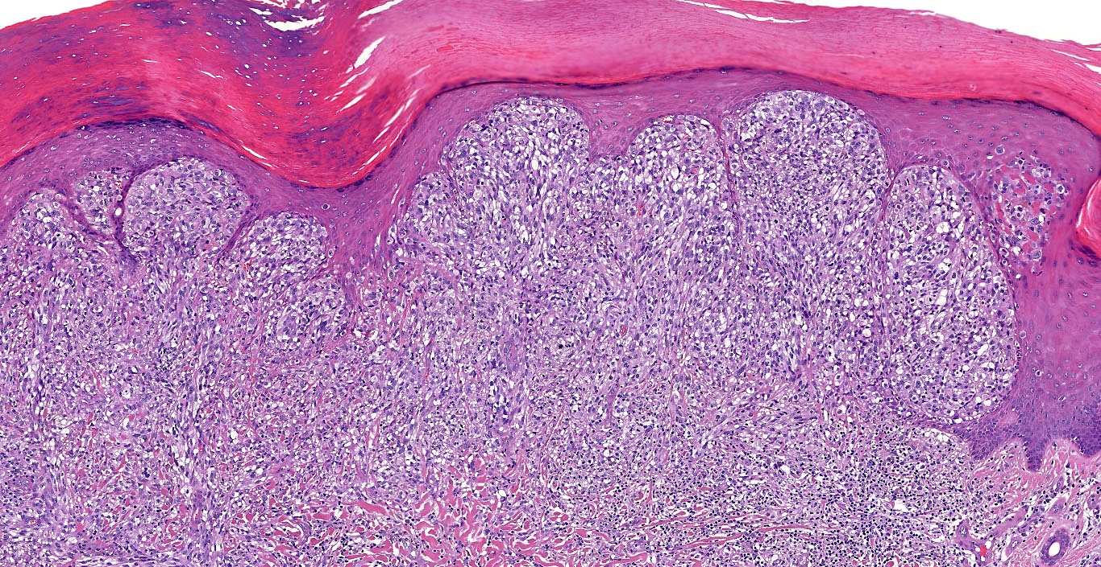


Acral lentiginous melanoma
Acral location (palms, soles and subungual)
Asymmetrical lentiginous proliferation >7 mm
Melanocytes mainly at the tips of rete ridges
Eccrine duct involvement
KIT mutation

Slide 9
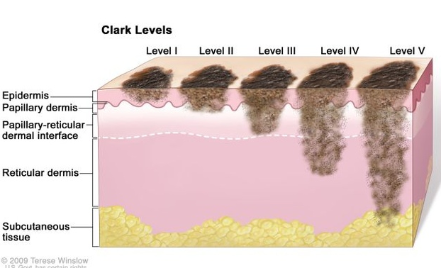
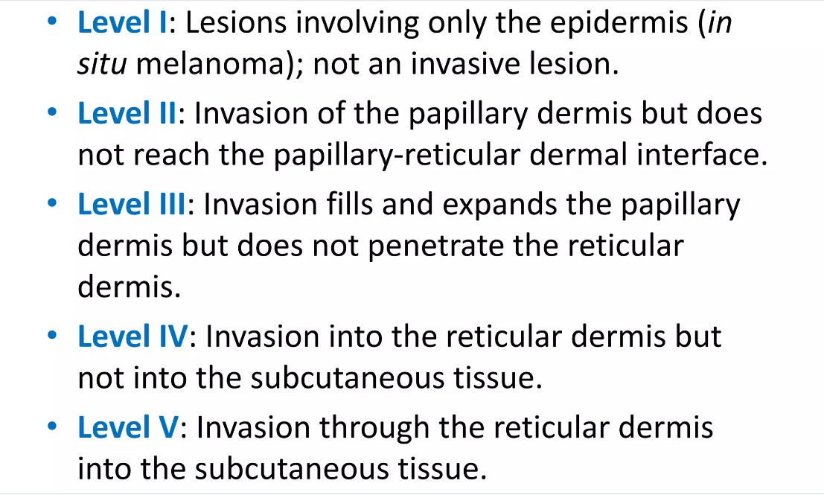
Stage (Clark’s level or Breslow depth)
Clark’s level is a staging system which describes the level of anatomical invasion of the melanoma of the skin.

Slide 10
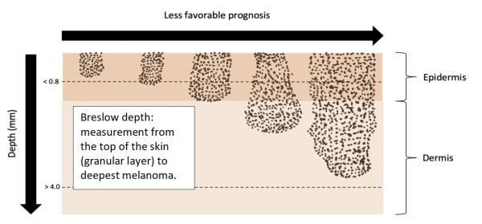
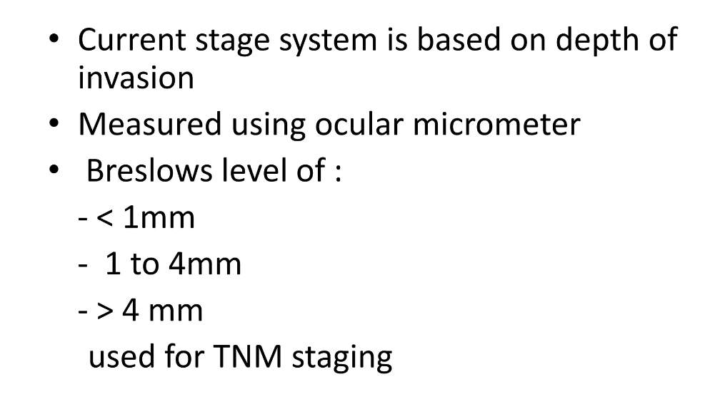

Breslow level of invasion

Slide 11
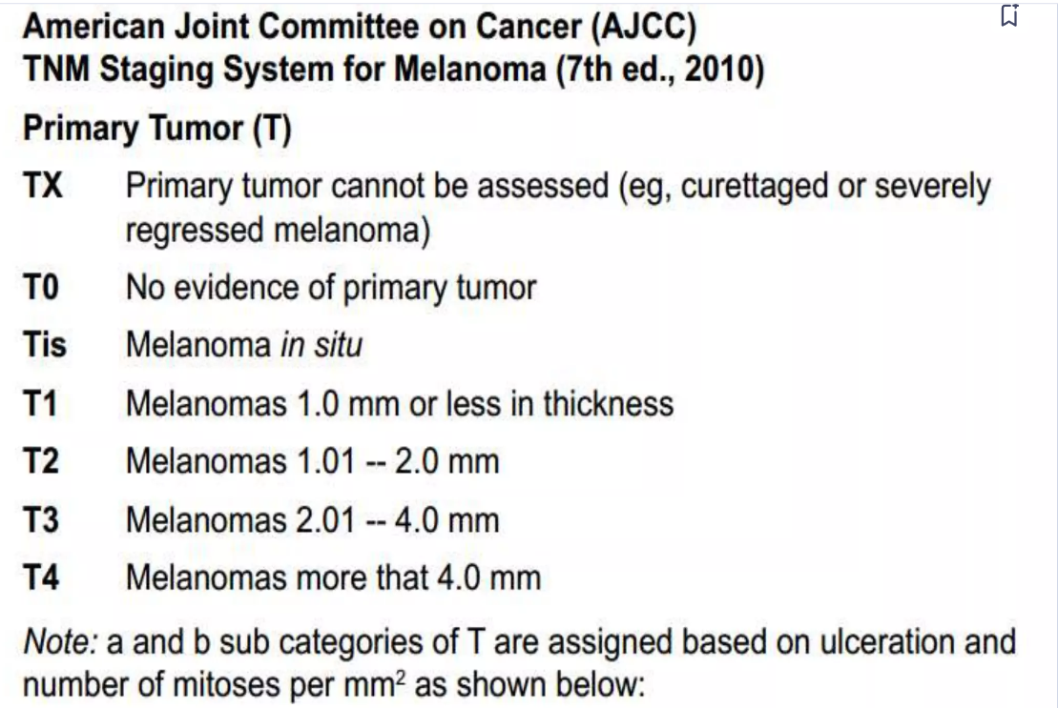

CAP protocol for reporting of melanoma
Size of Tumor
Growth Phase
Depth of Invasion (Breslow thickness)
Histologic Type
Presence or absence of ulceration
Mitotic rate
Any evidence of regression or satellite lesion
Tumor infiltrating lymphocytes (TILs)
Margins
TNM Staging

