Slide 1
LYMPHOCYTIC INFILTRATE
DR NADIA AKHTAR
PGR DERMATOLOGY

Slide 2
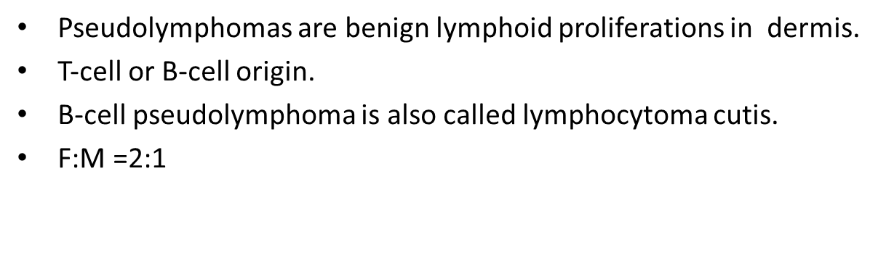
PSEUDOLYMPHOMA

Slide 3
CAUSATIVE ORGANISMS
B-CELL
T-CELL
Tattoos as a reaction to certain pigments.
Vaccination
Trauma
Acupuncture
Borrelia burgdorferi
Leishmania
MCs
Herpes zoster.
Arthropod bite
Persistant nodular scabies
Persistant CD
Drugs
Anticonvulsants
ACE inhibitors
β‐blockers
Cytotoxics
Antirheumatics.
Antidepressants

Slide 4
PATHOLOGY
T‐ or B‐cell lymphoid proliferation.
Nodular in B‐cell.
Nodular or band‐like in T‐cell proliferations.
Notes:
In B‐cell proliferations germinal centres may or may not be present, but typically reactive germinal centres have tingible body macrophages.

Slide 5
Notes:
H&E‐stained section of skin from a patient with a pseudolymphoma with conspicuous tagging of lymphocytes along basal epidermis, resembling lichenoid MF ; tattoo pigment is present in dermis.

Slide 6
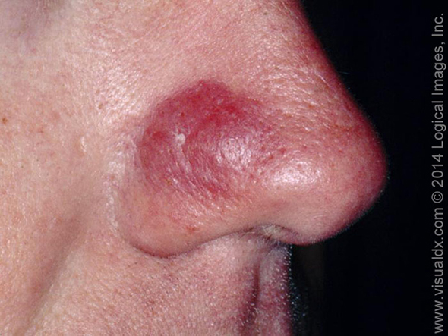
CUTANEOUS PRESENTATION
Solitary / multiple
Itchy or asymptomatic
Smooth surfaced or excoriated
Dermal papules , nodules, (plaque in T cell)
Persistent erythema , may develop into
exfoliative erythroderma.

Slide 7
SYSTEMIC FEATURES OF PSEUDOLYMPHOMA
Persistent lymphadenopathy
Low‐grade fever
Headache
Malaise
Arthralgia.

Slide 8
Multiple nodules & plaques of T‐cell pseudolymphoma affecting face due to a drug eruption induced by co‐trimoxazole.

Slide 9
DIFFERENTIAL DIAGNOSIS
Cutaneous B‐ cell lymphoma.
Cutaneous T‐cell lymphoma.

Slide 10
INVESTIGATIONS
Skin biopsy
TCR/immunoglobulin gene rearrangement analysis.
Serology for borellia
Patch test for CD
CBC ,LFTs
Notes:
Cbc for eosinophilia and LFTs for hepatitis

Slide 11
MANAGEMENT OF PSEUDOLYMPHOMA
Remove the cause.
Topical steroids for itch relief
Intra lesional steroid into nodules.
HCQ for generalized disease.

Slide 12
SMALL PLAQUE PARAPSORIASIS
A chronic asymptomatic condition, characterized by presence of persistent, small, scaly plaques, mainly on the trunk.
M:F = 3:1

Slide 13
PATHOLOGY
Small focal areas of hyperkeratosis & parakeratosis.
Small aggregates of morphologically normal CD4+ T cells around vasculature.

Slide 14
Notes:
H&E‐stained section of skin illustrating spongiosis, light lymphocytic
dermal inflammation and exocytosis – features commonly seen in chronic superficial scaly dermatitis.

Slide 15
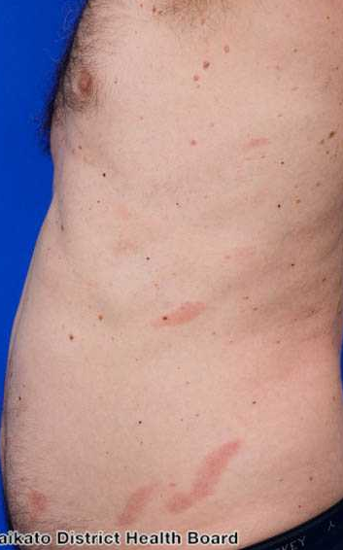
CLINICAL FEATURES
Asymptomatic.
Monomorphic.
Round /oval erythematous patches.
2.5–5 cm in diameter.
Slight scaling.
Slightly yellow, waxy tinge.
Sites :Trunk , limbs
Digitate dermatosis :
Finger‐like projections following dermatomes on lateral aspects of chest & abdomen.
Notes:
more obvious during winter. The lesions persist for years/ decades. There is sparing of the pelvic girdle
area & striking polymorphic appearance of individual patches seen in MF is lacking.

Slide 16
Typical pattern of chronic, superficial, scaly dermatosis showing fingerlike projections on sides of torso.

Slide 17
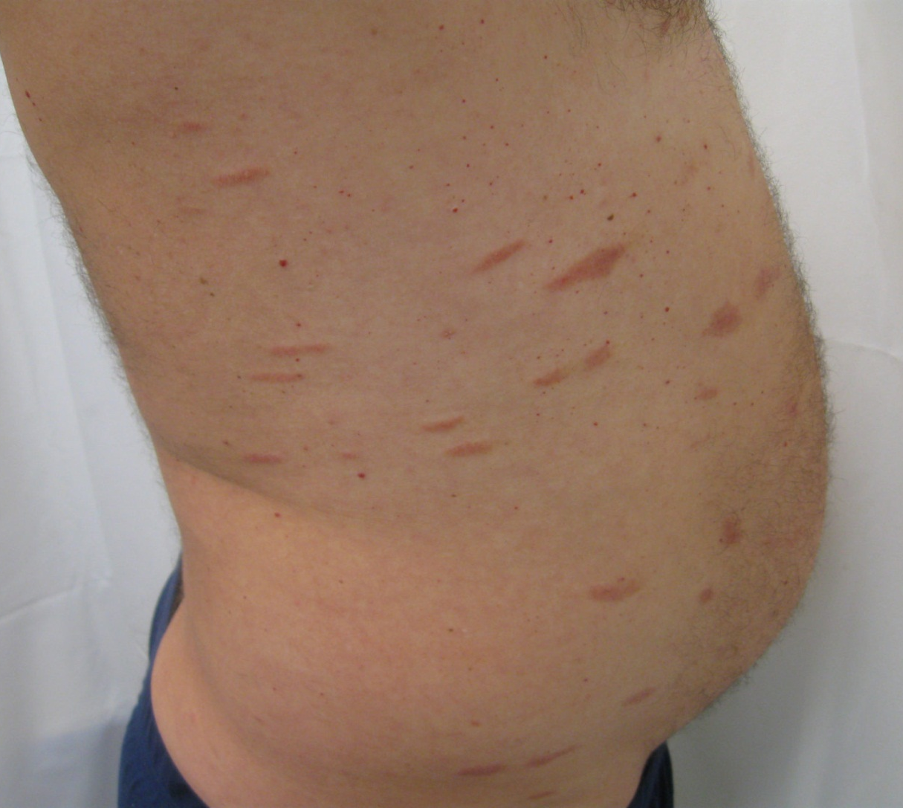

Slide 18
DIFFERENTIAL DIAGNOSIS
Discoid eczema.
Guttate psoriasis.
Pityriasis versicolor .
Allergic contact dermatitis.
Early‐stage cutaneous T‐cell lymphoma.

Slide 19
MANAGEMENT
Emollients.
Both PUVA , narrow band UVB phototherapy.
Topical nitrogen mustard.
Notes:
Both complete and partial responses have also reported with topical nitrogen mustard

Slide 20
LARGE PLAQUE PARAPSORIASIS
A chronic condition characterized by presence of fixed, large atrophic, erythematous plaques, usually on trunk and occasionally on limbs.
It may progress to MF.

Slide 21
PATHOLOGY
Frequently epidermal atrophy.
A lichenoid or interface reaction ,at dermal–epidermal junction.
A band‐like lymphocytic infiltrate in papillary dermis.
Free red cells.

Slide 22
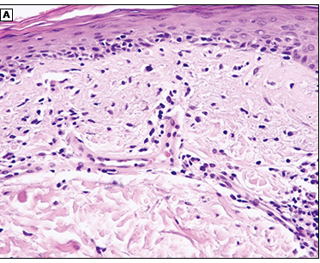
Notes:
The epidermis appears flattened and shows hydropic degeneration of basal cells.
(B) The upper dermis contains a band-like infiltrate, which in places extends into epidermis.

Slide 23
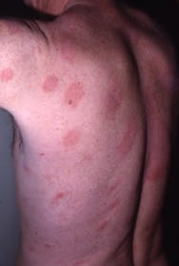
CLINICAL FEATURES
Persistent
Large
Yellow‐orange
Atrophic patches
Thin plaques on trunk & limbs.
Involvement of covered skin ( breast, buttock) suggests MF.

Slide 24
INVESTIGATIONS
A skin biopsy
Histology
Immunohistochemistry
TCR gene rearrangement analysis.

Slide 25
MANAGEMENT
Topical emollients.
UVB and PUVA.
Topical nitrogen mustard.

Slide 26
Pityriasis Lichenoides
TYPES
Pityriasis lichenoides chronica (PLC) ,most common.
Pityriasis lichenoides et varioliformis acuta (PLEVA)
Febrile ulceronecrotic Mucha–Habermann disease (FUMHD) aggressive form
Age : children , young adults.
Associated disorder : Mycosis fungoides .
Notes:
PLEVA is most common pattern in younger children

Slide 27
PREDISPOSING FACTORS
Infections (mainly viral)
Herbs
Drugs
Chemotherapeutic agents
Oral contraceptives
Astemizole

Slide 28
PATHOLOGY OF PL
An infiltrate of predominantly small lymphocytes surrounds and involves walls of dilated dermal capillaries, show endothelial proliferation.
In PLEVA, infiltrate may deep, dense wedge‐shaped rather than predominantly perivascular.
Epidermis is oedematous, with interface dermatitis , necrotic keratinocytes are generally present.
Intraepidermal and perivascular extravasation of erythrocytes is typical.
Later, over centre of lesion, a parakeratotic scale forms, containing lymphocytic pseudo‐Munro abscesses and prominent exocytosis of lymphocytes

Slide 29
In FUMHD :marked fibrinoid necrosis of deep vessels with luminal thrombi, partial necrosis of follicles ,complete necrosis of eccrine glands.

Slide 30
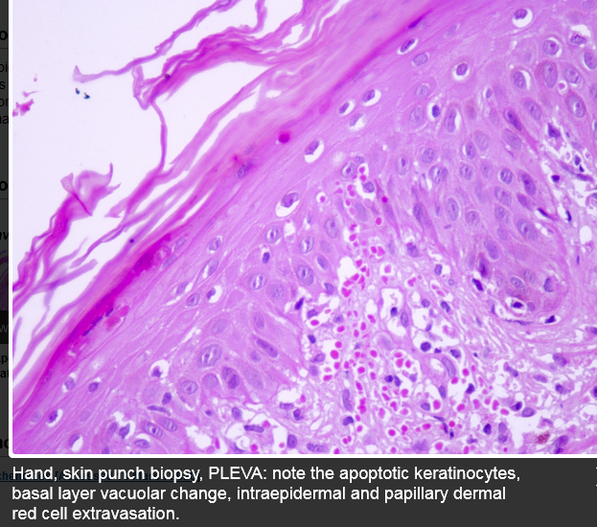

Slide 31
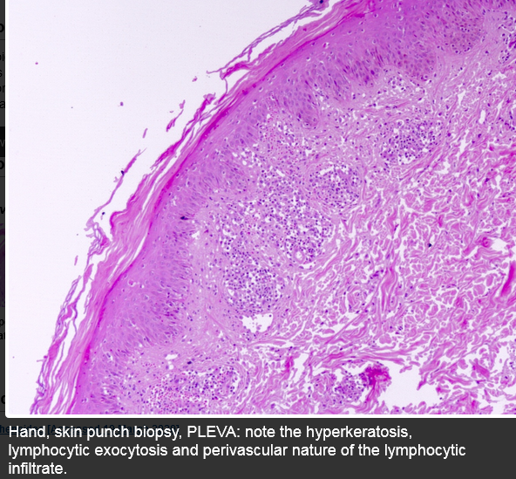

Slide 32
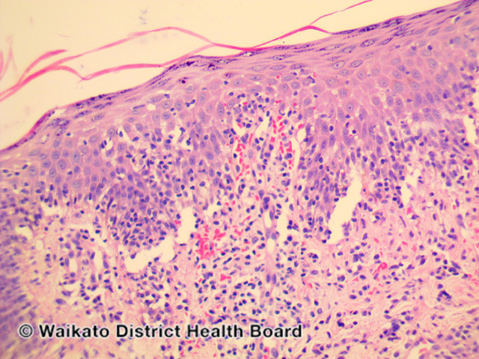
Notes:
PLEVA has sharply delimited, moderately dense, lymphocytic infiltrate involving the superficial vascular plexus, extends in a wedge-shaped pattern to involve the lower dermis

Slide 33
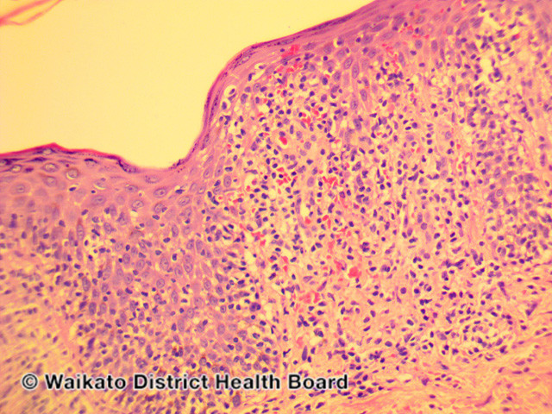
Notes:
The superficial dermis shows a dense lichenoid infiltrate and impressive exocytosis of lymphocytes into epidermis. The overlying stratum corneum shows parakeratosis which may be confluent and contain collections of neutrophil

Slide 34
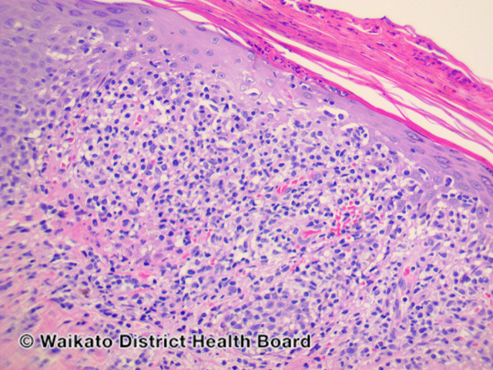
Notes:
The epidermis shows pronounced hydropic change and foci of keratinocyte necrosis. Scattered extravasated erythrocytes

Slide 35
Lymphocytic infiltrate obscuring dermal–epidermal junction.

Slide 36
PREDISPOSING FACTORS
Seasonal peaks of onset in autumn, winter.
Toxoplasmosis
Parvovirus B19, Adenovirus , (EBV) , CMV
Herpes simplex
Varicella‐zoster virus
HIV
Measles & MMR vaccines
Streptococci /Staphylococci
Mycoplasma infections.

Slide 37
CLINICAL PRESENTATION OF PLEVA
Asymptomatic (new lesion may cause burning).
Polymorphic
Oedematous pink papule.
Central vesiculation , haemorrhagic necrosis
Erythematous / necrotic lesions of mucous membrane.
Constitutional symptoms
Scarring
Face , scalp often spared.
SITES:
Trunk
Thighs
Upper arms especially flexor aspects,
Notes:
May generalized .
PLEVA in pregnancy carries a potential risk of premature labour if mucosal lesions in region of the cervical os

Slide 38
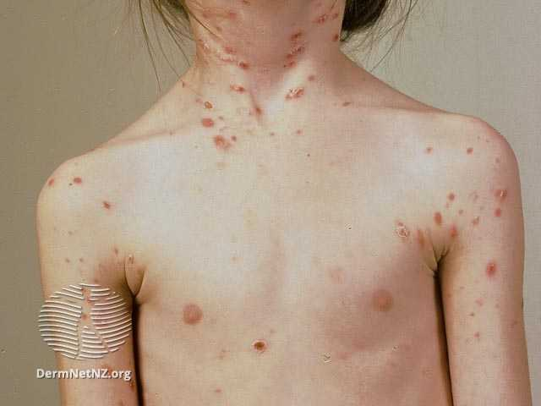
Pityriasis lichenoides acuta in a child

Slide 39
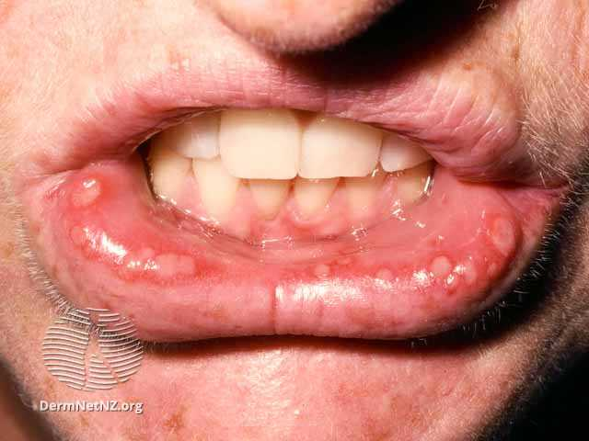
Mucosal ulcers in pityriasis lichenoides acuta

Slide 40
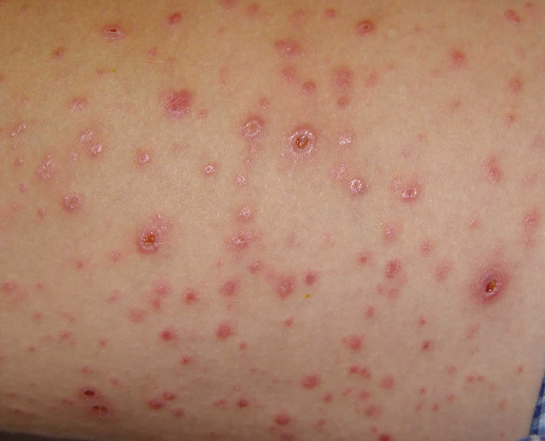
CLINICAL PRESENTATION OF PLC
Small, firm, lichenoid papule.
Reddish brown
Adherent ‘mica‐like’ scale.
Post inflammatory hypopigmentation (persistent).
Acral
Segmental
Notes:
3 or 4 weeks, papule flattens , scale separates spontaneously to leave a pigmented macule,
An adherent ‘mica‐like’ scale can be detached by gentle scraping to reveal a shining brown surface is a distinctive diagnostic feature

Slide 42
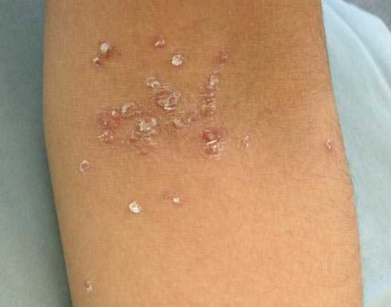
Mica-like scale in pityriasis lichenoides chronica

Slide 43
DIFFERENTIAL DIAGNOSIS
PLEVA
Varicella
Vasculitis
Pyoderma gangrenosum.
Lymphomatoid papulosis
PLC
Guttate psoriasis
LP
Secondary syphilis
Insect bite / drug reactions.
Notes:
Lymphoid papulosis =less vesicular & more necrotic papulonodular lesions

Slide 44
TREATMENT LADDER FOR PLC
IN CHILDREN
2nd LINE :
Erythromycin
3rd LINE :
Methotrexate,
Ciclosporin
Dapsone
1ST LINE :
Topical steroids
Immunomodulators.
2ND LINE :
Phototherapy ( UVB, PUVA)
(Tetracycline, erythromycin)
3RD LINE :
Acitretin (acitretin plus PUVA)
Methotrexate, ciclosporin, dapsone, UVA‐1

Slide 45
TREATMENT LADDER FOR PLEVA
1st LINE :
Oral antibiotics (erythromycin)
2nd LINE:
Phototherapy (broad‐/narrow‐band UVB, PUVA)
Acitretin plus PUVA
3rd LINE :
Systemic corticosteroids
Methotrexate
Ciclosporin,
Dapsone
UVA‐1
IN CHILDREN
2nd LINE:
Phototherapy (broad‐/narrow‐band UVB)
3rd LINE :
Systemic corticosteroids
Methotrexate
Ciclosporin,
Dapsone

Slide 46
LYMPHOCYTOMA CUTIS
A benign, cutaneous, B‐cell lymphoproliferative disorder , included as a subtype of pseudolymphoma.
Borrelia burgdorferi infection (children)
Ixodes ricinus tick
F:M 2:1
Notes:
Spiegler–Fendt sarcoid
• Lymphadenosis benigna cutis of Bafverstedt
It encompasses a spectrum of benign B‐cell lymphoproliferative diseases, share clinical and histopathological features.
• Reactive cutaneous lymphoid hyperplasia

Slide 47
PATHOLOGY
Grenz zone.
Nodular, dense infiltrate extending through full thickness of dermis without cellular atypia.
In classic cases, lymphocytes , histiocytes form a follicular arrangement (germinal centre) resembling appearance of a lymph node.
Majority of lymphocytes in dermis are B cells.
In cases with well‐formed germinal centres, a cuff of reactive T cells may be seen around periphery of main B‐cell aggregate.
There is polytypic expression of κ and λ light chains.

Slide 48
A dense, nodular infiltrate in dermis. There is a Grenz zone and a normal epidermis

Slide 49
Large reactive lymphoid follicles

Slide 50
PREDISPOSING FACTORS
Trauma
Vaccinations
Allergy hyposensitization injections
Drug ingestion
Arthropod bites
Acupuncture
Metallic pierced earrings
Treatment with leeches
Borrelia burgdorferi , MCs & Leishmania donovani.
In scars of previous herpes zoster .

Slide 51
CLINICAL PRESENTATION
Solitary or grouped
Asymptomatic
May be itchy / tender
Erythematous or plum‐coloured .
Papules, nodules or plaques
Face, chest & upper extremities.
Enlarge slowly , diameter of 3–5 cm.
Disseminated or miliary types.
Notes:
Lymphocytoma cutis secondary to Borrelia infection is most frequently seen at sites with low skin temperature , earlobes, nipples, nose and scrotum.

Slide 52
Extensive dermal nodules of lymphocytoma cutis on face.

Slide 53
DIFFERENTIAL DIAGNOSIS
Sarcoidosis
Granuloma faciale
Rosacea.
Jessner’s benign lymphocytic infiltration.
Tumid discoid lupus erythematosus (LE)
Polymorphic light eruption.

Slide 54
INVESTIGATIONS
A skin biopsy for histology, immunohistochemistry and immunoglobulin gene analysis.
Serology for Borrelia burgdorferi .
Patch testing if a contact allergen is suspected.

Slide 55
MANAGEMENT
1ST Line for localized disease:
Excision,
Topical / intralesional corticosteroids
Oral antibiotics for Borrelia .
In generalized disease, HCQ
2nd Line
Superficial radiotherapy
Intralesional interferon α (IFN‐α) ,
Cryotherapy
Intralesional rituximab ,
Topical 0.1% tacrolimus ointment
Topical photodynamic therapy

Slide 56
Jessner’s Lymphocytic Infiltrate
A chronic, benign, inflammatory condition, usually affecting photo‐exposed skin.
It may be a variant of LE.

Slide 57
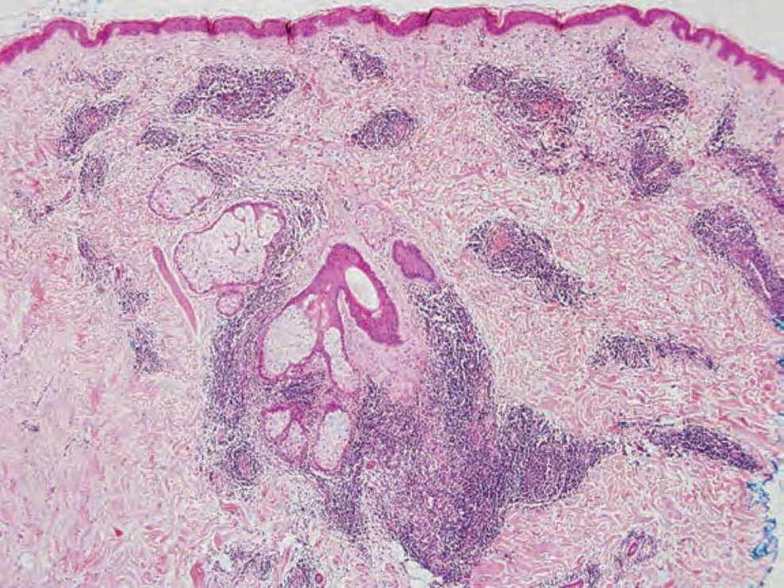
PATHOLOGY
Notes:
Epidermis is normal.
Moderately dense superficial & deep perivascular dermal lymphocytic infiltrate.

Slide 58
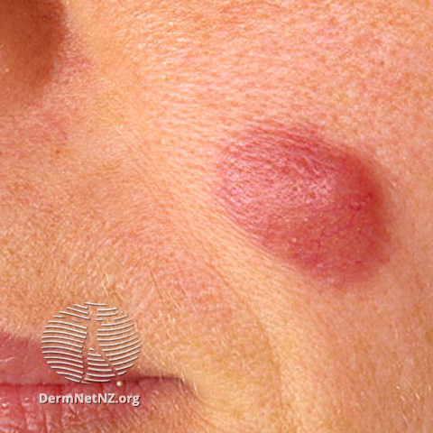
CLINICAL PRESENTATION
Asymptomatic
Non‐scaly
Erythematous
Papules & plaques
Central clearing of lesions may occur, annular appearance.
No atrophy or follicular plugging.
+/- history of onset following sun exposure
SITES:
Face
Neck
Upper chest.

Slide 59
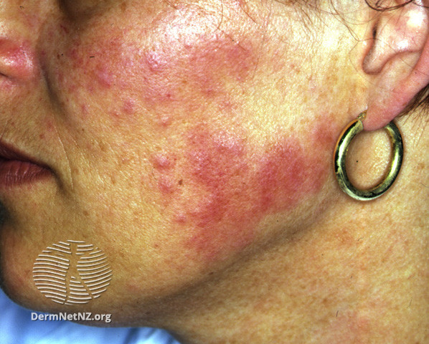

Slide 60
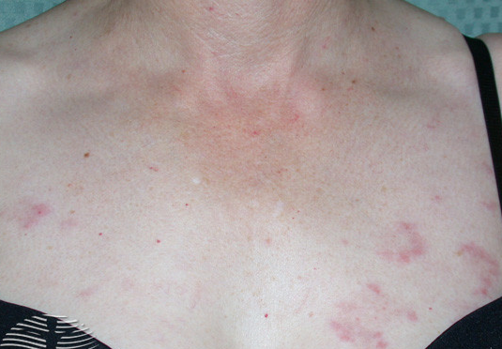
Central clearing giving annular appearance

Slide 62
DIFFERENTIAL DIAGNOSIS
Polymorphic light eruption
LE
Lymphocytoma cutis

Slide 63
INVESTIGATIONS
A skin biopsy for histology, direct immunofluorescence & molecular gene rearrangement studies.
Serology testing for SLE .
Phototesting in patients with a H/O photosensitivity
Notes:
Prognosis is good as it is benign in nature may resolve spontaneously;

Slide 64
MANAGEMENT
No treatment if it is asymptomatic.
Cosmetic camouflage
Excision of small lesions
Photoprotection
Topical / intralesional steroids
Notes:
Hydroxychloroquine , systemic steroids , cryotherapy . There are reports of benefit with methotrexate, retinoids and oral auranofin

Slide 65


