Slide 1
Lymph edema
By dr aqsa rauf

Slide 2
Define edema?
Lymphedema?
Composition of lymph
Composition of edema

Slide 3
Introduction
If edema is due to tissue compartment
Klippel trenaunay syndrome
Plexiform neurofibroma
If swelling is fluid
search for any systemic disease heart failure, venous edema ,lymphedema

Slide 4
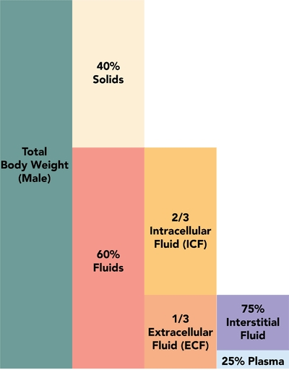

Slide 5
Introduction
Edema
Is an excess of interstitial fluid .any edema whatever the cause is due to cappillary filtration overwhelming the lymph drianage for sufficent period of time
Lymphedema
That occur when lymphatic system is impairedto the extent that the amount of given fluid exced the capacity to lymphatic trans systemto remove it

Slide 6
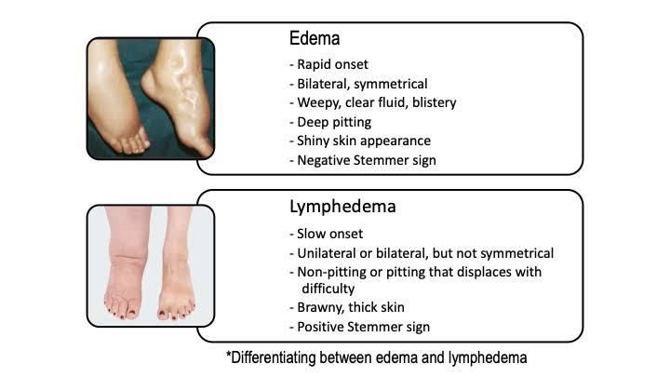

Slide 7
Lymphedema
Unilateral edema causes
Bilateral edema cuases
Pelvic lymph r venous obs
Post thrombotic syndrome
Inflammation
Infection
Hypoprotinemia
High central venous pressure
Heart failure
Obesity
Sleep apnea syndrome

Slide 8
Pathophysiology
Edema develop when microvascular filtration rate exceed lymph drainage
For edema to develope either the microvascular filtration is high r lymph flow is low r combination of two.
Starling principle of fluid exchange

Slide 9
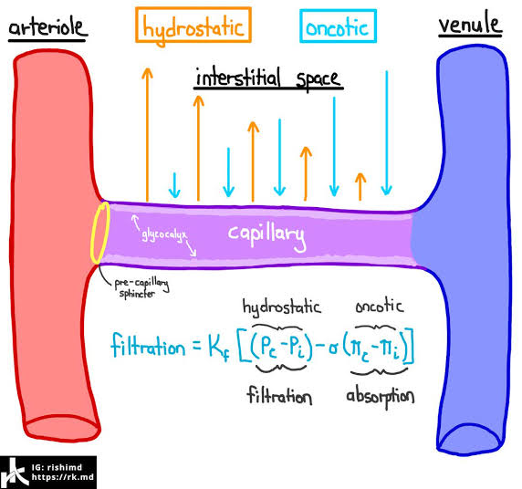

Slide 10
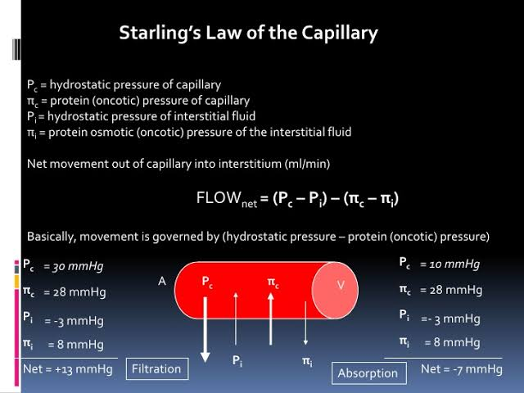

Slide 11
Clinical features of lymphedema
Lymphedema doesnot respond to elevation r diuretics except in early stages
Edema that donot reduce after overnight elevation r mostly lymphatic in origin
Some drugs cause chronic edema
Dermal edema manifest as peau d orange Due to expansion of interfollicular dermis
Subcutaneous edema give rise to pitting
Positive kapsi stemmer sign is pathogenomic of lymphedema

Slide 12
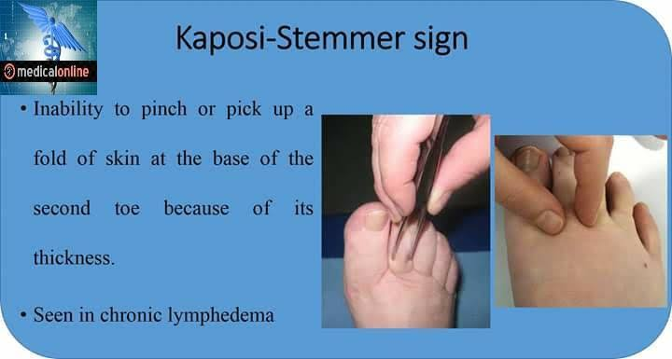

Slide 13
Chronically swollen leg
Swelling of lower limb ia due to edema caused by
Inc in microvascular fluid filtration overwhelming lymph drianage
Causes r
Inc venous presaure
Low plasma protein
Inflammatory state

Slide 14
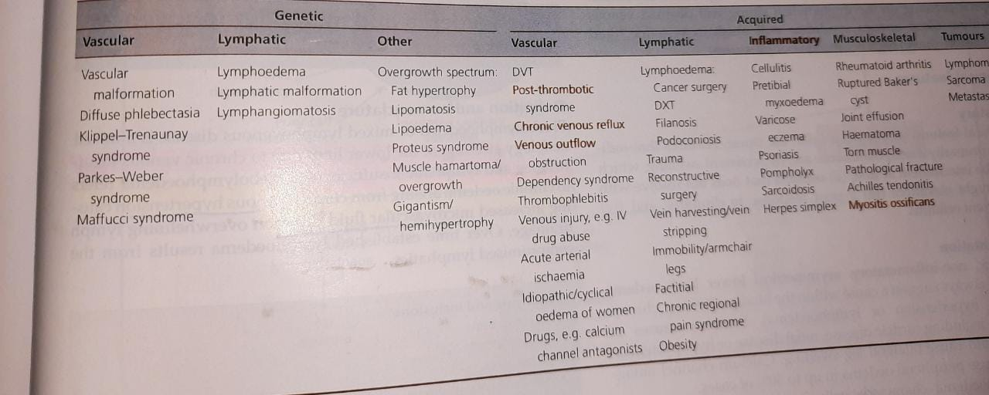

Slide 15
Presentation of chronically swollen leg
Chronic , asymetrical , non inflammatory lower limb edema suggest a cause(venous hypert r lymphedema)
Other systemic cause must be rule out
Lymphedema produce thickened skin wd inc chronicity n severity skin changes of hyperkeratosis n pappilomatosis and positive kaposi stemmer sign
In advance stage fat deposition n fibrosis lead to more indurated r brwany swelling of skin n subcut tissue

Slide 16
Yellow nail syndrome (yNs)
Yns comprises of overcurved , translucent, slow growing nail wd yellow discoluration along wd resp ailment such as chronic sinusitis , bronchiectasis, r pleural effusion and lymphedema
Epidemiology
100/127 pt age b/w 41 to 80year
M:f ...1.2:1
Pelural effusion
Serous 75%
Milky 22.3%
Purulent 7.3%
Pleural fluid protein value >3 g/dl

Slide 17
2 cases reported mother diagnosed wd yns
Baby girl born at 33wks and another29 weeks have hydrops on antenatal usg
These infants have recurrent cough n early onset bronchiectasia

Slide 18
History n presentation
Age of onset is 6th decade
Nail.....thickened , opaque, harder to cut ,yellow , green ,black colur ,fracuture n shed N painful nail due to paronychia loss of cuticle n lanulae
Reps.... Bronchiectasis ? Sinusitis, chronic cough n pleural effusion
Lymphedema ... Bilateralankel edema ,genital n upper limb rarely
Differntial diagnosis
Fungal infection
Familial

Slide 19
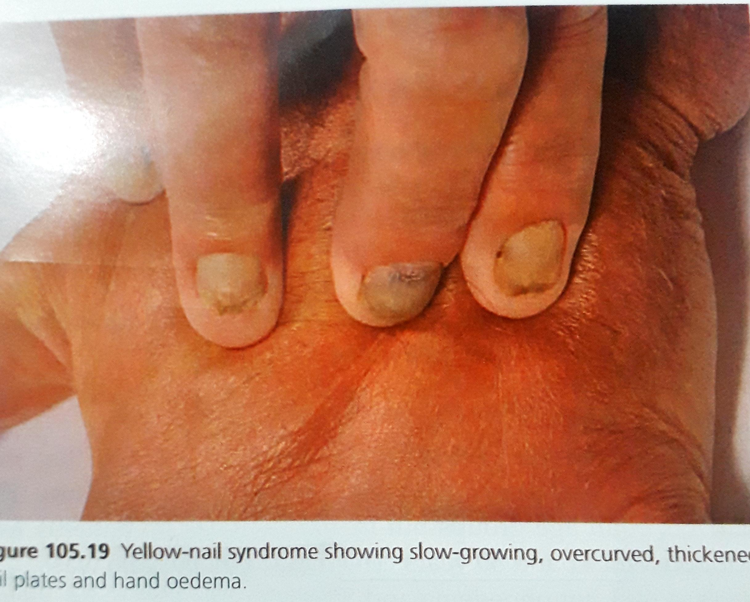
Complication n treatment
Recurrent chest infec
Recurrent cellulitis
Acute paronychia
Investigation
yns is clinical diagnosis
Management
Pleurodesis n pleurectomy
Vit e
Spironolactone
Fluconazole for paronychia

Slide 20
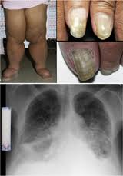

Slide 21
Lymphatic filariasis
Defination
It is a parasitic disease caused by microscopic Worms thats r transmitted by mosquito
Adult worm live within the human lymphatic system n dusrupt drainage result in lymphedema n hydrocele
Synonyms
Elephantiasis
Introduction n general description
Causative orgnisism

Slide 22
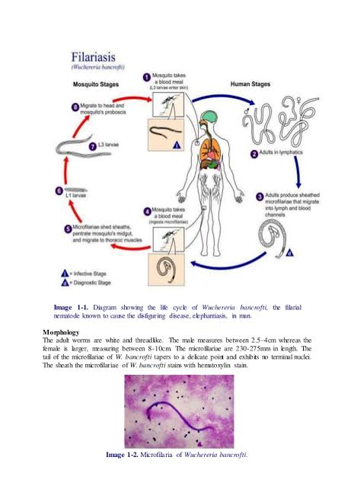

Slide 23
Wechereria bancrofti (90%)
Burgia Malayi
B. Timori
General description
adult worm reside in afferent lymphatic vessels r l.n while their larva (microfilariae ) circulate within peripheral blood r able to infect mosiquito vector as they feed And transmit to other host
adult female worm reside for more than decade n release 1000s of larvae in lymphatic circulation
Clinical sign r due to adult worms but not due to microfilariae live within lymph vessel

Slide 24
Epidemiology
Endemic in 73 countries
1.2 billion ppl r at risk
13 million wd elephantiasis
Edemic areas r africa ,south east asia( transimission n morbidity is high) ,western pacific , middle east
Age
Infection contracted throughout life Symptomatic in adulthood
Sex
M 》f

Slide 25
Pathophysiology
Adult worm in lymphatic vessel 》 worm secerete irritanat toxin 》vessel dialated 》reduce lymph flow》fibrosis 》2ndry infection 》 granuloma formation due to dead worms reside within vessel n block obs
Predisposing factors
Tropical n subtropical areas
Visiting tourist have very low risk of aquiring LF

Slide 26
Clinical presentation
Clinical manifestation from asymptomatic individual to disfiguring disease (elephantiasis)
Subclinical disease
Microscopic heamaturia / proteinuria
Swollen n dialated lymphatic vessel , scrotal edema in males
Adenolymphangitis in adoles (sudden onset fever , painful nodes ,lymohangtis ,edema )
Dermatolymphangioadenitis(skin , lymohangitis ,lymphadenitis) plus chills n fever
Elephantisis skin (hyperkeratosis ,pappilomatosis ,skin fissuring n chyluria)
Hydrocele

Slide 27
Complications
Chyluria is the presence of chyl in urinary tract.. Impared retroperitoneal flow below the cisterna chyli in to the renal lymph ...lwhich may repture lympahtic vessel n result in Lymph in urinary tract
Nutritional defi
Tropical pulmonary eosinophilia syndrome
Paroxysmal cough
Resp wheeze
Elevated eosiophils in cbc n high serum immunoglobulin E
Specific antifilarial antibodies

Slide 28
Diffrential diagnosis
Podoconosis
Chronic lymphedema
Prognosis
Is poor
Subsequent deformity lead to social stigma n financial burden of inc medical expenses

Slide 29
Investigations
History n clinical examination (endemic area where lower limb + genitalia involve likely to have l.F)
Doppler usg ( detect adult worms in scrotum)
PCR
Antigen testing
Burned out infection ( lymphedema , elephantiasis , hydrocele in absence of parasite dont exclude the l.f diagnosis)

Slide 30
Management
WHO launched programme GPELF which aim to stop spread of l.f by
Interuption of transmission of filarial infection in all endemic area
Prevention n allevation of disability n suffering in individual already affection by l.f
Mass drug administration (5 years)at least 65% of total population at risk so that reduction in blood level of microfilarae to a level where no longer transmission can occur
6mg/kg dietgylcarbamazine citrate wd 400mg albendaxole
150ug/kg ivermectin in combination wd 400 mg albendazole
Treat secondary infection

Slide 31
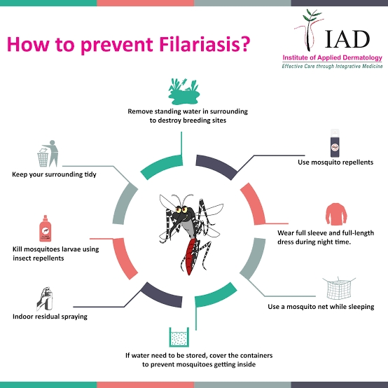
Pto
Surgical treatment include hydrocelectomy to achieve volume reduction
Life style managemnt
Foot wear
Mosquito net
Full seeleves n trouser
Mosquito spray n repllents

Slide 32


Slide 33
Differntial diagnosis
Phelbolymphedema
Heart failure
Obesity
Dependency
Chronic venous disease

Slide 34
Complications
Phelbolymphedema can camplicated wd lipodermatosclerosis, ulceration, dermatitis , lymphorrhoea n infection like cellulutis
Rarely malignancy (lymphangiosarcoma)
Prognosis
Is poor

Slide 35
Investigations
Venous duplex usg is investigation of choice
Lymphoscintigraphy is investigation of choice of lymphatic insufficency (sensitive but not specific test for lymphedema)

Slide 36
Management
1st line
Compression n exercise both treat lymphedema n venous disease
Decongestive lymph therapy
Venous ulcer compression banadages
Legs should be elevated to heart level
2nd line

