Slide 1


Slide 2
LICHEN PLANUS
AND LICHENOID DISORDERS
Dr Aneela Farooq
Speciality Registrar Dermatology
CMH Abbottabad
D.DERM UK
Board Certified Diplomate AAAM USA

Slide 3
Learning Objectives
To diagnose lichen planus clinically
To know the pathophysiology and histopathology.
To identify the clinical variants and complications
To manage the condition.

Slide 4
Lichenoid disorders:
inflammatory dermatoses characterized clinically by flat topped papular lesions and histologically by a lymphocytic infiltrate with a band like distribution in the papillary dermis.

Slide 5
Lichen Planus
Most typical and best characterized lichenoid dermatosis.
An idiopathic inflammatory skin disease
affecting the skin and mucosal membranes.
Notes:
often with a chronic
course with relapses and periods of remission.
often with a chronic
course with relapses and periods of remission.

Slide 6
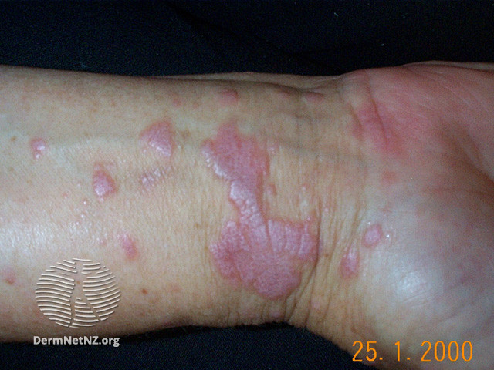
6-P’s of lichen planus
Purple
Planar
Papular
Polygonal
Pruritic
Plaques

Slide 7
Epidemiology
Prevalence: 0.5% of population
Rare in children
Commonly affects adults during their fourth to sixth decade

Slide 8
Pathophysiology
T-cell mediated autoimmune disease, possibly targeting the basal keratinocytes, which can be triggered by a variety of situations including viruses, drugs and contact allergens.

Slide 9
Pathophysiology
Lymphocytic infiltrate is composed of CD8+ T cells.
CD8+ cytotoxic T cells recognize an antigen (currently unknown) associated with MHC class 1 on lesional keratinocytes and lyse them.

Slide 10
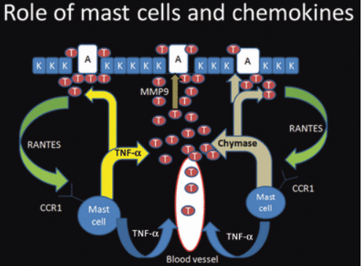

Slide 11
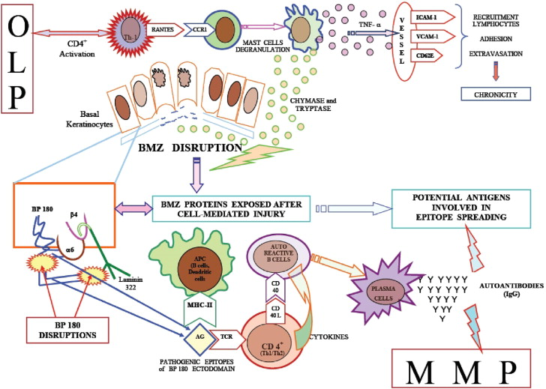
Notes:
RANTES: Regulated upon activation , normal t cell expressed and secreted

Slide 12
Causes
Viruses: Hep C,Hep B, HHV6&7, Hep B vaccines
Genetics: HLA-A3 and HLA-5
Drugs: antimicrobials, antihypertensives, antimalarials, antidepressants, anticonvulsants, diuretics, metals, NSAIDS, Imatinib, IV immunoglobulin,etanercept and adalimumab.
Mercury in dental amalgam
Notes:
Hep c virus modify self antigens on the surface of basal keratinocytes

Slide 13
Betel nut
Lichen planus-like contact dermatitis:
PPD,methacrylic acid esters used in car industry, dimethylfumarate found in sofas.
Radiotherapy
Anxiety
Depression
Stress
Notes:
Two types of reaction were observed – acute (eczematous) and subacute (lichenoid). Patch‐test reactions were usually positive to the substituted para‐phenylenediamine & were eczematous in nature, but might become lichenoid

Slide 14
Clinical features
Primary lesions: papules, polygonal plaques, flat topped and firm on palpation.
A tracery of thin white lines seen on the surface of lesions, wickham’s striae.

Slide 15
Clinical features
Sites: anywhere but most often front of the wrists, lower back and ankles.
Distribution: scattered, clustered, linear, annular or actinic (sun exposed sites such as face, neck and back of hands).
Notes:
VOLAR

Slide 16
Colour: New papules and plaques often have a purple or violet hue, except on palms and soles where they are yellowish-brown.
Post inflammatory macules can take a year or longer to fade.
Mucous membrane lesions in 30-70% of cases.

Slide 17
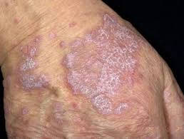
Wickham’s striae

Slide 18
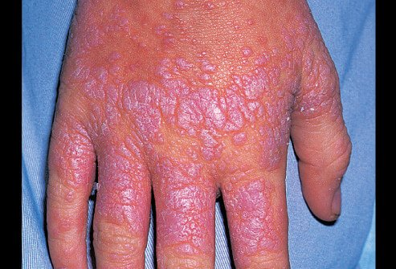

Slide 19
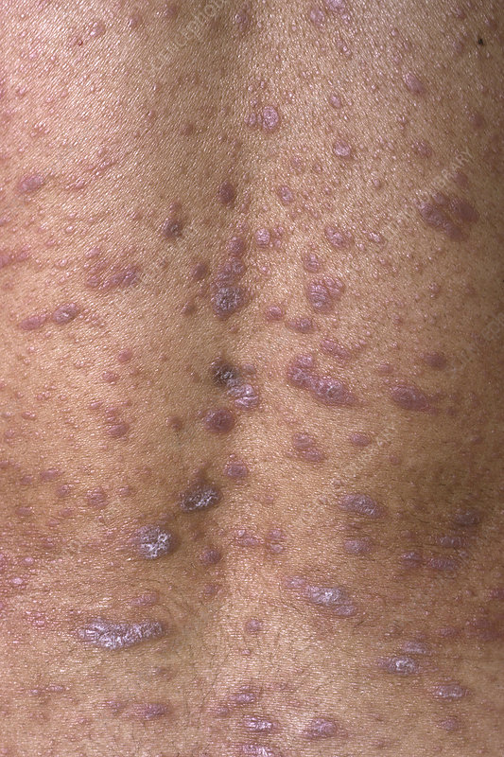

Slide 20
CLINICAL VARIANTS
MUCOSAL LP
LICHEN PLANOPILARIS
HYPERTROPHIC LP
LP OF THE PALMS AND SOLES
ACTINIC LP
LP PIGMENTOSUS
DRUG INDUCED LP
ANNULAR LP
GUTTATE LP
MIXED LP/DLE
BULLOUS LP/ LP PEMPHIGOIDES
LICHEN NITIDUS
NEKAM DISEASE
LICHEN STRIATUS

Slide 21
Oral lichen planus
Often involves the inside of the cheeks and the sides of the tongue, but gums and lips may also be involved.
Patterns are Reticular, atrophic, hypertrophic and erosive.
May also extend down to involve the larynx and oesophagus
Vulval and penile involvement.

Slide 22
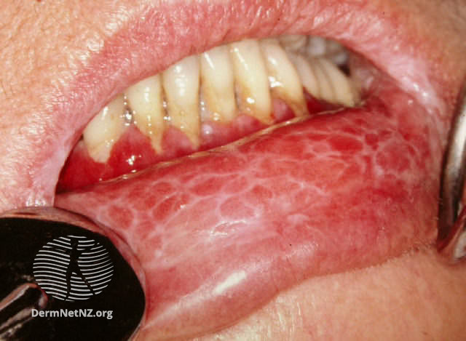
Reticular pattern

Slide 23
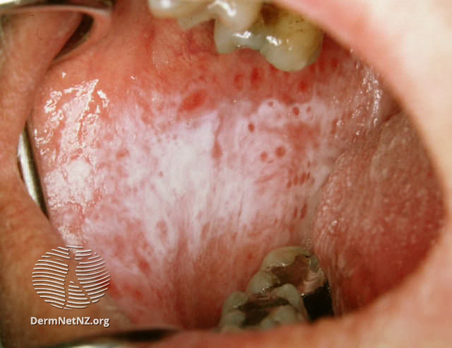
Plaque type

Slide 24
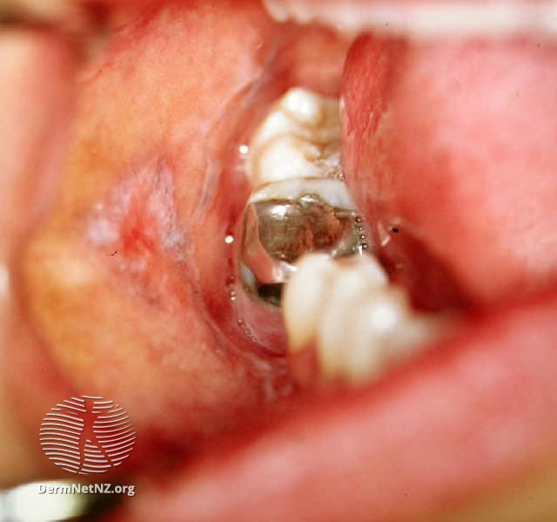
Lichenoid reaction to amalgam

Slide 25
Complications
Squamous cell carcinoma arising on cutaneous lesions of LP and ano‐genital lesions is definitely a rare phenomenon.
Cicatricial conjunctivitis and lacrimal canalicular obstruction are recorded .

Slide 26
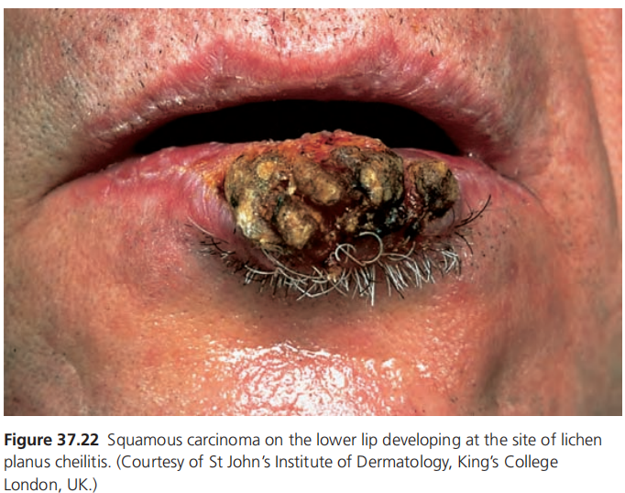

Slide 27
Follicular Lichen Planus
Three variants of follicular lichen planus
Classic lichen planopilaris (LPP)
Frontal fibrosing alopecia (FFA)
Graham‐Little syndrome.
All of them result in follicular scarring and hair loss.

Slide 28
Lichen planopilaris
Tiny red spiny follicular papules on the scalp and less often, elsewhere on the body.
Destruction of the follicles lead to scarring alopecia

Slide 29
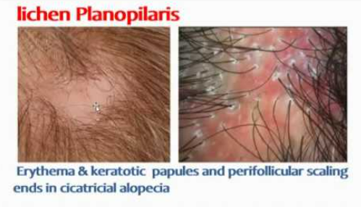

Slide 30
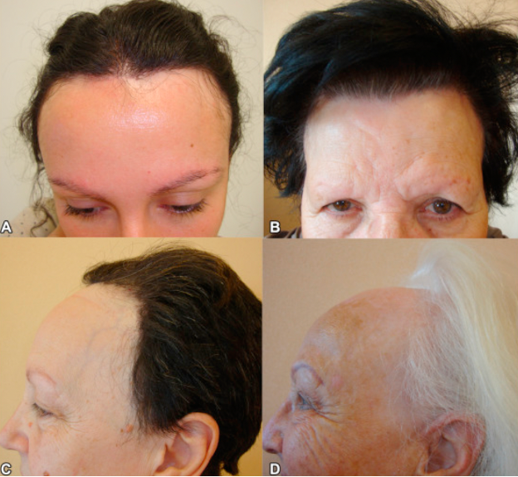
Frontal fibrosing alopecia: affects elderly women and frequently involves the eyebrows

Slide 31
Graham little-piccardi lassueur syndrome
Comprises the triad
Multifocal scalp cicatricial alopecia
Non-scarring alopecia of axilla and groin
Keratotic lichenoid follicular papules

Slide 32
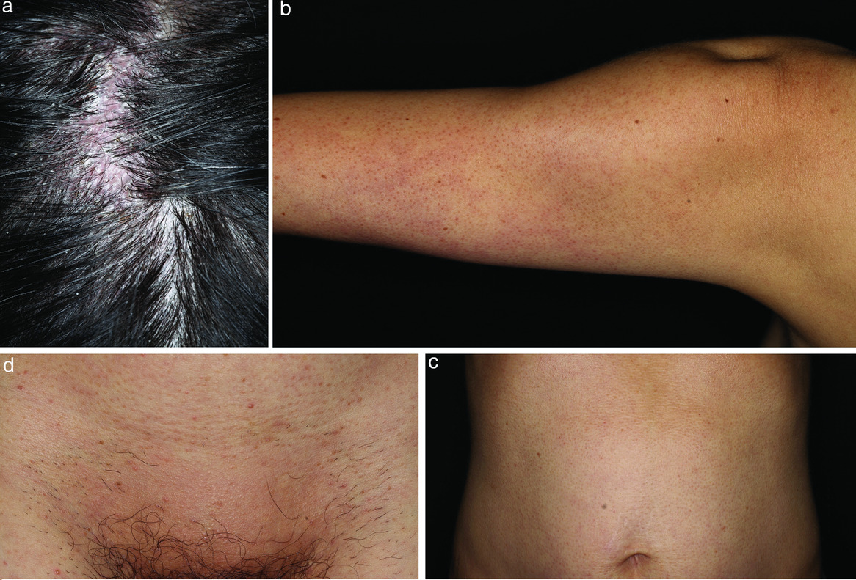
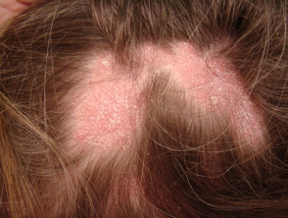
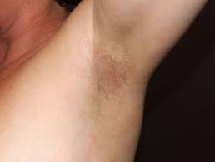

Slide 33
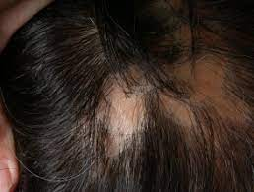
Pseudopelade of brocq: variant of lichen planus without inflammation or scaling. Areas of scarring without hair slowly appear, described as ‘like footprints in the snow’.

Slide 34
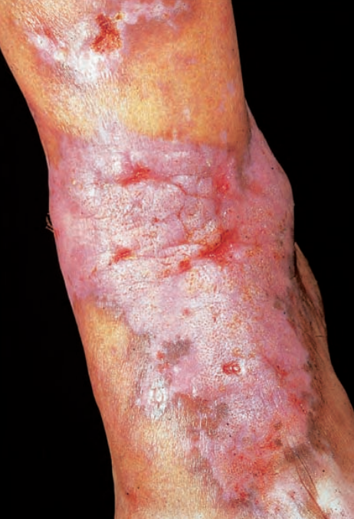
Hypertrophic lichen planus
Most often on lower limbs,esp around ankles persist for years, clears with hyperpig,scar,atrophy.
Notes:
Multiple cutaneous horns overlying hypertrophic LP are recorded as are keratoacanthoma and malignant transformation arising in hypertrophic LP, as
well as metastatic squamous cell cancer.

Slide 35
Lichen planus of palms and soles
ACUTE:
Volar aspect of the wrists or at the ankles
occur in more than 50% of cases of LP.
firm to the touch and yellow in hue.
CHRONIC:
A rare, very chronic form of LP involves large, painful, indolent ulcers on the sole of one or both feet with gradual, permanent loss of the toenails; there may be secondary webbing of the toes.

Slide 36
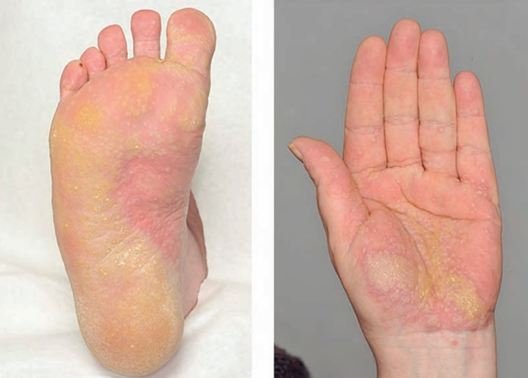
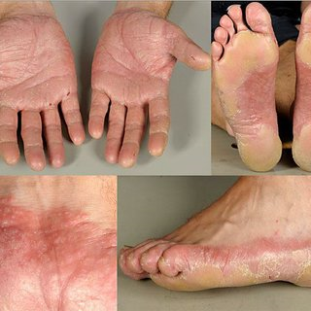
Lichen planus of palms and soles

Slide 37
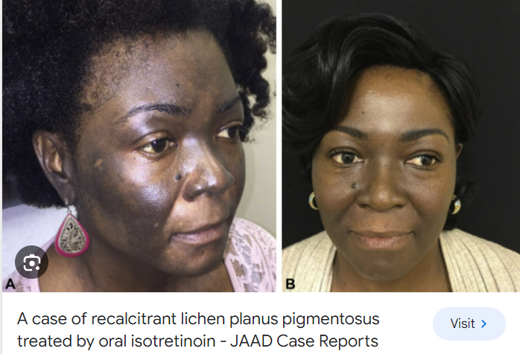

Slide 38
Lichen planus pigmentosus
This is a pigmentary disorder seen in India or in the Middle
East.
The macular hyperpigmentation involves chiefly the
face, neck and upper limbs.
The duration is 2 months to 21 years

Slide 40
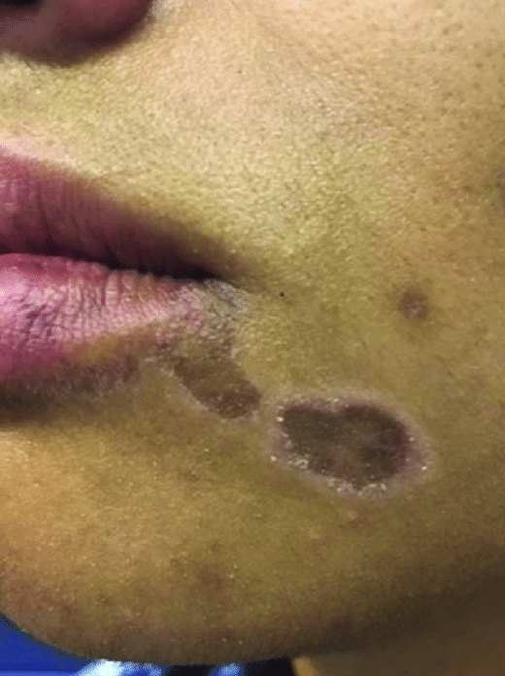
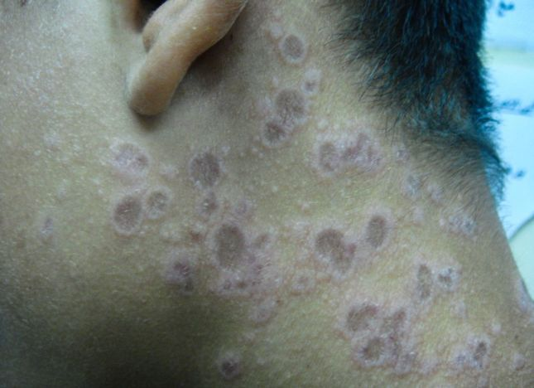
Actinic lichen planus

Slide 41
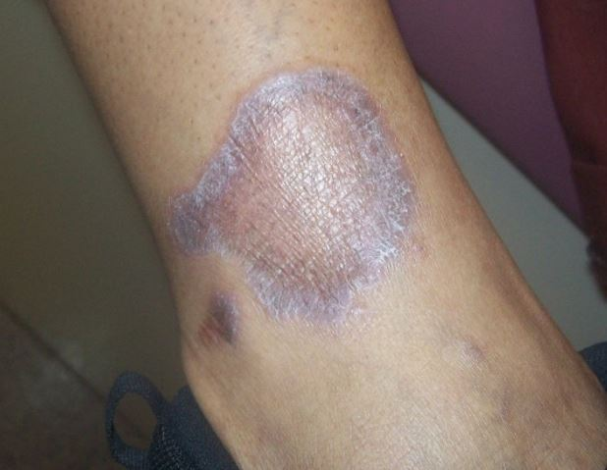
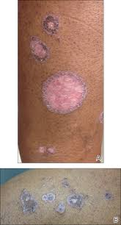
Annular lichen planus
Notes:
They may be widely scattered, and usually have a very narrow rim of activity and a depressed, slightly atrophic centre.
Much less often, the margin is wide and the central area is quite
small.The differential diagnosis includes granuloma annulare.

Slide 42
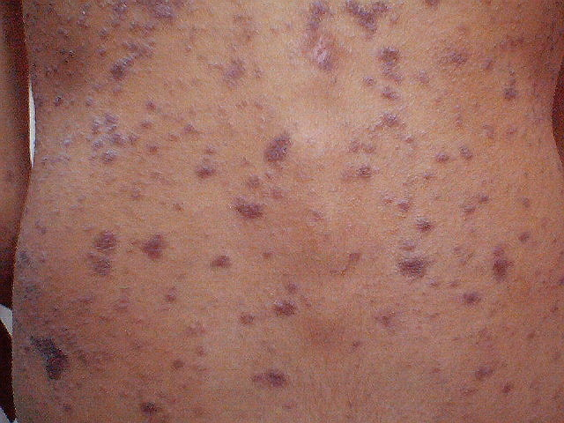
Guttate lichen planus
Notes:
Lesions are widely scattered and remain discrete, may be all small (1–2 mm up to 1 cm), Guttate psoriasis must be
excluded as a differentiatial.

Slide 43
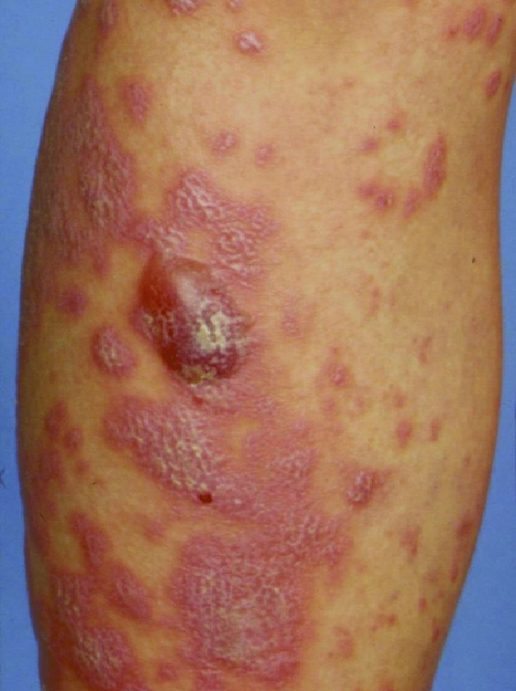
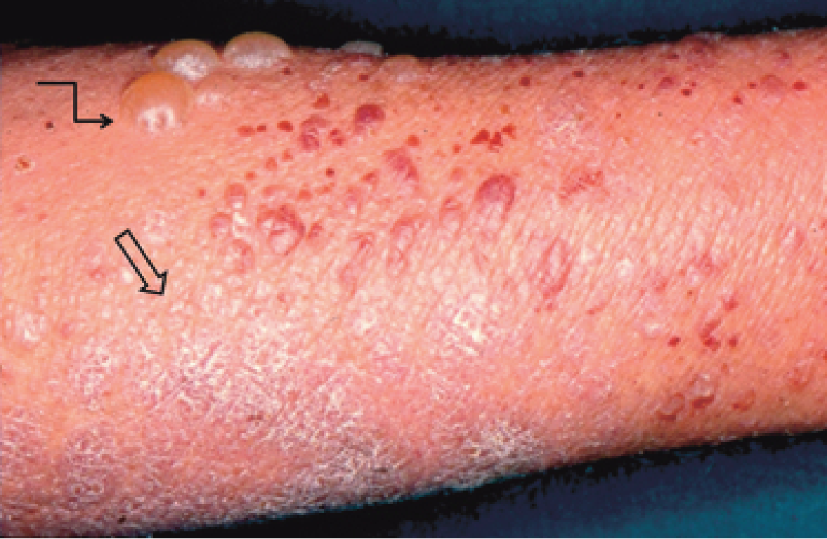
Bullous lichen planus and lichen planus pemphigoides
BULLOUS LP
LICHEN PLANUS PEMPHIGOIDES
Notes:
Immunoelectron microscopic studies reveal deposition of IgG and C3 in base of bulla and not in the roof as found in bullous pemphigoid.

Slide 44
BULLOUS LP
Blisters arise only on or near the lesions of .
Histologically subepidermal bulla formation with typical changes of LP.
Direct and indirect immunofluorescence are negative.
Notes:
Immunoelectron microscopic studies reveal deposition of IgG and C3 in base of bulla and not in the roof as found in bullous pemphigoid.

Slide 45
LICHEN PLANUS PEMPHIGOIDES
Bullae on both involved and univolved skin.
Histology shows a subepidermal bulla with no evidence of associated LP.
Direct immunofluorescence shows linear basement membrane zone deposition Of IgG and C3 in perilesional skin.
Notes:
Immunoelectron microscopic studies reveal deposition of IgG and C3 in base of bulla and not in the roof as found in bullous pemphigoid.

Slide 46
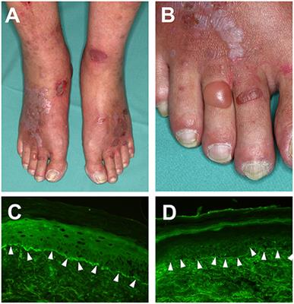
Notes:
Clinical features of Lichen planus pemphigoides. (A) Violaceous plaques with polygonal configuration affecting the dorsal aspects of the feet, with tense blisters and erosions on non-lesional skin. (B) Close-up view of the right foot. (C) detection of complement factor C3 deposition and, (D) IgG deposition at the dermal-epidermal junction in a punch biopsy from perilesional skin, using direct immunofluorescence microscopy (magnification 200×).

Slide 47
Lichen nitidus
Rare and is characterized clinically by the presence of pinpoint to pin head sized papules, asymptomatic and flesh colored, with a flat shiny surface.
Sites: forearms, penis, abdomen, chest and buttocks.
Nails: pitting, increased linear striations and longitudinal ridging.
Associations:
  crohn disease,
  trisomy 21
  congenital megacolon
  Niemann-Pick disease.

Slide 48
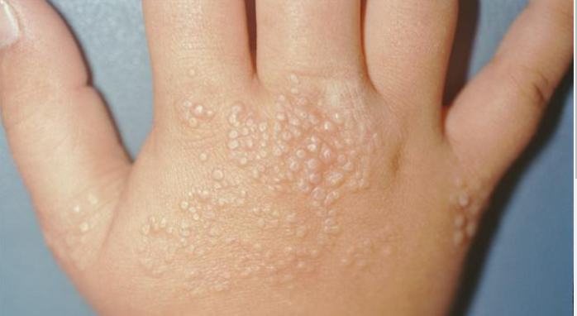

Slide 49
‘Mixed’ lichen planus/discoid lupus erythematosus disease patterns
With basement membrane
deposition of IgG in DLE overlapping features of both disorders.
Chronic atrophic DLE‐like lesions on the head, neck & upper trunk may accompany reticular white lesions in the oral cavity, and combinations of lichenoid or verrucous lesions.

Slide 50
Lichenoid drug eruption (drug-induced LP)
Despite the significant overlap between LP and lichenoid drug eruption there are both clinical and histologic clues that favor one diagnosis over the other

Slide 51
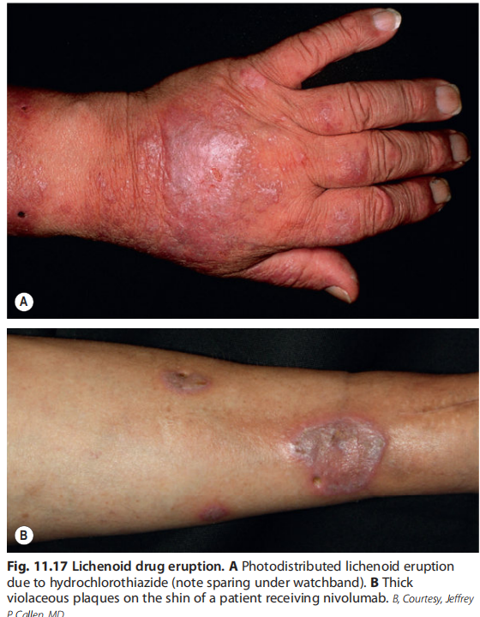

Slide 52
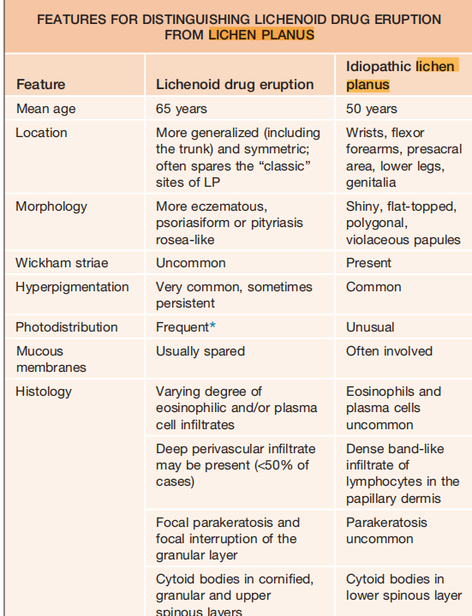

Slide 53
Nekam disease.
Syn:Keratosis lichenoides chronica
Violaceous keratotic papules and nodules arranged in a linear or reticulate pattern on the trunk and limbs in association with a seborrhoeic dermatitis like eruption on the face.
Other features: palmoplantar keratoderma, mucosal involvement with ulceration, nail and ocular involvement.

Slide 54
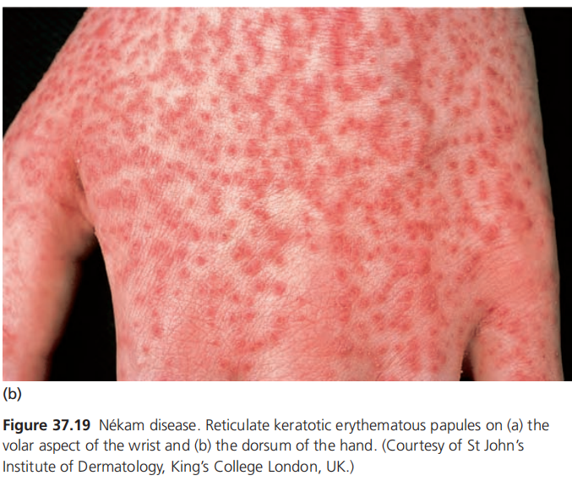

Slide 55
Nail LP
10% of cases.
Fingernails > toenails
Exaggeration of longitudinal lines
Linear depressions
Pterygium unguis (adhesion between the epidermis of the dorsal nail fold and nail bed causing partial destruction of nail.)
Rarely, nail is completely shed.

Slide 56
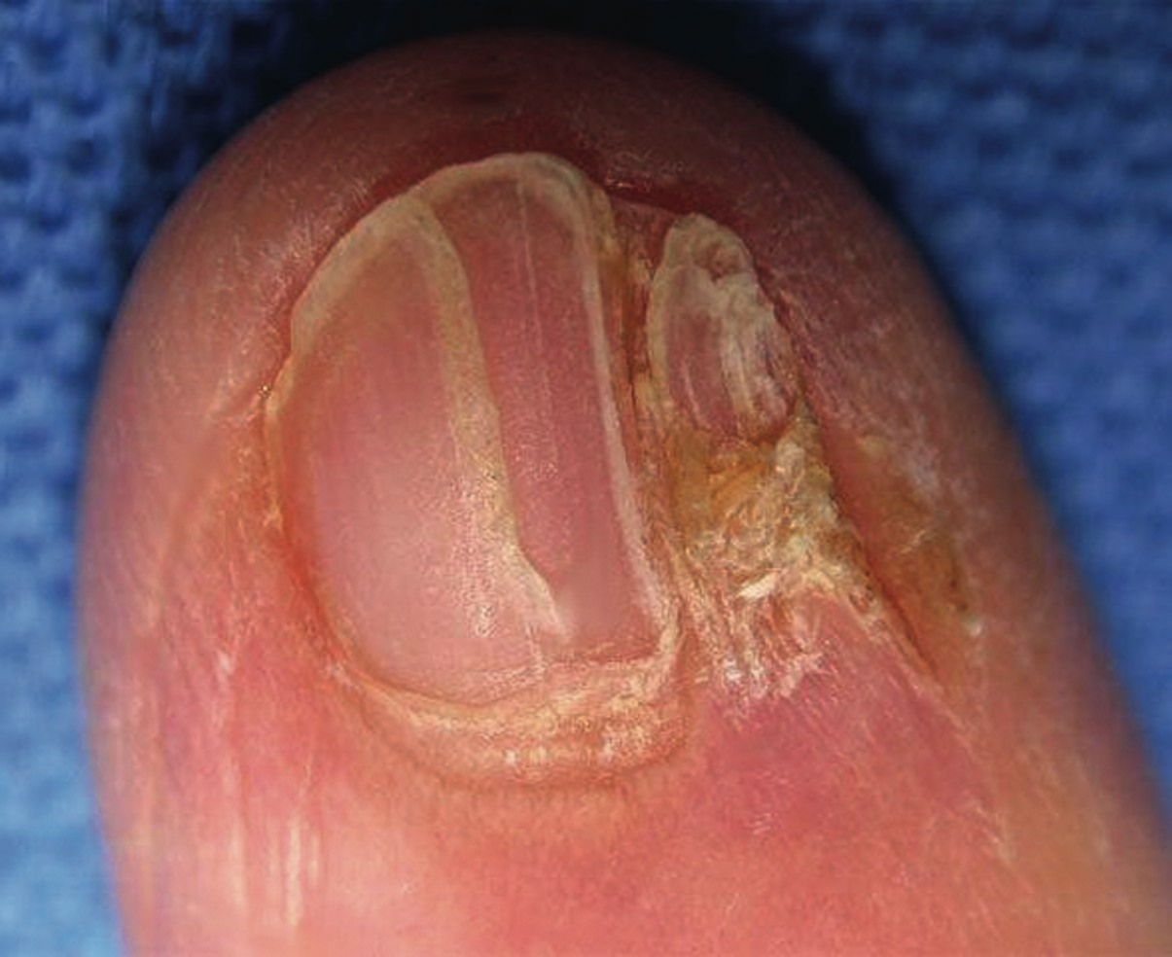

Slide 57
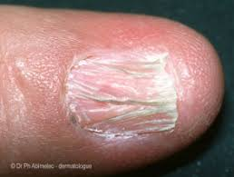
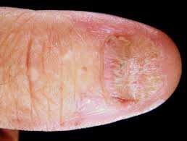
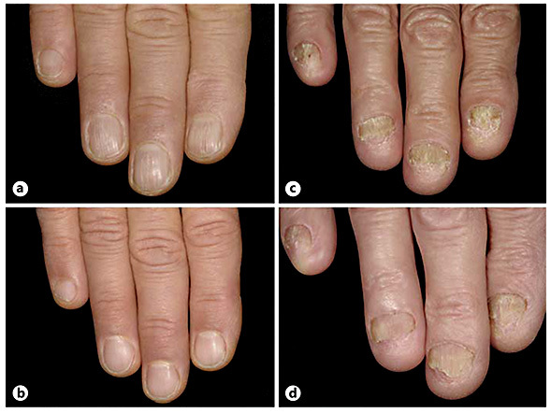

Slide 58
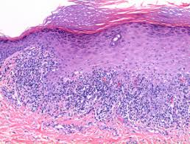
Histopathology

Slide 59
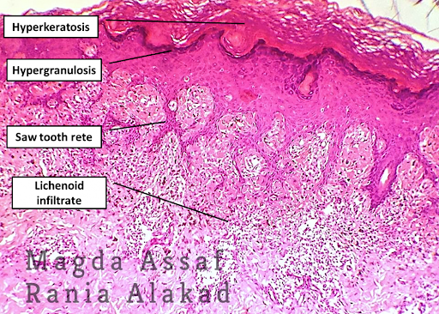

Slide 60
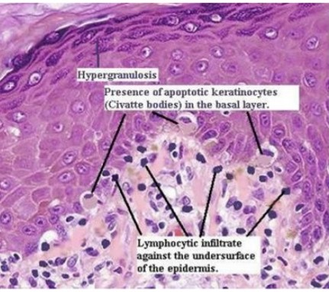

Slide 61
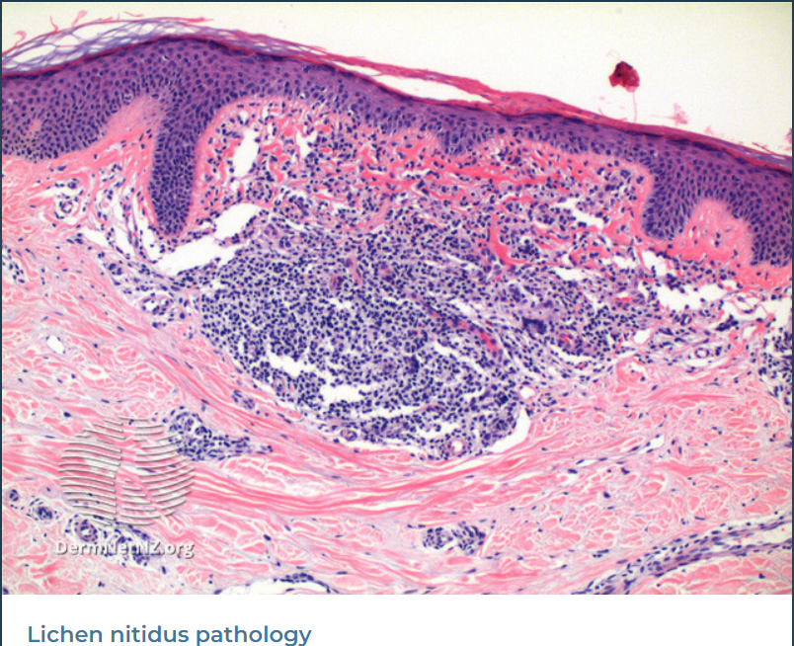
Notes:
“Max Joseph space” stands for “the appearance of the liquefaction degeneration of the basal cells and extracellular fluid accumulation about the individual basal cells (that) is strongly suggestive of mild irritation.

Slide 62
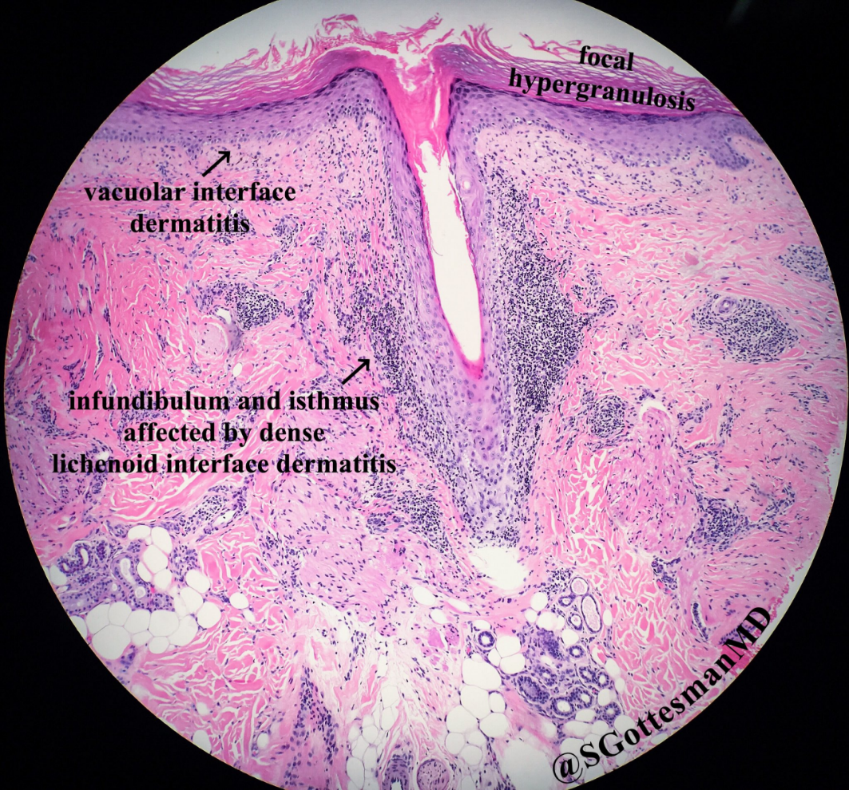
Notes:
Flattening of the rete pegs gives rise to a saw‐tooth configuration. There is liquefaction degeneration of the basal cells. Close up against the epidermis is a dense infiltrate of lymphocytes and some histiocytes. In many sections, colloid bodies can be seen. When the process involves hair follicles, the infiltrate extends around them and the hairs are replaced by keratin plugs.The follicles may ultimately be totally destroyed

Slide 63
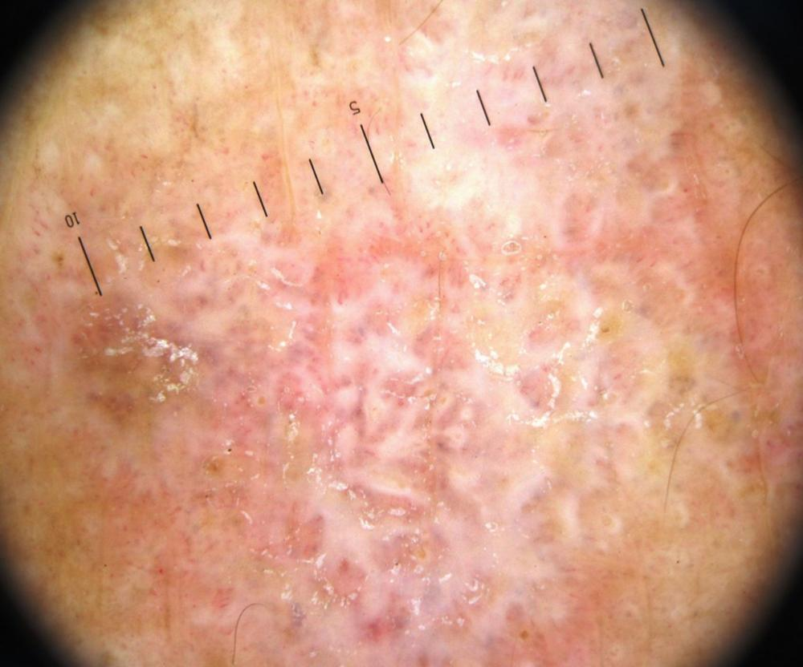
Dermoscopy
Network of whitish striae with red globules at the periphery.

Slide 64
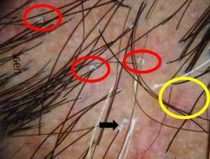
Notes:
Dermoscopic image showing perifollicular scales (red circles, peritubular cast (black arrows) and blue grey dots (yellow circles)

Slide 65
Management
Cutaneous lp can clear spontaneously within 1-2 years.
Aim of treatment is to reduce pruritus and time to resolution.
Main therapy is corticosteroids

Slide 66
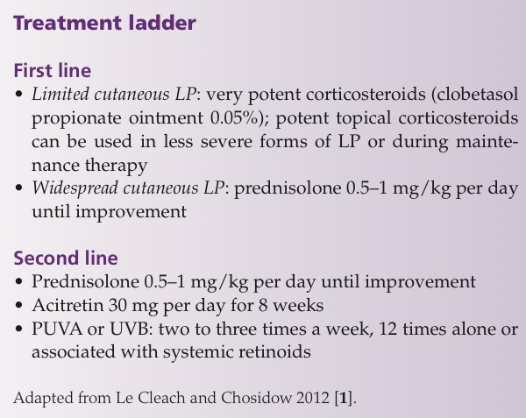

Slide 67
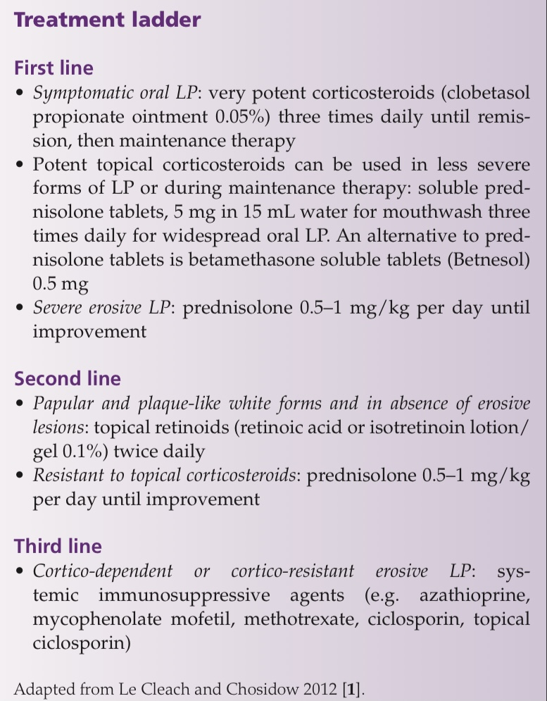

Slide 68
Lichen striatus
Self limiting and asymptomatic inflammatory dermatosis
Pink or red papules in a linear distribution that develop in the lines of Blaschko (represent embryonic migratory patterns of ectoderm)
Aetiology incompletely understood but 40% cases have a background of atopy.
Possible triggers include infectious agents and trauma.

Slide 69
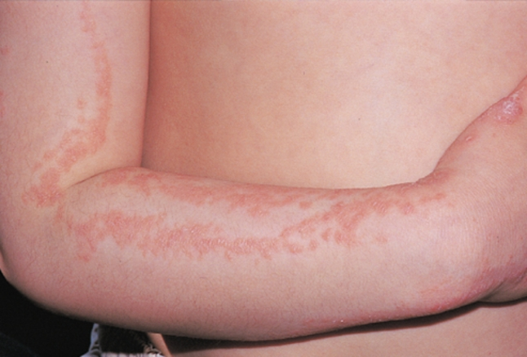

Slide 70
Pathology
Band like infiltrate of lymphocytes and histiocytes ,parakeratosis hyperkeratosis
Spongiosis, acanthosis
Dyskeratotic keratinocytes, like the ‘corps
ronds’ of Darier disease in50% of cases.
Focal liquefactive degeneration of the basal layer.
Notes:
oedema, stretching the tonofilament–desmosome complexes and
separating the epidermal cells

Slide 71
Course of disease
The area affected typically reaches its maximum extent within 2–3 weeks, but gradual extension can continue for several months.
Spontaneous resolution within 6–12 months but can persist for a year.
Followed by hypopigmentation or hyperpigmentation.

Slide 72
Presentation
Small, discrete, pink, flat‐topped, lichenoid papules in typical linear distribution rapidly coalesce to form a dull‐red to brown, slightly scaly, occasionally broaden into plaques,

Slide 73
Differential diagnosis
Linear inflammatory eruptions show a zosteriform distribution, including linear psoriasis, linear Darier disease, linear lichen planus, linear porokeratosis and inflammatory linear verrucous epidermal naevus(ILVEN)always pruritic & persists.
The differential diagnosis of hypopigmented lesions includes linear vitiligo or nevoid hypomelanosis

Slide 74
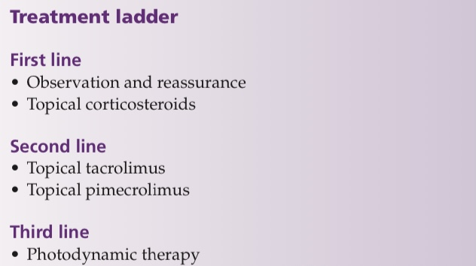

Slide 75
Thank you

