Slide 1


Slide 2
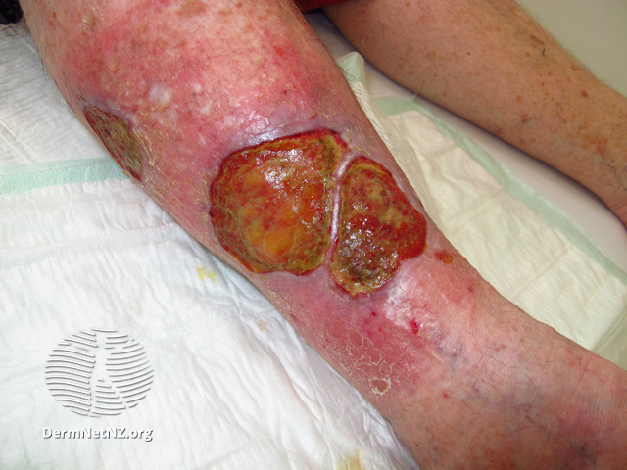
LEG ULCERS Presented by:Dr.Soonh Shah
MBBS,D.Derm Pg

Slide 3
Content
Part 1
Ulceration Resulting from Disorders of the Veins and Arteries
Part 2
Examination of Leg Ulcers

Slide 4
What is an Ulcer?
Full thickness loss of the epidermis
May have loss of the dermis or even subcutis heal with scarring

Slide 5
Leg Ulcer
Is discontinuity of the squamous epithelium of the skin usually around the ankle or on the foot

Slide 6
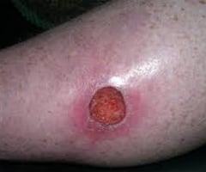
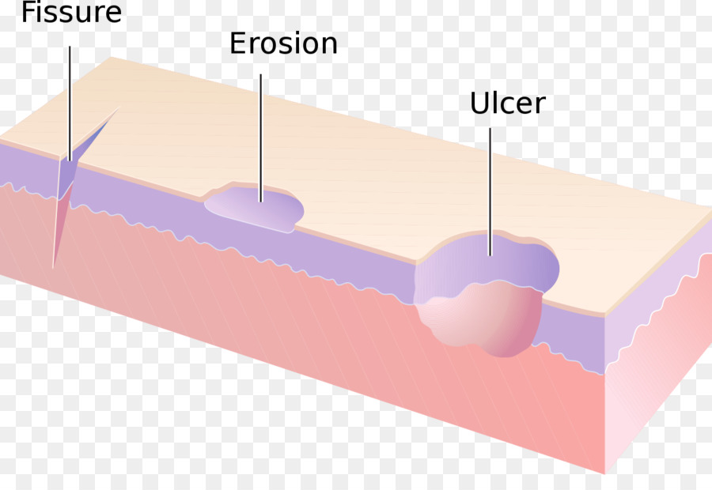
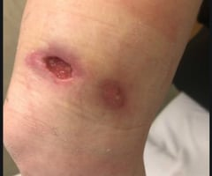

Slide 7
Major categories of leg ulcers
Venous Leg ulcers (VLUs)
Mixed Venous and arterial leg ulcers (MLUs)
Arterial Leg ulcers (ALUs)
Hypertensive Ischemic leg ulcers (HYTILUs)

Slide 8
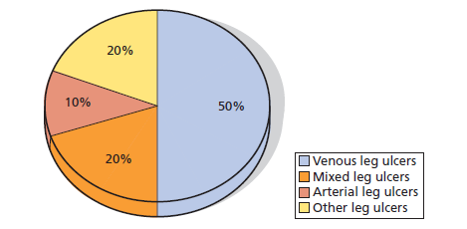
other Leg Ulcer
Ulcerated skin cancers
Necrotizing vasculitis
Pyoderma gangrenosum
Hydroxyurea (hydroxycarbamide) leg ulcers
Microvascular occlusive conditions
• Livedoid vasculopathy (primary or secondary)
• Leg ulcers in patients with collagen vascular disease
• Necrotizing embolia cutis (cholesterol, injected drugs etc., microorganisms)
Necrotizing bacterial infections (ecthyma, necrotizing cellulitis, etc.)
Deep dissecting haematoma
Leg ulcers after radiotherapy or cryosurgery

Slide 9
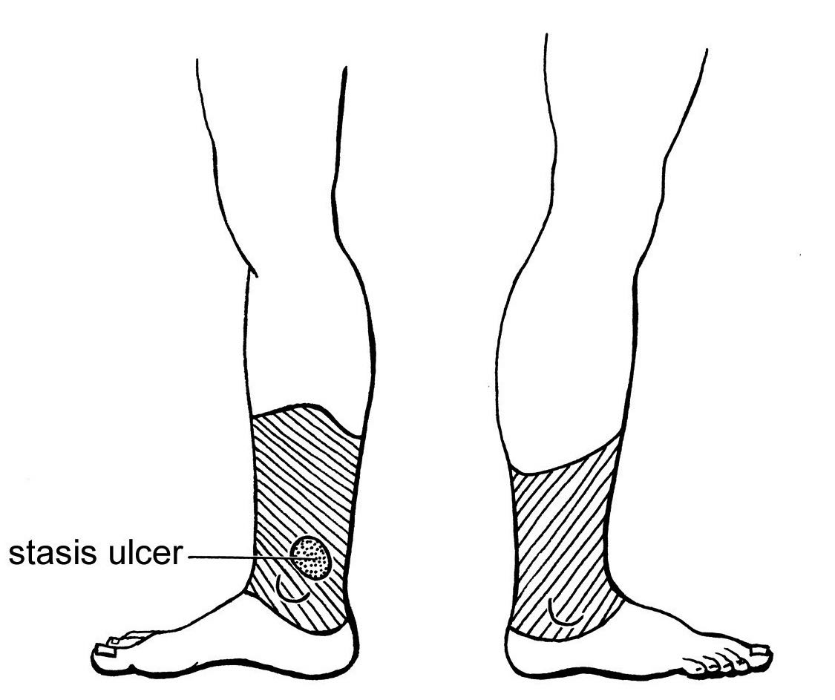
Venous leg ulcer
VLUs are chronic skin ulcers at the gaiter area
Venous leg ulcers are the most extreme manifestation of chronic
venous insufficiency

Slide 10
Epidemiology
Incidence and prevalence
Half of all leg ulcers are VLUs
The incidence of leg ulcers rises to 4% in the population aged over 80 years.
Age
VLUs primarily affect individuals aged over 65 years.

Slide 11
Disorders associated with venous leg ulcers
• Venous thromboembolism
• Superficial venous thrombophlebitis
• Varicose veins
• Chronic venous insufficiency
• Stasis dermatitis
• Lipodermatosclerosis
• Acroangiodermatitis
• Obesity
• Ankle joint ankylosis
• Rheumatoid arthritis
• Neuromuscular diseases with impact on venous calf pump ejection

Slide 12
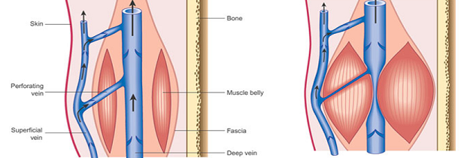
Venous Anatomy

Slide 13
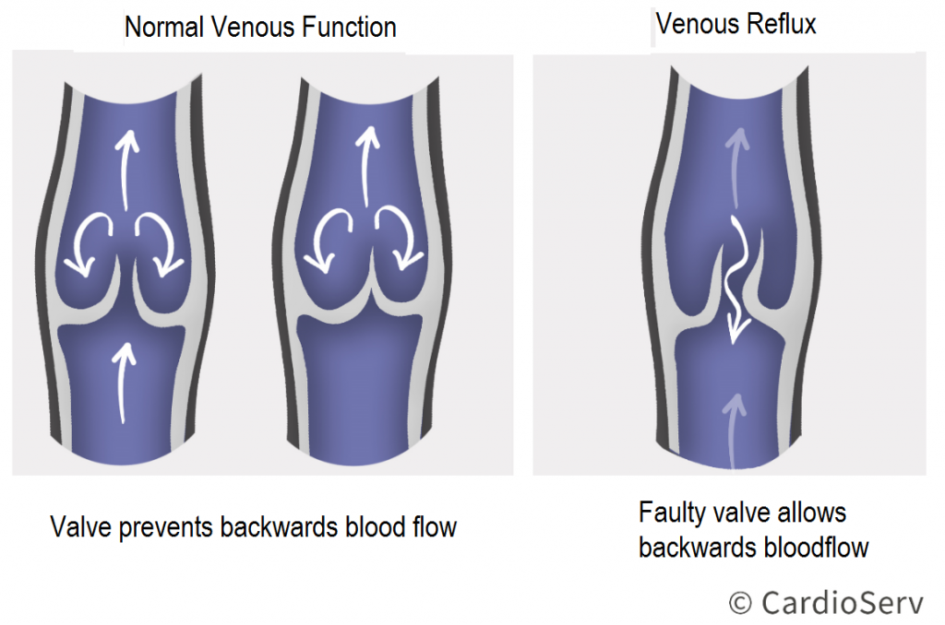
Venous Reflux

Slide 14
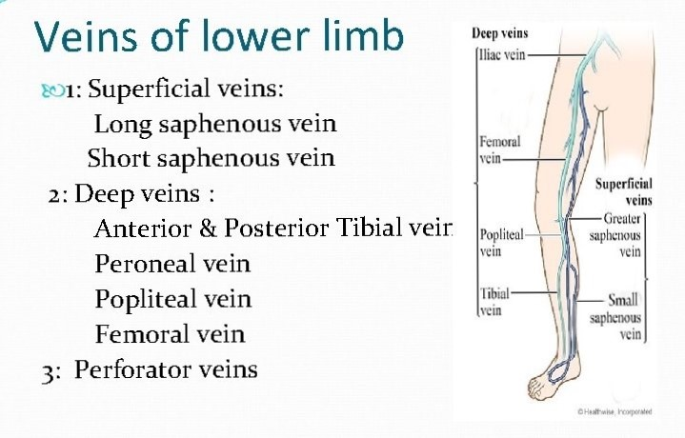

Slide 15
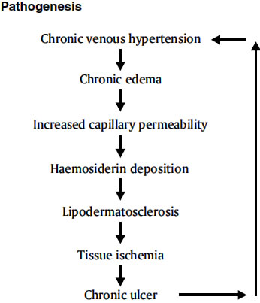
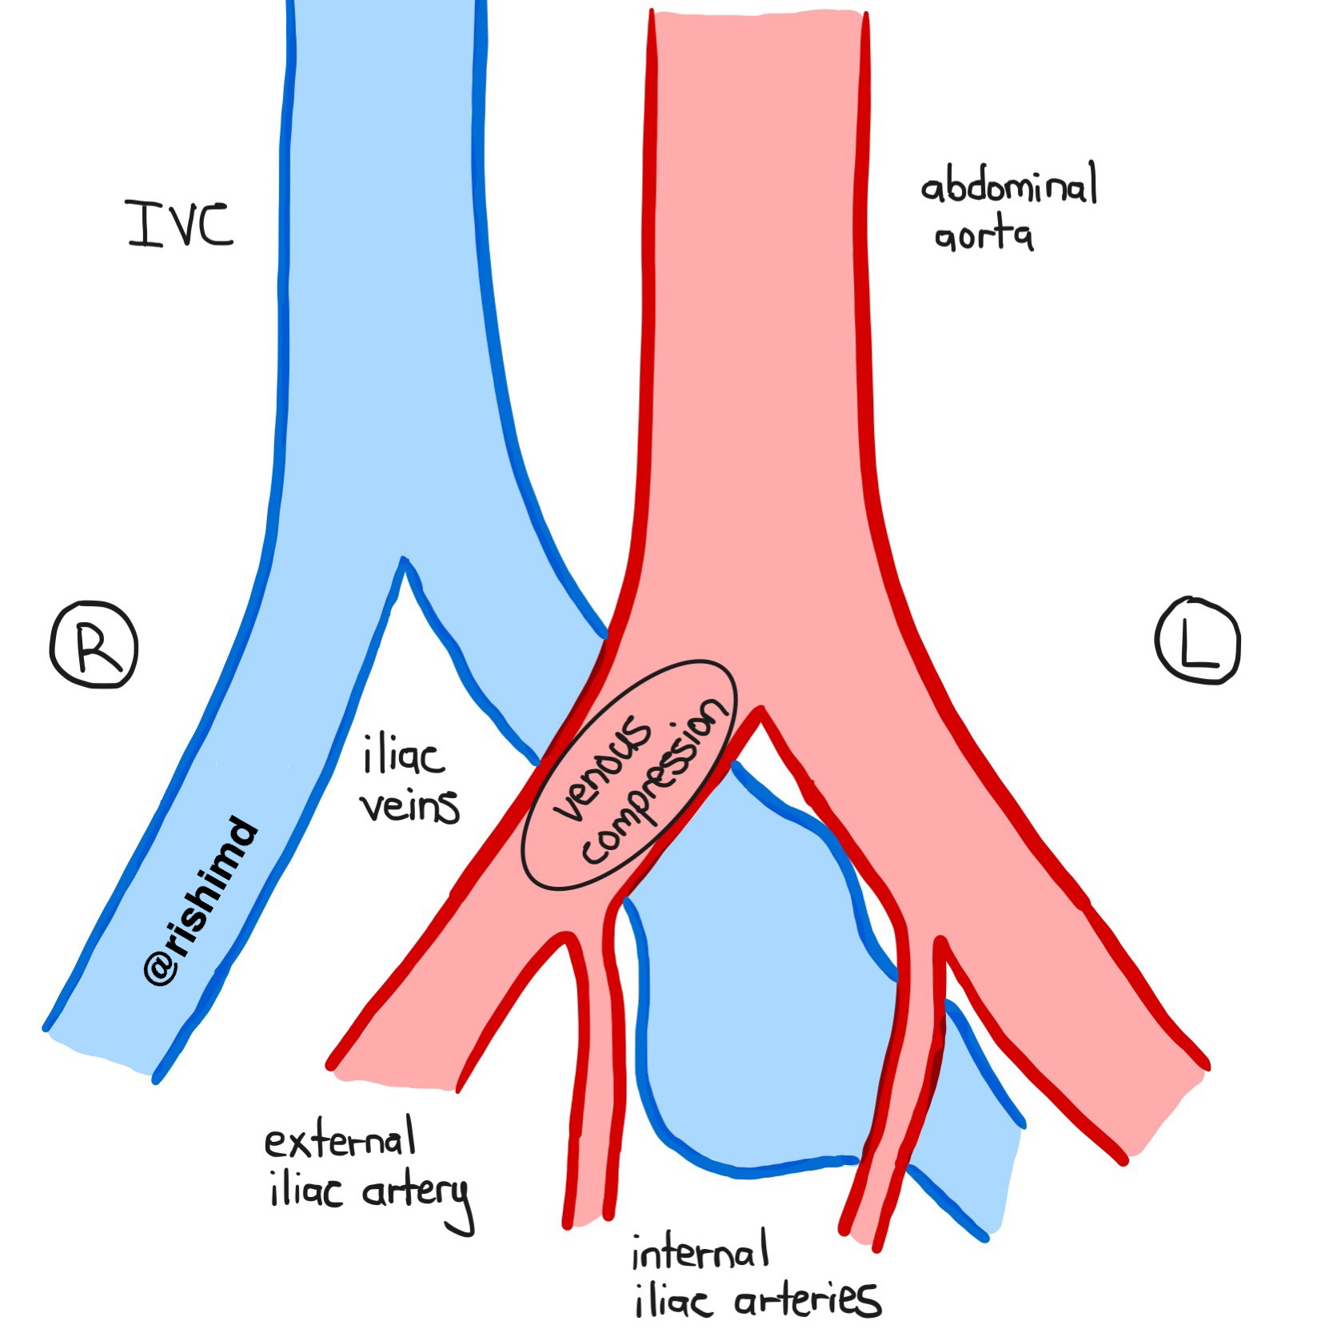
Pathophysiology
CVI and VLU result from Peripheral venous hypertension
        Gravitation
        Upright walk
        Dysfunctional venous ejection during leg motion
        Dysfunctional venous drainage due to obstruction (e.g. chronic occlusion, obesity, pregnancy)
        Congenital valvular aplasia
        May-Thurner syndrome

Slide 16
Predisposing factors
Family history
Obesity
Standing occupation
Venous thromboembolism
Varicose veins
Ankle joint ankyloses
Neuromuscular diseases with an impact on venous calf pump ejection

Slide 17
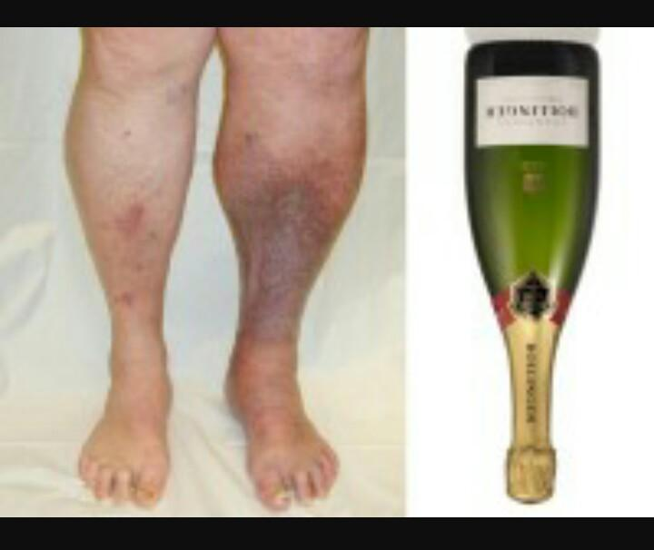
Clinical Features
common at the gaiter area
Trophic skin changes attributed to CVI (stasis dermatitis,lipodermatosclerosis, pigmentation,induration,leg shape of an inverted champagne bottle)
less commonly located in the lateral retromalleolar area (related to deep and short saphenous vein reflux)

Slide 18
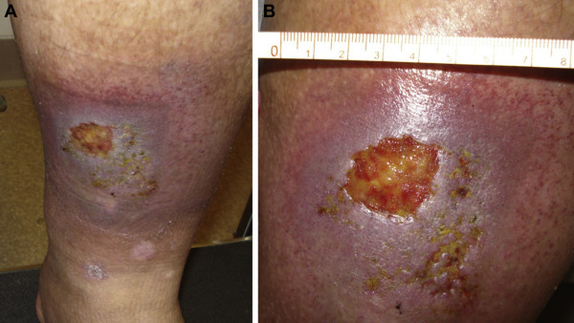
Clinical Features cont:
The leg has a feeling of heaviness and cramping.
The area ulcer dark red, purple, or brown.
The ulcer is shallow with a red base,sometimes covered by yellow tissue.
The venous ulcer has unevenly shaped borders.
The skin surrounding the ulcer may be shiny, tight, warm, or hot.
If the ulcer becomes infected, it may have a bad odor, and pus may drain from the wound.
There is general leg pain.

Slide 19
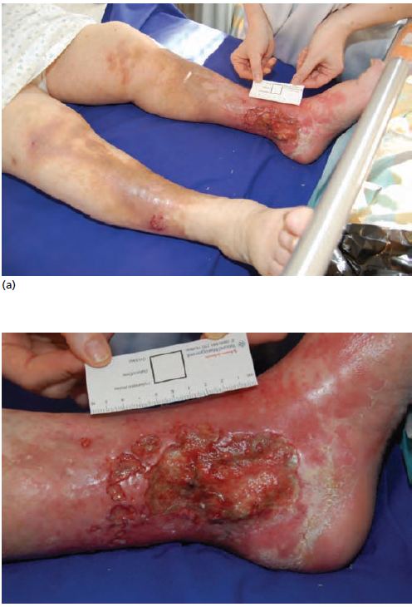

Slide 20
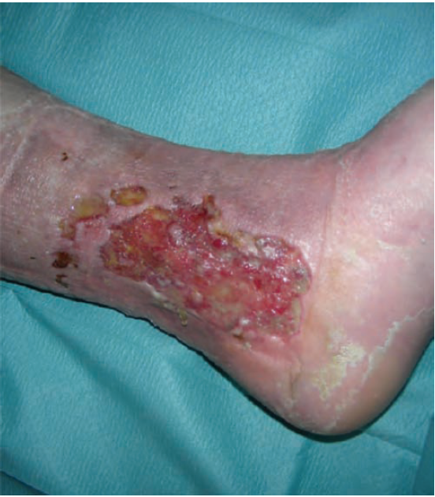

Slide 22
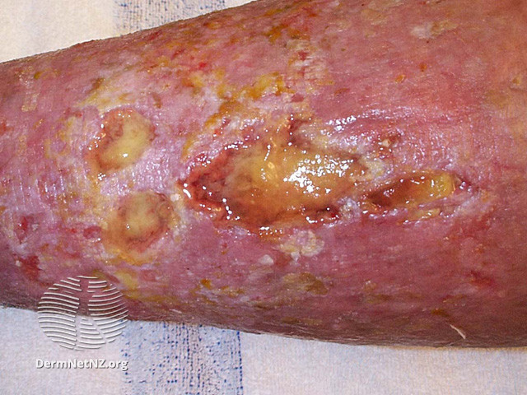

Slide 23
Differential Diagnosis
Mixed Leg Ulcers
Arterial Leg Ulcers
Hypertensive ischaemic leg ulcer
Vasculitic leg ulcer (particularly in patients with chronic hepatitis C with cryoglobulinaemia)
Males with Klinefelter syndrome.

Slide 24
Classification of venous leg ulcer
CEAP classification stands for
Clinical (C)
Etiological (E)
Anatomical (A)
Pathophysiological (P)
venous clinical severity score system (VCSS)

Slide 25
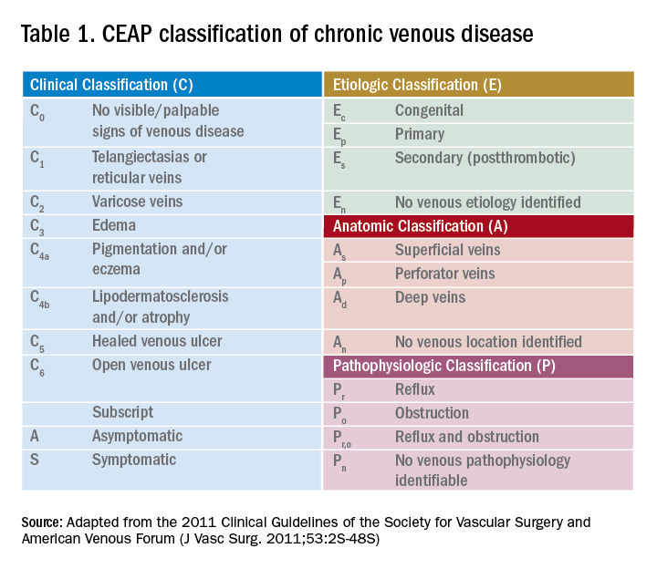

Slide 26
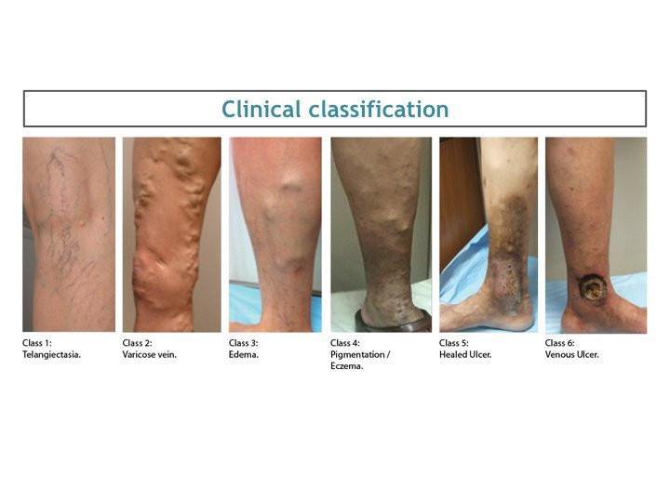

Slide 27
Complications and co‐morbidities
Chronic pain
Impairment of quality of life
Local wound infection
Systemic infection & Sepsis
Infestation with maggots (fly larvae)
Secondary squamous cell carcinoma
Secondary lymphoedema (periulcer lymphoedema and/or foot and toe lymphoedema).
Disease course and prognosis
Venous leg ulcers are chronic and recurrent unless patients receive
an accurate diagnostic assessment on which to base treatment and
secondary prevention.

Slide 28
Investigations
Vascular investigations (Doppler ultrasound, Venography,assessment of systolic ankle blood pressure and calculation of ankle brachial pressure index (ABPI)
Wound documentation (Electronic photographic documentation)
Microbiology (swab from the wound base,small tissue biopsy)
Wound histology (If chronic biopsy)
Assessment of malnutrition (Total protein, albumin and lymphocyte count)
Pain assessment (visual analogue scale (VAS)
Assessment of quality of life (standardized QoL questionnaire (e.g. the SF36)

Slide 29
Counselling
Quit smoking
Lose weight
Exercise
Eat healthy foods and get plenty of sleep at night.
Reduce the amount of salt in your diet.
Control your blood cholesterol and Sugar
Avoid crossing legs while sitting
Avoid sitting or standing for extended periods of time.
Avoid tight-fitting clothing and footwear
Raise (elevate) your legs for a short time, especially if you stand for extended periods

Slide 30
General Measure of Management
There is no proven role of antiseptics
Wash the wound with warm tap water or saline then dry
Remove slough or necrotic tissue by gentle washing
potassium permanganate 0.01% soak if the ulcer is malodorous
For uncomplicated, non-infected ulcers apply a simple low-adherent dressing like paraffin emollients n gauge and Zinc & replace weekly
Other dressings:(hydrocolloid),heavy exudate (alginate) or slough (hydrogel)
Compression therapy e.g bandages or stockings, are the mainstay in the treatment of VLUs

Slide 31
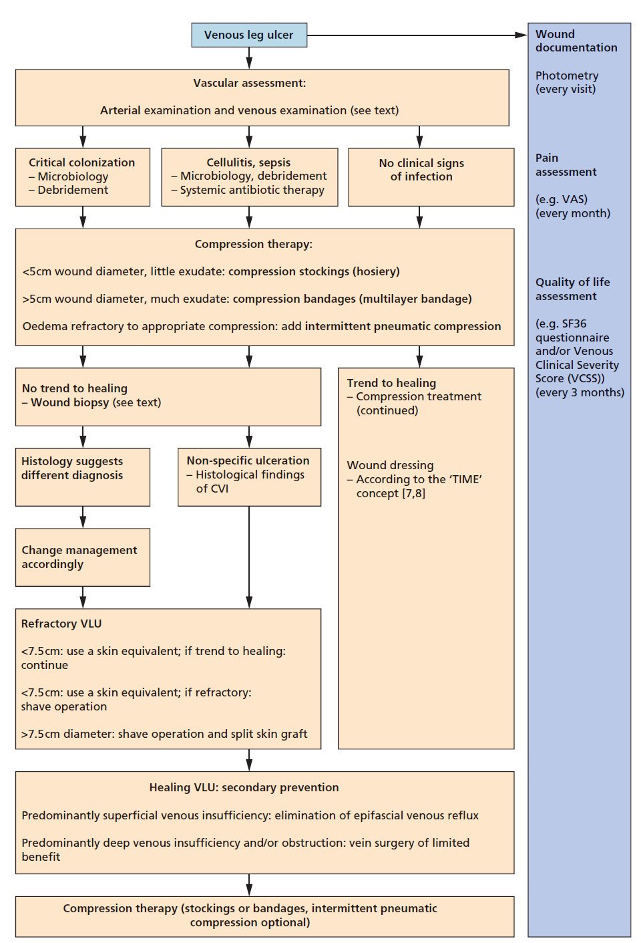
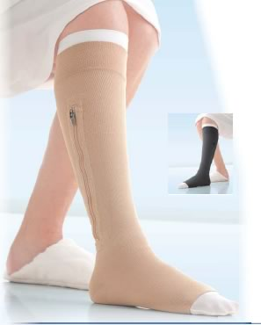
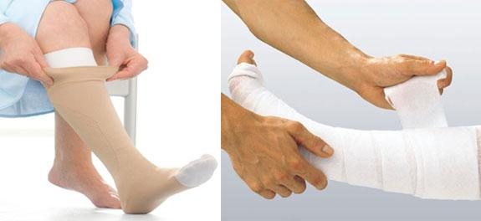

Slide 32
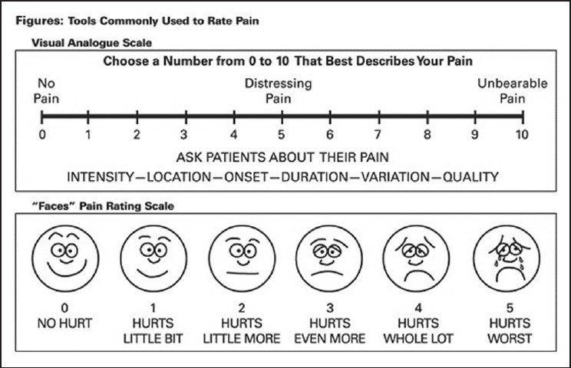
Visual analogue scale

Slide 33
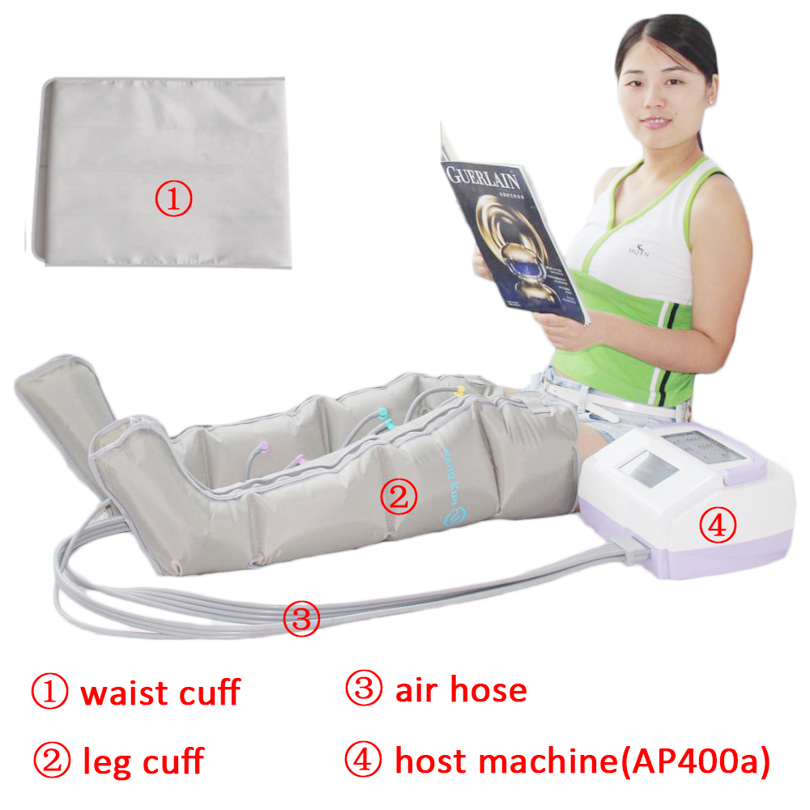
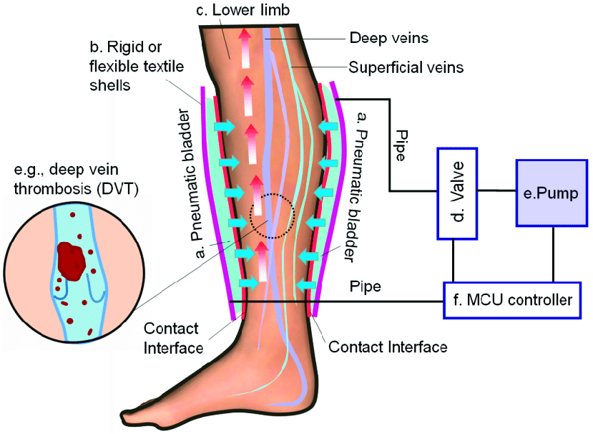
Intermittent pneumatic compression

Slide 34
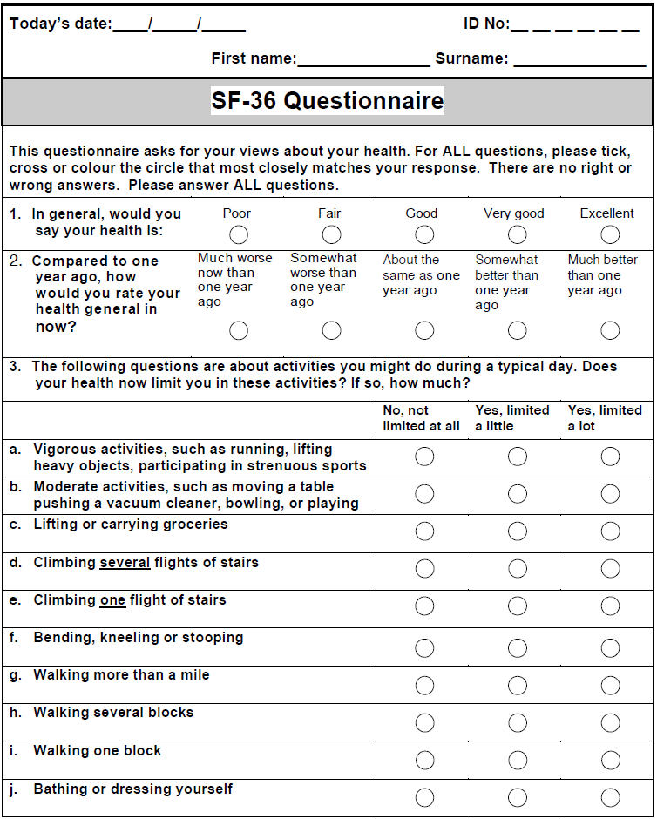

Slide 35
Major categories of leg ulcers
Venous leg ulcers (VLUs)
Mixed venous and arterial leg ulcers (MLUs)
Arterial leg ulcers (ALUs)
Hypertensive ischemic leg ulcers (HYTILUs)

Slide 36
Mixed leg ulcer
Mixed leg ulcers are VLUs in a leg with peripheral arterial disease (PAD)
They are harder to heal than VLUs
They cannot be distinguished from VLUs by clinical appearance alone.
Diagnosis can only be made after vascular assessment
Bimalleolar (both medial and lateral) ulcer location is more common in MLUs than in VLUs.

Slide 37
Disorders associated with mixed leg ulcers
Venous thromboembolism
• Superficial venous thrombophlebitis
• Varicose veins
• Stasis dermatitis
• Lipodermatosclerosis
• Acroangiodermatitis
• Obesity
• Smoking
• Diabetes
• Hyperlipidaemia
• Hypertension
• Coronary heart disease
• Stroke

Slide 38
History
Family history of CVI and VLU
Personal history of venous thromboembolism and varicose veins.
Obesity
Standing occupation
Neuromuscular disease and joint disease
Cardiovascular risk factors:
          (coronary heart disease,stroke,peripheral arterial disease)

Slide 39
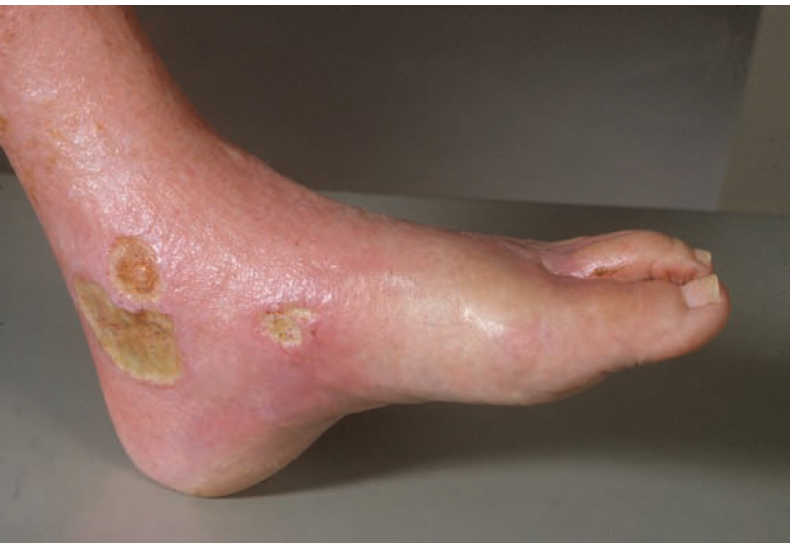
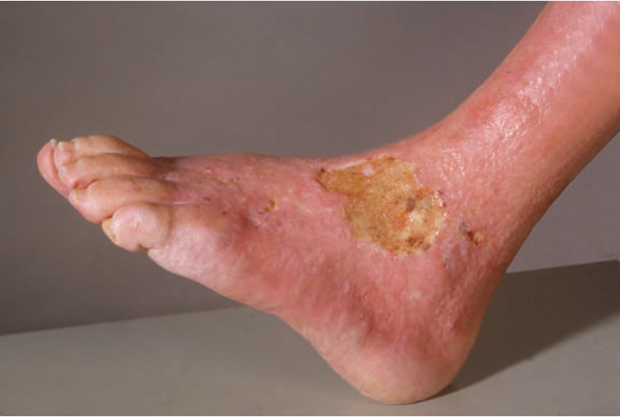
The same patient with a chronic leg ulcer at the lateral
ankle region (i.e. bimalleolar leg ulcers

Slide 40
Differential diagnosis
VLU
ALU
HYTILU
Vasculitic leg ulcer (particularly in patients with chronic hepatitis C with cryoglobulinaemia)
Males with Klinefelter syndrome.
Complications and co‐morbidities
Chronic pain
Impairment of quality of life
Local wound infection
Systemic infection and sepsis
Infestation with maggots (fly larvae)
Secondary squamous cell carcinoma
Secondary lymphoedema
Amputation.

Slide 41
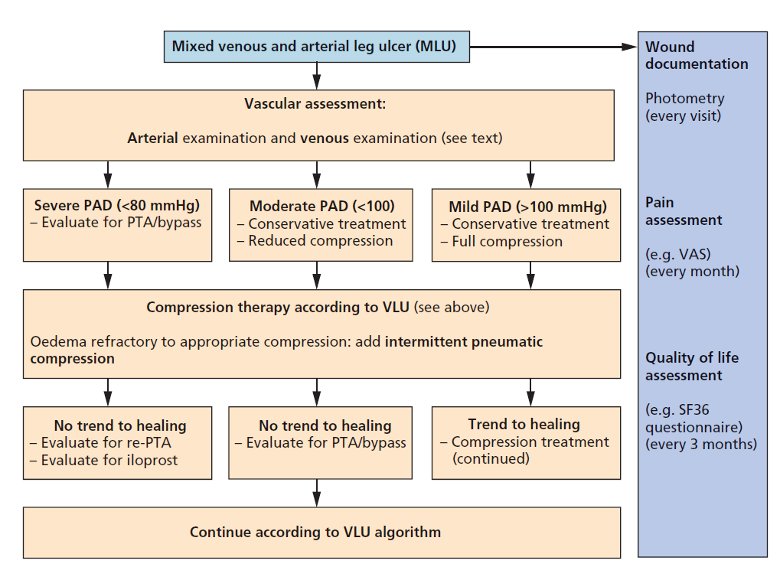

Slide 42
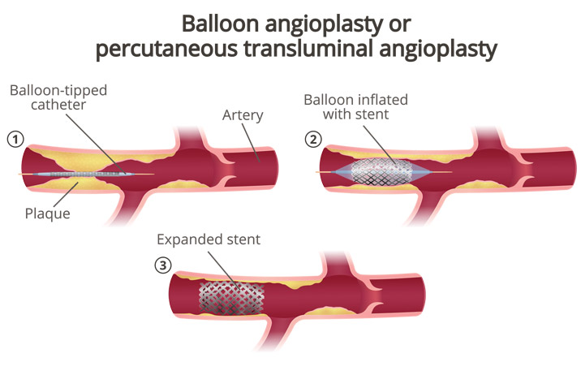
Percutaneous Transluminal angioplasty

Slide 43
Major categories of leg ulcers
Venous leg ulcers (VLUs)
Mixed venous and arterial leg ulcers (MLUs)
Arterial leg ulcers (ALUs)
Hypertensive ischemic leg ulcers (HYTILUs)

Slide 44
Arterial leg ulcer
Local skin ischaemia in advanced PAD
Spontaneously or after minor trauma to an area of ischeamic skin that is at risk of ulceration
Present as a black eschar or poorly granulating skin ulceration with a necrotic,black wound border.
lateral or pretibial aspect of the leg
Smaller ALUs are round in shape and have a ‘punched‐out’ appearance
Larger ALUs are polycyclic and figurated.
Surrounding skin does not exhibit signs of CVI, but looks unchanged and normal

Slide 45
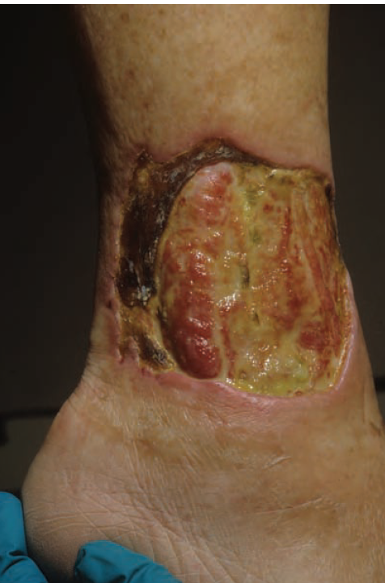
Single ulcer with yellowish slough necrotic edge and skin of surrounding area are normal in appearance

Slide 46
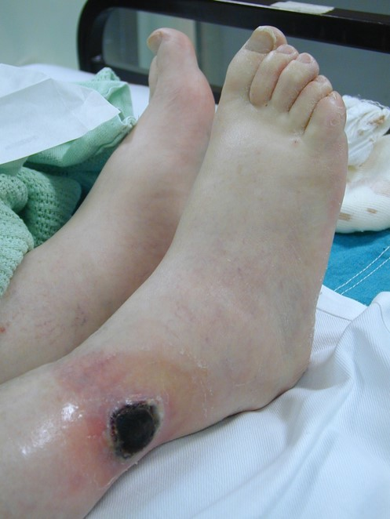
skin necrosis with an eschar at center of ulcer the left lateral ankle

Slide 47
Associated diseases
Obesity
Smoking
Diabetes
Hyperlipidaemia
Hypertension
Coronary heart disease
Stroke

Slide 48
Differential diagnosis
HYTILU (in some situations discriminating between ALU and HYTILU is difficult)
Necrotizing vasculitis
Pyoderma gangrenosum
Necrotizing cutaneous Infections
Deep dissecting haematoma

Slide 49
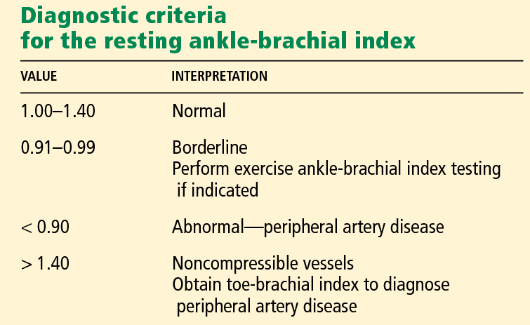
Classification of severity
Higher grades 3 and 4 of PAD commonly fulfil the criteria of chronic CLI
which are defined by
Systolic ankle (<50 mmHg) and Toe (<30 mmHg) pressure,
Transcutaneous oxygen pressure (tcP o2 ) (<30 mmHg)

Slide 50
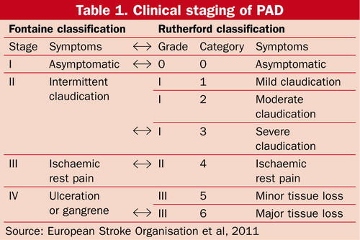

Slide 51
Disease course and prognosis
If PTA (balloon catheter angioplasty) than prognosis is favourable
Recurrence of ALUs is exceptional (unlike VLUs and MLUs)
Management
Percutaneous transluminal angioplasty (balloon angioplasty)
wound pain improves dramatically
Wounds do not necessarily start to heal
Autologous split‐skin graft to speed up wound healing

Slide 52
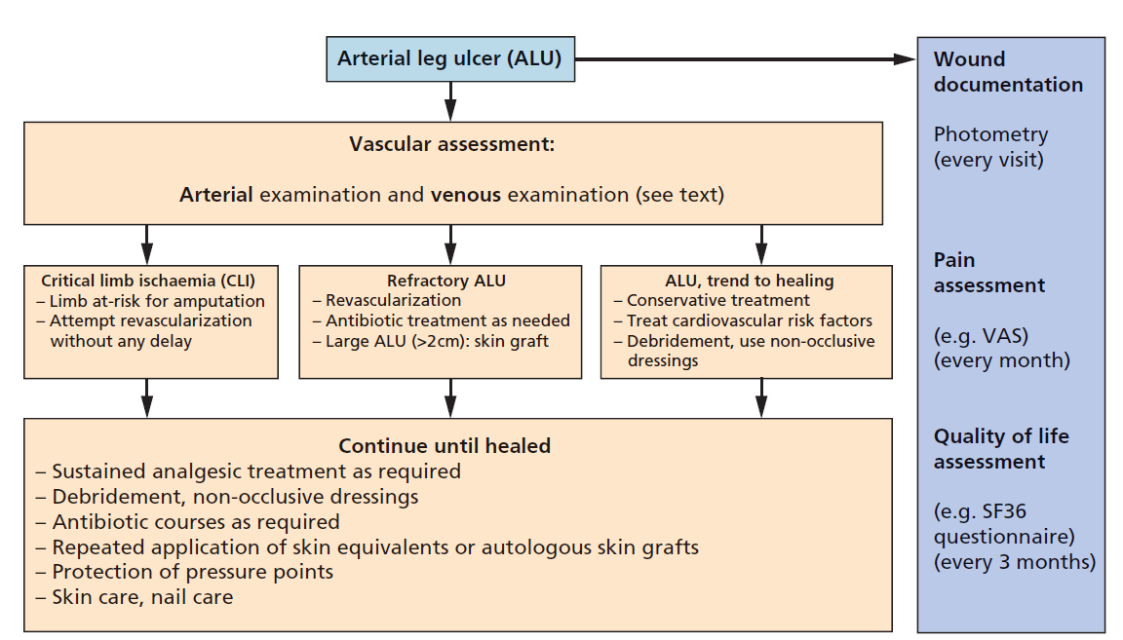

Slide 53
Major categories of leg ulcers
Venous leg ulcers (VLUs)
Mixed venous and arterial leg ulcers (MLUs)
Arterial leg ulcers (ALUs)
Hypertensive ischemic leg ulcers (HYTILUs)

Slide 54
Hypertensive ischaemic leg ulcer
A Martorell ulcer is a very painful ulcer of the lower leg assoc.with poorly controlled high blood pressure
Skin infarction due to ischaemic, subcutaneous arteriolosclerosis in a patient with hypertension.
Single or multiple eschars and skin ulcers at the laterodorsal of the leg an Achilles tendon
The wound border is livid or violaceus to black
The ulcer usually occurs within an area of livedo.
Eutrophication: calciphylaxis in normal kidney and parathyroid
gland function,proximal pattern involving medial thigh,groins,abdomen,upper arms,breasts

Slide 55
Clinical Features
Extreme pain
Solitary or symmetrical, affecting the same site on both lower legs
Red-purple inflamed ulcer edge
Episodes of sudden enlargement due to another area of skin death
Irregular shape
Satellite ulcers
Deep, exposing underlying tendons

Slide 56
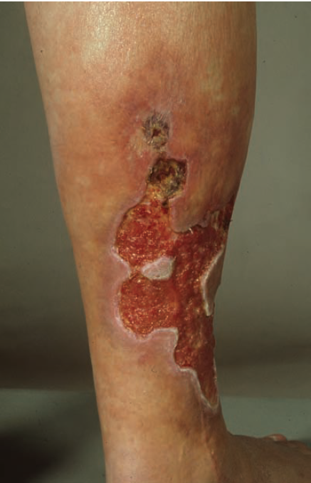
polycyclic, figurated, painful ulcer at the laterodorsal aspect of the right leg.

Slide 57
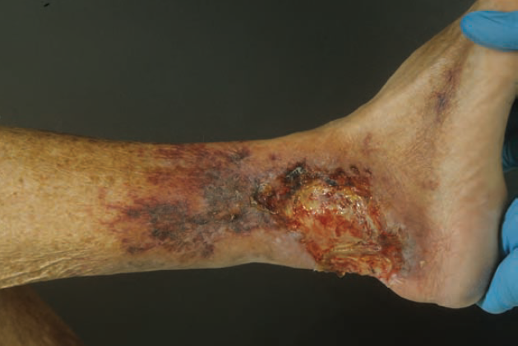
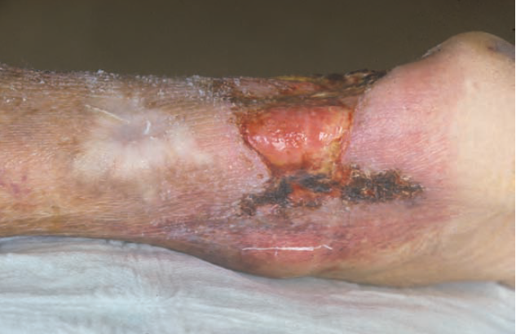

Slide 58
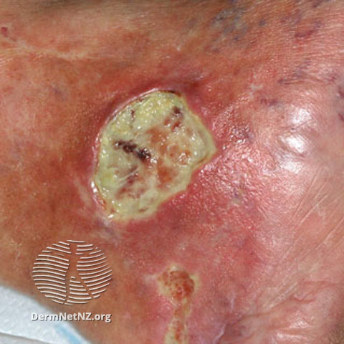
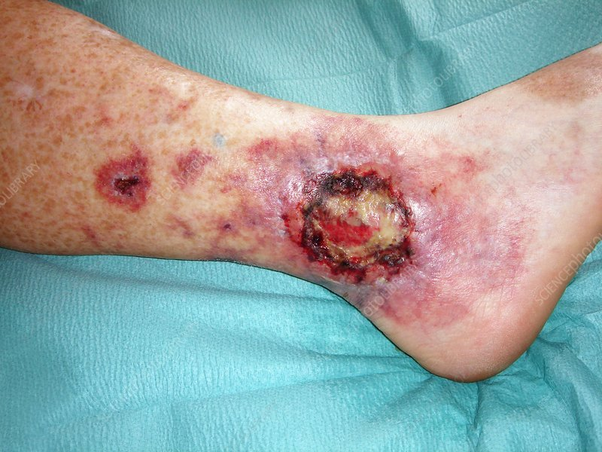

Slide 59
Differential diagnosis
Pyoderma gangrenosum
Vasculitic leg ulcer
Complications and comorbidities
Chronic pain
Local wound infection
Systemic infection, sepsis
Impairment of quality
Amputation
Disease course and prognosis
Prognosis is good even HYTILU severe disease in aged people

Slide 60
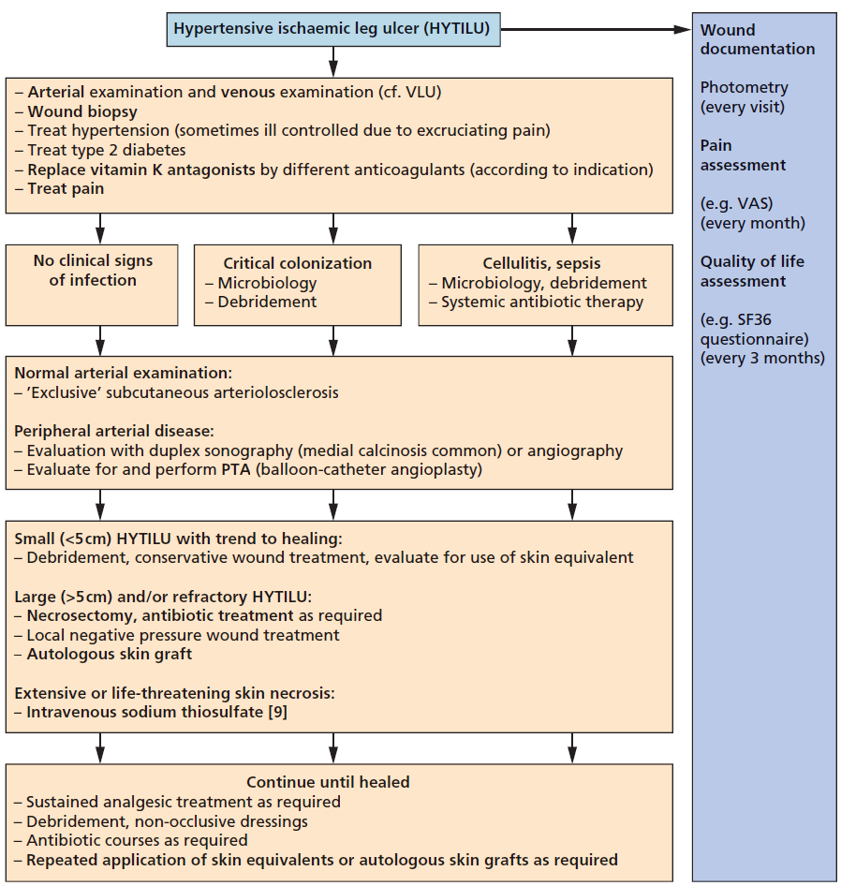

Slide 61
Classification of Chronic Leg Ulcers
VASCULAR
ARTERIAL
Atherosclerosis
Burger’s disease
Vasuclitis
Raynaud’s disease
VENOUS
Chronic venous insufficiency
Varicose vein
Post sclerotherapy
LYMPHATIC
Chronic lymphedema
INFECTIVE
Pyogenic
Osteomyelitis
Tuberculosis
Syphillis
Tropical disease
Fungal disease
TRAUMATIC
Radiation
Thermal burns
Bites
Decubitus
NEOPLASTIC
Melanoma
SCC
BCC
Kapsoi’s sacroma
SYSTEMIC METABOLIC
Ulcerative colitis
Diabetes
Martolle’s ulcer
Sickel cell disease
Avitminosis
NEUROPATHIC
Spinal Cord lesion
Pheripheral Neuropathies
Trauma
Diabetes
Tabes dorsalis
Alchoholism

Slide 62
Examination of leg ulcer
Inspection
Palpation
Examination of lymph nodes
Vascular insufficiency
Nerve lesions
INSPECTION
Location,size, shape, floor, edge, discharge, surrounding area.
PALPATION
Tenderness, local rise of temperature, bleeding on touch, consistency of the ulcer, edge, surrounding area - oedema, mobility
REGIONAL LYMPH NODES
SENSATIONS
PULSATIONS
FUNCTION OF THE JOINT
SYSTEMIC EXAMINATION

Slide 63
Inspection of Ulcer
LOCATION OF THE ULCER
FLOOR OF THE ULCER
DISCHARGE FROM THE ULCER
EDGE
SURROUNDING AREA

Slide 64
Location of the Ulcer
Arterial ulcer | Tip of the toes, , dorsum of the foot
Long saphenous varicosity with ulcer | Medial side of the leg
Short saphenous varicosity with ulcer | Lateral side of the leg
Perforating ulcers | Over the sole at pressure points
Nonhealing ulcer | Over the shin

Slide 65
FLOOR OF THE ULCER
Def: This is the part of the ulcer which is exposed or seen.
Red granulation tissue | Healing Ulcer
Necrotic tissue slough | Spreading ulcer
Pale, scanty granulation tissue | Tuberculous ulcer
Wash-leather slough | Gummatous ulcer

Slide 66
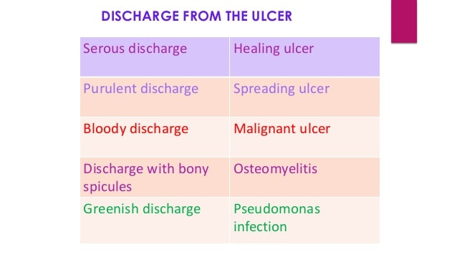

Slide 67
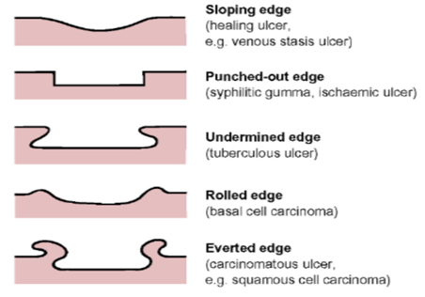
Edge of the ulcer
This is between the floor of the ulcer and the margin.
The margin is the junction between the normal epithelium and the ulcer.
These two parts represent areas of maximum activity.

Slide 68
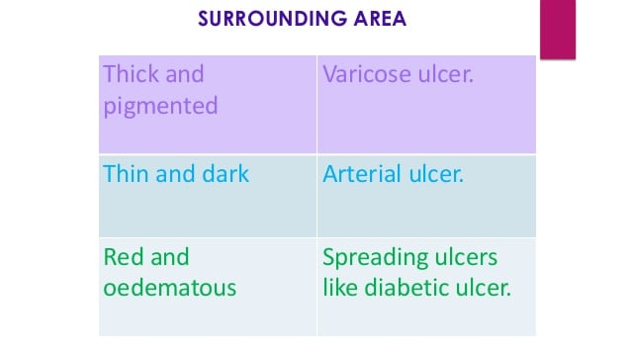

Slide 69
Palpation of the ulcer
EDGE:
Induration (hardness) of the edge is very characteristic of squamous cell carcinoma.It is said to be a host defense mechanism.Tenderness of the edge is characteristic of infected ulcers and arterial ulcers
BASE:
It is the area on which ulcer rests. Marked induration at the base is diagnostic of squamous cell carcinoma
MOBILITY:
Gentle attempt is made to move the ulcer to know its fixity to the underlying tissues.Malignant ulcers are usually fixed,benign ulcers are not
BLEEDING:
Malignant ulcer is friable like a cauliflower.On gentle palpation,it bleeds.Granulation tissue as in a healing ulcer also causes bleeding
SURROUNDING AREA:
Thickening and induration is found in squamous cell carcinoma.Tenderness and pitting on pressure indicates spreading inflammation surrounding the ulcer

Slide 70
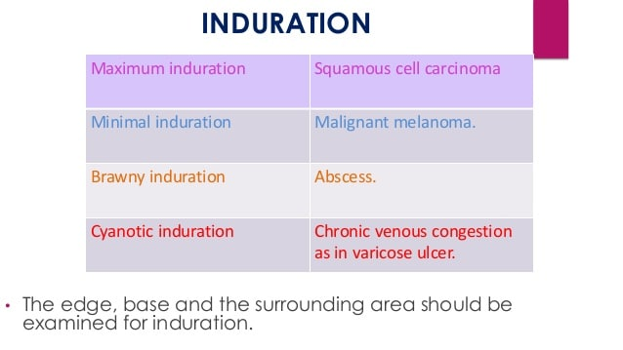

Slide 71
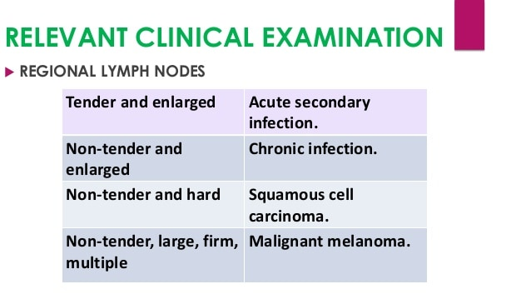

Slide 72
Summary
Venous leg ulcer are most common among other leg ulcer
Compression therapy are the mainstay for the venous leg ulcer
Arterial leg ulcer are present as painful blackish necrotic eschars
HYTILU present as single or mutiple eschars at laterodorsal site of leg over achilles tendon
Causes of chronic leg ulcers e.g vascular,tramatic,infective,systemic,neoplastic
Examination of leg ulcers

Slide 73


