Slide 1

Laser

Slide 2
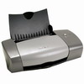


Lasers: everywhere in your life
Laser pointer
Laser printer
Notes:
4. Industry & Commercial
a. cutting, welding, marking
b. CD player, DVD player
c. Laser printers, laser pointers
d. Photolithography
e. Laser light display

Slide 3
Laser
Laser means “light amplification by stimulated emission of radiation.”

Slide 4
Stimulated emission of radiation
a beam of light passes through a specially prepared medium
initiates or stimulates the atoms within that medium
to emit light in exactly the same direction and exactly at the same wavelength as that of the original beam

Slide 5
What is Laser?
A device produces a coherent beam of optical radiation by stimulating electronic, ionic, or molecular transitions to higher energy levels
When they return to lower energy levels by stimulated emission, they emit energy.

Slide 6
Basic concepts for a laser

Slide 7

What is light?
It’s actually electromagnetic radiation:
We see light as color and brightness
Partly electric, partly magnetic
Flows in straight line (radiates)

Slide 8
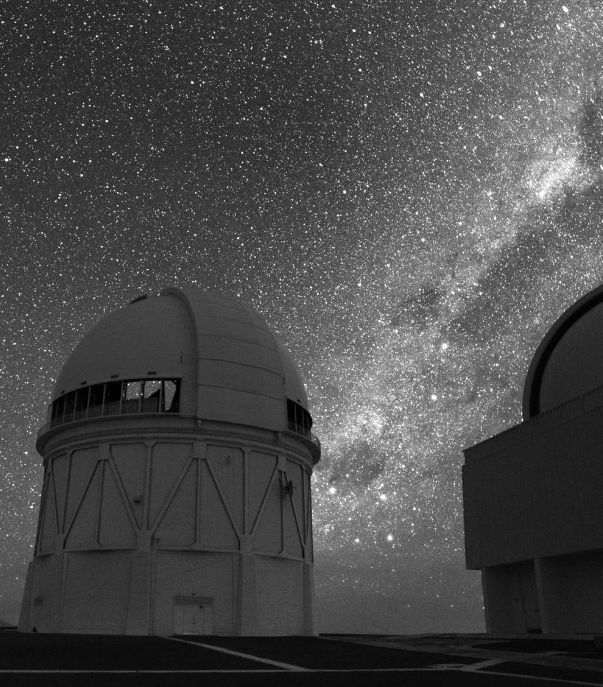
Where does light come from?
The Sun and stars
But how do they make light?

Slide 9
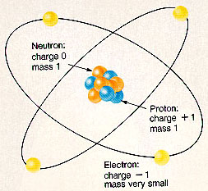
It All Starts With Atoms
A nucleus surrounded by electrons that orbit.
Like the planets in the solar system, electrons stay in the same orbit, unless…

Slide 10
Electrons Change Orbits
Electrons get kicked into a different orbit
This doesn’t happen very often in solar systems, but it does in atoms
If you add energy to an atom (heat it up), the electrons will jump to bigger orbits.
When atom cools, electrons jump back to original orbits.
As they jump back, they emit light, a form of energy

Slide 11
Light refers to a small band of frequencies visible to the human eye among the larger electromagnetic (EM) radiation scale

Slide 12
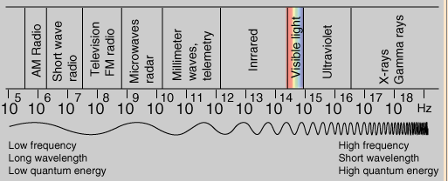
The Electromagnetic Spectrum

Slide 13
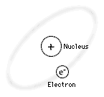
ATOM

Slide 14


Slide 15
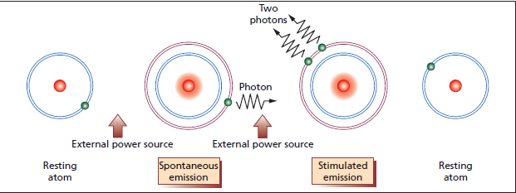
Notes:
Atoms consist of a nucleus surrounded by electrons. In their
resting state, electrons are usually at a low energy level and close
to the nucleus. By absorbing energy in the form of a photon (i.e.
a quantum of electromagnetic radiation or light), an electron will move to a higher energy orbit. The probability of
absorption is proportional to the radiation intensity of the light,
and also to the number of atoms in the resting state. In its excited
and unstable state, the tendency of the electron is to drop back to
the ground state. During this process, termed spontaneous emission
of radiation, a photon of energy is released.
Emission can also be stimulated, as in a laser. As stated above,
‘laser’ is an acronym for ‘Light Amplifi cation by Stimulated
Emission of Radiation.’ Stimulated emission occurs after an already
excited atom is perturbed by a photon with a frequency (wavelength)
corresponding to the energy gap between the excited and
ground states. If this happens, the excited atom reverts to the
resting state, releasing energy as a second photon of the same
frequency as the incident photon. Because the incident photon is
not absorbed, the atom emits two photons. Importantly, each of
these has the same wavelength and phase, that is they are coherent.
It is this property that allows light amplifi cation and the production
of a laser system. During the operation of a laser, all three
of these light–matter interactions take place simultaneously
(namely, the energizing of atoms as well as spontaneous and stimulated
emission). The energy that is required to excite the atoms
is provided to the laser by an external power source in a process
called pumping. When most of the atoms are in an excited rather
than in a lower energy state, they are described as having
undergone population inversion (a condition in which stimulated
emission is more likely).

Slide 16
Basic concepts for a laser
Absorption
Spontaneous Emission
Stimulated Emission
Population inversion

Slide 17
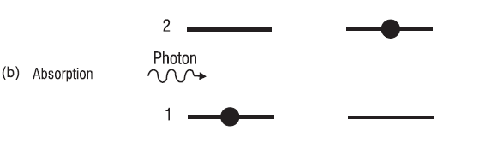
absorption
atom has its electron in level 1
a photon of light collides with the atom.
During the collision, the photon is absorbed by the atom
electron is moved up to the higher energy level 2.
Notes:
the atom has its
electron in level 1 & a photon of light of wavelength λ21 collides with the atom.
During the collision, the photon is absorbed by the atom and the electron is moved up to the
higher energy level 2. This process is the way light interacts with practically all of matter. It can
happen from any energy level that is occupied (generally the ground state) and always boosts
the atom to a higher-lying level while eliminating the photon. This often results in heating of the
absorbing material.

Slide 18
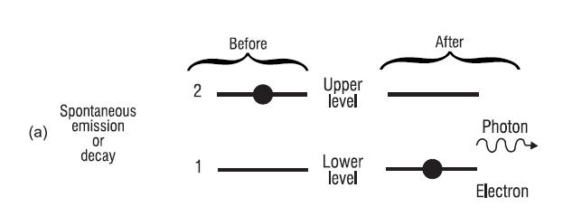
spontaneous emission
an electron residing in level 2 can spontaneously jump to level 1
Notes:
Each level has a specific lifetime τ over which it will
remain in that level before decaying to a lower-lying level. That lifetime is determined by the
interactions of the electron with the other electrons and nuclei of that atom. Typical lifetimes of
electrons residing in specific levels that decay by radiating in the visible portion of the spectrum
are of the order of 10–100 nsec. Of course the ground state cannot decay further and thus has
infinite lifetime

Slide 19
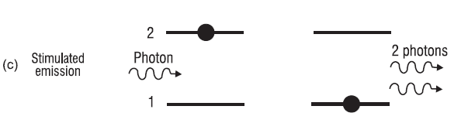
stimulated emission
Electron is in a higher-lying level, such as level 2
A photon of light collides with the atom
During the collision the photon stimulates the atom
atom radiates a second photon having exactly the same energy
Notes:
one photon leads to two identical photons, which, in effect, leads to an amplification process.
A photon has been gained at the expense of the loss of energy stored within the atom

Slide 20
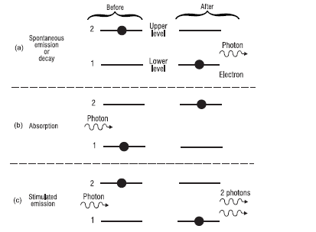

Slide 21
Population Inversion
A state in which a substance has been energized, or excited to specific energy levels.
More atoms or molecules are in a higher excited state.

Slide 22
Pumping.
The process of producing a population inversion is called pumping.
Examples:
→by lamps of appropriate intensity
→by electrical discharge

Slide 23
Basic laser components

Slide 24
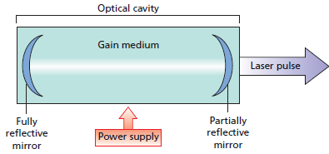
(substance capable of stimulated emission)
Delivery system
Pumping
Laser construction
optical cavity
Gain medium
Pumping - power supply
Delivery system
Operator handpiece
Notes:
An energy source to raise the energy levels of the electrons (Pumping)
A laser substance capable of stimulated emission
A system of mirrors to reflect the light repeatedly backwards and forwards through the laser substance

Slide 25
Laser construction
Gain medium
  A laser substance capable of stimulated emission
optical cavity
  A system of mirrors to reflect the light repeatedly backwards and forwards through the laser substance
Pumping - power supply
  An energy source to raise the energy levels of the electrons

Slide 26
laser components

Slide 27
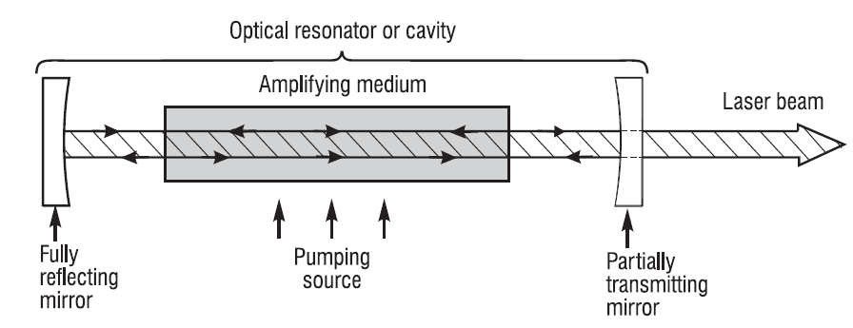

Slide 28
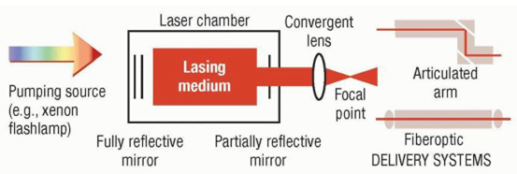

Slide 29
optical cavity
optical cavity consists of two opposing mirrors
    one of which is fully reflective and
    the other of which, the output coupler, is partly transparent.
Photons moving parallel to the axis of the
optical cavity are reflected between the two mirrors, in turn eliciting stimulated emission in the same axis

Slide 30
Laser gain medium
The optical cavity contains a substance called Gain medium
may be a gas, a liquid or a solid
Lasers are usually named after of the gain medium

Slide 31
Laser gain medium
carbon dioxide (CO2) laser
    CO2
Nd:YAG or Nd:glass lasers
    neodymium atoms doped in YAG or glass
red helium-neon (HeNe) laser
    red helium-neon (HeNe)
helium-cadmium (HeCd) lasers
    helium-cadmium
yellow copper vapor lasers (CVL)
    copper
Notes:
Nearly all lasers are produced as a result of electrons jumping from an excited energy level
within a radiating species to a lower-lying energy level and, in the process, radiating light that
contributes to the laser beam. Those radiating species can include

Slide 32
Laser materials
Material | Uses | Properties
Synthetic ruby | Early use in eye surgery
Argon | Eye surgery and removal of birthmarks | Passes through vitreous and aqueous humour. Absorbed by Hb and pigmented skin. Transmitted down optical fibres
Carbon dioxide | Most commonly used, removes layers of tissue | Absorbed by H2O – low penetration Cannot be used endoscopically
Nd-YAG (Neodymium- Yyrium-Aluminium-Garnet) | Coagulation and cutting | Not absorbed by H2O – good penetration Can be used endoscopically

Slide 33
pumping
energy that is required to excite the atoms is provided to the laser by an external power source in a process called pumping

Slide 34
delivery system
delivery system which transmits it to the operator handpiece
Fibreoptic cables
articulated arms

Slide 35
operator handpiece
Each delivery system ends in an operator handpiece through which light can be focused by a lens or transmitted as a collimated beam

Slide 36
population inversion
When most of the atoms are in an excited rather than in a lower energy state, they are described as having undergone population inversion
a condition in which stimulated emission is more likely.

Slide 37
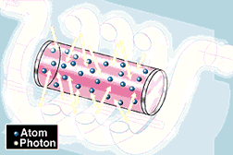
1. High-voltage electricity causes the quartz flash tube to emit an intense burst of light, exciting some of Cr³⁺ in the ruby crystal to higher energy levels.
2. At a specific energy level, some
Cr³⁺ emit photons. At first the photons
are emitted in all directions. Photons
from one Cr³⁺ stimulate emission
of photons from other Cr³⁺ and the
light intensity is rapidly amplified.

Slide 38
3. Mirrors at each end reflect the photons back and forth, continuing this process of stimulated emission and amplification.
4. The photons leave through the
partially silvered mirror at one
end.
This is laser light.

Slide 39
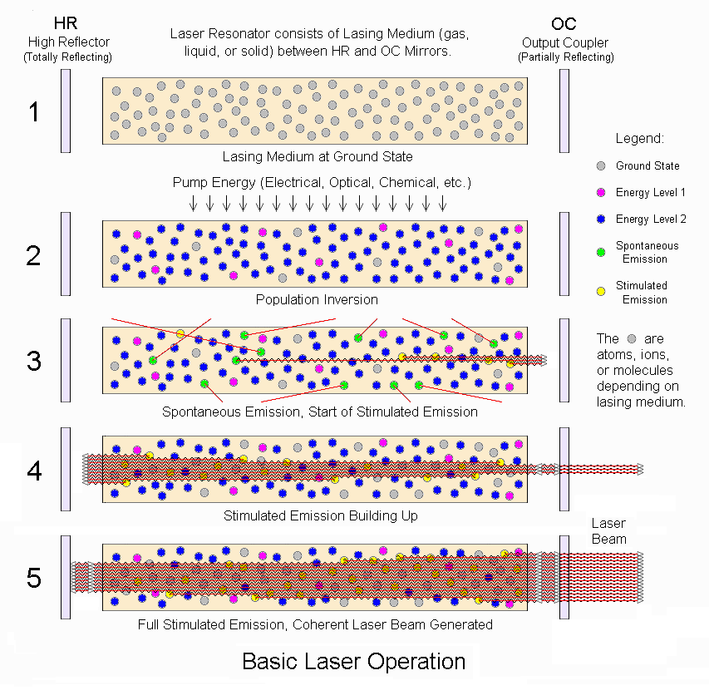

Slide 41
Properties of Laser light

Slide 42
Properties of Laser light
Monochromatic
Coherence
Collimation

Slide 43
Properties of Laser light
Monochromatic
  single, discrete wavelength
Coherence
  laser light traveling in phase with respect to both time and space
Collimation
  emission of a narrow, intense beam of light in parallel fashion to achieve its propagation across long distances without light divergence

Slide 44
Monochromatic
single, discrete wavelength

Slide 45
Coherence
laser light traveling in phase with respect to both time and space

Slide 46
Collimation
emission of a narrow, intense beam of light in parallel fashion to achieve its propagation across long distances without light divergence
Collimated light can be focused into small spot sizes allowing for precise tissue destruction.

Slide 48
Difference between Laser and IPL

Slide 49
Laser/ IPL
A laser emits an intense, collimated beam of light at a well-defined wavelength, which can be tightly focused, during essentially any period of time.
In contrast, an IPL emits broad-wavelength pulses of divergent light that cannot be tightly focused

Slide 50
laser
IPL
well-defined wavelength
collimated
can be tightly focused
broad-wavelength
divergent light
cannot be tightly focused.

Slide 51
Laser Skin interaction

Slide 52
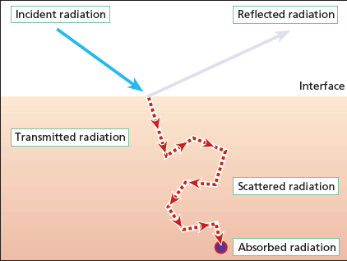
UVR interaction with skin
5%
chromophore

Slide 53
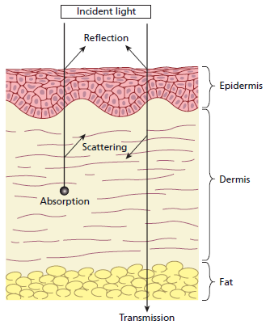
fate of incident light on skin
Reflection
Absorption
Scattering
Transmission
5%

Slide 54
first law of photobiology
light must be absorbed by tissue for a clinical effect to take place
transmitted or reflected light has no effect

Slide 55
Chromophores
Structures which absorb light

Slide 56
chromophores of the skin
Endogenous
  water
  melanin
  Hemoglobin
  collagen
Exogenous chromophore
  tattoo ink

Slide 57
Effects of Laser light
Once laser energy is absorbed in the skin, 3 basic effects are possible
Photothermal
Photochemical
          Photodynamic change
Photomechanical
Photostimulation.

Slide 58
Photothermal effects
a chromophore absorbs the corresponding wavelength of energy and destruction of the target results from the conversion of absorbed energy into heat

Slide 59
Photochemical effects
Photosensitizer related reactions
        serve as the basis of photodynamic therapy (PDT)

Slide 60
Photomechanical
acoustic waves and subsequent photomechanical destruction of the absorbing tissue.

Slide 61
Although all 3 types of laser effects can occur, photothermal and photomechanical reactions are most commonly observed in current cutaneous laser surgery practice.

Slide 62
Photostimulation
low energy lasers expedite wound healing.
The mechanism of this is unclear

Slide 63
How to get maximal effects with minimal collateral damage?

Slide 64
Thermal relaxation time (TRT)
Time taken for the target to dissipate about 63% of the incident thermal energy.

Slide 65
TRT
Related to the size of the target chromophore
  varies from a few nanoseconds (tattoo particles) to several hundred milliseconds or more (leg venules).

Slide 66
Pulse duration
Exposure duration of the tissue to light

Slide 67
Pulse duration
Pulse duration must be shorter than the chromophore’s thermal relaxation time
    limits the amount of thermal energy deposited within the skin
    Prevents extra damage

Slide 68
Fluence
The energy absorbed is measured in joules per square centimeter and is known as fluence
Power is the rate at which energy is delivered, and is measured in Watts (i.e. W or J/s).
irradiance refers to the power density—the rate at which energy is delivered per unit area—and is measured in W/cm2

Slide 69
  Fluence
  must be sufficient to achieve destruction of the target within the allotted time
The amount of absorption is determined by
  the chromophore present in the skin
  whether a wavelength that corresponds to the absorptive characteristics of that chromophore is used.

Slide 70
Fluence and irradiance are directly proportional each other
Both are inversely proportional to the square of the radius of the spot size.

Slide 71
doubling the spot size decreases the fluence and the irradiance by a factor of 4.
increasing the spot size (up to a maximum of about 12 mm) reduces scatter.

Slide 72
Theory of selective photothermolysis
controlled destruction of a targeted lesion without significant thermal damage to surrounding normal tissue

Slide 73
three basic requirements.
target structures must have preferential absorption at a wavelength
light pulse(s) must be delivered within a sufficiently short time so that the target structures do not transfer much heat to their surroundings during the pulse duration
fluence delivered by the optical pulse must be great enough to have a therapeutic effect but less than that causing non-specific thermal damage.

Slide 74
Light can be manipulated in terms of its wavelength, energy content and pulse duration so that a particular target chromophore absorbs light and is damaged or destroyed, whereas other chromophores are not.

Slide 75
Tailoring for specific cutaneous applications
AIMS
    to effect maximal target destruction
    with minimal collateral thermal damage
VARIABLE PARAMETERS
    wavelength
    pulse duration
    fluence

Slide 76
Wavelength
To achieve selective photothermolysis, a proper wavelength that is absorbed preferentially by the intended tissue target or chromophore is selected

Slide 77
Chromophores absorption of light
  Water
      mid and far infrared regions.
  Melanin
    Absorbs UV and visible light, with decreasing absorption into the near infrared spectrum.
  Hemoglobin
    absorption peaks in the UVA, blue (400 nm), green (541 nm) and yellow (577 nm) wavelengths
  Collagen
    absorbs in the visible and near infra-red spectra

Slide 78
Lasers types according to the pulse characteristics of the beam
Continuous
    uninterrupted beam of relatively low power
    eg CO2 laser
    Can be shuttered mechanically to interrupt the beam
Pulsed
Quality switched (Q-switched)
Q-switching is a means of creating a very short pulse (5–100 nanoseconds) together with an extremely high peak
power

Slide 79
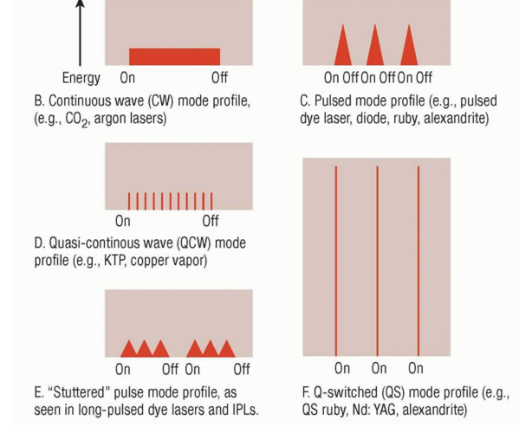
time

Slide 80
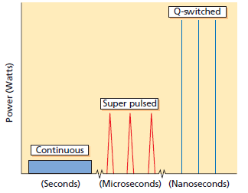

Slide 81
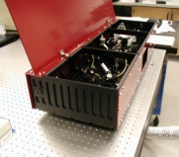
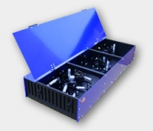
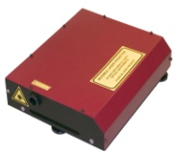
Types of Laser Output
cw
cw ML
Q-switch
Q-sw.ML

Slide 83
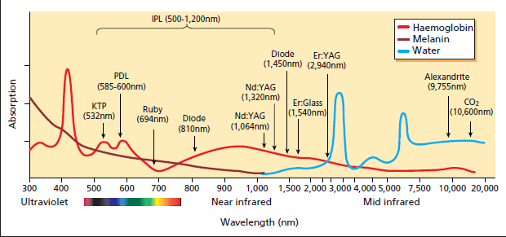
Absorption spectra of principal tissue chromophores.

Slide 84
thermal damage time (TDT).
This is the time for the entire target, including the primary chromophore (e.g. melanin) and the surrounding target (e.g. hair follicle) to cool by about 63% and includes cooling of the primary chromophore as well as the entire target.
The TDT is longer than the TRT as it allows for heat diffusion from the chromophore throughout the entire target.

Slide 85
‘thermokinetic selectivity’
large structures cool slower than small structures, it is proposed that they reach higher and potentially damaging temperatures if the light source is manipulated appropriately.

Slide 86
Tissue cooling benefits
allow treatments at higher energy fluences
  reduces the number of treatments required
cooling decreases the pain associated with
treatment
  reducesing the need for topical or local anaesthetic

Slide 87
Tissue cooling methods
Cold air convection
    Air, chilled to temperatures as low as −30°C, is directed onto the area to be treated
Contact cooling
    Icepacks
    cold water flows between colorless and transparent plates
Cryogen spray
    frozen gas is sprayed onto the skin immediately before the laser pulse

Slide 88
Tissue cooling types
Precooling
Parallel cooling
Postcooling

Slide 89
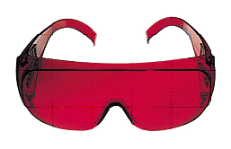
Precautions
Appropriate training
Suitably equipped area, all exposed surfaces matt finish
All instruments matt finish
No inflammable material near patient
Protective eye goggles and protection for patient’s eyes and skin
Well ventilated with smoke extraction
No inflammable or explosive anaesthetic gases

