Slide 1

Kaposi-Stemmer’s sign

Slide 2
Physical exam that is diagnostic of lymphedema
test measures the ability of a clinician to lift and tent tissue.
01
. A positive Stemmer’s sign is diagnostic of lymphedema.
02

Slide 3
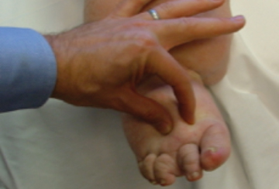

Slide 4
This test measures the ability of a clinician to lift and tent tissue.
A positive Stemmer’s sign is diagnostic of lymphedema.
It is classically measured at the base of the toes in the foot for patients with lower extremity swelling.
It can be measured anywhere in the body where lymphedema is suspected.

Slide 5
If you can gently pinch and can tent the tissue (bring the skin folds together), then the Stemmer’s sign is negative.
If you cannot gently pinch and tent the tissue, this is because the protein rich lymph fluid in the tissues prevents you from bringing the skin folds together and the Stemmer's sign is positive.
A positive Stemmer's sign is diagnostic of lymphedema

Slide 6
