Slide 1


Slide 2
KAPOSI SARCOMA
&
PYODERMA GANGRENOSUM
HISTOPATHOLOGY prepared by :dr mahtab khawajakhail pgr dermatology sph ,quetta

Slide 3
Kaposi sarcoma
It is one of the most common malignancies in HIV patients,
Caused by HHV-8 virus
TYPES: Classic, African, Epidemic, K.S in Renal transplant
CLINICAL & HISTOLOGICAL STAGES: Patch, Plaque, Nodular, Ulcerative

Slide 4
PATHOGENESIS
VIRAL PROTIENS
ANGIOGENIC AND PROINFLAMMATORY EFFECTS ON ENDOTHELIAL CELLS
CELLS PROLIFERATE TO FORM CHARACTERISTIC SPINDLE CELL TUMORS

Slide 5
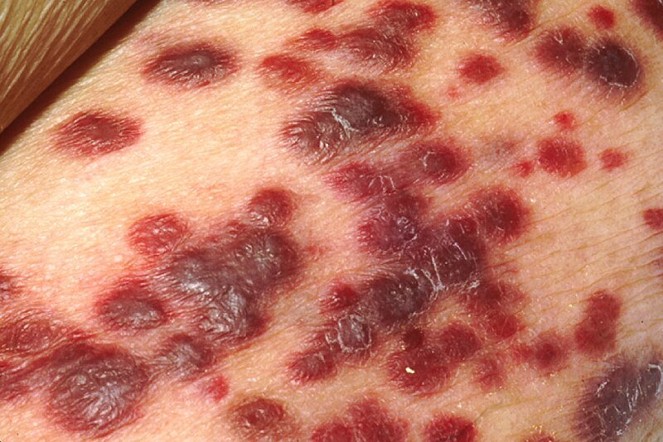
CLASSIC LESION IN HIV PATIENT

Slide 6
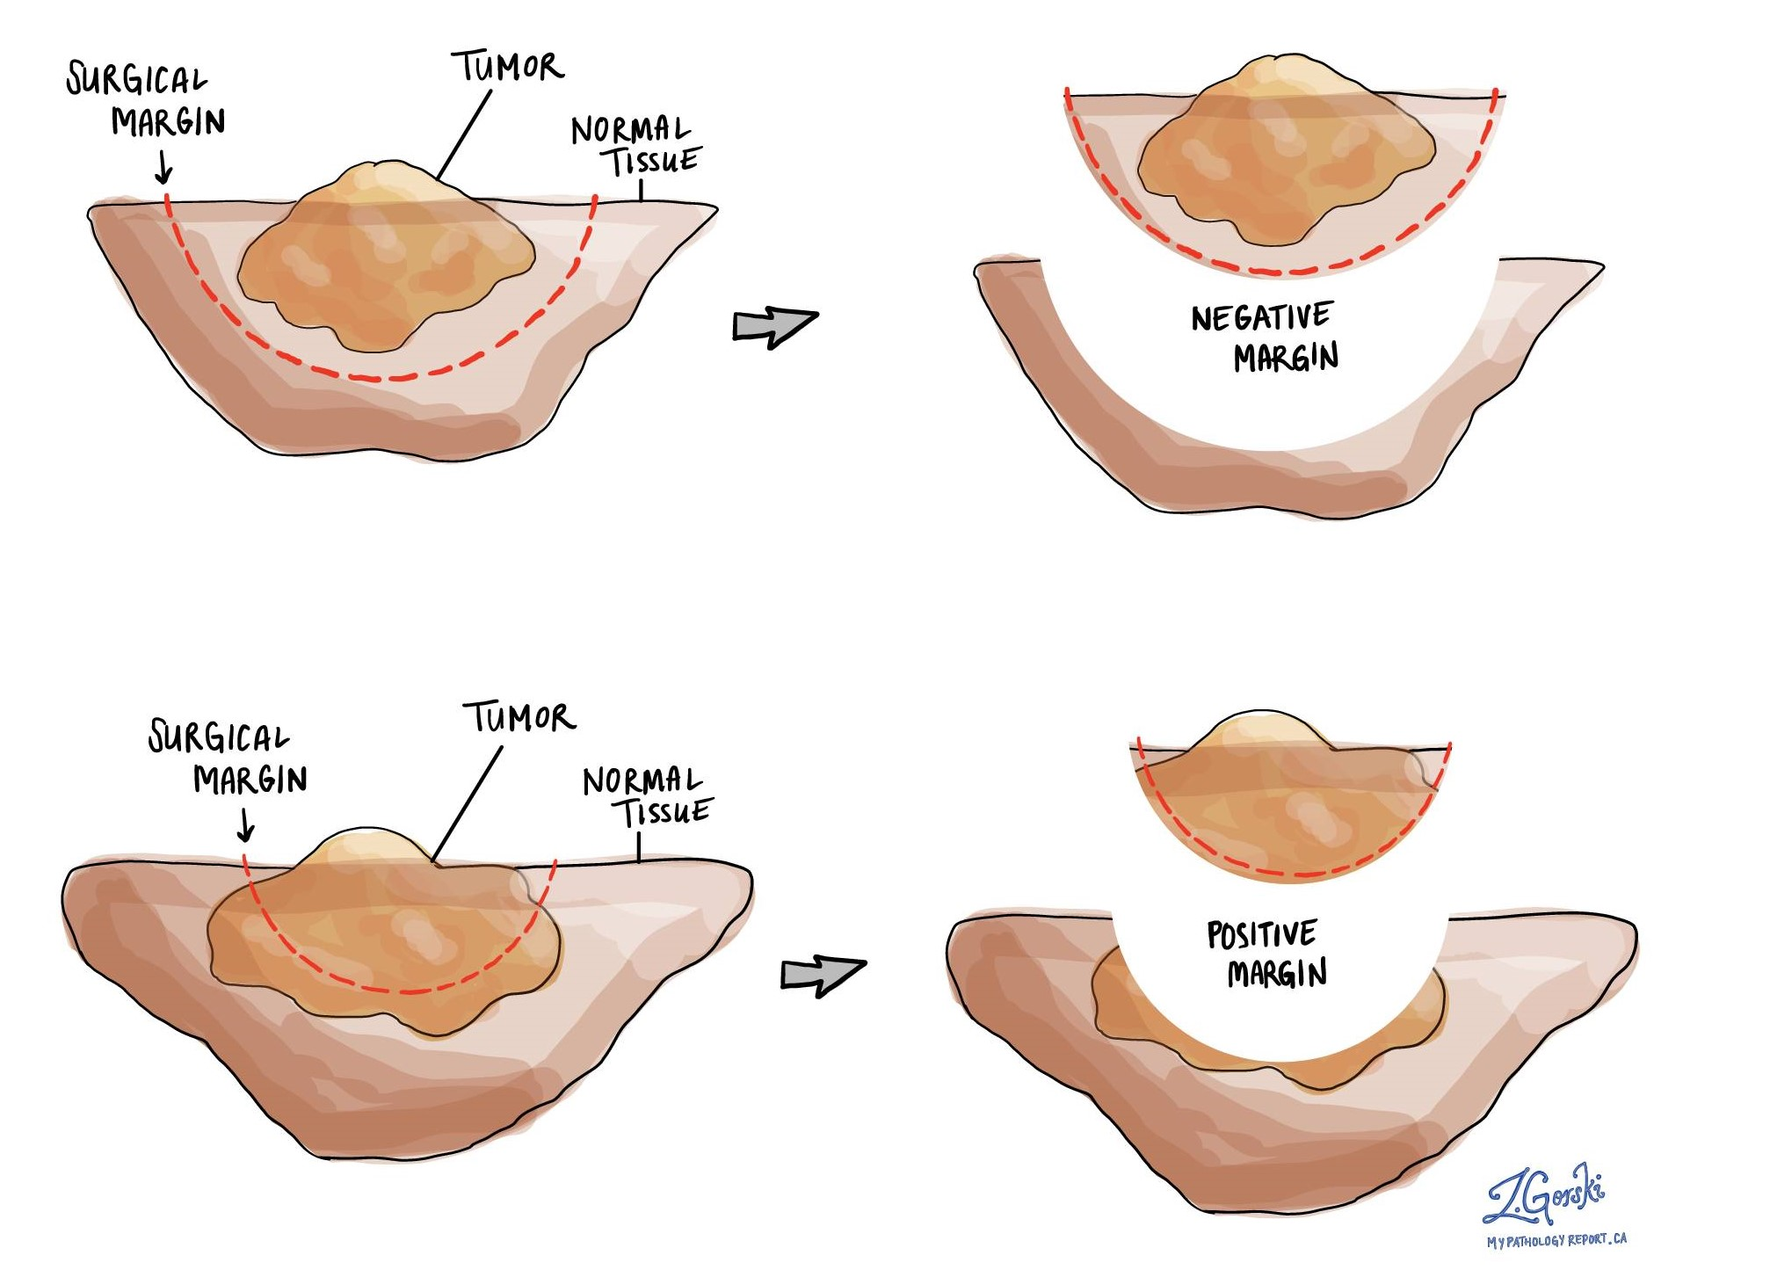
sHave or punch biopsy

Slide 7
Histological features
Slit like vascular spaces lined by endothelial cells and filled with blood
Multiple layers of Spindle cells Infiltrating the Dermis
Small background newly formed blood vessels within preexisting blood vessels – PROMONTORY SIGN
RBC extravasation
Plasma cells usually present
Hyaline Globules (may be degenerated RBCs)
HHV-8 positive

Slide 8
Histological variants
PATCH STAGE:
Earliest phase in evolution of cutaneous Kaposi Sarcoma
BUSY DERMIS or mild inflammatory dermatosis
Newly formed slit like vascular spaces
These slit like spaces are lined by endothelial cells with variable degree of erythrocyte extravasation
Promontory sign
These channels often contain RBCs
Mild background inflammatory cells (plasma cells)

Slide 9
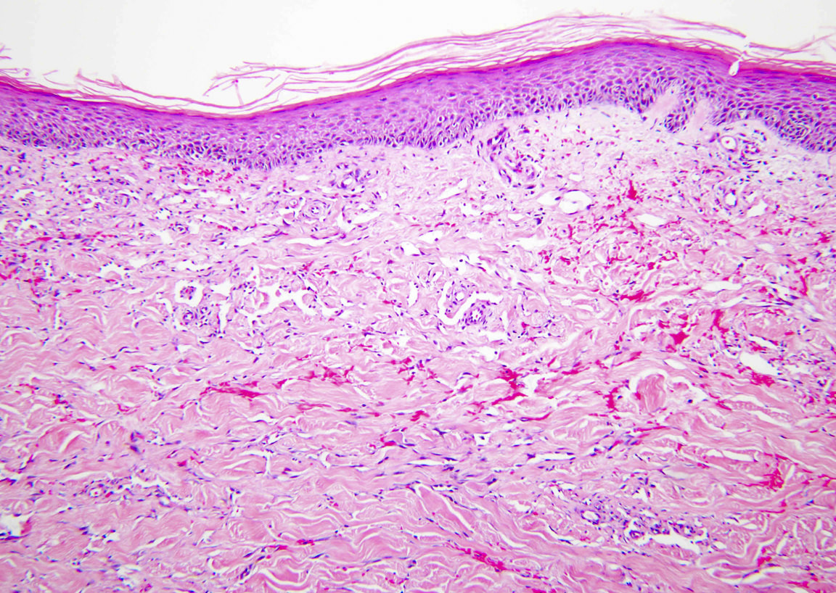

Slide 10
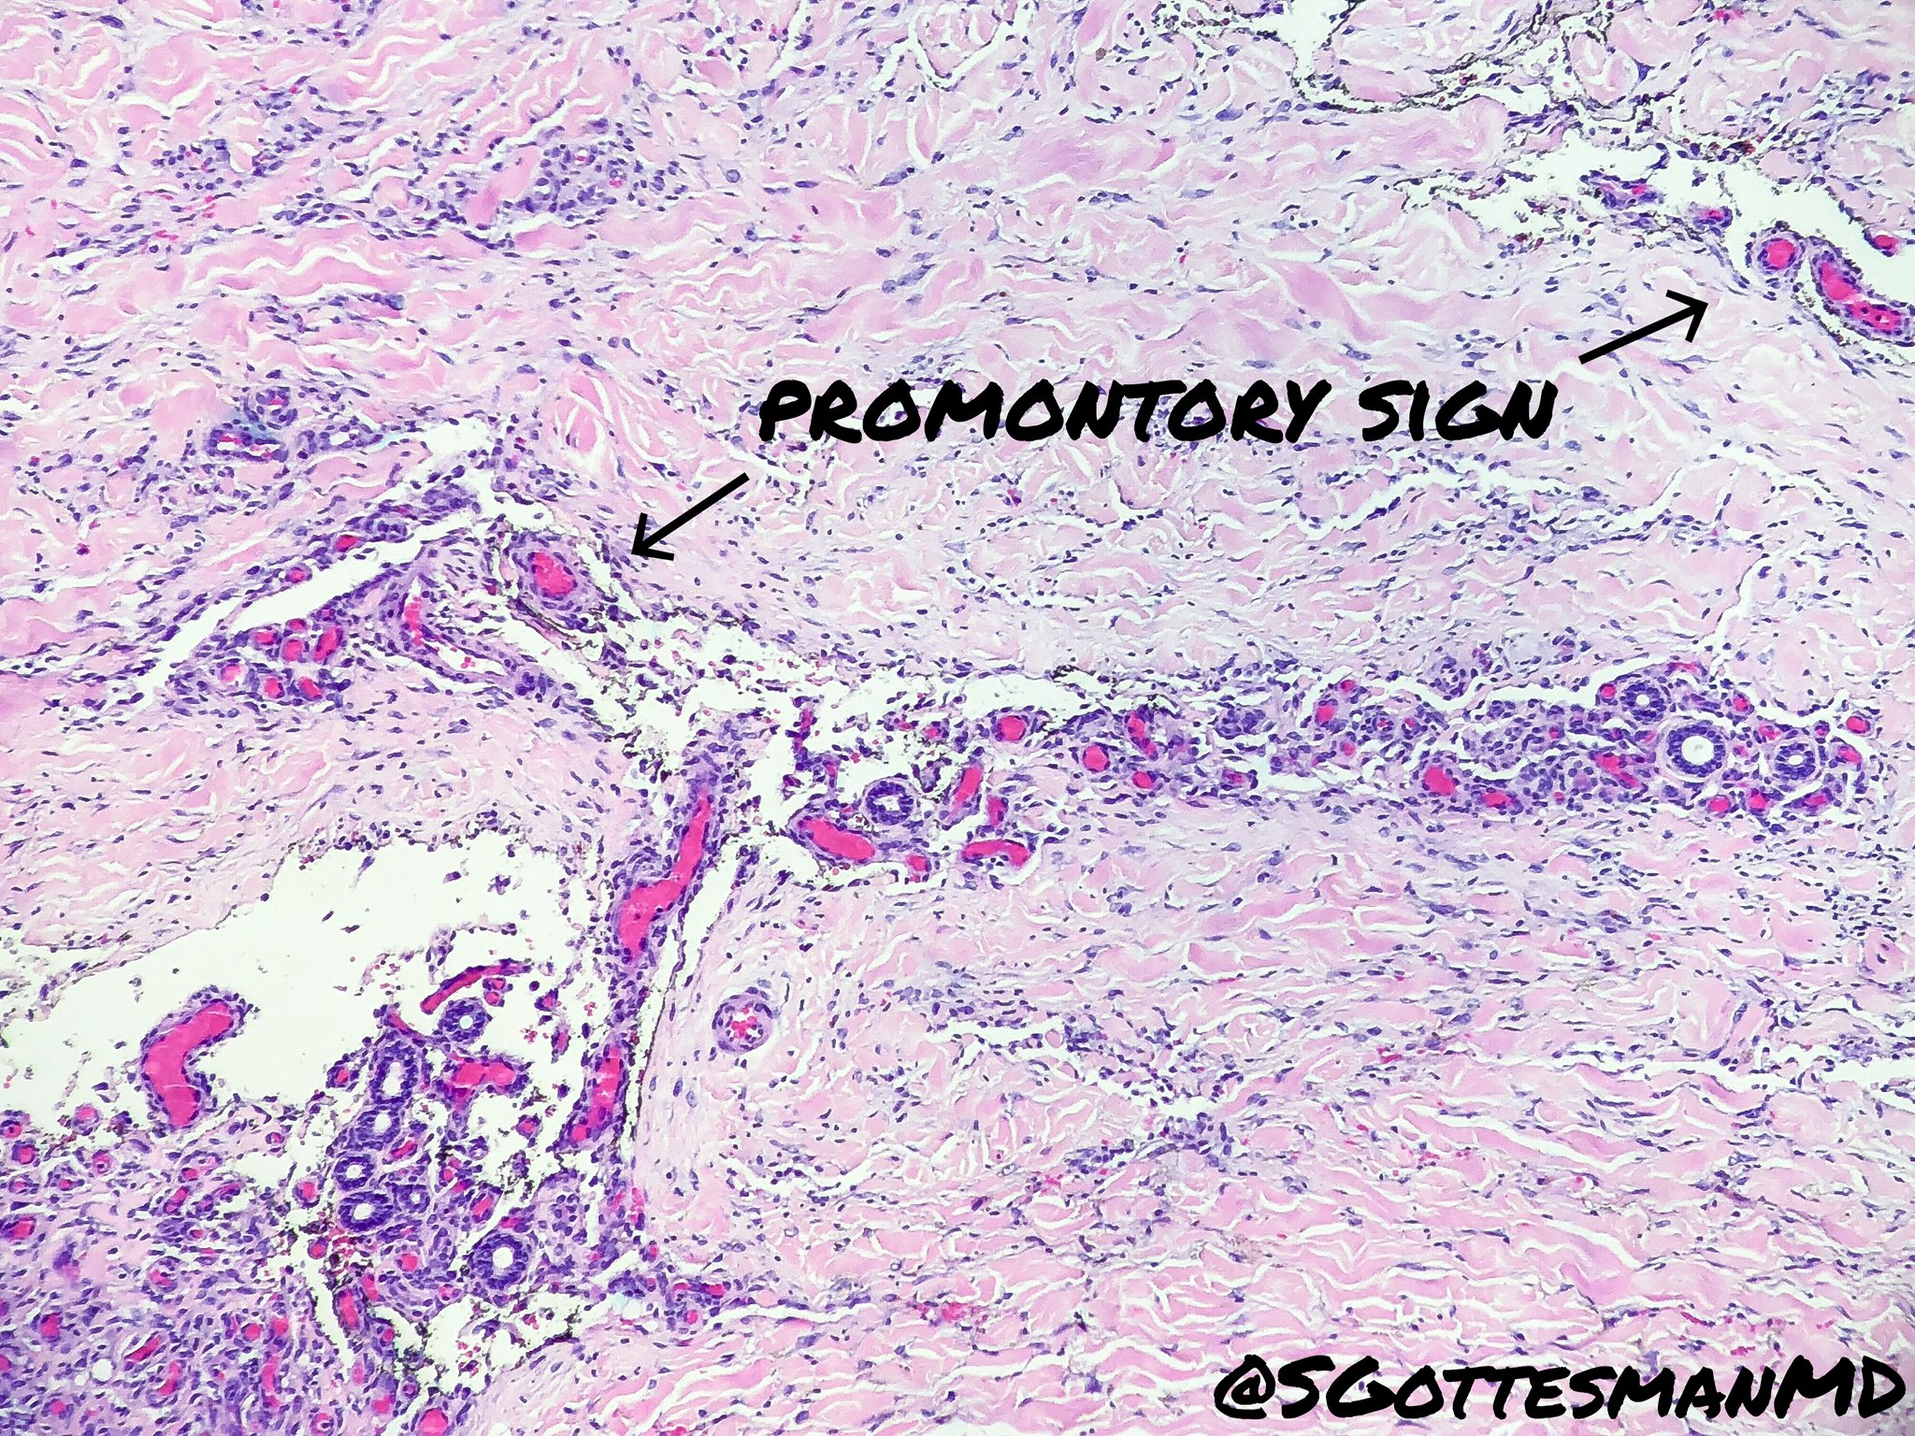

Slide 11
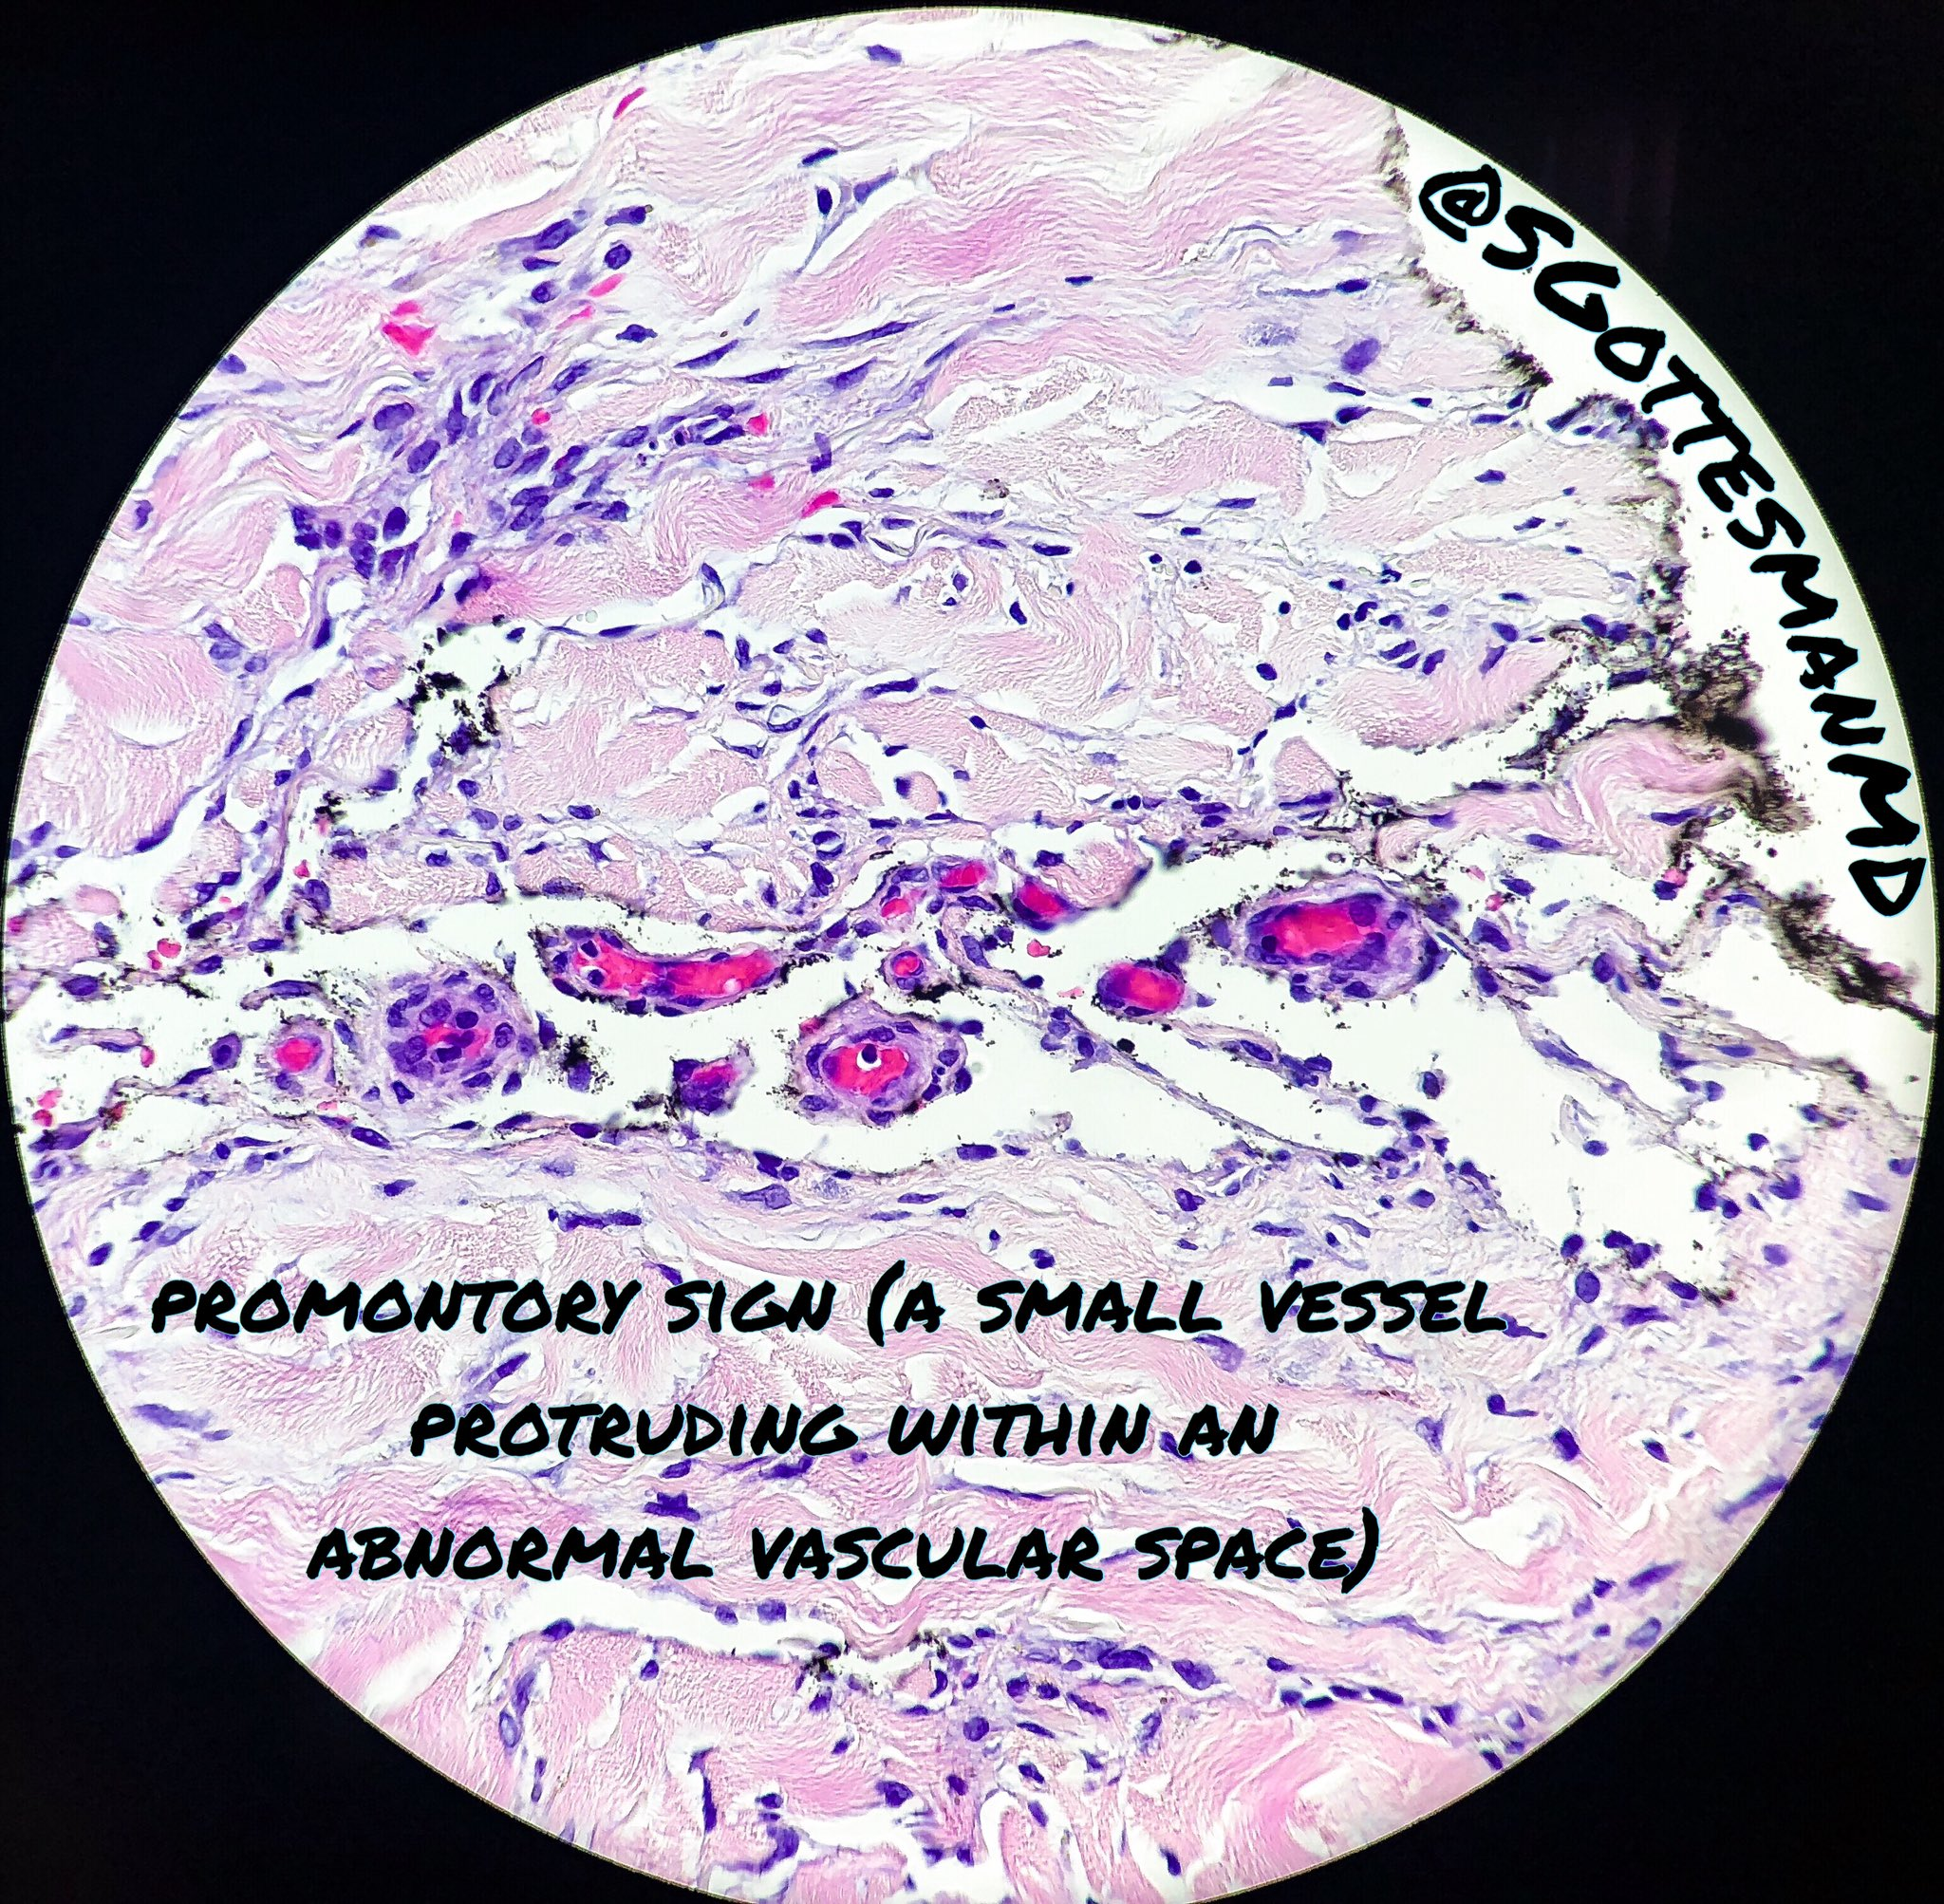

Slide 12
Histological variants
PLAQUE STAGE:
More diffuse dermal vascular infiltrate, extending into subcutaneous adipose tissue
The cells are spindle cells arranged in haphazard fascicles
Sparse mitotic figures
No nuclear or cytologic pleomorphism
Intra and extra cellular hyaline globules
Plasma cells inflammatory cells in background
Siderophages
Promontory sign

Slide 13
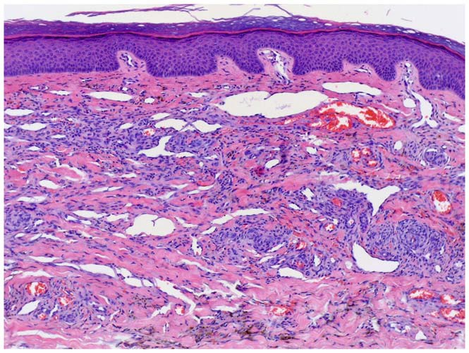

Slide 14
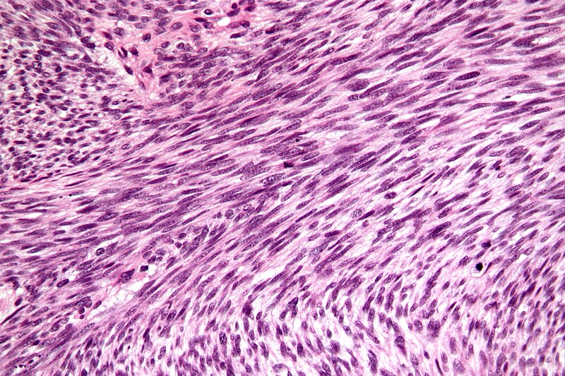
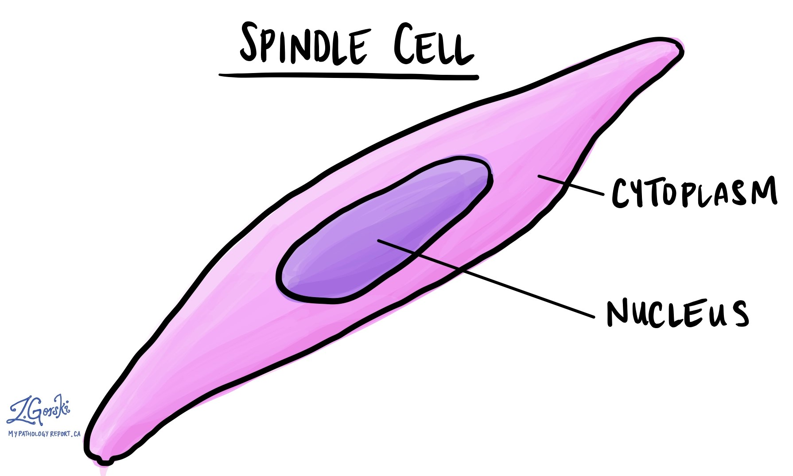

Slide 15
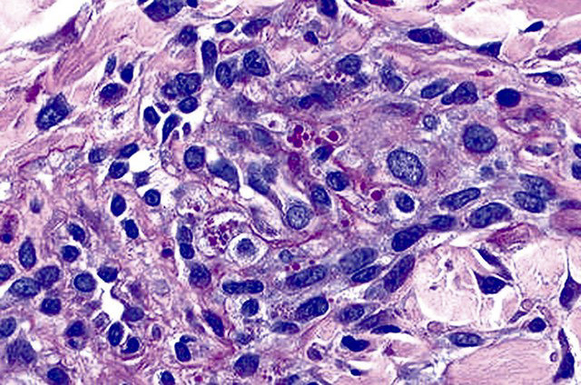
Hyaline globules

Slide 16
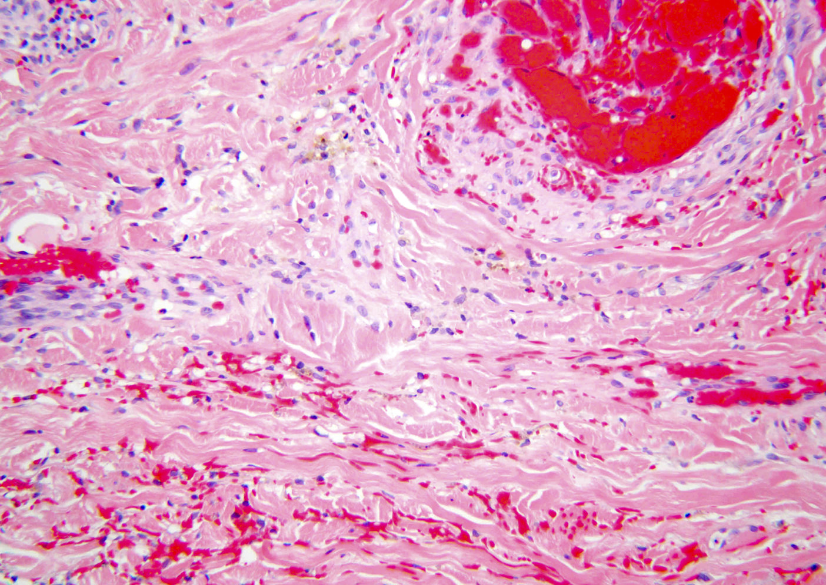

Slide 17
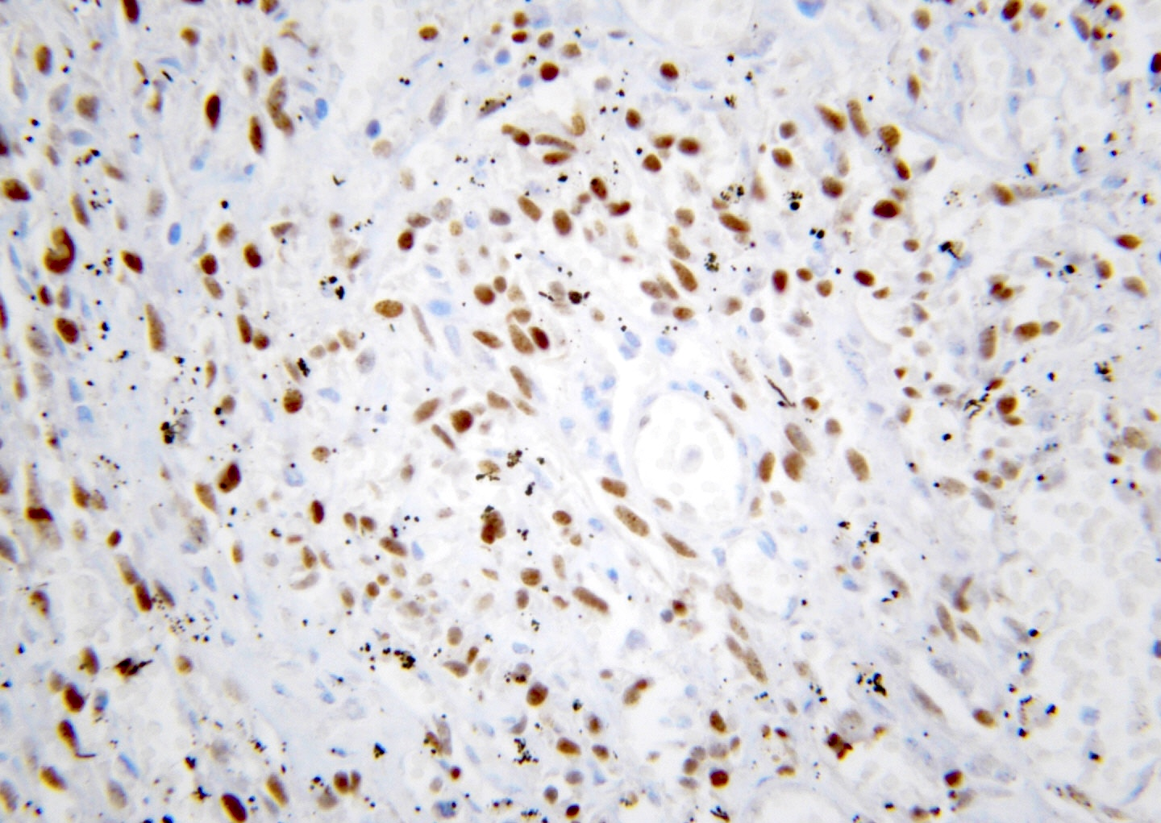
HHV-8 STAIN

Slide 18
Histological variants
NODULAR STAGE:
the dermis is extended by solid tumor nodule
Fascicles of monomorphic spindle cells , with slit like vascular spaces containing erythrocytes
nuclei show immunoreactivity for HHV-8 stain
Hyaline globules
Phenomenon of autoillumination

Slide 19
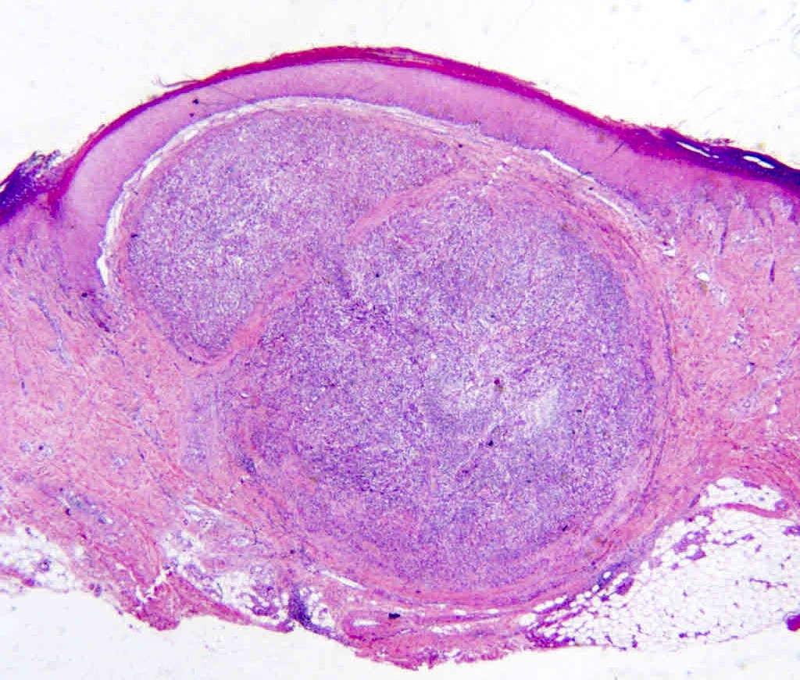

Slide 20
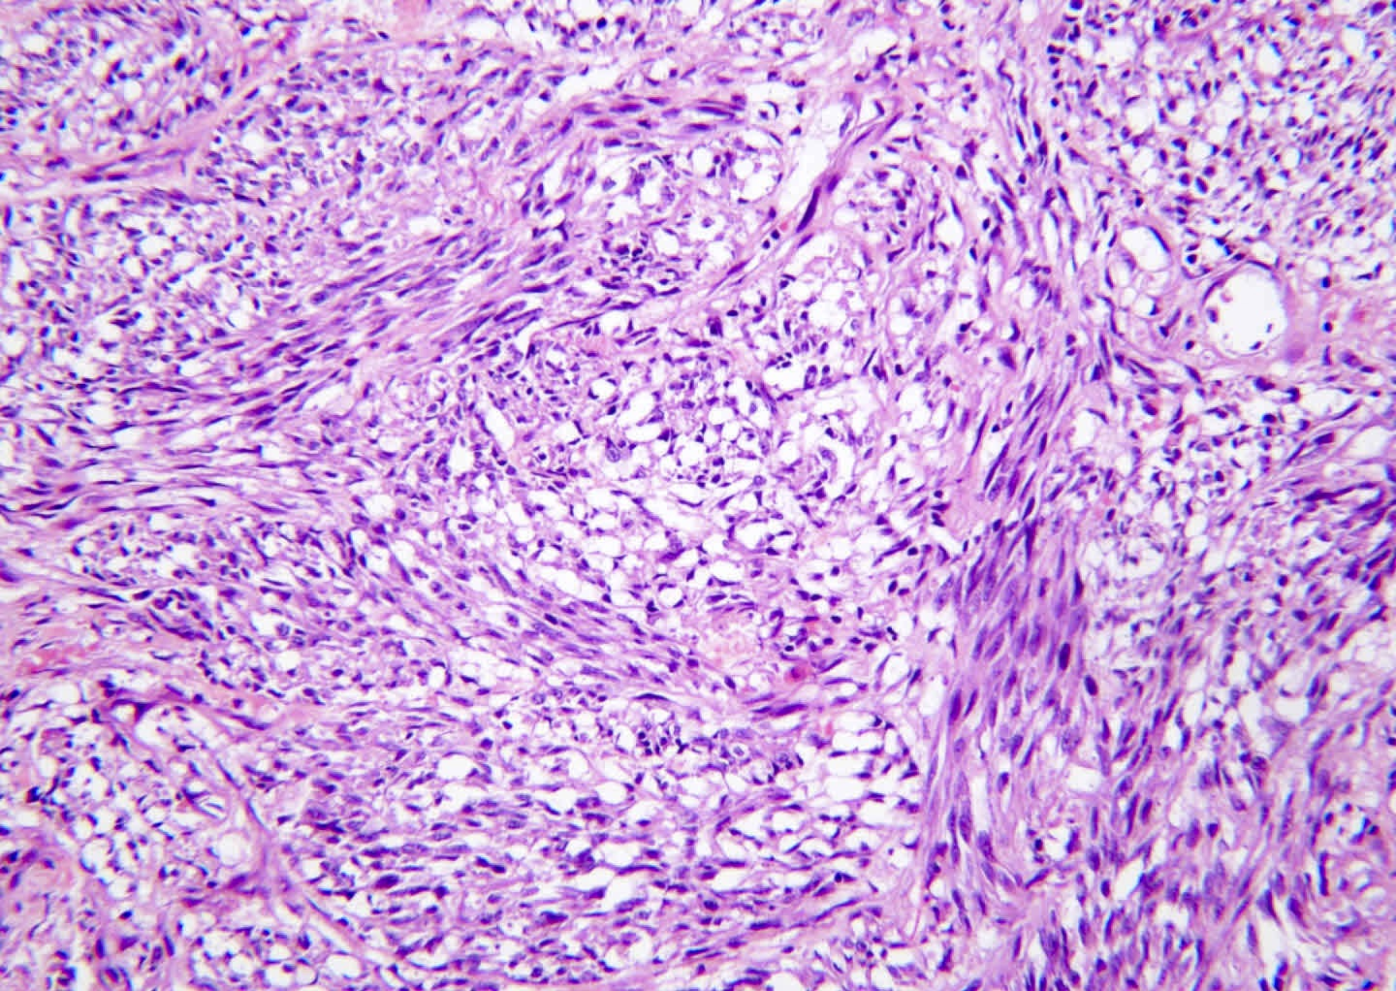

Slide 21
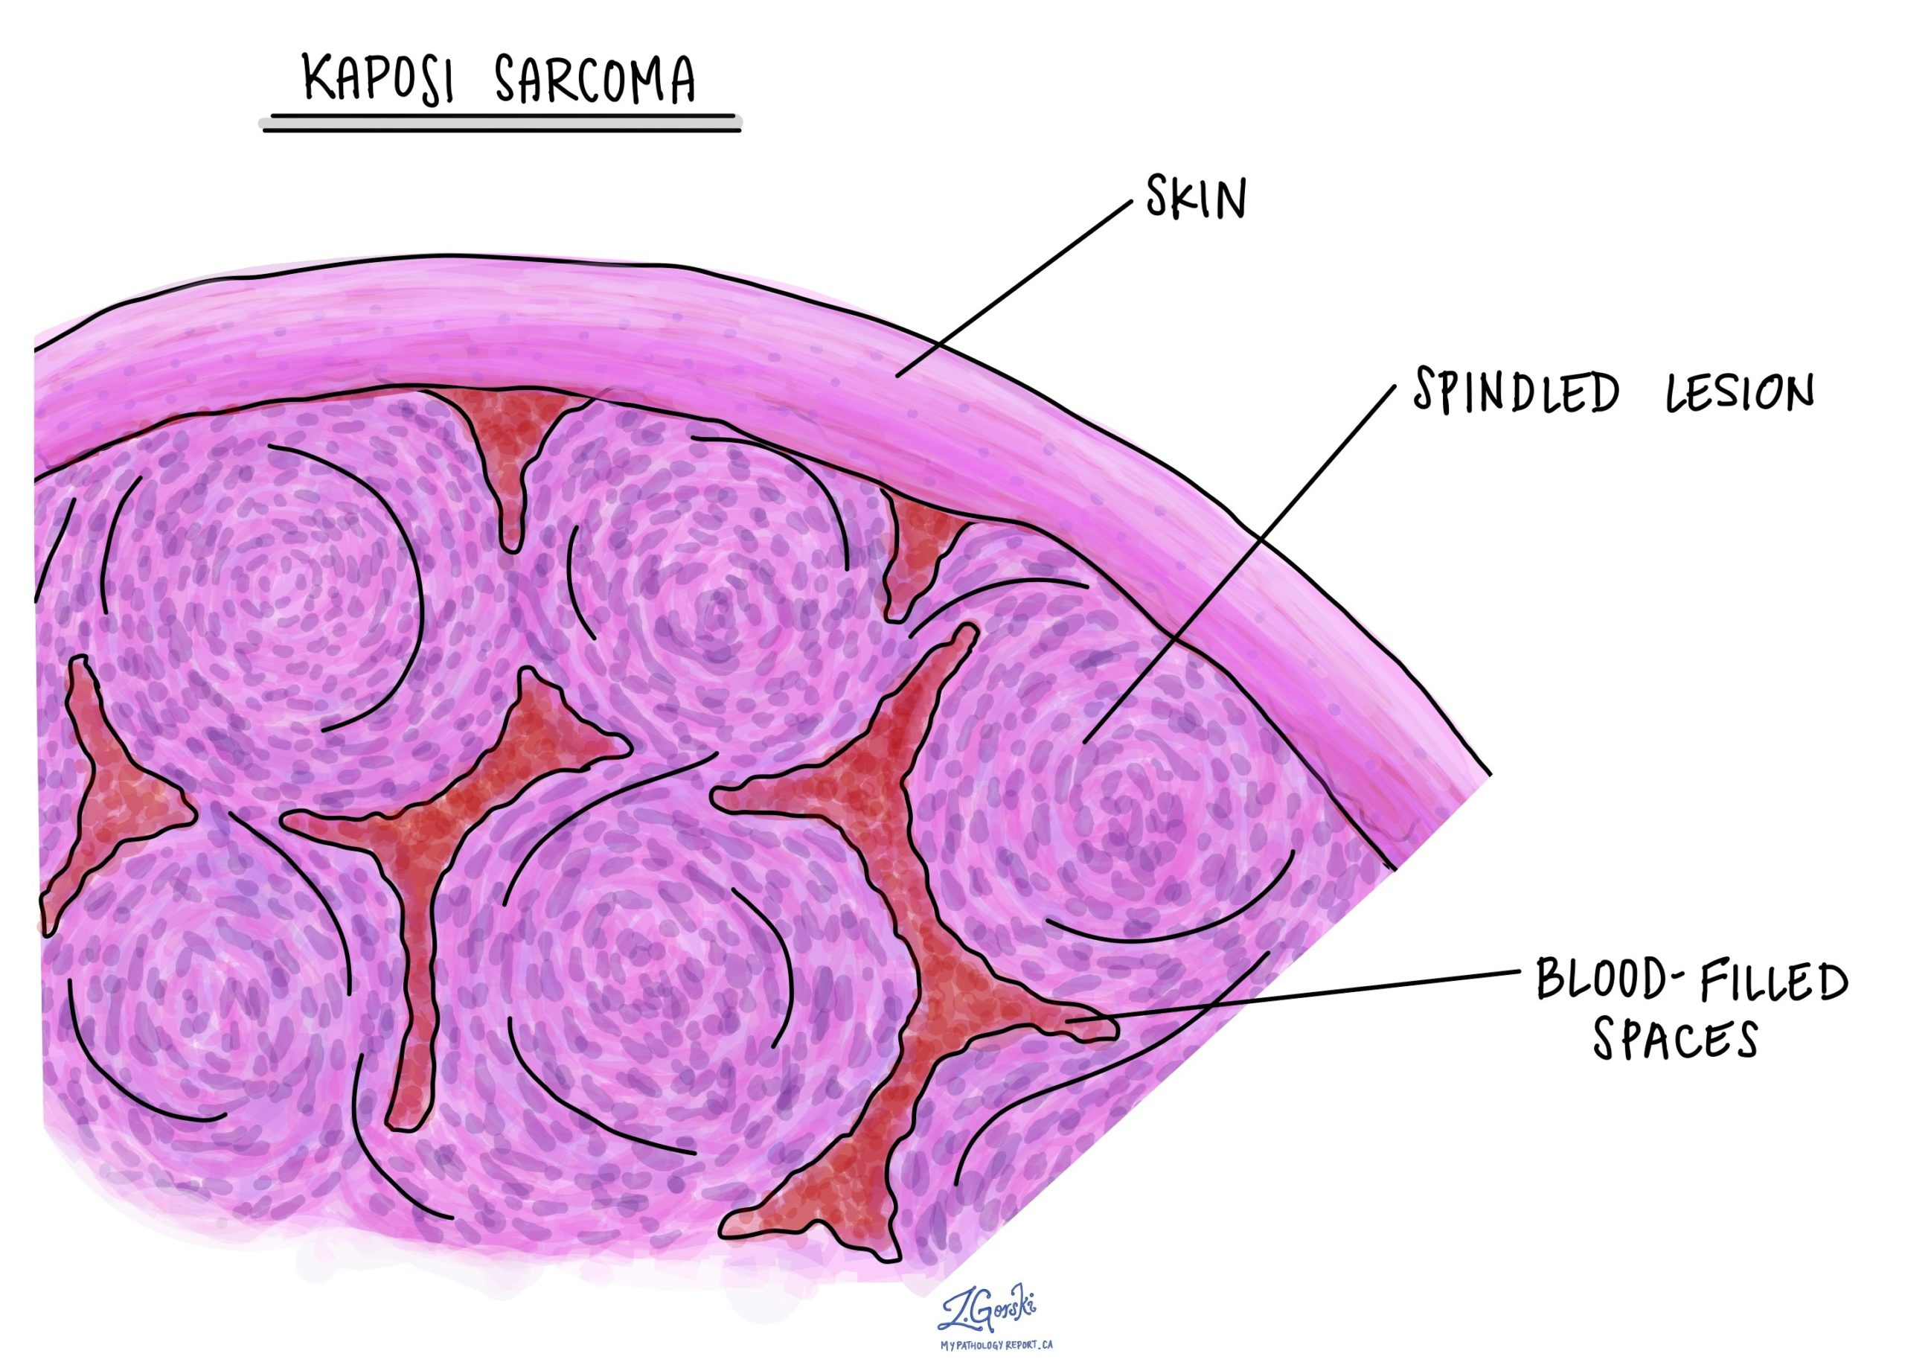

Slide 22
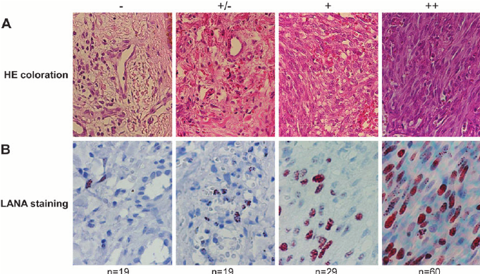

Slide 23
OTHER CLINICAL VARIANTS
Anaplastic KS
Lymphedematous KS
Lymphangioma like KS
Lymphangiectatic KS
Bullous KS
Telangiectatic KS
Hyperkeratotic
Keloidal KS
Micronodular
PG like KS
Ecchymotic KS
Regressing KS

Slide 24
PYODERMA GANGRENOSUM
Neutrophilic dermatosis
Begins as an inflammatory papule or pustule which progress to vesicle or nodule, to expanding purulent ulcer
Can present as single or multiple lesions usually on trunk or lower extremities
Triggered by local trauma (.pathergy)

Slide 25
pathogenesis
Underlying systemic inflammation
Neutrophylic dysfunction & dysregulation of immune system
Classic PG lesion

Slide 26
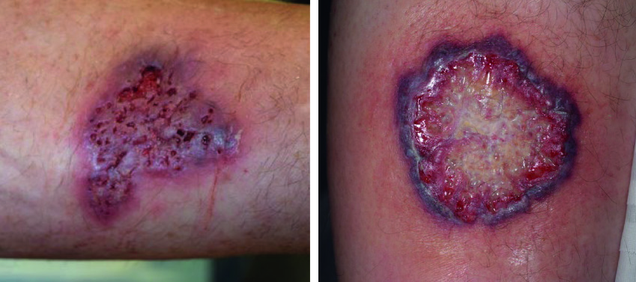
Pyoderma gangrenosum

Slide 27
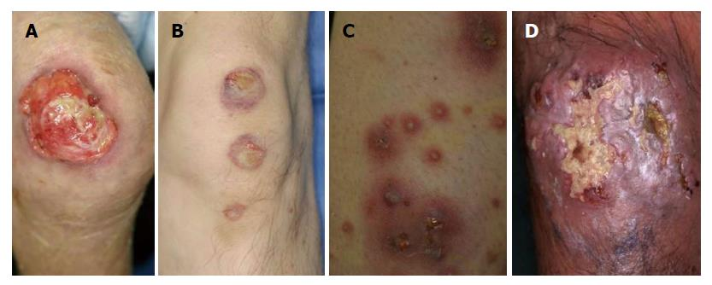

Slide 28
two biopsies (punch or incisional) that include the wound edge (with partial ulcer bed) and the central base

Slide 29
HISTOLOGY
Epidermal ulceration
BUSY DERMIS
Dermal edema in the upper dermis
Dermal neutrophilic & lymphocytic infiltrate
Suppurative granuloma with giant cells
Although vasculitis is not a feature, focal vasculitis is seen in fully developed lesions & is secondary to inflammatory process

Slide 30
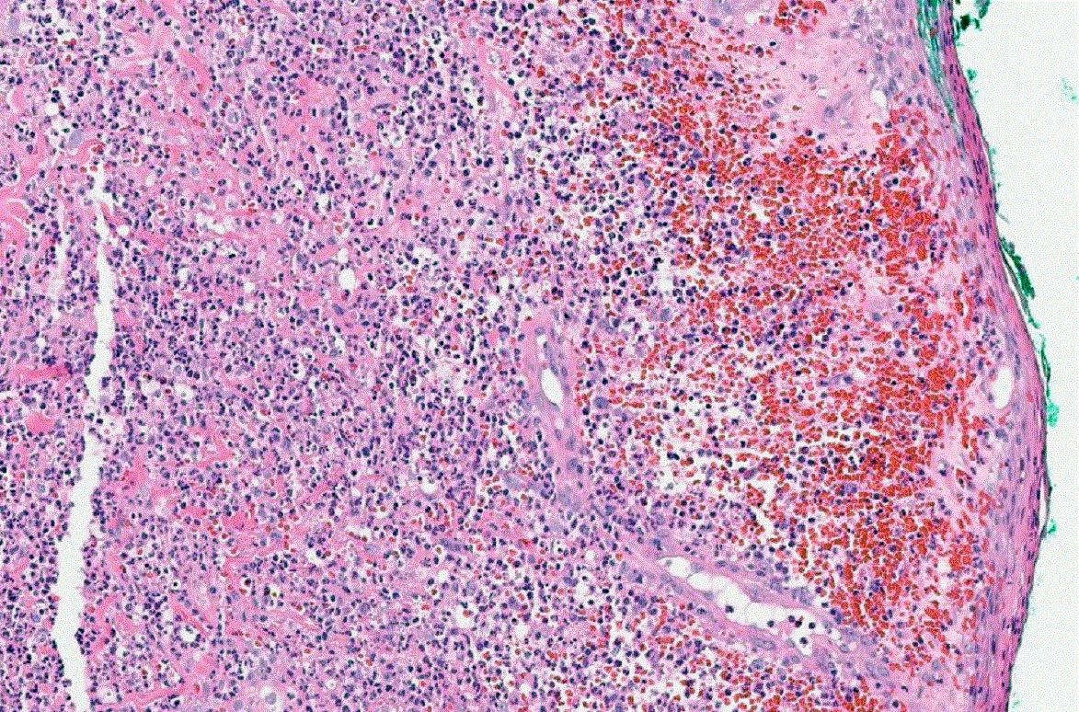

Slide 31
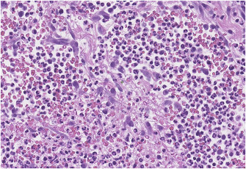

Slide 32
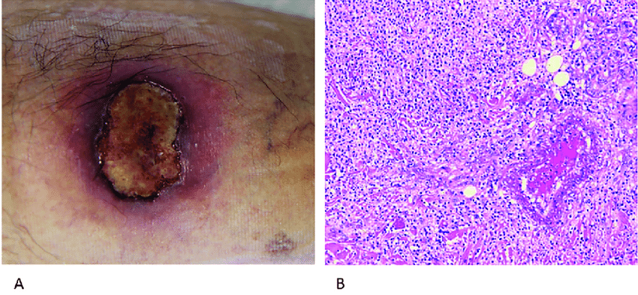

Slide 33


Slide 34
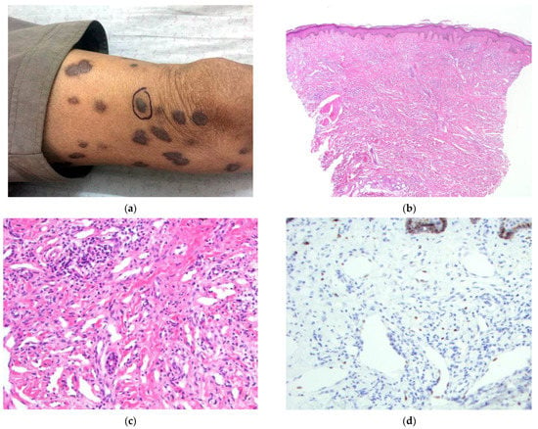
question
a 63-year-old male from Kabul who presented with a five-year history of generalized and increasing violaceous papules and nodules of the trunk and extremities
Physical examination also revealed a lesion of the soft palate and facial hyperpigmentation. HIV testing was negative. The clinical presentation strongly favors which disease..?
Briefly describe the histological features

Slide 35
Q: Which of the following is a feature of early pyoderma gangrenosum biopsies?
A. Eosinophilic pustulosis
B. Epidermal ulceration
C. Neutrophilic folliculitis
D. Subepidermal bullae

Slide 36


