Slide 1
Irritant contact dermatitis
Dr kashmala imam
Pg (mcps dermatology)

Slide 2
Outlines
Definition
Types
Epidemiology
Pathogenesis
Clinical features
Differential diagnosis
Investigations
Management

Slide 3
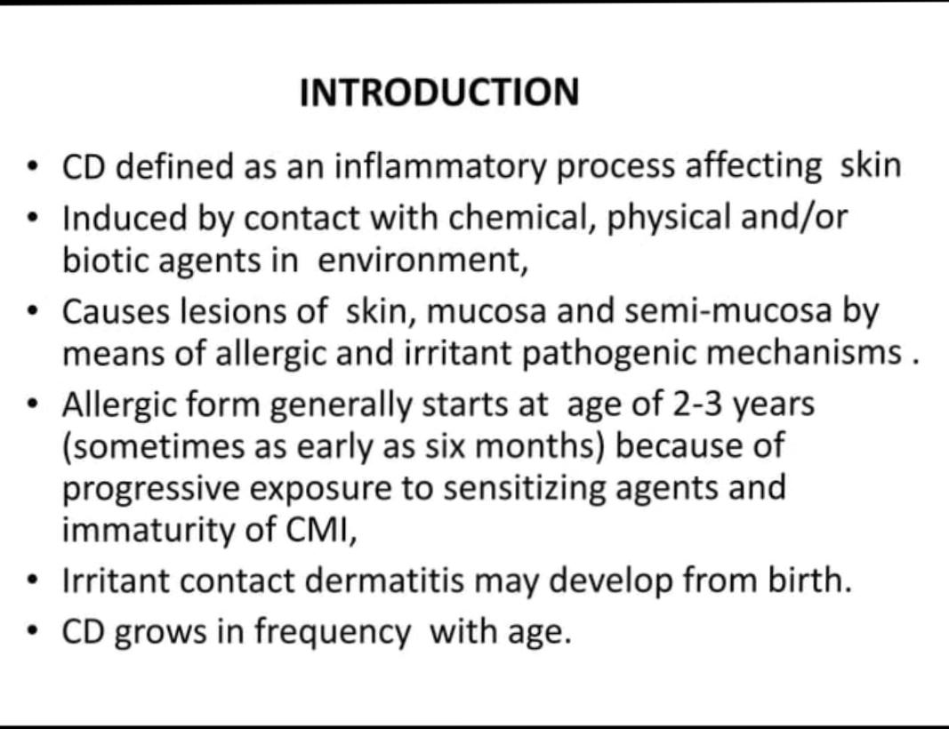

Slide 4
Classification
Irritant contact dermatitis (ICD) (80%)
Irritant contact dermatitis is defined as;A non-immunological local inflammatoryreaction characterized by erythema,edema or corrosion following single orrepeated application of a chemicalsubstance to an identical cutaneous sites".
Allergic contact dermatitis (ACD) (20%)
Inflammation caused by allergen-specific T lymphocytes.• Rapid development of dermatitis occurs following re-exposure tolow concentrations of allergen, not cause lesions in non-sensitizedindividuals

Slide 5
Case scenario
Question
60 year old lady who is domestic cleaner in the hospital. Shepresents with a 4 month history of gradually worseningerythematous rash On dorsal surfaceof hand localized chracterize By burning with associated blisters over her hands. Thereare no other systemic features.patch test negative Given the likely diagnosis Is

Slide 6
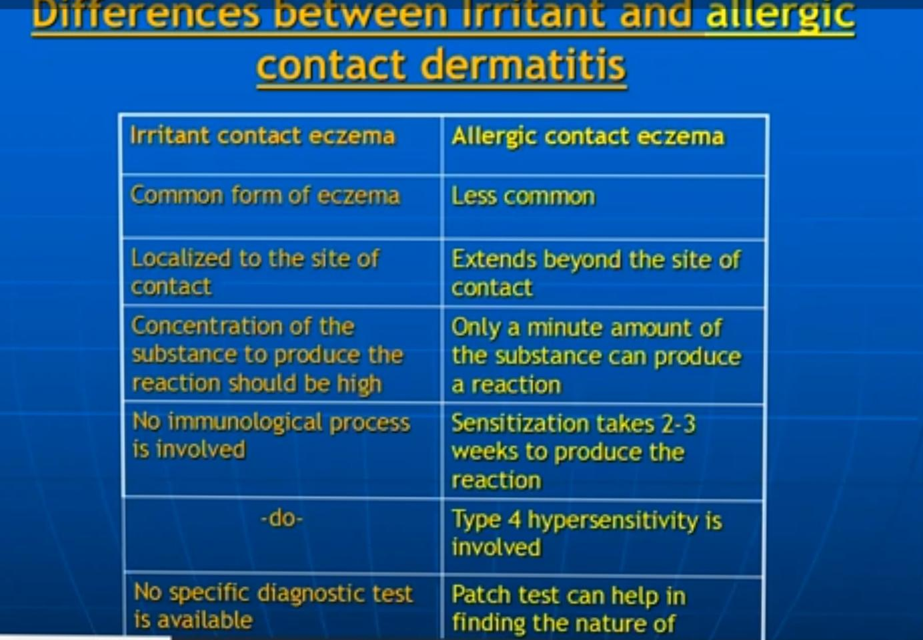

Slide 7
Types of irritant Contact reactions
1. Burns
2. Irritant contact dermatitis:
(a) acute (toxic) irritant contact dermatitis
(b) cumulative irritant/insult contact dermatitis
3. Transient or immediate-type non-immunecontact urticaria
4. Symptomatic (subjective) irritant responses
5. Other: pigmentary and granulomatousresponses and those localized to appendagealstructures.

Slide 8
Pathogenesis of ICD
Denaturation of epidermal keratin
Disruption of the permeability barrier•
Damage to cell membranes•
Direct cytotoxic effects

Slide 9
PathogenesisThe skin barrier▪ The skin provides the first and most importantline of defense against exogenous noxiousagents.■ The surface film is the first line of defense. It iscomposed of sebum emulsified with sweat andbreakdown products from the horny layer.
Mutations in the Filaggrin gene can cause absent or reduced filaggrin protein, leading to impaired keratinization and skin barrier defect

Slide 10
The mechanism of action ofirritants
An irritant is any agent, physical or chemical,which is capable of producing cellular damageif applied for sufficient time and in sufficientconcentration.■ Immunological memory is not involved anddermatitis occurs without prior sensitization.

Slide 11
Dermatitis arises when the defense or repaircapacity of the skin is exhausted.▪ Strong irritants will induce a clinical reaction inalmost all individuals, whereas with less potentirritants dermatitis only developing in the mostsusceptible or in situations where there isrepeated contact with irritants.

Slide 12
Pathogenesis Of icd
In the laboratory, barrier disruption has beenshown to induce interleukin-1a release andupregulation of tumour necrosis factor (TNF)- aand granulocyte-macrophage colony-stimulatingfactor (GM-CSF).■ Detergents acts by destroying lysosomalenzymes in the horny layer, whereas at higherconcentrations they will dissolve cellmembranes and damage lysosomes

Slide 13
Organic solvents such as methanol orchloroform will damage blood vessels causinghyperaemia, and dimethyl sulphoxide (DMSO) isa very effective degranulator of mast cells.■ Irritants affect everyone, although individualsusceptibility with regard to the developmentof dermatitis varies greatly.

Slide 14
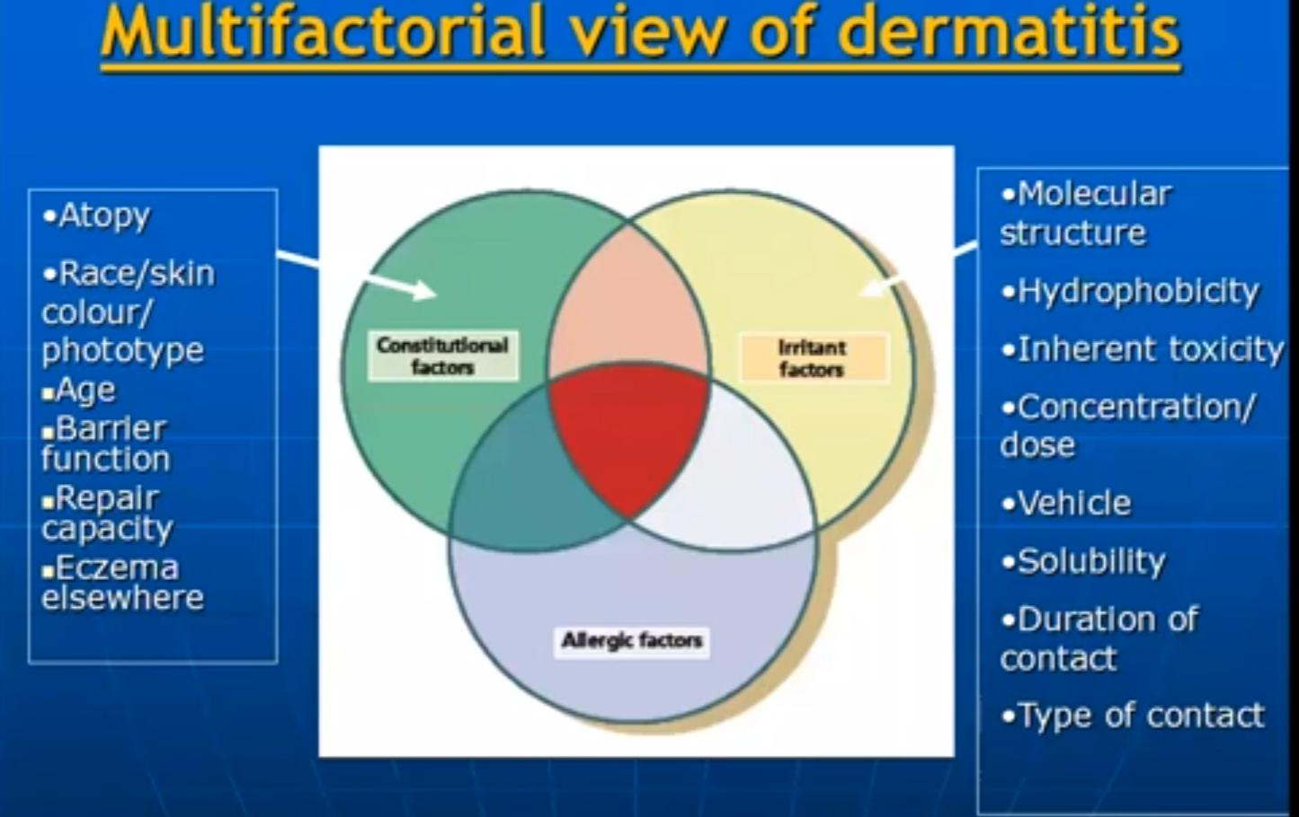

Slide 15
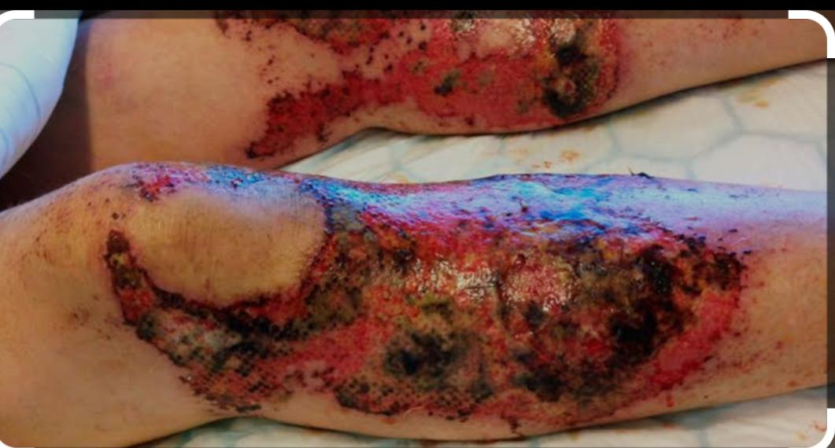
1 burns
Rapid onset of painful erythema, often withinminutes, at the site of exposure, followed byblistering and the development of necroticulcers.▪ Symptoms coincide with the exposure, but withsome chemicals, including phenols and weakhydrofluoric acid, the onset may be delayed.▪ Most acids (e.g. sulphuric, nitric, hydrochloric,chromic) or alkalis (e.g. sodium, calcium,potassium hydroxides, wet concrete; sodiumand potassium cyanides) can cause chemicalburns.

Slide 16
Acute irritant contact dermatitis
• Acute irritant contact dermatitis results from asingle exposure to a strong irritant.This results in acute inflammation of the skinassociated with burning and stinging sensations.The reaction is strictly limited to the site ofapplication of the irritant.There may be transient redness, chapping ofthe skin to edema, Inflammation, pain andvesiculation.. In more severe cases there may be bullaeformation and tissue necrosis.

Slide 17
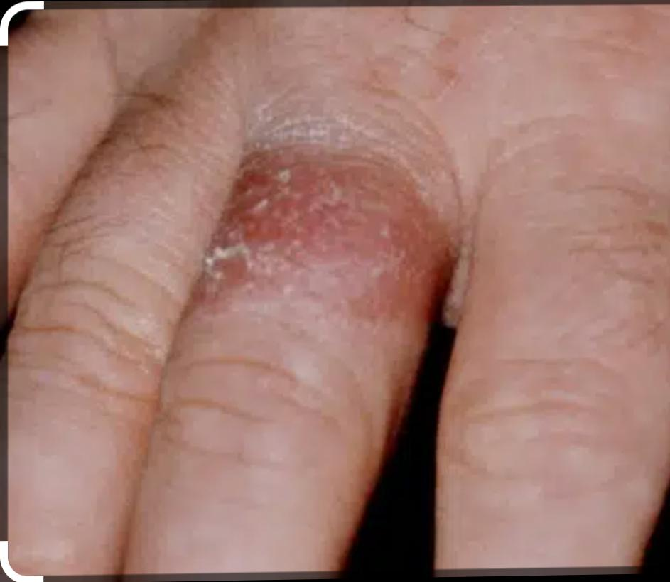
Cumulative /chronic irritant contact dermatitis
Cumulative irritant contact eczema mostly effectsthe thin exposed skin over dorsa of the hands andthe web spaces and face and eye lids.. It presents with localized patches of dry, slightlyinflamed or chapped skin.. This reaction is increased under occlusion, onmucosal surfaces, in low humidity and in extremeof weather.

Slide 18
Transient /immediate Type
some chemicals will cause painful sensationswithin seconds of contact.These include acids, chloroform, methanol &95% ethanol.The sensation abates quickly following removalof the irritant substance.

Slide 19
Delayed type of dermatitis
typically, there is no immediate stinging, butdiscomfort develops within 1-2min, reaches amaximum in 5-10min, and fades slowly over thenext half hour.Example; phenol, salisylic acid, aluminiumchloride, sodium hydroxide, benzyl peroxide.• Sensation is not alleviated by washing off theoffending chemical.

Slide 20
Symptomatic (subjective) type
irritantresponsesWith some irritants there is little or nothing tosee, but individuals complain of a subjectivesensation of stinging, burning or smarting.

Slide 21
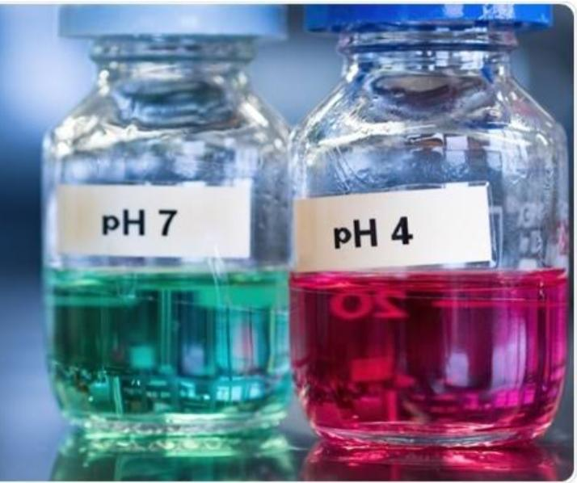
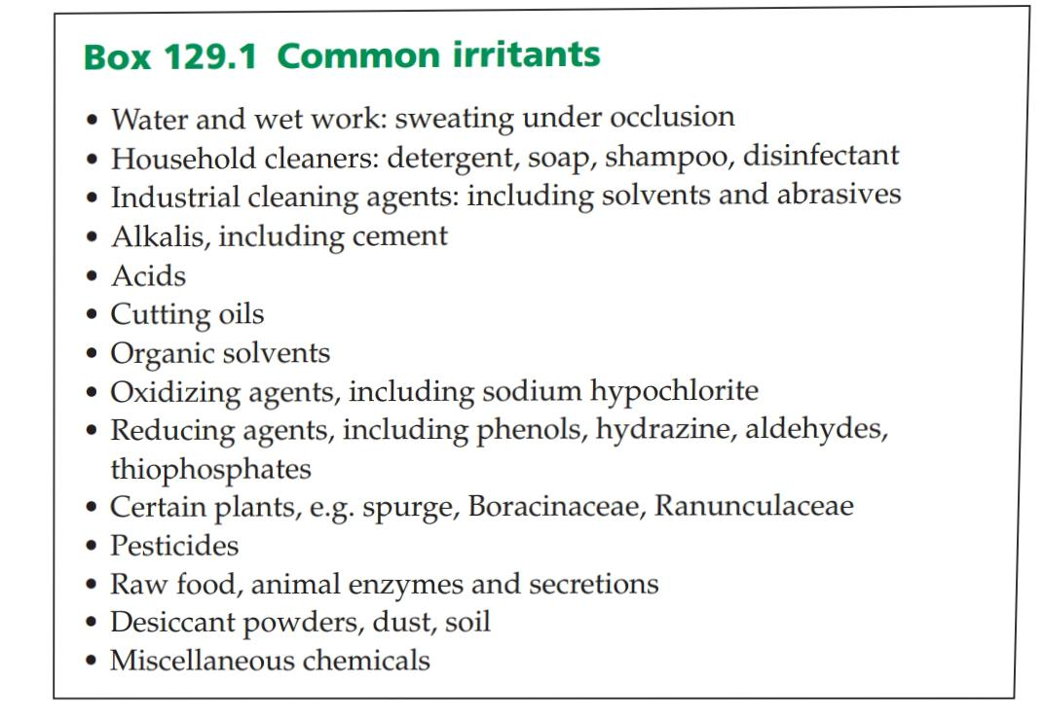


Slide 22
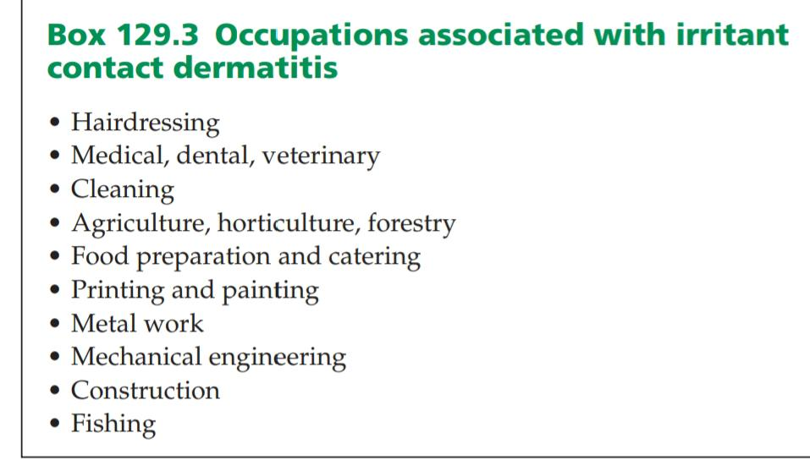
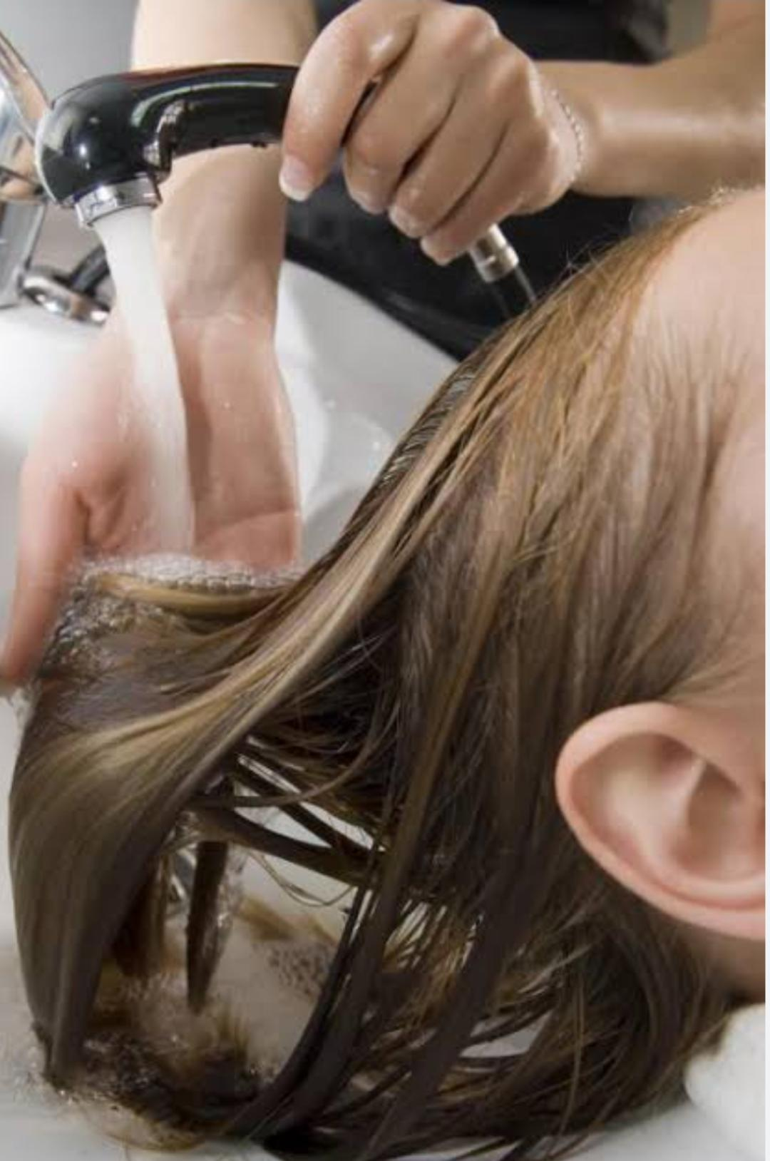
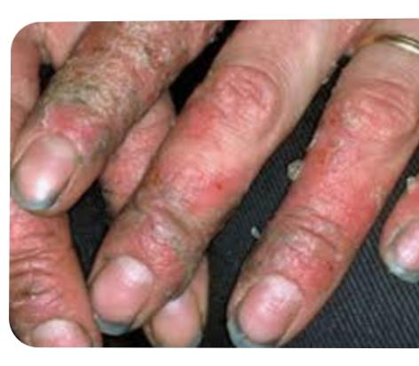

Slide 23
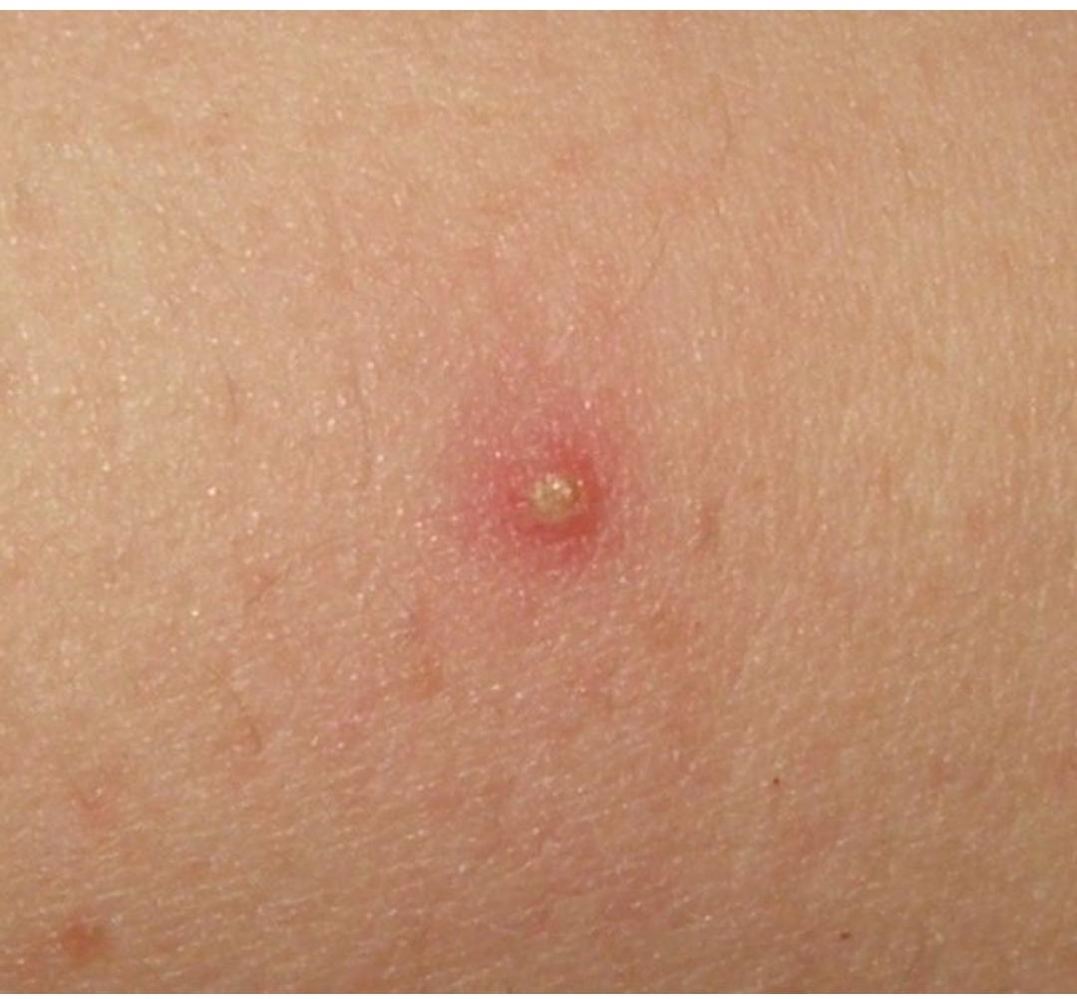
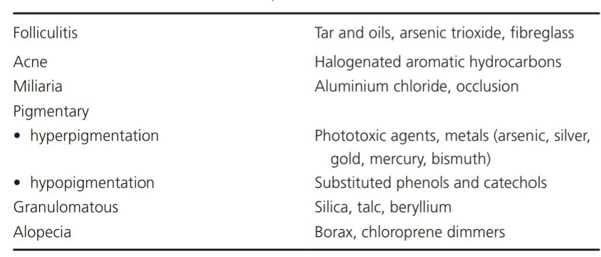
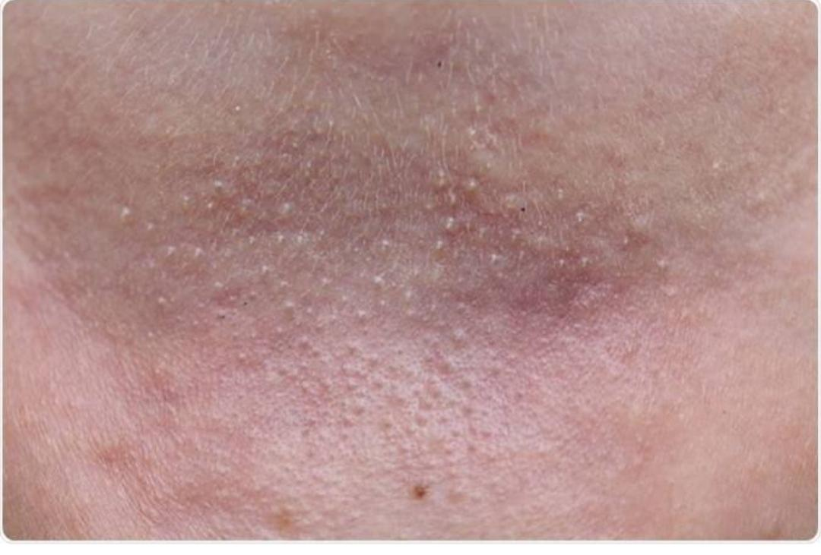
Other irritant responses

Slide 24
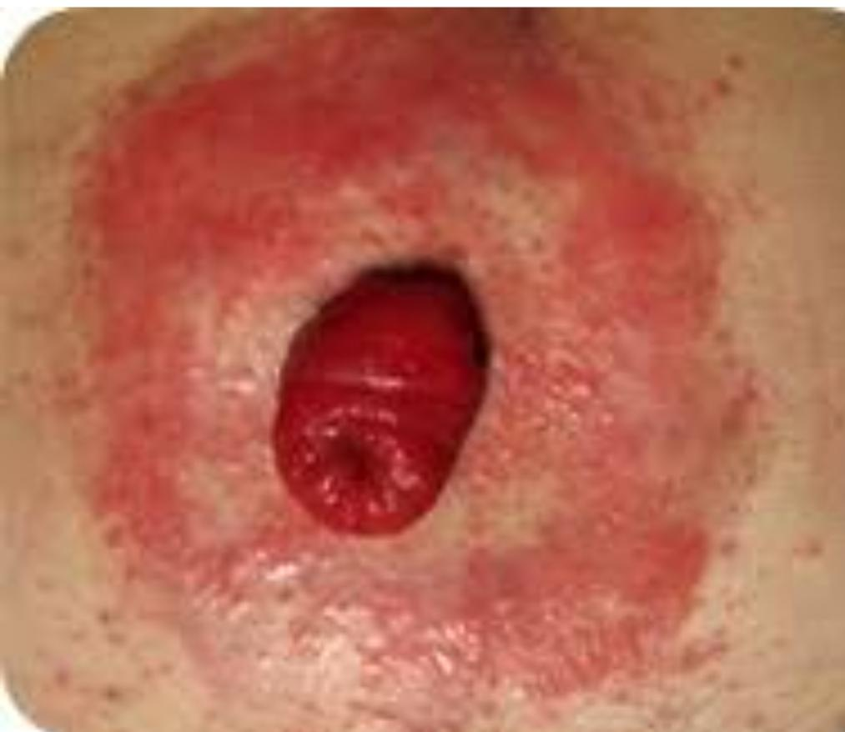
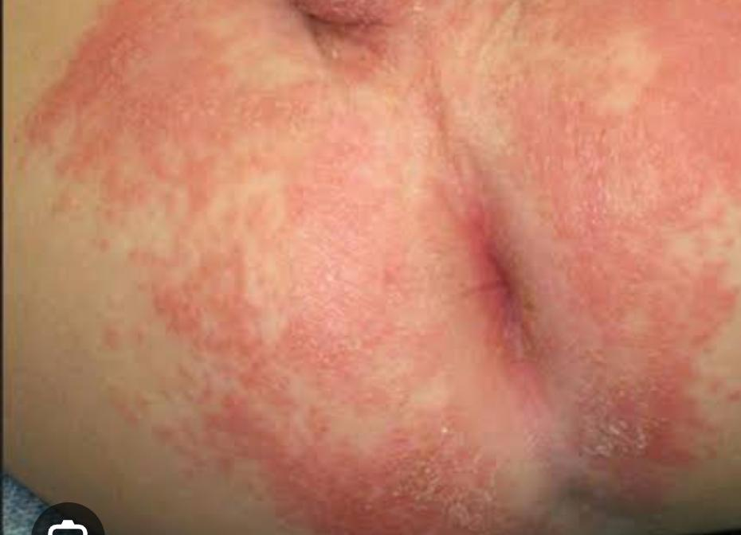
Napkin (diaper), peristomal and perianal dermatitis

Slide 25
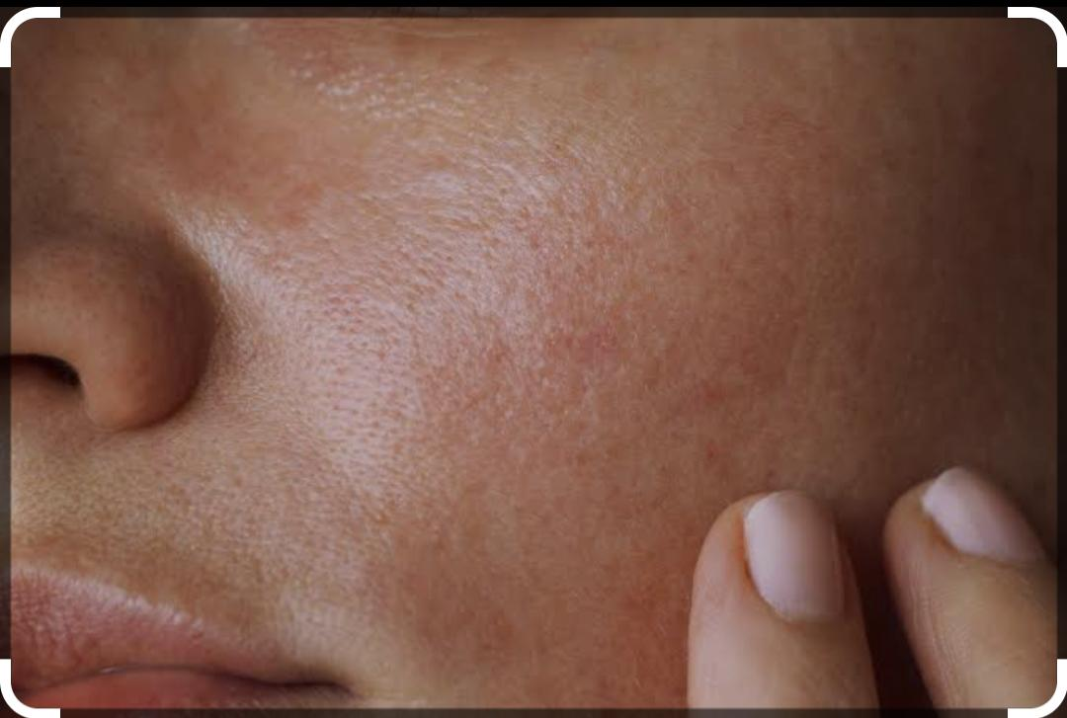
Cosmetic Dermatitis
Cosmetics.
ToiletrieS
.Skin care product, includingsunscreens■ In most cases, these are only mild or transient,and most consumers simply change to analternative product.■ The eyelids are particularly susceptible toirritants.■ Allergy is only excluded by comprehensivepatch testing to both product and ingredients.

Slide 26
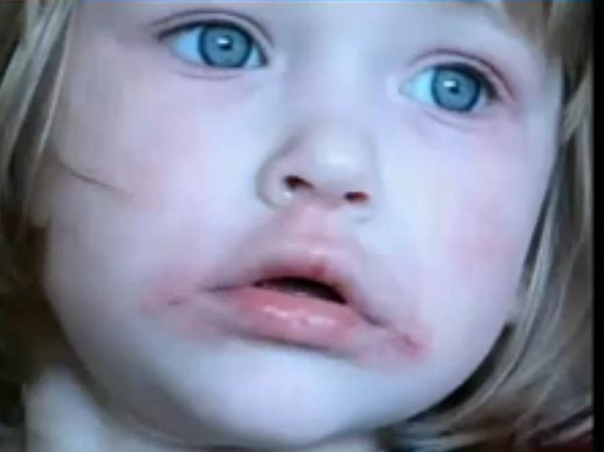
Cheilitis
Cheilitis is a common problem, often ofmultifactorial aetiology.▪ Atopic eczema frequently predisposes to itsdevelopment.■ The most common identifiable causes ofcheilitis are irritant dermatitis, due to liplicking, cosmetics and medication.

Slide 27
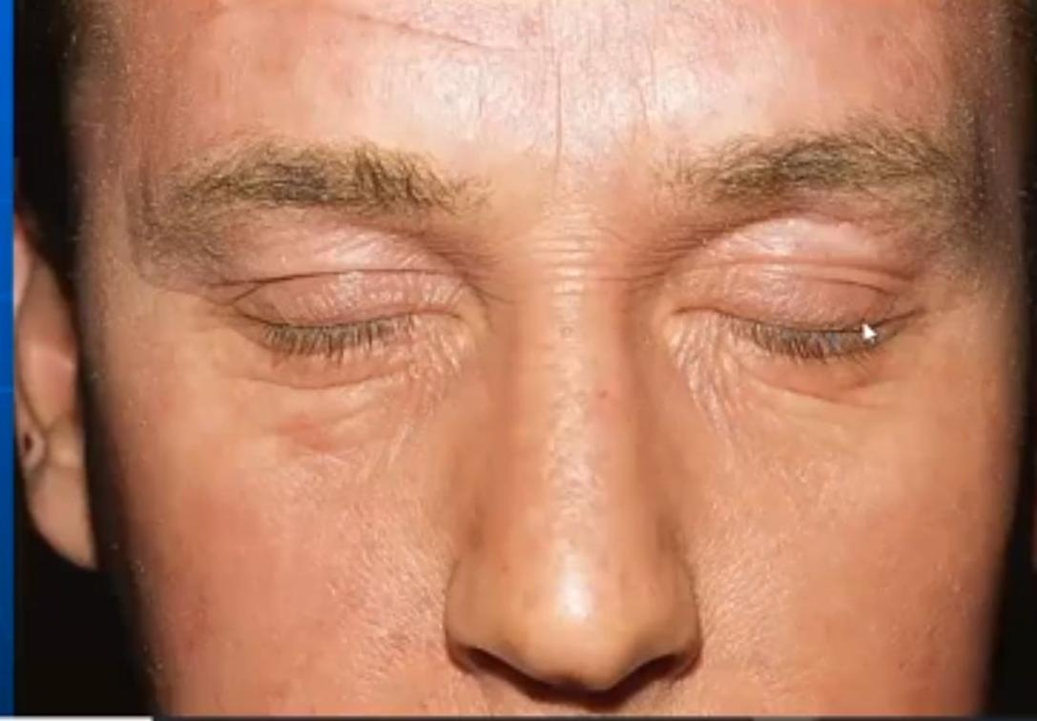
Volatile irritant contact dermatitis
Irritants, as well as allergens, may cause volatile contact dermatitis[29]. Volatile irritants are a not infrequent cause of eyelid dermati-tis. In any exposed-site dermatitis, one should consider the possi-bility of irritant volatile fumes or airborne particles. The fumes canbe from acids, alkalis, solvents, resins or any other irritant chemi-cal, such as ammonia or formaldehyde. Irritant dusts include thoseof some (mostly tropical) woods, cement, fibreglass or rockwool,some metals and metal salts, and powdered chemicals.

Slide 28
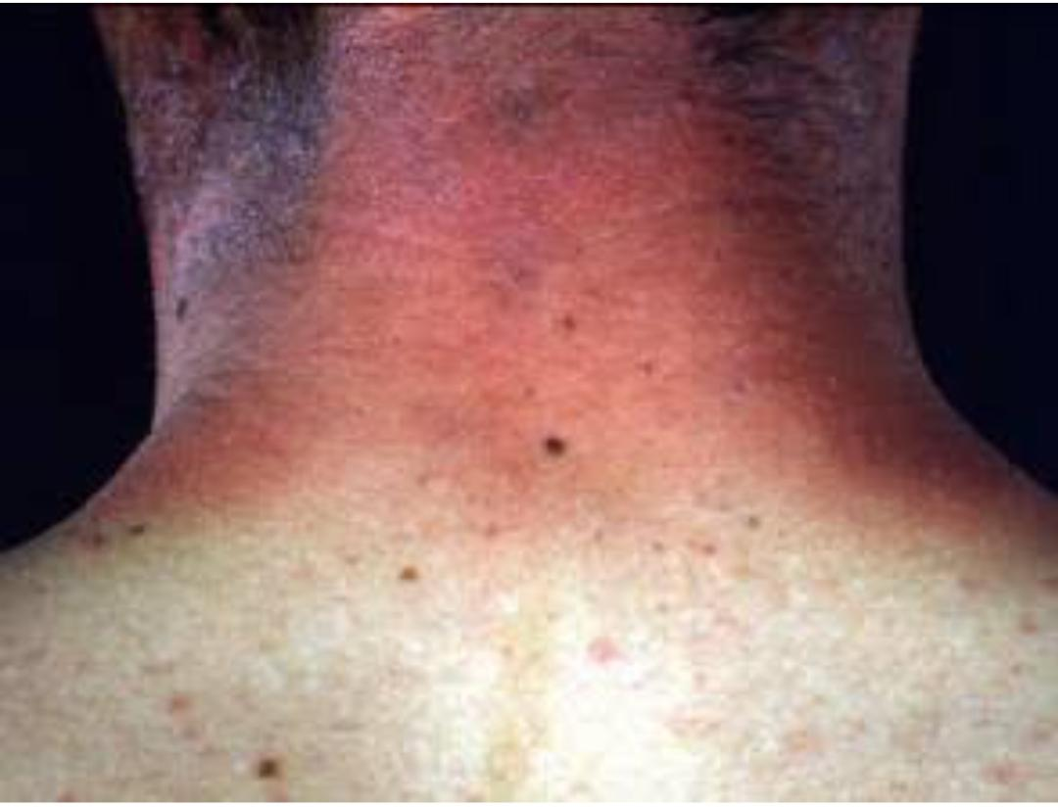
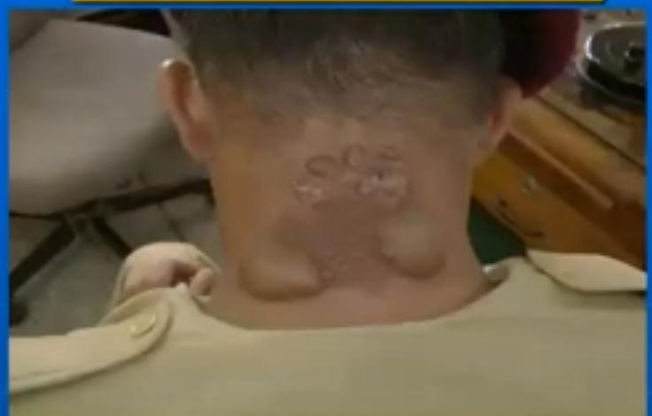
Photo toxicity
PhototoxicityA number of chemicals only cause irritation afterabsorption of photons; the photoactivated chemical hasaltered properties which are directly tissue damaging.■ They include psoralens, porphyrins, tetracyclines, non-steroidal anti-inflammatory drugs, phenothiazines andamiodarone.

Slide 29
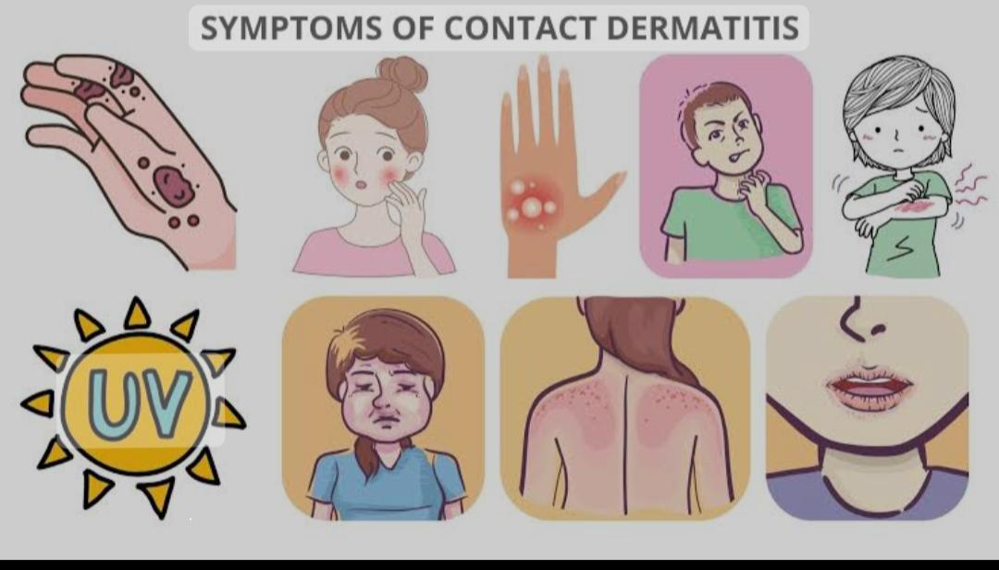
Sign and symptoms
Redness
Itching
Burning sensation
Stinging
Pain
Blisters
Swelling
Crusting

Slide 30
Differential diagnosis
Allergic contact dermatitis
Atopic eczema
Contact urticaria
Thermal injury

Slide 31
Investigation
• Diagnosis of CD depends on:
- Patient history
,- Clinical examination,-
Exposure assessment (including hazard identification,estimation of dermal exposure and
riskcharacterization),-
Analysis of all predisposing and contributory factors,- Comprehensive diagnostic testing.

Slide 32
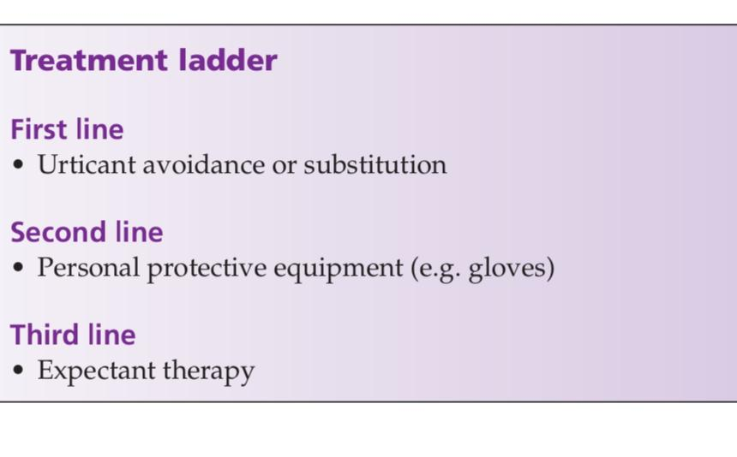
Management
Prevention
Identification of the susceptible individual andappropriate career advice
.m Mechanization: increased use of mechanizationfor wet or irritant work, will help to reduce the incidence of irritant contact dermatitis.
Personal protective equipment: Theprotective aspect of gloves outweigh anypotential to induce dermatitis.
Barrier creams /emollients
Soap substitutes
Use of shampoos conditioners and hair products with gloves

Slide 33
Treatment
Treatmet depend on type of irritant involved
Chemical burns.wash with Large volume of lukewarm water and soap if needed Ovoid high pressure or spLasing Use of antidotes in some chemicals eg 2.5% calcium gluconate gel for HydroFlouric Acid.
To prevent systematic absorption Debridement Of necrotic tissue with regular blood test
Ulcerated areas .use of antibacterial Creams to ovoid secoNdary Infection

Slide 34
Anti histamine to reduce itching
Creams and emollients To prevent dryness
Topical corticosteriods To reduce inflammTion

Slide 35
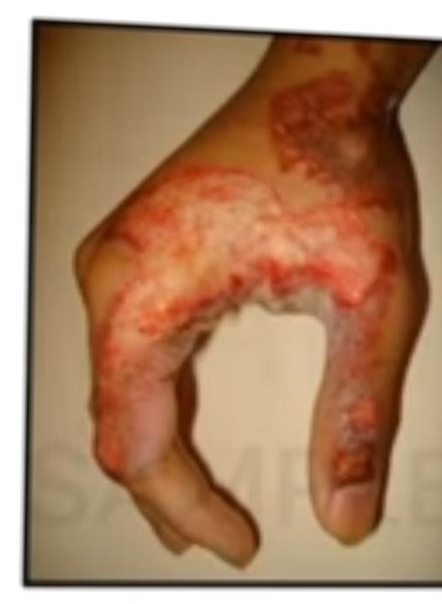
Case scenario
35 year old male presented with complain Of well Demarcated lesion on one
hand with history of burn due to acid with no other sites involved
Diagnosis?

Slide 36
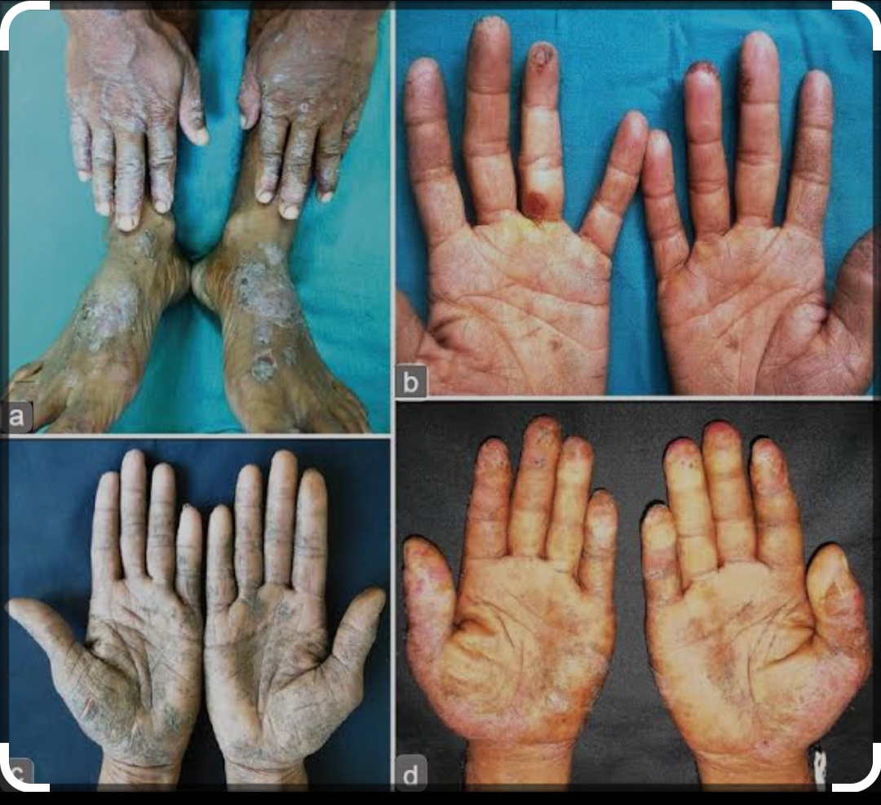
Case
40 year old male working at construction site developed
Lesion on foot without systematic signs cause of lesion?

Slide 37
False about ICD
A.Sensitization is not required
.bIt can occur in anyone without predisposing factor
.C it is a delayed type of hypersensitivity
D.Due to direct toxic effects of a strong chemic

Slide 38
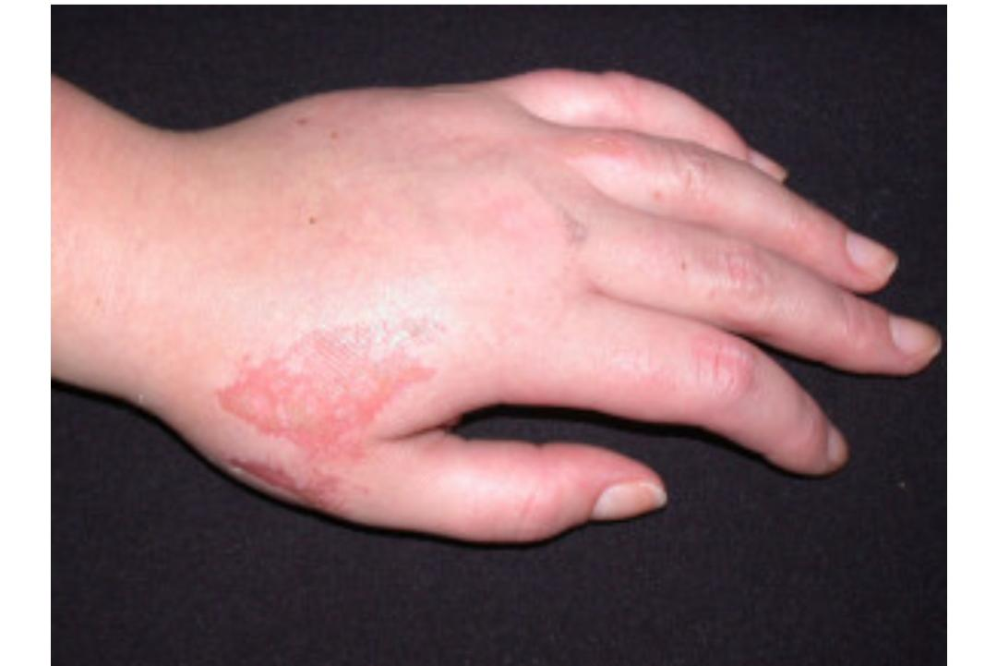
An apprentice hairdresser presented with odd-looking erosion on the dorsum of her hand; this appearance is characteristic of?

Slide 39
Thank you
Sourced
by Rooks book of dermatology
Medscape

