Slide 1
INHERITED METABLOIC DISEASES
DR. SOHAIL SHAHEEN

Slide 2
CONTENT
LYSOSOMAL STORAGE DISORDERS
MITOCHONDRIAL RESPIRATORY CHAIN DISORDERS
GLYCOSYLATION DISORDERS
AMINOACID METABOLISM DISRODERS
CHOLESTEROL SYNTHESIS DISORDERS
OTHERS

Slide 3
INTRODUCTION
INBORN ERRORS OF METABOLISM
CAUSED BY DEFECIENCIES OF ENZYMES OR TRANSPORT PROTIENS

Slide 4
LYSOSOMAL STORAGE DISORDERS
Deficencies of hydrolases leading to accumulation of various molecules in Lysosomes

Slide 5
MUCOPOLYSACCHARIDOSIS
The Mucopolysaccharidoses (MPSs) are a family of inherited multisystem disorders caused by defects in the degradation of glycosaminoglycans, which accumulate within lysosomes.

Slide 6
PATHOPHYSIOLOGY
GAGs:
  Long Sugar Chains containing sulphated residues.
  When bound to core protein → proteoglycans
  E.g Dermatan Sulphate, Heparan Sulphate, Keratan Sulphate. They accumulate in MPS
All MPS Disorders are AR Except Hunter Syndrome which is X-Linked

Slide 7
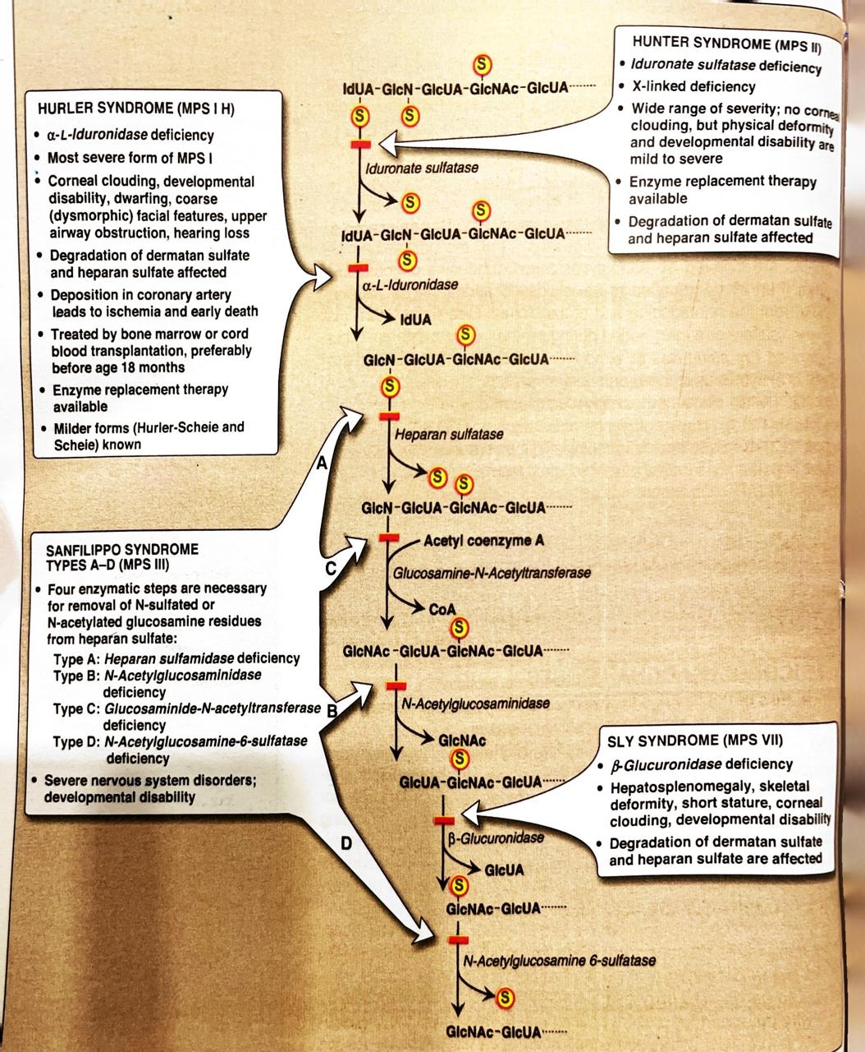

Slide 8
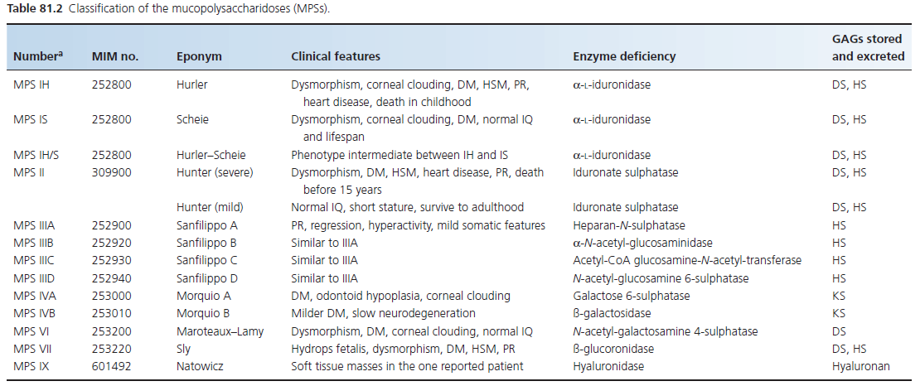

Slide 9

CLINICAL FEATURES
Early childhood with developmental delay, deafness and upper airway problems; a few patients present with skeletal or cardiac problems
Dysmorphism: Course Facial features.
  Hypoplasia of the mid‐facial bones leads to a flat nasal bridge.
  The skin is thickened, as are the lips, and the tongue is enlarged
  Generalized Hypertrichosis with synophrys
  Corneal Clouding

Slide 10
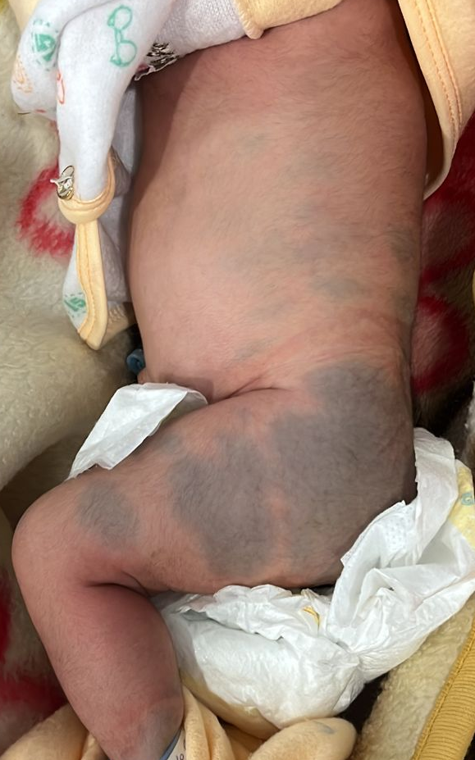
Skin Findings:
  Ivory white papules or nodules are often seen on the back of patients with severe MPS II (Hunter syndrome)
  The papules appear at 1–4 years of age and progress for a few years; they may clear spontaneously in older patients
Extensive Mongolion Spots:
  common in Hurler and Hunter syndromes
  in addition to the sacro‐coccygeal region, they may be found on the upper back, the anterior trunk or the limbs.
  The spots fade more slowly than in the general population

Slide 11
CLINICAL FEATURES
DEVELOPMENTAL REGRESSION:
Period of hyperactivity, behavior problems and sleep disturbance, patients gradually deteriorate into a vegetative state. Common in MPS III
Learning difficulties
DYSOSTOSIS MULTIPLEX:
Very short stature and joint laxity leading to arthritis of the hip and knee and a risk of atlanto‐axial dislocation. Common in MPS IV
OTHER FEATURES:
ENT infections, upper airway obstruction and deafness are common.
Valvular heart disease is often the cause of death.

Slide 12
INVESTIGATIONS
Urine for GAGs by 2D- Electrophoresis
Enzyme assays in leukocytes, plasma cells and fibroblasts
Mutation Analysis

Slide 13
HISTOLOGY
Pale Cytoplasm in Malpighian cells
Cytoplasmic Metachromasia of fibroblasts, Schwann Cells, SM and Sweat Gland Cells
Fragmentation of Collagen and increased Mucin
Cytoplasmic Vacoules which contain fibrogranullar material

Slide 14

MANAGEMENT
Symptomatic Treatment
HSCT for Hurler Syndrome
Enzyme replacement therapy available for MPS I, II, IV, VI

Slide 15
GLYCOPROTEIN DEGRADATION DISORDERS

Slide 16

GLYCOPROTIEN DEGRADATION DISRODERS
Oligosaccharide Component is degraded by hydrolases of lysosomes
Enzyme deficiency leads to accumulation
All are autosomal recessive
Abnormal Oligosaccharides in urine by TLC
Enzyme Assays
Cytoplasmic vacuoles on electron microscopy
Can be Managed by Symptomatic, HSCT, ERT

Slide 17
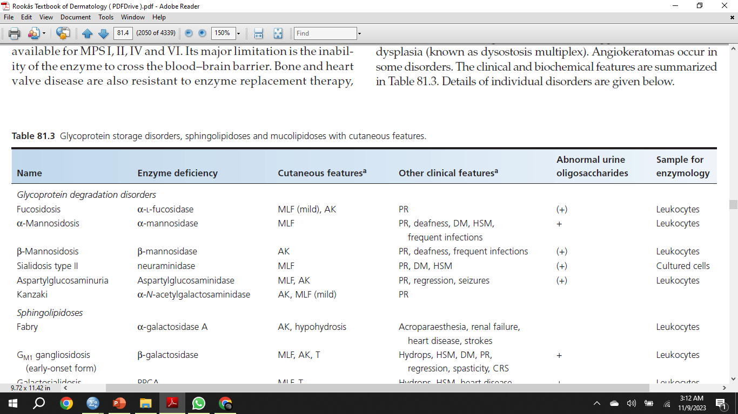

Slide 18
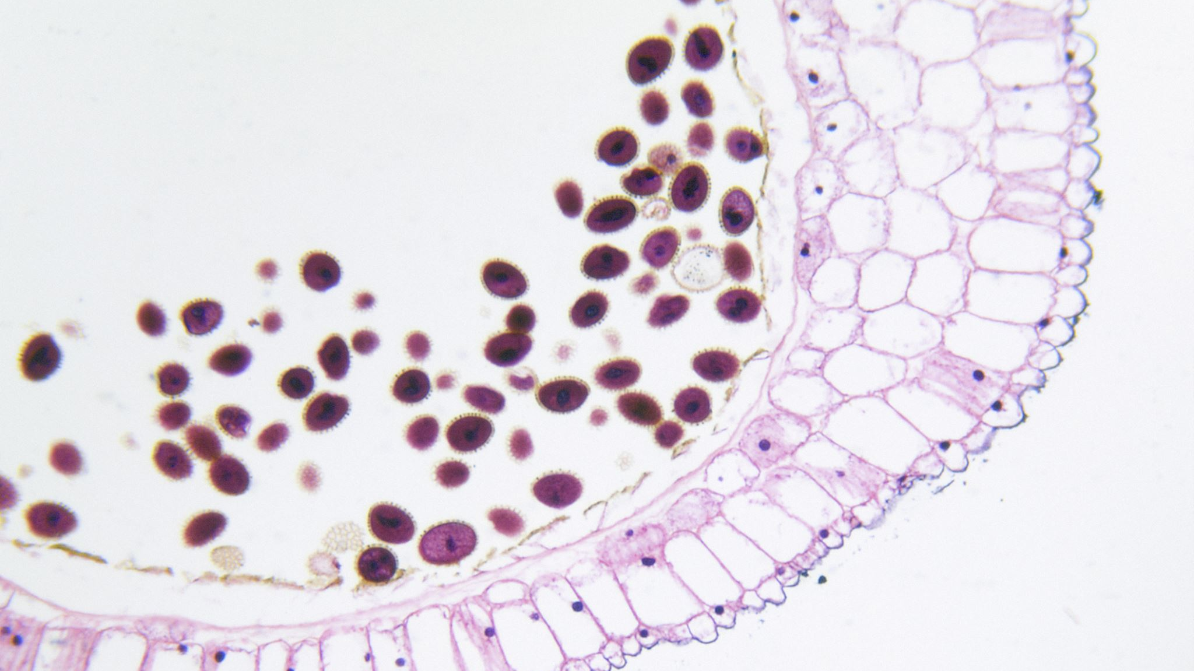
MUCOLIPIDOSES
AR Disorders
Enzymes fail to enter their organelle
Raised mis-target lysosomal enzymes in Plasma
Dense inclusion bodies in cells on histology
Only Symptomatic treatment is available

Slide 19
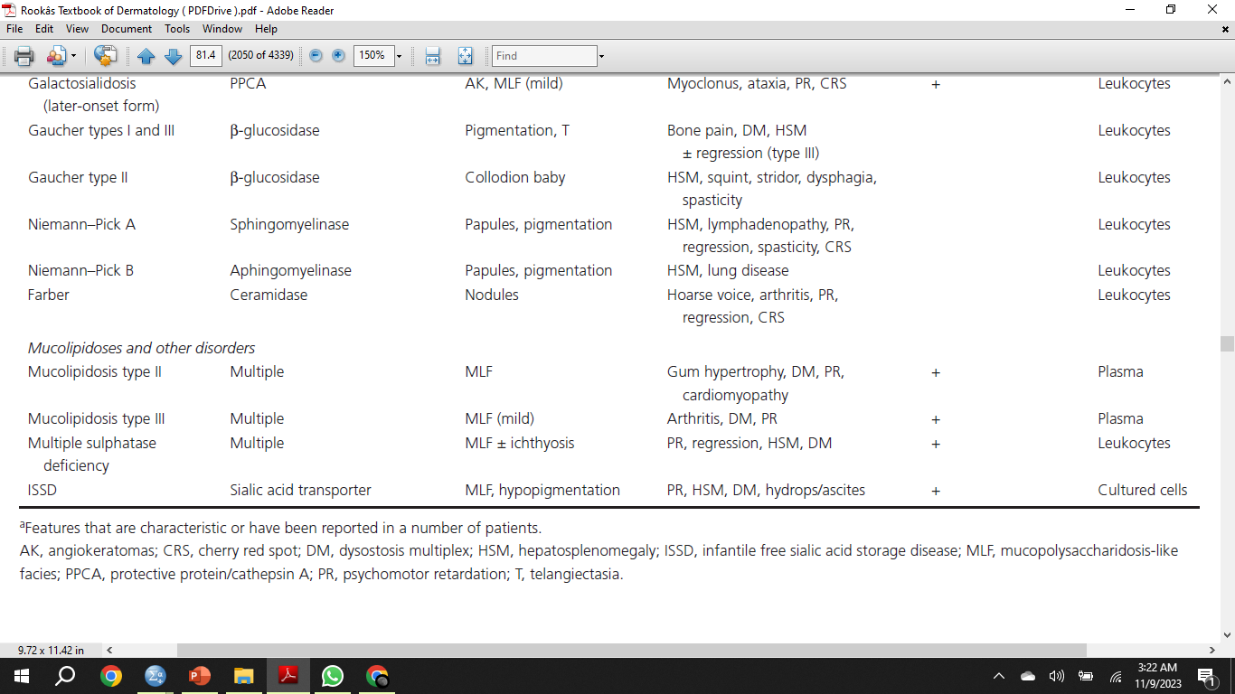

Slide 20

SPHINGOLIPIDOSIS

Slide 21
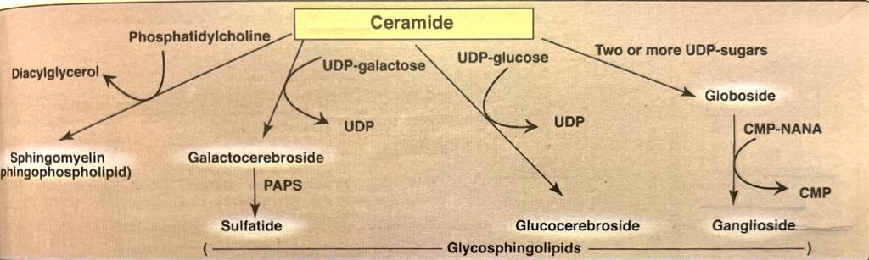
INTRODUCTION
Molecules containing Ceramide
Found in nerve membranes
Degraded by lysosomal hydrolases
Deficiency of enzymes involved in degradation results in Sphingolipidosis
All are AR except Fabry Disease which is X-Linked

Slide 22
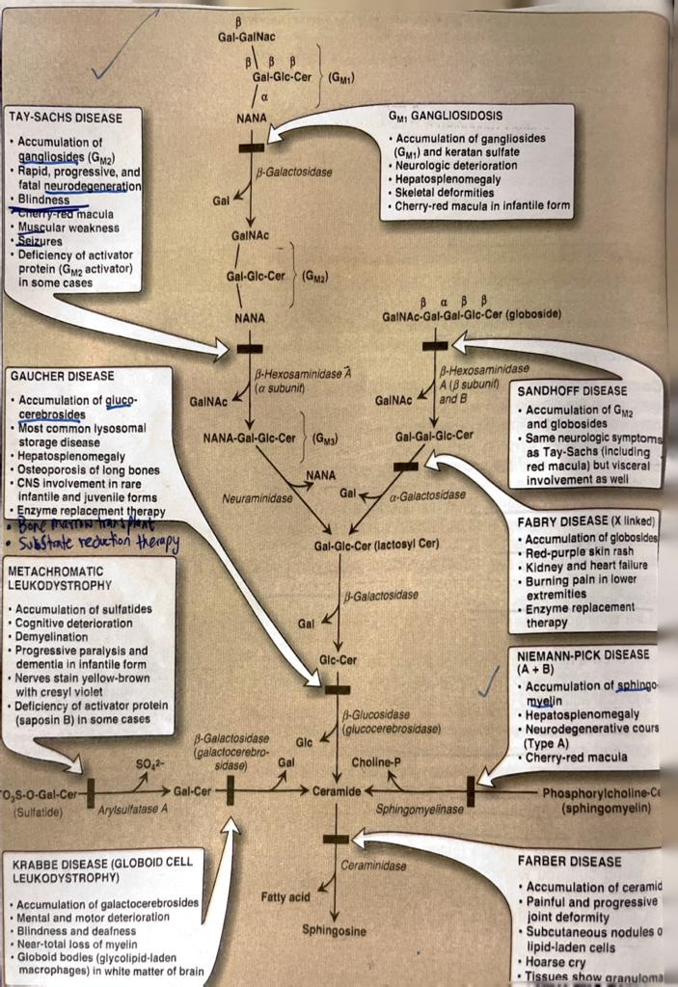

Slide 23
GM1 GANGLIOSIDOSIS
Very Rare
Hydrops, Hypotonia, HSM, Facial Dysmorphism
Neurodegeneration
Angiokeratomas
Telangiectasia and Extensive Mongolian Spots

Slide 24
GALACTOSIALIDOSIS
Extremely Rare
Combined Defeciency of neuraminidase and B-Galactosidase
Resemble GM1 Gangliosidosis.
Mild MPS like features, neurodegeneration, AKs

Slide 25
GAUCHER DISEASE
Most prevalent Lysosomal Disorder
THREE TYPES
TYPE I: ( non-neuropathic )
children or adults with hepatosplenomegaly, thrombocytopenia (due to hypersplenism) bone problems (ischaemic crises, bone pain or pathological fractures)
TYPE II: ( Acute Neuropathic )
6 months of age
neurological problems (squint, dysphagia and opisthotonus),
poor weight gain and hepatosplenomegaly
most die by 2 years.

Slide 26
GAUCHER DISEASE
TYPE III: ( Subacute neuropathic )
young children
hepatosplenomegaly, followed by an eye movement disorder and other neurological problems
CUTANEOUS FNDINGS:
Diffuse yellow pigmentation
Easy Tanning, Brown Macules, Telengiectasias
In few Type II → Collodion Baby

Slide 27
NIEMANN-PICK DISEASE
Sphingomyelinase Deficiency
TYPE A: ( Neuropathic )
presents in early infancy with diarrhea and vomiting, poor weight gain, hepatosplenomegaly and neurological problems;
patients die by 3 years of age
TYPE B: ( Non neuropathic )
children or adults with hepatosplenomegaly;
complications include interstitial lung disease, poor growth, hyperlipidemia and thrombocytopenia
SKIN:
patches of waxy induration and brownish yellow pigmentation.
Papular, papulonodular or suppurative lesions may be found on the face or trunk, occasionally becoming confluent

Slide 28
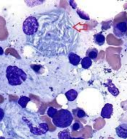
INVESTIGATIONS
Enzyme Assays on leukocytes
HISTOLOGY:
  Foam Cells in bone marrow and skin
  Niemann-Pick Cells are large, usually mononucleate histiocytes, whose cytoplasm is filled with lipid droplets
  Gaucher Cells large cells with pale‐staining cytoplasm that has a delicate, striated, ‘wrinkled tissue paper’ appearance

Slide 29
MANAGEMENT
ERT for Fabry Disease and Gaucher Disease Type I
HSCT
Miglustat; oral, decreases accumulation of glucocerebrosides

Slide 30
FABRY DISEASE
DEFICIENCY OF GALACTOSIDASE-A

Slide 31
FABRY DISEASE
X-LINKED Recessive
Prevents degradation of Gb3. accumulation in vascular endothelial, perithelial and smooth muscle cells leading to aneurysmal dilatation of blood vessels, ischaemia and infarction.
Also accumulate in the renal glomeruli and tubules, cardiac muscle, autonomic ganglion cells and corneal epithelium

Slide 32
CLINICAL FEATURES
ACROPARESTHESIAS:
Severe burning pain in palms and soles
5-15 Years
ANGIOKERATOMA CORPORIS DIFFUSUM:
Dark red telangiectatic macule or papule
Does not blanch
Clustered. Around umbilicus, inner thigh, lower back, buttocks, penis and scrotum
Telengiectasias on buccal mucosa, ears, lips and conjunctiva
ANHIDROSIS OR HYPOHIDROSIS
VASOMOTOR DISTURBANCE:
Flushing, cyanosis, blanching of hands

Slide 33
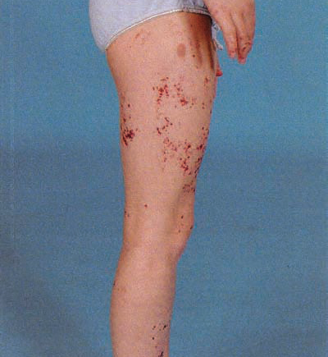
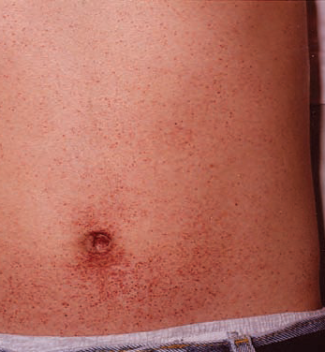

Slide 34
COMPLICATIONS
Cardiac Complications
Renal Function Detorioration
Early Strokes
Vertigo, dizziness and hearing loss
PROGNOSIS: 50 years life expectancy

Slide 35
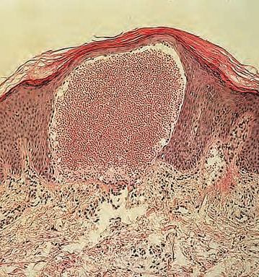
INVESTIGATIONS
SKIN HISTOLOGY:
  Angiokeratomas show dilated vessels in papillary dermis beneath thinned epithelium
  Vacuolated cells in media, intima of vessels.
  Accumulation of sphingolipids appear as ‘Maltese Crosses’ in polarized light
  Electron Microscopy shows electron dense and lamellar inclusion bodies

Slide 36
INVESTIGATIONS
2. SLIT LAMP EXAMINATION:
Cornea Verticilata; whorled streaks in cornea
Lens Opacity
3. Enzyme assay in leukocytyes, plasma cells and cultured fibroblasts

Slide 37
MANAGEMENT
ACROPARESTHESIAS:
1
Carbamazepine, Gabapentin, Phenytoin or Opiate
ANGIOKERATOMAS:
2
Laser therapy
CARDIAC and RENAL COMPLICATIONS
3
Aspirin, ACEI,
Dialysis, renal transplantation
ENZYME REPLACEMENT THERAPY
4

Slide 38
PHOSPHOMANNOMUTASE 2 DEFECIENCY
Inherited disorder of Glycosylation of cell surface proteins
Subcutaneous Fat pads esp over iliac crest, with lipodystrophy
Disappear later in life
Loose folds, thick skin. Peau’d orange appearance
Inverted nipples
Large dysplastic ears and long fingers and toes
PR, feeding problems
Diagnosed by Transferrin isoelectric focusing

Slide 39
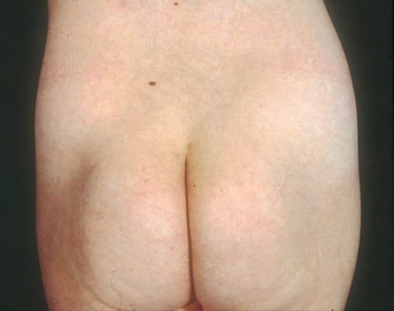

Slide 40
DISORDERS OF AMINOACID METABOLISM
Deficiency or Accumulation of of amino acids

Slide 41
PHENYLKETONURIA
High Blood PhenylAlanine concentration
Defect in Phenylalanine Hydroxylase. PA → Tyrosine cannot occur. AR
PR, Behaviour Problems, seizures
Eczemas
Decreased Pigmentation of hair, skin and iris
Diagnosed by neonatal screening and Plasma amino acid levels
Managed by Restriction of dietary phenylalanine. In pregnancy as well.
Semi synthetic diet having all aminoacids except phenylalanine
Tetrahydrobiopterin; drug that can lower PA levels

Slide 42
TYROSINAEMIA TYPE 2
Deficiency of Tyrosine aminotransferase. Catalyzes tyrosine degradation
EYE:
Photophobia
Red with lacrimation
Dendritic corneal ulcers
Corneal scarring
Glaucoma
SKIN:
Painful hyperkeratotic plaques on palms and soles esp at tips
Learning difficulties, agggresive beahviour
Investigation: plasma tyrosine concentration
Management: Special Diet

Slide 43
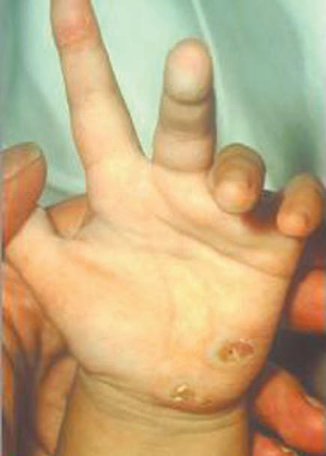

Slide 44

ALKAPTONURIA
Deficiency of Homogentisate dioxygenase. Involved in tyrosine degradation
Accumulation of Homogentasic Acid and its oxidized derivatives, polymerized to form dark pigment which gets deposited in different tissues
Low back pain, kyphosis → ankylosis
Arthritis of hip, knee,
In childrens, Urine gets darker with time
Ochronosis: Melanin-like black pigmentation. >30 years of age
Ear cartilage develop blue-black discolouration
Pigment may also be present in sclera, buccal mucosa, nails
Dusky discolouration of cheeks, forehead, axillae and groins

Slide 45
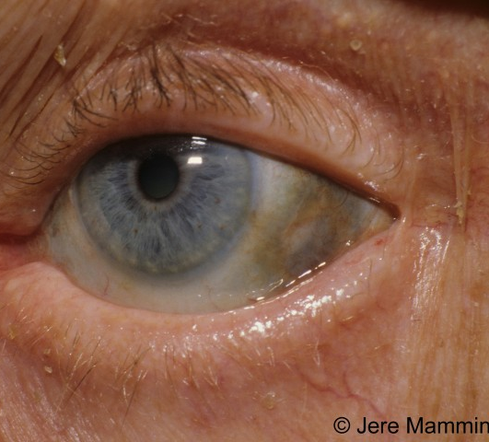
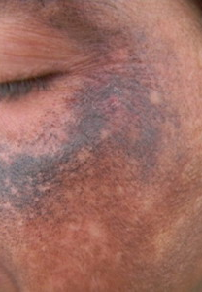

Slide 46
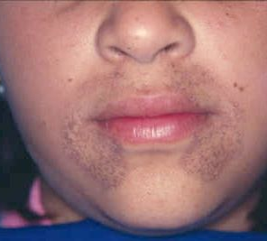
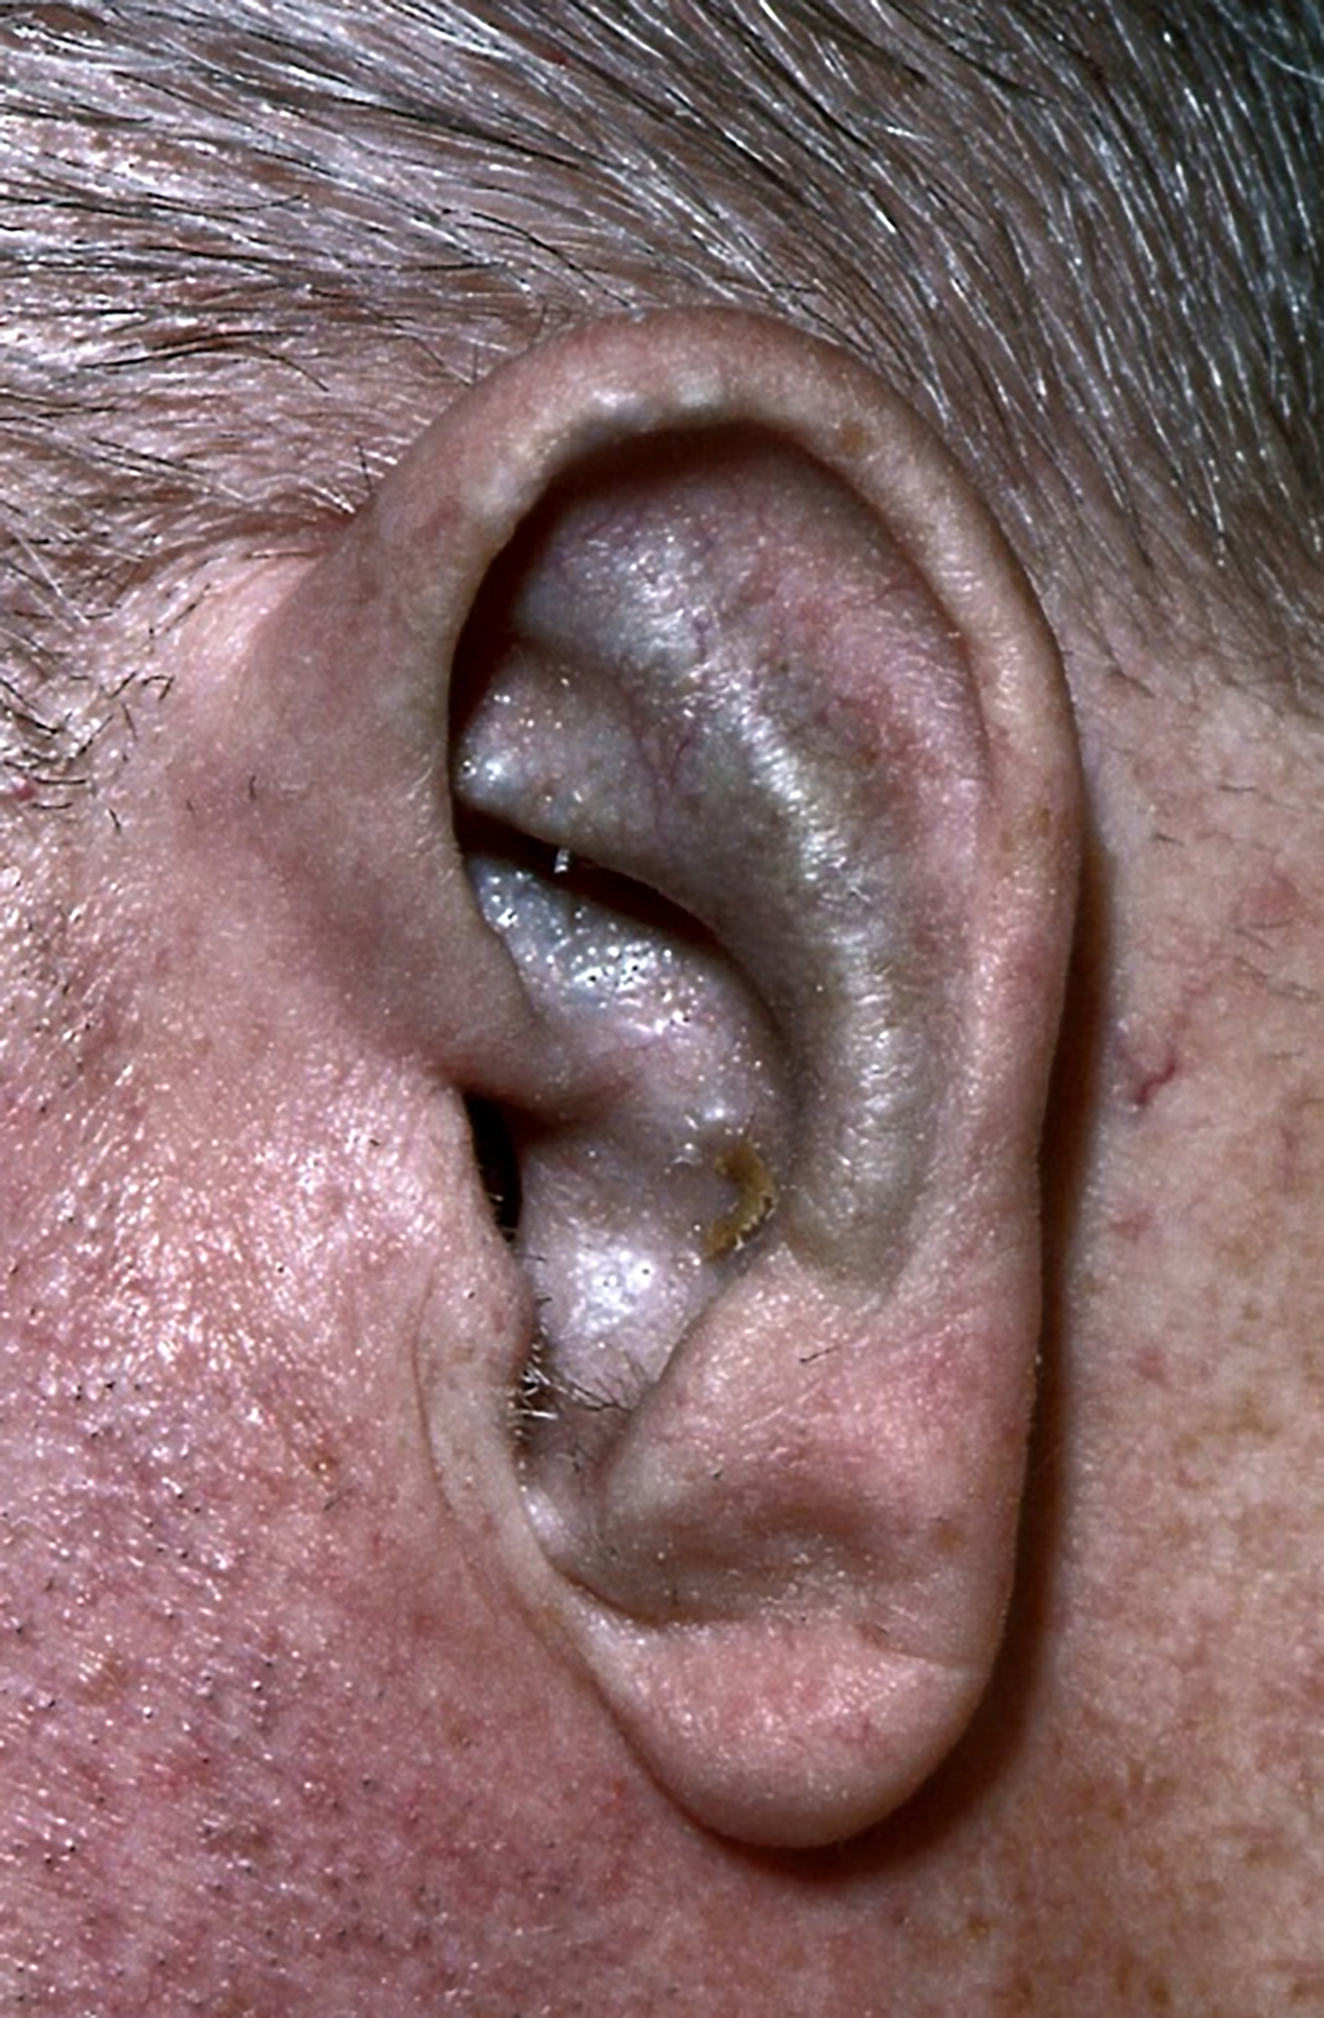

Slide 47
ALKAPTONURIA
INVESTIGATION:
Urine for homogentisic Acid
MANAGEMENT:
No Treatment for complications
Nitisinone; reduce plasma and urine homogentisic acid

Slide 48
PROLIDASE DEFICIENCY
Inability to breakdown Imidodipeptides leading to their accumulation
Very rare. 80 patients described so far
Recurrent and resistant skin ulcers
Dermatitis, fine scarring, purpura
Doughy consistency of skin
Plasma and Urine Amino acid analysis
Ointment containing glycine and proline. Vitamin C

Slide 49
ARGINOSUCCINIC ACIDURIA
Urea cycle disorder. Result in hyperammonaemia
ACUTE HYPERAMMONAEMIA:
  Vomiting, confusion, coma
  Episodes of encaphlopathy
  Chronically as learning difficulties
TRICHORRHEXIS NODOSA:
  Irregularly spaced swellings of hairshaft
  Loss of cuticle and exposure of cortical fibres
ASA in urine
Dietary protein restriction
Sodium benzoate and sodium phenylbutyrate
L-arginine

Slide 50
HARTNUP DISEASE
Results from deficiency of aminoacid transporter→ decreased absorption of tryptophan from intestine→ decreased formation of Nicotineamide
Well‐demarcated, dry, scaly patches occur on sun‐exposed skin, such as the face, backs of the hands. exposure to sunlight causes erythema, sometimes with blistering, and may be followed by desquamation and depigmentation
Cerebellar Ataxia
Nystagmus, tremor, psychiatric problems
Increased neutral aminoacids in urine and low-normal in plasma
Oral Nicotineamide 50-300mg/day. High protein diet

Slide 51
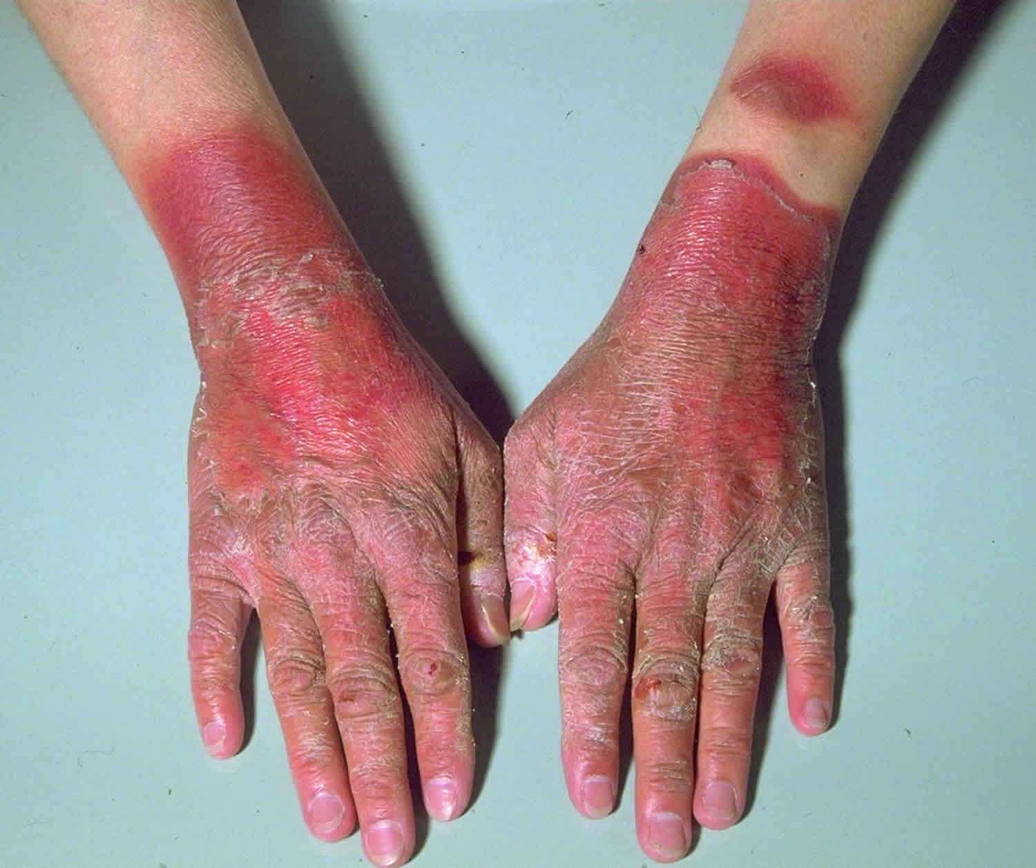
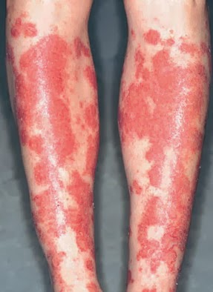

Slide 52
DISORDERS OF CHOLESTEROL SYNTHESIS

Slide 53
SMITH-LEMLI-OPITZ SYNDROME
7-Dehydrocholesterol Reductase Deficiency
Facial dysmorphism, 2/3 syndactyly of the toes, undescended testes, failure to thrive, microcephaly, mental retardation and autism
Photosenstivity
Diagnosed by elevated plasma 7-dehydrocholesterol levels
Treatment with Cholesterol

Slide 54
MEVALONATE KINASE DEFICIENCY
Fever and inflammation, which may happen every 4–6 weeks, with high levels of IgD
Erythematous maculopapular rashes
Severely affected patients have dysmorphism, failure to thrive and mental retardation
No specific Treatment

Slide 55
Other metabolic disorders

Slide 56
LESH NYHAN SYNDROME
Hypoxanthine-guanine phophoribosyl transferase ( HGPRT) deficiency
X-Linked Recessive Disorder
delayed motor milestones, followed by chorea, spasticity and dysarthria
compulsion to injure themselves; self‐ amputation of fingers or parts of the lips
renal uric acid stones but gouty arthritis
INVESTIGATIONS:
Uric Acid in urine and plasma
HGPRT Activity in RBCs
MANAGEMENT;
Allopurinol
Restraints for self-mutilation

Slide 57
DISODERS OF BIOTIN METABOLISM
Result from Biotinidase and holocarboxylase deficiency leading to multiple carboxylases deficiency
HOLOCARBOXYLASE DEFICIENCY:
  vomiting, lethargy, lactic acidosis and ketoacidosis and hyperammonaemia
  rash is usually widespread, erythematous and scaly, particularly affecting the napkin area. It may resemble ichthyosis or seborrhoeic dermatitis
BIOTINIDASE DEFICIENCY:
  Dermatological problems are common.
  Patchy erythematous or exudative rash, particularly around the mouth
  The rash may be widespread and there may be skin infections, conjunctivitis, blepharitis
Diagnosed by urinary organic acid analysis
Managed by oral Biotin

Slide 58
ACRODERMATITIS ENTEROPATHICA
Disorder of Absorption of ZINC

Slide 59
INTRODUCTION
AR Defect in Zinc Transporter.
Caused DERMATITS, ALOPECIA and DIARRHOEA
Present at 4-10 weeks of age with weaning
Periorificial Dermatitis and of hands and feet
Lesions progress to form vescicle, bulla, pustule and crusting
Alopecia
Diarrhoea and growth retardation
Poor wound healing

Slide 60
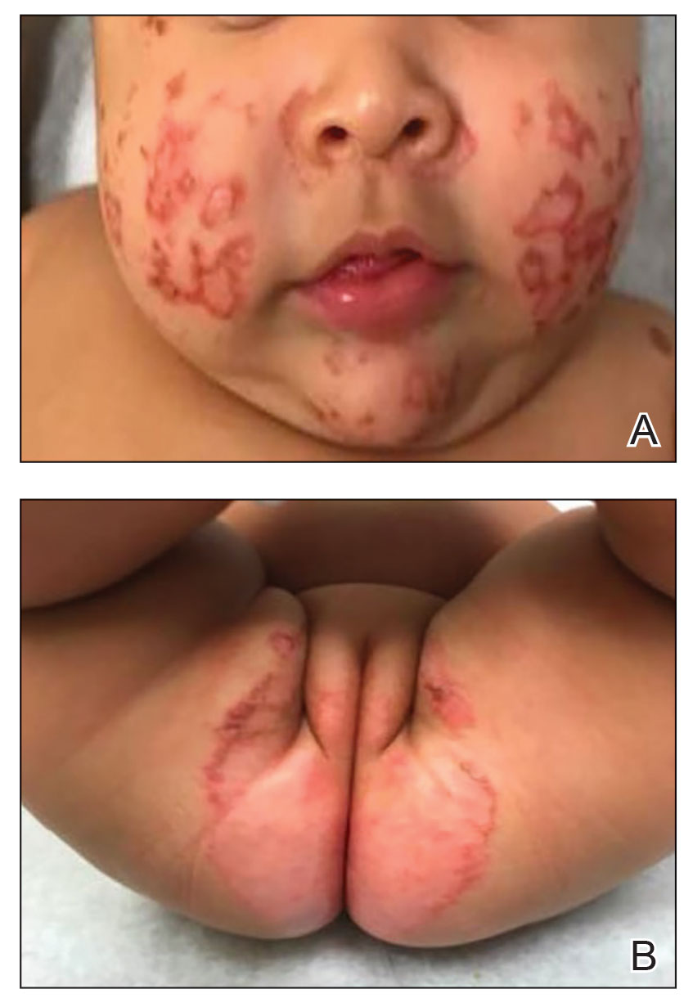

Slide 61
INVESTIGATION
Serum Zinc Levels
Trial Of Zinc Therapy

Slide 62
MANAGEMENT
Patient respond to oral zinc sulphate within a week
Childhood = 150-400mg/day
Pregnancy = 400-500mg/day
Lower dose after puberty

Slide 63
MENKES DISEASE
X-Linked Disorder of Copper Deficiency. ATP7A Gene Mutation
Hypotonia,Seizures, developmental regression
Hairs become sparse and brittle. Scanty blond hairs at vertex with stubble elsewere
Pili Torti and Trichorrhexis Nodosa
Characteristic Facial appearance with sagging cheek, frontal bossing
Untreated patients die by 3 years of age
Diagnosed by serum copper and ceruloplasmin level by 3 months of age
Management: Daily Subcut Inj of copper histidine

Slide 64
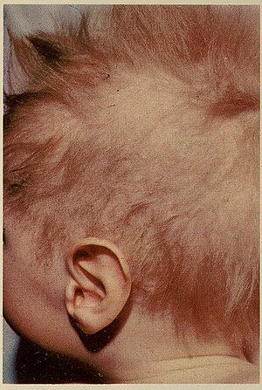

Slide 65
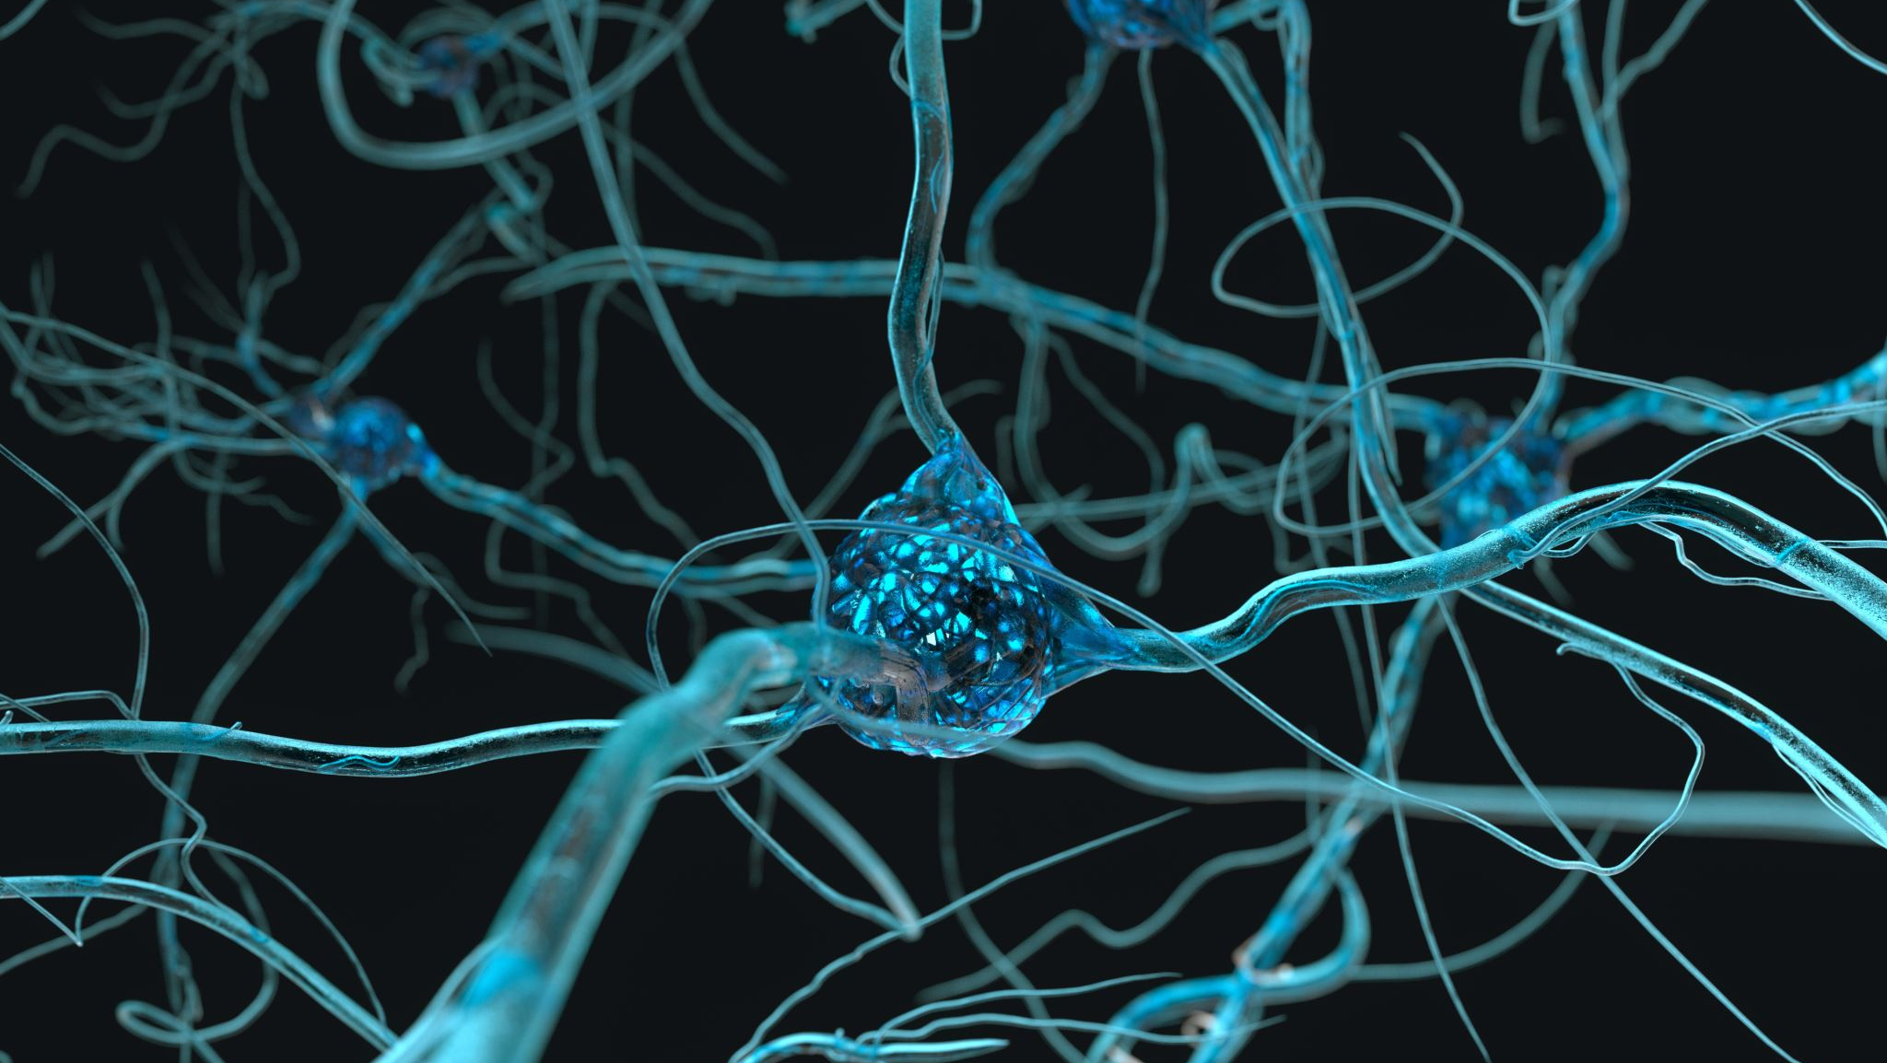
WILSON DISEASE
Accumulation of copper in liver, brain, kidneys etc
Hepatitis, liver failure or cirrhosis
NEUROLOGICAL MANIFESTATIONS:
  dysarthria and deteriorating handwriting are early symptoms, followed by tremor, dystonia and drooling
Behavioural changes or psychosis
KF Rings
Blue lunulae of the nails
xeroderma and grey‐brown hyperpigmentation, especially on the extensor surfaces of the legs, and cheilitis
Serum and Urine copper levels. 24H urine copper excretion. Plasma ceruloplasmin level
Managed by copper chelators e.g Penicillamine or Zinc
Liver Transplantation

Slide 66
FAMILIAL TUMORAL CALCINOSIS
HYPERPHOSPHATAEMIC FAMILIAL TUMORAL CALCINOSIS:
Hereditary counterpart of Metastatic calcification
large, calcified masses located mainly over the large joints
Cause pain, decrease mobility and infections
NORMOPHOSPHATAEMIC FAMILIAL TUMORAL CALCINOSIS:
Hereditary counterpart of Dystrophic Calcification
vasculitis‐like rash
calcified masses years later in the cutaneous and subcutaneous tissues
Perforate the skin, leading to painful ulcers and secondary infections
Managed by Surgical Removal of calcified masses

Slide 67
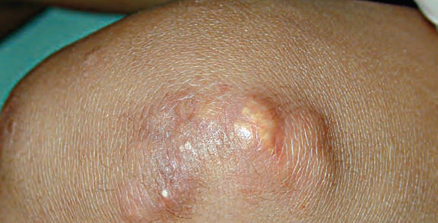

Slide 68
DERMATOLOGICAL FEATURES OF MITOCHONDRIAL DISORDERS

Slide 69
1. MULTIPLE SYMMETRICAL LIPOMATOSIS
Adults with multiple lipomas
Symmetrically distributed over neck and shoulders. Recur. Brown fat
Associated with neurological problems, deafness, ataxia

Slide 70
2. ACROCYANOSIS
Patients have intermittent red or purple discoloration of the feet ± hands
recurrent petechial rash and bruising
Orthostatic acrocyanosis is a characteristic finding in patients with ethylmalonic encephalopathy

Slide 71
3. PPK
Non‐epidermolytic palmoplantar keratoderma
01
Diffuse or circumscribed epidermal thickening particularly over pressure points
02
All individuals have sensineural hearing deafness
03

Slide 72

THANK YOU!

