Slide 1
INHERITED HAIR DISORDERS
DR. ARSLAN AHMAD
PGR DERMATOLOGY
NISHTAR HOSPITAL MULTAN

Slide 2
INHERITED HAIR DISORDERS
(GENOTRICHOSES)
Congenital and inherited disorders of hair growth and differentiation:
1.Hypertrichosis(Excessive Hair Growth)
2.Hypotrichosis(Decreased Hair Growth)
3.Atrichia(Absent Hair from entire surface of Skin)
4.Alopecia(Defective hair development)

Slide 3
INHERITED HAIR DISORDERS
(GENOTRICHOSES)
Can present in Isolation (Non-Syndromic) or as part of more complex clinical entities (Syndromic).
Underlying defects are congenital or inherited structural abnormalities of Hair Shaft or Hair follicle unit.

Slide 4
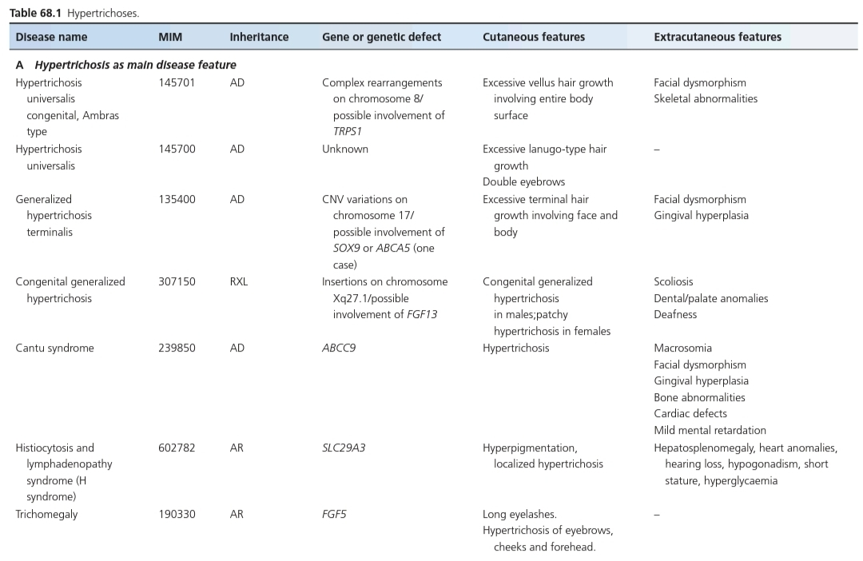
HYPERTRICHOSIS

Slide 5
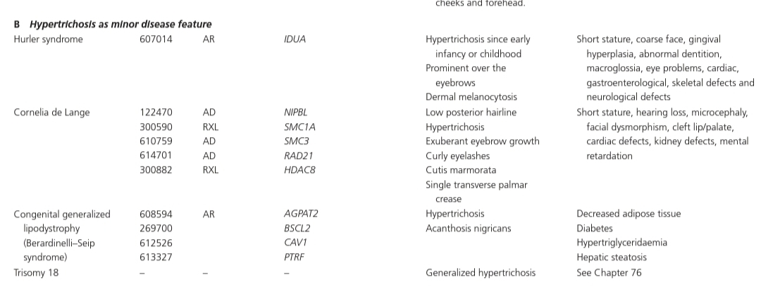
HYPERTRICHOSIS

Slide 6
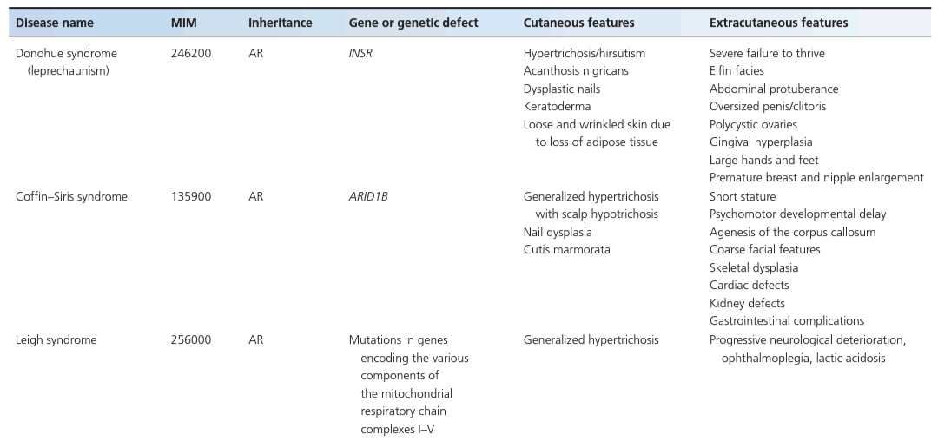
HYPERTRICHOSIS

Slide 7
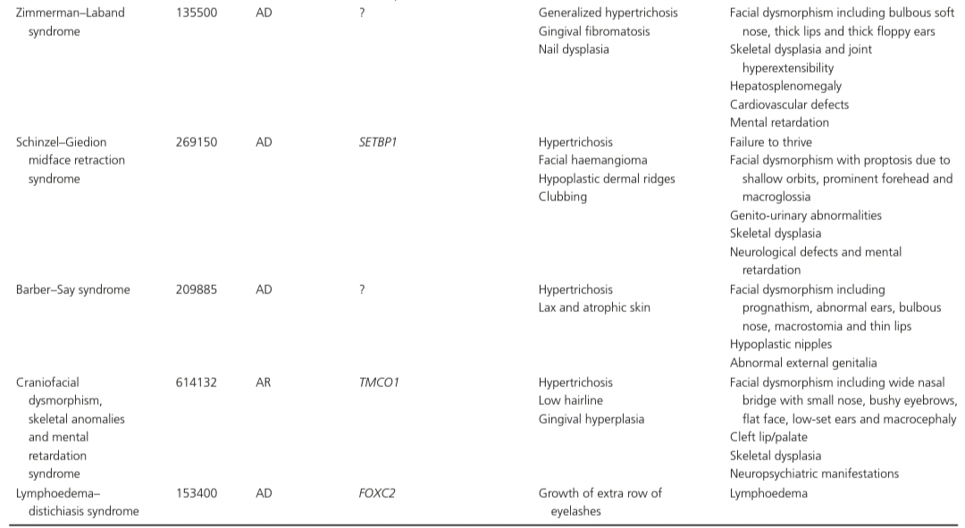
HYPERTRICHOSIS

Slide 8
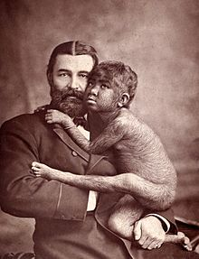
HYPERTRICHOSIS UNIVERSALIS
CONGENITA, AMBRAS TYPE
Generalized Hypertrichosis
Velus Hairs
Predilection for Face,Ears,Shoulders
Associated Facial Dysmorphism and Skeletal Abnormalities
Autosomal Dominant
Downregulation of TRPS1 gene(Also involved in Tricho-Rhino-Phalangeal Syndrome).

Slide 9
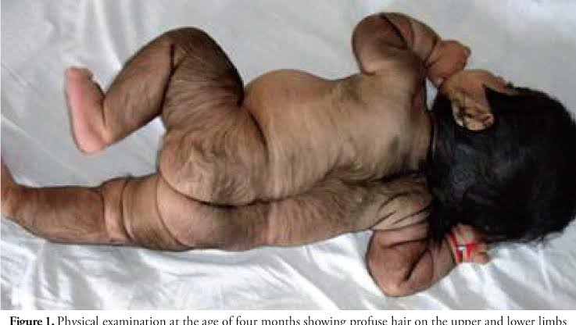
GENERALIZED HYPERTRICHOSIS
TERMINALIS
Excess of Terminal hair
Facial dysmorphism
Severe Gingival hyperplsia
Autosomal Dominant
Mutations in SOX9 and ABCA5 genes

Slide 10
CANTU SYNDROME
Congenital Hypertrichosis with long Curly Eyelashes
Facial dysmorphism
Gingival hyperplasia
Macrosomia
Skeletal anomalies
Cardiac defects
Mild Mental retardation
Autsomal Dominant
Activating mutation in ABCC9 gene, encoding Sulphonylurea receptor 2(Part of ATP-sensative pottasium channel complex targeted by Minoxidil)

Slide 11
LOCALIZED HYPERTRICHOSIS
Around Elbows(Hypertrichosis Cubiti)
Around Neck(Cervical Hypertrichosis)
Naevoid hypertrichosis
Histiocytosis and Lymphadenopathy Syndrome (H Syndrome)
Association with:
- Spinal dysraphism(Faun-Tail Nevus)
-Cranial dysraphism(Hair Collar Sign)
-Melanocytic Nevus
-Becker’s Nevus
-Congenital Porphyrias

Slide 12
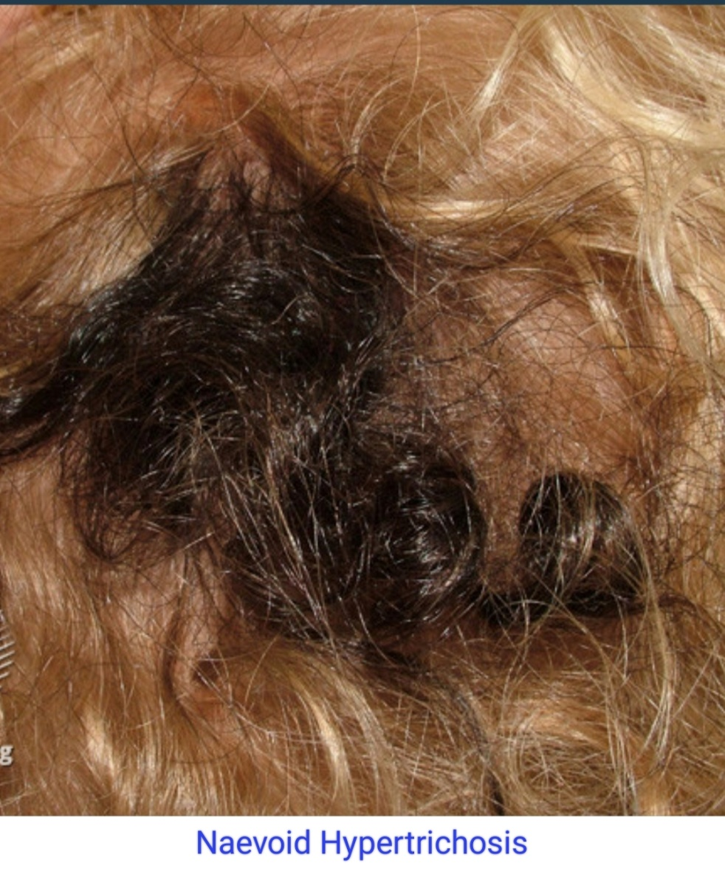
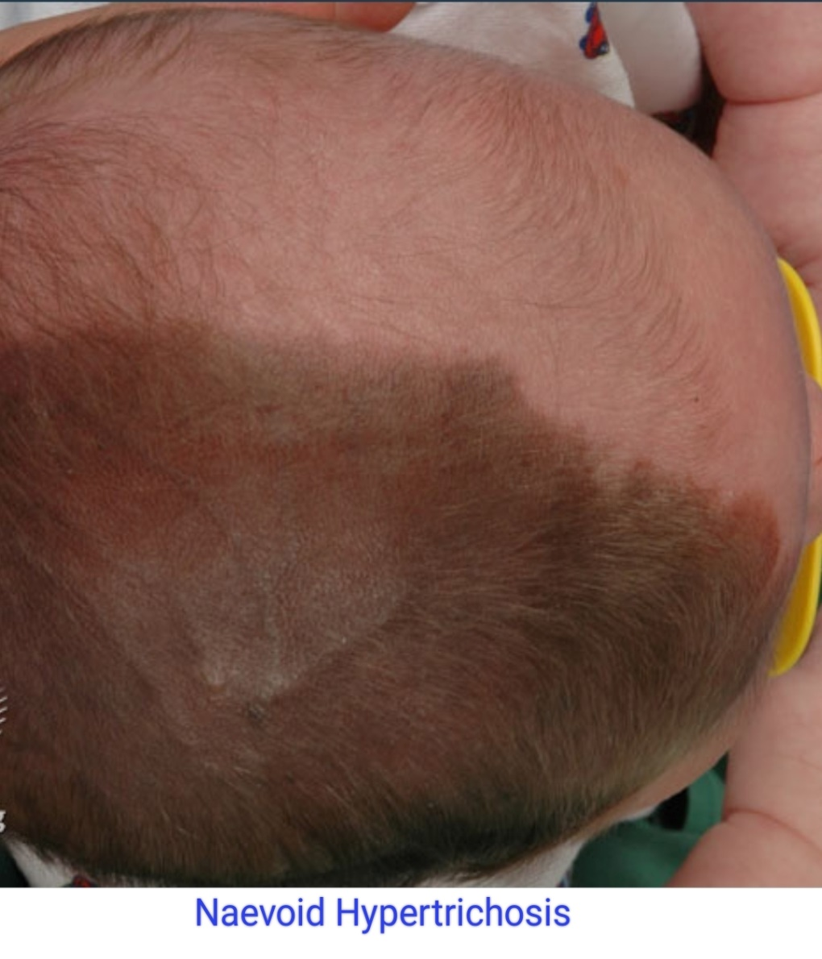
NAEVOID HYPERTRICHOSIS

Slide 13
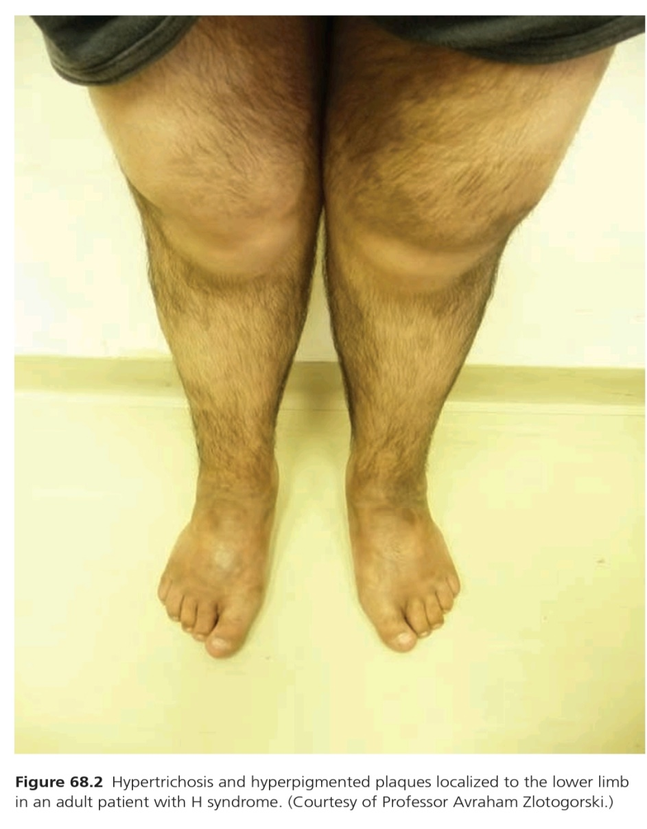
H-SYNDROME (HISTIOCYTOSIS AND
LYMPHADENOPATHY SYNDROME)
Localized Hypertrichosis
Skin Hyperpigmentation
Hepatosplenomegaly
Heart Anomalies
Hearing loss
Hypogonadism
Short stature
Diabetes
Autosomal recessive, mutations in SLC29A3

Slide 14
DIFFERENTIAL DIAGNOSIS AND
TREATMENT OF HYPERTRICHOSIS
Differential diagnosis:
-Hirsutism
(Excessive
growth of hair in male
pattern due to
Endocrinologoical,drug
or Paraneoplastic cause)
-Underlying malignancy
Treatment:
-Depilation
(Mechanical/Chemical)
-Laser hair Removal

Slide 15
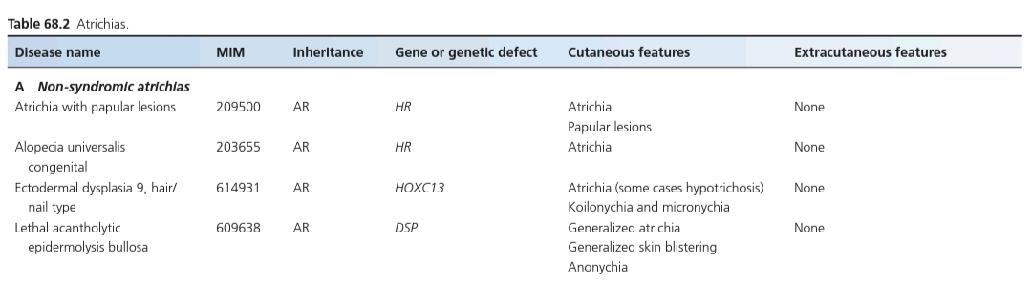
ATRICHIAS

Slide 16
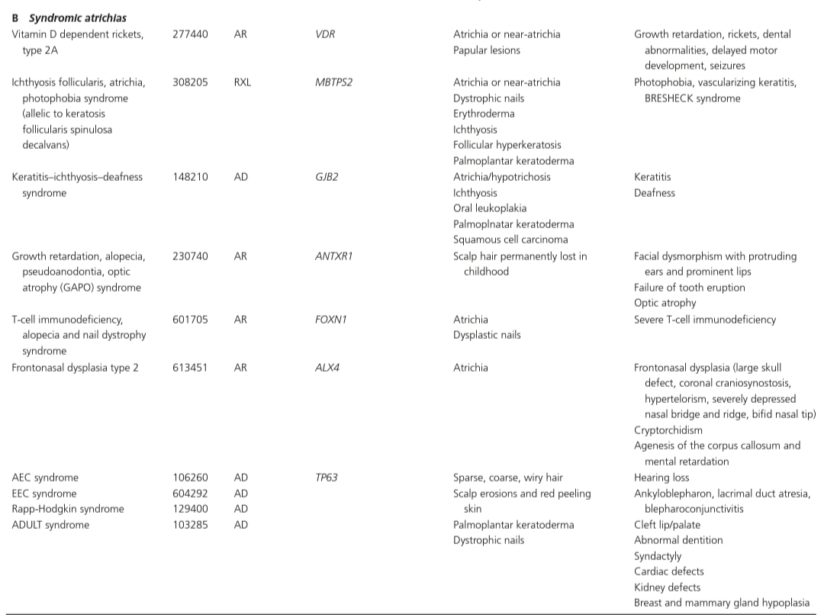
ATRICHIAS

Slide 17
ATRICHIA WITH PAPULAR LESIONS
Born with normal hair
Hair shed during first months of life,never regrow thereafter
During 2nd decade of life, Diffuse Papular rash develops on cheeks and scalp.
Mental retardation
GI polyposis
Delay in bone age
On histology=Dermal Cysts
Autosomal recessive
Mutations in HR gene(encodes transcription cofactor hairless)

Slide 18
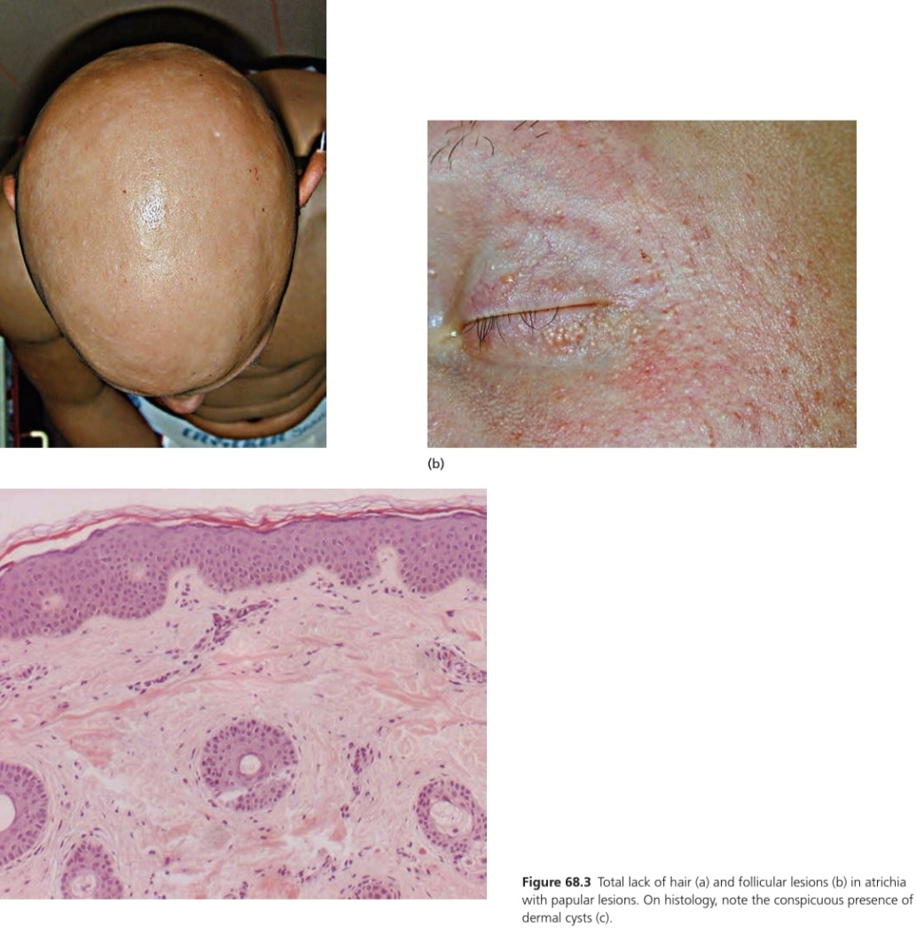
ATRICHIA WITH PAPULAR LESIONS

Slide 19
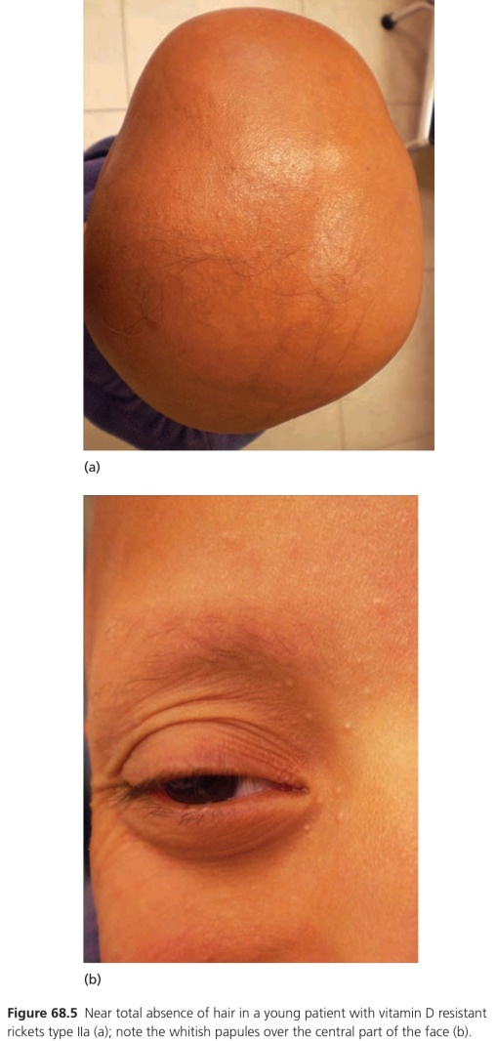
VITAMIN D RESISTANT RICKETS
Born with normal hair
Hair shed during first year of life, never regrows therafter
Bony changes of Rickets
Loss of teeth
Whitish, milia-like papular lesions on face
Autosomal Recessive
Mutations in VDR gene(encoding Vitamin D3 receptor)

Slide 20
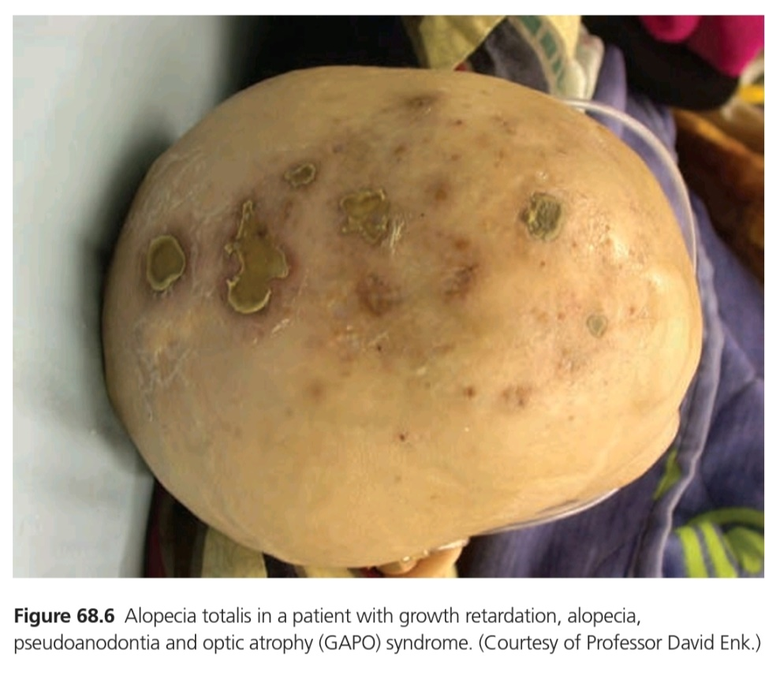
GAPO SYNDROME
Growth retardation
Alopecia totalis
Pseudoadontia
Optic atrophy
Autosomal recessive
Mutations in ANTXR1 gene

Slide 21
ICHTHYOSIS FOLLICULARIS WITH
ATRICHIA AND PHOTOPHOBIA
Total or partial Atrichia
Follicular hyperkeratosis
Scaling
Photophobia
Blindness
BRESHECK signs(Brain anomalies, Growth retardation, Ectodermal dysplasias, Skeletal deformities, Hirschsprung disease, Ear/eye anomalies, Cleft palate, Kidney hypoplasia)
X-linked recessive
Mutations in MBTPS2 gene

Slide 22
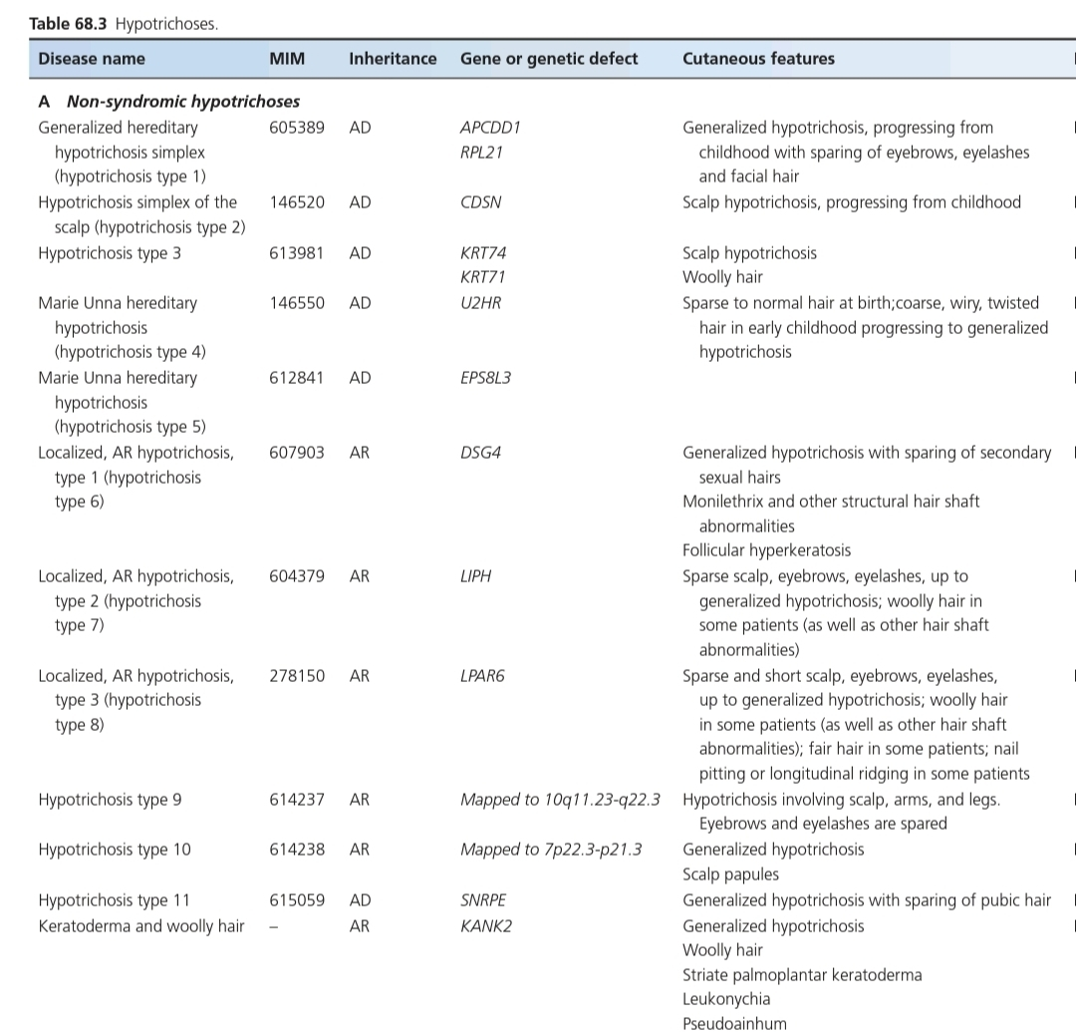
NON-SYNDROMIC HYPOTRICHOSIS

Slide 23
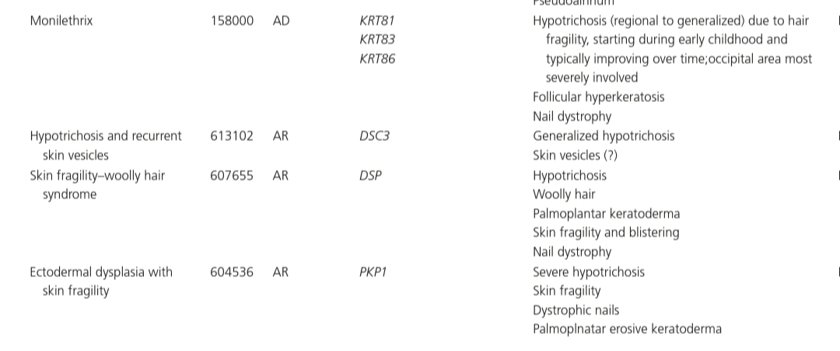
NON-SYNDROMIC HYPOTRICHOSIS

Slide 24
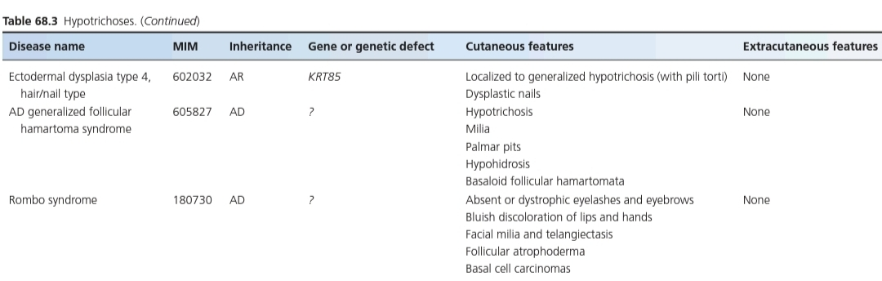
NON-SYNDROMIC HYPOTRICHOSIS

Slide 25
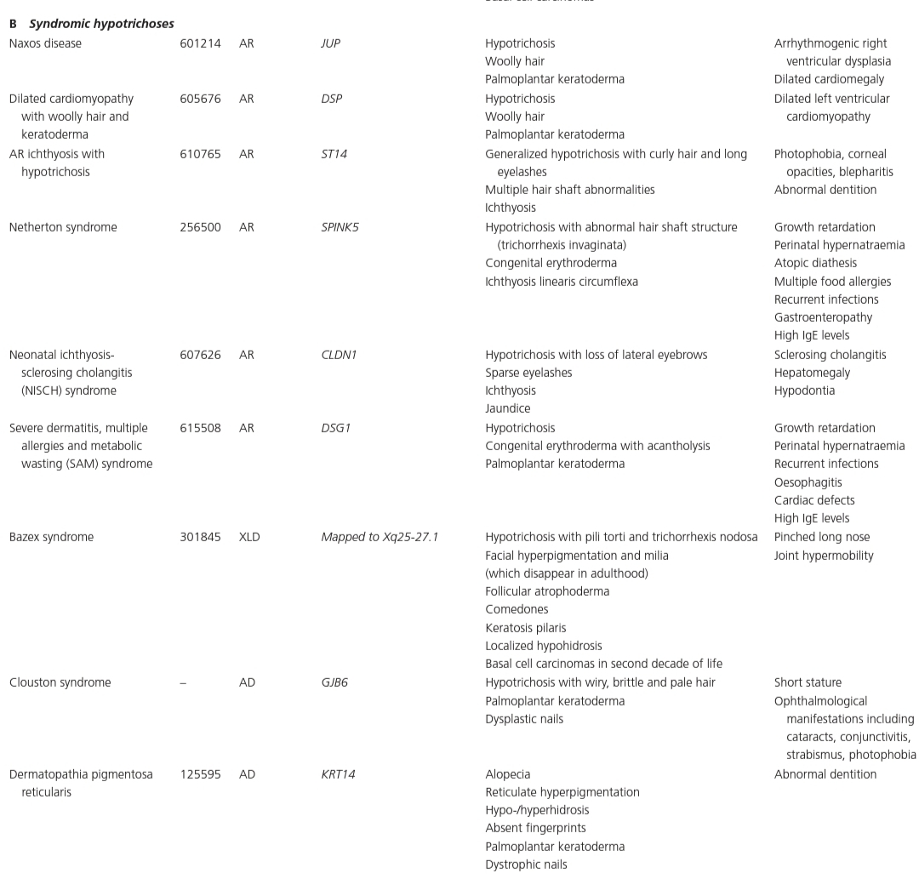
SYNDROMIC HYPOTRICHOSIS

Slide 26
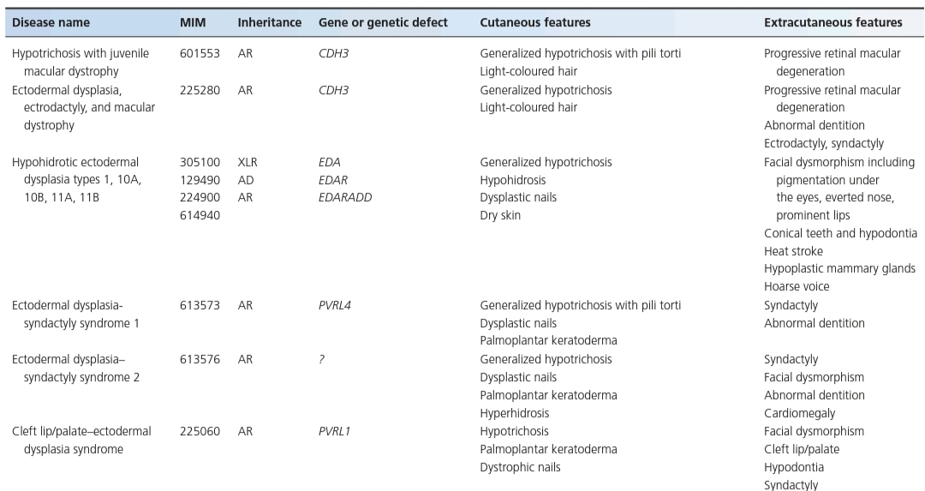
SYNDROMIC HYPOTRICHOSIS

Slide 27
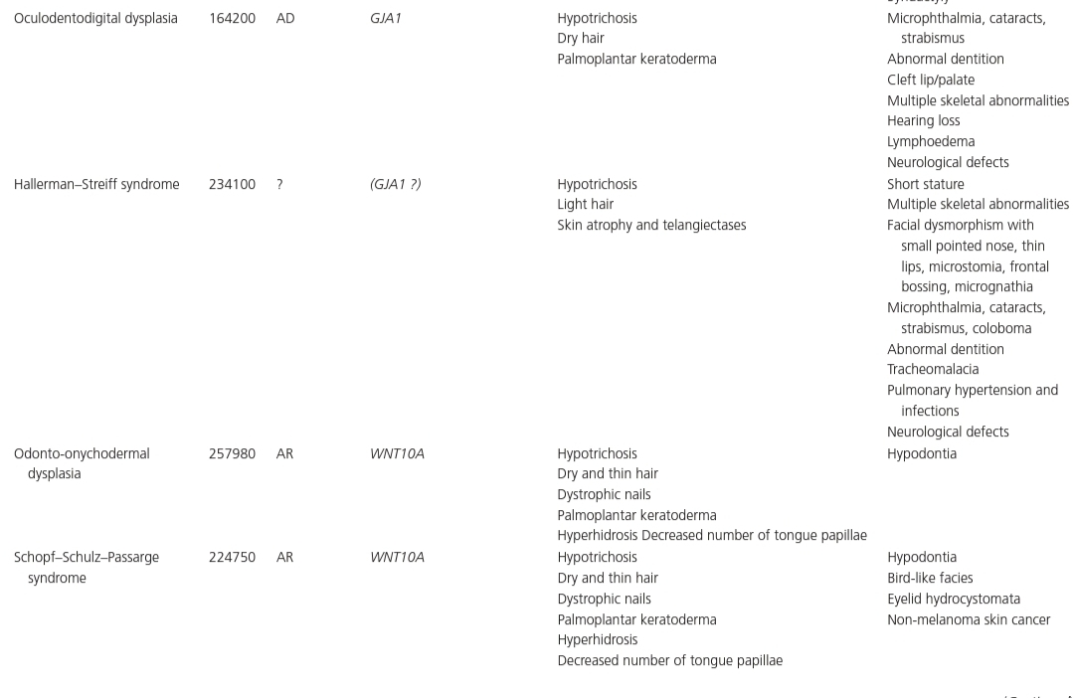
SYNDROMIC HYPOTRICHOSIS

Slide 28
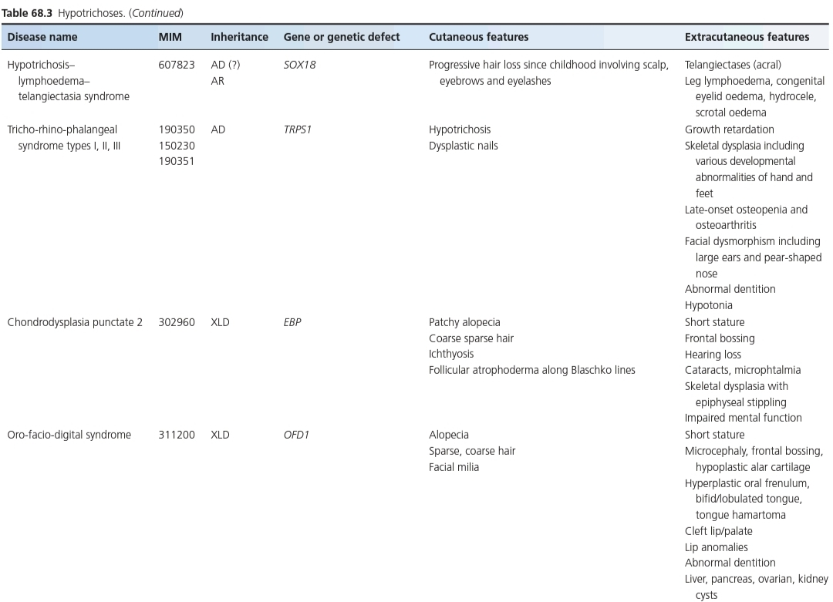
SYNDROMIC HYPOTRICHOSIS

Slide 29
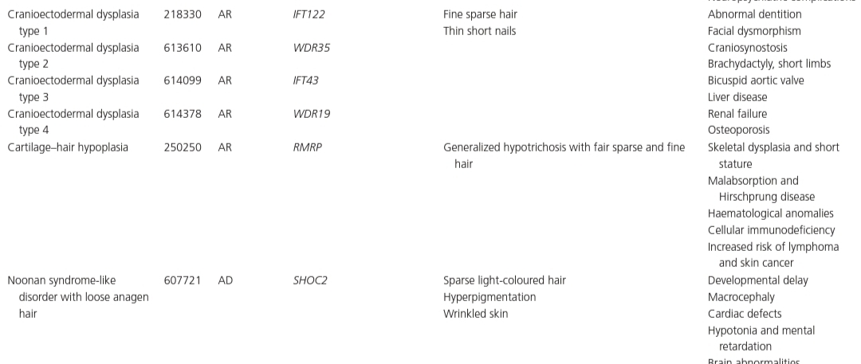
SYNDROMIC HYPOTRICHOSIS

Slide 30
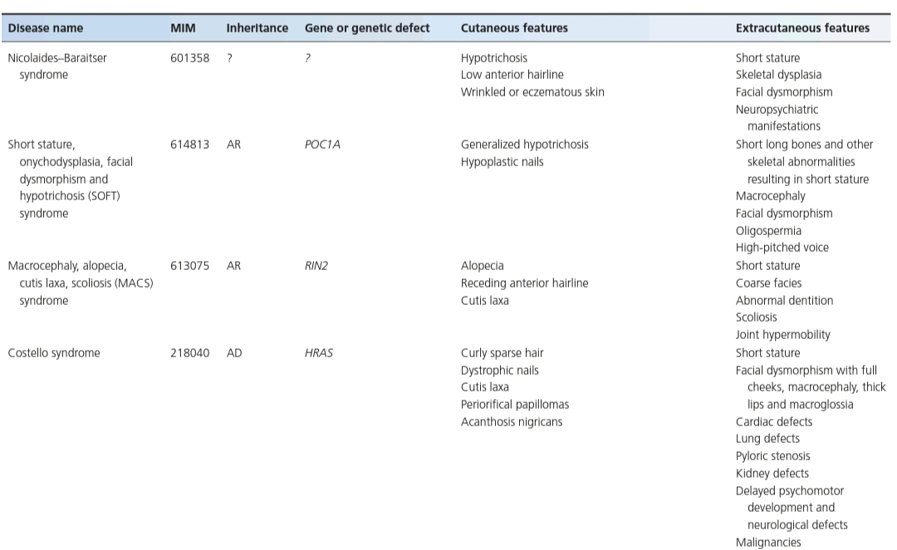
SYNDROMIC HYPOTRICHOSIS

Slide 31
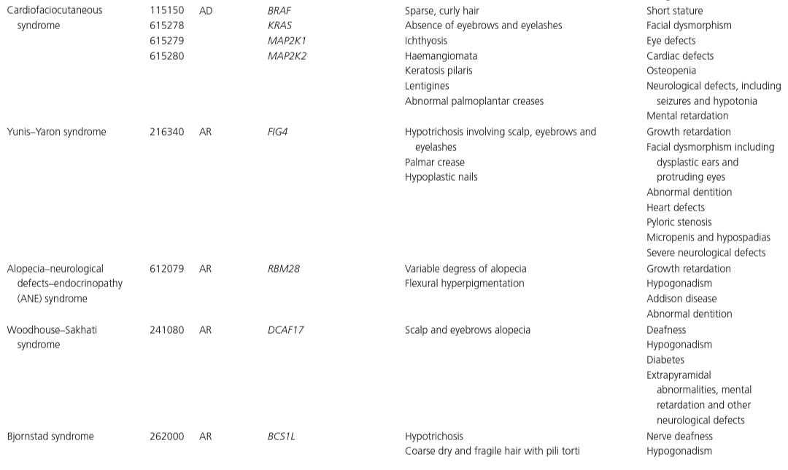
SYNDROMIC HYPOTRICHOSIS

Slide 32
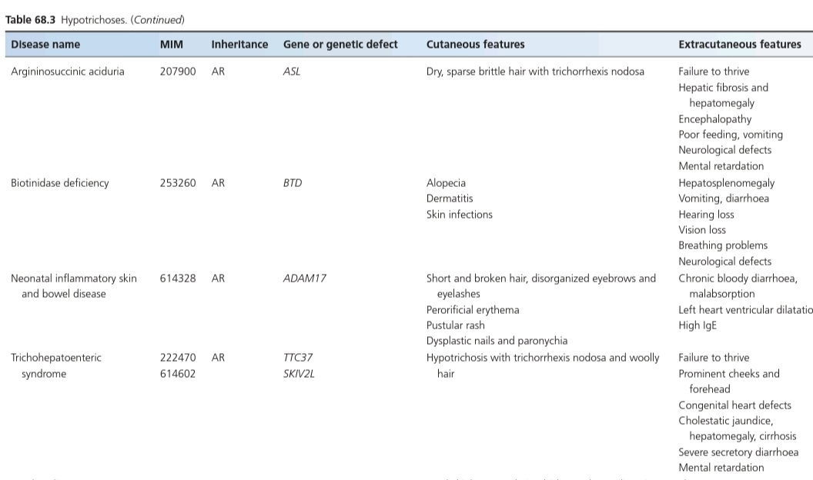
SYNDROMIC HYPOTRICHOSIS

Slide 33
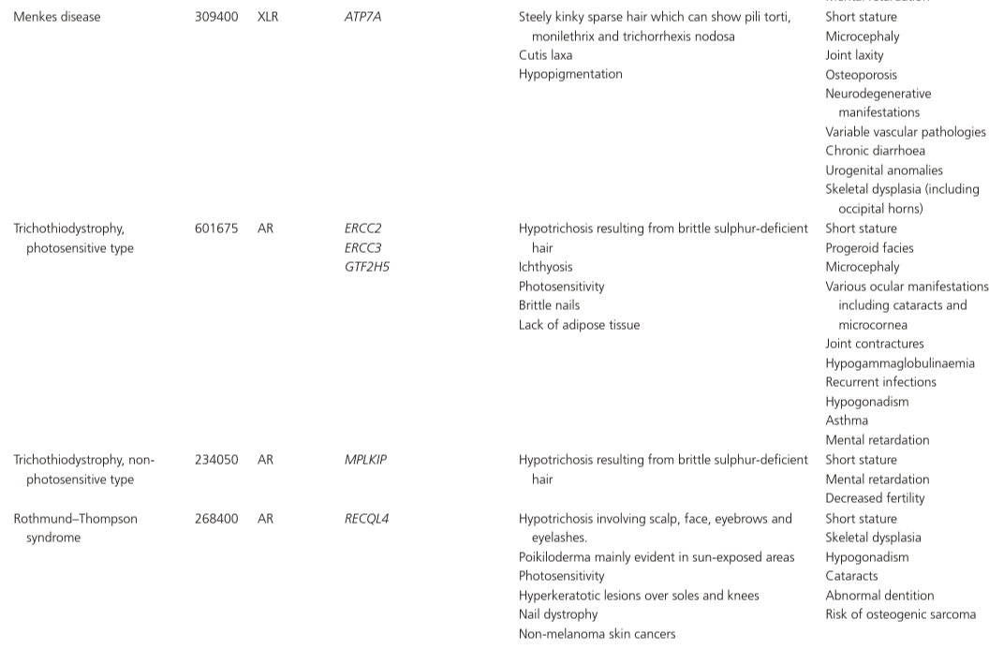
SYNDROMIC HYPOTRICHOSIS

Slide 34
SYNDROMIC HYPOTRICHOSIS

Slide 35
GENERALIZED HEREDITARY
HYPOTRICHOSIS SIMPLEX
Hypotrichosis type 1(Non-Syndromic)
Normal hair at birth
Progressive hairloss start during childhood
All parts of body except Eyelashes, Eyebrows and Beard
Hair Pigmentation also affected
Hair shaft Normal
Autosomal Dominant
Recurrent Mutation in APCDD1 gene

Slide 36
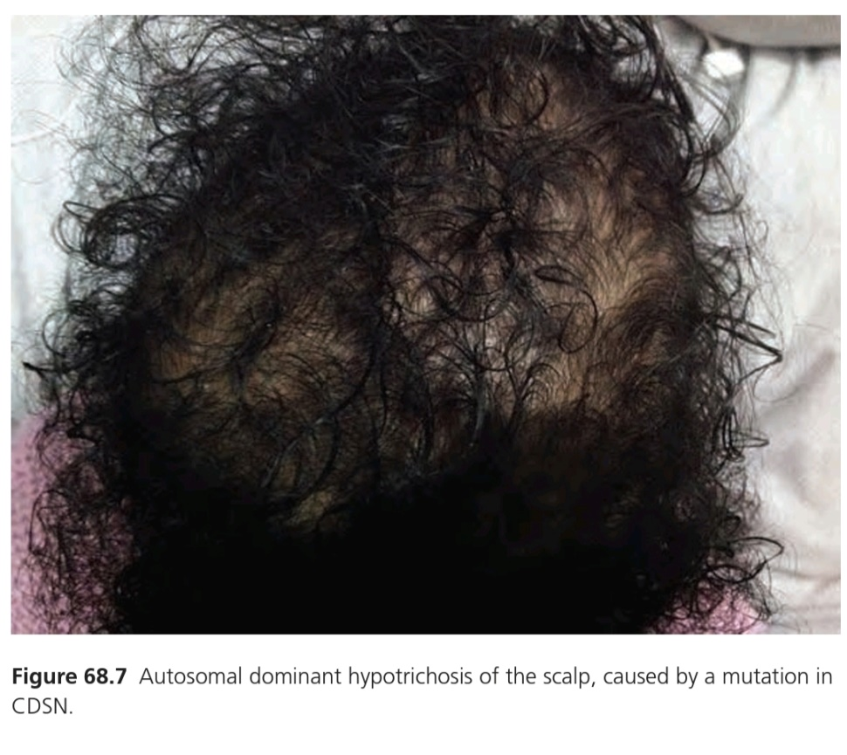
HYPOTRICHOSIS SIMPLEX OF SCALP
Hypotrichosis Type 2(Non-Syndromic)
Normal at Birth
Progressive hairloss start during childhood
Limited to Scalp
Autosomal Dominant
Mutations in CDSN gene(encoding corneodesmosin-Same gene alteration also involved in Skin peeling syndrome and Psoriasis)

Slide 37
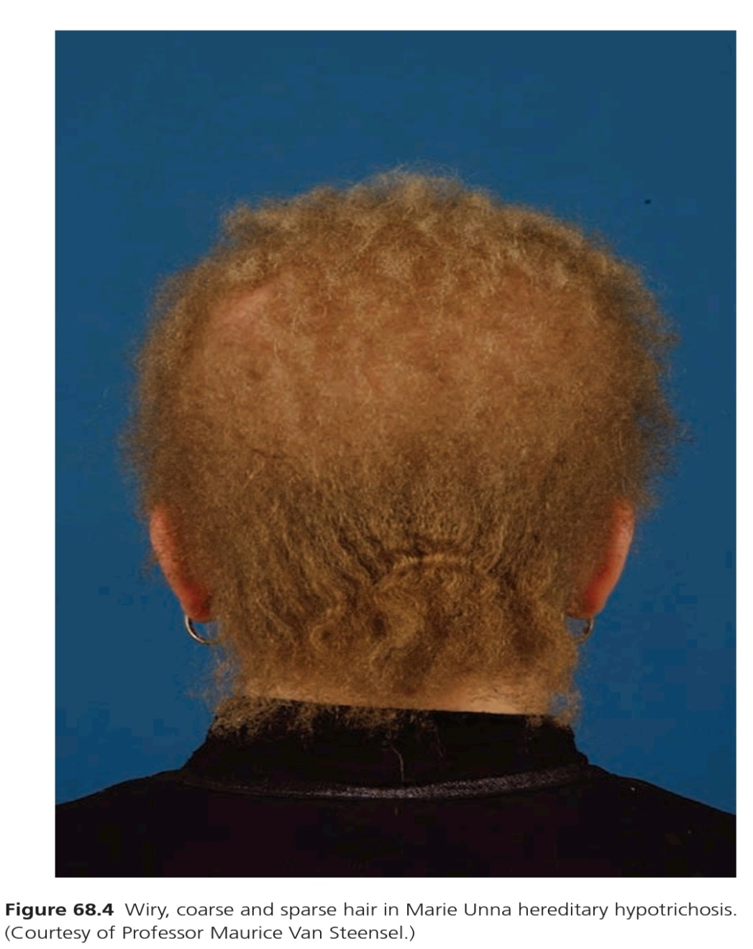
MARIE UNNA HEREDITARY
HYPOTRICHOSIS
Hypotrichosis type 4 and 5( Non-Syndromic)
Sparse to Normal hair at Birth
Coarse,Wiry, Twisted hair in early childhood
Followed by generalized Alopecia in adulthood
Autosomal Dominant
Overexpession of HR gene(encodes transcription cofator Hairless)

Slide 38
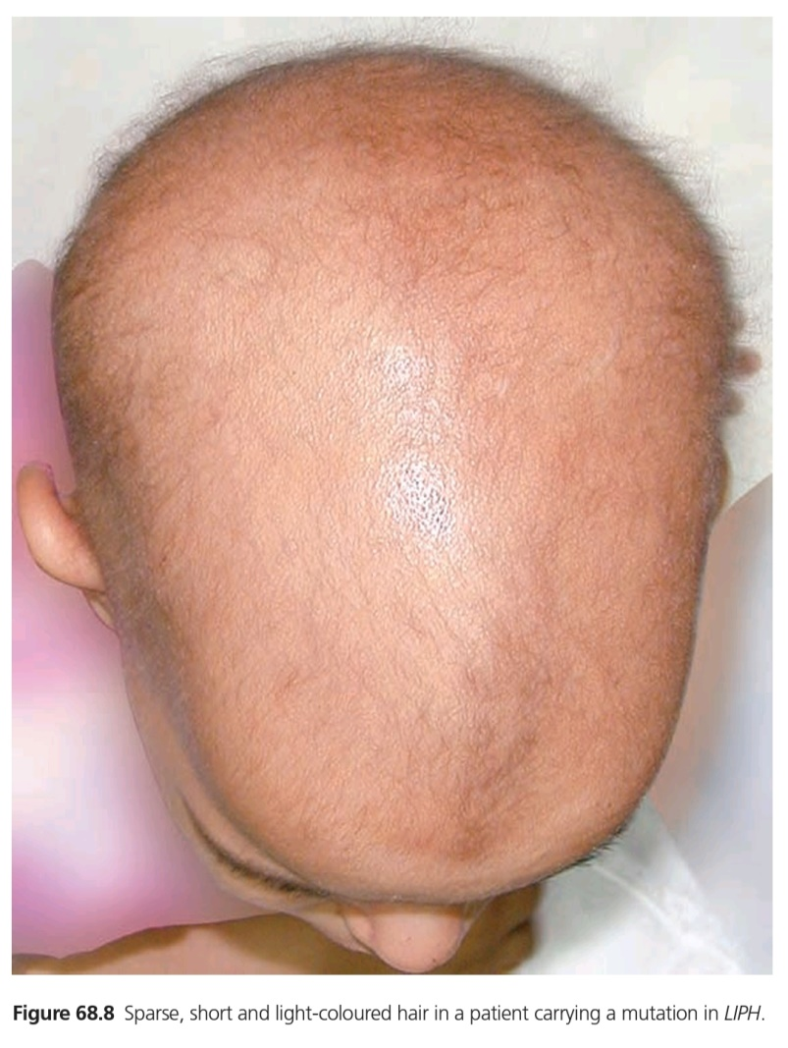
AUTOSOMAL RECESSIVE LOCALIZED
HYPOTRICHOSIS
Alias Hypotrichosis type 7 and 8(Non-Syndromic)
Decrease hair on most body parts including Eyebrows, Eyelashes and Facial hair
Decrease Pigmentation
Overlaps with Wooly Hair
Can be associated with Trichorrhexis Nodosa
Autosomal Recessive
Mutations in LIPH and LPAR6 genes.

Slide 39
TRICHO-RHINO-PHALANGEAL
SYNDROME
Sparse scalp hair
Bulbous Nose
Short Metacarpals and Metatarsals
Brachydactyly with cone-shaped epiphysis at middle phalanges
Short Stature
Skeletal deformities(more in Type III TRPS)
Multiple Exostoses(more in Type II)
Autosomal Dominant
Mutations in TRPS1 gene

Slide 40
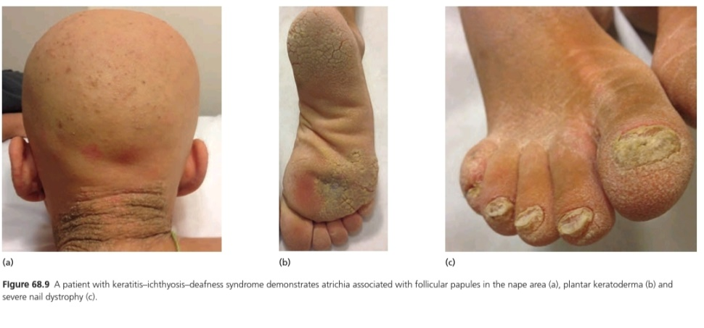
KERATITIS-ICHTHYOSIS-DEAFNESS
SYNDROME
Alopecia
Ichthyosis
Deafness
Plantar Keratoderma
Follicular Papules over scalp, more in Nape area
Nail Dystrophy
Autosomal Dominant
Mutations in GJB2 gene(Encoding Conexin-26)

Slide 41
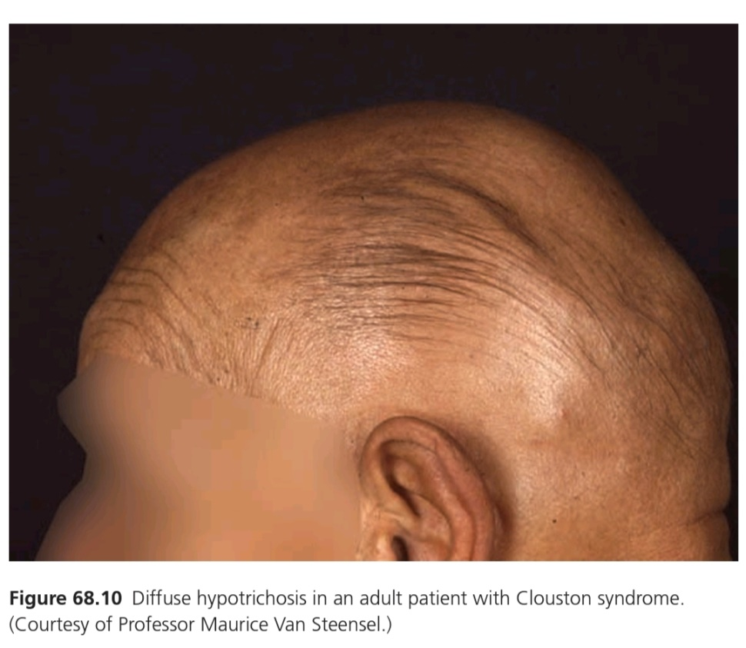
CLOUSTON SYNDROME
Focal or total Alopecia
Palmoplantar Keratoderma
Nail dystrophy
Autosomal Dominant
Mutations in GJB6 gene(encodes Conexin -30)

Slide 42
OCULO-DENTO-DIGITAL
DYSPLASIA(ODDD SYNDROME)
Fine, slow-growing, sparse hair
Palmoplantar Keratoderma
Facial dysmorphism
Eye Anomalies
Abnormal teeth
Cleft Lip or Plate
Hyperostosis
Skeletal Problems
Neurological defects
Autosomal Dominant
Mutations in GJA1 gene(encodes Conexin-43)

Slide 43
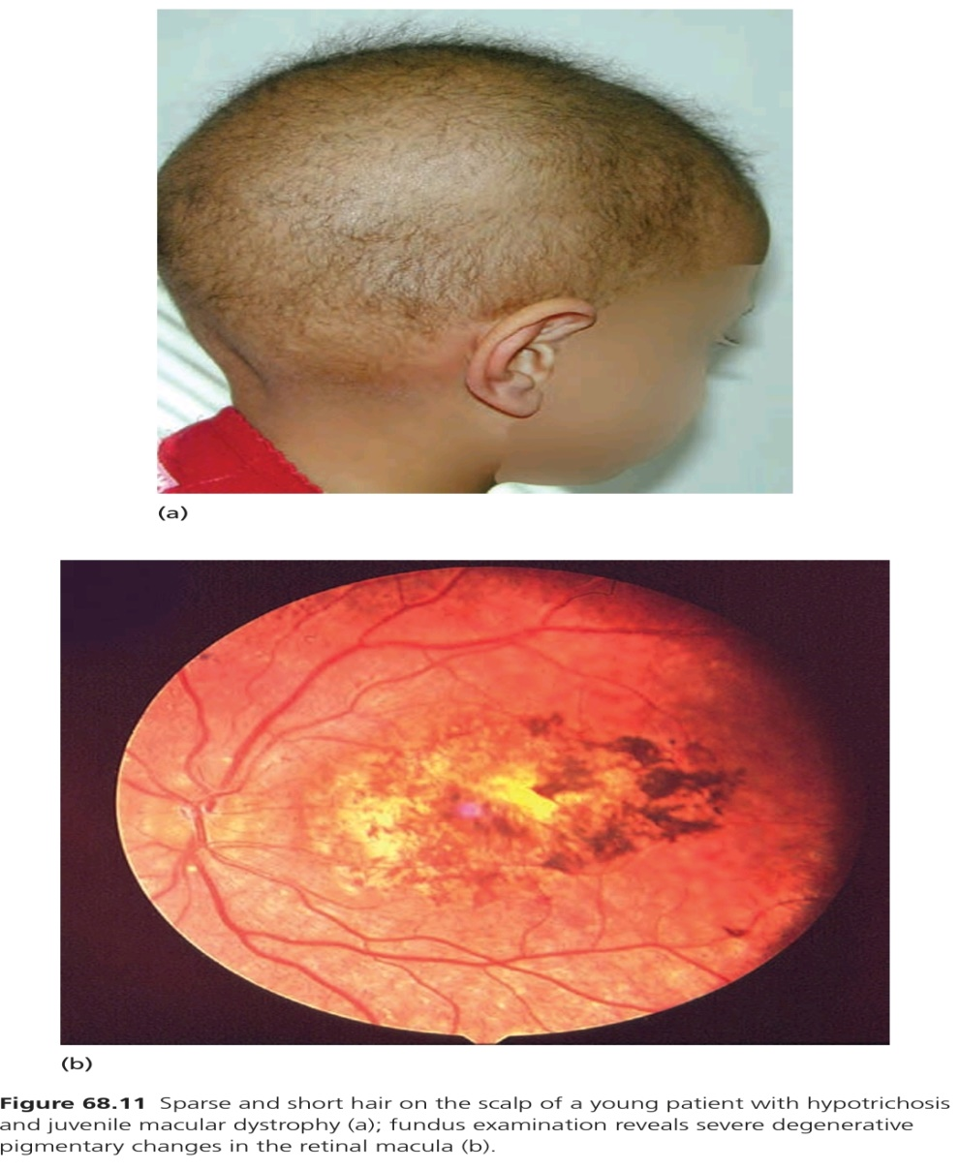
HYPOTRICHOSIS WITH JUVENILE
MACULAR DYSTROPHY
Short, light and sparse hair in early childhood
Progressive degeneration of Retinal macula leading to Blindness during 2nd to 3rd decade of life
Similar clinical features to EEM Syndrome(Ectodermal dysplasia, Ectrodactyly, Macular dystrophy)
Autosomal Recessive
Mutations in CDH3 gene(encode P-Cadherin)

Slide 44
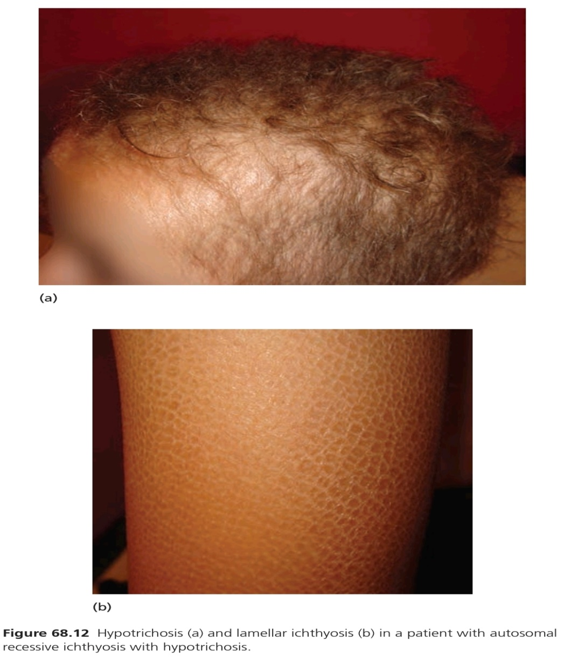
AUTOSOMAL RECESSIVE ICHTHYOSIS
WITH HYPOTRICHOSIS
Born with sparse and short Hair
Scaling(Ichthyosis)
Ophthalmological manifestations(Photophobia, Corneal Opacities)
Abnormal Dentition
Autosomal Recessive
Mutations in ST14 gene(encodes Matriptase)

Slide 45
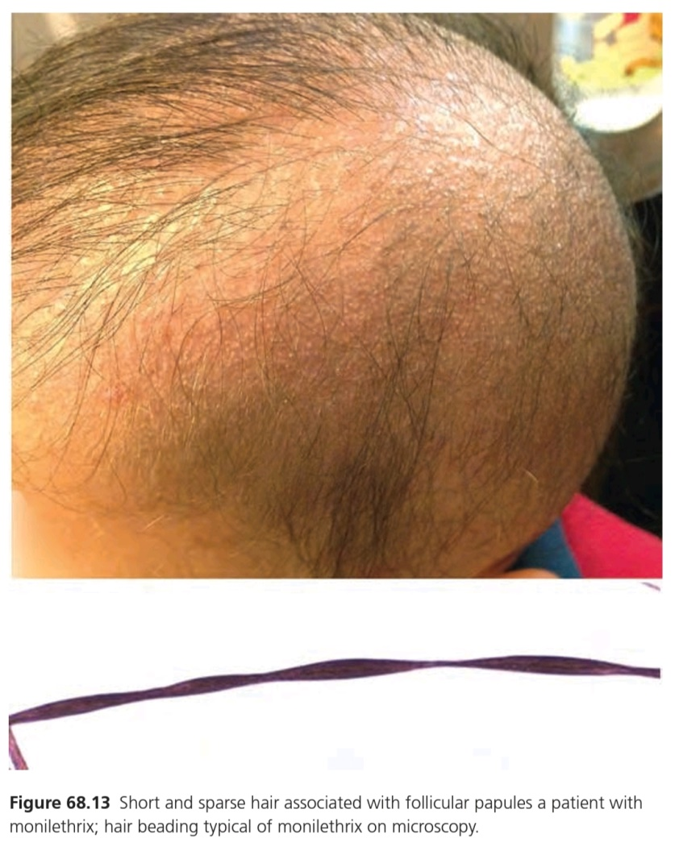
MONILETHRIX
Beaded Hair
Scalp hair fragile at constricted sites leading to apparent hypotrichosis
Gradual improvement with age
Body hair, eyelashes and eyebrows less involved
Follicular papules in nape area
Keratosis Pilaris
Nail dystrophy
Autosomal Dominant
Mutations in KRT81,KRT83,KRT86 genes(encode hair Keratin)

Slide 46
WOOLLY HAIR
Generalized or Localized occurrence of Curly hair
Slow growth, easy breakage
Hypopigmentation
Associations with Cardio-Cutaneous Disorders are reported.
Association with Noonan Syndrome is also reported(Short Stature, Ptosis, webbed Neck, reduced intellegence, pulmonary stenosis).
Woolly Hair described in the context of Naxos disease, Carvajal Syndrome.
Autosomal Recessive=Mutations in LPAR6 and LIPH genes.
Autosomal Dominant=Mutations in KRT71,KRT74 genes.

Slide 47
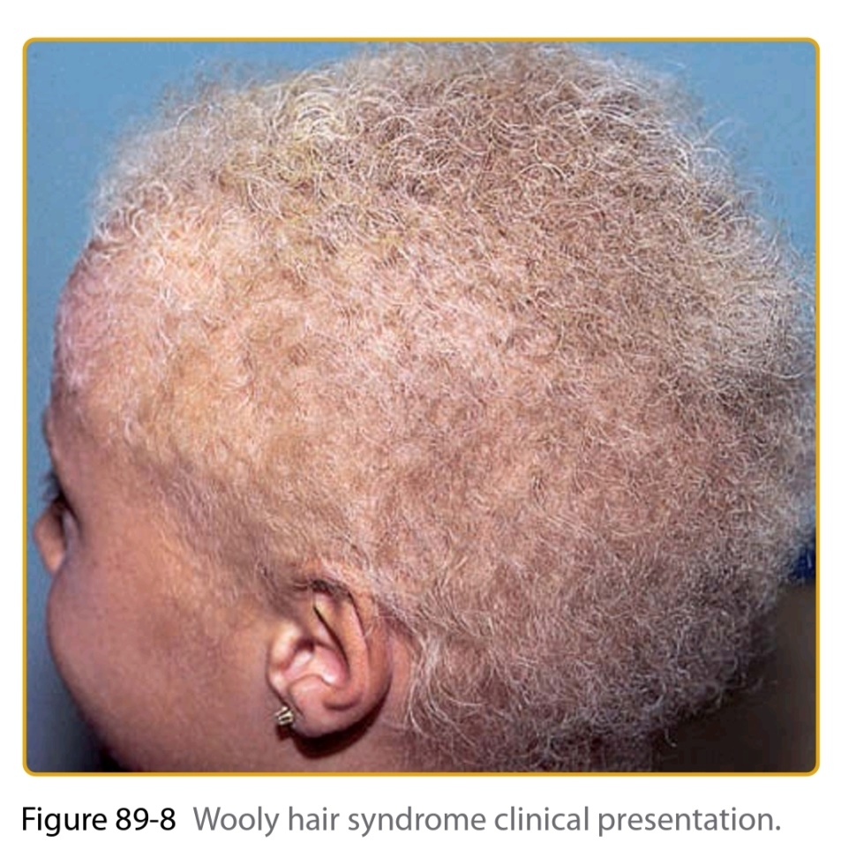
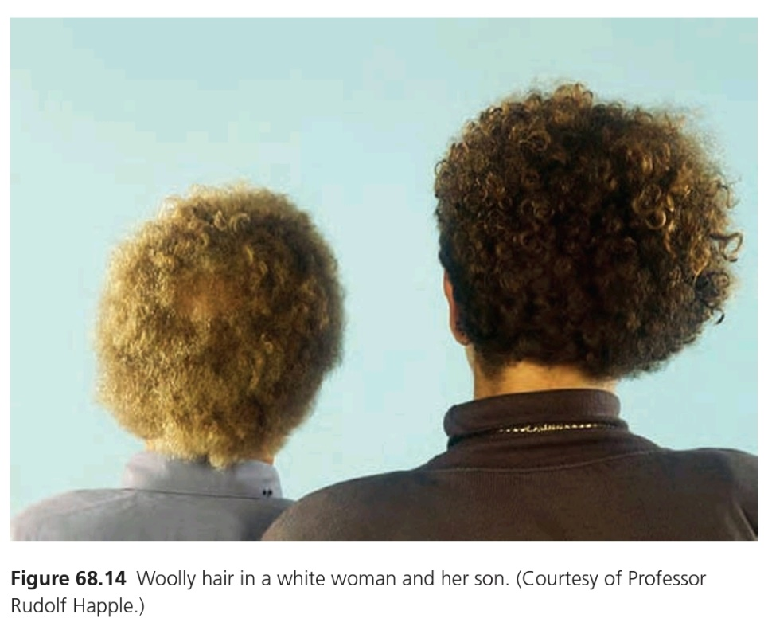
WOOLLY HAIR

Slide 48
PILI TORTI
Breakable, Short, Sparse hair over the scalp and body
Hair showing 180 degree twists under microscope
Pili Torti are associated with many complex syndromes:
-Menkes Disease
-Occipital Horn disease
-Bjornstad syndrome
-Netherton Syndrome
-Hypotrichosis with Juvenile Maculopathy
-Bazex Syndrome
-Citrulinaemia
-Autosomal Recessive Ichthyosis with Hypotrichosis
-Lupus Erythmatosus

Slide 49
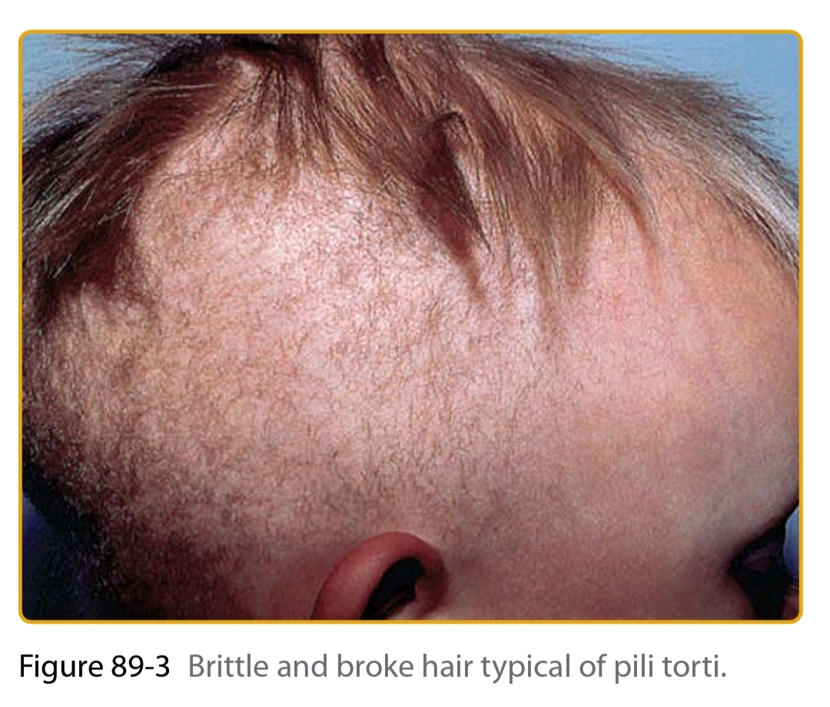
PILI TORTI

Slide 50
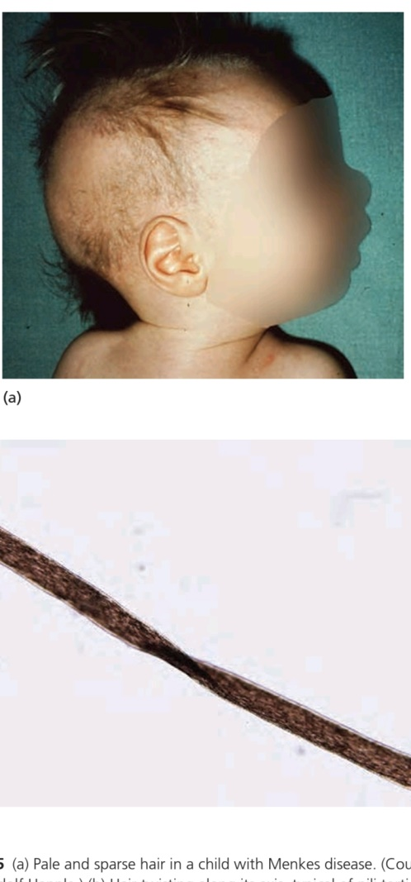
MENKES DISEASE
Fine, Sparse, Wiry, Fragile, Silver/White hair
Hair microscopy reveals Pili Torti, Monilethrix, Trichorrhexis Nodosa.
Skin may show mottled discolouration, often Lax.
Upper lip exaggerated
Neurological signs (Hypotonia,Seizure)
Skeletal dysplasia,Dental,Occular Anomalies.
Serum Copper and Ceruloplasmin levels are low.
X-Linked Recessive
Mutations in ATP7A gene(encodes trans-golgi membrane Copper Transporter).

Slide 51
TRICHORRHEXIS NODOSA
Irregular spaced swellings along the hair shaft-which appear to be result of cuticle loss
Hair prone to Fracture
Associated with:
-Netherton Syndrome(AR=SPINK5 gene mutation)
- Menkes Syndrome(XLR=ATP7A gene mutation)
-Trichothiodystrophy(AR=MPLKIP gene mutation)
-Argininosuccinic aciduria(ASL gene mutation)
-Trichohepatoenteric Syndrome(AR=TTc37,SKIV2L mutations)

Slide 52
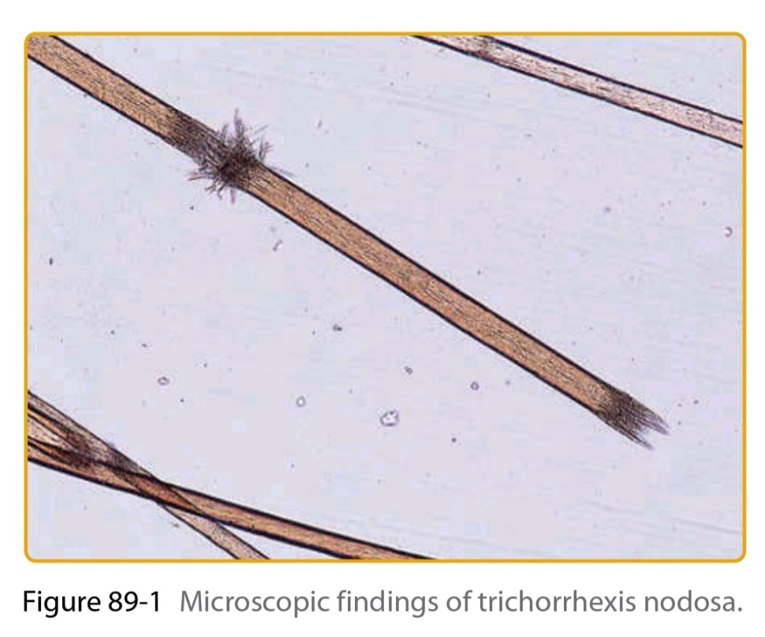
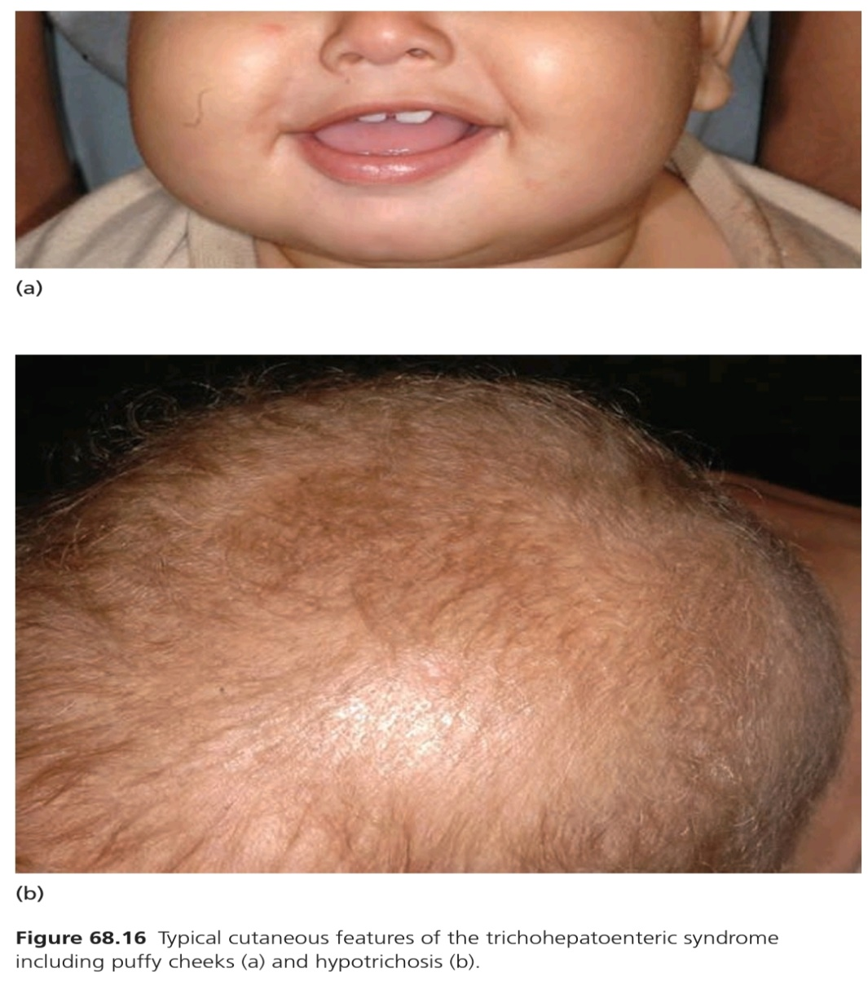
TRICHORRHEXIS NODOSA

Slide 53
TRICHORRHEXIS INVAGINATA
Sparse, short, very thin hair
Typical Ball and Socket(Bamboo Hair) appearance in which distal part of hair shaft compressed against dilated and cupped proximal shaft, better recognized in eyebrows.
Hallamark of Netherton Syndrome
Also seen in other Ichthyosiform disorders
Autosomal Recessive
SPINK5 gene mutations(encodes serine protease inhibitor LEKTI)

Slide 54
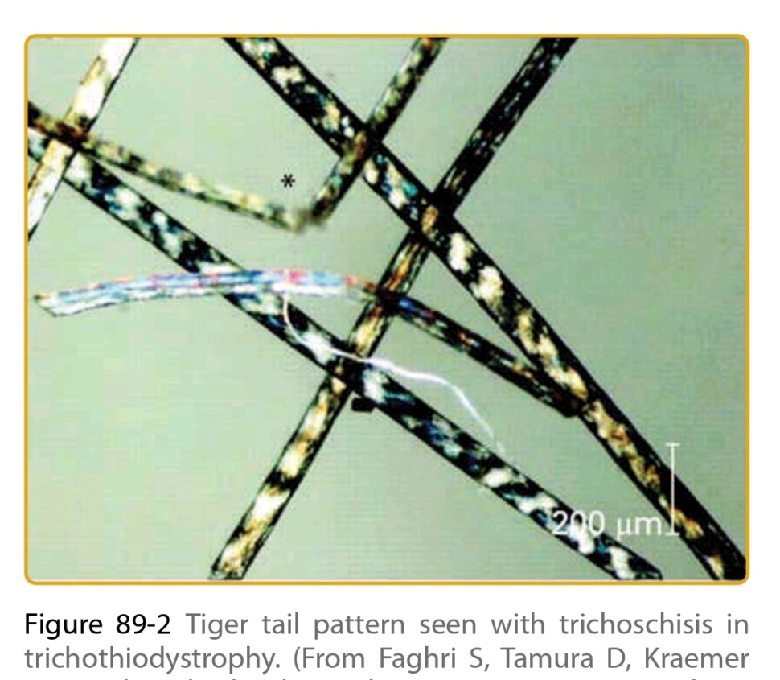
TRICHOTHIODYSTROPHY
Brittle, Fragile hair on scalp, eyebrows, eyelashes.
‘Tiger Tail Banding’ pattern on Hair Microscopy
Nail dystrophy
Short Stature
Progeroiod Facies(loss of adipose tissue)
Ocular manifestations
Joint contracture
Mental retardation
Photosensitivity
Autosomal Recessive
Mutations in MPLKIP,ERCC2 &3 genes

Slide 55
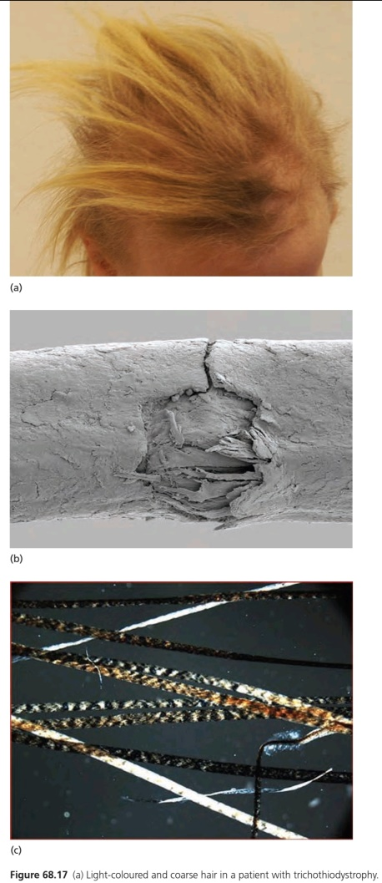
TRICHOTHIODYSTROPHY

Slide 56
PILI TRIANGULATI ET
CANALICULI
(UNCOMBABLE HAIR SYNDROME)
Dry, Course, Frizzy, Light hair which stand straight up from the scalp which cannot be combed.
Typical longitudnal grooves only visible on transverse section or electron microscopy.
Association with Skeletal dysplasias and other complex syndromes.
Autosomal Dominant/Recessive/Sporadic.

Slide 57
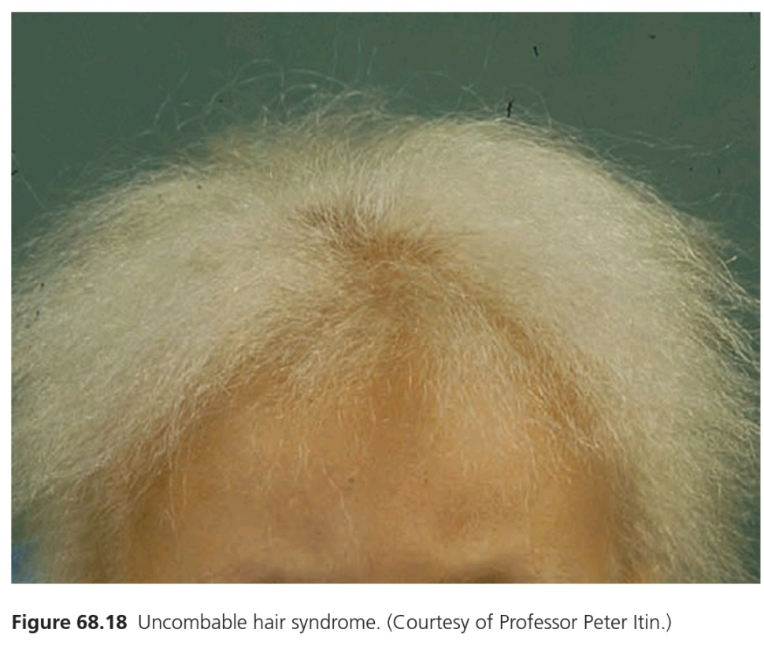
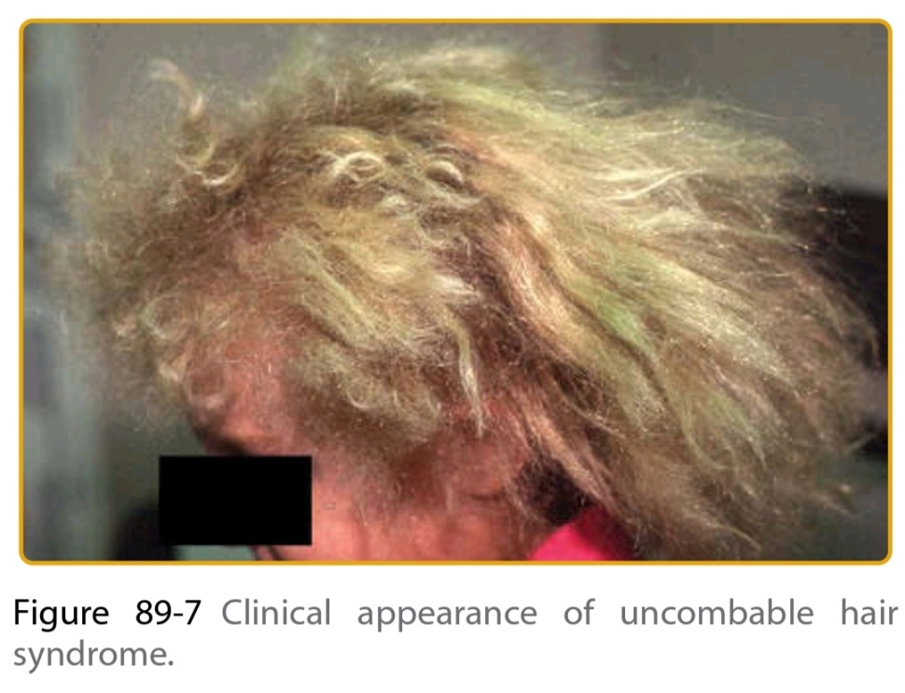
UNCOMBABLE HAIR SYNDROME

Slide 58
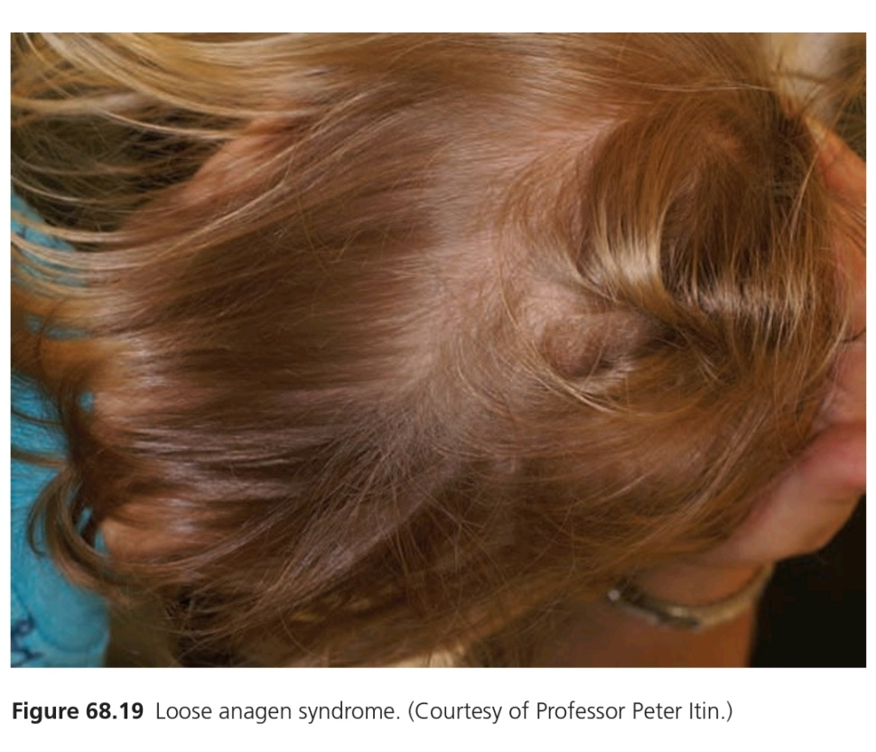
LOOSE ANAGEN SYNDROME
Hair which are easily pulled away from the scalp.
Starts in early childhood.
Slow growing, Short, Sparse, Light coloured hair.
Due to poor adhesion between cuticle and inner root sheeth.
Diagnosis based on presence of 70% or more loose anagen hair on a standard Trichogram.
Autosomal Dominant

Slide 59
OTHER INHERITED HAIR SHAFT
DEFECTS
PILI ANNULATI: Air-filled cavities within the hair shaft resulting in dark and light bands under microscope.
KINKY HAIR: Typical of Tricho-Dento-Osseous syndrome, mutations in DLX3 gene.
SPIKY HAIR: Hallmark of Bamroth-Lazarus Syndrome (Spiky hair, Cleft Palate, Athyroidal hypothyroidism, Choanal atresia, Bifid glottis).

Slide 60
DIAGNOSIS OF INHERITED HAIR
DISORDERS
Diagnosis is mostly Clinical, based on history of onset at birth or in early childhood, and typical clinical features.
Hair Microscopy of pulled hair
Scanning Electron Microscopy
Transverse Section of pulled hair
Skin Biopsy to rule out Acquired causes of Hair Loss
Dermoscopy

Slide 61
MANAGEMENT OF INHERITED HAIR
DISORDERS
Education and Counselling: About the Nature of defect,Course and Fate of the hair defect.
Depilation : For Hypertrichosis
Laser Hair Removal: For Hypertrichosis
Minoxidil: For some Hypotrichosis e.g: Monilethrix
Oral Retionoids: For some Hypotrichosis e.g: Monilethrix

Slide 62
THANK YOU !

