Slide 1
HIV AND THE SKIN
Dr Kiran Gul
Resident Dermatology
CMH Abbottabad

Slide 2
OBJECTIVES
Introduction to HIV & AIDS
Pathophysiology
Clinical presentation
Complications
Disease course & prognosis
Management
Dermatological manifestations of HIV

Slide 3
DEFINITION
Sexually transmitted disease
From blood or blood product
Vertically from mother
Birth or breast feeding
Virus infects immunocompetent cells CD4+ T cells

Slide 4
INTRODUCTION
Skin and mucosa: important routes for infection
Rare dermatoses or any skin disease presenting in an unusual manner, HIV testing is must

Slide 5
PATHOPHYSIOLOGY
VIROLOGY
Two types of HIV infect humans is HIV-1 & HIV-2
HIV-1 commonest cause of AIDS
HIV-2 more slowly than HIV-1

Slide 7
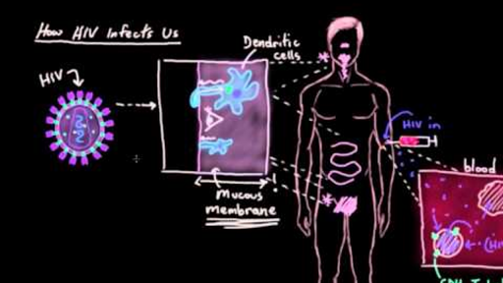

Slide 8
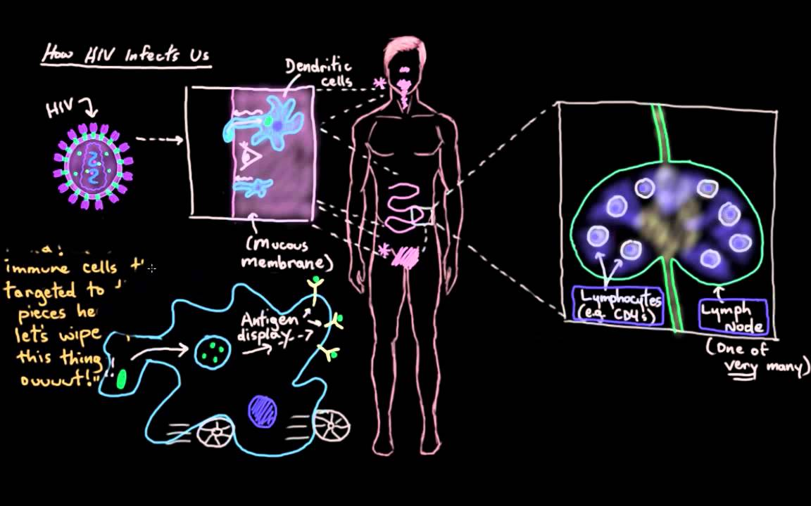

Slide 9
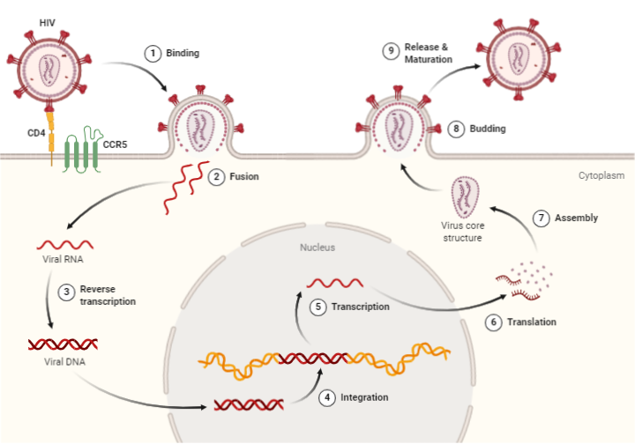

Slide 10
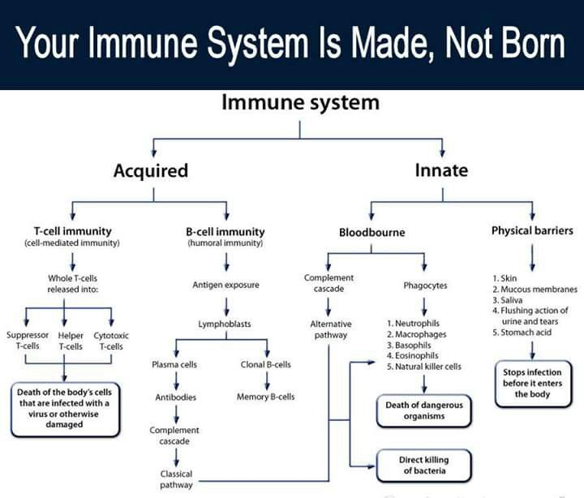

Slide 11
PRESENTATION
Acute primary HIV infection clinically silent
1-6 weeks after exposure
Non specific symptomatic illness = 90%
Fever, myalgia, arthralgia, lymphadenopathy, weight loss, nausea, vomiting & diarrhoea
Symptomatic primary HIV infection, strong predictor of progression to AIDS

Slide 12
Dermatological manifestations of HIV
seroconversion
• Exanthema
• Enanthema
• Urticaria
• Toxic erythema
• Erythema multiforme
• Oro‐pharyngeal candidosis
• Acute genito‐crural intertrigo
• Oral ulceration
• Genital ulceration

Slide 13
COMPLICATIONS
IRIS- immune reconstitution inflammatory syndrome
IRD- immune restoration disease
IRAD- immune reconstitution associated disease is the preferred terminology

Slide 14
Immunoreconstitution reactivates:
Host response to latent infections
Unmask autoimmune diseases
Increase the risk of Kaposi sarcoma and non-Hodgkin lymphoma
Pediatric IRIS/IRD/IRAD is common
Half of events are dermatological

Slide 18
DISEASE COURSE & PROGNOSIS
‘Rapid progressors’ develop AIDS within 2-3 years
‘Long term non progressors or long term survivors’ develop AIDS more than 10-15 years
Time from seroconversion to AIDS is 10 years

Slide 19
TIME FOR HIV SEROCONVERSION TO AIDS
7 years in transfusion recipients
10 years for haemophiliacs
10 years for IV Drug users
10-12 years for Homosexual men

Slide 20
CLINICAL INDICATORS
Oral thrush, oral hairy leukoplakia, herpes zoster, constitutional symptoms and weight loss
CD4 T-CELL COUNT
A CD4 T-cell count of less than 200 x 106 per L is diagnostic of AIDS and the median survival time is 38-40 months
The average CD4 T-cell count for the most common AIDS-defining conditions is in the range of 20-100 x 106 per L.

Slide 21
INVESTIGATIONS

Slide 22
HIV PREVENTION
ARV treatment : 96% reduction
Circumcision : 60% reduction
Newer strategies :
vaccines and microbicides,
topical and oral pre-exposure prophylaxis

Slide 23
ANTIRETROVIRAL TREATMENT
NRTI
NNRTI
PROTEASE INHIBITORS
INTEGERASE INHIBITORS

Slide 24
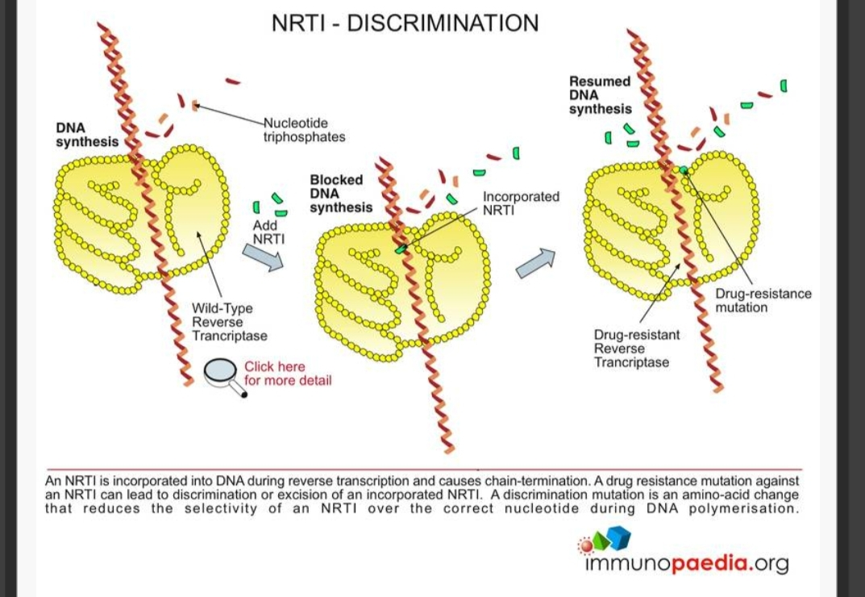
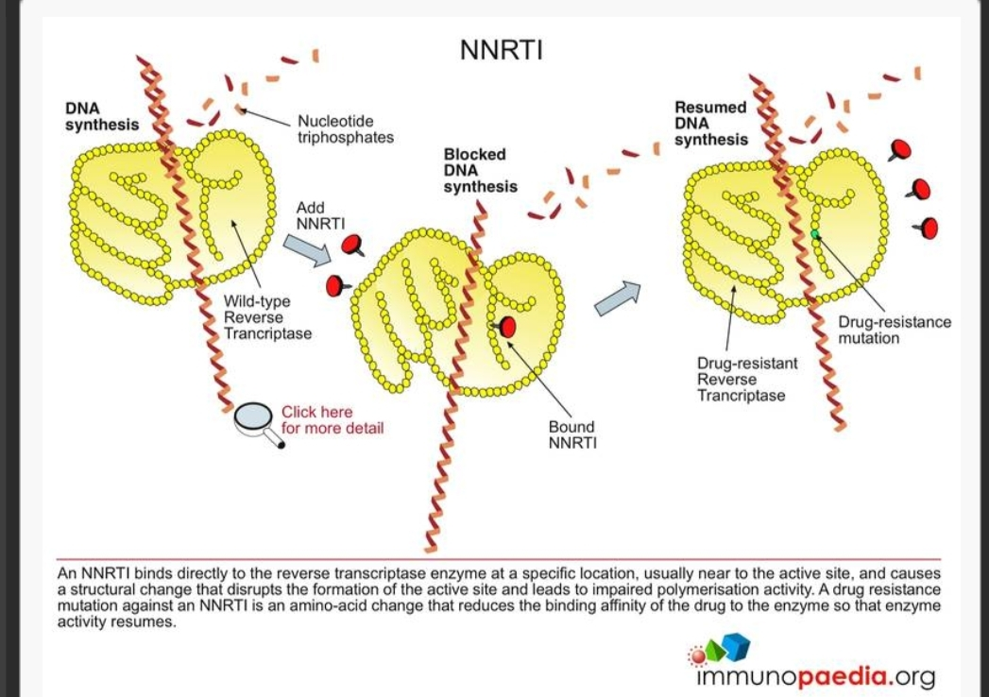
ANTIRETROVIRAL TREATMENT

Slide 25
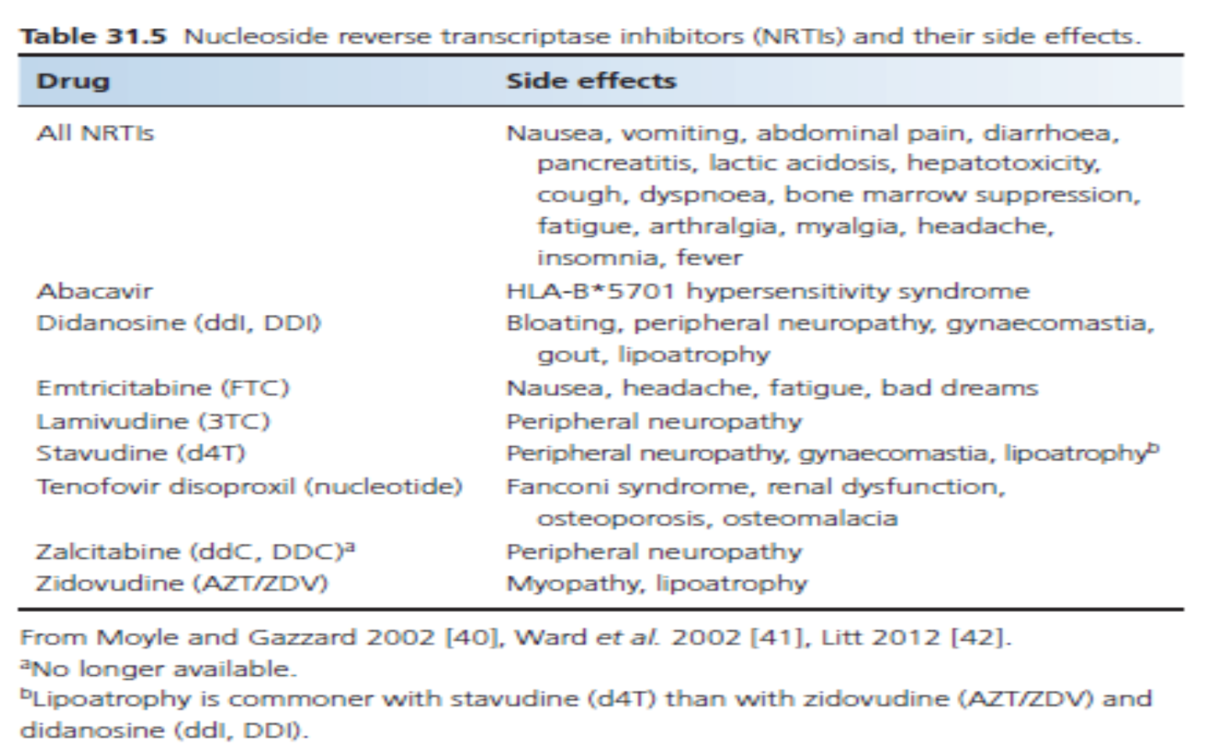

Slide 27
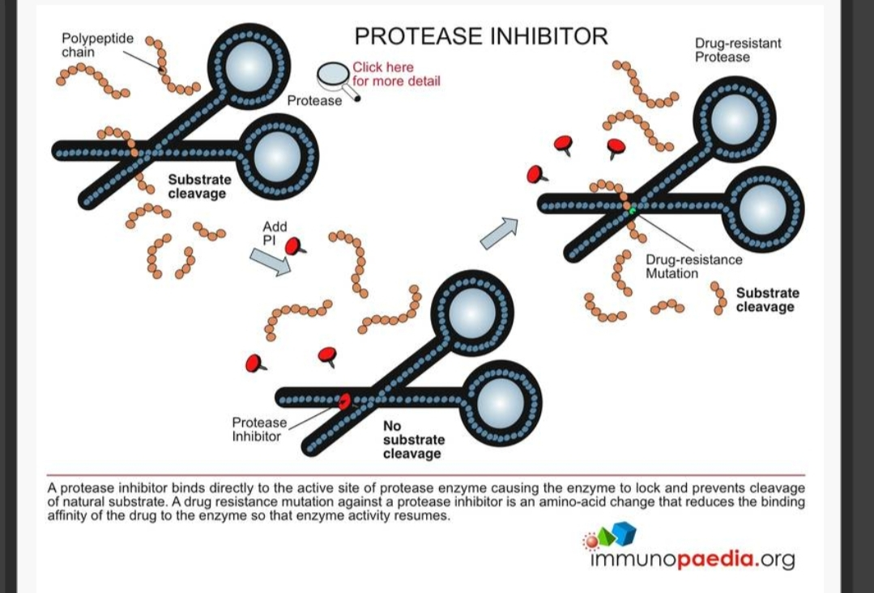
Protease Inhibitors
They inhibit protease enzyme thus inhibit viral maturation process resulting in lack of functional virion formation

Slide 29
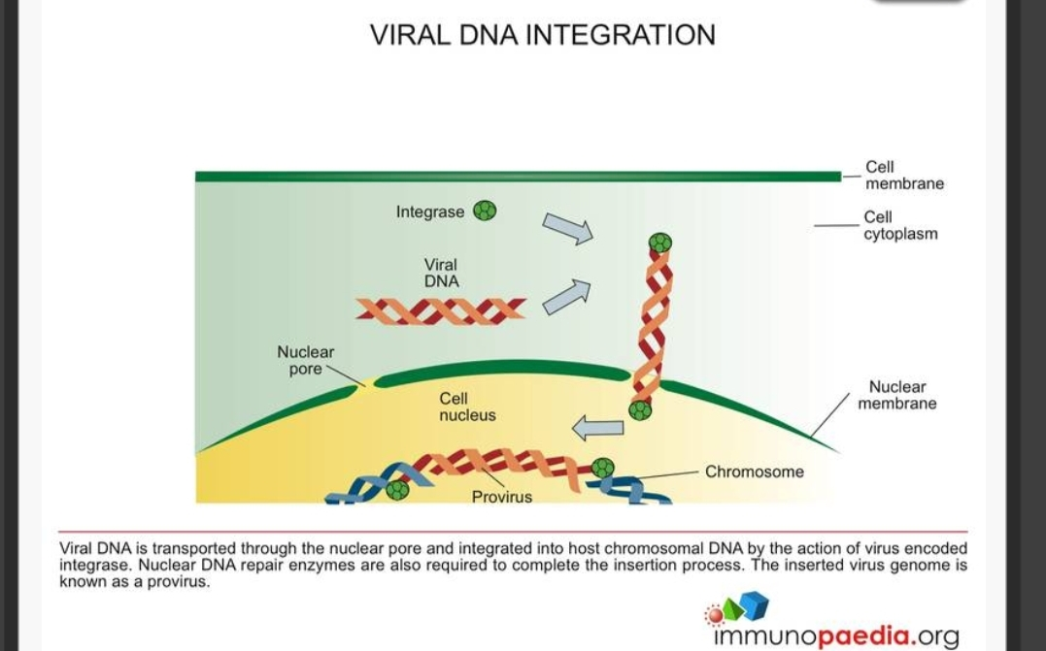
Integrase Inhibitors

Slide 30
Common dermatological conditions in
HIV infection
• Herpes simplex
• Herpes zoster
• Viral warts
• Mollusca
• Oral and vaginal candidosis
• Tinea (including onychomycosis)
• Scabies
• Basal cell carcinoma
• Squamous cell carcinoma
• Kaposi sarcoma
• Pruritus/ xerosis /ichthyosis
• Nodular prurigo
• Folliculitis
• Eosinophilic folliculitis
• Pruritic papular eruption
• Seborrhoeic dermatitis
• Psoriasis
• Granuloma annulare
• Drug eruption

Slide 31
INFLAMMATORY DERMATOSES
Seborrheic dermatitis
Earlier onset in homosexual & bisexual
Severity increased at CD4 T-cell counts below 100 x10⁶/L
Coexist with neurological disease like dementia and spinal cord disease
Atopic eczema
Granuloma annulare
Porphyria cutanea tarda
Drug reactions

Slide 32
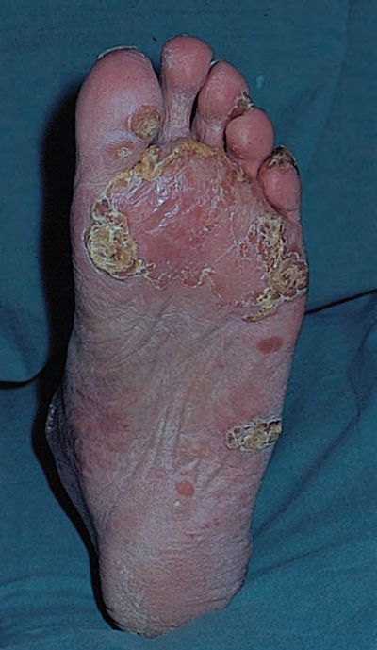
Psoriasis
More prevalent
Paradoxical phenomena
CD4 T cells decreases
Langerhan cell decreases
Worsen or appear for the first time in HIV
More florid, severe and atypical
CD4 cells:IL17 are central to pathogenesis
Psoriatic arthritis more common
Severe psoriasis: cessation of cART

Slide 33
PATHOGENSIS
Suppression of CD4 suppressor T cells result in unchecked proinflammatory pathways
HIV Nef proteins has superantigenic properties
Autoreactive T cells recognize autoantigens
Infections : drive via superantigen mediated autoimmunity

Slide 34
treatment
Psoralen and PUVA superior to UVB therapy
Retionids: etretinate, acitretin
Cautions with protease inhibitors with their retinoids like side effects (xerosis, chelitis, paronychia)
Methotrexate and ciclosporin causes serious complications in HIV patients (leukopenia and fulminant KS)
Methotrexate should be avoided
Treatment with zidovudine improves psoriasis
TNF alpha inhibitors are CI

Slide 35
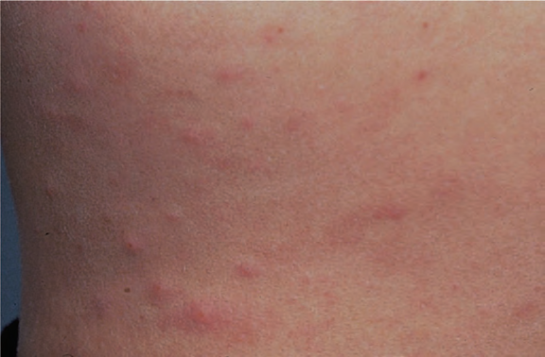
EOSINOPHILIC FOLLICULITIS
HIV specific disorder
Occurs at CD4 T cell count of 250-300*106
TH2 cytokines( IL4,5)
Centripetal eruption of pruritic erythematous, perifollicular papules and pustules
Subclinically photosensitive
Peripheral eosinophilia
Elevated levels of lgE

Slide 36
TREATMENT
Phototherapy: most successful treatment
Other treatments:
Topical disodium cromoglycate
Potent topical steroids
Topical tacrolimus
Oral antihistamines
Oral antibiotics, oral Iitraconazole, oral dapsone, oral indomethacin, oral isotretinoin

Slide 37
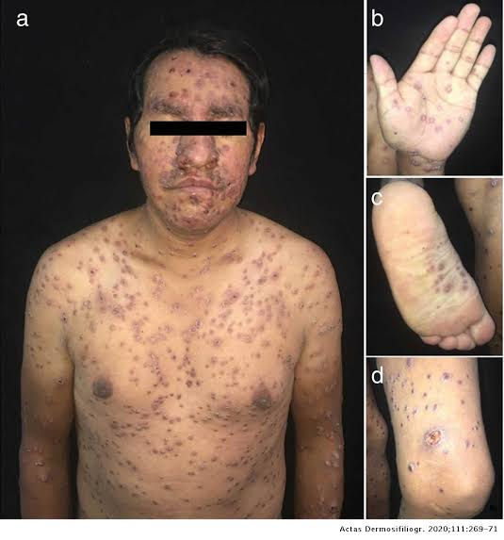
PRURITIC PAPULAR ERUPTION
Sign of an advanced degree of immunosuppression.
Similarity with papular eruption of pregnancy
First sign of HIV
Occurring at CD4 T-cell counts below 100-200 x 10⁶/L.
Present as excoriated, erythematous, urticarial papules
Eosinophilia
Elevated IgE

Slide 38
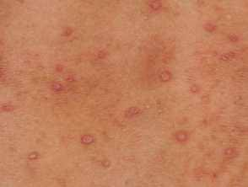
treatment
Phototherapy
Thalidomide and pentoxifylline
Oral antihistamines
Topical steroids

Slide 39
INFECTIONS
Bacterial Infections
Viral Infections
HSV
VZV
HPV
CMV
Mollusca
Protozoal Infections
Scabies

Slide 41
Cytomegalovirus
Reactivation of CMV in HIV infection occurs with a CD-4 count below 50 x 10⁶ /L
Present as purpura, papules, nodules , verrucous plaques and painful ulcers, coagulopathies and nodular prurigo

Slide 42
BACILLARY ANGIAMATOSIS
Caused by gram negative organism Bartonella henselae
Resemble KS
Purple, papular, nodular, vascular lesions
Diagnosis: skin biopsy
On H/P: lobular vascular proliferation, abnormally enlarged epithelial cells are epitheloid rather than spindle shaped in KS
Organisms can be demonstrated by Warthin Starry silver staining

Slide 43
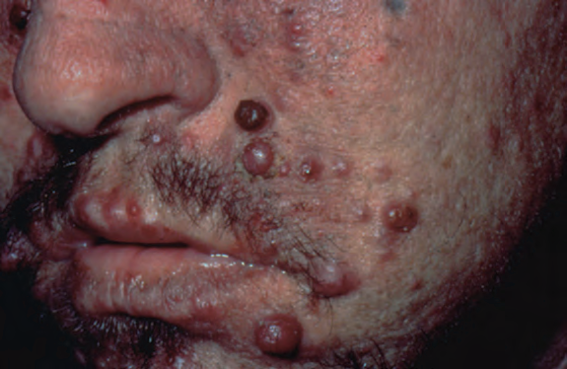
TREATMENT
Oral erythromycin
Isoniazid
Rifampicin
Ethambutol
Clofazimine

Slide 44
Mollusca
More common in homosexual
Lesions are not typically domed in shape and lack central umbilication

Slide 45
FUNGAL INFECTIONS
Candidosis
Dermatophytosis
Histoplasmosis
Cryptococcosis

Slide 47
Kaposi Sarcoma
KS is an AIDS defining diagnosis
Low CD-4 counts and high viral loads
Caused by HHV-8
More common homosexual men
Cutaneous KS is multicentric
involves the face, oral mucosa , palate ad genitalia
The classic lesion in HIV is a purple patch plaque or nodule which may ulcerate
cART has reduced the incidence of KS

Slide 48
Angiogenic and proinflammatory effects on endothelial cells that proliferate to form spindle shape cells
Follow skin creases may be grouped, linear or kobnerize
Yellow green penile plaques reported

Slide 49
Differential diagnosis of Kaposi sarcoma
• Naevus
• Histiocytoma
• Cryptococcosis
• Histoplasmosis
• Leishmaniasis
• Pneumocystis lesions
• Dermatophytosis
• Angioma
• Bacillary angiomatosis
• Pyogenic granuloma
• Melanoma

Slide 50
Local treatment
• Cryotherapy
• Radiotherapy
• Topical retinoids: alitretinoin
• Topical antivirals: cidofovir, docosanol
• Intralesional, e.g. IFN‐α, TNF‐α, vinca alkaloids
• Surgery, e.g. curettage, cautery, infrared coagulation
• Laser
• Photodynamic therapy
Systemic treatment
• cART
• Isotretinoin
• Cidofovir
• Intravenous chemotherapy, e.g. anthracyclines such as
liposomal daunorubicin, liposomal doxorubicin, bleomycin,
paclitaxel, vincristine, etoposide
• Interleukin 4
• Imatinib mesylate
• Thalidomide, lenalidomide

Slide 51
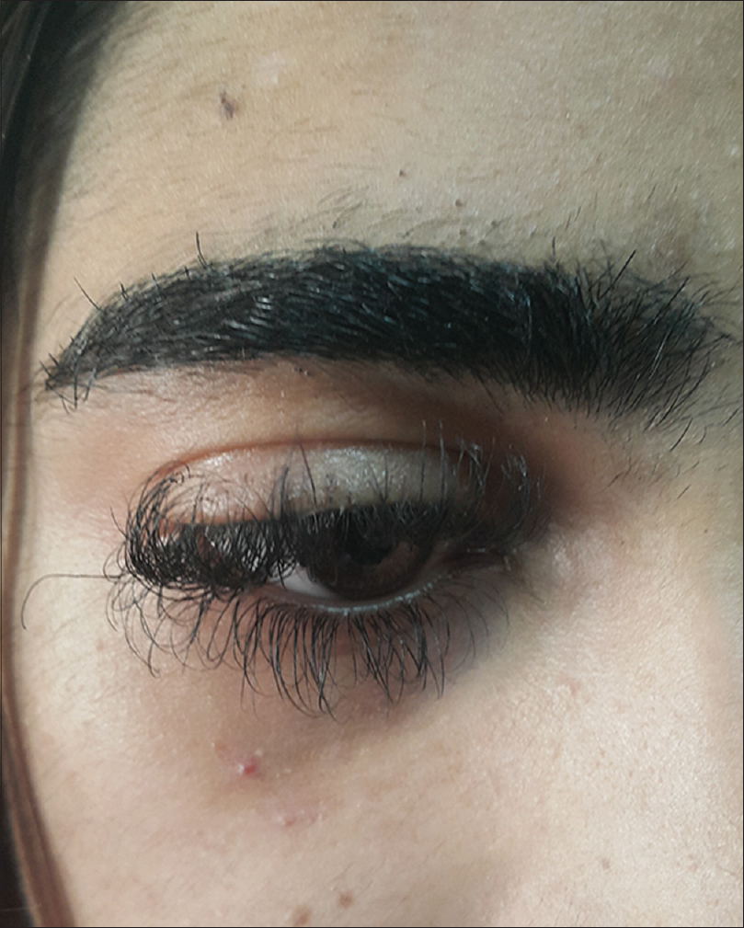
Hair and Nails
Acquired trichomegaly of the eyelashes (zidovudine)
70% of HIV patients have nail changes
Grey nails and distal banded nails, associated with low CD4 counts of less than 200 x 10⁶ /L

Slide 53
Oral hairy leucoplakia

Slide 54


