Slide 1
Graft vs. host disease(GVHD)
By Dr.Hamna Hafeez

Slide 2
Types of grafts
Autogenous : taken from the same organism e.g bone grafts, Plattlet rich plasma.
Allogenous : taken from another organism but of the same species e.g bone marrow transplant (HSCT)
Xenogenous : taken from another species
Isograft : grafting between twins

Slide 3
Definition & OVERVIEW:
GVHD is the totality of organ dysfunction caused by the action of donor derived immunocompetent T Lymphocytes against antigens expressed on cells of immunocompromised host.
Graft vs. host REACTION is expression of GVHD in a specific organ e.g cutaneous GVHR
Main organs affected are : skin , liver , GIT.

Slide 4
Overview
GvHD is a major casue of morbidity and mortality following allogenic HSCT. Mostly the first organ affected is the skin.
There are two types : ACUTE & CHRONIC
10 to 80% of HSCT will develop aGvHD
Major causes include HLA mismatch, unrelated donors, age above 40, gender mismatch,total body irradiation.

Slide 5
ACUTE GVHD
Disease presenting within first 100 days of
grafting ( but now being defined using
clinical features , regardless of time frame.

Slide 6
Pathophysiology of aGVHD
3 stages :
First, toxicity from conditioning chemotherapy or radiotherapy causes tissue damage in the host, resulting in the release of numerous inflammatory cytokines, termed ‘a cytokine storm’.
• Second, mature donor lymphocytes from the graft are recruited by these cytokines leading to activation and proliferation of donor lymphocytes when contact is made with host and donor antigen‐presenting cells (APCs) expressing disparate host antigens (such as minor histocompatibility antigens (MiHC)).
• third, alloreactive T cells expand to form cytotoxic effector T cells that, in turn, induce further tissue injury and release more inflammatory cytokines.

Slide 7
Dermatopathology
Lichenoid inflammatory process with linear arrangement of lymphocytes along basement membrane zone.
Focal vacuolization of basal cell layer, apoptosis of individual keratinocytes , mild perivenular mononuclear cell infiltrate, apposition of lyphocytes to necrotic keratinocytes (satellite cell ,HALLMARK OF aGVHD )

Slide 8
Cont..
Vacuoles coalesce to form sub epidermal clefts → sup epidermal blister formation .
Scattered eosinophils are found both in drug reactions and in GVHD.

Slide 9
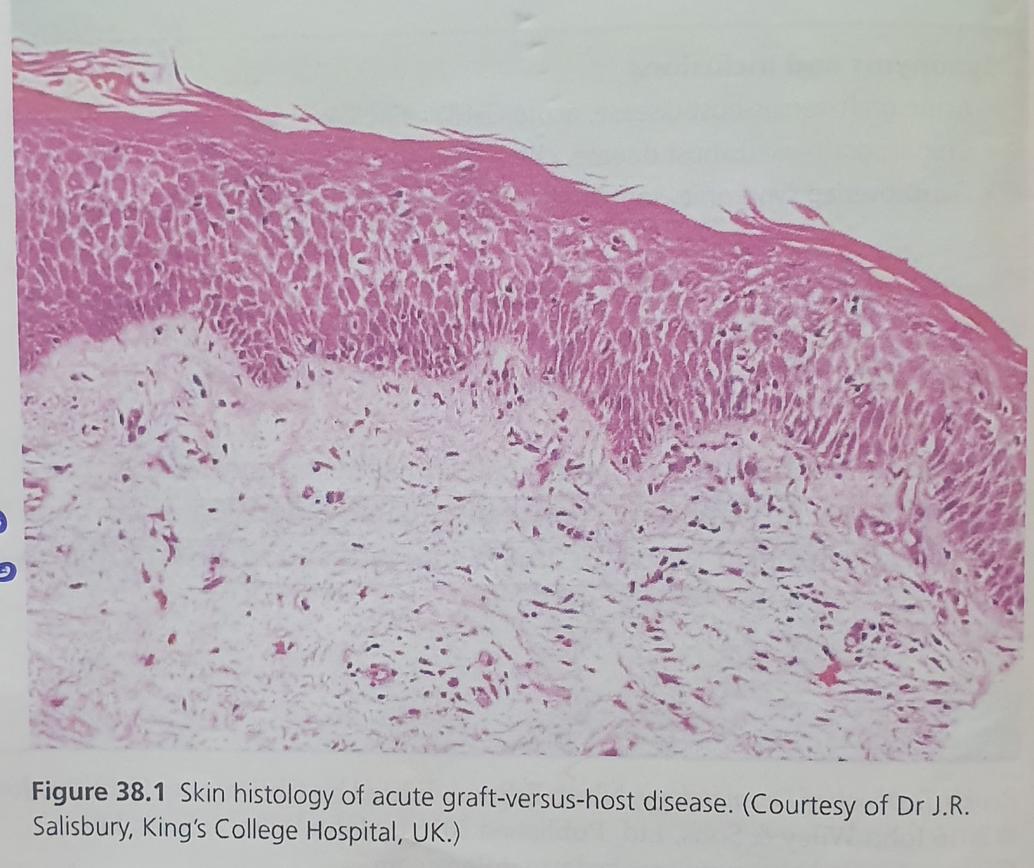

Slide 10
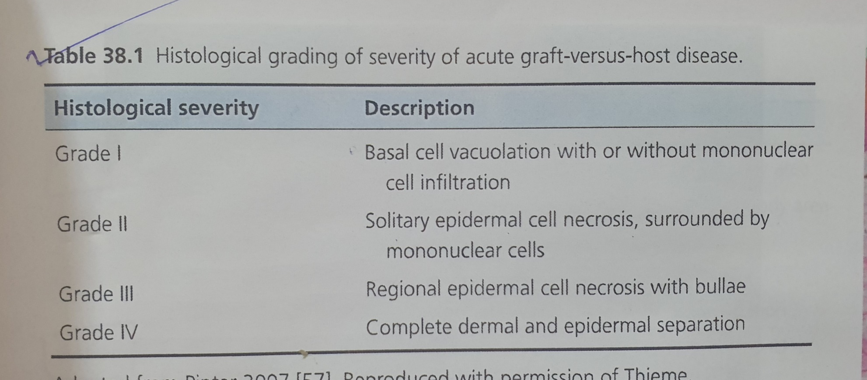
HISTOLOGICAL GRADES OF SEVERITY

Slide 11
History
Acute GvHD can present ant time after transplantation.
Pruritis or a burning sensation can precede skin eruption.
Oral or genital ulceration
Diarrhea, nausea,anorexia,vomitting,abdominal pain points to GI involvement.
Pale urine,dark stools ,RUQ pain may be present.

Slide 12
Presentation
Skin lesions : initiallay non blanching macules and or papules on upper extremeties and trunk esp on soles and palm
Mild edema with violaceous hue, periungal and on pinna. Erythema in perifollicular array
If controlled/resolved : erythema diminishes with subsequent desquamation &postinflammatory hyperpigmentation

Slide 13
Skin lesions continued:
If progresses , macules /papules become confluent and evolve into erythroderma.
And then eubepidermal bullae form
Positive Nikolsky’s sign
If bullae become widespread and rupture or erode, TEN like form of acute cutaneous GVHD occurs.

Slide 14
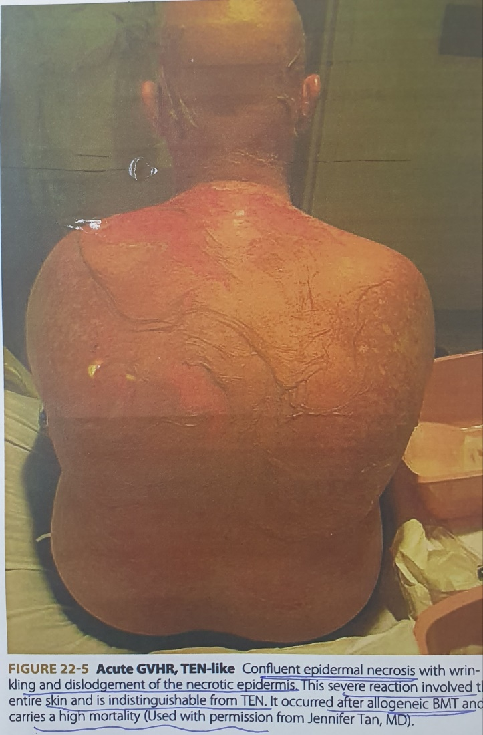

Slide 15
Presentation
Mucosal lesions : Lichen planus like
lesions in buccal mucosa, erosive
stomatitis, oral and occular sicca like
syndrome, esophagitis, keratoconjuctivitis.

Slide 16
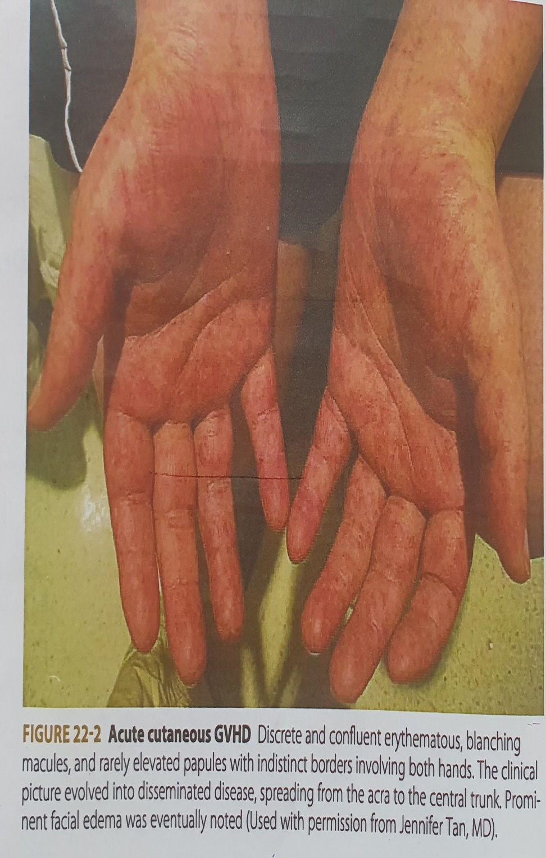
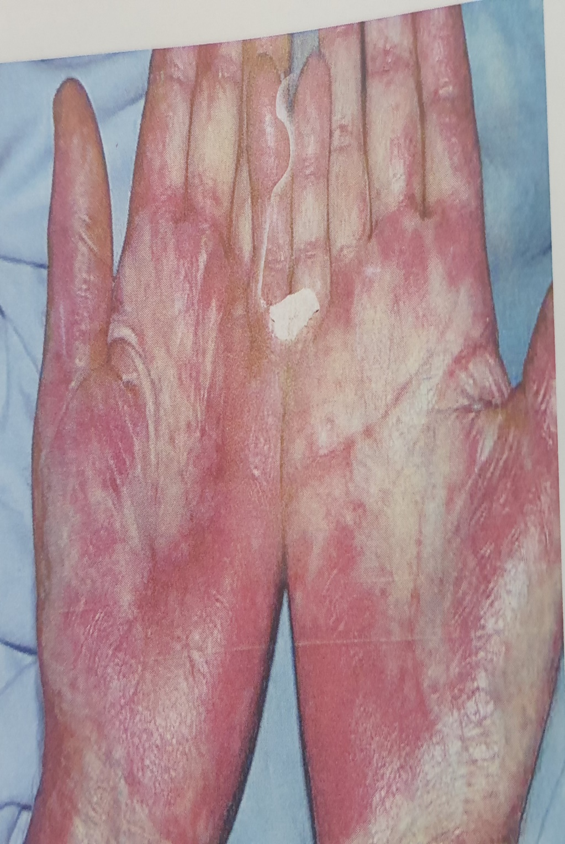

Slide 17
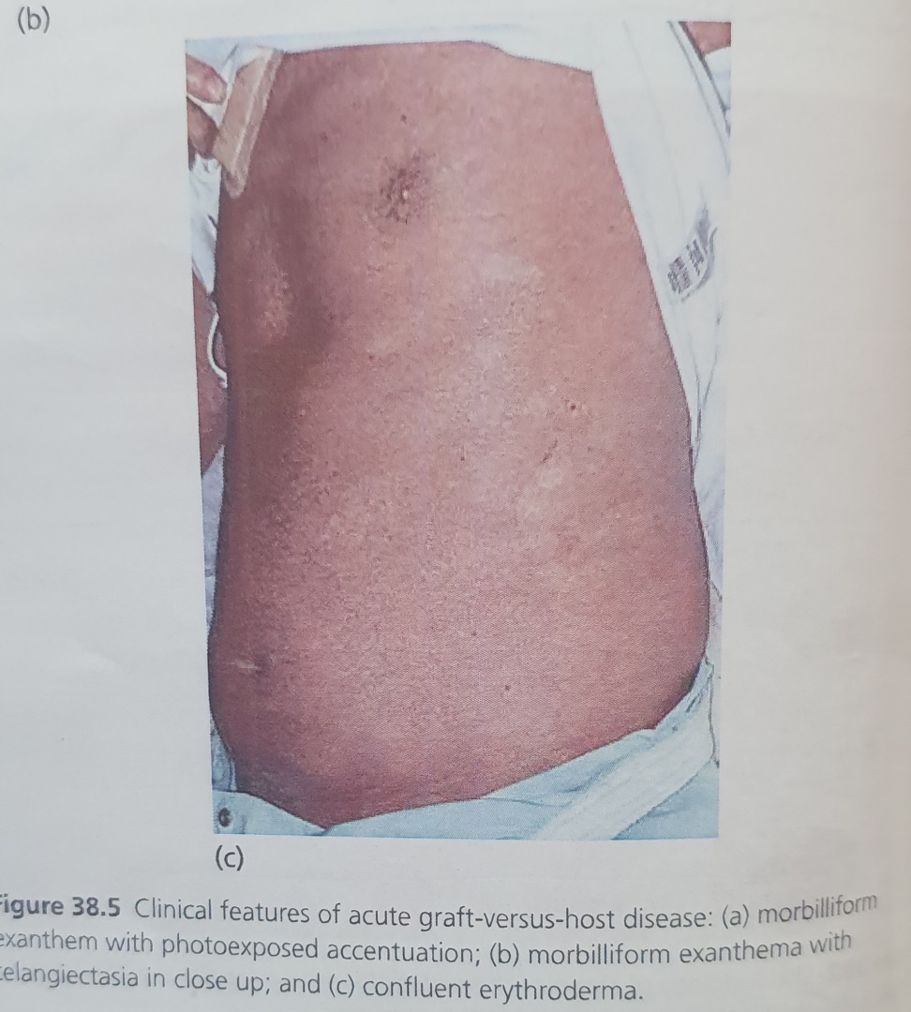
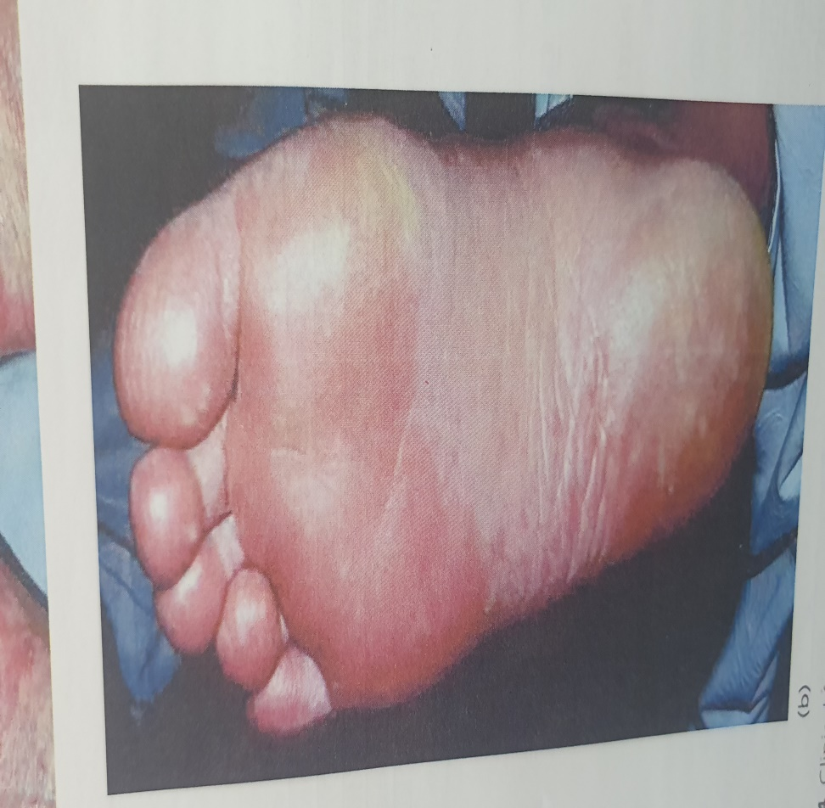
aGVHD

Slide 18
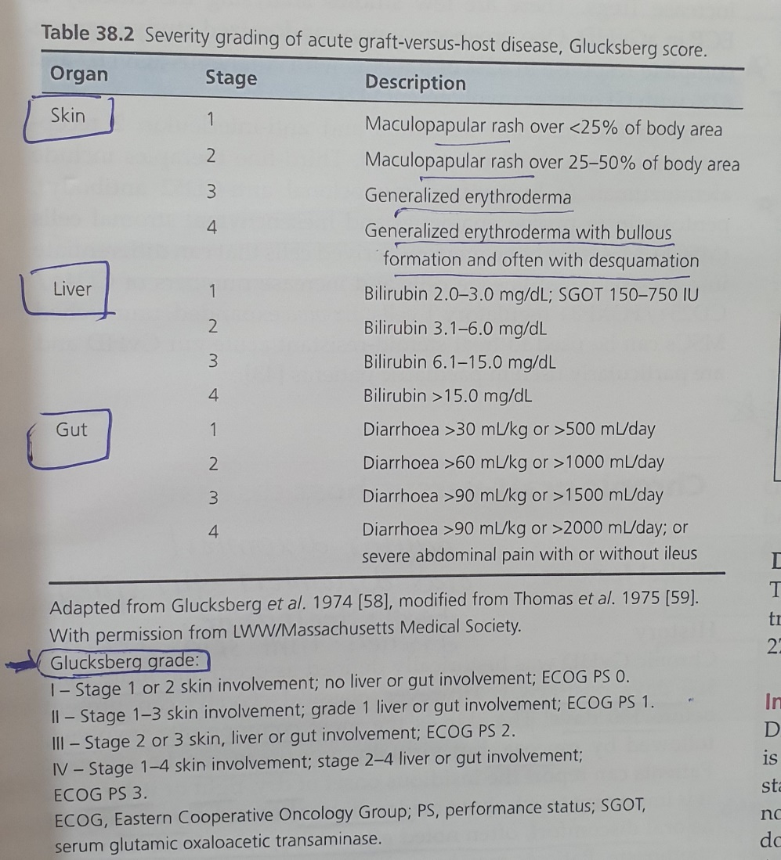

Slide 19
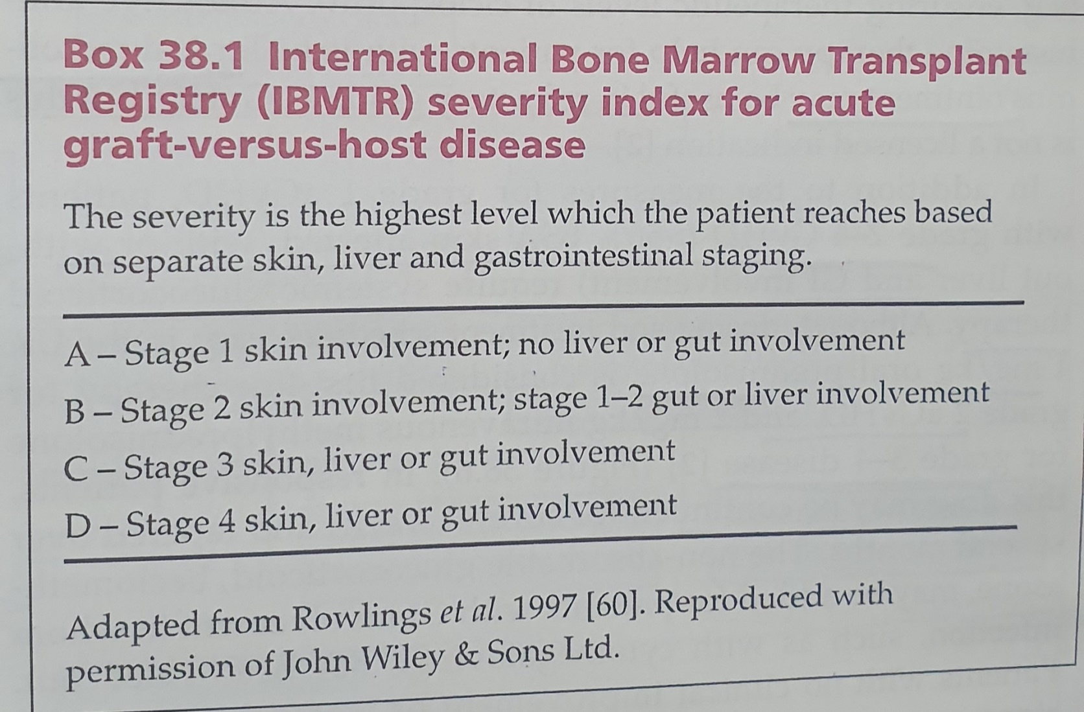

Slide 20
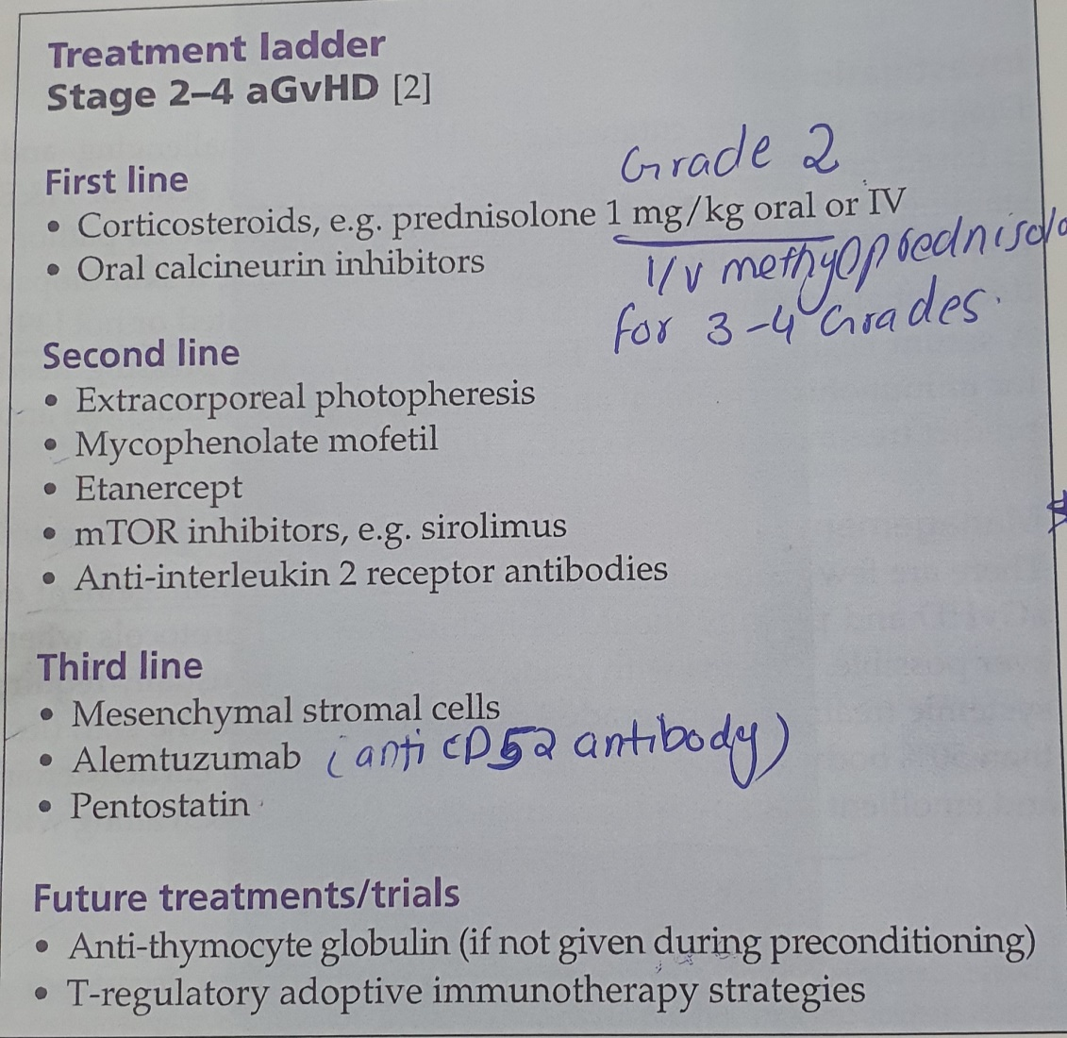

Slide 21
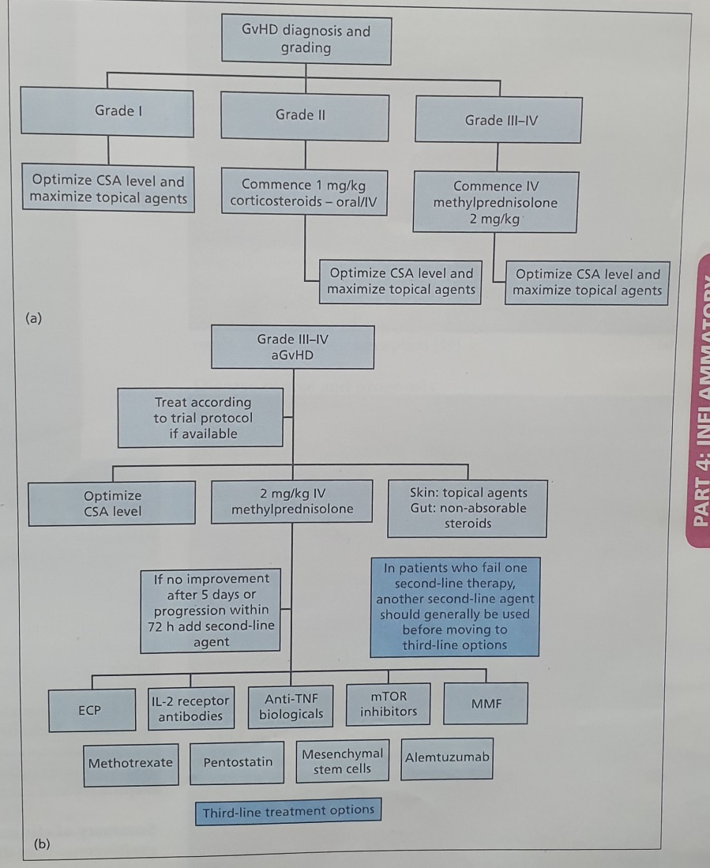

Slide 22
DD
Adverse drug reaction
Viral xanthema
Engrafment syndrome
TEN
Eytheroderma

Slide 23
Prognosis
The severity grade of GvHD correlates with overall survival. The transplant‐related mortality rates for grades 0–IV aGvHD are 28%, 27%, 43%, 68% and 92%, respectively

Slide 24
CHRONIC GVHD
was historically defined as occurring more than 100 days post‐HSCT. However, classical cGvHD can present before 100 days. The skin is the most common site involved, followed by mucosa, but virtually any organ can be affected.

Slide 25
Pathophysiology
(autoimmune) decreased immune tolerance is postulated to allow the activation and proliferation of donor T cells directed at ‘self’‐antigens shared between host and donor. Murine models suggest that donor T cells maturing in the host’s damaged thymus (due to conditioning regimens, age of recipient or aGvHD) escape from negative selection and then escape peripheral tolerance mechanisms, mediated by regulatory T cells (Tregs). Hence, analogous to autoimmunity, an imbalance between alloreactive T cells and Tregs may contribute

Slide 26
Cont..
Chronic donor T‐cell activation : A second model postulates that the presence of numerous disparate antigens may simply cause chronic stimulation of donor T cells, causing tissue damage and GvHD.

Slide 27
Dermatopathology
In cGVHD, histological changes depend on the type of skin involvement that may be lichenoid, or resemble scleroderma.
Lichenoid cGvHD histology has hyperkeratosis, hypergranulosis, acanthosis, saw‐toothed rete ridges, interface dermatitis and dyskeratotic keratinocytes. Periadnexal, particularly peri‐eccrine, infl ammation may be evident

Slide 28
History
Patients can report the insidious onset of dry, tight or itchy skin. Ask about ocular discomfort and dryness as well as oral discomfort, often noted after eating spicy foods or using toothpaste. Patients may be hesitant to report genital symptoms such as vulvovaginal dryness, itch and discomfort without direct questioning. GI symptoms of nausea, diarrhoea and vomiting, respiratory symptoms of shortness of breath (where infection has been excluded) and musculoskeletal symptoms, including muscle weakness and limited range of movement, are important in this multisystem disease.

Slide 29
Presentation
The skin features considered diagnostic are lichen planus-like lesions on the skin or in the mouth .sclerotic skin lesions and poikiloderma. Other distinctive associated clinical signs (not suffi cient alone to make the diagnosis) include skin dyspigmentation, nail dystrophy , alopecia, oral ulceration, mucoceles and xerostomia, keratoconjunctiva sicca and myositis.
Skin changes may be sclerotic or non‐sclerotic and have traditionally been classified as lichen planus-like (lichenoid) or scleroderma‐like (sclerodermoid) . a combination of lichen-planus like violaceous papules (that can be folliculocentric), sclerodermatous and poikilodermatous change is often seen, along with deep fascial involvement that can lead to contractures developing. With dermal involvement, a rippled cellulite appearance on thighs and upper arms can be seen, resembling eosinophilic fasciitis. ‘Grooving’ of the skin along the path of superficial vessels

Slide 30
Presentation
lichen sclerosus-like guttate hypopigmented atrophic plaques can be seen (when fibrosis is limited to the papillary dermis) and nummular morphoea‐like plaques (when dermal fibrosis has occurred).
Morphoea-like plaques exhibit an isomorphic response localizing to sites of pressure or trauma .
Non‐sclerotic (epidermal) manifestations also occur including eczema-like variants (eczematoid) papulosquamous, pityriasis rubra pilaris (PRP)-like, exfoliative and keratosis pilarislike presentations have been reported . As far as the mucosa, oral signs include mucoceles and Wickham’s striae on the lips and buccal mucosa.

Slide 31
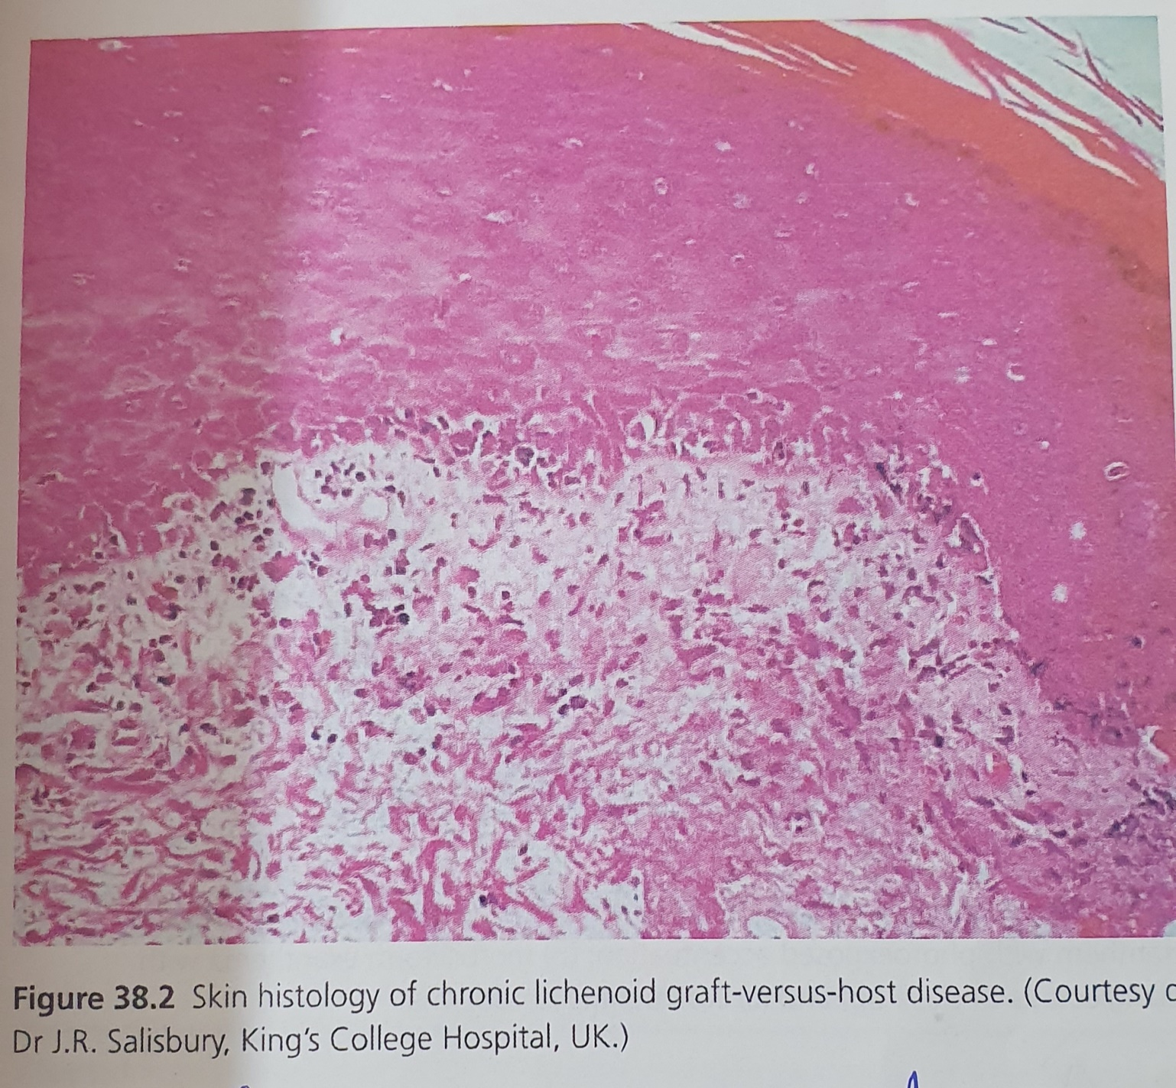

Slide 32
Dermatohistopathology
sclerotic lesions of cGvHD, lichen sclerosus‐like lesions show epidermal atrophy, oedema and homogenization of c ollagen in the superfi cial dermis Morphoeaform lesions show thickened dermal collagen fibre bundles with loss of adnexal structures and often no epidermal change. There may be involvement of the fat with thickened septae and lymphocytic infiltrate at the border between dermis and subcutis.

Slide 33
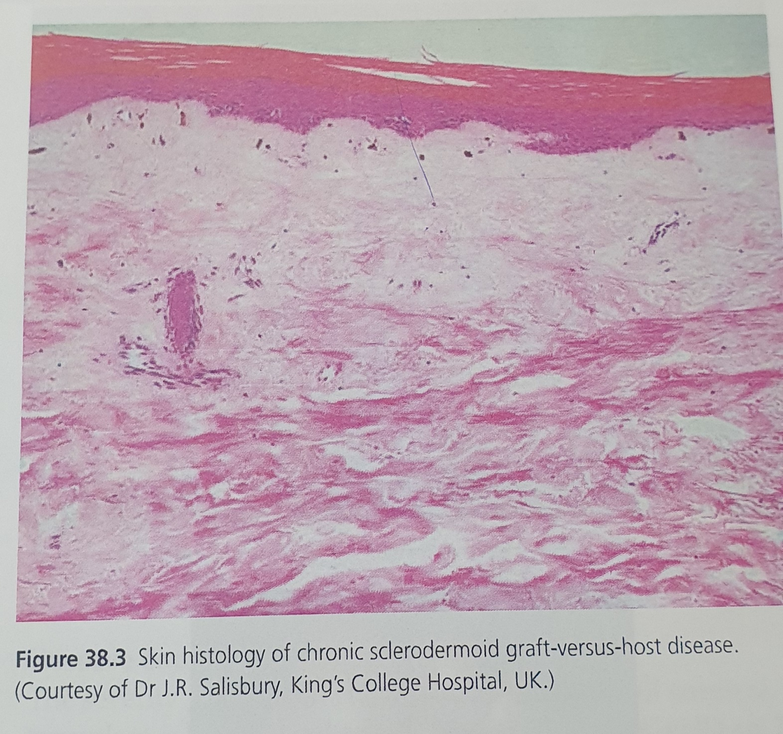

Slide 34
dd
The differential includes
drug‐induced lichenoid eruptions,
radiation‐induced fi brosis
skin sclerosis
morphoea.

Slide 35
Complications
Sclerotic disease and fascial contractures can cause severe limitation of movement and disability along with other issues such as diffi cult venous access. Dyspigmentation and poikiloderma can cause profound changes of appearance. The psychological burden of cGvHD and its impact on quality of life can be underestimated in patients who have already had to cope with the impact of malignancy and allogeneic transplant

Slide 36
prognosis
chronic GvHD is the major cause of mortality and morbidity in long‐term survivors of HSCT. Severity grading predicts prognosis . Chronic GVHD is associated with a higher treatment‐related mortality postallogeneic transplant despite a slightly lower rate of disease relapse . Overall survival at 2 years was 97, 86 and 62% for patients with mild, moderate and severe cGVHD, respectively

Slide 37
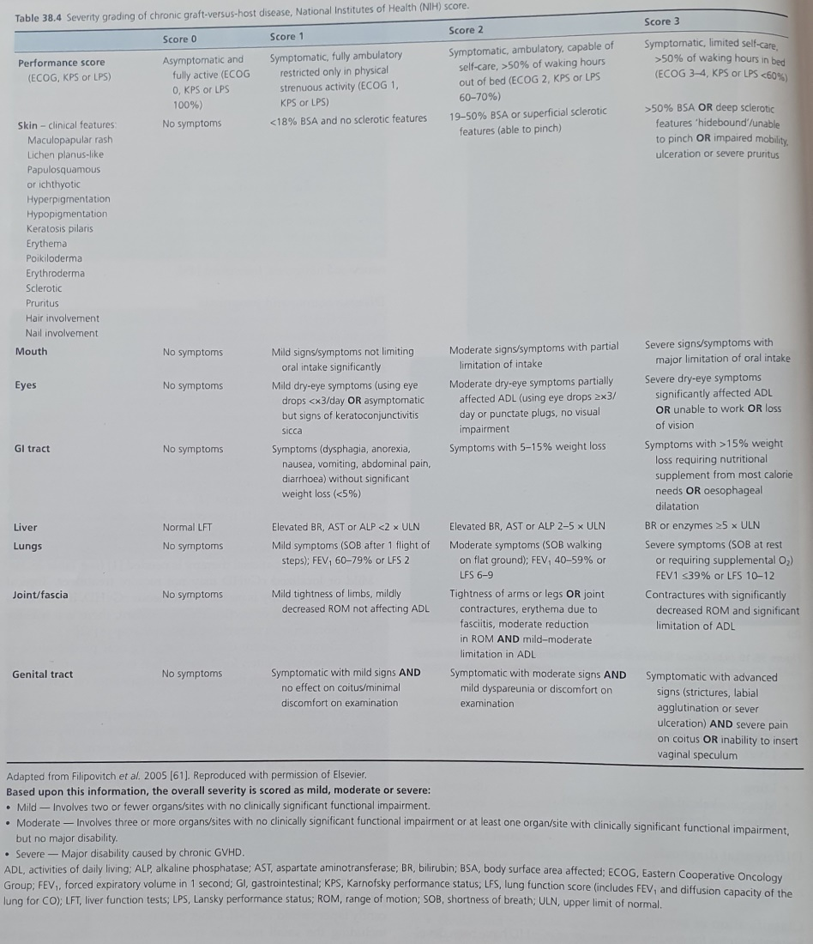

Slide 38
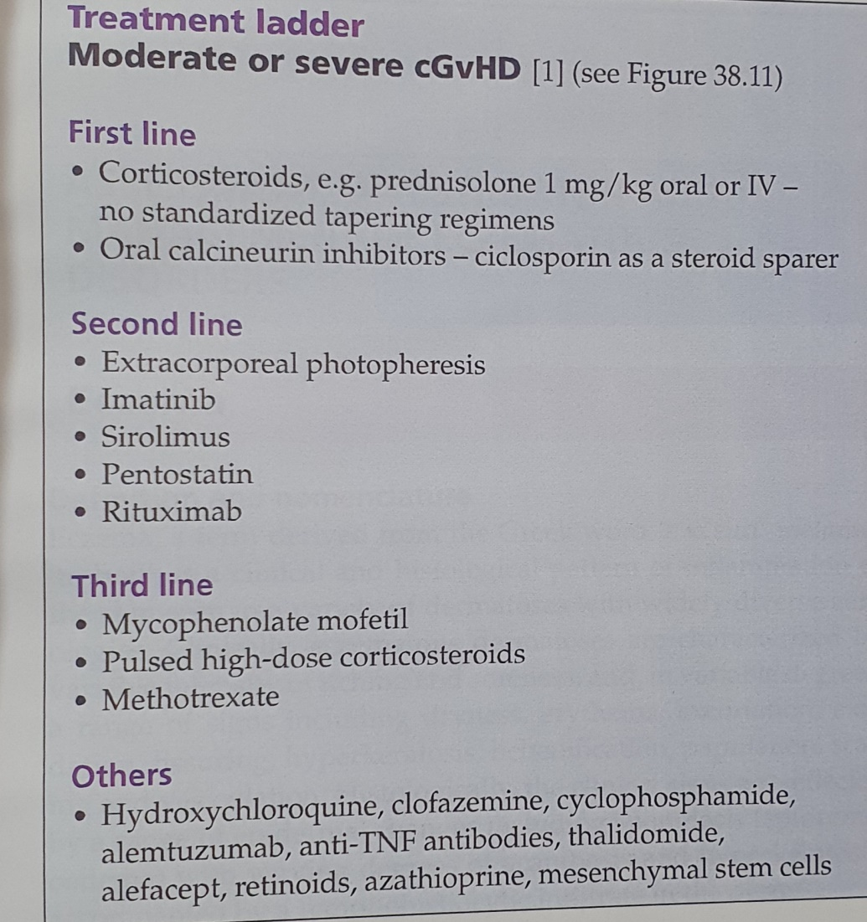

Slide 39
