Slide 1


Slide 2
GENETICS AND THE SKIN
Dr Shamayem Imdad
PGR Dermatology
Ibn e Sienna Hospital Multan

Slide 3
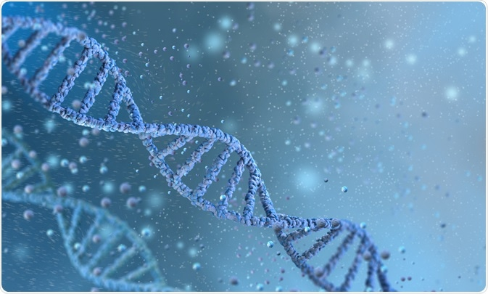
Outline

Slide 4
Outline
Advances in Genetics
Nosology and principles of genetics
Mutations and disease
Mosaicism, Lyonization and the lines of Blaschko
Genome sequence and analysis of inherited disorders
Pre-natal diagnosis

Slide 5
ADVANCES IN GENETICS
Chromosomal gene mapping
Next generation sequencing technologies
Mutations and their risk of causing the disease

Slide 6
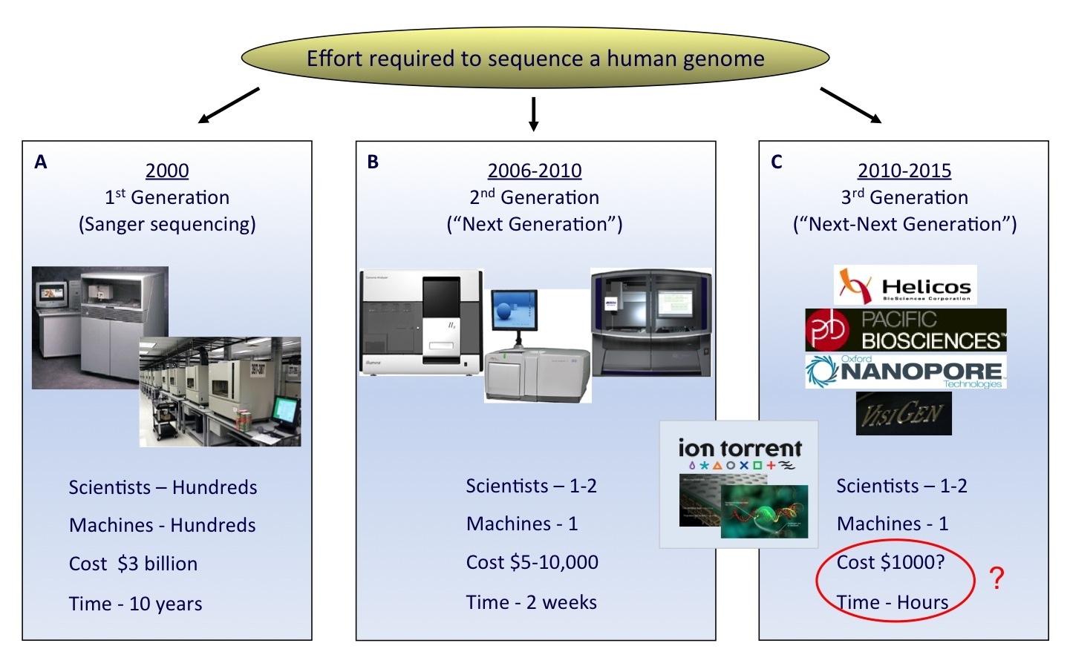

Slide 7
Human genome project
human genetic sequencing ( 3 x 109 bases)
Human genome contains 20,000 genes
Genes generate different length proteins through alternative splicing – 100,000 gene products
Coding regions of the genome – only 1.5 % of the total dna

Slide 8
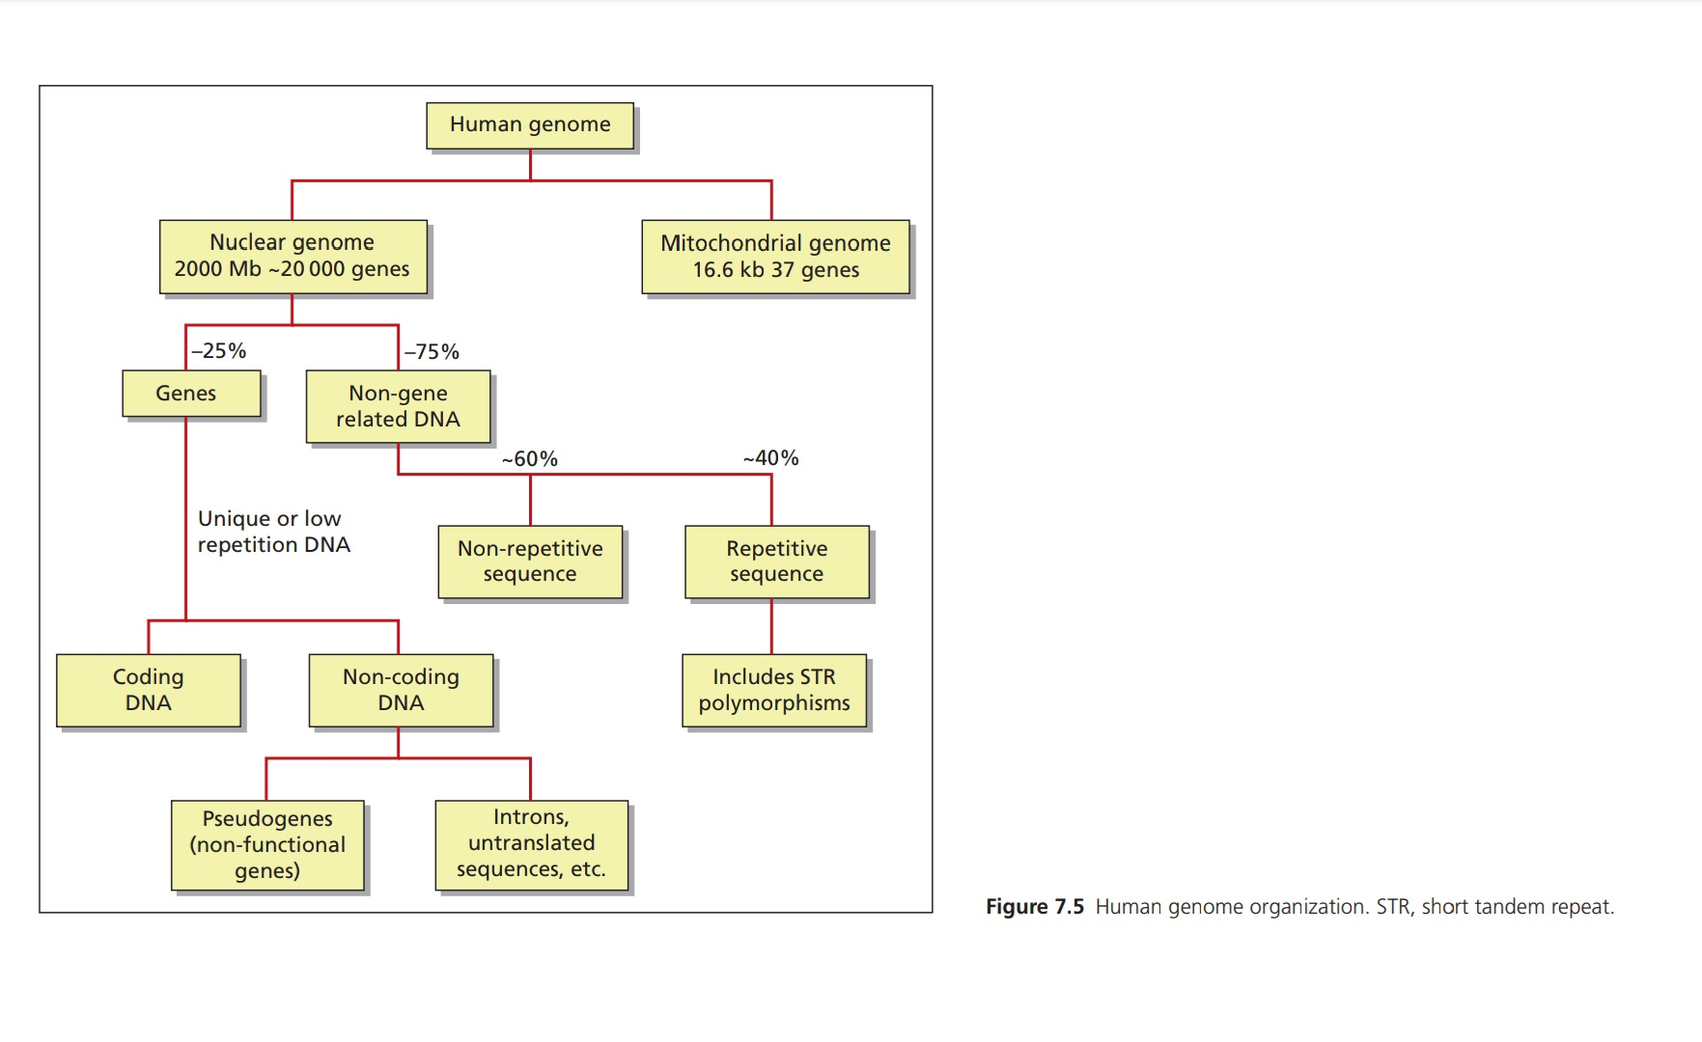

Slide 9
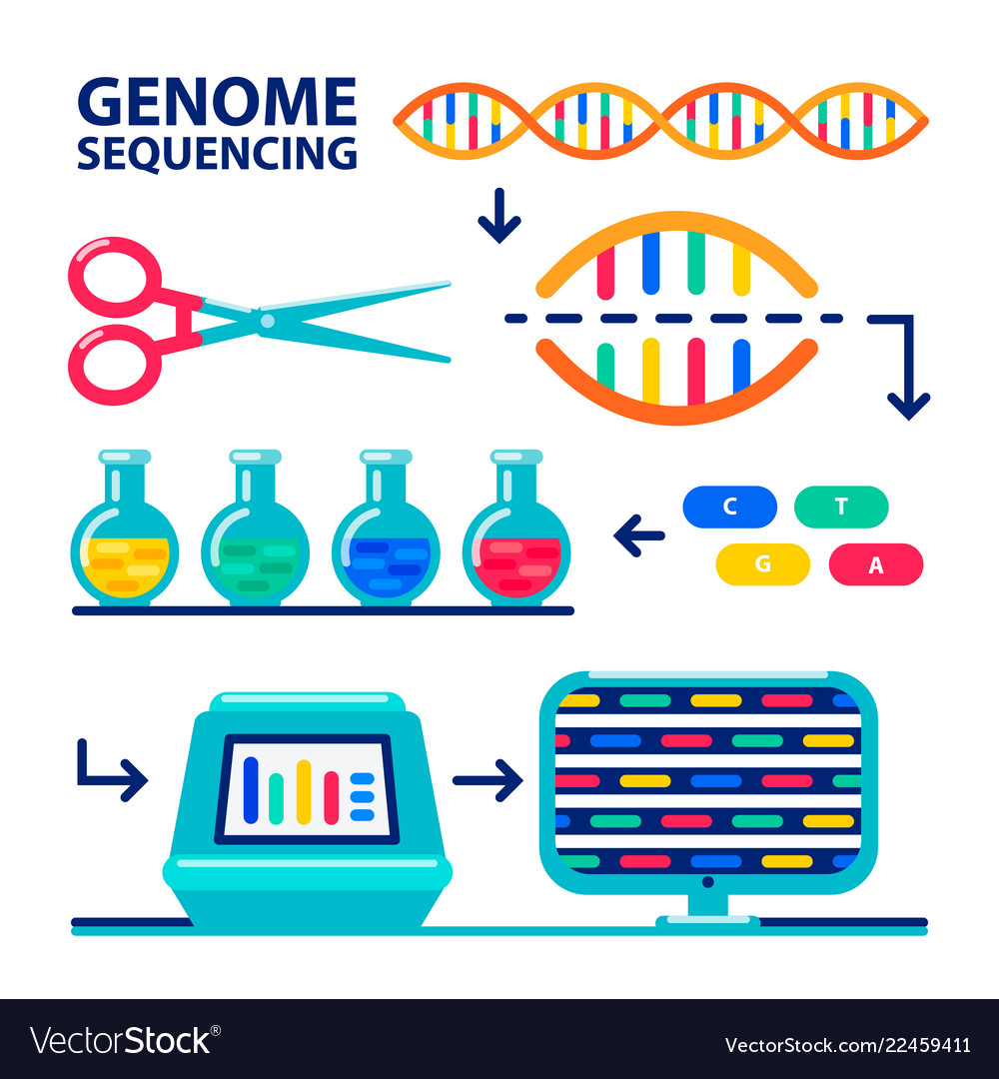

Slide 10
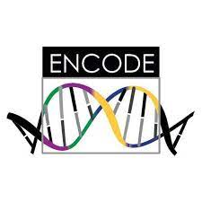
Encode consortium project
The Encyclopedia of DNA Elements (ENCODE) is a public research project which aims to identify functional elements in the human genome.
60% of genome transcribed with no known function
20% of non coding dna – functional with a role of regulating the expression of known coding genes – called regulome
Genotype phenotype correlation

Slide 11
NOSOLOGY AND PRINCIPLES OF GENETICS
Familial : clustering of diorder in a popuation. More close relatives affected than predicted
Inherited: transmission of genetic variants from one generation to the other
Congenital: character present at or detectable before birth. (developmental defects)

Slide 12
inherited
Single gene disorders common
Alterations in the function of the gene
Causing genodermatosis
4 inheritance patterns
aUtosomal dominant
Autosomal recessve
X – linked recessive
X – lined dominant

Slide 13
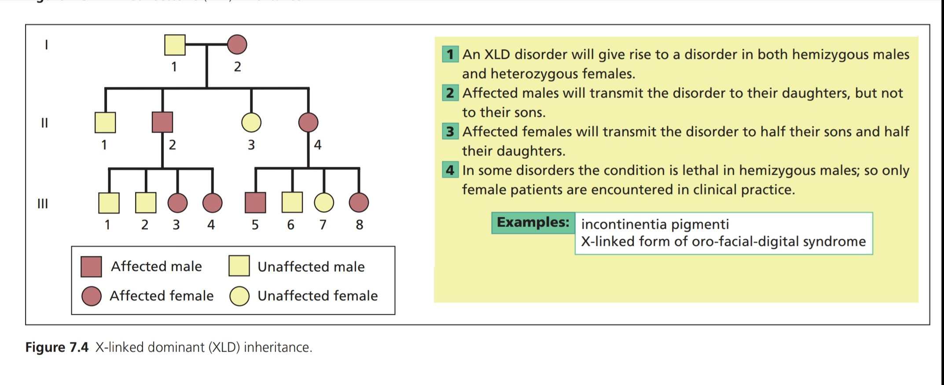
X – linked dominant

Slide 14
CHILD syndrome
X –linked ectodermal dysplasia
Conradii Hunerman Happel syndrome
Incontinentia pigmenti

Slide 15
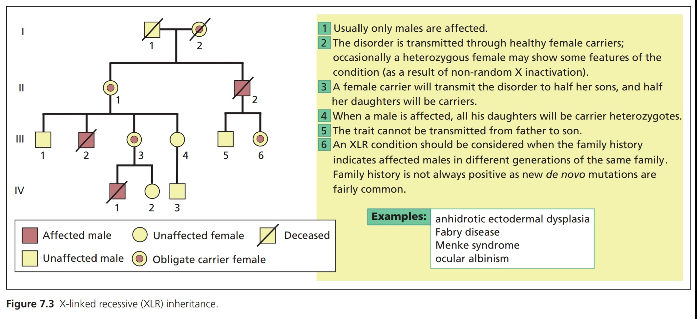
X – linked recessive

Slide 16
Chronic granulomatous disease
Hunters disease
Anhidrotic ectodermal dysplasia
Dyskeratosis congenita
SCID
Menkes kinky hair disease
Wiskott Aldrich syndrome
Icthyosis
X-linked fabrys disease
Ehler danlos V and IX
G6PD deficiency
Lesch - Nyhan

Slide 17
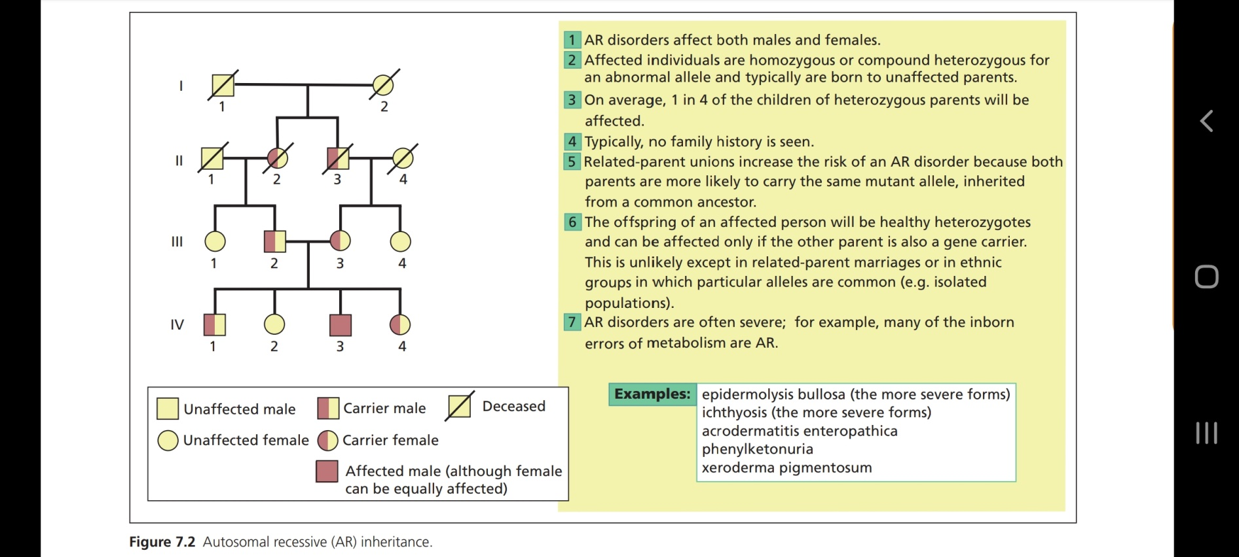
Autosomal recessive

Slide 18
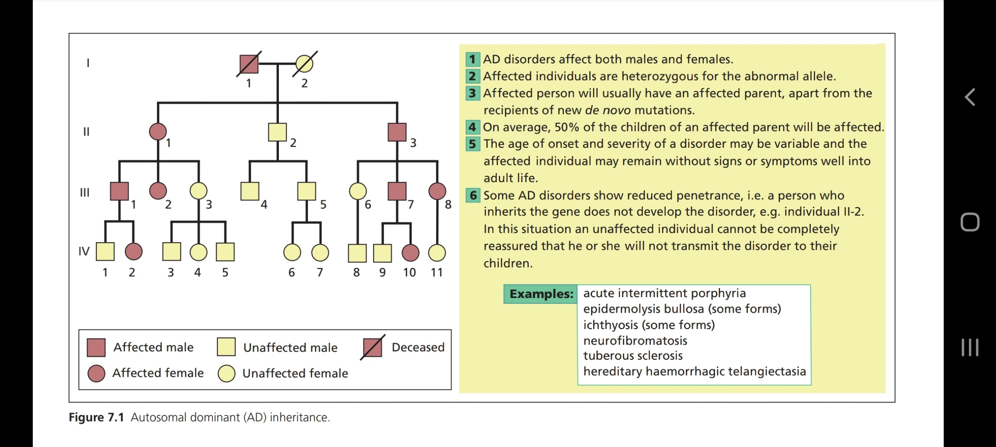
Autosomal dominant

Slide 19
Epistasis : the interaction of genes that are not alleles, in particular the suppression of the effect of one such gene by another.
Eg. the interaction between hair colour and baldness. The baldness phenotype supersedes genes for hair colour

Slide 20
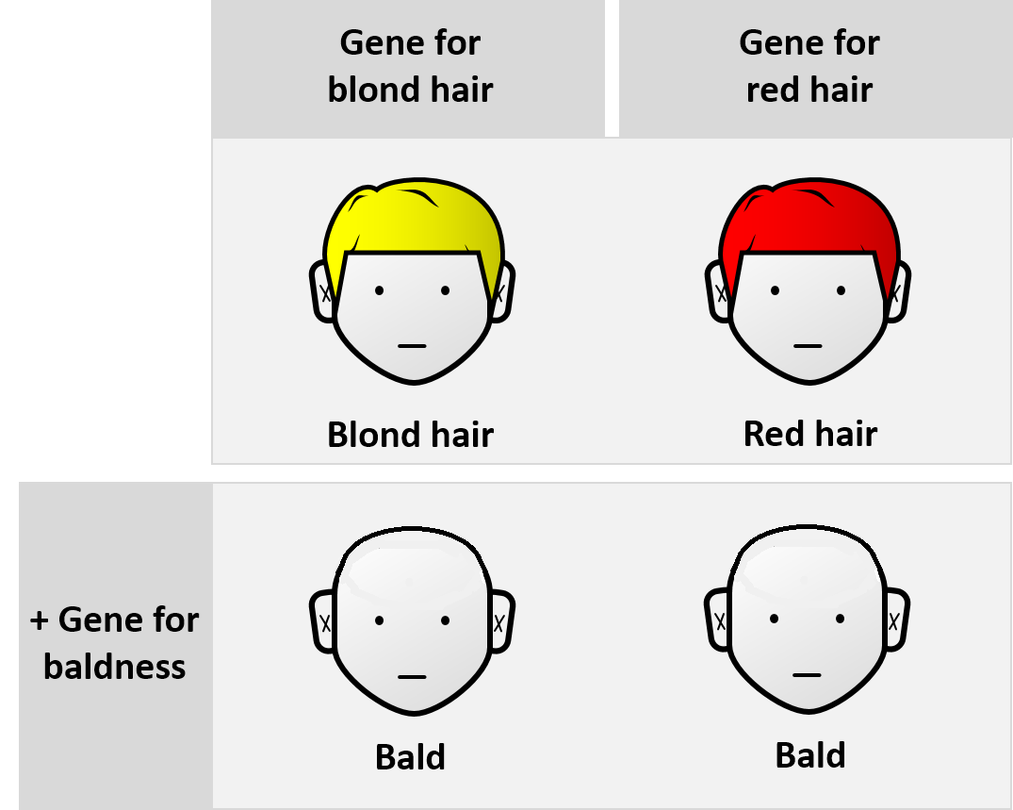

Slide 21
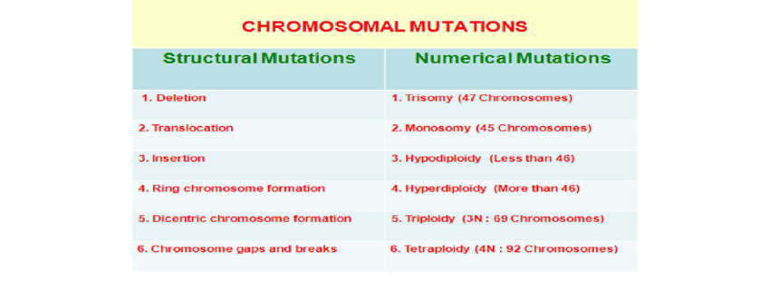
Chromosomal abnormalities

Slide 22
Gene : A gene is the basic physical and functional unit of heredity. Genes are made up of DNA. Some genes act as instructions to make molecules called proteins. However, many genes do not code for proteins
total 20,000 genes, 10 – 15 kb
Locus : fixed position on a chromosome where a particular gene or genetic marker is located.
Allele : An allele is one of two or more versions of a gene
Heterozygote : Heterozygous refers to having inherited different forms of a particular gene from each parent. A heterozygous genotype stands in contrast to a homozygous genotype, where an individual inherits identical forms of a particular gene from each parent.
Copy number variation : when the number of copies of a particular gene varies from one individual to the next.

Slide 23
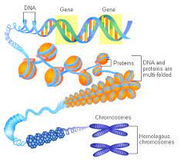

Slide 24
Transcription is the process of making an RNA copy of a gene sequence. This copy, called a messenger RNA (mRNA) molecule, leaves the cell nucleus and enters the cytoplasm, where it directs the synthesis of the protein, which it encodes.
Translation is the process of translating the sequence of a messenger RNA (mRNA) molecule to a sequence of amino acids during protein synthesis.

Slide 25
Exons are termed as nucleic acid coding sequences, which are present in mRNA. Introns are the non-coding sequences present in the DNA, which are removed by RNA splicing before translation
The process by which introns, the noncoding regions of genes, are excised out of the primary messenger RNA transcript, and the exons (i.e., coding regions) are joined together to generate mature messenger RNA.

Slide 26
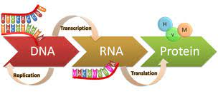

Slide 27
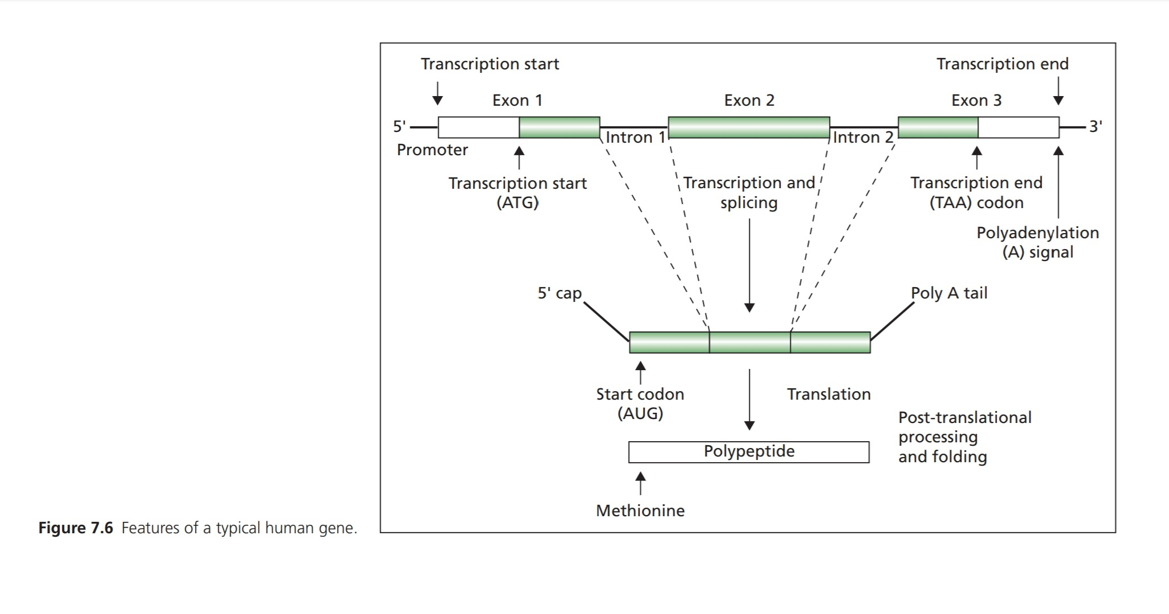

Slide 28
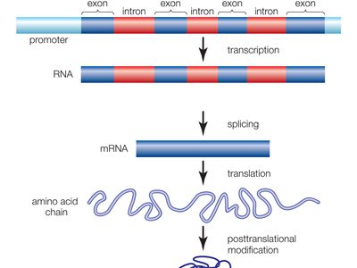

Slide 29
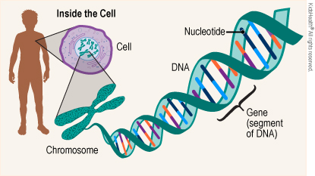

Slide 30
Dominant allele : manifests as phenotype in hetrozygous state
Recessive allele : homozygous or compound heterozygous to exert its full effect
Semidominant allele : consequences of inheriting one or two mutant alleles
more substantial clinical menifestation
parents unaffected
Autosomal dominant trait in >1 sibling
Autosomal genes
Sex linked genes

Slide 31
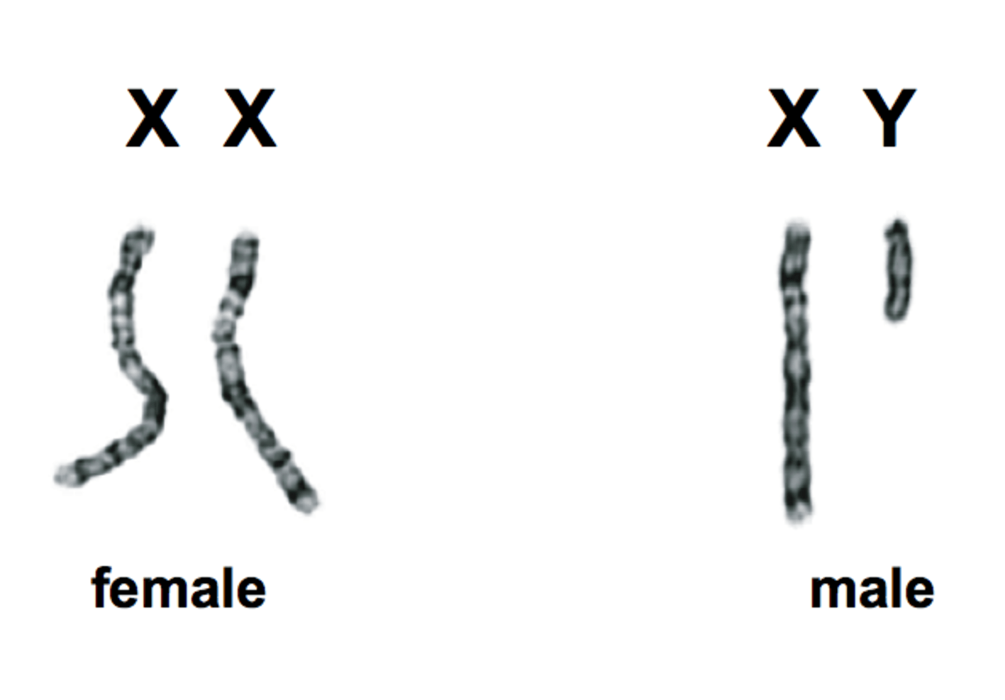

Slide 32
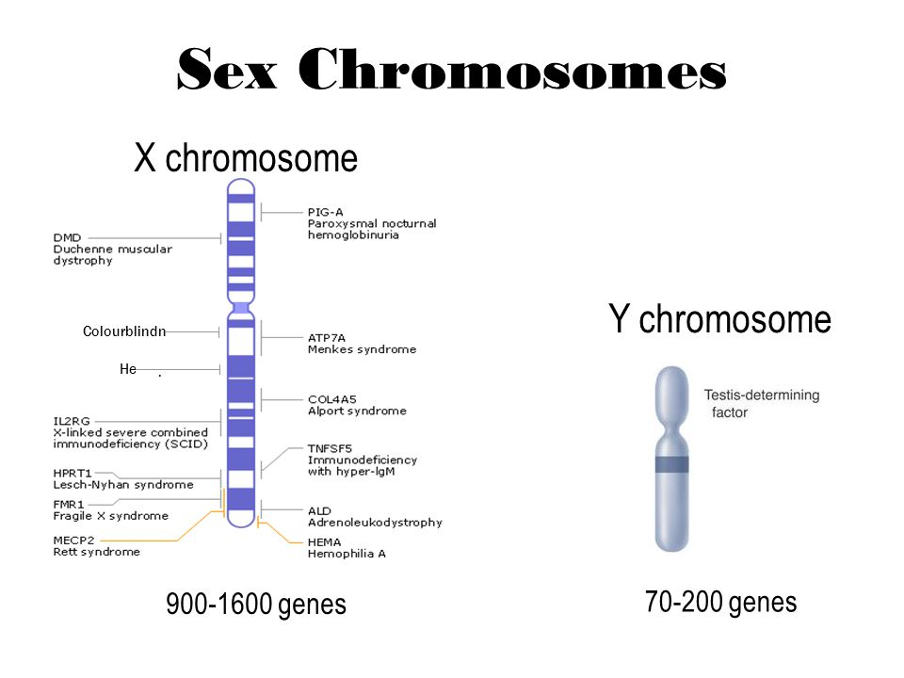

Slide 33
Penetrance refers to the likelihood that a clinical condition will occur when a particular genotype is present. For adult-onset diseases, penetrance is usually described by the individual carrier's age, sex, and organ site.
Heterogeniety : genetic mechanisms that produce the same or similar phenotypes.
Important because:
- similar diseases with different molecular defects
- accurate genetic counselling
- common complex disease states

Slide 34
Genomic imprinting is an epigenetic phenomenon that causes genes to be expressed or not, depending on whether they are inherited from the mother or the father. Genes can also be partially imprinted.
Dna from one parent acts in a different way than the other
Molecular basis of imprinting - methylation

Slide 35
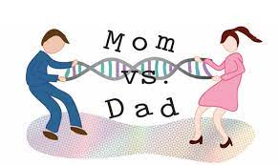

Slide 36
Mitochondrial inheritance
Mitochondria – circular chromosome
14 protein coding regions
Code for enzymes involved in respiratory chain, oxidative phosphorylation
Muscular, neurological, ophthalmological
Maternal inheritance
ageing

Slide 37
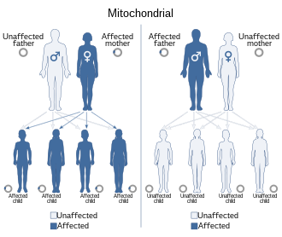

Slide 38
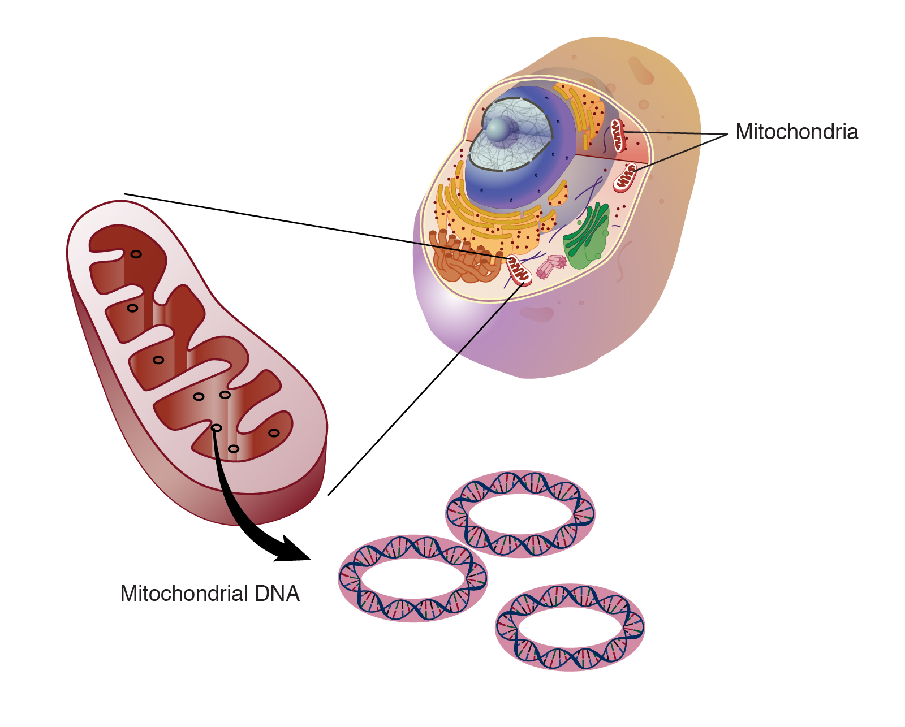

Slide 39
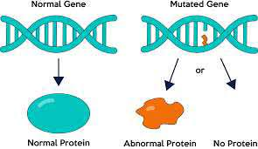
MUTATIONS AND DISEASE
A mutation is a change in a DNA sequence. Mutations can result from DNA copying mistakes made during cell division, exposure to ionizing radiation, exposure to chemicals called mutagens, or infection by viruses.

Slide 40
somatic mutation : genetic alteration acquired by a cell that can be passed to the progeny of the mutated cell in the course of cell division. Somatic mutations differ from germ line mutations, which are inherited genetic alterations that occur in the germ cells (i.e., sperm and eggs).

Slide 41
Chromosomal abnormalities :
number or form
autosomes or sex chromosomes
Somatic cells – diploid, 46 chromosomes
Gametes – haploid, 23 chromosomes

Slide 42
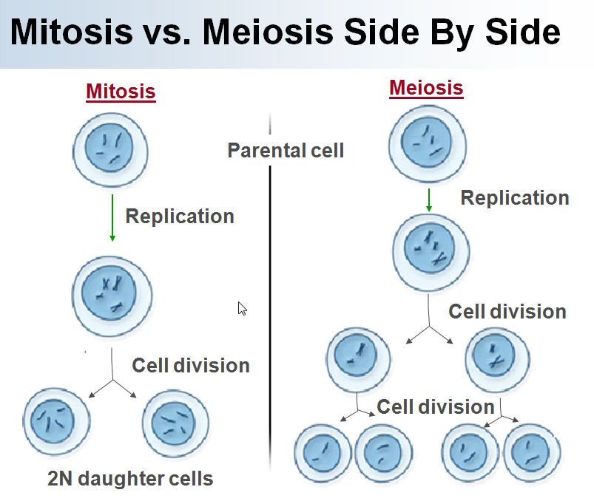

Slide 43
Aneuploidies : numerical abnormalities of loss or gain of chromosomes
Structural changes : breakage, reunion, different configurations

Slide 44
7.5% of all conceptions have a chromosomal disorder and are spontaneously aborted
Early spontaneous abortions – 60%
Late spontaneous abortions and stillbirth – 5%
Multiple congenital malformations with mental abnormality – suspect chromosomal abnormality
Incurable but pre-natal detection possible
Prenatal testing suggested for : couples with affected child
women > 35yrs

Slide 45
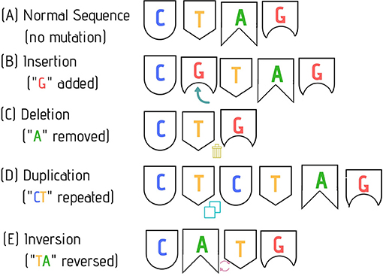
Types of mutations

Slide 46
Point mutation – substitution of a single base pair that alters dna sequence
Missense – different amino acids encoded
Non sense – premature termination of a protein due to a stop codon

Slide 47
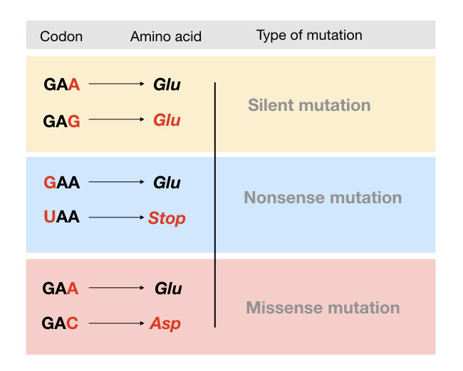

Slide 48
A frameshift mutation is a type of mutation involving the insertion or deletion of a nucleotide in which the number of deleted base pairs is not divisible by three. "Divisible by three" is important because the cell reads a gene in groups of three bases.
Leads to premature termination

Slide 49
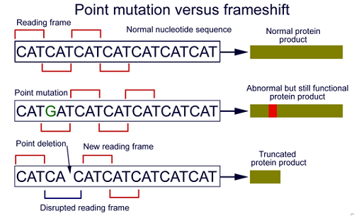

Slide 50
Polymorphism involves one of two or more variants of a particular DNA sequence. The most common type of polymorphism involves variation at a single base pair.
Eg. ABO blood groups

Slide 51
Epigenetic Phenomena : describes molecular events that occur on DNA but not within the DNA sequence
Epigenetic changes alter the physical structure of DNA. One example of an epigenetic change is DNA methylation — the addition of a methyl group, or a "chemical cap," to part of the DNA molecule, which prevents certain genes from being expressed. Another example is histone modification

Slide 52
Chemical modification occurs
Eg dna methylation, gene silencing
Dna methylation machinery :
Dna methyltransferases
Methyl cpg binding proteins
Analysis of changes in these processes is known as epigenomics
Epigenetic mutations are frequent in a lifspan

Slide 53
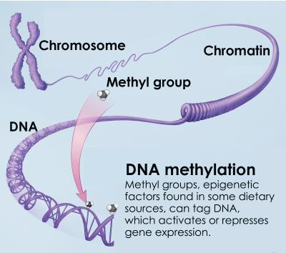

Slide 54
Association between HLA and disease
HLA : human leukocyte antigen
HLA are glycoproteins on nucleated cells.
immune system uses HLA to see which cells belong in your body and which do not.
Inherited in sets from each parent (halotypes)
Coded by genes on shirt arm of chromosome 6 (MHC)
4 – 5 genetic loci – A, B, C, D and DR
Gene produts HLA – A and so on
Polymorphism – multiple alleilic determinants
DNA sequencing to define HLA subtypes

Slide 55
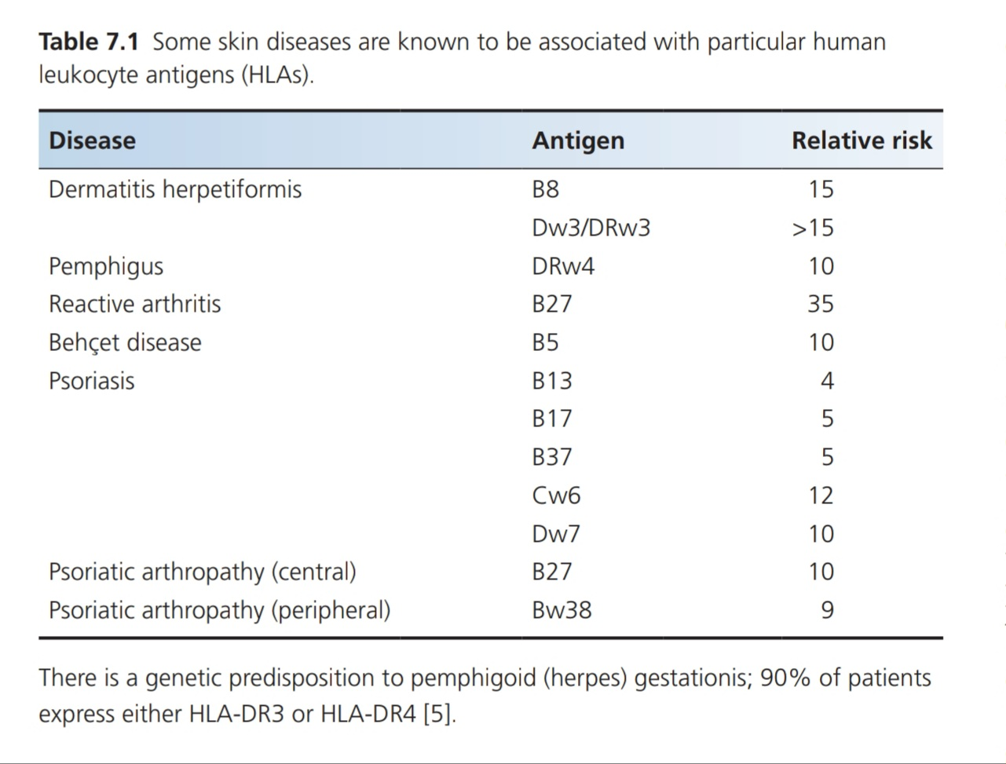

Slide 56
Molecular mimicry
occurs when similarities between foreign and self-peptides favor an activation of autoreactive T or B cells by a foreign-derived antigen in a susceptible individual.
Leads to infections or autoimmunity
Similar configuration to HLA

Slide 57
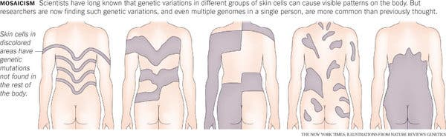
MOSAICISM, LYONIZATION AND THE LINES OF BLASCHKO
Mosaicism : two or more cell lines of different genotype, derived from the same zygote
Mosaic: tissue with mixed population of cells leading to phenotypic diversity

Slide 58
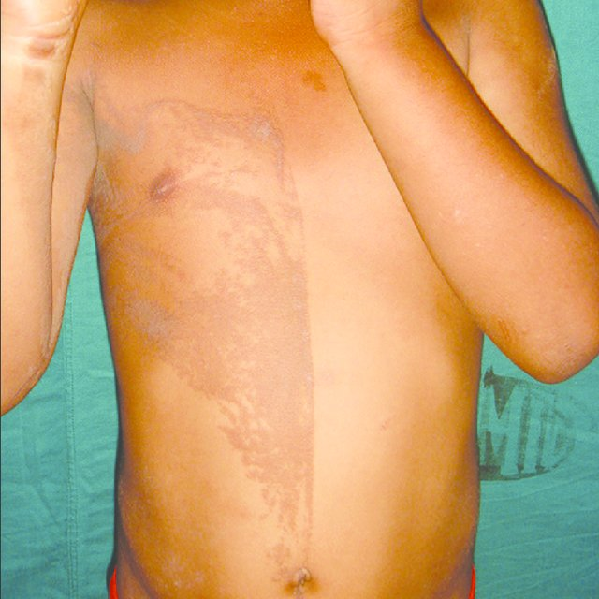

Slide 59
Somatic mosaicism : mutation event after fertilization
Gonosomal mosaicism : gonadal + somatic tissue mutation
Gonadal mosaicism : gonadal tissue

Slide 60
Segmental mosaicism : autosomal dominant pattern
Type 1 : post zygotic mutation in segment within the skin or outside segment with normal genomic DNA
type 2 : heterozygous genomic mutation in all cells exacerbated by loss of heterozygosiy or a second mutation, within a segment or along the lines of blaschko

Slide 61
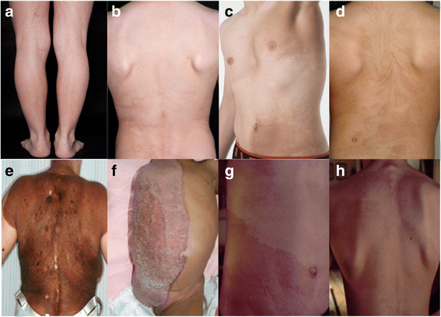

Slide 62
Lines of Blaschko - 1901
“system of lines on the human skin which the linear naevi and the dermatoses follow”
Do not correspond to any vascular nervous or lymphatic structure but represent developmental growth pattern within the skin

Slide 63
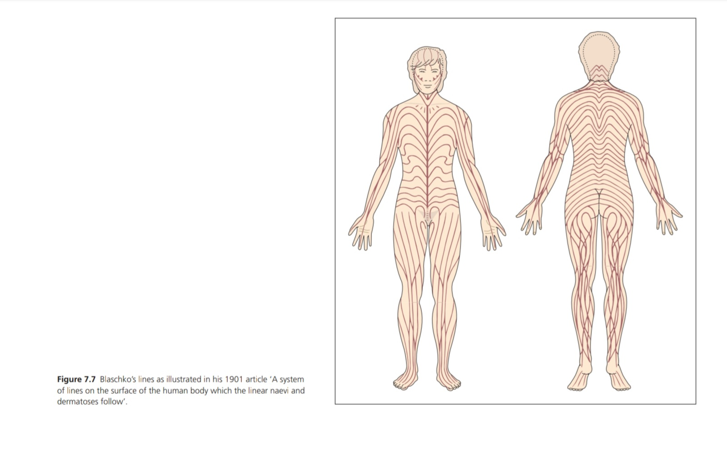

Slide 64
Mosaicism along the lines of blaschko seen in chromosomal and functional mosaicism
Chromosomal mosaicism – non-disjunction events occuring after fertilization
Functional mosaicism – related to x chromosome, inactivation of one x chromosome either maternal or paternal

Slide 65
All healthy females undergo funcional mosaicism
12 to 16 days after fertilization.
Inactvated condensed x chromosme becomes the barr body
Process known as lyonization

Slide 66
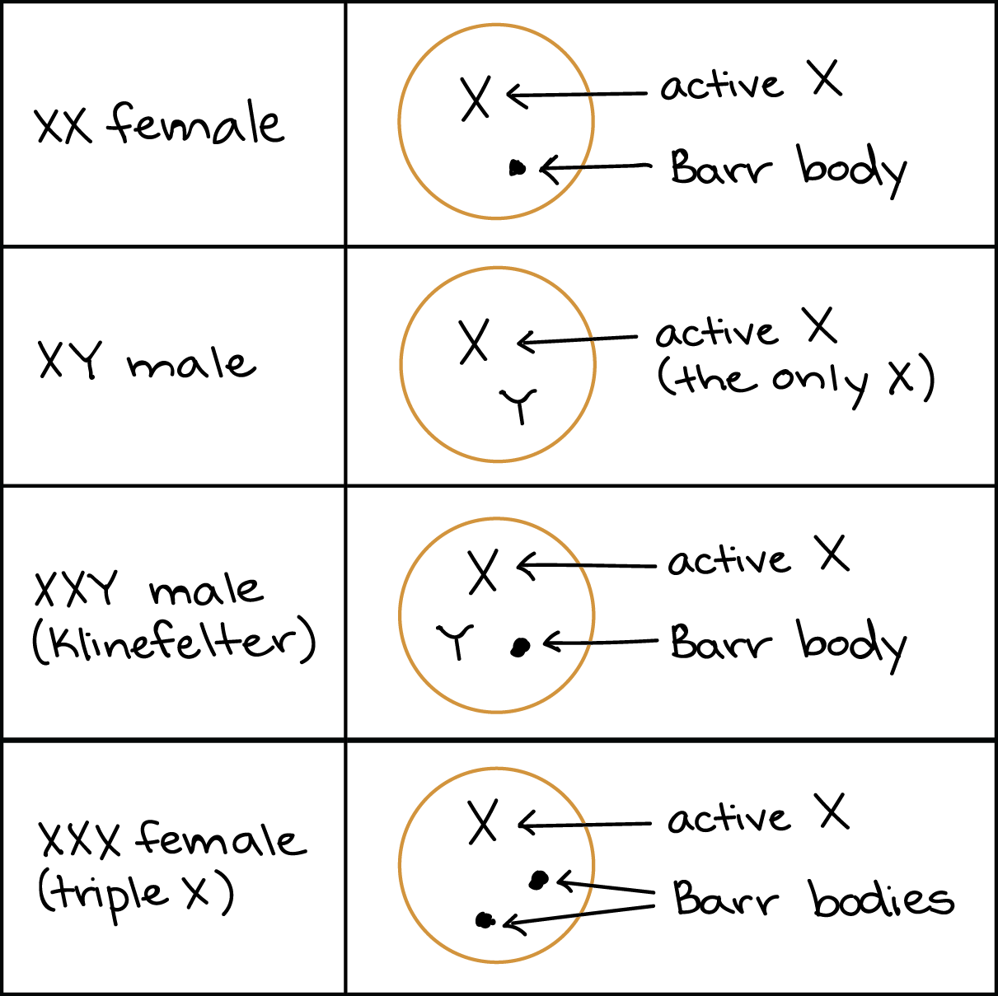
lyonization

Slide 67
Reverent mosaicism / natural gene therapy
Correction of genetic abnormlity by
- Back mutation
- Intragenic cross overs
- Mitotic gene conversion
- second site mutation
Depends on several factors
number of cells involved
how much reversal activity occurs
what stage in life reversion occurs

Slide 68
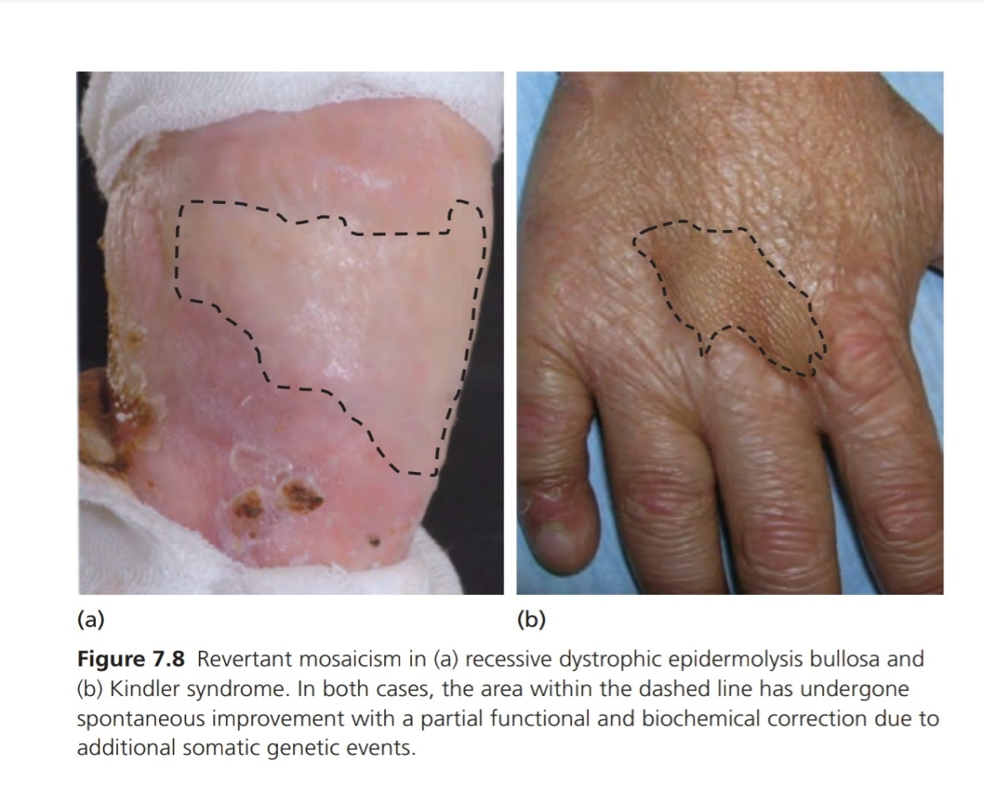
Tested using punch grafting
Culturing and grafting revertant keratinocytes to unrevertant areas
Role in regenerative
medicine

Slide 69
GENOME SEQUENCE AND ANALYSIS OF INHERITED DISORDERS
DNA markers
Gene mapping
Linkage analysis
LOD – ( logg of the odds) for statistical linkage analysis
>3 – significant
-2 – excludes linkage

Slide 70
Gene tracking
Closer genes are inherited together and are not separated in crossing over
Linkage disequilibrium : genes inherited together more or less frequently in a population than expected
cause – gene mutations, natural selection of genes

Slide 71
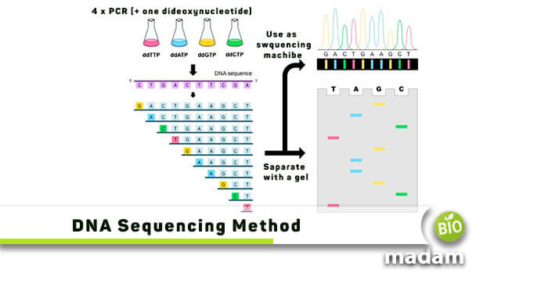
DNA sequencing
- whole genome
- whole exome

Slide 72
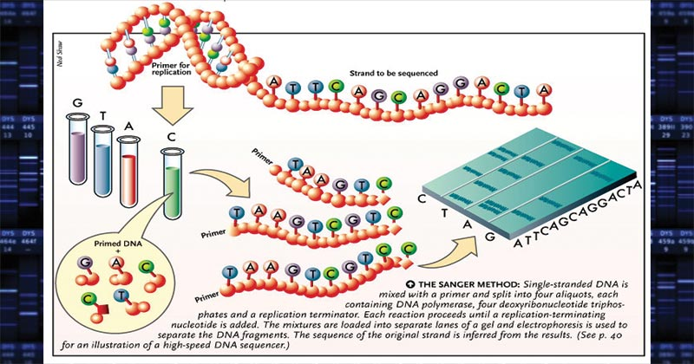

Slide 73
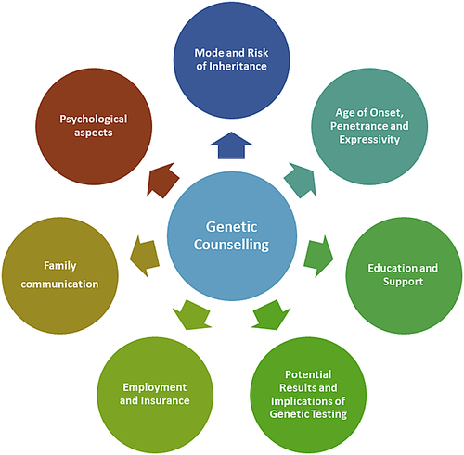
Genetic counseling
“Process of helping people understand and adapt to medical psychological and familial implications of genetic contribution to disease”

Slide 74
PRE NATAL DIAGNOSIS
5% live born infants – congnital defects or heriditary disease
20% of all infant deaths
Diagnosis in utero
Option for elective abortion
Testing of severe inherited skin disorders
eg. Herlitz junctional EB, Epidermolytic icthyosis

Slide 75
Rigid fetoscope – fetal skin biopsy
Later usg guided biopsies
Early 1980s – light microscope, transmission electron microscopy

Slide 76
Mid 1980s – monoclonal, polyclonal antibodies to basement membrane components
- Immunohistochemistry tests
- complement ultrastructural analysis
eg. Severe recessive dystrophic EB
transmission electron microscope – structural abnormality in anchoring fibrils and cleavage below lamina densa.
Floor of blister immunolabelling for type 7 collagen at dermoepidermal junction by IHC

Slide 77
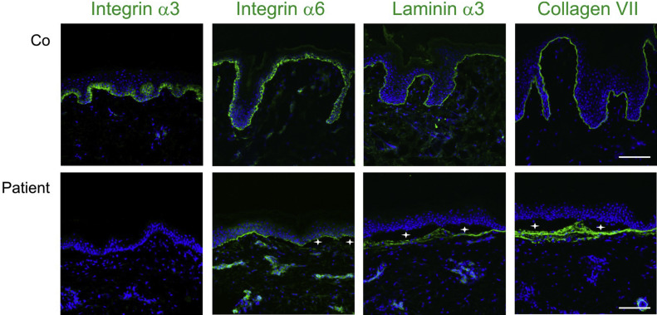
Immunoflourescence antigen mapping in EB

Slide 78
Fetal skin biopsy for EB – 16 to 17 weeks of gestation
Harlequin icthyosis – 20 – 22 weeks of gestation
Occulocutaneous albinism – biopsy from hair bearing site, immunohistochemistry of tyrosinase enzyme activity

Slide 79
Early 1990s – molecular basis of disorders discovered
DNA based diagnostic screenings
Chorionic villus sampling – 10 – 12 weeks
Amniocentesis – early in second trimester (between 15 and 20 weeks of gestation)
Testing genodermatosis by fetal DNA analysis

Slide 80
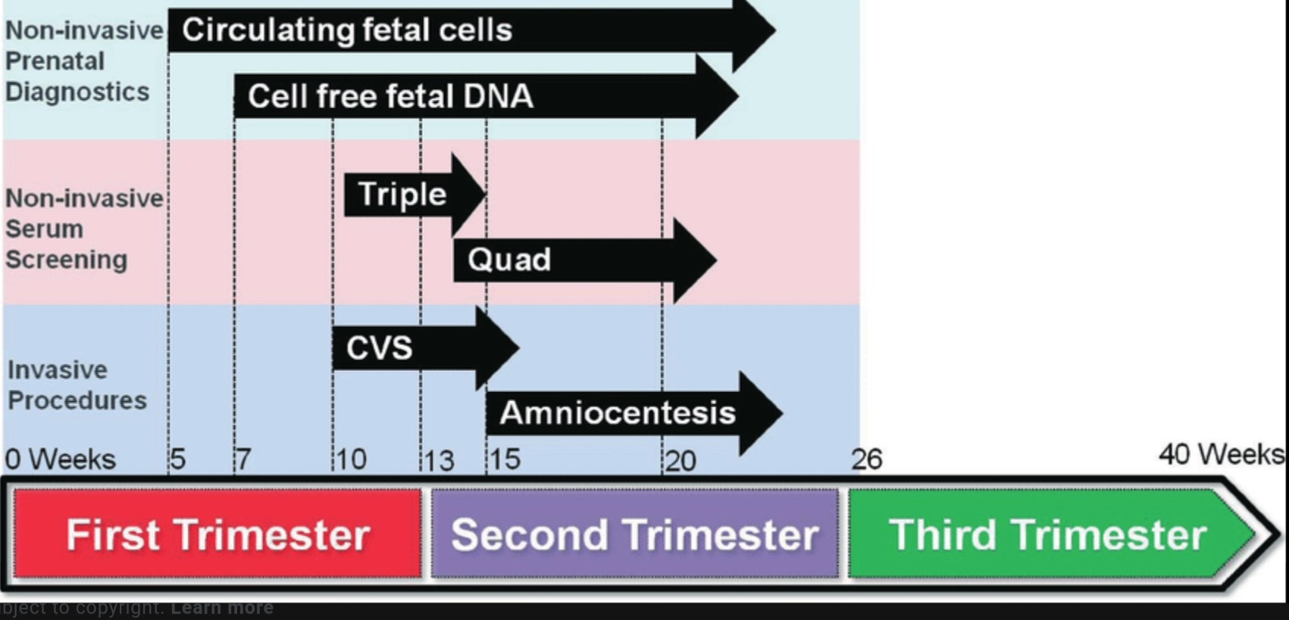

Slide 81
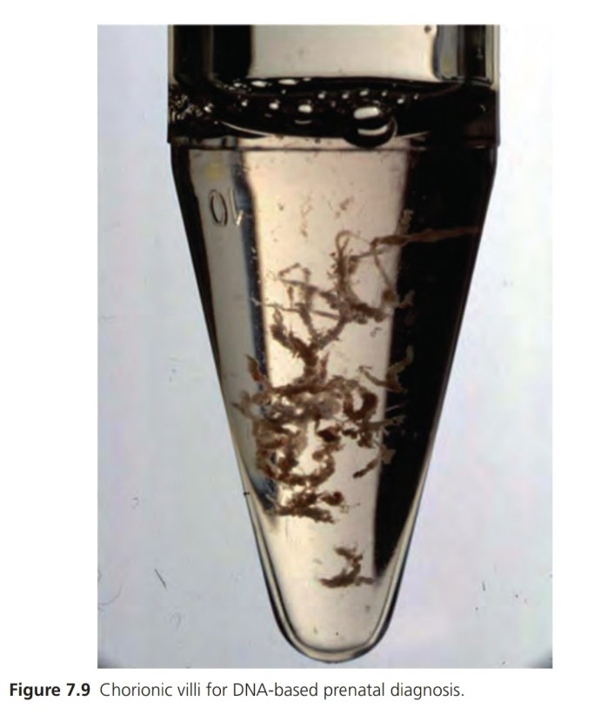

Slide 82
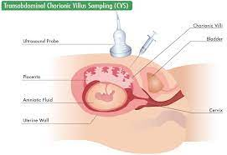

Slide 83
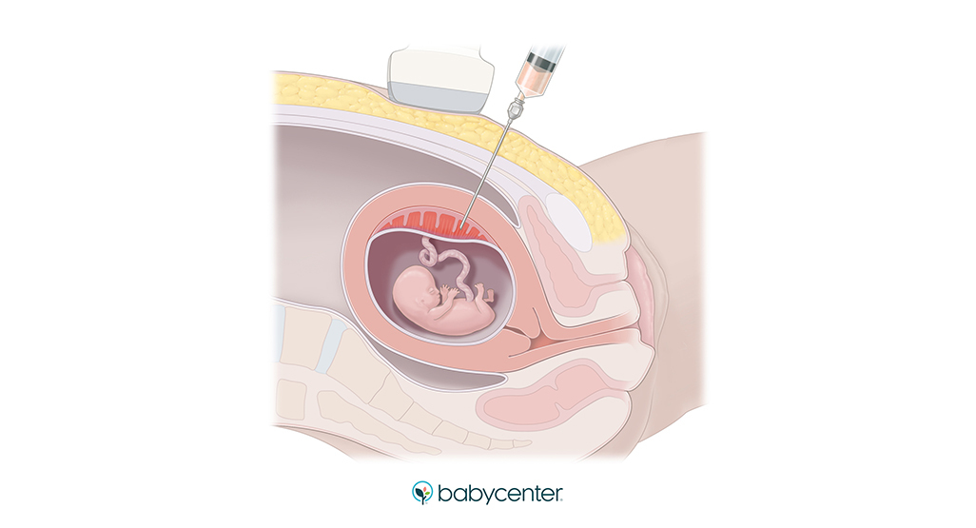

Slide 84
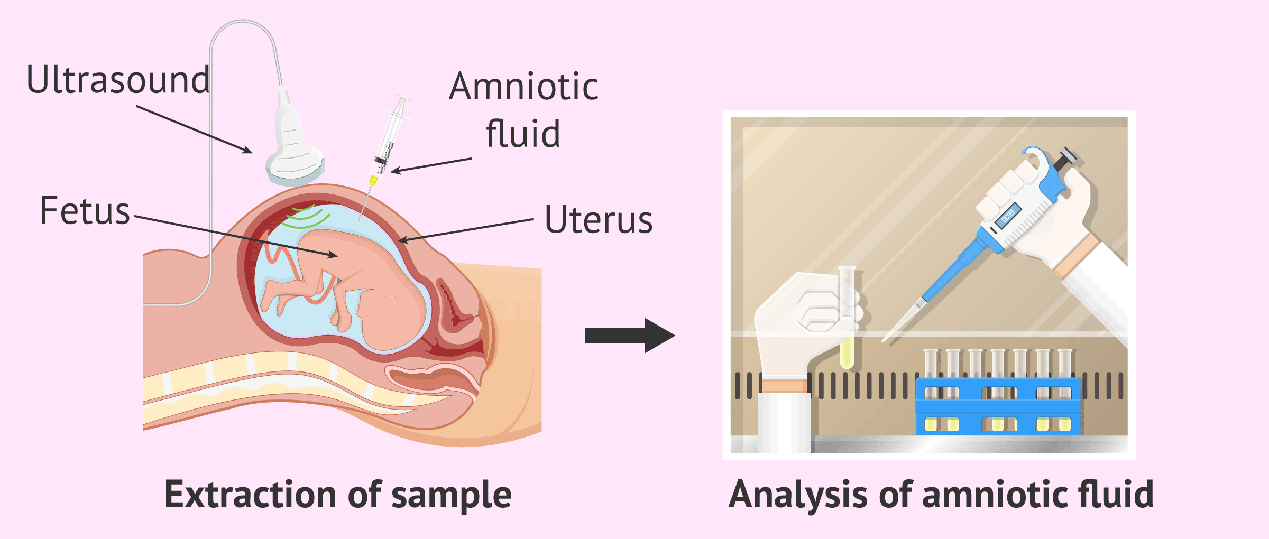

Slide 85
DNA testing for :
De-novo mutations (occuring in parental DNA for first time)
Uniparental isodisomy (affected child has 2 copies of defective gene from only one parent)
Non paternity

Slide 86
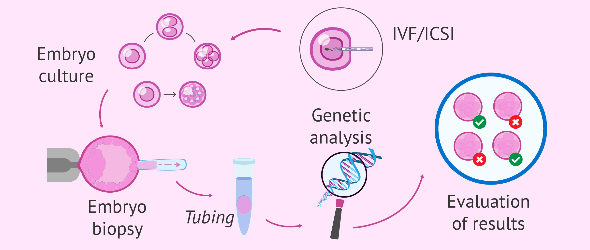
Pre-implantation genetic diagnosis

Slide 87
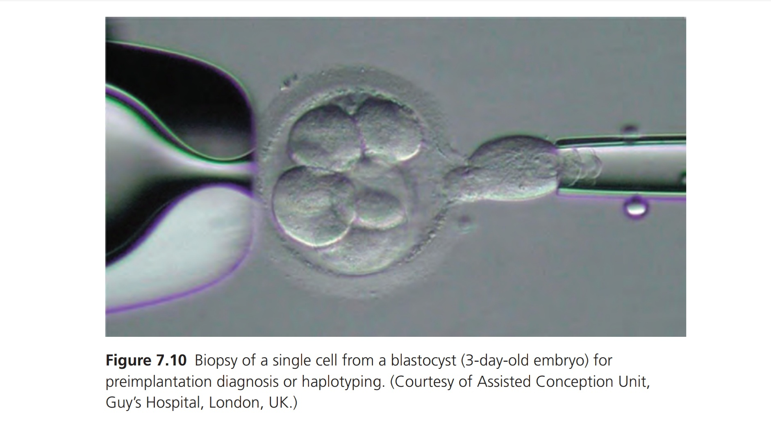

Slide 88
Less invasive methods
Analysis of free fetal DNA in maternal circulation – 6 weeks till birth
Fetal RNA analysis in maternal blood
3D ultrasound

Slide 89
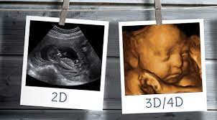

Slide 90
THANK YOU!

