Slide 1
GENETIC DISORDERS OF COLLAGEN, ELASTIN AND DERMAL MATRIX

Slide 2
EHLERS-DANLOS SYNDROME
The hallmarks of EDS are fragility of the skin and blood vessels, hyperextensibility of the skin and joint hypermobility
13 subtypes; most common autosomal dominant (classical and hypermobile types)
Defects predominantly involve collagen (Type IV causing classical subtype), although a fibronectin defect has been reported in type X, and most recently mutations in tenascin-X have been found to cause a newly recognized autosomal recessive form of EDS

Slide 3
EHLERS-DANLOS SYNDROME
Cutaneous features include varying degrees of skin fragility and hyperextensibility
The classical subtype exhibits soft, velvety skin that bruises easily and wounds that heal as thin, atrophic, gaping scars
Extracutaneous manifestations include: hypermobile joints with frequent dislocations, complications with pregnancy and delivery, and less commonly, cardiovascular manifestations, particularly aortic root dilation

Slide 4
EHLERS-DANLOS SYNDROME
Skin hyperextensibility should be assessed by pinching and lifting the skin, pulling until resistance is met, at a site not subjected to mechanical forces or scarring, such as the volar surface of the nondominant forearm
Hyperextensibility is present if the skin can be stretched beyond 1.5 cm on the distal forearms and/or dorsal hands and beyond 3 cm at the neck, elbow, and/or knees

Slide 5
EHLERS-DANLOS SYNDROME
Joint hypermobility is frequent and often greatest at the fingers and/or wrists. Chronic and excessive joint hypermobility frequently leads to early-onset osteoarthritis
Temporomandibular joint dysfunction is common and a frequent cause of secondary headache in cEDS.
Most patients with cEDS or hypermobile EDS (hEDS) are able to extend the tongue to touch the tip of the nose (Gorlin sign)
In suspected patients it is assessed using the Beighton scale with a score of 5 or greater out of 9 confirming joint hypermobility
Joint laxity decreases with age and criteria have been developed (5-point questionnaire) to address this when evaluating adult patients

Slide 6
EHLERS-DANLOS SYNDROME
Beighton Criteria for Joint Hypermobility:
1. Passive dorsiexion of the fifth finger >90 degrees
2. Passive apposition of the thumbs to the flexor aspect of the forearm (Beighton sign)
3. Hyperextension of the elbow >10 degrees
4. Hyperextension of the knees >10 degrees
5. Ability of the palms to completely touch the floor during forward flexion of the trunk with knees fully extended
Numbers 1 to 4 are scored for each side, so that a maximal score of 2 is possible if both left and right sides meet criterion; number 5 is scored as 1
A person who scores 5 or greater out of 9 is hypermobile

Slide 7
EHLERS-DANLOS SYNDROME
5-Point Questionnaire: An answer in the affirmative to 2 or more of the questions has 85% sensitivity and specificity
1. Can you now (or could you ever) place your hands at on the floor without bending your knees?
2. Can you now (or could you ever) bend your thumb to touch your forearm?
3. As a child did you amuse your friends by contorting your body into strange shapes or could you do the splits?
4. As a child or teenager did your shoulder or kneecap dislocate on more than 1 occasion?
5. Do you consider yourself double-jointed?

Slide 8
EHLERS-DANLOS SYNDROME
The diagnosis is mainly clinical
Confirmation of the subtype can require a combination of electron microscopy of dermal collagens, protein chemistry analysis from cultured fibroblasts and mutation detection
EDS should be distinguished from cutis laxa, in which the skin hangs in flaccid redundant folds. In EDS, redundant skin folds may develop in late adult life, but they are usually limited to the elbows and the skin around the eyes.
In Cutis Laxa, the hyperelastic skin does not return to its normal position after stretching

Slide 9
EHLERS-DANLOS SYNDROME
Hyperelastic skin is a feature of Turner’s syndrome, but the dwarfism, cubitus valgus and webbed neck are distinctive
The kyphoscoliotic and hypermobility forms of EDS must be distinguished from Marfan syndrome, which additionally is characterized by ectopia lentis and characteristic skeletal abnormalities

Slide 10
PROLIDASE DEFICIENCY
Prolidase (peptidase D) is involved in the latter stages of degradation of endogenous and dietary proteins and is particularly important in collagen catabolism
Deficiency of prolidase is a rare inborn error of collagen metabolism, associated with chronic skin ulceration, mental retardation and recurrent respiratory infections
The deficiency is inherited as autosomal recessive. Mutations in the prolidase gene (PEPD) result in loss of prolidase activity

Slide 11
PROLIDASE DEFICIENCY
Most patients are mentally defective, with an abnormal facies, but there is no characteristic or consistent pattern
The skin shows pitting and scarring, especially on the legs. The skin is fragile and leg ulcers are common
Occasionally, there may be photosensitivity, telangiectasia, purpura, premature greying and lymphoedema
Splenomegaly, recurrent infections and obesity or a protuberant abdomen occur in about 30% of cases
Diagnosis is confirmed by the finding of massive imidodipeptiduria with prolidase deficiency in the red cells, white cells or cultured fibroblasts

Slide 12
PROLIDASE DEFICIENCY
Topical proline has been successfully applied to the leg ulcers
Enzyme replacement by transfusion of prolidase containing red cells is a possibility, perhaps using manganese activation of the enzyme before transfusion
Pulsed corticosteroids may help

Slide 13
OSTEOGENESIS IMPERFECTA
This term is applied to a heterogeneous group of heritable disorders characterized by: osteoporosis with fractures, due predominantly to type I collagen abnormalities, blue sclerae, deafness, skeletal deformity, abnormal dentine formation (dentinogenesis imperfecta), mild joint hypermobility, hernias, mitral valve prolapse, arterial fragility and thin, fragile skin

Slide 14
OSTEOGENESIS IMPERFECTA
Type IA: Classic form. The commonest form, AD inheritance Fractures are common in childhood The sclerae are blue or grey, easy bruising and early-onset deafness are common, skeletal deformity is absent or mild, Joint laxity is common The incidence of mitral valve prolapse is increased, and the aortic valves are thin and occasionally incompetent
Most patients have increased skin collagen, with an increased ratio of type I/type III

Slide 15
OSTEOGENESIS IMPERFECTA
Type II: Lethal perinatal form This is the rarest form. Infants rarely survive for more than a few days after birth Inheritance is usually autosomal dominant
Type III: Progressively deforming form
Type IV: Mild form with normal sclerae This condition is similar to type I in clinical features and inheritance, but the sclerae are not blue, dentinogenesis imperfecta is frequent and deafness is rare

Slide 16
OSTEOGENESIS IMPERFECTA
Patients with short extremities and a large skull may be confused with achondroplasia, but bone fragility and thin skin do not occur in achondroplasia
Prenatal diagnosis of the more severe forms is possible, using ultrasonography from week 16
The skin of patients with OI is stiffer and less elastic than normal skin, and these differences in mechanical properties may prove useful in diagnosis and prognosis
Bisphosphonates have become standard care for patients although it is unclear how long therapy should be maintained
Somatic cell therapy, using allogeneic bone marrow and mesenchymal stromal cell transplantation have been used

Slide 17
GENERALIZED CUTIS LAXA
Generalized Elatolysis
Cutis laxa is characterized clinically by lax, pendulous and inelastic skin skin and histologically by loss of elastic tissue in the dermis
Histopathology shows sparse and fragmented elastic fibers, better visualized with stains (Verhoeff-van Gieson or orcein)
It has several causes and associations
It may be inherited (AD, AR, X-linked recessive) or acquired
It may accompany inherited disorders such as PXE and EDS

Slide 18
GENERALIZED CUTIS LAXA
Acquired causes may include: Inflammatory skin disease (Urticaria, Angioedema, EM), Drug hypersensitivity (Penicillin, Penicillamine), May develop in babies born to women taking penicillamine Complement deficiency, Systemic lupus erythematosus, Severe Rheumatoid Arthritis Multiple myelomatosis, Sarcoidosis, Syphilis, Coeliac disease, Amyloidosis, Klippel-Trenaunay Syndrome

Slide 19
GENERALIZED CUTIS LAXA
The skin becomes inelastic and hangs in redundant folds
The face and neck are often affected, which produces a ‘bloodhound’ appearance of premature ageing
In the AD form, the skin changes are less severe and tend to present later than in the recessive form
In the commoner, more severe, AR form there is a characteristic facies with downward slanting palpebral fissures, a broad flat nose, sagging cheeks and large ears. There are prominent skin folds around the knees, abdomen and thighs
Herniae, diverticula, severe pul emphysema, cor pulmonale, aortic aneurysm, dental caries, and osteoporosis may occur

Slide 20
GENERALIZED CUTIS LAXA
Diagnosis is suggested by finding loose skin that recoils only slowly after stretching and may be confirmed by histology
In EDS, skin is hyperextensible but not lax, and it recoils quickly
In PXE, the skin may be lax, but it is yellowish and the face is usually spared. It is distinguished histologically by calcification
There may be circumscribed folds of lax skin in NF 1
In Costello’s syndrome there is skin laxity, especially on hands and feet, with joint hyperextensibility, but the elastin fibres are normal under both light and electron microscopy
In severe actinic damage, there may be marked skin laxity due to damage to elastic fibres

Slide 21
PSEUDOXANTHOMA ELASTICUM
A multisystem disorder exhibiting progressive calcification of elastic tissue
Now classified as an AR disorder
PXE appears to be more severe in female patients
Mutations in multidrug resistance associated protein (MRP6), encoded by (ABCC6) on chromosome 16q13.1
It is suggested that PXE is a “metabolic” disease, with deficiency of hepatic ABCC6 leading to the deficiency of circulating factors necessary to prevent tissue mineralization
PXE is probably a primary metabolic disorder with secondary involvement of elastic fibres

Slide 22
PSEUDOXANTHOMA ELASTICUM
PXE is an inherited disorder characterized by generalized fragmentation and progressive calcification of elastic tissue in: Dermis- laxity of the skin Blood vessels- arterial insufficiency Bruch’s membrane of the eye-retinal haemorrhage
The complete syndrome consists of the distinctive skin lesions, retinal changes (angioid streaks) and vascular disturbances
The vascular involvement may be generalized but involve predominantly the larger arteries
Calcification of the internal elastic lamina of the arteries leads to vascular occlusion. HTN, angina, MI, CVA and recurrent mucosal haemorrhages may result

Slide 23
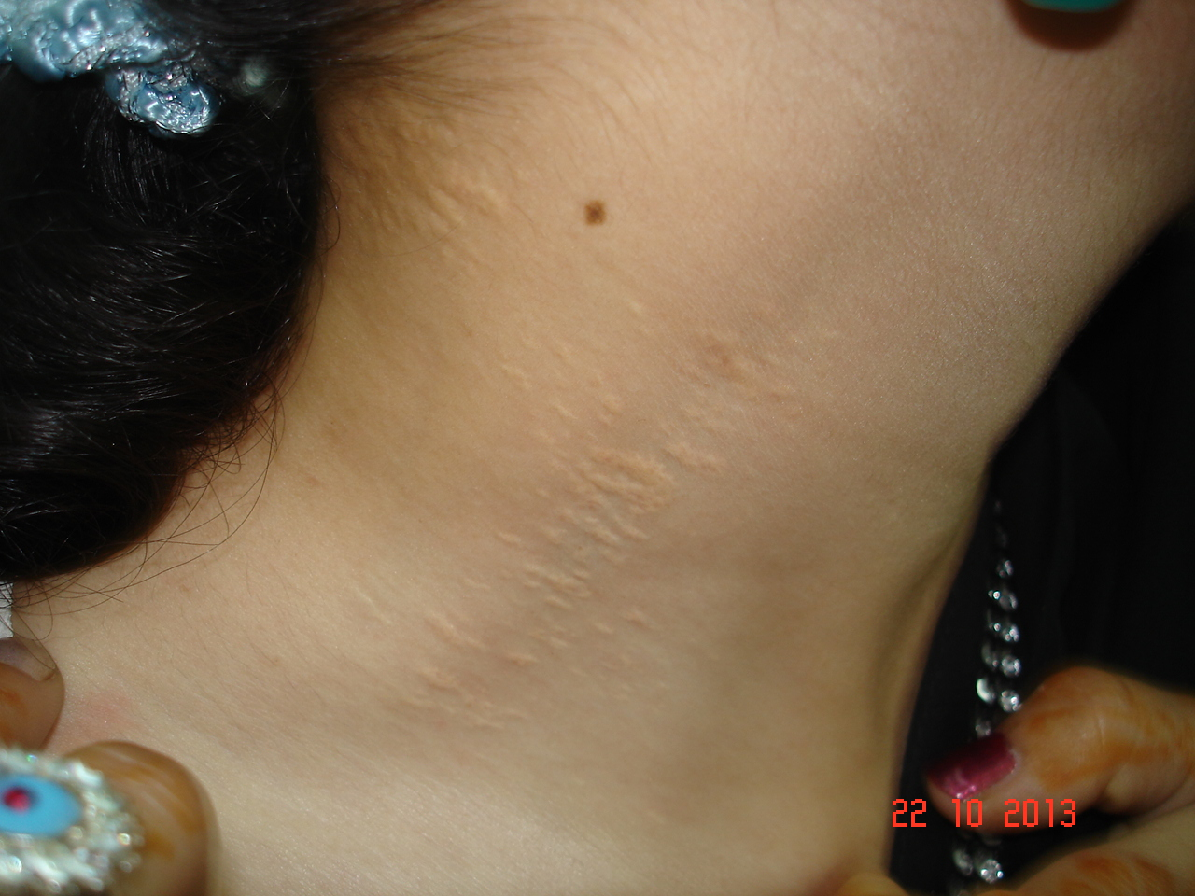

Slide 24
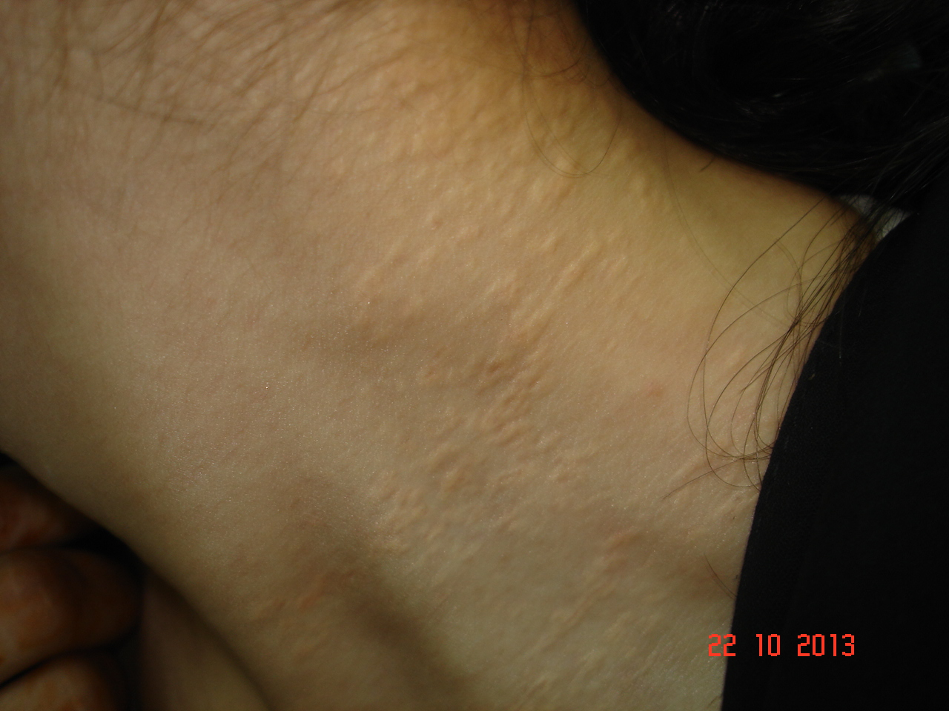

Slide 25
PSEUDOXANTHOMA ELASTICUM
Major Diagnostic Features:
1. Flexural yellow cobblestone lesions
2. Characteristic histological features of lesional skin, using elastic tissue and calcium stains (e.g. van Gieson and von Kossa)
3. Angioid streaks in the retina
Minor Diagnostic Features:
4. Characteristic histological changes in non-lesional skin
5. Family history of PXE in first-degree relatives

Slide 26
PSEUDOXANTHOMA ELASTICUM
It is suggested that prominence of the horizontal and oblique mental creases (which separate the lower lip from the chin) prior to 30 years of age is highly specific for PXE
There is an increased risk of miscarriage in the first trimester, possibly related to failure of placental development
Definitive diagnosis is made by molecular analysis of the ABCC6 gene. This also provides a means for prenatal and pre-symptomatic testing in families at risk for recurrence

Slide 27
PSEUDOXANTHOMA ELASTICUM
The most important aspect of treatment is to prevent complications from vascular involvement or dealt with speedily by the appropriate specialist
Patients should avoid any activity that might cause sudden increase in blood pressure or contact injury to the eyes
Cardiovascular risks should be minimized with control of blood pressure and serum lipids, and avoidance of smoking
The cosmetic appearance of the skin lesions may be improved by plastic surgery
Restriction of dietary calcium has been tried, with apparent benefit in some cases, but this treatment remains controversial

Slide 28
MARFAN’S SYNDROME
This is an autosomal dominant inherited connective tissue disorder with variable clinical manifestations
Mutations in the fibrillin-1 (FBN1) gene, located on chromosome 15q21.1, cause Marfan’s syndrome. Fibrillin is one component of the elastin-associated microfibrils
Patients with Marfan’s Syndrome show a striking lack of fibrillin in their skin and on culture of their dermal fibroblasts
The full syndrome is characterized by aortic dilatation, ectopia lentis and skeletal abnormalities

Slide 29
MARFAN’S SYNDROME
The “marfanoid habitus” is characteristically dolicho-stenomelic (tall and thin), with a lower-body segment (pubic symphysis to floor) that is longer than the upper segment (height minus lower segment)
Characteristically, the arm span exceeds the person’s height by several centimeters
The distal bones are excessively long (arachnodactyly)
Skeletal features of Marfan syndrome are characterized by bone overgrowth and joint laxity
Kyphoscoliosis may be severe and increases with the adolescent growth spurt

Slide 30
MARFAN’S SYNDROME
Pectus excavatum (sternal depression) and carinatum (sternal projection), result from excessive rib overgrowth & are common
Joint laxity may cause flat feet, knee or elbow hyper-extensibility (genu recurvatum), and occasional joint dislocation; dislocation of the hip, often detected during the newborn period, may be the first sign of Marfan syndrome
Screening tests for joint hypermobility are the thumb (or Steinberg) sign, in which the thumb extends well beyond the ulnar border of the hand when overlapped by the fingers, and the wrist (or Walker-Murdoch) sign, in which the thumb overlaps the fifth finger as they grasp the opposite wrist
The underlying joint hyperextensibility and long extremities of Marfan patients often enable them to reach around their back and touch their umbilicus from the opposite side

Slide 31
MARFAN’S SYNDROME
Medial necrosis of the aorta is the most common defect and diffuse dilation of the proximal segment of the ascending aorta with aortic regurgitation often occurs
The progression of dilation is not always continuous and this unpredictability mandates frequent monitoring
Aneurysmal dilatation of ascending aorta is the most important abnormality of the cardiovascular system
Aortic and mitral incompetence are common. Aortic dilatation may begin in childhood
Mitral valve prolapse occurs in 80% of cases
The prognosis is related to the severity of the cardiac defects

Slide 32
MARFAN’S SYNDROME
The common ocular abnormalities include ectopia lentis (usually upward), a trembling iris, myopia and retinal detachment; less frequent are blue sclerae and heterochromia of the iris
Skin changes: Serpiginous perforating elastosis, Striae atrophican, Papyraceous scars, Skin hyperextensibility

Slide 33
MARFAN’S SYNDROME
The full syndrome is unmistakable, but diagnostic certainty is impossible in the partial forms
Simple screening tests that may be helpful include: The thumb sign (positive if the thumb when completely opposed in the clenched hand projects beyond the ulnar border), the wrist sign (positive if the thumb and little finger overlap when wrapped around the opposite wrist) The lower body segment (pubic ramus to floor) is longer than upper body segment (height minus lower segment): low ratio of upper body segment to lower body segment

Slide 34
PREMATURE AGEING SYNDROMES
All the premature ageing syndromes are probably inherited, although the defect may not be obvious in the first few years of life
Cutaneous changes of a premature ageing syndrome include: atrophy, loss of cutaneous fat, wrinkling, canities, hair loss nail dystrophy, defective pigmentation, poikiloderma, sclerosis, ulceration

Slide 35
PREMATURE AGEING SYNDROMES
1: Classical inherited premature ageing syndromes:
(a) pangeria (Werner’s syndrome)
(b) progeria (Hutchinson–Gilford syndrome)
(c) acrogeria (Gottron’s syndrome)
2: Other congenital progeroid syndromes:
(a) trisomy 21 (Down’s syndrome)
(b) wrinkly skin syndrome
(c) familial mandibulo-acral dysplasia
(d) progeroid EDS
3: Excessive exposure to irradiation (usually UV)
4: Photosensitivity, especially congenital: poikiloderma congenitale, xeroderma pigmentosum, Cockayne’s syndrome
5: Diseases causing elastolysis, for example cutis laxa
6: Thickened immobile skin, for example diabetic cheiroarthropathy
7: Fragile skin, for example prolidase deficiency
8: Loss of subcutaneous fat, for example generalized lipodystrophy

Slide 36
PANGERIA (WERNER’S SYNDROME)
An inherited disorder in which the ageing process is accelerated, starting after puberty
It is characterized by short stature, senile appearance, cataracts, joint contractures, early menopause, premature arteriosclerosis, various skin changes (including scleroderma-like features, premature canities, baldness and ulceration) and an increased risk of malignancy
Werner’s syndrome is considered one of the genomic instability syndromes

Slide 37
PANGERIA (WERNER’S SYNDROME)
The earliest manifestation is greying at the temples, (usually at 14-18 years of age but rarely as early as 8 years
Lower legs, feet, forearms and hands most severely involved
Atrophy of the skin and loss of subcutaneous fat results in a tense, shining and adherent appearance
The joints become fixed, and there may be sclerodactyly and acral gangrene
Keratoses over pressure points on the feet and ankles separate to leave indolent ulcers
Mottled or diffuse pigmentation and telangiectasia are often conspicuous on the limbs, face and neck

Slide 38
PANGERIA (WERNER’S SYNDROME)
Combination of prematurely aged appearance, the physical immaturity, the scleroderma-like changes and the cataracts
Rothmund–Thomson syndrome: early onset, poikiloderma, no sclerosis
Systemic sclerosis: hands are involved more than the feet there is no premature ageing
Huriez syndrome may require exclusion

Slide 39
PROGERIA
Characterized by retarded physical development, abnormal facies, skeletal abnormalities and early onset of scleroderma in childhood
Although progressive senile degeneration occurs, cataracts and presbyopia, are not seen
The major changes are in the skin, bone and cardiovascular tissues

Slide 40
PROGERIA
Affected children usually appear normal at birth
During the second year there is profound growth failure, with reduced subcutaneous fat on the face and limbs
Facial appearance: a disproportionately large cranium with patent fontanelles and frontal bossing, prominent eyes and scalp veins, very sparse, downy scalp hair, sparse or absent eyebrows and eyelashes, centrofacial cyanosis, micrognathia, thin lips and a ‘beaked’ nose
Skin becomes thin, taut and shiny in some areas but lax and finely wrinkled in others

Slide 41
PROGERIA
After several years, progressive mottled hyperpigmentation develops, most marked on exposed sites, but there is no photosensitivity
The nails are usually small, thin and dystrophic
Generalized alopecia often begins in the first year of life
The dentition is abnormal and delayed, and there may be skeletal abnormalities such as dystrophic clavicles and coxa valga, with joint contractures and a ‘horse-riding’ stance. Sexual maturation is absent but intelligence is normal
Death usually occurs in the second decade as a result of severe, generalized atheroma

Slide 42
PROGERIA
The large, bald head with conspicuous veins, the birdlike facies and the well-proportioned little body are distinctive
Cockayne’s syndrome may cause confusion, but progeria is distinguished by the loss of hair, the lack of photosensitivity and ocular changes, and the absence of disproportionately large extremities

Slide 43
ACROGERIA
Acrogeria refers to premature ageing of the extremities
This disorder begins at birth or soon afterwards, and is characterized by cutaneous atrophy and loss of subcutaneous fat, particularly over the distal extremities, with no tendency to atheroma, diabetes mellitus or decreased life expectancy
The normal hair and eyes help to distinguish the condition from progeria and pangeria
Cases are occasionally described which do not fit easily into any of these previously recognized categories and have been termed metageria and acrometageria

