Slide 1
Genetic disorder affecting cutaneous vasculature
Dr Filzah Inam

Slide 2
Venous disorders
venous malformation
Cutaneo-mucosal venous malformation
Blue rubber bleb naevus syndrome
Glomuvenous malformation
Maffucci syndrome

Slide 3
Venous malformation
VMs –congenital sporadic vascular lesion
Dark blue lumps consists of malformed veins
Mainly solitary lesion –small blebs to large, bluish lesion
Palpation is not painful until thrombosis
No thrill or bruit
Intrabuccal VMs ----sleep apnoea
Pulmonary thromboembolism most common complication

Slide 4
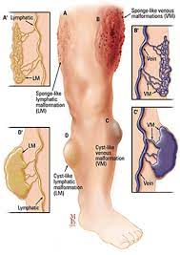
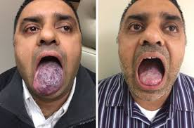

Slide 5
Investigations
Doppler Usg
MRI with spin-echo T1 T2
Management
Compression garment
LMW heparin, aspirin
Sclerosing agents
Rapamycin ---clinical trails

Slide 6
Cutaneo-mucosal venous malformation
AD
Involve skin and mucosa
TEK & VMCM mutation

Slide 7
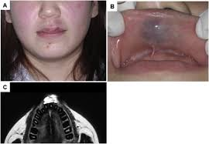
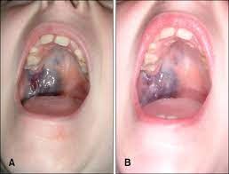

Slide 8
Clinical features
Mucocutaneous VM lesions multifocal and small <5cm
Tiny blue spots ----<5mm
Management
Genetic counselling

Slide 9
Blue rubber bleb naevus syndrome
Rare sporadic slow flow vascular anomaly
Cutaneous and internal VM---small rubbery bluish palmoplantar and gastrointestinal VMs
TEK mutation
Small 1-2 cm lesion present at birth progressive with age
Dark blue hyperkeratotic rubbery consistency ----soles and palms
GIT VMs----small intestine ----haemorrhage, anemia intussusception &infarction

Slide 10
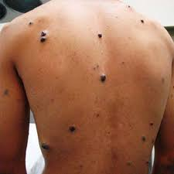
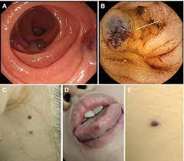

Slide 11
Investigations
Endoscopy ,colonoscopy
Management
Correct anemia
Surgical excision of intestinal lesion
Target molecular therapies---rapamycin

Slide 12
Maffuci syndrome
Multiple enchondromas associated withVMs
Grostesque deformity ---hands and feet
Mutation –PTHR1 & IDH1 ,IHD2

Slide 13
Clinical features
Enchondromas----abnormal proliferation of chondrocytes ---ossification of diaphysis or metaphysis
Spindle cell haemangiomas---suncutaneous, firm bluish nodules---fingers & toes
Mesodermal neoplasm---fibrosarcoma, glioma astrocytoma ovarian tumour
Adenocarcinoma

Slide 14
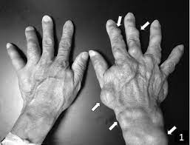

Slide 15
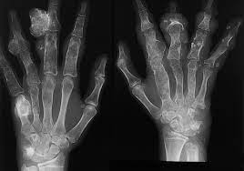
Investigations
X-ray –enchondromas –radiolucent multiple oval shaped osteolytic lesion with well defined margins in metaphysis or diaphysis
D- dimer levels---noramal
Management
Surgical excision of enchondromas

Slide 16
Lymphatic malformation(cystic hygroma)
LMs---focal lesion composed of dilated lymphatic channel
Macrocystic LMs– diagnosed in utero—multi lobulated well-defined, translucent soft on palpation
Microcystic LMs– head and neck, vesicular plaques, skin color blue purple ---intracystic bleeding
Visceral LMs – protein losing enteropathy & hypoalbuminemia
Recurrent erysipelas or cellulitis ---major complications

Slide 17
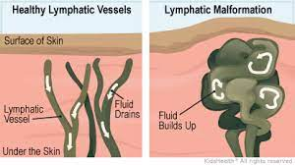
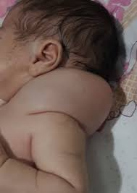

Slide 18
Gorham-stout syndrome ---vanishing bone disease
Progressive demineralization & destruction of bones ---replaced by lymphatic vessels & capillaries
Manifests as muscular atrophy, bone pain, fractures, pleural effusion, ascites & CSF rhinorrhea

Slide 19
Investigations
Doppler usg—cystic nature of vascular malformation
MRI
D dimer & fibrinogen
Management
Systemic antibiotics & pain killers
Surgical excision

Slide 20
Schimmelpenning-Feuerstein-Mims syndrome
Congnitive developmental delay & sebaceous naevus with CNS, CVS, ocular and skeletal anomalies
Post zygotic mutations ----HRAS & KRAS

Slide 21
Vascular anomalies---arterial coarctation, aneurysm or stenosis of renal & carotid arteries
LMs --- chylothorax, lymphedema
Genetic analysis
Multidisciplinary approach

