Slide 1
Genetic Blistering diseases
Dr Mohsin Mehmood
Trainee Dermatology
Cmh Bahawalpur

Slide 2
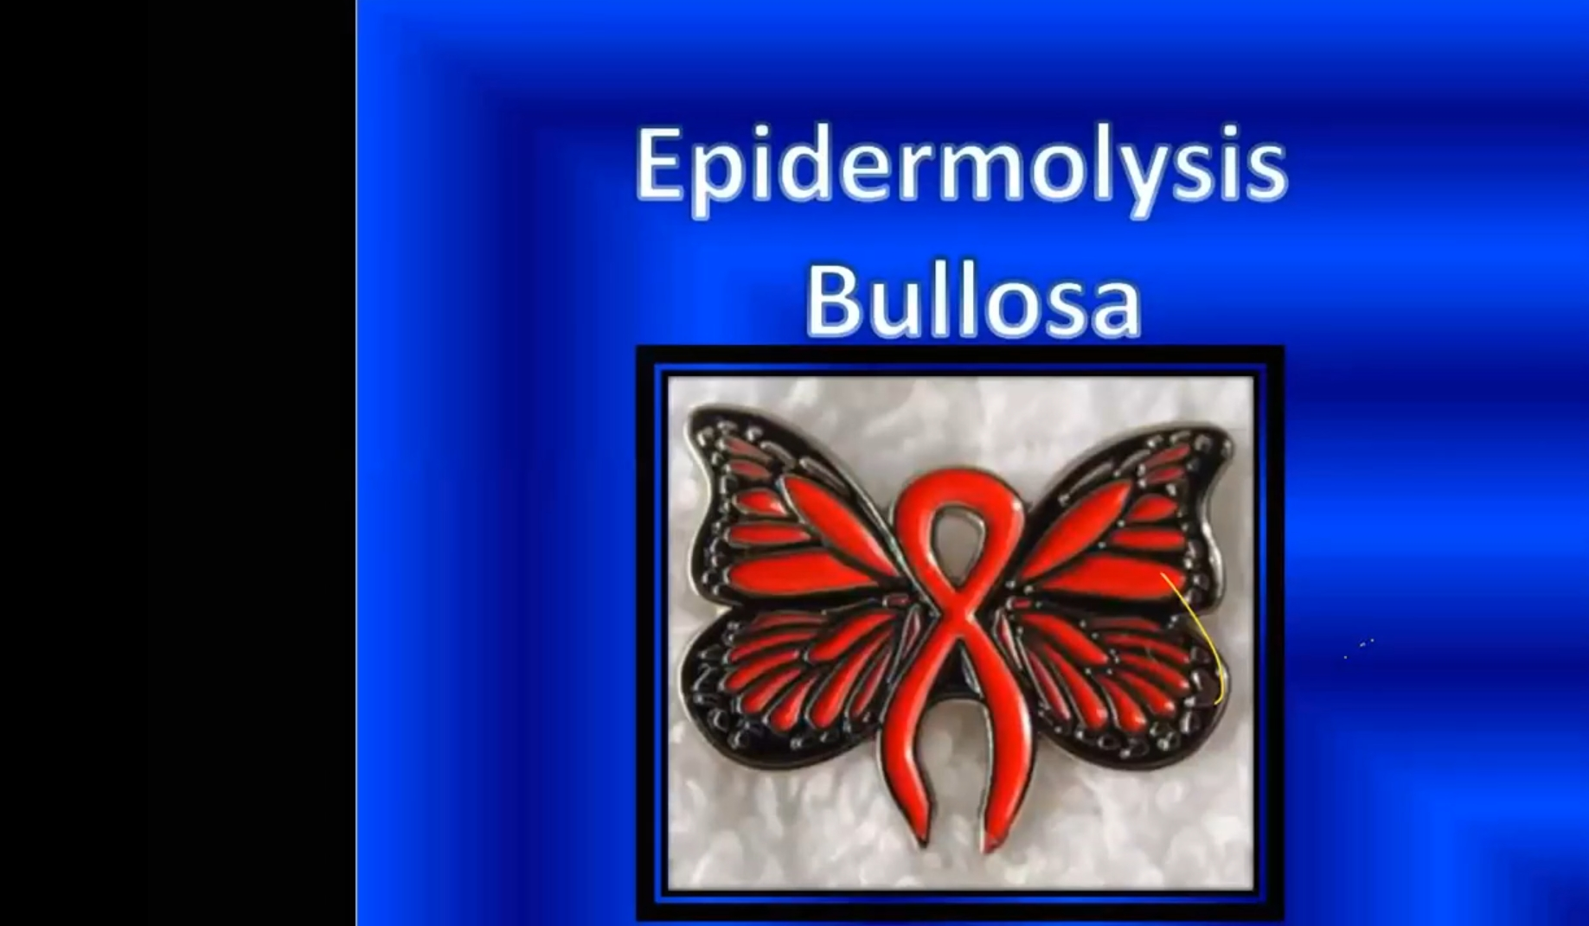

Slide 3
Definition
Epidermolysis bullosa comprises a group of genetically determined skin fragility disorders characterized by blistering of the skin and mucosae following mild mechanical trauma.
The alternative term therefore is mechanobullous diseases.

Slide 4
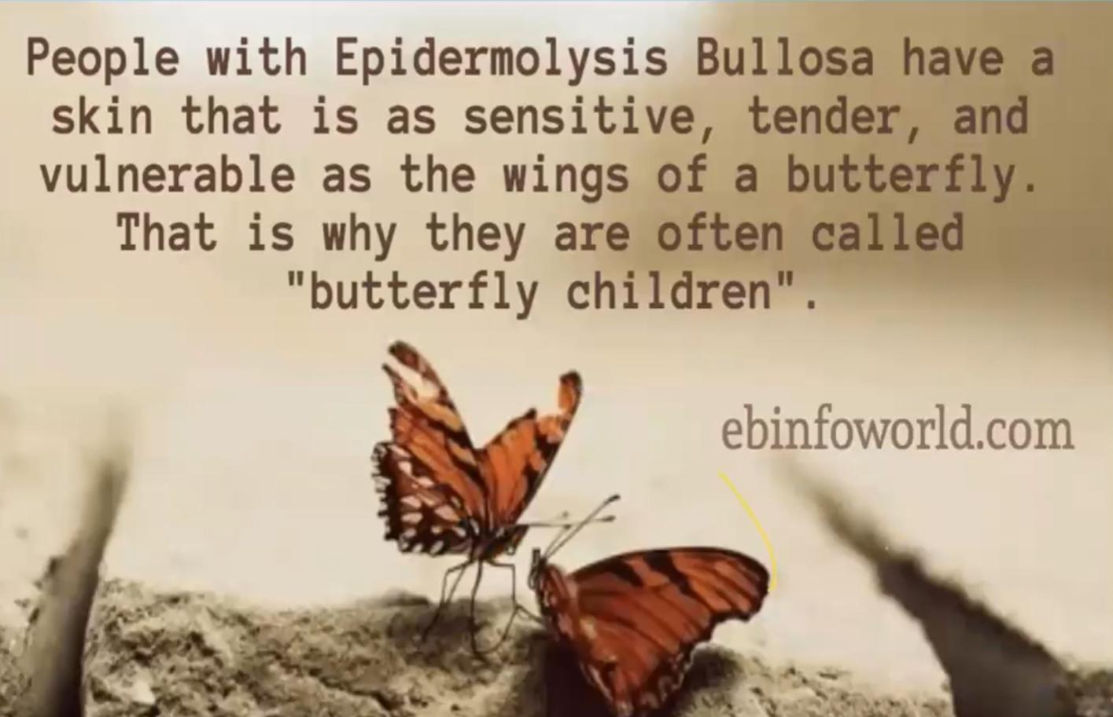

Slide 5
classification
The ultrastructural level of tissue cleavage (blister formation) in the skin is distinctive in the three major groups:
EB simplex (keratin filament disruption)
junctional EB(poorly formed hemidesmosomes )
dystrophic EB (rudimentary anchoring fibrils)

Slide 6
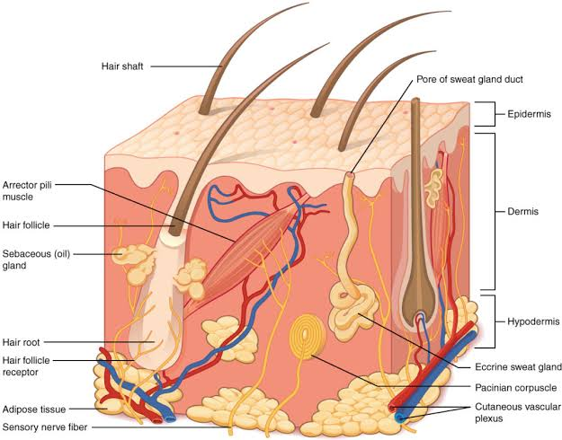
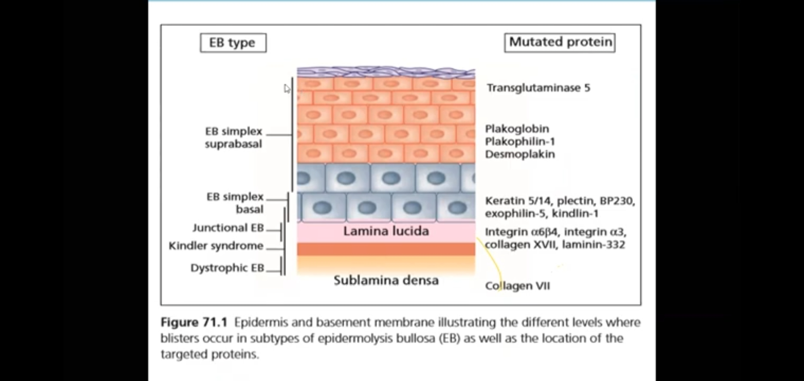
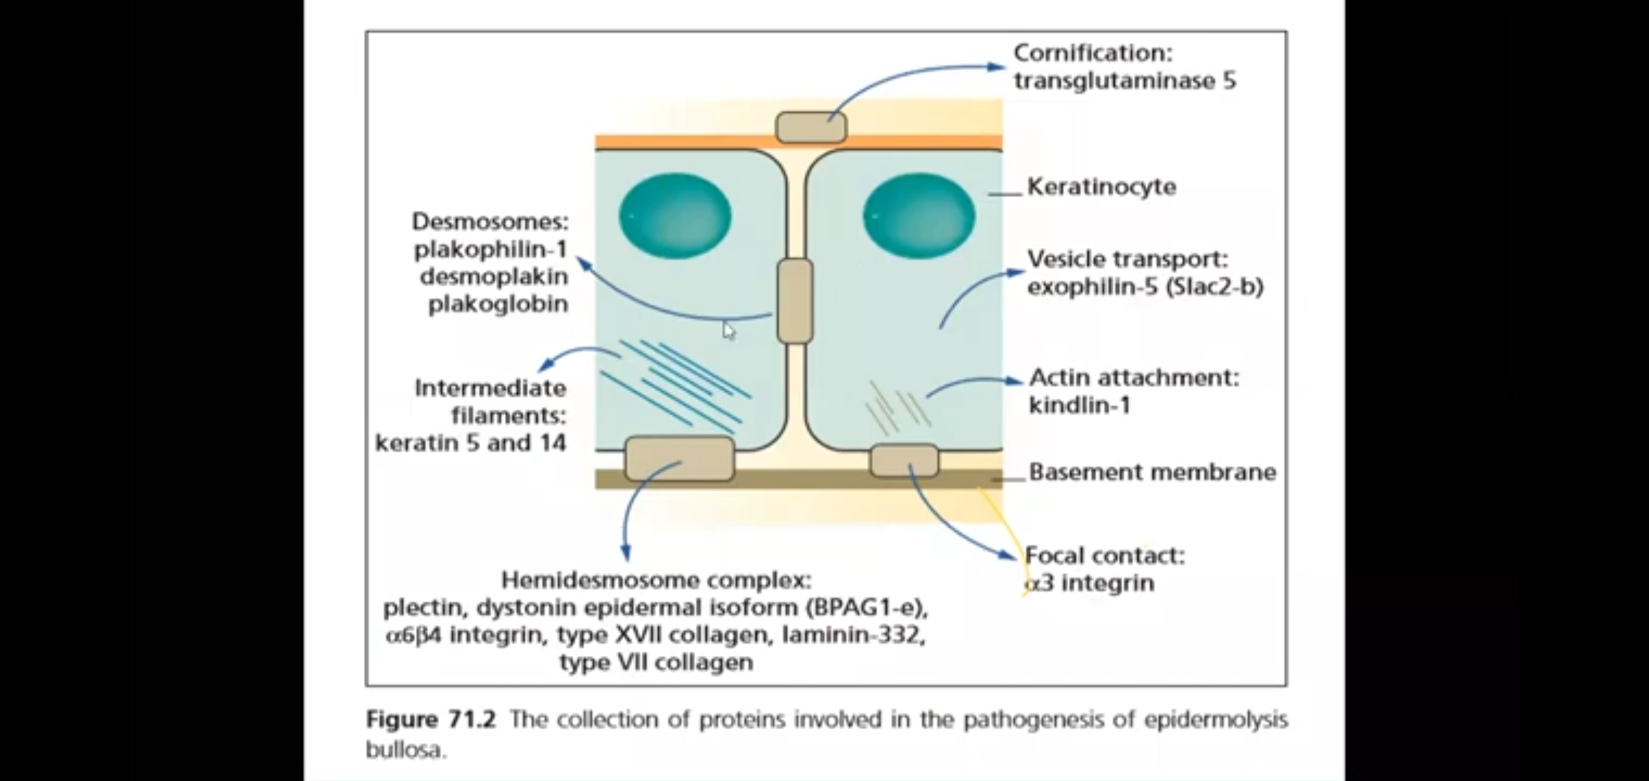
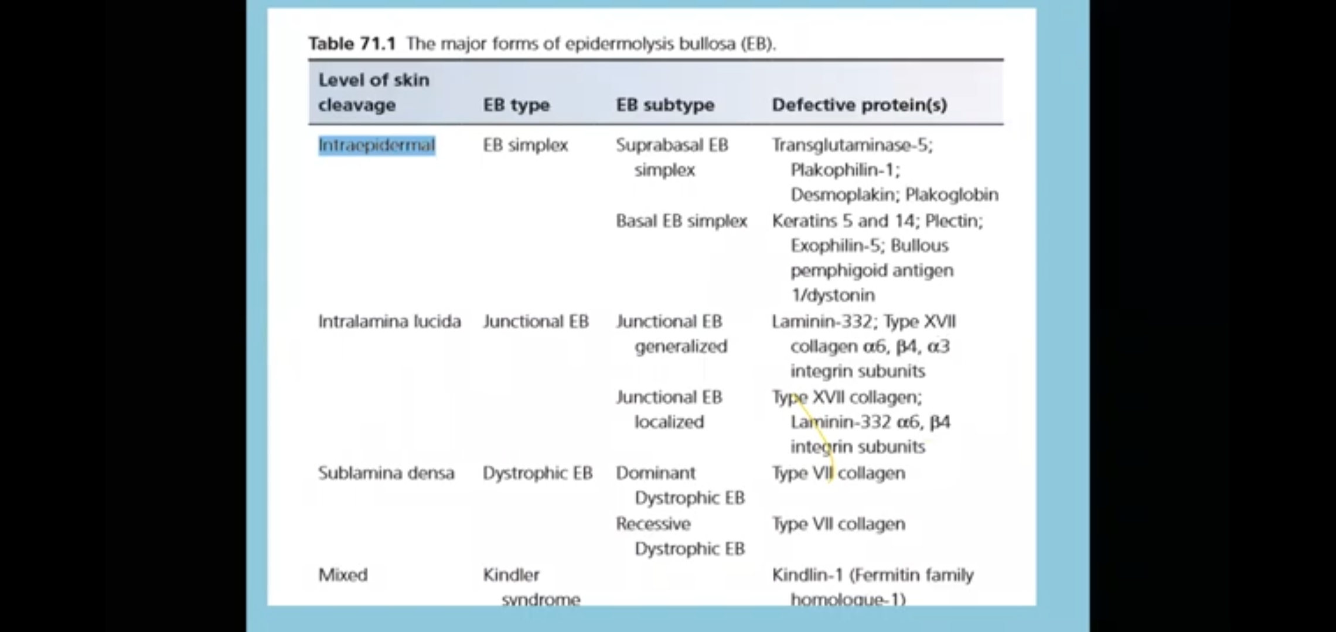

Slide 7
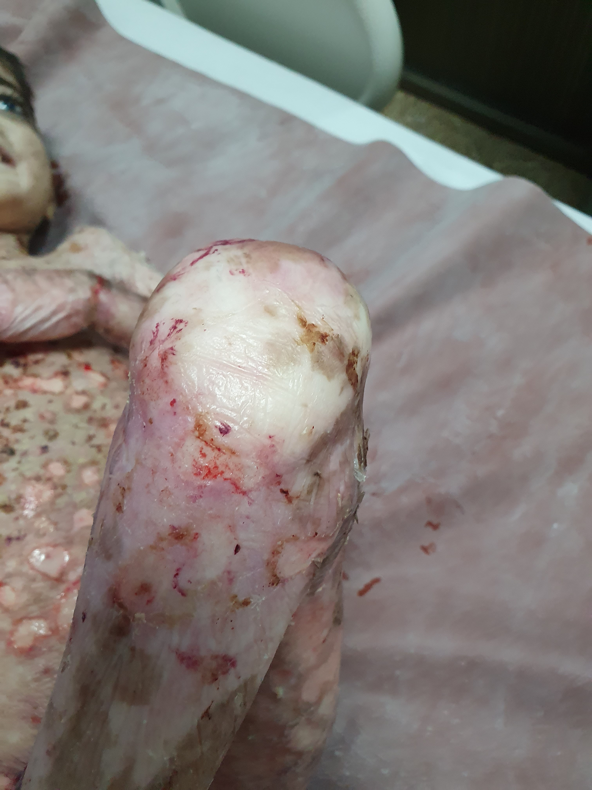
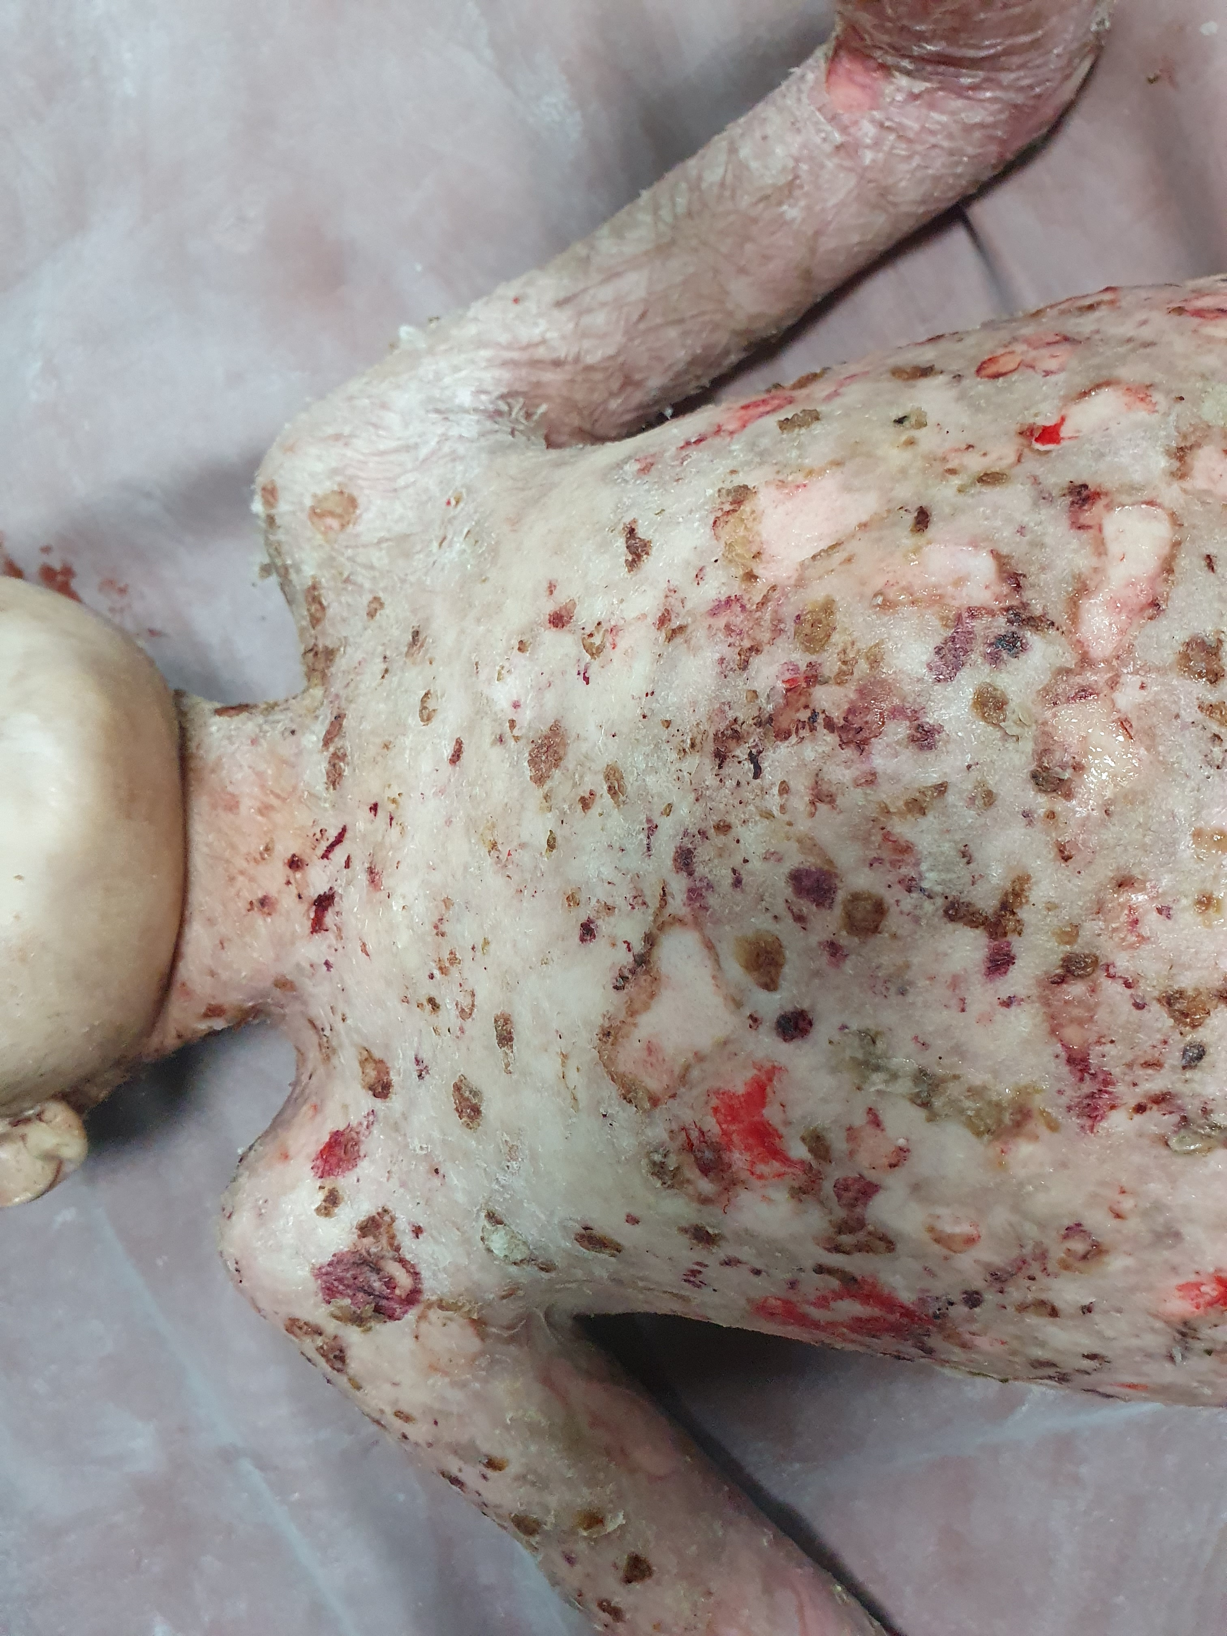
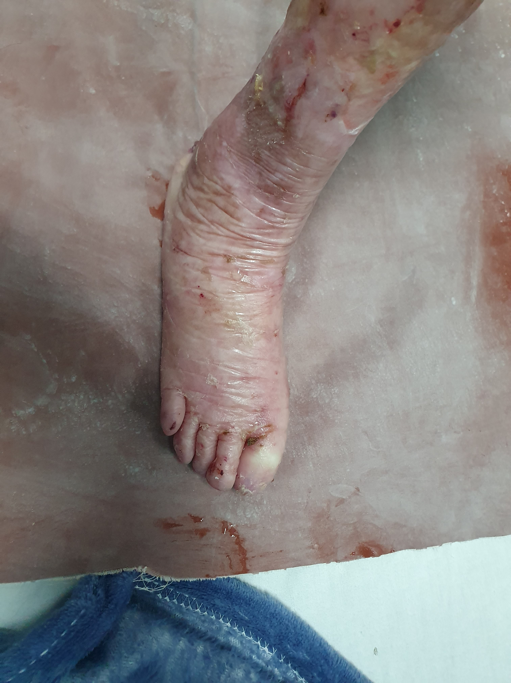
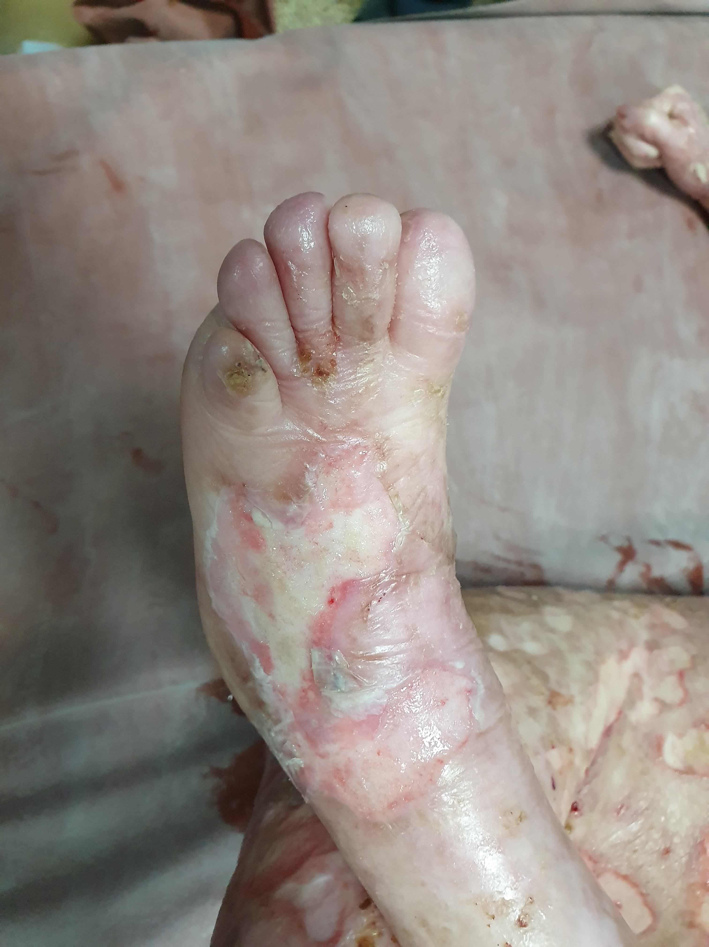
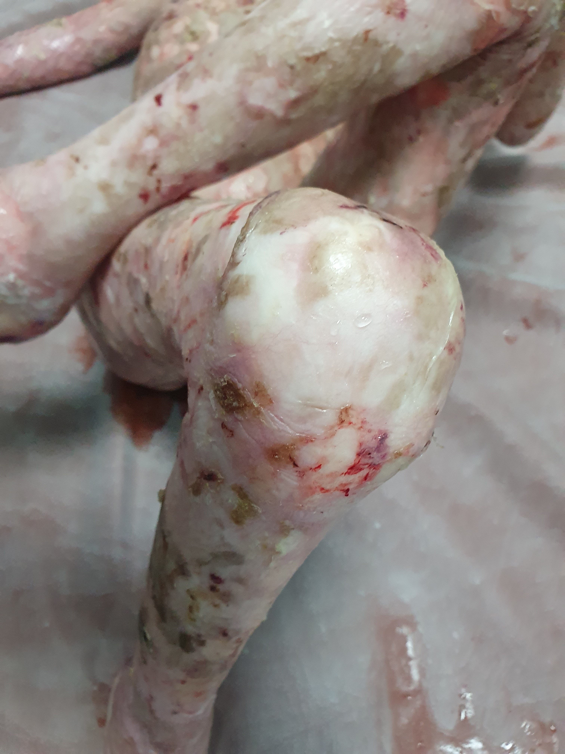
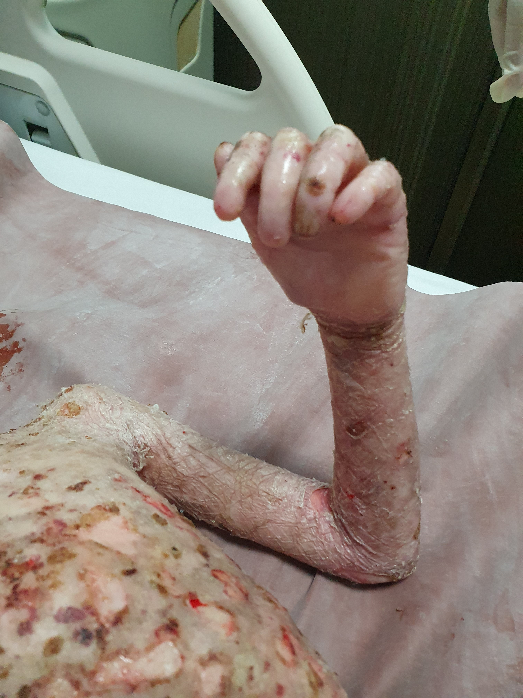

Slide 8
During the 1980s, the immunohistochemicallabelling of EB skin became a useful diagnostictool, to show reduced immunostaining for certainproteins.
Then in the 1990s, the discovery of candidate genes and pathogenic mutations, such as mutations in KRT14 in EB simplex (keratin 14) and cOL7A1 in dystrophic EB (type VIl collagen),heralded the era of molecular diagnostics.

Slide 9
This plethora of discoveries has had an impact on the diagnostic classification of EB and left dermatologists wondering whether to favour a classification based on phenotype, skin pathology or gene mutations - or a combination thereof.
Their most recent guidelines were published inJune 2014. There has been a general trend to eliminate use of historical eponyms and instead to use straightforward terms that refer to the extent of disease and severity.

Slide 12
Prevalence and incidence
Incidence:
19.60 per million live births
Prevelance:
8.22 per million population,
data suggest that there is no gender,racial, ethnic or geographical predilection for

Slide 13
Skin proteins and genes implicated in epidermolysis bullosa
Currently, 18 different genes have been shown to harbour mutations germane to the pathogenesis of EB.
These genes encode proteins involved in
the structural adhesion of cell-cell and cell-matrix junctions as well as
keratinocyte integrity and differentiation.

Slide 15
Stratum Corneum
• Transglutaminase 5
TGM5Autosomal recessive mutations in TGM5 have been shown to underlie acral peeling skin syndrome.
Transglutaminase 5 is one of eight different transglutaminase enzymes expressedin the sin and has a distinct roie in the formation of the cornified cell envelope.

Slide 16
Intracellular
• Keratins 5 and 14
Autosomal dominant mutations in KRT5 orKRT14 underlie the most common EB subtype,localized EB simplex,
usually results in minor blistering that is typically worse in the summer months and which does not result in scarring.

Slide 17
Exophilin-5
EXPH5A consanguineous pedigree has been reported with minor trauma induced skinscaling/crusting and intermittent skin blistering associated with mottled dyspigmentation.

Slide 18
Kindlin-1
KIND1/FERMT1Kindlin-1, is associated with anchorage of the actin cytoskeleton.
Autosomal recessive mutations result in Kindler syndrome, that may resemble dystrophic EB in early life.
With increasing age, the blistering often diminishes and photosensitivity and poikiloderma are most evident in sun-exposed areas

Slide 19
Desmosomal
• Plakophilin-1
PKP1Plakophilin-1 has a restricted localization to keratinocyte desmosomes,
autosomal recessive loss-of-function mutations in PKP1
result in ectodermal dysplasia/skin fragility syndrome.

Slide 20
Desmoplakin
DSP Desmoplakin is the major intracellular structural component of the desmosomal plaque.
Autosomal dominant mutations in DSP can give rise to striate palmo-plantarkeratoderma,
a disorder characterized by linear thickening (but no blisters) on trauma-prone sites on the palms or weight-bearing areas on the soles.

Slide 21
Plakoglobin
JUP Plakoglobin is an intracellular armadillo protein component of the desmosome.
Autosomal recessive mutations have been reported in individuals with Naxos disease
a combination of woolly hair, palmo-plantarkeratoderma and cardiomyopathy

Slide 22
Hemidesmosomne
• Plectin
PLEC Plectin is an epidermal plakin protein
plays a key role in linking the keratin filament network to hemidesmosomes at the plasma cell membrane.
Autosomal recessive mutations in PLEC Cause EB simplex associated with muscular dystrophy,
which manifests as relatively minor skin blistering and progressive muscle weakness

Slide 23
Dystonin epidermal isoform (BP230):DST-e
Autosomal recessive mutations in the epidermalisoform of dystonin, also known as the 230 kDa bullous pemphigoid antigen (BP230), have been shown to result in a relatively mild form of inheritedskin blistering.

Slide 24
a6ß4 integrin: /TGA6, ITGB4a6ß4
integrin is involved in hemidesmosome assembly.
Mutations in gene encoding a6 andB4 integrin subunits, respectively
shown to result in autosomal recessive junctional EB associated with pyloric atresia.

Slide 25
Type XVII collagen: COL17A1
TYPE XVII collagen, also known as the 180 kDabullous pemphigoid antigen, is a transmembranous protein located within the hemidesmosome and lamina lucida.
It is the antigenic target in bullous pemphigoid, but loss-of-function mutations result in generalized intermediate junctional EB (previously known asnon-Herlitz or generalized atrophic benign EB).

Slide 26
Laminin-332
LAMA3, LAMB3, LAMC2Laminin-332, previously known as laminin-5, Iocated within the lamina lucida/lamina densa of the epidermal basement membrane.
Autosomalrecessive mutations can give rise to severe generalized, forms of junctional EB (previouslyknown as Herlitz junctional EB).
It is the most severe form of EB, resulting in widespread mucocutaneous fragility and a poor prognosis, with most affected individuals not surviving beyond infancy.

Slide 27
Anchoring Fibrils
Type VII collagen: COL7A1Type VII collagen is the major component of anchoring fibrils,
which provide adhesion between the epidermis and dermis.
Mutations in COL7A1underlie both autosomal dominant and autosomal recessive forms of dystrophic EB.

Slide 28
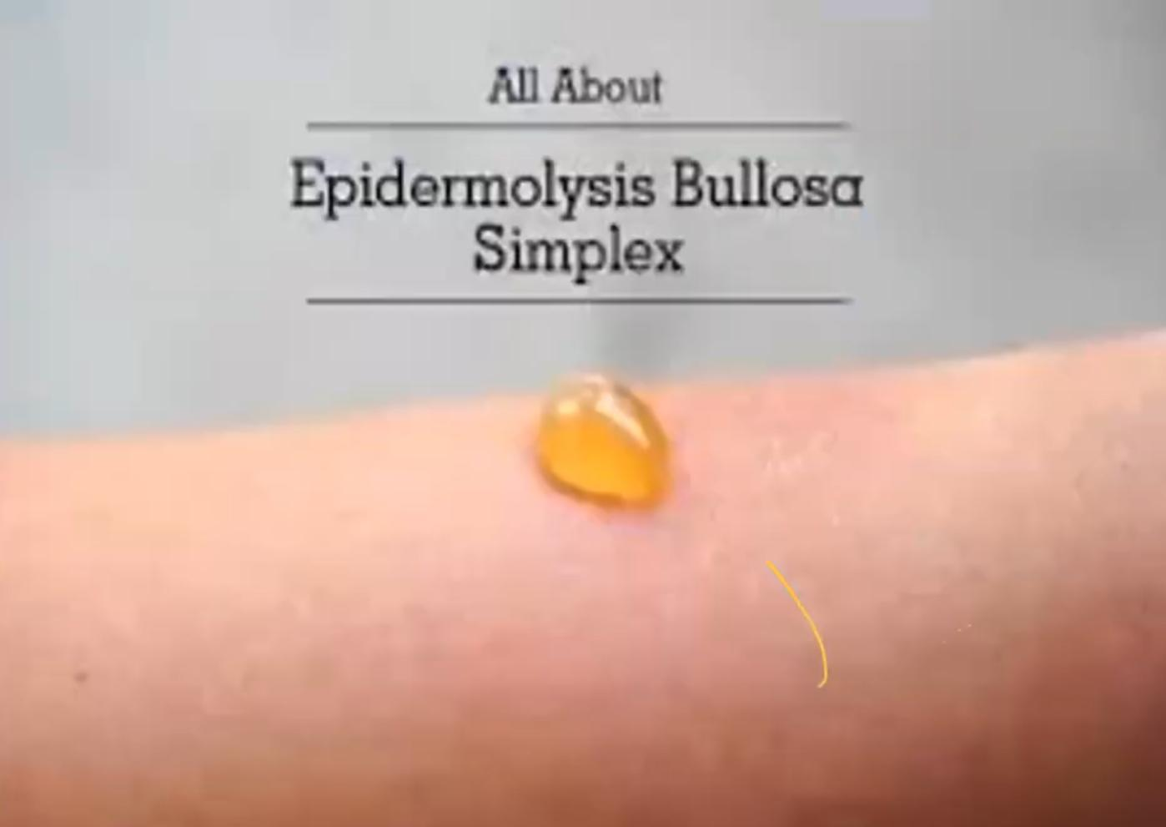

Slide 29
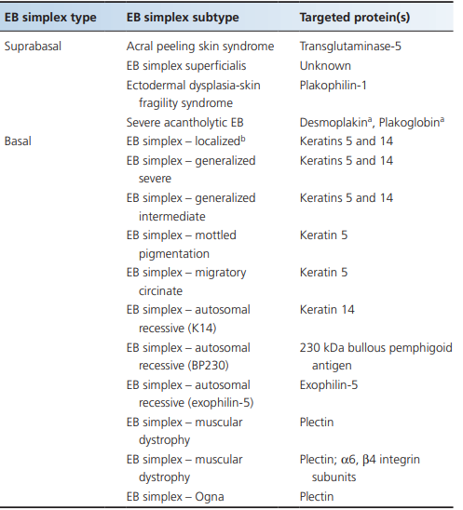
EB simplex
subtypes of EB simplex are subdivided into
basal
suprabasal variants,.

Slide 30
Localized EB simplex
most common type of EB.
AD.
The soles and palms are mainly affected, and
blistering may be painful.
In most individuals, blistering starts in childhood, but onset may be delayed until early adult life, onlymanifesting after strenuous physical activity.
The condition is typically worse in warm weather.
Hyperhidrosis of the feet is common; this increases friction, which also exacerbates blistering.
The blisters usually heal without clinically significantscarring or milia formation.
The hair and teeth are normal
nail dystrophy is infrequent, and is usually localized and mild.

Slide 31
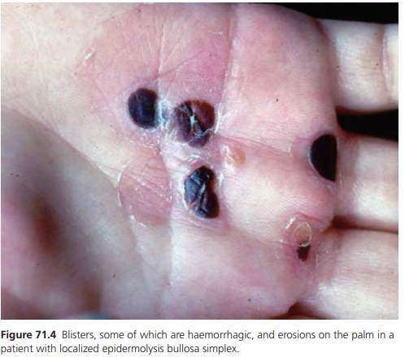

Slide 32
Acral peeling skin syndrome
An important differential diagnosis of localized autosomal dominant EB simplex is autosomal recessive acral peeling skin syndrome.
Blisters typically occur on the feet and resemble localized EB simplex although in acral peeling skin syndrome some of the blisters may be more evident on the sides or dorsal aspects of the toes.
The level of blistering occurs above the granular layer but because of the thicker stratum corneum in acral skin, the clinical consequences may be almost identical to blistering through the basal keratinocyte layer.

Slide 33
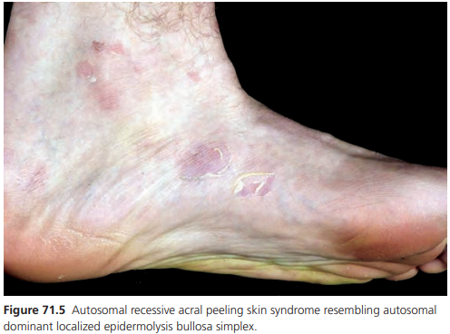

Slide 34
Generalized severe EB simplex
Previously known as Dowling-Meara EB simplex.
AD
Blisters tend to occur in groups reminiscent of those seen in dermatitis herpetiformis, hence the earlier use of the term EB herpetiformis.
In infancy, blistering may be severe and extensive with involvement of the mucous membranes, shedding of nails and formation of milia.
After several months, blistering of the palms and soles becomes more frequent
.The distinctive feature of this condition is spontaneous herpetiform, annular or arcuate blistering on the trunk, limbs and neck. Irregular hyperkeratosis of the palms and soles.

Slide 35
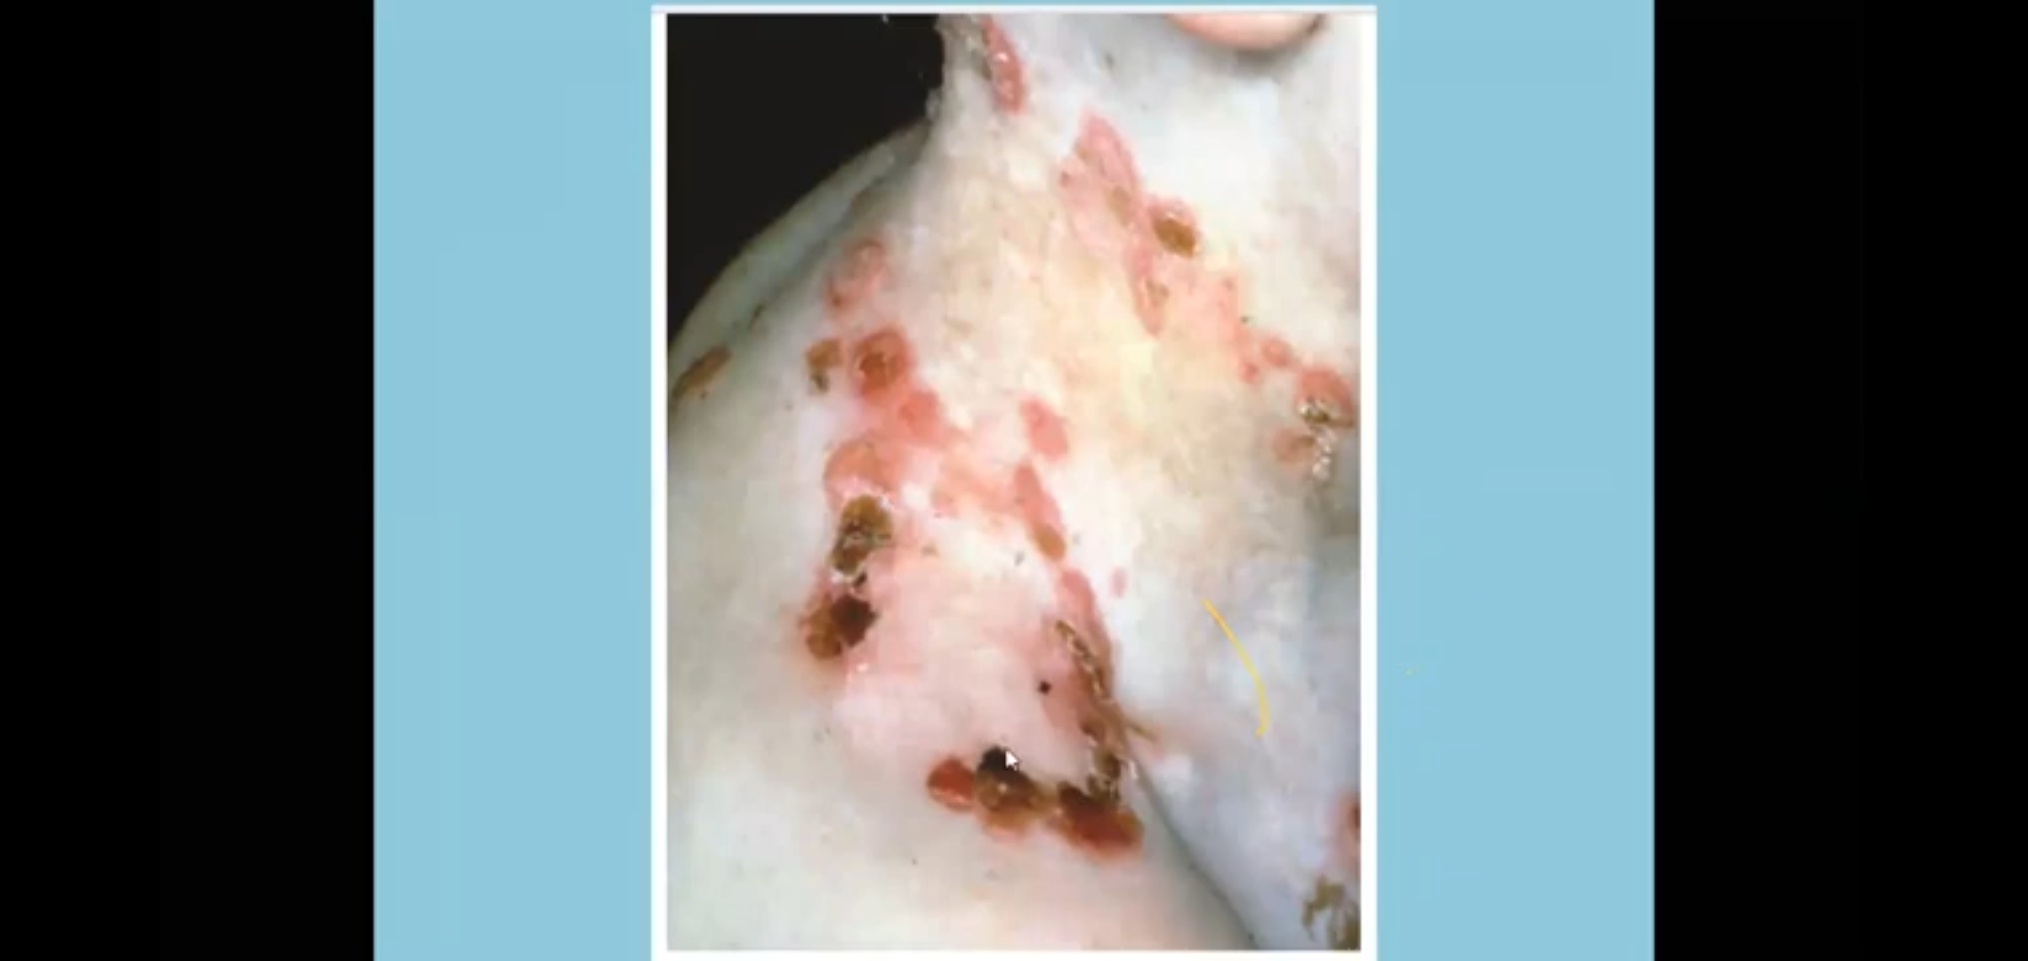

Slide 36
Generalized intermediate EB simplex
previously known as Koebner EB simplex.
AD.
Although usually mild, approximately 60% of patients have localized scarring and approximately 15% have milia.
The development of hair, teeth and nails is normal.
Blisters appear within the first year and maybe present at birth.
In common with other forms of EB simplex, blistering is worse in warm weather.
Although blistering occursthroughout life, some patients are alleged to improve after puberty.

Slide 37
EB simplex with mottled pigmentation
ausotomal dominant condition
can be distinguished from other forms of EB simplex by the associated pigmentary changes, which are present at birth or appear during infancy.
There is a reticulate pigmentation from acral sites to the trunk and which fade with age.
Blistering may be localized, or become more generalized. Punctate keratoses on the palms and soles sometimes progressing to keratoderma in some cases.
Mild localized skin atrophy and nail dystrophy are also features of the condition.

Slide 38
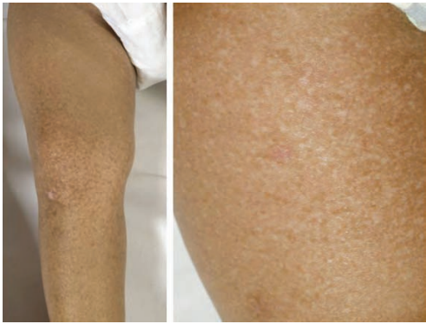

Slide 39
EB simplex Ogna
autosomal dominant condition
characterized by seasonal blistering of the hands and feet, and occasionally elsewhere.
This rare subtype of EB is distinguishable clinically by a generalized bruising tendency, haemorrhagic bullae and onychogryphotic great toenails.

Slide 40
EB simplex migratory circinate
Two families have been reported with an autosomaldominant form of EB simplex characterized by migratory circinate erythema and post-inflammatory hyperpigmentation.
Present at birth, blistering was generalized in distribution

Slide 41
EB simplex autosomal recessive keratin 14
Clinically cases may resemble generalized intermediate EB simplex.
Blisters are often scattered and there is usually minor palmo-plantar keratoderma
varying degrees of nail dystrophy
atrophic scarring
hyperpigmentation
oral and genital blistering.

Slide 42
EB simplex with pyloric atresia
AR
Pyloric atresia may rarely occur in the setting of EB simplex - most cases are classified as a junctional form of EB.
Affected infants tend to have generalized skin disease.
There are widespread blisters and erosions that increase infection risk with early demise in the neonatal period.
As such, this is one of the forms of EB simplex that is associated with a generally poor prognosis.

Slide 43
EB simplex autosomal recessive(BP230)
Blistering is lifelong and generalized but clinically is mild,
with only a few predominantly acral blisters that heal with no scarring
only mild post-inflammatory pigmentary.
Oral and genital mucosae are not afected.

Slide 44
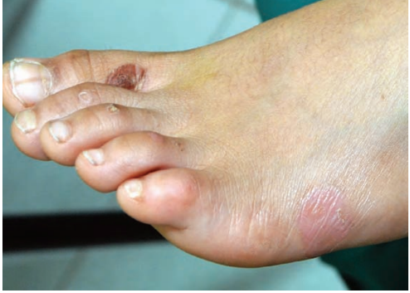

Slide 45
EB simplex autosomal recessive(exophilin-5)
Result in mild, scattered, trauma-induced skin fragility, although blistering can be generalized shortly after birth.
In later infancy, however, the clinical features mostly comprise crusted erosions on the limbs with few intact blisters.
No mucosal abnormalities are noted.

Slide 46
EB simplex (plakophilin-1 deficiency)
known as ectodermal dysplasia skin fragility syndrome.
AR
Widespread erosions are present at birth, with evident perioral cracking and hypotrichosis.
During infancy, the skin manifestations evolve to reveal trauma-induced scale crusting
a prominent palmo-plantar keratoderma with painful fissures and nail dystrophy.
The skin pathology affects the spinous but not the basal keratinocyte layer
there is no cardiac involvement in this condition, since plakophilin-1 is not expressed in the heart.

Slide 47
EB simplex with muscular dystrophy
Skin fragility and blistering are associated with a neuromuscular disorder, chiefly muscular dystrophy
myasthenia gravis and spinal muscularatrophy have also been described
cardiomyopathycan also occur.
The blisters, which affect the skin and oral mucosa are present at birth or soon afterwards.
There isassociated atrophic scarring, milia, nail dystrophyand alopecia, which can mimick junctional or dystrophic EB.
The disorder is autosomal recessive.

Slide 48
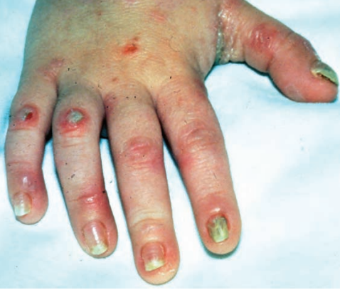

Slide 49
EB simplex (desmoplakin deficiency)
AR
It was originally termed lethal acantholytic EB.
This include a group of diseases known as cardiocutaneous syndromes in which dermatological features such as woolly hair and keratoderma may occur with, potentially life-threatening cardiac disease.
Blistering is present at birth and generalized in skin distribution. A characteristic feature is the presence of oozing erosions rather than frank blisters.
Other findings markedly abnormal nails, neonatal teeth, intraoral erosions and alopecia of the scalp.
The gastrointestinal,genito-urinary and respiratory tracts may also be involved.

Slide 50
EB simplex plakoglobin deficiency
Autosomal recessive mutations in plakoglobin,
result in a very severe form of inherited skin fragility.
This was originally termed lethal congenital EB,
Clinically there were widespread erosions and massive transcutaneous fluid loss leading to neonatal death.

Slide 51
EB simplex superficialis
autosomal dominant condition,
originallyreported in seven patients,
characterized by thepresence of superficial erosions rather than intact blisters, similar to those seen in pemphigus foliaceus.
Epidermal cleavage is typically just beneath the stratum corneum.
Healing results in localized atrophic scarring or postinflammatory hyperpigmentation.

Slide 52
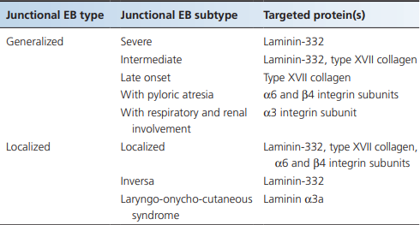
Junctional EB
autosomal recessive inheritance
blister formation at the level of the lamina lucida.

Slide 53
Generalized severe junctional EB
This is the most severe form of junctional EB.
Blistering and erosions are present at or soon after birth and rapidly become generalized.
The whole skin is extremely fragile and lifting or turning the baby may cause extensive blistering or peeling away of the epidermis.
Eroded areas are often very slow to heal. Healing may result in atrophic scarring.
Milia are not generaly seen,although they may occur after secondary infection.
Involvement of the oral and pharyrgeal mucosa is frequent and may be severe.
Most notably potentially life-threatening complication is stenosis or stricture
Many infants die early in infancy with overwhelminginfection or from failure to thrive.

Slide 54
Generalized severe junctional EB
The teeth show abnormal enamel formation, but normal dentine, and as a result are malformed, pitted and lost prematurely.
There is shedding of the nails and bulbous changes of the fingertips.
Blisters may occur on the cornea, resulting in pain,erosions and scarring.
A variety of genito-urinary tract complications may occur including urethral meatal stenosis, urinary retention, hydronephrosis and bladder hypertrophy.

Slide 55
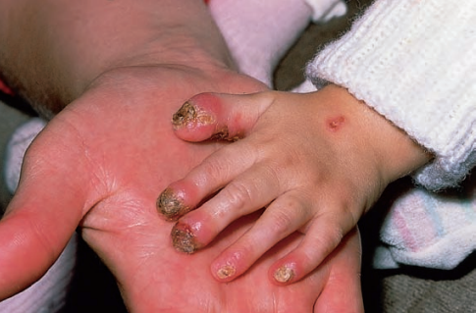
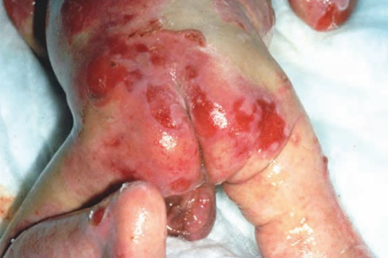

Slide 56
Generalized intermediate junctional EB
similar to the generalized severe variant with widespread skin fragility and blistering, but the patients usually survive to adulthood
there is a gradual lessening in severity of the disease with age
Mucous membranes are involved, but less severely than in generalized severe junctional EB.
The teeth show severe enamel defects and may fail to erupt normally.
The nails are dystrophic or frequently missing especially on the toes.
Up to 5% of patients may develop a degree of pseudosyndactyly, clinically suggestive of dystrophic EB.
heal with atrophic scarring, which can easily be mistaken for the scarring seen in dystrophic EB, especially on the lower legs or backs of the hands.
Post‐inflammatory hypopigmentation or depigmentation may be present in areas of scarring

Slide 57
Generalized severe junctional EB
An important sign of this form of EB is poor hair development
the alopecia affects the scalp,eye brows and eyelashes.
Oesophgeal stricture, laryngeal involvement, oral erosions, corneal ulcers and urethral stricture have all been reported.
In this type of junctional EB, it is common to observe small patches of skin that do no blister. This phenomenon is called revertant mosaicism.

Slide 58
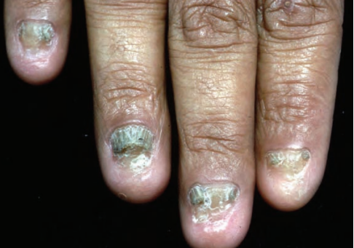
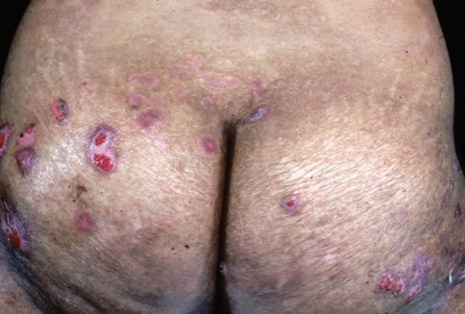
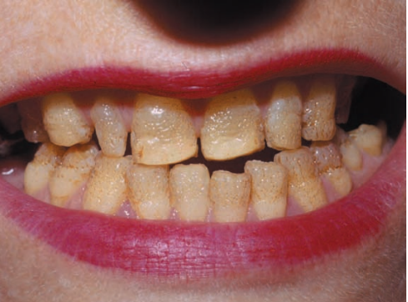
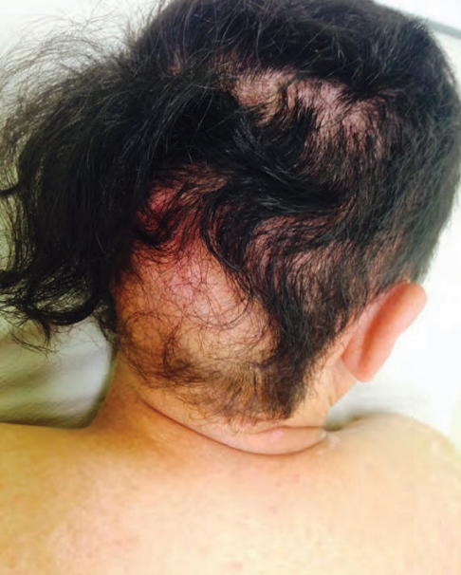

Slide 59
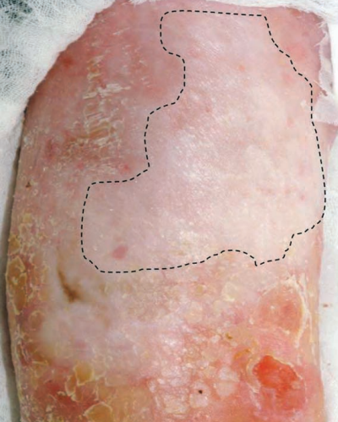
revertant mosaicism

Slide 60
Generalized late-onset junctional EB
The clinical features overlap with generalized intermediate junctional EB, except that the onset of symptoms is delayed-typically starting between 5 and 8 years of age.
Initially, the trauma-induced blisters mainly occur on the hands and feet, although they may be preceded by nail dystrophy. Later, knees and elbows are involved.
Progressive atrophic changes lead to early loss of fingerprint patterns and mild finger contractures.
The tooth enamel may be defective and the tongue papillae may disappear. The oral mucosa is sometimes involved.

Slide 61
Junctional EB with pyloric atresia
There is an overlap with EB simplex both clinically and in the classification of EB. Blistering is usually present at birth and widespread that can result in atrophic scarring.
The teeth are hypoplastic, lackingnormal enamel, and the nails are dystrophic.
Early attempts at feeding result in vomiting. The majority of cases do not survive eariy infancy.
In those children who survive, other features include haematuria, dysuria and recurrent urinary tract infections.

Slide 62
Junctional EB with respiratory and renal involvement
This is a recent addition to the classification of junctional EB. Three children were described with congenital nephrotic syndrome, interstitial lung disease and skin fragility.
The lesions healed slowly, without scarring but with residual erythema.
There was no mucosal involvement. The scalp hair, eyebrows and eyelashes were fine and sparse and some nails were dystrophic.
All cases died during infancy with recurrent lung infections and multi organ failure.

Slide 63
Localized junctional EB
typical clinical manifestations include nail dystrophy, dental enamel changes and blistering involving the lower legs and feet only.
In some individuals, chronic, painful erosions associated with hyperkeratosis develop on the soles.

Slide 64
Localized junctional EB inversa
In the neonatal period in the rare inversa subtype of localized junctional EB, the whole skin may be fragile with generalized blistering.
Later, however, the lesions affect chiefly the groins, perineum and axillae, hence the description of inversa.
Healing may result in small, atrophic, white streaks.
Dysplastic teeth, erosions of the cornea and feet and nail dystrophy are all features.

Slide 65
Localized junctional EB laryngo-onycho-cutaneous syndrome (Shabbir syndrome)
This subtype of junctional EB starts in infancy
with chronic erosions affecting the face (mainly around the nose and mouth) although erosions are also seen on the limbs, trunk and genitalia.
The nails are also involved with marked periungual and subungual inflammation and a universal feature is hoarseness.
The teeth may be notched.

Slide 66
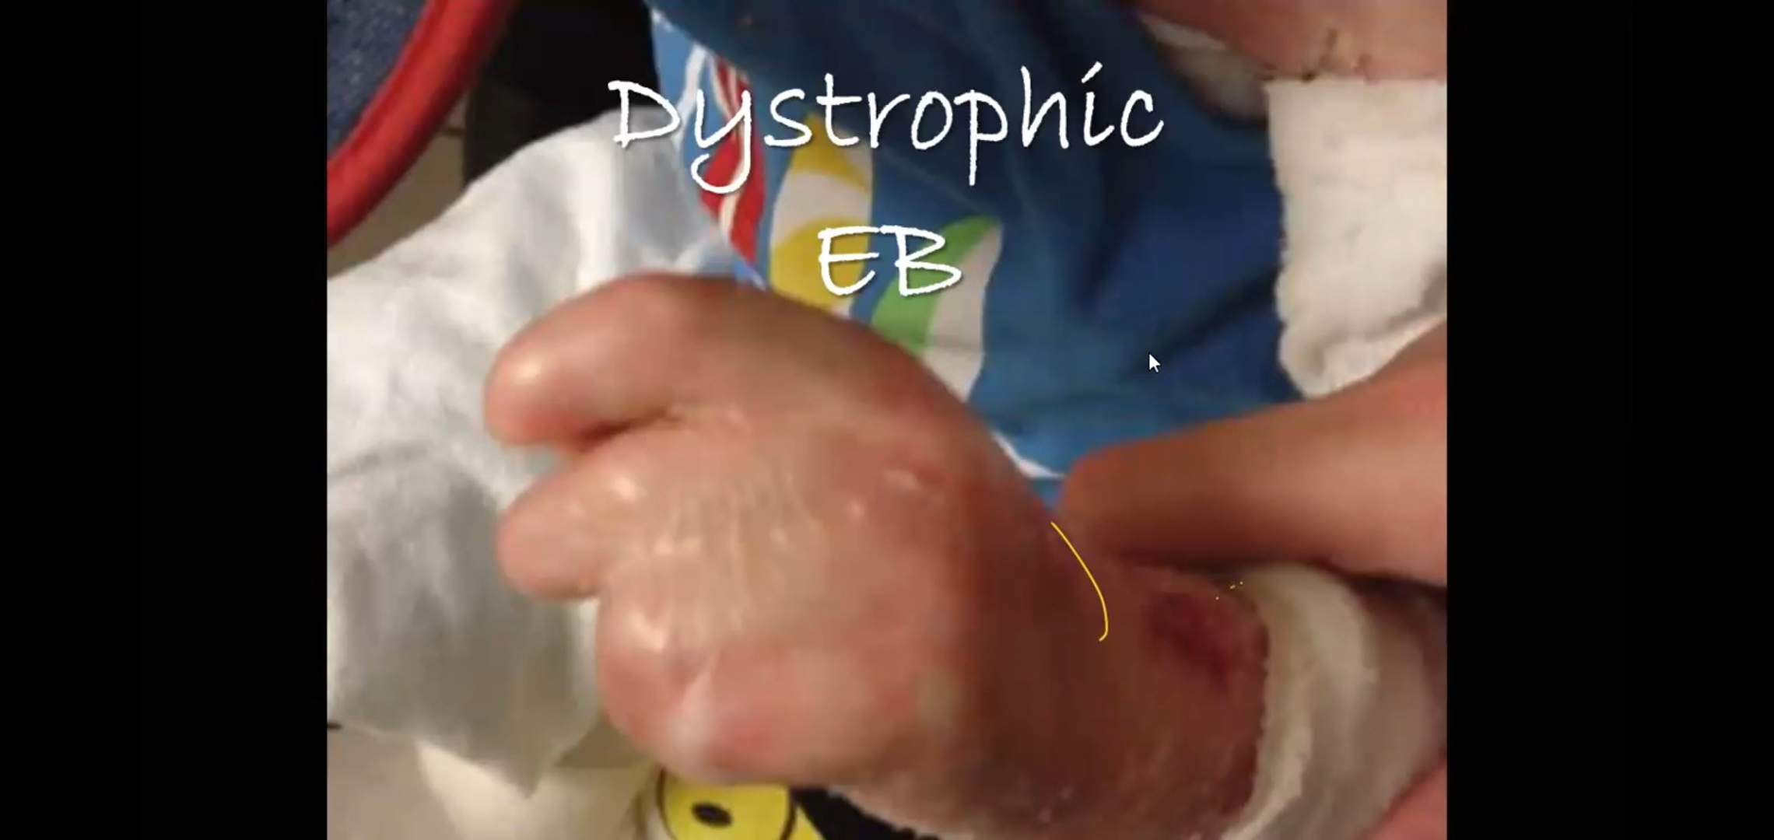

Slide 67
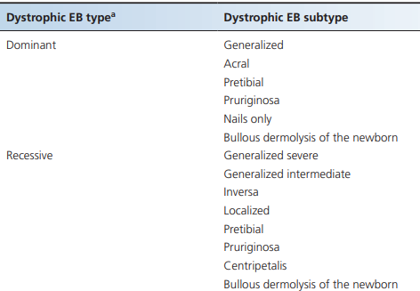
Dystrophic EB
Dystrophic EB can be autosomal recessive or autosomal dominant.
Clinically, dystrophic EB is characterized by skin fragility, blistering, scarring, nail dystrophy and milia formation.
Mucosal involvement is common and erosions and scarring can affect the mouth, oesophagus, genitalia and anus.
All cases of dystrophic EB, result from mutations in a single gene, COL7A1, which encodes type vii collagen, the major component of anchoring fibril structures beneath the lamina densa.

Slide 68
Classification
Dominant dystrophic EB subdivided into sixsubtypes:
generalized,
acral,
pretibial,
pruriginosa,
nails only
bulous dermolysis of the newborn..
Recessive dystrophic EB is subdivided into
generalized severe,
generalized intermediate,
inversa,
localized,
pretibial,
pruriginosa,

Slide 69
Dominant dystrophic EB generalized
Blisters in dominant dystrophic EB mainly occur following trauma to the skin overlying the bony prominences, such as the knees and ankles, and dorsa of the hands or feet.
The most consistent findings are localized scarring with milia formation and dystrophic nails.
Blistering in the mouth is usually mild and the teeth are generally normal.

Slide 70
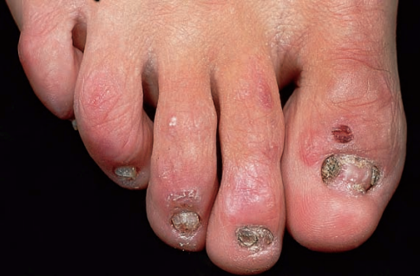

Slide 71
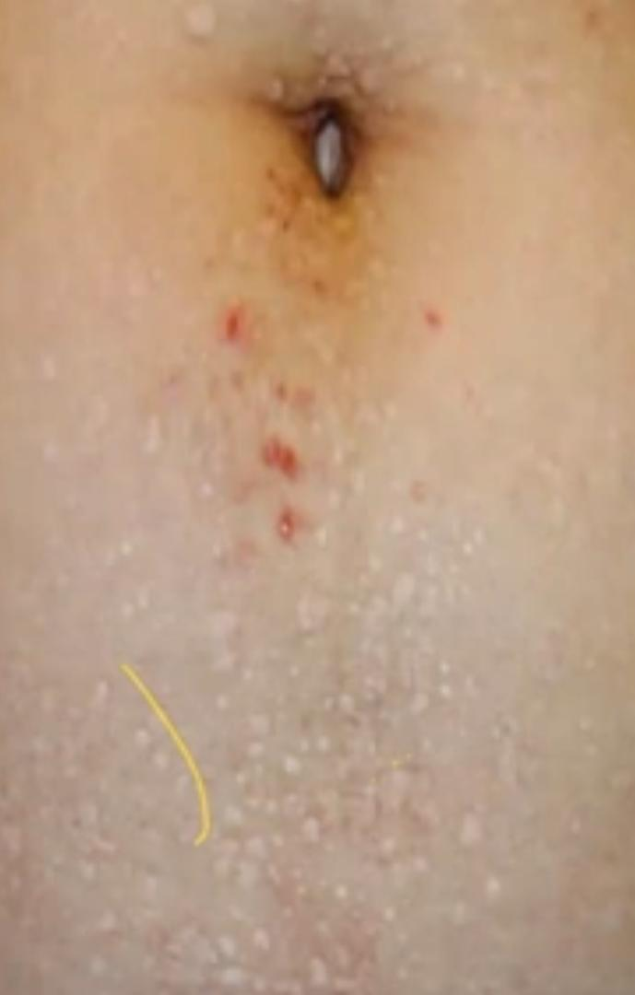
Terms such as Bart syndrome are obsolete. Cutaneous features such as a lbopapuloid lesions, once thought to be pathognomonic of dominant dystrophic EB ,are noW recognized to occur in several forms of dystrophic EB. These are white shiny papules.

Slide 72
Dominant dystrophic EB acral
inclusion in the latest classification of EB with a more localized pattern of skin involvement, usually involving the hands and feet.
Trauma-induced blistering, scarring and milia are typically present in acral skin.

Slide 73
Dominant or recessive dystrophic EB pretibial
Clinically, there are blisters, atrophy and scarring on the shins.
Lesions are usually violaceous, sometimes mimicking lichen planus.
Nails on both the hands an dfeet tend to be dystrophic.
The shins may be itchy and the phenotype can overlap with dystrophic EB pruriginosa.
Clinical signs are not exclusively confined to the shins and relatively minor skin fragility, scarring and milia maybe detected at other body sites, particularly overbony prominences.

Slide 74
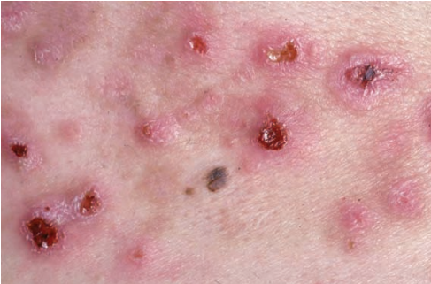
Dominant or recessive dystrophic EB pruriginosa
overlaps with the pretibial variant
The main difference is the intense pruritus.
No concomitant atopy.
The clinical features resemble hypertrophic lichen planus or nodular prurigo.
The initial onset of symptoms and signs may be delayed for several decades, The pruritic skin lesions can occur at any site.

Slide 75
Dominant dystrophic EB nails only
This condition is often only first diagnosed when a family member presents with trauma-induced skin blistering, with nail dystrophy but no history of blisters, Scarring, milia or mucosal ersosions.
In some individuals there are no clinical signs present apart from nail dystrophy, which can sometimes just be confined to the great toenails.

Slide 76
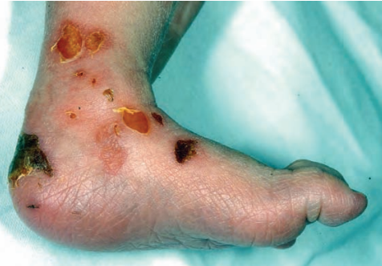
Dominant or recessive dystrophic bullous dermolysis of the new born
curious variant of dystrophic EB is when localized or generalized blistering in neonates starts to show signs of spontaneous clinical improvement over the first few weeks or months of life.
Now, it is appreciated that the majority of cases do not resolve completely and that there may be permanent stigmata of dominant or recessive dystrophic EB, albeit less severe than in early life.

Slide 77
Recessive dystrophic EB generalized severe
Bullae are present at birth or appear in early infancy and the skin is very fragile.
Blisters develop spontaneously or after the mildest trauma and may be haemorrhagic.
Healing lesions leave atrophic scars.
Milia formation is a nearly constant.
The sites of predilection are those subjected to repeated trauma. These include the knees, elbows, hands, feet.
There is increasing the risk of secondary infection.
Pruritus is frequent and constant rubbing may induce blisters.
The scalp is often involved. Hair growth on the scalp and body is impaired and scarring alopecia may occur.

Slide 78
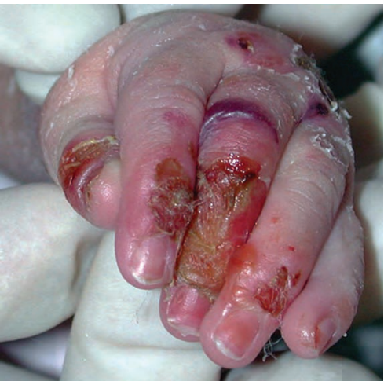
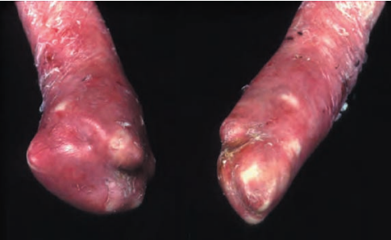
Repeated blistering with progressive scarring leads to fusion (ʻpseudosyndactyly') of adjacent fingers and toes, in childhood.
Digits resembling a mitten.
Marked ankyloglossia and microstomia.
The gums are fragile, and gentle tooth brushing may induce epithelial disruption with bleeding Blistering in the oesophagus may cause acute pain and dysphagia.
With time, partial or complete obstruction may result from oesophageal stricture.

Slide 79
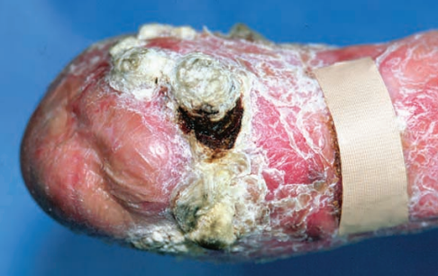
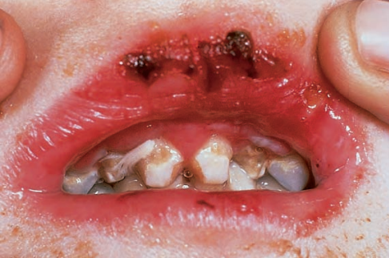
Perianal blistering, erosions and painful fissures are common in childhood.
The ocular complications include symblepharon, corneal erosions and corneal opacity or scarring. Most patients are very thin and have a short stature.
Refractory anaemia is evident.
Osteopaenia and osteoporosis are not uncommon
A very important complication is the development of squamous cell carcinomas, even in individuals as young as 6 years of age, death typically occurs within 5 years of the first malignancy.

Slide 80
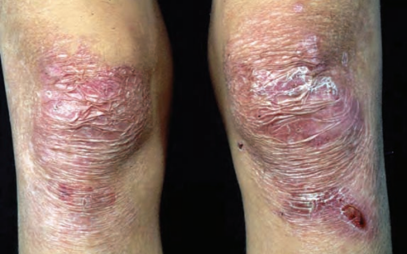
Recessive dystrophic EB generalized intermediate
This subtype of dystrophic EB shares several cutaneous and extracutaneous features with generalized severe recessive dystrophic EB, but is generally much milder.
Growth retardation and anaemia are usually mild.
Pseudosyndactyly, oesophageal involvement and squamous cell carcinoma may also occur, but these complications are usually milder or less frequent.

Slide 81
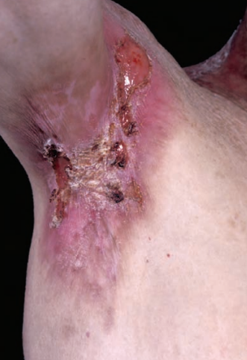
Recessive dystrophic EB inversa
In this variant of dystrophic EB, the primary areas of blistering and scarring include the groins, axillae, neck and lumbar area, although in early life the distribution of the blistering may be generalized.
Traumatic corneal erosions and oesophageal lesions are common.
Nail dystrophy, mucous membrane involvement and dental changes are similar to those in the generalized form of the condition. Patients are also at risk of developing squamous cell carcinoma.

Slide 82
Recessive dystrophic EB localized
Localized forms of recessive dystrophic EB overlapwith the generalized, inversa, pretibial or nails only.
Skin fragility, scarring and milia are mostly confined to hands, feet and nails, and may be trivial.
In some cases, onset of symptoms may be delayed for several years after birth. Significant mucosal involvement is rare.

Slide 83
Recessive dystrophic EB 'centripetalis
A single case. The reported individual had generalized blistering at birth but within the first year, her disease was confined to the hands and feet.
Over several decades her blistering slowly progressed proximally, in a centripetal manner, with active blistering and milia along the active edges and atrophic scarring and nail dystrophy distally.
At the time of death in late adulthood from unrelated causes, no blistering had occurred on the trunk, face or neck, and there was an absence of any systemic symptoms.

Slide 84
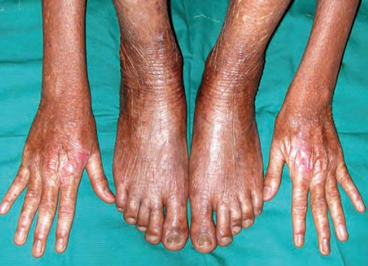
Kindler syndrome
Kindler syndrome is listed as a fourth category in the classification of EB.
AR.
Initially it can resemble generalized or localized forms of dystrophic EB, although skin biopsy typically shows a variable plane of cleavage.
The initial skin blistering lessens during childhood and instead signs of a progressive poikiloderma develop.
Kindler syndrome can also cause people to be highly sensitive to ultraviolet (UV) rays from the sun and to sunburn easily.

Slide 85
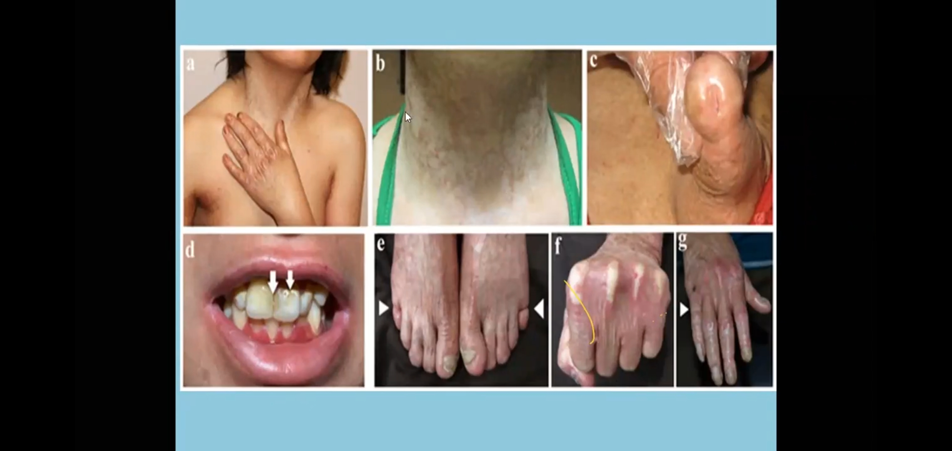

Slide 86


Slide 87
Diagnosis
Despite impressive advances in elucidating the molecular basis of the different forms of EB, the initial diagnosis still relies largely on careful clinical examination,
enquiry into the family history and establishing the level of blister formation.
Traditionally, transmission electron microscopy and immunofluorescence microscopy using a panel of antibodies are the preferred methods.
However, some cases of EB -may merit DNA sequencing as a primary diagnostic method.
For most recessive forms of EB, however, skin biopsy remains key to establishing the diagnosis.

Slide 88
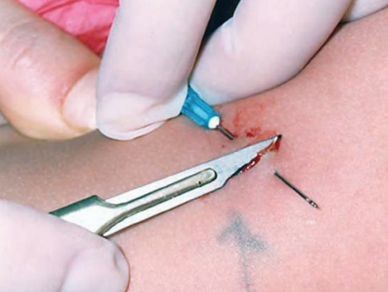
Skin biopsy
The main objectives of skin biopsy are first to establish the level of blistering.
Most blisters that are clinically evident, and especially those with blood stained contents, are often more than 12 h old and therefore too old for diagnostic purposes.
A sample of non-blistered skin that has been gently rubbed to produce a mild erythema is preferable, because this will usually contain a cleavage plane with few if any secondary changes.
Because the diagnostic signs are mostly seen in and around the dermal-epidermal junction, shave biopsy samples are preferable to thicker specimens.
The samples should be immediately immersed in suitable fixative for electron microscopy or in Michel's transport medium for immunofluorescence.

Slide 89
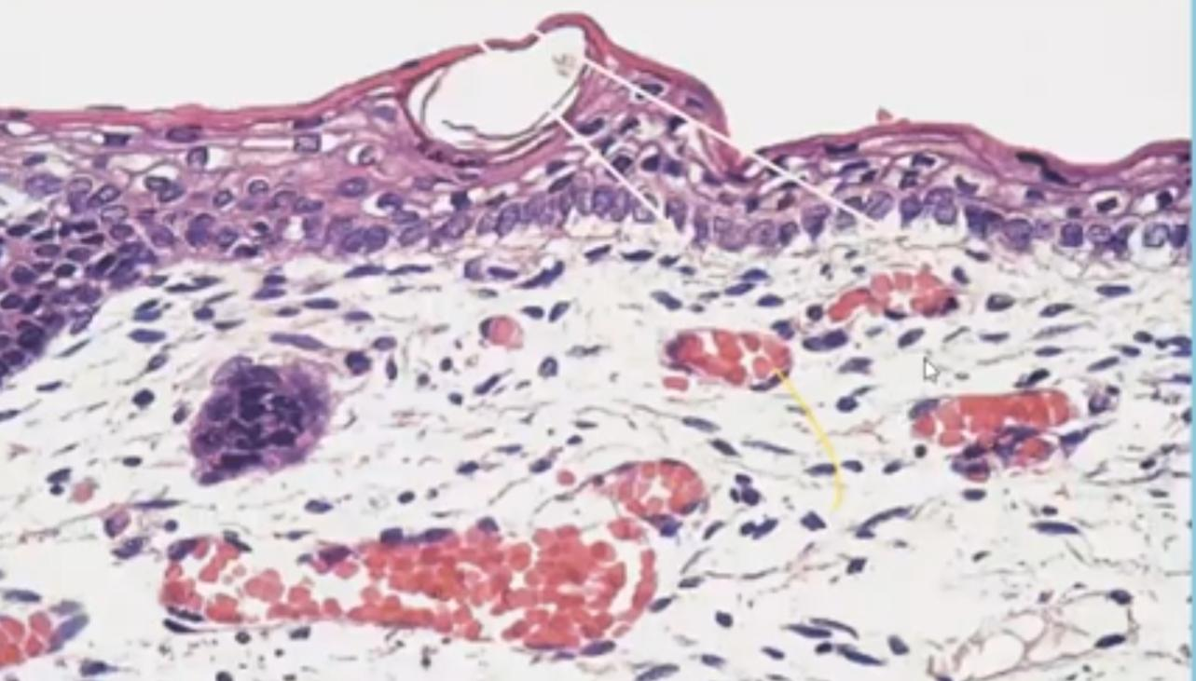
EB simplex: the earliest histological feature
in the development of a blister is marked vacuolation of the basalkeratinocytes, so-called cytolysis.

Slide 90
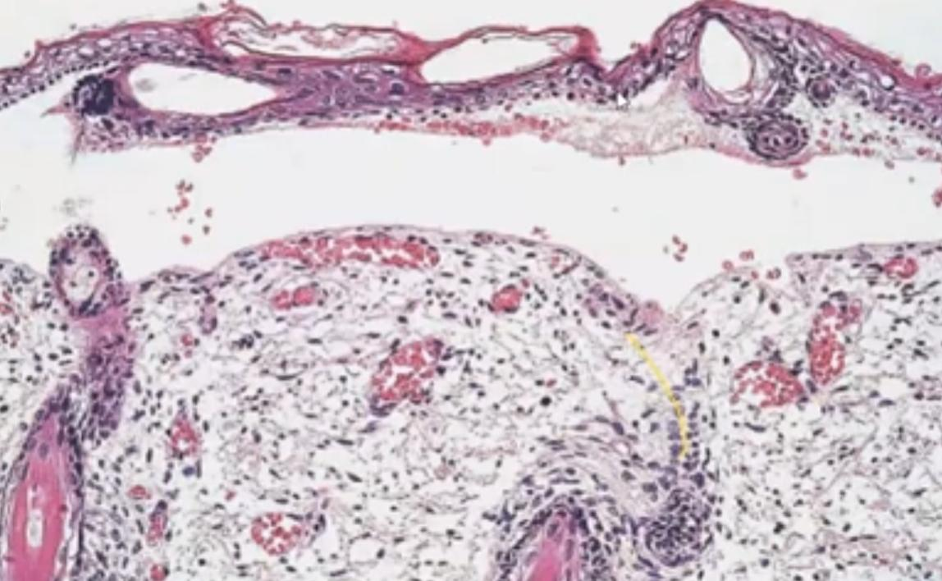
EB simplex: initial blister
is intraepidermal as a result of cytolysis but the established lesion shows 'subepidermal‘ vesiculation

Slide 91
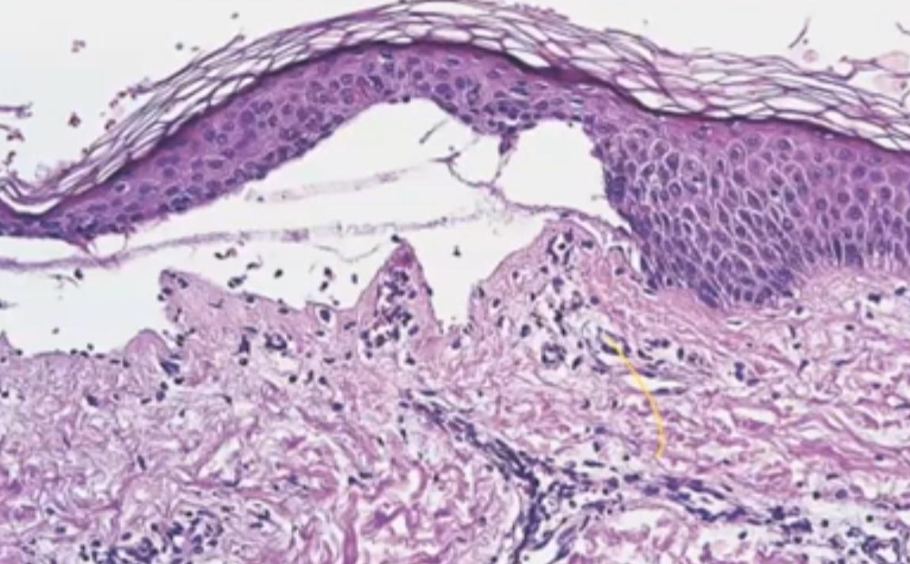
EB simplex: old lesion
the features are those of a cell-free subepidermal blister and are not specific.

Slide 92
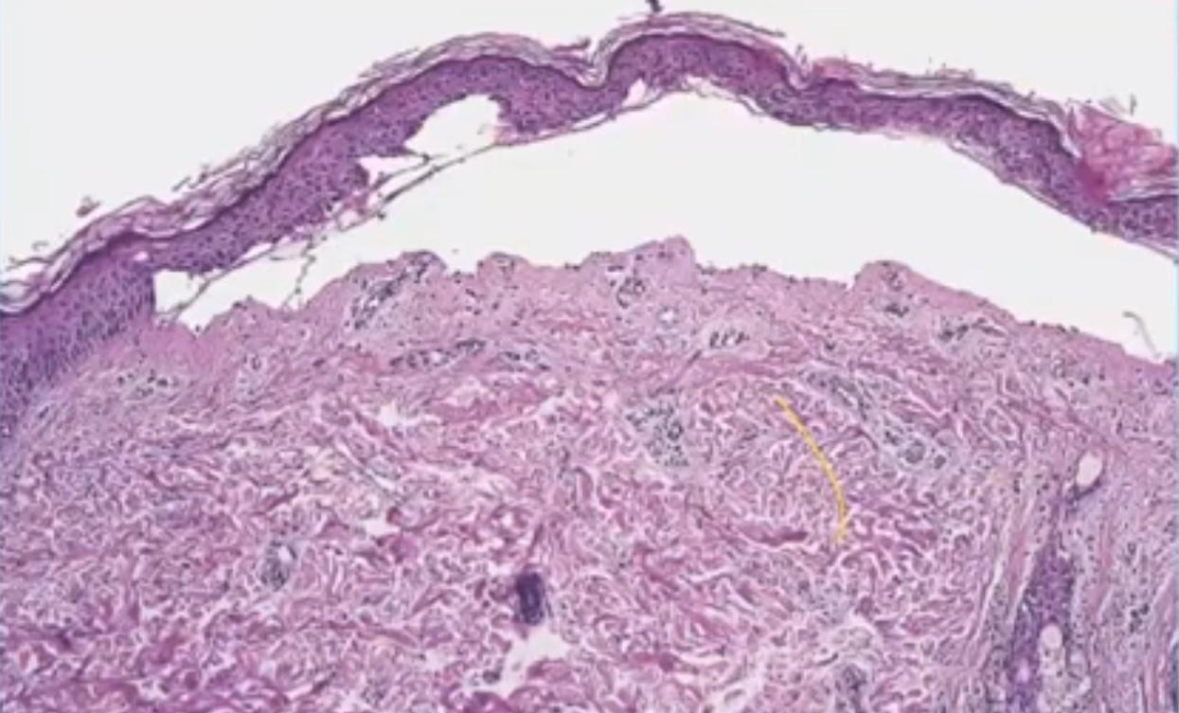
Junctional EB
ultra structurally the defect is in hemidesmosomes, but histologically the appearance is of a subepidermal cell-free blister.

Slide 93
Transmission electron microscopy
The main purpose of ultrastructural analysis of the skin is to demonstrate the level of tissue separation.
In EB simplex, the split is intraepidermal, in junctional EB it is through the lamina lucida, and in dystrophic EB it is beneath the lamina densa.
In Kindler syndrome the cleavage plane may be variable and mixed (all of the above levels).
Other ultrastructural features important for diagnosis are that keratin filaments tend to be disrupted or desmosome cell junctions may be abnormal.
Hemidesmosomes are generally sparse and small in the more severe forms of junctional EB and anchoring fibrils are reduced in number, absent or structurally abnormal in dystrophic EB.
Overall, electron microscopy now provides a useful contribution to EB diagnostics in about 10% of cases.

Slide 94
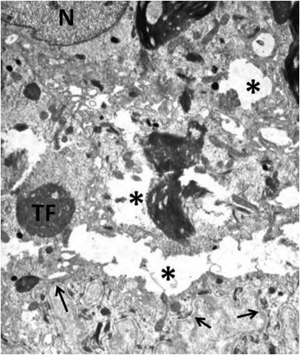
Electron microscopy of part of a basal keratinocyte in severe generalized epidermolysis bullosa simplex showing tonofilament clumping (TF) and cytolysis (asterisks). N, nucleus; arrows indicate dermal–epidermal junction

Slide 95
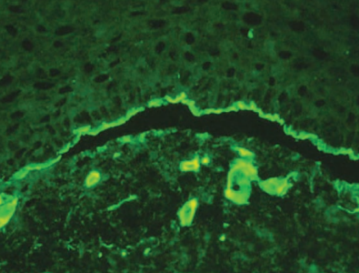
Antigen mapping and antibody probes
The level of blister formation can be determined using indirect immunohistochemical staining.
antitype IV collagen antibody will stain the lamina densa.
If this antibody labels the roof of a blister then the level of separation must be beneath the lamina densa.
Antigen mapping studies (e.g. with antibodies to keratin 14 or type IV collagen) may be informative on paraffin-emebdded sections.

Slide 96
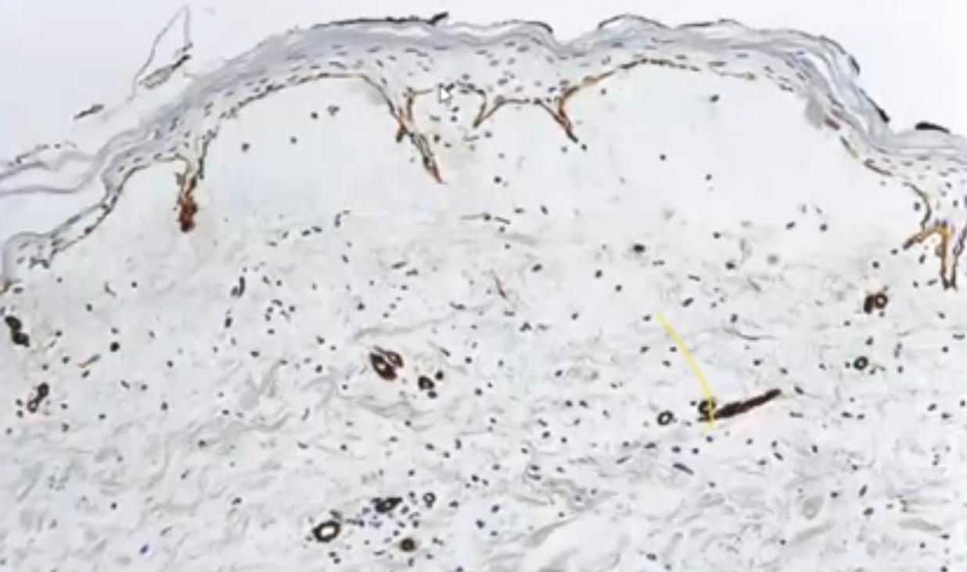
Paraffin-embedded immunoperoxidase antigen mapping: in epidermolysis bullosa dystrophica, type IV collagen is present along the roof of the blister cavity.

Slide 97

immunolabelling for type VII collagen in normal skin showing bright linear staining at the dermal–epidermal junction. In contrast, in a patient with severe generalized recessive dystrophic epidermolysis bullosa, there is a complete absence of type VII collagen immunoreactivity. Asterisk indicates blister; arrows depict roof and base of blister

Slide 98
Sanger sequencing
To date 18 different genes have been implicated in the molecular pathology of EB.
Most of the pathogenic mutations are point mutations, or involve small insertions or deletions. As such, mutation detection strategies have been established that are based on Sanger sequencing .
This is done by PCR amplification.

Slide 99

Sanger sequencing. The upper image shows a wild‐type DNA sequence but in the lower image there is a 1 bp deletion (G nucleotide) that induces a frameshift, resulting in a downstream premature termination codon. This type of mutation can be found in several recessive forms of epidermolysis bullosa.

Slide 100
Next generation sequencing
The aim of next generation sequencing is to sequence in one go all of the genome (wholegenome sequencing) or all the coding regions of the 22 000 or so known genes (whole exome sequencing) and then apply a series of bioinformatics filters to identify disease-causing mutations.

Slide 101


Slide 102
Differential diagnosis At infancy, following disorders may need to be included in the differential diagnosis of EB
bullous congenital ichthyosiform erythroderma
bullous impetigo
scalded skin syndrome
incontinentia pigmenti
neonatal herpes simplex
autoimmune bullous disease such as pemphigus or pemphigoid gestationis acquired transplacentally
aplasia cutis
focal dermal hypoplasia
Gunther disease
factitial skin damage, including child abuse, may also be a diagnostic consideration in some cases.

Slide 103


Slide 104
Treatment
At present there is no curative treatment for any form of EB
the mainstay of clinical management is based on protection and avoidance of provoking factors.
Major challenges include the treatment of the neonate with severe generalized disease and the older child, adolescent or adult with the chronic disability that accompanies generalized severe recessive dystrophic EB.

Slide 105
Management of neonates and infants
A key to successful management of neonates with EB is expert nursing care. Ideally, babies with EB are nursed on thick foam pads which are covered by a silk sheet.
The erosions are cleaned with sterile normal saline and covered comfortable non-adherent dressings
Some EB specialists may prefer to use a topical antiseptic,rather than topical antibiotics, chiefly because of the risk of antibiotic-resistant bacteria.
Another preference is to treat open wounds with 1% silversulfadiazine cream or an ointment containing polymyxin B or bacitracin,
The topical antibiotic mupirocin is not recommended for regular use, because of the emergence of mupirocin- resistant Staphylococcus aureus.

Slide 106
Management of EB simplex
Heat and humidity lower the threshold for blistering in patients with EB simplex.
Cotton socks are preferable to wool or synthetic fibres , and double-layer sports socks provide extra protection .
Use of 20% aluminium chloride hexahydrate can be used for the treatment of localized EB simplex, although it does not help everyone.
Dressings sometimes exacerbate the blistering. The use of non-sterile corn flour (cornstarch), applied directly, reduce blisters and improving wound healing.
The corn flour can be sprinkled into socks or shoes. There are no proven systemic therapies to improve EB simplex, although in some people oral tetracycline may reduce the numbers of new blisters.

Slide 107
Management of generalized severe junctional EB
• Individuals with the more severe form of junctional EB usually have a poor prognosis and mostly do not survive for more than few weeks or months.
Extreme care should be taken in handling affected children because of the profound mucocutaneous fragility.
Non-adhesive dressings should be used.
Assessment should also be made for extracutaneous abnormalities, like muscular dystrophy, pyloric atresia ,
Many wounds display exuberant granulation tissue that can improve following the application of potent topical steroids for a few days.
Skin grafting may also help.
Some children require tracheostomy because of vocal hoarseness and airways obstruction.

Slide 108
Management of generalized severe recessive dystrophic EB
Patients with the more severe forms of recessive dystrophic EB will often survive into middle age and will therefore require continuing care throughout life.
Special precautions should be taken in the use of adhesive tapes, blood presssure cuffs.
The following systems require particular attention:-

Slide 109
Oral and dental care
Microstomia, intraoral fibrosis and tethering of the tongue (ankyloglossia) make access and examination of the teeth and mucosa difficult
Treatment should start in early childhood, so the involvement of a paediatric dentist
treatment of caries and meticulous cleaning of tooth surfaces (paediatric electric toothbrushes are ideal).
Crown placement and even tooth implants (in adults) have been used successfully in some patients.
preventative measures include daily fluoride supplements and the use of a mouthwash containing sodium fluoride and aqueous chlorhexidine

Slide 110
Eyes
External abrasions should be dealt with urgently; they usually require topical treatment with an antibiotic and anaesthetic
Eye pads may need to be worn for 2–3 days following corneal injury until pain diminishes.
Scarring of the lids following blistering may result in inadequate lid closure and loss of normal protection to the eyes
. Plastic surgical reconstruction may be indicated.
Artificial tears are a useful lubricant during the day time, with lubricant ointments applied at night.

Slide 111
Gastrointestinal tract and nutrition
Dysphagia and pain on swallowing are common .
Oesophageal spasm, can sometimes be relieved by the administration of calcium-channel blocking agents(e.g. sublingual nifedipine).
The treatment of established strictures requires an endoscopically guided balloon dilatation, which will usually have to be repeated every few months.
Most patients have gastro-oesophageal reflux, which should be treated with a proton pump inhibitor
A high-fibre diet is important.

Slide 112
Musculoskeletal system
Although early exercises and physiotherapy may be helpful,
the progress of finger and hand contractures with eventual mitten type deformity is virtually inevitable.
Surgical release of the contracted fingers is a highly specialized procedure and requires skin grafting,
postoperative splinting and intensive physiotherapy and occupational therapy.

Slide 113
Anaemia
All patients with the more severe forms of recessive dystrophic EB have the picture of anaemia of chronic disease.
Despite the administration of oral iron supplements, the iron stores are usually low as assessed by serum ferritin levels.
Following intravenous iron, haemoglobin levels generally increase, and the patient's sense of well-being improves.
Transfusion of packed red cells may be required in some patients, especially when the blood haemoglobin level falls below 7.00 g/dL.

Slide 114
Bony abnormalities
Virtually all patients have bony changes, mainly osteoporosis.
Treatment with calcium supplements, vitamin D and bisphosphonates is usually indicated.

Slide 115
Genito-urinary tract abnormalities
Patients may infrequently develop a variety ofgenito-urinary and renal complications.
These may include stenosis of the external urethral meatus.
Urological intervention is recommended.
Dialysis has been successfully performed in occasional patients having end-stage renal disease.

Slide 116
Systemic treatments for recessive dystrophic EB
Long-term systemic corticosteroid treatment is not used now because of the high risk of complications , and phenytoin has not proved to be more effective than placebo .
Other systemic drugs with mixed results in small numbers of patients include vitamin E, minocycline, ciclosporin and retinoic acid.
Although, theoretically, the systemic use of a retinoid might reduce the risk of squamous cell carcinomas , there is no evidence to support a lifelong treatment. In addition, increased mechanical fragility, blistering and/or itching may occur.

Slide 117
Cancer and recessive dystrophic EB
Squamous cell carcinomas are expected to occur in every every patient with generalized severe recessive dystrophic EB.
Surgical excision is recommended.
Amputation of an affected limb may eventually be required in some cases.
Neither chemotherapy nor radiotherapy has been shown to provide lasting benefit.

Slide 118
Pain management
Patients with EB frequently experience severe pain, which is unresponsive to conventional treatment with non-opiate-based or non-steroidal anti-inflammatory agents.
Amitriptyline is useful in pain management in both adults and children, and
benzodiazipines such as midazolam can be helpful in reducing pain associated with changing dressings.
Psychological support and cognitive-behavioural techniques may also be helpful in managing pain.

Slide 119
Skin grafting
Autologous split-thickness skin grafts have had short- to longer term beneficial effects in the treatment of chronic ulcers or erosions in patients with generalized recessive dystrophic EB or pretibial
Cultured autologous keratinocytes have also been used successfully in the treatment of junctional EB.
Skin bio equivalents (use of epidermal and dermal components in the skin grafts) have also been used in the treatment of EB simplex, junctional EB and dystrophic EB, with mixed results.

Slide 120
Innovative therapies
Gene therapy for dominant EB One technique being assessed to achieve this is
silencing of the mutant allele using small interfering RNA (siRNA) approaches.
With regards to EB, siRNA technology has also been successfully used in vitro with silencing of mutant K5.
Delivery was a problem, since injecting siRNA into the dermis was painful and impractical.

Slide 121
Genomic editing
New technologies that edit or correct mutant genomic sequences also represent promising innovative therapies for EB.
Genomic editing utilizes the properties of engineered nucleases, which are molecules composed of two main components:
a sequence-specific DNA-bindingdomain and a non-specific DNA cleavage module.

Slide 122
Recombinant protein therapy
Intradermal injections of human recombinant type VII collagen localized to the basement membrane zone and organized into human anchoring fibril structures, thus reversing the pathological features of the disease.

Slide 123
Cell therapy with intradermal allogeneic fibroblasts
The type VII collagen protein is normally synthesized by keratinocytes and fibroblasts. Therefore, one therapeutic consideration in recessive dystrophic EB has been to assess whether injection of wild-type fibroblasts might help restore some type VII collagen expression in the skin for some time

Slide 124
Cell therapy with intradermal mesenchymal stromal cells
Intradermal injections of bone marrow-derived mesenchymal stromal cells (MSCs) have been assessed in individuals with recessive dystrophic EB.
Injection of 0.5 X 105 allogeneic MSCs compared with saline led to improved wound healing that was sustained for 4 months, after which the original skin fragility and pathology returned.

Slide 125
Innovative therapies
Bone marrow stem cell therapy
Natural gene therapy: revertant mosaicism
Inducible pluripotent stem cells
Nonsense read‐through drugs and small molecule therapies

Slide 126


