Slide 1
DISORDERS OF PIGMENTATION
DR MARRIAM ASAD

Slide 2
SKIN COLOR
Determined by - melanin
- haemoglobin
- carotenoids
Melanin - major determinant
Melanin is synthesized by melanocytes within melanosomes and transferred to keratinocytes
Constitutive skin colour - genetically determined
Facultative skin colour - induced by sun and hormones

Slide 3
MELANIN
Primary pigment producing brown coloration
Tyrosine – tyrosinase –melanin- this occurs in the melanosomes of melanocytes
Then the melanosomes are transferred from the melanocyte to a group of keratinocytes called the epidermal melanin unit
Variations in skin color is related to the number of melanosomes, the degree of melanization, and the distribution of the epidermal melanin unit

Slide 4
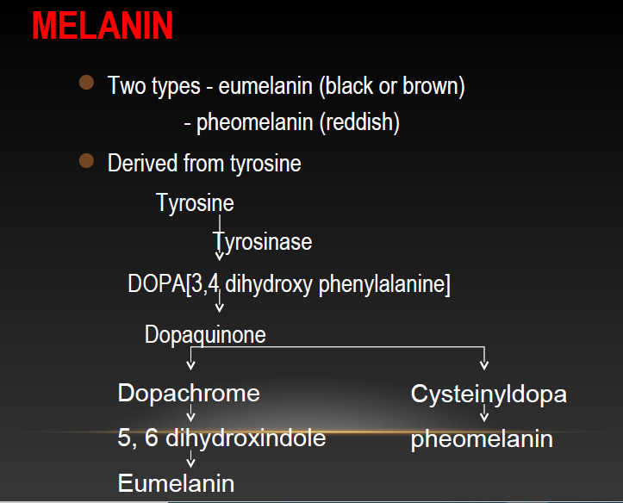

Slide 5
MELANIN PRODUCTION
The amount produced is dependent on:
1 -genetics
2 -the amount and the wavelengths of ultraviolet light received
3 -the amount of melanocyte-stimulating hormone (MSH) secreted
4 - the effect of melanoccyte stimulatingg chemicals like furocoumarins (psoralens)

Slide 6
TYPES OF SKIN

Slide 7
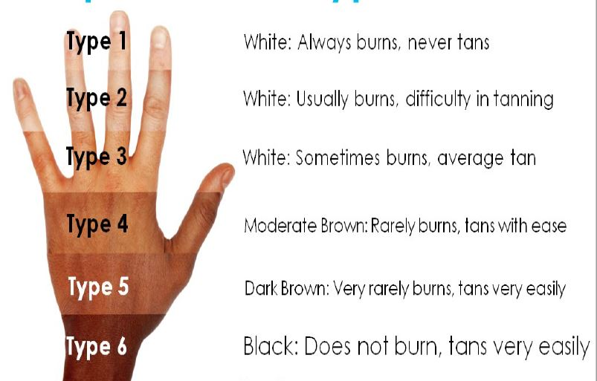

Slide 8
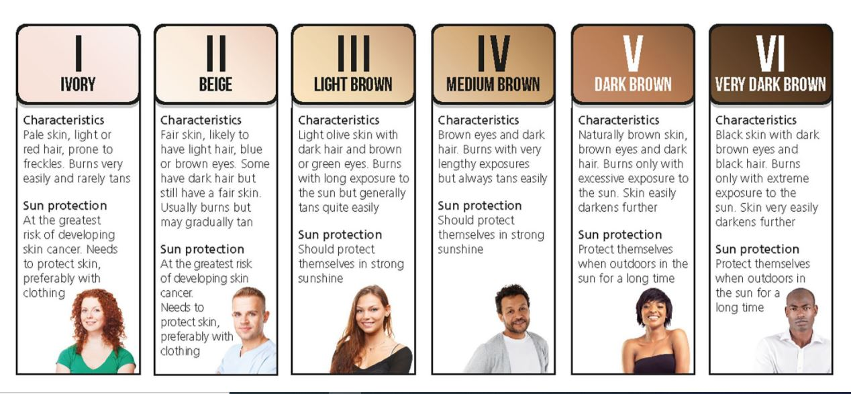

Slide 9
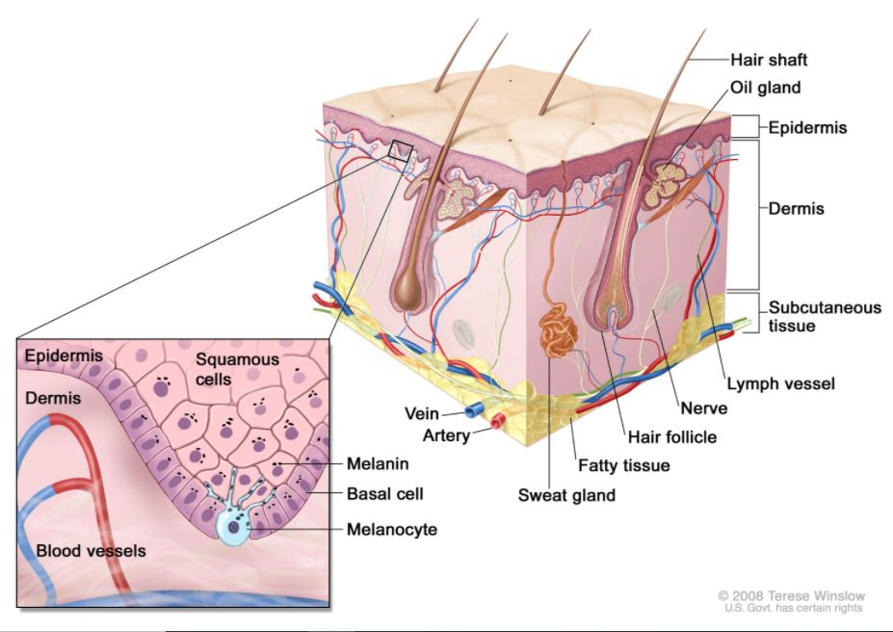

Slide 10
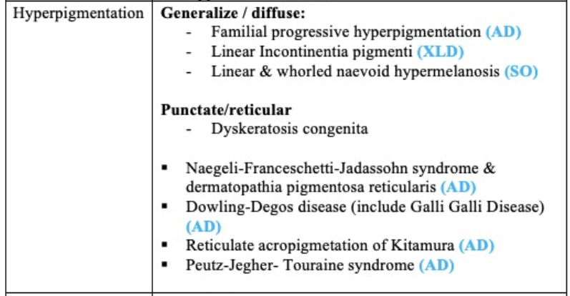

Slide 11
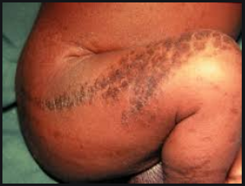
INCONTINENTIA PIGMENTAI
DEF…
Incontinentia pigmenti (IP) is a rare X‐linked dominant multi systemic ectodermal dysplasia that is usually lethal in males and that presents classically in females with skin lesions, teeth abnormalities, alopecia, nail dystrophy, and ocular and neurological findings

Slide 12
EPIDEMIOLOGY
Birth prevalence is 0.6–0.7/1 000 000.
The female to male ratio is 20 : 1.

Slide 13
PATHOPHYSIOLOGY
IP is caused by mutations of the IKBKG gene encoding the nuclear factor (NF)‐κB essential modulator (NEMO)
NEMO (IKK‐γ) is the regulatory subunit of the inhibitor of the I‐κB kinase (IKK) complex, which activates NF‐κB resulting in activation of genes involved in infl ammation, immunity, cell survival and other pathways
IP cells are highly sensitive to tumour necrosis factor‐induced apoptosis that could explain the development of skin, retinal and neurological lesions in patients with IP.

Slide 14
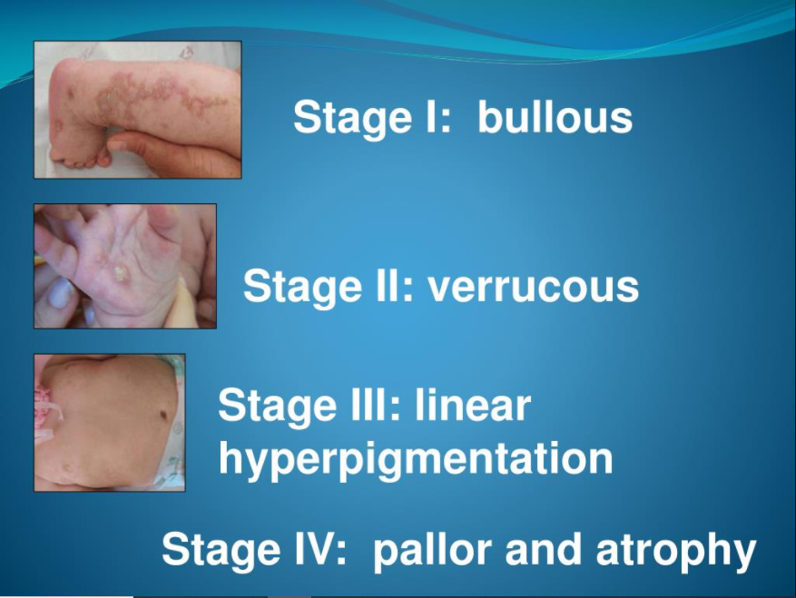

Slide 15
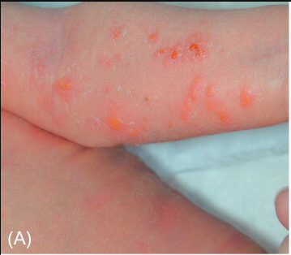

BULLOUS STAGE
IP cutaneous findings typically present perinatally with an erythematous vesicular rash following Blaschko’s lines
HISTOPATHOLOGY
Eosinophilic spongiosis, intraepidermal vesicles., inflammation of the dermis with a cellular infiltrate including numerous eosinophils

Slide 16
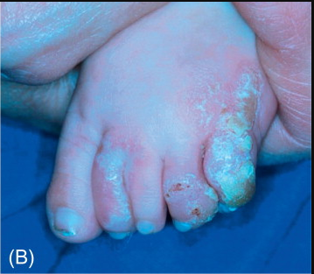

VERRUCOUS STAGE
Stage I evolves within a few months to a verrucous stage II, occurring mainly on the limbs characterized by hypertrophic wart like rash
HISTOPATHOLOGY
Dyskeratotic keratinocytes, acanthosis and papilomatosis. Macrophages laden with melanin may be present in upper dermis

Slide 17
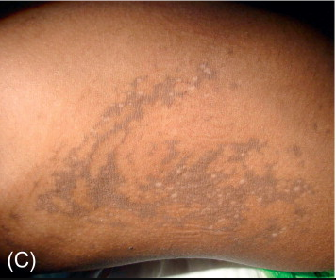

LINEAR HYPERPIGMENTATION
Stage III hyperpigmented streaks and whorls along Blaschko’s lines begin within months and fade in adolescence
HISTOPATHOLOGY
Melanin incontinence by melanocytes in the basal epidermal layer and its presence in the superficial dermis

Slide 18
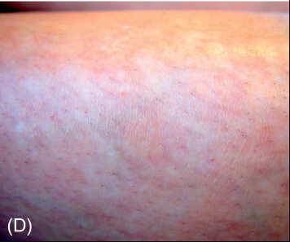
PALLOR AND ATROPHY
Stage IV patients have pale, hairless atrophic linear streaks or patches mostly on the lower extremities at adolescence

Slide 19
DIFFERENTIAL DIAGNOSIS
STAGE 1 | Bullous impetigo Epidermolysis bullosa Herpes or varicella zoster
STAGE 2 | Warts Epidermal nevus syndrome
STAGE 3 | Linear and whorled naevoid hypermelanosis
STAGE 4 | Itos hypomelanosis scarring

Slide 20
COMPLICATIONS
Life expectancy is normal. Patients without neonatal CNS abnormalities typically have normal physical and cognitive development.

Slide 21
TREATMENT
No specific treatment is available for IP. Symptomatic treatment includes standard management of blisters.
Ophthalmological follow‐up is required for retinal neovascularization monitoring and treatment and treatment of retinal detachment if it occurs.
Dental abnormalities should be managed by a pediatric orthodontist in combination with speech therapy and a paediatric nutrition programme.
Patients should be referred to a paediatric neurologist for evaluation if microcephaly, seizures, spasticity or focal deficits are present.
Brain magnetic resonance imaging is indicated in any child with functional neurological abnormalities or retinal neovascularization.

Slide 22
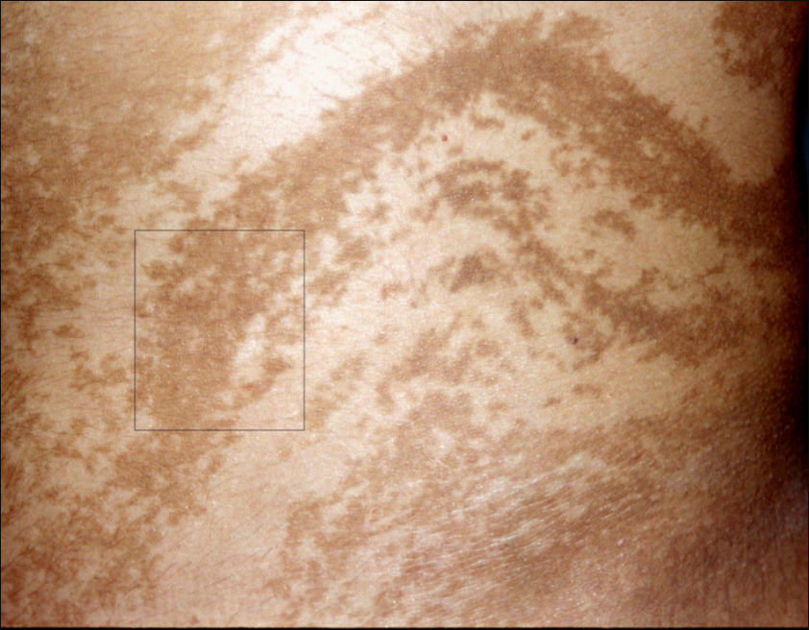
Linear and whorled naevoid hypermelanosis
Benign skin condition characterized by the onset in infancy of hyperpigmented regions that follow the lines of Blaschko's on the trunk and limbs. The soles, palms, face and mucous membranes are spared.

Slide 23
DESCRIPTION
In general, affected individuals have no accompanying extradermal features although the condition has been rarely associated with cardiovascular, neurological and musculoskeletal abnormalities.
This phenotype is the reverse of hypomelanosis of Ito
Mosaic chromosomal abnormalities have been detected
As stated above for hypomelanosis of Ito, the phenotype of either hyper‐ or hypopigmentation following Blaschko lines is the result of cutaneous mosaicism, either for a monogenic or a chromosomal disorder, rather than being a distinct disease.

Slide 24
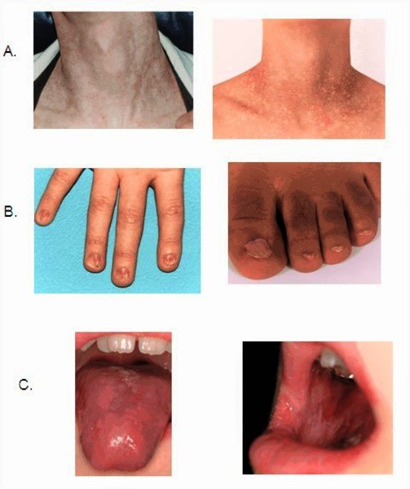
DYSKERATOSIS CONGENITA
DKC is a disease with a highly variable phenotype that is classically defined by reticulated skin pigmentation, nail dystrophy and leukoplakia of the oral mucosa often undergoing malignant transformation

Slide 25
INHERITANCE
DKC is a genetically heterogeneous disorder, showing autosomal recessive, autosomal dominant and X‐linked inheritance
The disease is caused by mutations in multiple genes coding for proteins involved in telomere function and maintenance

Slide 26
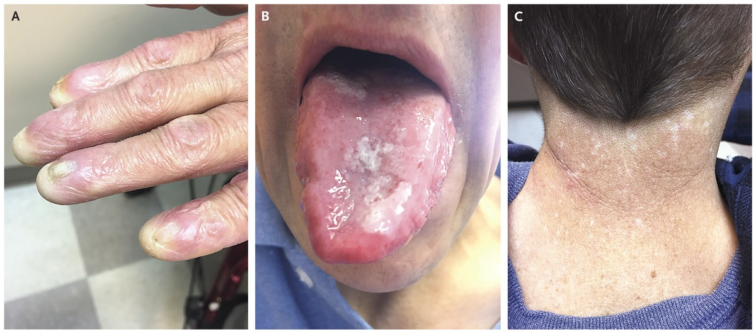
SITES
The pigmentary change may be limited to the neck, upper chest and proximal parts of the limbs initially, but within affected areas the involvement is always diffuse.

Slide 27
COMPLICATIONS
Bone marrow dysplasia
Hematological malignancies
Epithelial malignancies

Slide 28
DIAGNOSIS
The diagnosis is based mostly on hematological anomalies, especially pancytopenia

Slide 29
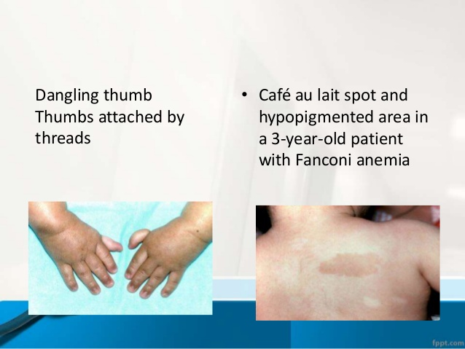
DIFFERENTIAL DIAGNOSIS
FANCONI ANEMIA..
a clinically and genetically heterogeneous disorder that causes genomic instability. Fanconi anemia is also sometimes associated with pigmentation anomalies including reticulated pigmentation and cafe‐au‐lait spots.

Slide 30
Naegeli–Franceschetti–Jadassohn syndrome and dermatopathia pigmentosa reticularis
These two diseases are closely related autosomal dominant ectodermal dysplasia syndromes that are both caused by mutations specifically located at the start of the KRT14 gene sequence
These mutations result in haploinsufficiency for keratin 14 and are associated with increased susceptibility of keratinocytes to proapoptotic stimuli

Slide 31
Clinical features of Naegeli–Franceschetti–Jadassohn syndrome
Reticular cutaneous pigmentation……starting in early life without a preceding inflammatory stage
Discomfort provoked by heat with diminished sweat gland function
Poor teeth
Moderate hyperkeratosis of the palms and soles
Males and females are equally affected

Slide 32
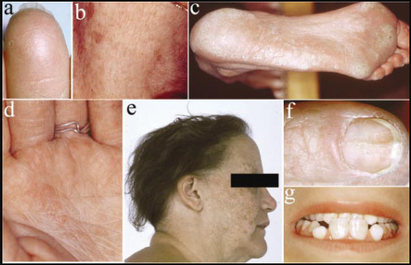

Slide 33
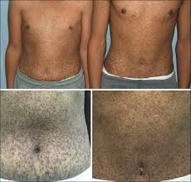
Clinical features of Dermatopathia pigmentosa reticularis
Reticulate hyperpigmentation
Non‐ cicatricial alopecia
Onychodystrophy.

Slide 34
COMBINE FEATURES
These two diseases clinically share complete absence of dermatoglyphics
A reticulate pattern of skin hyperpigmentation mainly involving the trunk and face, palmoplantar keratoderma, abnormal sweating and other subtle developmental anomalies including plantar bullae in early childhood
Dental anomalies
Nail dystrophy.

Slide 35
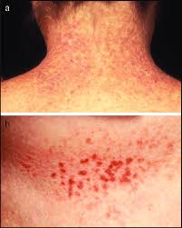
Dowling–Degos disease
Dowling–Degos disease is an autosomal dominant form of reticulate pigmentary genodermatosis with variable penetrance that was fi rst described by Dowling

Slide 36
CLINICAL FEATURES
The reticulate pigmentation usually has a flexural distribution.
Comedo like lesions on the neck and pitted perioral acneform scars and genital and perianal reticulated pigmented lesions have also been described
Onset is usually post pubertal and the reticulate hyperpigmentation is progressive and disfiguring.
No abnormalities of the hair or nails have been reported.
Generalized Dowling–Degos disease can also occur, with numerous hyperpigmented or erythematous macules and papules on the neck, chest and abdomen

Slide 37
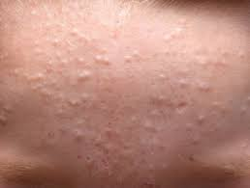
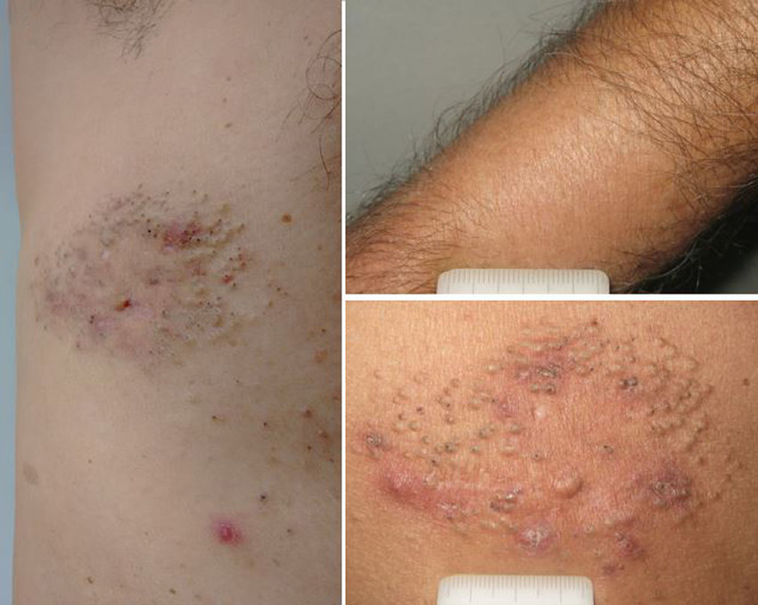
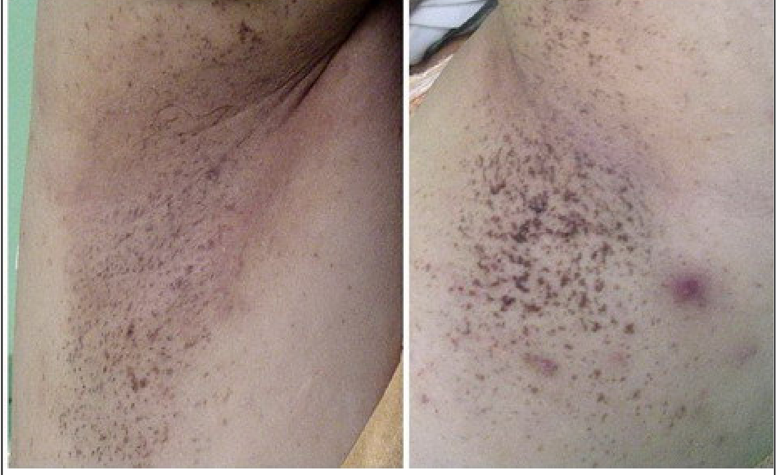

Slide 38
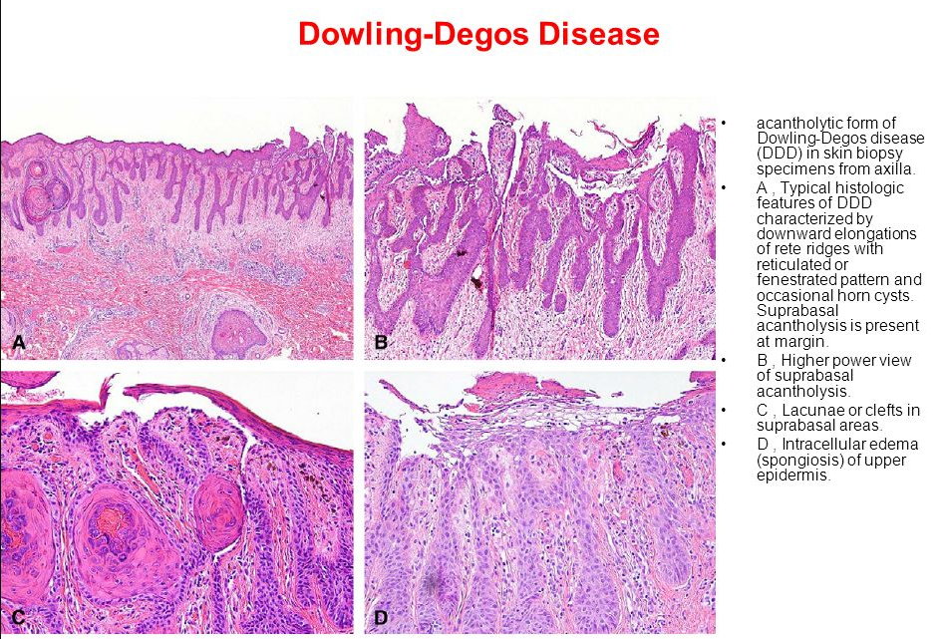

Slide 39
GENETICS
KRT5… encoding the initial part of keratin 5
POFUT1…. encodes protein O‐ fucosyltransferase 1
POGLUT1…. encodes protein O‐ glucosyltransferase 1
Knockdown of POFUT1 was shown to reduce the expression of KRT5 in keratinocytes.
In addition, both POGLUT1 and POFUT1 are essential regulators of Notch activity.

Slide 40
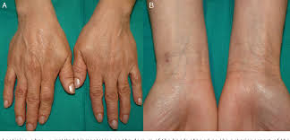
Reticulate acropigmentation of
Kitamura
Reticulate acropigmentation of Kitamura (RAK) is a rare pigmentary disorder that has an autosomal dominant pattern of inheritance. RAK was found to be caused by mutations in ADAM10 .

Slide 41
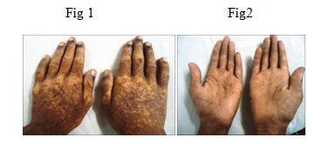
CLINICAL FEATURES
Typical features include reticulate hyperpigmented atrophic macules on the dorsa of the hands and ‘pits’ on the palms and soles in the first or second decade of life
The macules gradually darken and tend to spread to the proximal regions of the extremities with progression of the eruptions that stops in middle age.

Slide 42
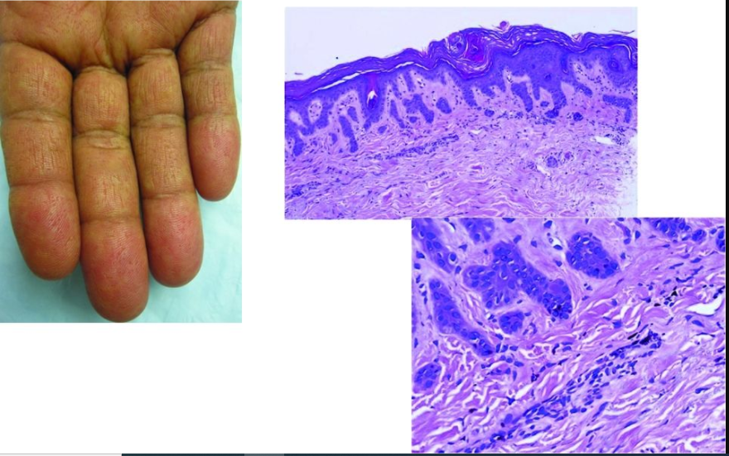
HISTOPATHOLOGY
The pigmented lesions show pigmentation in the tip of rete ridges with thinning of the epidermis, elongation and thinning of the rete ridges, and slight hyperkeratosis without parakeratosis

Slide 43
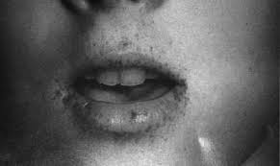
Peutz–Jeghers–Touraine syndrome
Characterized by hyperpigmented macules on the lips and oral mucosa and polyposis of the small intestine

Slide 44
CLINICAL FEATURES
Dark brown or black macules appear typically on the lips, especially the lower lip, in infancy or childhood
Similar lesions may appear on buccal mucosa, tongue, gingiva, and genital mucosa
Macules may also occur around the mouth, on the central face, backs of the hands, especially the fingers, and on the toes and tops of the feet.
Associated polyposis involves the small intestine
But, hamartomatous polyps of the stomach and colon may occur
Symptoms of hamhartomas of the small intestine may cause repeated bouts of abdominal pain and vomiting, and intussusception

Slide 45
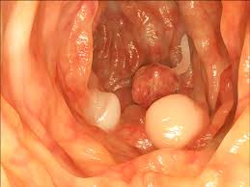
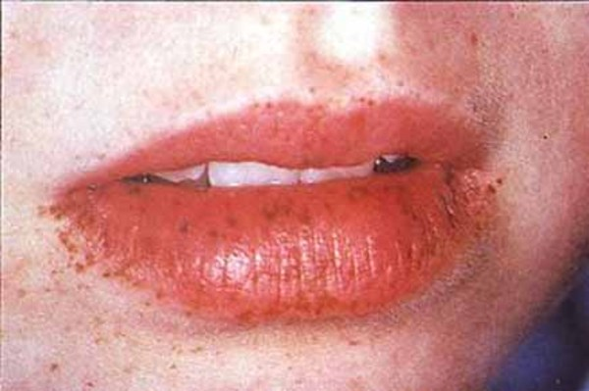

Slide 46
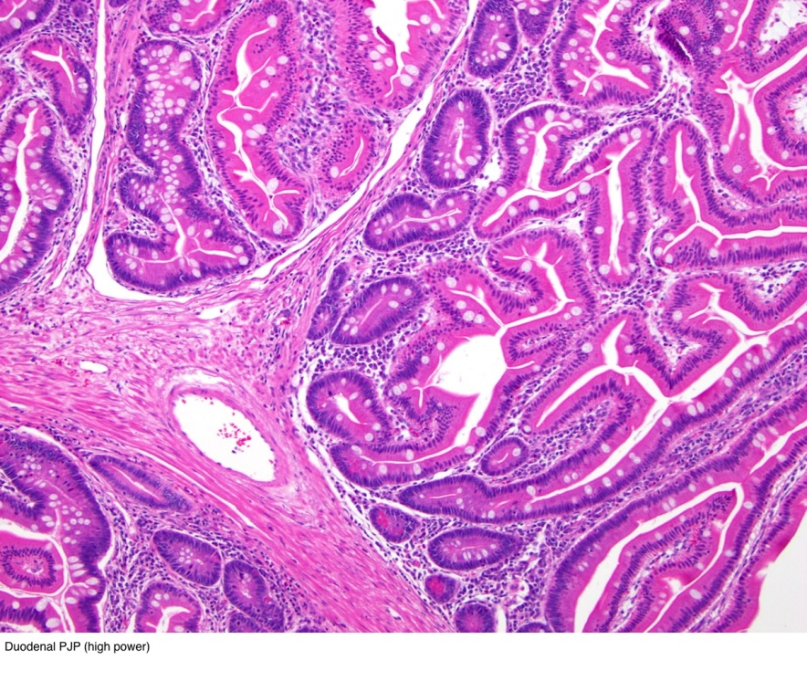
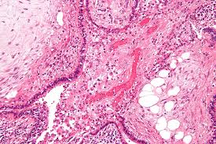
HISTOPATHOLOGY
Increased number of melanocytes with long dendrites filled with melanosomes, but few melanosomes in keratocytes, suggesting a pigment block
Gastrointestinal hamhartomas show an elongated, frond‐like epithelium with cystic dilatation of glands overlying network of smooth muscle bundles

Slide 47
GENETICS
The disorder is due to mutations in the serine threonine kinase ( STK11 ) gene
Mutations in the part of the gene involved in ATP binding and catalysis are rarely associated with cancer
Whereas mutations in the part of the gene involved in
substrate recognition are more frequently associated with malignancies.
Patients with PJT syndrome with breast cancers have predominantly truncating mutations

Slide 48
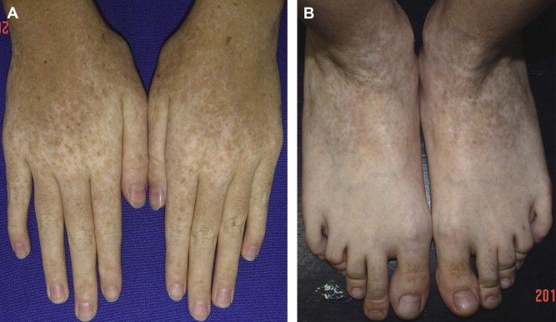
Dyschromatosis symmetrica hereditaria
Characterized by freckle‐like pigmented macules on the face associated with small hyper‐ and hypopigmented macules affecting the back of the hands and feet

Slide 49
GENETICS
Dyschromatosis symmetrica hereditaria has a dominant pattern of inheritance and is caused by a heterozygous mutation in the ADAR1 gene (adenosine deaminase acting on RNA1) located on chromosome 1q21
ADAR1 mediates a post‐transcriptional modification of the messenger RNA known as RNA editing.

Slide 50
Dyschromatosis universalis hereditaria
Dyschromatosis universalis hereditaria (DUH) is a rare autosomal genodermatosis characterized by hyper‐ and hypopigmented macules distributed over the entire surface of the skin
The lesions usually appear in infancy or early childhood.
Involvement of the palms or soles is unusual.
Abnormalities of the hair and nails have also been reported.
Also, DUH has been associated with neurological, ophthalmological and haematological complications

Slide 51
