Slide 1


Slide 2

ECZEMATOUS DISORDERS
DR MARRIAM ASAD

Slide 3
INTRODUCTION
DEFINITION | Derived from GREEK word meaning TO BOIL.. Clinical and histological pattern of inflammation of the skin seen in a variety of dermatoses with widely diverse etiologies
ECZEMATOUS DERMATOSES | Characterized by variable intensity of itching and soreness Signs… dryness, erythema, excoriation, exudation, fissuring, hyperkeratosis, lichenification, papulation, scaling and vesiculation
HISTOLOGY | Spongiosis (epidermal oedema) with varying degrees of acanthosis and hyperkeratosis, accompanied by a lymphohistiocytic infiltrate in the dermis.
EPIDEMIOLOGY | INCIDENCE… All forms.. 18/1000.. 7 of which are atopic hand, discoid, nummular.. 2/1000 AGE.. In infant and children.. Atopic is more common nummular and Asteatotic… common in elderly In factory workers.. Irritant and contact eczema.. common

Slide 4

CLASSIFICATION
EXOGENOUS ECZEMAS | ENDOGENOUS ECZEMAS

Slide 5
CLASSIFICATION
EXOGENOUS ECZEMAS | ENDOGENOUS ECZEMAS
Allergic contact eczema | Asteatotic eczema
Dermatophytide | Atopic eczema
Eczematous polymorphic light eruption | Chronic superficial scaly dermatitis
Infective dermatitis | Eyelid eczema
Irritant eczema | Hand eczema
Photoallergic contact eczema | Juvenile plantar dermatosis
Photoallergic contact eczema | Nummular dermatitis
Post‐traumatic eczema | P alba
 | Metabolic eczema
 | Seborrhic eczema
 | Venous eczema

Slide 6
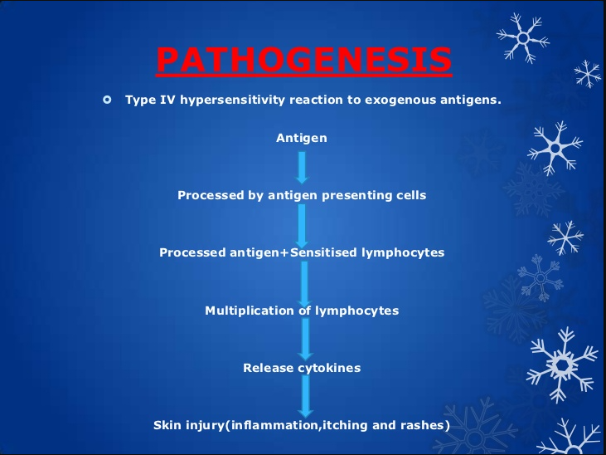

Slide 7
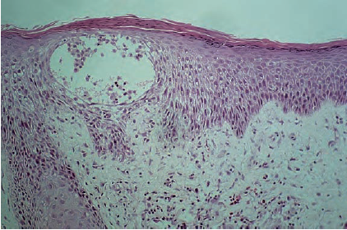
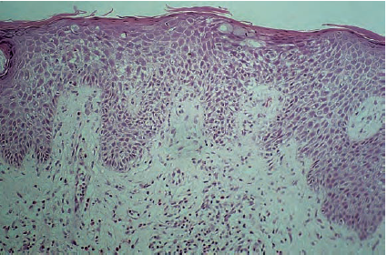
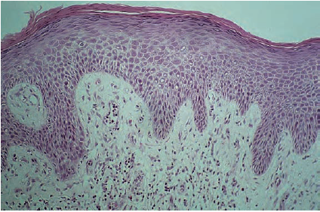
PATHOLOGY
ACUTE PHASE | Spongiosis, an intercellular epidermal oedema , vesicular formation , infiltration of the epidermis by lymphocytes , inc. epidermal mitotic activity leads to acanthosis
SUBACUTE STAGE | Spongiosis and vesiculation diminish and increasing acanthosis develops ..leads to formation of a parakeratotic horny layer. contains layers of coagulated plasma and pyknotic nuclei of inflammatory cells
CHRONIC ECZEMA | Hyperkeratosis replaces parakeratosis. Acanthosis is more prominent . Dermal changes become more prominent. The rete ridges become elongated and broadened, changes are then those of lichenification.

Slide 8
CLINICAL FEATURES
HISTORY | HALLMARK… pruritus Important to note occupation and recreational activities
PRESENTATION | ACUTE.. edematous, vesicular and may be exudative CHRONIC.. Erythema , scaling , excoriation and lichenification Two process occur.. Sec dissemination and Conditioned hyperirritability
SEC. DISSEMINATION | AUTOSENSITIZATION GEN. SPREAD… primary site on legs and feet Sec. eruption… first…small edematous papules. grouped papulovesicles … form small plaques. Occasionally…red macules or wheals. Distribution …symmetrical.
CONDITIONED HYPERIRRITABILITY | DEFINITION Associated with any focal inflammation of the skin The tendency for patients suffering from eczema, especially acute eczema, to have a higher proportion of false positive ‘irritant’ reactions to patch tests

Slide 9
INVESTIGATIONS
History and examination
Total IgE level
Secondary infection …swabs for culture and sensitivity to identify the causative organism and any bacterial resistance, such as methicillin‐resistant Staphylococcus aureus (MRSA).
KOH scrapings are done when dermatophyte infection is suspected
Microscopy, or dermoscopic examination of the skin, can also be helpful to confirm a diagnosis of scabies.
Biopsy can occasionally be helpful in confirming the eczematous nature of the eruption
Immunofluorescence can help identify less common conditions such as dermatitis herpetiformis or, in older patients, a non‐bullous presentation of bullous pemphigoid.

Slide 10
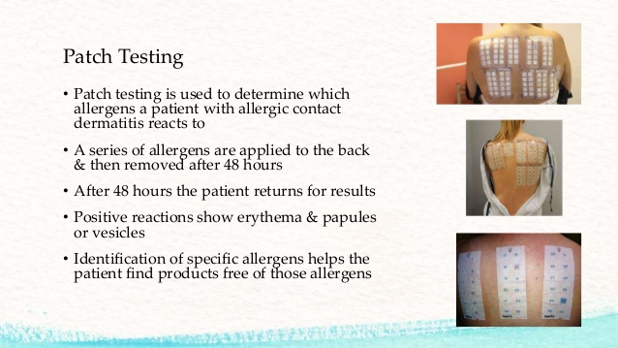

Slide 11
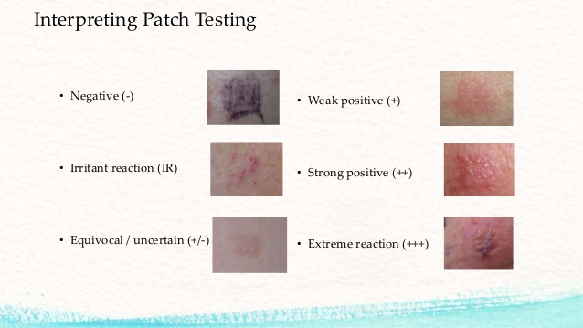

Slide 12
MANAGEMENT
FIRST LINE | Avoidance of irritants and allergens, emollients and soap substitutes
SECOND LINE | Topical corticosteroids and topical calcineurin inhibitors
THIRD LINE | Phototherapy, oral immunosuppressant and Alitretinoin

Slide 13
NUMMULAR DERMATITIS
DEFINITION | Nummular dermatitis is characterized by a single, non‐specific morphological feature, namely circular or oval plaques of eczema with a clearly demarcated edge.
EPIDEMIOLOGY | INCIDENCE… 2 PER 1000 AGE… women in early ager men in late age
PATHOPHYSIOLOGY | Subacute dermatitis indistinguishable from other forms of eczema, with spongiotic vesicles and a predominantly lymphohistiocytic infiltrate. Eosinophils present in the upper dermis. EM studies have shown that the intense intercellular oedema leads to a reduction in the number of desmosomes between the cells of the basal layer.

Slide 14
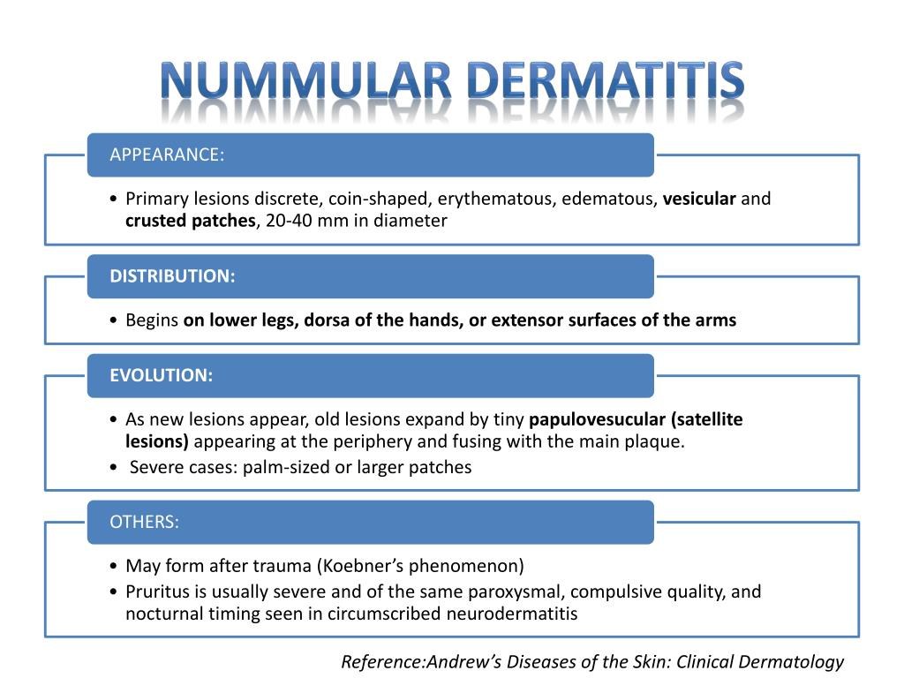
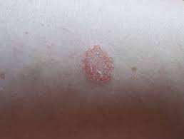
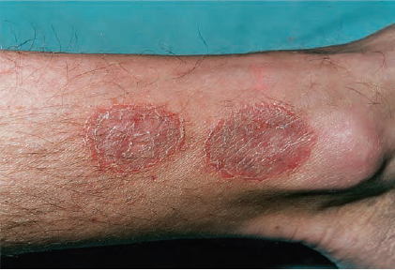

Slide 15
CLINICAL VARIANTS
EXUDATIVE TYPE | Resembles the acute phase of typical disease with leakage of serous fluid and crust formation
DRY TYPE | Uncommon Multiple dry scale round or oval discs on the arms and legs also scattered microvesicles on an erythematous base Minimal itching Resistant to treatment
NUMMULAR DERMATITIS OF THE HANDS. | Often develops as a single plaque May occur at trauma site Gen. spread is uncommon May occur with occupational exposure
EXUDATIVE DISCOID AND LICHENOID CHRONIC DERMATOSIS. | Widespread extremely pruritic eruption Discoid lesions with lichenoid and exudative phases Predominantly in adult males

Slide 16
DIFFERENTIAL DIAGNOSIS
DISEASE | DISTRIBUTION | FEATURES | HISTOLOGY
Nummular dermatitis
Tinea corporis
Pityriasis alba
Chronic superficial dermatitis
Prelymphomatos eruption

Slide 17
DIFFERENTIAL DIAGNOSIS
DISEASE | DISTRIBUTION | FEATURES | HISTOLOGY
Nummular dermatitis | Limbs more than trunk | Oval or round, very itchy | Eczema, often intense changes
Tinea corporis | Limbs or trunk | Oval or round, itchy Scraping produces scale for mycology | PAS stain shows fungus
Pityriasis alba | Face, proximal limbs | Depigmentation | Very mild eczema
Chronic superficial dermatitis | Limbs more than trunk | Oval or round, no infiltration | Epidermal eczematous
Prelymphomatos eruption | Flank, trunk, proximal limbs | Angular, infiltrated, itchy | Dermal infiltrate

Slide 18
TREATMENT
FIRST LINE | Emollient, topical corticosteroid ― topical or oral antibiotic
SECOND LINE | Topical calcineurin inhibitor
THIRD LINE | Phototherapy (narrow‐band UVB/PUVA), oral immunosuppressants including methotrexate or oral steroids

Slide 19
ASTEATOTIC ECZEMA
DEFINITION | Eczema developing in very dry skin usually affects the legs, arms and hands of elderly people. A characteristic ‘crazy paving’ pattern is observed on the legs in particular may flare during winter due to a reduction in humidity associated with central heating
EPIDEMIOLOGY | INCIDENCE N PREVELANCE… 16.4 % AGE… Elderly people affects more SEX.. No evidence ASS. DISEASE.. May be presenting feature of myxedema
PREDISPOSING FACTORS | 1. Dry skin 2. further reduction in lipid with age 3. chapping and degreasing 4. low environmental humidity 5. repeated minor trauma leading to inflammation
PATHOLOGY | Condition is due to a decrease in skin surface lipid, the exact pathogenesis of the skin changes is obscure. The amino acid content of the skin is lower in more severe cases A decrease in the keratohyaline‐derived natural moisturizers may also be important The histopathological features are those of a mild, subacute eczema, with a varying amount of dermal infiltrate

Slide 20
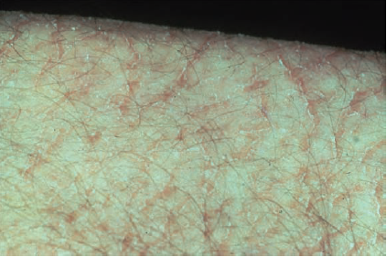
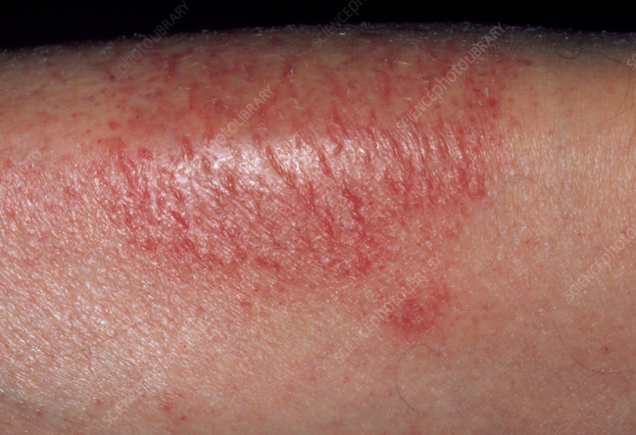
CLINICAL FEATURES | HISTORY.. Irritation.. Often intense Worse with changes of temperature PRESENTATION.. Dry and slightly scaly skin in hands and they become chapped or itchy Finger pulps are dry and cracked with parchment pulp On legs.. Sup. marking is more marked and deeper Borders become erythematous and slightly raised
CLINICAL VARIANTS | Extensive or generalized forms involving the trunk as well as the legs are rare but should raise the suspicion of malignancy. Malignant lymphoma Angioimmunoblastic lymphadenopathy Anaplastic gastric Adenocarcinoma Spheroidal cell carcinoma of the breast
TREATMENT | FIRST LINE.. Humidify environment and avoid sudden temperature changes SECOND LINE…Emollients, with or without urea, bath oil and soap substitute THIRD LINE…Mild topical corticosteroids pimecrolimus

Slide 21
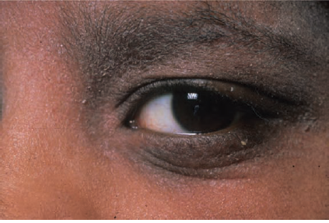
DERMATITIS AND ECZEMA OF THE EYELIDS
DEFINITION | This is eczema affecting predominantly the eyelids
PATHOPHYSIOLOGY | Eyelid involvement is a very common feature of atopic Seborrhoeic dermatitis Contact allergy to various components of eye makeup, Allergy to nickel.
TREATMENT | FIRST LINE.. Avoid allergens/irritants.. Emollient SECOND LINE.. Hydrocortisone 1% cream THIRD LINE.. Tacrolimus ointment or pimecrolimus 1% cream

Slide 22
DERMATITIS AND ECZEMA OF HANDS
DEFINITION | The term hand eczema implies that the dermatitis is largely confined to the hands, with only minor involvement of other areas. Hyperkeratotic palmar eczema ..‘ tylotic eczema’. Pompholyx known as ‘vesicular eczema of palms and soles’. When on palms… ‘cheiropompholyx’, When on soles,… ‘podopompholyx’
EPIDEMIOLOGY | INCIDENCE.. Minor degrees of hand eczema are common 25 % of patient does not seek medical advice AGE…. In women, hand eczema peaks in young adults and appears to decline with increasing age SEX…twice common in women than men ASS. DISEASE… more common in people with atopic dermatitis
PATHOPHYSIOLOGY | PREDISPOSING FACTORS.. Atopy, dry skin, contact allergic or irritant dermatitis, filaggrin gene mutations PATHOLOGY.. horny layer and the presence of numerous sweat glands is characteristic for hand eczema

Slide 23
AETIOLOGICAL POSSIBILITIES
EXOGENOUS | ENDOGENOUS
Contact irritants.. Chemical and physical | Idiopathic
Ingested allergens | Immunological and metabolic defects
Infection | Psychosomatic: stress aggravates
Sec. dissemination | Dyshidrosis: increased sweating aggravates
MORPHOLOGICAL PATTERNS OF HAND ECZEMA
Apron eczema | Pompholyx
Chronic acral dermatitis | Recurrent focal palmar peeling
Nummular dermatitis | Ring eczema
Gut eczema | ‘Wear and tear’ dermatitis (
Hyperkeratotic palmar eczema | Fingertip eczema

Slide 24
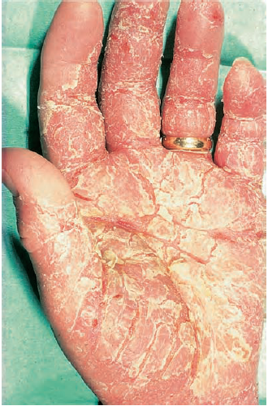
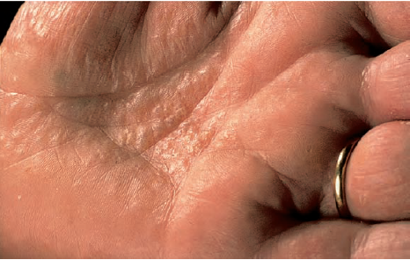
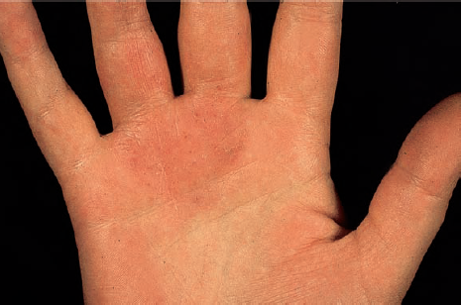
CLINICAL VARIANTS
Hyperkeratotic palmar eczema | Highly irritable, scaly , fissured , hyperkeratotic patches on palms and palmar surface of fingers
Pompholyx | Oedema fluid accumulates to form visible vesicles or bullae…the blisters tend to become relatively large before they burst. Pompholyx probably accounts for about 5–20% of all cases of hand eczema
Apron eczema | Involves proximal palmar aspect of two or more adjacent fingers and the palmar skin over the metacarpophalangeal joints, thus resembling an apron

Slide 25
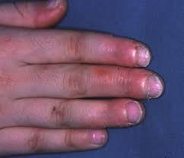
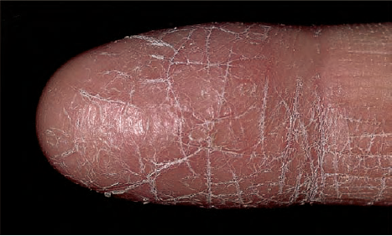
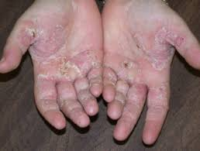
Chronic acral dermatitis | Affects patients in middle age. Chronic, intensely pruritic, hyperkeratotic, papulovesicular eczema of the hands and feet associated with elevated IgE
Fingertip eczema | Characteristic pattern, involving the palmar surface of the tips fingers. skin is dry, cracked and sometimes painful fissures . Two patterns All fingers are involved 2. Preferentially involving thumb , forefinger and third finger
Patchy vesiculosqu amous eczema | Irregular, patchy, vesiculosquamous lesions occur on both hands, usually asymmetrically. Nail changes are common if the nail folds are affected.

Slide 26
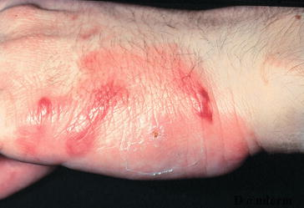
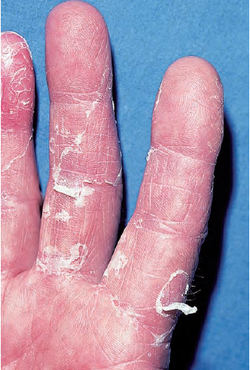
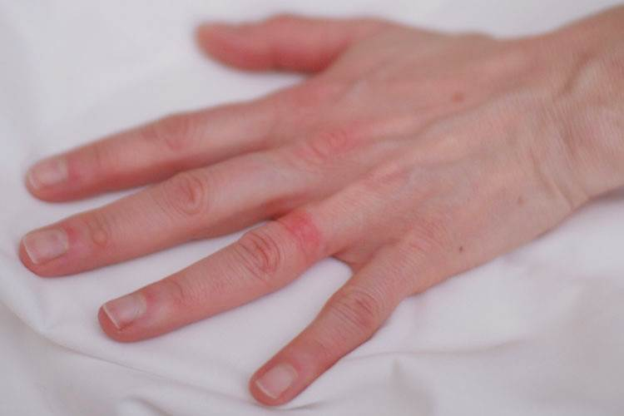
Slaughter house eczema | Starts in finger webs and spreads to the sides of the fingers. Mild, self‐limiting condition, which clears in a week or two, even if the patient remains at work, but it can recur at intervals.
Recurrent focal palmar peeling | Small areas of superficial, white desquamation develop on the sides of the fingers and on the palms or on the feet. They appear abruptly, and expand before peeling off. There is little or no irritation, and vesicles as such are not seen
Ring eczema | An irritable patch of eczema begins under a ring and typically spreads to involve the adjacent side of the middle finger and the adjacent area of palm.

Slide 27
DIFFERENTIAL DIAGNOSIS
NUMMULAR ECZEMA
PALMAR ECZEMA
POMPHOLYX
MANAGEMENT
FIRST LINE
SECOND LINE
THIRD LINE

Slide 28
DIFFERENTIAL DIAGNOSIS
NUMMULAR ECZEMA | Tinea Menem Psoriasis
PALMAR ECZEMA | Lichen planus Prp
POMPHOLYX | Palmoplantar pustulosis Pemphigus Linear IgA disease
MANAGEMENT
FIRST LINE | • Hand care advice • Irritant and allergen avoidance • Emollients • Soap substitute
SECOND LINE | • Potent or very potent topical corticosteroids
THIRD LINE | •Alitretinoin/PUVA/azathioprine/ciclosporin/ methotrexate

Slide 29
JUVENILE PLANTAR DERMATOSIS
DEFINITION | Characterized by shiny, dry, fissured dermatitis of the plantar surface of the forefoot.
EPIDEMIOLOGY | AGE.. Occur more commonly in children of age 3-14 SEX.. Male are more effected than female ASS. DISEASE… association with atopic dermatitis is observed
PATHOPHYSIOLOGY | HISTOLOGY…shows a mild, non‐specific eczema. A blockage of sweat ducts can sometimes be identified. GENETICS…reported in identical twins

Slide 30
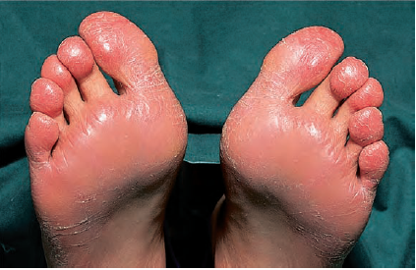
CLINICAL FEATURES | Redness and soreness on the plantar surface of the forefoot which assumes a shiny, ‘glazed’ and cracked appearance toe clefts are normal and this helps to distinguish the condition from tinea pedis Sometimes affect the hands, resulting in sore, shiny, fissured palms or fingertips.
INVESTIGATION | Skin scrapings… for tinea pedis Patch test… footwear allergy
TREATMENT | FIRST LINE.. • Change to leather footwear and cotton socks/open sandals SECOND LINE…• Emollients, including urea‐containing preparations THIRD LINE…• Lassar’s paste/tar/tacrolimus ointment

Slide 31


Slide 32


Slide 33
DEFINE ECZEMA ? AND NAME SOME TYPES

Slide 34
WHAT IS HALLMARK OF ECZEMA… AND DEFINE AUTOSENSITIZATION

Slide 35
HOW WILL YOU INVESTIGATE ?

Slide 36
DERMATITIS AND ECZEMA OF
THE LOWER LEGS
DEFINITION | Sub classified by ICD‐11 as venous eczema and stasis dermatitis Venous eczema…skin changes that result from venous hypertension. Stasis dermatitis… skin changes that result from reduced lower leg venous flow.
EPIDEMIOLOGY | INCIDENCE .. Venous eczema…3% Stasis eczema… 11% AGE.. Middle aged or elderly SEX… more in females ASS. DISEASE… Allergic contact dermatitis
CAUSATIVE ORGANISM | Secondary infection…. Staphylococcus and Streptococcus

Slide 37
PREDISPOSING FACTORS | 1.DVT 3.Immobility 2.Obesity 4. Cellulitis
PATHOLOGY | Insufficient venous return results in increased pressure in the capillaries with the result that both fluid and cells may "leak" out of the capillaries. This results in red cells breaking down, with iron containing hemosiderin possibly contributing to the pathology of this entity.
CLINICAL FEATURES | HISTORY…Venous eczema may develop suddenly or insidiously. It may occur as a late result of DVT. PRESENTATION… Erythematous, scaly, exudative eruptions… around the ankle and lower leg The skin appears thin, brown and tissue-like, with possible skin lesions (macule or patches), red spots, superficial skin irritation and/or darkening and/or thickening of the skin at the ankles or legs The skin may be weakened and may ulcerate in areas Legs, ankles, or other areas may become swollen

Slide 38
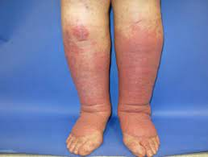
DIFFERENTIAL DIAGNOSIS
ATOPIC ECZEMA | May manifest as lichenified patches around the ankle or behind the knees.
NUMMULAR DERMATITIS | Common on the lower leg, usually on the anterior or anterolateral aspect
ASTEATOTIC ECZEMA | Commonly affects the legs of elderly patients.
PSORIASIS | May present as a single, irritating plaque on the leg, but is usually more scaly and clearly marginated
PROFUSE ACTINIC KERATOSES | May cause red, irritable patches on the lower legs
BORRELIOSIS | Leg can feel heavy, with thick cyanotic itchy skin that may mimic the changes of venous hypertension
COMPLICATIONS
Allergic contact dermatitis | Secondary infection
Lipodermatosclerosis | Venous ulceration

Slide 39
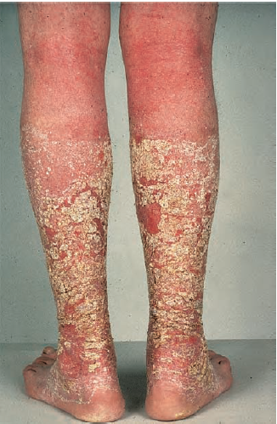
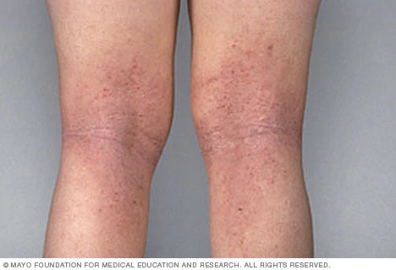
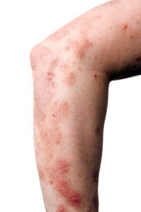
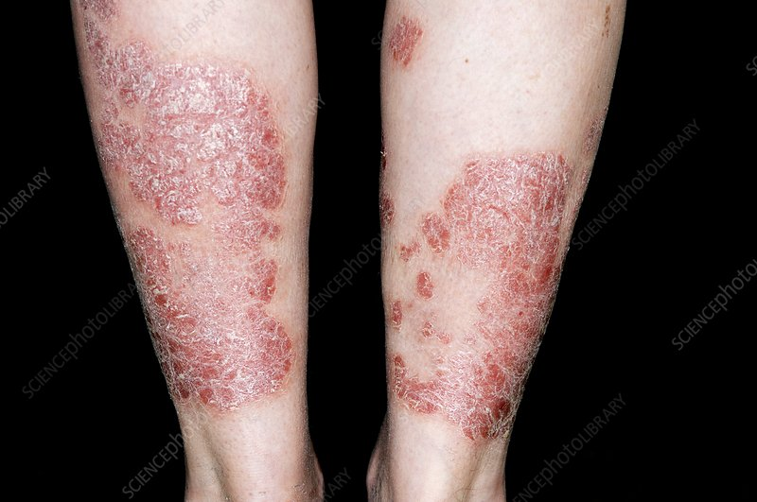
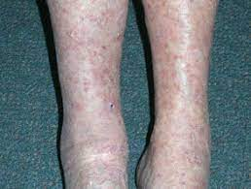
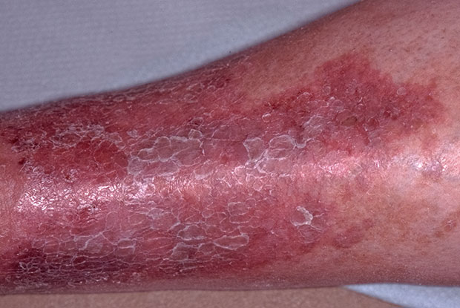
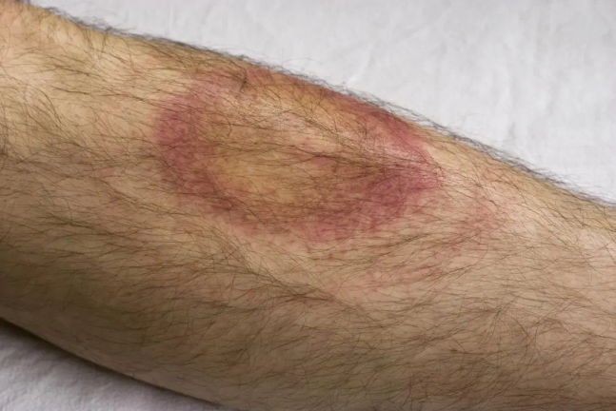
ATOPIC ECZEMA
CONTACT DERMATITIS
NUMMULAR
ECZEMA
PSORIASIS
PCK
ASTEATOTIC ECZEMA
BORRELIOSIS

Slide 40
INVESTIGATIONS | ABPI index is required prior to consideration of compression therapy. An ABPI of more than 0.8 indicates suitability for graduated compression bandages
TREATMENT
FIRST LINE | Skin care, including leg elevation, emollients and topical corticosteroids
SECOND LINE | Compression hosiery
THIRD LINE | Referral to vascular surgeon to consider surgical intervention

Slide 41
INFECTIVE ECZEMA
DEFINITION | Caused by microorganisms or their products, and that by definition clears when the organisms are eradicated
PATHOLOGY | Spongiosis is combined with acanthosis, hyperkeratosis and patchy parakeratosis. Dermis shows inflammatory changes, with polymorphonuclear and lymphocytic infiltration that invades the epidermis to a variable extent.

Slide 42
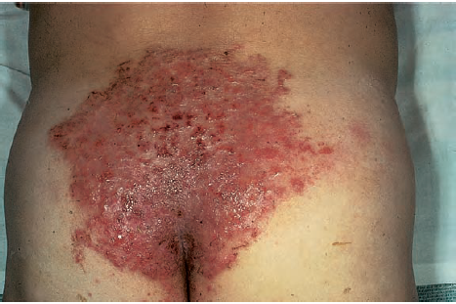
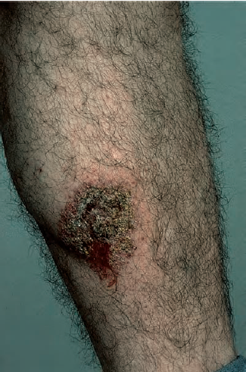
DIFF BETWEEN INFECTIVE AND INFECTED ECZEMA
INFECTED ECZEMA | INFECTIVE ECZEMA
Skin inflammation causing itchy red rash to patchy sores. Can allow superadded viruses, bacteria, and fungi infection CLINICAL FEATURES Erythema, exudation and crusting. Greasy, moist scale, beneath which the surface is raw and red. The margin is characteristically sharply defined, and the horny layer is often split to form an encircling collarette. Small pustules…where a flexure is involved | Skin inflammation , itching that is caused by any bacterial , viral and fungal infection CLINICAL FEATURES Presents as an area of erythema, with microvesicles. Seen predominantly around discharging wounds or ulcers, or moist skin Infective dermatitis is common in patients with venous leg ulcers. Tinea pedis may also become eczematous due to the overgrowth of Gram‐negative organisms

Slide 43
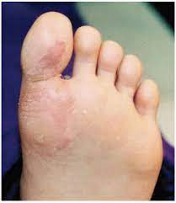
CLINICAL VARIANT
INFECTIVE DERMATITIS OF FOREFEET:-
Distinctive pattern of eczema that mainly affects the interdigital spaces on the dorsum of the medial toes.
Staphylococci or streptococci can be cultured, and the lesions respond to antiseptic or antibiotic therapy
This condition seems to occur particularly in patients with poor standards of hygiene, and is predisposed by hyperhidrosis and heavy footwear.

Slide 44
TREATMENT
FIRST LINE | Treat primary cause (e.g. ulcer) or modify footwear if relevant
SECOND LINE | Topical antibiotics
THIRD LINE | Systemic antibiotics (also potassium permanganate soaks for forefeet variant)

Slide 45
P. ALBA
DEFINITION | Pattern of dermatitis in which hypopigmentation is the most conspicuous feature. Some erythema and scaling usually precede the development of hypopigmentation
EPIDEMIOLOGY | AGE… 3-6 yrs. SEX… M equal to F ASS. DISEASE… atopic eczema
HISTOLOGY | Acanthosis and mild spongiosis, with moderate hyperkeratosis and patchy parakeratosis. There may be follicular plugging, spongiosis and sebaceous gland atrophy Electron microscopy …reduced numbers of active melanocytes and a decrease in the number and size of melanosomes in affected skin

Slide 46
CLINICAL FEATURES | Lesion is a rounded, oval or irregular hypopigmented not well marginated. Slightly erythematous and fine scaling. Initially, erythema and minimal serous crusting. Later, the erythema subsides completely Patches ranging from 0.5 to 2 cm in diameter, but larger on trunk. Children … most lesions on face ..In 20% the neck, arms and shoulders are involved
DIFFERENTIAL DIAGNOSIS | Vitiligo… Pearly white appearance on woods lamp Naevus depigmentosus… at birth or before 3 years of age and most often causes single, well‐marginated lesions on the trunk Mycosis fungoides…after healing lesions are hypopigmented which resemble P alba Nummular dermatitis…intensely pruritic, and the lesions are larger and more edematous.
TREATMENT | FIRST LINE.. Emollient SECOND LINE…Mild topical corticosteroids THIRD LINE…Topical tacrolimus or pimecrolimus

Slide 47
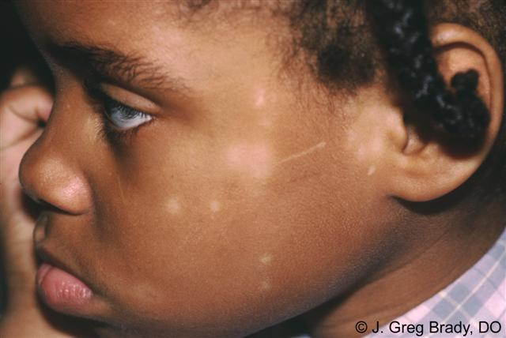
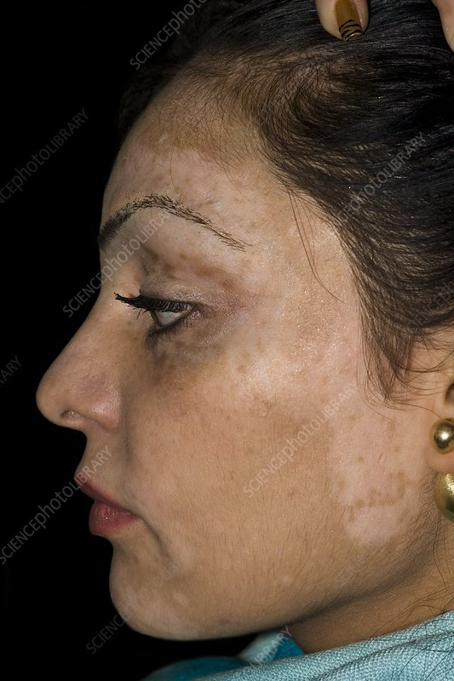
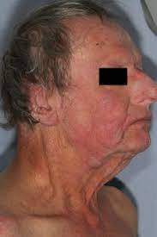
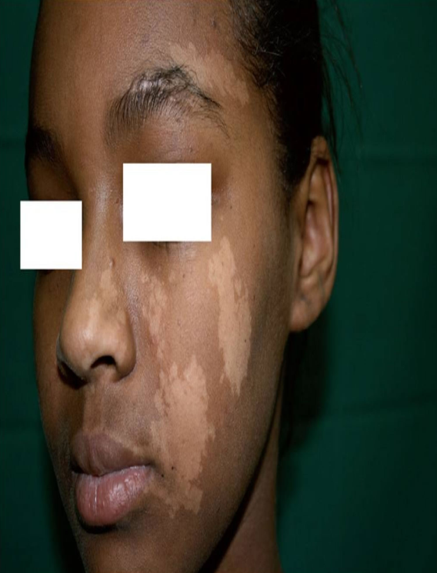
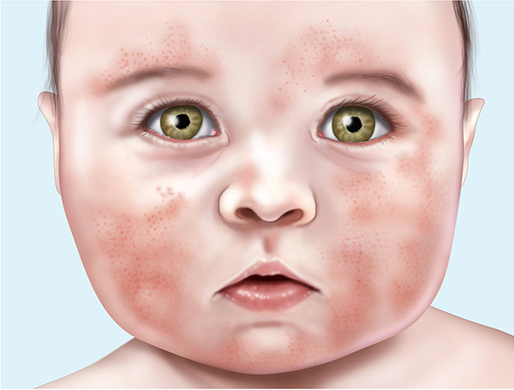
P ALBA
VITILIGO
MF
NEVUS DEPIGMENTOSUS
NUMMULAR DERMATITIS

Slide 48
CHRONIC SUPERFICIAL SCALY DERMATITIS
DEFINITION | Chronic condition characterized by the presence of round or oval erythematous, slightly scaly patches on the limbs and trunk
EPIDEMIOLOGY | AGE…middle aged SEX… more common in male ETHNICITY… common in all races
HISTOLOGY | Not characteristic. Mild eczematous eruption, consisting of patchy parakeratosis, mild spongiosis and a slight, mainly perivascular, infiltrate in the dermis, chiefly composed of lymphocytes

Slide 49
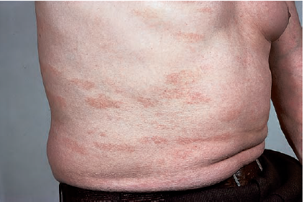
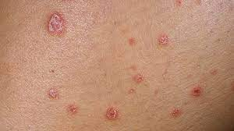
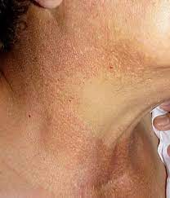
CLINICAL FEATURES | Erythematous, slightly scaly patches. Legs, trunk and arms are most often affected. Patches are generally round or oval, but finger‐like processes are also common.. ‘digitate dermatosis’. Patches are usually about 2.5 cm across Pink, brown or slightly yellow color Individual patches are often slightly wrinkled and appear like cigarette paper.
DIFFERENTIAL DIAGNOSIS | Nummular dermatitis Small plaque psoriasis Prelymphomatous poikiloderma

Slide 50
Prelymphomatous eruption | Chronic superficial scaly dermatitis
Bizarre or angulated shape | Regular, round or oval shape
Fine scales | Coarser scale
May be irritable | Little or no irritation
Progress to cutaneous lymphoma | Does not become malignant
Absence of epidermal eczema | May be eczematous changes
Dermal infiltrate | Little or no dermal infi ltrate
TREATMENT
FIRST LINE | Emollient
SECOND LINE | Mild topical corticosteroids
THIRD LINE | Phototherapy (narrow‐band UVB/PUVA)

Slide 51
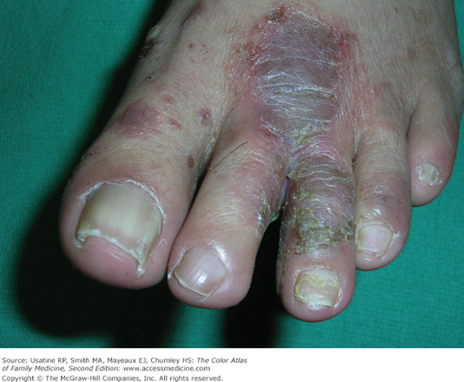
DERMATOPHYTIDE
This is a reaction, at a remote site, to a dermatophyte infection
this condition is rare, only 10 cases were confirmed in 1500 dermatophyte infections
CLINICAL FEATURERS:-
eczematous vesicles may occur symmetrically on the sides of the fingers, usually as a reaction to tinea pedis
An eczematous dermatophytide can also mimic pityriasis rosea
single case reports, including erysipelas‐like dermatitis, erythema nodosum, erythema annulare centrifugum, urticaria and erythroderma.

Slide 52
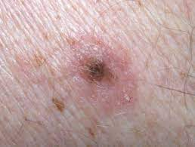
HALO DERMATITIS
Halo dermatitis is the occurrence of an eczematous ring surrounding a melanocytic naevus.
multiple, pruritic, papulosquamous lesions surrounding melanocytic naevi
Histology shows a benign naevus surrounded by a dermal lymphocytic and eosinophilic infiltrate, with overlying acanthosis, spongiosis and parakeratosis
The condition usually resolves spontaneously within a few months , without involution of naevus

