Slide 1
ECTODERMAL DYSPLASIAS
DR NIMRA KHAN
FCPS TRAINEE-DERM
JPMC

Slide 2
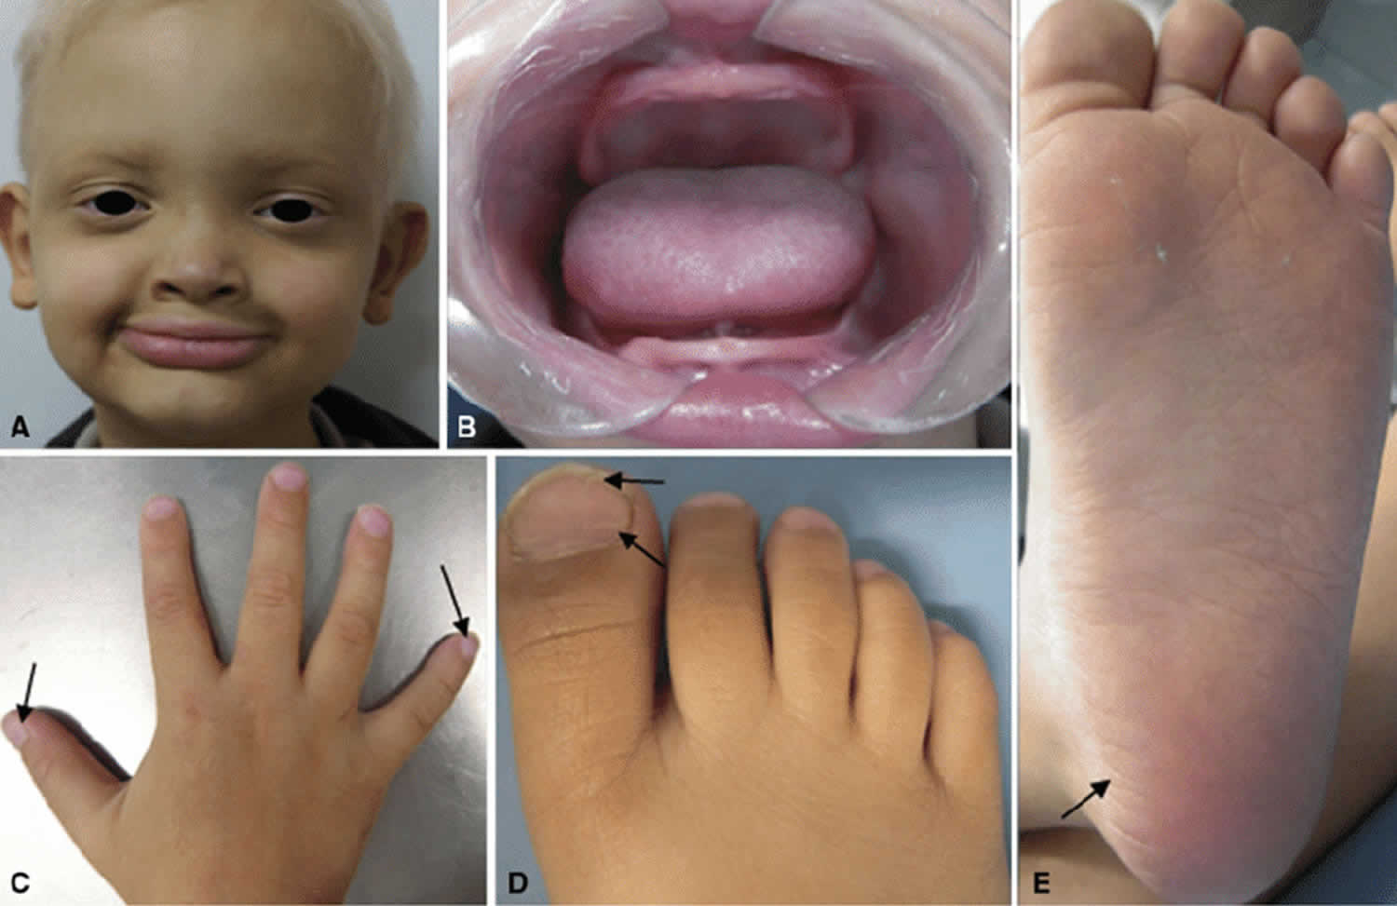

Slide 3
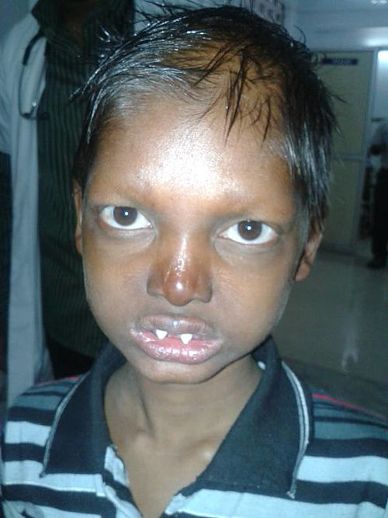

Slide 4
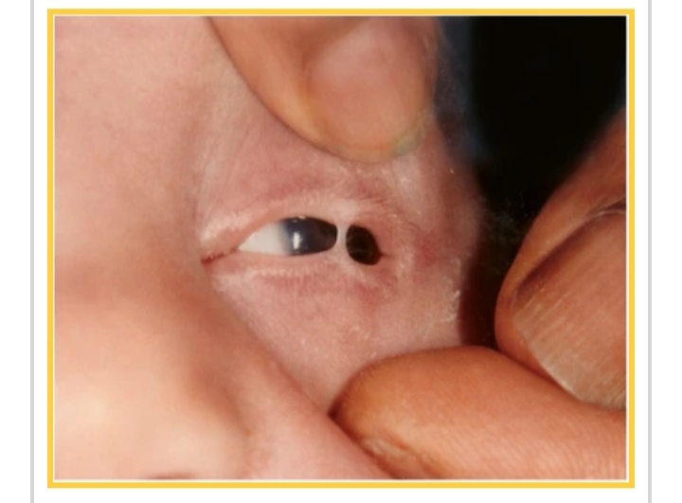

Slide 5
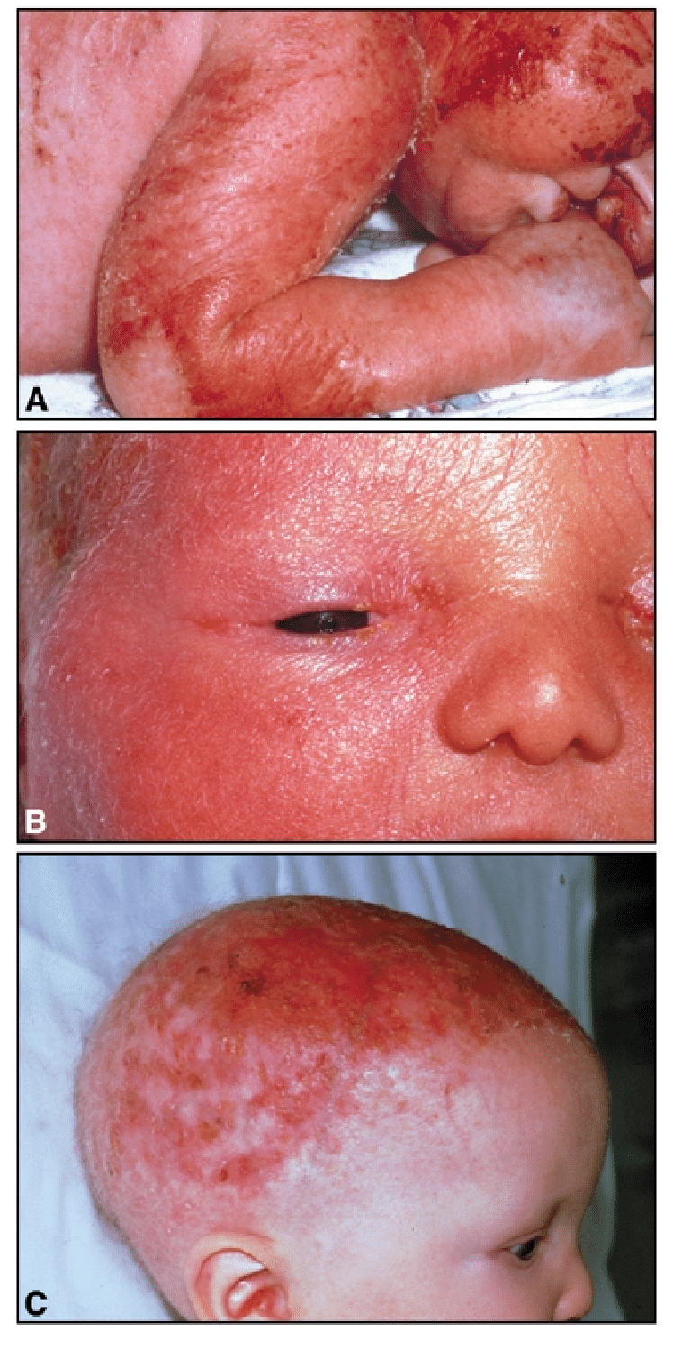
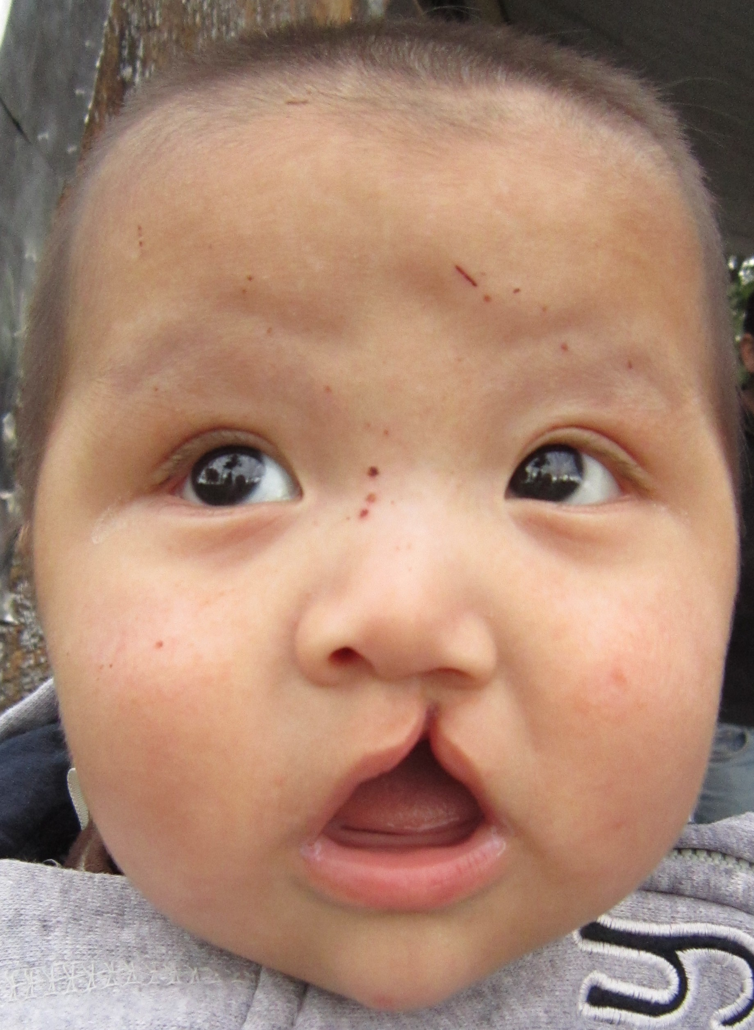

Slide 6
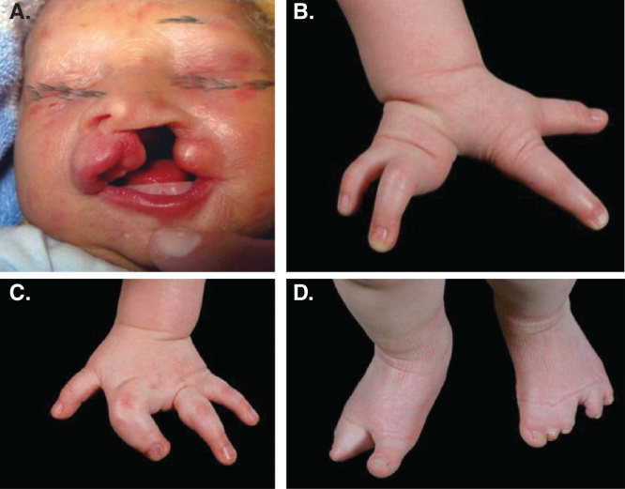

Slide 7
ECTODERMAL DYSPLASIA
Ectodermal dysplasias, a large group of heterogeneous heritable conditions, are characterized by congenital defects in two or more ectodermal structures, one of which at least involves the hair (trichodysplasia), teeth (dental defects), nails (onychodysplasia) or sweat glands (dyshidrosis).
Mesodermal and endodermal disturbances of development may co-exist.

Slide 8
EPIDEMIOLOGY
AGE:
Diagnosis is made within the first years of life.
Often after complications such as hyperthermia or pneumonia.
SEX :
Both males and females are affected

Slide 9
ASSOCIATED DISEASES :
- Atopic eczema
- Allerrgic asthma
-Rhinitis
- Food allergies

Slide 10
PATHOPHYSIOLOGY
The skin and its appendages are mainly composed of ectodermal structures but the development of appendages is orchestrated by signals from the mesoderm with the help of placodes.
A complicated network of signalling pathways, coordinates the formation and function of ectodermal structures.

Slide 11
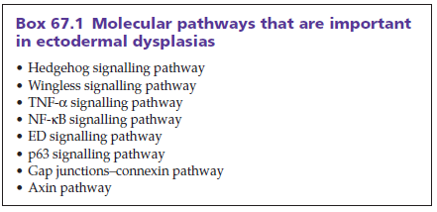
Molecular Pathways

Slide 12
Mesodermal signalling pathways such as wingless (Wnt) are crucial for the induction, of appendages, of the skin. Wnt signalling has influences on mesenchymal cells and on epithelial cells.
In the skin, Wnt signalling is important for the establishment, of the dermatome architecture, dermis, skin regions with individual appendages, axial determination and intra‐appendage regions.
Whereas the mesoderm induces the placodes, by Wnt, the ectoderm evolves into epidermis, with the help of ectodysplasin and sonic hedgehog.
Genetic defects in signalling pathways, which disturb the interaction between the ectoderm and mesoderm, lead to ectodermal dysplasia

Slide 13
Ectodermal dysplasias due to mutations in TNF‐like/NF‐κB signalling pathways
The transcription factor NF‐κB regulates the expression of multiple genes, encoding important mediators of immune and stress responses, cell adhesion, protection against apoptosis and inflammatory reactions.
In addition, this transcription factor plays critical roles in the development and homeostasis of the epidermis and the proper function, of lymphatic vessels.
The NF‐κB pathway is defective in a number of ectodermal dysplasias.
Mutations in p63 have now been identified in six distinct human phenotypes, all of which have ectodermal dysplasia as a key feature

Slide 14
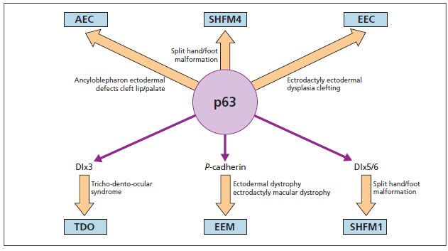

Slide 15
GENETICS
Ectodermal dysplasias are heterogeneous group of diseases, all inheritance patterns have been described including:
Autosomal recessive
Autosomal dominant
X‐linked
Mitochondrial.

Slide 16
X-linked Hypohidrotic Ectodermal Dysplasia
X-Linked hypohidrotic ectodermal dysplasia with immunodeficiency (EDA-ID) is a rare disease with the clinical hallmarks of :
Hypohidrosis
Delayed teeth eruption
Coarse hair
Frequent bacterial infections
Immunodeficiency

Slide 17
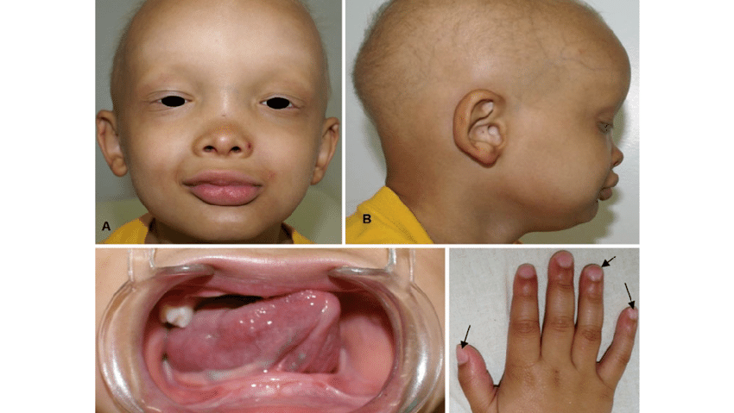

Slide 18
GENETICS
Causative mutations have been identified in the IKBKG gene, which codes for NF‐κB essential modulator (NEMO).
NEMO dysfunction leads to an impaired antimicrobial response, to polysaccharides, impaired NK‐cell activity, hyper IgM syndrome and hypogammaglobulinaemia.

Slide 19
GENERAL DESCRIPTION
Causative pathogens for recurrent infections, include:
-Gram‐positive bacteria (S. pneumoniae and S. aureus)
-Gram‐negative bacteria (Pseudomonas spp. and Haemophilus influenzae)
-Mycobacteria
Most patients have severe hypogammaglobulinaemia, with low serum IgG levels and varied levels of other immunoglobulin isotypes (IgA, IgM and IgE
Some patients have massively elevated IgM levels, and an impaired antibody response, to polysaccharides.

Slide 20
EPIDEMIOLOGY
INCIDENCE:
1 in 250,000 live male births
AGE:
Signs and symptoms may develop early
SEX:
Usually occur in males ( X- linked recessive )

Slide 21
ASSOCIATED DISEASES:
Inflammatory bowel disease
Rheumatoid arthritis
Osteopetrosis
Lymphoedema
Recurrent bacterial infections
ENVIRONMENTAL FACTORS:
Absent or decreased sweating causes heat intolerance.

Slide 22
CLINICAL FEATURES
Lack of normal hair growth
Many patients fail to thrive
Pyrexia of unknown origin
Heat intolerance
Missing teeth or malformed teeth,are also characteristics & clue for diagnosis in children.
Mutations in IKBKG should be considered in male infants, with recalcitrant seborrhoeic or atopic eczema‐like eruptions and intertrigo, especially when features, of ectodermal dysplasia, are present

Slide 23
DIFFERENTIAL DIAGNOSIS
Classic hypohidrotic ectodermal dysplasia

Slide 24
HYPOHIDROTIC ECTODERMAL DYSPLASIA
The disorder is characterized by hypotrichosis with fine, slow‐growing scalp and body hair, sparse eyebrows, hypohidrosis, nail anomalies and hypodontia.
Peg‐shaped primary and secondary teeth
Decreased sweating leads to heat intolerance and enhances, dryness of the skin

Slide 25
GENETICS
X linked recessive disorder, caused by mutations, in EDA gene
Autosomal dominant and autosomal recessive forms are caused by mutations, in EDAR and EDARADD genes.
AGE :
Between the ages of 11 - 18 years
SEX :
Females with X-linked HED show less prominent findings,displaying patchy lesions ,arranged along the lines of blaschko.
Generalized presentation seen in males.

Slide 26
PREDISPOSING FACTORS :
Positive family history
ASSOCIATED DISEASES :
Immunodeficiency
Lymphoedema
Breast hypoplasia or aplasia
Osteopetrosis

Slide 27
ENVIRONMENTAL FACTORS :
Patients should avoid hot places and extensive physical activity, without cooling devices and special clothes.
Patients should drink cool liquids in warm environments.
Wearing a hat in sunny climates is obligatory.

Slide 28
HISTOPATHOLOGY
Epidermis is thin, with flattening of rete ridges.
Hair shaft abnormalities include longitudinal clefts or grooves and transverse fissuring.
Missing or reduced sweat glands and sebaceous glands.
Hair follicles are reduced in number.
Apocrine glands are absent, sparse or even normal.

Slide 29
CLINICAL FEATURES
Missing or malformed teeth.
A history of heat intolerance, is characteristic.
Other family members have been affected, in the pedigree

Slide 30
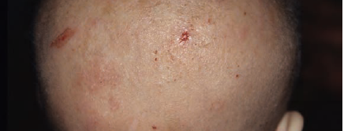
The hair is sparse, dry and lusterless with a light color.
There are parallel dark bands of different lengths, running across the full width, of the shaft.
Scanning electron microscopy studies have shows follicular distortion, follicular ridging and distorted bulbs.
Hypotrichosis in Hypohidrotic Ectodermal Dysplasia

Slide 31
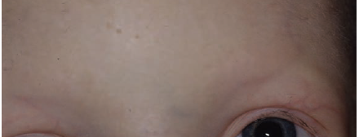
Eyebrows are scanty or absent; occasionally just the outer two‐thirds are missing.
The eyelashes may be normal, sparse or absent.
Reduced eyebrows in hypohidrotic ectodermal dysplasia

Slide 32
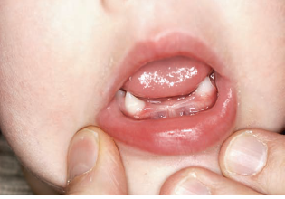
A wide range of dental abnormalities may be associated, ranging from a complete absence of teeth (anodontia) to sparse, abnormally shaped teeth.
Dentition is delayed and the erupted teeth are small, widely spaced and conical or peg shaped.
The alveolar ridges are hypoplastic, which gives rise to full, everted lips.
Conical teeth and hypodontia in hypohidrotic ectodermal dysplasia

Slide 33
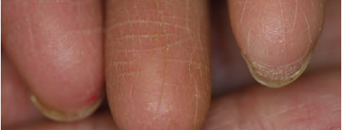
Dermatoglyphics are reduced or absent.
Rudimentary dermatoglyphics in hypohidrotic ectodermal dysplasia

Slide 34
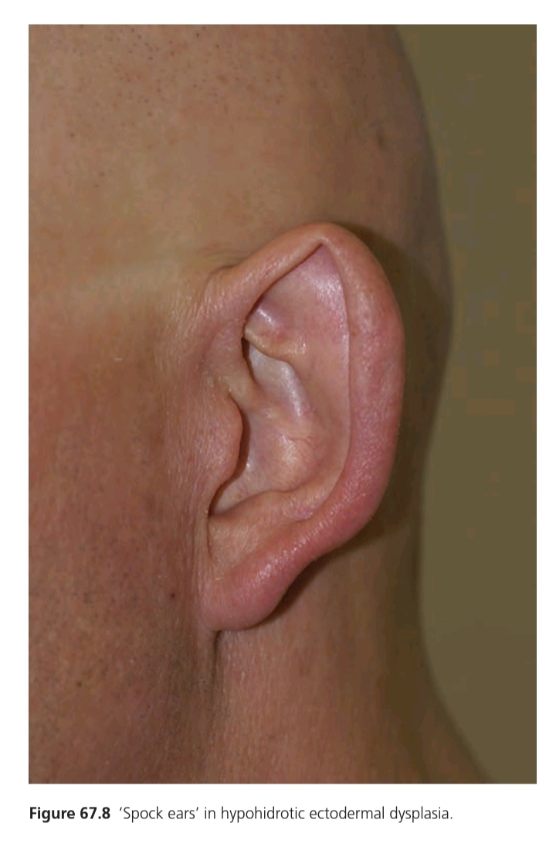
Spock ear in hypohidrotic ectodermal dysplasia

Slide 35
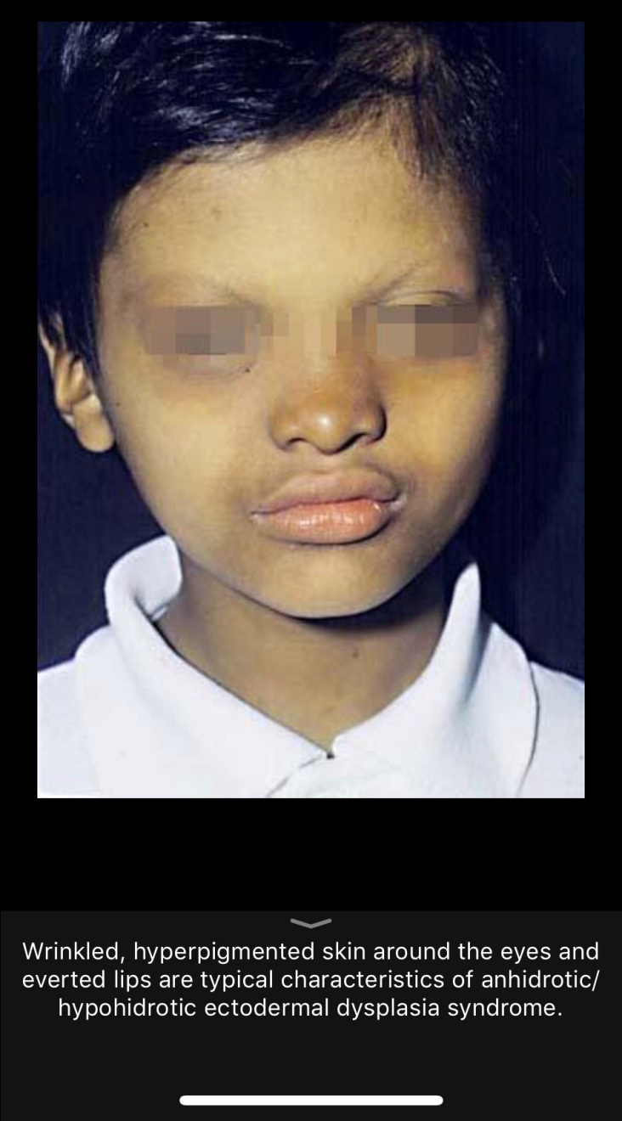
Periorbital hyperpigmentation and fine wrinkling around the eyes are characteristic features of the disorder

Slide 36
SWEAT GLANDS
Sweating is severely diminished or absent due to a paucity, or absence, of eccrine glands.
absence of sweating causes an inability to thermoregulate by evaporative cooling and hyperthermia occurs with physical exertion or in a warm environment.
Due to a lower body surface area ratio, thermoregulation is most problematic in infants and young children who experience recurrent bouts of fever as high as 42°C.
Heatstroke is the most common cause of death in patients with anhidrotic ectodermal dysplasia within the first years of life

Slide 37
OTHER FEATURES
Frontal bossing and saddle-bridged .
Affected individuals show heat intolerance, with episodes of hyperpyrexia, which causes seizures and neurological damage.
At birth, affected males show scaling or peeling, of their skin, which may be mistaken for a collodion membrane.
Eczema is common and prominent in the flexural areas.
Onychodysplasia has been reported in 39% of cases

Slide 38
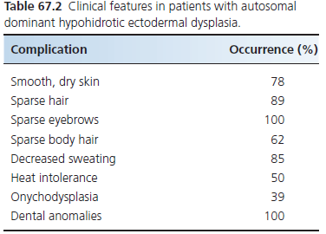

Slide 39
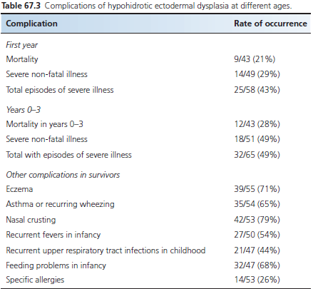
Complications

Slide 40
DISEASE COURSE & PROGNOSIS
Early diagnosis is imperative to avoid life‐threatening complications induced by hyperthermia and infections.
Avoiding heat and physical overexertion is the most important preventative measure
Cooling the body with wet clothing and cool drinks is the only efficient way of treating hyperthermia.

Slide 41
MANAGEMENT
Older children should learn to handle heat and heat‐generating activities, with physical cooling measures, such as frequent drinking of cool liquids, wetting the clothes or wearing special cooling vests and caps.
Strict monitoring of body temperature is necessary for babies in an incubator.
Exposure to heat must be monitored.
Early dental management leads to restoring function and improving the appearance of the teeth.
Orthodontic treatment includes bone grafting or sinus‐lift procedures, followed by the placement of dental implants, supporting dental prostheses

Slide 42
Orthodontic intervention is necessary, particularly for language development.
Meticulous dental hygiene should be taught to the children as caries develop early
Screening evaluation, regular monitoring and consideration of therapeutic intervention should begin in early childhood
3% minoxidil 1 mL, twice daily has been applied with success in a patient with HED.
HED with immunodeficiency requires immune‐based therapies plus aggressive management of infections or haematopoietic stem cell transplantation

Slide 43
Ankyloblepharon-ectodermal Defect Cleft Lip/Palate Syndrome
Characterized by:
  Cleft lip / palate
  Severe scalp erosions
  Abnormalities of epidermal appendages including hypotrichosis, hypodontia, absent or dystrophic nails and mild hypohydrosis
One distinctive feature is ankyloblepharon filiforme adantum- fusion of eyelid.

Slide 44
GENETICS
It is autosomal dominant syndrome, manifest at birth with eroded scalp dermatitis and collodion membrane.
ACE syndrome is result of missense mutation in TP63 affecting the p63 SAM of gene, which is protein-protein interaction domain.

Slide 45
HISTOPATHOLOGY
Lesion shows atrophy, focal orthokeratosis and superficial perivascular lymphocytic infiltrates.
Melanophages reflects postinflammatory chnages.
Electron microscopy of affected hair shaft shows various defects including fracture of cuticle and pili torti irregular indentations.
Skin biopsy of involved scalp tissues shows a thin granular layer and stratum corneum.
Sweat stimulation test reveal a patchy loss of sweat glands.

Slide 46
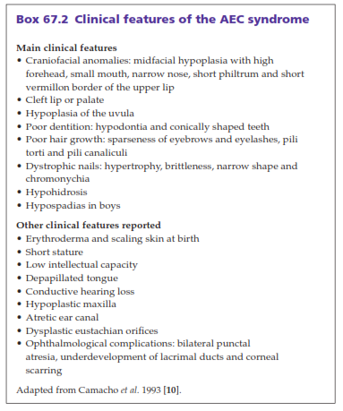
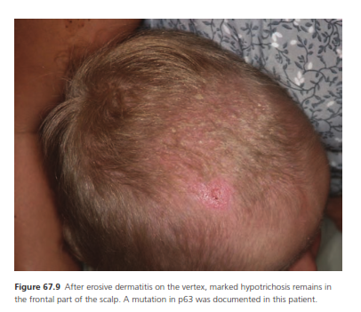

Slide 47
Clincal Variants
CHAND Syndrome
Rapp-Hodgkin Syndrome

Slide 48
DIFFERENTIAL DIAGNOSIS
Epidermolysis Bullosa Simplex
Hypohydrotic Ectodermal Dysplasis
COMPLICATIONS
Chronic otitis media, secondary hearing loss
Atresia of lacrimal gland leads to epiphora, chronic conjunctivitis
Scalp erosion and chronic scalp infection.

Slide 49
DISEASE COURSE AND PROGNOSIS
At birth, affected newborns have red eroded peeling of skin resembling a collodion membrane.
It resolve over the first few weeks and skin is dry.
Individual have recurrent scalp erosions, scalp infection, scarring
TREATMENT
Emollients for collodion like membrane in new born.
Neonates with AEC have extremely fragile skin ,they should be hadled with extreme care

Slide 50
Ankyloblepharon filiforme adnatum may require surgical intervention or may lyse spontaneously.
Scalp require aggressive wound care and treatment with topical or systemic antibiotics.
Cleft lip/palate, hypospadias and maxillary hypoplasia, lacrimal duct atresia is surgically corrected
Teeth preservation and restoration is imperative.

Slide 51
Ectrodactyly-ectodemal Dysplasia Cleft Lip / Palate Syndrome
EEC is inherited as autosomal dominant manner. The main features are:
  Ectrodactyly
  Cleft lip/palate
  Tear duct anomalies
  Abnormalities of epidermal appendages

Slide 52
Genetics
ECC is result of mutation in TP63 gene, encoding the p63 transcription factor.

Slide 53
Associated diseases:
  Malformations of genitourinary system
  Renal agenesis, urethral atresia, hydronephrosis
  Conductive or sensorineural hearing loss
  Mammary gland / nipple hypoplasia
  Severe opthalmological pathologies
  Lacrimal ducts alterations with atresia or hypoplasia
  Photophobia
  Corneal ulcerations
  Endocrine pathologies—hypoplastic thymus,hypopituitarism,GH deficiency
Environmental Factors
  As a reduction or absence of sweat glands may occur, hot and dry environment can be dangerous and leads to stoke, epilepsy or stoke

Slide 54
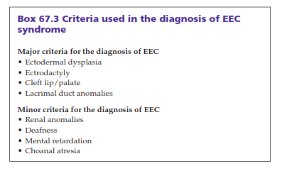

Slide 55
Other Clinical Features
Hypopigmented dry skin
Hypotrichosis with fine hair, of scalp and eyebrows
Small malformed and missing teeth, nail dystrophies
Malformation of urogenital system
Hypoplasia of breast and nipples
Photophobia, ulceration of cornea, keratitis, blepharitis, ectropion
Hormonal dysregulation

Slide 56
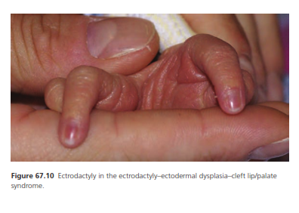
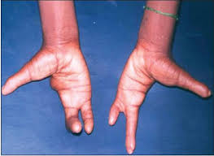

Slide 57
Differential Diagnosis
Includes whole spectrum of p63 syndromes
Ankyloblepharon-ectodermal defect cleft lip/palate
ADULT syndrome
Limb mammary syndrome
Split hand / foot malformation
Van der woude syndrome (mutation in IRF6, which is under regulation of p63. In this syndrome, hypodntia and lower lip pits occur.

Slide 58
Investigations
In patient with typical sign and symptoms of EEC, the diagnosis is straightforward.
Molecular genetic confirmation by documentation of mutation.
Prenatal diagnosis of EEC syndrome, based on identification of lobster claw anomaly is done by three dimensional ultrasound.

Slide 59
Management
The management of affected patient depends on which ectodermal structure are involved
Use of artificial tears to prevent damage to cornea
Patient with scalp erosion are treated with topical and systemic antibiotics
Patient with severe alopecia can wear wigs to improve their appearance
Early repair of cleft lip or palate

Slide 60
Thank You!

