Slide 1
OTHER DISORDERS OF PILOSEBACEOUS UNIT
Dr Nadia Akhtar
PGR Dermatology

Slide 2
Pseudofolliculitis
Inflammatory follicular & perifollicular foreign‐body reaction to hair trapped beneath skin surface from penetration or retraction of cut ends of hair into skin.
Gender :
Males mostly
Men of African descent
Age : after puberty.

Slide 3
Genetic predisposition is an important factor.
Curly hair is more liable.
Skin folds or irregularities due to scarring may allow ingrowth of straight hairs.
SITES:
Male beard area is naturally most common site.
Any shaved area may be affected in both genders.

Slide 4
PATHOLOGY
Inflammation
Microabcesses.
Foreign body granulomas.

Slide 5
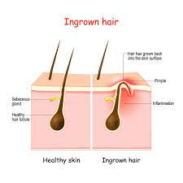
INGROWN HAIR

Slide 6
CAUSATIVE ORGANISM OF PSEUDOFOLLICULITIS
Coagulase‐negative staphylococci (sometimes).
Not primarily infective but rather a foreign‐body inflammatory reaction.

Slide 7
Clinical Features
Multiple small papules & pustules on shaven skin.
The skin of neck and over jaw is most commonly affected, although cheeks may also be involved.
Possible to identify some penetrating hairs (may not be visible in all cases).

Slide 8
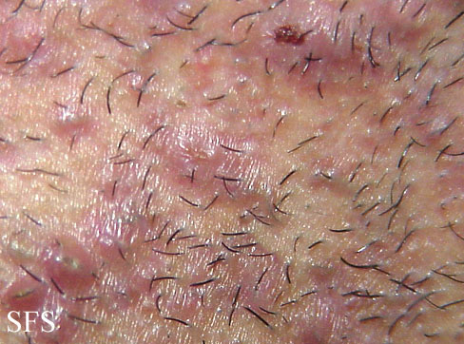

Slide 9
Pseudofolliculitis barbae showing typical distribution (a) and close‐up view

Slide 10
Differential Diagnosis Of Pseudofolliculitis
Bacterial folliculitis
Sycosis barbae
Dermatophytosis

Slide 11
COMPLICATIONS
Scar
Keloid formation
Hyperpigmentation

Slide 12
MANAGEMENT
First line :
Stop shaving affected area for 6 weeks , apply topical combination steroid/antibacterial cream
Second line :
Shave hair 2-3/ week rather than daily.
Hair should be left about 1 mm long.
Use chemical depilatories rather than physical hair removal
Third line :
Laser.

Slide 13
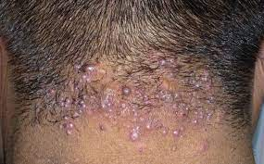
Folliculitis Keloidalis
Chronic inflammatory process
Sites :
hair follicles of nape of neck
leading to hypertrophic scarring
in papules and plaques.
Males are most commonly affected.
Age : 15-24 years

Slide 14
Predisposing Factors
Black males.
No specific organism has been firmly implicated.
Staphylococcus aureus may commonly be isolated from swabs from affected skin.
Friction from collar.
Frequent haircut (< 2 weeks interval)

Slide 15
CLINICAL FEATURES
Follicular papules or pustules, often in irregularly linear groups,
On nape of neck just below and within hair line .
Less often, extend upwards into scalp.
Papules may remain discrete or may fuse into horizontal bands or irregular plaques.
In other cases, inflammatory changes are persistent
and troublesome, with undermined abscesses & discharging sinuses.

Slide 16
Folliculitis Keloidalis of Nape of Neck

Slide 17
Disease course and Prognosis
The condition usually becomes chronic .
Permanent keloidal scarring.

Slide 18
Treatment Algorithm For Folliculitis Keloidalis.

Slide 19
Close shaving of hair on nape of neck and occipital scalp should be avoided.
Long-pulsed Nd:YAG laser

Slide 20
Necrotizing Lymphocytic Folliculitis Of Scalp Margin
Chronic scarring follicular dermatosis.
Necrotizing inflammation of follicles close to scalp margins
Multiple small round varioliform scars.
Termed as “acne necrotica varioliformis”
Aggravation in summer.
Staphylococcus aureus and Propionibacterium acnes

Slide 21
CLINICAL FEATURES
Mild pruritus.
Onset is insidious
Papules in frontal hairline
More rarely, seborrhoeic areas of skin.
Reddish‐brown papules, gradually umbilicate, developing focal areas of necrosis,
Crusting over weeks.
Depressed varioliform scars

Slide 22
Varioliform scars at the scalp margin secondary to necrotizing lymphocytic folliculitis.

Slide 23
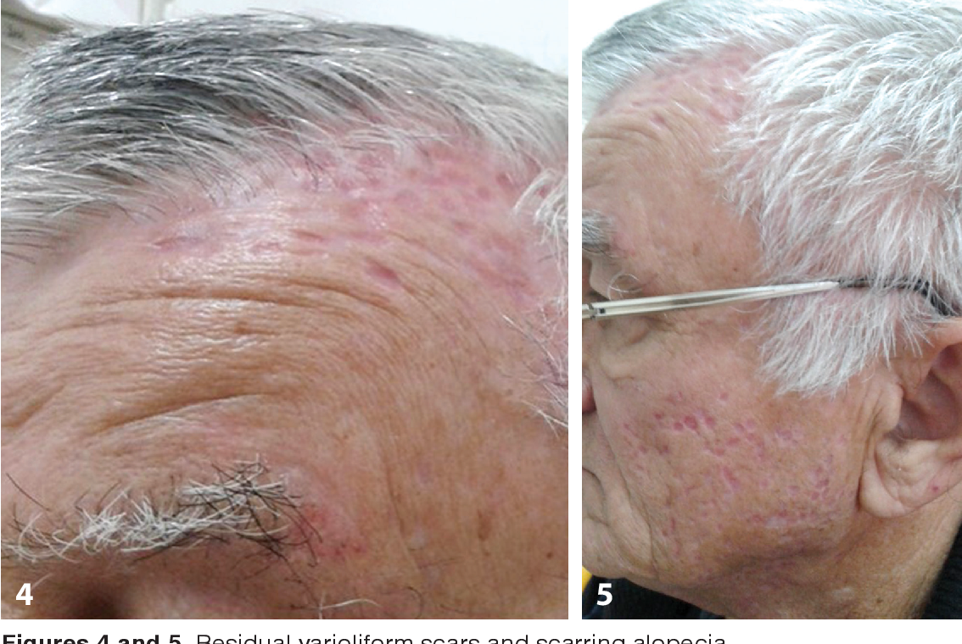

Slide 24
DIFFERENTIAL DIAGNOSIS
Papulonecrotic tuberculid
Tertiary syphilis
Repetitive excoriation
Folliculitis Decalvans
Eczema herpeticum
Pyogenic bacterial folliculitis
Molluscum contagiosum
Notes:
scalp folliculitis, the lesions are typically distributed throughout
the scalp, and are smaller, usually more numerous, non‐scarrining and more pruritic

Slide 25
MANAGEMENT
1st Line
If S. aureus is found, antistaphylococcal therapy along with treatment of possible concomitant nasal carriage
If S.aureus is not found, tetracyclines in acne dosing
Antibacterial shampoos are also recommended.
2nd Line
Topical or intralesional corticosteroids
3rd Line
Isotretinoin

Slide 26
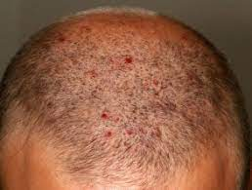
SCALP FOLLICULITIS
Non‐scarring chronic superficial folliculitis of scalp
Multiple minute
Very itchy pustules
Throughout scalp
Propionibacterium acnes.
M:F = 3:1
Neutrophilic folliculitis without necrosis

Slide 27
Scalp folliculitis with secondary excoriation

Slide 28
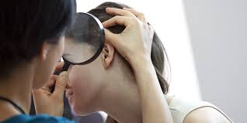
Management Of Scalp Folliculitis
Topical preparations
Tar shampoos might be of benefit.
Low‐dose tetracycline.
Topical corticosteroids do not help.

Slide 29
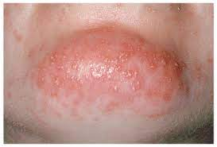
ACTINIC FOLLICULITIS
Rare photodermatosis
Unknown aetiology
Pruritic monomorphic
Follicular papules and pustules
Photo‐exposed sites
Several hours to days after sunlight exposure
M=F
Resolves within 10–14 days.
Cultures are negative.
Histologically, there is a superficial neutrophilic folliculitis with an admixture of lymphocytes.

Slide 30
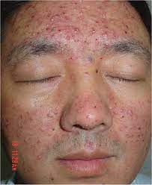
ACTINIC FOLLICULITIS

Slide 31
Follicular pustules on anterior chest 48 h after irradiation with broadband UVA in a patient with actinic folliculitis

Slide 32
Differential Diagnosis Of Actinic Folliculitis
Polymorphic light eruption
Miliaria
Papulopustular rosacea,
Photoaggravated acne vulgaris

Slide 33
Disease Course & Prognosis
May recur annually over many years
Worse at beginning of summer.
Investigation :
A follicular provocation test.

Slide 34
Management Of Actinic Folliculitis
Photoprotection
Use of hats, clothing & high factor sunscreen .
UVB phototherapy may provide useful desensitization.
Notes:
Standard acne therapy is
ineffective, but severe cases may respond to isotretinoin

Slide 35
Eosinophilic Pustular Folliculitis
Characterized by infiltration of pilosebaceous follicles by large numbers of eosinophils .
M:F = 5:1
Japan
Types :
Classical ( predominantly facial )
Immuno suppresion associated
( HIV , extra facial)
Infantile

Slide 36
Pathology
Heavy infiltration of outer root sheath & sebaceous gland by eosinophils
Scattered mononuclear cells & neutrophils.
Perifollicular and perivascular infiltration by eosinophils.
Blood eosinophilia in upto 35% of patients with classical type
Upto 50% with HIV‐associated type .

Slide 37
Histopathology of eosinophilic pustular folliculitis showing dense accumulation of eosinophils with in follicular canal

Slide 38
CLINICAL FEATURES
Crops of sterile follicular papules and pustules coalesce into inflammatory
Annular plaques with peripheral expansion and central clearing.
Face is commonest site of involvement.
Pustular inflammation of palms and soles may be seen.
Lakes of pus & erosions are sometimes seen.
Itch is frequent.

Slide 39
well‐defined, dark erythematous plaques with numerous pustules and crusts involving cheeks

Slide 40
Immunosuppression‐Associated Eosinophilic Pustular Folliculitis
Not restricted to Japanese
Pruritus is typically much more intense.
The pustular element is not as prominent
clustering into plaques is not a characteristic feature .
Facial skin is less commonly involved
Immune reconstitution inflammatory syndrome (IRIS)
Notes:
IRIS=Paradoxically, eosinophilic pustular folliculitis may first develop
after the CD4 count starts to rise with the introduction of highly activ antiretroviral therapy (HAART),

Slide 41
Immunodeficiency‐associated eosinophilic pustular folliculitis in
32‐year‐old woman with HIV infection

Slide 42
MANAGEMENT
.
Oral NSAIDs
Indometacin
Minocycline,
Isotretinoin,
Itraconazole
Cetirizine
Metronidazole and colchicine
Potent topical corticosteroids
Topical pimecrolimus and tacrolimus
Notes:
[

Slide 43
MANAGEMENT
1st Line :
Dapsone is effective in some cases and may be 1st drug of choice.
Potent topical corticosteroids,
Topical pimecrolimus/tacrolimus
Indometacin
Narrow‐band UVB phototherapy
2nd Line :
Oral corticosteroids
Oral antimicrobials (minocycline, itraconazole)
Cetirizine
Oral isotretinoin
Notes:
A proposed mechanism of action of oral indometacin
is that it interferes with prostaglandin D2 induced chemotaxis
by down‐regulating expression of CRTH2 (chemoattractant receptor homologous molecule) on the surface of eosinophils

Slide 44
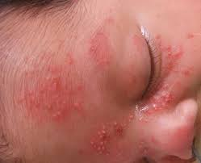
INFANTILE EOSINOPHILIC PUSTULAR FOLLICULITIS
An inflammatory pustular disorder of infants associated with cutaneous and peripheral blood eosinophilia.
Age : Average 6months
M:F = 4:1

Slide 45
ASSOCIATED DISORDERS
HIV
Hyper‐IgE syndrome
Atopic disease

Slide 46
PATHOPHYSIOLOGY
Tzanck smear shows an abundance of eosinophils.
Biopsy shows an intense follicular polymorphonuclear , eosinophilic infiltrate .
Hair follicles were identified in only 63% of biopsies.

Slide 47
Infantile eosinophilic pustular folliculitis with dense infiltrate of eosinophils, spongiosis and microabscess formation with follicle

Slide 48
CLINICAL FEATURES
Recurrent crops of itchy sterile pustules
On scalp predominantly
Axillary, inguinal or cervical lymphadenopathy
Pustular lesions resolve spontaneously without scarring .

Slide 49
Sterile Pustules in scalp

Slide 50
Disease Course And Prognosis
Self‐limiting disease
Spontaneous resolution from 3 months-3years of age.

Slide 51
Differential Diagnosis
Infantile eosinophilic Pustular folliculitis
Erythema toxicum neonatorum
Transient neonatal Pustular melanosis
Infantile acropustulosis
Langerhans cell histiocytosis

Slide 52
Investigations
Tzanck smear
Culture for bacteria and fungi
HIV test
IgE levels.

Slide 53
MANAGEMENT
First line
Expectancy, topical corticosteroids
Second line
Anti histamines
Topical tacrolimus
Third line
Dapsone

Slide 54
Heterotopic Sebaceous Glands
(Fordyce spots)
Fordyce spots are heterotopic sebaceous glands (duct is
connected directly to overlying epidermal or mucosal surface
( not associated with hair follicles).
Contain similar lipids to follicle‐associated sebaceous glands.

Slide 55
CLINICAL FEATURES
Multiple smooth, creamy white to yellow
Well‐demarcated papules ,
Coalesce into irregular plaques.
Size : 1–2 mm / larger
Slightly to moderately elevated .
Sites:
Vermilion of upper lip (most common)
Buccal mucosa
labia minora
Prominent penile or scrotal involvement
Notes:
Sebaceous glands are found within the tubercles of Montgomery
on the areola of the female breast. Typical Fordyce spots on the
areolae have, however, been described in a man with coexistent
labial and penile lesions

Slide 56
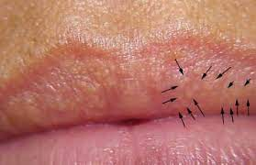
FORDYCE SPOTS

Slide 57
Fordyce spots on vermilion of upper lip

Slide 58
Fordyce spots on buccal Mucosa

Slide 59
Fordyce spots on labia minora and penis

Slide 60
CLINICAL VARIANT OF FORDYCE SPOTS
Coronal sulcus of penis to either side of frenulum.
Glands of Tyson
Normal
No treatment

Slide 61
DIFFERENTIAL DIAGNOSIS
Leucoplakia.
Human papillomavirus infection.
Post‐herpetic changes.

Slide 62
MANAGEMENT
First line
Reassurance
Second line
Local destruction with superficial cautery or electrodessication
Topical trichloracetic acid
Third line
Systemic isotretinoin
Carbon dioxide laser

Slide 63
SEBACEOUS GLAND HYPERPLASIA
Scattered flesh‐coloured to yellowish papules due to hypertrophy of sebaceous glands.
Benign proliferation of sebocytes within normal pilosebaceous units in
hair bearing skin.
Association : Immunosuppression in transplant recipients
Notes:
most commonly seen in
adults but may manifest in the neonatal period due to the passage
of maternal androgens across the placenta

Slide 64
CLINICAL FEATURES
Scattered
Asymptomatic
Flesh‐coloured to yellowish‐pink
Umbilicated papules 1–3 mm in diameter
SITES :
Forehead,
Temples
Cheeks,
May occur on upper trunk.

Slide 65
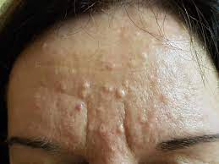
SEBACEOUS GLAND HYPERPLASIA

Slide 67
DIFFERENTIAL DIAGNOSIS
Heterotopic sebaceous glands (Fordyce spots)
Multiple basal cell carcinomas
Cowden disease (multiple hamartoma syndrome)
Fibrous papule of face
Follicular infundibulum tumour
Folliculoma
Granulomatous rosacea
Lichen nitidus
Lipoid proteinosis
Milia
Molluscum contagiosum
Muir–Torre syndrome
Multiple endocrine neoplasia type 1
Sebaceous adenoma , Sebaceous carcinoma
Syringoma
Trichilemmoma , Trichoepithelioma Trichofolliculoma

Slide 68
MANAGEMENT
First line :
Cosmetic camouflage
Second line
Gentle cautery,
Cryotherapy
Trichloroacetic acid .
Pulsed dye laser
1450 nm Diode laser

Slide 69
Third Line :
Oral isotretinoin
Photodynamic therapy ( amino laevulinic acid)
Notes:
A therapeutic trial
of oral isotretinoin may help to differentiate between sebaceous hyperplasia and multiple early basal cell carcinomas in transplant recipients,
Cyproterone actetate in combination with a combined oral contraceptive

Slide 70


