Slide 1
Dermatosis of PREGNANCY
Dr. Muhammad Ilyas
Resident Dermatology

Slide 2
LEARNING OBJECTIVES
Classification
Diagnosis
Clinical Features
Management of Dermatoses of Pregnancy

Slide 3
OuTLINE
Introduction
Polymorphic Eruption of Pregnancy
Pemphigoid gestationis
Atopic eruption of pregnancy
Intrahepatic cholestasis of pregnancy

Slide 4
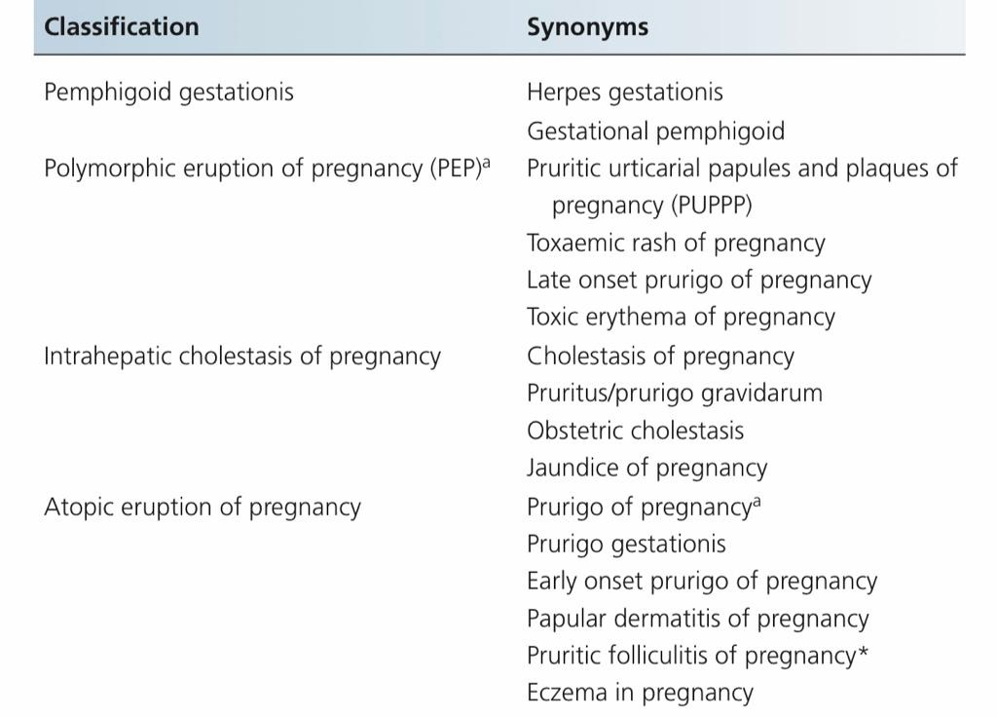

Slide 5
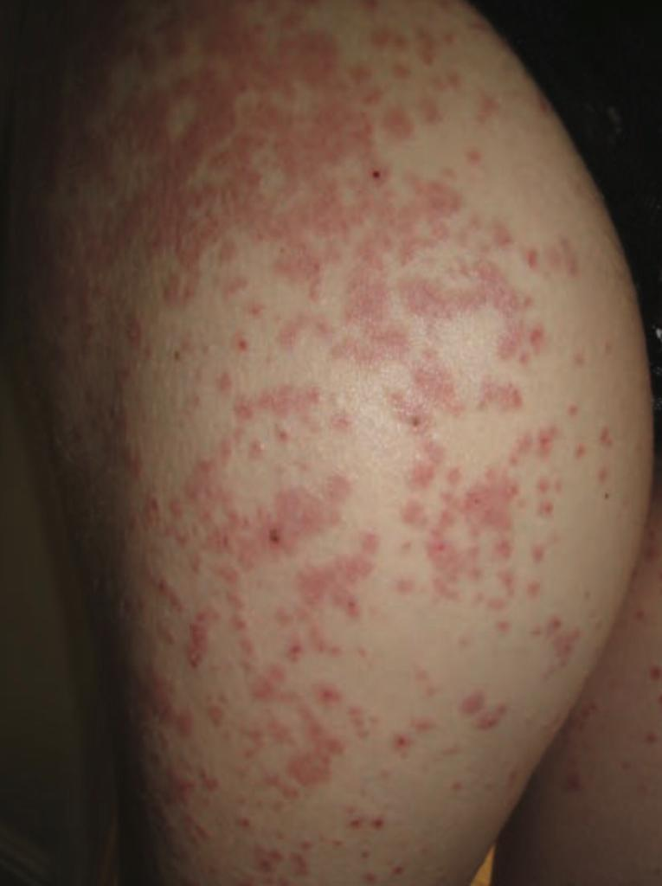
1. POLYMORPHIC ERUPTION OF PREGNANCY

Slide 6
POLYMORPHIC ERUPTION OF PREGNANCY
Most common of the pregnancy specific dermatosis
Synonym: pruritic urticarial papules and plaques of pregnancy
Benign
Self-limiting
Pruritic inflammatory disorder
Blisters are not a feature

Slide 7
POLYMORPHIC ERUPTION OF PREGNANCY
Usually effects primigravidae
Associated with:
Excessive maternal weight
Multiple pregnancies
Occurs in third trimester or immediately after delivery

Slide 8
CLINICAL FEATURES
Typically starts on abdomen, often within striae distensae
Pruritic urticarial papules
Coalesce into plaques, spreading to the buttocks and proximal thighs
Umbilical sparing is a characteristic finding
Can quickly become generalized in severe cases

Slide 9
CLINICAL FEATURES
Later on, morphology may become polymorphic (in half of patients):
Vesicles (never bullae)
Widespread erythema
Targetoid lesions
Eczematous lesions

Slide 10
Polymorphic eruption of Pregnancy

Slide 11
Disease course AND prognosis
Maternal and fetal prognosis is unimpaired
No cutaneous involvement of newborn
Self-limiting
Does not recur
Resolution usually occurs within 4-6 weeks independently of delivery

Slide 12
INVESTIGATIONS
Diagnosis of exclusion
Histopathology is non-specific
Skin biopsy:
Epidermal and upper dermal edema
Perivascular infiltrate of lymphocytes, histiocytes and eosinophils
Direct immunofluorescence: negative

Slide 13
Management
First Line:
Topical emollients: aqueous cream + 1-2% menthol
Topical corticosteroids
Oral antihistamines
Second Line:
Prednisolone (starting at 40-60mg per day and tapering to over few weeks)

Slide 14
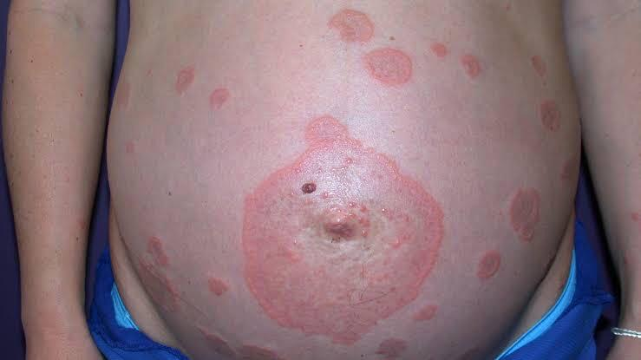
2. Pemphigoid gestationis

Slide 15
Pemphigoid gestationIs (pg)
Most important dermatosis in pregnancy
A rare, autoimmune, bullous disease
Mainly presents in late pregnancy or immediately after delivery
An increased rate adverse maternal and fetal outcomes

Slide 16
pathophysiology
Pathogenetically circulating complement – fixing IgG1 binds to BP-180 or bullous pemphigoid antigen 2
Hemidesmosomes of the dermo-epidermal junction
Tissue damage and blister formation

Slide 17
pathophysiology
The primary site of auto immunity seems not to be the skin, but the placenta
Antibodies bind not only to basement membrane zone of epidermis, but also to that of chorionic and amniotic epithelium
Aberrant expression of MHC class II molecules on chorionic villi
Allogenic immune reaction to placental matrix

Slide 18
Clinical features
Intensely itchy hive-like rash during mid to late pregnancy
Initially, red urticated papules and plaques on abdomen
Characteristically involving the periumbilical skin
Thereafter , the rash spreads to involve limbs and torso
The face, scalp, palms, soles and mucous membranes are usually spared

Slide 19
Clinical features
After 2-4 weeks, large, tense fluid-filled blisters form
The face, scalp, palms, soles and mucous membranes are usually spared
Flare up at the time of delivery
Resolves within weeks to months after delivery

Slide 20
Prognosis
FETAL:
Increased risk of prematurity and small for size babies
Risk correlates with disease severity
NEONATAL PG:
Passive transfer of antibodies from mother to fetus
Skin lesions in 10% of newborns
Resolves spontaneously within days to weeks

Slide 21
PROGNOSIS
MATERNAL:
Can recur in subsequent pregnancies
Further episodes present at an early gestation and increased severity
An increased risk of developing other organ specific autoimmune diseases
Most important being Graves disease

Slide 22
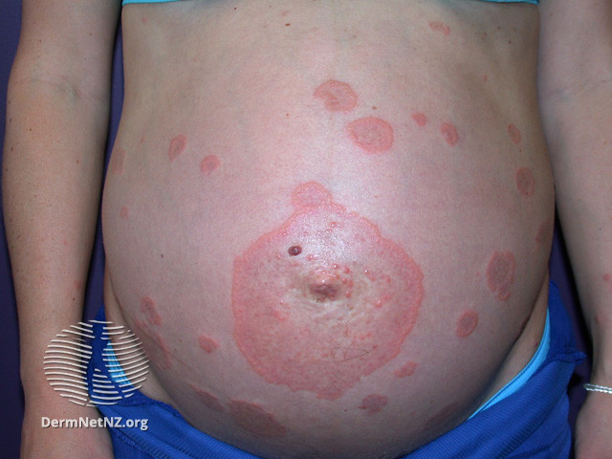

Slide 24
INVESTIGATIONS
Skin Biopsy
Pre-bullous stage:
Edema of upper and middle dermis perivascular infiltrate of lymphocytes, histiocytes and eosinophils
Bullous stage:
Subepidermal blistering

Slide 25
INVESTIGATIONS
Gold Standard: DIF of perilesional skin
Linear C3 deposition along dermo epidermal junction in 100% cases
Additional IgG deposition in 30-100% cases
Antibody levels correlate with disease activity
Can also be monitored using ELISA and immunoblotting techniques

Slide 26
management
Treatment on severity of disease
Aims to control pruritis and to prevent blister formation
First Line:
Topical emollients: aqueous cream + 1-2% menthol
Potent topical steroids
Oral antihistamines: Loratadine and cetirizine

Slide 27
MANAGEMENT
Second Line:
Prednisolone : usually started at a dose of 0.5-1mg/kg/day
Third Line:
Azathioprine
Plasma Exchange
Intravenous Immunoglobulins

Slide 28
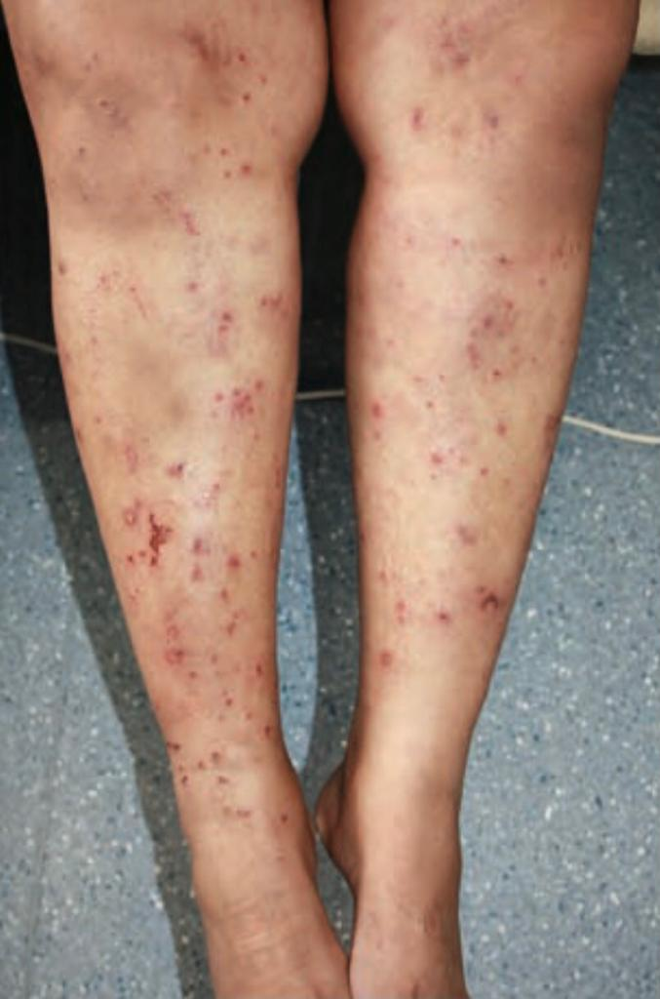
3. Atopic eruption of pregnancy

Slide 29
Atopic eruption of pregnancy
Most common dermatosis in pregnancy accounting for 50%
Starts in early pregnancy, with 75% cases presenting before third trimester
Benign pruritic disease of pregnancy
Eczematous papular lesions in patients with an atopic susceptibility

Slide 30
PATHOPHYSIOLOGY
Dominant Th2 immune response
This is pregnancy specific immunological change:
Reduced cellular immunity and reduced production of Th1 cytokines (IL-2, interferon–γ, IL-12)
Dominant humoral immunity and increased secretion of Th2 cytokines (IL-4, IL-10)

Slide 31
CLINICAL FEATURES
20% patients suffer from exacerbation of preexisting atopic eczema with typical clinical picture
Remaining 80% experience atopic changes for the first time or after a long remission

Slide 32
CLINICAL FEATURES
Of these 2/3rd present with widespread eczematous changes (so called E-type AEP) often affecting typical sites such as face, necks and flexural surfaces of limbs
1/3rd have papular lesions (P-type AEP)

Slide 33
CLInICAL FEATURES
Small erythematous papules
Disseminated on trunk and limbs
Typical prurigo nodules
On shins and arms
Recurrence in subsequent pregnancies is common

Slide 35
INVESTIGATIONS
Diagnosis: Clinical
Histopathology: Non-specific, varies with type and stage of disease
Both direct and indirect immunofluorescence are negative
Laboratory tests may reveal elevated serum IgE levels

Slide 36
Management
  First line:
  Topical emollients
  Topical corticosteroids
  Oral antihistamines: loratadine and cetirizine

Slide 37
MANAGEMENT
Second Line:
  Narrow-band UVB phototherapy
  Third Line:
  Prednisolone
  Azathioprine

Slide 38
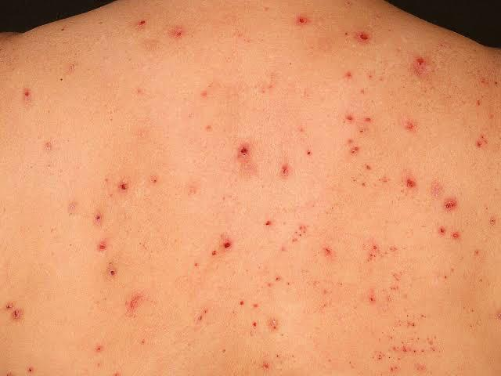
4. INTRAHEPATIC CHOLESTASIS OF PREGNANCY

Slide 39
Pathophysiology and clinical features
  Reversible form of hormonally triggered cholestasis
  Typically develops in genetically predisposed individuals in late pregnancy
  Itching begins in second or third trimester
  Localized to the abdomen, or the palms and soles
  May also be widespread

Slide 40
CLINICAL FEATURES
Mild jaundice: 10% of cases
In case of jaundice and vitamin K deficiency, there is an increased risk for intra and post-partum hemorrhage
Secondary skin lesions: due to scratching
Range from subtle excoriations to severe prurigo nodules

Slide 41
Disease course and prognosis
  Maternal: Good
  After delivery, pruritus disappears simultaneously within days to weeks
  Fetal prognosis can be impaired
  Increased risk of prematurity
  Fetal distress
  Still birth

Slide 42
InvestigationS
  LFTs are usually normal
  ALP may be raised
  Serum bile acids are elevated

Slide 43
MANAGEMENT
Treatment of choice: Ursodeoxycholic acid
Effective in reducing itch and serum bile acids
First line: Topical emollients and oral antihistamines
Second line: Cholestyramine and Dexamethasone
Close obstetric surveillance
Early delivery is sometimes recommended

Slide 44
Thank you!

