Slide 1
DERMATOSES OF THE EYE, EYELIDS AND EYEBROWS
Dr. Taherah
PG R3 Ophthalmology
Civil Hospital, Karachi.

Slide 2
CICATRIZING CONJUNCTIVITIS ASSOCIATED
WITH IMMUNOBULLOUS DISORDERS
Cicatrizing conjunctivitis is conjunctival inflammation with progressive scarring.
The immunobullous disorder MMP is the commonest cause of progressive conjuctival scarring

Slide 3
Immunobollous disorders associated with cicatrizing conjunctivitis
INTRA EPITHELIAL | SUB EPITHELIAL
Pemphigus vulgaris vegetans | Pemphigoid bullous mucous membrane
Paraneoplastic pemphigus | Epidermolysis bullosa acquisita
Lichen planus | Linear IgA disease
 | Dermatitis herpetiformis

Slide 4
MUCOUS MEMBRANE PEMPHIGOID
It is an immunologically heterogeneous group of systemic autoimmune disorders , affecting mucous membranes and skin.
The age range is 30–90 years.
The male : female ratio is most commonly 1 : 3

Slide 5
In the EYE, following can lead to the development of autoantibodies against basement membrane, and a clinical and immunopathological phenotype typical of ocular MMP.
  drug‐induced pemphigoid
  Stevens–Johnson syndrome
  toxic epidermal necrolysis
  ectodermal dysplasia

Slide 6
In the EYE, irreversible blinding consequences occur as a result of two main pathological processes:
  Excessive inflammation
  Fibrosis.

Slide 7
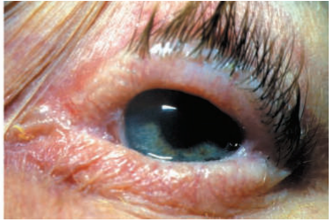
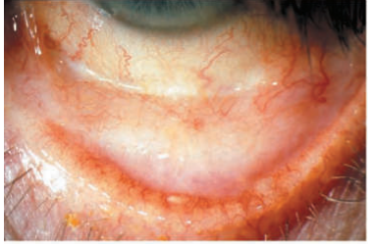
Ocular signs of MMP
loss of the medial canthal structures with a reduced interpalpebral aperture secondary to shortening of the fornices
Inferior fornix shortening and subconjunctival scarring

Slide 8
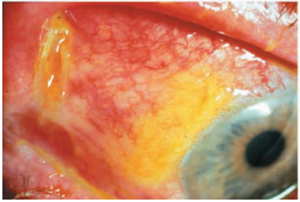
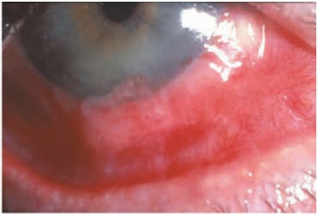
Acute exacerbation showing conjunctival ulceration
Severe conjunctival inflammation and limbitis

Slide 9
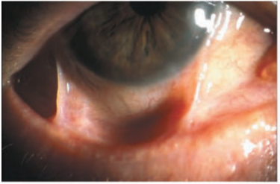
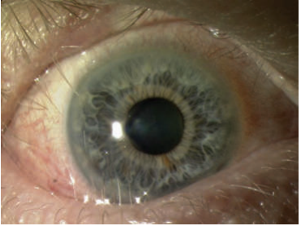
Upper and lower lid trichiasis due to cicatricial entropion
Conjunctival symblepharon

Slide 10
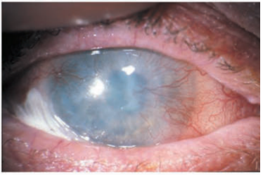
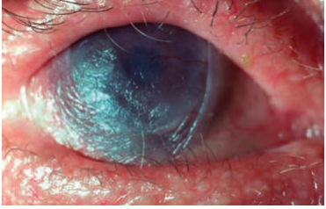
Ocular surface failure and keratinization in advanced pemphigoid.
Terminally dry keratinized blind eye
with trichiasis and entropion

Slide 11
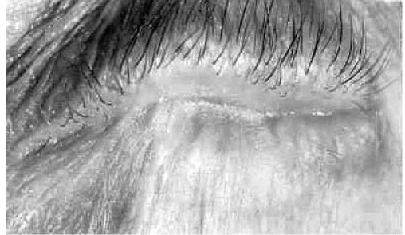
Ankyloblepharon
(Late complication of ocular MMP)

Slide 12
Clinical variants of ocular MMP
  Idiopathic autoimmune (most common).
  Associated with other immunobullous disorders
  As a result of drug‐induced conjunctival damage.

Slide 13
CLASSIFICATION OF SEVERITY
(Fosters Staging System)
STAGE | CHARACTERISTICS
1 | Subconjuctival scarring and fibrosis
2 | Fornix shortening, any degree
3 | Presence of symblepharon, any degree
4 | Ankyloblepharon, frozen globe

Slide 14
Diagnosis
Conjunctival biopsy facilitates the early diagnosis of MMP.
Linear immunoreactant (immunoglobulin and/or complement) deposition at the BMZ confirms the diagnosis

Slide 15
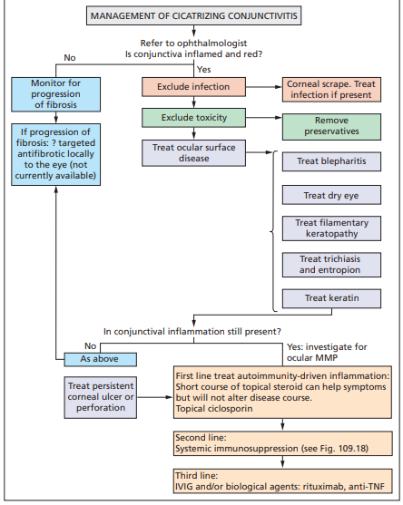

Slide 16
Management
Trichiasis: epilate in the short term, use electrolysis or laser for odd lashes, cryotherapy for misdirected lashes and surgery for entropion.
Blepharitis: use oral tetracyclines and lid hygiene.
Keratinization: topical retinoic acid.

Slide 17
Dry eye and filaments: lubricants, topical acetylcysteine as a mucolytic, punctal occlusion to conserve tears , courses of topical steroids and topical ciclosporin.
Persistent corneal epithelial defect: therapeutic lenses (BCL), close the eye with a botulinum toxin or with a temporary tarsorrhaphy.
Corneal perforation: temporize BCL, followed by keratoplasty.

Slide 18
Exclude and treat any secondary infection.
Eliminate or minimize treatment toxicity
Suppress inflammation
commence immunosuppressive therapy

Slide 19
Other subepithelial disorders and conjunctivitis

Slide 20
ERYTHEMA MULTIFORME MAJOR AND STEVENS–JOHNSON SYNDROME/TOXIC EPIDERMAL NECROLYSIS.
The ocular complications are identical.

Slide 21
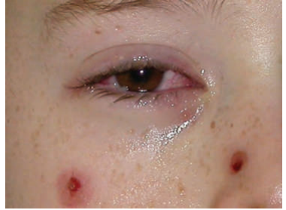
Acute conjunctivitis with mucus discharge occurring concurrently with typical erythema multiforme skin lesions

Slide 22
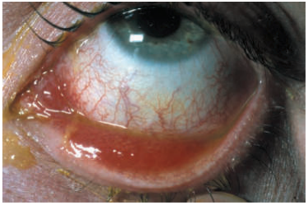
Acute conjunctivitis in a patient with mild Stevens–Johnson syndrome

Slide 23
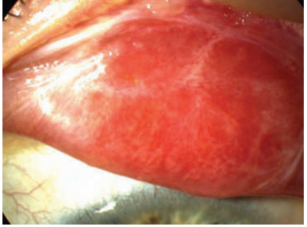
Upper tarsal conjunctival scarring in Stevens–Johnson syndrome

Slide 24
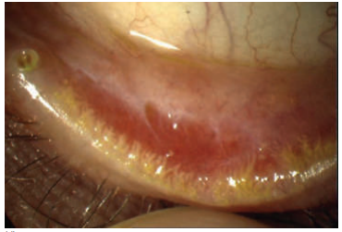
Lower tarsal conjunctival scarring with squamous metaplasia and keratinization adjacent to the mucocutaneous junction of the lower lid.

Slide 25
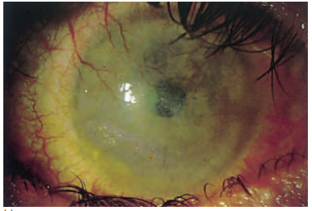
The late ocular complications of Stevens–Johnson syndrome showing entropion, a
dry eye with ocular surface failure

Slide 26
Management of acute ocular SJS/TEN includes
topical steroids
Urgent amniotic membrane transplantation in acute disease with extensive ulceration can be helpful.

Slide 27
Management of chronic ocular SJS/TEN includes
management of severe dry eye, trichiasis and entropion , limbal stem cell deficiency and inflammation.
Systemic immunosuppression may be needed if inflammatory complications of chronic disease do not respond to topical therapies.

Slide 28
VIRAL INFECTIONS

Slide 29
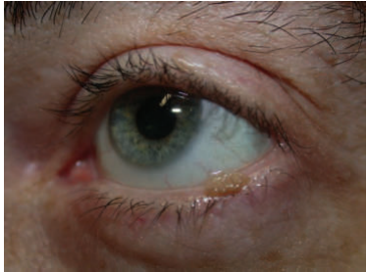
WARTS
These are common and found on the eyelid margins, often as a long thin (filiform) projection.

Slide 30
Management
Lesions in this site are best treated with careful cryotherapy and accurate application of liquid nitrogen to the tip of the lesion using a cotton wool bud rather than cryospray

Slide 31
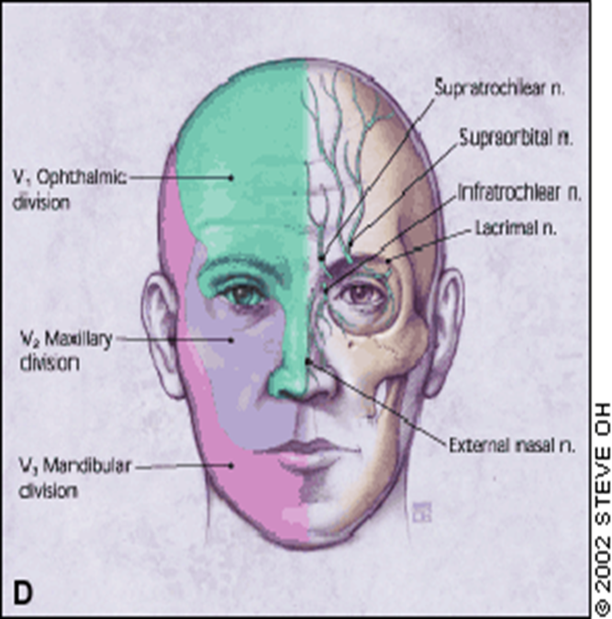
HERPES ZOSTER OPHTHALMICUS
It is an infection and inflammation of that portion of skin and eye which is innervated by ophthalmic division of trigeminal nerve(5th CN).

Slide 32
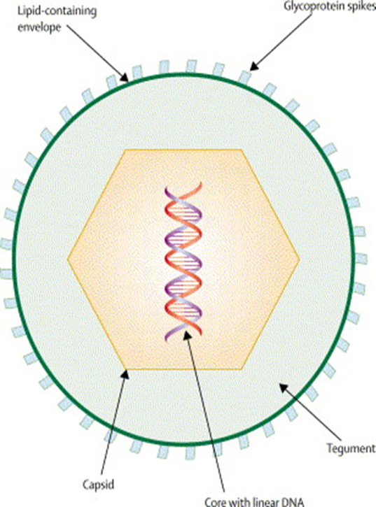
ETIOLOGY
Double stranded DNA virus VARICELLA ZOSTER VIRUS (HHV-3)
HHV-3 causes two different clinical conditions,
Varicella chicken pox
Zoster
shingles/herpes zoster ophthalmicus.

Slide 33
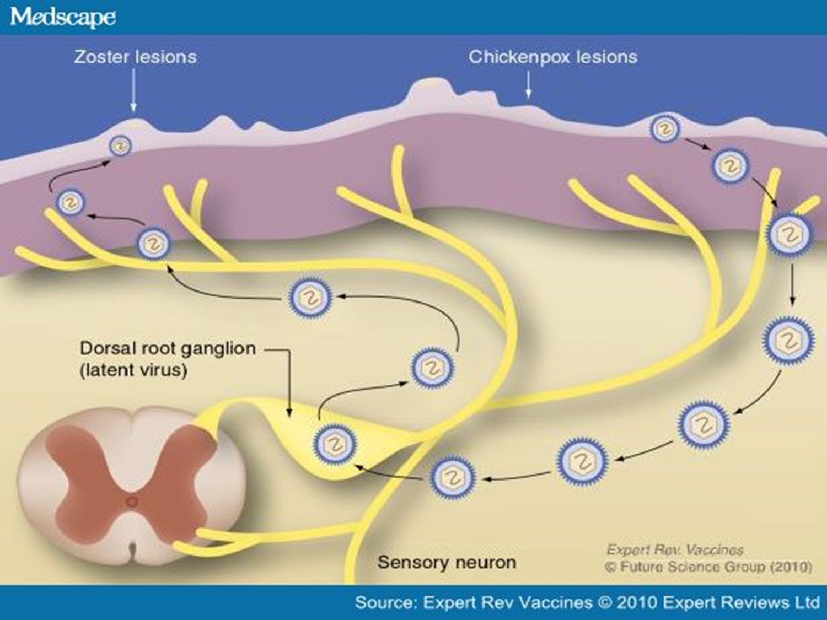

Slide 34
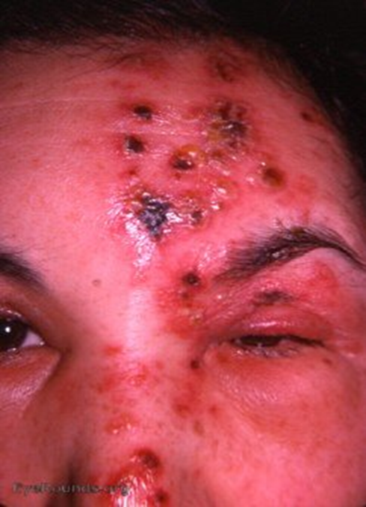
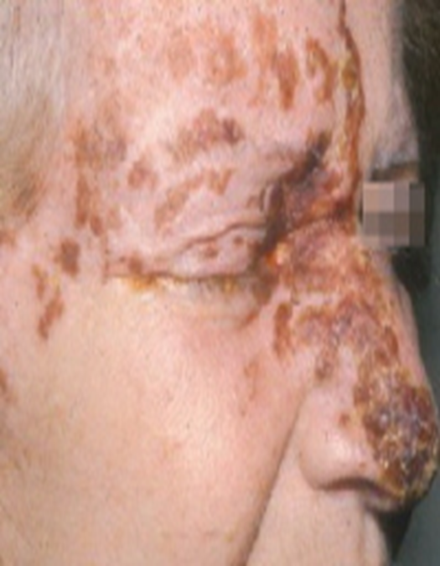
HUTCHISON’s sign describes involvement of the skin supplied by the external nasal nerve, a branch of the nasociliary nerve supplying the tip, side and root of the nose.

Slide 35
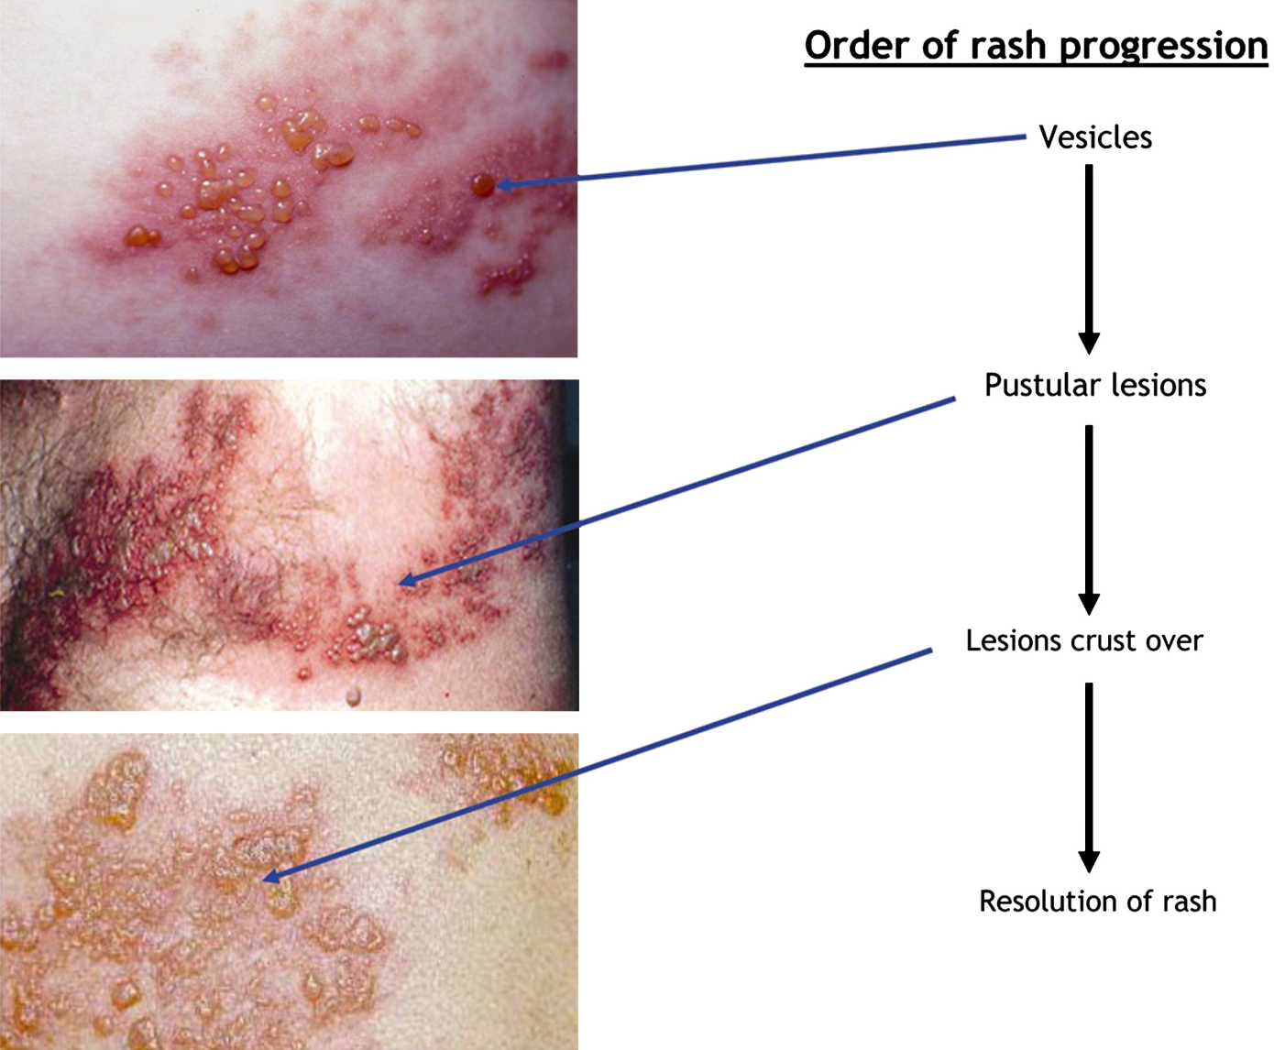

Slide 36
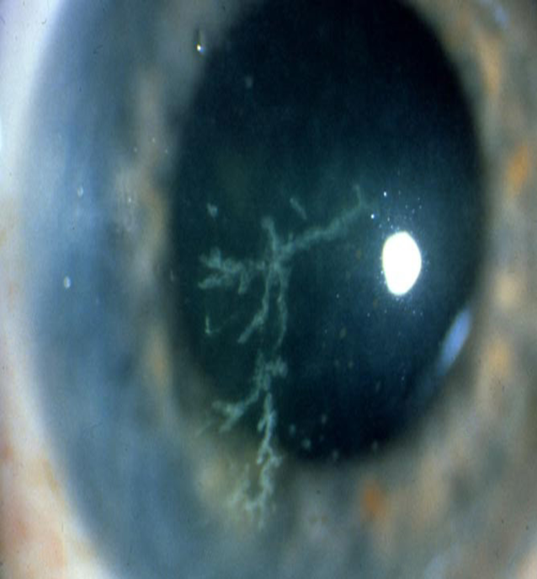
ACUTE EYE DISEASE
Acute epithelial keratitis
characterized by dendritic lesions which are small , fine and have tapered ends without terminal bulbs.

Slide 37
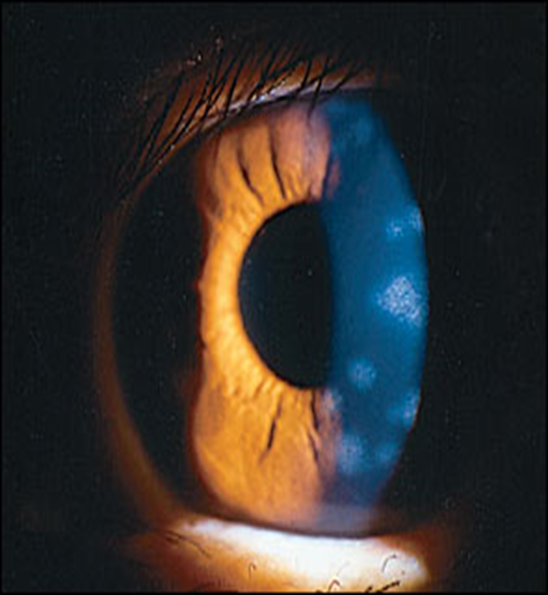
Nummular Keratitis
characterized by fine granular subepithelial deposits surrounded by a halo of stromal haze

Slide 38
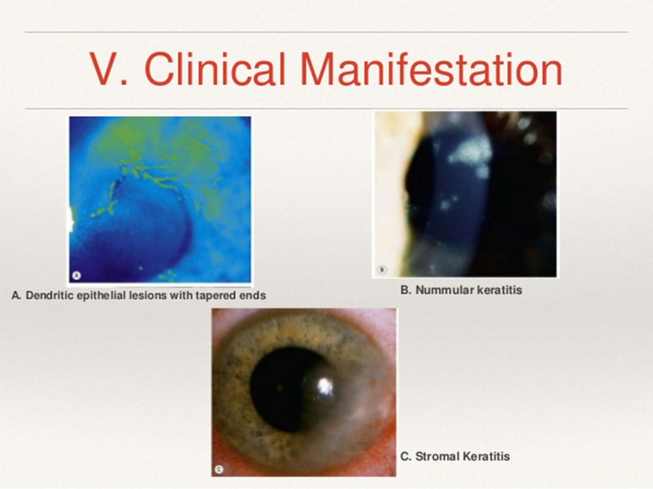

Slide 39
Other acute findings
Conjunctivitis
Scleritis
Episcleritis
Anterior uveitis
IOP elevation
Neurological complications like Cranial nerve palsies affecting the third (most common), 4th and 6th nerves usually recover within 6 months

Slide 40
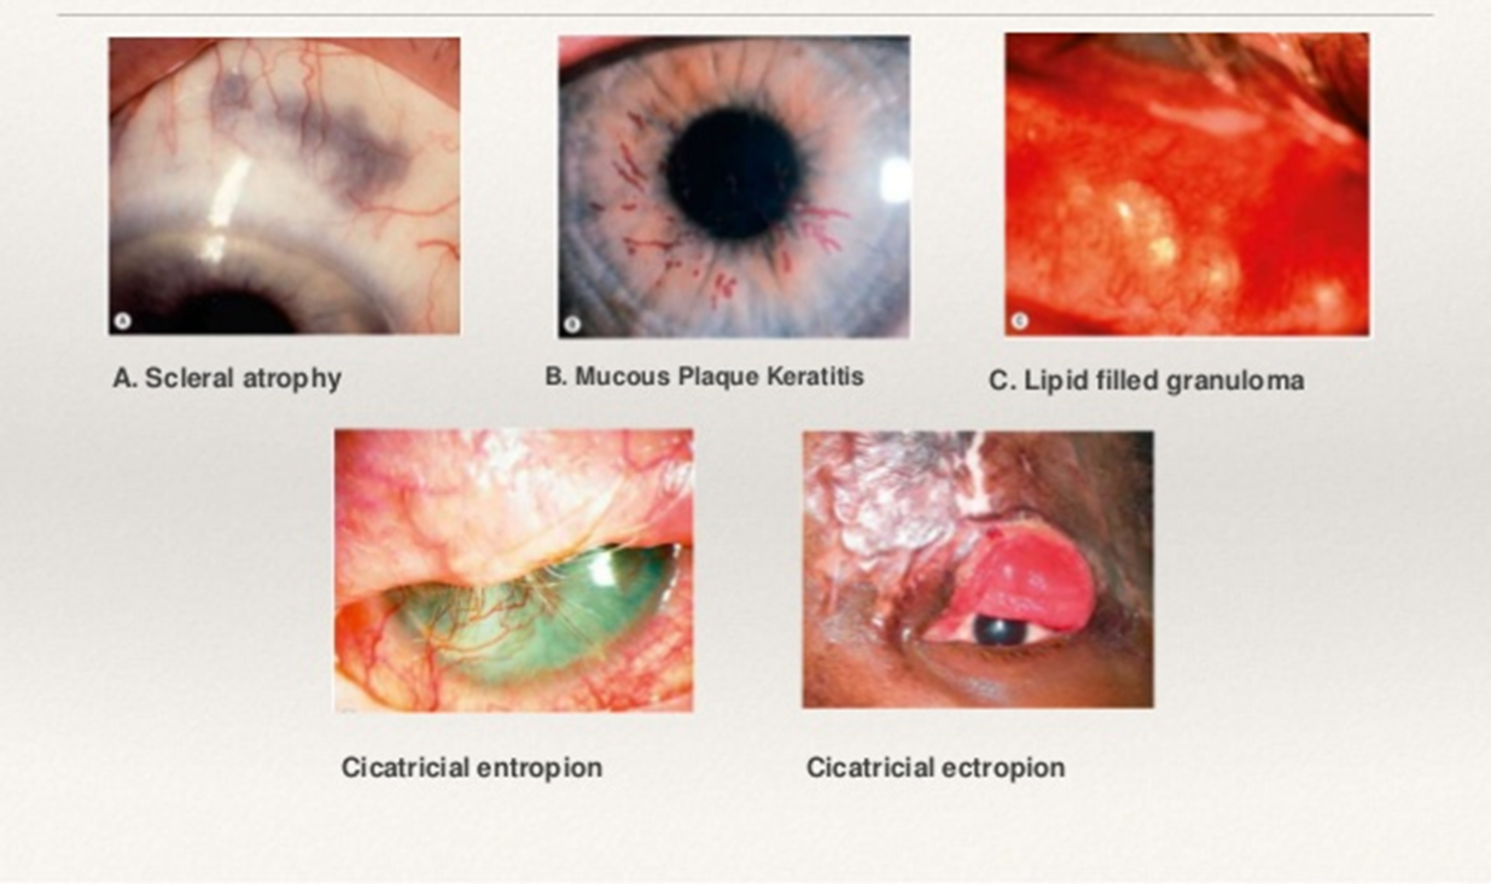
CHRONIC PHASE

Slide 41
Work up
Diagnosis of herpes zoster is based primarily on the history and physical findings.
For accurate diagnosis modern tests like direct fluorescent antibody (DFA) testing or PCR are preferred to the Tzanck smear.
Skin biopsy can also be advised in complicated cases.

Slide 42
TREATMENT
Acute epithelial keratitis: with a topical antiviral.
Nummular keratitis: The lesions fade in response to topical steroids but recur if treatment is discontinued prematurely.
Stromal keratitis: It responds to topical steroids but can become chronic and require slow tapering
Episcleritis: A mild nonsteroidal anti-inflammatory may be used if necessary.

Slide 43
Scleritis: Treatment of indolent lesions is with oral flurbiprofen (Froben) 100 mg t.i.d. Occasionally, oral steroids with antiviral cover may be required for severe involvement.
Mucus Plaque keratitis: Treatment involves a combination of topical steroid and acetylcysteine
Oral aciclovir has been the standard therapy at doses of 800 mg five times a day for 7–10 days. Valaciclovir (1000 mg three times per day) or famciclovir (500 mg three times per day for 7 days)

Slide 44
BACTERIAL INFECTIONS

Slide 45
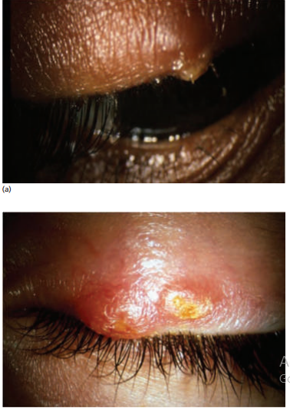
STAPHYLOCOCCAL INFECTIONS
External hordeolum (stye) is caused by staphylococcal infection of
an eyelash follicle and its associated glands
Internal hordeolum is a staphylococcal abscess of the meibomian glands

Slide 46
Management:
No treatment is usually required beyond the application of local soothing compresses and removal of the affected lash.
If there is a local cellulitis then systemic antibiotics should be given.
An internal hordeolum needs incision and drainage.

Slide 47
MYCOBACTERIAL INFECTIONS

Slide 48
TUBERCULOSIS
There are no specific ocular findings in tuberculosis.

Slide 49
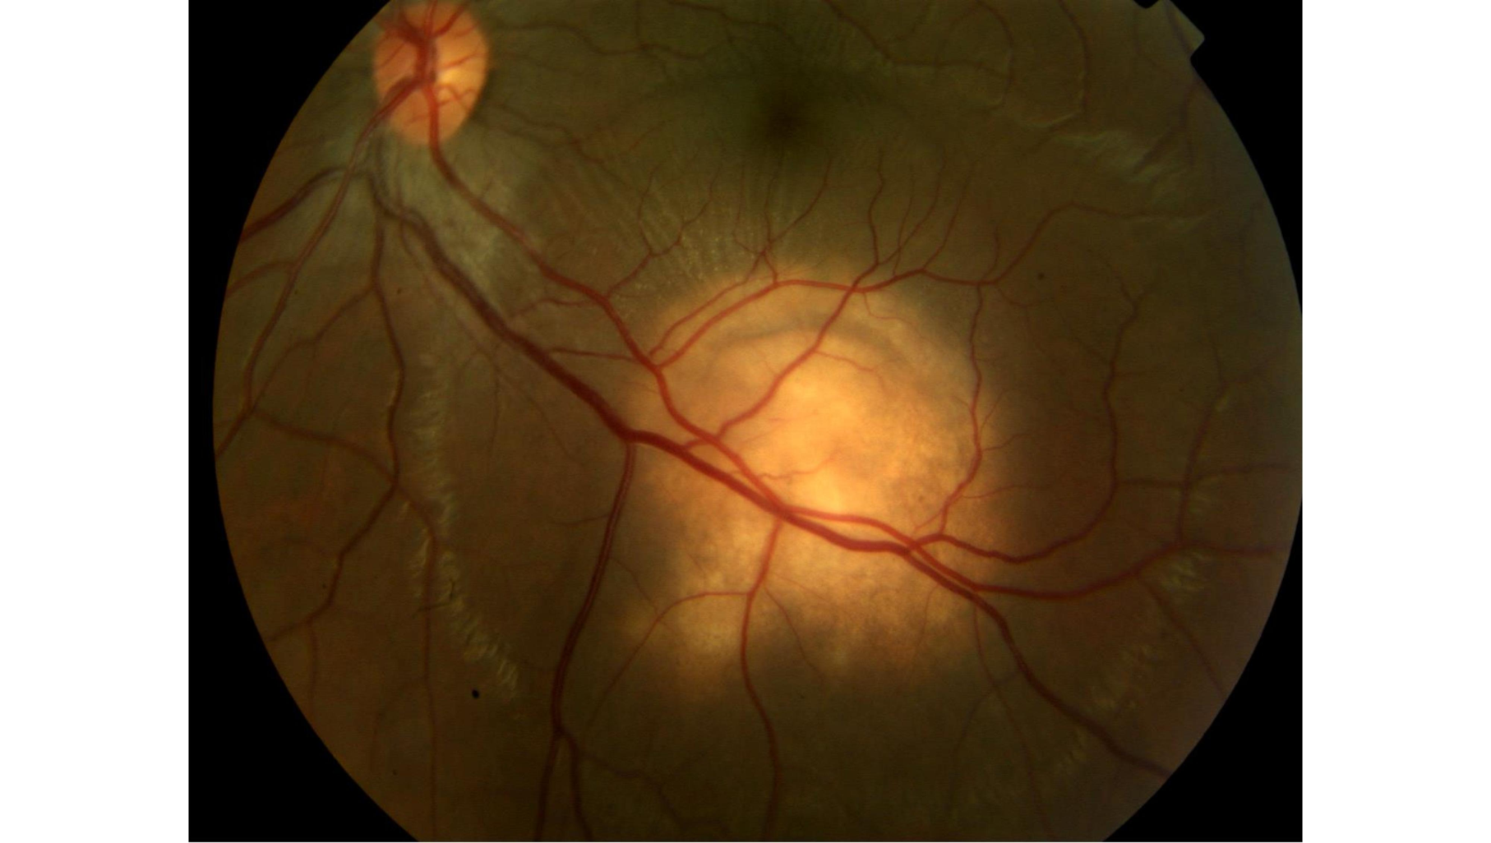
choroidal granuloma

Slide 50
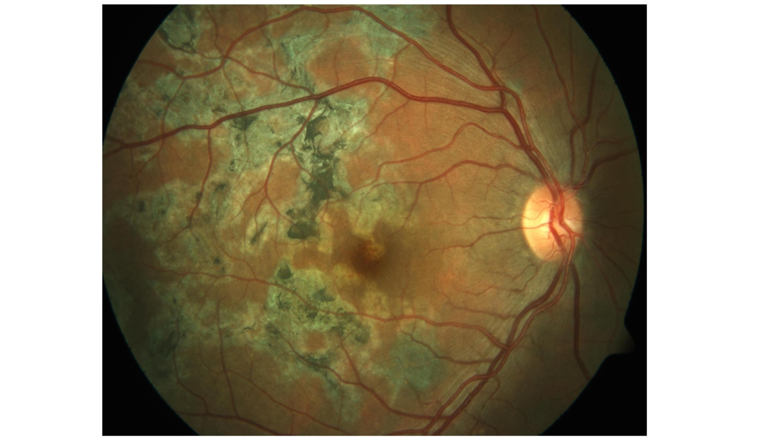
Multifocal serpiginoid choroiditis

Slide 51
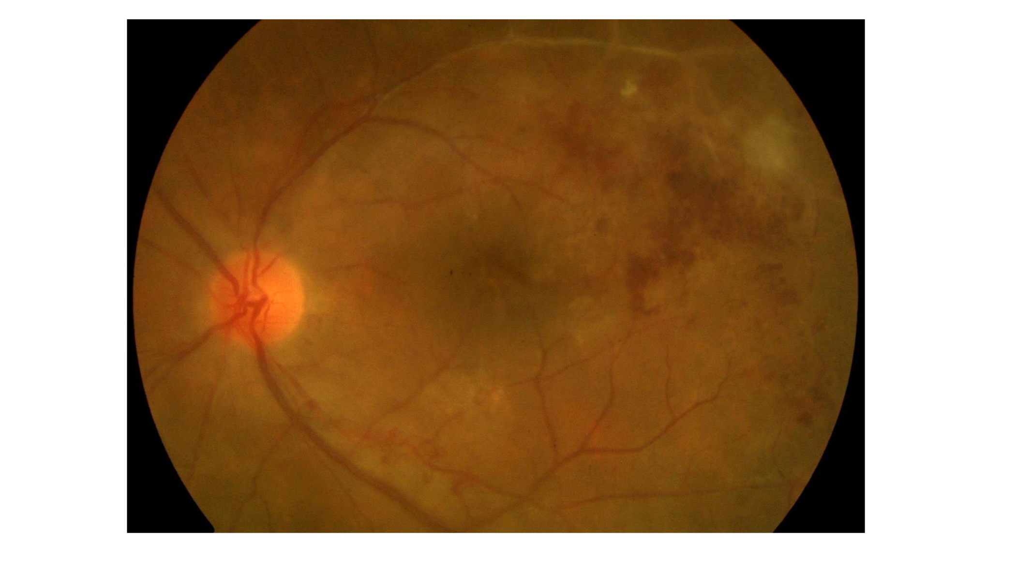
TB delayed hypersensitivity uveitis presenting with hemorrhagic ischemic vascular occlusion

Slide 52
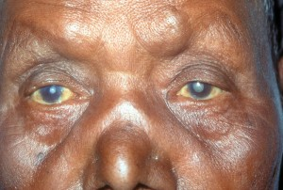
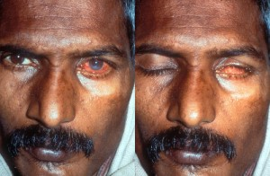
LEPROSY
OCULAR COMPLICATIONS:
Cataract
Lagophthalmos

Slide 53
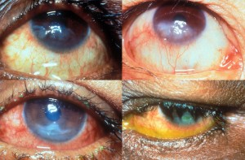
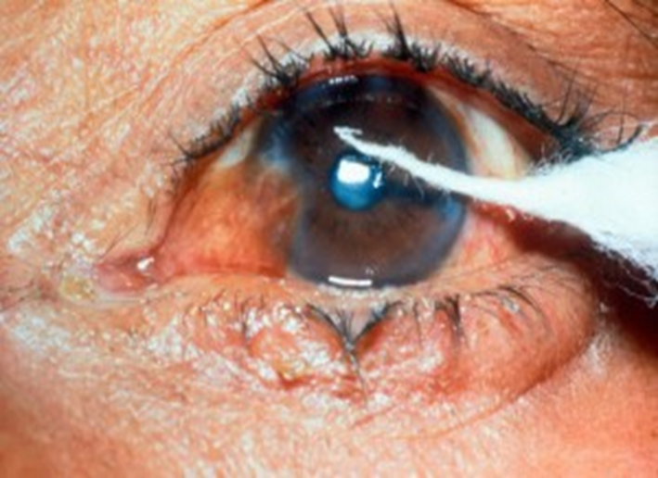

Exposure keratitis

Slide 54
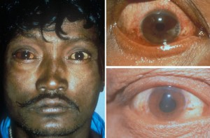
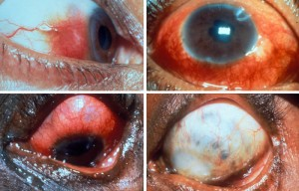
Acute Episcleritis and Scleritis
Acute Iritis

Slide 55
PARASITIC INFECTIONS

Slide 56
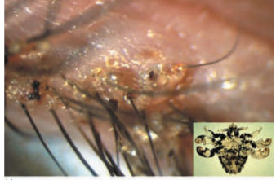
PHTHIRIASIS (lice)
This is an infestation of the eyelashes by the pubic louse, Phthirus pubis .
It causes chronic itching, irritation and rubbing of the lids

Slide 57
Treatment
mechanical removal with forceps,
epilation and trimming of infested lashes,
and application of fluorescein, occlusive ointments (e.g. petrolatum) or aqueous malathion for 7–10 days.

Slide 58
Tumours
BENIGN TUMOURS OF THE EYELID

Slide 59
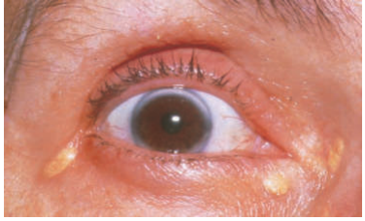
XANTHELASMA
These present as yellowish cutaneous plaques
usually bilateral
common in elderly patients.
About 60% of patients have an associated hypercholesterolaemia

Slide 60
Treatment
Treatment is done for cosmetic reasons.
90% trichloroacetic acid applied with a cotton wool bud.
0R surgical excision or ablation with carbon dioxide laser.

Slide 61
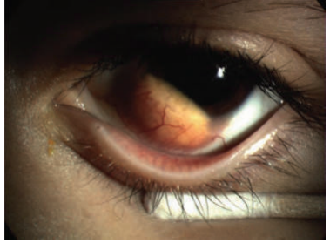
Juvenile Xanthogranuloma
These lesions occasionally involve the eyelid, conjunctiva or uveal tract.
They may be associated with glaucoma and threaten sight

Slide 62
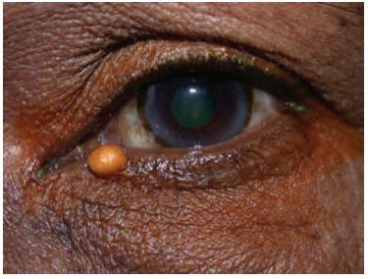
BENIGN CYSTS OF THE EYELID
A cyst of Moll usually presents as a small translucent lesion on the anterior lid margin
Glands of Zeis are sebaceous glands and their retention cysts contain oily secretions and are more opaque than a cyst of Moll
They are treated by excision and submission for histology.

Slide 63
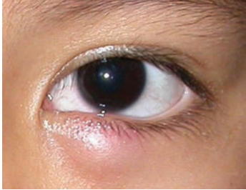
CHALAZION
Chronic granulomatous inflammatory reaction around a blocked sebaceous gland.
Patients with seborrhoeic dermatitis and rosacea are at increased risk

Slide 64
Treatment
Chalazia will usually resolve spontaneously
For large and chronic I&C is done through the tarsal plate
recurrent chalazion benefit from using tetracyclines & Hot compresses

Slide 65
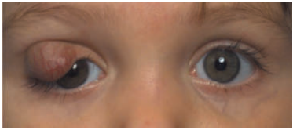
STRAWBERRY NAEVUS (CAPILLARY HAEMANGIOMA)
A unilateral red raised lesion, grows quickly during the first year of life
Amblyopia is the main complication

Slide 66
Treatment
Spontaneous involution occurs usually by age 9 years.
Both systemic and intralesional corticosteroids
Or systemic and topical β‐blockers .
Or Surgical resection or laser therapy

Slide 67
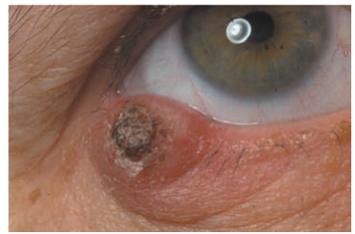
KERATOACONTHOMA
A small papule which grows rapidly, developing a characteristic keratin‐filled crater and may reach up to 3 cm in diameter.

Slide 68
The lesions then stop growing and remain static for 2 or 3 months before spontaneously involuting, which can lead to significant scarring of the eyelid.
It should be excised at an early stage.

Slide 69
Malignant tumours of the eyelid

Slide 70
BASAL CELL CARCINOMA
These are the most common skin malignancy (90%).
They rarely metastasize e but cause problems by local tissue destruction
They are more difficult to excise than those elsewhere, because of the high risk of damaging the tear duct.
The majority of BCCs are solid or cystic

Slide 71
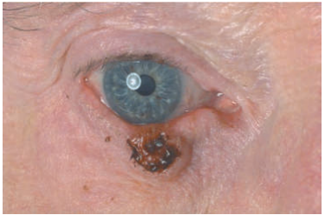
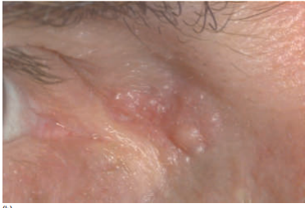
Ulcerated BCC on the lower lid.
Poorly defined BCC at medial canthus.

Slide 72
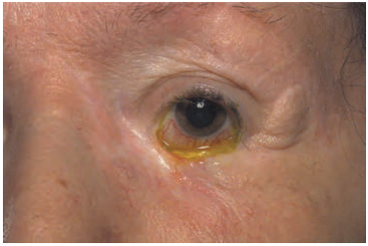
Morphoeic BCC along the lower lid.

Slide 73
Treatment
Mohs micrographic surgery is usually the treatment of choice where margins are in doubt
Radiotherapy damages and scars the eyelid tissues and should be reserved for situations when surgery is otherwise inappropriate.

Slide 74
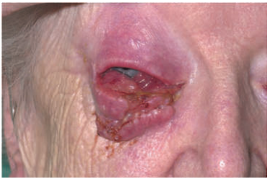
SQUAMOUS CELL CARCINOMA
less common (10%). They may arise de novo or from pre‐existing actinic keratoses.
SCC of the eyelids may be nodular, plaque‐like or ulcerated
Tumours greater than 2 cm in diameter and those with deep penetration have a higher risk of metastasis.

Slide 75
Treatment
Excision with adequate margins is the treatment of choice.
Mohs micrographic surgery is indicated where the initial margins are not free of tumour.
As with BCC, cryotherapy and radiotherapy are reserved for situations where surgery is inappropriate

Slide 76


