Slide 1
Dermatoses of the Neonate
Dr Ayesha Naeem

Slide 2
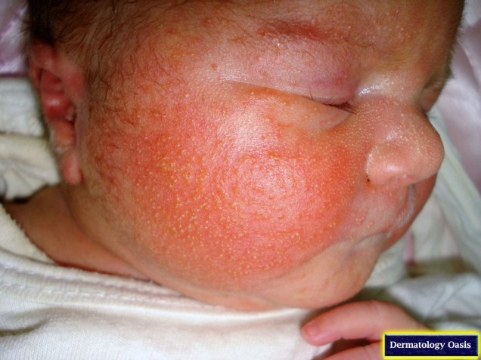
SKIN DISORDERS IN THE NEONATE
Toxic erythema of the newborn
is a common, transient, blotchy,
Red macular rash (sometimes with small pustules) seen in the first few days of life.
Synonyms and inclusions
Erythema toxicum neonatorum
Epidemiology
Incidence and prevalence
Thirty to 50% of children develop a degree of toxic erythema. The
incidence appears to decrease with both prematurity and smallness for dates.
Equal prevalence
It occurs in all racial groups.
Associated diseases
Blood eosinophilia is associated.
Pathophysiology
The cause is unknown. There is frequently an associated blood
eosinophilia.

Slide 3
Pathology
the macular erythema shows oedema in the upper
dermis, perivascular inflammatory
infiltrate comprising principally of eosinophils. Papular
lesions are characterized, in addition, by eosinophil infiltration of
the outer root sheath of one or more hair follicles, above the point
of entry of the sebaceous duct.

Slide 4
Clinical features
Most commonly, the eruption initially takes the form of a blotchy,
macular erythema, the number of individual lesions varying from
one or two to several hundred. They are most profuse on the trunk,
particularly the anterior trunk, but also commonly appear on the
face and proximal parts of the limbs, especially the thighs. Sparing the palms
and soles. In the mildest cases, these macules fade within a day

Slide 5
Differential diagnosis
pustular miliaria, transient neonatal pustular melanosis,
incontinentia pigmenti, herpes simplex
virus (HSV) infection, varicella, impetigo neonatorum and
Malassezia furfur pustulosis.

Slide 6
Disease course and prognosis
Spontaneous recovery occurs rapidly, usually within 3 days, but
recurrences are occasionally seen and have been reported as late
as the sixth week of life. Investigations are rarely needed as it is a clinical diagnosis.
Management
No treatment is needed

Slide 7
Transient pustular melanosis
Synonyms and inclusions
Lesions are usually present at birth. The most characteristic component
of the eruption is 1–3 mm flaccid, superficial, fragile pustules,
with no surrounding erythema. These pustules may occur
at any site, but favour the chin, neck, forehead, back and buttocks.
Sites where they have ruptured are marked initially by a detachable brown crust, and subsequently by a small collarette of scale.
Sometimes, pigmented macules are already present at birth. The pigmented macules are a prominent element in black infants, and are seen more rarely in other races.
Affected infants are otherwise entirely well. Diagnosis
can usually be made on clinical grounds

Slide 8
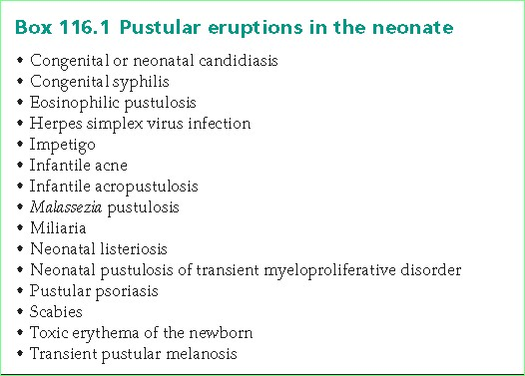

Slide 9
Infantile acropustulosis
presents with recurrent crops of
intensely itchy, 1–4 mm vesicopustules that appears on
the soles ,sides of the feet, hands, and on the
ankles, wrists and forearms. Scattered lesions may also be seen on
the face, scalp and trunk, but a predominantly acral distribution is
characteristic. Mucosal lesions do not occur. Individual
lesions appear to start as tiny, red papules, which evolve into vesicles
and then pustules over about 24 h. Excoriation results in erosions
and then crusts.,

Slide 10
Neonatal pustulosis of transient myeloproliferative disorder
neonates with trisomy 21 (and
mosaic trisomy 21) developing pustules and vesicles (on an erythematous
background), predominantly on the face, as part of congenital
leukaemia or transient myeloproliferative disorder (TMD)
They may pustulate at sites of trauma, such as venepuncture sites or
under adhesive tape..
. Skin biopsy shows intraepidermal pustules
with a perivascular dermal infiltrate of neutrophils, eosinophils and
atypical mononuclear cells. The lesions often resolve spontaneously
over a few weeks

Slide 11
Congenital erosive and vesicular dermatosis healing with reticulated supple scarring
is a rare cause of blistering at birth
It occurs at birth and is greater in boys than in girls.
Biopsies of vesicular areas have shown spongiosis or epidermal
necrosis with dermal haemorrhage and inflammation .
Parakeratotic scale may be present. Scarred
areas have shown an increased density of dermal collagen, and
absence of eccrine sweat glands. Direct immunofluorescence does
not show any specific pattern of deposition of immunoglobulins,
C3 or fibrin.

Slide 12
There are extensive, superficial erosions, with scattered vesicles and
bullae, affecting up to 75% of the body surface. These erosions may
extend in the first few days. The trunk and limbs tend to be more
severely affected than the face and scalp. Hands and feet may be
spared .
Following healing of the skin lesions, there may be residual loss of
eccrine sweating in scarred areas, with the potential for hyperthermia
under appropriate conditions, patchy alopecia, partial loss of
eyelashes and the absence or hypoplasia of nails.
Teeth are normal. Mild, localized, recurrent vesiculation may occur.

Slide 13
Associations
Preterm birth (79%), nail dystrophies (46%), hyperthermia/
hypophidrosis (46%), maternal chorioamnionitis (43%), neurological
disorders (microcephaly, convulsions, developmental delay)
lacrimal duct obstruction,
macular or corneal scars) (36% each) and tongue atrophy (29%)

Slide 14
Differential diagnosis
This includes infective blisters (e.g. herpes simplex), epidermolysis bullosa, bullous ichthyosiform erythroderma, incontinentia pigmenti, aplasia cutis congenita, focal dermal hypoplasia and staphylococcal scalded skin syndrome.
Disease course and prognosis
Spontaneous healing occurs within 2 weeks to 3 months.
Investigations
Skin swabs and blood culture are needed to investigate for infections
(viral, bacterial and fungal). Skin biopsy may be useful

Slide 15
Management
The child will need to be nursed on an appropriate neonatal unit
for the management of fluid balance, temperature control and any
infection if this develops. Non‐adhesive dressings (e.g. silicon
dressings) will be needed for the first few weeks of life until healing
occurs .There is no specific treatment for this condition.

Slide 16
COMPLICATIONS OF PREMATURITY
Anetoderma of prematurity
Anetoderma is due to loss of elastic tissue in the dermis and
Presents with atrophic lesions that often herniate. Anetoderma
may occur in preterm babies appearing at, or soon after, birth
caused by electrocardiogram (ECG) electrodes.

Slide 17
Presentation
Anetoderma of prematurity presents with nummular areas of cutaneous atrophy appearing on the trunk.
Proximal limbs within a few weeks of birth All cases have been born between the 24th and 29th weeks of gestation.
Cases that present later at 2–3 months of age are more likely a consequence of trauma from gel ECG Electrodes.

Slide 18
DISORDERS CAUSED BY TRANSPLACENTAL
TRANSFER/MATERNAL MILK
Transplacental transfer of maternal Autoantibodies
Neonatal pemphigus vulgaris
Transplacental pemphigoid gestationis

Slide 19
Neonatal lupus erythematosus
Introduction and general description
Neonatal lupus erythematosus (NLE) is a rare syndrome comprising
transient skin lesions resembling subacute cutaneous
lupus erythematosus (LE) and/or congenital heart block. NLE occurs in the babies of mothers with clinical
or subclinical autoimmune connective tissue disease, and is
associated with the transplacental passage of maternal autoantibodies
to the ribonucleoproteins (RNPs) Ro‐SSA (>90%), La‐SSB.

Slide 20
Epidemiology
Incidence and prevalence
Only 1–2% of Ro‐positive/La‐postive mothers will have babies
with NLE .It occurs in neonates.
an equal sex incidence.
in all racial groups.
Associated diseases
The risk of connective tissue disease later in life is increased

Slide 21
this disease is provoked in the fetus or
newborn infant by maternal IgG autoantibodies that have crossed
the placenta In 95% of cases, these are of IgG1 class and
are directed against the Ro RNP antigen.
Anti‐La, anti‐native DNA, anticardiolipin or antinuclear antibodies, or
rheumatoid factor, may be present in addition to Ro antibodies.

Slide 22
Pathology
Skin biopsy specimens from infants with cutaneous lesions
generally demonstrate the features of LE: epidermal atrophy,
liquefaction degeneration of basal keratinocytes, colloid bodies
and a perivascular and periappendageal lymphohistiocytic inflammatory infiltrate in the dermis.
Direct immunofluorescence is positive in about 50% of cases, showing dermal epidermal junction and perivascular deposition of IgG, IgM and C3.
Environmental factors
Sunlight may induce skin lesions.

Slide 23
neonatal LE have either skin lesions (90%) or
cardiac lesions (1%); approximately 8% have both.
well‐defined areas of macular or slightly elevated erythema,
frequently annular, occurring predominantly on the face, particularly
the forehead, temples and upper cheeks, and on the scalp and neck.
A ‘spectacle‐like’ distribution of lesions around the eyes is especially characteristic. The chest, back or limbs may also be affected.
Provocation or exacerbation of lesions by sun exposure has been reported in some cases.
Follicular plugging is not prominent, but scaling is a commonearly feature.
A degree of atrophy and/or telangiectasia are frequent long‐term sequelae.
Permanent hair loss may occur.

Slide 24
Neonatal lupus erythematosus showing fading facial lesions in a characteristic periorbital distribution, with residual atrophy, in 4‐month‐old infant.

Slide 25
Clinical variants
Occasionally, neonatal LE presents as extensive reticulate erythema with atrophy,
closely resembling cutis marmorata telangiectatica congenita .
Complications and co‐morbidities
cardiac involvement is the commonest. Congenital heart block (due to fibrosis of the conducting tissue) occurs in about 1–2% of Ro‐positive pregnancies,
Anti‐Ro antibodies can bind to cardiac conduction cells during mid to late fetal development, leading to altered membrane repolarization and selective damage to the atrioventricular node.
Congenital heart block can be detected as early as the 18th week of gestation by ultrasound or electrocardiography .
The block is generally permanent, and is not associated with structural cardiac abnormalities such as septal defects. About a half of affected infants require pacemakers.

Slide 26
A smaller proportion of infants have combinations of hepatomegaly,
splenomegaly, lymphadenopathy and pneumonitis,
Autoimmune Haemolytic anaemia and thrombocytopenia vasculopathy and cerebral vasculitis.
Investigations
A skin biopsy will usually allow an accurate diagnosis of neonatal.
Management
The skin lesions of neonatal LE require no treatment, but sun protection
is essential.
Occasionally, thrombocytopenia, haemolytic anaemia or hepatitis
may warrant systemic steroid therapy. Up to 50% of infants
with cardiac involvement will require a pacemaker ,The pregnancy of a woman who has Ro, La antibodies should be monitored to detect a slow fetal heart rate

Slide 27
DISORDERS OF SUBCUTANEOUS FAT
Four separate conditions are described :-
cold panniculitis
Neonatal cold injury
subcutaneous fat necrosis of the newborn and
sclerema neonatorum

Slide 28
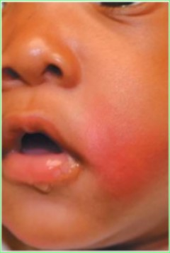
Cold panniculitis
The fat of the newborn appears to be more highly saturated than that of older children and adults, with the effect that it solidifies at a higher temperature .Applying ice for 50 s causes panniculitis in all newborn infants, Cold panniculitis in infancy has most often followed exposure of the cheeks to:
Extremely cold air
Ice bags applied as a therapy for supraventricular tachycardia
Frozen lollies (popsicles) .
Indurated, warm, red, subcutaneous plaques and nodules appear within hours or days of appropriate cold exposure. Skin biopsy is not usually needed but if done
early it shows a lymphohistiocytic infiltrate around blood vessels at the junction of the dermis and subcutaneous fat .
The induration resolves over a period of a week or so, often leaving some residual postinflammatory hyperpigmentation. No treatment is required.

Slide 29
Neonatal cold injury
Neonatal cold injury is a disorder, now rare in developed countries,
in which cold exposure of a small‐for‐dates neonate cause hypothermia associated with lethargy and generalized pitting
oedema of the skin, clinically and pathologically distinct from sclerema neonatorum
The infant is usually a full‐term neonate, born at home, but small for gestational age.
The most striking features are intense erythema or cyanosis of the face and extremities, and firm, pitting oedema

Slide 30
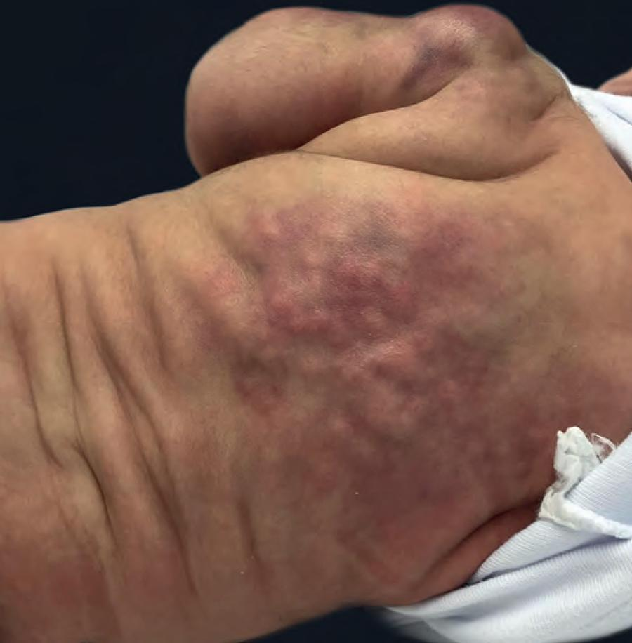
Subcutaneous fat necrosis of the newborn
Definition
Subcutaneous fat necrosis of the newborn is an uncommon and
transient disorder of neonates in which focal areas of fat necrosis
cause nodular skin lesion
Subcutaneous fat necrosis generally occurs in full‐term or postterm infants of normal birth weight during the first 6 weeks of life
Associated diseases
Maternal pre‐eclampsia, diabetes, perinatal asphyxia and hypothermia may be associated

Slide 31
Pathology
Biopsies of the affected subcutaneous tissue show patchy fat necrosis,
with a granulomatous inflammatory reaction of foreign‐body type, and fibrosis .
Both the fat cells and the giant cells contain needle‐shaped clefts, which may be radially arranged.
Calcium deposits are commonly found in the necrotic fat

Slide 32
Clinical features
subcutaneous tissues is usually first detected
between the second and 21st days of life.
The nodules tend to be symmetrically distributed
and show a predilection for the buttocks, thighs, shoulders, back,
cheeks and arms. Lesions may be single or multiple, rounded or
oval, and pea‐sized or many centimetres in diameter. They are
initially discrete, but may fuse to form large plaques. The overlying
skin is often red or bluish red. The nodules feel rubbery or
hard, and are not attached to deeper structures. The lesions may
be painful .New nodules may continue to develop for a week

Slide 33
The condition has occasionally been fatal, particularly when visceral
fat has been involved, or
where there has been complicating hypercalcaemia
Complications and co‐morbidities
Subcutaneous fat necrosis of the newborn may be associated with
hypercalcaemia, which tends to occur in around a quarter of all cases
The cause of the hypercalcaemia is unknown. It may be due
to increased calcium absorption due to extrarenal production of
1,25‐dihydroxyvitamin D ,which has been observed in
other granulomatous disorders including sarcoidosis. The fi nding
of increased urinary excretion of prostaglandin E 1 led to the suggestion
that increased bone calcium resorption might be responsible

Slide 34
Disease course and prognosis
No treatment is generally required as the condition spontaneously resolves over several weeks.
Management
Analgesia may occasionally be required.
Hypercalcaemia should be treated aggressively to prevent soft‐tissue calcification.
Treatments include diuretics, dietary
restriction of calcium and vitamin D, and sometimes oral corticosteroids.
In resistant cases bisphosphonates can be Used.

Slide 35
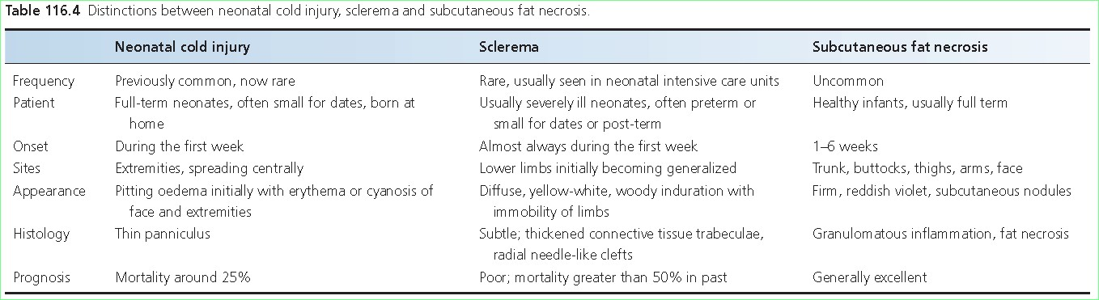

Slide 36
Collodion baby
This term describes a highly characteristic clinical entity present at
birth where a child is born with an ‘extra’ skin resembling a shiny
membrane or collodion.
Synonyms and inclusions
Lamellar desquamation/exfoliation of the newborn
Introduction and general description
Collodion baby is a distinctive phenotype present at birth.
It usually precedes the development of one of a variety of ichthyoses,
The commonest of which are the autosomal recessive ichthyoses

Slide 37
Associated diseases
Almost 90% of collodion babies will go on to develop a severe form of autosomal recessive ichthyosis in the first few weeks of life: lamellar ichthyosis and non‐bullous ichthyosiform erythroderma (syn. congenital ichthyosiform erythroderma) are the most common (see Chapter 65 ).
The collodion baby phenotype is also reported in the rarer autosomal dominant form of lamellar ichthyosis and in bathing suit ichthyosis ; it is also characteristic of the trichothiodystrophy–ichthyosis syndrome .
There are other ichthyoses in which an initial collodion baby phase has occasionally been reported. These include the Netherton syndrome ,
neutral lipid storage disease , Loricrin keratoderma (syn. Camisa’s keratoderma) and Sjögren–Larsson syndrome , but the great majority of neonates with these disorders do not demonstrate the collodion baby phenotype.
A transient collodion membrane has also been reported in Gaucher disease .
In about 10% of cases, the collodion baby phase is followed by a relatively mild ichthyosis of lamellar type or indeed normal skin (self‐healing ichthyosis).

Slide 38
Clinical features
Presentation
The severely affected infant is bright red and encased in a taut, glistening, yellowish, translucent covering resembling collodion .The face is immobilized; tension on the skin results in
ectropion, eversion of the lips (eclabion), producing a rather fish‐like appearance of the mouth, and effacement of the nose and ears.
The nostrils may be blocked. The skin over the fingers, hands, toes and feet may result in immobility and may interfere with blood flow, occasionally resulting in the loss of parts of the digits.
Within hours, this membrane dries and cracks, and bleeding may occur along the resulting fissures. Within 1 or 2 days, it starts to peel off, either in extensive sheets or as large, light brown scales, but may reform several times.
The shedding will generally be more or less complete within 4 weeks. Subsequently, the typical features of one of several varieties of ichthyosis gradually emerge over a period of weeks or months.
During the first day or two, tightness of the skin on the thorax may interfere with respiration, and very occasionally, respiratory distress may be caused by nasal obstruction

Slide 39
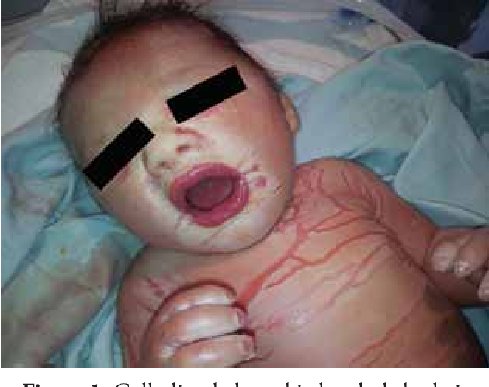

Slide 40
Clinical variants
Rarely, the collodion phenotype can be confined to acral areas.
This usually heals spontaneously (‘acral self‐healing collodion baby’) .
Differential diagnosis
May be confused with harlequin ichthyosis as the facial appearances can be similar.
However a child with harlequin ichthyosis has much thicker skin, which typically encases the baby like a suit of armour with deep fissures. Harlequin ichthyosis shows almost fusion of the fingers and toes with thick palmoplantar skin.
Finally, the ears are usually bound down to the scalp in harlequin ichthyosis whereas they are normally ‘free’ in collodion babies.

Slide 41
Restrictive dermopathy also results in a neonate with tight and
immobilizing skin, but in this condition the skin appears thin and
transparent, with prominent underlying blood vessels. The mouth
is also open, but ectropion is not present. The skin does not dry out
and come away. Death occurs rapidly as a consequence of respiratory failure.
Neonates with the lethal autosomal recessive Neu–Laxova
syndrome may have skin changes closely resembling a collodion
membrane. The condition is characterized by intrauterine growth
retardation, and central nervous system, skeletal and cranial
abnormalities.

Slide 42
Complications and co‐morbidities
The collodion baby is at risk, largely because of the consequences of losing the skin barrier function .
This results in the following:
Impaired temperature regulation.
Increased insensible water loss, hypernatraemic dehydration and acute renal failure.
Septicaemia (bacterial, Candida ).
Percutaneous toxicity from topical medicaments (increased absorption).
Respiratory failure.
Respiration may be impaired as a result of intrapartum aspiration of squamous debris shed into the amniotic fluid.
Immobility of the chest may also compromise respiratory function, and predispose to pneumonia . With good neonatal care mortality fi gures have fallen from 50% in the 1960s to less than 5% today in the western world.

Slide 43
Investigations
Genetic analysis, if available.
Management
The baby should be nursed in an incubator in a high‐humidity atmosphere, with careful monitoring of body temperature .Great attention needs to be given to fluid and electrolyte balance .Peritoneal dialysis may be indicated if renal failure occurs. Fluid loss is significantly reduced by frequent applications of lipid; a 50%/50% mixture of white soft paraffin and liquid paraffin is ideal for this purpose. Frequent oiling of the skin increases mobility and comfort, accelerates healing of fissures and may reduce the risk of infection.
Supplemental feeds may be needed via a naso‐gastric tube. Avoid topical products that contain active compounds (e.g. urea or salicylic acid) as toxicity is a real risk due to absorption.

Slide 44
. Skin punctures should be kept to a minimum, and vascular access
should be avoided as far as possible. Deeper fissures are more
likely to become infected especially if inflamed, so regular swabs
should be done for bacteria and Candida as septicaemia is a common
Complication.
Bands of tight skin constricting the digits, hands or feet may
occasionally require surgical division.

Slide 45
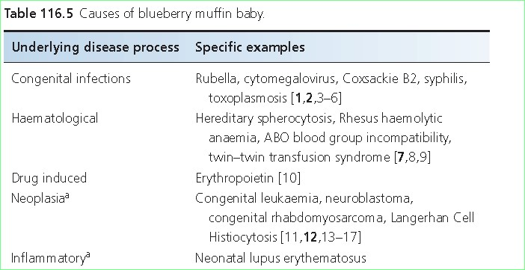
Blueberry muffin’ baby (dermal erythropoiesis)
‘This term has been used to describe a characteristic eruption in neonates, often present at birth, widespread, purple, erythematous, oval or circular macules, papules and nodules reflecting dermal erythropoiesis

Slide 46
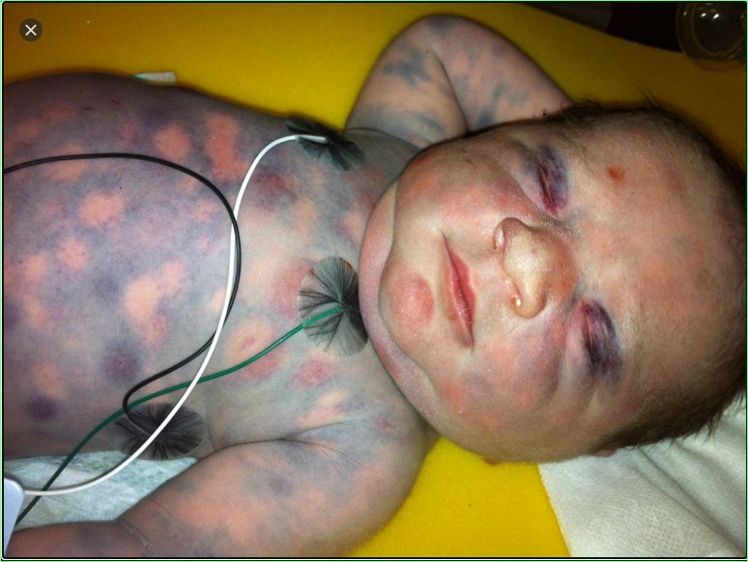

Slide 47
Neonatal purpura fulminans
Neonatal purpura fulminans is a potentially lethal disorder characterized
by progressive haemorrhagic necrosis of the skin associated
with cutaneous vascular thrombosis. It is usually due to a
genetically transmitted thrombophilic disorder: most commonly
homozygous deficiency of protein C or, less frequently, protein S
In the older child, purpura fulminans is a
highly characteristic feature of meningococcal septicaemia,
neonatal purpura fulminans can occur due to infection, such as
group B Streptococcus , meticillin‐resistant Staphylococcus aureus ,
varicella and measles.

Slide 48
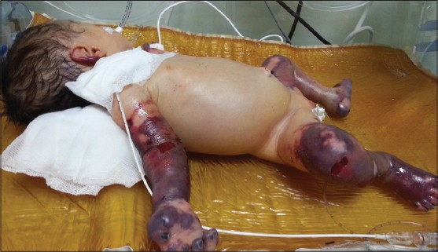
less symmetrical and
well‐defined ‘lakes’ of confluent ecchymosis, without petechiae
The lesions occur most often on the limbs, particularly
at sites of pressure, but may also appear on the trunk
and on the face and scalp. The onset is sudden, and the lesions
enlarge rapidly, with coalescence and the development of haemorrhagic
bullae and central necrosis. There is surrounding erythema
and the lesions are tender. The patient is frequently febrile. These
infants are also at risk of thrombosis in the central nervous system
and in the retinal vessels. There is a substantial danger of internal
haemorrhage, shock and death.

Slide 49
Management
fresh frozen plasma should be given urgently in
a dose of 10–15 mL/kg/12 h.
protein C concentrate should continue until
the skin lesions have healed
Liver transplantation can be curative
Any concomitant
infection needs to be treated as well.

Slide 50
INFECTIONS
Viral infection
Neonatal herpes simplex
Fetal varicella syndrome
Congenital rubella
HIV
Bacterial infections
Bullous impetigo
Staphylococcal scalded skin syndrome
Periporitis staphylogenes and sweat gland abscesses
Mastitis and breast abscesses
Neonatal staphylococcal cold abscesses of the large folds
Omphalitis
Preorbital and orbital cellulitis
Necrotizing fasciitis
Neonatal listeriosis
Ecthyma gangrenosum

Slide 51
Noma neonatorum (cancrum oris/oro‐facial gangrene)
is a gangrenous disorder of the nose, lips, mouth, perianal area and, occasionally, the scrotum and eyelids,
It is frequently caused by P. aeruginosa and is almost invariably lethal in the absence of appropriate antibiotic treatment.
A similar condition may be seen in older children and adults in the context of poor nutrition, delayed growth and immunodefi ciency.
It was also seen in concentration camp victims in the Second World War.
Treatment is with parentral antibiotics and often requires plastic surgery later to repair large facial defects.

Slide 52
Congenital syphilis
The skin is clinically affected in about 40% of neonates with
congenital syphilis . the initial lesions occurring between the
second and eighth week, and occasionally later. Sites of predilection
are the ano‐genital area, the face and the palms and soles.
The lesions are reddish brown in colour;
macular or papular, and tend to be larger and firmer than those
seen in acquired secondary syphilis . In about 3%
of cases the lesions are bullous. Paronychia is commonly present.
Small, round, moist, papular lesions, traditionally termed mucous
patches, are frequently present in the mouth and on other mucosal
surfaces. Condylomata lata may be present in the ano‐genital flexures
or at other flexural sites, for example between the toes or in the angles of the mouth

Slide 53
Fungal infections
Neonatal candidiasis
This is a relatively common disorder that occurs in the early weeks after birth, in the form of oral candidiasis with or without candidiasis in the napkin area. The rash is usually
focused in the perianal area, and is a deep ‘beefy’ red colour, with a moist appearance, often with pustules at the periphery, which is often scalloped in outline. Just beyond the margin, in as yet unaffected
skin, there may be punctate erythematous lesions, sometimes pustular (‘satellite’ lesions).
The occurrence of localized palmar pustules in an infant with neonatal oral
candidiasis was believed to reflect the inoculation of Candida from the mouth into the skin as a result of sucking .
Treatment is with topical anticandidal creams and oral gels. Systemic neonatal candidiasis can cause septicaemia and death.

Slide 54
Congenital candidiasis
An extensive eruption of scattered pinkish red macules and papules is present at birth or appears within a few hours. The lesions generally progress to a vesicular phase, and then either to a pustular or a bullous phase, over a period of 1–3 days.
More or less any part of the skin surface may be affected, including the nails, palms and soles. In fact, palmar and plantar pustules are regarded as a hallmark of congenital cutaneous candidiasis.
Paronychiamay occur and isolated involvement of the nail plates has been described . Oral involvement is usually absent, and the napkin area tends to be spared, at least initially.

Slide 55
Skin and mucosal involvement may be complicated by systemic candidiasis, particularly in the premature .
The lungs maybe affected hepatosplenomegaly and abnormal liver functionhave also been recorded .
Candidal meningitis is another potential complication
Systemic antifungal therapy
should be considered in at‐risk infants amphotericin B is probably
the drug of choice .

Slide 56
Malassezia pustulosis
Colonization of the skin by M. furfur starts soon after birth and
progresses until the age of about 3 months, probably reflecting the
activity of the sebaceous glands during this period
erythematous papulopustular eruptions occurring
on the face and scalp in neonates, a condition now widely termed
neonatal cephalic pustulosis
Differential diagnosis includes eosinophilic pustulosis of the
scalp, transient pustular melanosis, scabies, neonatal acne and
infections with Candida or Staphylococcus aureus.

Slide 57
Thank you

