Slide 1
Dermatoses of the Male Genitalia
DR KINZA

Slide 2
Trauma and artefact
Penile haematoma and rupture
Sclerosing lymphangitis
Strangulation of the penis
Foreign body
Lipogranuloma
Dermatitis artefacta and mutilation
Child abuse

Slide 3
Penile haematoma and rupture
The genitals may be readily traumatized, including by sexual activity
The penis is very vascular but haematoma formation and ‘fracture’ (penile rupture) are quite rare
Pain, swelling and deformity associated with the history of a cracking noise during strenuous or contorted intercourse characterize the diagnosis
Splitting of the tunica albuginea of the corpus cavernosum can result in urethral damage, haematoma and retention
The prognosis is generally good but Peyronie disease can occur
Injection of drugs for erectile dysfunction can be complicated by haematoma

Slide 4
Sclerosing lymphangitis
Serpiginous mass in the coronal sulcus
Lesion usually arises after prolonged or frequent sexual intercourse with a passive or unenthusiastic partner; subsequent sexual activity may result in tenderness and enlargement
The circumferential scar left by circumcision may be a predisposing factor. There may be spontaneous resolution, or surgical excision may be needed
Thrombophlebitis of superficial penile and scrotal veins is analogous to Mondor phlebitis of the chest wall, but it may be associated with polyarteritis nodosa and thromboangiitis obliterans
Penile thrombophlebitis has been misdiagnosed as Peyronie disease, and has also been the initial manifestation of a paraneoplastic migratory thrombophlebitis resulting from pancreatic cancer

Slide 5
Strangulation of the penis
ring devices, including vacuum erection equipment , condom rings,rubber bands, string, rings (washers), nuts, bushes and sprockets, which are placed deliberately on the penis by the patient for masturbation or to prolong erection
Penile strangulation – the tourniquet syndrome – causes pain, swelling, urethral fistula, pseudoainhum, gangrene, amputation and even death

Slide 6
Foreign body
Self‐instrumentation of the external genitalia may have an autoerotic, psychiatric, therapeutic (relief of itch , aiding voiding, cleaning) or accidental aetiology.
Complications include frequency, haematuria, abscess, retention, fistulae and calculi.
The diagnosis is made by palpation and radiography. Endoscopic removal is usually possible for foreign bodies below the uro‐genital diaphragm

Slide 7
Lipogranuloma
Patients may take it upon themselves to inject various substances with the aim of maintaining erection or enlarging the penis.
Infection is an obvious risk
Mineral oil, petroleum jelly and silicone introduced into the genital skin can elicit lipogranuloma or paraffinoma. Most cases are self‐induced, either to increase penile size or enhance sexual pleasure, but some may be accidental

Slide 8
Dermatitis artefacta and mutilation
Lesions are typically geometrical, angulated and rectilinear. Sometimes they are induced by needles, knives or cigarette burns, and extraneous foreign material may be introduced into the skin (lipogranuloma and silicone granuloma are discussed earlier)
Psychotic patients may mutilate their genitalia, as may transvestites , but non‐psychotic genital self‐mutilation can also occur
Biopsy and other investigations may be necessary to exclude penile cancer
It is important also to consider pyoderma gangrenosum, which is rare but frequently omitted from the differential diagnosis of penile ulceration by non‐dermatologists.

Slide 9
Child abuse
Physical and sexual child abuse should be considered in the differential diagnosis of cutaneous disease of the ano‐genital area in children, but signs should be interpreted with caution and re‐examination should be avoided

Slide 10
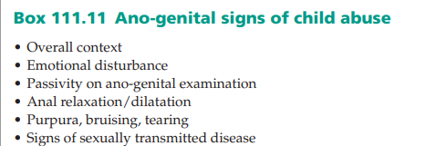

Slide 11
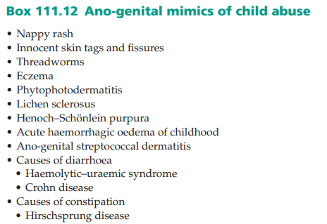

Slide 12
Inflammatory dermatoses
Psoriasis
common condition that can affect the male genital region in isolation or as part of widely distributed disease

Slide 13
Epidemiology
Approximately 2% of the population are said to have psoriasis
Pathophysiology Psoriasis and its clinical manifestations and the relationship of psoriasis to HIV/AIDS

Slide 14
Clinical features
Ano‐genital presentations of psoriasis may be vague in symptomatology and non‐specific on examination
usually not itchy; significant itch should arouse suspicions of another dermatosis such as an eczematous dermatitis or tinea.
Soreness occurs with superinfection, especially with Candida
Other typically affected sites should be examined for signs of the disease.

Slide 15
Genital appearances may be challenging to interpret, especially in the uncircumcised patient, because a mucosal site is affected rather than keratinized skin
Inverse pattern psoriasis refers to the manifestation of the disease on intertriginous skin in the axillae, natal cleft, gluteal folds, groins and in the preputial sac and on the glans of the uncircumcised male, where its occurrence is probably brought about by the Koebner phenomenon

Slide 16
Differential diagnosis
Eczema
fixed drug eruption
lichen planus
carcinoma in situ
extramammary Paget disease.

Slide 17
Investigations
Usually, diagnosis is clinical, but a biopsy may be necessary (e.g. of a solitary mucosal lesion in an uncircumcised individual) to distinguish psoriasis from Zoon balanitis, lichen planus, carcinoma in situ (Bowen disease, erythroplasia of Queyrat) or Kaposi sarcoma
Carcinoma in situ and extramammary Paget disease may be misdiagnosed as psoriasis when there are single or several foci on the penile shaft and/or in the groins.

Slide 18
Management
Topical treatment includes emollients, soap substitutes, corticosteroids combined with antibiotic and antifungal agents or weak tar solutions
Strong crude tar preparations should be avoided at this site given that ano‐genital skin has a propensity to increased absorption of topical agents and because of the risk of genital cancer; one of the first occupational diseases described was scrotal carcinoma in chimney sweeps

Slide 19
Dithranol is usually avoided in this region
vitamin D analogue calcipotriol can be helpful
Topical ciclosporin (100 mg/mL in wet dressings three times daily) has been advocated
Topical calcineurin inhibitors may be helpful and appear to be well tolerated but should be used with circumspection in the uncircumcised because of the squamous cancer risk
Phototherapy is contraindicated because of the risk of ano‐genital cancer
Severe cases is indication for systemic treatment
Circinate balanitis responds to topical calcineurin inhibitors.

Slide 20
Eczema
Eczematous dermatoses
Itching and lichenification, particularly around the scrotum, are common presenting problems
Contributory factors include pre‐ existing dermatoses such as xerosis, atopy and psoriasis, sedentary occupations, motor car and aeroplane travel, and tight underclothing and trousers
Irritation is a key adverse exogenous influence

Slide 21
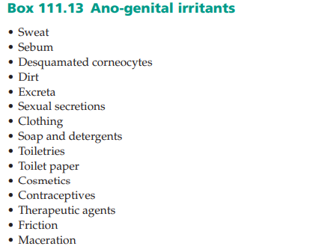

Slide 22
Lichen simplex
common around the male genitalia
not usually a flexural condition but can be seen on the penile shaft and scrotum
Giant forms (of Pautrier) occur, giving a pineapple appearance .The skin may be broken by excoriations and become secondily impetiginized or colonized by Candida

Slide 23
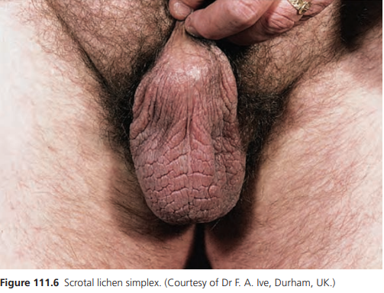

Slide 24
Allergic contact dermatitis
The risks of allergic contact dermatitis
(i) direct contact with the allergen (e.g. medicaments – even coal tar allergy has been reported, contraceptive usage and prosthetic limbs in amputees
(ii) transfer of allergen (e.g. urushiol as in poison oak, poison ivy and poison sumac dermatitis) to the genitalia and possibly subsequent exposure to sunlight (e.g. psoralens from fig or citrus plants, as in phytodermatitis
(iii) involvement in a more generalized eczematous response (e.g. to a medicament or dressing used on venous eczema or ulceration, as in the autosensitization/secondary spread/secondary generalization syndrome).].

Slide 25
Eczematous symptomatology can appear approximately 1 week after first contact with the allergen if previously unsensitized, or within a few hours if already allergic
The patient may present with pruritus ani or paraphimosis
More immediate symptomatology and acute erythema and angio‐oedema suggest a contact urticaria, which can occur with some of the rubber constituents

Slide 26
Atopic eczema
Genital skin disease caused by atopic eczema is not uncommon but rarely occurs in isolation, unlike other common chronic dermatoses such as seborrhoeic dermatitis and psoriasis
Evidence of atopy was found in a possible 67% of a total of 72% of patients diagnosed as having irritant dermatitis from a consecutive series of men presenting to a genito‐urinary clinic with ‘balanitis’ – probably balanoposthitis

Slide 27
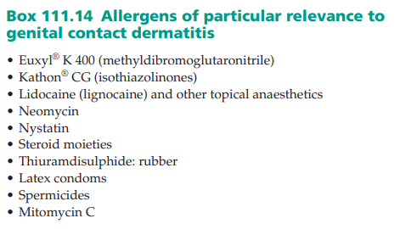

Slide 28
Radiodermatitis
Radiodermatitis is not usually a diagnostic challenge or a therapeutic problem in the acute stage after radiotherapy to the ano‐ genital skin for skin disease or internal cancer. In the chronic state, there may be pruritus together with the typical poikiloderm
Radiotherapy has been used for the treatment of numerous ano‐genital dermatoses over the years, including Bowen disease, erythroplasia of Queyrat, squamous carcinoma, psoriasis, Peyronie disease and pruritus ani
Radiotherapy confers a long‐term increased risk of skin cancer, especially basal cell carcinoma

Slide 29
Seborrhoeic dermatitis
Genital involvement is frequent with this common dermatosis
The groins and penis may be the only sites involved
A good history (including family history) and careful examination of other sites typically affected aid the diagnosis
On the scalp, the face, in the flexures and at ano‐genital sites seborrhoeic dermatitis and psoriasis may be indistinguishable.

Slide 30
Investigations
The diagnosis is usually clinical
Biopsy is rarely required
Patch testing may be suggested for cases suspicious of a contact precipitant.

Slide 31
Management
Irritants should be identified and eliminated or reduced
Advice is given about soap substitutes, moisturizers, towels and toilet paper
Topical corticosteroid ointments, with or without antibiotic and anticandidal agents
Oral antihistamines
No treatment of seborrhoeic dermatitis may be required other than reassurance that it is not sexually transmitted or related to poor hygiene
Topical local anaesthetics should be avoided because of the risk of sensitization
secondary infection may be severe; a swab should be taken and oral antibiotics and oral antifungals prescribed

Slide 32
Zoon balanitis
An asymptomatic, inflammatory and irritant condition of the glans and mucosal prepuce that is probably overdiagnosed
Epidemiology
middle‐aged and older uncircumcised male although an analogous condition has been reported to afflict the vulva, mouth, lips and epiglottis

Slide 33
Pathophysiology
chronic, reactive, principally irritant dermatosis brought about by a dysfunctional prepuce
Retention of urine and squames between two tightly apposed and infrequently and inadequately separated and/or inappropriately bathed, commensally hypercolonized, desquamative, secretory epithelial surfaces leads to a disturbed ‘preputial ecology’ and excessive frictional trauma and irritation by urine
Zoon balanitis is often located on the dorsal aspect of the glans and/or the adjacent prepuce, sites of maximal friction on foreskin retraction

Slide 34
Pathology
epidermal attenuation with absent granular and horny layers, and diamond‐ or lozenge‐shaped basal cell keratinocytes with sparse dyskeratosis and spongiosis
band of dermal infiltration with plasma cells of variable density
Extravasated erythrocytes, haemosiderin and vascular proliferation are also seen
plasma cell infiltrate

Slide 35
Clinical features
indolent and asymptomatic, although staining of the underclothes with blood has been reported
Well‐ demarcated, glistening, moist, bright red or autumn brown patches involve the glans and visceral prepuce, with sparing of the keratinized penile shaft and foreskin
The navicular fossa may be involved. Other signs include dark red stippling – ‘cayenne pepper spots’ – and purpura with haemosiderin deposition, solitary or multiple lesions of differing sizes (guttate or nummular), characteristically symmetrical about the axis of the coronal sulcus and ‘kissing’
atypical or unusual morphology should be viewed with great suspicion and biopsied

Slide 36
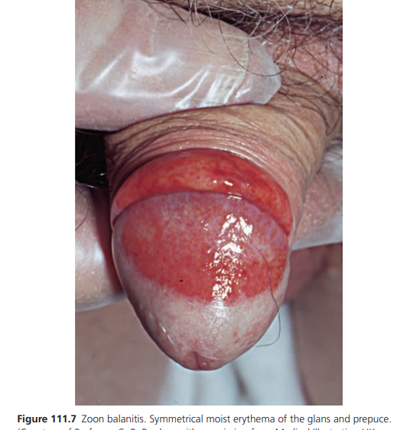

Slide 37
Differential diagnosis
lichen sclerosus
erosive lichen planus
Psoriasis
seborrhoeic dermatitis
contact dermatitis
fixed drug eruption
secondary syphilis
histoplasmosis
erythroplasia of Queyrat
Kaposi sarcoma

Slide 38
Investigations
The diagnosis is usually clinical.

Slide 39
Management
can improve with altered washing habits and the intermittent application of a mild or potent topical corticosteroid (with or without an antibiotic and anticandidal agent)
it usually persists or relapses
topical calcineurin inhibitors,but these agents should be used with circumspection in the setting of a dysfunctional foreskin and the attendant risk of penis cancer, long term
erbium : YAG or carbon dioxide laser treatment is effective [8,23–26]
efficacy with topical imiquimod 5%
Circumcision is curative

Slide 40
Lichen sclerosus
Lichen sclerosus is a common inflammatory dermatosis with a predilection for ano‐genital skin
Synonyms and inclusions
Lichen sclerosus et atrophicus

Slide 41
Lichen sclerosus is a common dermatosis of the penis
Epidemiology
Genital lichen sclerosus is more common than extragenital or oral disease, but there may (rarely) be concomitant involvement of these sites
In adults, 10 times more common in women than men. Perianal disease is very rare in the male
age of presentation is bimodal

Slide 42
Pathophysiology
Uncircumcised men
inconsistent association with organ‐specific autoimmune disease and atopy
association with ECM1 autoreactivity,squamous carcinoma , the bimodal pattern of prevalence ,the relationship with obesity ,anatomical abnormality and trauma,specifically, lichen sclerosus occurs in hypospadias and complicates its repair

Slide 43
Cont….
HPV has been reported to be present in 70% of cases of childhood penile lichen sclerosus (types 6, 16 and 18) [27,28], and in 17.4% of adult cases (types 16, 18 and 45) compared with 8.7% of normal males
Borreliosis and hepatitis C have been implicated and refuted

Slide 44
Pathology
epidermis is atrophic with basal cell hydropic degeneration
superficial dermis is oedematous and hyalinised
Deep to the hyalinzed zone is a band‐like lymphohistiocytic infiltrate
In early cases, the inflammatory infiltrate may be found superficially
Plasma cells ,lymphocytes and histiocytes
Telangiectatic vessels are common, as is purpura

Slide 45
Cont..
The occasional association of endarteritis led originally to the usage of the term ‘obliterans’
A ‘garland‐like’ basal lamina has been found ultrastructurally
histological features may simulate mycosis fungoides

Slide 46
Clinical features
The development of secondary phimosis in school‐age boys is highly suggestive of lichen sclerosus
In the older male, persistent primary phimosis or the secondary development of phimosis in a previously retractable foreskin may be related to lichen sclerosus
usually asymptomatic, but diverse, sometimes vague, symptomatology is usually encountered at rest or during or after sexual congress

Slide 47
Cont..
Patients may describe itching, burning, bleeding, tearing, splitting, rash haemorrhagic blisters
sexual dysfunction or dyspareunia, discomfort with urination and narrowing of the urinary stream
changing anatomy of their genitalia
atrophic leukodermic patches or plaques, or lilac, slightly scaly patches with telangiectasia and sparse purpura

Slide 48
Cont..
may be subtle or florid mixed lichenoid and zoonoid balanoposthitis
Predominant purpura, angiokeratomas, bullae, erosions and ulceration may be encountered
Signs may be subtle, with meatal ‘pin hole’ narrowing, slight tightening of the retracted prepuce because of sclerotic plaques, bands and adhesions, with or without difficulty in retraction – incomplete paraphimosis or ‘waisting’ due to a constrictive posthitis

Slide 49
severe inflammation, gross adhesions, loss of anatomical definition and dissolution or effacement of the normally sharply defined architectural features, especially of the frenulum and the coronal sulcus and rim: pearly penile papules may be destroyed
The arrangement of the naviculo‐meatal fossa and meatus may be abnormal
Post‐inflammatory hyper‐ and hypopigmentation are often seen
evident signs of dysplasia, carcinoma in situ or of a frank cancer

Slide 50
Cont…
Posthitis xerotica obliterans refers to chronic damage to the prepuce by lichen sclerosus, whereas balanitis xerotica obliterans properly describes involvement of the glans penis (although the term has been used imprecisely)
Balanitis xerotica obliterans can be a consequence of other scarring dermatoses such as lichen planus and cicatricial pemphigoid

Slide 51
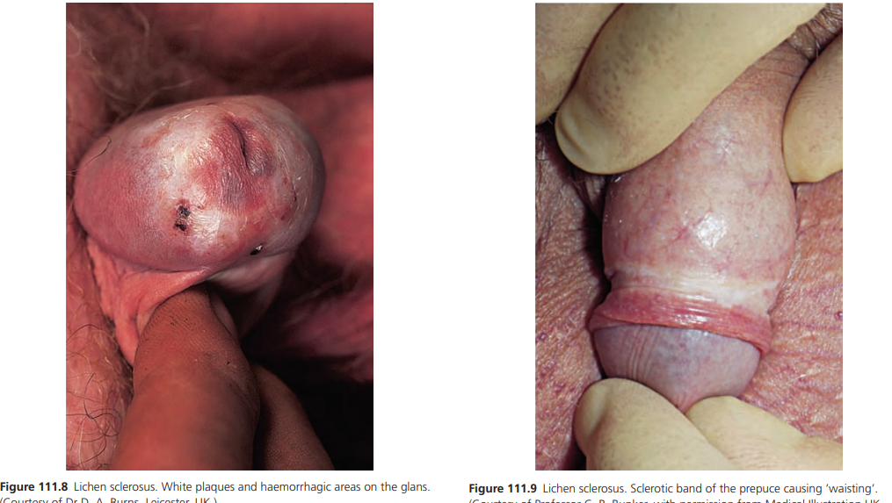

Slide 52
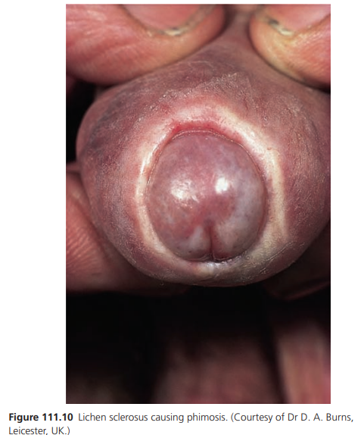

Slide 53
Investigations
diagnosed clinically
biopsy is rarely required.

Slide 54
Management
The aims are early diagnosis and effective treatment to obtain normalization of sexual function, reverse or check urinary dysfunction and limit urethral disease and reduce, if not abolish, the risk of penis cancer

Slide 55
Cont..
Contact with soap, urine and pubic hair should be avoided by use of a soap substitute and a barrier preparation
An ultrapotent topical corticosteroid (usually clobetasol propionate) used under supervision for a finite course is effective
Patients with a history of genital herpes simplex virus (HSV) should be prescribed prophylactic aciclovir.

Slide 56
Cont..
Secondary candidal and bacterial infection should be treated
Topical testosterone propionate, oral stanozolol, freezing with ethyl chloride, liquid nitrogen cryotherapy, carbon dioxide laser and adrenocorticotrophic hormone (ACTH) have been used but are not recommended

Slide 57
oral acitretin has shown some benefit
topical calcineurin inhibitors is to be deprecated because of the risk of accelerated carcinogenesis
If medical treatment not possible or fails, then surgery is indicated
Circumcision (including by carbon dioxide laser), frenuloplasty, meatotomy, glans resurfacing and sophisticated plastic repair

Slide 58
Persistent disease requires individualized follow‐up and management
Residual burnt‐out disease on the glans may improve with long‐term topical retinoid treatment
Subdermal injection of polydeoxyribonucleotide (a mitogen for fibroblasts, endothelial cells and adipocytes) is an interesting new approach

Slide 59
Lichen planus
common inflammatory dermatosis
Pathophysiology
aetiopathogenesis is not known. Drugs can cause a generalized lichenoid eruption; a case of a lichenoid drug eruption confined to the penis resulting from propranolol

Slide 60
Clinical features
can present in, and remain localized to, the ano‐ genital area, including the groins and perianal skin
Like the classical disease at other sites, it presents as itchy red‐purple papules, patches, plaques and annular lesions
also present as phimosis
commonest site for the annular subtype of LP
Koebner phenomenon may partly explain the oro‐genital predilection

Slide 61
Cont..
Occasionally, an erosive form is encountered
There is a male equivalent of the vulvovaginal syndrome of Hewitt – the genitogingival syndrome – with chronic erosive gingival and genital lesions
In most cases, ano‐genital lichen planus is self‐limiting, although some patients remit and relapse
Adhesions can form and contribute to phimosis
Post‐inflammatory hyperpigmentation can persist for months or years.

Slide 62
Cont..
Chronic mucosal erosive lichen planus is associated with a risk of progression to squamous carcinoma, but most reports of this concern oral lichen planus
Lichen nitidus has an affinity for the penis; it is sometimes seen on penile skin in isolation in young Asian males
Lichen nitidus can be difficult to diagnose because the signs may be subtle, even when the lesions are widespread

Slide 63
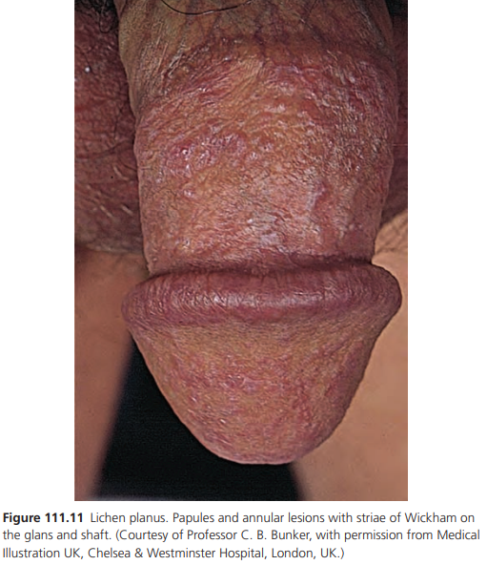

Slide 64
Differential diagnosis
Psoriasis
Zoon balanitis
lichen sclerosus
viral warts
BP
porokeratosis.

Slide 65
Complications and co‐morbidites
In the follow‐up of cases of chronic ano‐genital lichen planus, erosive, ulcerative or verrucous features arouse concern about the development of squamous carcinoma.

Slide 66
Investigations
biopsy is frequently necessary for diagnostic purposes.

Slide 67
Management
Potent and ultrapotent topical corticosteroids usually suffice for treatment
Patients are told to continue with the treatment until the lesions are non‐itchy and flat; they are warned about post‐inflammatory hyperpigmentation
Reactivation of genital warts may occur
Topical and oral ciclosporin have been used but risk of squamous carcinoma arising in lichen planus of the penis treated with topical ciclosporin

Slide 68
Cont..
Topical calcineurin inhibitors should be used with caution
Circumcision may be necessary for phimosis and should be considered in refractory erosive disease
Photodynamic therapy
Pulsed dexamethasone therapy has been used for erosive disease

Slide 69
Peyronie disease
affects middle‐aged and older men
localized fibrotic disorder involving tissue immediately adjacent to the erectile tissues
presents with pain and curvature on erection, a sensation of a cord within the penis, palpation of a lump or knot, decreased erection distal to the plaque, interference with intercourse and progressive impotence
may be subclinical in many men
Psychological complications and marital difficulties occur.

Slide 70
The penis curves towards the lesion, with dorsal curvature being most common
Peyronie (a physician to Louis XIV) described nodules as ‘rosary beads’ but plaques vary in size
associated with systemic sclerosis and such patients may have penile Raynaud phenomenon
occurred as a complication of the use of a vacuum erection device,mostly cause is unknown
Some evidence for an autoimmune pathogenesis
complicating chronic graft‐versus‐host disease

Slide 71
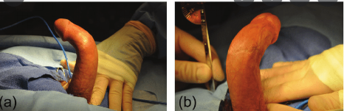

Slide 72
Differential diagnosis
congenital curvature
fibrosis secondary to trauma or urethritis and abscess
syphilitic gumma
lymphogranuloma venereum
and infiltrative tumours (e.g. lipogranuloma).

Slide 73
Cont..
Penile thrombophlebitis as the initial presentation of a paraneoplastic migratory thrombophlebitis resulting from pancreatic cancer has been misdiagnosed as Peyronie disease

Slide 74
Mangement
there may be spontaneous regression. Treatments include intralesional corticosteroid injection including delivery by Dermojet
Surgery is avoided, but some specialized techniques are available
Symptomatic relief has been claimed following iontophoresis of drugs such as dexamethasone, lidocaine (lignocaine), para‐aminobenzoic acid and verapamil [

Slide 75
Drug reactions
The penis is a site of predilection for fixed drug eruption
symptoms are itch or burning. The eruption is acute, with an erythematous plaque, sometimes with central blister formation, erosion and ulceration

Slide 76
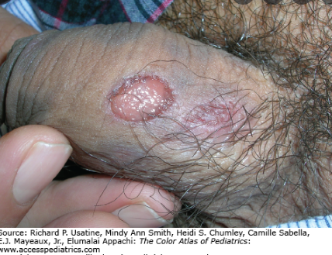

Slide 77
Cont..
co‐trimoxazole, diclofenac, isosorbide and aspirin are the drugs cited
Foscarnet cause of genital ulceration in HIV‐infected patients
Nicorandil is a newly recognized cause of ano‐genital and peristomal ulceration
Erosion following the use of topical steroids
Penile argyria due to chronic application of silver sulfadiazine
necrosis following warfarin administration

Slide 78
Differential diagnosis
herpes simplex
erythema multiforme

Slide 79
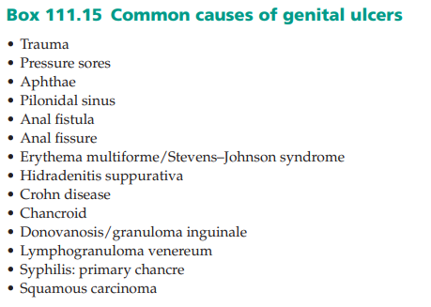
Ulcerative disease and penile necrosis

Slide 80
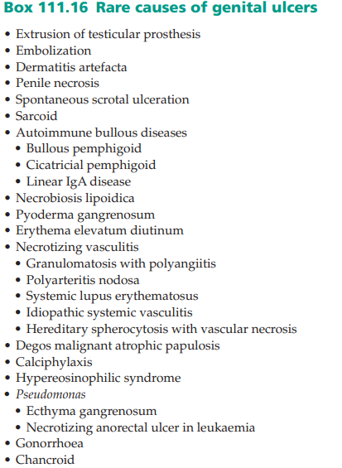

Slide 81
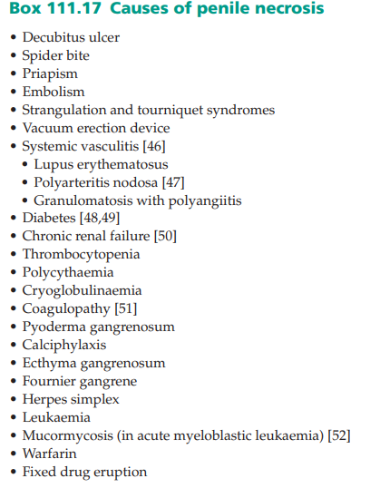

Slide 82
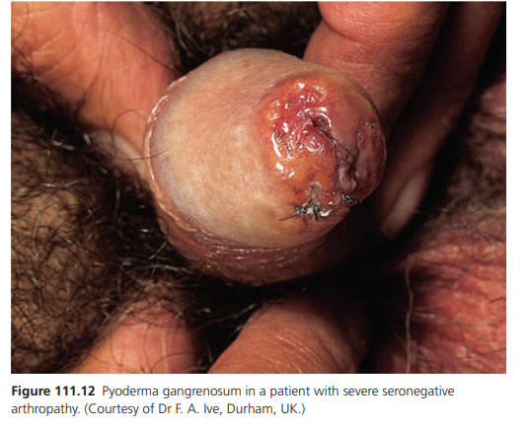

Slide 83
Chronic penile oedema
Chronic penile lymphoedema is a relatively rare, reactive, disfiguring condition that causes sexual dysfunction and phimosis
It has been called tumorous lymphoedema or elephantiasis verrucosa nostra

Slide 84
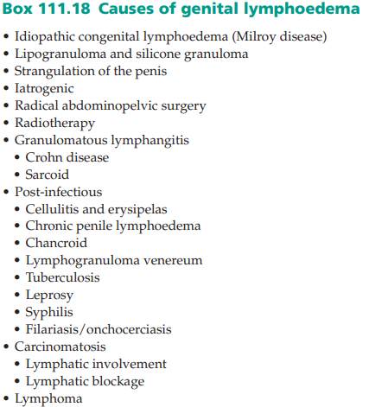

Slide 85
Cont..
Patients with chronic penile oedema present with chronic swelling of the penis, foreskin, scrotum, pubic mound, buttocks and thighs, which may be warm and red
There may be intercurrent attacks of cellulitis and/or erysipelas with systemic upset

Slide 86
Cont..
Acute attacks require admission to hospital and treatment with systemic broad spectrum antibiotics; a short course of prednisolone may also be helpful
Investigations should be directed at elucidating possible underlying causes (such as streptococcal infection (ASOT), Crohn disease and sarcoid, pelvic cancer and filariasis)

Slide 87
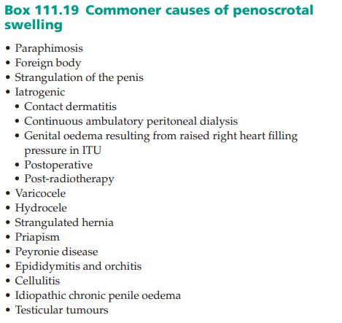

Slide 88
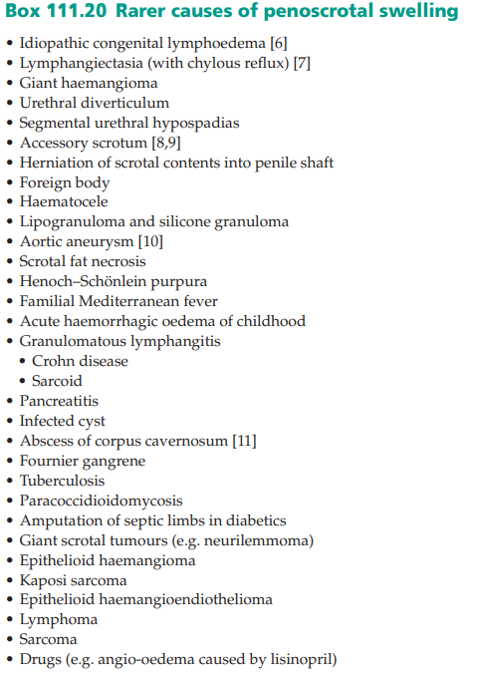

Slide 89
Cont..
Long‐term treatment with erythromycin, clarithromycin, clindamycin, clindamycin plus rifampicin, trimethoprim, sulphamethoxazole plus trimethoprim or ciprofloxacin appears to ameliorate and stabilize the process
Antibiotics together with short intermittent courses of oral prednisolone should improve both the appearance and function of the penis

Slide 90
Cont..
surgical intervention in the form of circumcision
Plastic repair may be necessary after excision of affected tissue and may lead to improvement in quality of life

Slide 91
Fournier gangrene
Fournier gangrene is analogous to necrotizing fasciitis and Meleney gangrene
The disease begins with urethral or appendageal polybacterial infection
Most of the organisms isolated are resident urethral or lower gastrointestinal flora, and most patients have mixed infections
In children, staphylococci and streptococci are most commonly isolated

Slide 92
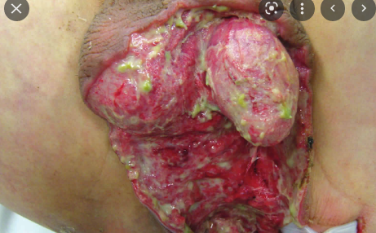

Slide 93
Cont..
A necrotizing vasculitis, possibly exotoxin mediated, ensues with devastating consequences for involved skin, subcutis, fascia and muscle
It is held to be the human counterpart of the local Shwartzman phenomenon

Slide 94
Cont..
A typical presentation is characterized by painful, erythematous, non‐suppurative swelling of the genital skin (particularly the scrotum where a dark red or a black spot may appear, or the perianal zone or lower abdominal skin, accompanied by crepitus , marked systemic toxicity (may be absent in children and urinary retention
Necrosis of skin and deeper tissues can occur rapidly, and there is a very high mortality unless the diagnosis is made promptly and radical management undertaken

Slide 95
Plain X‐rays may show soft‐tissue gas
Preceding surgery, including vasectomy and instrumentation, including genital piercing especially in patients with the listed risk factors, is particularly important

Slide 96
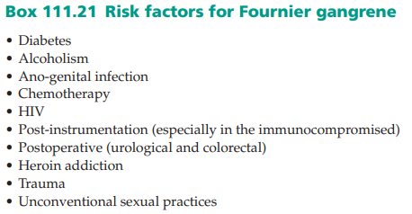

Slide 97
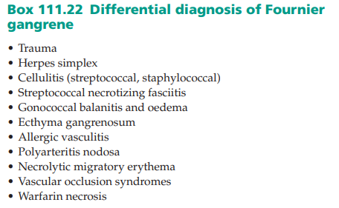

Slide 98
Cont..
Plastic repair can be undertaken if the patient survives
Hyperbaric oxygen, high‐ dose systemic steroids and unprocessed honey treatment have been used
In adults, the mortality is approximately 25%
Children can be treated with more conservative surgery, and their mortality rate is lower

Slide 99
Tuberculosis
Tuberculosis of the penis is rare
Primary penile ulceration (solitary and multiple), with or without inguinal lymphadenopathy, caused by sexual infection or contact with infected clothing may occur
ulceration may be secondary to tuberculosis elsewhere (e.g. the lung)
A cold abscess (presenting as erectile impotence)
Tuberculides have involved the penis, including in isolation
Penile manifestations have also followed immunotherapy

Slide 100
Non‐syphilitic spirochaetal ulcerative balanoposthitis
presenting as large serpiginous foul‐smelling ulcers in uncircumcised men, associated in some with non‐tender inguinal lymphadenopathy
Treatment is with penicillin or metronidazole

Slide 101
Candidosis
Genito‐urinary physicians maintain that Candida can be the cause of urethritis and balanoposthitis and cause erosive disease of the glans and prepuce
The glans penis and prepuce may be eroded
Candida of the penis (with a prevalence of approximately 10% of that of vaginal candidosis) has attracted very little research interest

Slide 102
Cont..
An underlying dermatological or medical cause should be excluded
The symptoms and signs of Candida may be more florid than the underlying predisposing cause
Medical causes include diabetes, iatrogenic immunosuppression and systemic antibiotic treatment. Although oropharyngeal candidosis is almost invariably found in HIV infection, candidal balanoposthitis is not generally associated, perhaps because it is overlooked or because many patients take long‐term imidazole antifungals orally.

Slide 103
Cont..
Treatment includes topical nystatin, clioquinol or an imidazole, often usefully combined with hydrocortisone or a moderately potent corticosteroid
In severe disease, an oral imidazole may be indicated.

Slide 104
Dermatological aspects of sexually transmitted disease
Syphilis is endemic throughout the world
effect both heterosexual and homosexual populations
All manifestations of syphilis can affect the genital region
Balanoposthitis can complicate and obscure penile chancre
granulomatous gumma may affect the genital area as an ulcer, a white plaque or as an atrophic scar
Pseudochancre redux describes gummatous (tertiary stage) recurrence at the site of the primary chancre; it is very rare.

Slide 105
Viral Warts
Circumcised men are more likely to have genital warts than the uncircumcised, but when warts are present in uncircumcised men they are more likely to be distally situated
Subclinical or latent genital HPV infection may be 100 times more common than classical condylomas

Slide 106
Cont..
The clinical diagnosis of HPV infection is usually certain, but condylomata lata (secondary syphilis), lichen planus, molluscum contagiosum, bowenoid papulosis and pearly penile papules enter the differential diagnosis.

Slide 107
Cont..
Solitary lesions have a wider differential diagnosis, including giant condyloma, squamous carcinoma and transitional cell carcinoma of the distal urethra, which can present as a warty lesion at the urethral meatus
Biopsy should be performed if there is diagnostic doubt
Patients with ano‐genital warts and their partners may require full STDs and sometimes colorectal assessment
Treatment can be challenging

Slide 108
HIV infection
Ulcerative genital disease is a risk factor for HIV,but ano‐ genital ulceration may be a consequence of HIV infection
Biopsy, with special stains and culture, is mandatory

Slide 109
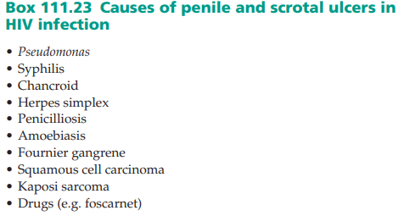

Slide 110
Scabies
Scabies may present with ano‐genital itch, ‘folliculitis’ (including of the buttocks) and penile, scrotal and pubic nodules
An AIDS patient with single non‐pruritic, ‘crusted’ lesion on the glans penis has been described
Topical pimecrolimus has been used with benefit in the treatment of steroid‐resistant post‐scabies nodules

Slide 111
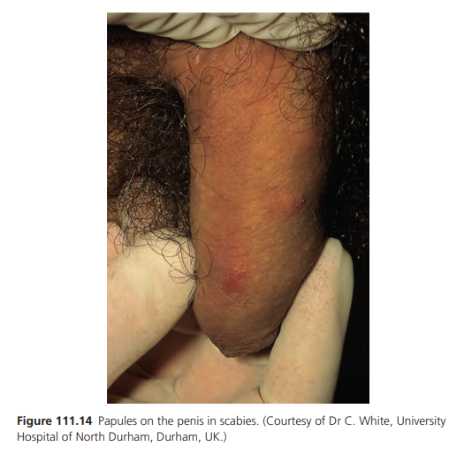

Slide 112
Benign tumours
Median raphe cysts
Congenital cystic median raphe anomalies may remain unobtrusive until adulthood
Cystic or nodular and linear swellings of the ventral penis occur near the glans
In adolescence or adulthood they may become traumatized or infected with staphylococci, gonococci or Trichomonas and present as tender, erythematous, purulent nodules
Histologically, they are either dermoid or mucoid, depending on their embryology or epithelial lining
Very rarely, the basal epithelial lining of the cysts may contain melanocytes, imparting a brown‐black pigment to the lesion

Slide 113
Mucoid cysts
These are rare lesions that are present at birth or develop in childhood as small, flesh‐coloured, mobile cystic papules or nodules with no punctum, commonly on the ventral glans or foreskin, rarely in the perineum
can be asymptomatic, become infected or interfere with intercourse
The histological features suggest that they arise from ectopic urethral tissue during embryological development

Slide 114
Scrotal calcinosis
relatively common, benign, idiopathic disorder
presenting as solitary or multiple, hard, smooth, white papules or nodules on the scrotum, rarely the penis
may become secondarily inflamed or infected following trauma
Their origin has been debated: they have been said to arise from epidermoid cysts, eccrine duct milia, eccrine epithelial cysts, dystrophy of the dartos muscle, trauma and the presence of foreign bodies

Slide 115
Cont..
may occur after meconium peritonitis, with leakage of meconium through the processus vaginalis, and in testicular tumours such as teratomas, gonadoblastomas and Leydig cell tumours
In endemic areas of onchocerciasis, calcified scrotal cysts may be caused by the living or dead nematodes, and patients have evidence of the disease elsewhere
Onchocercal nodules are more common on the iliac crests and the rib cage

Slide 116
Cont..
The unsightly and embarrassing lesions can be treated by incision and eventration under local anaesthesia
Idiopathic calcinosis of the penis is very rare
A man who presented with a dome‐ shaped nodule on his glans has been described; the dystrophic calcinosis here was thought to derive from syringoma
Other associations are trauma, self‐injection with papaverine, Peyronie disease and cytotoxic chemotherapy
Metastatic calcinosis is due to renal failure and secondary hyperparathyroidism.

Slide 117
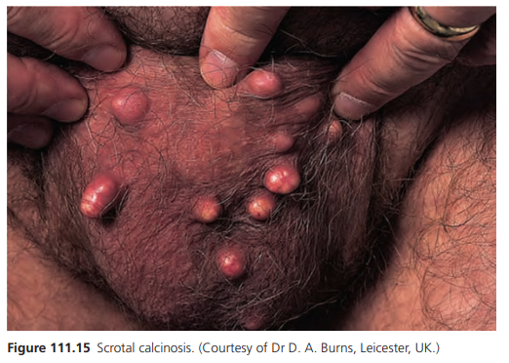

Slide 118
Verruciform xanthoma
mainly affects the mouth
genitalia are the next most frequently involved area, where it presents as a painless, yellow‐brown or red, verrucous, sessile or papillary plaque
The histological findings are hyperkeratosis, focal parakeratosis, acanthosis and fat‐filled foam cells in the papillary dermis
represent epidermal degeneration, with keratinocyte lipid then taken up by dermal macrophages or fibroblasts to form the foam cells
HPV infection and lymphoedema have crucial cofactors in the pathogenesis
Treatment is by surgical excision.

Slide 119
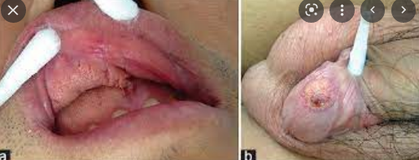

Slide 120
Erythroplasia of Queyrat, Bowen disease of the penis and bowenoid papulosis
Erythroplasia of Queyrat, Bowen disease of the penis (BDP) and bowenoid papulosis (BP) are three clinical variants of carcinoma in situ of the penis.

Slide 121
Cont..
Distinct morphological subtypes of PeIN, differentiated and undifferentiated (bowenoid), are recognized, and the latter can be subdivided into warty, basaloid and warty‐basaloid: mixed types can be encountered
Differentiated PeIN manifests basal and parabasal atypia (and this can be subtle) and is associated with SH and lichen sclerosus and the ‘usual’ and verrucous keratinizing subtypes of squamous carcinoma of the penis
Undifferentiated (or ‘usual’ type PeIN) has bowenoid histology (two thirds to full thickness PeIN type 3) koilocytic change and high‐grade SIL and is associated with HPV and the warty, condylomatous, basaloid and ‘mixed’ subtypes of penile squamous carcinoma

Slide 122
Cont..
Erythroplasia of Queyrat should be used to describe red shiny patches or plaques of the ‘mucosal’ penis (glans and prepuce of the uncircumcised), although erythroplasia of Queyrat has been recorded in a partially circumcised man
BDP should be used to describe red, sometimes slightly pigmented, scaly patches and plaques of the keratinized penis

Slide 123
Cont..
BP is analogous to, but clinically different from, erythroplasia of Queyrat and BDP
BP lesions are less papillomatous, smoother topped, more polymorphic and more coalescent than common genital viral condylomata acuminata, and occur in younger, sexually active men, as opposed to the patches or scaly plaques of erythroplasia of Queyrat and BDP, respectively, seen in older men

Slide 124
Cont..
BP may be associated with a lesser risk of squamous carcinoma than erythroplasia of Queyrat and BDP
associated with HPV infection (especially HPV‐16) and HIV infection

Slide 125
Aetiology and pathophysiology
The exact aetiology of erythroplasia of Queyrat, BDP and BP is not known
Local carcinogenic influences in uncircumcised men such as poor hygiene, smegma, trauma, friction, heat, maceration, inflammation, phimosis, dermatoses such as lichen sclerosus and smoking (tar metabolites in urine)
HPV (commonly types 16, 18, 39 and 51)

Slide 126
Clinical features
lesions may be quite young
There may be several foci of BDP or erythroplasia of Queyrat and they may occur concomitantly
The non‐specificity of the clinical appearances makes for an important differential diagnosis, which includes psoriasis, lichen sclerosus, lichen planus, Zoon balanitis and extramammary Paget disease

Slide 127
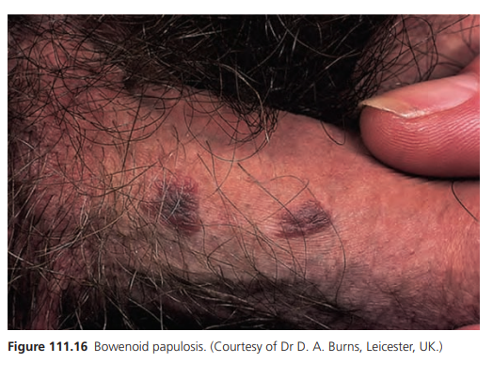

Slide 128
differential diagnosis
lichen planus
common warts
seborrhoeic warts
naevi and
condylomata lata

Slide 129
Cont..
A biopsy is indicated in instances where the clinical diagnosis is uncertain
Reflectance confocal microscopy shows promise
Secondary amyloid deposition has been reported histologically

Slide 130
Investigations
Occasionally, it may be necessary to perform several biopsies

Slide 131
Management
Treatment choice depends on many factors
Circumcision removes a major risk factor for cancer and provides extensive tissue for histology
Topical 5‐fluorouracil as a 5% cream
Other treatments include cryosurgery, curettage and electrocautery, excisional surgery, glans resurfacing, Mohs micrographic surgery, laser and photodynamic therapy
Radiotherapy should be avoided
Topical imiquimod may help some patients

Slide 132
Cont..
Topical cidofovir has been used
A recent retrospective review of patients with penile carcinoma in situ using topical 5‐ fluorouracil as first line therapy, and topical imiquimod as second line treatment, demonstrated a complete response in 57%, partial response in 13.6%, and no response in 29.5%
HPV vaccination may have a part to play in prevention and treatment

Slide 133
Cont..
Patients with these conditions should be counselled and screened for HPV and other sexually transmitted diseases, including HIV infection
stop smoking
Sexual partners should be advised to seek assessment
Follow‐up may need to be long term depending on individual circumstances

Slide 134
Squamous hyperplasia and squamous intraepithelial lesion(s)
SH lesions consist of white patches and plaques
most common epithelial abnormality found in association with invasive squamous carcinoma of the penis
histologically there is no cytological atypia, Acanthosis and orthokeratotic hyperkeratosis ; it is associated with differentiated PeIN, underlying lichen sclerosus and penile carcinoma of the ‘usual’ and verrucous subtypes.

Slide 135
Cont..
SIL presents clinically as redder or more pigmented papules and plaques
classified histologically into squamous, basaloid or warty, high‐ or low‐grade subtypes
it is associated with undifferentiated (or ‘usual’ type) bowenoid PeIN, HPV and the warty, condylomatous, basaloid and ‘mixed’ subtypes of penile squamous carcinoma

Slide 136
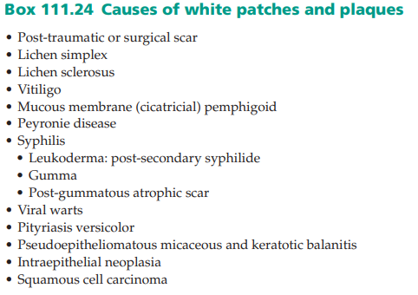

Slide 137
Penile horn
It is rare for cutaneous horn to affect the penis
Multiple lesions in a 70‐year‐old man
underlying causes include pseudoepitheliomatous micaceous and keratotic balanitis , verrucous carcinoma and squamous carcinoma
Chronic inflammation and recent circumcision for longstanding phimosis are said to be important predisposing factors

Slide 138
pre‐malignant or, in one‐third of cases, malignant at presentation, with squamous carcinoma the underlying pathology
Treatment should be dictated by precise diagnosis achieved by adequate excision and histology of the whole lesion
Follow‐up is mandatory because recurrence may occur.

Slide 139
Porokeratosis
Genital porokeratosis of Mibelli is rare
classical lesions have been reported on the penis and scrotum
commoner in Asian populations
Pruritus and ulceration may occur
It can be confused with psoriasis, Bowen disease, granuloma annulare or lichen planus
biopsy differentiates these conditions
Topical 5‐fluorouracil and imiquimod have been used for treatment

Slide 140
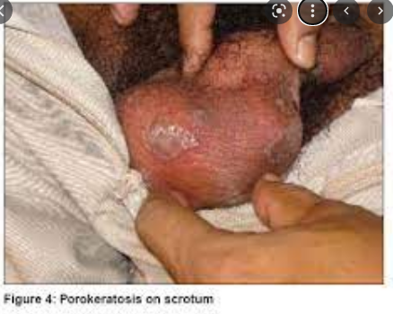

Slide 141
Pseudoepitheliomatous micaceous and keratotic balanitis
rare penile condition
It presents as thick scaly micaceous patches (possibly a cutaneous horn) on the glans penis in older uncircumcised men
Perimeatal hyperkeratosis may cause multiple urinary streams on micturition – a ‘watering‐can penis’
Histological shows hyperkeratosis, parakeratosis, acanthosis, prolongation of the rete ridges and mild lower epidermal dysplasia, with a non‐specific dermal inflammatory infiltrate of eosinophils and lymphocytes

Slide 142
PEMKB is a variant of lichen sclerosus unassociated with HPV but strongly associated with verrucous carcinoma
Metastastic spread has not occurred except where there was a penile horn and in one patient who developed an aggressive soft‐ tissue sarcoma of the penis
Recurrence is common
Topical 5‐fluorouracil, radiotherapy and surgery have been the principal treatment choices

Slide 143
Carcinoma of the penis
The earliest stages of penis cancer and pre‐cancer form a heterogenous spectrum of disease
some penile cancers arise de novo, others develop from pre‐malignant situations
aetiologies unknown
but the picture has become much clearer in recent years: there is a dichotomous pathway, HPV related or lichen sclerosus related, as in the vulva.

Slide 144
Epidemiology
Of the approximately 500 new cases per year, carcinoma of the penis causes about 100 deaths per annum in the UK and accounts for less than 1% of deaths from cancer in the USA
10–20% of tumours seen in males in either developing countries or in areas where early circumcision is not commonly practised
highest incidence is in Africa, South America and Asia (2–4/100 000 inhabitants) and lowest in the USA and Europe (0.3–1/100 000)

Slide 145
Pathophysiology
The presence of a foreskin, HPV infection and lichen sclerosus are the most important considerations
Neonatal circumcision protects against penile carcinoma
Circumcision in later life may reduce the risk but does not abolish it, especially if the circumcision was performed for penile disease
associated with multiple sexual partners and previous sexually transmitted disease

Slide 146
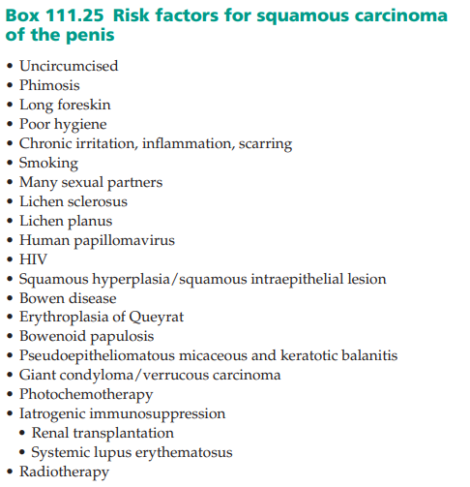

Slide 147
HPV is certainly implicated in penis cancer, but many patients have no evidence of HPV
Oncogenic HPV, particularly types 16 and 18 (but also types 31, 33, 35, 39, 45, 51, 52, 54, 56, 58, 59, 66, 68 and 69), have been incriminated in 22–45% of penile squamous cell carcinoma and in 70–100% of penile squamous cell carcinoma in situ

Slide 148
Pathology
histological subtypes of penile squamous cell carcinoma
Histological signs of SH, SIL, CIS, PeIN, lichen sclerosus and HPV are commonly found

Slide 149
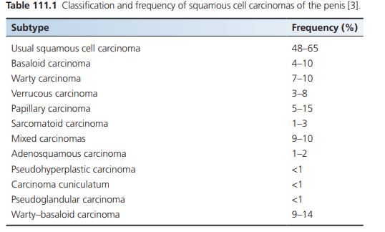

Slide 150
Clinical features
Itch, irritation, pain, bleeding, discharge, ulceration or the mass
long history of preceding problems with the penis and foreskin, manifest as dyspareunia, balanoposthitis or phimosis and dysuria. Irregular nodular and ulcerative morphology is found on examination
there may be background BDP, erythroplasia of Queyrat and BP, lichen sclerosus or lichen planus. Undiagnosed, untreated disease is destructive and mutilating
The inguinal lymph glands must be palpated, although in penile cancer only 50% of enlarged glands will be found to contain tumour
concomitant presence of STDs and immunocompromise should be excluded

Slide 151
differential diagnosis
intraepithelial neoplasia (and the differential diagnosis of these)
erosive or ulcerative STDs
basal cell carcinoma
Kaposi sarcoma
pyoderma gangrenosum and
artefact

Slide 152
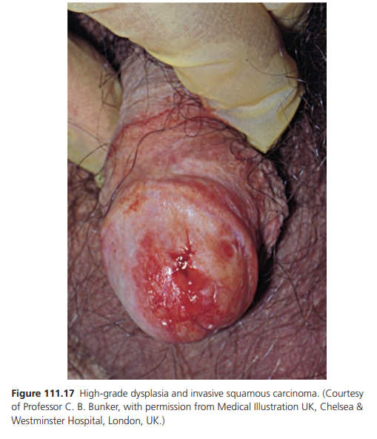

Slide 153
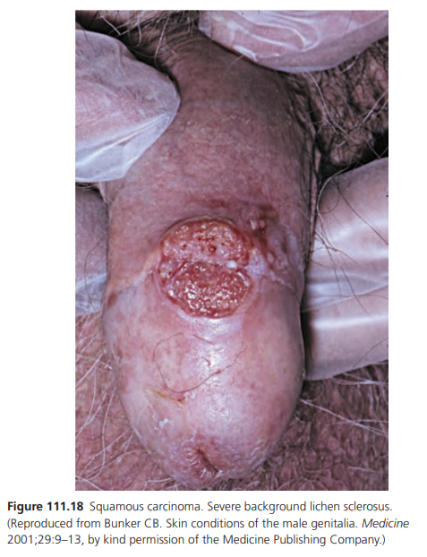

Slide 154
Investigations
Diagnosis is confirmed histologically by incisional or excisional biopsy
An incisional biopsy should be of adequate size and depth, and it may be necessary to sample several sites
The biopsy(ies) may need to be performed by a urologist under general anaesthesia
Patients who have negative or equivocal biopsies, but who have risk factors or in whom there is a high index of suspicion, should be followed up closely and rebiopsied if indicated. Staging should not be based on incisional biopsies.

Slide 155
Management
The treatment of ano‐genital squamous carcinoma is not generally the province of the dermatologist
The penile surgery may need to be radical, total or partial, depending on location and extent
To conserve tissue and minimize residual sexual dysfunction, conservative techniques are increasingly used, with narrow excisional margins and innovative plastic repair, as are laser treatment and Mohs micrographic surgery for squamous carcinoma of the penis

Slide 156
indications for sentinel node biopsy and inguinal and pelvic lymphadenectomy
Radiotherapy may be offered as an adjunct to surgery or as definitive alternative treatment
Combination chemotherapy has been used for palliation and adjuvant treatment of carcinoma of the penis, but remains under evaluation
Lymphatic or haematogenous dissemination of genital cancer dictates individualized expert multidisciplinary treatment, in the UK, by a multidisciplinary team

Slide 157
The prognosis of penis cancer relates to the extent of inguinal lymphadenopathy and involvement of the corpus
It does not correlate with HPV status
Penile cancer puts female sexual partners at risk of cervical cancer
prognosis for scrotal carcinoma is not good, despite apparently adequate primary surgical treatment: the 5‐year mortality is 50–60%.

Slide 158
Verrucous carcinoma/giant condyloma/ Buschke–Löwenstein tumour
interchangeably for large verruciform tumours of the penis presenting with an exophytic and papillomatous pattern of growth
well differentiated, with low metastatic rate and better survival compared with usual squamous cell carcinoma
Verrucous carcinoma is HPV unrelated but associated with lichen sclerosus and more dangerous
Dramatic polypoid or cauliflower‐like clinical lesions are encountered

Slide 159
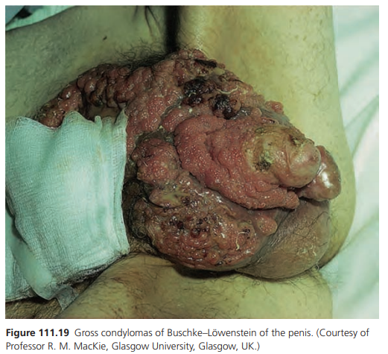

Slide 160
As well as lichen sclerosus, tumours occurring on background hidradenitis suppurativa and very rarely lichen planus have occurred
A deep surgical biopsy is necessary
Surgical excision is the treatment usually recommended (e.g. glansectomy [5] or penectomy). Mohs micrographic surgery, cryotherapy , laser treatment interferon‐α , radiotherapy or bleomycin

Slide 161
The prognosis can be poor because verrucous carcinoma might continue to grow and invade locally, causing death by exsanguination from femoral arterial invasion or cachexia
Even with treatment, recurrence and progressive malignant transformation do occur so follow‐up is necessary.

Slide 162
Extramammary Paget disease
Extramammary Paget disease is a malignant skin condition in which there is intraepidermal infiltration by neoplastic cells showing glandular differentiation
Epidemiology presents in men aged 60–70 as irritating, itchy, burning, red scaly patches or plaques that may be solitary or multifocal.

Slide 163
Pathophysiology
Immunohistochemical and enzyme histochemical evidence points to sweat gland epithelium as the source of Paget cells in extramammary Paget disease
The distribution along the ‘milk line’ has led to the suggestion that the ‘clear cells of Toker’ are the histogenic precursors of both clear cell papulosis and mammary and extramammary Paget disease
HPV is not present, but the c‐erbB‐2 oncoprotein may have a role in the pathogenesis of extramammary Paget disease

Slide 164
Pathology
Histological examination shows nests of large vacuolated cells with circular nuclei and foamy pale cytoplasm in the epidermis (Paget cells)
Dermal involvement signifies a poor prognosis. Pagetoid dyskeratosis can be found in a number of benign lesions such as naevi, skin tags and lentigines
Pale cells can be seen incidentally in benign papular intertriginous conditions, and in nearly 40% of prepuces sent for histological examination following circumcision for phimosis
Ano‐genital Paget disease can be accompanied by epidermal hyperplasia similar to fibroepithelioma of Pinkus.

Slide 165
Clinical features
Extramammary Paget disease can occur anywhere in the ano‐ genital area, including the glans penis
it is frequently misdiagnosed as psoriasis, eczema, tinea or Bowen disease
An ‘underpants’ pattern of erythema has been reported in a number of patients
Subclinical disease has been documented, where the skin looks normal macroscopically but is involved microscopically
It behaves indolently, spreading by local extension and metastasis

Slide 166
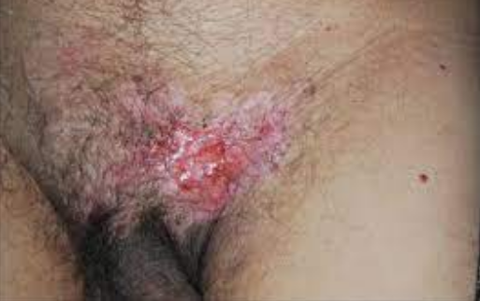

Slide 167
differential diagnosis
Vitiligo
hypopigmented mycosis fungoides and
lichen sclerosus

Slide 168
Investigations
Diagnosis is by biopsy
underlying adenocarcinoma should be undertaken

Slide 169
Management
Wide excisional surgery is the treatment of choice
cryotherapy and topical 5‐fluorouracil, micrographic surgery, radiotherapy, and photodynamic therapy
Topical imiquimod has been promising
Recurrence is common
Excision of an underlying neoplasm, if present, can cause regression of the extramammary Paget disease

Slide 170
Malignant melanoma
rare condition
estimated to account for 1–1.5% of all malignancies of the penis and less than 0.15% of all melanomas
Melanoma is even rarer on the scrotum

Slide 171
presents as a pigmented macule or as a pigmented or amelanotic papule or nodule, possibly developing from a lentiginous area or pre‐existing dysplastic naevus or ‘kissing’ naevus, that may ulcerate or bleed
Multifocal melanoma of the glans penis
middle‐aged or older, although it has been reported in a boy
The diagnosis is often delayed

Slide 172
Between 60% and 70% of lesions occur on the glans
family history of melanoma and other atypical or ‘dysplastic’ naevi on examination
The inguinal and other nodes, as well as the abdomen, should be palpated. Between 40% and 50% of patients have lymphatic or other metastatic dissemination at the time of presentation
Clinically, atypical lesions should be biopsied

Slide 173
Treatment is by primary excision. Subsequent management depends on the Breslow thickness of the lesion and complete clinical staging
Radical surgery and chemotherapy may be needed, but the prognosis is poor for all melanomas that have already metastasized

Slide 174
Miscellaneous cutaneous male genital condition
Penile melanosis They are benign but, because they may be large or enlarging, with irregular edges and multifocal and variegated pigmentary patterns, they arouse concern about atypical melanocytic proliferation and acral lentiginous melanoma. Such clinical concerns should lead to biopsy
Hypopigmentation

Slide 175
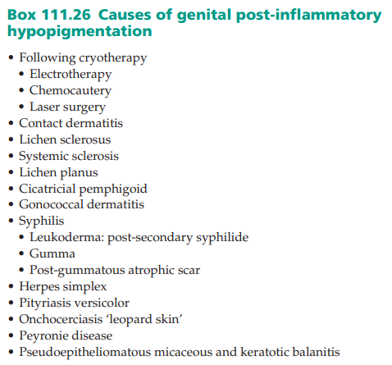

Slide 176
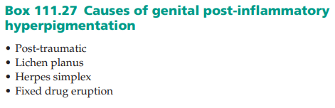

Slide 177


