Slide 1
DERMATOSES OF ORAL CAVITY AND LIPS
Dr M Rahim Achakzai
FCPS Resident derma
Pns shifa Karachi.

Slide 2
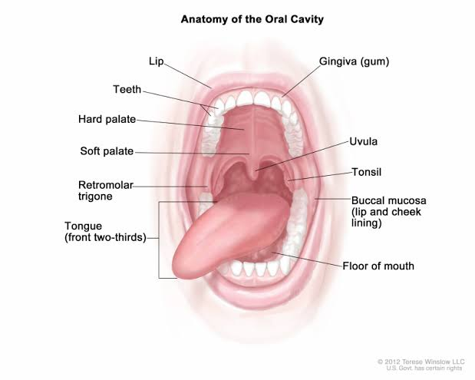
ANATOMY OF ORAL CAVITY
Oral Epithelium
Lips
Oral mucosa
Teeth
Tongue

Slide 3
EXAMINATION OF THE MOUTH
Lymph nodes
Temporomandibular joints and muscles of mastication
Jaws
Salivary glands
Oral cavity

Slide 4
DISORDERS AFFECTING ORAL MUCOSA OR LIPS
Blisters, erosions and ulcers
Lumps and swellings
Pigmentation
Redness
White patches

Slide 5
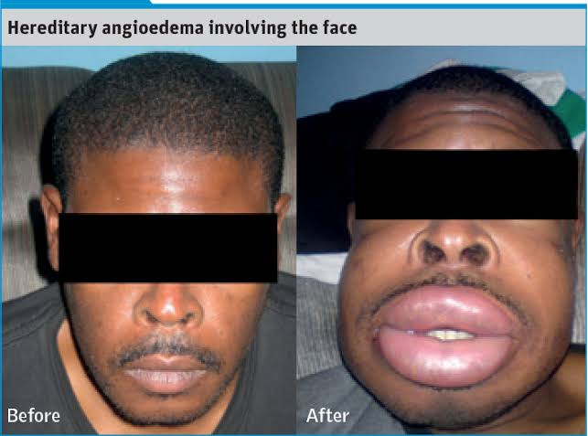
GENETIC DISORDERS AFFECTING THE ORAL
MUCOSA OR LIPS
LUMPS AND SWELLINGS
Hereditary angioedema (HANE)
Edema of lips, mouth, face and neck
Focal dermal hypoplasia
Papillomas of oral mucosa and lips
Dental anomalies
Cleft lip and palate

Slide 6
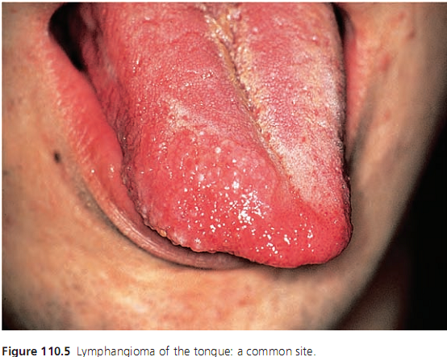
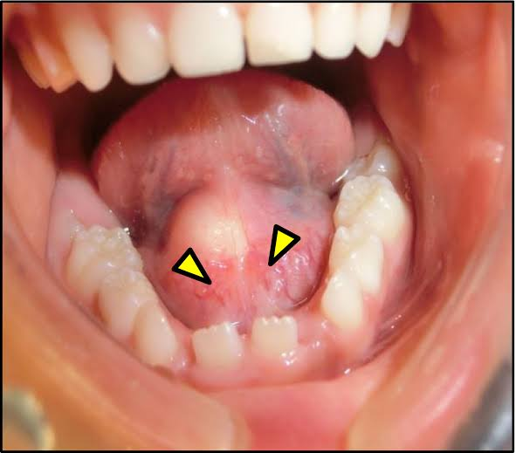
Lymphangioma
Frog spawn appearance on tongue
Dermoid cyst
Hamartoma on midline of neck,
above mylohyoid, tongue, antrum
and parotid.

Slide 7
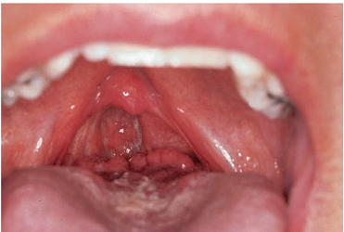
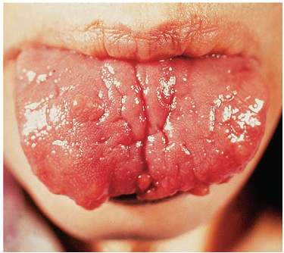
Lingual tonsil
Mass of lymphoid tissue in the
posterior third of tongue
Lingual thyroid
Smooth surfaced lump in the midline of
the base of the tongue
Multiple mucosal neuroma syndrome
MEN type 2b thyroid CA,
Phaeochromocytoma and multiple
mucosal neuromas.

Slide 8
PIGMENTED LESIONS
Centrofacial lentiginosis syndrome
bone abnormalities, malformations due to dysraphia,
endocrine dysfunctions and neurological diseases
Complex of myxomas, spotty pigmentation and endocrine
over activity→ oral hyperpigmentation and myxomas
Inherited patterned lentiginosis in black people
Hyperpigmented macules om face, lips, extremities

Slide 9
Laugier–Hunziker syndrome
oral, labial, perianal and digital hyperpigmented
lenticular macules
Melanocytic macule
Acquired small flat, brown to brown black lesion
Vermilion border, gingiva, buccal mucosa and palate
Naevi
Vermilion border, palate or buccal mucosa

Slide 10
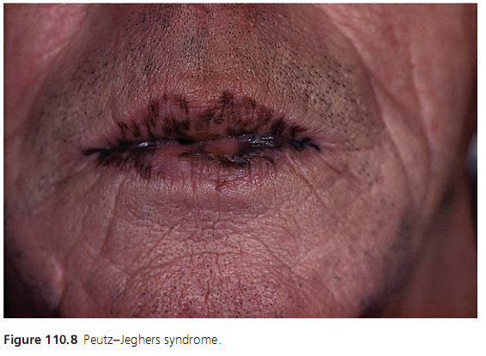
Peutz Jeghers syndrome
brown to bluish black macules
mainly around the oral, nasal
and ocular orifices.
Pseudoxanthoma elasticum
white patches on mucosa of lips

Slide 11
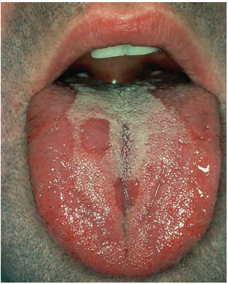
RED LESIONS
Benign migratory glossitis (geographic tongue)
map‐like red areas with increased
thickness of filiform papillae
Reassurance, benzydamine HCL mouth wash
Tacrolimus
Hereditary hemorrhagic telangiectasia
telangiectasia on the lips, perioral skin,
oral and nasal mucosae.
Cryo, cautery, Laser.

Slide 12
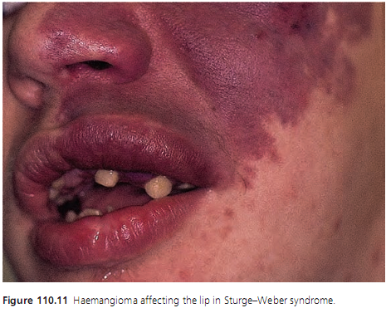
Hemangioma
Sturge–Weber–Krabbe syndrome ,
Klippel–Trenaunay–Weber syndrome,
Blue rubber–bleb naevus syndrome,
Glomovenous malformations,
Maffucci syndrome.
Mucoepithelial dysplasia
red macules or maculopapules and
on the palate and gingiva.

Slide 13
VESICULOEROSIVE DISORDERS
Acrodermatitis enteropathica
AR, Inborn error of metabolism zinc deficiency
vesiculobullous dermatitis with perioral involvement
Epidermolysis bullosa
blisters, sometimes preceded by white patches
Felty syndrome
Oral ulceration

Slide 14
WHITE LESIONS
Disease | Oral Manifestations
Chronic mucocutaneous candidosis | Persistent adherent white lesions in the mouth, with angular stomatitis
Clouston syndrome | Palmoplantar hyperkeratosis, hair defects, nail dysplasia and oral white lesions
Darier disease | IN 50% pts, flattish, coalescing, red plaques eventually turn white on tongue, palate and gingiva
Dyskeratosis congenita | Diffuse white lesions with a malignant potential
Focal palmoplantar and oral hyperkeratosis Syndrome | Hyperkeratosis of the gingiva
Fordyce spots | Whitish yellow papules or spots on lips, buccal mucosa
Hereditary benign intraepithelial dyskeratosis | Milky white smooth plaques buccal mucosae, lips and ventrum of the tongue.

Slide 15
WHITE LESIONS
Disease | Oral Manifestations
Keratitis, ichthyosis and deafness (KID) Syndrome | persistent oral ulceration, chronic mucocutaneous candidosis and occasional CA
Leukoedema | Faint whitish lines
Naevus sebaceous of Jadassohn | Papillomatous growth of tongue, gingiva or palate.
Olmsted syndrome | Perioral keratoderma
Pachyonychia congenita | Oral keratosis, natal teeth and angular stomatitis
Sebaceous adenoma | Bump on buccal mucosa, rare
Tylosis | Oral white lesions
Warty dyskeratoma | Nodule or papule on the gingiva, palate or alveolar ridge
White sponge naevus | Painless, shaggy or folded white lesions on buccal mucosa

Slide 16
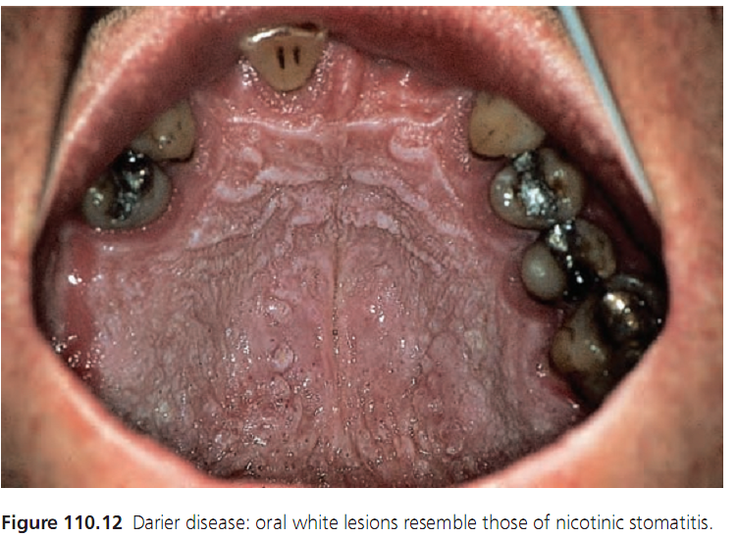
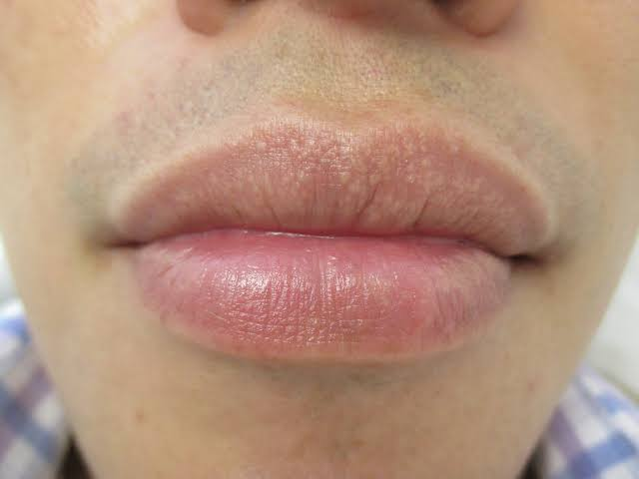

Slide 17
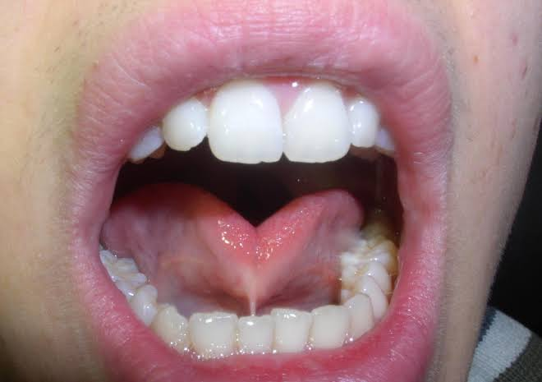
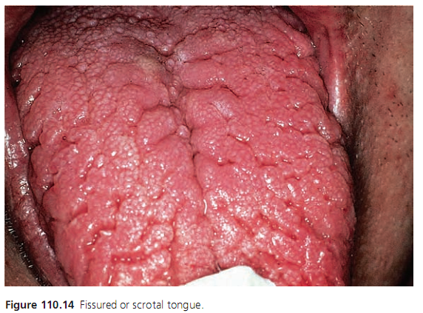
OTHER CONGENITAL ANOMALIES
Ankyloglossia
Lingual fraenum is tight and
the tongue can’t be protruded
Surgery
Fissured tongue
Fissures on the dorsum of the tongue
Reassurance

Slide 18
VARIOUS OROCUTANEOUS SYNDROMES
Cleft lip/palate
Failure of fusion of maxillary and medial nasal processes
Syndromic and non syndromic
More common clefts are Unilateral
Male female 2:1
Low socioeconomic classes, maternal smoking, obesity,
DM, stress, isotretinoin, thalidomide, anticonvulsants
steroids

Slide 19
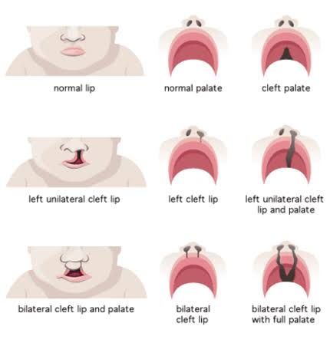

Slide 20
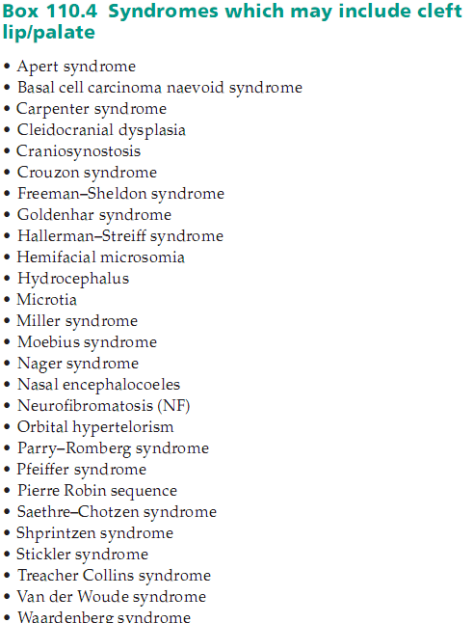

Slide 21
TGF‐α , PVRL1 ,RARA, TBX22, GAD, IRF6 ,MSX1 and FGF.
Dental, skeletal, feeding, ear, speech problems
Prenatal USG

Slide 22
Lip Alone cosmetic repair 3-6 months
Cleft Palate surgical repair 6-12months
Age 1-5 years Ear ventilation tubes for good hearing
Age 5-13 years (orthodontist) malocclusion, bone grafting
(speech pathologist) pharyngoplasty
Age 13-18 years scar revisions, rhinoplasty orthodontic surgery

Slide 23
Orocutaneous syndromes
Disease | Oral Manifestations
Cowden syndrome | Smooth, pink or whitish fibromas on palatal, gingival and labial mucosae
De Lange syndrome | Long philtrum, crescent shaped mouth with down turned corners
Double lip | Fold of redundant tissue on the inner aspect of lip
Down syndrome | Cleft lip and palate, angular cheilitis
Erythropoietic protoporphyria | Scars on lips, perioral furrowing (pseudorhagades)
Focal mucinosis | Elevated mass on gingiva and alveolar mucosa
Gardner syndrome | Jaw Osteomas, Dental anomalies
Gorlin syndrome | Keratocystic odontogenic Tumors(KCOT)

Slide 24
Disease | Oral Manifestations
Jacob disease | New joint formation b/w mandible and zygomatic arch
Kindler syndrome | Atrophy of buccal mucosa, white patches on gingiva and mouth
Lip pits and sinuses | Small blind fistulae on vermilion border
Noonan syndrome | Oral keratosis, giant cell lesions of jaws
Tuberous sclerosis | pit‐shaped enamel defects in both dentitions, and gingival fibromatosis
Van der Woude syndrome | lower lip pits are with cleft lip and/or palate
Von Recklinghausen neurofibromatosis | Intraoral neurofibromas, Enlarged fungiform papillae
Xeroderma pigmentosum | Squamous cell CA

Slide 25
ACQUIRED DISORDERS OF THE ORAL
MUCOSA OR LIPS
Mouth ulcers of local etiology
Eosinophilic ulcer of the oral mucosa (EUOM)
Traumatic eosinophilic granuloma , Rida Fede disease.
Benign, self limited,
painful nodular inflammatory infiltration,
with ulceration.

Slide 26
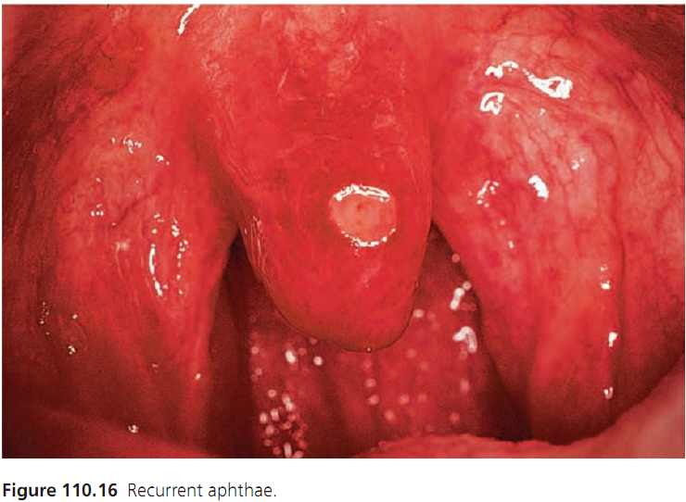
Recurrent aphthous stomatitis
Recurring episodes of ulcers, typically
from Childhood or adolescence, lasting
from 1 to 4 weeks before healing.
Stress, trauma, cessation of tobacco.
Round or ovoid ulcers with a
Circumscribed margin, erythematous
halo and a yellow or grey floor.

Slide 27
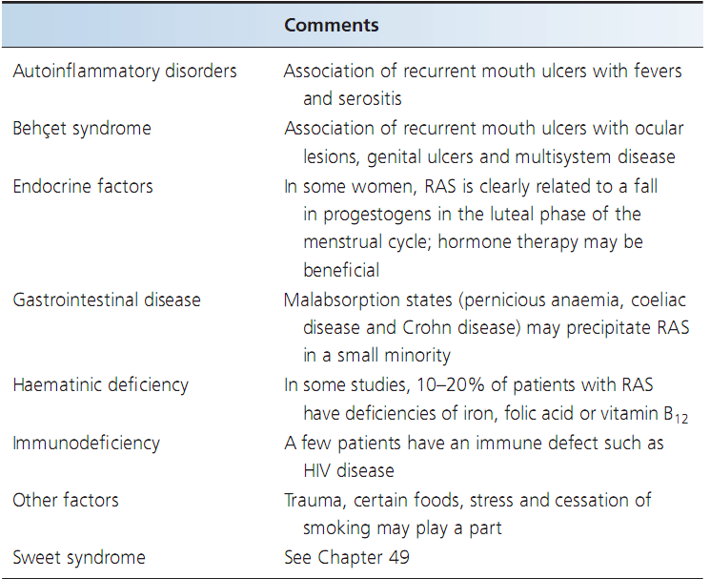

Slide 28
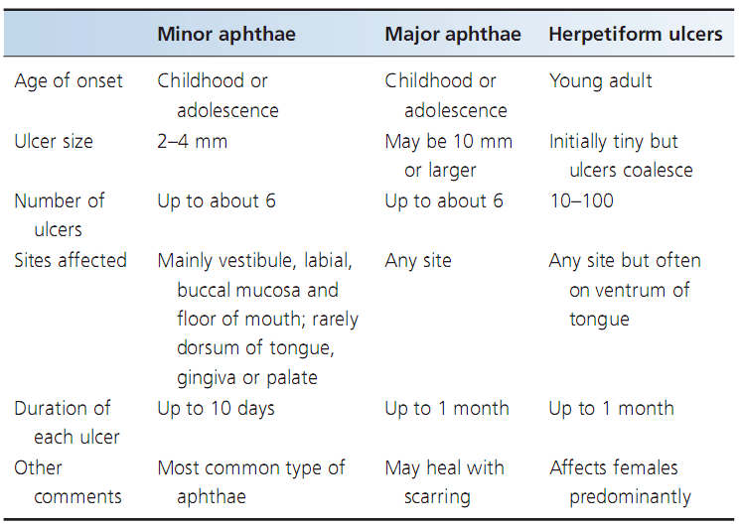

Slide 29
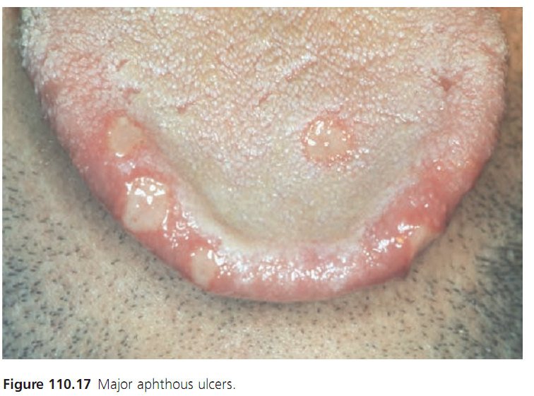
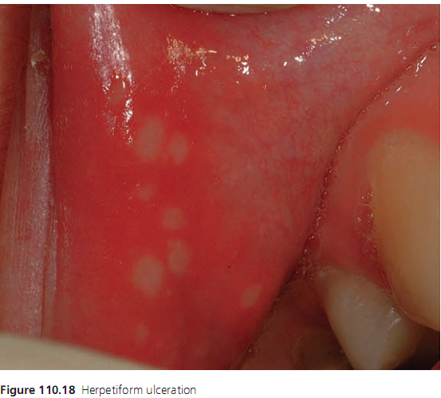

Slide 30
FBC, HB assay, Iron studies, RBC folate level,
serum B12 level, anti endomycial Ab, anti tTG Ab
Correction of predisposing factors, Good oral Hygiene
Mouthwash (chlorhexidine, triclosan)
Topical minocycline, tetracycline
Hydrocortisone pellets , Triamcinolone paste qid.

Slide 31
Topical bethametasone, beclomethasone, clobetasol
Systemic corticosteroids
Sucralfate, cochicine, pentoxyfylline
thalidomide 50-300mg Remission
Vitamin B12
Carbenoxolone, benzydyamine, dapsone

Slide 32
Behçet syndrome
Multisystem disorder characterized by recurrent oral
ulcers, genital ulcers and Ocular lesions.
Etiology is uncertain. HLA-B5,HLA-B51, B101, MICA6,
HLA-DR/DQ association.
Genetic, Autoimmune and vascular dysfunction.
Systemic perivasculitis, endothelial swelling and panvasculitis

Slide 33
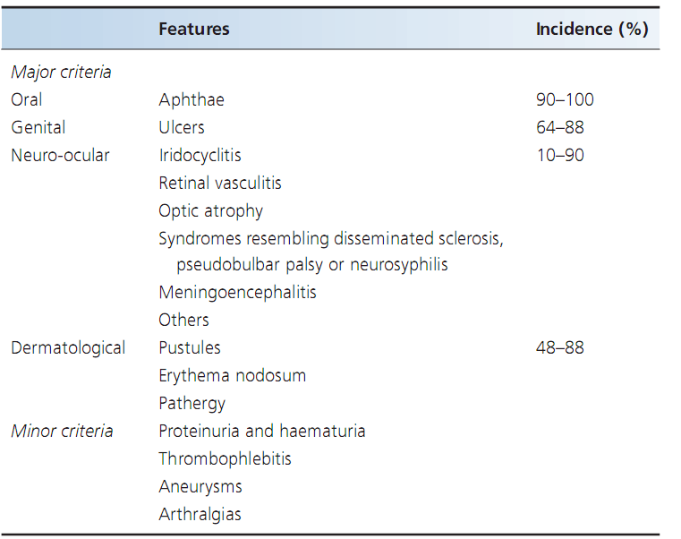

Slide 34
The diagnosis is made on the basis of recurrent aphthous
Stomatitis plus two or more of following
1. Recurrent genital ulceration
2. Eye lesions
3. Skin lesions
4. pathergy test.

Slide 35
Oral ulcers
Topical corticosteroid, 5‐aminosalicylic acid nicotine
patches
Systemic
colchicine 0.5–1.5 mg daily ,corticosteroids, azathioprine,
ciclosporin, chlorambucil, cyclophosphamide, dapsone,
interferon‐α, levamisole, thalidomide and anti‐TNF‐α biologicals.

Slide 36
Malignant neoplasms
Oral Squamous cell Carcinoma
Most common site for cancer in the head and neck.
Lip cancer; most occur on the lower lip
Intraoral cancer; most develop on the lateral tongue and the
Floor of the mouth
Oropharyngeal cancer; arise in the fauces/posterior tongue.

Slide 37
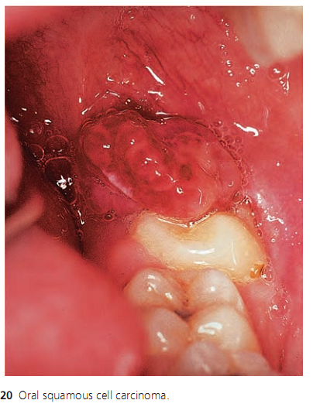
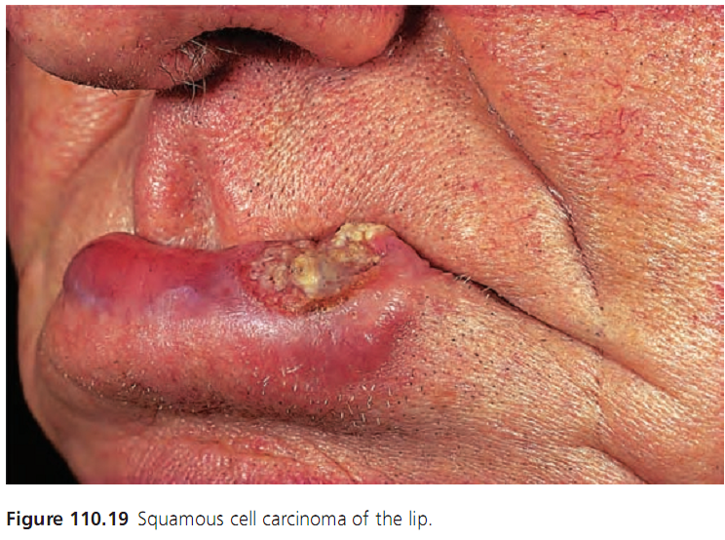

Slide 38
Predisposing factors
Over 45
Male
Low socioeconomic class
Tobacco use
Betel use
Alcoholic beverages
A diet poor in fresh fruit and vegetables.
In the case of lip carcinoma, exposure to sunlight.
In the case of oropharyngeal carcinoma, exposure to human
papillomavirus (HPV).

Slide 39
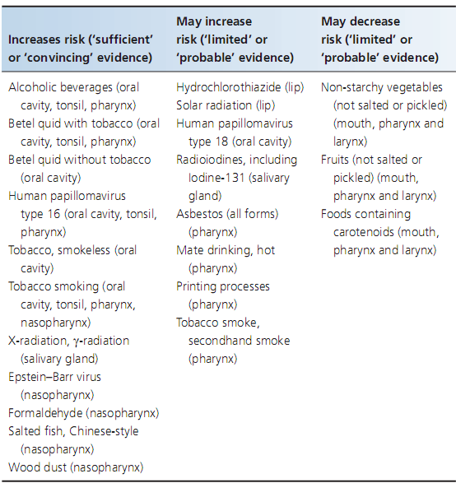
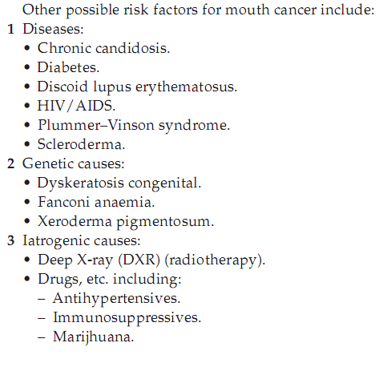

Slide 40
CLINICAL PRESENTATION
Initially red or red and white (erytholeukoplastic)
area without symptoms.
In advance stages red or red and white single lesion, ulcer or lump
with irregular margins which are rigid to touch (indurated)
and there may be pain.
Lesion of more than 3 weeks (red and/or white, ulcer, lump)
should be regarded as suspicious and biopsy be arranged.

Slide 41
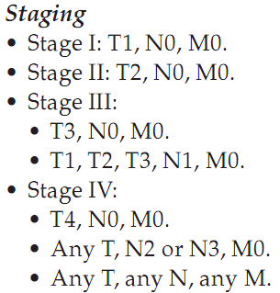
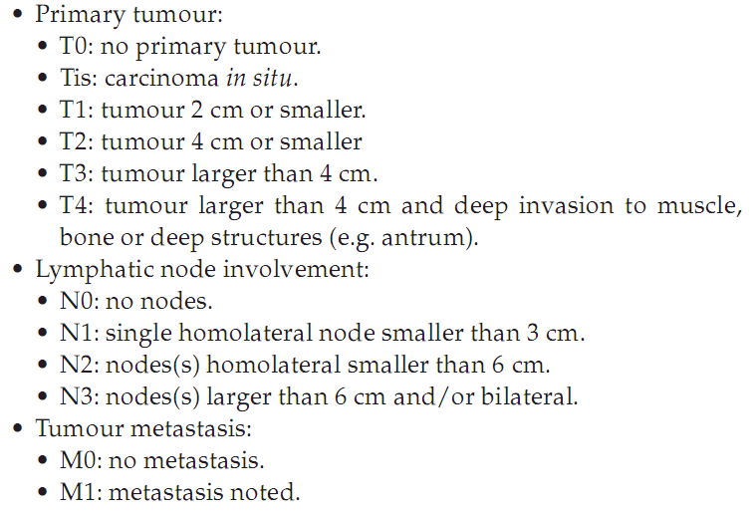
TNM CLASSIFICATION

Slide 42
• Stage 0 or carcinoma in situ :
this is a very early stage cancer.
• Stage 1 : this is the earliest stage of invasive cancer;
it is <2 cm across and has not spread to nearby tissues,
lymph nodes or other organs.
• Stage 2 : this is >2 cm across, but <4 cm
and has not spread to lymph nodes or other organs.

Slide 43
Stage 3 :
Either the cancer is >4 cm
but has not spread
to any lymph nodes or other parts of the body,
or
the tumor is any size but has spread to one lymph node
on the same side of the neck as the cancer.

Slide 44
Stage 4
Stage 4A
through the tissues, LNs may or may not
Stage 4B
Any size and has spread to more than one
LNs on the same side of the neck OR
LN is bigger than 6 cm.
Stage 4C
Spread to other parts(lungs or bones)

Slide 45
INVESTIGATIONS
Conventional oral examination (COE)
Examination under general anesthesia (EUA)
Endoscopy
PET
CT
FNA, US-FNC
Sentinel LN biopsy (SNLB)
Biopsy from the primary site.

Slide 46
TREATMENT
Lip cancer → Surgery
Intraoral cancers
T1 → Surgery or Radiotherapy
T2 → Surgery
Tumor of lateral margin of tongue Radiotherapy
plus iridium implant.
If LNs Surgery together with Radiotherapy
T3 → Surgery followed by Radiotherapy
T4→ Chemotherapy

Slide 47
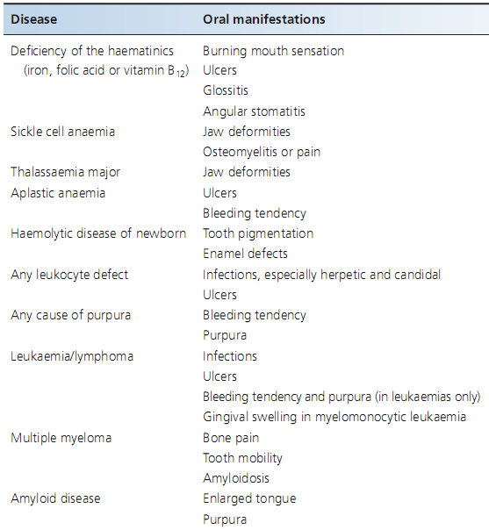
Ulcers in association with systemic disease
Haematological diseases

Slide 48
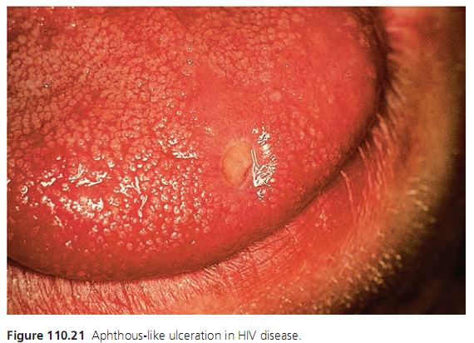
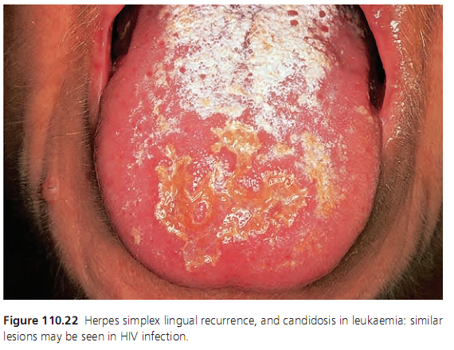

Slide 49
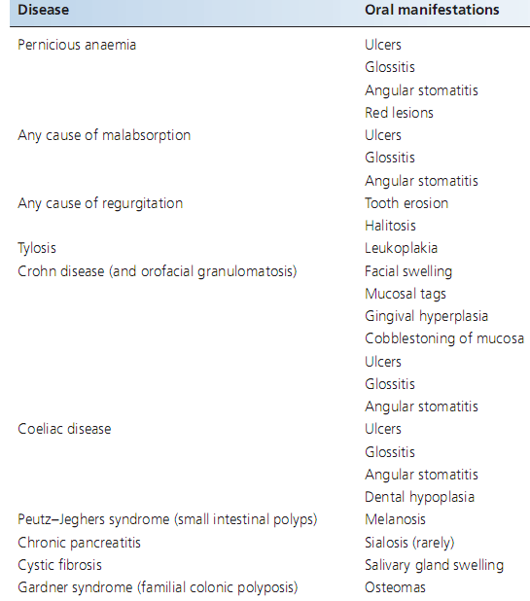
Gastrointestinal diseases

Slide 50
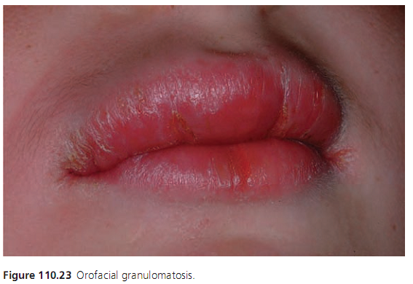
Orofacial Granulomatosis
Granulomatous inflammation resulting
In lips swelling, oral ulceration, mucosal
Tags, angular cheilitis and cobblestone
Mucosa.
Investigation done to rule out Crhon’s
Disease.
Elimination diet, topical and I/L steroids and clofazimine.

Slide 51
Dermatological diseases
Chronic ulcerative stomatitis with epithelial ANA
Desquamative gingivitis with or without
lesions on buccal or lingual mucosa
Chronic bullous dermatosis of childhood
Oral ulceration and desquamative gingivitis
Dermatitis herpetiformis and adult linear IgA disease
Macules, papules, petechiae, vesicles, bullae and erosions
or desquamative gingivitis

Slide 52
Epidermolysis bullosa acquisita
Blisters/ulcers of oral mucosa
Erythema multiforme
Blisters break down to irregular extensive painful erosions with extensive surrounding erythema

Slide 53
Lichen planus
Oral LP eight times more common than cutaneous LP.
Vulvovaginal gingival syndrome
Oral LP, gingival involvement, vulvovaginal lesions
Bilateral white lesions in the buccal and/or lingual mucosa
Reticular, papular or plaque like. Symptomless.

Slide 54
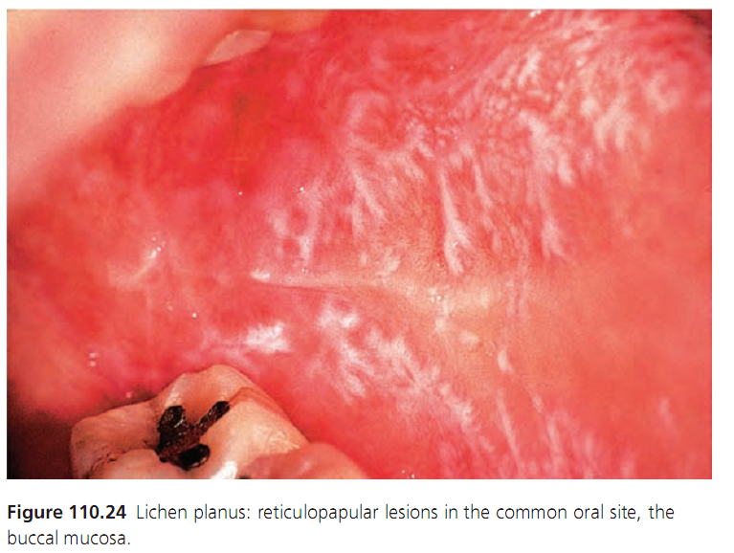
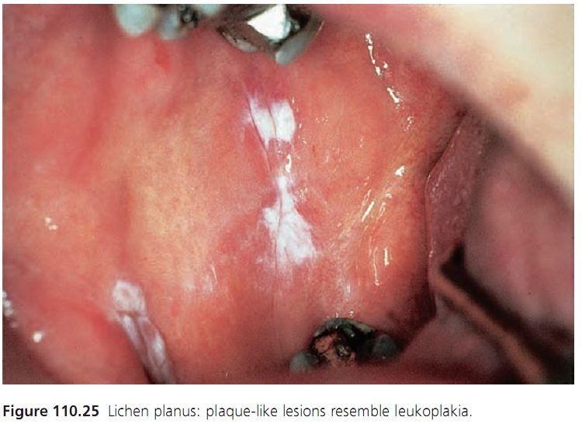

Slide 55
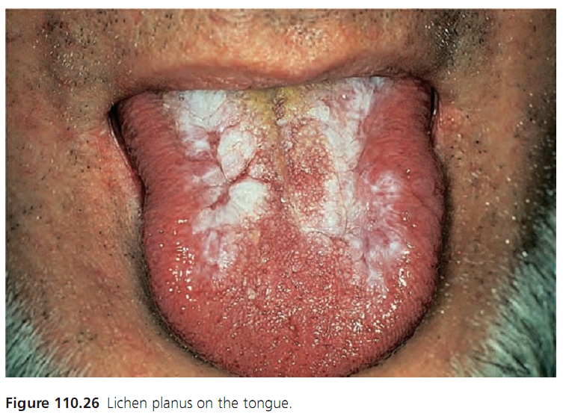
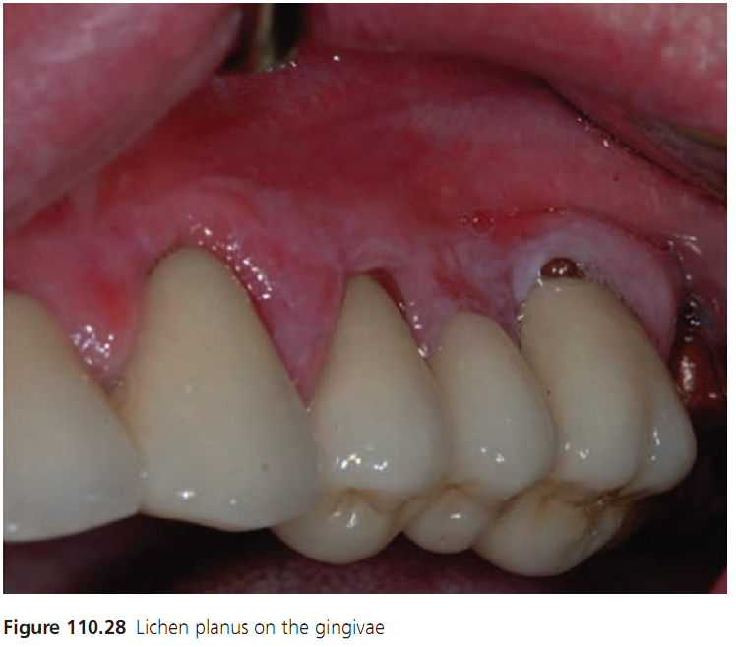

Slide 56
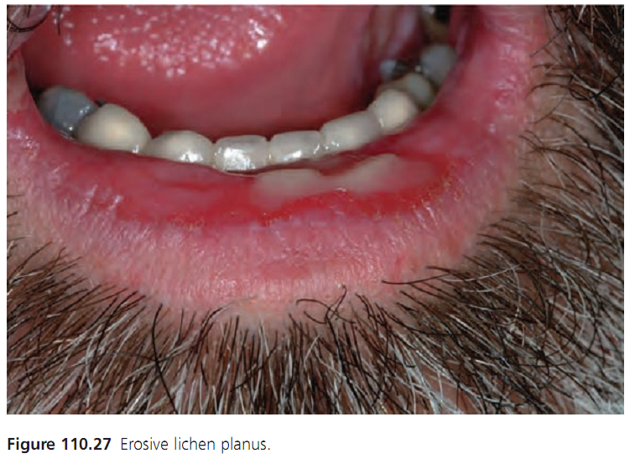
Erosive LP
Affects dorsum and
lateral borders of the tongue or
the buccal mucosae on both sides.
Erosions are often large,
slightly depressed or
raised with a yellow slough,
and have an irregular outline.

Slide 57
Correction of predisposing factors
Culprit drugs identified and changed
DM, HCV treatment
Oral hygiene
Topical corticosteroids
High potency topical corticosteroids
Topical ciclosporin or tacrolimus with topical steroids
Systemic steroids, azathioprine, cyclophosphamide,
HCQ, actretin, thalidomide or ciclosporin.`

Slide 58
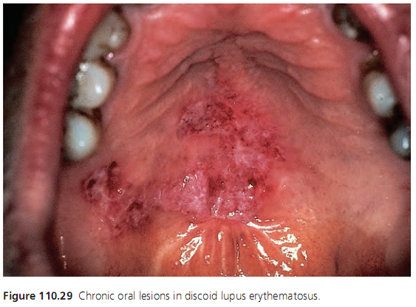
Lupus erythematosus
Red patches that break down to irregular
slit like ulcers which often heal with
scarring.
Similar lesion with white borders occur
In DLE.
Pemphigoid (subepithelial immune bullous diseases)
oral blisters, Erosions and desquamative
Gingivitis.

Slide 59
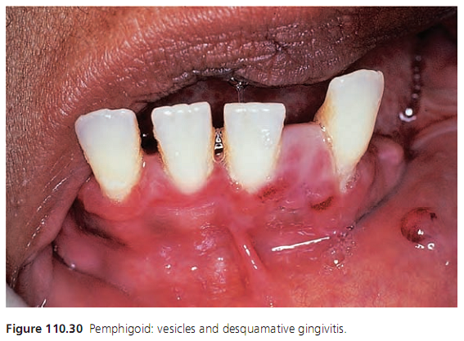
Mucous membrane pemphigoid
involves the oral mucosa in one‐third of cases
desquamative gingivitis characterized
By erythematous glazed sore gingivae.
Biopsy is required for diagnosis.
Topical steroids or tacrolimus
Tetracyclines, Dapsone, Infliximab.

Slide 60
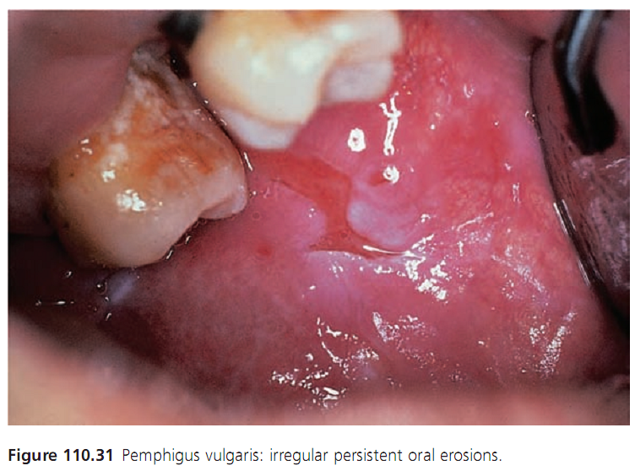
Vegetating cicatricial pemphigoid (synonym pemphigoid vegetans)
Oral Blisters and Erosions
Pemphigus
Bullae appear on oral mucosa,
breaks rapidly patient presents
with large, painful, irregular and
persistent red lesions, by the time
They become secondarily infected.

Slide 61
Diagnosis should be confirmed by biopsy and immune studies.
Patients with predominantly oral disease may only have Dsg3 antibodies
corticosteroids, with azathioprine, dapsone, methotrexate, cyclophosphamide, gold or cilosprin.

Slide 62
Paraneoplastic pemphigus
Associated with lymphoproliferative disease or thymoma
Painful extensive stomatitis, painful paronychia and lichenoid
papules.
I.V steroids, rituximab and mycophenolate
Pemphigus vegetans
Hyperplastic masses

Slide 63
Stevens–Johnson syndrome/toxic epidermal necrolysis
Extensive detachment of full‐thickness epithelium.
Cough, sore throat, burning eyes, malaise and low fever, followed after about 1–2 days by skin and mucous membrane lesions.
Oral lesions 2% lidocaine (lignocaine) and
0.2% aqueous chlorhexidine mouth baths.

Slide 64
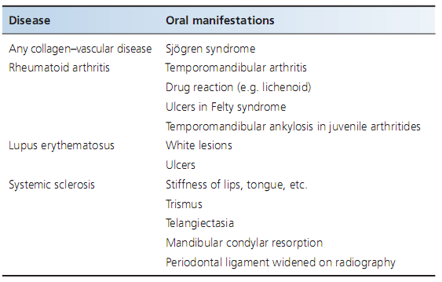
Collagen–vascular diseases

Slide 65
Infective diseases
Viral
Disease | Oral Manifestations
Chikungunya | Oral ulceration
Dengue | Gingival bleeding and taste changes
Herpengina | Oral ulcers predominantly on soft palate
Hand Foot and Mouth disease | Oral ulcers (round)
Herpes simplex stomatitis | Diffuse, purple, boggy Gingivitis(Herpetic Gingivostomatitis) Vesicles followed by ulcers of oral mucosa and gingiva
Chicken pox | Oral ulcers
Herpes zoster | Oral ulcers in the distribution of involved nerve division
Epstein Barr virus | Oral ulceration, soft palate petchiae and whitish exudate on tonsil
Cytomegalovirus | Oral ulcers

Slide 66
Herpes simplex stomatitis
Malaise, anorexia, irritability, fever, enlarged and
tender anterior cervical LNs, and a diffuse, purple,
boggy gingivitis, with multiple vesicles followed by
round or ovoid ulcers scattered across the oral
mucosa and gingiva.
Resolves spontaneously in 7-14 days.
FBC, Nucleic acid studies, immunodetection and
antibody titre.

Slide 67
• Encourage patient not to touch lesions.
• Encourage patient not to transmit.
• Avoid sharing eating utensils, or toys.
• Wash utensils by dishwasher, or by hand.
• Wash hands frequently.
• Blisters and sores should be kept dry.
• Antiviral medications can shorten outbreaks.

Slide 68
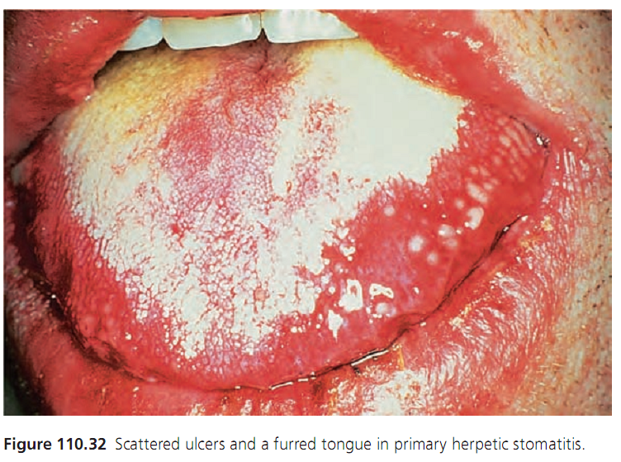
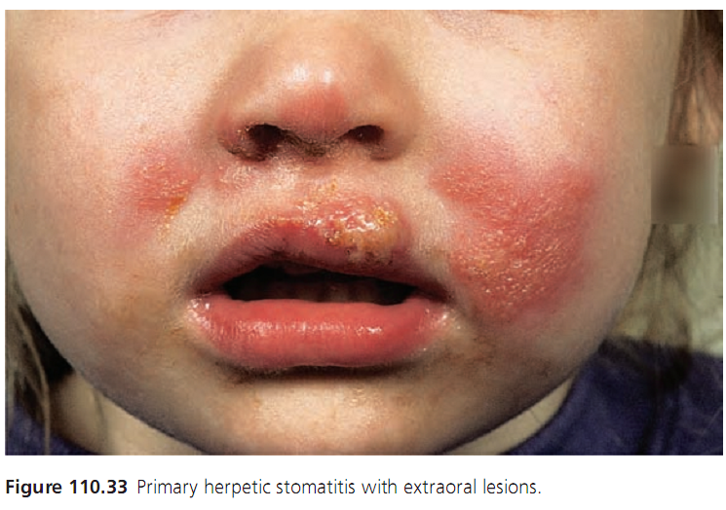

Slide 69
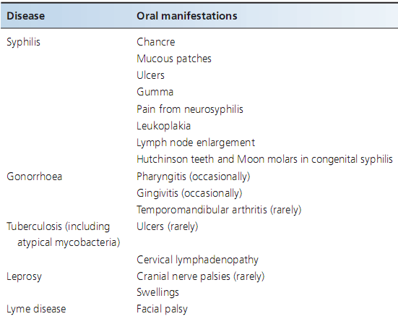
Bacterial infections

Slide 70
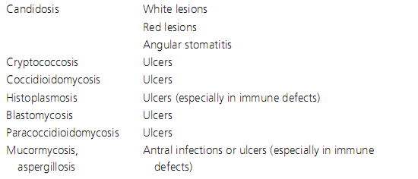
Fungal Infections
Disease | Oral manifestations

Slide 71
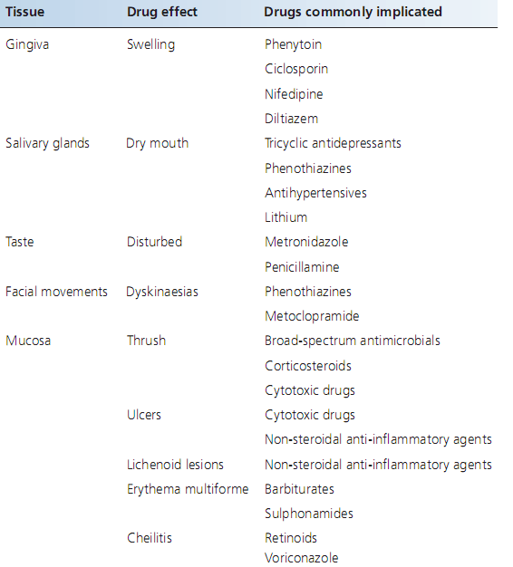
Drugs

Slide 72
LOSS OF ELASTICITY OF ORAL TISSUES
Oral submucous fibrosis
chronic disease of the oral mucosa
caused by exposure to constituents of the Areca nut.
Betel quid, gutka, Pan, Mawa etc.
Early stages I/L steroids, Jaw exercise
Fibrosis Surgery

Slide 73
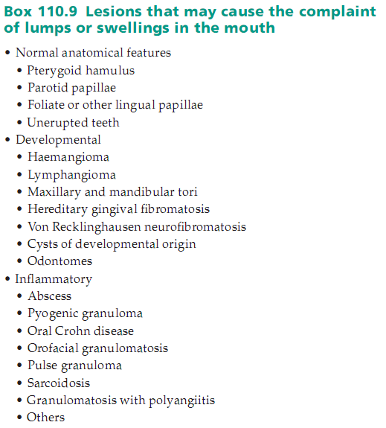
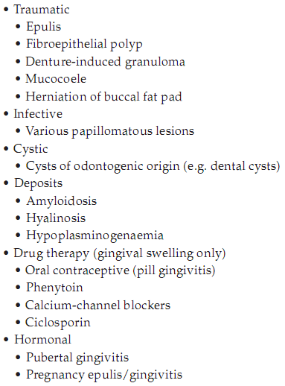
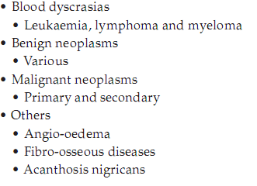

Slide 74
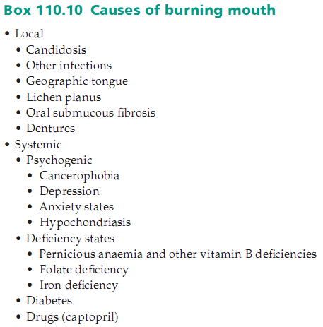
ORAL SORENESS WITHOUT ULCERATION
Burning mouth syndrome
Chronic burning sensation of the mouth
Primary and Secondary
Avoiding things that aggravates symptoms
Reassurance, CBT
Topical benzydamine 0.01% rinse or spray
Antidepressants, Topical capsaicin cream
Clonazepam tablet, α‐lipoic acid systemically.

Slide 75

Deficiency glossitis
Deficiency of iron, folate or vitamin B12 ,
associated with angular stomatitis
and mouth ulcers.
Alcoholics and Malabsorption
Anemic glossitis tongue red sore
and smooth.

Slide 76


PIGMENTED LESIONS

Slide 77




Pigmented lesions

Slide 78

Candidosis

Slide 79




Slide 80
Management
Acute→ Topical polyenes (nystatin, amphotericin)
Imidazoles (miconazole)
HIV→ARVT, antifungals
Chronic Hyperplastic→ flucytosine, ketoconazole, fluconazole,
itraconazole, voriconazole or caspofungin.
Denture related stomatitis→ Disinfection, antifungal medications
Median Rhomboid glossitis→ smoking cessation, antifungals

Slide 81
Leukoplakia
White patch or plaque on the mucosa that cannot
be rubbed off and that is not recognized as a
specific disease entity.
Homogenous Leukoplakia(flat, thin, uniform white)
Non‐homogeneous leukoplakia, either
white and red lesion (erythroleukoplakia), that may be
either irregularly flat (speckled), or
Nodular, or Verrucous

Slide 82



Slide 83

Surgical excision
CO2 laser therapy

Slide 84

ACQUIRED LIP LESIONS
Actinic cheilitis
keratosis of the lip caused by exposure
to solar irradiation.
Redness and edema → Dry and scaly
→Plaques → Warty nodules
5% flurouracil tds 10 days
TCA, topical tretinoin, diclofenac gel,
Vermilionectomy (lip shave)
Laser ablation, Photodynamic therapy

Slide 85
Actinic Prurigo
photodermatosis characterized by symmetrical involvement of sun exposed areas of the skin, lips and conjunctivae.
Intensely itchy, excoriated papular and nodular skin eruption, and
lip pruritus, edema, scales, fissures, crusts and ulceration
Sunscreens, β‐carotene, psoralen
and UVA (PUVA), and antihistamines.

Slide 86

Angular chelitis
acute or chronic inflammation of the skin
and contiguous labial mucous membrane
at the angles of the mouth.
Triangular area of erythema
and edema at angle of mouth
Denture removal at night and disinfection.
Antifungals.
Fusidic acid for staphylococcal infection.

Slide 87
Cancer pf the lip
Basal cell carcinoma
Ulcerated nodule or papule
Nodular
Morphoeic
Superficial
scalpel, electrosurgery, cryosurgery and laser
surgery, radiation, curettage and intralesional
chemotherapy or α‐interferon.

Slide 88
Keratoacanthoma
Rapidly growing lesion arises from the supraseboglandular part of a sebaceous gland.
Manifest at the vermilion border, as indurated dome shaped nodules displaying a characteristic central, keratin filled, crusted and frequently darkened crater.
Surgical excision. Intralesional therapy with methotrexate or 5‐ fluorouracil, intralesional interferon α‐2a and systemic isotretinoin

Slide 89
CHEILITIS
Contact Cheilits
Inflammatory reaction provoked by the irritant or sensitizing
action of chemicals. Most common sources women
(lip cosmetics) men (tooth pastes).
Persistent irritation and scaling or a more acute
reaction with edema and vesiculation.
Offending agent should be avoided.
Topical steroids or pimecrolimus.

Slide 90


Slide 91

Drug‐induced cheilitis
Etretinate and isotretinoin and voriconazole causes cheilitis,
dryness and cracking of the lips.

Slide 92

Eczematous cheilitis
Secondarily to atopic eczema
Emollients and topical steroids

Slide 93
Exfoliative cheilitis (Factitious Cheilitis)
chronic superficial inflammatory disorder of the vermilion
borders of the lips characterized by persistent scaling.
Common in young girls, irritation or burning and
can be observed frequently biting or sucking the lips.
Oral hygiene, moisturizing agents, topical steroids or
Tacrolimus, psychotherapy and antidepressants.

Slide 94



Slide 95
Foreign body cheilitis
Injectable fillers may induce foreign body reactions
Dimethylpolysiloxane (silicone), bovine collagen, polylactic acid,
polymethylmethacrylate (PMMA) and polyethylene.
Painless or painful, diffuse lip or facial swellings
Foreign body granulomas with multinucleated giant cells
Steroids

Slide 96
Glandular cheilitis
Inlfammatory changes and swelling of salivary
glands in the lips
Lower lip thickness and swelling, numerous
pinhead‐sized orifices.
Excision of affected tissue, vermilionectomy.

Slide 97

Granulomatous cheilitis
Chronic swelling of lip due to granulomatous
inflammation of unknown cause.
Melkersson–Rosenthal syndrome
Labial edema, fissured tongue and recurrent facial palsy

Slide 98
Sudden diffuse or nodular swellings, fissured tongue
Regional LNs, facial palsy, fever, headache.
Sarcoidosis, tuberculosis, orofacial granulomatosis
Crohn disease
I/L Triamcinolone, Topical pimecrolimus 1%.
Metronidazole, penicillin, erythromycin,
Sulphasalazine, clofazimine.

Slide 99
Infective cheilitis
Viral→ HSV, VSZ, HPV
Bacterial→ syphilis, TB, Rhinoscleroma
Protozoal→ Leishmaniosis
Fungal→ Blastomycosis, paracocidomycosis
Plasma cell cheilitis
Circumscribed flat or elevated patches of erythema
If genitals involved plasma cell balanitis or vulvitis
Clobestol, triamcinolone, griseofulvin, tacrolimus

