Slide 1
Dermatoses Resulting from Disorders of the Veins and Arteries
Dr. Shama Benazir
PGT Dermatology BBH

Slide 2
Arterial disease and peripheral ischaemic disorders
Definition and nomenclature
Disorders where the arterial blood supply to the limb (usually the leg) is damaged by atherosclerosis, a chronic disorder that can result in intravascular thrombosis that leads to damage and death of the tissues.
Synonyms and inclusions
• Atherosclerosis
• Peripheral ischaemia
• Peripheral vascular disease

Slide 3
Epidemiology
Atherosclerosis is responsible for more than 90% of all arterial disease in the Western world.
It affects 5% of men over the age of 50 years, of which 10% may develop critical limb ischaemia; this increases to 20% if diabetic patients are included
Apart from diabetes, tobacco smoking is one of the most important risk factors for arterial disease.
A family history of arterial disease and the presence of hyperlidaemia are the two other major factors associated with atherosclerosis

Slide 4
Pathophysiology
This is a multifactorial disorder but it is thought that the underlying mechanism is immunological.
Cardiovascular risk factors induce endothelial injury and endothelial dysfunction. Monocytes recruited to the inflamed endothelium of blood vessels differentiate into phagocytic macrophages which scavenge modified lipids to produce foam cells.
This is the basis for the development of the lipid‐rich atheroma core, there is further influx and inflammation leading to unstable atherosclerotic plaques which can eventually ulcerate through the endothelial lining exposing a highly thrombogenic surface.
Platelets adhere to the ulcerated plaque and platelet aggregates may embolize distally or may initiate local thrombosis.
Inadequate collaterals, or occlusion by thrombosis or embolism, will lead to tissue infarction (e.g. peripheral gangrene).

Slide 5
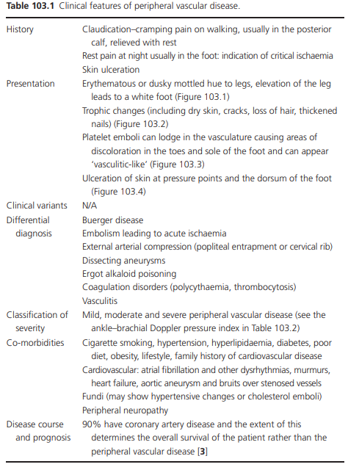

Slide 6
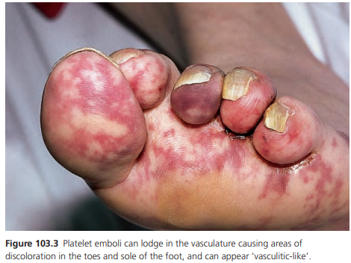

Slide 7
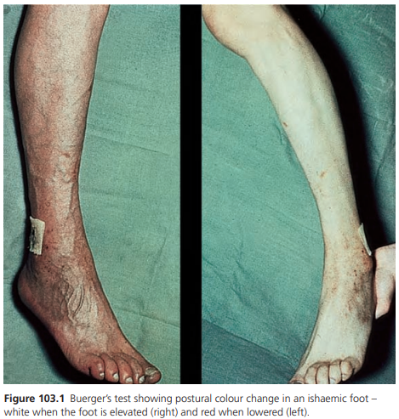

Slide 8
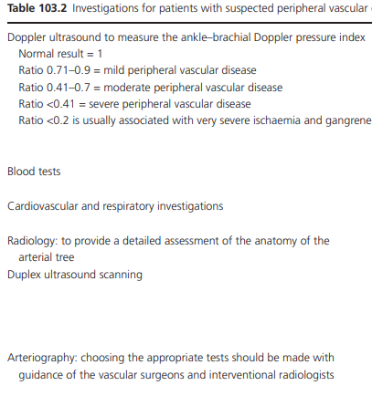

Slide 9
Management
Once the diagnosis of peripheral vascular disease is made, the patient is best managed by a vascular surgeon who can address the underlying cause.
Treatment options differ for patients presenting with claudication, rest pain or gangrene and acute limb ischaemia

Slide 10
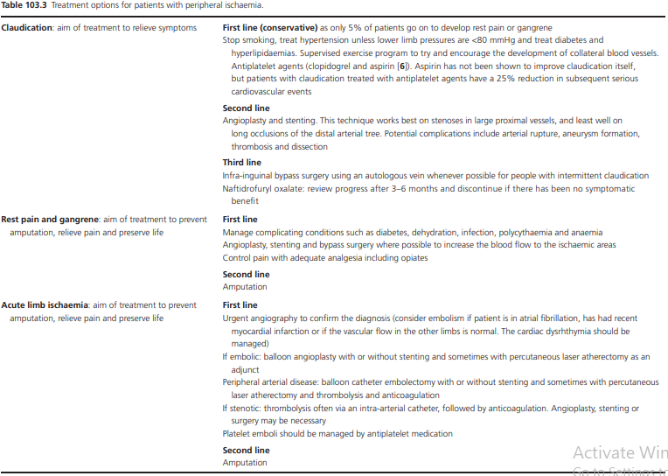

Slide 11
Thromboangiitis obliterans
This is a non‐atherosclerotic segmental infl ammatory disease of the small and medium sized arteries of the distal extremities of predominantly young male smokers
Synonyms and Inclusions
Buerger Disease

Slide 12
Introduction and general description
Thromboangiitis obliterans (Buerger disease) appears to be a distinct condition separate from other forms of vascular occlusion with differences in the pathological appearance of the vessel wall, and in the population affected, compared with other arterial diseases.

Slide 13
Epidemiology
Incidence and prevalence
It is a rare condition. The prevalence is falling in the USA, from 104/100 000 in 1947 to 13/100 000
Age
Most are under 40.
Sex
The number of women with the condition is rising but is about 11% in the USA

Slide 14
Pathophysiology
Predisposing factors
The aetiology of this condition is unknown although tobacco addiction is invariably a major contributing factor, and a failure to overcome this addiction is associated with progressive occlusion of the vessels
Pathology
Circulating autoantibodies have been identifi ed, in particular antiendothelial cell antibodies are present in high titre in active disease.
Antibodies have a pathogenic role and can be used to monitor disease activity. The full thickness of the vessel wall is invaded by lymphocytes, eosinophils, plasma cells and monocytes which disrupt the internal elastic lamina.

Slide 15
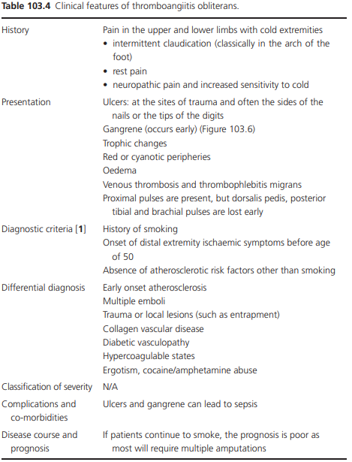

Slide 16
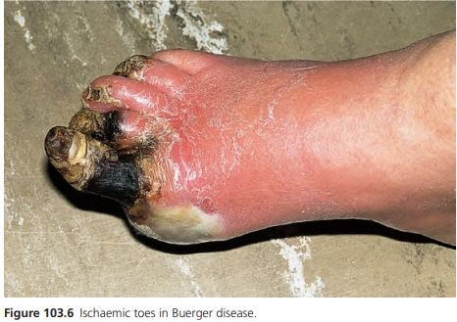

Slide 17
Investigations
There are no diagnostic tests but angiography shows arterial occlusion and the development of corkscrew collaterals.
The erythrocyte sedimentation rate (ESR) may be elevated and blood tests should be undertaken to exclude collagen vascular disorders and coagulation abnormalities.

Slide 18
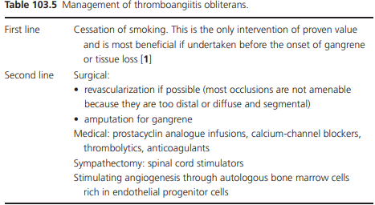

Slide 19
NEUROVASCULAR DISORDERS
Erythromelalgia
Introduction and general description
Erythromelalgia is derived from the Greek erythros = red, melos = limb and algos = pain.
The painful burning attacks typically affect the hands or feet but can involve the face and ears.
It is a disabling disorder which may be primary idiopathic or hereditary (15% of patients have been shown to have a mutation in the SCNA9A gene) or secondary to thrombocythaemia and polycythaemia.
It is poorly understood and treatment is often unsuccessful.

Slide 20
Synonyms and inclusions
• Mitchell disease (after Silas Weir Mitchell )
• Acromelalgia
• Red neuralgia
• Erythermalgia

Slide 21
Incidence and prevalence
There is not much data on the incidence of this rare condition.
One study from the USA suggested a rate of 1.3/100 000 of the general population with 5% of those having the primary inherited form
Age
Age of onset is variable and though earlier reports from the Mayo Clinic suggested a median onset age in the primary form of 10 years, later studies showed a wide range of onset: 5–91 years, with a median age of 60 overal

Slide 22
Sex There is a small female predominance.
Ethnicity
There is no current evidence that this is relevant.
Associated diseases
Erythromelalagia may be secondary to myeloproliferative disorders in 9–19% of cases

Slide 23
Pathophysiology
Primary erythromelalgia
Erythromelalgia is the first condition in which an ion channel mutation has been associated with chronic pain
15% of cases are due to genetic mutations.
Other cases are thought to have a non‐genetic cause or may be mediated by mutations in one or more as yet unidentified genes.
Ten mutations in the SCN9A gene have been identified in erythromelalgia

Slide 24
The SCN9A gene codes for the α‐subunit of a sodium channel called NaV1.7. Sodium channels transport positively charged sodium ions into cells.
They act as threshold sensors and initiate action potentials.
The mutations alter the activation profile to produce channels that are open for a longer period of time, leading to more prolonged changes in the membrane potential

Slide 25
The hyperexcitability of the C fibres in the dorsal root ganglion leads to the burning pain that characterizes erythromelalgia.
In the sympathetic system, there is hyporeactivity resulting in altered vascular responses to stimuli such as heat and exercise, which causes persistent vasodilatation of the affected skin

Slide 26
Secondary erythromelalgia
In cases associated with thrombocythaemia, biopsies have revealed arteriolar fi brosis and vascular occlusion due to platelet thrombi.
It is thought the abnormally functioning platelets in thrombocythaemia clump in vessels and induce neurovascular damage by triggering inflammation

Slide 27
Causative organisms
There has been epidemic outbreaks of erythromelalgia reported in students in rural China.
The cause is unknown but poxviruses were isolated from throat swabs of several patients in different areas and at different times of the year

Slide 28
Environmental factors
Eating certain fungi, such as Clitocybe acromelalgia (Japan) and Clitocybe amoenolens (France), has lead to reports of mushroom‐ induced erythromelalgia which has persisted for up to 5 months following ingestion.
In medication‐induced erythromelalgia, calcium‐channel blockers and bromocriptine can trigger the condition

Slide 29
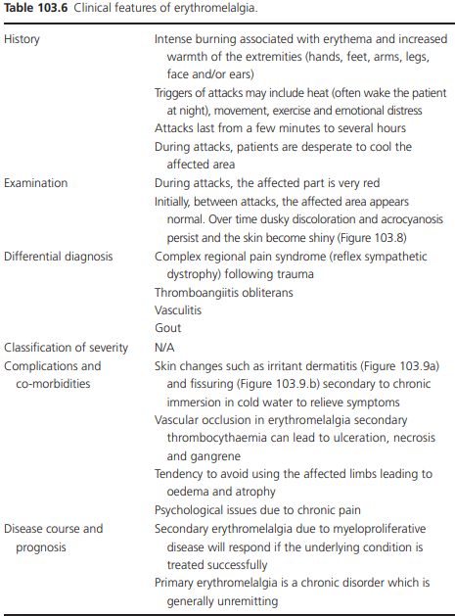

Slide 30
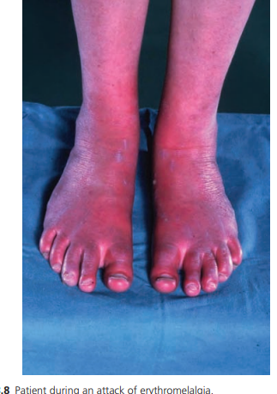
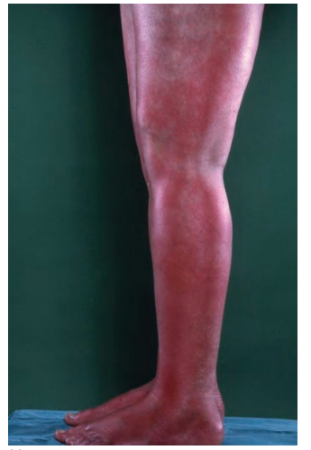

Slide 31
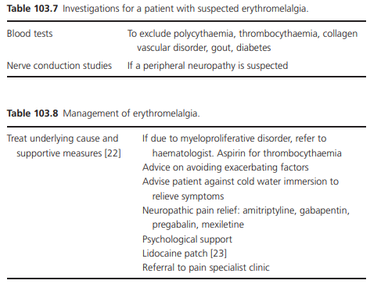

Slide 32
TELANGIECTASES
Introduction and general description
Telangiectases appear on the skin and mucous membranes as small, dull red, linear, stellate or punctate markings.
They represent dilatations (expansion, stretching) of pre‐existing vessels without any apparently new vessel growth (angiogenesis) occurring.
As such, telangiectases can be bracketed with spider angioma (spider naevi) and capillary aneurysm–venous lakes, whereas vascular malformations represent anomalies of embryological development (disturbances in vasculogenesis or angiogenesis

Slide 33
Pathophysiology
The telangiectases are a heterogeneous group of disorders.
They can be broadly divided into primary and secondary according to their aetiology though one of the commonest naevi (spider naevi) can be both

Slide 34
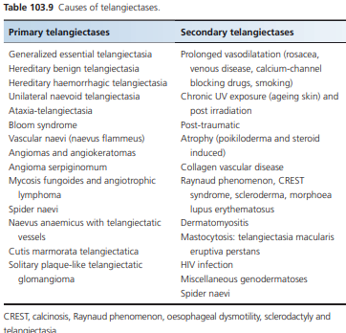

Slide 35
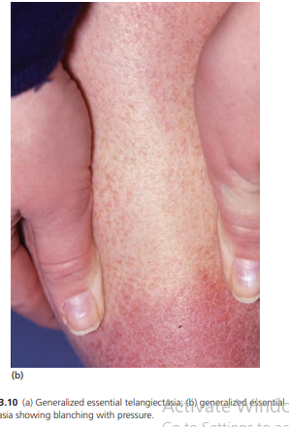

Slide 36
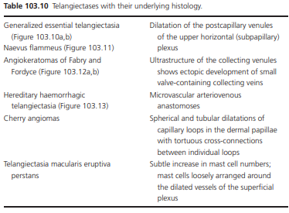

Slide 37
Spider telangiectases
Introduction and general description
These are common small vascular lesions found on the skin of the upper body which are benign.
They have a characteristic appearance which can resemble a spider
Synonyms and inclusions
• Arterial spider • Spider naevus • Naevus araneus • Spider angioma

Slide 38
Spider telangiectases may be solitary or multiple.
Their characteristic appearance is due to a central red arteriole (which resembles the body of the spider) surrounded by a circular pattern of thin‐walled capillaries (which look like the multiple legs of a spider)

Slide 39
Epidemiology
Incidence and prevalence
Spider telangiectases occur in up to 15% of completely normal persons
Age
They are a frequent fi nding in healthy children
Sex
Commoner in women (especially when pregnant or on the oral contraceptive pill).
Ethnicity
No difference in racial groups has been reported but the lesions are much more visible in patients with less pigmented skins.

Slide 40
Associated diseases
They occur in large numbers during pregnancy – one or more spider naevi are found in two‐thirds of all pregnant women.
They may appear in the first few months, but tend to increase in number until term; they usually disappear within 6 weeks of delivery but may persist or recur in the same sites in subsequent pregnancies.
They are also characteristically found in patients with liver disease, when they can be a presenting sign and in thyrotoxicosis.

Slide 41
Pathology
The main vessel of the spider telangiectasis is an arteriole.
The blood flows from this to the periphery, and then passes into a capillary network.
The pressure in spider telangiectases rises to 40 mmHg.
The lesions consist of a central, ascending, spiral, thick‐walled arteriole which ends in a thin‐walled ampulla just beneath the epidermis.
From the ampulla, thin‐ walled branching channels radiate peripherally in the papillary dermis.
Glomus cells have been described in the wall of the central arteriole

Slide 42
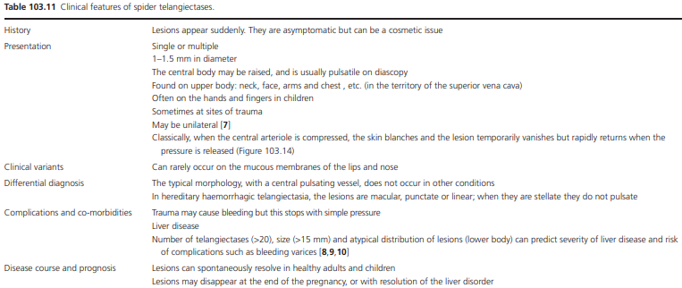

Slide 43
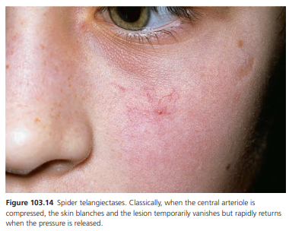

Slide 44
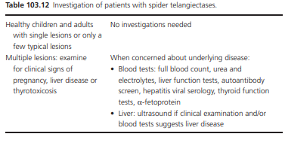

Slide 45
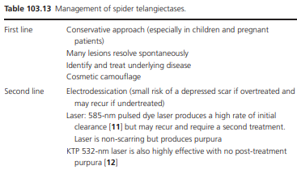

Slide 46
Cherry angiomas
Synonyms and inclusions • Cherry haemangioma • Campbell de Morgan spots • Senile angiomas
Introduction and general description
Cherry angiomas are the commonest angiomas seen in the skin. They are entirely benign and increase in numbers with age
These are cherry red papules seen in the skin due to abnormal vascular proliferations.

Slide 47
Incidence and prevalence
Cherry angiomas were observed in 5% of adolescents and 75% of adults over 75 years of age.
Age They normally spontaneously appear in middle age and increase in number with age though they can fi rst appear in the second decade of life.
Sex There is no difference between the sexes
Ethnicity They occur in all ethnic groups, though are more obvious in patients with less pigmented skins.
Associated diseases They have been reported to appear in pregnancy

Slide 48
Pathophysiology
Pathology
Cherry angiomas are true capillary haemangiomas, formed by numerous, newly formed capillaries with narrow lumens and prominent endothelial cells arranged in a lobular pattern in the papillary dermis.
One study has suggested a possible molecular basis for their pathogenesis.
The level of MicroRNA424 is reduced in cherry angiomas when compared to normal skin.
This is thought to lead to increased expression of MEK1 and Cyclin E1 which in vitro causes endothelial cells to proliferate and could possibly result in the vascular proliferations which make up cherry angiomas

Slide 49
Environmental factors
Exposure to chemicals such as bromides, solvents and mustard gas has been associated with the development of cherry angiomas

Slide 50
Clinical features
History
They appear as small asymptomatic red dots on the skin usually in the third and fourth decade of life.
They often start as pin prick sized lesions which gradually grow.
They increase in numbers with increasing age. Presentation
They may be single or multiple lesions predominantly on the upper trunk and arms.

Slide 51
They can arise anywhere on the skin, although rarely on the hands and feet and not on the mucous membranes.
Typically, they appear as round to oval, bright red, dome‐shaped papules and pinpoint macules varying from less than 1 mm in diameter and up to several millimetres in diameter. The larger lesions may be purple in colour

Slide 52
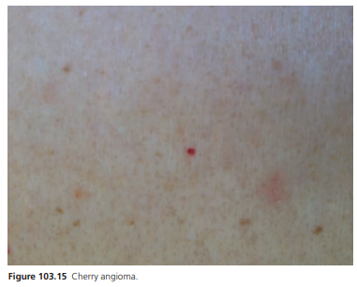

Slide 53
Differential diagnosis
This includes angiokeratomas, infantile haemangiomas, bacillary angiomatosis and blue rubber bleb naevus syndrome
Complications and co‐morbidities
If traumatized cherry angiomas may bleed. They are not associated with underlying disease.
Disease course and prognosis These lesions are benign and increase in number with age

Slide 54
Investigations
The diagnosis is usually made clinically, but a biopsy can be confirmatory in doubtful cases.
Management
No treatment is needed in most cases as cherry angiomas are benign and asymptomatic.
For lesions that are bleeding, or cosmetically troubling, treatment options include shave excision, hyfrecation, cryotherapy and pulsed dye laser and intense pulsed light

Slide 55
Angiokeratomas
Introduction and general description
Angiokeratomas are not true angiomas but occur in existing vessels
They are characterized by superfi cial vascular ectasia and overlying acanthosis or hyperkeratosis.
They may be solitary or diffuse

Slide 56
clinical types of Angiokeratomas
. There are many different clinical types with similar histology.
The main ones are as follows:
• Angiokeratoma of Mibelli – acral skin.
• Angiokeratoma of Fordyce – scrotal skin.
• Angiokeratoma corporis diffusum – seen in Fabry disease
• Angiokeratoma circumscriptum – usually congenital, associated with naevus flammeus, cavernous haemangioma.
• Solitary or multiple angiokeratomas.

Slide 57
Angiokeratoma circumscriptum
Incidence and prevalence
This is not known, though they are much rarer than other telangiectases such cherry angiomas and spider naevi.
Age The lesions may be congenital or acquired and therefore can be present at birth. They are more frequently seen in childhood and early adulthood.
Sex They are commoner in females than males

Slide 58
Associated diseases
Angiokeratoma circumscriptum may coexist with other types of angiokeratomas and with Klippel–Trenaunay syndrome (KTS), naevus flammeus, cavernous haemangiomas and traumatic arteriovenous fistulas

Slide 59
Pathophysiology
Pathology
There is a thin layer of hyperkeratosis with papillomatosis and slight acanthosis of the overlying epidermis.
There are dilated thin‐walled vascular spaces encircled by elongated rete ridges fi lled with red blood cells.
There may be associated telangiectasia in the subcutis .
Genetics
These are not thought to be genetically determined

Slide 60
Clinical features
History
Generally, these lesions are solitary (though multiple lesions may occur in adulthood) and usually occur on the lower extremities.
However, they can occur anywhere on the skin including the tongue and may be multiple and even distributed in band‐like formation.
They are largely asymptomatic but patients usually present because very dark or black in colour and there is a concern about it being a malignant melanoma

Slide 61
Presentation
Angiokeratomas are usually red/blue or purple in colour, sometimes with a slightly rough surface.
They may appear black if they have thrombosed or if they have been traumatized and bled.
Lesions vary from small papules to larger plaques.
Dermoscopy can be helpful in revealing blood‐filled vascular spaces

Slide 62
Differential diagnosis
This includes other angiokeratomas, malignant melanoma and cherry angiomas.
Complications and co‐morbidities
Trauma may lead to bleeding and/or thrombosis. Disease course and prognosis
The lesions are benign and generally resolve spontaneously

Slide 63
Investigations
No investigations are needed for isolated lesions. If there are multiple lesions, Fabry disease should be considered and genetic testing undertaken

Slide 64
Management
None is needed if the lesions are asymptomatic.
If there is diagnostic diffi culty, they can be surgically excised.
Other treatment modalities that can be adopted are hyfrecation for superfi cial and small lesions and curettage and cautery and cryotherapy.
Different lasers have been used (argon, carbon dioxide, erbium) but the KTP laser or 800‐nm diode laser appears to be both effective and the least scarring thus giving the best cosmetic result

Slide 65
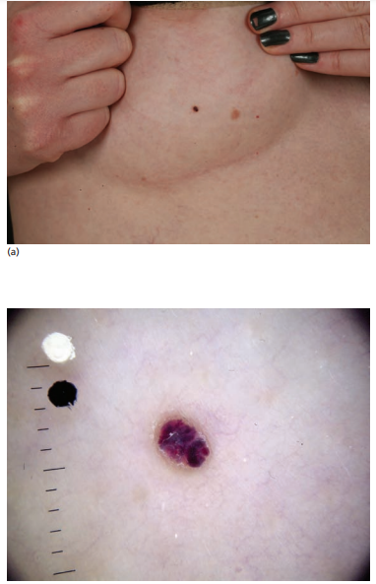

Slide 66
Venous lakes/Phlebectases
Introduction and general description
Venous lakes are composed of dilated venules.
They are dark purple/ blue papules that appear on the face, lips and ears of elderly patients.
Though venous lakes are entirely benign they can clinically mimic melanoma.

Slide 67
Epidemiology
Incidence and prevalence
The incidence of venous lakes is unknown.
A study from a dermatology clinic in Italy identified the prevalence of venous lakes of the lips as 3.7% over a 10‐month period.
Age
Venous lakes occur in the elderly.
The mean age has been reported to be variously 65 and 76.7 years .

Slide 68
Sex
They are commoner in men; early studies suggested 95% occurred in men though a more recent report found the male to female ratio to be 1.5 : 1.
Women may present for treatment more readily than men.
Ethnicity
There is no known racial predilection for this condition.
Associated diseases significant increase in solar keratoses in patients with venous lakes.

Slide 69
Pathophysiology
Pathology
Venous lakes are dilated venules.
The lesions consist of a single layer of fl attened endothelial cells and a thick wall of fibrous tissue.
There is often elastosis in the surrounding tissue.
Environmental factors
Sunshine and ageing have been thought to be triggers, and possibly smoking

Slide 70
Clinical features
History
The patient usually presents with a painless dark purple/blue papule often on the lip which bleeds if traumatized.
Presentation
The papule is soft and compressible.
They are usually single but multiple lesions can occur.
The commonest sites are the ears, face and lips.
If they occur on the lips, the lower lip is the commonest site

Slide 71
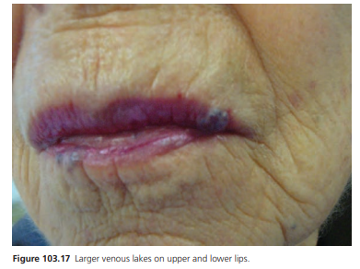

Slide 72
Differential diagnosis
The fact that they can be emptied by compression usually excludes malignant melanoma on clinical grounds.
Cherry angiomas and angiokeratomas can be similar clinically.
Complications and co‐morbidities
Venous lakes are benign and usually asymptomatic but occasionally when traumatized they will bleed and cosmetically they can be an issue for patients.
Disease course and prognosis Untreated venous lakes persist

Slide 73
Management
Investigations
None are necessary but biopsy can be confi rmatory if the diagnosis is in doubt.
Treatment is only needed if the patient is having problems with bleeding or finds the lesions cosmetically disabling.
The lesions can be excised, treated with cryotherapy or laser.
Many different lasers have been used (such as argon, carbon dioxide, pulsed dye and potassium titanyl phosphate lasers).
The more destructive the laser treatment, the more likely it is to be effective; however, the risks of scarring are increased

Slide 74
Primary telangiectasia
Angioma serpiginosum
This is a benign vascular condition characterized by small red puncta that cluster together in linear, serpiginous or gyrate patterns, chiefly on the lower limbs in females.
Age The condition may be present at birth and often starts in childhood. Eighty per cent of cases occur before the age of 20 years. Sex Ninety per cent of cases occur in females

Slide 75
Associated diseases
There is one report of a family whose members had
oesophageal papillomatosis associated with angioma serpiginosum inherited in an X‐linked dominant fashion with the genetic defect linking to Xp11.3‐Xq12

Slide 76
Pathophysiology
Generally
it is thought that the condition results from a vascular malformation or neoplasm and is not just a simple telangiectasia.
The classical puncta of angioma serpiginosum are caused by either congenital hyperplasia or ectasia of pre‐existing superfi - cial dermal capillaries.
Histology shows that the affected papillae are distended by a large single ectatic capillary, lined by fl attened endothelial cells of normal appearance. Infl ammatory changes are not present.
Sometimes the vascular spaces disappear due to thrombosis.

Slide 77
Genetics
Most cases are sporadic. However, both autosomal dominant and X‐linked dominant inheritance has been recorded and PORCN gene mutations or deletions have been reported

Slide 78
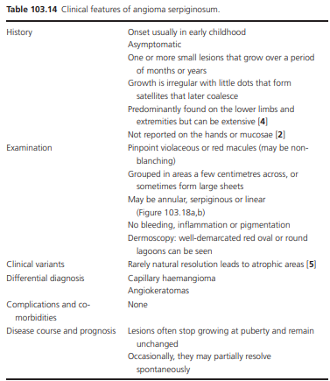

Slide 79
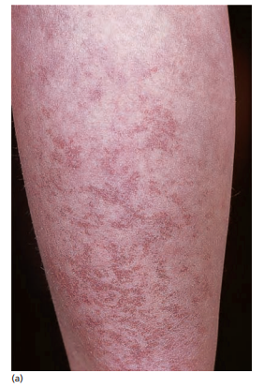

Slide 80
Investigations
If the diagnosis is in doubt, skin biopsy and imaging can be performed. Management Angioma serpiginosum is benign and asymptomatic.
Treatment is only indicated for cosmetic reasons. Cosmetic camouflage can be helpful, treatment with pulsed dye laser can be effective

Slide 81
Generalized essential telangiectasia
This is a syndrome of primary acquired telangiectases with a widespread cutaneous distribution of lesions
This is a benign, non‐inherited condition chiefl y distinguished from hereditary haemorrhagic telangiectasia by the distribution of the lesions, their arrangement into sheets and the usual lack of bleeding from the lesions

Slide 82
Age
It commonly starts in late childhood or early adult life, although one report of 13 patients found the mean age of onset to be 38 years.
Sex
It is much commoner in women (10 out of 13 were females.
Ethnicity
There is no known racial predilection for this condition. Reported cases have largely been in patients with less pigmented skin which may just reflect the fact that the telangiectasia are less noticeable in darkly pigmented skins

Slide 83
Pathophysiology
Pathology
There is chiefly dilatation of the capillaries with some dilated postcapillary venules of the upper horizontal (subpapillary) plexus.
There are no associated epidermal or dermal changes.

Slide 84
Environmental factors
The role of environmental factors in unknown but female hormones, trauma and UVB have been postulated to be of importance.

Slide 85
Clinical features
History
The eruption frequently starts on the lower limbs as individual lesions but spreads to form red confluent sheets comprised of blanching telangiectasia.
It is usually asymptomatic but tingling and numbness has occasionally been reported.
Presentation
The eruption is usually symmetrical.
Early lesions are small red or pink linear telangiectases with occasional larger macules arranged in groups.
The lesions spread over the skin to become large erythematous sheets and individual telangiectasia can be diffi cult to distinguish.
There is a predilection for the lower body but they can occur anywhere and occasionally mucosal and conjunctival lesions have been reported.
The sheeted telangiectasiae are usually fixed but will blanch on pressure.

Slide 86
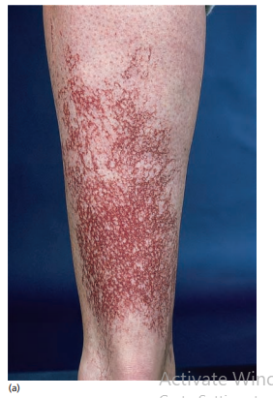
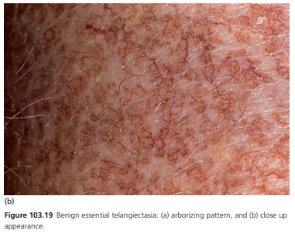

Slide 87
Differential diagnosis
hereditary haemorrhagic telangiectasia,
hereditary benign telangiectasia
telangiectasiae triggered by calcium‐ channel blockers
Disease course and prognosis
This benign condition is progressive and the lesions become fixed with time

Slide 88
Management
Treatment is largely for cosmetic issues.
Skin camouflage creams can be helpful but laser (pulsed dye and ND‐Yag) treatment is often attempted.
The lesions are often so widespread that multiple treatments are needed and those on the lower leg are often very resistant to treatment.
Sclerotherapy is not feasible due to the size and number of lesions

Slide 89
Unilateral naevoid telangiectasia syndrome
A condition of telangiectasiae occurring in a Blaschkoid distribution on the skin
This condition may be congenital or acquired and runs a benign course
Age
The congenital form appears during or shortly after the neonatal period. The acquired form often starts at puberty or during pregnancy but can occur at any time.
Sex The congenital form is commoner in males but the acquired form is much commoner in females

Slide 90
Associated diseases
Often there are no associated diseases but in the acquired form it has been seen in patients with liver disease, hyperthyroidism and during pregnancy

Slide 91
Pathophysiology
The Blaschkoid distribution of the lesions suggests that there is genetic mosaicism that leads to the development of the telangiectasia.
Pathology
Biopsy of lesions shows multiple, dilated, thin‐walled vessels lined by pump endothelial cells in the papillary and upper reticular dermis.
Genetics The congenital form has been reported to be inherited in an autosomal dominant fashion
Environmental factors
The occurrence of the acquired form of this condition has been reported to be associated with states of oestrogen excess.

Slide 92
Clinical features
History
Patients develop asymptomatic unilateral telangiectases.
Presentation
The telangiectases are often distributed in the third and fourth cervical dermatomes in a Blaschkoid fashion.
The lesions are most commonly seen on the upper body especially on the face, neck, shoulder and arm.
Sometimes there is a pale ring (‘anaemic halo’) in the skin surrounding the telangiectases. The lesions blanch on pressure.

Slide 93
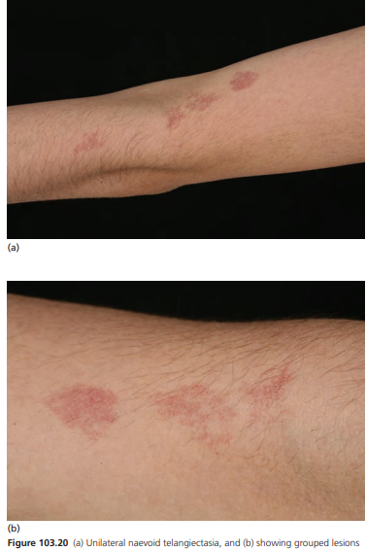

Slide 94
Differential diagnosis
Benign essential telangiectasia, angioma serpiginosum.
Complications and co‐morbidities
Unilateral naevoid telangiectasia is asymptomatic and benign.
There are no complications but it can be associated with high oestrogen states, such as liver disease.
Disease course and prognosis
In most cases of the acquired and congenital form, the lesions are fi xed and persist. However, occasionally if the condition is associated with pregnancy or the oral contraceptive pill

Slide 95
Investigations
None are necessary but liver function tests and a pregnancy test may be helpful if there are clinical indications of those underlying conditions.
A skin biopsy may help if there are diagnostic difficulties.

Slide 96
Management
No treatment is necessary for this benign condition unless the patient finds it cosmetically disabling.
Cosmetic camouflage can be helpful.
If the patient is pregnant or on the contraceptive pill then waiting to see what happens when the oestrogen levels normalize is advised.
Pulsed dye laser can be effective but some authors have reported recurrence

Slide 97
MALFORMATIONS

Slide 98
Arteriovenous malformations
Definition and nomenclature
Arteriovenous malformations are fast‐flow vascular lesions composed of malformed arterial and venous vessels connected directly to one another without an intervening capillary bed.
Synonyms and inclusions
• AV malformations
• AVMs
• Arteriovenous anomalies

Slide 99
Arteriovenous malformations can occur throughout the body in many different organs and can be fatal in certain instances.
For instance, brain arteriovenous malformations account for 1–2% of all strokes.
Dermatologists are more likely to encounter arteriovenous malformations when the vasculature affected involves the skin or mucosal surfaces or as an association of hereditary haemorrhagic telangiectasia

Slide 100
Incidence and prevalence
This is not known for arteriovenous malformations involving the skin but the incidence of brain arteriovenous malformations is ∼1/100 000 per year
Age
Approximately half are visible in the neonatal period and others become apparent during childhood and adolescence
Sex
There is equal incidence in females and males

Slide 101
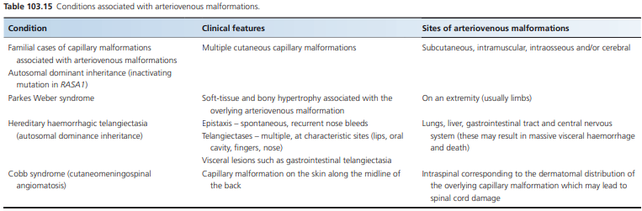

Slide 102
Pathophysiology
Pathology
Arteriovenous malformations consist of arteries connecting directly to veins without the intervening capillary bed. Where they connect is called the nidus.
The feeding arteries have a deficient muscularis layer and the draining veins dilate due to the high‐velocity blood fl ow they receive. It is not known how these abnormal connections arise.

Slide 103
Genetics
Although most cases of arteriovenous malformations are sporadic, there are a few inherited syndromes whose molecular genetics have been elucidated.
A mutation in the gene RASA1 has been identified on chromosome 5q in families with capillary malformations associated with arteriovenous malformation

Slide 104


Slide 105
Investigations
1 To confirm the diagnosis and monitor the response to treatment: ultrasound with colour Doppler examination shows low‐ resistance high‐velocity arterial flow, with high diastolic flux, and pulsatile venous flow below the baseline. Arteriovenous shunting is seen within tortuous vessels.
2 To evaluate the extent of the arteriovenous malformation: magnetic resonance imaging (MRI) and magnetic resonance angiography (MRA) demonstrate a collection of vascular flow voids which are the fast‐flow vessels that do not enhance with contrast (no tumour aspect); the arteriovenous malformations and its network can be delineated.
If the patient is bleeding, full blood count and clotting studies should be undertaken.

Slide 106
Management
A multidisciplinary approach is essential with specialist vascular surgeons and invasive radiologists and paediatricians where appropriate
Arteriovenous malformations often recur following embolization and surgical resection because incomplete destruction of the lesion leads to rapid recruitment of new vessels from adjacent arteries to supply the nidus, with growth and recurrence of the lesion.

Slide 107
Surgery
The aim of surgery is curative. It may be possible for small and accessible lesions. Sometimes embolization is performed beforehand to reduce intraoperative bleeding.
Embolization
The aim is to temporarily occlude the nidus with either glue or coils. This is usually palliative for bleeding, pain or the control of heart failure or prior to surgery.
Sclerotherapy Alcohol is injected into the nidus. Sclerotherapy is palliative

Slide 108
When to treat
For stage I and II arteriovenous malformations in infancy and early childhood, there is no treatment; just monitor (see later for staging system).
When the child is older, some clinicians offer surgical resection if the cosmetic result is predicted to be acceptable and the lesion amenable.
Follow‐up is essential as there is a high rate of recurrence.
For stage II later in childhood, and stage III and IV, surgical treatment (excision and reconstruction) where possible should be considered.
However, often the lesions are too deep or extensive for cure and management is only palliative using embolization and partial resection

Slide 109
Venous malformations
Solitary venous malformations
Venous malformations are slow‐flow, non‐proliferating vascular birthmarks.
They are composed of anomalous ectatic venous channels.
Synonyms and inclusions
• Venous angioma
• Cavernous angioma
• Phlebangioma

Slide 110
Introduction and general description
These are the commonest of all vascular anomalies.
They are classified as ‘slow‐flow’ lesions.
They vary enormously clinically, ranging from single small superficial lesions to deep extensive lesions.
They may be single or multiple and can arise in the skin and mucosae and can involve the limbs, the gastrointestinal tract and cranio‐facial area.
They may be asymptomatic or a major problem for patients with pain, bleeding and disfigurement being the commonest complications.

Slide 111
Epidemiology
Incidence and prevalence
Venous malformations are relatively common and the incidence has been reported to be between 1 and 4% of the population.
Age
The lesions are always present at birth but may not become clinically noticeable until later in childhood as they grow with the child.
Sex There is no sex difference in venous malformations.
Ethnicity There is no known racial difference.

Slide 112
Associated diseases
Patients with Turner syndrome may have venous malformations of the intestine and feet.
In blue rubber bleb naevus syndrome (Bean syndrome), there are cutaneous and gastrointestinal venous malformations which typically become apparent with age.
There may be a risk of severe gastrointestinal haemorrhage.
Maffucci syndrome is a rare condition characterized by venous malformations usually on the extremities and dyschondroplasia resulting in enchondromas.

Slide 113
Pathophysiology
Pathology
The vascular channels of venous malformations are irregular, have narrow lumens lined with flattened endothelial cells and lack smooth muscle cells. The basement membranes are thin and there is no expression of vascular endothelial growth factor or basic fibroblast growth factor.
Genetics Most cases of venous malformations are sporadic. There have been familial cases of patients with multiple mucosal and cutaneous venous malformations.
Genetic analysis has found a mutation in the gene that encodes for the tyrosine kinase domain of the endothelial cell receptor TIE2.
Somatic mutations are seen in the angiopoietin receptor gene TEK associated with solitary sporadic and multiple venous malformations

Slide 114
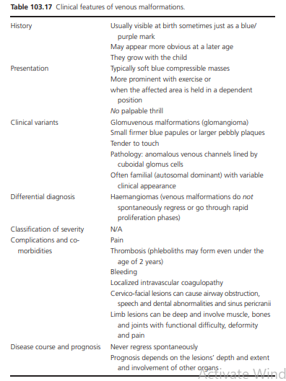

Slide 115
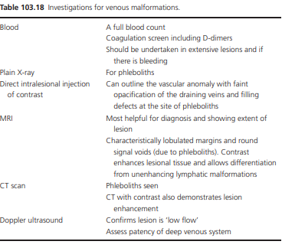

Slide 116
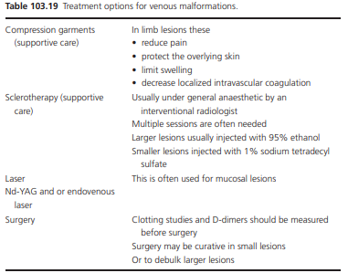

Slide 117
Verrucous haemangioma
Definition
This is a congenital vascular anomaly made up of a dermal and subcutaneous capillary vascular component with an overlying warty surface.
There has been some debate as to whether it should be classifi ed as a vascular neoplasm, though recent evidence supports the original view that it should be regarded as a vascular malformation

Slide 118
Incidence and prevalence
This is a rare condition but the prevalence is unknown.
Age
It is usually noted at birth but can appear during the first 2 years.
Sex
The condition is equal in males and females.
Ethnicity There is no known racial predilection.

Slide 119
Pathophysiology
The pathogenesis is not understood.
The lesions show overlying epidermal hyperkeratosis, papillomatosis and irregular acanthosis with underlying dilated capillary vascular channels in the dermis and also often in the subcutis.
The vessels are organized in a diffuse or lobular pattern.
Most studies show positive staining for GLUT-1 and WT-1, suggesting it is a type of vascular tumour. Recently, however, the largest study to date of 74 patients found most were negative for WT-1 staining, supporting the clinical view that these lesions behave like vascular malformations

Slide 120
History
Over 70% occur on the lower limb but lesions can involve the upper limb and more rarely the trunk; most are solitary.
Presentation
The lesions initially are non-keratotic, soft and bluish-red in colour. They are well-circumscribed linear vascular plaques and vary from a few centimetres to 25 cm in diameter.
Over time the surface becomes hyperkeratotic and verrucous.
Over 50% are asymptomatic, however the lesions may be painful and itchy.
Differential diagnosis
Angiokeratomas
circumscribed lymphangioma.

Slide 121
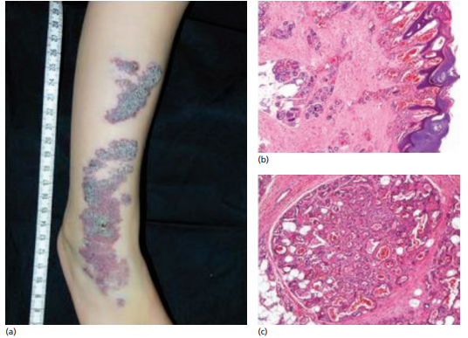


Slide 122
Complications and co-morbidities
They may ulcerate and become infected.
Disease course and prognosis
Unlike infantile haemangiomas they do not undergo spontaneous regression and grow in proportion to the child’s growth.
Investigations
Skin biopsy and magnetic resonance imaging should be undertaken to confirm the diagnosis and to evaluate the extent of the lesion.

Slide 123
Management
Surgery is the treatment of choice.
Most can be excised in a single procedure or in stages.
However, if lesions are deep and excision is incomplete, recurrence may be a problem.
Where excision is not possible, NdYAG laser for plaques and pulsed dye laser for patches can help improve the appearance and relieve symptoms.

Slide 124
Disorders associated with venous malformations

Slide 125
Klippel–Trenaunay syndrome
Definition
Klippel–Trenaunay syndrome is characterized by three features:
(i) a capillary malformation (port‐wine stain) of the skin associated with
(ii) a soft‐tissue and bone overgrowth and hypertrophy in combination with
(iii) varicose veins, with or without deep venous and lymphatic abnormalities.
It can be diagnosed if only two of the three features are present

Slide 126
KTS most commonly involves the lower limbs, followed by the arms, the trunk and rarely the head and neck.
KTS is a congenital condition of unknown aetiology, the management of which is largely supportive

Slide 127
Incidence and prevalence
It is rare with an incidence < 1: 10000
Age
It is a congenital anomaly present at birth but clinically may present later in childhood
Sex
There is no sex difference in the incidence of KTS.
Ethnicity
There is no known racial predilection.

Slide 128
Pathology
The capillary malformations consist of ectatic capillaries with superficial dilated dermal venules corresponding to nodular lesions within the port‐wine stains.
When there are lymphatic malformations they appear to be due to lymphatic hypoplasia resulting in lymphatic macrocysts on the pelvis or trunk and microcysts on the abdominal wall, gluteal region and/or limbs.

Slide 129
The atypical varicose veins are persistent embryonic veins of the superficial venous system which lack valves and are long and tortuous.
The deep venous system is abnormal in 25% of patients with KTS and abnormalities include aneurysmal dilatations, duplications, hypoplasia, aplasia and external compression form anomalous vessels or fibrotic bands.
Some patients get perianal and perirectal varicose veins and suprapubic varicose veins can be a sign of atresia of the iliac vein

Slide 130
Genetics
Most cases of KTS are sporadic.
However, there have been reports of a defect in the angiogenic factor VG5Q , RASA1 mutations and a de novo supernumerary ring chromosome 18 in KTS patients.
A case report of KTS in a monozygotic twin with an unaffected twin suggests the possibility of paradominant inheritance

Slide 131
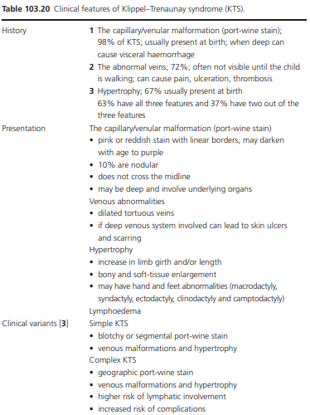

Slide 132
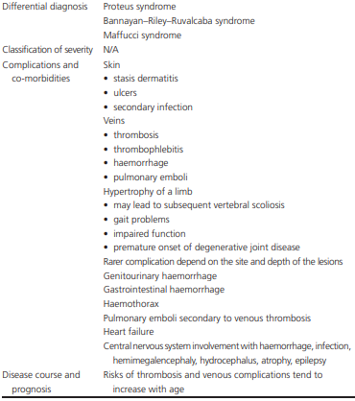

Slide 133
Investigations
Klippel–Trenaunay syndrome is often diagnosed on the history and examination alone.
Physical examination should include auscultation and palpation of the involved area to assess for the presence of an arteriovenous malformation to rule out Parkes Weber syndrome.
Duplex ultrasound scanning is the study of choice to evaluate for superficial and deep venous anomalies, and in differentiating vascular tumours from vascular malformations and arteriovenous fistulae.
MRI scans are effective for visualizing the extent of tissue overgrowth of lesions and infiltration.
X‐rays may show increased thickness or abnormal density of the affected soft tissue and phleboliths.
Venograms may be required to delineate the venous abnormality and to exclude deep vein agenesis.

Slide 134
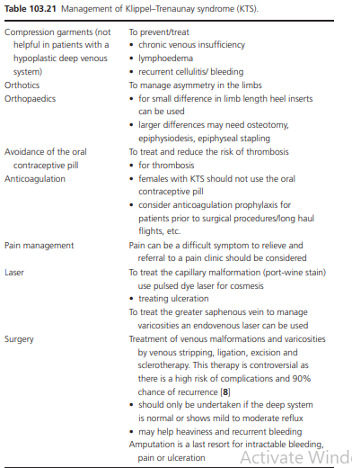

Slide 135
Parkes Weber syndrome
It is a combined vascular malformation, similar to KTS, characterized by an arteriovenous fistula with varicosities and hypertrophy of the affected extremity.
It differs from KTS because of the presence of the arteriovenous fistula and the absence of the following associations:
an overlying vascular naevus,
a marginal vein malformation and lymphatic malformations.
The musculoskeletal involvement is often less prominent than in KTS

Slide 136
Incidence and prevalence
This is a rare condition but the prevalence is unknown.
Age It is present from birth.
Sex The condition is equal in males and females.
Ethnicity
There is no known racial predilection

Slide 137
Pathophysiology
The pathogenesis is not fully understood.
The pathology of the arteriovenous malformation is described under arteriovenous malformations above
Genetics
Most cases are sporadic.
A mutation in the gene RASA1 has been identified on chromosome 5q in families with capillary malformations associated with arteriovenous malformations

Slide 138
History
Over 70% occur on the lower limb but Parkes Weber syndrome can involve the upper limb and the head and neck.
The tissue overgrowth leads to limb enlargement that continues past puberty and gets progressively worse.
There is frequently bone involvement rather than just soft‐tissue overgrowth.
The arteriovenous malformation may not appear until puberty or after trauma.
Presentation
An obvious pulsatile swelling may be visible with discoloration of the overlying skin and large veins radiating from it.
The overlying skin feels warm; there are prominent vessels with a possible palpable thrill.
Auscultation of the lesion should detect a machinery murmur. There may be obvious asymmetry of the affected limbs.

Slide 139
Clinical variants
• Capillary malformation – arteriovenous malformation, a new clinical and genetic disorder caused by RASA1 mutations.
• Cloves syndrome congenital lipomatous overgrowth, vascular malformations, epidermal naevi and scoliosis, seizures and spinal and skeletal abnormalities.
Differential diagnosis
• Klippel–Trenaunay syndrome.
• Proteus syndrome.

Slide 140
Classification of severity
The classification of the severity of arteriovenous malformations is described
Complications and co‐morbidities
The main risks are complications of the arteriovenous fistula such as tissue ischaemia and high output cardiac failure.
Disease course and prognosis
This is dependent on type, location and severity of the arteriovenous malformation.

Slide 141
Investigations
To confirm the diagnosis and monitor the response to treatment.
Ultrasound with colour Doppler examination which shows low‐resistance high‐velocity arterial flow, with high diastolic flux, and pulsatile venous flow below the baseline and arteriovenous shunting within tortuous vessels.
To evaluate the extent of the arteriovenous malformation.
MRI and MRA demonstrate a collection of vascular flow voids which are the fast‐flow vessels that do not enhance with contrast (no tumour aspect).
The arteriovenous malformation and its network can be delineated.

Slide 142
Management
A multidisciplinary approach is essential with specialist vascular surgeons, invasive radiologists and paediatricians where appropriate.
Management is challenging.
Treatment is frequently palliative.
Sclerotherapy, embolization and surgery are all options.
Orthotics and compression garments may help with limb involvement.

Slide 143
VENOUS DISORDERS

Slide 144
Venous thrombosis
Deep‐vein thrombosis
Introduction and general description
A deep‐vein thrombosis (DVT) is a blood clot that forms within the deep veins usually of the leg but can occur in the veins of the arms and in the mesenteric and cerebral veins
Deep‐vein thrombosis is part of the venous thromboembolism disorders which represent the third most common cause of death from cardiovascular disease after heart attacks and stroke.
Even in patients who do not get pulmonary emboli recurrent thrombosis and ‘post‐thrombotic syndrome’ are a major cause of morbidity.

Slide 145
Incidence and prevalence
Deep‐vein thrombosis and pulmonary emboli are common and often ‘silent’ and thus go undiagnosed or are only picked up at autopsy.
Therefore their incidence and prevalence is often underestimated. It is thought the annual incidence of DVT is 80 cases per 100 000 with a prevalence of lower limb DVT of 1 case per 1000 population.
Annually in the USA, more than 200 000 people develop venous thrombosis; of those, 50 000 cases are complicated by pulmonary embolism

Slide 146
Age
Deep‐vein thrombosis is rare in children and the risk increases with age, most occurring in the over 40s.
Sex
There is no consensus about whether there is a sexual bias in the incidence of DVT.
Ethnicity
There is evidence from the USA that there is an increased incidence of DVT and an increased risk of complications in African Americans and white people when compared to Hispanics and Asians

Slide 147
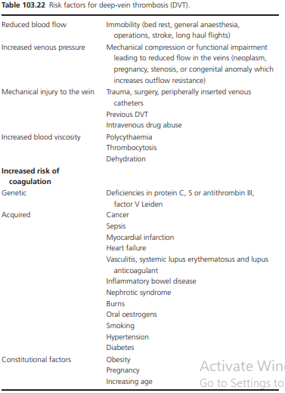

Slide 148
Pathophysiology
Pathology
In 1856, Virchow postulated that the main causes of thrombus formation were damage to the vessel wall, alterations in blood flow and hypercoagulability.
This is called ‘Virchow’s triad’ and is still valid today.
Maintenance of the fluidity and circulation of the blood and its ability to thrombose are essential for the maintenance of life and are governed by extremely complex homeostatic mechanisms.
Thrombosis is a protective mechanism which prevents loss of blood and seals off damaged blood vessels.

Slide 149
Fibrinolysis counteracts or stabilizes the thrombosis.
The triggers of venous thrombosis are frequently multifactorial, with the different parts of the Virchow triad contributing in varying degrees in each patient, but all resulting in early thrombus interaction with the endothelium.
This then stimulates local cytokine production and causes leukocyte adhesion to the endothelium, both of which promote venous thrombosis.
Depending on the relative balance between the coagulation and thrombolytic pathways, thrombus propagation occurs.
DVT is commonest in the lower limb below the knee and starts at low‐flow sites, such as the soleal sinuses, behind venous valve pockets.

Slide 150
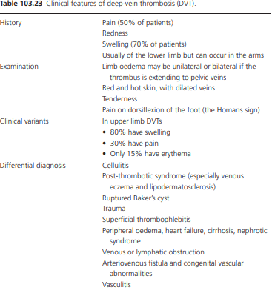

Slide 151
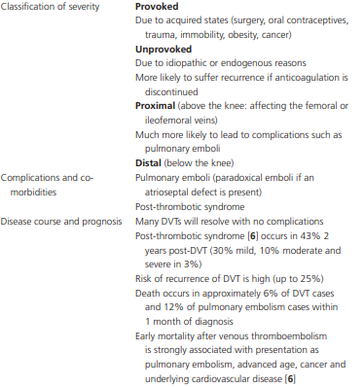

Slide 152
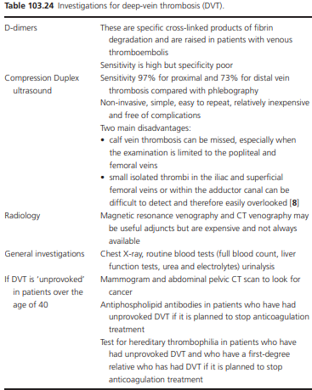

Slide 153
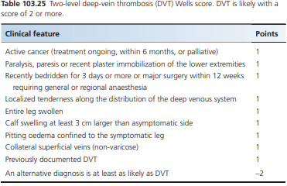

Slide 154
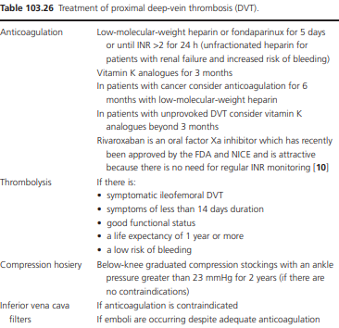

Slide 155
Superficial venous thrombosis
Introduction and general description Superficial venous thrombosis is an uncomfortable but self‐ limiting condition.
It is often seen on the lower leg associated with varicose veins and in hospitals at the sites on intravenous canulae.
However, it can be associated with deep thrombosis and the serious consequences of venous thromboembolism
Synonyms and inclusions
• Superficial thrombophlebitis

Slide 156
Incidence and prevalence
Superficial venous thrombosis is a common condition.
The actual prevalence and incidence is unknown. However, up to 25–35% of all hospitalized patients are thought to experience superficial phlebitis at the site of venous cannulae
Age The mean age of onset is 60.
Sex It is commoner in females (55–70% occurring in women).
Associated diseases Migratory thrombophlebitis may be associated with an underlying carcinoma (such as pancreatic cancer) or Behçet disease

Slide 157
Pathophysiology
Pathology The pathogenesis is similar to that of DVT though trauma to the vein is thought to be the predominant trigger in the Virchow triad (stasis, increased coagulability and vessel wall injury).
There is an association between superficial venous thrombosis and venous thromboembolism.
Superficial venous thrombosis located in the main trunk of the saphenous vein has the strongest association with venous thromboembolism.
Superficial venous thrombosis usually develops in the lower limbs. In 60–80% of cases, the GSV system is involved, and in 10–20% the SSV system .
The main cause of superficial venous thrombosis of the lower limbs is varicose veins, which are present in 70% of cases .
The main cause of superficial venous thrombosis in the upper limb is iatrogenic, for example intravenous catheters or infusion of drugs such as chemotherapy or heroin.
Mondor disease may also be a form of superficial venous thrombosis.

Slide 158
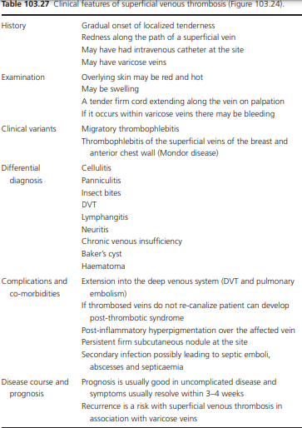

Slide 159
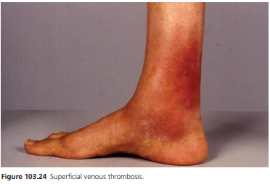

Slide 160
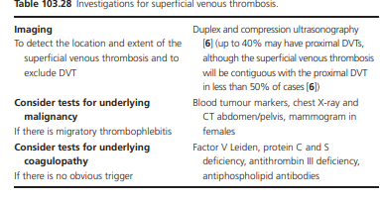

Slide 161
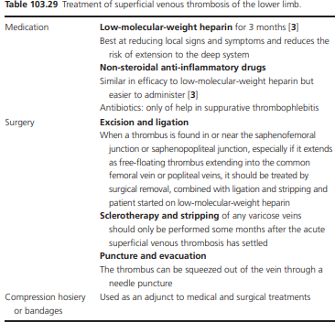

Slide 162
Thrombophlebitis migrans
Introduction and general description
This is a form of superficial venous thrombosis which is recurrent and diffuse affecting the large and small veins throughout the body.
This is a rare disorder which is important because it is often associated with underlying disease such as internal malignancy (Trousseau syndrome), Behçet disease and Buerger disease.

Slide 163
Epidemiology
Incidence and prevalence
This is not known but it is rare. In one study of 1500 cases of thrombophlebitis, 31 of 77 occurring in association with malignancy were of a migratory type.
In this study, carcinomas of the lung and pancreas were the most common sites for the primary tumours, although carcinomas of the breast, colon and stomach were also reported.
Other associated diseases are Behçet (between 2 and 20% of all cases) and Buerger disease (one study found thrombophlebitis migrans in up to 65.4% of 86 patients).
There is no known gender or racial predilection.

Slide 164
Pathophysiology
This is not fully understood.
As with superficial venous thrombosis, the mechanism is thought to be within the Virchow triad (stasis, increased coagulability and vessel wall injury).
In the thrombophlebitis migrans associated with malignancy, some have suggested that there is a state of chronic disseminated intravascular coagulation

Slide 165
Clinical features
History
Patients develop crops of painful red lumps and streaks in the skin.
These may resolve and then new ones develop. The lesions appear on the legs, arms, abdominal wall and flanks.
Presentation
The lesions are hot and tender and can be linear or oval subcutaneous lumps or streaks.
The overlying skin usually remains intact.
Differential diagnosis
This is wide as there are no pathognomonic features and includes cellulitis, panniculitis, DVT and states with increased coagulability.

Slide 166
Investigations
Ultrasound to confirm the diagnosis
clotting studies and tests to look for an underlying malignancy are all advised.
CT scanning, ultrasound, MRI
positron emission tomographic (PET) scans of the abdomen may be necessary to pick up a pancreatic carcinoma.

Slide 167
Management
Treatment is generally conservative
Patients should be treated with adequate anticoagulation.
Lowering triglycerides may be advisable and exercise is good prophylaxis.
Medical elastic compression stockings or bandages may alleviate symptoms.
In Behçet disease, immunosuppressive medication is given

Slide 168
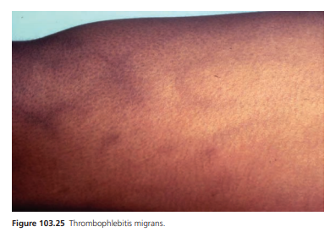

Slide 169
Mondor disease
Introduction and general description
This is a form of superficial venous thrombosis in the chest wall and affects veins that include the lateral thoracic vein, the superior epigastric vein and the thoracoepigastric vein.
This is a rare, self‐limiting and benign condition that was first described in 1939
Similar cases have been reported in the antecubital fossa, inguinal area, axilla, penis , abdomen and lower limbs

Slide 170
Incidence and prevalence
The incidence and prevalence of this rare condition are unknown.
Less than 500 cases have been published in the literature.
Penile Mondor disease is rarer still and accounts for less than 10% of cases.
Age Typically the patients are between 30 and 60 years old.
Sex The sex ratio is 3 : 1 female : male.
Ethnicity There is no known racial bias.

Slide 171
Pathophysiology
The pathogenesis of Mondor disease is not understood.
As with superficial venous thrombosis the mechanism is thought to be within the Virchow triad (stasis, increased coagulability and vessel wall injury).
In the chest wall type , a study of pooled cases of the disease found one‐third of cases were idiopathic, most of the rest were related to trauma (injury, muscular strain, poorly fitting bras, surgery, breast prosthesis, etc).
Rare causes were underlying breast cancer, hypercoagulable states and connective tissue disorders.
In the penile type , surgical trauma, excessive sexual activity, sexual vacuum practices, use of constrictive elements during sexual activity, intravenous drug abuse, prolonged sexual abstinence, local or distant infection, venous obstruction due to bladder distension and pelvic tumours have all been reported

Slide 172
Pathology
It is a two‐ stage process: initially there is a dense inflammatory cell infiltrate and usually a thrombus occluding the lumen of the affected veins
Thereafter, connective tissue proliferation occurs in the vessel leading to a hard cord which resolves when the vessel canalizes.

Slide 173
Clinical features
Mondor disease of the chest wall.
The lesions appear and may be painful or asymptomatic.
On examination, the lesions may involve any subcutaneous vein on the upper anterolateral chest wall and produce a fibrous painful cord with skin retraction.
However, unlike classical superficial venous thrombosis there is no overlying cutaneous inflammation.
Mondor disease involving other venous territories.
The most usual site of involvement is the penis.
A fibrous painful cord with local preputial inflammation but without skin retraction is seen.
Other possible sites include the brachial, femoral and calf veins but, unlike chest wall Mondor disease, local inflammation is present.

Slide 174
Mondor disease after breast surgery.
This is a subtype described in association with axillary lymph node dissection in breast cancer, and is characterized by retractile scarring of the fascia.
Some authors call it axillary web syndrome (AWS).
It manifests with palpable cords which ‘bowstringing’ across the axilla, creating a web of skin.
The cords are painful and restrict shoulder movement.
They can extend into the ipsilateral arm, and even the forearm, creating linear grooves. There is usually no concomitant superficial venous thrombosis.

Slide 175
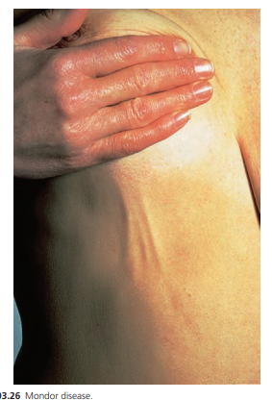

Slide 176
Differential diagnosis
The differential diagnosis is wide and includes
cellulitis,
erythema nodosum,
skin metastatic carcinoma,
lymphangiectasia
lymphangioma.

Slide 177
Disease course and prognosis
This depends on the site and type of disease.
In Mondor disease on the chest wall , this is generally benign and self‐limiting with spontaneous resolution usually with 2–8 weeks and only 13% recurrence is reported in one series.
In Mondor disease involving other venous territories , the natural history is less well known and, as with other conditions with superficial venous thrombosis, can be associated with deeper thrombosis.
In Mondor disease after breast surgery , this usually spontaneously resolves.

Slide 178
Investigations
Diagnosis is largely clinical.
Ultrasound examination can diagnose superficial thrombus and exclude a deep thrombus.
Mammography can be helpful if there is suspicion of an underlying carcinoma

Slide 179
Management
This depends on the type of Mondor disease.
In Mondor disease on the chest wall , as this is generally benign and self‐limiting, no anticoagulation is needed and simple analgesia can be given if the patient is in pain.
In Mondor disease involving other venous territories , anticoagulation is recommended and sometimes in penile disease the superficial dorsal vein of the penis is treated with thrombectomy or excision.
In Mondor disease after breast surgery , no anticoagulation is needed. If the fascial fibrous bands persist, they can be manually ruptured with immediate return of function and reduction in pain

Slide 180
Varicose veins
Introduction and general description
Varicose veins are very common and their characteristics and management were described by Hippocrates and Galen
These are visible, dilated and tortuous elongations of the larger superfi cial venous trunks and their tributaries

Slide 181
Incidence and prevalence
Varicose veins are common.
The incidence of varicose veins is unknown but several studies have reported the prevalence to be high (varying from 10% to 50% of the adult population).
Age and sex The prevalence increases with age and they are commoner in females.
By 20 years of age, the prevalence of varicose veins is 10%; by the age of 40 years, it is 40% in women and 25% in men and varicose veins are present in about 70% of 80‐year‐old women and 60% of 80‐year‐old men.

Slide 182
Associated diseases
Klippel–Trenaunay syndrome where there is a congenital malformation leading to varicose veins.
Ethnicity
There is no known ethnic variation in varicose veins

Slide 183
Pathophysiology
In the healthy venous system, there is venous blood flow through the superficial system into the deep system and back to the heart.
One‐ way valves exist in both systems and in the perforating veins which connect the two.
Incompetence in any of the valves can disrupt the normal flow of the blood and cause venous hypertension.
The pathogenesis of varicose veins is not fully understood.
Valvular incompetence and venous hypertension are thought to be important and interdependent but how they occur remains to be fully elucidated.
The mechanical issues of valve incompetence and raised pressure can occur in both and lead to complex molecular and histopathological alterations in the vessel wall and the extracellular matrix

Slide 184
Pathology
The chief findings in varicose veins are intimal hypertrophy, subendothelial fibrosis, luminal dilation and wall thickening.
Genetics
A genetic basis has been thought to be possibly relevant in the pathogenesis of varicose veins.
Genetic studies in twins suggests that FOXC2 plays a critical role in valve development and function, and that mutations in FOXC2 may promote varicose veins.
Other studies have suggested a link with varicose veins and mutations in the NOTCH3 gene (thrombomodulin promoter), mutations in the NDP gene (which cause Norrie disease) and in the transforming growth factor β receptor 2 gene.
Environmental factors A prevalence of varicose veins is twice as high in an urban population as in a rural population

Slide 185
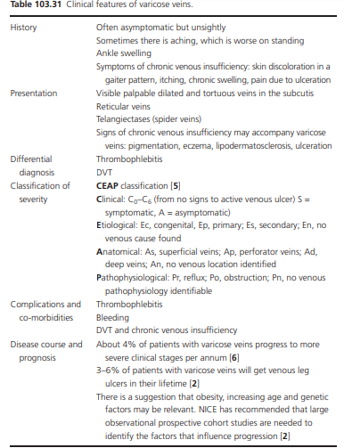

Slide 186
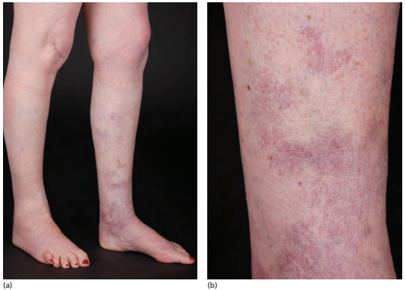


Slide 187
Investigations
Colour duplex Doppler ultrasound scanning is used to investigate patients with varicose veins as it provides an anatomical picture of the venous system.
It is the investigation of choice for detecting deep‐vein reflux.
Duplex scanning is also essential to investigate patients with skin changes attributed to venous hypertension.
There is some evidence that the incidence of recurrent varicose veins is lower after duplex assessment has been used to plan surgery.

Slide 188
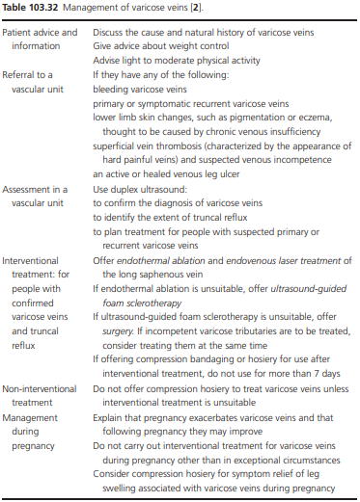

Slide 189
Chronic venous insufficiency
Definition and nomenclature
This is a state which occurs when the blood no longer flows in the correct path from the superficial system into the deep venous system and thence back to the heart.
This results in venous congestion and impairment of the venous system.
Chronic venous insufficiency may be classified anatomically into three categories

Slide 190
Superficial vein insufficiency.
This is indicated by the presence of visible, tortuous, truncal varicose veins. It arises from primary valve failure or when the superficial veins become distended, causing the valves to become secondarily incompetent.
Perforating vein insufficiency.
This is a rare condition in isolation, when it is caused by primary valve insufficiency. Secondary perforating vein insufficiency often occurs in combination with deep‐ vein insufficiency (post‐thrombotic limb).

Slide 191
Deep‐vein insuffi ciency.
Reflux is the most common type of abnormality, but in about 10% of cases a functional obstruction from thrombosis (non‐recanalized thrombosis) will be present, in which case it is likely to be associated with the post‐thrombotic syndrome.
Avalvulosis is rare unless associated with a mutation of the FOXC2 gene.
If untreated venous insufficiency in either the deep or superficial system causes the progressive syndrome of chronic venous insufficiency

Slide 192
Incidence and prevalence
One large study in 30 000 subjects found a prevalence of 7% for varicose veins and 0.86% for ‘symptomatic’ chronic venous insufficiency.
Another screened 1566 subjects and found chronic venous insufficiency in 9.4% of men, and 6.6% of women.
Prevalence rose significantly with age: 21.2% in men >50 years and 12.0% in women >50 years.
Serious chronic venous insufficiency leading to venous ulcers has an estimated prevalence of approximately 0.3%, although active or healed ulcers are seen in up to 1% of the adult population .
In the USA, it is thought that approximately 2.5 million people have chronic venous insufficiency and about 20% of those develop venous ulcers

Slide 193
Age Chronic venous insufficiency prevalence increases with age.
Sex Varicose veins are more common in females but studies differ on the sex difference in the prevalence of severe chronic venous deficiency.
Ethnicity It is not thought that there is any racial difference in the prevalence of chronic venous insufficiency.
However, it occurs more commonly in Western society and this probably reflects lifestyle differences such as sedentary or standing occupations, higher rates of obesity and generally reduced levels of physical activity.

Slide 194
Pathophysiology of venous reflux and chronic venous insufficiency
Venous reflux is regarded as the major cause of venous disorders.
Reflux is the presence of retrograde flow in a vein in response to a stimulus such as a calf squeeze.
It occurs during standing when the valves are incompetent.
It can occur in the superficial, deep and perforating veins of the lower extremity

Slide 195
An elevated and sustained ambulatory venous pressure (venous hypertension) is indicative of chronic venous insufficiency.
This may be caused by valvular incompetence or venous outflow obstruction or poor muscle pump function.
Venous outflow obstruction occurs in some patients after a DVT, is more serious than reflux and more difficult to treat.
In this situation, when the leg muscles contract, the venous pressure increases, rather than the usual lowering of venous pressure that occurs during ambulation when the vein is not obstructed.
Such heightened pressure is transmitted distally as far as the capillary system of the skin, causing capillary hypertension, and eventually leading to destruction of the nutritive capillaries

Slide 196
Genetics
A genetic basis has been thought to be relevant in the pathogenesis of varicose veins, since familial clustering of cases does occur.
Genetic studies in twins suggests that FOXC2 plays a critical role in valve development and function, and that mutations in FOXC2 may promote varicose veins.
Chronic venous insufficiency may also be a feature of KTS.
Environmental factors
A sedentary lifestyle reduces the efficiency of the muscle pump and thus leads to reduced venous return and occupations with prolonged standing act to increase the risk of higher venous pressures in the legs

Slide 197
Clinical features
History
The clinical features of chronic venous insufficiency vary from mild oedema to severe incapacitating leg ulceration
Complain of burning, swelling, throbbing, aching, cramping and heaviness in the legs.
Those with deep venous insufficiency almost always have pain.
The symptoms are often improved by elevation and rest of the legs.

Slide 198


Slide 199
Classification of severity
The CEAP classification is used for chronic venous insufficiency as it is for varicose veins.
Complications and co‐morbidities
These include thromboembolic disease, venous ulceration and secondary lymphoedema.

Slide 200



Slide 201
Disease course and prognosis
It is not known overall how many patients with chronic venous insufficiency progress to end‐stage venous ulceration.
About 4% of patients with varicose veins progress to more severe clinical stages per annum.
Of patients with varicose veins, 3–6% will get venous leg ulcers in their lifetime.
Patients with lipodermatosclerosis have an increased risk of venous ulceration.
About 3% of patients with DVT will go on to develop severe chronic venous insufficiency

Slide 202



Slide 203


Slide 204


Slide 205
THANKS

