Slide 1
DERMATOMYOSITIS
DR NIDA ARIF

Slide 2
DEFINITION
Dermatomyositis (DM) is an autoimmune disorder affecting, predominantly, the skin and skeletal muscle
It is classified alongside polymyositis in the idiopathic inflammatory myopathies (IIMs).

Slide 3
INTRODUCTION &GENERAL DESCRIPTION
In DM, autoimmune inflammation damages the skin, muscle and, in certain cases, internal organs such as the lungs, joints, oro‐pharynx and heart.
The main causes of death in IIM are cardiac disease (15–64% deaths), respiratory disease (5–36% deaths)and malignancy (10–47% deaths’.
Interstitial lung disease (ILD)may affect the patients with DM.ILD and cancers are major cause of deaths in DM.

Slide 4
Amyopathic dermatomyositis
‘a subset of DM characterized by biopsy‐confirmed cutaneous manifestations of classic DM occurring for 6 months or longer with no clinical evidence of proximal muscle weakness and no serum muscle enzyme abnormalities’
Clinically amyopathic DM is functional designation used to refer either amyopathic or hypomyopathic DM.

Slide 5
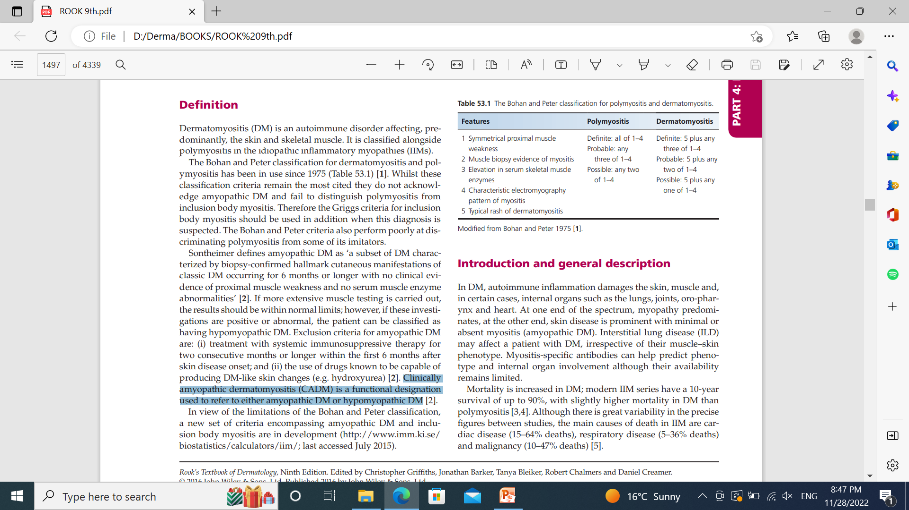
The Bohan and Peter classification for polymyositis and dermatomyositi

Slide 6
EPIDEMOIOLOGY
The IIMs are rare with a reported annual incidence varying widely from 0.1 to 6.7 per 100 000 person‐years.
DM is approximately twice as high in women .
The peak incidence of adult DM occurs around 50–60 years of age.
Juvenile DM having median age of onset at 6.8 years.

Slide 7
ASSOCIATED DISEASES
The majority are adenocarcinomas
Adenocarcinomas of the breast and ovary
were the commonest malignancies in women, while lung cancer in men.
Naso‐pharangeal carcinoma was the commonest myositis‐associated malignancy.

Slide 8
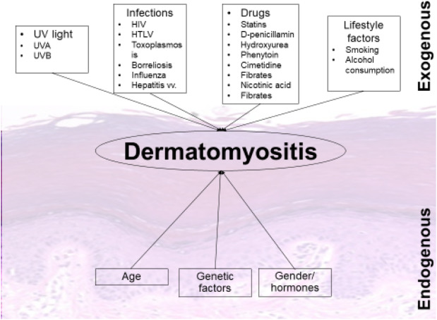
PATHOPHYSIOLOGY

Slide 9
IMMUNOPATHOGENESIS
There are findings of perifascicular and perivascular infilterate, which comprises B cells, CD4+ T cells macrophages and plasmocytoid dendritic cells.
In contrast to polymyositis where there is evidence of cell‐mediated cytotoxicity with CD8+ T cells invading muscle fibres.
Type 1 interferon inducible gene expression is increased in DM in both muscle tissue and in the peripheral blood

Slide 10
IMMUNOPATHOGENESIS
Humoral mediated autoimmune response-autoantibodies-complement system activation --capillary destruction that leads to ischemia and microinfarction ,hypoperfusion, and perifascicular atrophy

Slide 11
HISTOPATHOLOGY
SKIN
A lichenoid tissue reaction with vacuolar changes in the basal layer and occasional Civatte bodies is typical
There is only a sparse superficial perivascular infiltrate of lymphocytes with upper dermal oedema and mucinous change

Slide 12
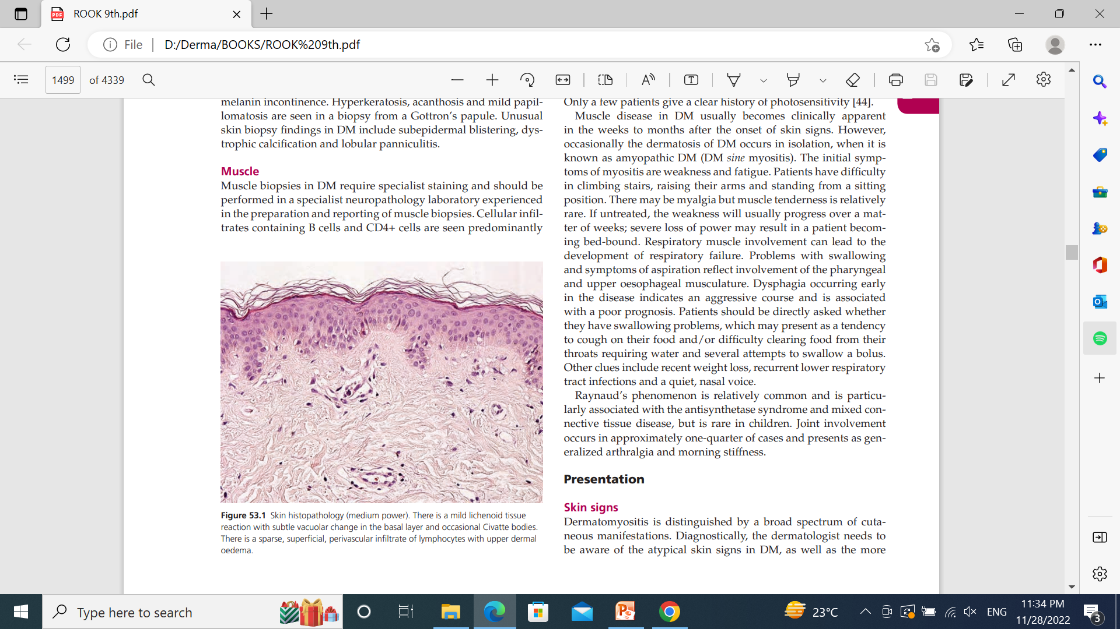

Slide 13
HISTOPATHOLOGY
Hyperkeratosis, acanthosis and mild papillomatosis are seen in a biopsy from a Gottron’s papule
Unsual skin biopsy findings in DM include subepidermal blistering, dystrophic calcification and lobular panniculitis.

Slide 14
HISTOPATHOLOGY
MUSCLE
Cellular infiltrates containing B cells and CD4+ cells are seen predominantly in the perivascular and perifascicular areas.
Muscle fibres show perifascicular atrophy.
An early change is C5b‐9 deposition on the capillary walls.
HLA class I up‐regulation is also found in areas where no inflammatory infiltrates are seen

Slide 15
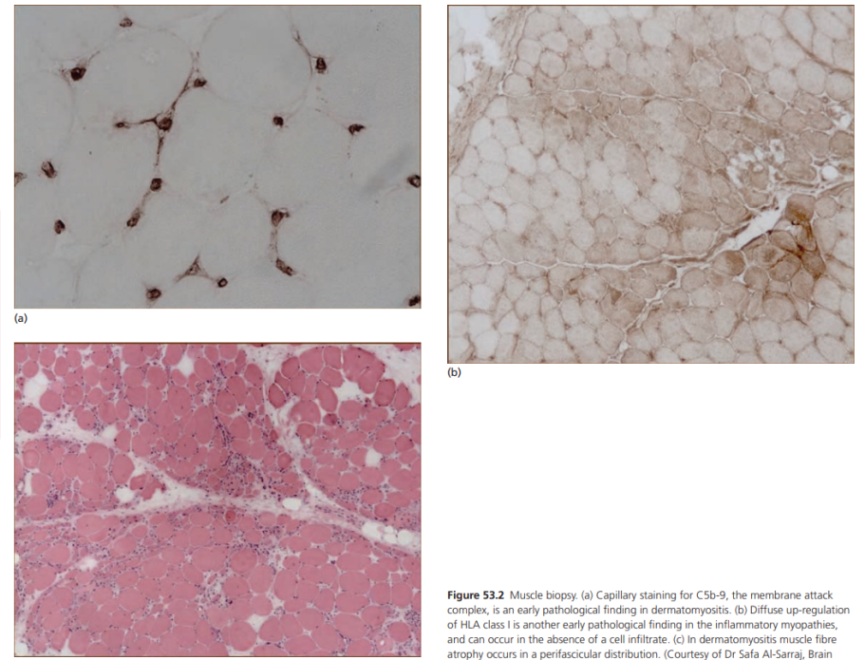

Slide 16
CLINICAL FEATURES
SKIN DISEASE
MUSCLE DISEASE
LUNG DISEASE

Slide 17
SKIN DISEASE
The classic cutaneous signs in DM involve the skin of the face ,hands and extensor surfaces of the limbs; however, all of the skin may be affected.
Typically encountered are:
Facial rash,
Eyelid erythema and oedema
Nail fold changes
Gottron’s papules
Involvement of the upper chest and back
Extensor surface dermatosis
Scalp erythema and hair loss

Slide 18
FACIAL RASH
Confluent erythema of the whole face, extending onto the neck and upper chest.
Alternatively, a lupus erythematosus‐like malar rash can occur with fixed erythema over the nose and cheeks .
Some patients have a seborrhoeic dermatitis‐like eruption, with involvement of the hairline, facial margins and naso‐labial folds .

Slide 19
FACIAL RASH
Scalp involvement in DM is common and is characterized by erythema sometimes poikiloderma and a diffuse non‐scarring hair loss.
The facial eruption may be accompanied by light scaling; scalp involvement may also be scaly.

Slide 20
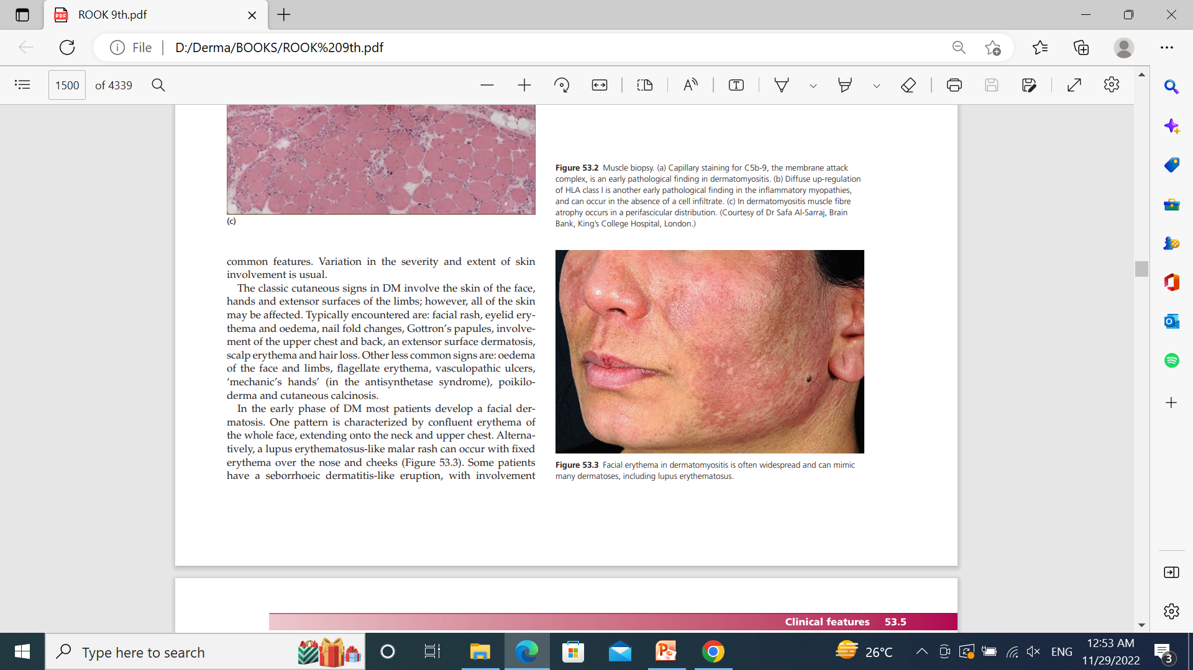
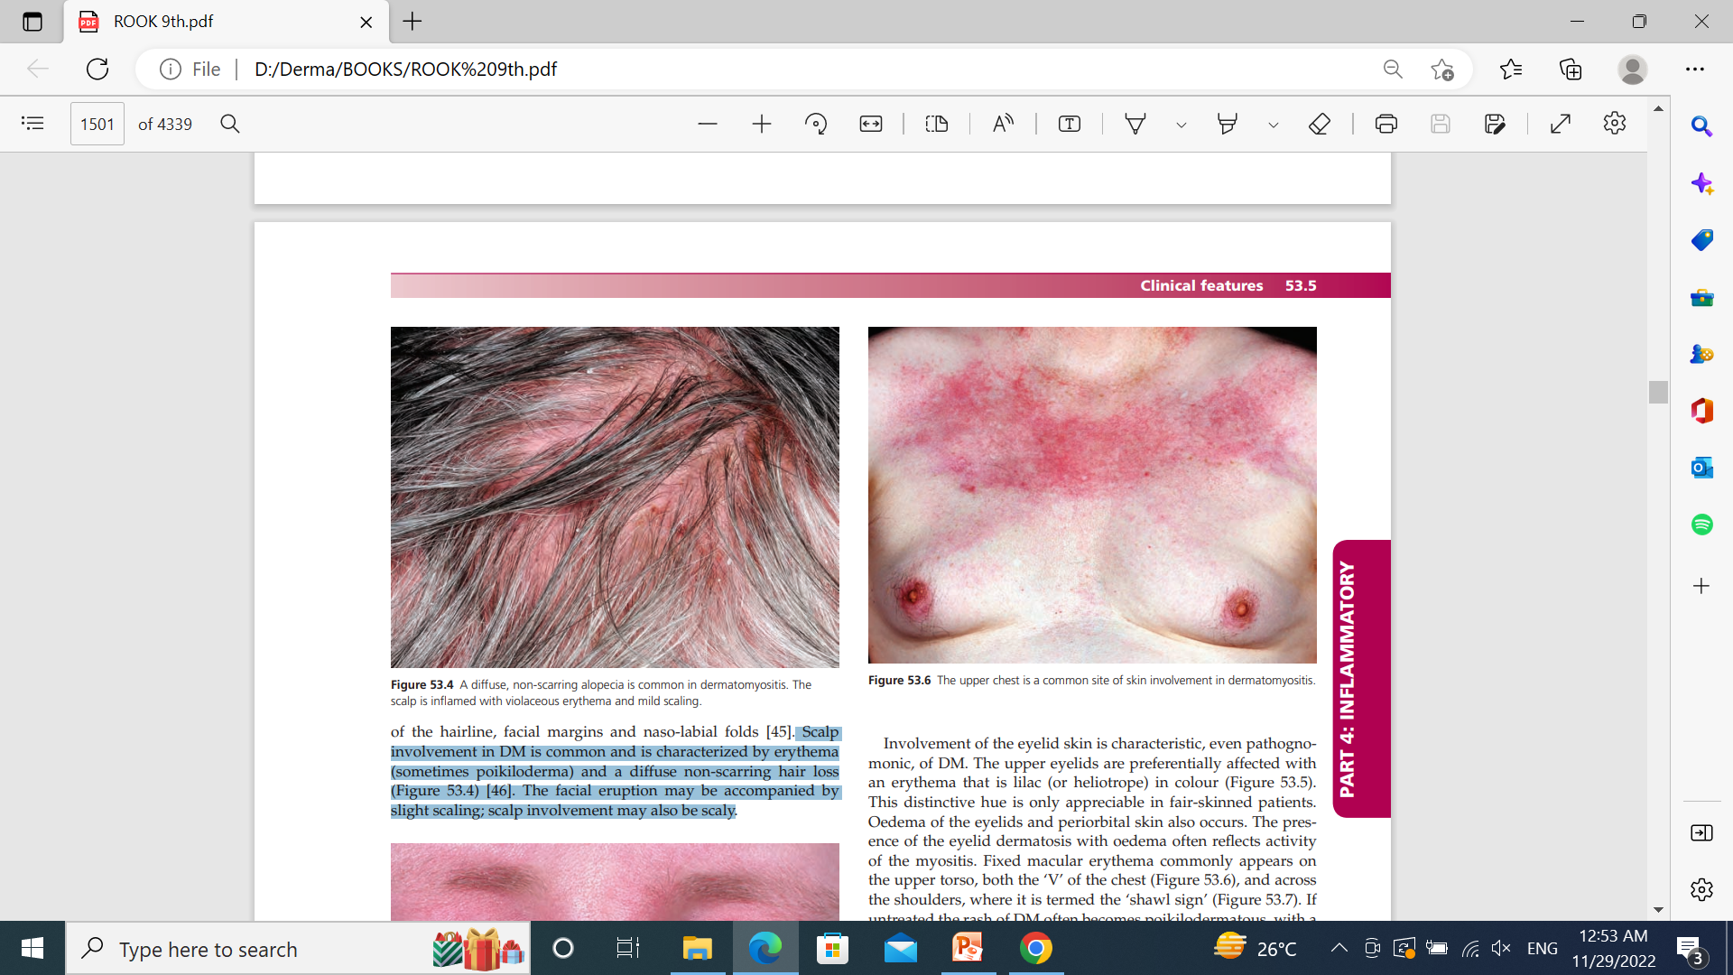

Slide 21
HELIOTROPERASH
Involvement of the eyelid skin is characteristic, even pathognomonic, of DM.
The upper eyelids are preferentially affected with an erythema that is lilac (or heliotrope) in colour.
Oedema of the eyelids and periorbital skin also occurs. The presence of the eyelid dermatosis with oedema often reflects activity of the myositis.

Slide 22
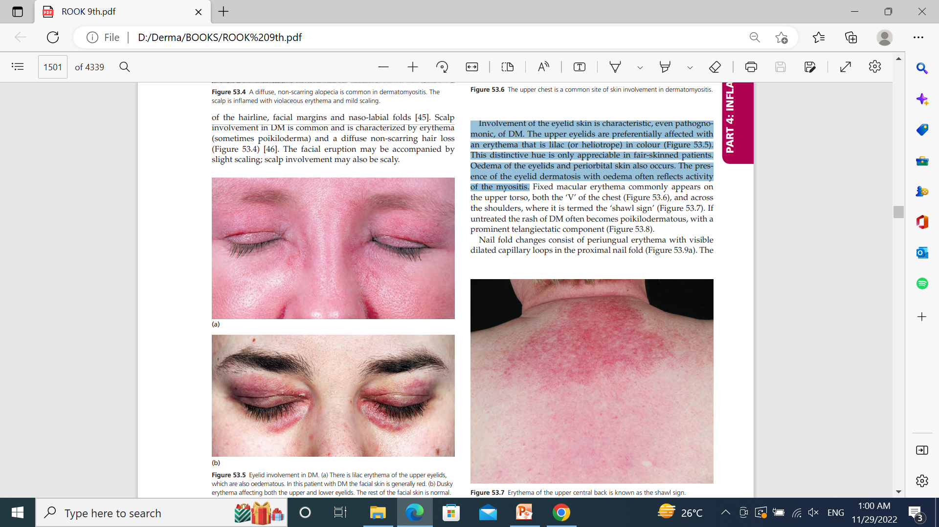

Slide 23
SHAWL SIGN
Fixed macular erythema commonly appears on
The upper torso, both the ‘V’ of the chest , and across the shoulders, where it is termed the ‘shawl sign
If untreated the rash of DM often becomes poikilodermatous, with a
Prominent telangiectatic component

Slide 26
NAIL FOLD CHANGES
Consist of periungual erythema with visible dilated capillary loops in the proximal nail fold.
Small haemorrhagic infarcts are also sometimes seen within the hyperaemic nail folds.
Hypertrophic cuticles which are dystrophic (‘ragged’), are typical.

Slide 27
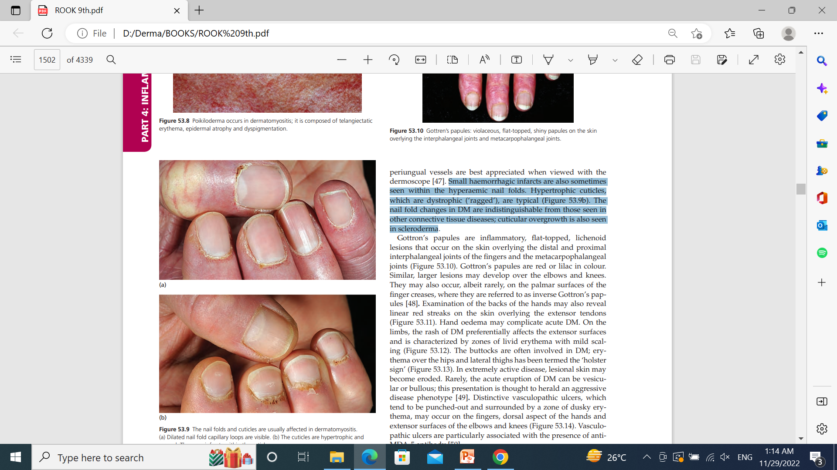

Slide 28
GOTTORNS PAPULES
Are inflammatory, flat‐topped, lichenoid Lesions that occur on the skin overlying the distal and proximal interphalangeal joints of the fingers and the metacarpophalangeal joints.
Gottron’s papules are red or lilac in colour.
Similar, larger lesions may develop over the elbows and knees.
They may also occur, rarely, on the palmar surfaces of the finger creases, where they are referred to as inverse gottron’s papules.

Slide 29
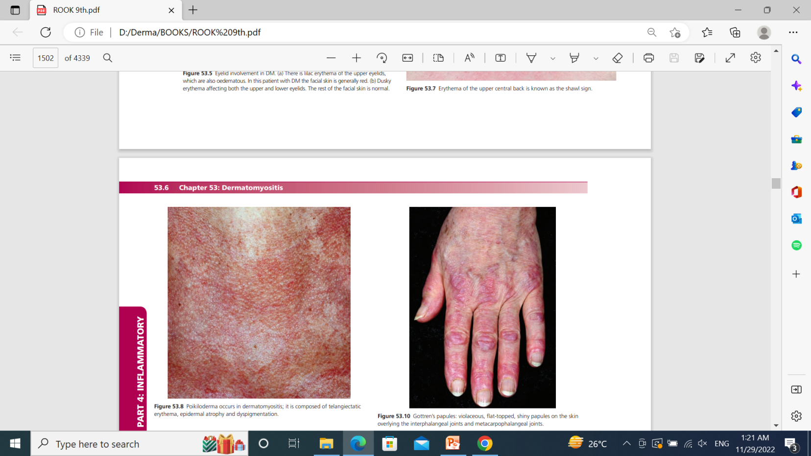

Slide 30
HAND LESIONS
Examination of the backs of the hands may also reveal linear red streaks on the skin overlying the extensor tendons.
Hand oedema may complicate acute DM.
In the antisynthetase syndrome, a skin change known as‘mechanic’s hands’ can be seen.
The term mechanic’s hands denotes non‐infl ammatory hyperkeratosis occurring on the hands or feet, usually over the radial surfaces of the fingers and the outer border of the feet

Slide 31
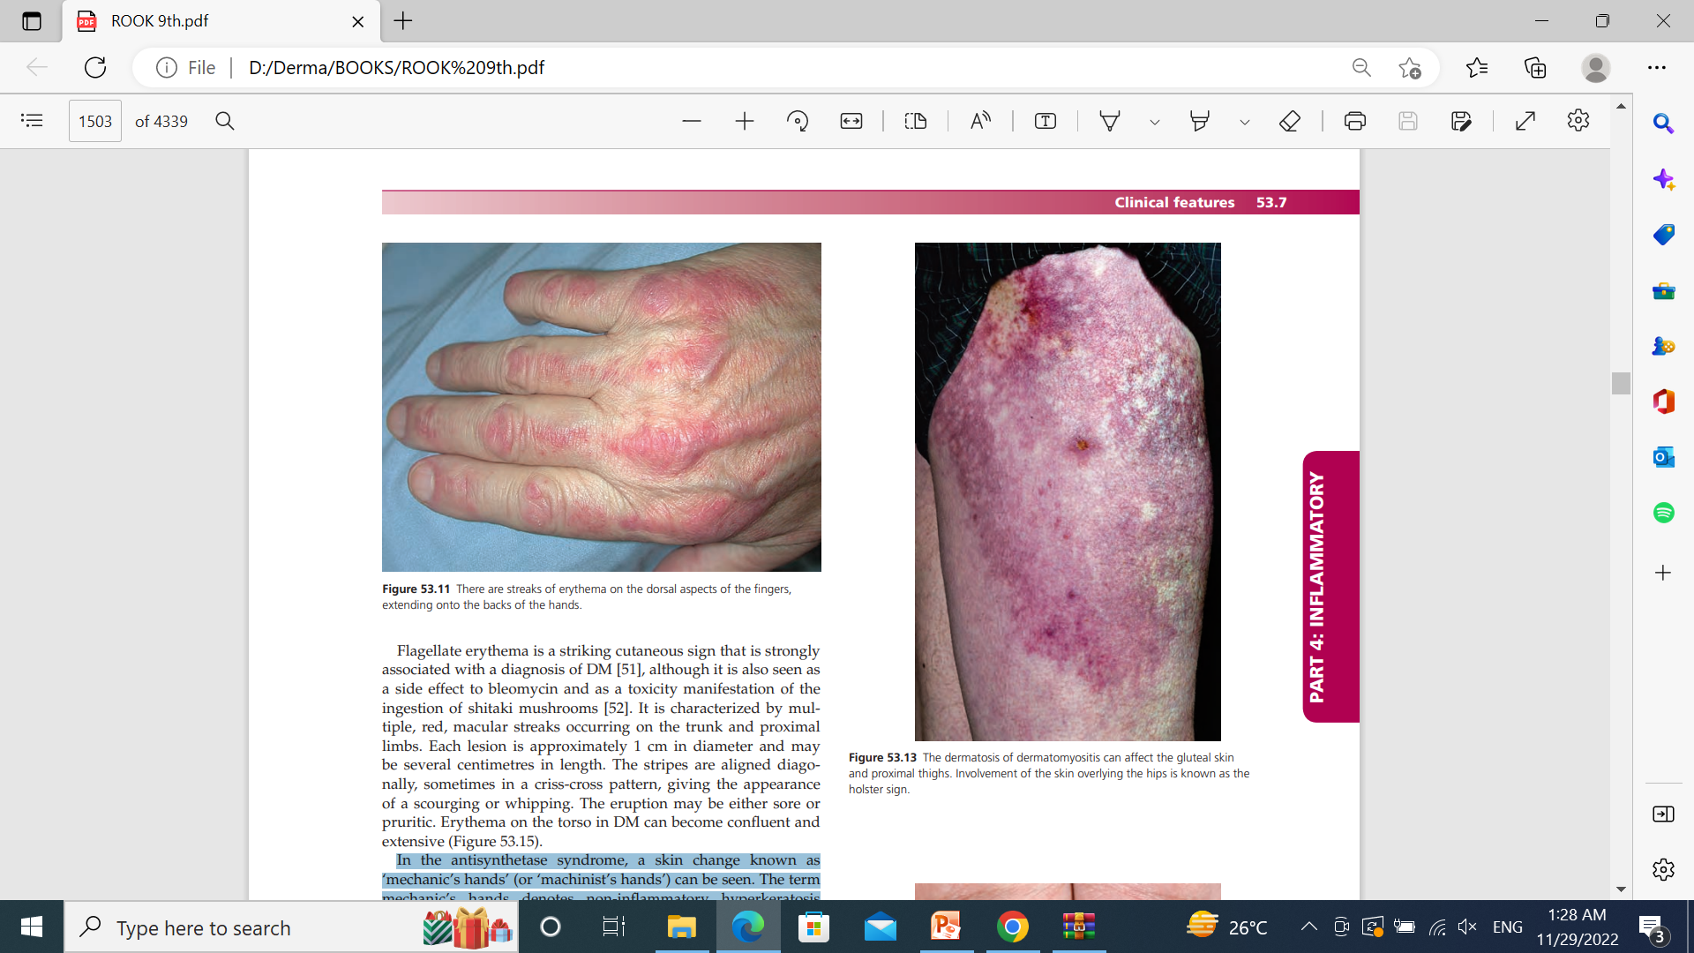
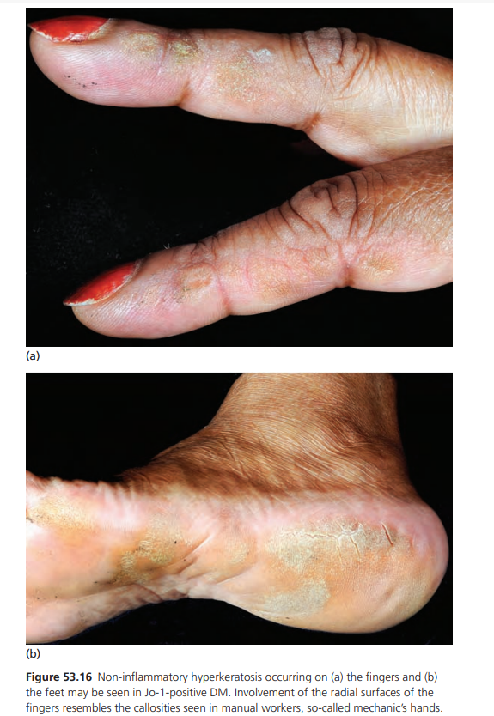
HAND LESIONS

Slide 32
HOLSTER SIGN
On the limbs, the rash of DM preferentially affects the extensor surfaces and is characterized by zones of livid erythema with mild scaling.
The buttocks are often involved in DM; erythema over the hips and lateral thighs has been termed the ‘holster sign’.

Slide 34
VASCULOPATIC ULCERS
Distinctive vasculopathic ulcers, which tend to be punched‐out and surrounded by a zone of dusky erythema, may occur on the fingers, dorsal aspect of the hands and extensor surfaces of the elbows and knees .
Vasculopathic ulcers are particularly associated with the presence of anti‐MDA‐5 antibody.

Slide 35
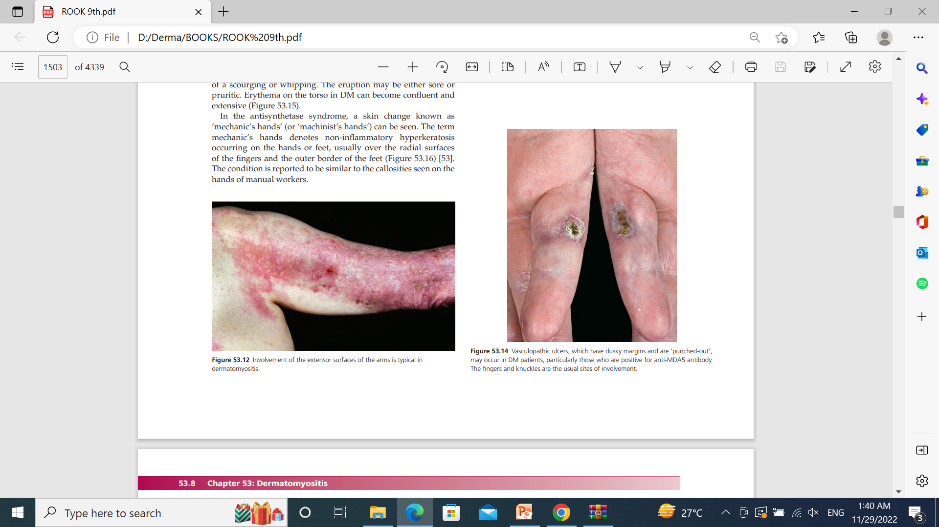

Slide 36
FLAGELLATE ERYTHEMA
Flagellate erythema is a striking cutaneous sign that is strongly associated with a diagnosis of DM.
It is characterized by multiple, red, macular streaks occurring on the trunk and proximal limbs.
Each lesion is approximately 1 cm in diameter and may be several centimetres in length.
The eruption may be either sore or pruritic.

Slide 37
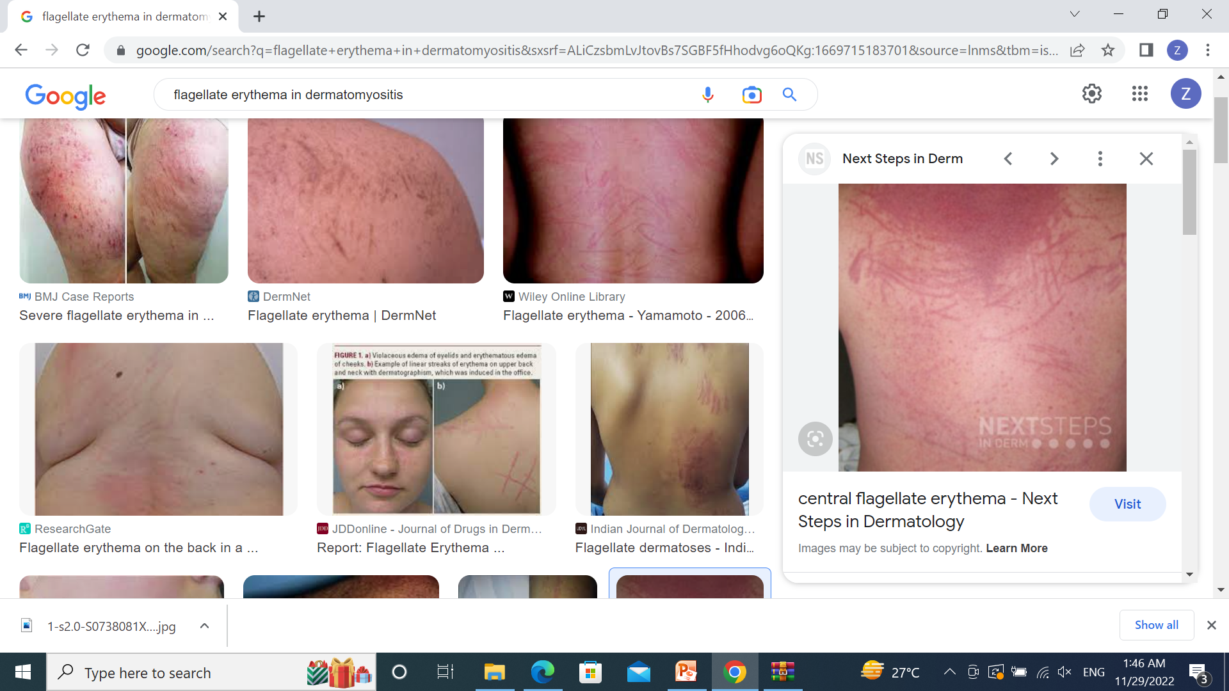

Slide 38
CALCINOSIS CUTIS
Is a complication of DM in which insoluble calcified material is deposited in the skin and subcutaneous tissue.
Calcinosis occurs in around 10% of adult DM patients and is more common in patients with longer periods of sustained disease activity, digital ulceration and anti‐NXP2 antibodies .
The areas of calcification are usually palpable to the patient and are felt as bony‐hard nodules or sheets.

Slide 39
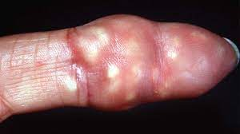
CALCINOSIS CUTIS

Slide 40
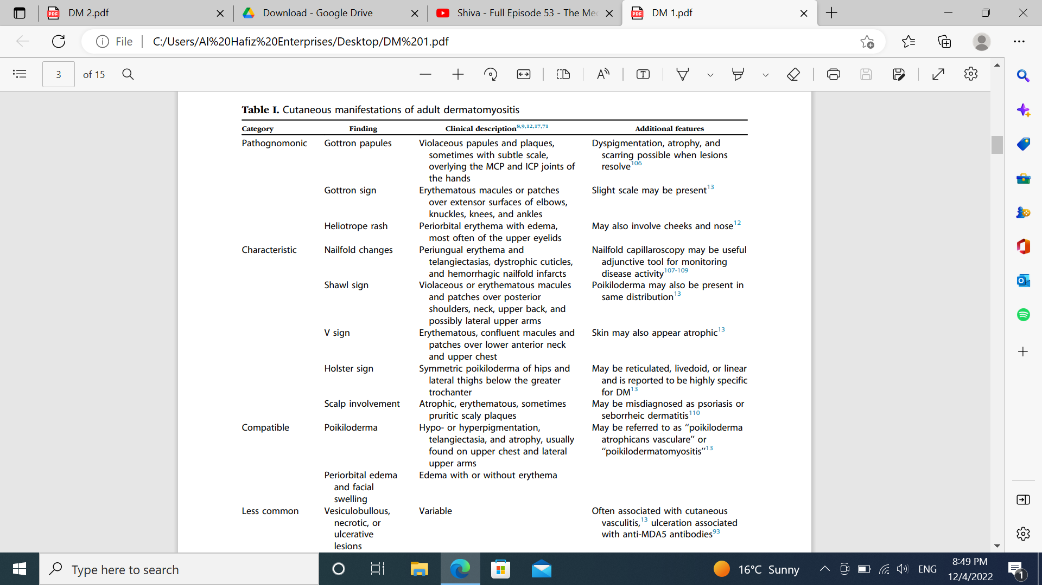

Slide 41


Slide 42
MUSCLE DISEASE
Dermatomyositis is a proximal myopathy and as such patients frequently present with problems climbing stairs, getting out of chairs and performing tasks that requiring lifting the hands above the head such as brushing hair
A brief screen for muscle involvement can be made by assessing hip flexion, shoulder abduction and elbow extension.
If there is evidence of weakness, formal manual muscle testing should be performed

Slide 43
LUNG DISEASE
Respiratory compromise in DM may be caused by ILD, respiratory muscle weakness or aspiration in patients with dysphagia or immunosuppression.
Patients usually present with a dry cough and exertional dyspnoea and have fine, late inspiratory crepitations on chest auscultation.
The majority of ILD is non‐specific interstitial pneumonitis.
Usual interstitial pneumonitis (UIP), cryptogenic‐organizing pneumonia (COP) and diffuse alveolar damage (DAD) occur less frequently.

Slide 44
LUNG DISEASE
Generally, COP has a very good prognosis, responding rapidly to steroids.
Dad is usually a severe disorder and carries a poor prognosis.
The oro‐pharynx and the upper oesophageal sphincter are frequently affected in dm causing dysphagia.
Early detection of this complication is important to
Prevent aspiration.

Slide 45
OTHER SYSTEMS
Mild cardiac abnormalities such as minor rhythm disturbances and cardiac failure.
Cardiac failureis due to myocarditis responds to immunosuppression.
A symmetrical, non‐deforming arthritis may develop, usually affecting the small joints of the hands, wrists and ankles.
In the antisynthetase syndrome a more aggressive, erosive arthritis may occur.

Slide 46
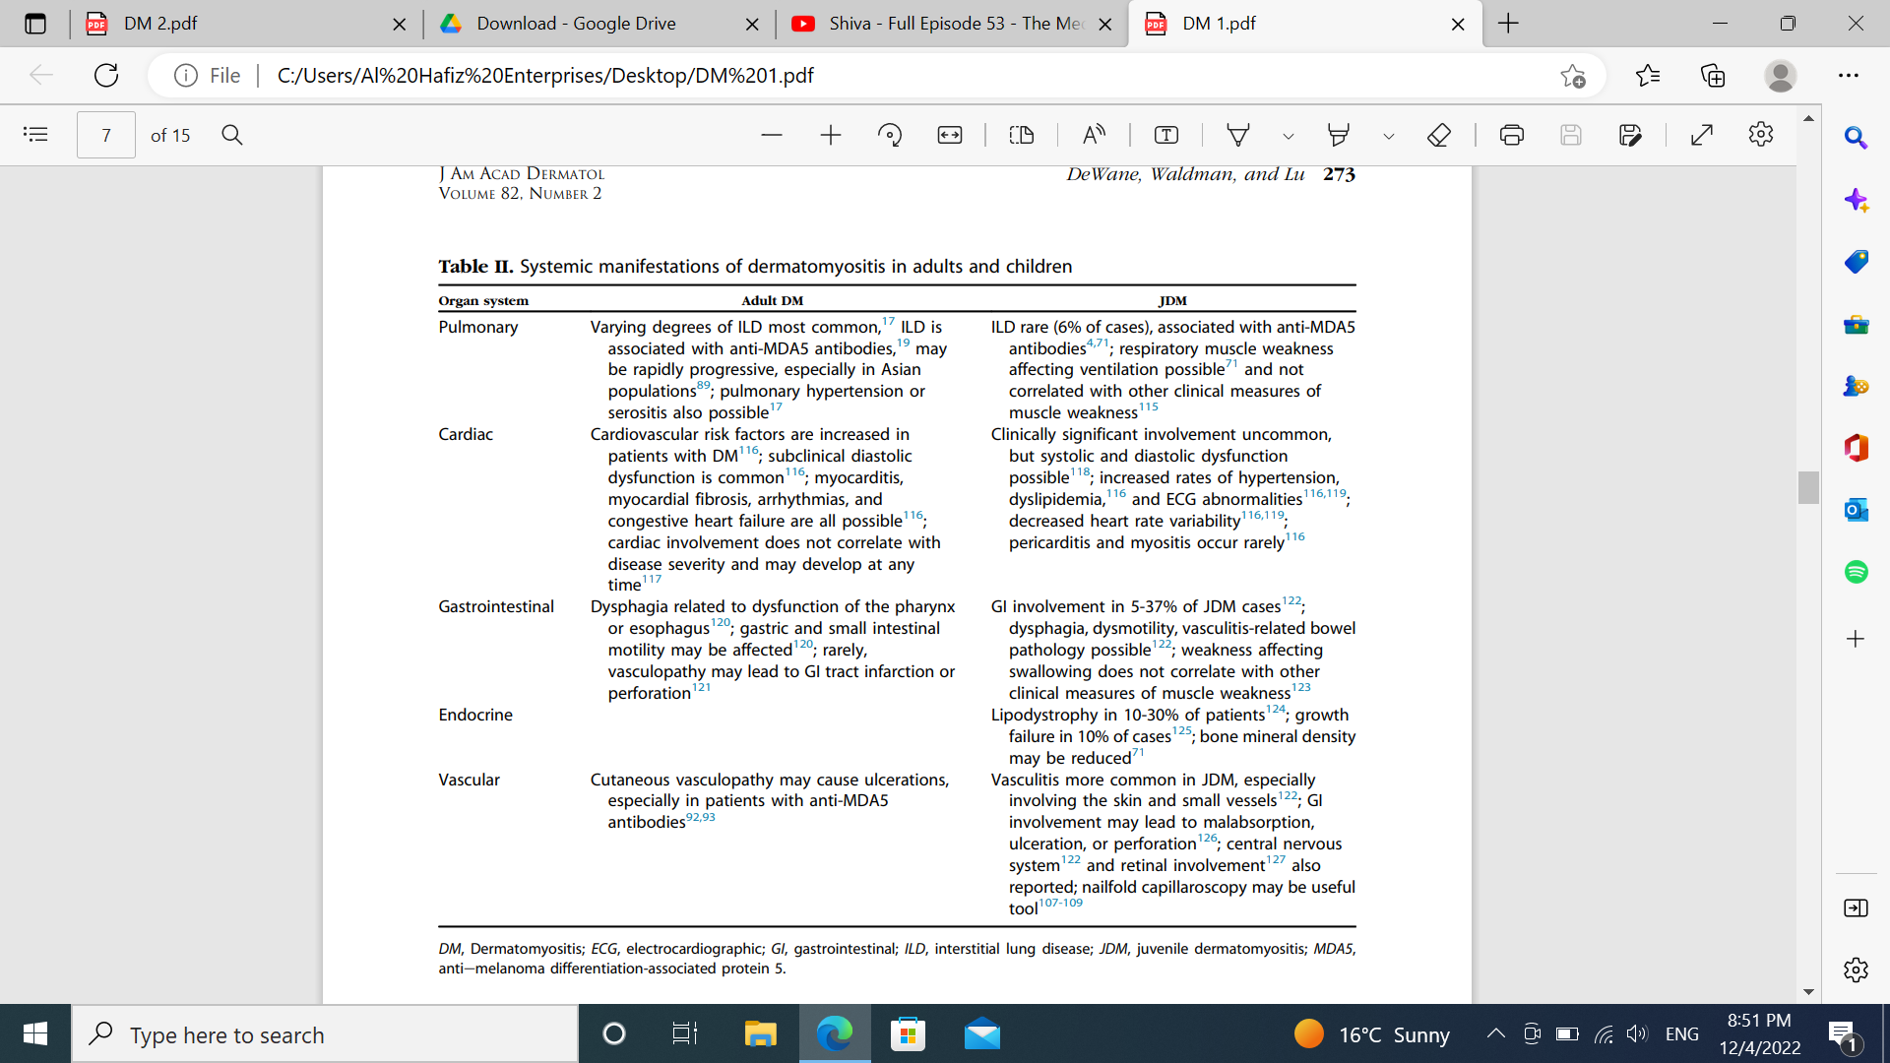

Slide 47
DERMATOSYTOSIS IN PREGNANCY
17% of DM known before pregnancy will relapse during the pregnancy period.
various factors have been considered as triggers for development of DM during pregnancy
exposure of the mother to fetal antigens
changes in maternal hormonal status
the reactivation of certain viruses by pregnancy.

Slide 48
DERMATOSYTOSIS IN PREGNANCY
Poor prognosis for both the mother and the fetus
Complications of hypertension
IUGR
55% of increase in the rate of fetal loss
50% of pregnancies ended prematurely
The occurrence of juvenile DM after post partum

Slide 49
DERMATOSYTOSIS IN PREGNANCY
steroids as first-line therapy is indicated
Other chemotherapeutic agents, such as intravenous immunoglobulins and antineoplastic agents can be used as second-line drugs to control disease activity and to maintain pregnancy.
Hydroxychloroquine has good outcome too.

Slide 50
CLINICAL VARIENTS
OVERLAP SYNDROME
Mixed connective tissue disease is an overlap connective tissue disease characterized by high titre anti‐RNP antibodies, Raynaud’s phenomenon, sclerodactyly, inflammatory myositis, ILD and pulmonary hypertension.

Slide 51
CLINICAL VARIENTS
Antisynthetase syndrome
Occurs in the presence of antisynthetase antibodies, most commonly anti‐histidyl tRNA synthetase
(Anti‐jo‐1) antibody, which is found in 10–20% of DM cases.
The antisynthetase syndrome is characterized by myositis ,arthritis, raynaud’s phenomenon, ILD, fever and ‘mechanic’s hands’ .
ILD is particularly common, occurring in around 75% cases

Slide 52
JUVENILE DERMATOMYOSITIS
DM presenting in childhood
Unlike adult DM there does not seem to be an increased risk of malignancy in JDM’ .
However, calcinosis ,which is relatively rare in adults, is found in 6–50% of children with JDM.
Calcinosis is associated with increased disease activity, being commoner in those with a delayed diagnosis and inadequately treated disease

Slide 53
JUVENILE DERMATOMYOSITIS
In children four forms of calcinosis occur,
A superficial cutaneous or subcutaneous calcinosis,
Intramuscular tumourous calcification,
Calcinosis of the myofacial planes
An extensive encasing calcinosis or ‘exoskeleton’
Acquired lipodystrophy, is a relatively common finding in patients with JDM occurring in the region of 10% children.
It is associated with insulin‐resistant type 2 diabetes and acanthosis nigricans.

Slide 54
JUVENILE DERMATOMYOSITIS
Anti‐TIF‐1γ is associated with cancer in adult disease; whereas in juvenile disease there is an association with ulcerating skin lesions .
Anti‐Jo‐1 occurs in around 20% of adult myositis cases but occurs in only a few percent of JDM patients

Slide 55
CLINICAL VARIENTS
Clinically amyopathic dermatomyositis
Drug‐induced dermatomyositis

Slide 56
DIFFERENTIAL DIAGNOSIS
Lupus erythematosus
Seborrhoeic dermatitis
Rosacea
Allergic contact dermatitis
Psoriasis
Lichen planus
Lichenoid drug eruption
Cutaneous T cell lymphoma

Slide 57
COMPLICATIONS AND CO‐MORBIDITIES
Hypoventilatory respiratory failure
Dysphagia
Aspiration pneumonia
Weight loss
Inflammatory cardiomyopathy
ILD

Slide 58
INVESTIGATIONS
Full biochemical profile
Full blood count
Inflammatory markers
Muscle enzymes
ANA
ENA, double‐stranded DNA (dsdna),
Lupus anticoagulant,
Complement levels,
Anticardiolipin antibodies and
Β2 ‐glycoprotein 1 antibodies.

Slide 59
INVESTIGATIONS
MYOSITIS ASSOCIATED ANTIBODIES
Are antibodies that occur in myositis but are not specific for it.
Anti‐52kD Ro antibodies are the commonest MAA, found in 20% of IIM cases, and may be found in conjunction with other myositis antibodies particularly anti‐Jo‐1
Anti‐Ku, anti‐U1‐RNP, U3‐RNP and PM‐Scl antibodies.

Slide 60
INVESTIGATIONS
MYOSITIS SPECIFIC ANTIBODIES
are antibodies that are specific for DM.
anti‐Jo‐1(20%) –found in anti synthase syndrome
Raynaud phenomenon
Antibodies to MDA‐5(19-35%) --CADM (85–100%)
ILD (92%)
vaculopathic ulcers
Anti‐TIF‐1γ antibodies(15-20%) — Malignancy(adult
skin disease JDM

Slide 61
INVESTIGATIONS
MYOSITIS SPECIFIC ANTIBODIES
Anti‐NXP2 antibodies(11-23%)—Calcinosis cutis
Anti‐Mi‐2 antibodies(10-20%) --Gottorns papules
Shawl sign
V sign
Anti‐SUMO‐ antibodies(8%) —Skin disease
Dysphagia

Slide 62
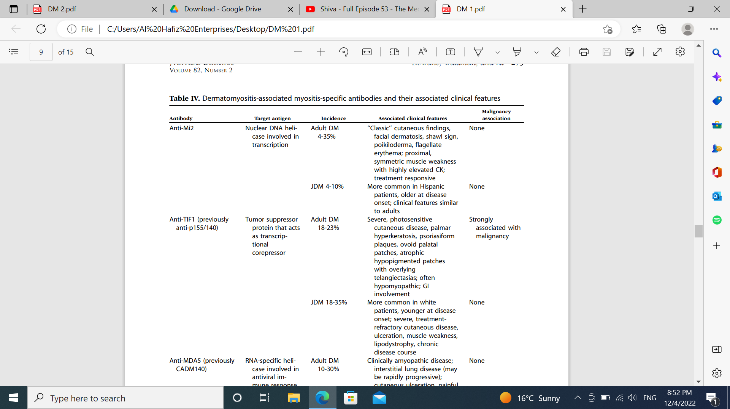

Slide 63
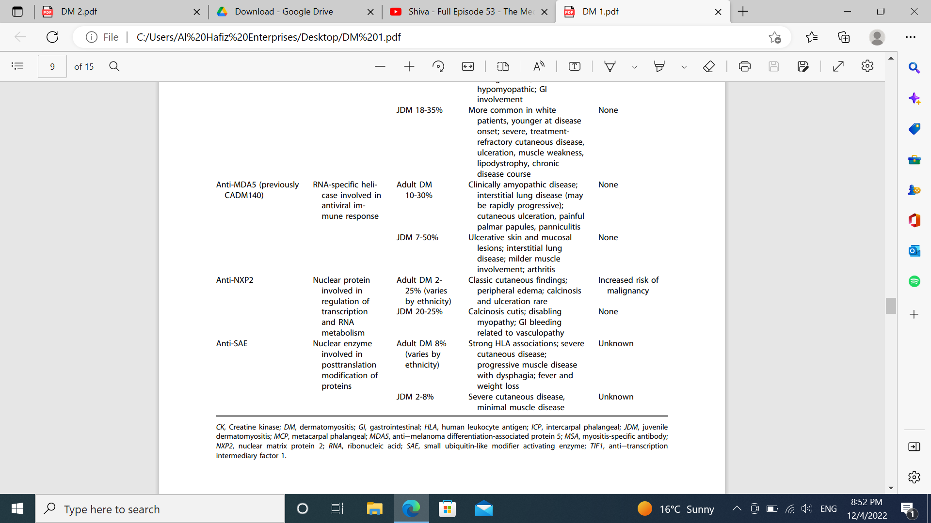

Slide 64
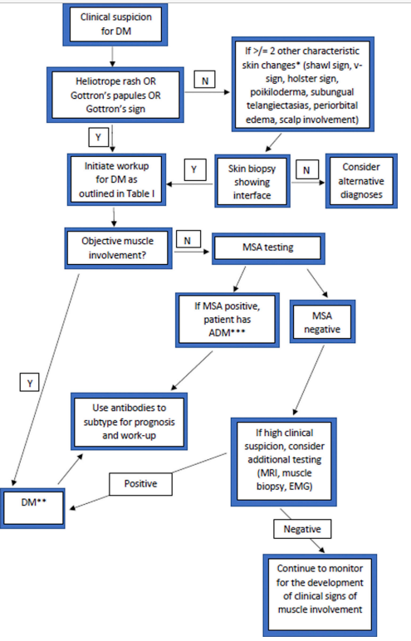

Slide 65
COURSE AND PROGNOSIS
20–35% --monophasic illness
20–30% following a relapsing &remitting course
Remainder following a chronic continuous course
Cancer and ILD being the two major causes of death

Slide 66
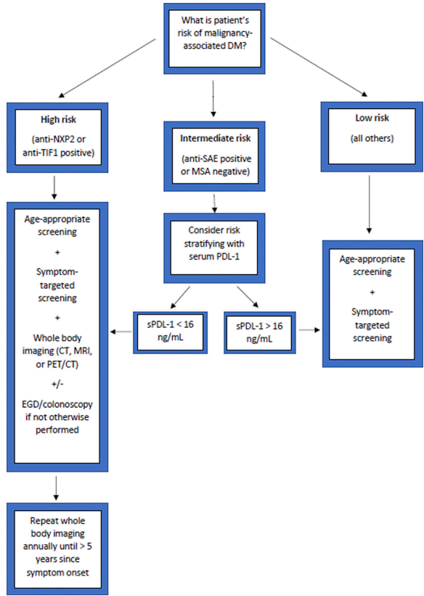

Slide 67
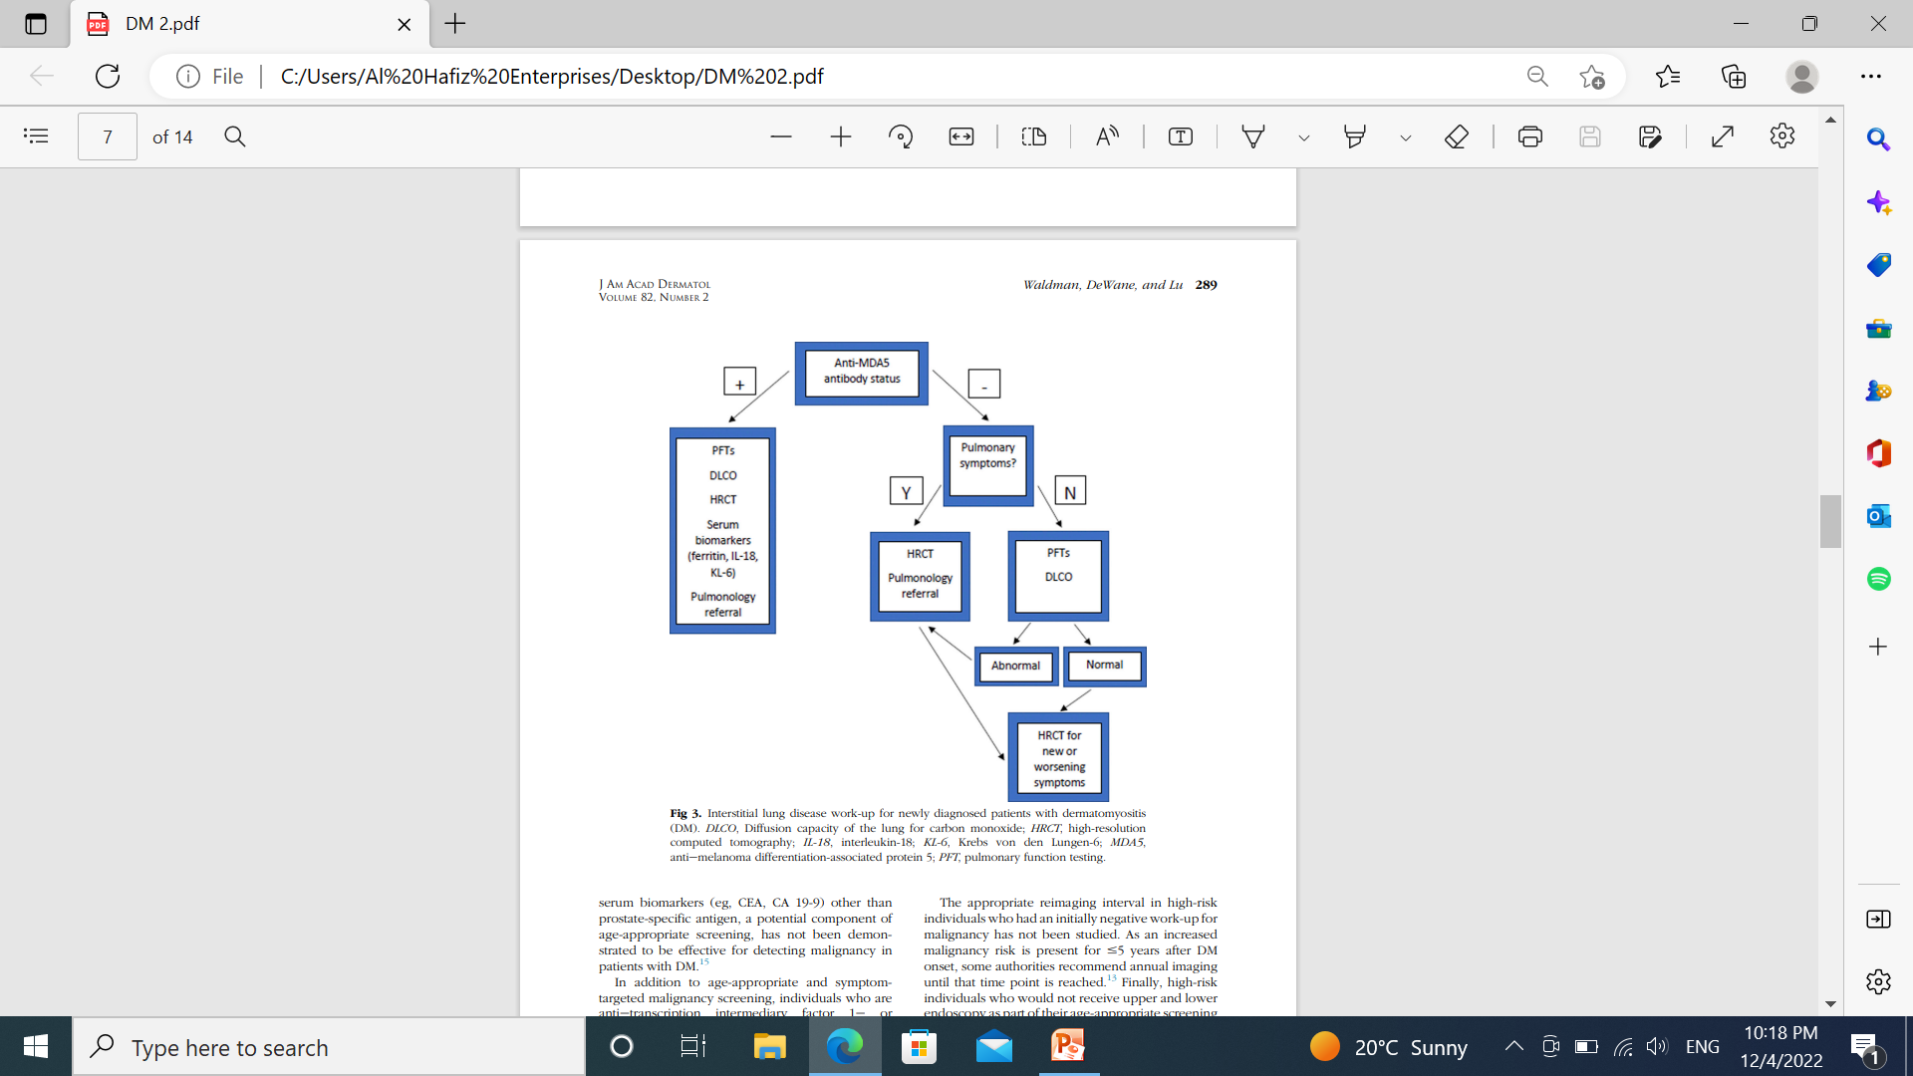

Slide 68
MANAGEMENT
The appropriate treatment approach is determined by consideration of 5 factors:
Lesion type --Is the lesion nonvasculopathic
,vasculopathic(digital pulp ulcers, inverse Gottron papules,or calcinotic
Degree of muscle involvement--Is the patient amyopathic/hypomyopathic or myopathic.
Presence of systemic symptoms
Presence of MSAs
Patient age

Slide 69
MANAGEMENT
Systemic corticosteroids are the gold standard initial treatment for DM-related myopathy.
They should not be used in
CADM
as a monotherapy

Slide 70
MANAGEMENT
Many patients report improvement in the rash and muscle weakness within 1–2 weeks of starting systemic corticosteroids
Pulsed intravenous methylprednisolone can be administered, 0.5–1 g/day for 3 consecutive days---in case of severe disease

Slide 71
MANAGEMENT
FIRSRT LINE
Pulsed IV methylprednisolone 0.5–1.0 g/day on 3 consecutive days (for severe life‐threatening disease)
Followed by oral prednisolone 0.5‐1 mg/kg/day
Notes:
DMARD after pulsed methyl prednisolone, such as methotrexate , azathioprine or ciclosporin
Consider IVIg, particularly if the patient has dysphagia

Slide 72
MANAGEMENT
FIRSRT LINE (Alternative)
Pulsed IV methylprednisolone 0.5–1.0 g/day on three consecutive days (for severe life‐threatening disease)
Followed by IV cyclophosphamide (for severe life‐threatening disease)
plus prednisolone 1 mg/kg/day
DMARD after cyclophosphamide, such as methotrexate , azathioprine or ciclosporin
Consider IVIg, particularly if the patient has dysphagia

Slide 73
MANAGEMENT
SECOND LINE
Mycophenolate mofetil
or
Oral tacrolimus
For skin‐limited disease
Potent topical corticosteroid ointment or topical tacrolimus 0.1% ointment
plus hydroxychloroquine (± mepacrine

Slide 74
MANAGEMENT
THIRD LINE
Rituximab
In individuals with vasculopathic or calcinotic lesions, adults with anti-MDA5 positivity, or children with NXP-2 positivity, rituximab plus systemic corticosteroids can be considered first-line treatment.
Rituximab is the only treatment associated with improvement in nailfold capillary abnormalities that may represent prevention of pathogenic vessel damage.

Slide 75
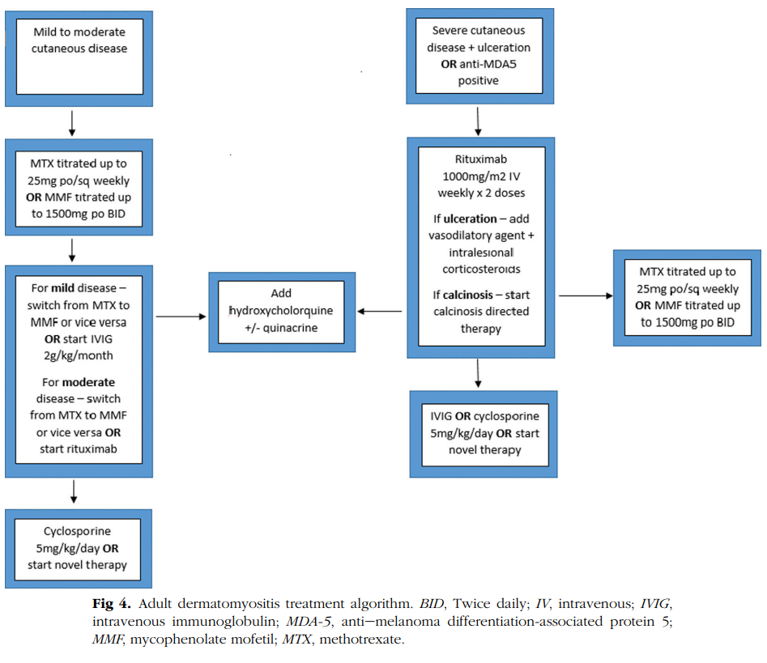

Slide 76
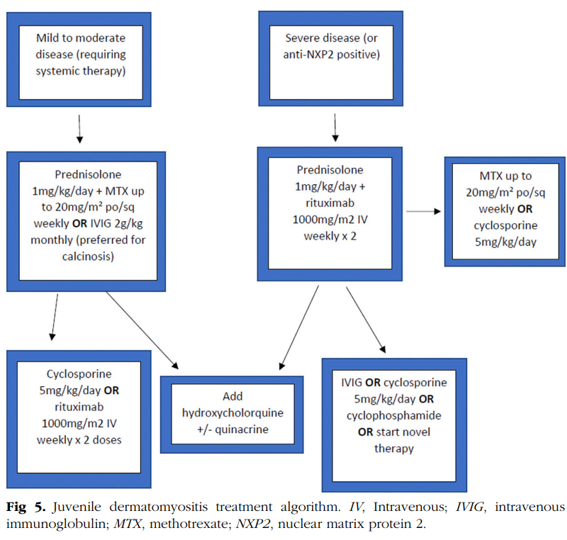

Slide 77


