Slide 1
DISORDERS AFFECTING CUTANEOUS VASCULATURE
BY DR NAZISH MEMON
FCPS II TRAINEE
DERMATOLOGY

Slide 2
CAPILLARY DISORDERS

Slide 3
CAPILLARY MALFORMATONS
Also known as port-wine stain
Capillary malformation is a sporadic, homogenous, pink, red or purple macule present at birth.

Slide 4
EPIDEMIOLOGY
Most common vascular malformation.
3 of 1OOO newborns.
Have equal sex distribution.

Slide 5
PATHOPHYSIOLOGY
Characterized by dilatation of normal numbers of capillaries of papillary or upper reticular dermis combined with areas of increased number of normal-looking capillaries.
flat endothelial cells.
Immunohistochemistry shows normal factor vii, fibronectin and basement membrane protien .
S1OO staining shows abnormal innervation.
Somatic activating change found in GNAQ gene.

Slide 6
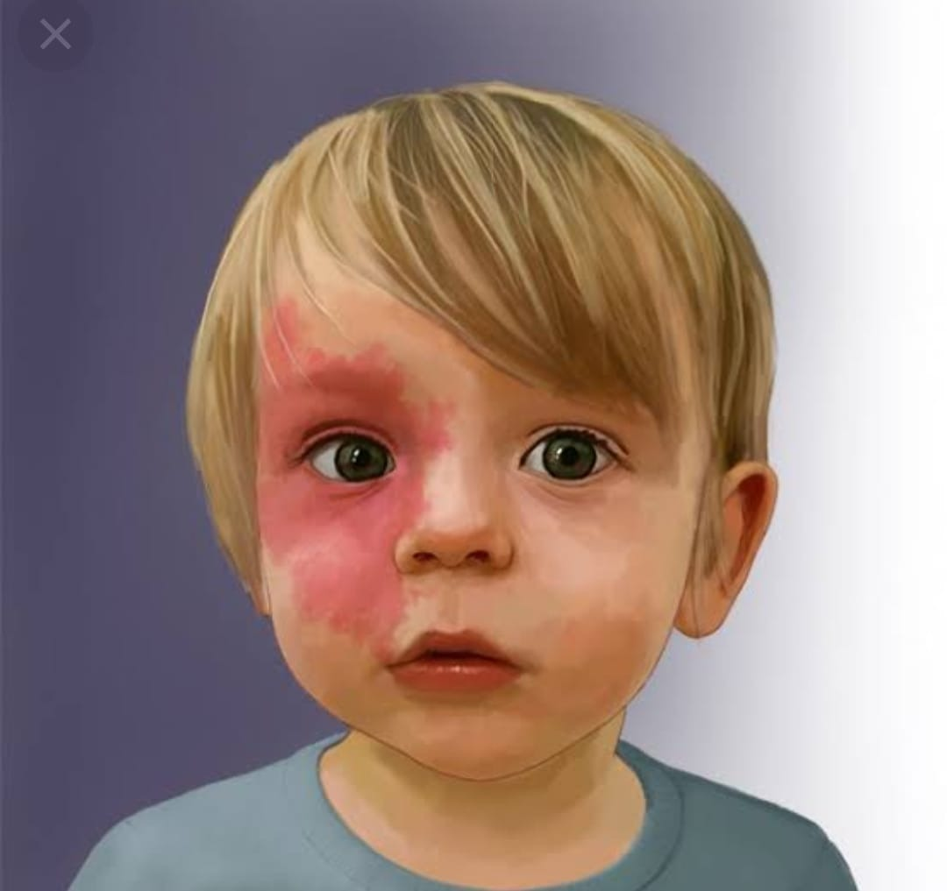
CLINICAL FEATURES
Pink, red or purple macule of variable size with geographic borders,
Head and neck, trunk or limb
Grows proportionately with child’s age.
Persists throughout life.
Lesion darkens and often thickens with age
Underlying tissues are hypertrophic.

Slide 7
INVESTIGATIONS
Usually require no treatment
Associated sign and symptoms , large size and multifocality evoke a possible syndromic form.
Capillary malformations need scaniometry at around eight years of age to evaluate growth discrepancy.

Slide 8
MANAGEMENT
Pulsed–dye laser is first line treatment.
It reduces coloration in 75% of patients without modifying skin texture.
Surgery is usually done to correct tissue hyperplasia.

Slide 9
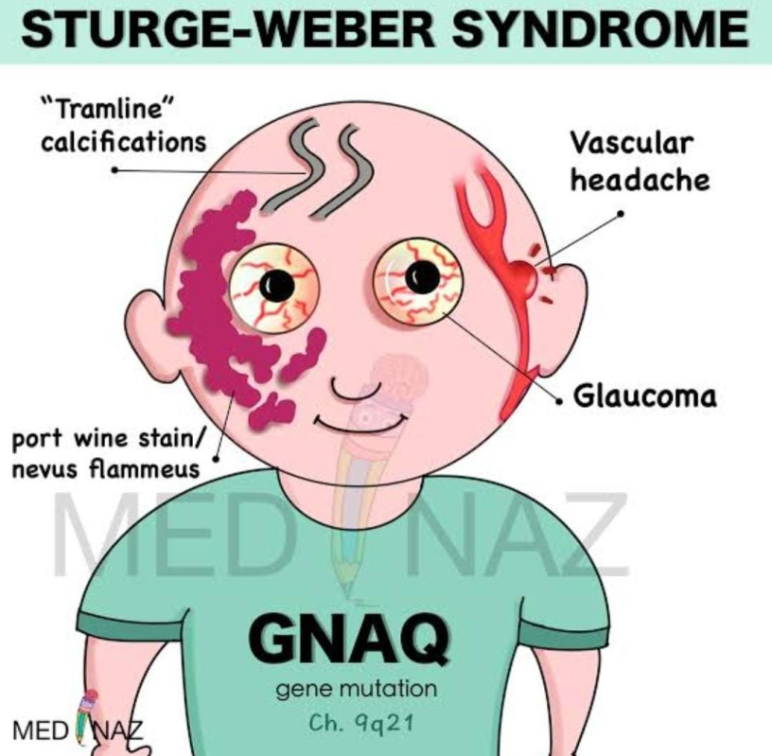
STURGE-WEBER SYNDROME
SWS is a severe neurocutaneous sporadic disorder.
Characterized by capillary malformation located on the territory of first branch of trigeminal nerve, leptomeningeal and/or retinal capillary-venous malformation on the same side.

Slide 10
PATHOPHYSIOLOGY
As for common capillary malformation there is somatic activating change in GNAQ gene in SWS.
If same mutation occur earlier then it causes SWS and if it occur late then causes CM.

Slide 11
CLINICAL FEATURES
Characterized by capillary malformation located on the forehead and the upper eyelid,
Associated with ipsilateral leptomeningeal capillary-venous anomaly and/or ocular involvement.
CM can be bilateral or extensive covering the territory of maxillary and mandibular branch of trigeminal nerve and sometimes trunck and limbs.
75% develop seizure begin at the age of two years
Contralateral neurologic deficit and learning difficulties.
Glaucoma in 5o%.

Slide 12
INVESTIGATION
Frontopalpebral CM needs MRI imaging and opthalmological evaluation of the fundus of the eye.
Intraocular pressure assesement.

Slide 13
MANAGEMENT
Pulsed-dye laser can be used to treat CM.
Manage epilepsy and glaucoma as an emergency.
For intractable seizure lobectomy can be required
Regular opthalmologic follow up is needed throughout life.

Slide 14
CAPILLARY MALFORMATION ARTERIOVENOUS MALFORMATION
Autosomal dominant disorder
Characterized by multifocal capillary malformation and increased risk for fast-flow vascular malformations.

Slide 15
PATHOPHYSIOLOGY
Caused by heterogenous loss-of-function mutation in RASA1 gene
Somatic second hit could explain the intrafamilial clinical variability.

Slide 16
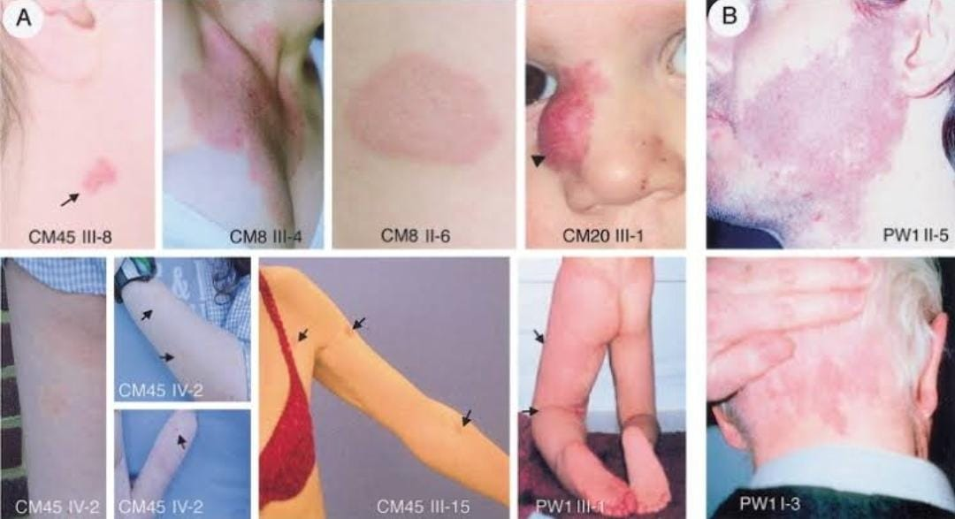
CLINICAL FEATURES
All affected individual have cutaneous capillary malformations.
CM are multifocal usually and have variable size, with haphazard distribution.
In contrast to common CM additional lesions can appear with time

Slide 17
CM are pink, red to brownish, homogenous or telangiectatic and about half of them have characteristic white halo around the lesion.
CM can be within CNS or outside the CNS.
Intra Central nervous system AVM/AVF are usually symptomatic early in life perinatally or during childhood.
Associated symptoms:- cardiac failure, hydrocephaly, epilepsy, developmental delay, para or tetra plegia and neurogenic bladder.

Slide 18
One third patient have fast-flow vascular malformations e.g arteriovenous malormation ,
Arteriovenous fistula or Parker weber syndrome
Parker weber syndrome characterized by capillary blush on an upper or lower extremity, bony and soft tissue hypertrophy and multiple arteriolo-venous microfistulae.
Major problem with PWS is leg length discrepancy causing scoliosis.
Cardiac failure can occur.

Slide 19
INVESTIGATION
Small CMs do not require investigation unless warm on palpation.
AVM/AVF need dopplar ultrasound, MRI or arteriography.
For leg length discrepancy radiography done.
Genetic consultation needed.
RASA1 gene mutation foud then screen the asymptomatic cerebral and spinal fast-flow lesions by MRI.

Slide 20
MANAGEMENT
The CM of CM-AVM respond only partially or not at all to pulsed-dye laser.
Patient with AVM or AVF need multidisciplinary approach.
Treatment of parker weber syndrome is as conservative as possible e.g elastic stockings and leg length discrepancy is monitored untill end of the puberty.
Genetic counselling is needed.

Slide 21
ARTERIOVENOUS DISORDERS

Slide 22
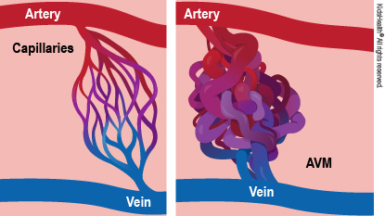
ARTERIOVENOUS MALFORMATIONS
AVM are congenital, destructive, fast-flow vascular malformations that tend to be worse with time.
Can occur in any body part.

Slide 23
EPIDEMIOLOGY
No sex bias
AVM can be isolated or part o4 a disorder such as CM-AVM, HHT, or PTEN hamartoma tumour syndrome.

Slide 24
PATHOPHYSIOLOGY
Arteries and veins are distorted with thickened muscle walls due to AV shunting and fibrosis.
In AVM normal capillary bed is replaced by a nidus , via which blood shunts from feeding vessels into draining veins.
AVF consists of direct communication between an artery and a vein.
AVF are less frequent than AVM.

Slide 25
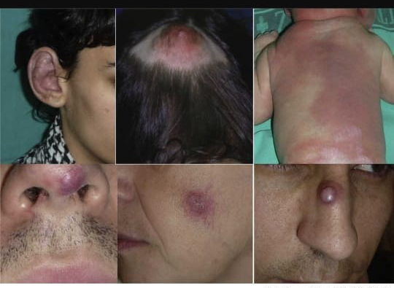
CLINICAL FEATURES
AVM are localized affecting brain, skin, muscle, bone or viscera.
PWS consists of multiple microfistulae.
AVM expands slowly, but can worse rapidly at puberty, during pregnancy, after trauma or after incomplete treatment.

Slide 26
At birth AVM involving skin can appear as a capillary blush, which can misdiagnosed with CM.
Presence of increase warmth, thril or bruit suggset a fast-flow component.

Slide 27
Symptoms in childhood and adulthood varry:-
In intracranial lesions:-hydrocephaly, headache, epilepsy, haemorrhag and focal neurologic deficit.
In pulmonary lesions:- cyanosis, clubbing, polycythemia, right-to-left shunt with cerebral abscess and embolic stroke.
In hepatic lesions:- portal hypertension and billiary disease.
In cutaneous, subcutaneous and muscular lesions:-heaviness, pulsatile mass, thrill, trophic changes and bleeding.

Slide 28
INVESTIGATIONS
Radiological investigations to confirm clinical diagnosis, to delineate lesion and to evaluate therapeutic approach.
Doppler ultrasound shows high-velocity arterial and pulsatile venous flow with low resistance.
T2- Weighted MRI shows dilated veins and arteries with normal or hypertrophied tissue.
Arteriography done as a pre-treatment examination to identify the feeding arteries and to localize the nidus.

Slide 29
MANAGEMENT
Management needs multidisciplinary approach
Conservative treatment include anti-hypertensive, analgesics, elastic stockings and wound management
Invasive treatment only done in reference centre by trained physicians.
Treatment should be as complete as possible to avoid recruitment of new feeding arteries.

Slide 30
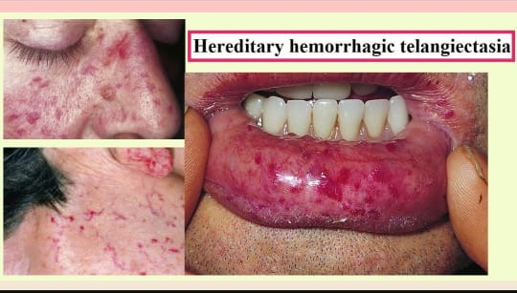
HERIDTARY HAEMORRHAGIC TELENGIECTASIA
Also called as Osler-Weber-Rendu syndrome.
An AD disorder characterized by mucocutaneous and GIT telengiectasias associated with AVM/AVF in lungs, liver or brain.

Slide 31
PATHOPHYSIOLOGY
Telengiectasias of HHT are micro-AVFs.
Histology shows vessel dilatation, and variable thickness and disorganization of the smooth muscle cell layer.
Atleast 6 genes are involved :- four identified e.g ENG, ACVRL1, SMAD4, GDF2
Two localized e.g HHT and HHT4.
More than eighty percent of HHT have mutation in ENG, ACVRL1, SMAD4.
These three genes encode component o4 TGF-B

Slide 32
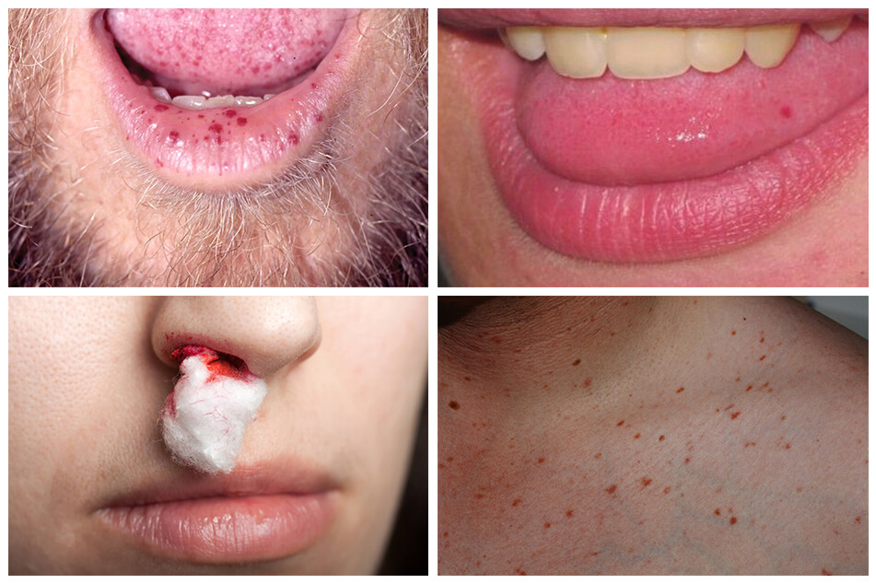
CLINICAL FEATURES
Diagnosis o4 HHT based on Curacao criteria.
CURACAO CRITERIA:-
It includes
Epistaxis
Telengiectasis
Visceral fast flow lesions
Family history

Slide 33
Diagnosis is considered as DEFiNITE if three or more criteria are met,
POSSIBLE if two criteria are met and
UNLIKELY when only one criteria is met

Slide 34
INVESTIGATIONS
Contrast echocardiography is indicated.
Cerebral MRI, thorasic CT scan and hepatic doppler ultrasound should be performed to screen for asymptomatic AVM in children and young adults, as they are at high risk of haemorrhage.
Genetic consultation is needed to assess family history and to perform genetic testing.

Slide 35
MANAGEMENT
Treatment is symptomatic and multidisciplinary.
Regular follow up of oximetry and blood count for anemia polycythemia.
Iron supplementation and transfusion for anaemia.
Nasal humidification, lubricants and haemostatic products for nasal bleedig.
Laser can be used for cutaneous, nasal or GIT telengiectasias.
Antiangiogenic molecules such as thalidomide and bevacizumab, an anti avascular endothelial growth factor A are currently under treatment.

Slide 36
PTEN HAMARTOMA TUMOUR SYNDROME
It is an autosomal dominant disorder that regroup patients with bannayan-Riley-Ruvalcaba syndrome BRRS and Cowden syndrome.

Slide 37
PATHOPHYSIOLOGY
Heterozygous PTEN mutation is described in 6o% of BRRS and eighty one % of cowden syndrome patients.
Most PTEN mutations cause premature termination codons suggest a loss of function effect and haploinsuficiency.

Slide 38
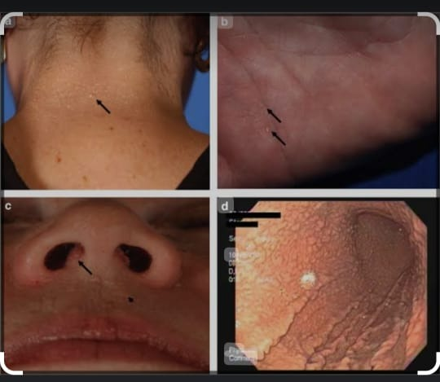
CLINICAL FEATURES
Eighty six % have fast-flowing vascular anomalies.
Extracranial features are in ectopic at, disrupted architecture, severe and prolonged enlargement o4 the affected muscle.

Slide 39
BRRS is characterized by macroceohaly, developmental delay, hamartomatous intestinal polyposis, lipoma and pigmented macule of glans penis .
Cowden syndrome is characterized by macrocephaly, multiple hamartomas, increase risk for beningn and malignant tumours such as thyroid, breast and endometrial cancer and mucocutaneous lesions e.g trichilemmomas, acral keratosis, papilomatous lession.
Both are part of phenotypic spectrum o4 PHTS.

Slide 40
INVESTIGATIONS
Measurement of head circum4erence
Family history of the disease
Ultrasound of thyroid and breast to rule out malignancy.
Yearly breast mammography of women more than thirty years
Colonoscopy or colorectal cancer survillence started at age thirty five years
Radiological investigations of vascular lesion include doppler ultrasound, T2-Weighted MRI and MRA.

Slide 41
MANAGEMENT
Or symptomatic papillomatous papules topical agents are used like curretage, cryosurgery, laser or surgery.
Treatment o4 4ast-4low lesions is similar to that o4 sporadic AVM.
Rapamycin seems e44ective in clinical trials
Genetic councelling is needed.

Slide 42
VENOUS DISORDERS

Slide 43
VENOUS MALORMATIONS
Also called as venous angiomas or cavernomas.
Venous malformations are sporadic vascular lesions.
Characterized by localized light-to-dark blue lumps consisting o4 malformed veins.
Can be emptied by compression or upright position.

Slide 44
ASSOCIATED DISEASES
Elevated d-dimer level suggest fibrinolysis
Most sporadic VMs have LIC.
In 25% patient with LIC , d-dimer levels are very high over twice the normal range
4o% have concomittent low fibrinogen level,hence associated with high risk of DIC
LIC has 96% specificity or venous malformation.

Slide 45
PATHOPHYSIOLOGY
Histologically there is enlarged, convulated venous channel lined by a single flattened layer of endothelial cells surrounded by irregularly distributed smooth muscle cells.

Slide 46
Somatic mutation in TEK encoding the endothelial cell tyrosine kinase receptor TIE2 present in above 5o% of VMs.
It causes strong hyperphosphorylation of TIE2
This hyperphosphorylated TIE2 activates the PIK->AKT->OXOL signalling pathway leading to decrease PDGF-B.

Slide 47
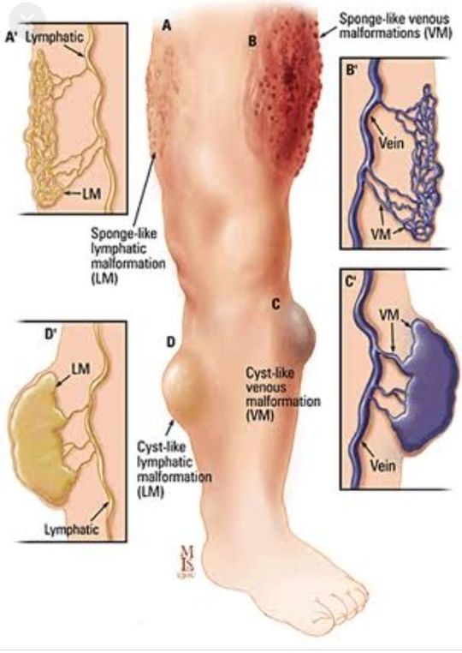
CLINICAL FEATURE
Venous malformations are mainly solitary but less than 1%are multifocal.
They vary from small blebs to large bluish lesions.
Non-tender unless thrombosis occur.
No thrill or bruit
Malformation is not warmer than non-lesional areas.

Slide 48
VMs can affect skin, mucosa, muscles, joints, nerves, bones and internal organs.
Intrabuccal malformations are associated with sleep apnoea
Migraine is common if VMs located in temporal muscle.

Slide 49
COMPLICATIONS AND CO-MORBIDITIES
Pulmonary thromboembolism with or without pulmonary arterial hypertension seen in patient with extensive VMs of extremities with LIC.

Slide 50
DISEASE COURSE AND PROGNOSIS
VMs grow proportionately with the individual.
Never regress spontaneously.
Initially asymptomatic lesion often become painfull at puberty.
They can be lfie threatening.

Slide 51
INVESTIGATIONS
Doppler ultrasound is best examination to confirm the vascular nature of the lesion e.g slow flow and to identiy anatomy of the draining vessels.
MRI with spin-echo T1 and T2- weighted and at saturation sequences depict the anatomical relationship between vascular lesion and adjacent structure.
Blood test needed to identify the associated coagulation abnormalities.

Slide 52
MANAGEMENT
Compression garment is used for symptomatic and extensive VMs of extremities to reduce pain and thrombosis.
Aspirin help in children with painful VMs and elevated d-dimer level,
LMWH 1OO anti-Xa/kg/day is used to relieve pain associated with elevated d-dimer levels and to prevent bleeding during a surgical procedure.
Sclerotherapy followed by surgical resection is the treatment of choice.

Slide 53
Pulsed dye laser or yag laser can be efficient for small superficial lesion.
Well localized VMs can be surgically resected.
Extensive VMs should undergo several session of sclerotherapy.
Sclerosing agents include detergents e.g sodium tetradecyl sulphate, polidocanol and microfoam, bleomycin, and radio-opaque ethylcellulose ethanol,

Slide 54
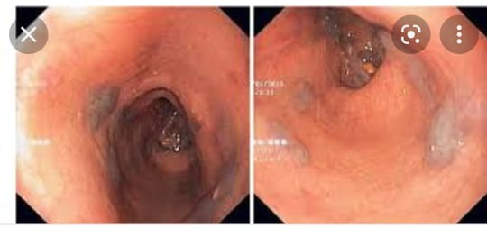
BLUE RUBBER BLEB NAEVUS SYNDROME
Also called as BEAN SYNDROME
Blue rubber bleb naevus syndrome is a rare, sporadic, congenital, slow-flow vascular anomaly.
Characterized by numerous widely distributed, cutaneous and internal VMs.
Pathognomic are small, rubbery, dark bluish, palmoplanter lesions and gastrointestinal VMs.
BRBN syndrome is associated with LIC.

Slide 55
PATHOPHYSIOLOGY
Like VM and VMCM , BRBN syndrome is caused by activating TEK mutations.
These are somatic double mutations in cis on the same allele.
They cause strong receptor activation.

Slide 56
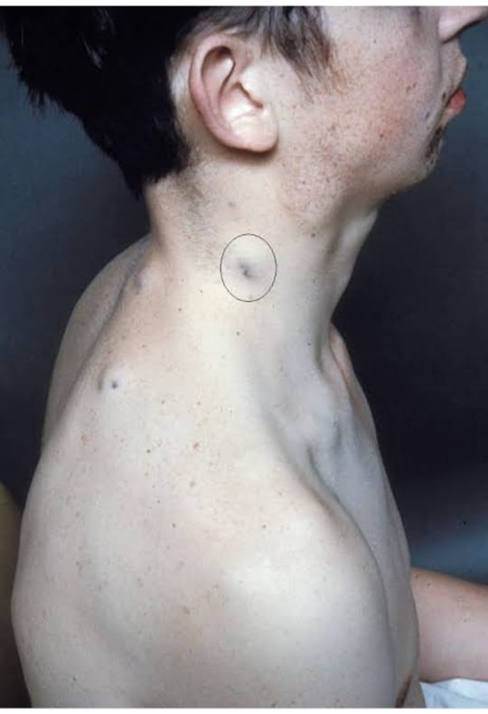
CLINICAL FEATURES
Most patients born with large VMs.
Additional small 1-2cm lesions are usually present at birth and increase in size and number with age.
Color is dark bluish to purple
Lesion arw oten hyperkeratotic and o rubbery consistency.
Frequent at palms and soles.
GIT VMs usually located at small intestine. But can be found anywhere from mouth to anus.

Slide 57
Can cause GI haemorrhage with chronic iron deficiency anemia, intussusception, volvulus and inarction.
VMs can also involve brain, kidneys, lungs and other organs

Slide 58
INVESTIGATIONS
Endoscopy, colonoscopy, wireless capsule endoscopy or MRI are needed to document GT lesions.

Slide 59
MANAGEMENT
Iron supplementation and even blood tranfusion or chronic anemia.
Aggressive surgical excision of all GIT lesions requiring blood transfusions.
Targeted molecular therapy with rapamycin is under clinical trials.

Slide 60
MAUFFUCI SYNDROME
Characterized by multiple enchondromas associated with superficial and deep slow-flow venous like malormations, containing areas with spindle cells.
These lesion are called spindle cell haemangiomas.

Slide 61
PATHOPHYSIOLOGY
Spindle cell haemangiomas are composed of thin walled, venous like channels separated by spindle fibroblastic cells.
Maffuci syndrome is sporadic, non-inherited disease .
Somatic mutation in IDH1 and IDH2 encoding isocitrate dehydrogenase 1 and 2 respectively identified in enchondromas and spindl cell hemangiomas

Slide 62
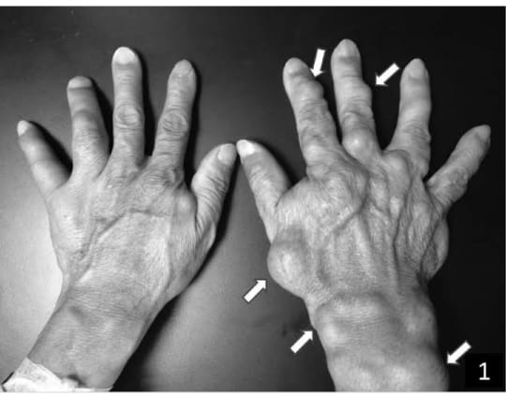
CLINICAL FEATURES
Maffuci syndrome belongs to spectrum of enchondromatoses.
Enchondromas are bilatral, asymmetrical and found anywhere.
Spindle cell haemangiomas are subcutaneous, firm, bluish nodules appear around puberty on finger and toes.
There is increase risk of skeletal and non skeletal malignant lesions.
Enchondromas can degenerate into chondrosarcomas.

Slide 63
Most chondrosarcomas are of low histological grade 1 or 2 and sucessuly treated with surgical resection.
Other neoplasm include fibrosarcoma, glioma, astrocytoma, ovarian tumours ,haemangiosarcoma ad leukemia.

Slide 64
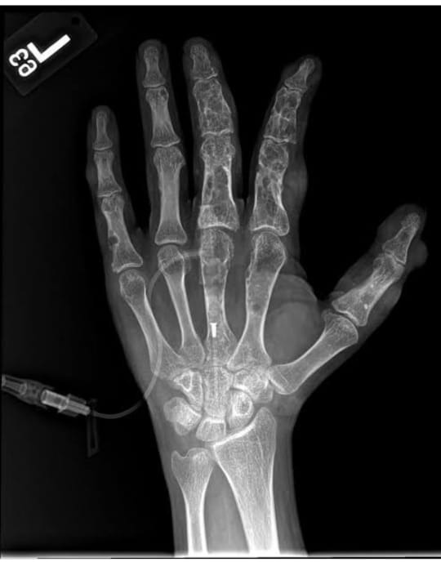
INVESTIGATIONS
On conventional radiographs, enchondromas are radiolucent.
Multiple, ova-shaped oteolytic lesions with well define margins in metaphyis and diaphysis of long tubular and lat bones often seen.
D-dimer levels are normal in contrast to venous malformation.
Histological analysis confirms the clinical diagnosis.

Slide 65
MANAGEMENT
Surgical excision o spindle cell haemagiomas and enchondromas done.
Malignant lesions are surgically treated.

Slide 66
LYMPHATIC DISORDERS

Slide 67
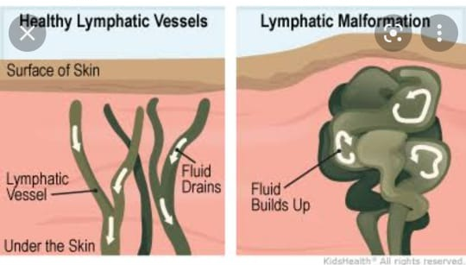
LYMPHATIC MALFORMATION
Lymphatic malformations are focal lesions of dilated lymphatic channels disconnected from the lymphatic system.
LM can be macrocystic, microcystic or combined.

Slide 68
PATHOPHYSIOLOGY
Macrocystic LMS are composed of single or multiple lymphatic cysts surrounded by a thick fibrous membrane.
microcystic LMs are characterized by dilated lymphatic channels with variable thickness of walls.
Blood can be seen after intracystics bleeding or in combined lymphatico-venous malformations.
Endothelial cells express specific lymphatic markers such as podoplanin, D2-4O and VEGFR-3.

Slide 69
Lymphatic malformation can be seen as a component of Klipple-Trenaunay-Weber syndrome and CLOVES syndrome caused by somatic activating mutation in PIK3CA .

Slide 70
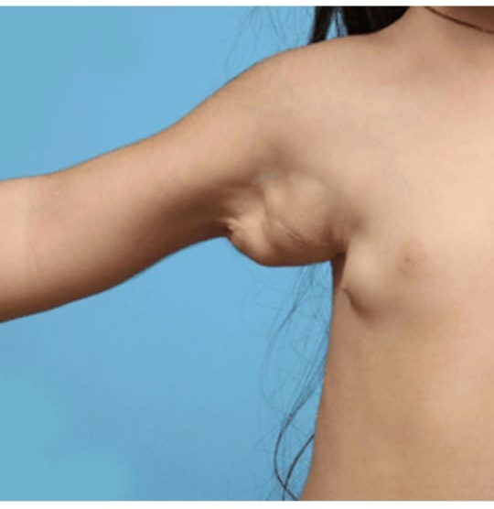
CLINICAL FEATURES
Macrocystic malformation can be diagnosed in utero as early as the first trimester of pregnancy.
located on neck, chest wall and axilla.
Manifest as multilobulated, well-defined lesions that are translucent, soft, but only slightly compressible on palpation.
Microcystic LMs mostly located on head and neck.
they are ill-defined vesicular plaques

Slide 71
Skin can be normal in colour but becomes blue or purple when intracystic bleeding occurs.
LM often caues asymmetry with bone overgrowth especially on face. suddenly become painful and enlarge due to intralesional bleeding or infection. Recurrent erysipelas or cellulitis are major complication
Gorham-stout syndrome or vanishing bone disease is characterized by progressive demineraization and destruction of the bones which are replaced by lymphatic vessels and capillaries.

Slide 72
INVESTIGATIONS
Doppler ultrasound-> best examination to conirm thecystic nature o the slow-flow vascular malformation.
In contrast to VM , the cysts cannot be completely emptied by compression and often cintain echogenic debris.
MRI imaging with spino-echo T1 and T2weighted and fat saturation sequence depicts the anatomical relation between vascular lesion and adjucent structure.

Slide 73
MANAGEMENT
Systemic anbiotics for bacterial infection.
Complete surgical excision can be done.
Recurrence is frequent for microcystic lesions.
Macrocystic lesions are treated by fluid aspiration followed bypercutaneous intralesional inection o sclerosing agent by interventional radiologist.

Slide 74
sclerosing agents include OK-432, doxycycline, bleomycin and ethanol
Microcystic LM can be treated by laser.
Rapamycin is under clinical trial.
Sildenail have some effect.

