Slide 1
Guideline for the Safe Use of Hyaluronidase in Aesthetic Medicine, Including Modified High-dose Protocol
Presented By: Dr. Arif Ullah
Resident Dermatology CMH Abbottabad

Slide 2
Outline
Introduction
Complications of dermal fillers
Formulation and allergic reaction of hyaluronidase
Uses of hyaluronidase in aesthetic medicine

Slide 3
Introduction
Cross-linked hyaluronic acid (HA) is the most used filler for volume replacement and soft tissue augmentation
Endogenous hyaluronic acid is found within the skin
Function in tissue architecture and maintain hydration due to its hygroscopic nature

Slide 4
Complication of hyaluronic acid dermal filler
Vascular occlusion
Tyndall effect
Delayed onset nodule
Poor aesthetic 0utcome

Slide 5
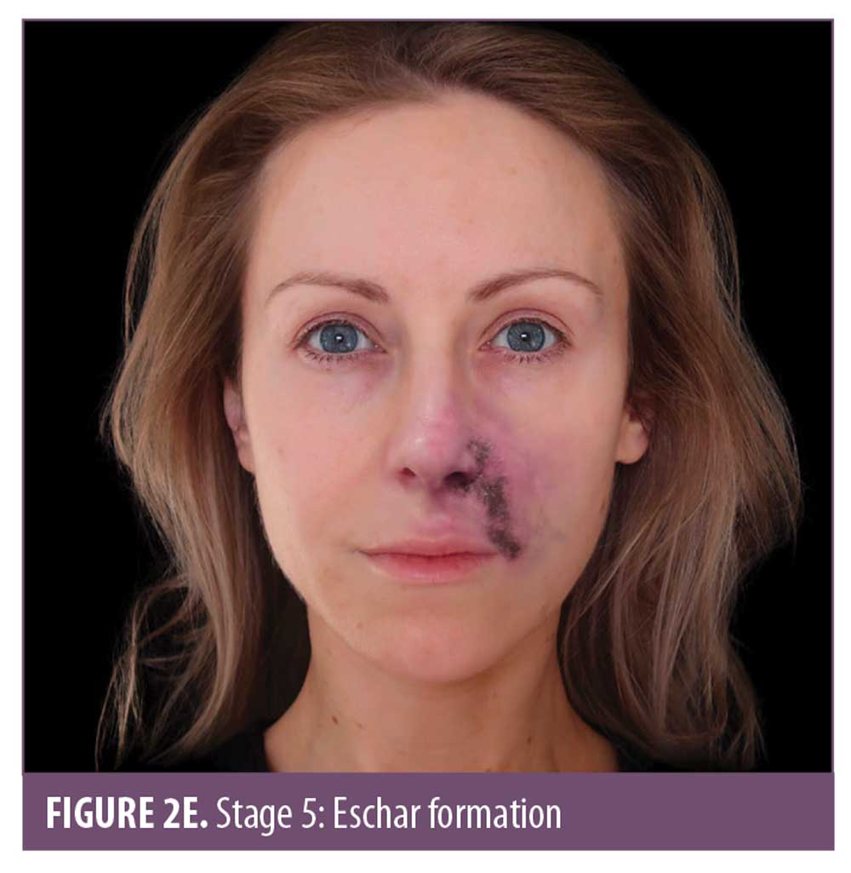
Vascular occlusion

Slide 6
Tyndall effect
Tyndall effect also called tyndall phenomenon,scattering of a beam of light by a medium containing small suspending particle
when particular filler is injected into superficial plane
Due to shorter wavelengths blue light scattered more strongly than longer wavelenght red light
HA alters the tissue physiology, allowing deeper absorption of red light
Effect of this makes the tissue appear more blue

Slide 7
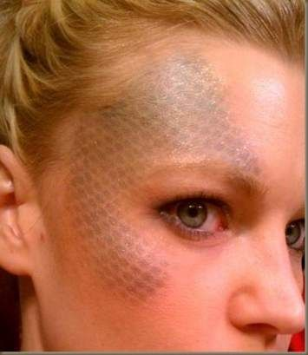
Tyndall effect

Slide 8
Delayed-onset nodules
Appearance of nodules weeks and months after injection of dermal fillers
Caused by any soft-tissue filler, including cross-linked HA
Challenging due to the limited access to investigations and the reluctance of patients to permit tissue sampling
Causes: Delayed (Type IV) hypersensitivity reactions, granulomas, and biofilms
Hyaluronidase should be administered only under broad-spectrum antibiotic cover

Slide 9
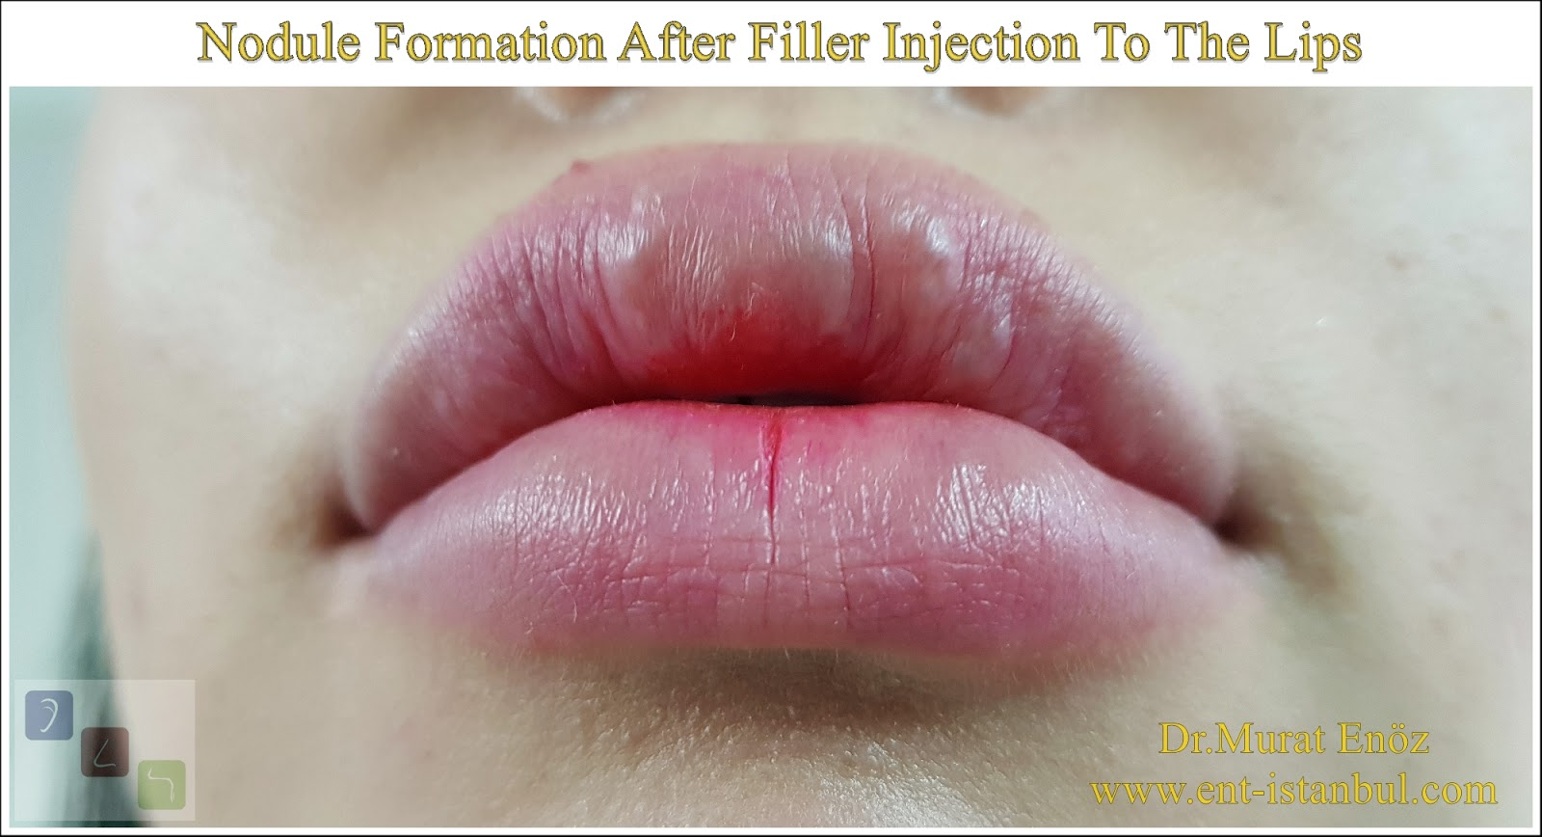

Slide 10
Poor aesthetic outcome
Causes: Incorrect placement of filler, excess filler, and migration/redistribution

Slide 11
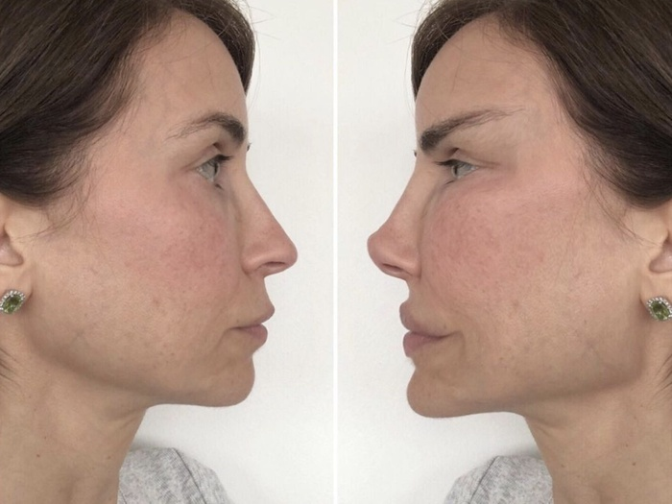


Slide 12
HYALURONIDASE
Hyaluronidase is a soluble protein
In the last 15 years, used for to dissolve cross-linked hyaluronic acid
USES
Treating keloids scars as an alternative to steroids
Dissolution of hematomas and treatment of lymphedema
MOA:
Breakdown complex hyaluronan glycosaminoglycan polysaccharides
Also, breakdown C1 and C4 bond between the glucosamine and glucuronic acid
Function in cross-linked HA dermal fillers, resistant edema, increase capillary and tissue permeability

Slide 13
Formulation and allergy
1) From ovine or bovine testes
2) Recombinant forms
United States use recombinant hyaluronidase (hylenex; halozyme therapeutics)
The presence of protein impurities within the formulation is a contributing factor to the allergic response
Thimerosal(preservative), NaCl 0.9%(bacteriostatic) are known to cause allergic reactions

Slide 14
Since 1949, there have been four case reports detailing allergic reactions to hyaluronidase
The incidence is extremely small
The incidence of hypersensitivity is 0.1%, unless large intravenous doses (in excess of 200,000 units)
Chances of Type I reaction rate of 33 in case of large intravenous doses
localized Type IV reactions

Slide 15
Dose and allergy
Dose ranges of less than 1500 units;
allergic reactions will be at injection sites
Dose range from 1500 to 200,000 IU;
Generalized symptoms will appeared

Slide 16
ELECTIVE AND EMERGENCY USE OF HYALURONIDASE
ELECTIVE REVERSAL
In the event of elective reversal of hyaluronic acid fillers,
There are no standard concentrations or doses, different brands of cross-linked HA can dissolve differently, some requiring more hyaluronidase and some less.
Cross-linked HAs demonstrate different physicochemical properties that may change as residence time in the tissue increases.

Slide 17
ELECTIVE AND EMERGENCY USE OF HYALURONIDASE
Emergency reversal
Hyaluronidase is a dispersal agent, moving the diluent away from the point of injection
CMAC advises administrating the initial dose and applying firm massage before reassessing the vascular flow. The hyaluronidase should be re administered at these points if flow is not established.
Re dosing should be applied after 15 to 20 minutes.

Slide 18
CMAC also advises the co administration of hyaluronidase with lidocaine without adrenaline.
Lidocaine is known to lessen the fatigue of patient and it has a vasodilator effect.

Slide 19
Prior to injection, the area should be clean and thoroughly disinfected
Palpate and mark out the area to be injected
The injections should be performed using an aseptic technique and either a cannula or needle
Consider the depth and site of injection
Palpating and targeting nodules individually if present
After injection, firmly massage the area to aid in the breakdown of the cross-linked HA

Slide 20
Do not inject hyaluronidase; if
Botulinum toxin has been given in the past 48 hours
Area where there is infective sequelae

Slide 21
CMAC GUIDELINES

Slide 23
THANKS

