Slide 1
Cutaneous manifestation of diabetes
By Dr AQSA RAUF

Slide 2
A 17 year old female known diabetic for past 10 years presented to us in opd wd complain of brownish black plaques with erosion in front of chest, legs n arm for past 6 months. Assosiated with joint pain n pruritis all over body
On examination there is black brown ulcerated plaques wd well defined n raised boder

Slide 3
Cutaneous manifestation of dm
A metabolic disorder characterized by hyperglycemia resulting from defect in insulin secretion, insulin action r both.

Slide 4
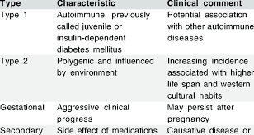
Types of Dm

Slide 5
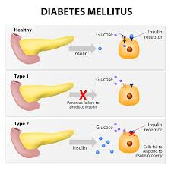

Slide 6
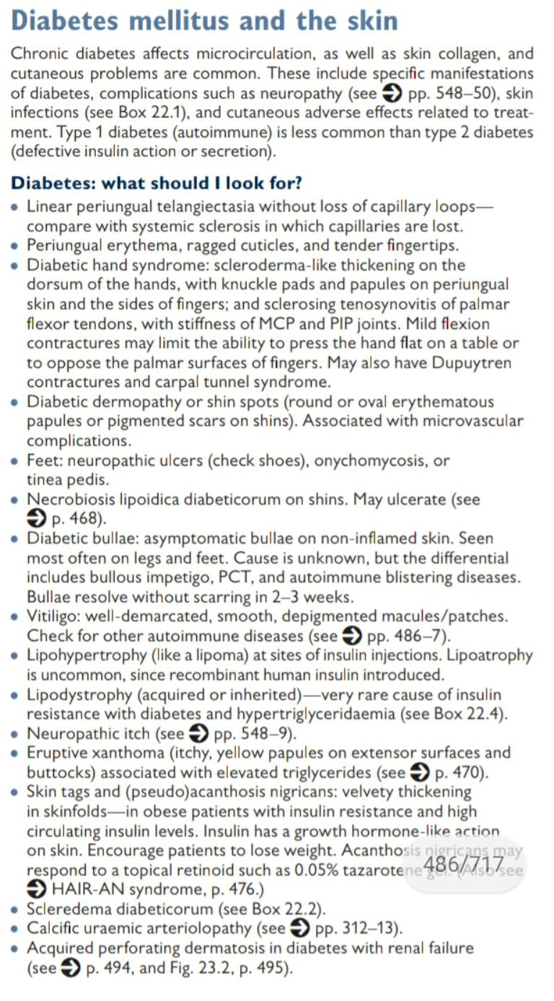
Cutaneous manifestation of dm

Slide 7
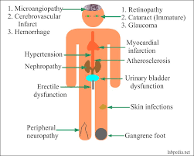
Cutaneous manifestation of dm
1 vascular damage
Leg ulceration
Wet gangrene of foot
Erysipelas like erythema
Diabetic dermopathy
Rubeosis
2 Neurological damage
Diabetic foot
Diabetic foot ulcer
3 Infection
4

Slide 8
Autoimmune disease
Genetic n other systemic disease
Miscellaneous
Granulomatous disorder
Stiff skin n joints
Pruritus
Diabetic bullae

Slide 9
4 Obesity n hyperlipedemia releated skin disease
Ancanthosis nigrican
Skin tags
Eruptive xanthomas of skin
5 treatment releated skin manifestation
Insulin lipodystrophy
Allergic reaction to insulin
Allergic reaction to oral hypoglycemic drugs
6disease assosiated with genetic syndrome
reactive perforating collegenosis

Slide 10
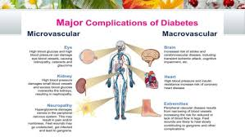
Vascular damage in dm
Microvascular n macrovascular complication

Slide 11
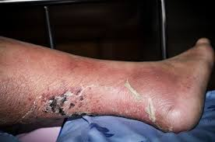
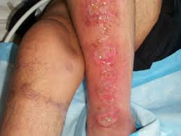
Skin manifestation in dm
Leg ulcer
Ulceration due to vascular n neurological damage
Structural n functional impairment both occur

Slide 12
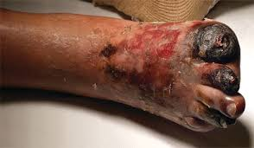
Wet gangerene of foot
sudden loss of perfusion to already compromised cutaneous microcirculation may result in wet necrotic area

Slide 13
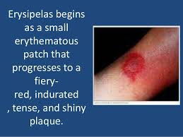
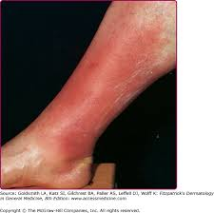
Erysipelas like erythema
Well defined erythema on legs n feet

Slide 14
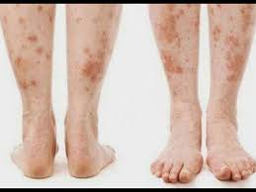
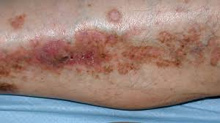
Diabetic dermopathy
Asymptomatic ,oval ,dull,red papule 0.5 -1cm in dia
On shin ,bony prominence, forearm thigh
Produce superficial scales n atrophic scars

Slide 15
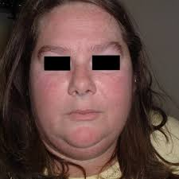
rubeosis
Rosy reddening of face n hands n feet
Attributed by microvascular n nueropathy

Slide 16
Neurological damage in dm
Chronic , long term , symmetrical , length dependent poluneuropathy due to damaged endoneurial microvessels
Symptoms r numbness, tingling, burning,impaired sweating, aching, intensify at night

Slide 17
Diabetic foot.
R diabetic charcot arthopathy
Presented with warm, red, swollen , eryhtematous foot n ankle
Motor n sensory neuropathy
Trauma n unnecssary pressure point lead to fusion of joint ,dislocation n fracture of bone
Foot may deformed

Slide 18
Diabetic foot ulcer.
Painless, slow progressing ulcer on sole
Ulcer is circular , punched out in shape, occur in middle of callosity
Sunepidrmal hemorrhagic bullae give rise to discolouration of surrounding skin
Risk factor of diabetic foot
Poor diabetic control
Duration of diabetes
Peripheral neuropathy

Slide 19
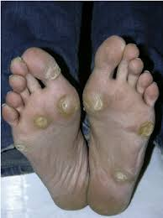
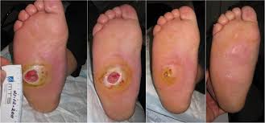

Slide 20
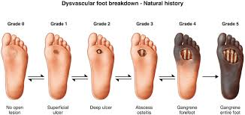
Neurological damage

Slide 21
infections
Mostly occur in dm type 2
Pseudomonas infec. Of ear may occur in severe form invole nerves n bones
Candida infe. Can also seen in poorly controlled pt

Slide 22
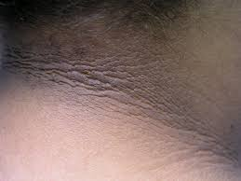
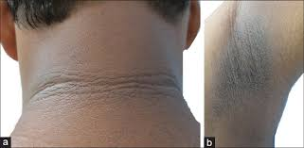
Obesity n hyperlipedemia releated skin disease
Acanthosis nigrican.
Smooth velvety hyperkeratotic hyperpigmented skin
Affecting flexures seen in type 2 dm

Slide 23
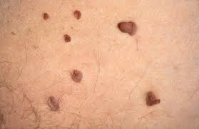
Skin tags
Are small soft pedunculated lesions occuring on eyelids neck axilla
Assosiated wd obesity

Slide 24
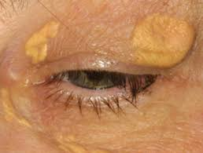
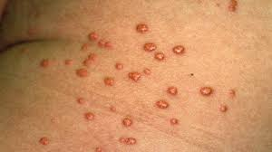
Eruptive xanthomas of skin
Seen in hyperlipedemia pt
Significantly risk for pencreatitis
Lesion resolve when diabetes n hyperlipedemia managed properly

Slide 25
Treatment related skin manifestation
insulin lipodystrophy
1.lipohypertrophy …common in those who don’t change the injection site
2 .Lipoatrophy….appear to be immunological reaction
Allergic reaction to insulin
Localized allergic reaction to insulin including urticaria , painful nodules n granulomas
Contact dermatitis due toinsulin nickel needles ,epoxy resin may occur

Slide 26
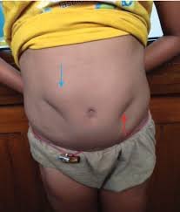
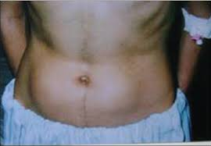
Allergic reaction to hypoglycemic drugs
Sulphonylureas are coomonly caused reaction
disulfiram like reactions due to chlorpromide

Slide 27
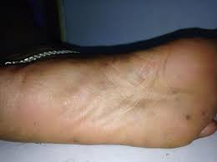
Disease assosiated n genetic syndromes
Reactive perforating collagenosis (folliculitis)
Attributed to glycylation of collagen n minor injury such as pressure scratching
Autoimmune disease
Seen in autoimmune pt
Seen in type 1 dm
Eg. Vitilogo hypo n hyperthyroidism n addision disease

Slide 28
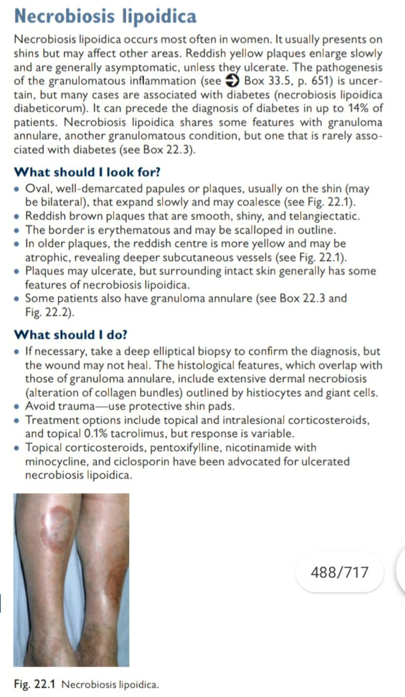
miscellaneous
Granulomatous disorder

Slide 29
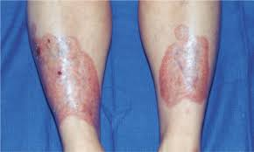
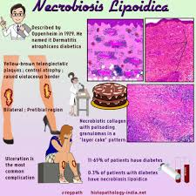

Slide 30
Stiff joint and skin
Attributed to irreversible cross linking of collagen n other protein in the skin like AGEs products which stimulate FGF n inflammatory cytokines thru protein kinase C pathway
Cheiroarthopathy
Waxy tight skin on back of hand n limited joint mobility(prayer sign)
Common in type 1 dm
Finger pebbles
These r multiple grouped minute papules on extensor surface of fingers in or near the kunkle pads r periungual region

Slide 31
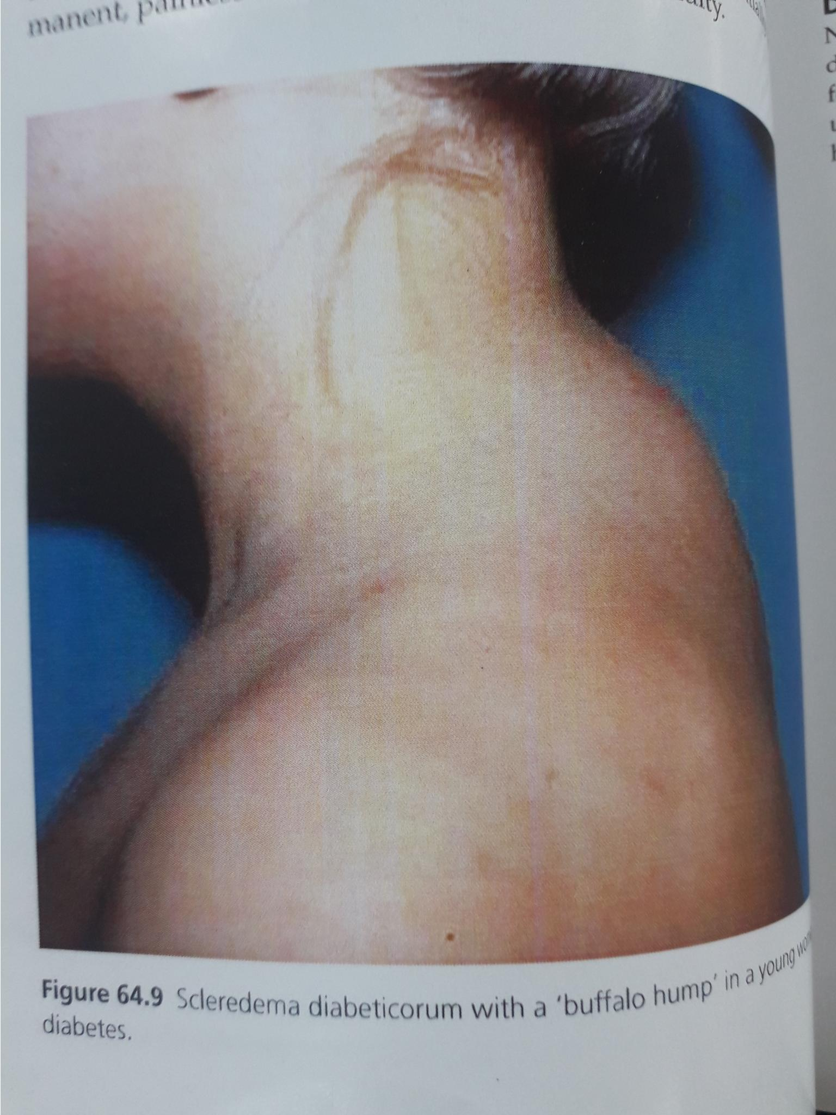
Scleredema diabeticorum
Illdefined induration of the skin usullay painless n permanent
Common in neck n upper back
Common in type 2 dm

Slide 32
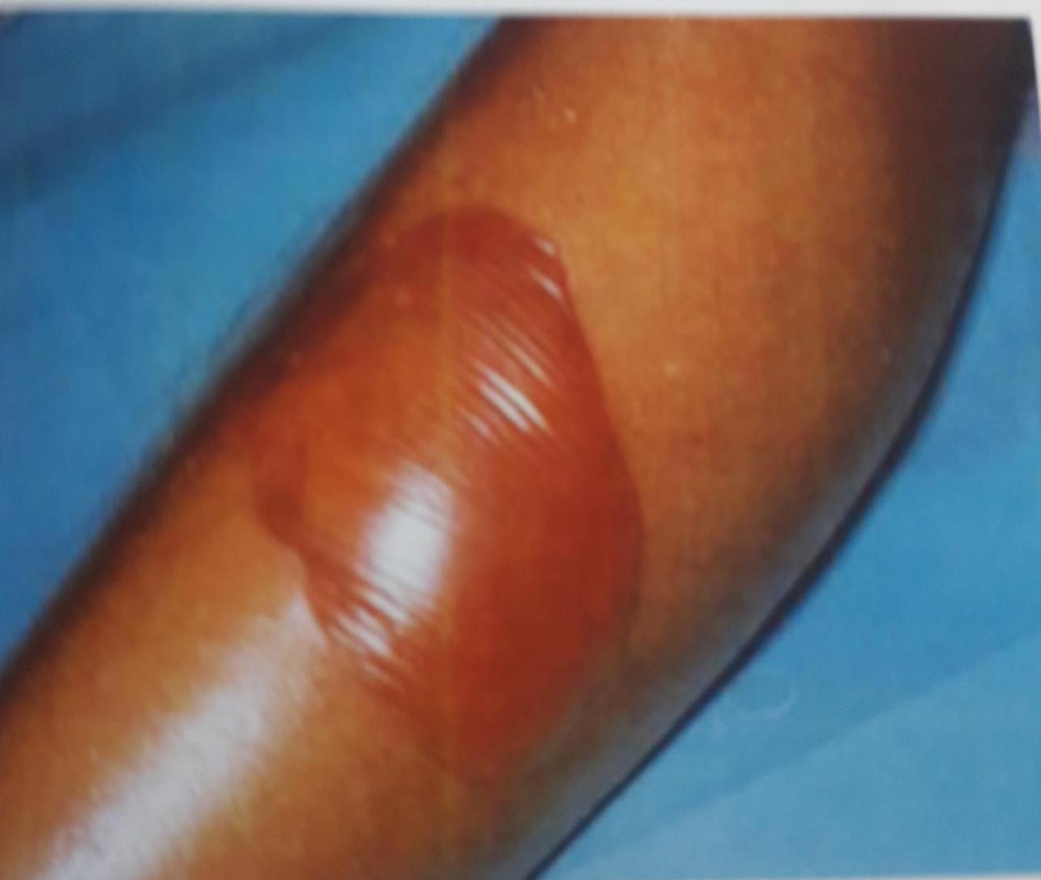
Pruritus
All over body
May be due to secondary infec. Like candidiasis r haemolytic strep.
Diabetic bullae
Non scarring subepidermal bullae upto several centi. In dia on a non inflammed base on lower leg hand feet n fingers

Slide 33


