Slide 1
Cutaneous amyloidosis
By Dr Mohsin

Slide 2
Introduction
Amyloid means ‘starch like’ (Latin: amylum), a term introduced by Rudolf Virchow, who described extracellular precipitates that turn brown after incubation with iodine.
Even though these precipitates are proteins, and not carbohydrates, the terms ‘amyloid’ and ‘amyloidosis’ are still used.
The key feature of amyloidoses is the extracellular deposition of autologous proteins as morphologically characteristic amyloid fibrils .

Slide 3
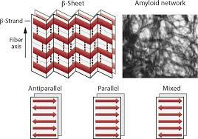
Structure and pathology
Amyloid deposits consist of a loose network of unbranched fibrils measuring 7.5–10 nm in diameter.different amyloid precipitates is a fibrillary antiparallel β‐sheet structure.
The second component of amyloid precipitations is the amyloid P component, which can be detected in almost all deposits and amounts to approximately 15% of the total weight of the extracted amyloid
Cellular factors that contribute to protein misfolding include membrane interactions, altered cell chemistry, posttranslational modifications, crowding, and pathogenic mutations, acidification, temperature, protein concentration, and oxidative stress

Slide 4
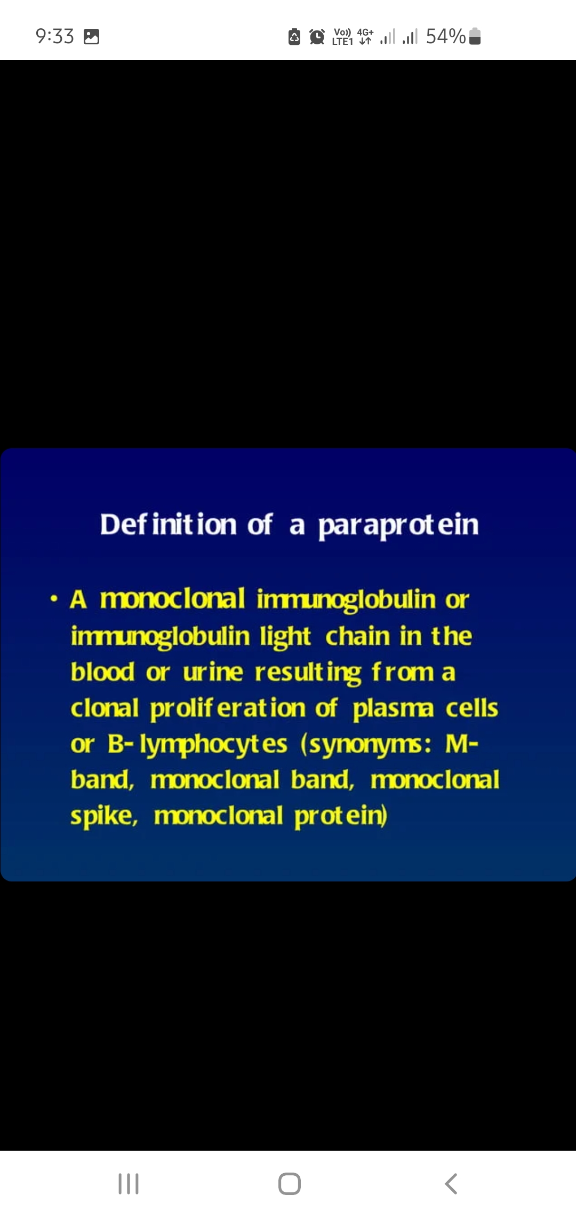
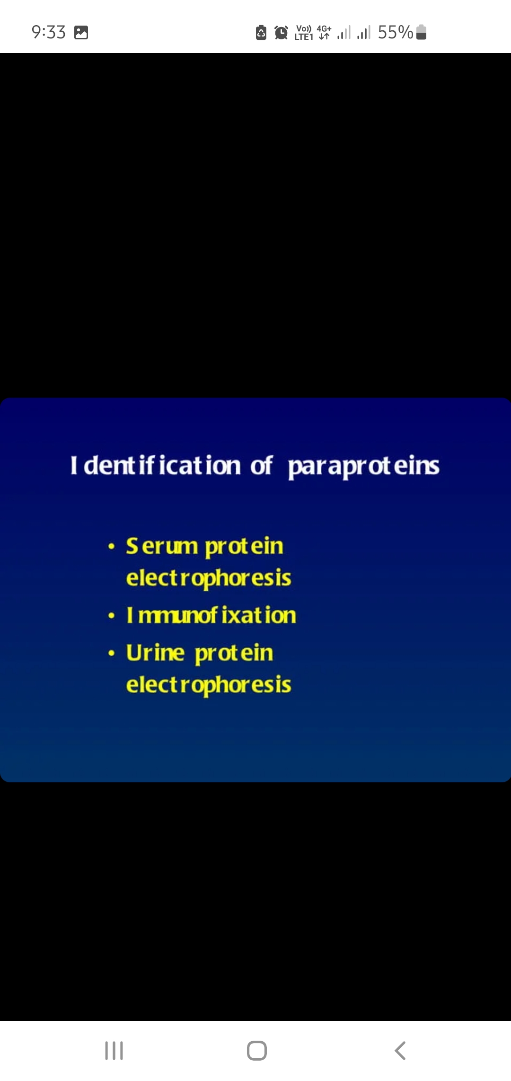
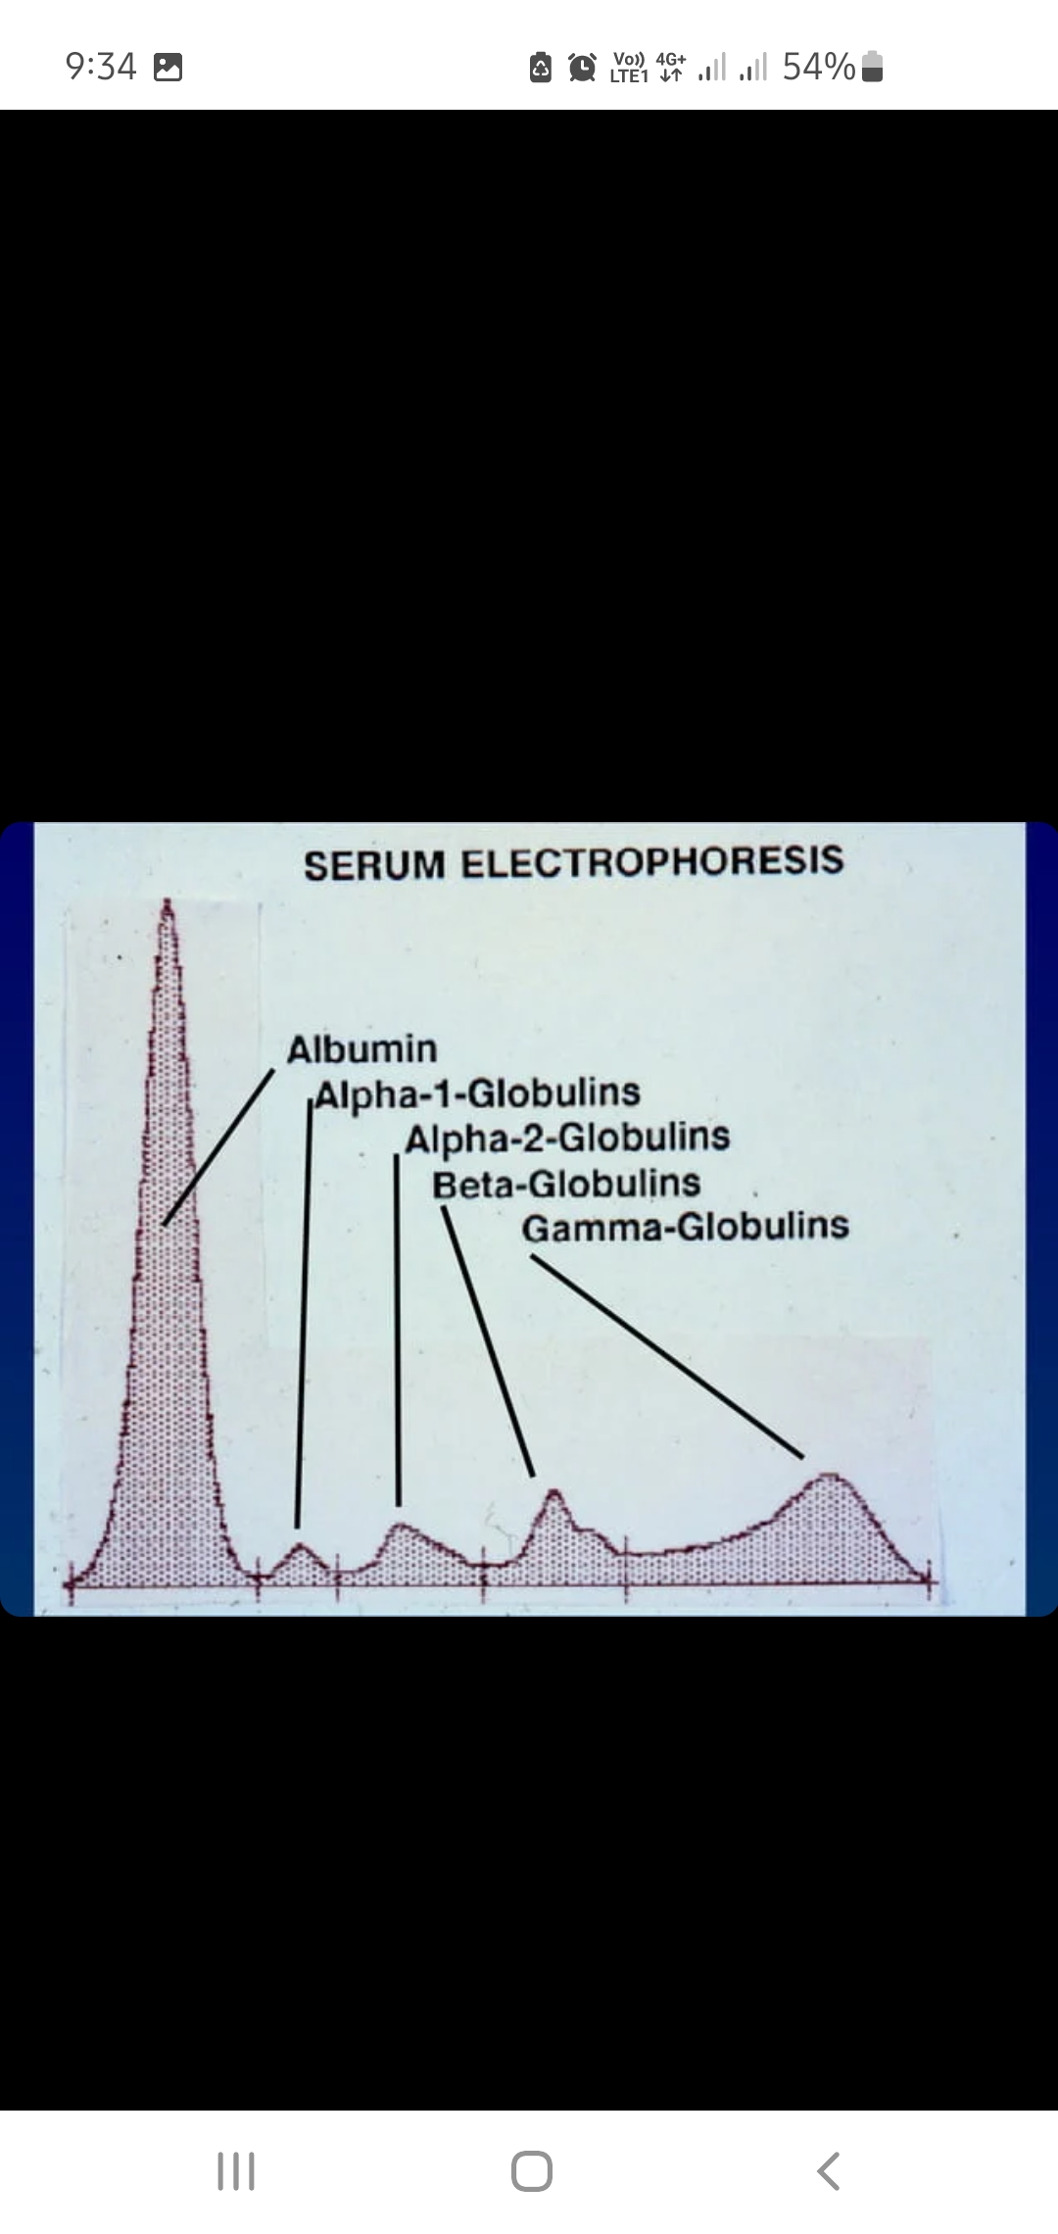
Paraproteinemia

Slide 5
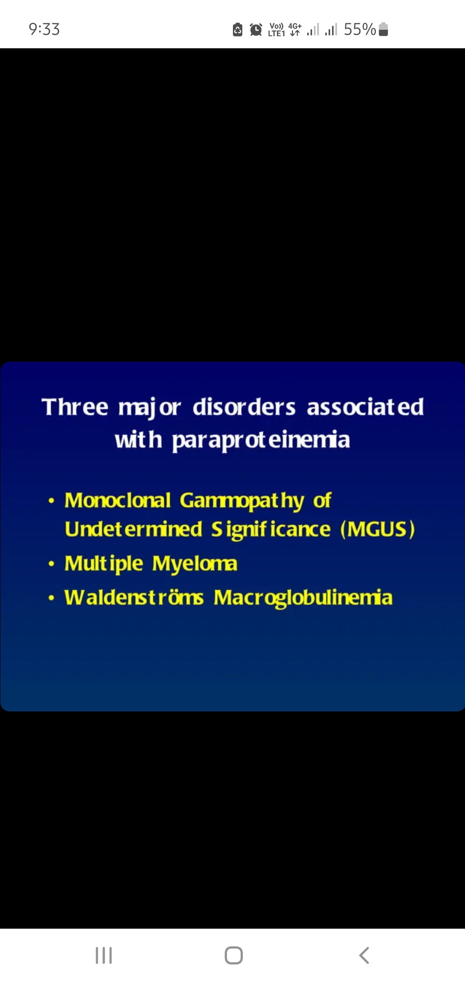
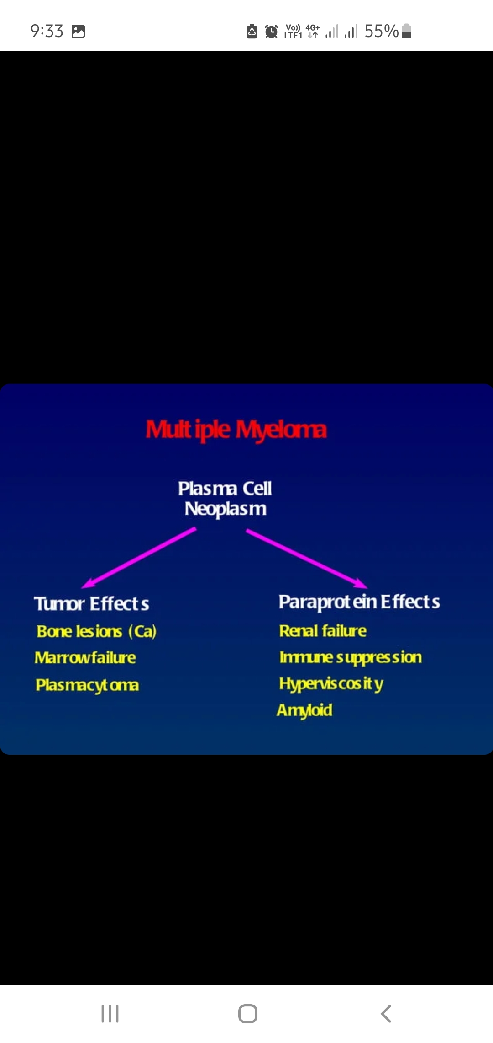

Slide 6
Classification
Localized cutaneous amyloidosis
primary localized cutaneous amyloidosis (PLCA),
secondary localized cutaneous amyloidosis (SLCA),
systemic amyloidosis with cutaneous involvement,
secondary cutaneous amyloidosis originating from other systemic diseases

Slide 7
Clinical feature
Localized cutaneous amyloidoses often show yellowish or brownish macules, papules or plaques of varying configuration,
whereas cutaneous amyloidosis due to systemic disease often initially presents with petechiae, ecchymosis and non‐healing ulcers.
These differences in clinical presentation are due to the amyloid deposition, which in localized cutaneous amyloidoses occurs more or less exclusively in the papillary dermis, whereas it also affects deeper skin layers in systemic amyloidoses.
Amyloid precipitation in blood vessel walls makes vessels fragile, eventually causing intracutaneous micro‐ and macro‐haemorrhages.
For cutaneous amyloidoses, pruritus is a typical symptom.

Slide 8
Localized cutaneous amyloidosis

Slide 9
Definition
In localized cutaneous amyloidoses, amyloid precipitates are limited to the skin, mostly to the papillary dermis. Hereditary and non‐hereditary types of localized amyloidoses can be differentiated.

Slide 10
Localized cutaneous amyloidosis
Non-hereditry
Macular
Papular
Nodular
SLCA( sec localized cutaneous amyloidosis
Hereditary
Familial PLCA

Slide 11
Epidemiology
Incidence and prevalence
Macular ( c . 35%),
papular ( c . 35%)
mixed (biphasic, allotropic) maculopapular (c . 15%)
PLCA account for the vast majority of localized cutaneous amyloidoses, whereas nodular (tumefactive) PLCA ( c . 1.5%) is quite rare
Sex
F>M
3:1
Women seem to be more frequently affected by PLCA than men (female : male c . 2–3 : 1) . In contrast to the lichenoid form, macular PLCA more frequently occurs in women.
Ethnicity
>> Asian
It has been reported that in countries nearer to the equator the prevalence of PLCA is higher

Slide 12
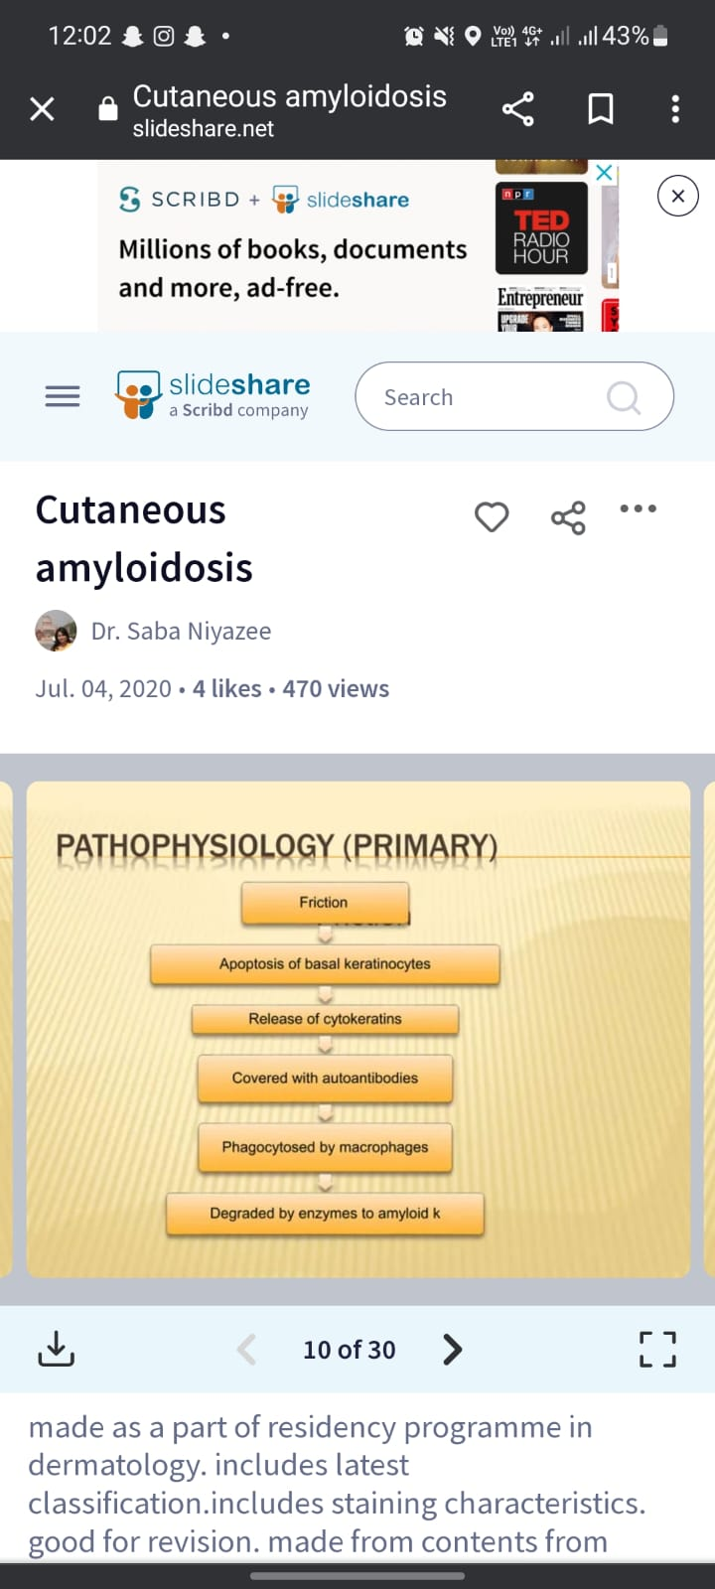
Pathopysiology

Slide 13
In macular PLCA, friction may play a key pathogenetic role as a mechanical stimulus that may induce apoptosis
The rare form of nodular PLCA is characterized by amyloid that is composed of immunoglobulin light chains (AL amyloid).
Plasma cells infiltrating the skin (e.g. in extramedullary plasmocytoma) produce monoclonal immunoglobulin light chains of κ‐ or λ‐type as amyloid precursors.
There are two major factors that differentiate nodular amyloidosis from macular and lichenoid amyloidosis.
First, nodular amyloid is composed of immunoglobulin light chains derived from a monoclonal expansion of plasma cells , whereas in papular/macular PLCA amyloid consists of cytokeratins.
Second, the amyloid of nodular PLCA infiltrates the entire dermis, from the papillary dermis to the subcutis

Slide 14
Associated diseases
Macular PLCA
MEN 2a ( multiple endocrine neoplasia)
Primary biliary cirrhosis
Nodular PLCA rare form
Diabetes
Sjogren syndrome
CREST one case
Lichenoid PLCA
Keobner phenomenon

Slide 15
Clinical feature
Intense pruritus
In papular PLCA, firm papules with pink to brownish lichenoid glossiness are often found on the legs or on the trunk,
whereas in macular PLCA, well or vaguely demarcated, hyperpigmented, yellowish to brownish macules often present in the interscapular space or elsewhere on the trunk.
Nodular PLCA presents with solitary or multiple,mostly asymptomatic, brownish to red, firm plaques or nodules, typically on the nose , legs – especially the feet – genitalia or trunk .
The clinical presentation of hereditary (familial) PLCA (autosomal dominant) does not significantly differ from non‐hereditary papular PLCA.

Slide 16
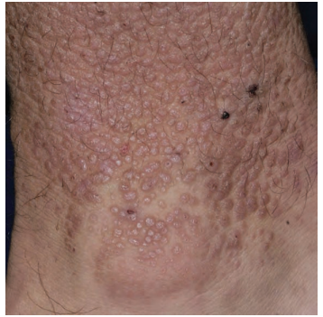
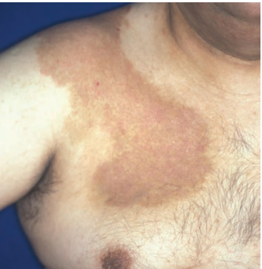

Slide 17
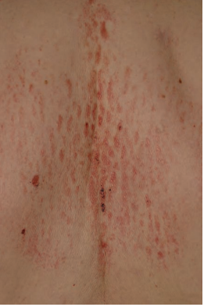
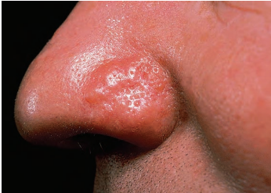

Slide 18
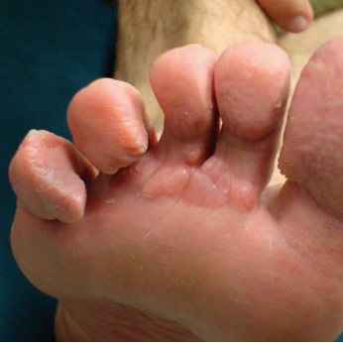
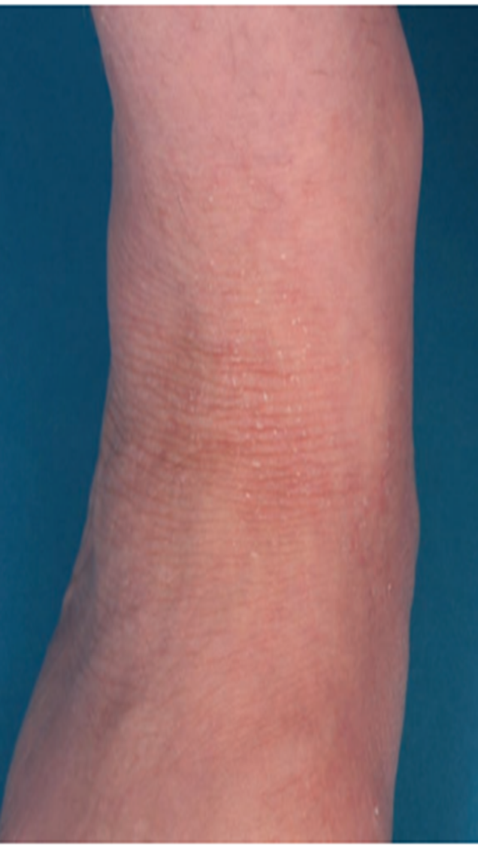

Slide 19
Clinical variants
mixed variant (biphasic, allotropic) PLCA, in which both lichenoid and macular lesions occur
A rare poikilodermatous form of PLCA exists, in which lichenoid or macular lesions occur in combination with blisters and poikilodermatous skin lesions
A familial variant of poikilodermatous PLCA has also been reported
amyloidosis cutis dyschromica is a rare variant with only a few cases reported worldwide
Bullous forms of amyloidoses occur both in PLCA and in systemic amyloidoses with cutaneous involvement

Slide 20
■ Towel-associated amyloidosis induced by prolonged contact with nylon towels.
■ Anosacral amyloidosis has been described mainly in Chinese and Japanese patients presenting with brownish patches of plaques in the anosacral region. It is often associated with lichenification, and most patients report pruritus.
■ Notalgia paresthetica amyloidosis isolated sensory neuropathy that typically occurs on the back may be associated with amyloid, likely resulting from prolonged pruritus and scratching.
■ Friction melanosis or amyloidosis prolonged contact with sponges, towels, plant sticks and leaves.
■ Lichen amyloidosis of the auricular concha hyperpigmentation of the bowl of the ear; likely a variant of lichen amyloidosis

Slide 21
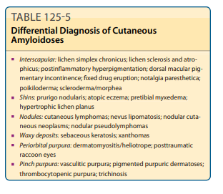
Differential diagnosis
The differential diagnoses for lichenoid and macular PLCA include
xanthomas,
perforating dermatoses (collagenoses),
nodular PLCA,
lichen planus
Mycosis fungoides
Differential diagnoses for nodular PLCA include
squamous cell carcinoma,
verruca vulgaris,
adnexal tumours
keloid/ hypertrophic scars

Slide 22
Complication and disease course
In papular and macular PLCA the aesthetic aspect is often quite problematic and pruritus may be a serious issue
nodular PLCA can even progress to systemic amyloidosis.
The rate of progression of nodular PLCA to systemic amyloidosis is controversial

Slide 23
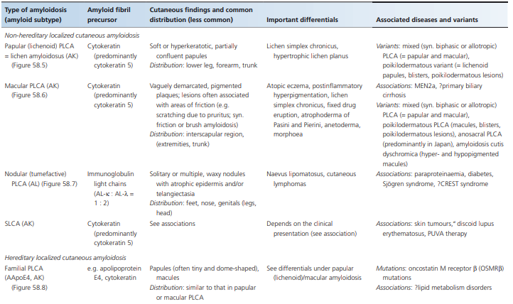
table

Slide 24
Cutaneous amyloidoses due to systemic disease

Slide 25
Non hereditary
Primary systemic and myeloma or plastocytoma –associated amyloidosis
Systemic amyloidosis with inflammatory tumor
Secondary hemodialysis associated systemic amyloidosis
Hereditary
Transthyretin/ familial polyneuropathy
Apo A1 amyloidosis
Hereditary gelsolin amyloidosis
Hereditary systemic disease with secondary cutaneous amyloidosis
Muckle well syndrome
TNF receptor 1 associated periodic fever syndrome

Slide 26
Introduction
Systemic amyloidoses are often characterized by amyloid deposition in mesenchymal structures of the internal organs (generally heart muscle, liver and kidneys), which may lead to a progressive loss of function and eventually to death.
In cutaneous involvement, all skin layers as well as vessel walls may be affected.

Slide 27
Systemic amyloidoses show cutaneous involvement in about 50% of patients, which allows physicians to diagnose the underlying systemic disease at an early stage

Slide 28

Pathophysiology

Slide 29
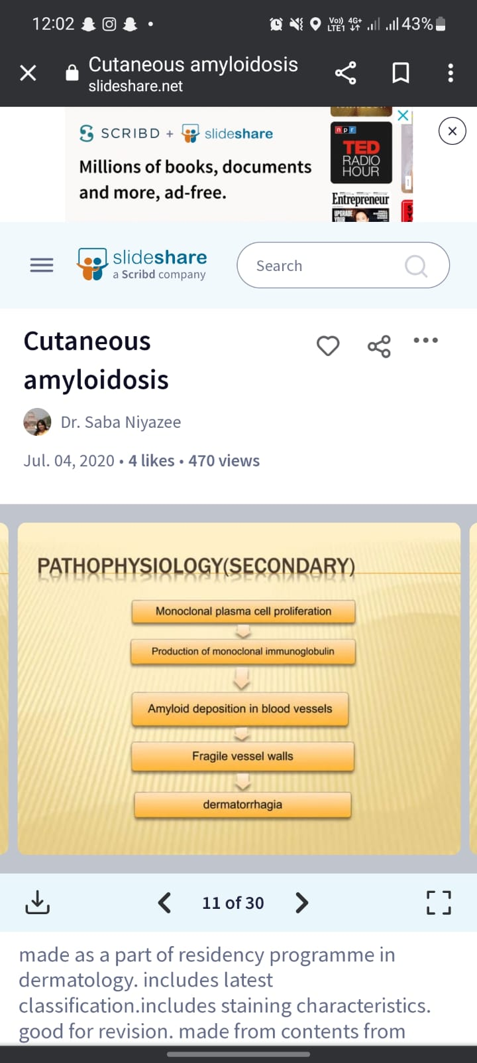
Pathopysiology

Slide 30
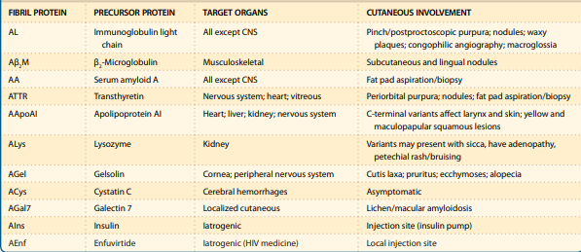

Slide 31
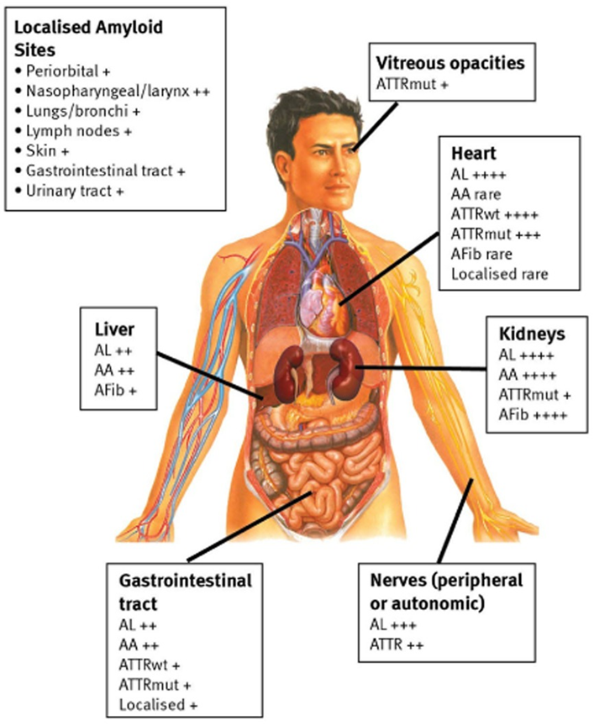

Slide 32
Clinical feature
The clinical presentation of cutaneous involvement in systemic amyloidoses is often characterized by petechiae, haemorrhages, ecchymosis and pruritus.
Bleeding is often seen in the periorbital or intertriginous regions due to the deposition of amyloid in and around vascular structures a deposition pattern that is rarely seen in localized cutaneous amyloidosis
Typically, amyloid purpura occur above the nipple line, mostly on the head and neck, especially on the eyelids. As purpura may be among the first signs of systemic amyloidoses, it is important to keep this sign in mind.
If the dermis is extensively infiltrated by amyloid, scleroderma‐like skin changes (especially of the fingers) may occur, known as scleroderma amyloidosum Gottron. Also, blisters and nail dystrophy have been reported as manifestations of myeloma‐associated amyloidosis

Slide 33
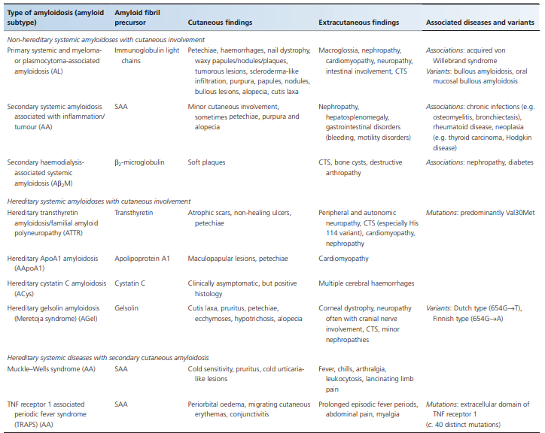
Clinical feature and finding

Slide 34
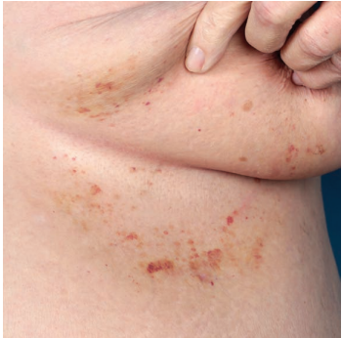
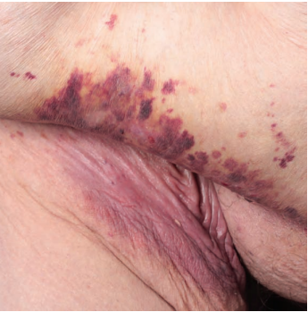
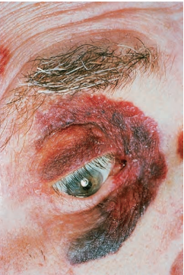

Slide 35
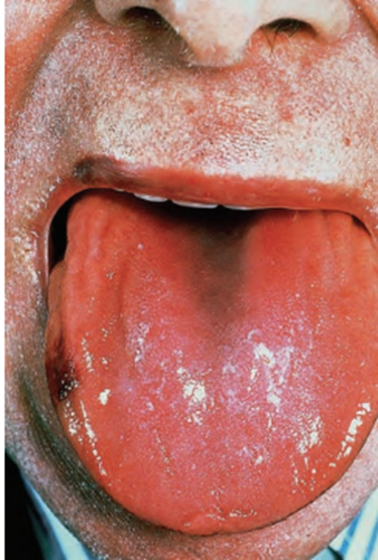
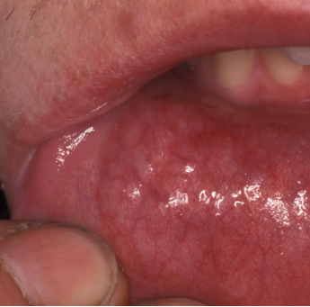

Slide 36
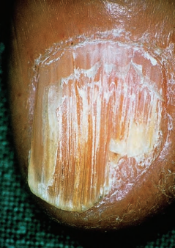
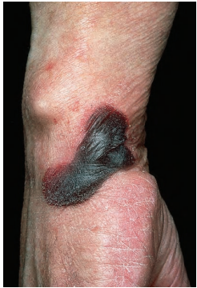

Slide 37
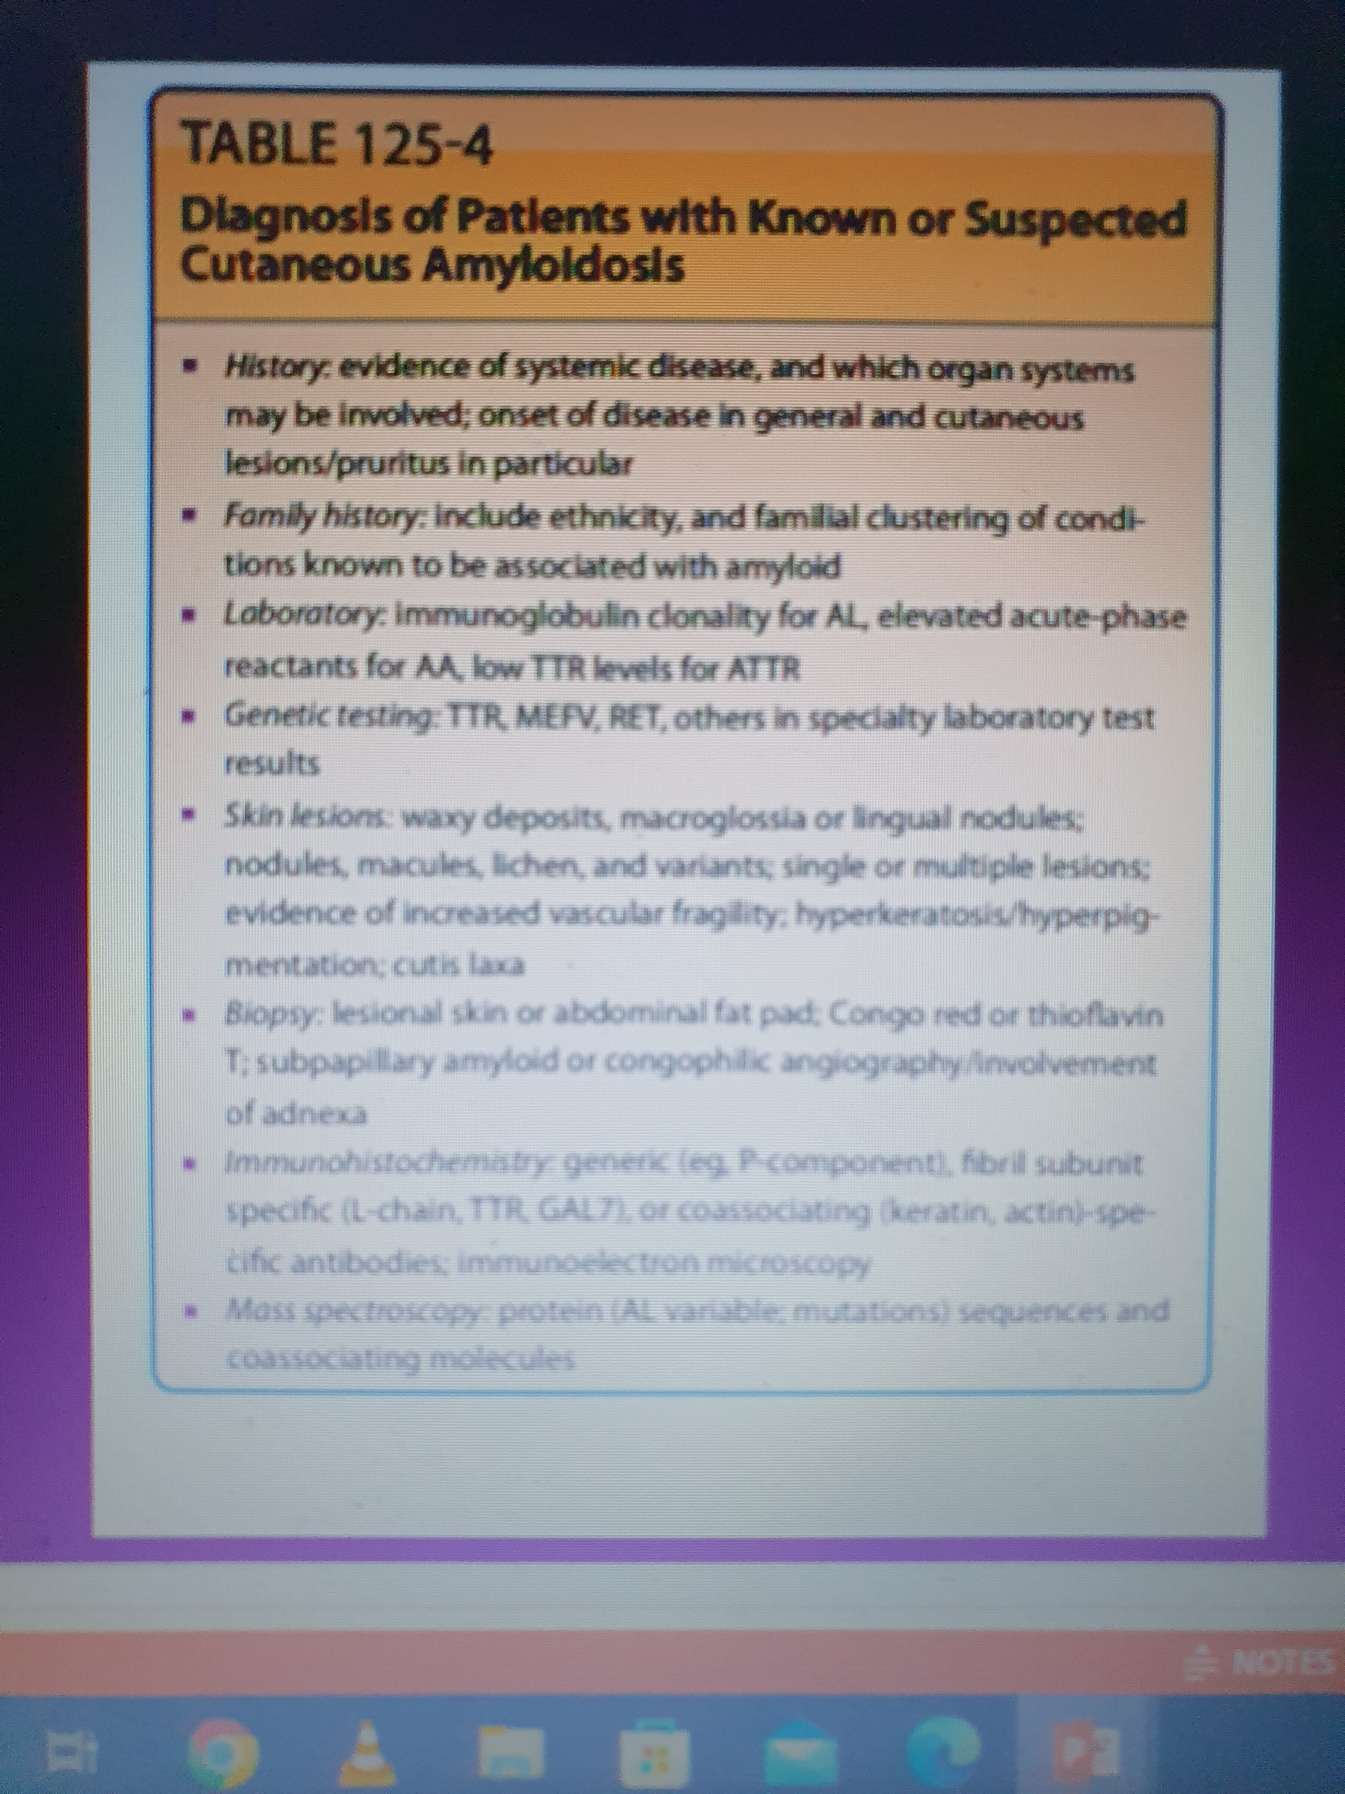
• Histology
• Standard stainings: H&E, toluidin blue and alkaline fuchsin
• Amyloid stainings: Congo red, thiofl avin T, (crystal violet, methyl violet)
• Immunohistochemistry
•Electron microscopy
• From skin sample: for all kinds of amyloidoses affecting the skin • Abdominal fat or rectum biopsy: for all suspected systemic amyloidoses and nodular primary localized cutaneous amyloidosis

Slide 38
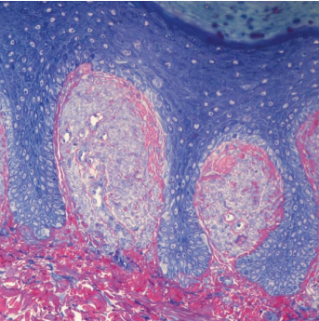
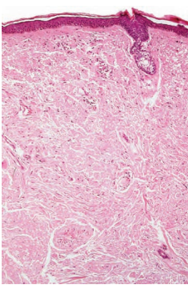
Histology

Slide 39
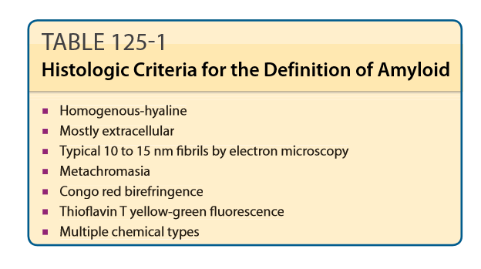

Slide 40
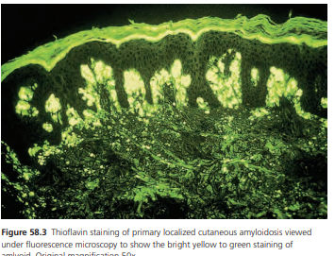
Immunohistochemistry
For immunohistochemistry, antibodies are available for the subclassification of amyloid precipitates, directed against cytokeratin or immunoglubulin light chains
CK5 is predominantly found in basal keratinocytes. In descending frequency, other cytokeratins are also present in primary (CK5 > 1 > 14 > 10) and secondary (CK5 > 1 > 10 > 14) cutaneous amyloidoses . Antibodies against CK5 may be used for diagnosing amyloidosis

Slide 41
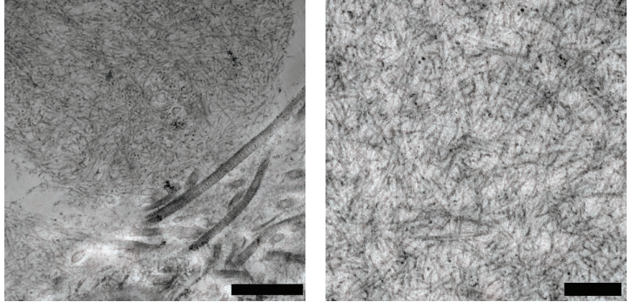
Electron microscopy
Definitive confirmation of amyloidosis in tissues can be achieved with electron microscopy, which shows the typical aggregates of amyloid with fibrils 7.5–10 nm in diameter
Apart from organ biopsies, biopsies taken from the rectal submucosa or from abdominal subcutaneous adipose tissue contribute to the diagnosis of systemic amyloidosis.

Slide 42
Managemnet of Amyloidosis
Topical therapy
Topical administration of steroids (occlusive dressings)
intralesional corticosteroid injections are the classic treatments.
phototherapy (narrow band UVB)
photochemotherapy (PUVA)

Slide 43
Systemic treatment
Acetretin; used in treatment of
Lichen amyloidosis
Mixed amyloidosis
As a dose of 0.5 mg/kg
Cyclophosphamide used in treatment of
Papular amyloidosis
Reduce pruritis, hyperpigmentation
Used in dosage of 50mg per day/ per oral
DMSO
Can be used for decreasing pruritis but no reports in efficacy

Slide 44
Immuosuppression
Cholchicine and anakinra for FMF
Canakinumab ,rilanocept And anakinra muckle well syndrome
Others
IVIG
Plasma exchange
haemodialysis has enabled the long‐term survival of patients with severe chronic renal failure

Slide 45
Others
surgical treatment strategies may be helpful when conservative treatments are of limited efficacy
pulsed dye laser
carbon dioxide laser evaporation

Slide 46
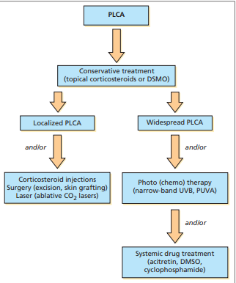
Treatment flow chart

