Slide 1
Cutaneous Side Effects Of Chemotherapy And
Radiotherapy
DR NADIA AKHTAR
PGR DERMATOLOGY

Slide 2
TOXIC ERYTHEMA OF CHEMOTHERAPY
Overlapping cutaneous reactions to chemotherapy agents.
TEC is a non allergic reaction.
Notes:
Palmoplantar erythrodysaesthesia
• Intertriginous eruption associated with chemotherapy
• Neutrophilic eccrine hidradenitis

Slide 3
Drugs Associated With TEC
Methotrexate
Cytarabine
Anthracyclines (e.g. doxorubicin)
5‐Fluorouracil
Capecitabine
Taxanes (e.g. docetaxel)

Slide 4
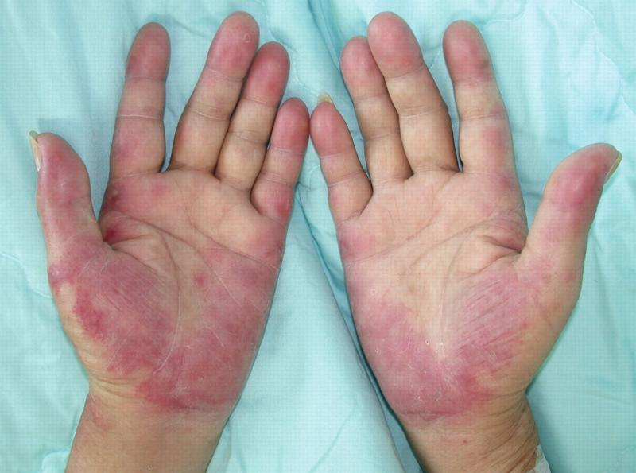
CLINICAL FEATURES
2days- 3weeks.
Sites : palms, soles , intertriginous areas
Pain
Pruritus
Peresthesia / tenderness.
Erythematous patches
Oedematous plaques
Delayed onset= 2-10 Months

Slide 5
CLINICAL VARIANTS OF TOXIC ERYTHEMA OF CHEMOTHERAPY

Slide 6
Variant | Palmoplantar erythrodysaesthesia | Intertriginous eruption | Neutrophilic eccrine hidradenitis
Onset | 24H -3weeks | 1-25 days | 2days- 3weeks
Clinical features | tingling or burning Sensation well‐demarcated palmoplantar erythema with oedema Bulla formation ,may erode. | Dusky red papules Patches Plaques Dusky erythema | Red papules nodules Plaques preceded by fever Pustules Purpura urticarial lesions
Sites | Palms Soles | Major flexures Axillary Inguinal folds Ante cubita lfossae Areas of occlusion. | extremities, trunk, face and palms
Culprit drugs | Doxorubicin cytarabine, Docetaxel 5-FU capecitabine |  | cytarabine
Management | Dose reduction | Self limiting with PIH , desquamtion | Resolves spontaneously within 4 weeks
Notes:
The reaction (1)generally resolves 1–2 weeks after stopping chemotherapy.

Slide 7
Severe palmoplantar erythrodysaesthesia secondary to docetaxol demonstrating erythema, desquamation and erosions

Slide 8
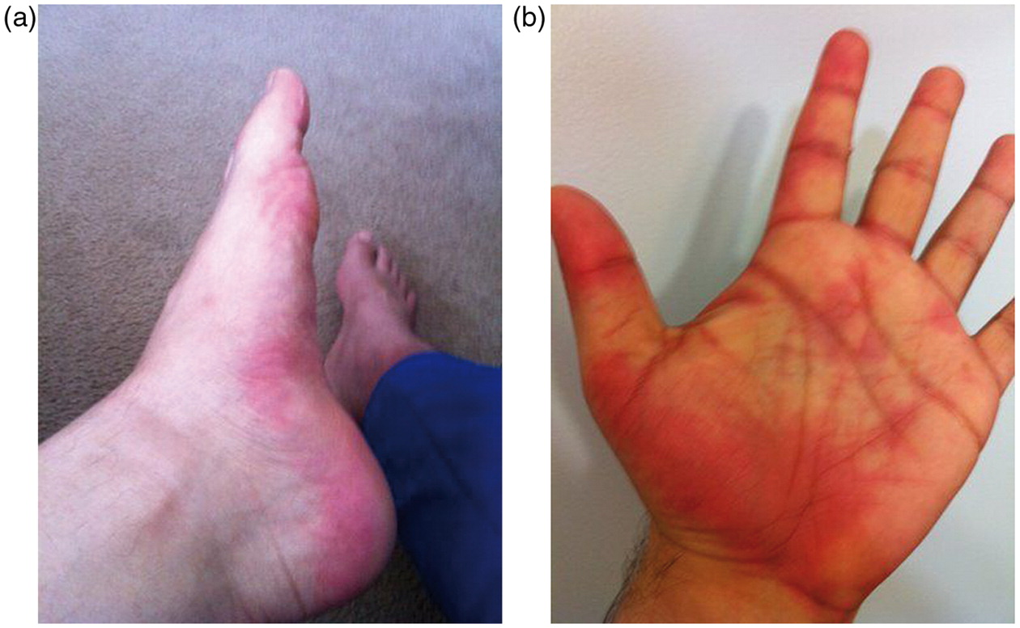
Paclitaxel induced palmoplanter eythema

Slide 9
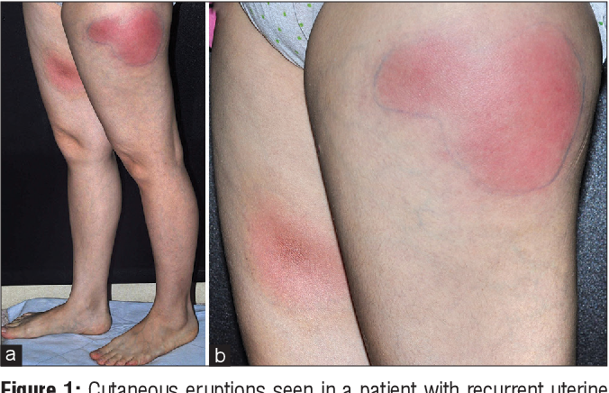
NEUTROPHILIC ECCRINE HIDRADENITIS
Notes:
Pazopanib ,tyrosine kinase inhibitor as a new culprit in neutrophilic eccrine hidradenitis

Slide 10
DISEASE COURSE , MANAGEMENT
Can recur.
Dose reduction
Lengthening of cycle interval.
Symptomatic management.

Slide 11



Slide 12

CHEMOTHERAPY INDUCED NAIL CHANGES
Onycholysis
Onychomadesis
Beau’slines
Transverse leuconychia (Mee’s lines).
Melanonychia.
Subungual erythema
Subungual haemorrhage
Paronychia
Notes:
All patients receiving EGFR inhibitors are at risk of nail changes,
usually after 1–2 months of treatment.
Similar changes
are also seen in patients receiving MEK inhibitors.

Slide 13
DRUGS | NAIL CHANGES
Methotrexate | Paronychia, onycholysis
Cyclophosphamide , Doxorubicin | Beau’s lines, onycholysis
Fluorouracil | Onycholysis, dystrophy, onychomadesis
Sorafenib , sunitinib | Subungual haemorrhage
Docetaxol, paclitaxel | Onycholysis, Beau’s lines, pigmentation, Onychomadesis subungual haemorrhage
Melphalan , Daunorubicin | Transverse leuconychia ( Mee’s lines)
Gefitinib, Lapatinib | Paronychia

Slide 14
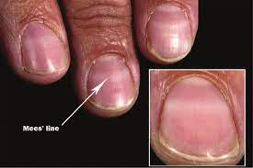
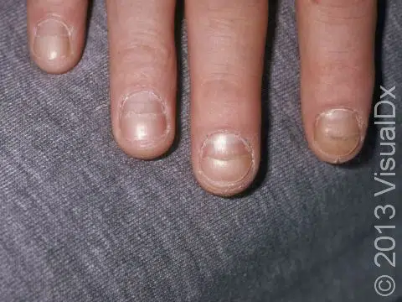
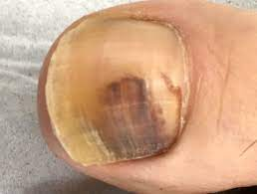
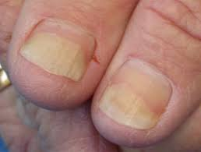
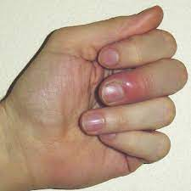
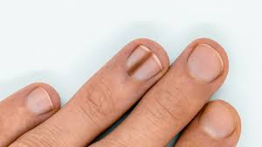

Slide 15
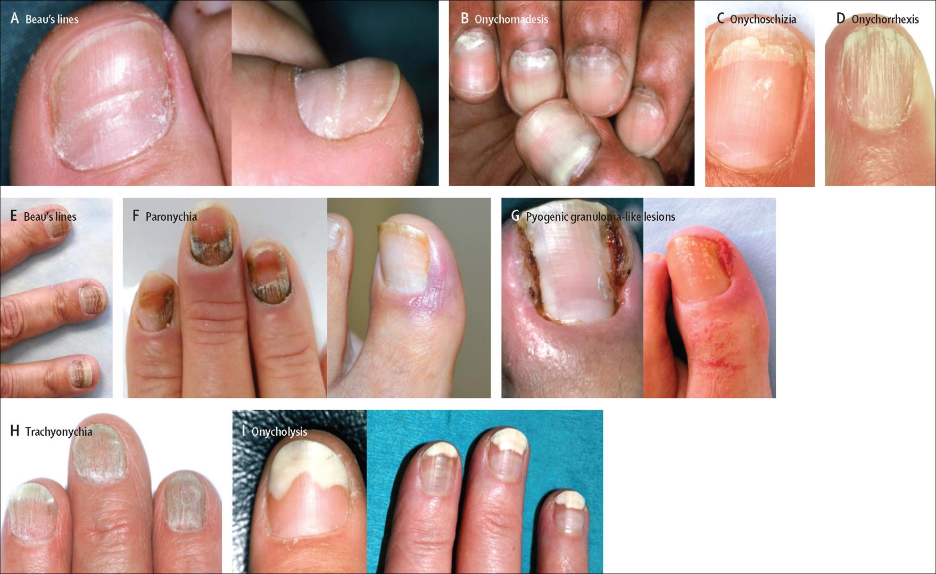

Slide 16
DIFFERENTIAL DIAGNOSIS
Psoriasis
Tinea
Trauma
Vasculitis.
Idiopathic melanonychia,
Melanocytic naevus
Melanoma.

Slide 17
DISEASE COURSE
Most nail changes reverse after the causative chemotherapeutic agent is stopped
Full resolution many months

Slide 18
The Multinational Association of Supportive Care in Cancer (MASCC)
Skin Toxicity Study: Paronychia Recommendations.
Notes:
wearing comfortable shoes and avoiding aggressive nail manicuring
Drug withdrawal is not recommended

Slide 19
PAPULOPUSTULAR ERUPTIONS
With in 2 weeks of starting chemo.
Sterile follicular pustules
Papules
No comedones.
Seborrhoeic distribution
Extremities, abdomen ,buttocks
EGFR, MEK and TK inhibitors
Resolves with no scarring in 2 months
Notes:
four phases: (i) sensory disturbance with erythema
and oedema on the face and upper trunk; (ii) papulopustular
lesions; (iii) crusting lesions; and (iv) persistent xerosis, erythema
and telangiectasis

Slide 20
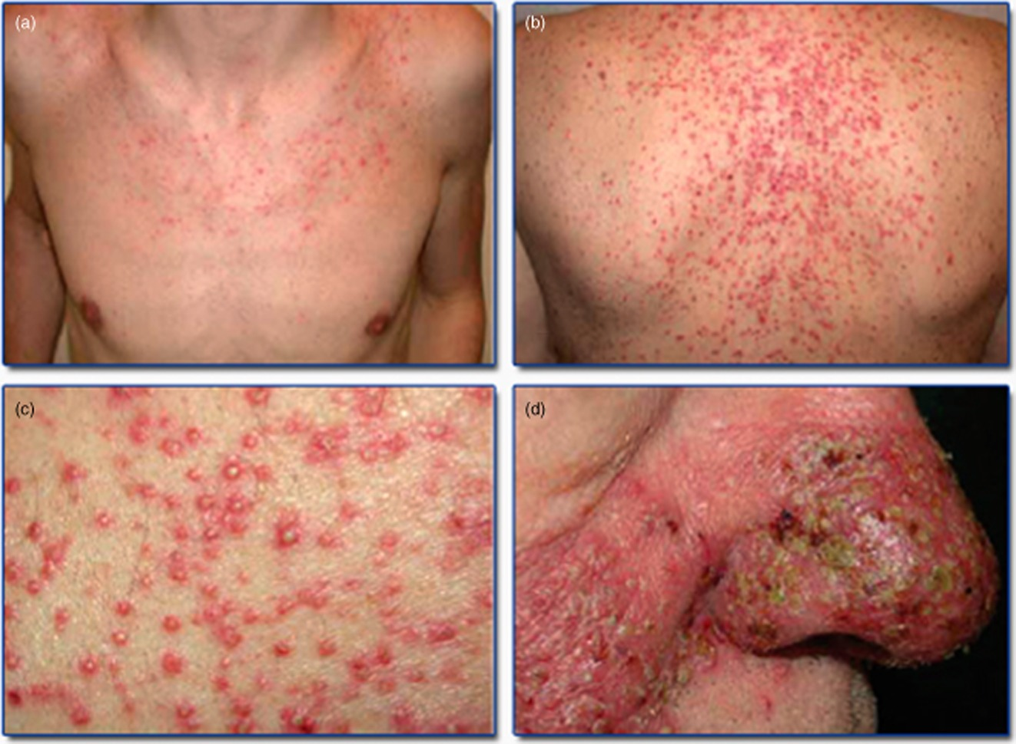

Slide 22
DIFFERENTIAL DIAGNOSIS OF PAPULOPUSTULAR ERUPTIONS
Drug‐induced acne
Malassezia folliculitis
Staphylococcus folliculitis
Eosinophilic folliculitis
Tinea barbae

Slide 23
Preventive Management
Starting 24hour prior to chemo
Topical :
Hydrocortisone 1% cream, moisturizer & sunscreen BD
Systemic :
Minocycline 100 mg daily
Doxycycline 100mg BD.

Slide 24
TREATMENT
Topical
Fluocinomide 0.05% cream BD
Alclometasone 0.05% cream
Clindamycin 1%
Systemic :
Minocycline 100 mg daily
Doxycycline 100mg BD.
Low‐dose isotretinoin 20–30 mg daily (severe cases)

Slide 25
CHEMOTHERAPY INDUCED HAIR CHANGES

Slide 26


Slide 27

CHEMOTHERAPY INDUCED ALOPECIA
Loss of scalp and body hair caused by cytotoxic effect of chemotherapy on hair follicles.
Anagen effluvium.
Dose , duration , route and type of drug.
Notes:
chemotherapy drugs target
dividing cells and in so doing interrupt the cell division of the hair
matrix cells. 90% of scalp hair is in the anagen, proliferative
phase at any given time and therefore the pattern of alopecia is
known as anagen effluvium.

Slide 28
CIA ASSOCIATED CHEMO-DRUGS
Antimicrotubule agents (paclitaxel, docetaxel)
Topo isomerase inhibitors (etoposide, doxorubicin)
Alkylators (cyclophosphamide, ifosfamide)
Antimetabolites (5‐FU)
Notes:
1= >80%
2= 60-100%
3=>60%
4= 10-50%

Slide 29
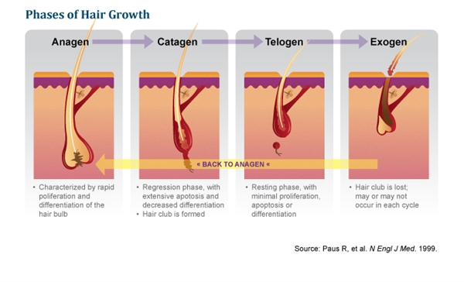

Slide 30
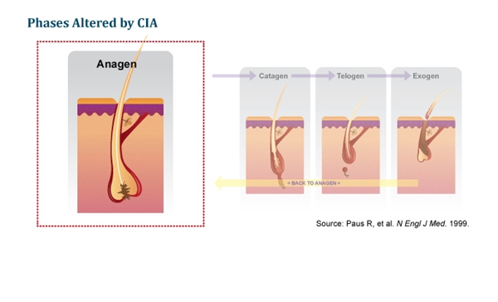

Slide 31
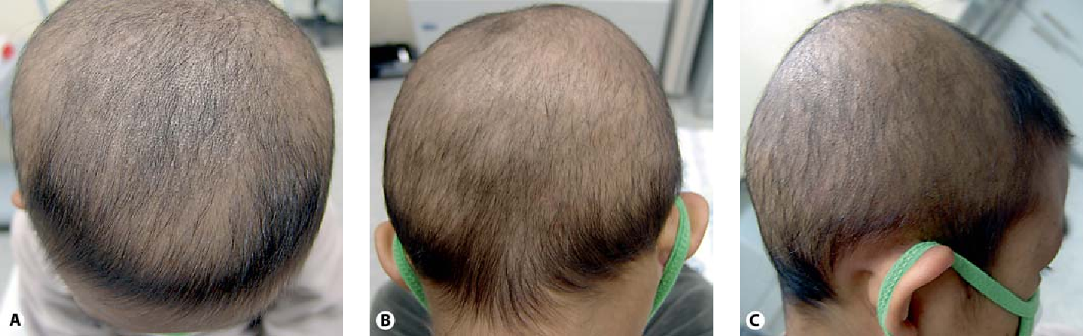
Anagen effluvium , 4 months after BMT of Fanconi’s anemia. It spares hairs of total hairline area, frontal, , occipital and temporal.

Slide 32
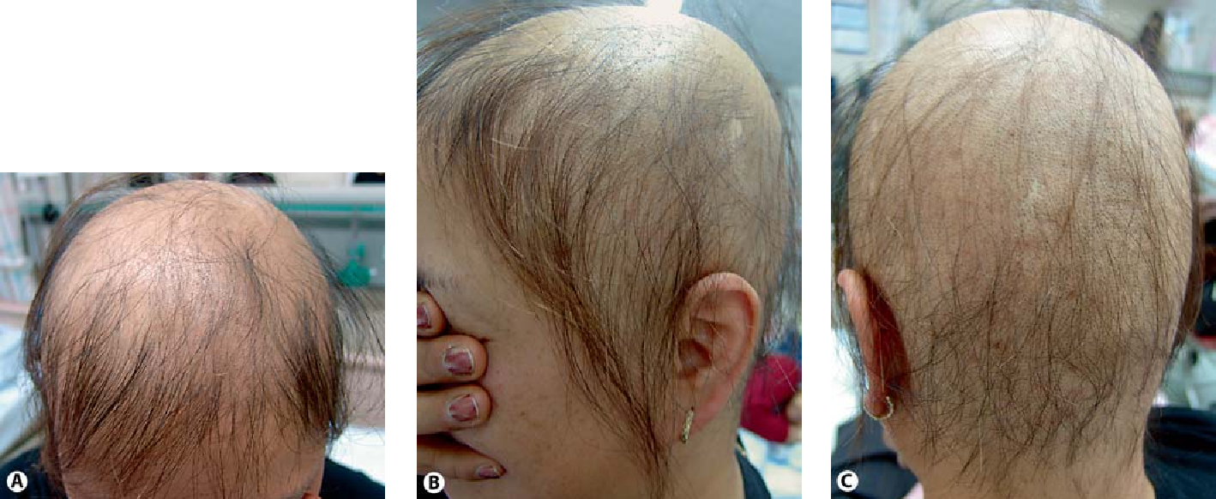
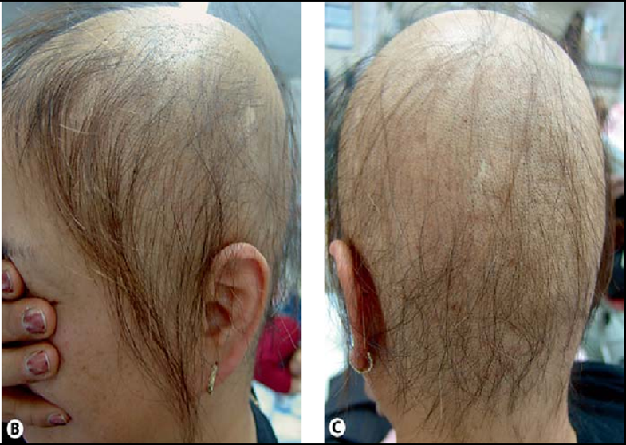
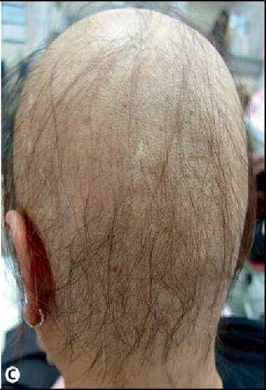
Anagen effluvium by chemotherapy of breast cancer , preservation of total hairline area, frontal, temporal & occipital.

Slide 33
Normal hair growth is comprised of three phases: 1) Anagen—matrix cells proliferate and differentiate; 2) Catagen—involution occurs as the dermal papilla moves upward, below the hair bulge; and 3) Telogen—the dormant phase where the hair shaft matures.[3] (The anagen phase is primarily affected in CIA, which is thought to result from the disruption of matrix cells proliferation and Pohl-Pinkus constrictions; this is characterized by diminished follicle function.[

Slide 34
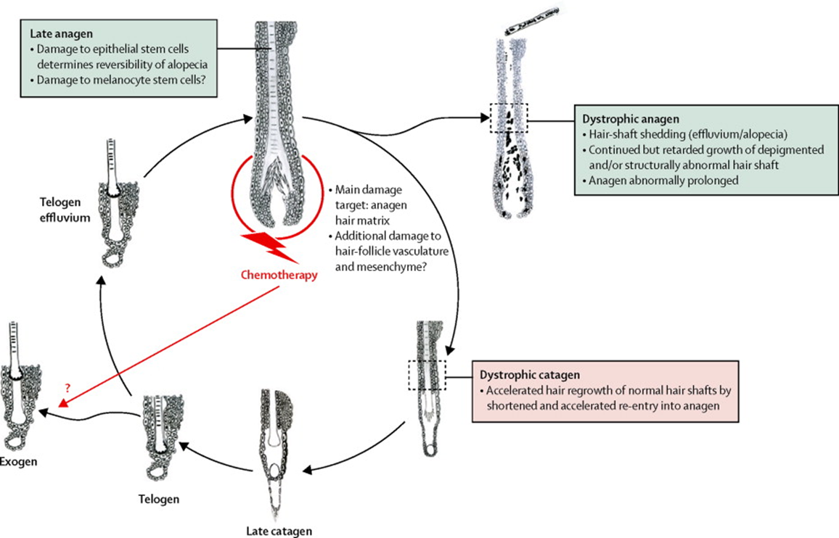

Slide 35

CLINICAL FEATURES
Starts within days-weeks
Vertex
Sides of head above ears.
By 2–3 months, diffuse or patchy pattern
of alopecia

Slide 36
DISEASE COURSE AND PROGNOSIS OF CIA
Reversible
Spontaneously within 1–3 months.
Fully recovery by 6 months
Change in texture , colour of new hair.
Permanent CIA
Bulsulphan, cyclophosphamide & taxane therapy.
Notes:
Dystrophic anagen hairs recover more
slowly, are of poor hair shaft quality and have pigmentary defects.
dystrophic catagen pathway is associated with fastest and most complete recovery of damaged hair follicles.

Slide 37


MANAGEMENT OF CIA
Careful explanation
Psychological support
Access to wigs.
Scalp cooling therapy

Slide 38
Chemotherapy Induced Hypertrichosis
Reversible
Facial hypertrichosis
Slow‐growing, brittle, curly hair
Increased thickness, length & curvature of eyebrow hair and eyelashes.
Culprit Drugs:
Interferon α , Cetuximab , Erlotinib , Gefitinib.
Notes:
The differential diagnosis includes paraneoplastic hypertrichosis.
hair changes are usually reversible and disappear within a
month of stopping treatment.

Slide 39
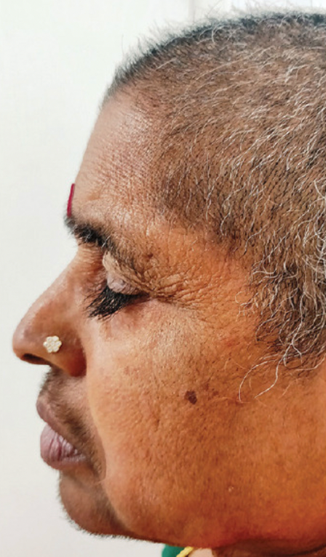
Trichomegaly and hypertrichosis due to EGFR inhibitor ,Erlotinib.

Slide 40
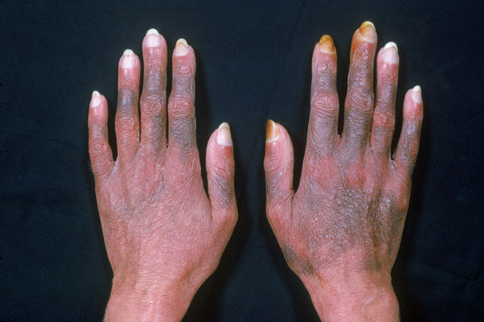
Chemotherapy Induced Hyperpigmentation
Skin, mucosa and nail pigmentary changes.
Types:
Local at site of infusion
Diffuse
Resolves after discontinuity of culprit drug.

Slide 41
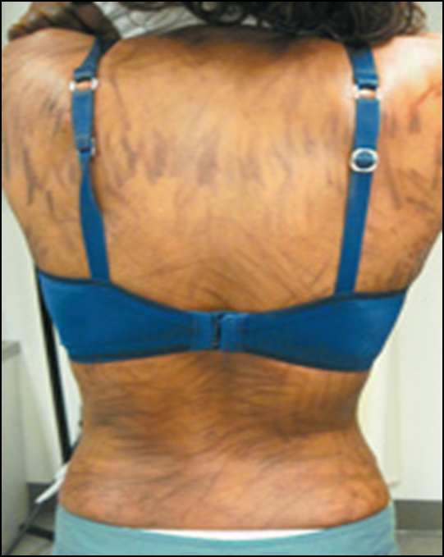
Flagellate Pigmentation
Multiple, macular linear streaks
Initially red, then pigmented.
A criss‐cross pattern
Bleomycin

Slide 42
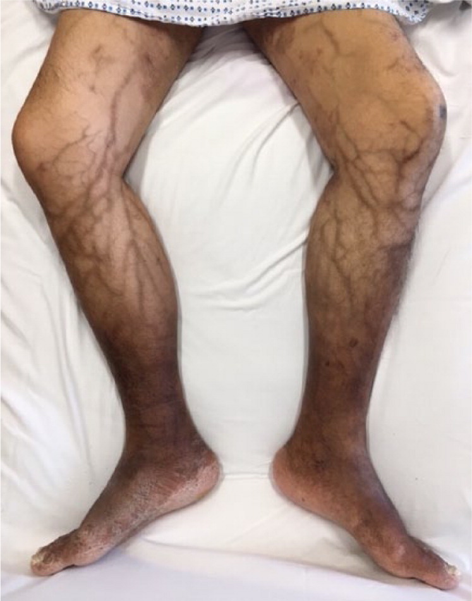
Serpentine Supravenous Hyperpigmentation.
Follow distribution of veins.
Fluorouracil
Vinorelbine
Daunorubicin

Slide 43
Postulated mechanisms of drug‐induced hyperpigmentation
A direct pigmentary effect of the deposited drug in skin.
A direct toxic effect on epidermal melanocytes stimulating increased melanin production
The suppression of adrenal function leading to increased ACTH and MSH causing hyperpigmentation;
A depletion of tyrosinase inhibitors resulting in increased pigmentation.

Slide 44
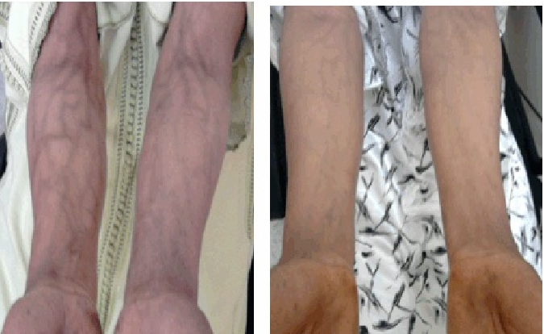
Serpentine supravenous hyperpigmentation by Fluorouracil infusion

Slide 45
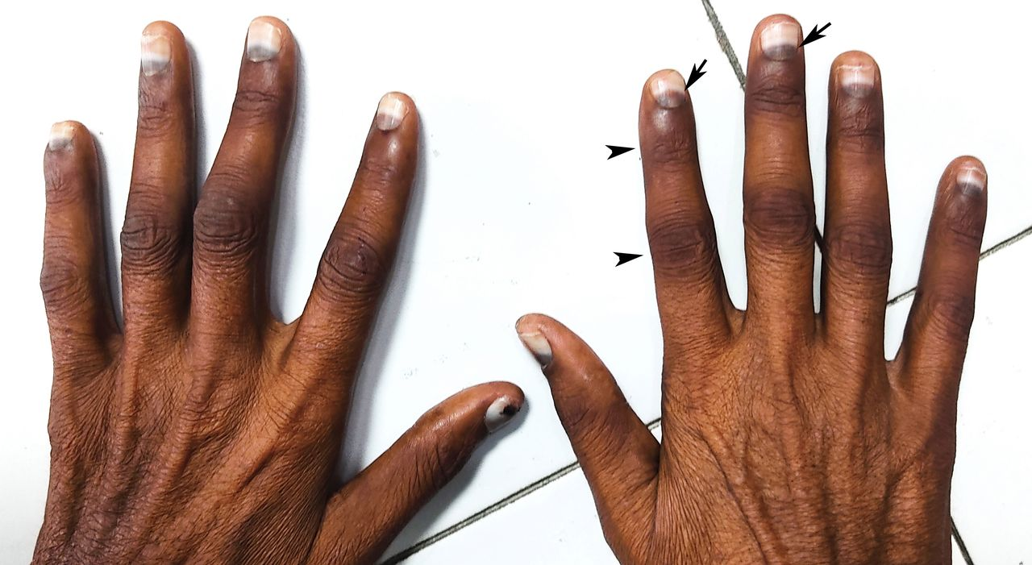
LUNULAR PIGMENTATION BY HYDROXYUREA

Slide 46
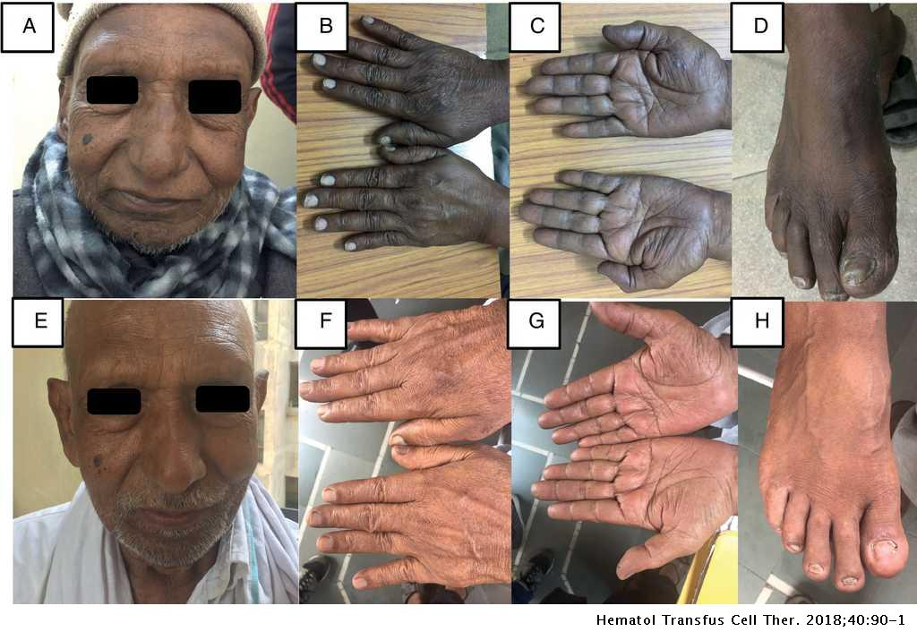
Notes:
Clinical photograph of patient showing hyperpigmentation of skin involving face, hand and foot. Repeat clinical photograph of the patient showing near complete resolution of the hyperpigmentation of affected areas

Slide 47
D.Ds of Chemotherapy Induced Hyperpigmentation
Post‐inflammatory hyperpigmentation,
Haemochromatosis
Addison disease
Hypermelanosis in metastatic melanoma

Slide 48
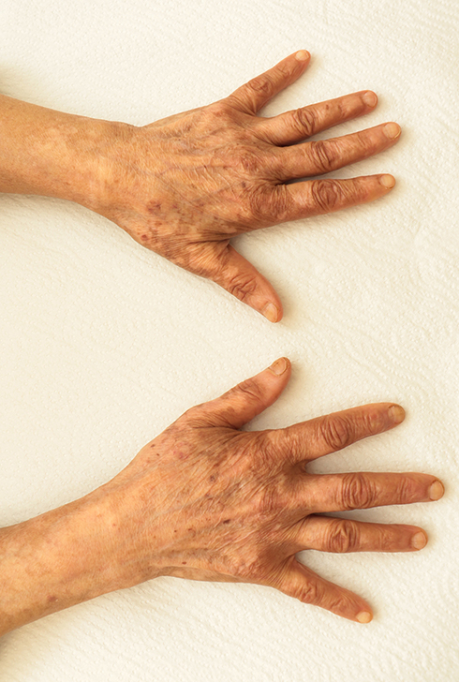
Chemotherapy Induced Hypopigmentation
A partial or complete decrease in skin pigmentation caused by chemotherapy.
Hypomelanotic & amelanotic macules
Symmetrically
SITES :
Distal digits
Peri orificial sites.
Notes:
D.D=idiopathic vitiligo and post‐inflammatory hypopigmentation.

Slide 49
Cancer chemotherapy Agents
Associated with Hypopigmentation
Doxorubicin
Imatinib
Dasatinib
Gefitinib
Vemurafenib
Imiquimod
Interferon α , β
Interleukin 2 ,4
Mitoxantrone
Survivin inhibitor

Slide 50

Recall Reaction
Drug induced inflammatory eruption confined to an area of skin that has previously been irradiated.
Median interval is 40 days.
Notes:
secondary to vemurafenib

Slide 51
DRUGS CAUSING RECALL REACTIONS
Methotrexate
Gemcitabine
Docetaxel
Paclitaxel
Hydroxyurea
Etoposide
Doxorubicin
Capecitabine
Tamoxifen
Vemurafenib

Slide 52
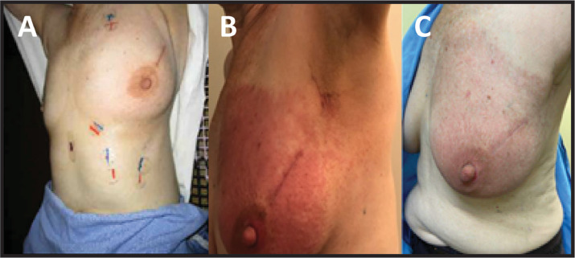

Slide 53
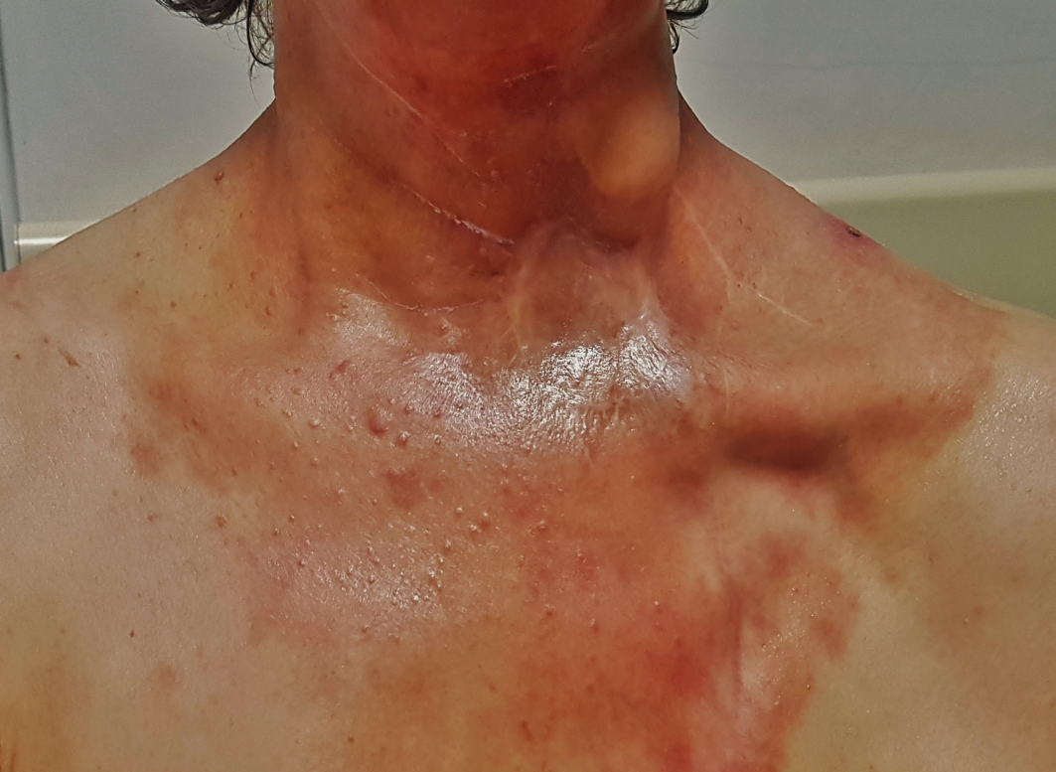
Recall reaction after Nivolumab administration at previously irradiated area for SCC neck
Notes:
erythematous plaque-like lesions were formed starting from the bilateral temporomandibular region and spreading to the anterior chest, which corresponded to the previously irradiated area

Slide 54
MANAGEMENT
Discontinue triggering drug.
Minimizing exposure to sun.
Systemic or topical steroids
NSAIDs
Antihistamine

Slide 55
Radiotherapy‐Associated Skin Side Effects
Side effect of external beam ionizing radiation.
TYPES:
Early
Late
Dose dependent
Erythema = 3-10 Gy
Permanent epilation= 7-10 Gy
Moist desquamation = 12-25 Gy
Necrosis = 25 Gy
Notes:
(days-weeks) (months-years)

Slide 56
RISK FACTORS FOR RADIATION DERMATITIS
Obesity
HIV
Diabetes
Poor nutrition
Existing skin disease
Prolonged/multiple procedures.
Porphyria
CTD
Ataxia telangiectasia

Slide 58
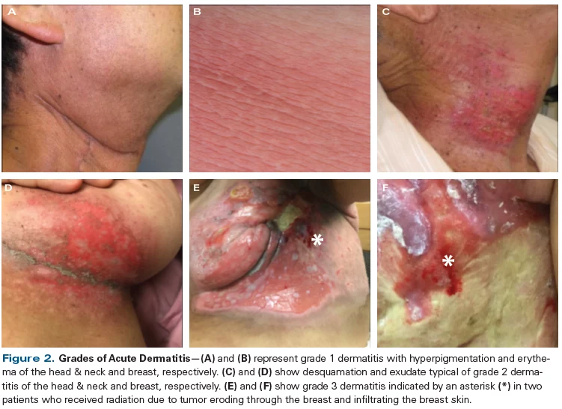

Slide 59
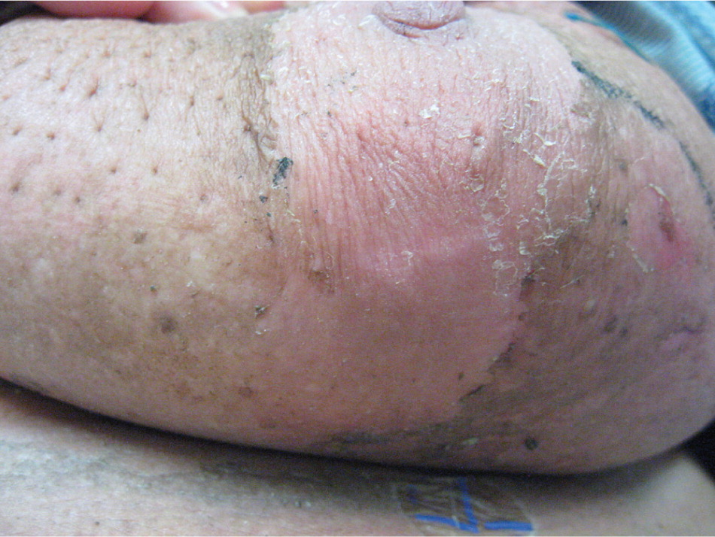
Dry desquamation on final day of radiation therapy (6,120 cGy) in a 64-year-old woman with an infiltrating ductal carcinoma of left breast

Slide 60
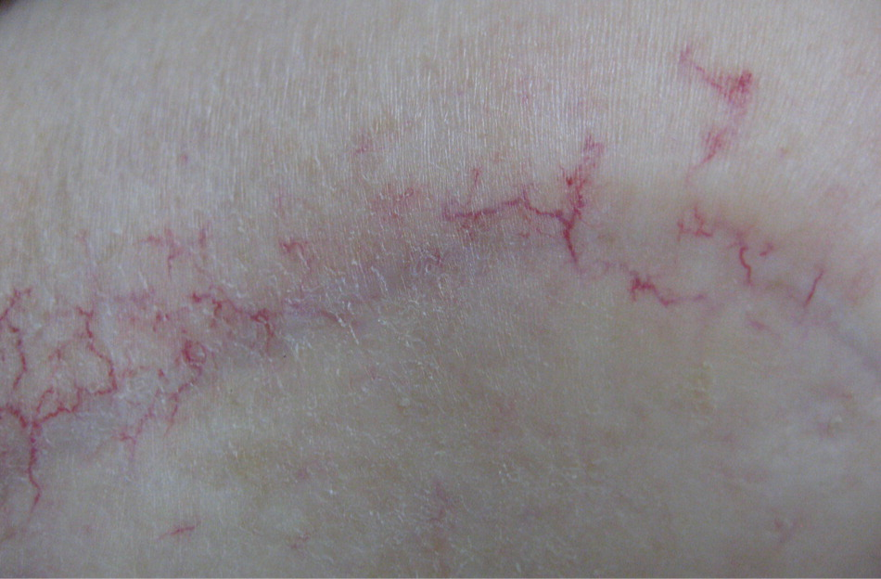
Notes:
Telangiectasis in a 73-year-old woman who completed external beam radiation therapy three and one half years earlier for an infiltrating ductal carcinoma of the right breast (T4N2M0; stage IIIB). Treatments included radiation to the chest wall, supraclavicular area, and posterior axilla (5,040 cGy), followed by an electron boost to the incision line

Slide 61

MANAGEMENT
Avoid sun exposure
Broad spectrum sun protection.
Good hygiene.
Topical antibiotics
Hydrophilic dressings.
Topical steroids.

Slide 62


