Slide 1
Cutaneous Photosensitivity Diseases
DR. VINESHA DEVI
Resident Dermatology

Slide 2
OBJECTIVES
INTRODUCTION
TYPES OF PHOTOSENSITIVITY
BASICS OF CLINICAL PHOTOMEDICINE
PRINCIPLES OF DIAGNOSTIC MODALITIES
DISORDERS ASSOCIATED WITH PHOTOSENSITIVITY
TREATMENT

Slide 3
INTRODUCTION
Photosensitivity:
An abnormal response to UV radiations
Abnormal Photosensitivity:
Individual’s cutaneous responses to sunlight (UVR and/ or visible radiation) fall outside the ranges for healthy subjects
Notes:
Energy is either dispersed harmlessly or elicits chemical reactions that lead to clinical disease.

Slide 4
Absorption of photon energy by molecules in the skin.
Absorbing molecules:
  Exogenous Agents topically or systemically
  Endogenous Molecules either present in skin or produced by an abnormal metabolism
  A Combination Of Exogenous And Endogenous molecules
Notes:
Energy is either dispersed harmlessly or elicits chemical reactions that lead to clinical disease

Slide 5
TYPES OF PHOTOSENSITIVITY
Acute Photosensitivity:
  A sunburn-type response
  A rash response
  Urticarial response
Chronic Photosensitivity:
  Chronic repeated sun exposures that result in polymorphic skin changes dermatoheliosis (DHe) or photoaging
Notes:
A sunburn-type response with skin changes simulating a normal sunburn or rash such as in phototoxi
A rash response with macules, papules, or plaques, as in eczematous dermatitis. usually photoallergic in nature.
Urticarial responses are typical for solar urticaria;

Slide 6
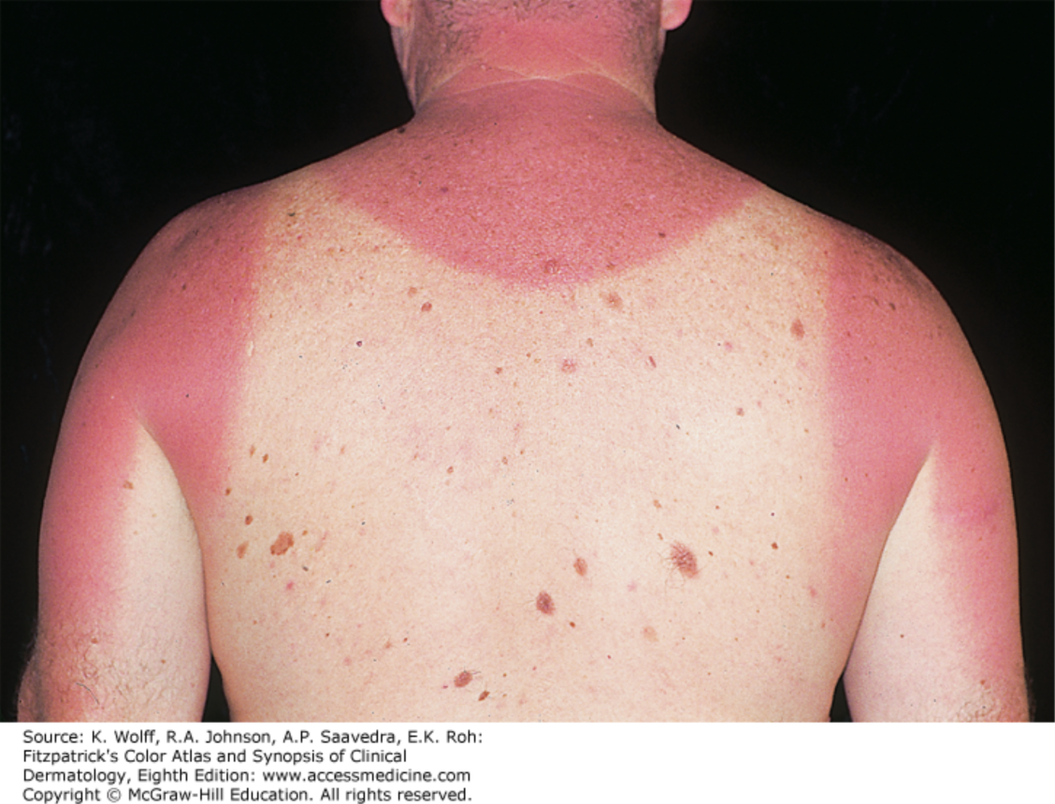
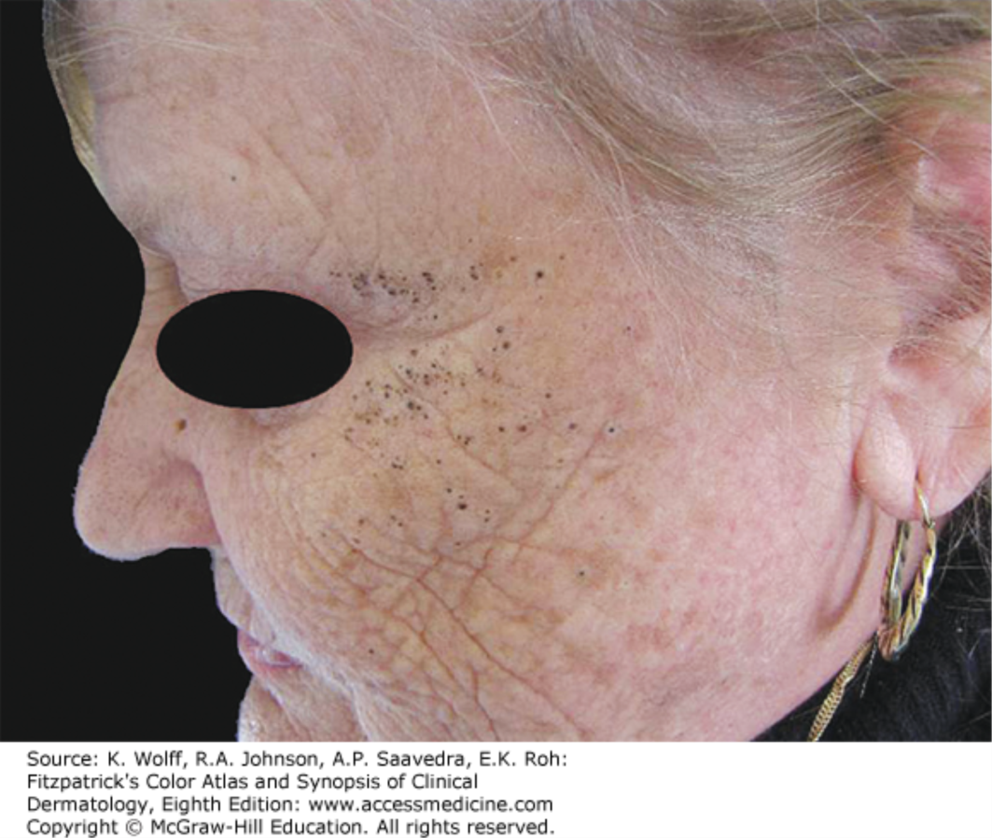
Notes:
Acute sunburn erythema with mild edema of the upper back with sharp demarcation between the sun-exposed and sun-protected white areas.
PHOTOAGING severe deep wrinkling. The skin appears waxy, with a yellowish hue (solar elastosis) ACCumulation f abnormal elastin after repeated nd prolonged sunexposure This old age female farmer multiple black comedones in the zygomatic region

Slide 7
BASICS OF CLINICAL PHOTOMEDICINE
Solar radiation-induced skin pathology → UV portion of the solar spectrum.
UVC
(200-280nm)
UVB
(280–315 nm)
UVA
(315-400nm)
Filtered by the ozone layer
Responsible for sunburn, suntan and skin cancers
Medically most important
Wood’s lamp →long UV radiation 390nm
photochemotherapy
Notes:
The main culprit of solar radiat…………...: UVB the "sunburn spectrum,“ UVB radiationi is significantly more effective (100–1000 times more potent) than UVA at producing erythema, cellular effects and DNA damage. UVA radiation is less energetic but penetrates more deeply into the skin, has been implicated in chronic skin photoageing

Slide 8
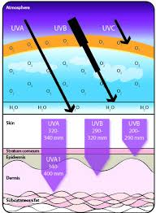

Slide 9
FITZPATRICK SKIN PHOTOTYPES
Skin type | Unexposed skin color | Reaction to sun exposure
I | White | Always burns, never tans
II | White | Always burns, minimal tan
III | White to olive | Burns minimally, gradually tans
IV | Light brown | Burns minimally, tans well
V | Brown | Very rarely burns, tans profusely
VI | Dark brown to black | Never burns, tans deeply
Notes:
sunburn is seen most frequently in individuals who have pale white or white skin and a limited capacity to develop inducible, melanin pigmentation (tanning) after exposure to UVR.
Basic skin color is divided into white, brown, and black.

Slide 10
PRINCIPLES OF DIAGNOSTIC TECHNIQUES

Slide 11
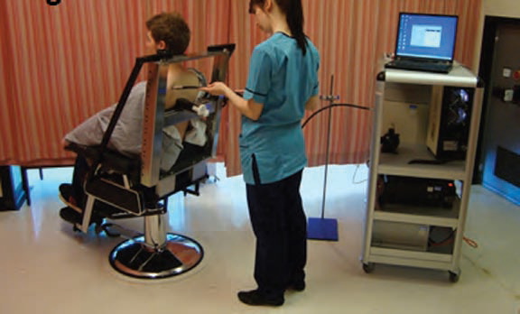
MONOCHROMATOR PHOTOTESTING
  Filtered high‐pressure xenon arc lamp
  Delivers relatively monochromatic UV and visible light across the solar spectrum
  Precise dose ranges
  Skin on the back
  Spectra responsible
Notes:
1;Monochromator z a device that disperse light into its constituent wavelength to which pt z then exposed
End Immediate and delayed erythemal responses are assessed based on the MEDs at each wavelenght and are compared with normal population

Slide 12
Minimal Erythema Dose (MED)
Dose of radiation that produces minimal, just perceptible erythema, at 24hours post irradiation.
Notes:
MEDs below the normal range indicate abnormal photosensitivity.

Slide 13
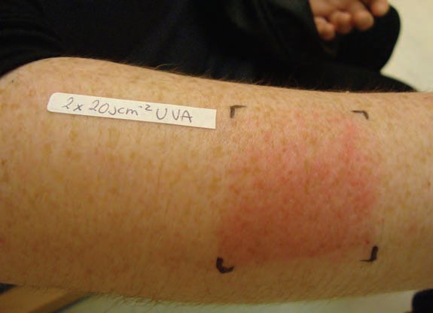
ITERATIVE PROVOCATION TESTING
  Daily for three days, a 10 x 5 cm area on one forearm is exposed to UVB from a fluorescent lamp source
  Similar area on other arm is exposed to UVA
  If the rash develops
  Biospy done
Notes:
1; It z desined to try to provoke an abnormal response that pt experiences when exposed to sunlight
2 ;Done at site whr rash z provoked wth natural sunlight
3; therefor pt z exposed to wide range of wavelength , These doses are equivalent to those received in about an hour of midday summer sun. Ibiopsy particularly useful in PLE ND ACTINIC PRURIGO.

Slide 14
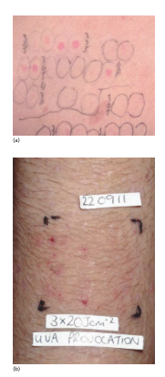
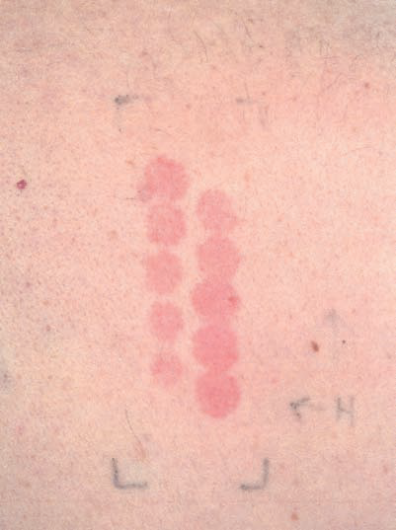
Notes:
A monochromator shows broad band UVB ND UVA photosensitivity
B + UVA photoprovocTION ON FORErm
C abnormal UVB photosen erythema at all narrow band test site

Slide 15
PATCH AND PHOTOPATCH TESTING
Patch testing is a technique for detecting an allergic response to substances that come into contact with the skin.
Photopatch testing is a technique for detecting photoallergic response to substances, usually sunscreen chemicals, in the presence of light.

Slide 16
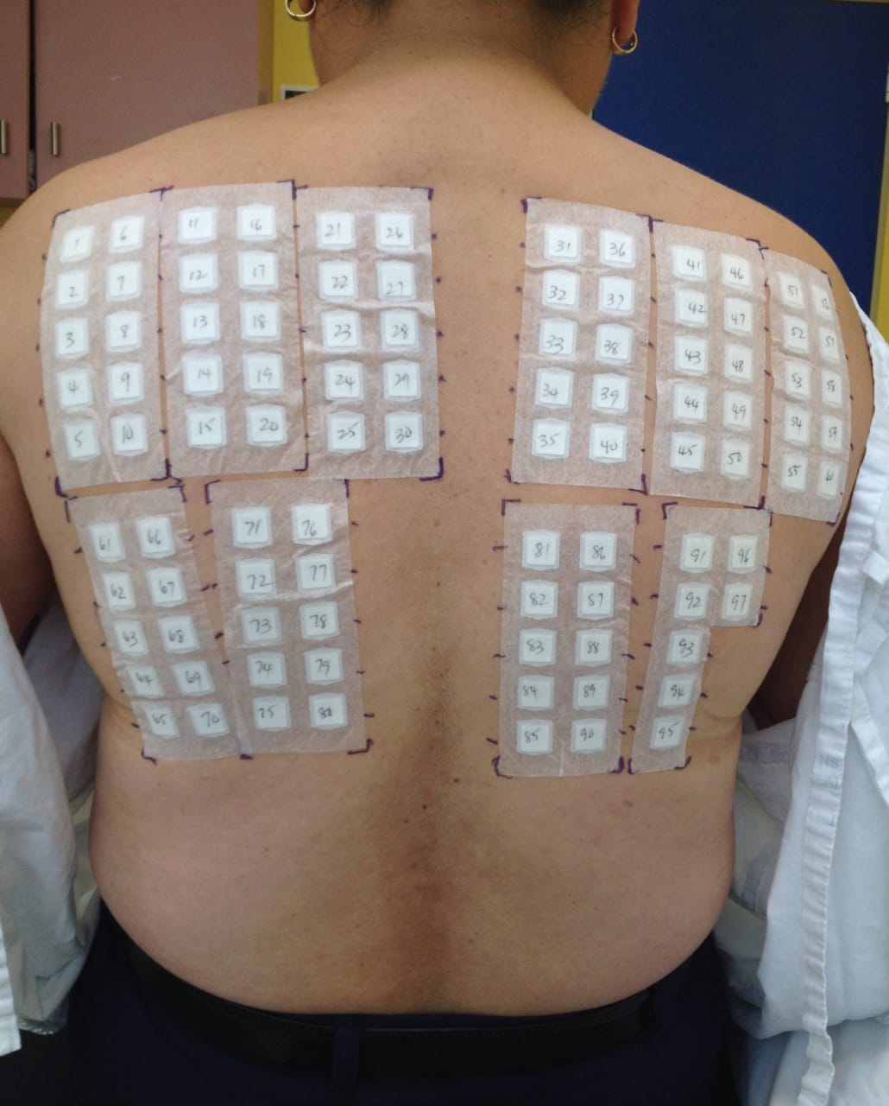
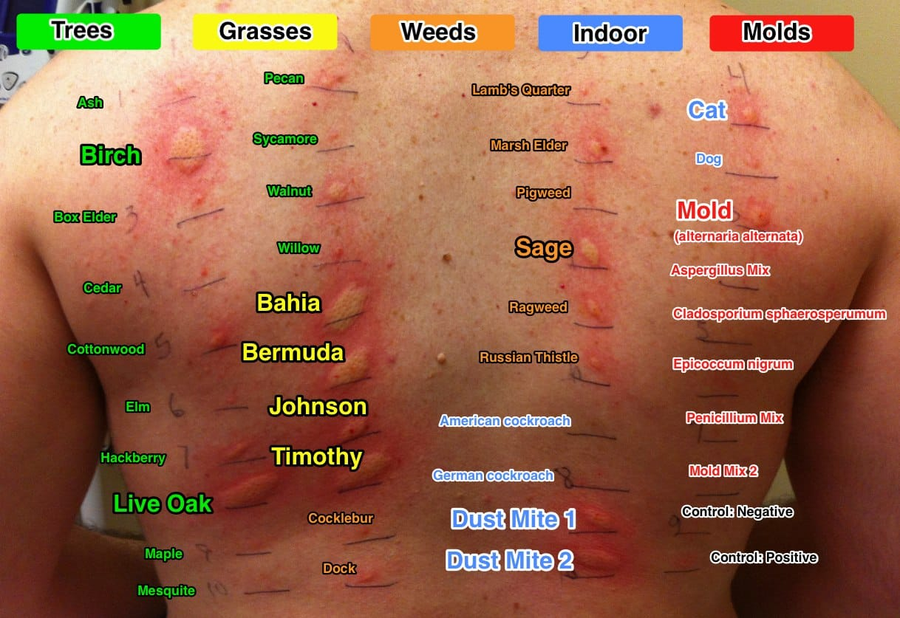
PATCH AND PHOTOPATCH TESTING
Series of allergens are applied to aluminum chambers, which adhere to hypoallergenic tape strips.
Patch testing, the strips of chambers are applied to the skin (normally the upper back) and kept in place for 48 hours.
Notes:
The amount of UVA light is small and unlikely to cause any skin reaction on its own
Allergens latex medications frangrances preservative hair dyes metAls resins

Slide 17
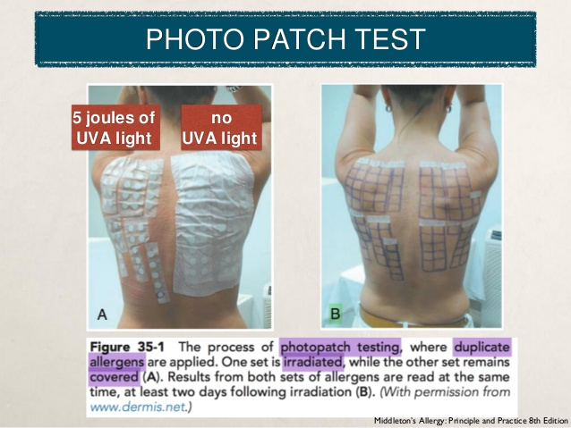
PATCH AND PHOTOPATCH TESTING
Photopatch testing
Duplicate sets are applied to the skin
Kept in place for 24 hours
One set is irradiated with UVA light
Observation for 48 hours after removing the strips
Positive reaction:
erythema
papules
vesicles
Notes:
TEST SITES R kept under observation

Slide 18
PATCH AND PHOTOPATCH TESTING
INDICATIONS
  Patch Testing
    Eczematous eruptions
    Contact allergic dermatitis
  Photopatch Testing
    Photocontact allergy (sunscreens)
    Contact allergic dermatitis
    Regular sunscreen users
    Unexplained deterioration

Slide 19
CUTANEOUS PHOTOSENSITIVITY DISORDERS
Heterogenous group of diseases where patients have abnormal sensitivity to ultravoilet or visible radiations.

Slide 20
The Cutaneous Photosensitivity Diseases
IDIOPATHIC (IMMUNOLOGICAL):
Polymorphic light eruption (PLE)
Juvenile spring eruption (JSE)
Actinic prurigo (AP)
Chronic actinic dermatitis (CAD)
Solar urticaria (SU)
Hydroa vacciniforme (HV)
DRUG OR CHEMICAL INDUCED PHOTOSENSITIVITY:
Endogenous – porphyrias
Exogenous – systemic or topical drug/chemical photosensitivity
PHOTOAGGRAVATED SKIN DISEASES

Slide 21
The Cutaneous Photosensitivity Diseases
IDIOPATHIC (IMMUNOLOGICAL)
Polymorphic Light Eruption (PLE)
Juvenile spring eruption (JSE)
Actinic prurigo (AP)
Chronic actinic dermatitis (CAD)
Solar urticaria (SU)
Hydroa vacciniforme (HV)

Slide 22
POLYMORPHIC LIGHT ERUPTION
The Cutaneous Photosensitivity Diseases
Commonest
Recurrent
Delayed‐onset
Abnormal reaction to sunlight (or artificial UVR source)
Notes:
several morphological variants , hence the term ‘polymorphic’.
PLE is the commonest cause of photosensitivity.

Slide 23
POLYMORPHIC LIGHT ERUPTION
Onset: before 30 years of age
F > M
At higher latitudes
Spring and summer
Most common in SPT I, II, and III

Slide 24
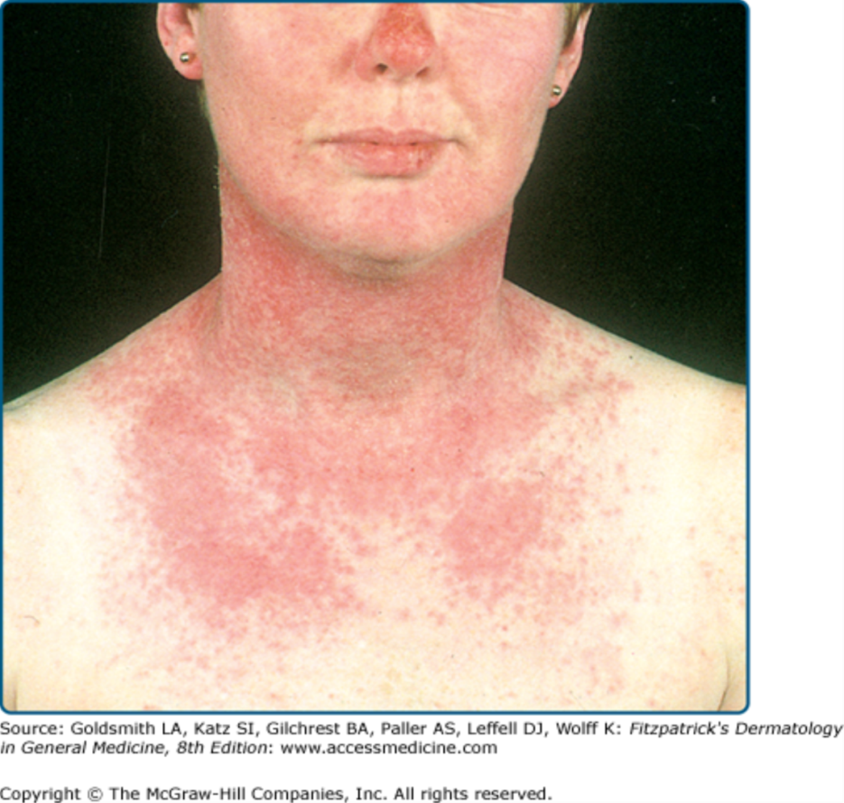
CLINICAL FEATURES
POLYMORPHIC LIGHT ERUPTION
Onset : 10 min, up to several hours
Delay of >= 6
Intensely itchy eruption
Sunlight‐exposed areas
Sites : face, neck, chest, upper back, extremities
Persists for 7 to 10 days
Notes:
As little as 10 min, up to several hours, of sunlight exposure , usually after a delay, an exposed site eruption that is often intensely itchy
Facial involvement is more commonly seen in children with PLE

Slide 25
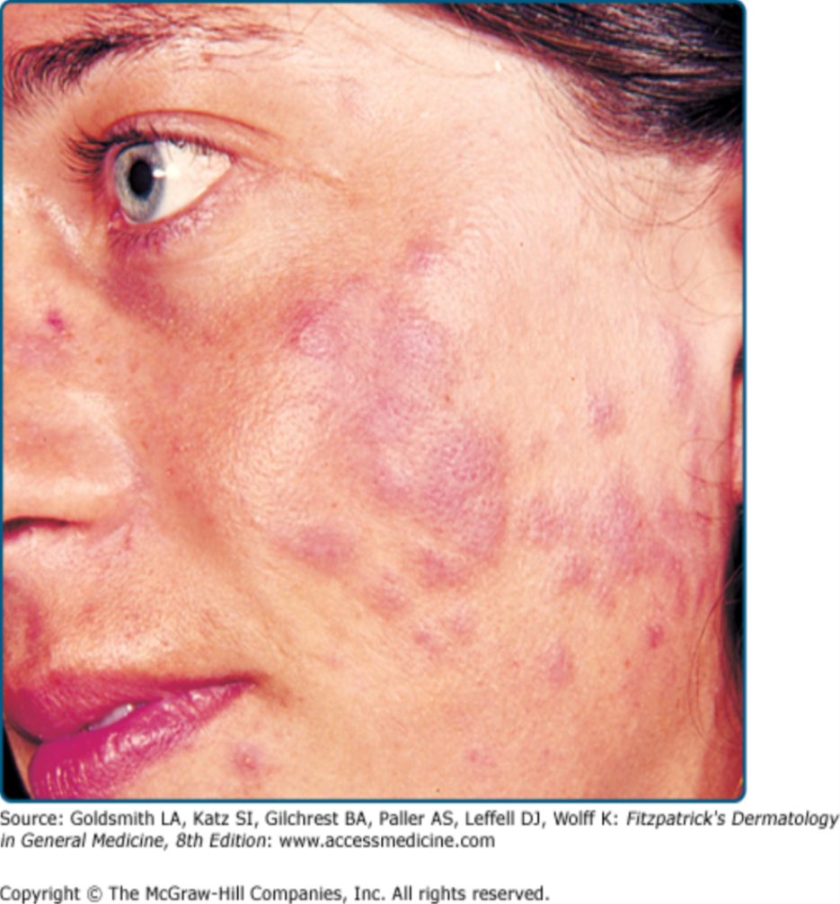
CLINICAL FEATURES
POLYMORPHIC LIGHT ERUPTION
Recurrent
Erythematous macules, papules, vesicles or plaques
Non- scarring
Monomorphic
Exposure source:
sunlight
sunbeds
arc welding
photocopying
equipment
Notes:
Pic . Erythematous plaques on the cheeks
End monomorphic within individuals – it looks similar each time it occurs

Slide 26
POLYMORPHIC LIGHT ERUPTION
PRIMING PHENOMENON:
  Sunny holidays
  2-3 days of exposure before rash
HARDENING PHENOMENON:
  Decline of PLE susceptibility
  After repeated sunlight exposure
  Tendency of PLE to be less troublesome towards end of summer
Notes:
Some, particularly those who only have a signifi cant problem during sunny holidays, describe a ‘priming phenomenon’ –
the need for 2 or 3 days of initial exposure before PLE occurs

Slide 27
CLINICAL VARIANTS
POLYMORPHIC LIGHT ERUPTION
Mixed papulovesicular : frequent
Plaque
Papular/micropapular
Vesiculo‐ bullous
Erythema multiforme‐like
An insect bite‐like PLE variant (strophula)
Purpuric/haemorrhagic
Notes:
PAPULOVESICULAR Z MOST FREQUENT

Slide 28
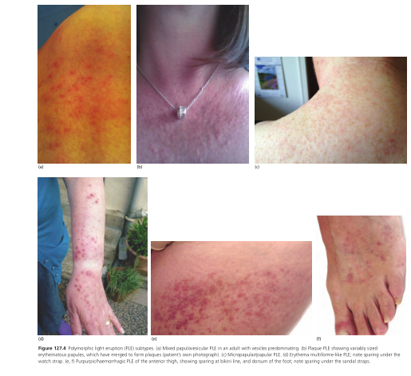
POLYMORPHIC LIGHT ERUPTION
Notes:
Variants (a) Mixed papulovesicular ,vesicles predominating. (b) Plaque erythematous papules, coalesced to form plaques . (c) Micropapular/papular PLE.
(d) Erythema multiforme‐like PLE; note sparing under the watch strap. (e, f) Purpurpic/haemorrhagic PLE of the anterior thigh, showing sparing at bikini line, and dorsum of the foot; note sparing under the sandal straps.

Slide 29
ASSOCIATIONS
POLYMORPHIC LIGHT ERUPTION
Lupus Erythematosus ( Systemic, SCLE, DLE)
Actinic Prurigo (AP)
Photosensitive Psoriasis

Slide 30
PATHOPHYSIOLOGY
POLYMORPHIC LIGHT ERUPTION
Delayed‐type hypersensitivity
Response to UV‐induced allergen (photoallergen).
ACTION SPECTRUM
    UVA
    UVB (LESS COMMON)
Notes:
PLE appear less prone to skin cancer than would be expected due to sunlight
avoidance alone [ 50 ]; perhaps those who show easier induction
of skin antigen recognition after UVR exposure are better immunologically
protected against skin cancer but more prone to PLE.

Slide 31
PATHOLOGY
POLYMORPHIC LIGHT ERUPTION
Superficial and deep, predominantly perivascular, dermal T cell inflammatory infiltrate
Upper dermal Oedema
Spongiosis
Some basal liquefaction
DIF is negative in PLE
Notes:
The cells of this infi ltrate are mainly T lymphocytes usually CD4+ in early lesions and CD8+ later
SPONGIOSIS IS intercellular edema in epidermis

Slide 32
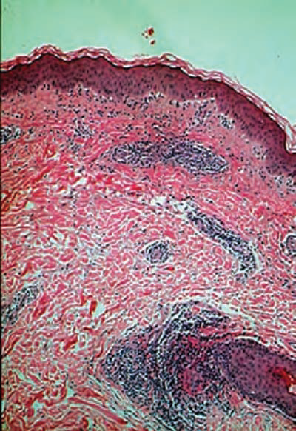
POLYMORPHIC LIGHT ERUPTION
Notes:
, predominantly perivascular, lymphohistiocytic, dermal infl ammatory infi ltrate

Slide 33
DIFFERENTIAL DIAGNOSIS
POLYMORPHIC LIGHT ERUPTION
Solar urticaria (idiopathic or secondary to drugs)
Reticular erythematous mucinosis
Lymphocytic infiltration of jessner
Lupus erythematosus
Actinic prurigo
Actinic reticuloid
Notes:
Compared with reticular erythematous mucinosis, mucin deposition is absent in PLE Clinically, PLE resolves once exposure to sunlight has ceased
such as lymphocytic infiltration of Jessne presence of marked papillary dermal edema, favour PLE
lupus erythematosus DIF is negative in ple
actinic reticuloid. Dense dermal nd subcutaneous mixed inflammatory , multinucleate stellate giant cells large atypical, hyperchromatic cerebriform lymphoid cells

Slide 34
General Management
POLYMORPHIC LIGHT ERUPTION
  Sun avoidance and protection
  UV‐absorbing window Film for car and house
  Clothing (tightly woven fabrics)
  Broad‐spectrum high SPF sunscreens (thickly, evenly and frequently)
  Vitamin D supplements
Pyschological support
Counselling

Slide 35
General Management
POLYMORPHIC LIGHT ERUPTION
2ND LINE:
  Prophylactic phototherapy/photochemotherapy
  Topical potent/very potent corticosteroid
  Oral steroid
3RD LINE:
  Azathioprine
  Ciclosporin
Notes:
1; Courses given in the spring serve to ‘harden’ the skin (by tanning and epidermal thickening and effects on immune responses)
3; Prednisolone GVN to pts wd holiday type PLE just to shorten duration f eruption

Slide 36
DISEASE COURSE
POLYMORPHIC LIGHT ERUPTION
Chronic and recurrent
“Tolerance" by the end of the summer
Eruption recurs following spring
Spontaneous improvement or even cessation
Notes:
2; Some patients may develop toleranc
4; OF eruptions occurs after years

Slide 37
The Cutaneous Photosensitivity Diseases
IDIOPATHIC (IMMUNOLOGICAL):
Polymorphic Light Eruption (PLE)
Juvenile Spring Eruption (JSE)
Actinic prurigo (AP)
Chronic actinic dermatitis (CAD)
Solar urticaria (SU)
Hydroa vacciniforme (HV)

Slide 38
JUVENILE SPRING ERUPTION
The Cutaneous Photosensitivity Diseases
Common
Spring time eruption
Intense sunlight exposure
School children
Farmer ( lambing season)
Military personnel
M > F

Slide 39
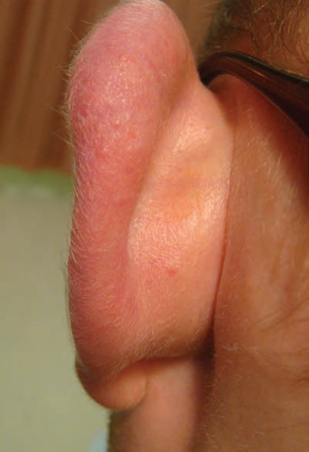
CLINICAL FEATURES
JUVENILE SPRING ERUPTION
Pruritic
Blisters or papules
Upper pinnae
Sunlight exposure
Notes:
typically a condition of males. due to differences in hairstyles meaning that the upper pinnae of boys and men are more often exposed to intense sunlight.
pic Sunlight induced papules on the prominent Pinna of a young male

Slide 40
HISTOPATHOLOGY
EARLY
Dermal
Perivascular
Mononuclear cell infiltration
Epidermal ulceration
Acanthosis
LATE

Slide 41
DIFFERENTIAL DIAGNOSIS
JUVENILE SPRING ERUPTION
PLE
BULLOUS LE
HYDROA VACCINIFORME
EPP
EM

Slide 42
MANAGEMENT
JUVENILE SPRING ERUPTION
Counselling
Benign nature
Spontaneous resolution
Grow hair to cover pinnae

Slide 43
MANAGEMENT
JUVENILE SPRING ERUPTION
1ST LINE:
  • Sunlight avoidance – best by hair cover
2ND LINE:
  • Desensitization : Naturally by repeated low level, less intense sunlight exposure.
3RD LINE:
  Prophylactic (desensitization) phototherapy:
                narrow‐band UVB

Slide 44
The Cutaneous Photosensitivity Diseases
IDIOPATHIC (IMMUNOLOGICAL):
Polymorphic Light Eruption (PLE)
Juvenile spring eruption (JSE)
Actinic prurigo (AP)
Chronic actinic dermatitis (CAD)
Solar urticaria (SU)
Hydroa vacciniforme (HV)

Slide 45
ACTINIC PRURIGO
The Cutaneous Photosensitivity Diseases
Perennial
Chronic
Typically worse in summer
Delayed type hypersensitivity reaction
Chromophore/photo-induced allergen
F > M
Notes:
Chromophore is a chemical group that absorbs nd transmits light at specific frequency
like nitro ethylene acetylene carbonyl acids esters nd so on

Slide 46
ACTINIC PRURIGO
Onset : Childhood
HLA‐DR4 tissue type
High altitude
Spectrum of abnormal photosensitivity:
UVA & UVB
Notes:
2 ;strong evidence of a genetic component with inheritance occurring within families
4; Frequent in people living at…..

Slide 47
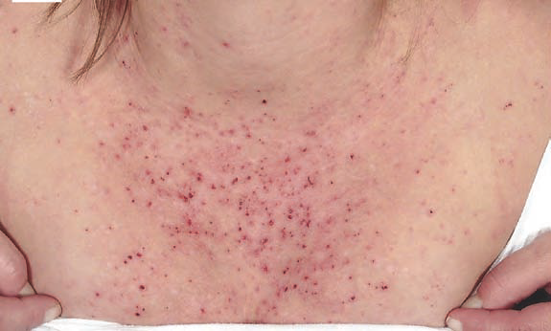
CLINICAL FEATURES
ACTINIC PRURIGO
Symmetrical
Itchy
Early pink papules, small nodules, plaques or vesicles
Rapidly excoriated, crusted and scabbed
Eczematization
Scarring
Notes:
Distinct flares related to UVR exposure
Pic excoriated papules on photoexposed part f chest

Slide 48
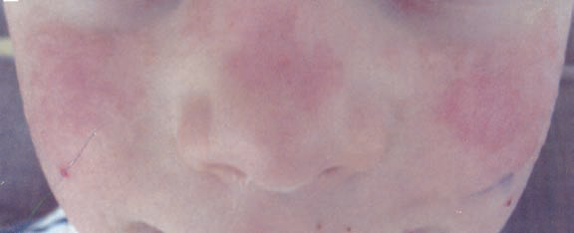
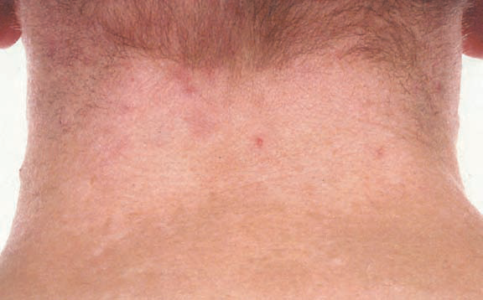
CLINICAL FEATURES
ACTINIC PRURIGO
Sites:
Face (esp dorsal nose)
Distal limbs
Buttocks (severe cases)
Hypo/hyperpigmented resolving lesions
Notes:
Pic papules nd plaques on nose nd bl cheek
Pic HYPER hypopigmentation on chronically photoexposed site of back of neck

Slide 49
DIFFERENTIAL DIAGNOSIS
ACTINIC PRURIGO
Severe PLE in background of atopic eczema
Insect bite reaction
Photoaggravated atopic eczema
Prurigo nodularis
Notes:
. Photoaggravated atopic eczema and nodular prurigo may be distinguished on clinical grounds
insect bites by their shorter time course and asymmetry; phototesting would be normal in these conditions

Slide 50
HISTOPATHOLOGY
ACTINIC PRURIGO
EARLY:
Dermal
Perivascular
Mononuclear cell infiltration.
LATE:
Epidermal ulceration
Acanthosis
Fibrosis.

Slide 51
MANAGEMENT
ACTINIC PRURIGO
  1ST LINE:
    Potent/very potent topical corticosteroids
    Narrow‐band (TL‐01) UVB phototherapy
2ND LINE:
    Psoralen–UVA photochemotherapy
    Thalidomide
Notes:
potent topical steroid to the treated areas immediately after each exposure reduces the risk of disease flares
3; phototherapy; usually only photo‐exposed sites
5; Thalidomide restricted by teratogenicity and the risk of irreversible peripheral neuropathy.
Antitumour necrosis factor α (anti‐TNF‐α) effects

Slide 52
MANAGEMENT
ACTINIC PRURIGO
3RD LINE:
  Pentoxifylline
  Tetracycline and vitamin E
  Oral corticosteroids
  Azathioprine
  Chloroquine
  Topical ciclosporin

Slide 53
DISEASE COURSE AND PROGNOSIS
ACTINIC PRURIGO
Spontaneously improves
By teenage years or early adulthood.
Complicated :
secondary bacterial (staph or strep) infection
Notes:
Severity judged by DLQI

Slide 54
The Cutaneous Photosensitivity Diseases
IDIOPATHIC (IMMUNOLOGICAL):
Polymorphic Light Eruption (PLE)
Juvenile spring eruption (JSE)
Actinic prurigo (AP)
Chronic Actinic Dermatitis (CAD)
Solar urticaria (SU)
Hydroa vacciniforme (HV)

Slide 55
CHRONIC ACTINIC DERMATITIS
The Cutaneous Photosensitivity Diseases
2nd most common idiopathic photodermatoses
Persistent
Eczematous eruption
Photo-exposed sites
Pseudo-lymphomatous features
The photosensitivity to broad‐band (UVB wavelengths).

Slide 56
CHRONIC ACTINIC DERMATITIS
Elderly males
Young age with atopic eczema.
M > F
Delayed hypersensitivity reaction
Unknown allergen

Slide 57
ASSOCIATIONS
CHRONIC ACTINIC DERMATITIS
Contact allergy
Photocontact allergy
Atopic eczema
Seborrhoeic dermatitis
HIV infection
Solar urticaria
Notes:
It is uncommon to develop CAD in the absence of a pre‐existing dermatitis

Slide 58
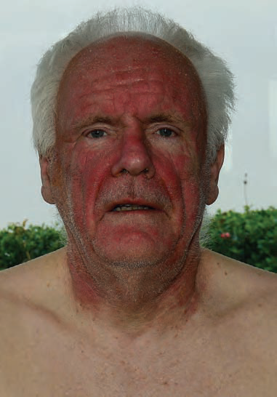
CLINICAL FEATURES
CHRONIC ACTINIC DERMATITIS
Pruritic
Recurrent
Persistent dermatitis
Worse in summer
Sharp cut-off at photoprotected sites
ACUTE:
  erythematous, exudative, vesicular dermatitis
Notes:
PIC Note the prominent head and neck involvement and sharp cutoff
at the collar line. There was sparing of the upper eyelids, and in creases under the
eyes and in the shaded areas under the lower lip and chin

Slide 59
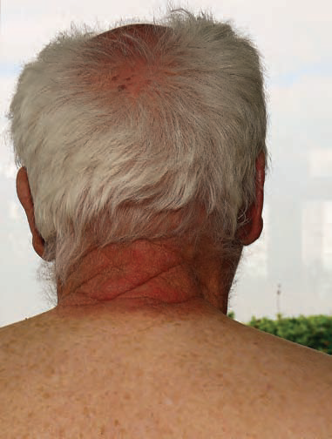
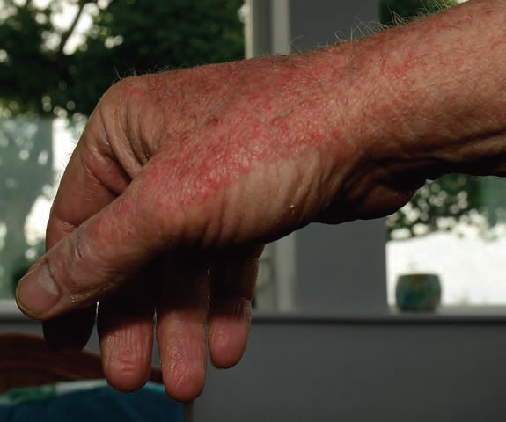
CHRONIC ACTINIC DERMATITIS
Notes:
. Ivolvement of the back of the neck AND SCALP with a cut‐off at the collar line
(extensor surfaces of hand and the sharp cut‐off at photoprotected sites

Slide 60
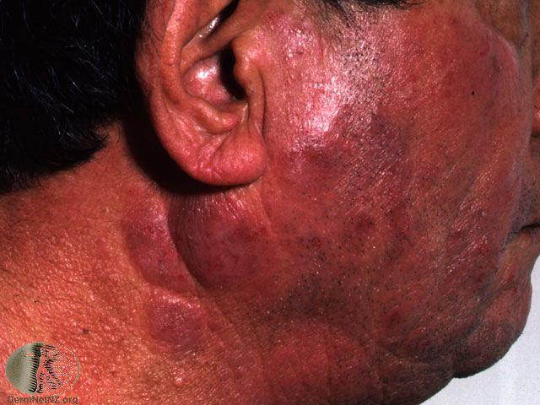
CHRONIC ACTINIC DERMATITIS
CHRONIC:
Lichenification
  Pseudo‐lymphomatous infiltrative plaques
  Alopecia
  Ectropion.
  Hyper /hypopigmentation
Erythroderma

Slide 61
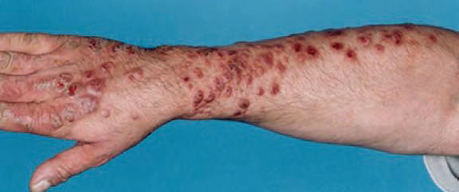
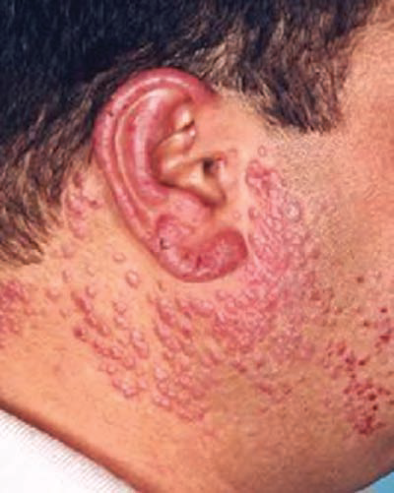
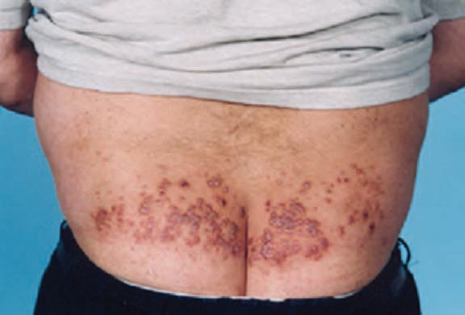
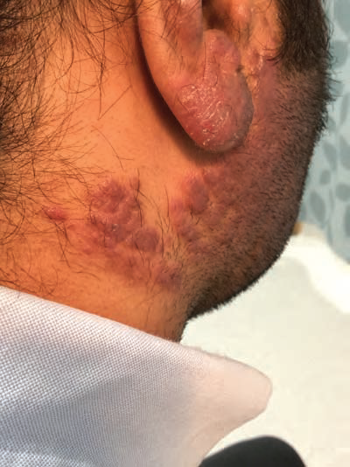
Notes:
a nodular prurigo‐like morphology (a) Prominent
involvement of photo‐exposed sites the extensor forearm. (b) lower back (c) Note the involvement of photo‐exposed
sites of the ears and side of neck. (d) The relative sparing behind the ear (Wilkinson’s
triangle should be examined by pulling the ear forward)

Slide 62
DIFFERENTIAL DIAGNOSIS
CHRONIC ACTINIC DERMATITIS
Airborne Contact Dermatitis
Photoaggravated Atopic Or Seborrhoeic eczema
Drug‐induced Photosensitivity
Cutaneous T‐cell Lymphoma
Notes:
1; AIRBORN typically involve upper eyelid under nose and chin while back f neck z spared exposed parts to fibres dust vapours spray gases plant materials
4 ; Cutaneous T‐cell Lymphoma Especially If There Is Erythroderma

Slide 63
HISTOPATHOLOGY
CHRONIC ACTINIC DERMATITIS
Acute:
Epidermal spongiosis
Acanthosis
Lymphohistiocytic infiltrate
Perivascular
Upper dermal
Chronic:
Epidermal hyperplasia
Deep, dermal infiltrate
Perivascular histiocytes
Epidermotropism (lymphocytes residing in epidermis)
Atypical lymphocytes

Slide 64
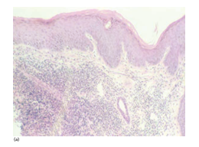
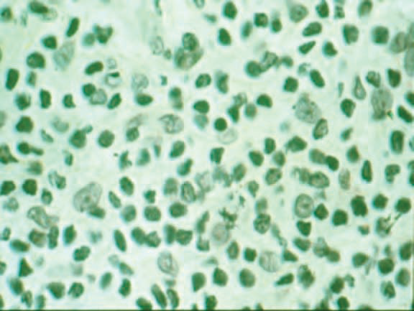
CHRONIC ACTINIC DERMATITIS
Notes:
A Epidermal spongiosis Upper dermal perivascular lymphohistiocytic infiltrate
(b) Atypical lymphocytes can be seen chronically with a pseudo‐lymphomatous picture.

Slide 65
MANAGEMENT
CHRONIC ACTINIC DERMATITIS
1ST LINE:
  Very potent/potent topical corticosteroids
2ND LINE:
  Topical tacrolimus or Pimecrolimus
  Systemic glucocorticoids (in acute flares)
3RD LINE:
  Azathioprine 150 Mg/Day, (TPMT) Measurement
Notes:
Hydroxychloroquine Ciclosporin, MMF, Hydroxycarbamide Etretinate , Danazol , Thioguanine , Topical Nitrogen Mustard, Thalidomide, Infliximab And Inf‐α

Slide 66
DISEASE COURSE & PROGNOSIS
CHRONIC ACTINIC DERMATITIS
If UVB photosensitivity : Severe and
Contact allergies: persists
Poorer prognosis
In the absence of erythroderma: Normal

Slide 67
The Cutaneous Photosensitivity Diseases
IDIOPATHIC (IMMUNOLOGICAL):
Polymorphic Light Eruption (PLE)
Juvenile spring eruption (JSE)
Actinic prurigo (AP)
Chronic Actinic Dermatitis (CAD)
Solar Urticaria (SU)
Hydroa vacciniforme (HV)

Slide 68
SOLAR URTICARIA
The Cutaneous Photosensitivity Diseases
Sporadic
Immediate
Type I hypersensitivity
Against cutaneous or circulating photoallergen(s)
Exposure to:
UVA
Visible
UVB radiation (less common)
Notes:
The proposed pathway is likely that of photochemical alteration of an endogenous chromophore by UVR and/ or visible light, resulting in antigen. This is then recognized by specifi c IgE on mast cells, with subsequent mast cell degranulation, histamine and other mediator release causing increased vascular
permeability and dermal oedema. other mediators in SU are likely to be involved, possible candidates include leukotrienes, platelet‐activating factor, substance P, serotonin and acetylcholine

Slide 69
SOLAR URTICARIA
  Primary (idiopathic)
  Secondary:
  drugs
  chemicals
  porphyrins
  lupus
Peak incidence: 3rd – 5th decade
F > M

Slide 70
ASSOCIATIONS
SOLAR URTICARIA
Urticaria
Photodermatosis
  PLE
  CAD
  AP
Notes:
Other types furticaria

Slide 71
CLINICAL FEATURES
SOLAR URTICARIA
Sudden onset
Perennial
Occur within seconds to minutes of exposure
  Itching
  Burning sensation
  Erythema
  Urticaria/weals
Notes:
“fixed solar urticaria” has been reported and is characterized by urticarial lesions that are induced repeatedly in the same location.¹¹
^{PERENNIAL} lasting fr long or continually recurring

Slide 72
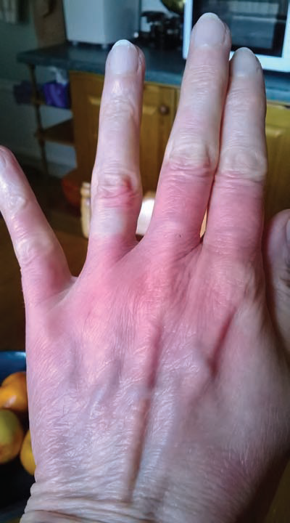
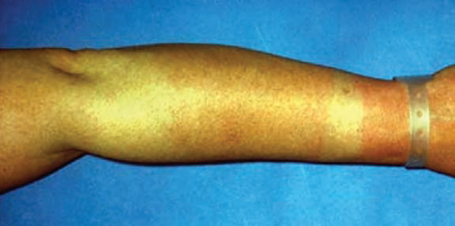
SOLAR URTICARIA
Notes:
Acute erythema on the back of the hand after 2 min of wintertime daylight exposure. Note sparing of the distal phalanges and under the wedding ring.
( Solar urticaria occurring within a few minutes of sunlight exposure. Note sparing under the watch strap and sleeve on the upper forearm.

Slide 73
SOLAR URTICARIA
Hardening phenomenon: Negative
Refractory period: Present
Resolution:
  Urticarial lesions: in upto 2 hours
  Erythema: take 24 hours
Notes:
Hardening that z decline f PLE after repeated sun light exposure nd to b less severe towards end f summer
refractory period when, after an acute episode, affected skin may be more resistant to further involvement for a few hours

Slide 74
DIFFERENTIAL DIAGNOSIS
SOLAR URTICARIA
Drugs
Porphyria (EPP & PCT)
Lupus
Urticaria ( heat‐induced urticaria)
Notes:
drugs tetracyclines flouroquinolones (NSAIDs; notably benoxaprofen ,repirinast, topical tar, pitch sunscreens, such as the benzophenones

Slide 75
HISTOPATHOLOGY
SOLAR URTICARIA
Perivascular infiltrate:
neutrophils
eosinophils
mast cells
Swelling of the endothelial cells:
dermal vessels
dermal oedema
Vasculitic features
Notes:
Vasculitic features occasionally

Slide 76
MANAGEMENT
SOLAR URTICARIA
  1st LINE:
  Antihistamines (H1 &H2)
2ND LINE:
  Doxepin , ketotifen, chromoglycate and montelukast
3RD LINE:
  Ciclosporin
  Systemic glucocorticoids and other immunosuppressants
  Intravenous immunoglobulins
  Plasmapheresis
  Omalizumab
Notes:
Anxiety and depression r common in SU

Slide 77
DISEASE COURSE
SOLAR URTICARIA
Chronic
Relapsing
Remitting course
Spontaneous resolution is variable

Slide 78
The Cutaneous Photosensitivity Diseases
IDIOPATHIC (IMMUNOLOGICAL):
Polymorphic Light Eruption (PLE)
Juvenile spring eruption (JSE)
Actinic prurigo (AP)
Chronic Actinic Dermatitis (CAD)
Solar urticaria (SU)
Hydroa Vacciniforme (HV)

Slide 79
HYDROA VACCINIFORME
The Cutaneous Photosensitivity Diseases
Acquired photodermatosis
Children (1-16years)
Provocation : UVA wavelengths
M=F
photo‐exposed site :
  cheek
  nose
  ears
  back f hands
Notes:
Varioliform mean resemble smallpox

Slide 80
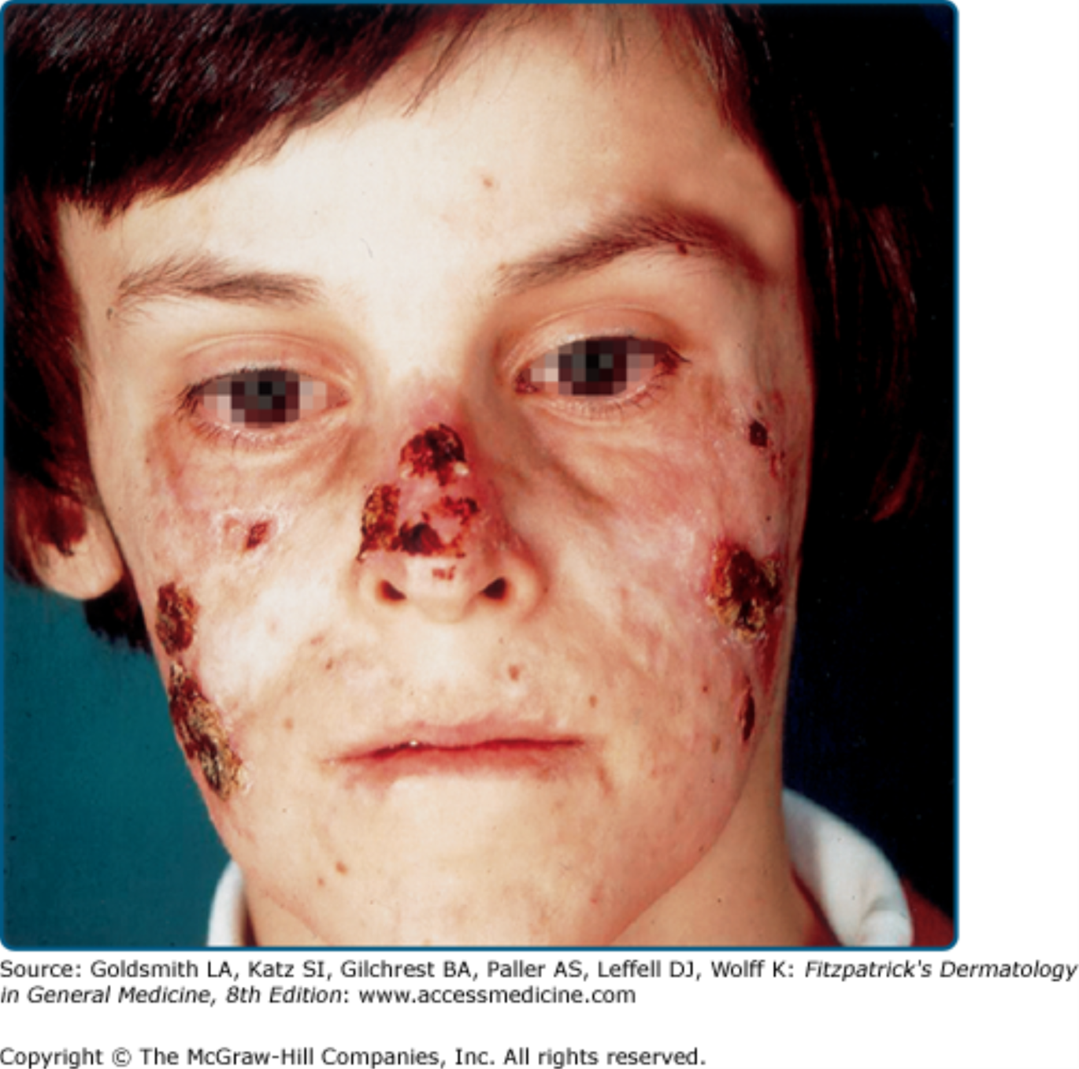
CLINICAL FEATURES
HYDROA VACCINIFORME
Intensely pruritic crops
Papules and vesicles
Erythema & oedema
Burning sensation
Pain
Crusting (heamorrhagic)
Varioliform scars

Slide 81
COMPLICATIONS
HYDROA VACCINIFORME
Varioliform scarring
Cartilage destruction
Contractures of digits
Ocular inflammation
Notes:
Eyes Photophobia, conjunctivitis, keratitis, anterior uveitis, corneal clouding and neovascularization, scarring and visual impairment

Slide 82
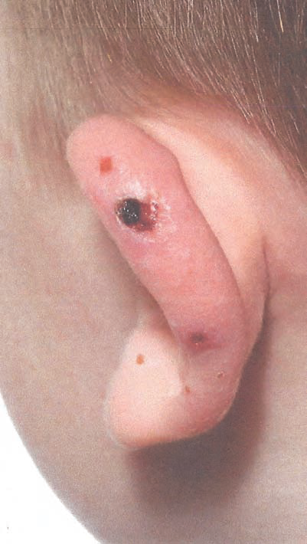
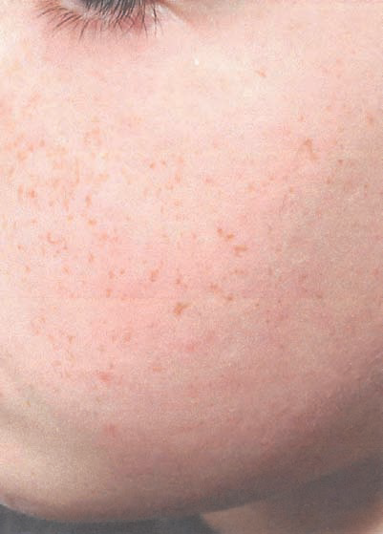
HYDROA VACCINIFORME
Notes:
SITES cheek nose ears back f hands
Hydroa vacciniforme. vacciniform scars.

Slide 83
DIFFERENTIAL DIAGNOSIS
HYDROA VACCINIFORME
Bullous lupus erythematosus
EPP
Hartnup disease (pellagra-like dermatosis)
T‐cell lymphoma

Slide 84
HISTOPATHOLOGY
ACUTE:
keratinocyte degeneration
Spongiosis
Perivascular lymphohistiocytic infiltrate
CHRONIC
Ulceration
Epidermal necrosis
Papillary oedema
Upper dermal necrosis

Slide 85
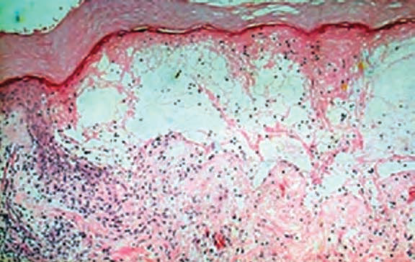
HYDROA VACCINIFORME
Notes:
dermal oedema
lymphohistiocytic inflammatory infiltrate.

Slide 86
MANAGEMENT
HYDROA VACCINIFORME
1ST LINE:
  Photoprotection and topical corticosteroid
2ND LINE:
  Springtime desensitization with narrow‐band UVB
  PUVA
3RD LINE:
  Oral glucocorticoids,
  Β‐carotene
  Azathioprine
  Ciclosporin
  Antimalarials
  Dietary fish oil
Notes:
PUVA is used less often as most patients are children

Slide 87
DISEASE COURSE
HYDROA VACCINIFORME
Condition improves
Resolves:
  later teenage
  Disease duration: 9 years
Notes:
Usually the condition improves and resolves in later teenage years, with a mean disease duration of 9 years .
A persistence of disease into middle age may also occur [

Slide 88
INVESTIGATIONS
DISEASES | Monochrometer PT | UVA Provocation Testing | Patch & Photopatch Testing
Polymorphic Light Eruption | Normal | +ve | -
Juvenile spring eruption | Normal | +ve | -
Actinic prurigo | Abnormal photosensitivity | +ve | -
Chronic actinic dermatitis | Abnormal photosensitivity | +ve | +ve
Solar urticarial | Abnormal photosensitivity | +ve | -
Hydroa vacciniforme | Normal UVA sensitivity | +ve | -

Slide 89
INVESTIGATIONS
Full blood count
ANA
ENA
Porphyrin Biochemistry
HLA typing
TO EXCLUDE OTHER CAUSES

Slide 90
DRUG‐ AND CHEMICAL‐INDUCED
PHOTOSENSITIVITY
These are abnormal cutaneous reactions to UVR and visible radiation induced by photosensitizing drugs and chemicals

Slide 91
Mechanisms of photosensitivity
DRUG‐ AND CHEMICAL‐INDUCED PHOTOSENSITIVITY
Phototoxicity
Photoallergy
Pseudoporphyria
Drug‐induced lupus
Lichenoid reactions
Erythema multiforme
Pellagra
Notes:
Photoallergy: uncommon and poorly defi ned with systemic drugs and most frequently seen with topical sunscreens, NSAIDs certain fragrances
Sunscreens are the commonest topical photoallergens

Slide 92
DRUG‐ AND CHEMICAL‐INDUCED PHOTOSENSITIVITY
Phototoxic
Occur in anyone exposed to sufficient doses of phototoxic agent and UV radiation
Manifests as an exaggerated sunburn reaction
Rash develop within 24hrs
Non immunologic
Photoallergic
Immune reaction to a UVA-modified chemical, commonly topical sunscreen agents, antimicrobials & topical NSAIDS
It presents as eczematous eruption on sun-exposed areas.
Delayed hypersensitivity respose
Rash takes few days to develop
Notes:
Phptosestivity to exogenous agents z broadly divided into phototoxicity ann photoallery

Slide 93
EXOGENOUS PHOTOSENSITIZERS
DRUG‐ AND CHEMICAL‐INDUCED PHOTOSENSITIVITY
SYSTEMIC
Diuretics: thiazides, furosemide
Antibiotics
NSAIDS
Quinine , Hydroxychloroquine
Amiodarone, CCB , ACE inhibitors, statins
Retinoids
Psoralens
Azathioprine
Pyridoxine B6
TOPICAL
Psoralens (PT)
PAH (PT)
Dyes (PT)
Fragrances (PT, PA)
Sunscreens (PT, PA)
NSAIDS(PT, PA)
Notes:
• Antibiotics: fluoroquinolones, tetracyclines , sulphonamides
•PAH Polycyclic aromatic hydrocarbons

Slide 94
CLINICAL FEATURES
DRUG‐ AND CHEMICAL‐INDUCED PHOTOSENSITIVITY
Immediate burning sensation
on sun‐exposed sites
Erythema
urticaria
Blistering
Peaking at 24 hr
Psoralens:
  delayed erythema peak btw 72 and 120 hr
  erythroderma (rarely)
Notes:
The symptoms of drug phototoxicity….. it is more common for photosensitivity to develop if a drug is new or the dose increased,
Pseudoporphyria typically presents with photo‐exposed‐site fragility, blistering, milia and scarring

Slide 95
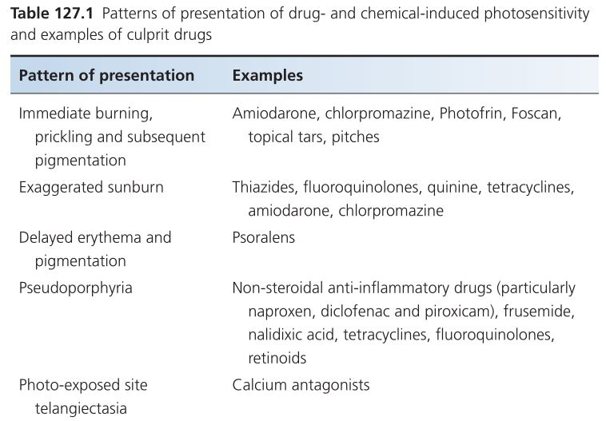

Slide 96
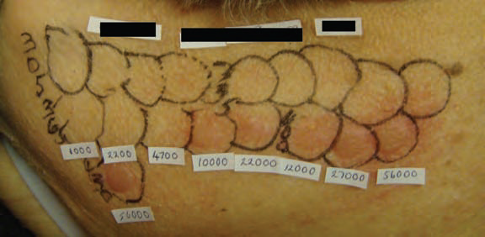
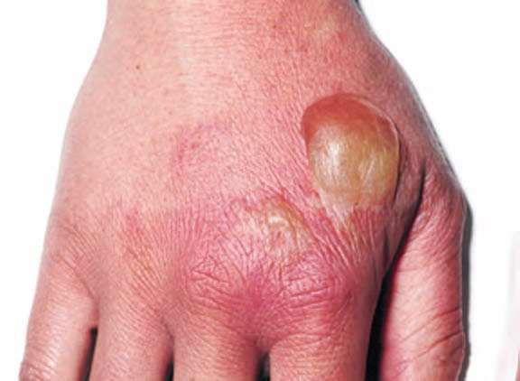
DRUG‐ AND CHEMICAL‐INDUCED PHOTOSENSITIVITY
Notes:
Phototoxicity to demeclocycline. There is predominant UVA and visible light photosensitivity. Acute erythema, oedema and urticaria were seen at the test sites within 15 min of phototesting and abnormal delayed erythema was still present at 24 h.
Phytophotodermatitis. Erythema and blistering is seen on sites immersed in psoralen‐rich lime marinade during barbeque preparations and subsequently exposed to sunlight. Psoralen containing umbelliferea nd rutaceae plant families

Slide 97
HISTOPATHOLOGY
DRUG‐ AND CHEMICAL‐INDUCED PHOTOSENSITIVITY
PHOTOTOXIC REACTION:
  Epidermal necrosis
  Apoptotic keratinocytes
  Mild inflammation
PHOTOALLERGIC
  Spongiotic dermatitis

Slide 98
MANAGEMENT
DRUG‐ AND CHEMICAL‐INDUCED PHOTOSENSITIVITY
1ST LINE
  Stop the drug
  photoprotection
  Emollients and topical corticosteroids
2ND LINE
  Induction of tolerance using narrow‐band UVB or PUVA
Notes:
Second line
If a drug, such as amiodarone [ 87 ], cannot be stopped, the
induction of tolerance using narrow‐band UVB or PUVA may be
helpful

Slide 99
DISEASE COURSE AND PROGNOSIS
DRUG‐ AND CHEMICAL‐INDUCED PHOTOSENSITIVITY
Resolution of photosensitivity :
1. Bioavailability
2. Half‐life
Notes:
The time course for the resolution of photosensitivity off the drug will depend on its bioavailability and the half‐life of any photoactive metabolites

Slide 100
PHOTOAGGRAVATED DERMATOSES
Exacerbated by natural or artificial UV or visible radiation
Notes:
A range of skin diseases can be aggravated or exacerbated by natural or artifi cial UV or visible radiation, although they also occur in the absence of sun exposure
psoriasis and eczema generally improve with sun exposure, but in a minority (approximately 10% there is worsening of the dermatosis with sun exposure (Fig This may manifest as a disease fl are at photo‐exposed sites initially, followed by the spread of cutaneous infl ammation to covered skin.

Slide 101
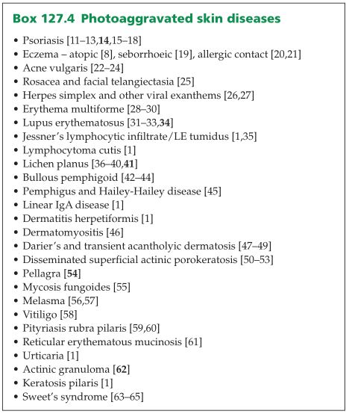

Slide 102


