Slide 1
Infantile and Congenital hemangioma

Slide 2
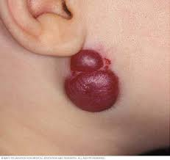
Definition
is a bright red birthmark that shows up at birth or in the first or second week of life. It looks like a rubbery bump and is made up of extra blood vessels in the skin. A hemangioma can occur anywhere on the body, but most commonly appears on the face, scalp, chest or back.

Slide 3
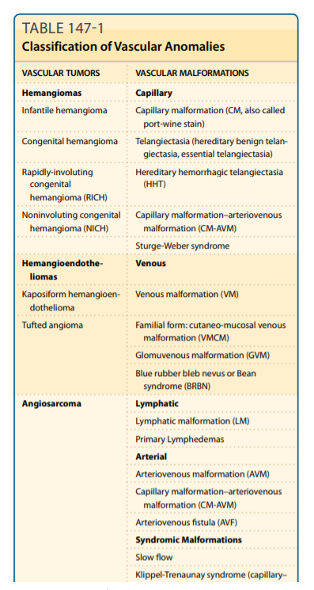
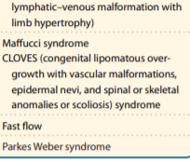
classification

Slide 4
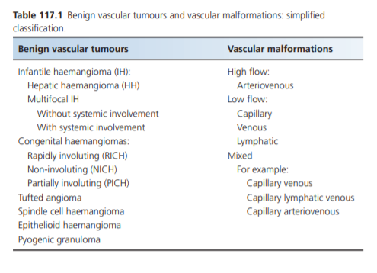
April 2014 General Assembly of the International Society for the Study of Vascular Anomalies (ISSVA)

Slide 5
Infantile haemangiomas
are common, benign, vascular tumours that develop in early infancy and undergo spontaneous involution thereafter.
Terms such as strawberry naevus, capillary haemangioma and cavernous haemangioma have contributed to the diagnostic confusion in the field of vascular anomalies, and are best avoided

Slide 6
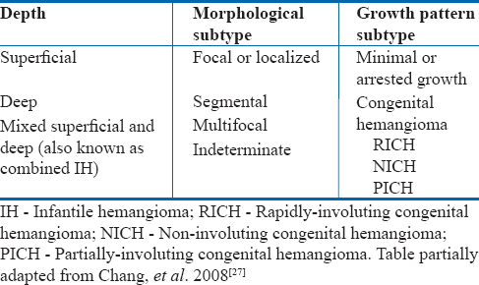
Infantile haemangiomas are the most common tumours of infancy, occurring in up to 10% of infants, more commonly in girls than boys
Classification:
Segmental or plaque‐like infantile haemangiomas of the head and neck and of the lumbo‐sacral region may be associated with structural anomalies.
Multifocal infantile haemangiomas are usually asymptomatic but may occasionally be associated with extensive visceral involvement.
.• Reticular, abortive or minimal growth.

Slide 7
Pathogenesis
The aetiology of infantile haemangioma remains unclear. Endothelial cells are characterized by the surface marker GLUT‐1, an erythrocyte‐type glucose transporter protein, which is also expressed on the placental vasculature. It has been proposed that this placental phenotype may be the result of embolization of placental endothelial cells to the fetal circulation. Against this theory is the lack of evidence of maternal–fetal chimerism
An autosomal dominant inheritance pattern and a linkage to 5q have been reported in a small number of families
Mutations in the integrin‐like receptor tumour endothelial marker 8, and in VEGFR2 ,

Slide 8
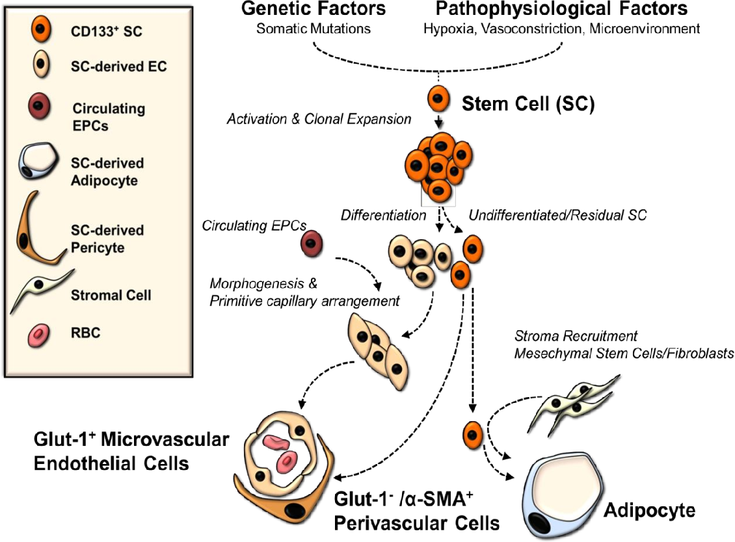

Slide 9
Histology
During the early phase of growth the haemangiomas consist of solid groups of cells with few lumina.
The endothelial cells flatten out as the lumina develop. The cells are surrounded by a thickened basement membrane.
During the process of involution a more lobular appearance develops, with islands of fibrous and fatty tissue between the lobules. Mast cells are evident at all phases.
Immunohistochemistry is positive for factor VIII, CD31 and von Willebrand factor. Glucose 1 transporter protein (GLUT‐1) positivity can be useful in differentiating infantile haemangiomas from other vascular lesions, such as congenital haemangiomas, but it may also be positive in verrucous vascular malformations

Slide 10
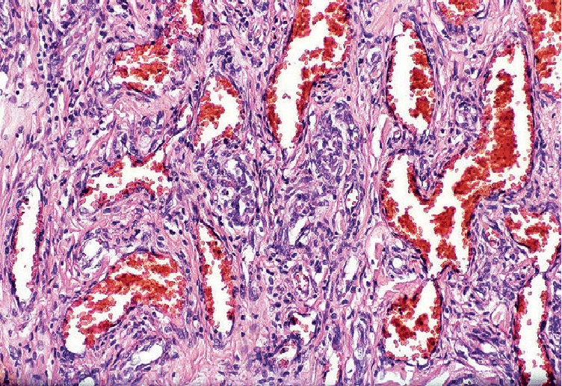

Slide 11
Clinical features
Haemangiomas may be evident shortly after birth as a faint telangiectatic patch or an area of pallor or as a flat pink mark which rapidly becomes red and raised.
Superficial types of infantile haemangioma show their most rapid growth between 5.5 and 7.5 weeks of age.
Deep haemangiomas, which develop in the lower dermis and subcutis,tend to appear blue or purple, may have no overlying skin changes , often present later and continue to grow for longer than superficial haemangiomas.
Mixed infantile haemangiomas, sharing features of both the superficial and deep types, are common.
A minority of infantile haemangiomas, sometimes referred to as abortive infantile haemangioma, show relatively little proliferation, remaining as a patch of telangiectatic vessels

Slide 12
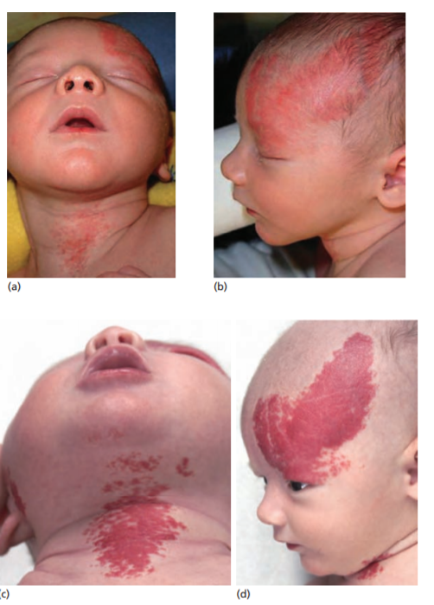

Slide 13
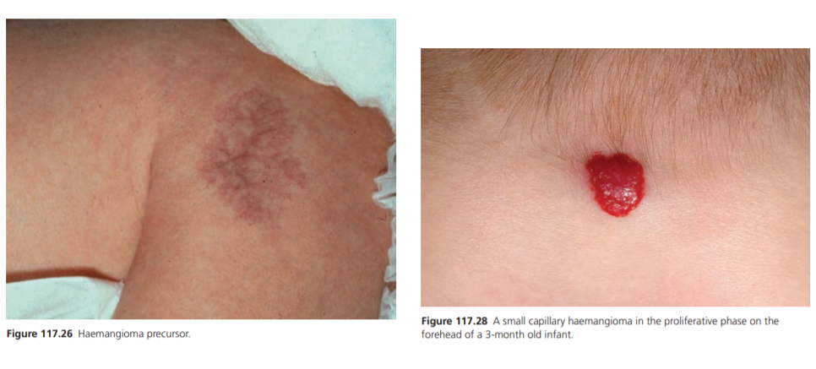

Slide 14
Irrespective of subtype or depth, most infantile haemangiomas reach 80% of their final size by 3 months of age.
During the proliferative phase, infantile haemangiomas are firm. With involution they become softer. In untreated lesions, involution is complete at a median age of 3 years, and most cases cease to improve significantly after 3.5 years of age .
Therefore, surgical reconstruction, if indicated, may be best undertaken at this age, as further aesthetically beneficial, spontaneous improvement is unlikely to occur. Permanent changes – most frequently telangiectases, atrophy and residual bulk in the form of fibrofatty tissue – have been reported to remain in up to 69% of untreated haemangiomas .

Slide 15
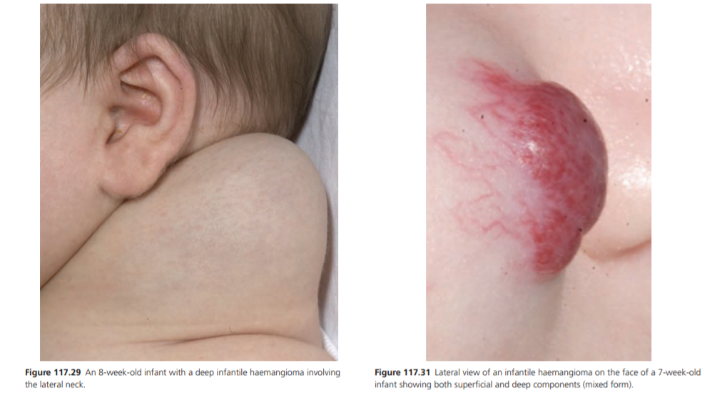

Slide 16
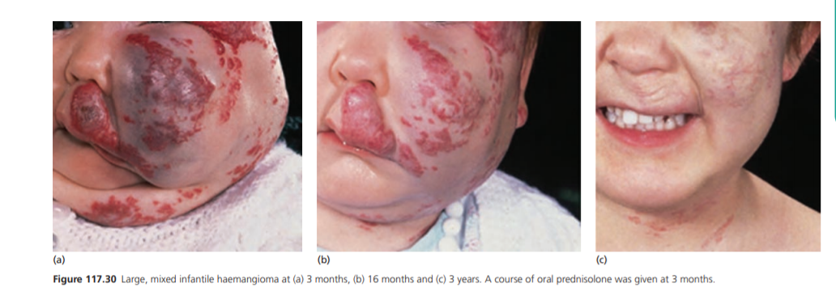

Slide 17
Clinical variants
Segmental infantile haemangioma. A proportion of infantile haemangiomas, referred to as segmental or plaque‐like, involve a broad anatomical region, thought to reflect embryological metameres
Segmental infantile haemangioma of the face and of the lumbo‐sacral region may be associated with underlying structural anomalies .

Slide 18
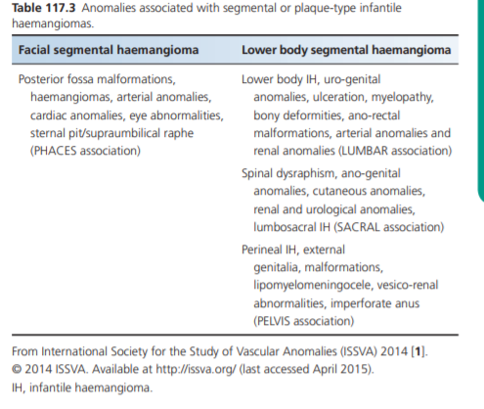
Up to 30% of large segmental facial infantile haemangiomas are associated with the PHACES syndrome
Segmental infantile haemangiomas of the frontotemporal or mandibular regions are at the highest risk, but rare cases of PHACES have been reported without facial involvement
Abnormalities of the cerebral vasculature and
coarctation of the aorta are the most common extracutaneous findings .
Head and neck magnetic resonance angiography (MRA), echocardiogram and ophthalmological examination are recommended for patients with large segmental facial infantile haemangiomas.

Slide 19
Segmental infantile haemangiomas in the beard region, especially if bilateral, may be associated with airway haemangiomas. Otolaryngological advice should be sought for such infants, even in the absence of overt respiratory symptoms
Segmental infantile haemangioma in the lumbo‐sacral and perineal regions may be associated with spinal dysraphism, uro‐genital abnormalities, ano‐rectal malformations, arterial anomalies and renal abnormalities .
For infants under the age of 3 months, spinal ultrasound may be useful for the initial assessment, but spinal MRI with contrast is advisable.

Slide 20
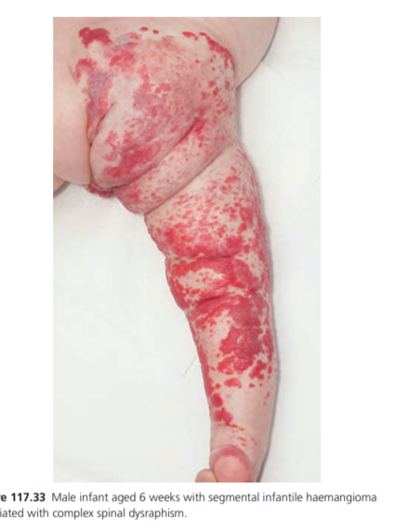
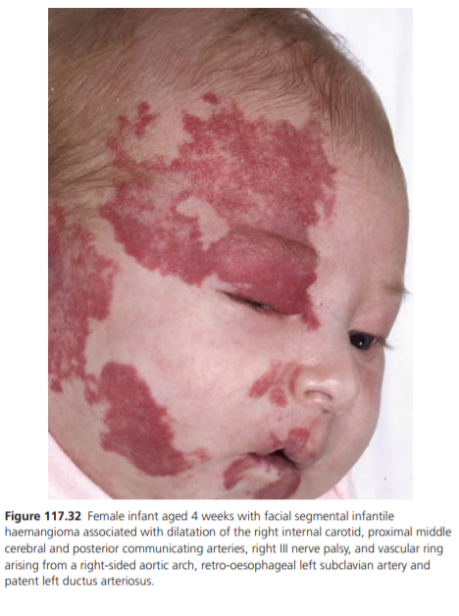

Slide 21
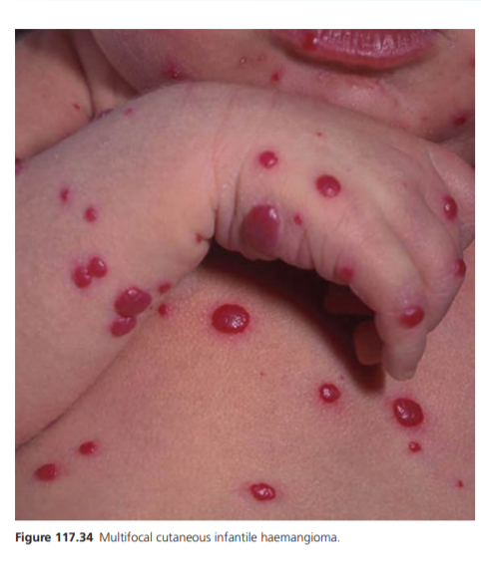
Clinical variant
Multifocal cutaneous infantile haemangioma with and without extracutaneous involvement.
Multifocal haemangiomas may range in number from a few
to hundreds, and are usually small .
Most affected infants follow an uncomplicated course, but
some have symptomatic visceral lesions, with liver
involvement being the most common

Slide 22
Hepatic haemangioma. Hepatic haemangioma (HH) may occur with or without cutaneous infantile haemangioma. Many HH are asymptomatic, and those that become symptomatic usually do so within the first 3 months of life, presenting with hepatomegaly and high‐output cardiac failure
HH may be focal, multifocal or diffuse.
Focal HH may be evident on antenatal ultrasound, are usually GLUT‐1‐negative, occur without cutaneous lesions, regress rapidly and probably represent RICH of the liver.
Multifocal HH are usually associated with multiple, small, cutaneous infantile haemangiomas, and are GLUT‐1 positive.

Slide 23
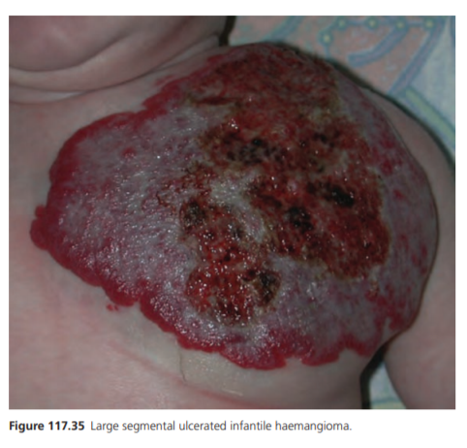
Complications and co‐morbidities
The main complications of infantile haemangiomas are ulceration, disfigurement and functional impairment.
• Ulceration is common, the risk being greatest between 4 and 6 months of age. Ulceration is more likely in large infantile haemangiomas , segmental morphology and location on the neck, ano‐genital area or lip, where there is exposure to friction and moisture
Ulceration can occur in up to 20% cases, is painful,
may be associated with bleeding and infection, and almost
always results in scarring
• The risk of disfigurement depends on the location,
morphological subtype and size. Even relatively
small infantile haemangiomas on the central face,
lips and nose , particularly those with a
dermal component, can lead to permanent distortion

Slide 24
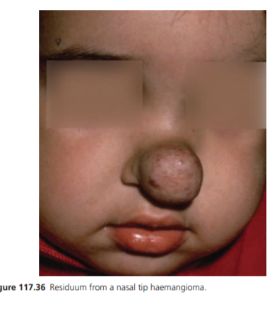
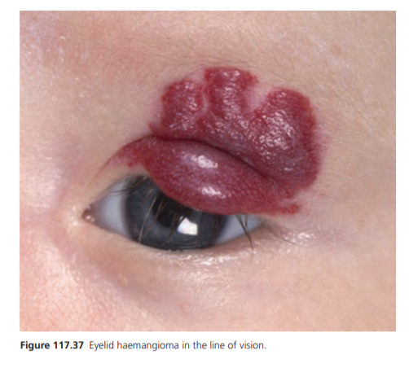
• Impairment of function is most commonly encountered with peri‐ocular infantile haemangiomas , which may cause astigmatism, visual axis obstruction and strabismus, which in turn can lead to amblyopia and the risk of permanent visual loss. Haemangiomas involving the airway and the nose can endanger breathing, and those on the lip may interfere with feeding

Slide 25
Management
OBSERVATION
Treatment will depend on the location, morphology and stage of evolution, impact on function, risk of disfigurement and co‐ morbidities.
serial photography illustrating examples from the time of maximum proliferation until complete resolution.

Slide 26
2.Until 2008, treatment for infantile haemangiomas included systemic and intralesional corticosteroids and α‐ interferon.
All of these treatments were associated with significant adverse effects.
3. In 2008 the first report of the successful use of propranolol was done
The specific mechanism of action of β‐blockers remains largely unknown, but it appears that clinical improvement may occur through the induction of vasoconstriction and the decreased expression of pro‐angiogenic factors

Slide 27
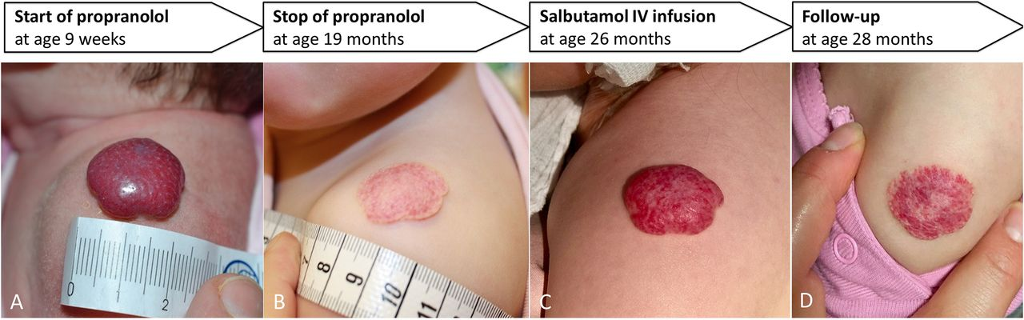
Relapse appears to be less likely if treatment is continued for at least 12 months .
4. there is far greater experience with timolol maleate, usually as a gel‐ forming solution (GFS), with benefit reported particularly for very small superficial lesions .
The use of one drop of timolol maleate 0.5% GFS up to three times a day to non‐ ulcerated, non‐mucosal lesions appears to be safe.

Slide 28
5.Pulsed dye laser (PDL) can be helpful for the treatment of ulcerations , and may be required for telangiectases and erythema post‐involution.
6.Surgery may very occasionally be required for infantile haemangioma in the proliferative phase if functional impairment or ulceration cannot be managed medically.
In the involuted phase, indications for surgery include abnormal contour due to a fibrofatty residuum and distortion of an important anatomical structure.
4.Embolization may have a role for life‐threatening haemangiomas, particularly those leading to congestive cardiac failure that have not responded to medical therapy

Slide 29
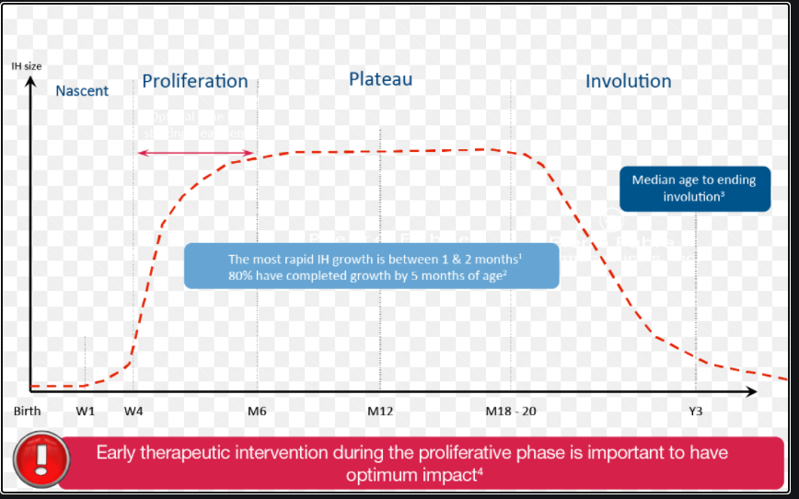
Disease course and prognosis
The prognosis is excellent without treatment for small infantile haemangiomas. Prognosis is also excellent for larger haemangiomas if there is no functional impairment, and if it is not at an aesthetically important site.

Slide 30
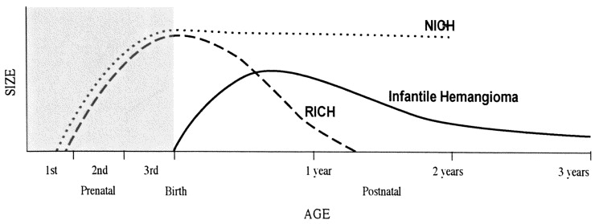
Congenital haemangiomas
Congenital haemangiomas are benign vascular tumours that proliferate in utero, and do not show further proliferation postnatally .
They may be evident as early as 12 weeks of gestation by prenatal ultrasound studies .
An uncommon intermediate type is also recognized, presenting with early features similar to a RICH, but showing only partial involution, and referred to as partially involuting congenital haemangioma (PICH) .
All three types are GLUT‐1 negative. Congenital haemangiomas occur equally in male and female infants, and usually arise on the head or the extremities. The pathogenesis is unknown.

Slide 31
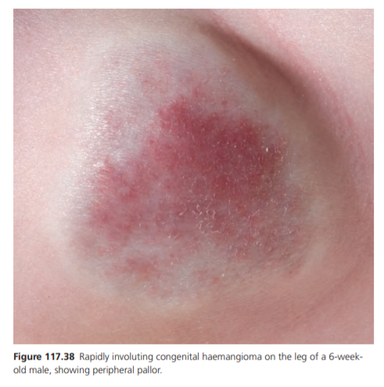
RICH
typically present as blue or purple tumours, often with telangiectases and peripheral pallor and sometimes with a central ulcer, scar or depression. The rapid regression may leave pronounced atrophy.
Ultrasonography demonstrates a uniform hypoechoic mass with centrilobular draining channels .
Histology shows small lobules of capillaries with plump
endothelium peripherally, and more thin‐walled vessels
with surrounding fibrous tissue centrally .

Slide 32
RICH may be associated with transient thrombocytopenia, which usually resolves spontaneously .
Large lesions may cause haemodynamic instability.
Embolization or excision may need to be considered for RICHs that are ulcerated, bleeding or causing haemodynamic instability.
Sclerotherapy may be indicated for prominent veins in areas of atrophy following involution.

Slide 33
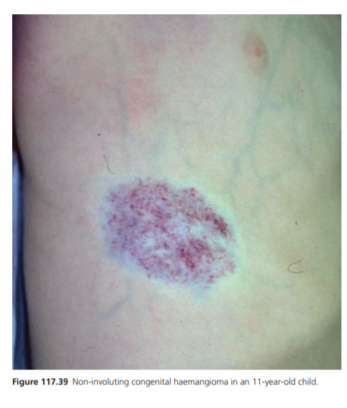
NICH
present as violaceous plaques or tumours with coarse telangiectases and peripheral pallor , and may be warm to touch. They grow in proportion with the affected individual, but never regress. On ultrasound, NICH often show prominent arterial flow.
Histology shows large lobules of small vessels in a stroma of fibrous tissue containing abnormal appearing arteries and veins .
For NICH requiring treatment, surgery is the preferred option

Slide 34
Protocol for the use of propranolol
Before starting propranolol
• Full clinical history and examination including HR, BP and oxygen saturation
• Treatment explanation plus written information given to parents
• Clinical photography
• ECHO and ECG in selected patients

Slide 35
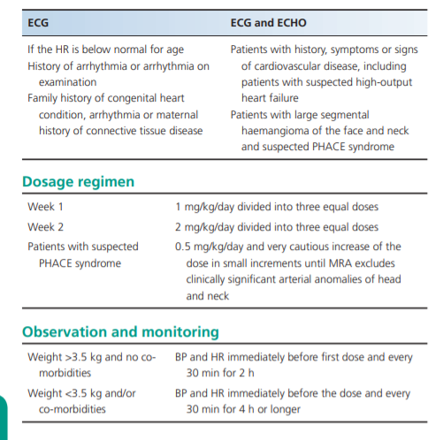
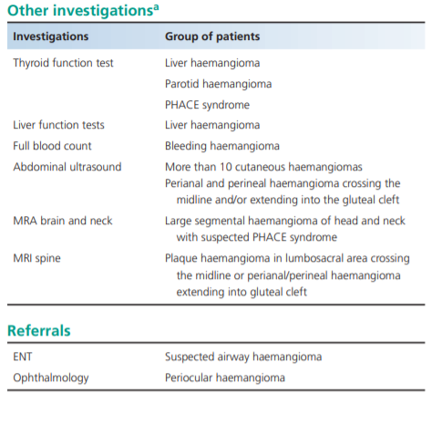

Slide 36
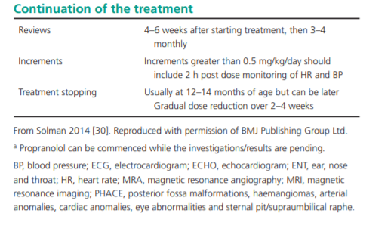

Slide 37
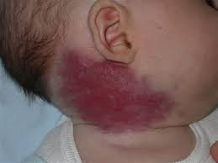
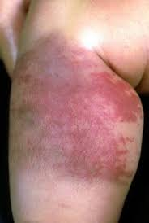
hemangioendothelioma
Kaposiform hemangioendothelioma
Kaposiform hemangioendothelioma (KHE) is a rare and aggressive vascular tumor that is benign (noncancerous and does not spread to other locations in the body). It is an abnormal growth made up of blood vessels.
Tufted angioma
Tufted angioma (TA) is a benign tumor of the blood vessels
that grows in and just below the skin.

Slide 38
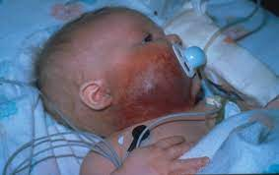
Angiosarcoma
is cancer that forms in the lining of blood vessels and lymph vessels. It often affects the skin and may appear as a bruise-like lesion that grows over time.

