Slide 1
CONGENITAL SYPHILIS

Slide 2
SYPHILIS
Infectious disease
Causative agent
  Spirochetal bacterium Treponema pallidum

Slide 3
CONGENITAL SYPHILIS
Transplacental passage
Infected pregnant women

Slide 4
INCIDENCE AND PREVALENCE
1.86 million cases globally each year

Slide 5
AGE
Shortly after birth

Slide 6
SEX
Male = Female

Slide 7
ETHNICITY
No Racial predisposition

Slide 8
PATHOLOGY
Major fetus - small perivascular inflammatory foci & lymphocyte infiltrate
    Reduced growth of parenchymal cells
Placenta
    heavy, bulky, pale, greasy
Placenta HPE-
    Necrotizing funistis
    Villus enlargement
    Acute villitis
Stillborn fetus
    macerated appearance with collapse of skull
    Protuberant abdomen
    Hemorrhagic bulla

Slide 9
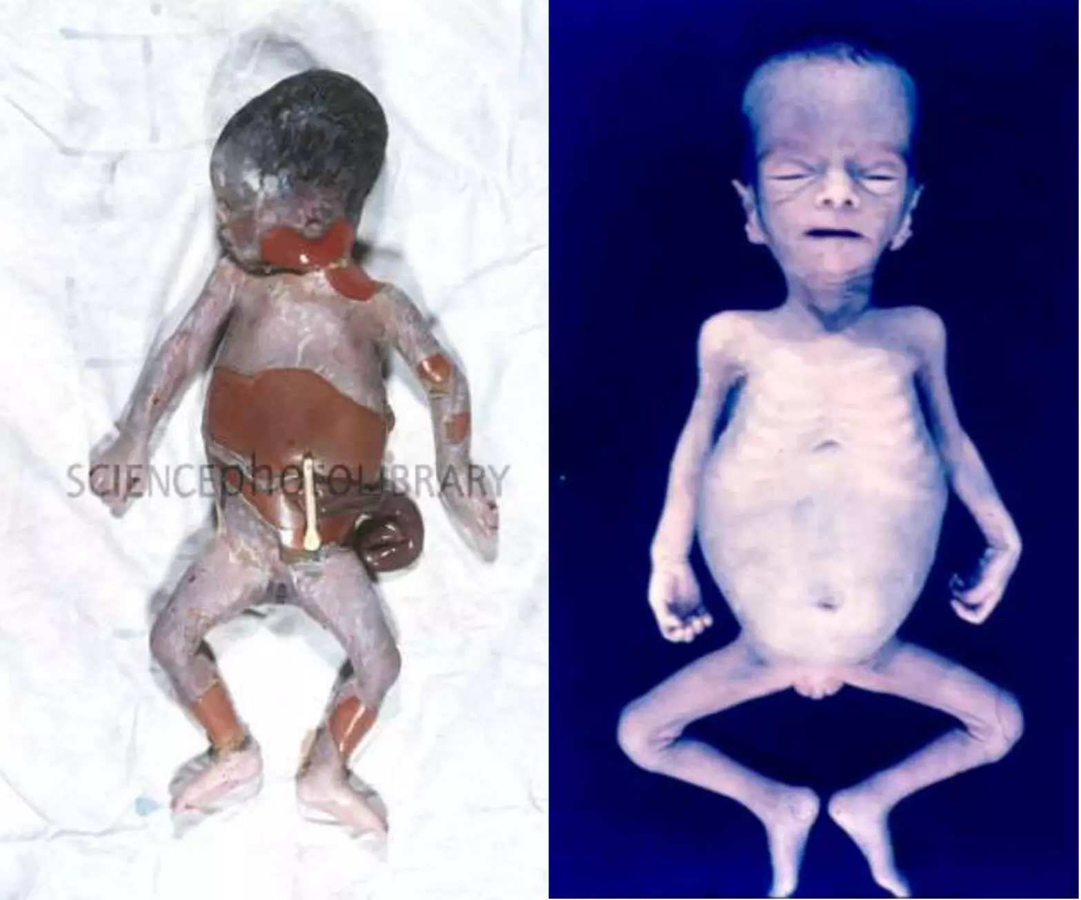

Slide 10
RISK FACTORS
Mother received
    no or inadequate treatment
    non penicilin treatment during pregnancy
    Lack of prenatal care
    Treated within 30 days of infant birth
    Infant of high risk mother
          HIV, lack of placental care, sex worker, teen pregnancy

Slide 11
CLASSIFICATION
Early disease >> within first 2 years of life
Late disease >> from age 3 onward
Stigmata of congenital syphilis

Slide 12
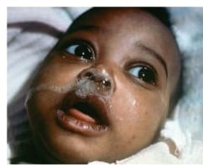
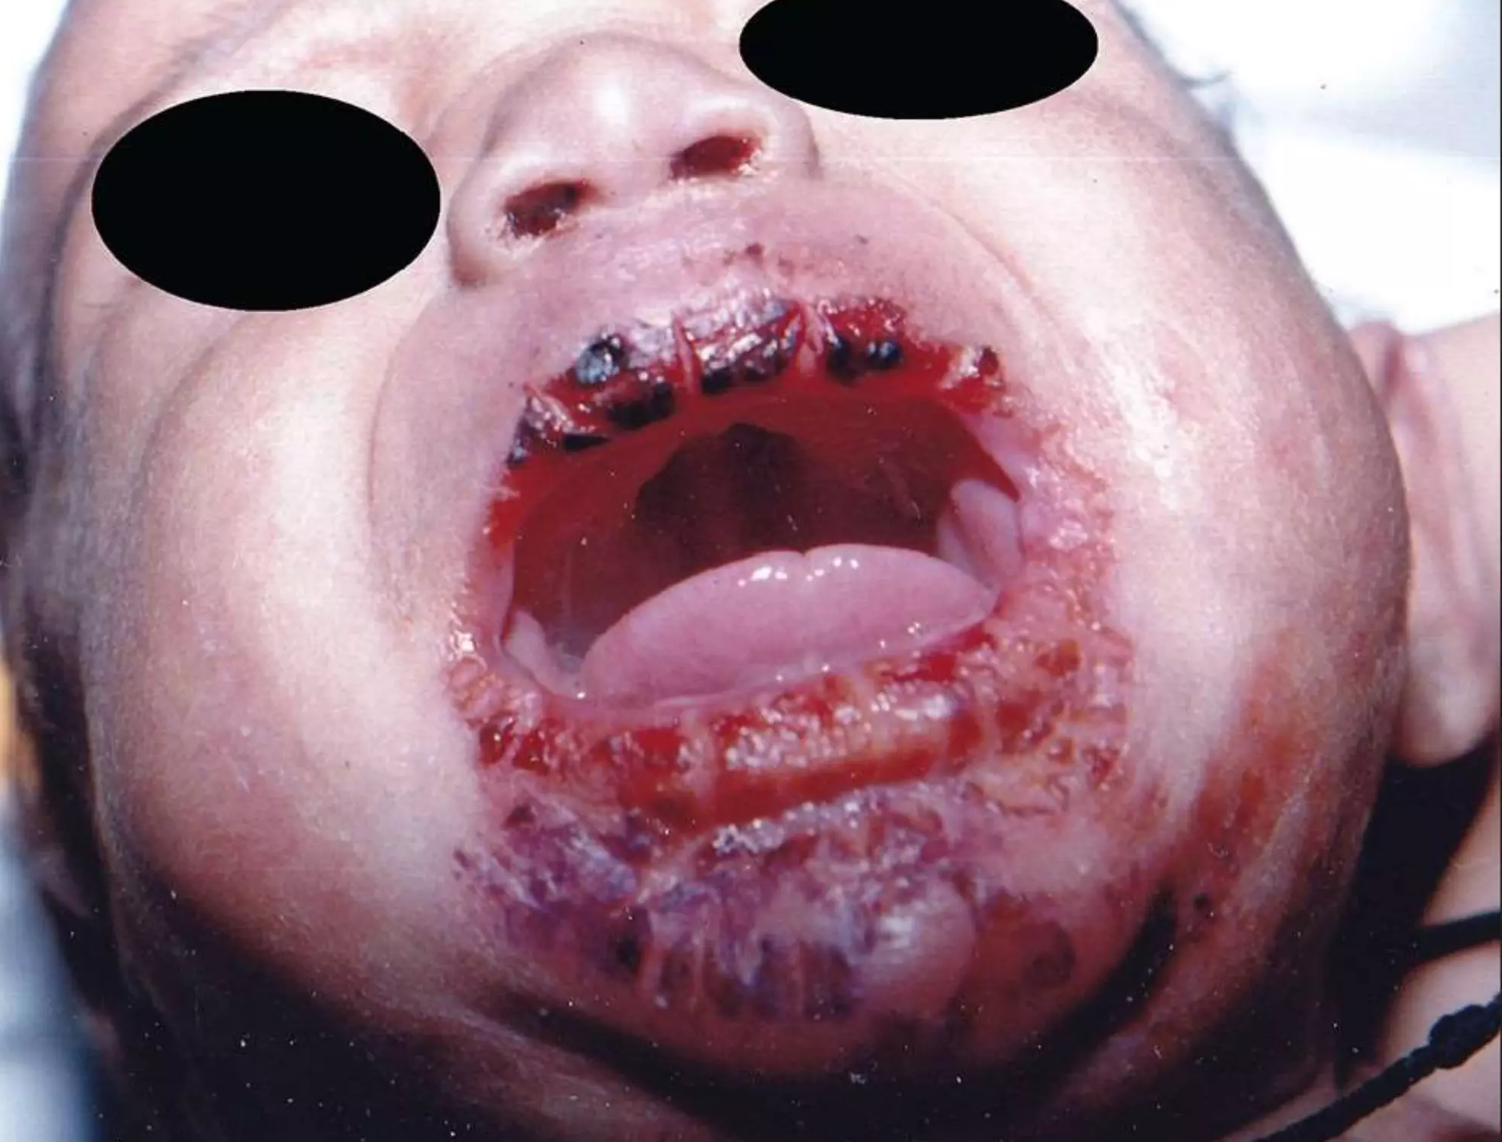
CLINICAL VARIANTS
Early Congenital Syphilis
Rhinitis with serosanguinous nasal discharge
Chorioretinitis and visceral lesions
Vesicubullous eruptions of skin
    Vesicobullous rash ( pemphigus syphiliticus )
    Lesions around oral cavity, genitelia, trunk
        contagious

Slide 13
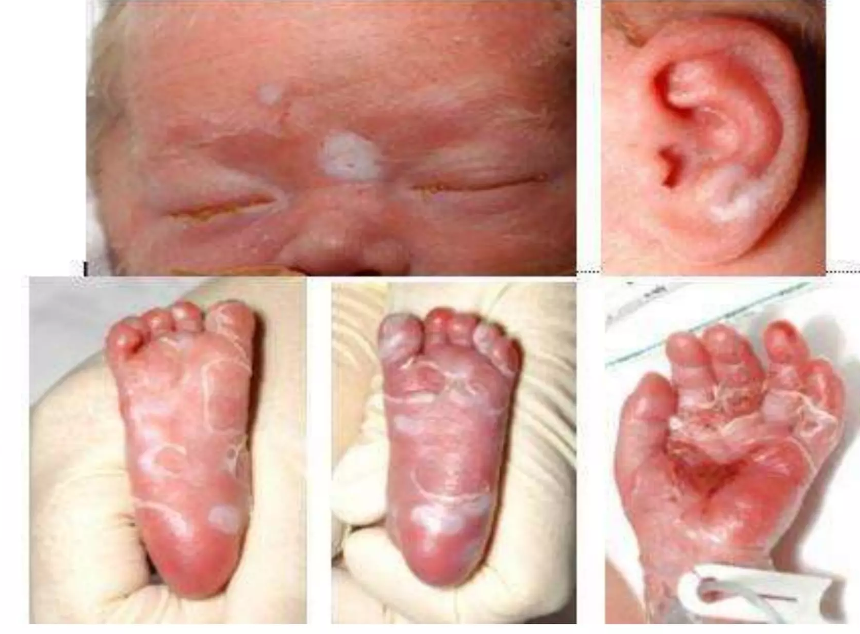
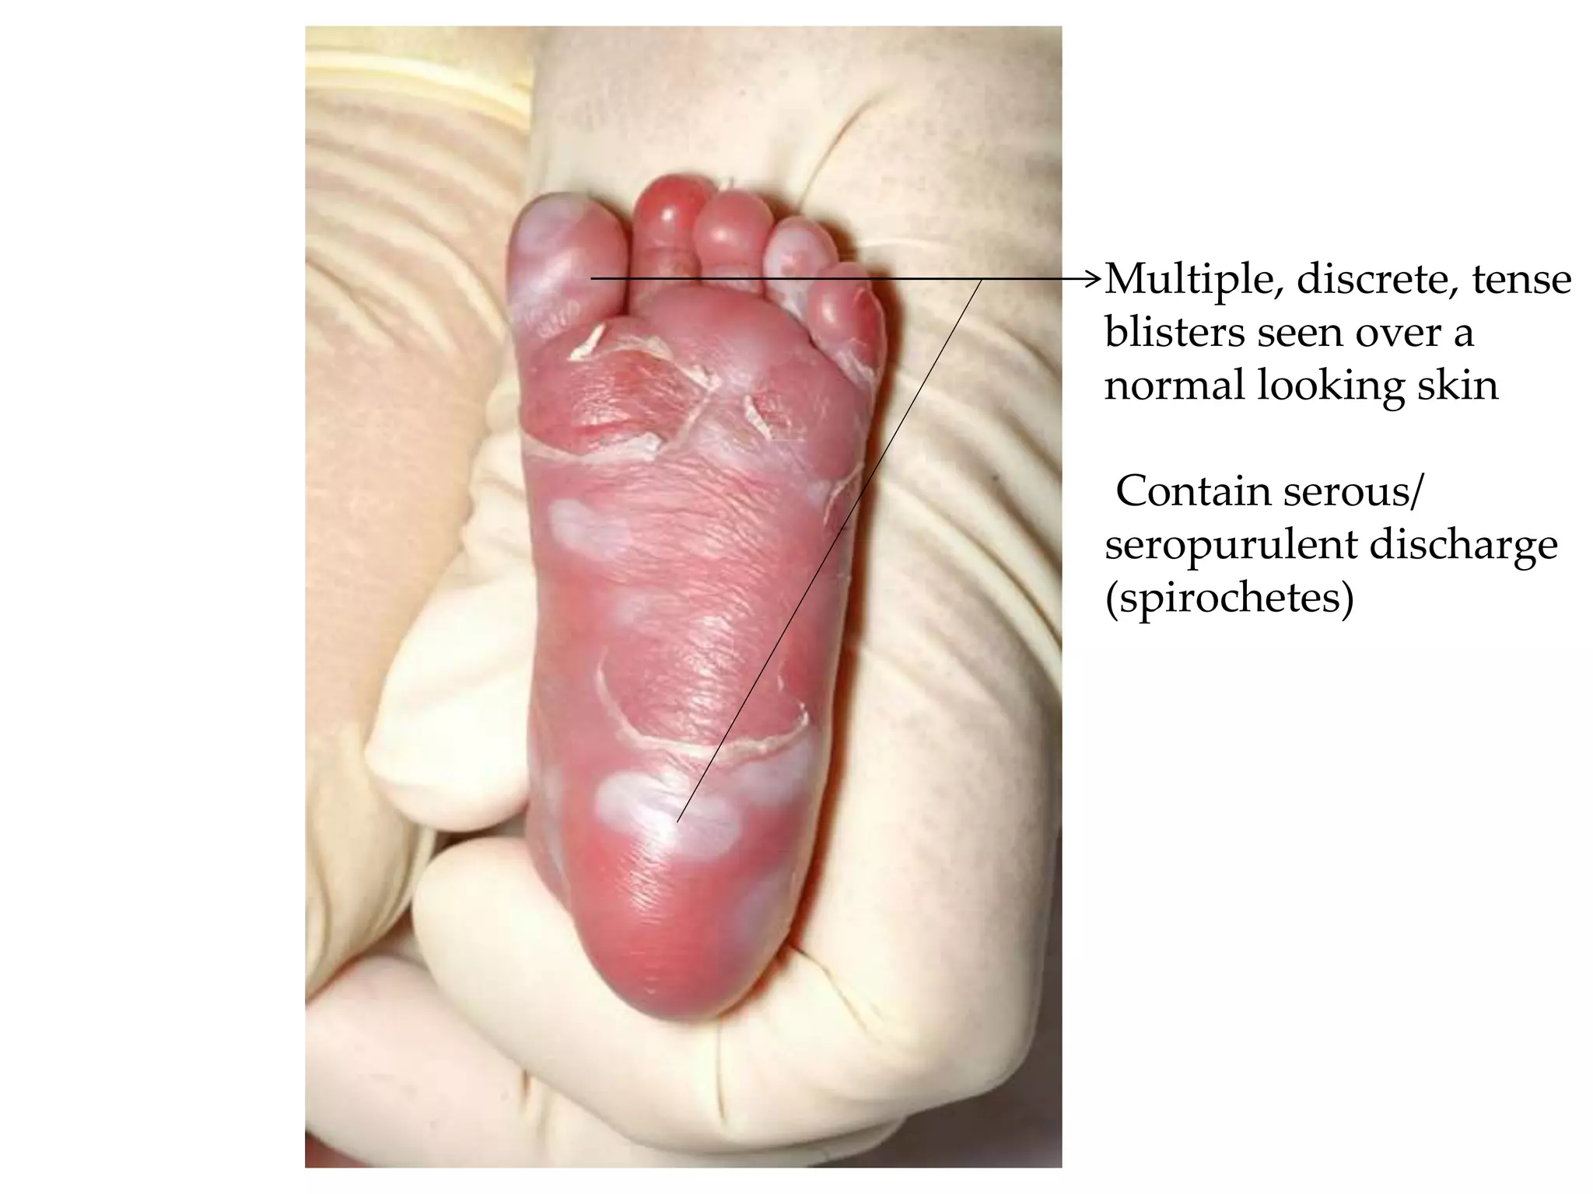

Slide 14
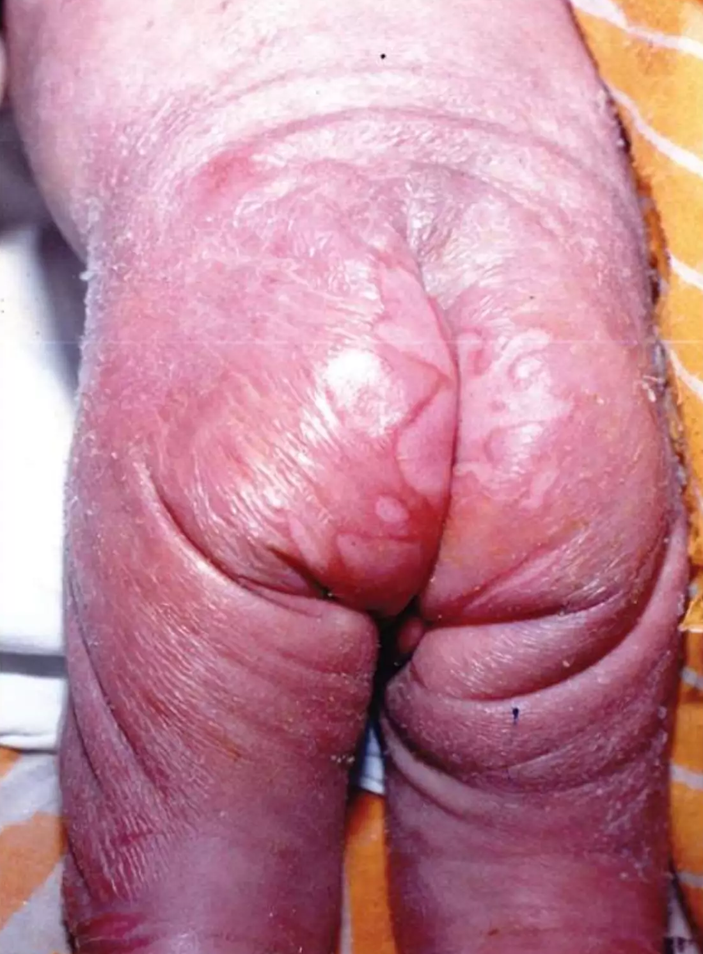
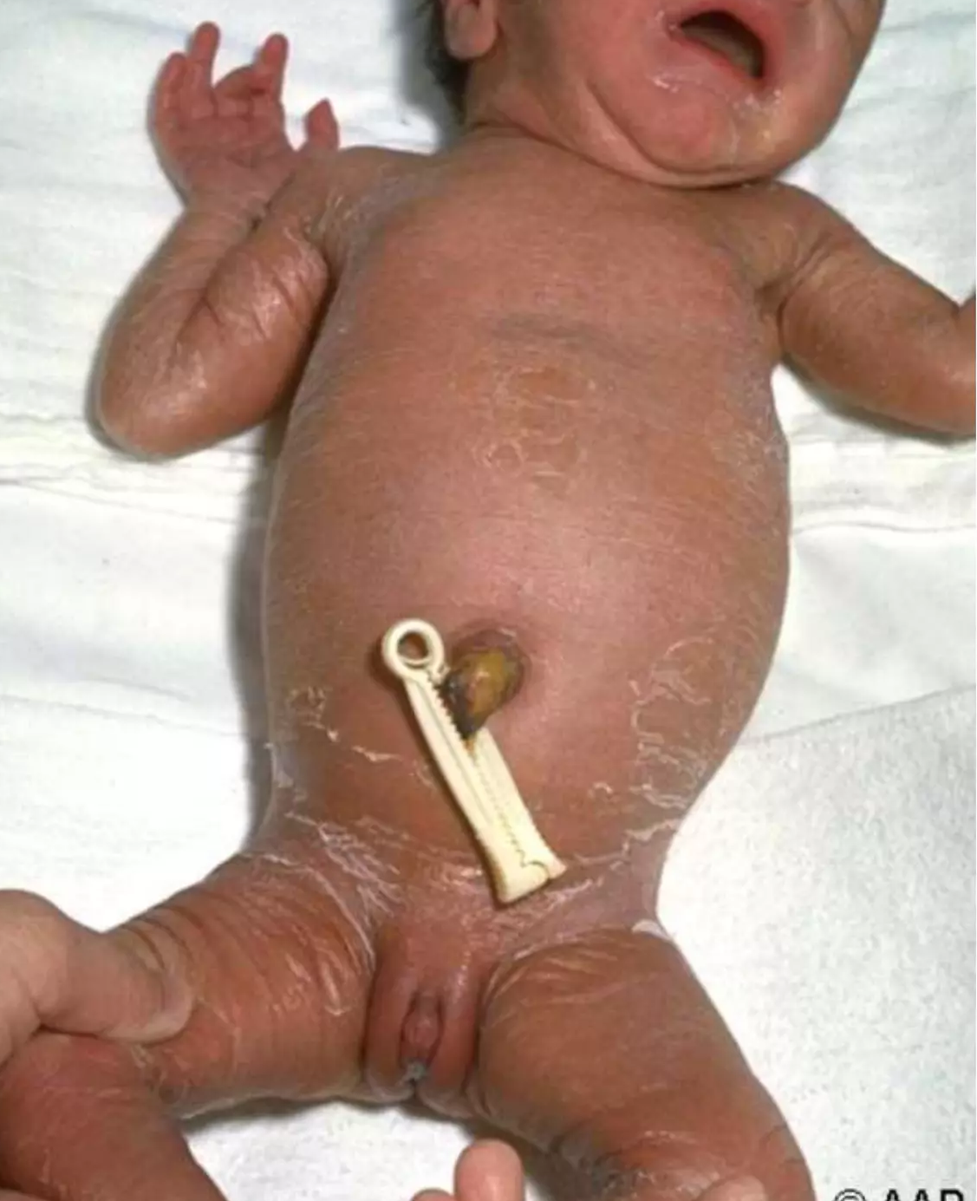

Slide 15
CLINICAL FEATURES
GIT
    Hepatosplenomegaly, ascites >> hypoprotienaemia, jaundice
    Syphilitic diarhoea
Renal
    Hyaline, albumin, granular casts in urine >> MPGN
Respiratory
    Pneumonia
CVS
    Mayocarditis

Slide 16
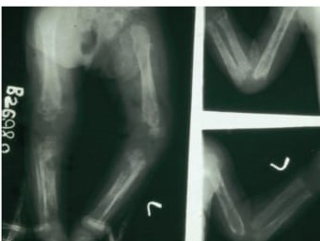
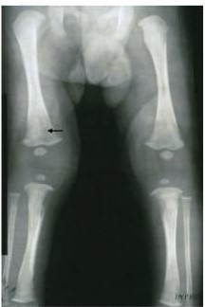
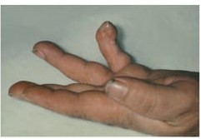
  Other features
    Bony abnormalities
      Osteochondritis of long bones
      Syphilitic pseudo paralysis
      Wimberger’s sign
      Syphilitic dactylitis
    Periosteal changes

Slide 17
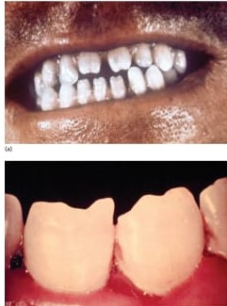
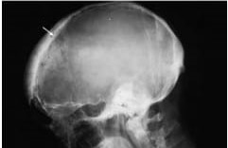
LATE CONGENITAL SYPHILIS
Skeletal developmental defects
Dental abnormalities
Gummatous syphilis
Neurosyphilis

Slide 18
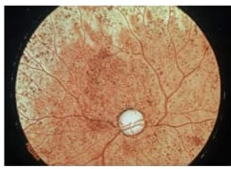
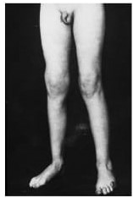
Clutton’s joint
    Perisynovitis of knee
    Painless swelling
    Unilateral/ bilateral
    Mobility preserved
Bone involvement
Neurol deafness
    Involvement of cochlear part of VIII CN
    Tinnitus, vertigo, hearing loss, cochlear degeneration
Interstitial keratitis(iridocyclitis)

Slide 19
DIAGNOSIS
Investigations
  Clinical evaluation
  Darkfield microscopy of lesions
  Nucleic acid – based amplification assays ( PCR)
  Serology ( GOLD STANDARD)
      Non specific treponemal antibody (NTA) test ( VDRL, RPR, automated regain test )
          Screening test
      Specific treponemal antibody (STA) test
          Confirmatory test
  CSF analysis

Slide 20
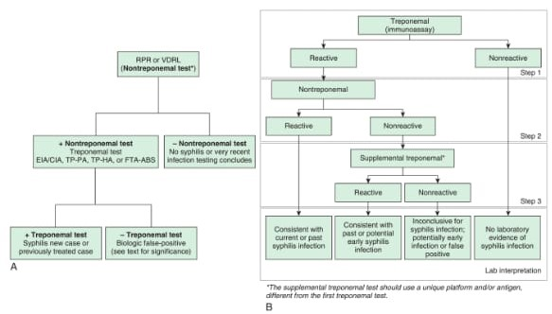

Slide 21
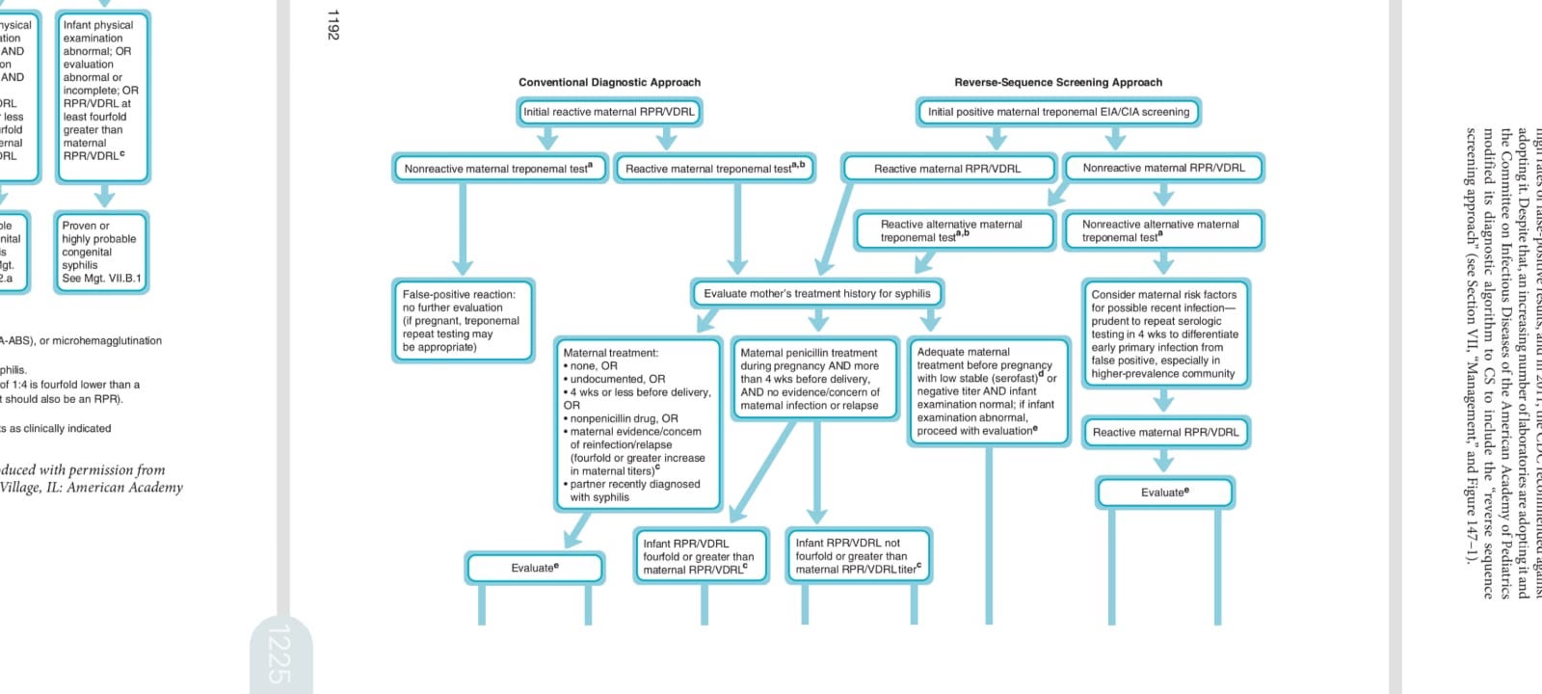

Slide 22
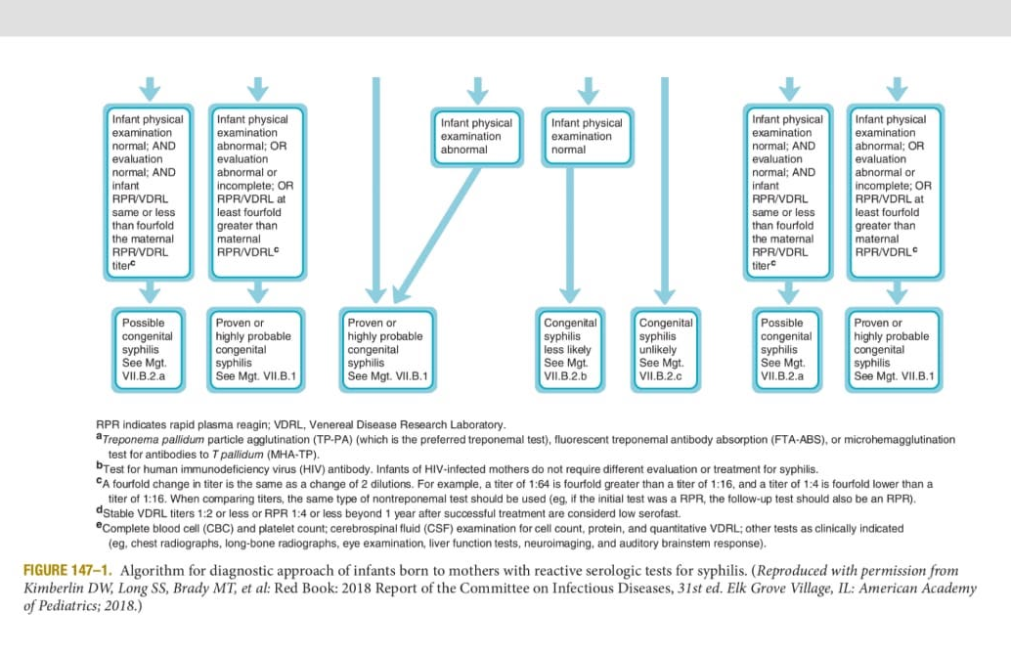

Slide 23
TREATMENT
Infants with proven/highly probable congenital syphilis
  Aqueous crystalline penicillin G
    50,000 U/kg/dose 12 hourly first 7 days
    Every 8 hours thereafter total 10 days
  Procaine Penicillin G
    50,000 U/kg/dose, IM, single dose for 10 days

Slide 24
Maternal treatment uncertain ( possible CS )
    Benzathine penicillin 50,000 U/kg single IM dose
Maternal treatment during pregnancy is adequate (CS less likely )
    Benzathine penicillin 50,000 U/kg single IM dose
        All compnonents of evaluation normal, csf normal, ensure follow up
Maternal treatment before pregnancy adequate, mother’s NTA low or stable during pregnancy & at delivery
    No further evaluation needed
    Benzathine penicillin 50,000 U/kg single IM dose cosidered if follow-up uncertain

Slide 25
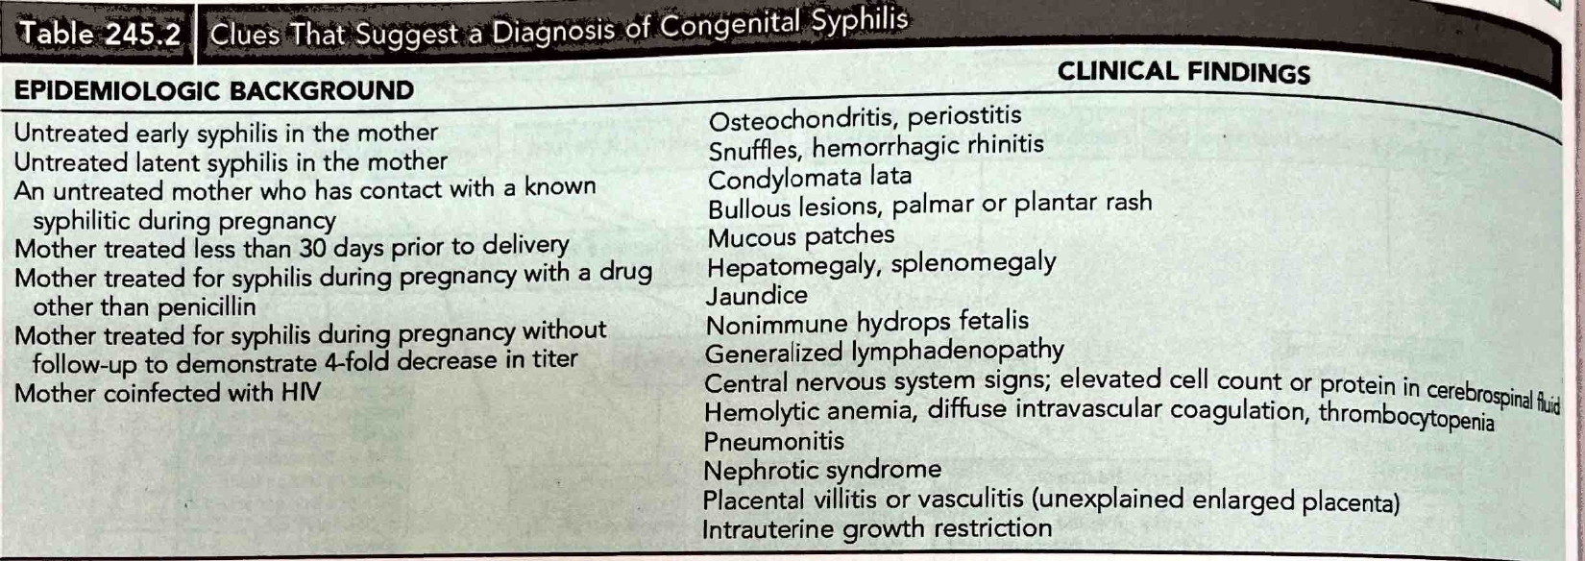

Slide 26
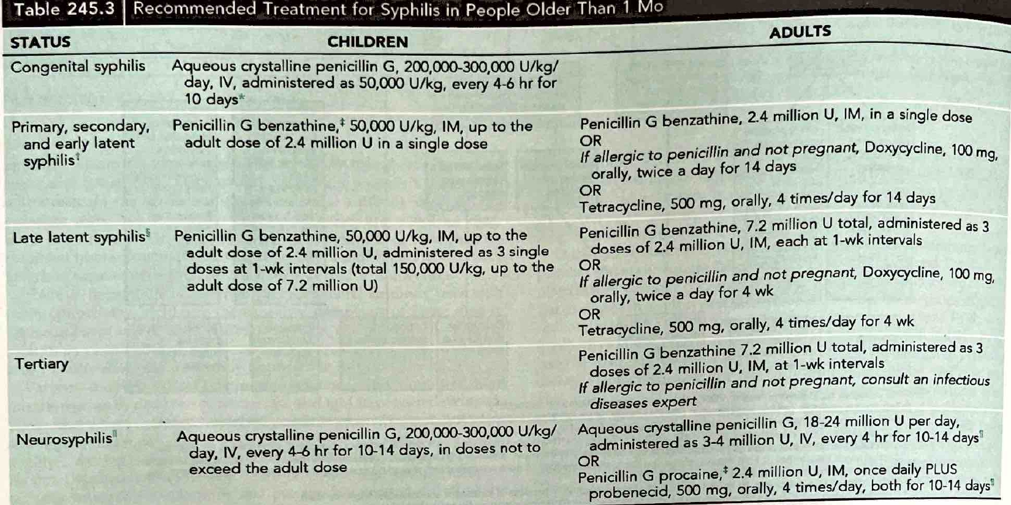

Slide 27
Precautions
    Drainage, secretion, blood and body fluids are indicated for all infants with proven or suspected CS until therapy given for 24 hours
Follow up care
    Quantitative NTA testing at 3, 6, 12 months

Slide 28
Thank you

