Slide 1
Genetic Nail Disorders
Dr Zarghoonah Sajid

Slide 2
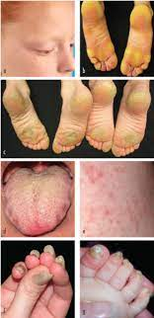
Pachonychia Congenita :
Dominant keratin mutations
Toe nail dystrophy , plantar keratoderma , plantar pain.

Slide 3
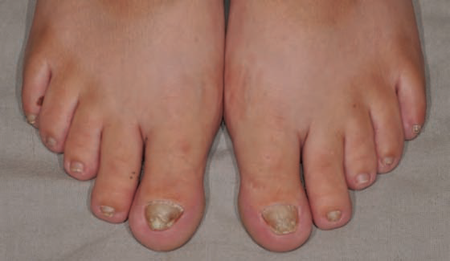
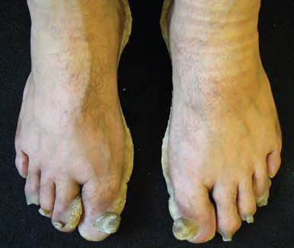

Slide 4
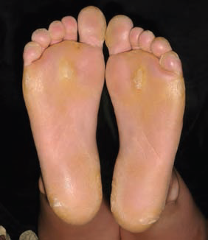
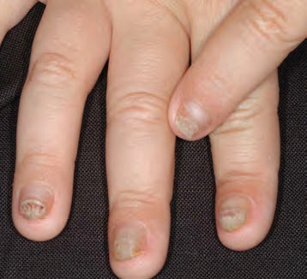

Slide 5
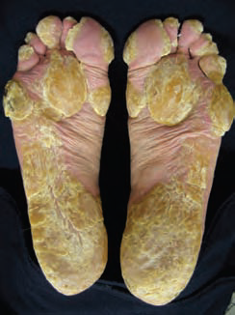
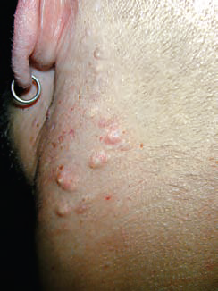

Slide 6
Toenail Dystrophy
Fingernail dystrophy
Plantar keratoderma
Plantar pain
Palmar keratoderma
Hoarseness
Oral leukokeratosis
Natal teeth
Pilosebaceous cysts
Follicular hyperkeratoses

Slide 7
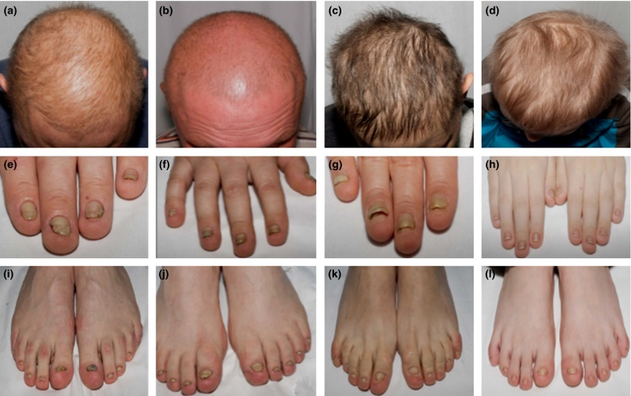

Slide 8
Management :
Mechanical Rx of nails
Antibiotics & antifungal for sec inf
Pain control management
Botulinum toxin inj ( relieves for 3 months)
Oral retinoids & Rapamycin … controversial

Slide 9
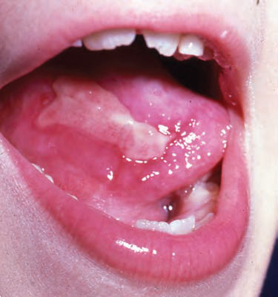
Dyskeratosis congenita :
Nail dysplasia
Oral leukoplakia
Reticulated hyperpigmentation
Risk of bone marrow failure & SCC

Slide 10
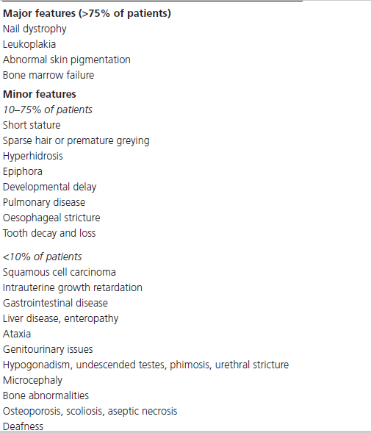
Atleast 2 major & 2 minor features needed to diagnose

Slide 11
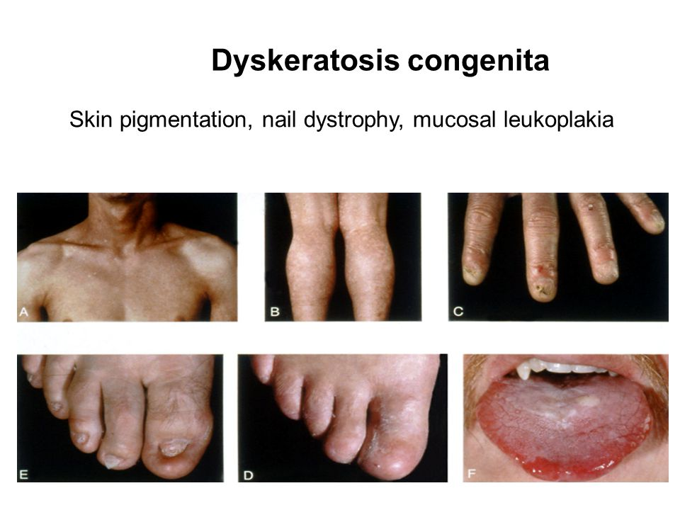
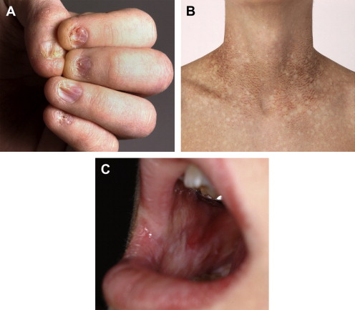

Slide 12
Other Cutaneous features :
Telangiectasia of the trunk.
Redness and atrophy of the face with irregular macular hyperpigmentation.
Acrocyanosis.
Palmoplantar hyperkeratosis.
Hyperhidrosis and bullae of the palms and soles.
Wrinkled atrophic skin over the elbows, knees and penis.
Diffuse atrophic, transparent and shiny appearance on the
dorsal aspects of the hands and feet

Slide 13
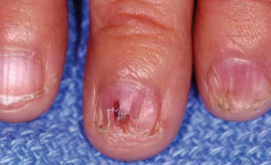
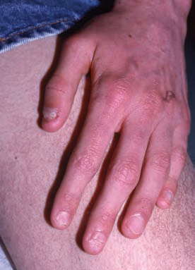
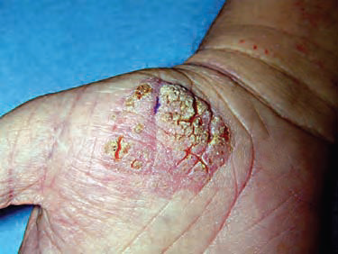

Slide 14
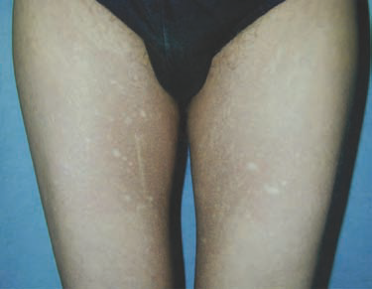
Hoyeraal–Hreidarsson syndrome :
Cerebellar hypoplasia
Developmental delay
Growth retardation
Severe immunodeficiency
Enteropathy
Aplastic anaemia

Slide 15
Revesz syndrome :
B/L exudative retinopathy, cerebellar hypoplasia & growth retardation, nail dystrophy, fine hair & bone marrow hypoplasia
life expectancy is 44 years.
bone marrow failure (∼60–70%), pulmonary disease (∼10–15%) or malignancy (∼10%)

Slide 16
Rothmund‐Thomson syndrome
Epidermolysis bullosa simplex with mottled pigmentation
Naegeli‐ Franceschetti‐Jadassohn syndrome/dermatopathia pigmentosa
Reticularis Clericuzio‐type poikiloderma with neutropenia
LP , GvHD

Slide 17
Management :
Flow cytometry & flow-FISH ( telomere shortening)
Surveillance :
biannual blood counts
bone marrow evaluations annually
hepatic ultrasounds
annual pulmonary functional tests
skin cancer screening

Slide 18
Rx to be started :
HB persistently below 8 g/dL
Platelets <30,000/mm3
Neutrophils <1000/mm3
Allogeneic stem cell transplantation
10 yr survival rate ???
Oxymetholone or danazol … (to inc 10 yr survival rate)

Slide 19
Bougienage for oesophageal stenosis
Fulguration, curettage & surgical excision (leukokeratosis)
Lifelong regular supervision for early detection of mucosal or cutaneous carcinomas

Slide 20
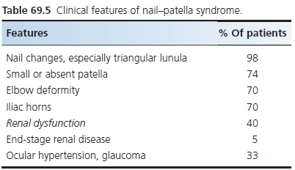
Nail–patella syndrome
Nail changes
Dystrophy of the patella & iliac horns

Slide 21
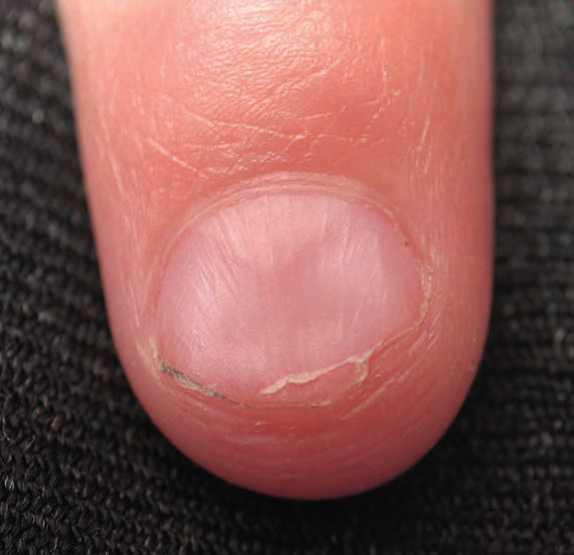
small irregularly shaped or absent patella with recurrent dislocation or subluxation
Flexion fractures
B/L conical horny projections of iliac bone , asymptomatic
Proteinurea with or without haematuria & HTN
Open-angle glaucoma
Crumbling teeth & thin dental enamel

Slide 22
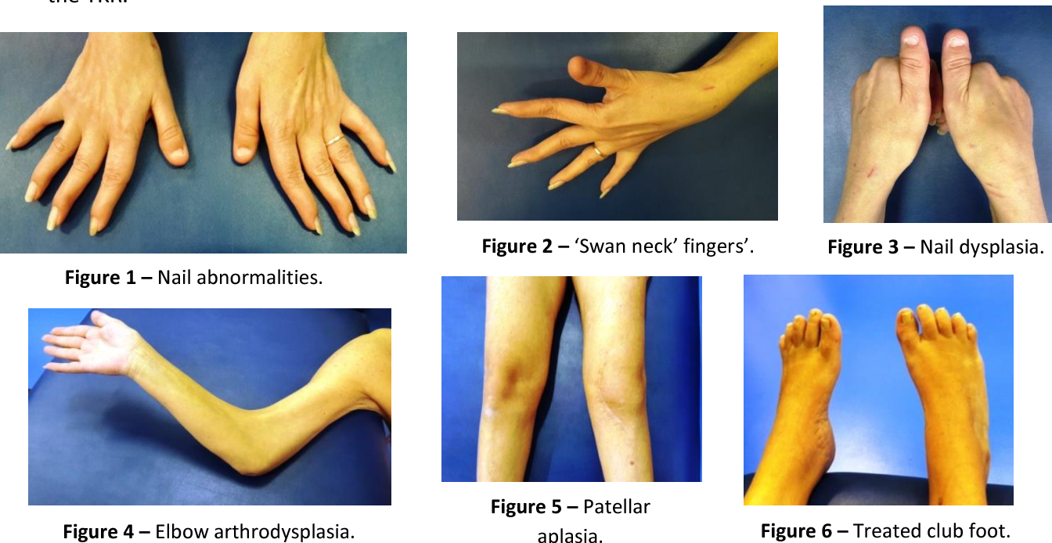

Slide 23
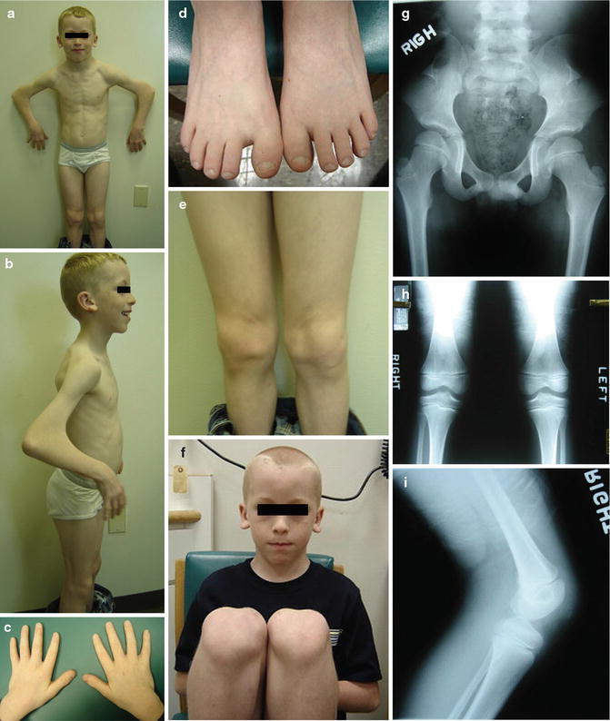

Slide 24
Management :
Clinical Diagnosis
X ray
Renal biopsy
No Rx for nails abnormailities
Physiotherapy, splinting or bracing, analgesics and occasionally surgery
Monitoring of glaucoma, HTN & Renal disease
Renal transplant usually needed to improve HTN
DEXA scan
Avoid NSAIDs

